Slide 1
Hidden Slide #1
Presenter notes information
Tools and documents
Helpful suggestions
Notes:
To Know: The Common Formative Assessment learning package is organized in six modules. The first three are an Overview, Meaningful Learning Targets, and Sound Assessment Design. The remaining three modules address development of selected response, constructed response, and performance task assessments.
The CW Content Fidelity Checklist aligned to each learning package includes all critical items for a training session (draft, pending approval). The CW HQPD Training Checklist and Coaching Checklist contain process elements to be used as guidance when designing, revising, or coaching high quality professional development.
Important notes:
A script of presenter notes is included in the PowerPoint. Background information for the presenter is shown as “To Know.” Statements to be shared with participants are shown as “To Say.” In some instances, the “To Know/To Say” are the same material. For fidelity of content and consistency among presenters, the “To Say” information should be presented with minimal paraphrasing. The presenter notes also include “To Do” prompts and cues for “Handouts.”
A presenter may add slides to supplement the content. For example, a slide of essential questions may be added since only objectives have been included.
A presenter may choose to differentiate a presentation to meet the needs of the participants. For example, another form may be substituted for the Next Steps template if the district or building already uses a similar form or protocol.
Additional activities, examples, videos, etc. are being developed. (The details are in progress.) A presenter may interchange the additional material for the corresponding PowerPoint content.
There is one pre/post assessment for the entire CFA package (all six modules).
An Implementation Fidelity Checklist is available for frequent monitoring by a teacher or observer.
A print Practice Profile and an electronic Practice Profile Self-Assessment tool are available for use by individuals, teams, or schools for periodic self-assessment and monitoring of implementation of practice or to identify training or coaching needs.
The presenter should download onto a hard drive or a flash drive any video intended for use in a training. The links shown on slides may not be able to be accessed online at the school sites.
Breaks should be inserted at the discretion of the presenter based on the needs of participants.

Slide 2
Hidden Slide #2
Session at a Glance
Introductions/CFA materials/Objectives/Guiding Questions/ Norms
Brief Review of Assessments, Module #2
Selected Response Items
Constructed Response Items
Performance Tasks
Continue completing Unit of Study Template
Evaluate Your Test
Notes:
To Know: This is an optional slide and may be used as an agenda.

Slide 3
Hidden Slide #3
Supplies needed:
Index cards 3x5 or paper
Chart paper
Notes:
To Know: Supplies needed for the third module, Sound Assessment Design, of the CFA Learning Package.

Slide 4
Hidden Slide #4
Handouts needed:
Pre-reading, Ronan, A. (2015). Every teacher’s guide to assessment. Retrieved from: http://www.edudemic.com/summative-and-formative-assessments/
CFA Infographic (slide 13)
Definition/Benefits/Considerations of Assessments (slide 27)
CFA Development Process Template (slides 59-62)
  Color coded, blank
  Color coded, example
  No shading, blank
Evaluate Your Test (slide 63)
Possible Causes for Faulty Items/Low Scores on Items (slide 65)
Practice Profile (slide 68)
Self Assessment Practice Profile Workbook (slide 69)
Implementation Fidelity Checklist (hidden slide 70)
Next Steps (slide 71-72)
Notes:
Handouts: Handouts are listed on MOEDUSAIL, CFA Learning Package first page. The corresponding slide number(s) are included.

Slide 5

Sound Assessment Design
Common Formative Assessment
This work is licensed under a Creative Commons Attribution-NonCommercial-NoDerivatives 4.0 International License.
Draft: 3/30/2013
Notes:
To Know/To Say: Good morning/afternoon! We will begin in ___ minutes.
To Do: Greet participants.

Slide 6

Acknowledgements
Special thanks to all contributors to the development and revision of this module.
The original collection of learning packages was roll-out for use by Regional Professional Development Center (RPDC) Consultants in July 2013 after being developed by a team of content experts. The collection of learning packages was developed through efforts funded by the Missouri State Personnel Development Grant (SPDG). The following individual/groups are thanked immensely for their hard work in developing this package.
----------------------------------------------------------------------------------------------------------------------------------------
Content Development and Revision Support
UMKC Institute for Human Development
Ronda Jenson, Director Stefanie Lindsay
Arden Day Carla Williams
Jodi Arnold
SPDG Management Team
Notes:
To Know/To Say: Special thanks to all contributors to the development and revision of this module.

Slide 7
Initial Content Development Team, 2013
Rob Gordon, Team Leader, MO PLC Rebecca Rider, SE RPDC
Alan Bancroft, C RPDC Kelley Ritter, SW RPDC
Debra Cole, StL, RPDC Jay Roth, SW, RPDC
Cheri Fuemmeler, SE RPDC Jana Scott, HOM, RPDC
Jane Jackson, NW RPDC Thea Scott, DESE
Melanie Whitener Needling, SE RPDC Alicia Wilson, KC RPDC
Linda Null, SE RPDC
2016 Revision Team
Nancy Steele, Facilitator, NE SIS Janet Crafton, SC RPDC
Pam Carte, NE RPDC Ginger Henry, DESE
Beverly Colombo, StL, RPDC Rebecca Rider, SE RPDC
Liz Condray, SC RPDC Sarah Spence, C SIS
Notes:
To Know/To Say: Thank the contributors.

Slide 8
Welcome and Introductions
Please take a moment to introduce (or reintroduce) yourself to the group, by telling your name, district, and position.
Our trainers for the day are….
Notes:
To Know/To Say: Welcome to Sound Assessment Design for Common Formative Assessments.
The introductions may be formal or informal depending on how well you know the group. Trainers should use whatever process is comfortable for introductions. I am/we are _______________ (provide some background about trainers.) Please introduce yourself to the group (name, district, position.)
To Do: (optional) Review/reflection activity – flip charts or Bingo sheet with questions from previous sessions.

Slide 9
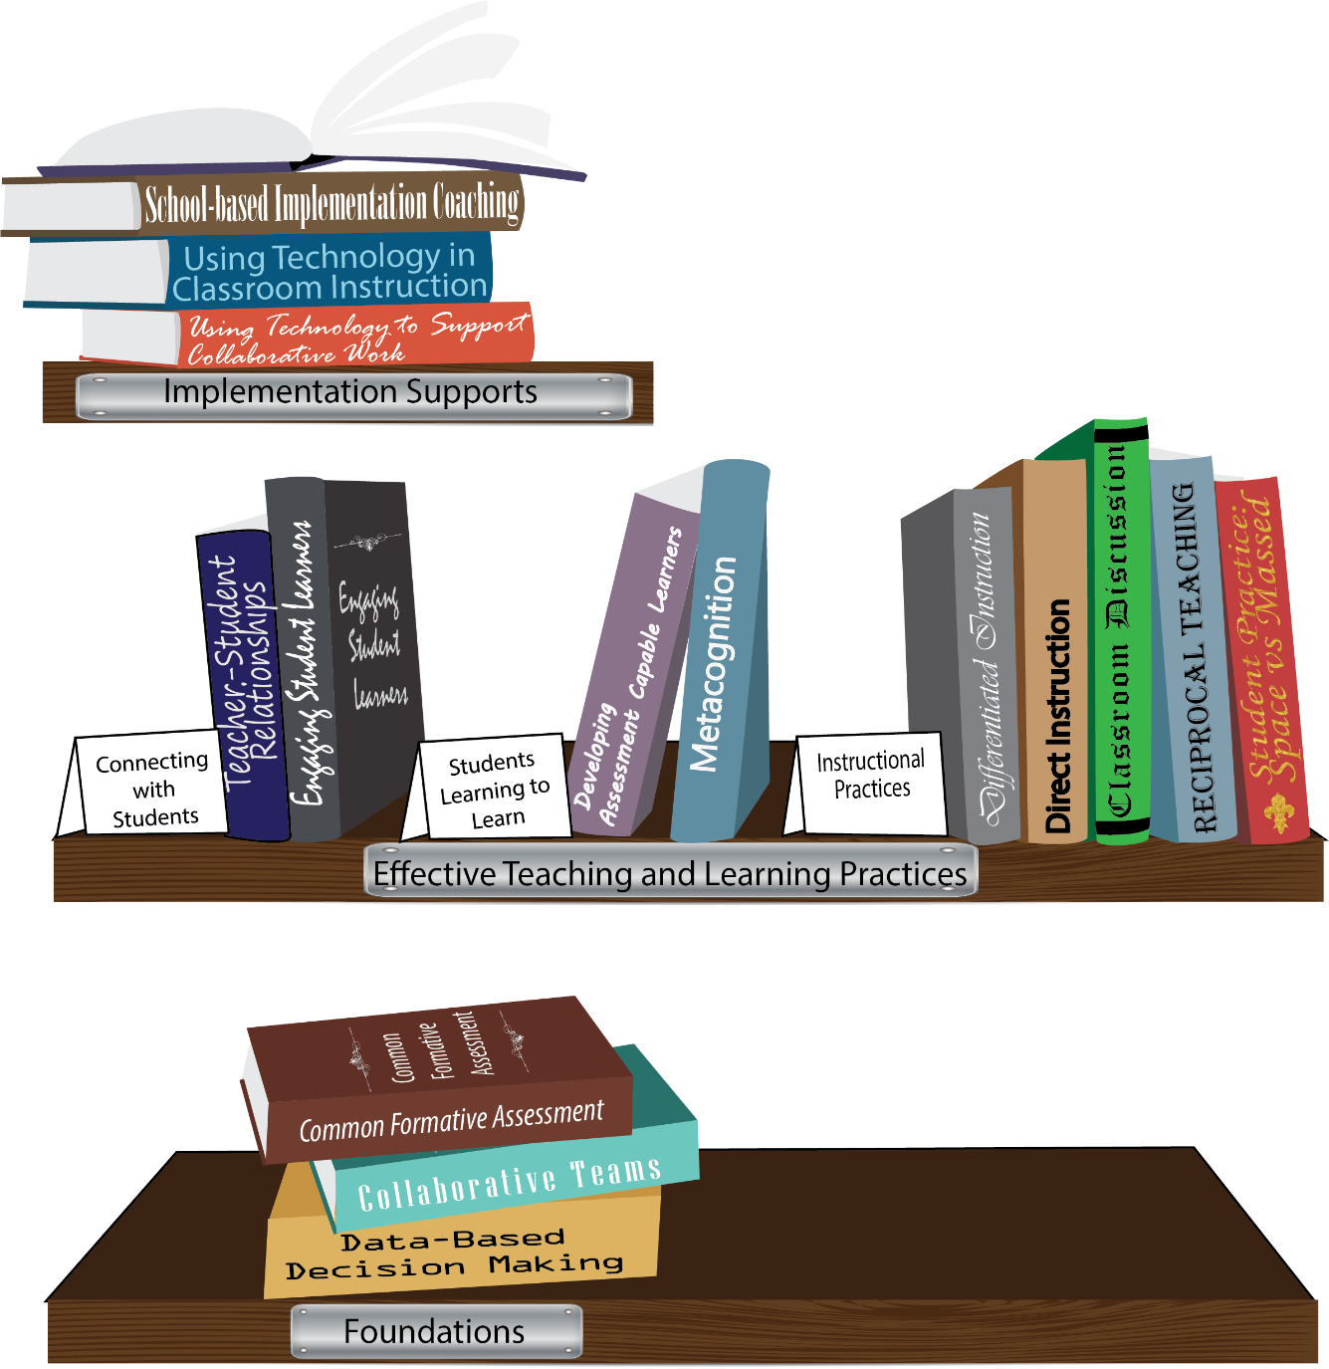
Notes:
To Know/To Say: Missouri’s professional development learning packages are organized in three categories: Foundations, Effective Teaching & Learning Practices, and Implementation Supports. All schools begin their professional development journey with the Foundations, as these learning packages provide foundation knowledge in three key areas: Collaborative Teams, Data-based Decision-making, and Common Formative Assessment. Effective Teaching & Learning Practices encompass research-based instructional practices for deepened learning. These learning packages address ways of connecting with students, ways of helping students learn how to learn, and feature specific instruction practices. Implementation Supports are learning packages designed to help school staff support and enhance the Implementation of Effective Teaching & Learning Practices through using technology and peer coaching supports.
To Do: Explain how the graphic depicts professional development in Missouri.

Slide 10

Collaborative Work Foundations
3 Key Areas
1. Collaborative Teams
2. Common Formative Assessment
3. Data-Based Decision Making
CFA – utilize
Quality assessments
as feedback to improve teaching & learning.
DBDM – utilize data for continuous improvement through dialogue about teaching & learning
CT – utilize team processes to improve teaching & learning.
Notes:
To Know/To Say: The learning packages forming the foundation knowledge of the Collaborative Work are Collaborative Teams, Data-Based Decision Making, and Common Formative Assessment.
Collaborative Teams (CT) utilize team processes to improve teaching and learning.
Common Formative Assessment (CFA) utilize quality assessments as feedback to improve teaching & learning.
Data-Based Decision Making (DBDM) utilize data for continuous improvement through dialogue around instruction.

Slide 11
Common Formative Assessment
Modules 1-3
Overview
Sound Assessment Design
Meaningful Learning Targets
Notes:
To Know: The Common Formative Assessment learning package contains six modules. The first three modules, Overview and Purpose of Assessment, Meaningful Learning Targets, and Sound Assessment Design were revised in 2016. The remaining three modules addressing how to write selected responses, constructed responses, and performance tasks will be revised at a later time.
To Know/To Say: The preceding slide of the bookshelf graphic represents the Collaborative Work as a whole and is followed by a graphic showing how the three key areas; Collaborative Teams, Data-Based Decision Making, and Common Formative Assessment, align to form the foundation knowledge for Collaborative Work. This slide introduces the first three modules of the Common Formative Assessment learning package; The Overview and Purpose of Assessment, Meaningful Learning Targets, and Sound Assessment Design. Today will address Sound Assessment Design

Slide 12
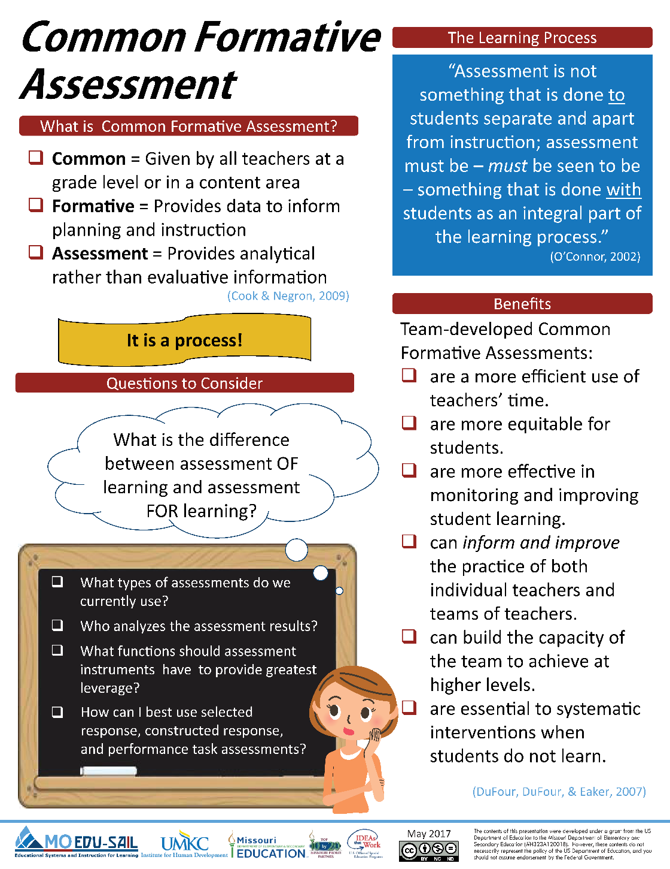
Notes:
To Know/To Say: This is the Common Formative Assessment Infographic updated in May 2017. Missouri Collaborative Work magazine located on MOEDU-SAIL. Definitions, Process, and Benefits are listed on this graphic.
Common Formative Assessment is one of the foundational pieces of the Collaborative Work process. Extensive educational research shows the effectiveness of Common Formative Assessments with student achievement. Definitions and process will be the focus of this training.
To Do: Distribute the Common Formative Assessment Infographic Handout.
References: Cook & Negron. (2009). http://www.powershow.com/view4/52b1e8-NjFmM/Overview to Common Formative Assessments CFAs Powerpoint ppt presentations.
Dufour, R., DuFour, R., Eaker, R. (2007). The case for common formative assessments. Retrieved from: www.allthingsplc.com.
O’Connnor, K. (2007). How to grade for learning: Linking grades to standards. Glenview, IL: Skylight Professional Development.
Handout: Common Formative Assessment Infographic

Slide 13
Missouri Teacher Standards
Common formative assessments address the following Missouri Teacher Standards:
  Standard #7: Student Assessment and Data Analysis
  Standard #2: Student Learning, Growth and Development
  Standard #4: Critical Thinking
  Standard #9: Professional Collaboration
(Missouri Department of Elementary and Secondary Education, 2013)
Notes:
To Know/To Say: Explain how the Missouri Teacher Standards fit with Common Formative Assessment.
Standard #7: Student Assessment and Data Analysis: The teacher understands and uses formative and summative assessment strategies to assess the learner’s progress and uses both classroom and standardized assessment data to plan ongoing instruction. The teacher monitors the performance of each student, and devises instruction to enable students to grow and develop, making adequate academic progress.
Standard #2: Student Learning, Growth and Development: The teacher understands how students learn, develop and differ in their approaches to learning. The teacher provides learning opportunities that are adapted to diverse learners and support the intellectual, social, and personal development of all students.
Standard #4: Critical Thinking: The teacher uses a variety of instructional strategies and resources to encourage students’ critical thinking, problem solving, and performance skills.
Standard #9: Professional Collaboration: The teacher has effective working relationships with students, parents, school colleagues, and community members.
Reference: Missouri Department of Elementary and Secondary Education (2013). Teacher standards: Missouri’s educator evaluation system. Retrieved from: http://dese.mo.gov/sites/default/files/TeacherStandards.pdf.

Slide 14
Learner Objectives of the
Formative Assessment Series
Understand the clear purposes of assessment by clarifying
  Why they are assessing
  Who will use the results of assessment data
  What they will do with the assessment data
Develop clear and meaningful learning targets to guide instruction and student learning.
Construct quality assessment instruments which are of sound design and measure pre-determined learning targets.
Notes:
To Know/To Say: The area of focus for the day is the last bullet. In module #2, you began the process for developing a pre/post assessment which may be used in the data team process (steps 1 through 5 in the CFA Template). Today, you will continue that process by completing steps 6 through 11 in the CFA Template.
Handout: CFA template (if participants have completed steps 1-5 and brought their templates with them, they will not need another copy. If they did not bring a partially completed copy, provide a copy of the template.)

Slide 15
Outcomes for the Day
As a result of today’s training you will…
Develop a better understanding of the components and characteristics of a quality formative assessment.
Develop a better understanding of various types of assessment items and the pros and cons of each type.
Continue using a backwards design approach and a template form to write a formative assessment.
Evaluate your formative assessment for quality.
Notes:
To Know/To Say: Our outcomes for the day are … (paraphrase outcomes or ask participants to read.)

Slide 16

Module 3: Sound Assessment Design
Guiding Questions:
What decisions drive the type of assessment items to use in common formative assessments?
What are the essential components needed to create a quality formative assessment?
What are the characteristics of quality Selected Response, Constructed Response and performance tasks?
Notes:
To Know/To Say: These essential questions will guide our work for this session. We will review these questions at the end of the session.

Slide 17
Norms
Begin and end on time
Be an engaged participant
Be an active listener – open to new ideas
Use electronics respectfully
Notes:
To Know/To Say: As in previous sessions, these are our norms for the day. Would anyone like to add any norms that are important to you?

Slide 18



Accurate Assessment
Clear Learning Targets
ASSESS WHAT?
Clear Purpose
WHY ASSESS?
What are the learning
targets?
What’s the purpose?
Are they clear?
Who will use the results?
Are they good?
Sound Design ASSESS HOW?
What method?
Written well?
Sampled how?
Avoid bias how?
Student Involvement
Students are users too!
Student Involvement
Be sure students
understand targets too!
Students track progress and communication,!
Effective Communication COMMUNICATE
HOW?
Students can participate
in the process too!
Effectively Used
How is information
managed?
reported?
(Stiggins, Arte, Chappuis & Chappuis, 2004)
Notes:
To Know/To Say: Stiggins and Chappuis developed 5 keys for assessment. The keys are clustered around two main components, ‘accurate assessment’ and ‘effectively used’. The 4 major keys are: 1) Clear Purpose – Why are we assessing? 2) Clear Learning Targets - Assess what? What are the learning targets? 3) Sound Design - Assess how? What methods are we using to assess? 4) Effective Communication – Communicate how? How are we managing and reporting the assessment results? The fifth key is student involvement, which is connected to the other 4 keys. As we progress with the keys you will note the interdependence they have on curriculum, instruction, and summative assessment. These keys are also the basis for Chappuis’ 7 strategies for assessment and Assessment Capable Learners.
To Do: Trainer may have a handout of this slide for review purposes.
NOTE: Refer back to Module 1 for a review of Key 1 if necessary.
Reference: Stiggins, R., Arter, J., Chappuis, J., & Chappuis, S., (2004). Classroom assessment for student learning: Doing it right – Using it well (2nd ed.). Portland, OR: Pearson Assessment Training Institute, Inc.
Handout: Accurate Assessment slide (optional)

Slide 19
Accurate Assessment
Sound Design
ASSESS HOW?
What method?
Written well?
Sampled how?
Avoid bias how?
(Stiggins, et al., 2004)
Notes:
To Know/To Say: Sound Design or how we assess is the key which will be the focus for today’s training.
Reference: Stiggins, R., Arter, J., Chappuis, J., & Chappuis, S., (2004). Classroom assessment for student learning: Doing it right – Using it well (2nd ed.). Portland, OR: Pearson Assessment Training Institute, Inc.

Slide 20

Read and Reflect with a shoulder partner…
Every educator must understand the principles of sound assessment and must be able to apply those principles as a matter of routine in doing their work. Accurate assessment is not possible unless and until educators are given the opportunity to become assessment literate. (They) must understand student achievement expectations and how to transform those expectations into accurate assessment exercises and scoring procedures.
(Ainsworth & Viegut, 2006)
Notes:
To Know/To Say: Read this quote and turn to a shoulder partner to discuss how you think this quote relates to your work. Then I will ask a few partners to share their thoughts.
To Do: Ask the participants to read this quote, then turn to a person sitting next to them and reflect upon the relevance of the statement to their work in creating meaningful assessments.
Reference: Ainsworth, L. & Viegut, D. (2006). Common formative assessment: How to connect standards-based instruction and assessment. Thousand Oaks, CA: Corwin Press.

Slide 21
What is Assessment Literacy?
“The ability to understand the different purposes and types of assessment in order to select the most appropriate type of assessment to meet a specific purpose.”
(Ainsworth & Viegut 2006)
Notes:
To Know/To Say: In Larry Ainsworth’s book Common Formative Assessment: How to Connect Standards-Based instruction and Assessment, he emphasizes the importance of understanding different types of assessment and their purposes.
Reference: Ainsworth, L. & Viegut, D. (2006). Common formative assessment: How to connect standards-based instruction and assessment. Thousand Oaks, CA: Corwin Press.

Slide 22
What evidence do we need that students have met our stated purpose(s)?
Carol Ann Tomlinson stated, “Fruitful assessment often poses the question ‘what is an array of ways I can offer students to demonstrate their understanding and skills?’ In this way, assessment becomes a part of teaching for success and a way to extend rather than merely measure learning.”
(Ainsworth & Viegut 2006)
Notes:
To Know/To Say: Carol Ann Tomlinson makes the point that we need to offer students a variety of ways to show their understanding and skills.
Reference: Ainsworth, L. & Viegut, D. (2006). Common formative assessment: How to connect standards-based instruction and assessment. Thousand Oaks, CA: Corwin Press.

Slide 23
Video Clip
http://www.youtube.com/watch?v=_CqgnZhb--Q
Notes:
To Know/To Say: Watch this video and think about the problem with this type of assessment.
To Do: Show video clip and ask a few participants to share the issues with assessing students in this manner.
Note: This funny clip about a young man who is taking an exam, and when turning in the exam a bit late, the professor indicates that he is late and as a result, fails the exam. The boy asks him if he knows who he is, and the professor says “I have no idea.” So the boy inserts his exam in the middle of the stack of exams and walks away to the amazement of the professor.

Slide 24
Assessment of Missouri
Learning Standards
The knowledge, skills and processes specified in Missouri’s Learning Standards (MLS) will be measured by using a variety of test item types: selected response, constructed response and performance tasks.
Notes:
To Know/To Say: The new standards will be assessed by a variety of methods.

Slide 25
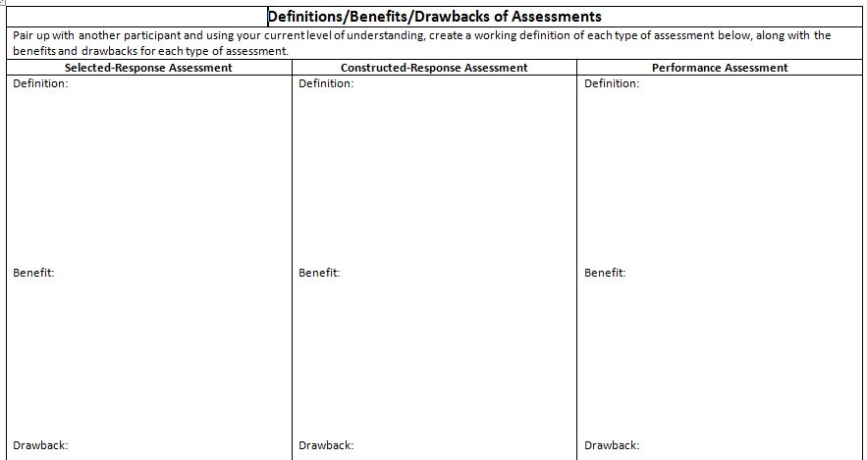
Let’s define…
Selected Response assessments
Constructed Response assessments
Performance Assessments
Pull out this template and pair up with someone. Using your current level of understanding, create a definition, identify the benefits and considerations of each type of assessment.
Notes:
To Know/To Do: To activate your prior knowledge and provide a focus for what you are about to learn, find a partner and create a definition for each type of assessment and list some benefits and some considerations for each type.
To Do: Point out the handout in the packet.
Handout: Definitions/Benefits/Considerations of Assessments. In the participant packet provide this template to create a definition and to identify the benefits and considerations of each type of assessment.

Slide 26
Selected Response Assessments:
require students to select one or more correct responses from a provided list,
include multiple-choice, true-false, matching, short answer/fill-in-the-blank,
include short answer/fill-in-the-blank (with a listing of answer choices provided),
assess the student’s knowledge of factual information, main concepts, and basic skills.
Notes:
To Know/To Say: How did you define selected response?
To Do: Ask participants to share some definitions and list some characteristics.

Slide 27
Benefits of Selected Response Items
Can be scored quickly
Can be scored objectively as correct or incorrect
Can cover a wide range of content
Notes:
To Know/To Say: What are some benefits of selected response items?
To Do: Ask participants to share some benefits. Validate responses and add benefits from slide if needed.

Slide 28
Selected Response Considerations
Tend to promote memorization of factual information rather than higher-level understanding
Inappropriate for some purposes (performance, writing, and creative thinking)
Lack of student writing in most cases, unless part of assessment design
(Haladyna, 1997)
Notes:
To Know/To Say: What are some considerations when we use selected response items? (After some participants respond, Researchers have found these considerations or limitations for selected response items.)
References: Halaydyna, T. (1997). Writing test items to evaluate higher order thinking. Boston, MA: Allyn and Bacon.

Slide 29
Five Roadblocks to Effective
Item Writing
Unclear directions
Ambiguous statements
Unintentional clues
Complex phrasing
Difficult vocabulary
(Popham, 2003)
Notes:
To Know/To Say: According to James Popham, some of the common roadblocks for writing test items include these 5 roadblocks. How many of you have experienced these? Another common roadblock is that sometimes teachers do not have a clear understanding of the standard targeted for assessment. Unless there is a clear understanding of the learning target being measured…….it is impossible to write questions that produce the necessary evidence to determine whether or not the student has mastered the standard. (Popham uses the term Roadblocks—this module uses the word considerations.)
Reference: Popham, W. J. (2003). Test better, teach better: The instructional role of assessment. Alexandria, VA: Association for Supervision and Curriculum Development.

Slide 30
Key Points for Writing SR Items
Write item stem first; then write distractors including the correct response or responses.
Choose an appropriate format.
Make sure the items will produce the needed evidence to determine mastery.
Include the vocabulary of the standard.
Match the rigor of the question with the rigor of the standard.
Notes:
To Know/To Say: These are some general guidelines for writing selected response items. “Distracters” are generally defined as other possible answers that students might choose. Those distracters can tell us where students are in their point of the learning. In math, the responses might exhibit common math errors (process errors add, subtract, multiply, divide). In reading, we look at common types of “thinking errors”, for example, did not give evidence from text, answered from different point of view, different character/plot, etc. Can you think of any other important points for writing selected response items?

Slide 31
Example of a Selected Response Item
1. An example of a predator-prey relationship would be
  tree – water.
  cow – grass.
  hawk – mouse.
  tick – dog.
2. The food chain is
  the same as a food web.
  the line from producers to consumers.
  always the same number of levels.
  where we go to buy our groceries.
Notes:
To Know/To Say: Look at this example, then with a partner assess whether or not this is a well written selected response item. Why do you think it is or is not well written? (Correct answers: 1. b, 2. b)
To Do: Allow participants time to review the example, share with a partner, and then ask a few participants to share.

Slide 32
Example of Selected Response Item
Based on Text
The Supreme Court is the highest court in the United States. The Supreme Court hears cases that are appealed from lower courts. Of the 7,500 cases that reach the Court each year, only about 80-100 cases are accepted. Once the Court makes a decision, it can only be changed by another Supreme Court decision or by changing the Constitution. This power is really important in the lives of many people.
Notes:
To Know/To Say: This example is a selected response item based on text. Read the text and look at the selected response items on the next two slides. What are your thoughts about these items?
To Do: Show this slide and the two following slides together.

Slide 33
Supreme Court
1. Based on the text, which answer shows how previous Supreme Court decisions can be changed?
  By amending the Declaration of Independence.
  By a process of impeachment.
  By a president’s executive decision.
  By another Supreme Court decision.
Notes:
To Know/To Say: Based on the text, what do you think the correct answer is? Share with a partner. (Correct answer: d)
To Do: Show the previous slide with text after participants have read the entire question.

Slide 34
Based on the text, what will most likely happen to a case that is sent to the Supreme Court?
  The Supreme Court will fail to accept it.
  The Supreme Court will send it to a higher court.
  The Supreme Court will begin a process of impeachment.
  The Supreme Court will make a decision that amends the Constitution.
Notes:
To Know/To Say: Based on the text, what do you think the correct answer is? Share with a partner. Why are “most likely” questions difficult for some students? (Correct answer: a)
To Do: Show the previous slide with text after participants have read the entire question.

Slide 35
Example of a Selected Response Item for Industrial Technology
1. Before students begin working in the shop, they should
  know how to operate every piece of equipment
  know the safety rules for working in the shop
  read the textbook to learn how to design plans
  wash their hands, change clothes, and tie their shoes
Notes:
To Know/To Say: This is an example of a selected response item in an elective class. Which answer is probably the correct response? (Correct answer: b)

Slide 36
Regardless of where students are working, the most important safety rule is
  return all tools to their proper location before leaving.
  sweep the area where work was completed after work is done.
  wear safety glasses or goggles at all times in the shop area.
  bring prints or drawings to the area before beginning work.
Notes:
To Know/To Say: This question is based on a discussion of safety rules and a safety rules handout. Which answer do you think is probably the correct answer? (Correct answer: c)

Slide 37
Video Clip
http://www.youtube.com/watch?v=gp7W6wV-obs
Notes:
To Know/To Say: This video clip shows what some students do to ensure that they can answer questions correctly.
(Note: Video clip is about a little boy who prepares for his exam the night before by writing some of the answers inside the sleeve of his shirt. Look what happens when Momma finds out!)

Slide 38
Constructed Response Items
Require students to organize and use knowledge and skills
Include short-answer, open response, extended response, and essays
Are more likely to reveal whether or not students understand and can apply what they are learning
Utilize performance criteria (rubrics) to evaluate degree of student proficiency
Notes:
To Know/To Say: The next type of assessment item is Constructed Response items. How did you define Constructed Response on your template? Is your definition/list of characteristics similar to this list? (Validate responses and add as needed.)

Slide 39
Benefits of Constructed Response Items
Contribute to making valid inferences about student understanding
Measure higher cognitive processing
Allow for diversity in student responses or solution processes
Provide a better picture of students’ reasoning
Promote the use of evidence to support claims and ideas.
Notes:
To Know/To Say: What were some of the benefits you listed for constructed response items? Validate their responses.) These are some of the most obvious benefits of using constructed response items in an assessment.

Slide 40
Constructed Response Considerations
Take longer to score
Depend on student writing proficiency
Must be scored consistently and objectively
Must have clear rubrics/scoring guide for scoring criteria
Notes:
To Know/To Say: What were some of the considerations you listed for constructed response items? (Validate their responses.) These are some of the considerations or limitations for constructed response items. So test item developers should weigh the options when deciding if and when to use constructed response items.

Slide 41
Constructed Response Questions
Questions should be open-ended.
Items must match the level of rigor of the standard being assessed.
Answers reflect a command of higher-order skills and concepts.
Notes:
To Know/To Say: When developing constructed response questions, these are some key points to remember. Can you think of any other important tips?

Slide 42
Example of Constructed Response Item
Bill is going to order new jerseys for his baseball team with the team logo printed on the front. Bill asks 2 local companies to give him a price.
1. ‘Print It’ will charge $21.50 each for the jerseys. Using n for the number of jerseys ordered and c for the total cost in dollars, write an equation to show the total cost of jerseys from ‘Print It’.
2. ‘Top Print’ has an initial set-up cost of $70 and then charges $18 for each jersey. Using n to stand for the number of jerseys ordered and c for the total cost in dollars, write an equation to show the total cost of jerseys from ‘Top Print’.
3. Use the two equations from questions 1 and 2 to figure out how many jerseys Bill would need to order for the price from ‘Top Print’ to be less than from ‘Print It’.
Notes:
To Know/To Say: This is an example of a constructed response item for math. Notice, even though there is only one correct answer, there are different ways to find the answer. What other thoughts do you have about this constructed response item (strengths, suggestions?)

Slide 43
Example of CR Item Based on Original Source Text
Source:
Letter from Joseph F. Green, a soldier in the Union Army, to his friend Julia Reynolds on January 2, 1863.
Source text:
"Well we are trying to get a long the best we can and I tell you that is poor a nough. The troops all Seem to be discouraged Since the last battle at Fredericksburgh. I tell you that they hadent better ever take this army back to Alexandria or they will all [desert] and go home. I dont see what our government is doing."
Notes:
To Know/To Say: This example is based on original source text. Read the text and think about what students need to do when they are reading original source material. The next two slides are the constructed response items for this text.

Slide 44
Original Source Questions
Question 1: Explain why a historian might not think that Joseph F. Green’s letter reflects the morale of the entire Union Army.
Question 2: Read the 3 documents below. Explain whether each document could be used to support Joseph F. Green’s claims about the morale of the Union army.
Notes:
To Know/To Say: How would you answer question 1? (Possible answers: one soldier’s opinion in letter to friend, has been involved in battles, etc.)
The 3 documents that students need to read for Question 2 are not included in this presentation but what kind of thinking is question 2 asking them to do? What standard(s) are being assessed by Question 2? (Thinking skills and standards: comparing, analyzing, evaluating, synthesizing, finding text evidence, supporting arguments with text evidence, reading non-fiction text, reading original source material)

Slide 45
A Third Example of a CR Item
Vertical Line Test
1. A graph must pass the vertical line test to be a function. Use this information to figure out how to determine if a set of points is a function or not. Explain your answer.
2. A graph must pass the vertical line test to be a function. Use this information to figure out how to determine if a table (an x column and a y column) of points is a function or not. Explain your answer.
Notes:
To Know/To Do: This example is a higher level math item. What level of thinking does it require? (Thinking skills: evaluation, analysis, supporting solution with evidence, problem-solving, etc.)

Slide 46
Performance Tasks
Require students to construct, create, or perform
Allow for diversity
Use scoring criteria given in advance
Are highly engaging
Promote critical thinking and/or problem solving
Promote peer and self-assessment
Notes:
To Know/To Do: The last type of item is Performance Tasks. How did you define Performance Tasks on your template? What characteristics did you list? How does your definition compare to this list?

Slide 47
Benefits of Performance Tasks
These tasks can assess multiple learning targets and application of knowledge.
They offer multiple opportunities for students to revise work using scoring guide feedback.
Notes:
To Know/To Do: What benefits did you list? (Validate their responses.) These are some other benefits.

Slide 48
Considerations for Performance Tasks
Rubrics are more involved and take longer to develop.
Performances take longer to score.
Success can be partially dependent on factors other than those targeted for assessment (i.e. writing ability, verbal skills, physical abilities, etc.)
Must be scored consistently and objectively.
Notes:
To Know/To Do: What considerations did you list for performance tasks? (Validate their responses and add these to the list.)

Slide 49
Key Points for Performance Tasks
Student performance should be described on a checklist or scoring rubric.
Task contains a written prompt that cues the student to perform some type of task that requires a demonstration, presentation or product creation.
Measures learning targets across strands or content areas.
Should measure higher-level cognitive processes.
May be completed over time.
Notes:
To Know/To Say: Some tips for writing performance tasks include these key points. What other tips could you share?

Slide 50
Example of a Performance Task
Part I: Brainstorm a list of habits you, your family, friends of yours or people you know participate in on a regular basis. These can be positive or negative. List may include, but not be limited to the following: coffee, smoking, ice cream, breakfast at the local diner, fast food, soda, vending machine snacks, indoor tanning, lottery tickets, exercise, video games, etc.
Part II: a) Choose one habit and write a description of how and why the habit can be costly including your computation of the cost of your habit. b) Create a visual of your habit including: costs (financial, physical, emotional, social, etc.), positives and negatives, pictures/graphics. Refer to the scoring rubric as you create your description and your visual.
Notes:
To Know/To Do: This is an example of a performance task for health or a personal living class. Note that there are two parts to this performance task. The first part is brainstorming a list of habits. Then students need to pick one habit to describe in depth and create a visual. It mentions the use of a rubric which will be used to score the performance task.
To Do: Ask the participants to spend a few minutes in a small group discussing what that rubric might look like. What would be the essential elements which would be included on the rubric?

Slide 51
Another Example of Performance Task
  Character Essay Prompt
  How does Scout change over time in To Kill A Mockingbird? Give specific text evidence for:
  What do her actions tell you about how she changes?
  In what ways does the author use Scout’s effect on others to show how she changes?
  What is Scout’s motivation for how she changes?
  How does the author use Scout’s speech to show how she changes?
Notes:
To Know/To Say: This ELA example requires students to write an essay using specific text evidence. In assessing the quality of the student’s response, what would be some of your look fors? What might be included in a scoring guide or rubric to help you assess their level of competency on this task?
To Do: Ask the participants to share some ideas with one another.

Slide 52
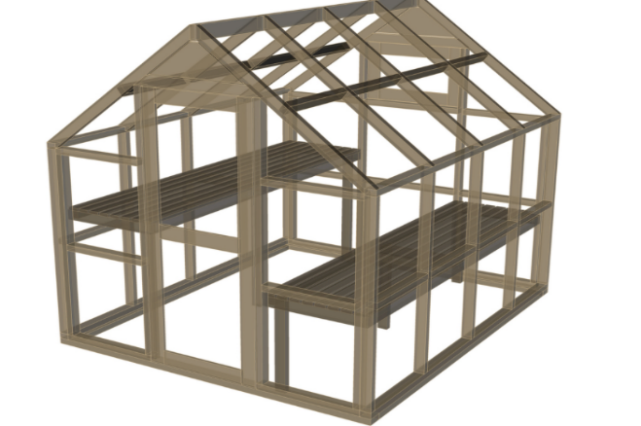
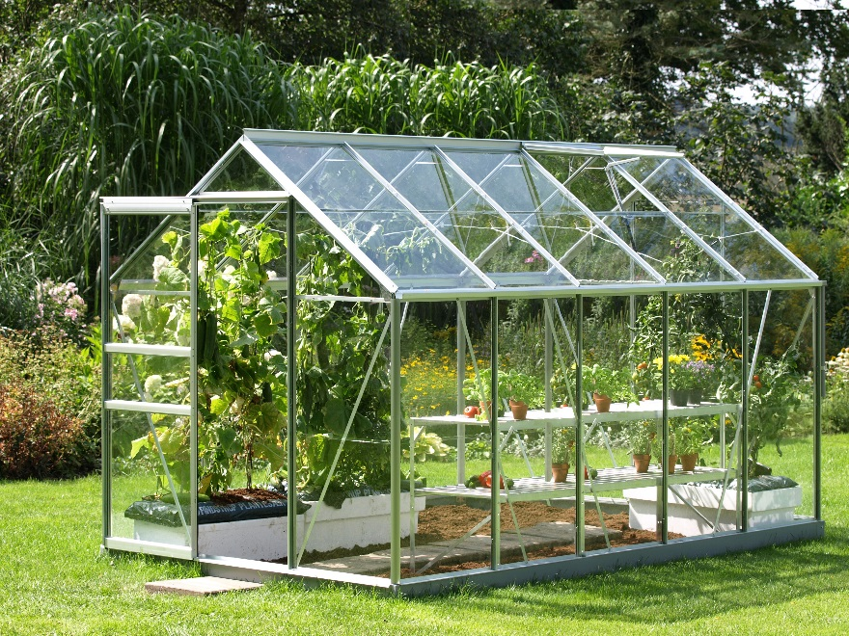
A Third Example of Performance Task
Your school has decided to build a greenhouse and garden on the side of the school. The principal has asked your class to give a written estimate of the cost of building the greenhouse and creating a large garden. You will need to calculate how much metal framing and glass is needed and how many bolts/fasteners and hinges are needed for the greenhouse. You also need to calculate the costs of shelves, pots, soil, plants, and other materials for growing plants. In addition, you need to calculate the cost of creating a garden next to the greenhouse. Use the materials information sheet to help you calculate the total cost.
Notes:
To Know/To Say: In this performance task, the students are given an information sheet which they will be asked to use in determining the cost estimate for this project.
To Do: Ask the participants take a few moments to reflect upon this task and think about the key elements would be that should be identified in the rubric or scoring guide.

Slide 53
Performance Task Based on Data
The Friends of Nature youth club has been studying a local greenbelt area for several years. The plants and land shapes in the area have changed very little, except that a very strong wind about a year ago blew down nearly all the large dead trees. Some of the other things the club has learned are shown in the table in the next slide.
Notes:
To Know/To Say: This performance task is based on data that a club collected. Read this description and look at the chart on the next slide.

Slide 54
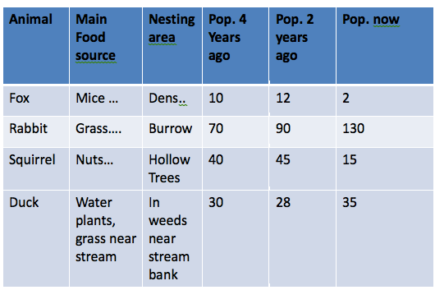
Friends of Nature Table
Notes:
To Know/To Say: What does this chart tell you about the animals they studied? (Performance Task is on next slide.)

Slide 55
From the Friends of Nature table
Predict the following:
  Which food supply may be reduced if current trends continue? What evidence supports your prediction?
  Which animal population may become out of control if predators do not come into the greenbelt? Why? What evidence supports your answer?
  Which populations are likely to remain stable? Why? What evidence supports your answer?
Design a plan for managing the greenbelt animal population.
Notes:
To Know/To Say: Based on the table, students are asked to make some predictions and design a plan. What kinds of thinking does this performance task require?

Slide 56
Reflection Time
Think about the content, skills and processes you teach in your classroom and answer the three questions below.
What content information and simple skills do you teach in your classroom that would lend itself well to being assessed by using SR items? | What concepts, principles and processes do you teach in your classroom that would lend itself well to being assessed by the use of CR items. | When might you ask students to do a PT to show their application of multiple skills and processes?
Notes:
To Know/To Say: Now that we have reviewed the 3 types of assessment items, think about the content and skills that are best assessed through selected response vs. constructed response vs. performance task items.
To Do: Ask participants to answer the questions then share with a partner. Have the participants take out a blank sheet of paper or index cards to craft their responses to the three questions.

Slide 57

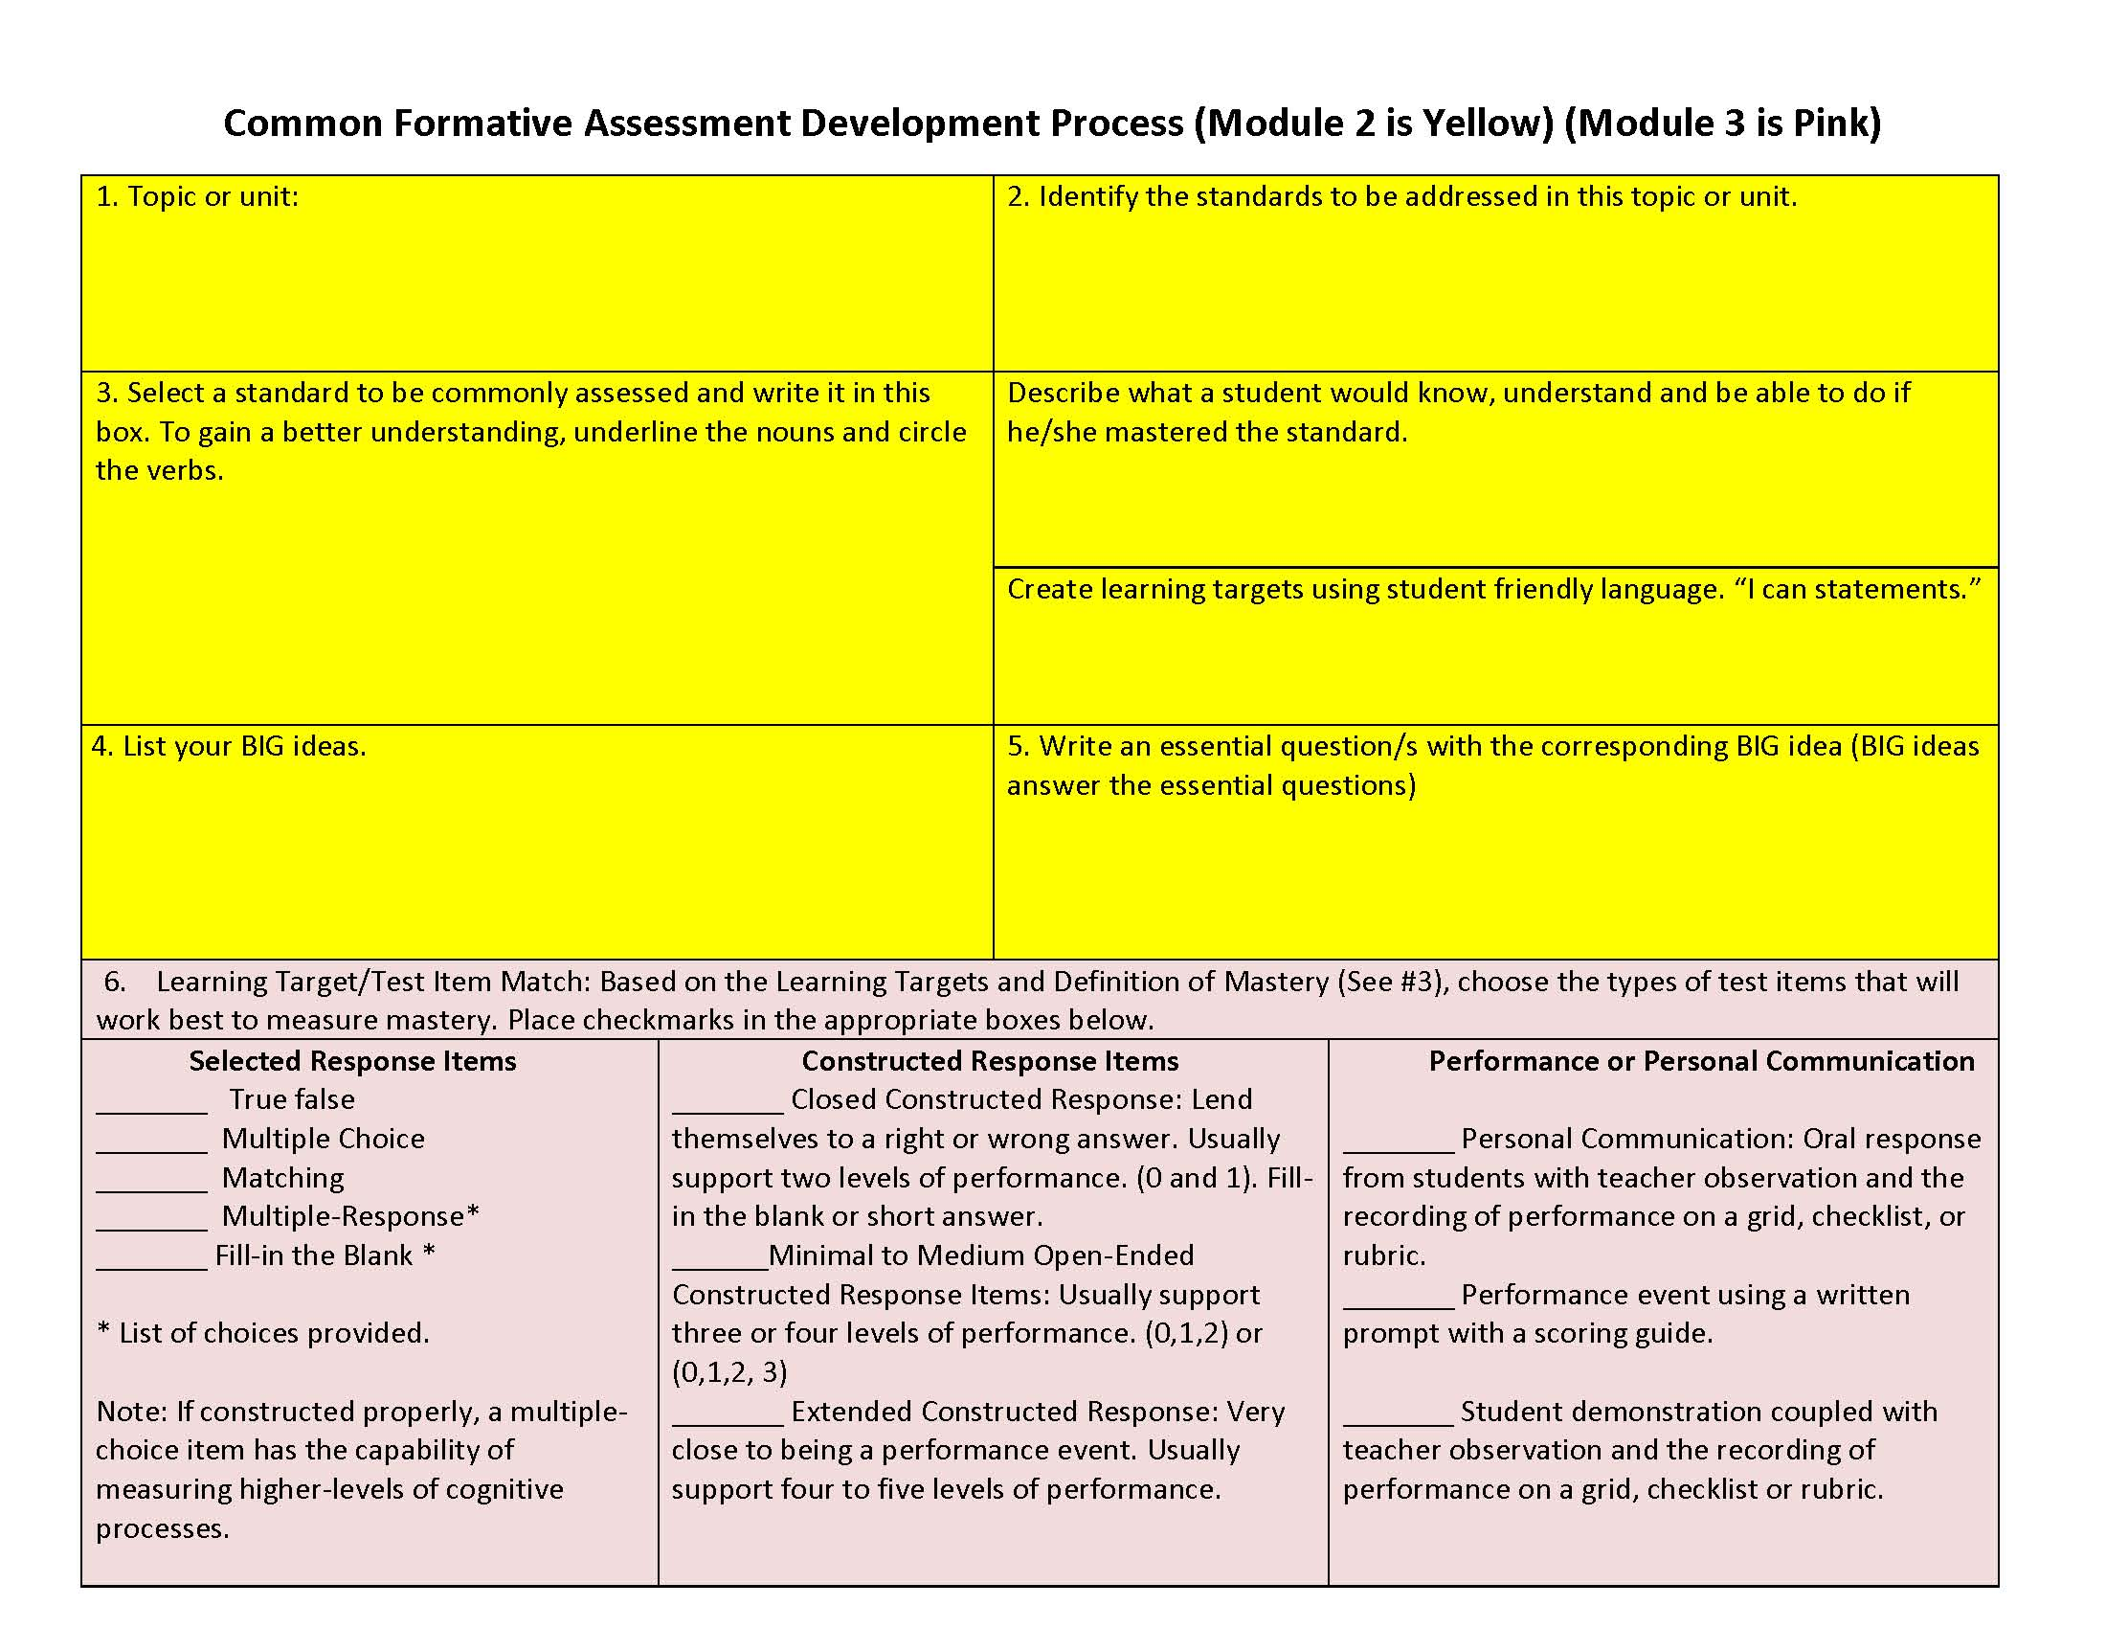
Module #3 is a continuation of
Module #2!
Module 2
Module 3
Adapted from Ainsworth, L. & Viegut, D. (2006).
Notes:
To Know/To Say: At this point we can continue to work on the CFA template.
To Do: If teams have completed Module 2 and have filled out the yellow portion of the template, have them pull their completed work on steps 1 through 5 and reference the template as they continue work on steps 6 through 11. Note for the participants that steps 12 through 14 in white are important steps to this process, but included in the training for Data-Based Decision-Making and work of data teams.
Resources: Ainsworth, L. (2010). Planning for rigorous curriculum design. Englewood, CA: Lead and Learn Center.
Ainsworth, L. & Viegut, D. (2006). Common formative assessment: How to connect standards-based instruction and assessment. Thousand Oaks, CA: Corwin Press.

Slide 58
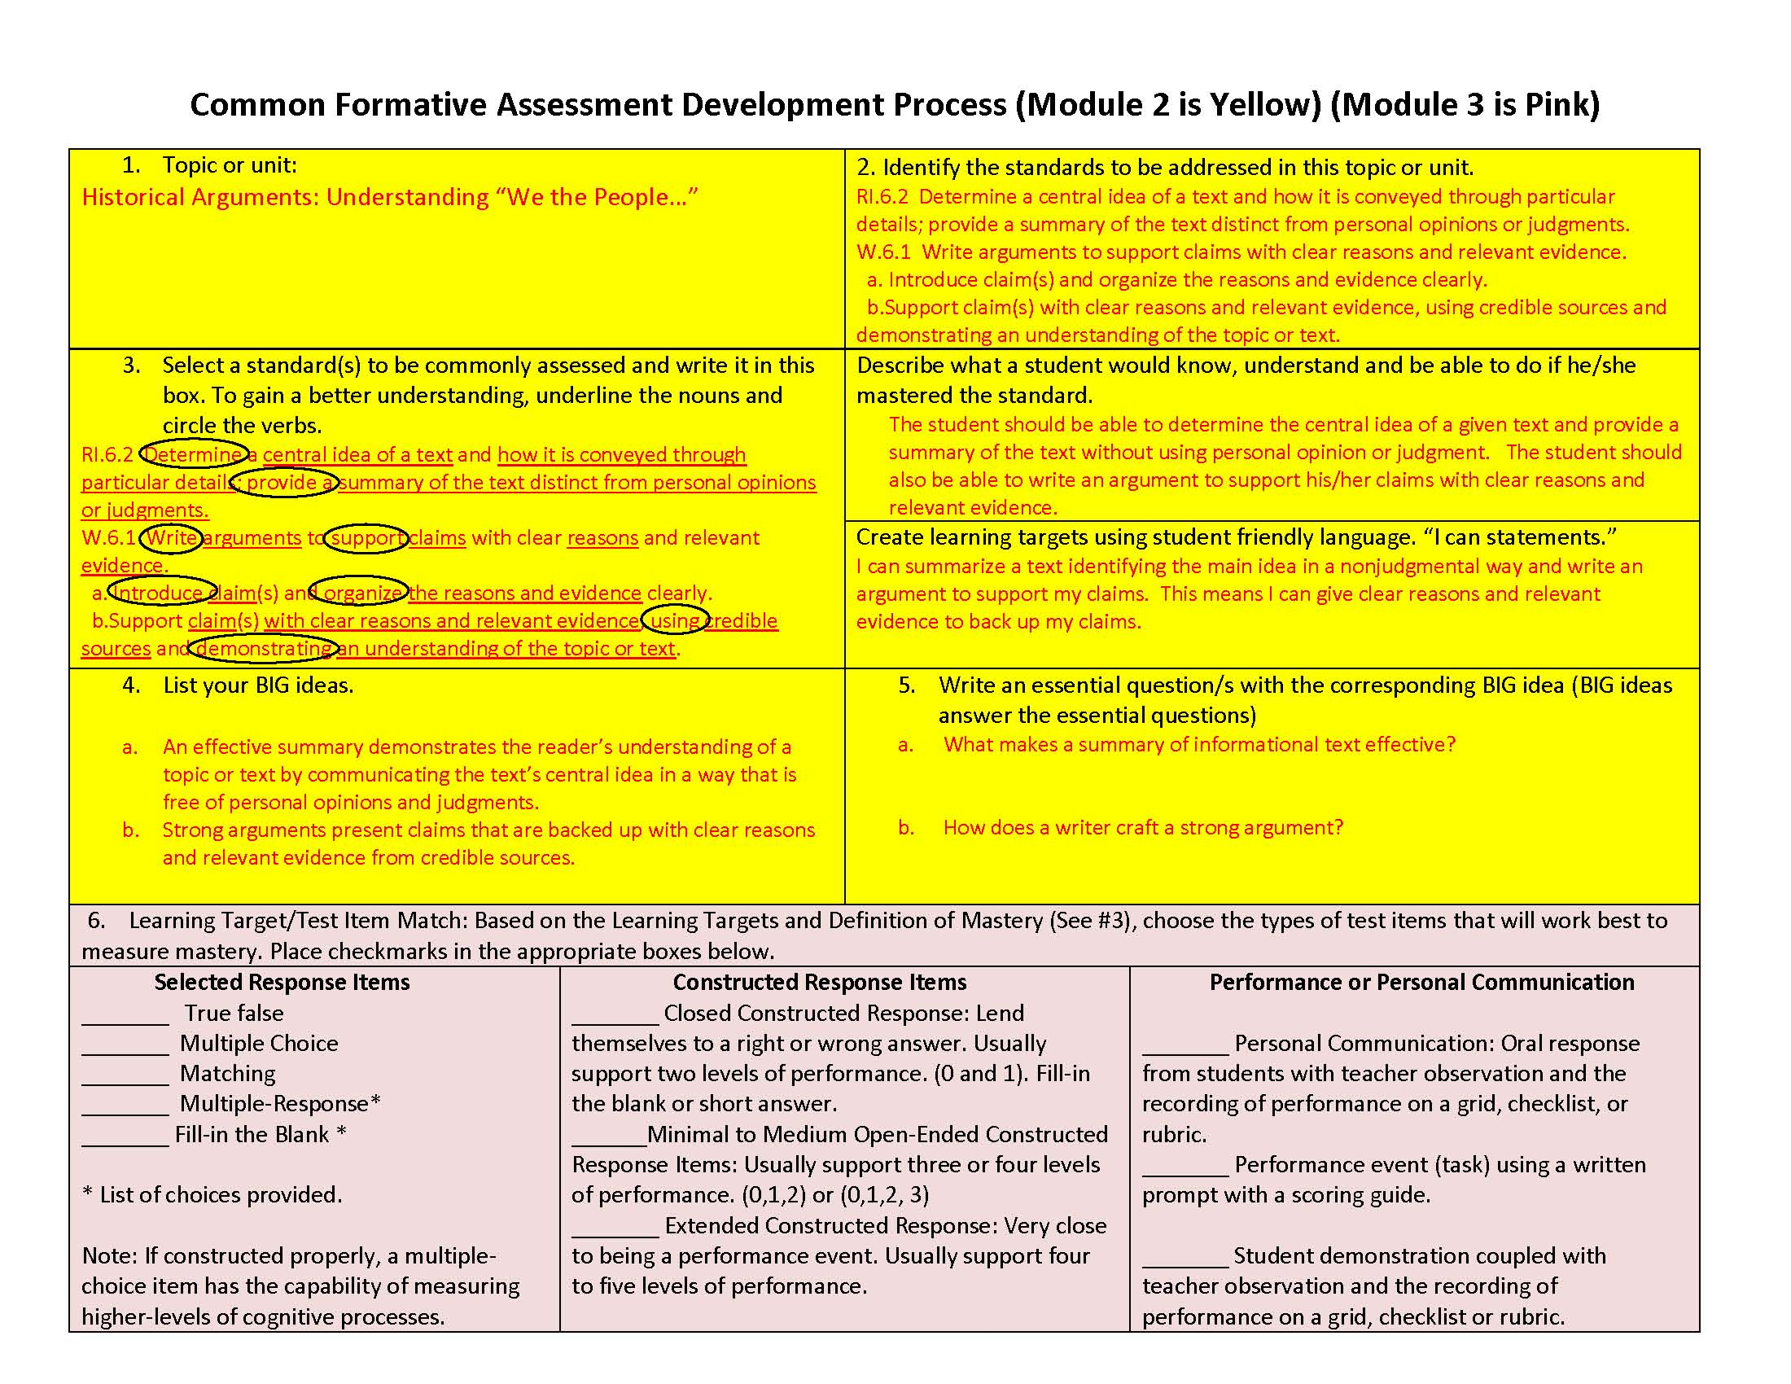
Now let’s practice!
Using either the sample CFA Development Template, or personal work created in steps 1 through 5 previously, complete Steps 6 through 9 by selecting the appropriate types of assessments, matching up the test items with the learning target.
Adapted from Ainsworth, L. & Viegut, D. (2006).
Notes:
To Do: Ask participants to work on steps 6 through 9 in selecting appropriate types of test items, and then writing the items using what they have learned about SR and CR items writing. They may use the sample template with steps 1 through 5 pre-determined, or they may continue work they completed in Module #2.
Resources: Ainsworth, L. (2010). Planning for rigorous curriculum design. Englewood, CA: Lead and Learn Center.
Ainsworth, L. & Viegut, D. (2006). Common formative assessment: How to connect standards-based instruction and assessment. Thousand Oaks, CA: Corwin Press.

Slide 59
Step 10: Define Achievement Levels
When items are written, complete step 10 by describing how information from the scoring guides can be used collectively to determine achievement levels for students. These levels will be used later in the Data Team Process.
Adapted from Ainsworth, L. & Viegut, D. (2006).
Notes:
To Know/To Say: The example in Step 10 has 7 questions – 5 selected response, 1 constructed response worth 3 points, and the fourth is another constructed response item worth four points. In step #10, it is necessary to determine the levels of achievement to determine those students who are advanced, proficient, close to proficient, etc. What do you think the level of achievement or cut score should be for each level?
To Do: Ask participants to discuss how many points would be needed for each level and why. Ask some to share with the large group. Ask participants to review their own test and determine levels.
Resources: Ainsworth, L. (2010). Planning for rigorous curriculum design. Englewood, CA: Lead and Learn Center.
Ainsworth, L. & Viegut, D. (2006). Common formative assessment: How to connect standards-based instruction and assessment. Thousand Oaks, CA: Corwin Press.

Slide 60
Step 11: Review and Revise
Review test items collaboratively to affirm the quality and appropriateness of the test items.
Adapted from Ainsworth, L. & Viegut, D. (2006).
Notes:
To Know/To Say: Now that you have created a CFA, exchange your test with another partner/group. Use the questions on the next slide to evaluate the quality of the assessment.
To Do: Participants exchange tests with a partner or another group.
Resources: Ainsworth, L. (2010). Planning for rigorous curriculum design. Englewood, CA: Lead and Learn Center.
Ainsworth, L. & Viegut, D. (2006). Common formative assessment: How to connect standards-based instruction and assessment. Thousand Oaks, CA: Corwin Press.
Note: Questions might arise about steps 12 through 14. While these are obviously very important “next steps” to the Common Formative Assessment item development, they will not be addressed in this module. Rather, these steps are integral to the data team process, which is a separate training.

Slide 61
Evaluate Your Test
Collectively, do the assessment items produce the necessary evidence to determine whether or not the student has mastered the standard(s) targeted for assessment?
Are the assessment items the most appropriate type to use to measure the targeted standard?
Do the assessment items require students to demonstrate the same level of rigor as specified by the targeted standard?
Are the items worded clearly and concisely?
Are the directions written so students clearly understand what they are to do?
Are the items free of any type of bias?
Notes:
To Know/To Say: As you review the test, think about these questions. A team of teachers could use these to evaluate the quality of their common formative assessment.
To Do: Partners/groups discuss the tests and provide feedback to authors of the tests.

Slide 62
Using Data to Inform Test Writing Skills
Use of data from a careful item analysis can help a teacher improve his/her test writing skills.
Additionally, looking at student results can give the teacher ideas as to improvements that need to be made in instruction and/or curriculum.
Notes:
To Know/To Say: After administering the post-assessment, completing an item analysis and looking at student results helps teachers improve their test writing skills.

Slide 63
Possible Causes for Faulty Items/Low Scores on Items
Basic content or skills have not been addressed or taught.
Students are unfamiliar with the process needed to solve the problem/answer the question (i.e. problem solving, deductive/inductive thinking, making an inference, etc.)
Students are unfamiliar with the format needed to answer the question. (i.e. political cartoon, letter, graph, etc.)
Students are unfamiliar with the meaning of the language used in the test item. (i.e. compare and contrast, paraphrase, illustrate, evaluate, etc.)
Lack of reading ability. Vocabulary used in item stem or stimulus is too difficult.
Wording of the item is unclear or confusing.
The rubric does not align with the test item. The rubric holds students accountable for something that was not cued in the item stem.
The rubric holds students to a standard that is not grade-level appropriate.
The item is asking the impossible or improbable (i.e. Asking for two similarities and two differences when there are not that many. Asking for three details when there are not that many.)
The stimulus material used as a basis for item development is at fault.
Notes:
To Know/To Do: After the post test, this list of possible reasons for low scores can be used to analyze why students may have not answered correctly. It can help the team revise the test questions.
Handout: This list can be copied as a reference sheet for analyzing test results.

Slide 64
Reflection
Based on what you have learned today,
What steps might you take in order to become a “top notch” writer of formative assessments and of the various types of test items?
What potential challenges do you foresee? How might these be overcome?
What tools and/or resources might you use to ensure the assessments and assessment items you write are top quality?
Notes:
To Know/To Say: Based on our discussion of assessment design today, what are the next steps for you?
To Do: Ask participants to write responses to these questions on a reflection sheet you provide or on the evaluation sheet. Use these ideas to determine the follow-up coaching and resources needed to ensure success. Share out as large group and chart responses to gather information on follow-up.
Handout: Copy the questions on a reflection sheet (or ask participants to write their responses on their evaluation sheet.)

Slide 65

CLOSING & Follow-up
Common Formative Assessment
Sound Assessment Design
Notes:
To Know/To Say: This is the end of the CFA Module 3, Sound Assessment Design. The final three sections offer ways to create quality Selected Response Questions, Constructed Response Questions, and Performance Events.
To Do: Allow time for any additional questions before going on to the Practice Profile, Self Assessment Practice Profile Workbook, and Next Steps.
Handouts: Common Formative Assessment Practice Profile, Self Assessment Practice Profile Workbook, Next Steps

Slide 66
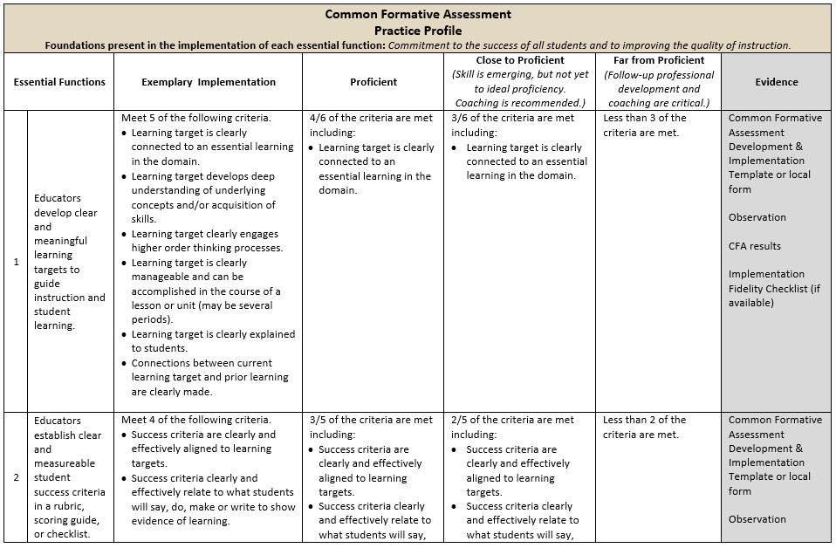
Practice Profile
66
Notes:
To Know/To Say: The Practice Profile template includes four pieces and is anchored by the essential functions. First, as a header is the foundation of implementation that philosophically grounds implementation. Then moving from left to right across the template are the essential functions of the practice, implementation performance levels, and lastly, evidence which provides data or documentation for determining implementation levels.
The essential functions align with the teaching/learning objectives for each learning package. Four levels of implementation are described for each teaching/learning objective: exemplary, proficient, close to proficient, and far from proficient. The professional development provider should walk through the practice profile with the educator-learners, referring to the data and artifacts listed as suggested evidence. It is an important tool for self-monitoring their own implementation because it serves as a reminder as to the implementation criteria and is also aligned with the fidelity checklists and the electronic practice profile self-assessment tool. These sources provide data regarding further training or coaching.
Review the practice profile with the participants. Suggestion is to do self-analysis three or four times a year as well as ask a coach or administrator to also complete this form. Discussion would occur in comparing the self-analysis to the “outside analysis.”
To Do: Review the practice profile with the participants. Suggest all stake-holders complete a self-analysis three or four times a year and engage in collaborative conversation.
Handout: Common Formative Assessment Practice Profile

Slide 67
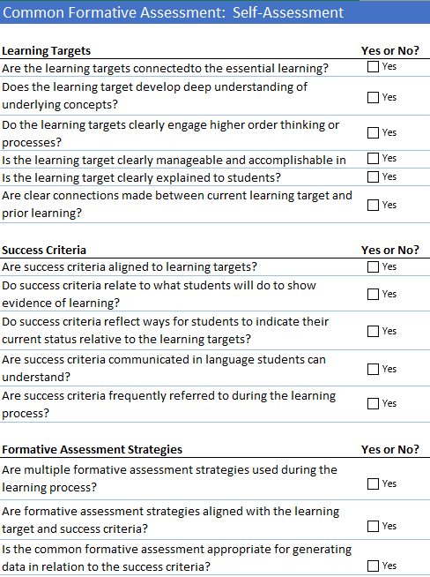
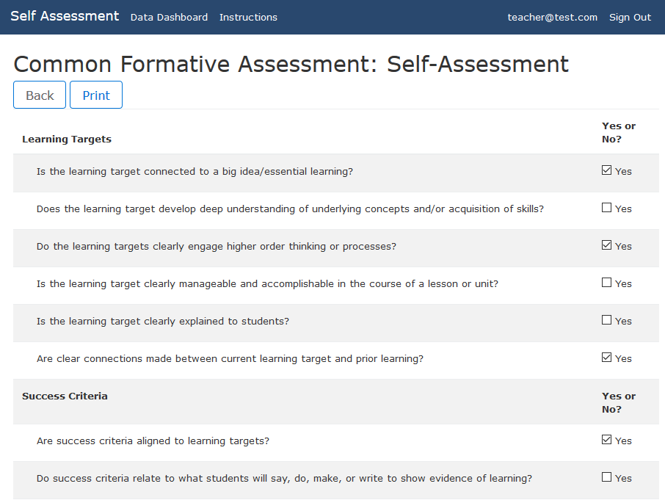
Self-Assessment Practice Profile
Excel Workbook
http://sapp.missouripd.org
Notes:
To Know/To Say: The Self-Assessment Practice Profile Workbook is an excel document allowing individuals to determine their implementation level for a specific learning package topic. The self-assessment is also available online at http://sapp.missouripd.org/. This self-monitoring tool may be utilized at the beginning, mid-points, and end of the year. These results from the staff may be compiled onto a Practice Profile and may be utilized for team discussion.
Reference: Available online at http://sapp.missouripd.org/

Slide 68
Implementation Fidelity
 | Yes | Partially | No | If partially or no, please explain.
Common formative assessment is linked to selected learning standards.
Learning goal engages higher order thinking processes.
Learning goal can be accomplished in the course of a unit.
Learning target is written in language that students can clearly understand.
Learning target is clearly explained to students.
Success criteria are written in language that students can clearly understand in a rubric or checklist.
Students receive feedback based on learning goal and their assessment results.
The quality of assessment items for measuring mastery is reviewed and items revised as needed.
Total
Notes:
To Know: The Implementation Fidelity Checklist is a hidden slide and will be review/revised at a later time.

Slide 69
Next Steps
Create CFAs and use the tools provided to evaluate the quality of your CFAs.
Use the Practice Profile, Practice Profile Self-Assessment Workbook, and Implementation Checklist to reflect on your implementation.
Notes:
To Know/To Say: The next steps are to create CFAs and evaluate the quality of your CFAs with the tools provided and your test results.

Slide 70
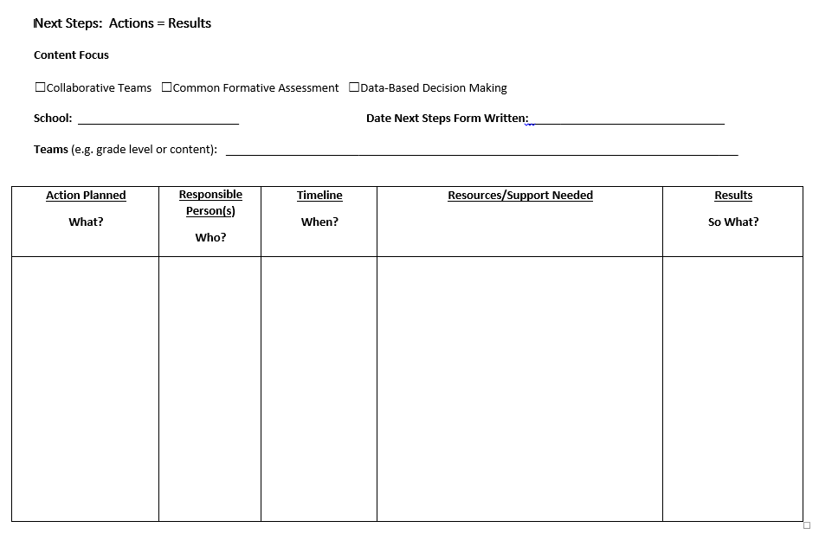
Next Steps: Action = Results
What steps will you take to start implementing?
Notes:
To Know/To Say: The Next Steps template is used for planning either today or back in your building. What resources do you need to begin implementing Common Formative Assessments or Formative Assessments. How will these assessments be used? What might be a timeline for the use of CFAs?
To Do: Complete the Next Steps template. Example is included in the learning package materials.
Handout: Next Steps: Action = Results

Slide 71

For Additional Learning
In-depth additional training from RPDC staff members on how to write quality selected response items, constructed response items and performance events.
Books contained in Bibliography on the next slide.
Websites and Videos about Formative Assessment
  http://www.youtube.com/watch?v=2K8qbI_FzGE
  http://www.amle.org/Publications/WebExclusive/Assessment/tabid/1120/Default.aspx
  http://www.ncpublicschools.org/docs/accountability/educators/fastresearchresources.pdf
  http://www.ncpublicschools.org/accountability/educators/vision/formative
Notes:
To Know: This hidden slide may be used as a handout or used in training.

Slide 72
Contact Information
Please contact me to schedule follow-up coaching and/or additional professional development.
Notes:
To Know/To Say/To Do: Include presenter’s contact information.
Please contact me to schedule follow-up coaching and/or additional professional development. Thank you.

