Slide 1
Hidden Slide #1
Presenter notes information
Tools and documents
Helpful suggestions
Notes:
To Know: The Common Formative Assessment learning package is organized in six modules. The first three are an Overview, Meaningful Learning Targets, and Sound Assessment Design. The remaining three modules address development of selected response, constructed response, and performance task assessments.
The CW Content Fidelity Checklist aligned to each learning package includes all critical items for a training session (draft, pending approval). The CW HQPD Training Checklist and Coaching Checklist contain process elements to be used as guidance when designing, revising, or coaching high quality professional development.
Important notes:
A script of presenter notes is included in the PowerPoint. Background information for the presenter is shown as “To Know.” Statements to be shared with participants are shown as “To Say.” In some instances, the “To Know/To Say” are the same material. For fidelity of content and consistency among presenters, the “To Say” information should be presented with minimal paraphrasing. The presenter notes also include “To Do” prompts and cues for “Handouts.”
A presenter may add slides to supplement the content. For example, a slide of essential questions may be added since only objectives have been included.
A presenter may choose to differentiate a presentation to meet the needs of the participants. For example, another form may be substituted for the Next Steps template if the district or building already uses a similar form or protocol.
Additional activities, examples, videos, etc. are being developed. (The details are in progress.) A presenter may interchange the additional material for the corresponding PowerPoint content.
There is one pre/post assessment for the entire CFA package (all six modules).
An Implementation Fidelity Checklist is available for frequent monitoring by a teacher or observer.
A print Practice Profile and an electronic Practice Profile Self-Assessment tool are available for use by individuals, teams, or schools for periodic self-assessment and monitoring of implementation of practice or to identify training or coaching needs.
The presenter should download onto a hard drive or a flash drive any video intended for use in a training. The links shown on slides may not be able to be accessed online at the school sites.
Breaks should be inserted at the discretion of the presenter based on the needs of participants.

Slide 2
Hidden Slide #2
Session at a Glance
Introductions/CFA materials/Objectives/Guiding Questions/Norms
Key 2: Meaningful Learning Targets
Determine Unit of Study
Identify Standards Selected for Assessment
Unwrap Standards Selected for Assessment
Write Big Ideas
Write Essential Questions
Unit of Study Template
Notes:
To Know: This is an optional slide and may be used as an agenda.

Slide 3
Hidden Slide #3
Supplies needed:
Post Its
Chart Paper (one per table group)
Colored Markers
Current content standards—participants should bring their own
Notes:
To Know: Supplies needed for the second module, Meaningful Learning Targets, of the CFA Learning Package.

Slide 4
Hidden Slide #4
Handouts needed:
Pre-reading, Dufour, R., Dufour, R., & Eaker, R. (2007). The case for common formative assessments. Retrieved from: www.allthingsplc.org. (slide 21)
CFA Infographic (slide 13)
CFA Development Process Template (slides 30, 37, 52, 64)
Color coded, blank
Color coded, example
No shading, blank
Concepts, Skills, DOK (slide 36)
Frayer model (slide 41)
Practice Profile (slide 70)
Self Assessment Practice Profile Workbook (slide 71)
Implementation Fidelity Checklist (hidden slide 72)
Next Steps (slide 73)
Notes:
To Know: The pre-reading, the first three pages of the blog, may be accessed by using the reference information and then copied for participants.
To Do: Send out article ahead of time and ask them to read and highlight what they see as important. Then bring back to the meeting ready to share out in groups. If sending the article ahead of time will not work, trainer could do this activity early in the training.
Handouts: Handouts are listed on MOEDUSAIL, CFA Learning Package first page. The corresponding slide number(s) are included.
Reference: Dufour, R., Dufour, R., & Eaker, R. (2007). The case for common formative assessments. Retrieved from: www.allthingsplc.org.

Slide 5
Meaningful Learning Targets
Common Formative Assessment
Draft: 03/27/2013
This work is licensed under a Creative Commons Attribution-NonCommercial-NoDerivatives 4.0 International License.
Notes:
To Know/To Say: Good morning/afternoon! We will begin in _____ minutes.
To Do: Greet participants.

Slide 6
Acknowledgements Special thanks to all contributors to the development and revision of this module. The original collection of learning packages was rolled-out for use by Regional Professional Development Center (RPDC) Consultants in July 2013 after being developed by a team of content experts. The collection of learning packages was developed through efforts funded by the Missouri State Personnel Development Grant (SPDG). The following individual/groups are thanked immensely for their hard work in developing this package.
----------------------------------------------------------------------------------------------------------------------------------------
Content Development Support
UMKC Institute for Human Development
Ronda Jenson, Director Stefanie Lindsay
Arden Day Carla Williams
Jodi Arnold
SPDG Management Team
Notes:
To Know/To Say: Special thanks to all contributors to the development and revision of this module.

Slide 7
Initial Content Development Team, 2013 Rob Gordon, Team Leader, MO PLC Rebecca Rider, SE RPDC Alan Bancroft, C RPDC Kelley Ritter, SW RPDC Debra Cole, StL, RPDC Jay Roth, SW, RPDC Cheri Fuemmeler, SE RPDC Jana Scott, HOM, RPDC Jane Jackson, NW RPDC Thea Scott, DESE Melanie Whitener Needling, SE RPDC Alicia Wilson, KC RPDC Linda Null, SE RPDC
2016 Revision Team
Nancy Steele, Facilitator, NE SIS Janet Crafton, SC RPDC
Pam Carte, NE RPDC Ginger Henry, DESE
Beverly Colombo, StL, RPDC Rebecca Rider, SE RPDC
Liz Condray, SC RPDC Sarah Spence, C SIS
Notes:
To Know/To Say: Thank the contributors.

Slide 8
Welcome and Introductions
Please take a moment to introduce (or reintroduce) yourself to the group, by telling your name, district, and position.
Our trainers for the day are….
Notes:
To Know/To Say: Welcome to Meaningful Learning Targets for Common Formative Assessments.
The introductions may be formal or informal depending on how well you know the group. Trainers should use whatever process is comfortable for introductions. I am/we are _______________ (provide some background about trainers.) Please introduce yourself to the group (name, district, position.)
To Do: (optional) Review/reflection activity – consultant could create a flip chart or Bingo sheet with questions from previous session.

Slide 9
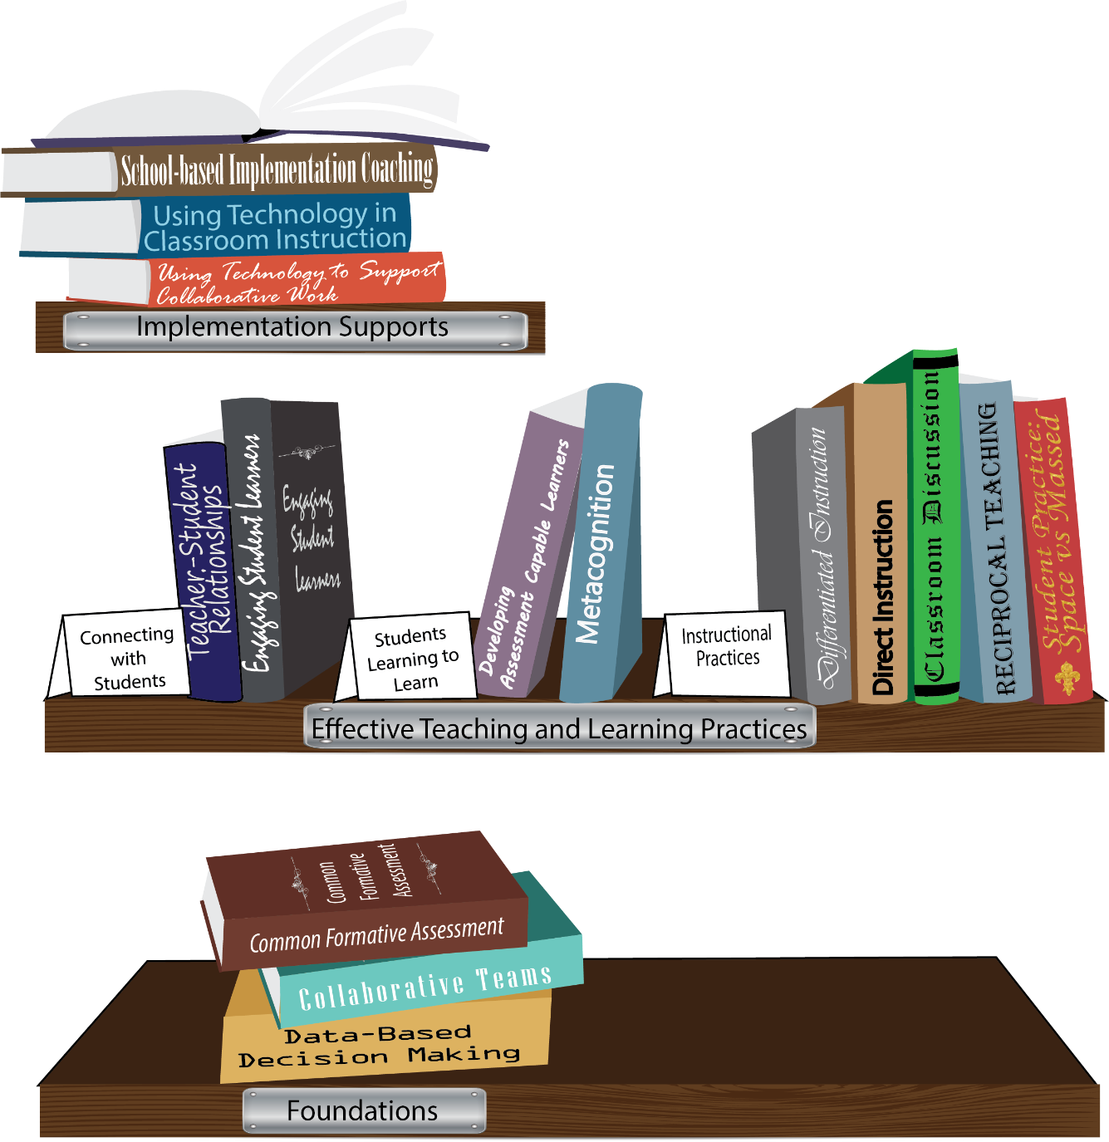
Notes:
To Know/To Say: Missouri’s professional development learning packages are organized in three categories: Foundations, Effective Teaching & Learning Practices, and Implementation Supports. All schools begin their professional development journey with the Foundations, as these learning packages provide foundation knowledge in three key areas: Collaborative Teams, Data-based Decision-making, and Common Formative Assessment. Effective Teaching & Learning Practices encompass research-based instructional practices for deepened learning. These learning packages address ways of connecting with students, ways of helping students learn how to learn, and feature specific instruction practices. Implementation Supports are learning packages designed to help school staff support and enhance the Implementation of Effective Teaching & Learning Practices through using technology and peer coaching supports.
To Do: Explain how the graphic depicts professional development in Missouri.

Slide 10
Collaborative Work Foundations
CFA – utilize
Quality assessments
as feedback to improve teaching & learning.
3 Key Areas
1. Collaborative Teams
2. Common Formative Assessment
3. Data-Based Decision Making
DBDM – utilize data for continuous improvement through dialogue about teaching & learning
CT – utilize team processes to improve teaching & learning.
Notes:
To Know/To Say: The learning packages forming the foundation knowledge of the Collaborative Work are Collaborative Teams, Data-Based Decision Making, and Common Formative Assessment.
Collaborative Teams (CT) utilize team processes to improve teaching and learning.
Common Formative Assessment (CFA) utilize quality assessments as feedback to improve teaching & learning.
Data-Based Decision Making (DBDM) utilize data for continuous improvement through dialogue around instruction.

Slide 11
Common Formative Assessment
Modules 1-3
Overview
Sound Assessment Design
Meaningful Learning Targets
Notes:
To Know: The Common Formative Assessment learning package contains six modules. The first three modules, Overview and Purpose of Assessment, Meaningful Learning Targets, and Sound Assessment Design were revised in 2016. The remaining three modules addressing how to write selected responses, constructed responses, and performance tasks will be revised at a later time.
To Know/To Say: The preceding slide of the bookshelf graphic represents the Collaborative Work as a whole and is followed by a graphic showing how the three key areas; Collaborative Teams, Data-Based Decision Making, and Common Formative Assessment, align to form the foundation knowledge for Collaborative Work. This slide introduces the first three modules of the Common Formative Assessment learning package; The Overview and Purpose of Assessment, Meaningful Learning Targets, and Sound Assessment Design.

Slide 12
Notes:
To Know/To Say: This is the Common Formative Assessment Infographic updated in May 2017. Missouri Collaborative Work magazine located on MOEDU-SAIL. Definitions, Process, and Benefits are listed on this graphic.
Common Formative Assessment is one of the foundational pieces of the Collaborative Work process. Extensive educational research shows the effectiveness of Common Formative Assessments with student achievement. Definitions and process will be the focus of this training.
To Do: Distribute the Common Formative Assessment Infographic Handout.
References: Cook & Negron. (2009). http://www.powershow.com/view4/52b1e8-NjFmM/Overview to Common Formative Assessments CFAs Powerpoint ppt presentations.
Dufour, R., DuFour, R., Eaker, R. (2007). The case for common formative assessments. Retrieved from: www.allthingsplc.com.
O’Connnor, K. (2007). How to grade for learning: Linking grades to standards. Glenview, IL: Skylight Professional Development.
Handout: Common Formative Assessment Infographic

Slide 13
Missouri Teacher Standards
Common formative assessments address the following Missouri Teacher Standards:
Standard #7: Student Assessment and Data Analysis
Standard #2: Student Learning, Growth and Development
Standard #4: Critical Thinking
Standard #9: Professional Collaboration
(Missouri Department of Elementary and Secondary Education, 2013)
Notes:
To Know/To Say: Explain how the Missouri Teacher Standards fit with Common Formative Assessment.
Standard #7: Student Assessment and Data Analysis: The teacher understands and uses formative and summative assessment strategies to assess the learner’s progress and uses both classroom and standardized assessment data to plan ongoing instruction. The teacher monitors the performance of each student, and devises instruction to enable students to grow and develop, making adequate academic progress.
Standard #2: Student Learning, Growth and Development: The teacher understands how students learn, develop and differ in their approaches to learning. The teacher provides learning opportunities that are adapted to diverse learners and support the intellectual, social, and personal development of all students.
Standard #4: Critical Thinking: The teacher uses a variety of instructional strategies and resources to encourage students’ critical thinking, problem solving, and performance skills.
Standard #9: Professional Collaboration: The teacher has effective working relationships with students, parents, school colleagues, and community members.
Reference: Missouri Department of Elementary and Secondary Education (2013). Teacher standards: Missouri’s educator evaluation system. Retrieved from: http://dese.mo.gov/sites/default/files/TeacherStandards.pdf.

Slide 14
Learner Objectives of the Formative Assessment Series
Understand the clear purposes of assessment by clarifying
Why they are assessing
Who will use the results of assessment data
What they will do with the assessment data
Develop clear and meaningful learning targets to guide instruction and student learning
Construct quality assessment instruments which are of sound design and measure the learning targets
Notes:
To Know/To Say: Today’s training will focus on Module Two—Clear Learning Targets
To Do: [trainer note: all HQPD should have learner objectives clearly given to participants. If participants do not have a copy of the PowerPoint, objectives may be posted on chart paper or printed on a handout]
Common Formative Assessment Training includes three major components: Understanding clear purposes, developing clear and meaningful targets, and constructing quality assessments. Today’s focus is on understanding the clear purposes of assessment. By gaining an understanding of the purpose, teachers become more aware of how to better construct assessments. Today is about seeing a larger purpose and overview of assessments.
Module two is about the process of connecting curriculum to students and assessments through the use of learning targets.
The third section is about designing quality assessment instruments to serve the purpose of the assessment.

Slide 15
Module 2: Meaningful Learning Targets Guiding Questions
How do we use targets to guide instruction?
How do we use targets to help students guide their own learning?
Notes:
To Know/To Say: In Module 1, CFA Overview, participants discussed the differences between formative and summative assessments and the importance of creating effective assessments. Also included were the five keys to quality assessment and the importance of student involvement in the assessment process. Today’s focus is on these two essential questions.
To Do: Use a shoulder partner to discuss these 2 questions. Do not have them share out at this time. This slide is an opportunity to begin shifting their thinking to the training ahead.

Slide 16
Learning Outcomes
Develop clear and meaningful learning targets to guide instruction and student learning.
Determine Unit of Study
Identify Standard Selected for Assessment
Unwrap Standard Selected for Assessment
Write Big Ideas
Write Essential Questions
(Ainsworth & Viegut, 2006)
Notes:
To Know/To Say: During this training, participants will complete a template that will include these five steps to creating quality assessments. The CFA template is located in the participant handout resources, and participants will end the day with a finished product of the first 5 steps.
To Do: Make sure all participants have the handout in resources. Trainer may open with some discussion concerning these five steps. Which ones are you already familiar with? Which ones might be confusing? Does your school have a curriculum template already in use? Any similarities or differences between what you are using and what you see here?
Handout: CFA Template
Resource: Ainsworth, L. & Viegut, D. (2006). Common formative assessment: How to connect standards-based instruction and assessment. Thousand Oaks, CA: Corwin Press.

Slide 17
Norms
Begin and end on time
Be an engaged participant
Be an active listener – open to new ideas
Use electronics respectfully
Notes:
To Know/To Say: Briefly touch upon the norms for the day. These norms are used consistently for all of the training modules.
To Do: If your group already has established norms, use the ones already in place. If you have a favorite norm to add, feel free to do so. Norms should be posted on chart paper or available on tables as a reminder throughout the day.

Slide 18
Clock Partners
Notes:
To Know/To Say: Random partners is a good way to mix up a group for quick discussion. Too often we sit with people we know well or people we work with. Discussion with partners from other school districts or grade levels, can let people hear other ideas. This random partner protocol includes drawing a clock. Have participants draw a clock on a piece of paper. Find a partner for 3 o’clock, 6 o’clock, 9 o’clock, and 12 o’clock from another team. We will use these partners through this training.
Directions: Everyone draws a clock on a piece of paper or use one created as a handout. At a signal from the presenter, participants will go around the room looking for different partners at the 12, 3, 6 and 9 positions. One optional rule is that participants first look for partners outside their table. For example: Partner 1 is looking for a 3 o’clock partner. He/She finds someone also needing a 3 o’clock partner and they both sign each other’s paper at 3 o’clock. Partner 1 looks for a 12 o’clock partner and finds a new person also needing a 12 o’clock partner. They both sign each other’s paper at 12 o’clock. Continue finding partners and writing names in the 4 time slots. If someone cannot find someone with a blank space at a time needed, that person may join another group at that time or may partner with the presenter. When the presenter asks for a specific time partner, the people at the time called will find each other and have a discussion or activity. Sometimes, in a large room, it is important to also include which part of the room a partner is located or include the color of shirt or jacket.
To Do: Be sure participants have paper available for the clock. The clock could also be used as a handout with lines drawn on the 12, 3, 6, and 9 positions.

Slide 19
Share Activity
With your 12 o’clock partner:
Using your copy of the Article “The Case For Common Formative Assessments” take turns sharing what you found of interest from the 6 arguments put forth.
Share whether you agree or disagree.
(Dufour, Dufour, & Eaker, 2007)
Notes:
To Know: It will be necessary to access the first three pages of the blog (article) by using the reference information and then copied for participants.
To Know/To Say: Ask participants to find their 12 ‘clock partner. They need to bring the copy of the article listed above as well as something to write with.
To Do: When 12 o’clock partners are found continue discussion with asking participants to decide which one will be A and which will be B. If participants have trouble with this, just say A has the longer hair.
Using A/B partners
A shares then B comments then
B shares and A comments
Continue until all 6 are covered.
To Do: (optional method)
Write comments on sticky notes. Share with the 12 o’clock partner and then post the notes on a T-Chart labeled Agree on one column and Disagree on the other column. Remind all participants to review the notes during their break.
Reference: Dufour, R., Dufour, R., & Eaker, R. (2007). The case for common formative assessments. Retrieved from: www.allthingsplc.org.

Slide 20
Accurate Assessment
WHY ASSESS?
ASSESS WHAT?
What’s the purpose?
What are the learning
targets?
Who will use the results?
Are they clear?
Are they good?
ASSESS HOW?
What method?
Written well?
Sampled how?
Avoid bias how?
Students are users too!
Be sure students
understand targets too!
Students track progress and communication,!
Students can participate
in the process too!
COMMUNICATE
HOW?
How is information
managed?
Effectively Used
reported?
(Stiggins, Arte, Chappuis & Chappuis, 2004)
Notes:
To Know/To Say: This slide is a review of Module 1—Why Assess? Today we are looking at Key 2—Assess What? Identify the ‘Five Keys’ (noting ½ keys). The 5 keys are clustered by two main components, ‘accurate assessment’ and ‘effectively used’. As we progress with the keys you will note the interdependence they have on curriculum, instruction, and summative assessment. Note: students are linked to both the accurate components and the effectively used component.
To Do: Trainer may have a handout of this slide for review purposes.
NOTE: Refer back to Module 1 for a review of Key 1 if necessary.
Reference: Stiggins, R., Arter, J., Chappuis, J., & Chappuis, S., (2004). Classroom assessment for student learning: Doing it right – Using it well (2nd ed.). Portland, OR: Pearson Assessment Training Institute, Inc.
Handout: Accurate Assessment Slide (optional)

Slide 21
Accurate Assessment
ASSESS WHAT?
What are the learning
targets?
Are they clear?
Are they good?
Be sure students
understand targets too!
Students can participate
in the process too!
(Stiggins, et.al., 2004)
Notes:
To Know/To Say: For the purposes of this module, this slide graphically depicts the portion that relates to the establishment of meaningful learning targets. This is Key 2.
Reference: Stiggins, R., Arter, J., Chappuis, J., & Chappuis, S., (2004). Classroom assessment for student learning: Doing it right – Using it well (2nd ed.). Portland, OR: Pearson Assessment Training Institute, Inc.

Slide 22
Key 2: Meaningful Learning Targets
Determine Unit of Study
Identify Standard(s) Selected for Assessment
Unwrap Standard(s) Selected for Assessment
Write Big Ideas
Write Essential Questions
(Ainsworth & Viegut, 2006)
Notes:
To Know/To Say: This is a transition slide used throughout this training module. Key 2, Meaningful Learning Targets has multiple components. These are the first five steps of the CFA Template. We will be training to all five today in this module. Each time a new section of the targets is discussed, this slide will appear and the focus will be in red. Our first section is to determine the Unit of Study.
Resource: Ainsworth, L. & Viegut, D. (2006). Common formative assessment: How to connect standards-based instruction and assessment. Thousand Oaks, CA: Corwin Press.

Slide 23
Determine Unit of Study
A unit of study is a series of specific lessons, learning experiences, and related assessments – based on designated prioritized standards and related supporting standards – for a topical, skills-based, or thematic focus.
(Ainsworth & Viegut, 2006)
Notes:
To Know/To Say: Know the difference between topical, skills-based, and thematic units. An in-depth discussion of the three is not necessary at this time. This is also a good place to ask if schools already have a template for units of study.
Topical Units of Study – Focus on a specific portion of a larger subject or discipline. Examples include: estimation, story elements, solids and liquids
Skills-based Units of Study – Emphasize application. Examples include: converting fractions to decimals, making text connections, editing and revising
Thematic Units of Study – Emphasize connections to other topics within the same discipline or to completely different disciplines. Examples include: life cycles, impact of war, art and multimedia
To Do: If time allows, trainers may ask participants to discuss any words or phrases on this slide that seem important or confusing.
Resource: Ainsworth, L. & Viegut, D. (2006). Common formative assessment: How to connect standards-based instruction and assessment. Thousand Oaks, CA: Corwin Press.

Slide 24
Key 2: Meaningful Learning Targets
Determine Unit of Study
Identify Standard(s) Selected for Assessment
Unwrap Standard Selected for Assessment
Write Big Ideas
Write Essential Questions
(Ainsworth & Viegut 2006)
Notes:
To Know/To Say: This is a repeat of the earlier slide, and is used as a transition slide to show which section we are moving toward.
Resource: Ainsworth, L. & Viegut, D. (2006). Common formative assessment: How to connect standards-based instruction and assessment. Thousand Oaks, CA: Corwin Press.

Slide 25
Identify Standards Selected for Formative Assessment
Review the standards for your grade level and/or course. Identify those that match the focus for your unit of study based on the following criteria:
Leverage
Readiness
Endurance
Critically important for state assessment
Notes:
To Know/To Say: Explain the process of identifying standards selected for the common formative assessment.
1. Leverage: Which standards are essential in multiple content areas (cross-curricular).
2. Readiness: Which grade or course specific standards are critical for our students to know and understand to be prepared for the next level of learning? Which standards help going from 4th grade to 5th grade? From Algebra I to Algebra II?
3. Endurance: Which standards are life-long skills? Which will be essential beyond school?
4. Which of these standards based on our high stakes assessment data do we need to emphasize? Look at trend data for this—hard to choose based on one assessment?
To Do: Have participants use their current standards and pick a grade level or course level. Using just a portion of the standards document, have participants practice finding a priority standard for their grade or course. When finished, share with table group and defend choices.
Reference: Reeves, D. B. (2002). The leader’s guide to standards: A blueprint for educational equity and excellence. San Francisco, CA: Jossey-Bass.

Slide 26
Standards Selected for Formative Assessment…
are aligned with college and work expectations;
are clear, understandable and consistent;
include rigorous content and application of knowledge through high-order skills;
build upon strengths and lessons of current state standards;
are evidence-based.
Notes:
To Know/To Say: Another way to look at Priority/Power Standard/ Essential Learnings. When teachers choose standards for formative assessments, these bullets should be additional considerations.
To Do: Facilitate discussion about how teachers currently decide on essential learnings for students.

Slide 27
“It is critical that all of the assessed standards be truly significant. From an instructional perspective, it is better for tests to measure a handful of powerful skills accurately than it is for tests to do an inaccurate job of measuring many skills.”
(Popham, 2003)
Notes:
To Know/To Say: This is just a reminder that CFAs are used FOR LEARNING as a measure to determine students progress towards proficiency. Also this quote is connected to Robert Marzano’s observation that schools would have to be K-22 in order to master state standards.
To Do: Optional discussion about how participants decide on which standards should have the most focus.
Reference: Popham, W. J. (2003). Test better, teach better: The instructional role of assessment. Alexandria, VA: Association for Supervision and Curriculum Development.

Slide 28
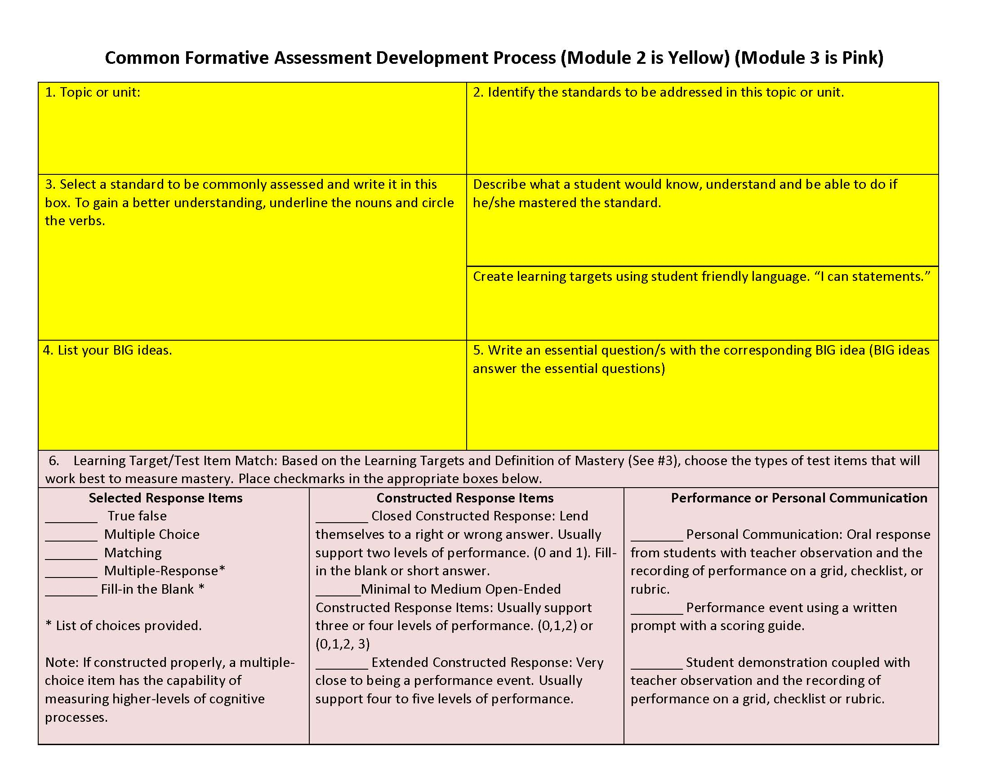
Unit of Study: Identify Standard Selected for Assessment
Identify Priority Standards
Adapted from Ainsworth, L. & Viegut, D. (2006).
Notes:
To Know/To Say: This is the first working step for participants. If a school district already has a template in place, continue to use district templates. Order of steps do not have to follow this order. Sometimes trainers prefer to talk about Essential Questions (step 5) before the Big Idea (Step 4). Presenter should also point out that the yellow sections will be completed during this Module and the pink sections will be completed in Module 3.
To Do: Give participants about 10-15 minutes to do these first two steps (topic or unit focus and standards within that unit). Circulate among them to answer questions and gauge who is finishing and how quickly.
Handouts: Unit of Study Template (Participants will need to use the content standards they brought with them.)
Resources: Ainsworth, L. (2010). Planning for rigorous curriculum design. Englewood, CA: Lead and Learn Center.
Ainsworth, L. & Viegut, D. (2006). Common formative assessment: How to connect standards-based instruction and assessment. Thousand Oaks, CA: Corwin Press.

Slide 29
Share Activity
With your 3 o’clock partner:
Why is it important to match Selected Standards to your Unit of Study?
Reflect on what choosing these standards would look like in your classroom.
Discuss potential challenges and possible solutions for choosing appropriate standards for the Common Formative Assessment.
Notes:
To Know/To Say: Participants will find their clocks and locate their 3 o’clock partner. Using the information on their templates, have partners discuss the questions or reflections on this slide.
To Do: Ask for volunteers to share out highlights from discussions.

Slide 30
Key 2: Meaningful Learning Targets
Determine Unit of Study
Identify Standard Selected for Assessment
Unwrap Standard Selected for Assessment
Write Big Ideas
Write Essential Questions
(Ainsworth & Viegut, 2006)
Notes:
To Know/To Say: This is step three of understanding Meaningful Learning Targets
Resource: Ainsworth, L. & Viegut, D. (2006). Common formative assessment: How to connect standards-based instruction and assessment. Thousand Oaks, CA: Corwin Press.

Slide 31
“Unwrapping” the Selected Standards
“Unwrapping” is a way to collectively analyze a standard to ensure shared understanding of the learning goal.
“Unwrapping” is a process of deconstruction to clearly identify the skills and concepts represented in the standard.
(Ainsworth & Viegut, 2006)
Notes:
To Know/To Say: The collaborative process used to unwrap is key to deeper understanding of the standard, allowing teachers to pinpoint the content and skills that all students need. Even if you are a singleton teacher in your building, you can still collaborate with other teachers and discuss your understanding of a particular standard.
Reference: Ainsworth, L. & Viegut, D. (2006). Common formative assessment: How to connect standards-based instruction and assessment. Thousand Oaks, CA: Corwin Press.

Slide 32
“Unwrap” the Selected Standards
Identify the key concepts (important nouns or noun phrases) by underlining them.
Identify the skills (verbs) by circling them or making them All CAPS.
(Ainsworth & Viegut, 2006)
Notes:
To Know/To Say: To introduce this slide, ask participants how many of them are familiar with the “unwrapping” or “unpacking” process. Some will be, but many will not. This can become a steep learning curve for people without a background in “unwrapping,” but assure participants that the provided examples and the opportunity to practice this powerful method for managing the standards will enable them to successfully “unwrap” the standards they have matched to their instructional topic.
It is also possible, that participants have a great deal of experience with unwrapping standards. For discussion purposes, ask what method they use or what has been effective for them in the past.
Another method of unwrapping is to look at the grade/content just previous to the participant’s grade or content. Ask participants to identify what new learning is taking place? What skills are supposed to be mastered at this point?
To Do: Facilitate discussion of unwrapping standards.
Reference: Ainsworth, L. & Viegut, D. (2006). Common formative assessment: How to connect standards-based instruction and assessment. Thousand Oaks, CA: Corwin Press.

Slide 33
“Unwrapping” a Standard
Know and use various text features (e.g., headings, tables of contents, glossaries, electronic menus, icons) to locate key facts or information in text.
(Ainsworth & Viegut, 2006)
Notes:
To Know/To Say: For practice, look at the standard on the slide. Ask participants to determine the nouns and verbs independently or with a partner.
Note: Sometimes the wording of a standard, benchmark, or grade level expectation is confusing in terms of identifying the skills (verbs) and concepts (nouns or noun phrases). The important thing to remember is to identify what the student is expected to do (skill) and know (noun).
To Do: When participants are finished, show the markings.
Reference: Ainsworth, L. & Viegut, D. (2006). Common formative assessment: How to connect standards-based instruction and assessment. Thousand Oaks, CA: Corwin Press.

Slide 34
Sample Standard: Know and use various text features (e.g., headings, tables of contents, glossaries, electronic menus, icons) to locate key facts or information in text.
Concepts (What students need to know) | Skills (What students must be able to do) | Bloom’s or DOK
Heading Table of contents Glossaries Electronic menus Icons Key facts Titles Labels Graphs | Use various text features Locate key facts and information in a text | Knowledge (1) Application (2)
Notes:
To Know/To Say: Ask participants to fill out the graphic organizer with the information from the unwrapping exercise. When filling out the graphic organizer, mention that some of the “knows” and “dos” come from the standard while others are generated from teacher discussion. The teacher discussion “knows” are in bold font in the table under “concepts”.
On the CFA Unit Development Template, encourage teams to add a table to Box #3a where they can list the Knows, Understands, and Dos, to help organize their thinking.
To Do: Remind participants that the DOK must be considered as they unwrap the standard. What DOK level does the standard imply? Participants can add the DOK to Box #3a.
Handout: Concepts, Skills, DOK

Slide 35
Unit of Study: Create Learning Targets
Adapted from Ainsworth, L. & Viegut, D. (2006).
Notes:
To Know/To Say: Participants will work on Step 3 at this point. Confirm the source of the template and give credit.
Participants should pick one standard from Box #2 that fits the Leverage, Readiness, and Endurance “test” of choosing a priority standard. Write this standard in Box #3 and underline the nouns and circle the verbs. In the circled top box on the right, describe how a student might show mastery of the standard. Participants might also list new learning—what is changed from the grade or course before? Be certain that the DOK level indicated by the standard is included in the description.
For those working on computers, suggest CAPITALIZING all the verbs rather than trying to use the drawing tool to circle each one. The other option is to highlight the concepts in one color and the skills in another.
To Do: Circulate, answer questions, monitor progress.
During this activity participants will complete all three fields for Step 3.
References: Ainsworth, L. (2010). Planning for rigorous curriculum design. Englewood, CA: Lead and Learn Center.
Ainsworth, L. & Viegut, D. (2006). Common formative assessment: How to connect standards-based instruction and assessment. Thousand Oaks, CA: Corwin Press.

Slide 36
Share Activity
With your 9 o’clock partner:
Why is it essential to “unwrap” the standards?
Reflect on what unpacking selected standards would look like in your classroom.
Discuss potential challenges and possible solutions for unpacking the standards.
Notes:
To Know/Say: Take out your clock and find your 9 o’clock partner to address the comments posted on this slide.
To Do: Circulate and monitor conversations. Ask for group share-outs.

Slide 37
Unwrapping to Learning Targets
Notes:
To Know/To Say: Once standards have been unwrapped, participants will create Student Learning Targets and write them in student-friendly language. This is a continuation of Step 3.

Slide 38
What a Learning Target Is and Isn’t
A learning target IS a statement sharing the objective (intended learning) with the students in language they can understand.
“I Can…This Means…”
A learning target IS NOT written from the teacher’s point of view.
Notes:
To Know/To Say: Having posted learning targets will give the students a clear focus on what they are going to learn. This does not mean to ignore the academic language of the standards---this means that students may need extra support with the vocabulary of the standard.

Slide 39
What a Learning Target is and isn’t…
Frayer Model
Definition Clear description of what is to be learned; Provides a clear vision of the ‘destination’ for student learning | Facts/Characteristics Measurable & attainable Focus on intended learning Focus on “chunks” of a standard Clear, specific language congruent to standard
Examples I can add fractions with unlike denominators. I can identify characteristics of a linear function and use them to create a graph. | Nonexamples Adding fractions Do exercise 3.7 on page 148 Learning Activities Tasks Pre-Requisites Assessments
Learning Target
Notes:
To Know/To Say: Learning Targets convey to students the destination for the lesson—what to learn, how deeply to learn it, and exactly how to demonstrate their new learning in student friendly “I can” statements. The Frayer model is a graphic organizer much like the Venn Diagram.
Handout: A blank Frayer model.

Slide 40
Key 2: Meaningful Learning Targets
Determine Unit of Study
Identify Standard Selected for Assessment
Unwrap Standard Selected for Assessment
Write Big Ideas
Write Essential Questions
(Ainsworth & Viegut, 2006)
Notes:
To Know/To Say: Again, a transition slide to a new piece of information. At this point, presenter may want to reverse steps 4 and 5 in order to talk about Essential Questions before Big Ideas.
Resource: Ainsworth, L. & Viegut, D. (2006). Common formative assessment: How to connect standards-based instruction and assessment. Thousand Oaks, CA: Corwin Press.

Slide 41
What Are Big Ideas?
Core concepts within a content area
Foundational understandings students will remember long after instruction ends
What you want students to discover as a result of the learning experience
Notes:
To Know/To Say: These are general guidelines for defining Big Ideas. Big Ideas are usually not stated directly to the students.
To Do: Ask for sharing of what participants think of as being a Big Idea for their grade level/content area.

Slide 42
Big Ideas
“An idea is ‘big’ if it helps us make sense of lots of confusing experiences and seemingly isolated facts. It is like the picture that connects the dots or a simple rule of thumb in a complex field. The water cycle, the hero’s journey, measure twice and cut once.”
(Wiggins, McTighe, Kiernan, Frost, 2005)
Notes:
To Know/To Say: This quote is Grant Wiggins from his book, Understanding By Design. Remember, the Big Idea is the enduring understanding, the knowledge that goes on beyond the daily lessons and objectives.
To Do: Optional discussion on key phrases or words from the quote.
Reference: Wiggins, G. P., McTighe, J., Kiernan, L. J., Frost, F. (2005). Understanding by design. Alexandria, VA: Association for Supervision and Curriculum Development.

Slide 43
Why focus on Big Ideas?
Research demonstrates that when instruction is organized and taught around Big Ideas, students
understand how ideas, concepts, examples and details are connected
comprehend content better
retain essential information better
“By focusing instruction on big ideas, more mileage can be achieved with less instruction.”
(Dixon, 1996)
Notes:
To Know/To Say: Help participants understand the need to focus on Big Ideas.
Reference: Dixon, R. (1996). Access to curriculum: Instructional tools for students with learning difficulties. Reston VA: Council for Exceptional Children.

Slide 44
Guidelines to Determine Big Ideas
Will this Big Idea…
apply to more than one content area of learning?
apply to more than one grade level?
be one that students remember long after instruction ends?
Notes:
To Know/To Say: This slide shows criteria for determining Big Ideas.
To Do: Have participants write down examples of each talking point on this slide. Can the participants find one Big Idea that will apply to more than one content area, grade level, and is enduring?

Slide 45
Big Ideas
“Ah-ha’s!” students reach on their own
Key generalizations students can articulate
Lasting and relevant understandings
Open-ended, enduring ideas
(Ainsworth & Viegut, 2006)
Notes:
To Know/To Say: Optional Slide Additional criteria to apply to Big Ideas. If an Idea fits these bullet points, it could be classified as a Big Idea.
To Do: Use the examples generated from the participants and the previous slide to encourage the participants to answer the following question…”How do your examples measure up to the bullets on this slide?”
Reference: Ainsworth, L. & Viegut, D. (2006). Common formative assessment: How to connect standards-based instruction and assessment. Thousand Oaks, CA: Corwin Press.

Slide 46
Examples of Big Ideas
Humans attempt to resolve these problems through ADMIT: accommodating, dominating, moving, inventing or tolerating.
Geography has an influence on people and their lives: where you live affects how you live.
Everything we observe can be categorized by what we know (or don’t know). -MATH
All material in the universe is made of very small particles.
Historical events are responses to economic or human rights problems.
Good readers and writers evaluate the reliability of sources and apply that in their writing.
Notes:
To Know/To Say: Share these sample Big Ideas as examples of what this might look in practice. Pause after referring to each example and tie to whether the examples:
Relate to more than one content area.
Relate to more than one grade level.
Are easy to remember long after instruction ends.
To Do: Facilitate discussion surrounding the examples on Big Ideas from this slide and participant-generated examples.

Slide 47
Example of Applying Big Ideas in SS history
Notes:
To Know/To Say: A concept model for applying Big Ideas.

Slide 48
Share Activity
With your 6 o’clock partner think about a Big Idea in English/Language Arts, Math, Science, Social Studies or an elective area (Art, Music, Health, etc.)
How does/could that Big Idea help students answer an essential question, master the learning target, or connect prior learning to current learning?
Share your thinking with your partner and be prepared to share with the group.
Notes:
To Know/To Say: Take out your clock and find your 6 o’clock partner. Take your examples of Big Ideas with you for discussion.
To Do: Facilitate partner conversations over the question on the slide. Prepare to share with large group.

Slide 49
Unit of Study: Determine the Big Ideas
Adapted from Ainsworth, L. & Viegut, D. (2006).
Notes:
To Know/To Say: Using the Unit of Study, check your “unwrapped” concepts/skills on the graphic organizer.
To Do: Decide the essential understandings you want students to realize on their own.
Write Big Idea in both teacher and student language
References: Ainsworth, L. (2010). Planning for rigorous curriculum design. Englewood, CA: Lead and Learn Center.
Ainsworth, L. & Viegut, D. (2006). Common formative assessment: How to connect standards-based instruction and assessment. Thousand Oaks, CA: Corwin Press.

Slide 50
Key 2: Meaningful Learning Targets
Determine Unit of Study
Identify Standard Selected for Assessment
Unwrap Standard Selected for Assessment
Write Big Ideas
Write Essential Questions
(Ainsworth & Viegut, 2006)
Notes:
To Know/To Say: This is a transition slide. We are now starting Step 5 of Key 2.
To Do: Optional: Trainer may choose to discuss Essential Questions before Big Ideas. If this is the case, switch sections 4 and 5.
Resource: Ainsworth, L. & Viegut, D. (2006). Common formative assessment: How to connect standards-based instruction and assessment. Thousand Oaks, CA: Corwin Press.

Slide 51
Essential Questions
“Questions, not statements, stimulate student curiosity.”
(Ainsworth & Viegut, 2006)
Notes:
To Know/To Say: Read the above statement to bring the conversation to an end before digging deeper into Essential Questions. This is why essential questions are needed to reach the Big Idea.
Reference: Ainsworth, L. & Viegut, D. (2006). Common formative assessment: How to connect standards-based instruction and assessment. Thousand Oaks, CA: Corwin Press.

Slide 52
Guidelines for Writing Essential Questions
Engaging Questions That Lead to Discovery
Align with the Rigor in the Skills
Open-Ended
Notes:
To Know/To Say: Keys to Essential Questions:
Provokes deep thought, lively discussion, sustained inquiry, and additional questions leading to new and/or deep insights
Asks students to consider alternatives, weigh evidence, support their ideas and rethink key ideas
Supports connections within and across content and context

Slide 53
Characteristics of Essential Questions
Cannot be answered with a “yes” or “no”
Have no single obvious right answer
Cannot be answered from rote memory
Match the rigor of the “unwrapped” standard
Go beyond who, what, when, and where to how and why
(Ainsworth & Viegut, 2006)
Notes:
To Know/To Say: This slide is self explanatory. It gives some further pointers concerning the use of Essential Questions.
Reference: insworth, L. & Viegut, D. (2006). Common formative assessment: How to connect standards-based instruction and assessment. Thousand Oaks, CA: Corwin Press.

Slide 54
Essential Questions
Essential Question: What are literary devices? Why do authors use them?
(Big Idea: Literary devices enhance and deepen fiction’s impact upon the reader.)
This is an example of
a “one-two punch” question.
The Big Idea in parentheses
is an appropriate response
to the second part of the essential question.
(Ainsworth & Viegut, 2006)
Notes:
To Know/To Say: This slide adds a deeper concept of Essential Questions, which is the addition of the “one-two punch” question. The two essential questions can be reflected in the Big Idea statement.
Reference: Ainsworth, L. & Viegut, D. (2006). Common formative assessment: How to connect standards-based instruction and assessment. Thousand Oaks, CA: Corwin Press.

Slide 55
Some examples…
What do the following essential questions have in common?
What should I do when I am stuck as a reader?
What strategies could I use to solve this problem?
How does geography affect civilizations?
How do I decide how much debt to take on?
How do I know who I can trust when I need help?
Notes:
To Know/To Say: These are examples of “Acceptable” Essential Questions.
To Do: Show the slide to participants and give 1-2 minutes to have a conversation about the commonalities of the listed essential questions. Do the same for the following slide of “non-examples”.
Commonalities:
Open ended
No one right or wrong answer
Thought provoking
Provoking deep thought, lively discussion, sustained inquiry, and additional questions leading to new and/or deep insights
Asking students to consider alternatives, weigh evidence, support their ideas and rethink key ideas
Support connections within and across content and context

Slide 56
Some non-examples…
What do you notice about these questions?
Is this fiction or nonfiction?
Is plus or minus used in a subtraction problem?
Which geographical feature affected Egypt?
What is the problem with adjustable rate mortgages?
Which person can we trust?
Notes:
To Know/To Say: These are “non-examples” Essential Questions.
To Do: Show the slide to participants and give 1-2 minutes to have a conversation about the commonalities of the listed questions.
Commonalities:
These should be the opposite of the previous examples
One answer
Low level of rigor
Does not provoke discussion

Slide 57
Checking for Understanding
Literature
Must a book be popular to be a “great” book?
How old is Romeo and Juliet?
How timeless is Romeo and Juliet?
Notes:
To Know/To Say: For the next three slides, have participants as teams read the example questions and determine which ones are essential questions and why. Our goal is not to give them the answers, but for them to have conversations the when, how and why of whether they are essential questions.
Question #1: Yes it is acceptable. It is open-ended and not from rote memory.
Question #2: No this is not acceptable. It represents a singular correct answer and reflects rote memory.
Question #3: Yes, it is acceptable. It is open-ended and not from rote memory.

Slide 58
Checking for Understanding
Grammar
What is the predicate?
Can a complete sentence be created without the subject?
Notes:
To Know/To Say:
Question #4: No this is not an acceptable essential question as it requires and relies upon memorization.
Question #5: No, this is not an acceptable essential question, as it is a “yes/no” response question.

Slide 59
Checking for Understanding
Math
What operation should be used to solve this word problem?
What does the (+) symbol tell you to do?
Notes:
To Know/To Say:
Question #6: No, it is not acceptable. It has a single correct answer. You may have examples of word problems with more than one answer.
Question #7: No, it has a single correct answer.

Slide 60
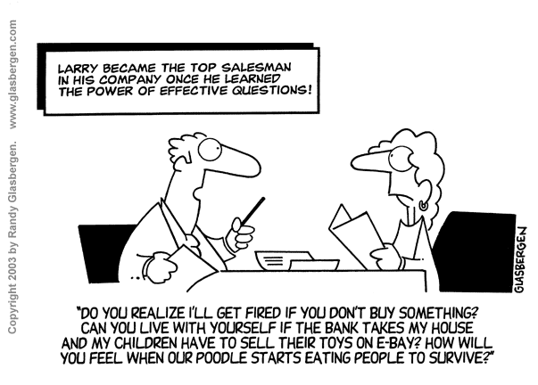
Notes:
To Know/To Say: A slide to lighten the mood.

Slide 61
Unit of Study: Write Essential Questions
Adapted from Ainsworth, L. & Viegut, D. (2006).
Notes:
To Know/To Say: Using the Unit of Study Template, ask participants to:
Review the Big Ideas.
What questions would lead to the discovery of your Big Ideas?
Can you include any “one-two punch” questions?
Litmus Test: Do your Big Ideas answer or respond to your Essential Questions?
To Do: Facilitate Discussion
References: Ainsworth, L. (2010). Planning for rigorous curriculum design. Englewood, CA: Lead and Learn Center.
Ainsworth, L. & Viegut, D. (2006). Common formative assessment: How to connect standards-based instruction and assessment. Thousand Oaks, CA: Corwin Press.

Slide 62
Share Activity
With your 12 o’clock partner:
What would be the benefits of using Essential Questions in your classroom for both the teacher and the student?
Notes:
To Know/To Say: Using the clock, find your 12 o’clock partner. This is a reflection opportunity for participants to pair up and process the previous information concerning essential questions.
To Do: Facilitate Discussion

Slide 63
Gallery Walk Poster
Create a poster displaying your
Unit of Study
Identified Standard Selected for Assessment
Unwrapped Standard Selected for Assessment
Big Ideas
Essential Questions
Notes:
To Know/To Say: Using your Unit of Study Template, you will now create a poster-sized graphic of sections 1 -5. This may be an individual or team effort.
To Do: llow approximately 10-15 minutes for this activity. This will then be used with the next slide.

Slide 64
Gallery Walk
Participants will use post-it notes to provide feedback to the work of individuals or teams.
Participants will note ideas to take back to their team and share.
Notes:
To Know/To Say: This next activity will be a Gallery Walk. Participants will walk from poster to poster and leave comments or questions on posters in the Gallery. Participants may want to take notes of ideas they see from other posters. Have participants rotate through the work every 2-3 minutes.
To Do: Be a time-keeper for rotations. Observe and Listen. Ask participants to return to their original poster and see if any questions/comments were left behind. Allow participants to return to tables and reflect on what was posted or what they saw.

Slide 65
Reflection
Why do we use targets to guide instruction?
How do we use targets to help students guide their own learning?
Notes:
To Know: Reflection questions for discussion.

Slide 66
CLOSING & Follow-up
Common Formative Assessment
Meaningful Learning Targets
Notes:
To Know/To Say: This is the end of the CFA Module 2, Meaningful Learning Targets. The next section is Sound Assessment Design. The final three sections offer ways to create quality Selected Response Questions, Constructed Response Questions, and Performance Events.
To Do: Allow time for any additional questions before going on to the Practice Profile, Self Assessment Practice Profile Workbook, and Next Steps.
Handouts: Common Formative Assessment Practice Profile, Self Assessment Practice Profile Workbook, Next Steps

Slide 67
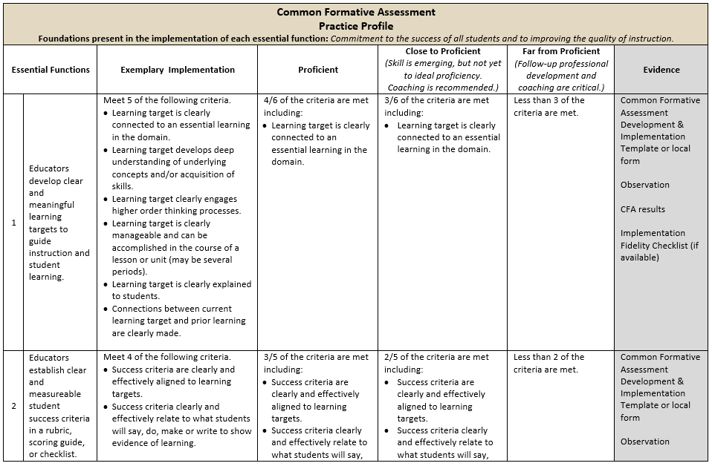
Practice Profile
67
Notes:
To Know/To Say: The Practice Profile template includes four pieces and is anchored by the essential functions. First, as a header is the foundation of implementation that philosophically grounds implementation. Then moving from left to right across the template are the essential functions of the practice, implementation performance levels, and lastly, evidence which provides data or documentation for determining implementation levels.
The essential functions align with the teaching/learning objectives for each learning package. Four levels of implementation are described for each teaching/learning objective: exemplary, proficient, close to proficient, and far from proficient. The professional development provider should walk through the practice profile with the educator-learners, referring to the data and artifacts listed as suggested evidence. It is an important tool for self-monitoring their own implementation because it serves as a reminder as to the implementation criteria and is also aligned with the fidelity checklists and the electronic practice profile self-assessment tool. These sources provide data regarding further training or coaching.
Review the practice profile with the participants. Suggestion is to do self-analysis three or four times a year as well as ask a coach or administrator to also complete this form. Discussion would occur in comparing the self-analysis to the “outside analysis.”
To Do: Review the practice profile with the participants. Suggest all stake-holders complete a self-analysis three or four times a year and engage in collaborative conversation.
Handout: Common Formative Assessment Practice Profile

Slide 68
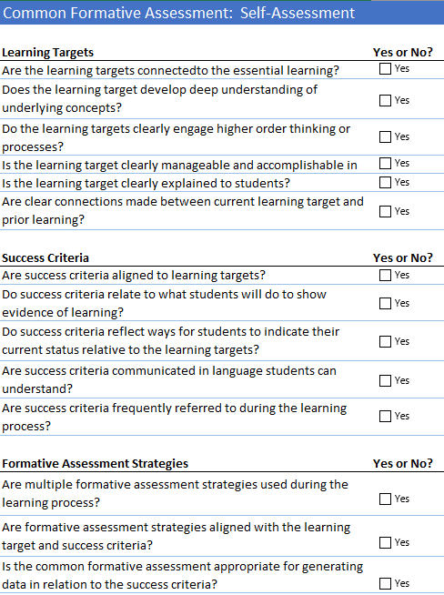
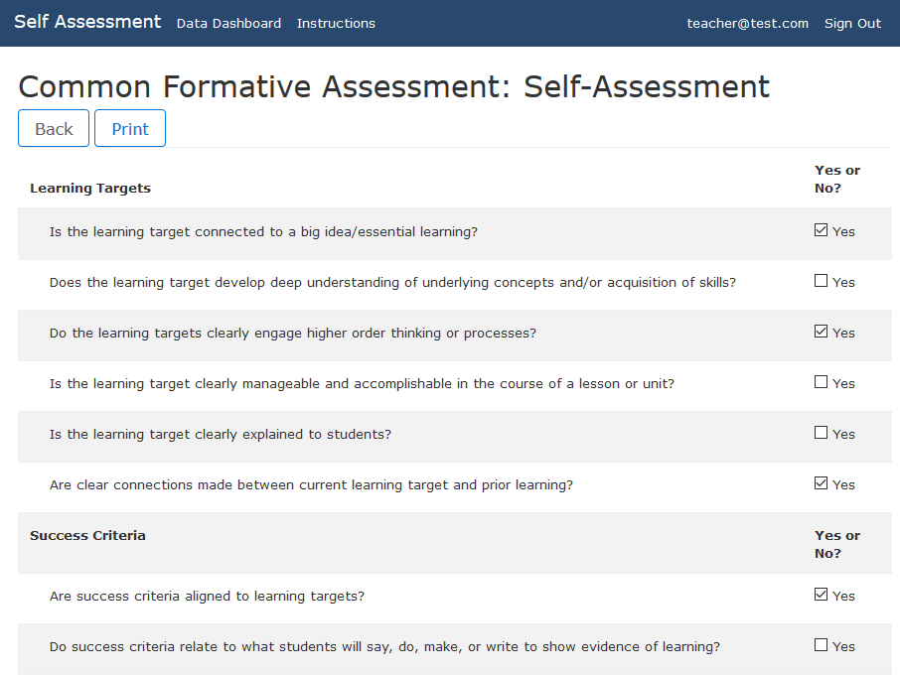
Self-Assessment Practice Profile
Excel Workbook
http://sapp.missouripd.org
Notes:
To Know/To Say: The Self-Assessment Practice Profile Workbook is an excel document allowing individuals to determine their implementation level for a specific learning package topic. The self-assessment is also available online at http://sapp.missouripd.org/. This self-monitoring tool may be utilized at the beginning, mid-points, and end of the year. These results from the staff may be compiled onto a Practice Profile and may be utilized for team discussion.
Reference: Available online at http://sapp.missouripd.org/

Slide 69
Implementation Fidelity
 | Yes | Partially | No | If partially or no, please explain.
Common formative assessment is linked to selected learning standards.
Learning goal engages higher order thinking processes.
Learning goal can be accomplished in the course of a unit.
Learning target is written in language that students can clearly understand.
Learning target is clearly explained to students.
Success criteria are written in language that students can clearly understand in a rubric or checklist.
Students receive feedback based on learning goal and their assessment results.
The quality of assessment items for measuring mastery is reviewed and items revised as needed.
Total
Notes:
To Know: The Implementation Fidelity Checklist is a hidden slide and will be review/revised at a later time.

Slide 70
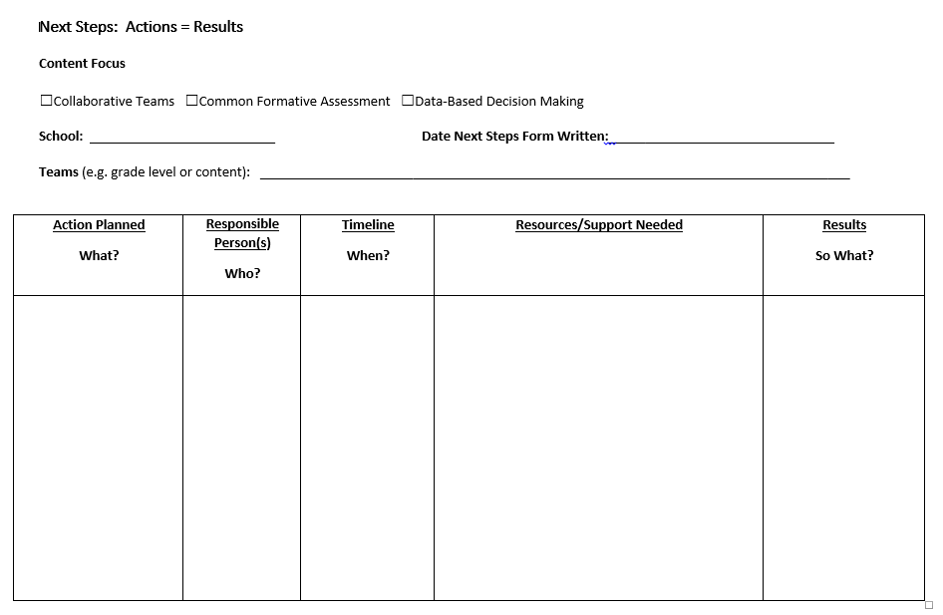
Next Steps: Action = Results
What steps will you take to start implementing?
Notes:
To Know/To Say: The Next Steps template is used for planning either today or back in your building. What resources do you need to begin implementing Common Formative Assessments or Formative Assessments. How will these assessments be used? What might be a timeline for the use of CFAs?
To Do: Complete the Next Steps template. Example is included in the learning package materials.
Handout: Next Steps: Action = Results

Slide 71
Contact Information
Please contact me to schedule follow-up coaching and/or additional professional development.
Notes:
To Know/To Say/To Do: Include presenter’s contact information.
Please contact me to schedule follow-up coaching and/or additional professional development. Thank you.

