Slide 1
Team Workshop for SW-PBS Teams: Session – Check-In, Check-Out MO SW-PBS Tier 2 Training

Slide 3
Team Workshop for SW-PBS Teams: Session – Check-In, Check-Out MO SW-PBS Tier 2 Training

Slide 4
Working Agreements
Be Respectful
Be an active listener—open to new ideas
Use notes for side bar conversations
Be Responsible
Be on time for sessions
Silence cell phones—reply appropriately
Be a Problem Solver
Follow the decision making process
Work toward consensus and support decisions of the group
Notes:
“These will be the Working Agreements we will honor during all our training sessions this year.”

Slide 5
Attention Signal Practice
Select and teach an attention signal.
Notes:
“One of our agreements is to follow the attention signal.”
“Your team will work with your school to develop an attention signal you will use in every setting.”
“In order to get all of you focused after discussions, activities or breaks, I will ________________________.”
(Insert your attention signal here.)
“Your task will be to finish your sentence, quiet your voice and ____________________________.”
(Insert what you want participants to do.)

Slide 6
Introductions
Insert an Introductions Activity.
Notes:
Choose an Introductions Activity found in the Introduction Activities PowerPoint located in . . .
Google Drive>2015-2016 CDR>3_Training>Standard Activities>Introductions

Slide 7
Session Outcomes
At the end of the session, you will be able to…
Describe students who are most likely to benefit from Check-In, Check-Out.
Identify the daily, weekly/twice-monthly, and quarterly components of Check-In, Check-Out.
Tell main findings of research associated with Check-In, Check-Out.
Describe the responsibilities for CICO Coordinator and Facilitator prior to assigning roles.
Determine CICO location, number of students served per facilitator, and intervention name.
Develop a Daily Progress Report (DPR).
Develop a system to provide reinforcement for students participating in Check-In, Check-Out.
Develop a system to provide reinforcement for staff who actively participate in Check-In, Check-Out.
Notes:
Read the outcomes or direct participants to read the outcomes.
You may choose to list outcomes on a poster or table placemat.

Slide 8
Session Outcomes
At the end of the session, you will be able to…
Develop a consistent response to office discipline referrals of students participating in Check-In, Check-Out.
Develop a system for identifying CICO participants.
Develop a system for CICO data management.
Determine criteria for starting to fade a student from CICO.
Develop a system for teaching self-management prior to fading.
Develop a system for fading CICO.
Develop a system for graduating students from CICO and providing ongoing support.
Develop implementation training for staff, students, and families.
Develop a system for monitoring fidelity of CICO implementation.
Develop a system for monitoring CICO social validity.
Notes:
Read the outcomes or direct participants to read the outcomes.
You may choose to list outcomes on a poster or table placemat.

Slide 9
Session Outcomes
At the end of the session, you will be able to…
Develop a system for monitoring intervention outcomes.
Develop Intervention Essential Features documentation to provide a clear description of all CICO intervention components.
Develop modifications to CICO based on student needs.
Understand key issues to consider when CICO is identified as a support for students receiving special education services.
Develop CICO Adaptations for Preschool Implementation.
Develop CICO Adaptations for High School Implementation.
Understand the core components of cultural competence.
Develop modifications to culturally adapt Tier 2 Systems and CICO for intended consumers.
Notes:
Read the outcomes or direct participants to read the outcomes.
You may choose to list outcomes on a poster or table placemat.

Slide 10
Reflective Questions
Do you currently have a support for at-risk students where they check in and out with a staff member at the beginning and end of the day? If you do:
How is the support structured similarly for all students receiving it?
How is the function of behavior determined?
How are goals established?
How is data kept?
How is feedback provided to the student?

Slide 11
Lesson 1: CICO Intro Overview

Slide 12
Lesson 1: CICO Intro Overview
Outcomes
By the end of this lesson, you will be able to:
Describe students who are most likely to benefit from CICO.
Identify the daily, weekly/twice-monthly, and quarterly components of CICO.
Tell main findings of research associated with CICO.

Slide 13
Crone, D. A., Hawken, L. S. & Horner, R. H. (2010). Responding to Problem Behavior in Schools: The Behavior Education Program. New York: Guilford Press.
Notes:
Responding to Problem Behavior in Schools- the Behavior Education Program is recommended for teams implementing CICO. This is a constant resource throughout the training.

Slide 14
Which Students Will Benefit?
Students with attention maintained behavior will benefit.
Students with willingness to participate will benefit.
Students with more intense problems may benefit, but will need additional supports!

Slide 15
Student Recommended for CICO
CICO Implemented
Morning
Check-in
CICO Coordinator
Summarizes Data
For Decision Making
Parent
Feedback
Regular Teacher
Feedback
Bi-weekly CICO Meeting
to Assess Student
Progress
Afternoon
Check-out
169
Revise
Program
Exit
Program
Notes:
A brief review of material we have already covered in Day 1.
Morning Check-in = Intervention Facilitator
Regular Feedback = Classroom Teacher
Afternoon check-out = Intervention Facilitator
All of this occurs with the support of a TEAM. Teacher is NOT responsible for implementing the entire program.
Team is responsible for setting student goal, monitoring progress, giving feedback to student, family and participating teachers.

Slide 16
Implementation Example
Morning Check-in
Consistent location
Begin with positive greeting
Prompt for picking up Daily Progress Report (DPR)
Prepare for day (breakfast, pencil, paper, planner)
Reminder of expectations
Provides access to positive adult attention, precorrect for behavioral and academic expectations and organizing student materials.
Notes:
CHECK-IN. Participating students complete a “check-in” with a CICO facilitator each morning after arriving to school. The facilitator provides students with a Daily Progress Report (DPR) and offers precorrects for meeting daily behavior expectations and point goals.

Slide 17
Check in Example
Notes:
Video – CICO Pre 1 Video Clip

Slide 18
Implementation Example
Throughout the Day
Student carries a Daily Progress Report (DPR)
Teacher greets and pre-corrects
Established criteria for pre-corrects and points
Teacher provides feedback and awards points
Provides high rates of adult attention and specific performance feedback.
Notes:
REGULAR TEACHER FEEDBACK. Using expectations listed on the DPR, students receive regularly scheduled specific feedback about behavioral performance from their classroom teacher. Teacher feedback occurs at the end of each class period or during natural transitions throughout the school day. Specifically, the classroom teacher gives positive, specific praise for appropriate behavior, provides corrective feedback when applicable, and then rates student demonstration of expectations using a predetermined point system. Teachers are explicitly directed to initiate the feedback interactions if a child does not independently ask for ratings on the DPR.
We will see some video clips of what Teacher feedback looks like in a bit.

Slide 19
Implementation Example
End of Day Check-Out
Consistent Location
Adult positive greeting
Total points, calculate percentage, and enter data
Daily and/or weekly reinforcement for meeting goals
Quick debrief with student
Provide parent communication
Provides positive adult attention, specific performance feedback and progress monitoring.
Notes:
CHECK-OUT. At the end of each school day, students return to the intervention facilitator for “check- out”. At this time points earned on the DPR are totaled. Intervention facilitators provide students with additional verbal praise and may offer a token associated with the existing schoolwide recognition system if daily or weekly goals are met. If a point goal is not met, the facilitator provides re-teaching of expectations and supportive encouragement.
The following slide provides a video example of the check-out process.

Slide 20
Check Out Example

Slide 21
Implementation Example
Data Collection and Progress Monitoring
Facilitators enter DPR percentages.
Student data graphed.
Results reviewed and intervention decisions are made.
Notes:
Intervention facilitators enter percentage of DPR points earned by each student into a data collection spreadsheet. Student data is periodically graphed and then reviewed by the school’s behavior support team. Results are used to monitor progress and make intervention decisions.

Slide 22
Implementation Example
Family Participation
Students are reminded to take DPR home.
Students receive additional feedback from parent.
Parents sign and return DPR to school the following day.
Notes:
The intervention facilitator promotes school to home communication and family participation with the intervention. Students are reminded each day to take their DPR home. This allows an opportunity to receive additional feedback from a parent or guardian. Parents are asked to sign and then return the DPR to school the following day. If a DPR is not signed and returned, re-teaching and encouragement are provided but no point loss or punitive responses occur.

Slide 23
Why does CICO Work?
Improved structure
-Prompts for correct behavior provided throughout the day.
-Provides link with at least one positive adult.
-Student chooses to participate.
Student is “set up for success”
-First contact each morning is positive.
-May prevent “Blow-out” days.
-First contact each class or activity period is positive.
Increase in specific feedback
-Feedback occurs more often.
-Feedback is tied to student behavior.
Notes:
Why does CICO work?
Improves structure of a student’s day
Sets student up for success; first contact every day is a positive contact.
Increases the amount of specific feedback the student receives.

Slide 24
Why Does CICO Work?
Program can be applied in all school locations
-Classroom, playground, cafeteria
(anywhere there is a supervisor)
Links school support and home
-Provide format for positive student/parent contact
Organized to fade into a self-management system
-Increased options for making choices
-Increased ability to self-monitor performance/progress
Notes:
Intervention can be applied in all settings
May increase feedback student receives at home
Moves student to a self-managing system; student will not always rely on the teacher feedback.

Slide 25
Lesson 2: CICO Program Design

Slide 26
Lesson 2: CICO Program Design
Outcomes
By the end of this lesson, you will be able to:
Describe the responsibilities for CICO Coordinator and Facilitator prior to assigning roles.
Determine CICO location, number of students served per facilitator, and intervention name.

Slide 27
Resources Needed
CICO Coordinator – Manages and supports CICO
-Sends introductory letter to parents
-Orientates parents and student to intervention
-Maintains student progress monitoring graphs
CICO Facilitator – Works with students in CICO
-Daily contact with student participants
-Helps with parent contact and updates
-Collects and distributes DPR
Notes:
The primary responsibility of the CICO Coordinator is organizing resources and supports for effective delivery of the intervention…typically having limited contact with students.
The CICO Facilitators are responsible for direct, daily contact with student participants…providing the daily CICO components of the program and assisting with school to home communication.
Page 174 of the workbook has Estimated Times for Coordinator & Facilitator Tasks.
In larger schools, one Coordinator might support multiple Facilitators, who may serve as many as 10-15 students each. In a smaller school, one staff member may perform the tasks of the Coordinator and the Facilitator, with fewer students participating in the intervention.

Slide 28
Activity: CICO Coordinator and Facilitator
Using chart paper, make a T-chart with the headings “Coordinator” and “Facilitator.”
In each column, list specific duties/tasks that each person will be responsible for in your setting.
Estimated Time for Coordinator and Facilitator Tasks (Workbook page 164)
CICO Coordinator and Facilitator Responsibilities
CICO Coordinator and Facilitator Responsibilities
Notes:
Using knowledge gained from Lesson 2 – Program Design, and the two resources above, determine the specific responsibilities of the Coordinator and Facilitator(s) in your building. Designate who will be the CICO Coordinator, Facilitator(s), and substitute Facilitator(s) in your building.

Slide 29
CICO Host Environment
Classrooms with clearly defined
-Expectations and Rules
-Procedures and Routines
-Acknowledgement for appropriate behavior
-Consistent response to problem behavior
Teacher willingness to participate
Flexibility with student schedules (end of day)
Notes:
Are the universals in place? Have the Classroom Effective Practices been taught to staff?
It is important to find and use teachers that want to be part of CICO. Their positive feedback is a vital reinforcer.
Is everyone willing to work with the student’s schedule? If it becomes a problem or confusing, chances for success drop.
What happens if a student is having Tier 2 behavior problems (Low level disruptions across multiple settings), but the above conditions aren’t present in that student’s classroom(s)? Address the Eight Effective Classroom Practices, provide Professional Learning and support for teacher, adjust schedules, etc.

Slide 30
Discussion: CICO Classrooms
What classrooms in your building meet the criteria for CICO to be implemented effectively?
How do you know?
Which classrooms would be best to pilot the intervention in?
Notes:
Allow teams time (10 minutes) to discuss the bulleted items.

Slide 31
Number of Students Served
Recommended Limits:
Middle/High Schools – average is 10-15 students; no more than 30 students. More students can result in difficulties in maintaining fidelity of CICO and responding to student needs.
Elementary Schools – no more than 10-15 students. Students at this age may need more support, prompting, or classroom (rather than centralized) check-in and check-out (Crone, Hawken, & Horner, 2010, p. 92).

Slide 32
Lesson 3: CICO Daily Progress Report

Slide 33
Lesson 3: CICO Daily Progress Report
Outcomes
By the end of this lesson, you will be able to:
Develop a Daily Progress Report (DPR)

Slide 34
Daily Progress Report (DPR)
Schoolwide Expectations with individualized rules
-No more than 5 expectations listed
Teacher-friendly
-Allow for circling ratings, not narrative feedback
Consider a narrow range of scores
-3 point system recommended; 1-3, 0-2
-If using 0-2, 80% is considered mastery
-If using 1-3, 85% is considered mastery
Include a rating “key”
-Staff should clarify and agree on the difference
between ratings
Notes:
Here are some recommendations as your are designing your DPR.
You should have the Schoolwide expectations clearly stated. Some DPRs also have individualized rules so that the reminder of expected behavior consistently in front of both student and ‘check in/out’ adult. Sort of a quiet precorrect. Also close to the expectations should be a place for the student goal – short, easy to remember and positively stated.
The DPR needs to be as ‘teacher friendly’ as possible. It should allow the check in to be brief. One way to do this is by having the teacher rate according to number ratings that are circled and not narrative feedback. There could be a space for written comments, but this is not required. However, encourage positive written feedback when possible.
A key should be somewhere on the DPR. This provides for consistent rating throughout the day. A discussion of how the rating should be set up is important for your team and staff before implementation.
Because of the potential data inflation among schools who do not include a 0 or who have a broad rating scale, data review for students with DPR averages in the 61-84% range should also include other indicators to determine how well the student is progressing (e.g. Are additional ODR and/or classroom minors occurring? If yes, student should return to team problem solving. If ODR, minor, nurse visits, etc. are not occurring the student can be viewed as making progress).

Slide 35
Daily Progress Report (DPR)
Consider a place to record “success” rather than “comments.”
DPR could fit on a half sheet to reduce copying costs.
Non-classroom settings typically NOT included on DPR.
Include a minimum of 4 rating periods.
-Correspond with natural transitions in day
-Optimally, marking period is not longer than 75 minutes
Notes:
More things to consider:
The comment space might serve better as a ‘success’ space to provide positive feedback.
Because it is recommended the DPR be on NCR paper, it is logical to try to get two forms per page. However, NCR paper can be expensive, so having a copier close by might be an option. Still, the efficient approach seems to be having 2 DPRs per page.
A reminder that non-classroom settings are not typically on the DPR. This is because the main concern is students missing instruction.
The DPR should include a minimum of 4 rating periods a day. These should be at natural transitions and ideally the marking period is not longer than 75 minutes.

Slide 36
Daily Progress Report (DPR)
Include a column/place for teacher initials
Include a line for parent signature and place to record “success”
Include an area for total points earned
Determine if the percentage point goal will be listed
-Some provide a range, student circles his/her goal:
50% 55% 60% 65% 70% 75% 80%
Notes:
Some other suggestions: (read points on the slide).

Slide 37
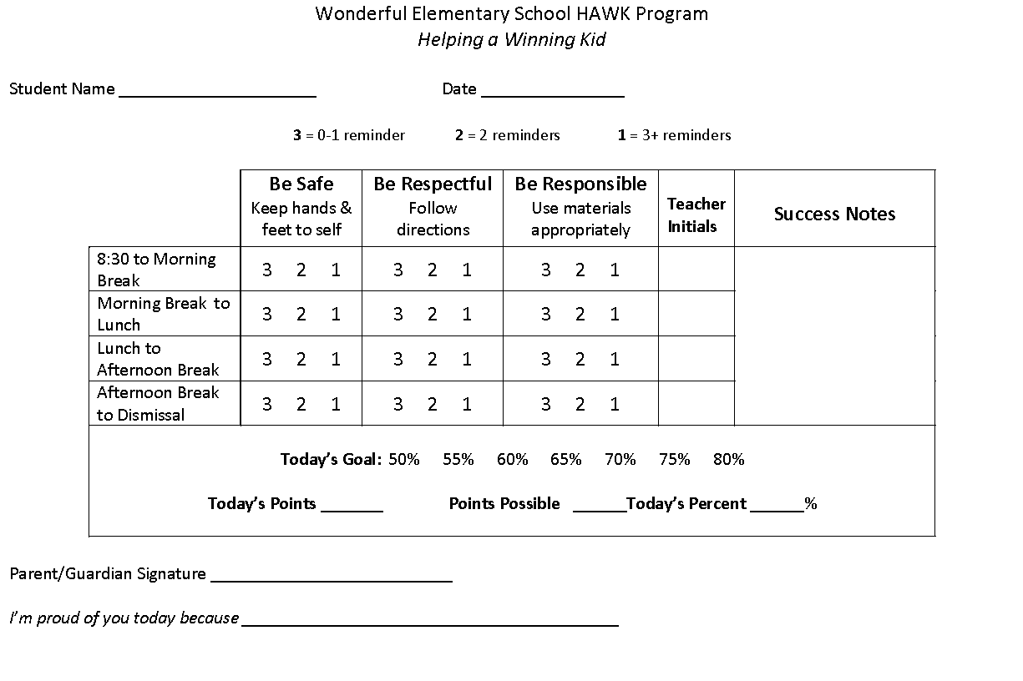
Notes:
Elementary DPR…

Slide 38
Wonderful Middle School EAGLES Program
Excel and Gain Life Educational Skills
Parent/Guardian Signature ___________________________
Congratulations for ___________________________________________________________
 | Be Safe Keep hands & feet to self | Be Respectful Use polite language | Be a Learner Follow directions | Teacher Initials | Success Notes
Period 1 | 3 2 1 | 3 2 1 | 3 2 1
Period 2 | 3 2 1 | 3 2 1 | 3 2 1
Period 3 | 3 2 1 | 3 2 1 | 3 2 1
Period 4 | 3 2 1 | 3 2 1 | 3 2 1
Period 5 | 3 2 1 | 3 2 1 | 3 2 1
Period 6 | 3 2 1 | 3 2 1 | 3 2 1
Period 7 | 3 2 1 | 3 2 1 | 3 2 1
Today’s Goal: 50% 55% 60% 65% 70% 75% 80% Today’s Points _______ Points Possible ______Today’s Percent ______%
Notes:
MS/HS DPR

Slide 39
CICO Report
Date ________ Student____________Teacher__________
1 =3 or more 2= 2 reminders 3= 0 – 1 | Be Safe | Be Respectful | Be Your Personal Best |  | Teacher initials
 | Keep hands, feet, and objects to self | Use kind words and actions | Follow directions | Working in class
Class | 1 2 3 | 1 2 3 | 1 2 3 | 1 2 3
Recess | 1 2 3 | 1 2 3 | 1 2 3 | 1 2 3
Class | 1 2 3 | 1 2 3 | 1 2 3 | 1 2 3
Lunch | 1 2 3 | 1 2 3 | 1 2 3 | 1 2 3
Class | 1 2 3 | 1 2 3 | 1 2 3 | 1 2 3
Recess | 1 2 3 | 1 2 3 | 1 2 3 | 1 2 3
Class | 1 2 3 | 1 2 3 | 1 2 3 | 1 2 3
Total Points = Points Possible = 50 |  | Today ______________% |  | Goal ______________%
Notes:
A suggestion for the percentage space is to have the percentages figured in chart fashion and either laminate or slip into a page protector for easy use.

Slide 40
Activity: DPR Design
Using an electronic sample, adjust a DPR to fit the needs of your school.
Notes:
Allow sufficient time for teams to develop their DPR. Prompt teams to use their CICO Intervention Development Checklist DPR Section -10 indicators- to guide this process.

Slide 41
Discussion: Daily Progress Report (DPR) Planning
CICO Intervention Development Checklist
With your team, discuss the 10 indicators on the Daily Progress Report (DPR) section of the CICO Intervention Development Checklist.
Notes:
Allow 15 minutes for team discussion

Slide 42
Lesson 4: CICO Reinforcement System

Slide 43
Lesson 4: CICO Reinforcement System
Outcomes
By the end of this lesson, you will be able to:
Develop a system to provide reinforcement for students participating in CICO.
Develop a system to provide reinforcement for staff who actively participate in CICO.
Develop a consistent response to teacher-managed and office-managed referrals of students participating in CICO.

Slide 44
Reinforcement System
Reinforcers for
-Checking in
-Checking out
-Meeting daily and/or weekly point goal
Notes:
A critical component of CICO is to regularly provide reinforcement for appropriate behavior. Remember, students who qualify for Tier 2 support have not made progress with the school wide Tier 1 prevention efforts. Therefore, these students need additional reinforcement and feedback to get their behavior on the right track. Experience tells us that if we do not intervene early with problem behavior, the behavior will worsen over time.

Slide 45
Reinforcement System
The primary reinforcer is personal connection with CICO adult.
Remember, students who participate in the CICO Intervention still participate in the schoolwide system of encouraging appropriate behavior.
Reinforcer Checklist – pp 212-213 BEP manual
Notes:
Because personal connection is the primary reinforcer, do not overlook the positive reinforcement that comes from earning privileges or extra time with an adult such as basketball tips, helping with bulletin boards, being a help with the custodian or bus duty.
While you already have in place a recognition system to use as reinforcers, keep in mind the student has already had Tier1 opportunities earn these. Always check to see if and how many recognitions they have received. Often, during CICO, offering a different recognition for appropriate behavior can be a powerful reinforcer because it is new and different.
Possible suggestion- a spinner or some other way they have a choice. Another suggestion is to develop a reinforcer checklist to be completed by student. BEP manual, pp. 212-213. (Optional Handout)

Slide 46
Reinforcing Staff
Reinforcing staff is just as important as reinforcing students.
Connect this opportunity for staff reinforcement to already existing structures.

Slide 47
Ideas to Encourage Staff
Recognition during staff meeting or assembly
Ticket to school event
Preferred parking spot
School t-shirt
Lunch delivered
Release from duty
Principal teaches class
Pass to leave work early or arrive late
Notes:
More ideas to encourage staff are described on page 180 in the 2018-19 workbook.
Read this list and ask participants what would encourage them. Share ideas.
“Let’s look at a system of encouraging teachers utilized by a school in southeast Missouri.”

Slide 48
Teacher Tangible
1
1
Franklin Elementary School
ONE
1
1
DR. DUNHAM DOLLAR
Notes:
“This school uses tangibles called ‘Dr. Dunham Dollars’ with their staff. Teachers must disseminate approximately 50 tickets to recognize students for demonstrating expected behavior. When the teachers go to the office to receive more student tickets, they receive a Dunham Dollar. Teachers can collect the Dunham Dollars, or give them to another teacher to recognize him/her for displaying positive behavior. The SW-PBS team often uses the Dunham Dollars (earned by recognizing students) to recognize the good work of other teachers in promoting a positive climate. Teachers throughout the school report the positive actions of their peers, then the SW-PBS team members place Dunham Dollars in that staff person’s mailbox with a note indicating exactly what the person did to earn the recognition.”

Slide 49
Dr. Dunham’s Dollars
10 | 15 | 20 | 25 | 30 | 40 | 50
Take and pick up students from Encore classes for 1 day | Free pass for one duty | Dust a classroom | Free pass for duty (2 days) | Reserve parking spot for 1 week | Leave 30 minutes early on Friday | Jean Pass for entire staff for 1 day
Copy 3 class sets of papers | Extra time for lunch (15 minutes) | Jean pass for a day | 1 day of graded and filed papers | Papers copied for one week | Jean pass for entire week | Flip Flop pass for entire staff for 1 day
Favorite snack or candy bar | Read to a class | Sweatpants pass for a day |  |  |  | Sweatpants pass for entire staff for one day
Free 32 oz. soda |  | Flip flop pass for a day
Notes:
“Here is the Teacher ‘Menu of Reinforcers.’ Teachers can work with other teachers to combine their dollars for a bigger prize. Sometimes they save up for the whole staff to wear jeans during the week.”
“Is it working? Read the response of the staff on the next slide.”

Slide 50
Discussion: Program Design Planning
CICO Intervention Development Checklist
With your team, discuss the two indicators on the Reinforcement System section of the CICO Intervention Development Checklist.
CICO Intervention Development Checklist
Notes:
The CICO Intervention Development Checklist is a tool that your team can use to guide the development of CICO in your building. It is a roadmap of what components should be in place for maximizing the effects of the intervention.
As a team, discuss the 6 indicators in the Program Design section of the Checklist… marking the “Completed” box as decisions are made. Do the same for the two items on the Reinforcement System section. Tasks not completed should be addressed on the Tier 2 Action Plan (next slide).
Allow teams sufficient time to discuss and come to a decision on the majority of Reinforcement System items.

Slide 51
Referral Response
Response for major and minor office referral
-Plan in advance
-Align with SW continuum of response
-Communicate to student and teachers
Notes:
What will be your response if a student in the CICO intervention should receive a discipline referral – either major or minor – during one of the feedback periods? Would this affect the number of points awarded on the DPR? The response to the misbehavior should align with what is already in place within the schoolwide continuum of response. The scoring of points on the DPR should be directly aligned with the goals the students is working on in the CICO intervention. This will need to be clearly communicated to all stakeholders.

Slide 52
Lesson 5: CICO Identification and Data Management

Slide 53
Lesson 5: CICO Identification and Data Management
Outcomes
By the end of this lesson, you will be able to:
Develop a system for identifying CICO participants.
Develop a system for CICO data management.

Slide 54
Identifying CICO Participants
Your Tier 2 system:
identifies students at risk for future failure.
function maintaining behaviors
CICO is for students whose behavior is maintained by adult attention.
Behavior
Obtain/Get
Something
Avoid/Escape Something
Stimulation/
Sensory
Social
Tangible/
Activity
Adult
Peer

Slide 55
Data Management
Program for summarizing data
-SWIS CICO
-Advanced Tiers Data Collection Spreadsheet
Frequency of data sharing
-Tier 2 team
-Participating Teachers
-Parents
-Faculty/Staff
Notes:
Two programs that we can suggest to summarize data are SWIS CICO and the Advanced Tier Data Spreadsheet.
SWIS CICO has an additional cost which is not included in the DESE refundable offer.
The Advanced Tiers Data Collection Spreadsheet is a Microsoft Excel graphing spreadsheet that is available on the Missouri SW-PBS website. This free tool will let you enter student data for up to a year and also create graphs of data points to help make decisions.
In addition to the Tier 2 team, data should be regularly shared with teachers and parents. This is not only to keep them informed , but to get valuable feedback. It is also important to get feedback from students to determine how ‘consumers’ of CICO feel about the intervention.

Slide 56
Advanced Tiers Spreadsheet – Collecting Student Information
Provides a second student information collection option to teams
Demographic information
ODR, minors
Attendance, tardies
Academic performance
Access to Tier 1
Problem behavior
Possible function of behavior
Intervention(s) and goal
Notes:
Provide access to the current year’s Advanced Tiers Spreadsheet with Bar Graphs.
If your team decides to use the Adapted FACTS Part A for collecting student information, you do not need to fill out this information on the Advanced Tiers Spreadsheet. There is no need to do ‘double-entry.’ However, you will need to enter the student’s name in the Student Information section.
It should be noted that the Advanced Tiers Spreadsheet does not allow for entry of contextual/schedule information like page 2 of the Adapted FACTS Part A nor does it allow for the writing of a Behavior Pathway.

Slide 57
Advanced Tiers Spreadsheet – Recording Student Data
Tracks percentage of daily points earned.
Charts daily points on bar graphs.
Allows flexibility in assigning daily points.
Allows user to indicate intervention phase changes on graphs.
Allows user to show goal on chart.
Individual students have their own page.
Can be used for multiple interventions.
Notes:
Many teams use only the progress monitoring section of the Advanced Tiers Spreadsheet in order to graph student response to intervention.

Slide 58
Advanced Tiers Spreadsheet – Main Menu
Notes:
This is the screen you’ll see when you first open the spreadsheet. You will click student information to enter each new student. The student will then be assigned a number. If your team is going to use the Adapted FACTS Part A for gathering student information and the Advanced Tiers Spreadsheet for charting and graphing intervention data, your intervention coordinator or facilitator will need to enter the student’s name in the ‘student information’ section so a tab will appear for that student’s data entry.
Consultant note – for this slide and the next 4, it is recommended that you have the spreadsheet open and show teams the actual spreadsheet; this could be in addition to the slides if you wish.

Slide 59
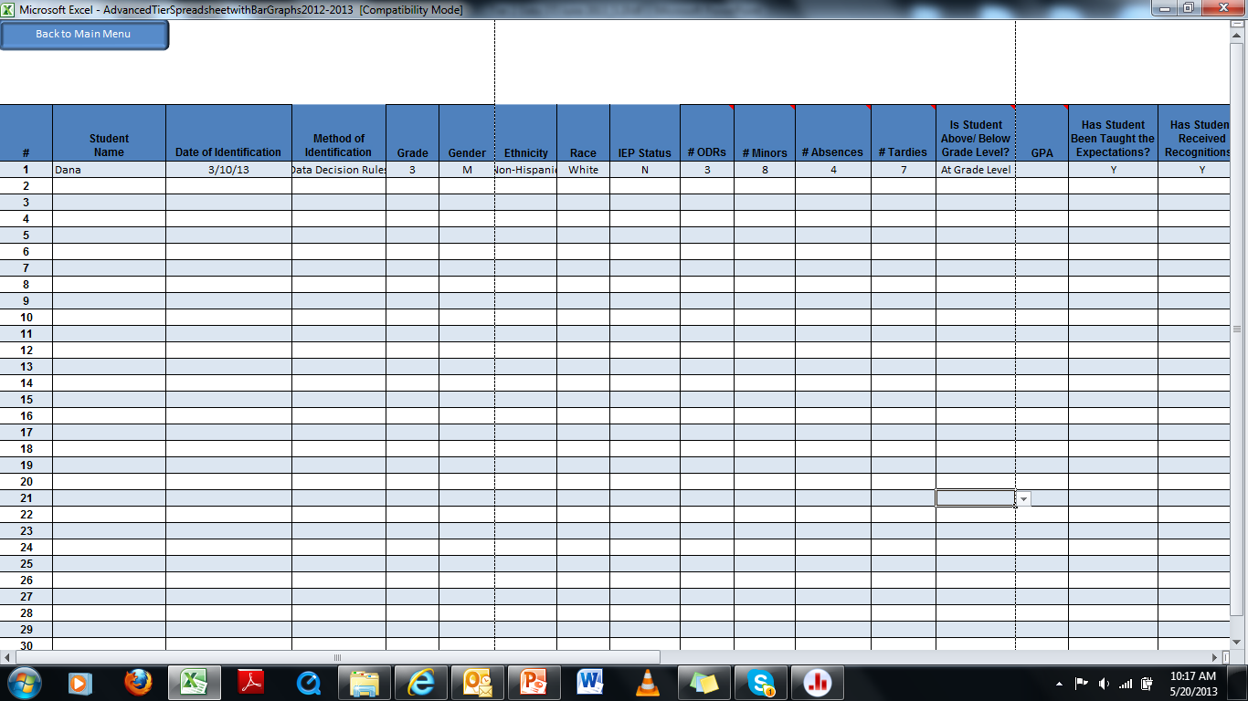
Notes:
This is a screen shot of the student identification page with a student’s information entered.
In this example, the team is using the Advanced Tiers Spreadsheet to gather Dana’s information as well as for graphing her response to intervention. This screen shot provides only part of the student information page; when the spreadsheet is open, scroll to the right to enter additional information about Dana.
They are listed on the next slide.

Slide 60
Advanced Tiers Spreadsheet – Main Menu
Notes:
The second page is where daily student performance data can be recorded. These are examples of information that can be included in the Advanced Tiers Spreadsheet.

Slide 61
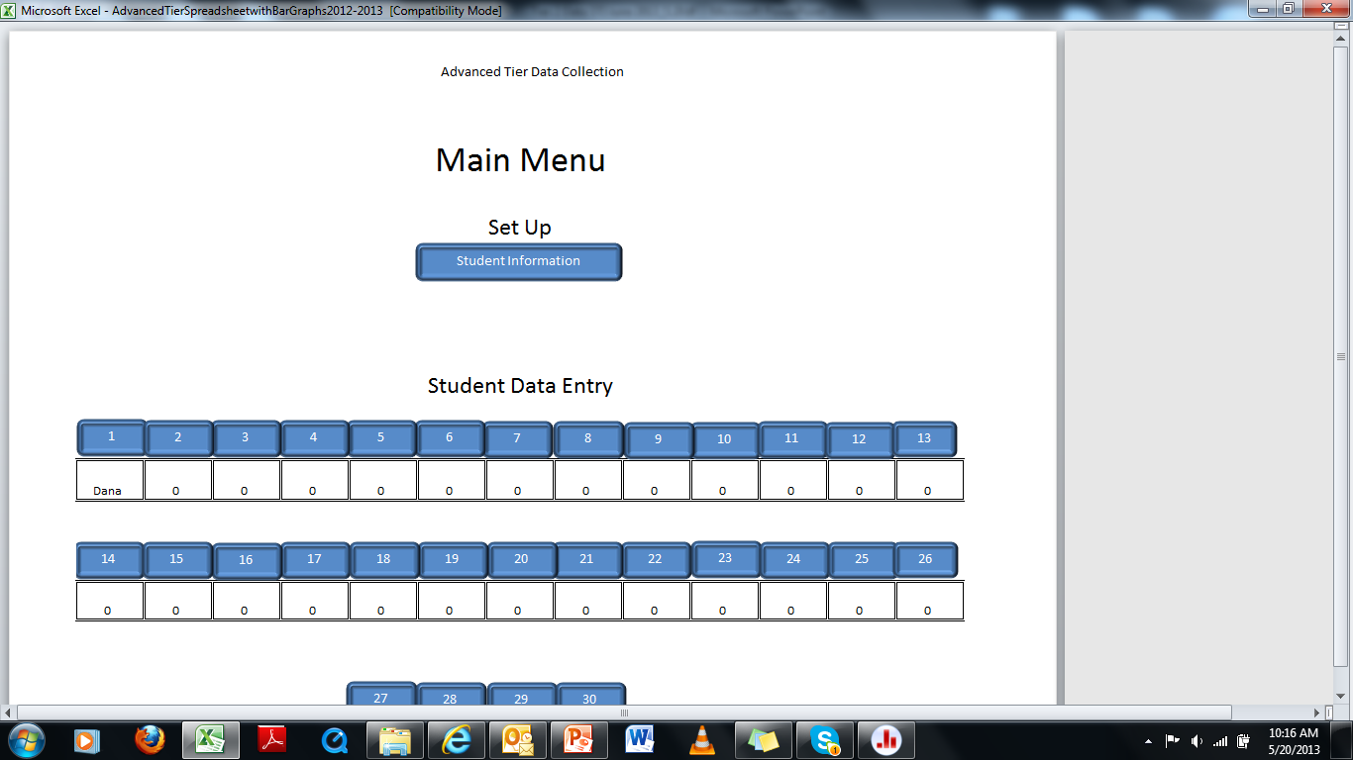
Notes:
Since Dana’s information has been entered in the ‘student information’ page, Dana now has a number.

Slide 62
Advanced Tiers Spreadsheet – Example Student Data
Notes:
Student level of Performance.
The student’s level of performance is entered each day from the Daily Progress Report or summarized weekly. Performance is indicated by percentage of DPR points earned.
Desired level of Performance.
The desired level of performance is determined by the student’s behavioral goal. This line on the graph is called the “Goal Line”. The Tier 2 Team will determine an initial goal using baseline data. The goal is then increased as the student shows progress until a final goal is consistently achieved (typically 80%).
Trend Line.
The trend line is a line that is drawn through a series of data points to represent the student’s actual rate and level of progress. Rate of progress refers to how long it will take the student to reach the goal line. An increasing, stable, or decreasing trend signifies the level of progress.
This student data graph provides an example of graphed data that includes baseline performance, a phase change line, student level of performance during intervention, a goal line, and a trend line.

Slide 63
Discussion: Collect Performance Data
Will you use the Advanced Tiers Data Collection Spreadsheet or a different tool?
Who will record individual student data into the database?
Will this person also bring data to meetings?
How will you have students graph their own progress?
Notes:
You will need to keep a record of student progress in the intervention over time. Graphing allows for quick evaluation of data to determine if trend is positive. Graphs should be viewed regularly to determine when to fade, intensify, or change the intervention. Refer to your data decision rules for an intervention.

Slide 64
Monitoring Progress
“The charting of progress monitoring data not only facilitates data-based decision making, but it is an intervention component capable of improving student outcomes.”
(Sprague, Cook Wright & Sadler, 2009, p.80; Fuchs & Fuchs, 1986)
Consider having each student graph their own progress.
Notes:
Data that is collected when monitoring a student’s response to an intervention answers the question “Is this intervention effective?” Without objective measures, behavior change may be too gradual to determine if the student is responding to the intervention.
Data should be collected at least weekly. The child should participate in data collection and should also review his or her response to intervention.

Slide 65
Monitoring Progress
Using Graphs …
Student Level of Performance
Desired Level of Performance
Trend Line-Actual Rate of Improvement
Time to Goal
Notes:
Remember… the Advanced Tier Data Collection Spreadsheet can generate a graphic display.
Why graph? The graph provides a visual representation of a student’s acquisition of skills and allows for easier analysis of progress.
Level of Performance – The child’s level of performance is entered each day from the Daily Progress Record.
Desired Level of Performance – The desired level of performance is determined by the student’s behavioral goal. This line on the graph is called the “Goal Line.”
Trend Line – The line that you draw through a series of data points that represents the student’s actual rate and level of progress.
Time to Goal – The number of weeks it will take for the student to reach the goal.

Slide 66
Implementation Example Monitoring Progress
Set a Goal that Aligns with your Schoolwide Matrix.
Collect baseline data to determine initial daily point goal.
Monitor Progress Toward the Goal.
-Daily point total at 80% or higher
Long-term Goal
-80% on DPR four out of 5 days per week for 4 weeks
-Decrease in rate of office referrals/classroom minors
-Increase in attendance and/or grades
Notes:
Within the context of a team and before the student begins with the program, an outcome goal should be determined. That goal should align with the SW Matrix. First we think, what is it we want this student to do that he is not currently doing? This comes from your behavior matrix. Is it follow directions? Complete work? Keep hands and feet to self?
Then we ask. “How will we know the student is consistently demonstrating the goal?”
Teams typically examine student baseline data to decide on a performance goal the student is likely to meet fairly rapidly. Remember, it is important that students experience early success with the CICO intervention. For example, students with baseline data in the 50-55% range may not increase performance to 80% in a short period of time. Instead the behavior support team may choose to select an initial goal of 65-70% so that the child can reach his or her first goal immediately or shortly after beginning the intervention. Gradually, over time, the support team will increase expectations for the student.
We monitor points earned on the DPR, but we may also want to consider other data indicators… attendance, grades, work, office referrals etc.
Continue to monitor progress on what ever information brought this student to the attention of the team.

Slide 67
Discussion: Monitoring Progress
Are there any problems to be solved concerning the monitoring of student progress?
Are students graphing progress daily?
Are data entered into an excel document at least weekly?
- Is there a person in place for this task?
- What tool is being used?
Notes:
Be prepared to solve any issues teams have had in using Advanced Tier Spreadsheet, and to project the Spreadsheet to review.

Slide 68
Data Decision Rules
A student in a Tier 2 Intervention should first reach the goal line within 3 weeks. (Sprague, 2008)
The general recommendation from most researchers is that we need at least eight data points within 3 weeks of instruction before making a decision about whether or not an intervention change is needed. (Lembke, 2008)
Notes:
Sprague (2008) indicates that a student in a Tier 2 Intervention should first reach the goal line within 3 weeks. If the student in a Tier 2 Intervention does not reach the goal line within 3 weeks, the rate of progress may be considered too slow.
Dr. Erica Lembke advises that the general recommendation from most researchers is that we need at least eight data points within 3 weeks of instruction before making a decision about whether or not an intervention change is needed.

Slide 69
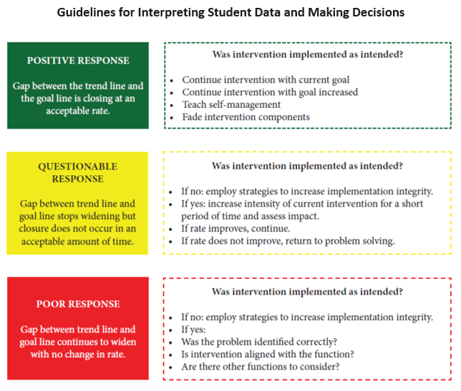
Interpreting Student Data
Notes:
Regular monitoring of student data must be done by the Tier 2 team to determine whether the student is showing a positive, questionable, or a poor response to the CICO Intervention. This chart (Workbook page 132) shows an example of the types of questions that a team must ask when making decisions.

Slide 70
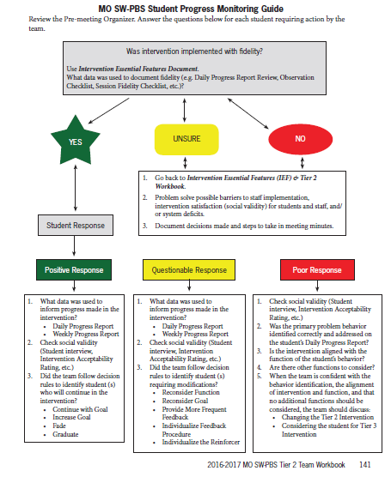
Notes:
The MO SW-PBS Student Progress Monitoring Guide (p 131 of the workbook) is a flow-chart with step-by-step instructions on the team’s process to monitor student response to the intervention.
Near the top of this Guide, teams are directed to look at intervention-specific fidelity monitoring tools. For CICO, this would be the Monitoring Fidelity of Implementation CICO Observation Checklist (p. 209) and the DPR Review (p. 207).

Slide 71
Positive Response
Gap between trend line and goal line is closing at an acceptable rate
Notes:
71
The gap is the distance between the student’s trend line and the goal line.
When the distance between the student’s trend line and the goal line is closing at an acceptable rate, the response to the intervention is positive.
Dr. Erica Lembke advises that the general recommendation from most researchers is that we need at least eight data points before making a decision about whether or not an intervention change is needed. Some researchers advise as many as ten to twelve data points are needed. It is important to systematize your process so you avoid making arbitrary decisions.

Slide 72
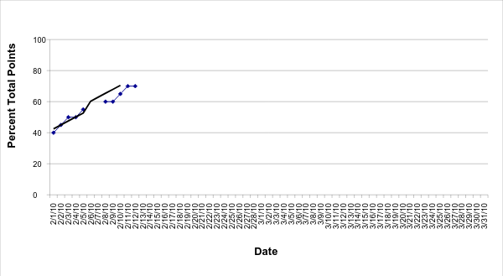
Positive Response
Goal Line
Trend Line
Level of Performance
Notes:
This child’s level of performance is entered each day. This child’s level of performance ranges from 40% to 70%.
The desired level of performance for this child is 80%. The goal line is drawn in red.
3) The Advanced Tier Data Collection Spreadsheet automatically calculates the trend line when you enter the percentages on the Data Entry Tab. Remember, the trend line represents the student’s actual rate of progress.
4) At this student’s current rate of progress, he will reach the goal line in 3 weeks. The student is making progress toward the goal at an acceptable rate.

Slide 73
Data Decision Rules
Positive Response to the Intervention
Continue intervention with current goal.
If goal was not at 80%, continue intervention with goal increased.
Teach self-management and begin fading intervention components to determine if the student has acquired functional independence (i.e., continues successful behavioral performance with less teacher feedback).
Notes:
73
Before deciding to teach self-management the student should demonstrate a consistently positive response. Behavior teams typically establish specific criteria for success. As a general guideline the following represents a reasonable goal that indicates consistent success; four consecutive weeks with four or more daily data points per week at 80% or higher.
Generally student self-management is promoted by teaching the student to monitor, record, and evaluate his/her own performance. In addition, longer intervals of successful performance may be required before reinforcement is delivered.

Slide 74
Notes:
Now we will look at the steps to take if the student data shows a questionable response to the intervention…

Slide 75
Questionable Response
Gap between trend line and goal line stops widening, but closure does not occur at an acceptable rate.
Notes:
75
When the distance between the student’s trend line and the goal line is closing, however, is closing at an unacceptable rate, the response to the intervention is questionable.

Slide 76
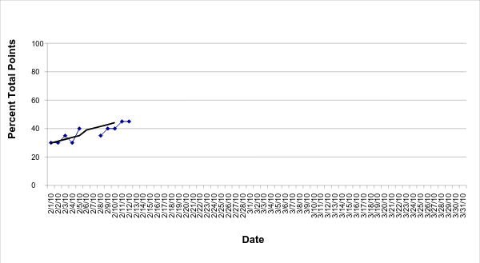
Questionable Response to Intervention
Goal Line
Trend Line
Level of Performance
Notes:
This child’s level of performance is entered each day. This child’s level of performance ranges from 30% to 45%.
The desired level of performance for this child is 80%. The goal line is drawn in red.
3) The Advanced Tier Data Collection Spreadsheet automatically calculates the trend line when you enter the percentages on the Data Entry Tab. Remember, the trend line represents the student’s actual rate of progress.
4) At this student’s current rate of progress, he will require 6 weeks to reach the goal. The student is making progress, however, the rate is slower than what we would considerable acceptable.

Slide 77
Data Decision Rules
Questionable Response to the Intervention
Was intervention implemented as intended?
How do you know?
If no - employ strategies to increase fidelity of implementation.
Notes:
77
How do you know if the intervention was implemented as intended?

Slide 78
Fidelity of Implementation
Fidelity of Implementation
-Delivered as planned
-All steps completed accurately
“The positive outcomes that have been documented in the research literature are related to high fidelity of implementation by school staff.” (Crone, Hawken & Horner, 2010, p. 88)
Notes:
In other words, the intervention will achieved “promised” results ONLY when the adults “follow the intervention instructions.”

Slide 79
Data Decision Rules
Questionable Response to the Intervention
Was intervention implemented as intended?
If yes –
Did the team follow decision rules to ID students requiring modifications?
Reconsider Function
Reconsider Goal
Provide More Frequent Feedback
Individualize Feedback Procedure
Individualize the Reinforcer
Notes:
79
Let’s take a look at what each of these might look like…
Advance to next slide.

Slide 80
Questionable Response
If the team is satisfied that the intervention has been implemented with fidelity, then the team may decide to modify or intensify the intervention.
Notes:
Move to next slide to continue.

Slide 81
Questionable Response
Other considerations:
Reconsider function
Ensure the correct function was identified.
Confirm the intervention aligns with the function.
Review all features of the implemented intervention to determine alignment with the function.
Reconsider the goal
Review the initial goal to ensure it was appropriately established based on the baseline data.
Review student’s current daily percentages and adjust goal as appropriate to ensure student success; as success is achieved, begin increasing the goal.
Notes:
Read slide

Slide 82
Notes:
Now we will look at the steps to take if the student data shows a poor response to the intervention…

Slide 83
Poor Response
Gap between trend line and goal line continues to widen with no change in rate.
Notes:
83
When the distance between the trend line and the goal line widens, the response to the intervention is poor.

Slide 84
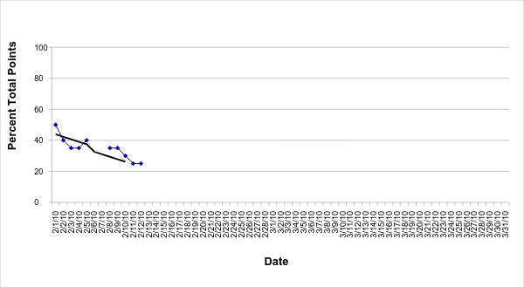
Poor Response to the Intervention
Trend Line
Notes:
This child’s level of performance is entered each day. This child’s level of performance ranges from 50% to 25%.
The desired level of performance for this child is 80%. The goal line is drawn in red.
The Advanced Tier Data Collection Spreadsheet automatically calculates the trend line when you enter the percentages on the Data Entry Tab. Remember, the trend line represents the student’s actual rate of progress.
The gap between this child’s trend line and the goal line is growing wider. The response to the intervention is poor.

Slide 85
Data Decision Rules
Poor Response to the Intervention
Was intervention implemented as intended?
How do you know?
If no - employ strategies to increase fidelity of implementation
Notes:
85
How do you know if the intervention was implemented as intended?

Slide 86
Decision Rules
Poor Response to the Intervention
Was intervention implemented as intended?
If yes -
Was the problem behavior identified correctly and addressed on the DPR?
Is intervention aligned with the function?
Are there other functions to consider?
After the above questions are considered, discuss:
Change the Tier 2 Intervention?
Is student a candidate for Tier 3?
Notes:
86
If the intervention was implemented with fidelity, and the team is confident with the behavior identification, the alignment of intervention and function, and that no additional functions should be considered, the team should then discuss whether or not to change to a different Tier 2 intervention or to perhaps refer the student for more intensive supports.

Slide 87
Decision Rules – Poor Response
If problem behavior was not identified correctly, use intensifying procedures with the correct behavior specifically monitored on the DPR.
If intervention does not align with function, change reinforcement to match OR move to a different intervention.
Student may need individualized supports.
Notes:
Cross out unrelated behaviors on the DPR and clarify specific behavior where it applies on the DPR

Slide 88
Tier 2 Pre-Meeting Organizer
Notes:
The Tier 2 Team Pre-Meeting Organizer (p. 129) can be used to decide which students need to be discussed at each Tier 2 team meeting. Only students who are responding questionably, poorly or who are eligible for fading will be discussed during the meeting. This form should be completed before the Tier 2 meeting by each Intervention Coordinator (Remind teams that they have an electronic version of this tool).

Slide 89
Discussion: Use Student Data to Make Decisions
Who will be responsible for completing the Tier 2 Pre-Meeting Organizer?
How often will student performance data be monitored by the Facilitator?
How often will the Tier 2 team meet to review student data and make decisions?
Notes:
Allow 10 minutes for team discussion

Slide 90
Lesson 6: CICO Self Management, Fading, and Graduation

Slide 91
Lesson 6: CICO Self Management, Fading, and Graduation
Outcomes
By the end of this lesson, you will be able to:
Determine criteria for starting to fade a student from CICO.
Develop a system for teaching self-management prior to fading.
Develop a system for fading CICO.
Develop a system for graduating students from CICO and providing ongoing support.

Slide 92
Generalization and Maintenance
Social skills instruction can be effective, but delivering social skills instruction so that generalization and maintenance occur is very difficult and has not been broadly perfected.
(Gresham, Sugai & Horner, 2001)
MO SW-PBS
Notes:
Read the slide or direct participants to read the slide.

Slide 93
Generalization and Maintenance
Definition
Generalization refers to the ability to perform a behavior outside the original training environment.
Maintenance refers to the ability to perform a behavior over time.
MO SW-PBS
Notes:
Read the slide.

Slide 94
Generalization and Maintenance
Appropriate behavior becomes automatic in the natural settings and continues long term.
Student becomes more independent with acquiring needed antecedents.
Behavior has moved from short term replacement behavior to long term replacement behavior.
Reinforcers have moved to more natural ones.
Student is taught how to reinforce self.
Natural reinforcement maintains behavior.
MO SW-PBS
Notes:
Teachers have learned to help cue students as to the appropriate behavior expected. The behavior should become habit. The student should start taking responsibility for any “help” strategies which are provided.
Reinforcement moves from continuous to intermittent and then to self reinforced. The hope is that natural reinforcement will have had time to begin. i.e – student begins to have more friends due to appropriate interactions.

Slide 95
Generalization and Maintenance
GOAL:
It is meaningless to change behavior unless the change can be made to last and unless behavior will occur in settings other than the original training site and in the absence of the original trainer. (Alberto & Troutman, 2006)
MO SW-PBS
Notes:
In other words, we want our efforts for change to be permanent

Slide 96
Planning for Generalization
Generalization should be embedded in the intervention from the first day planning is started. To know what behavior you want to continue in all settings, it is important to keep the behavior goals in mind.
What behavior skills do you want the student to continue?
Where are the strategies being taught?
- multiple settings
- multiple adults
MO SW-PBS
Notes:
Students need to understand that appropriate behavior is the same regardless of location. The more adults that connect and interact with the student while teaching the strategies, the more opportunities to realize that appropriate behavior is expected with any authority/adult situation.

Slide 97
Planning for Maintenance
Natural reinforcers - observe which specific behaviors are regularly reinforced.
Strategies for maintenance should consider necessary adaptations for culture or diverse learners-know student’s common experiences and challenging life circumstances.
Instruct the student in a selected number of such naturally reinforced behaviors such as grooming, manners and social skills.
MO SW-PBS
Notes:
How are they reinforced in the major settings that are the student’s natural environment?

Slide 98
Planning for Maintenance
Teach student how to recruit or request reinforcement-tactfully ask peers or others for approval or recognition or allow themselves a treat or a break because they have finished their work.
Teach the student how to recognize reinforcement when it is offered. Gestures or facial expressions may be subtle reinforcement for many students.
MO SW-PBS
Notes:
It’s presence in certain gestures or facial expressions may be quite subtle for many students

Slide 99
Generalization and Maintenance Strategies To Use with intervention
Use real life examples relevant to the students’ circumstances.
Use existing schoolwide reinforcers.
Use the language of school-wide PBS system.
Use a number of teachers or other adults.
Continue training for a sufficient amount of time.
Be present first few occasions when student is practicing in generalized setting.
MO SW-PBS
Notes:
“Maintenance and generalization has to be part of the plan from the beginning. These are some strategies that can embed maintenance and generalization during the intervention.”
Then read the slide or direct participants to read the slide.

Slide 100
Discussion: Generalization and Maintenance
Identify strategies you have used to promote generalization of skills you have taught your students.
Share these strategies with a person from another school.

Slide 101
Fading and Graduation
Criteria for fading students out of the program.
Train student for self-management (goal setting, self-evaluation, self-recording, self-reinforcement, self-instruction).
Communication with student, parent and participating teachers.
Celebration of “graduation” from the program.
Support for student after the program ends.
Notes:
When making decisions about when/how you will fade students from the intervention, these (bulleted items) are things to consider and should be the topic of team discussion.
Fading refers to a process of gradually removing CICO intervention components for students who have met program goals.
Self-Management refers to the student’s ability to effectively be aware of and modify his or her own behavior. Typical aspects of self-management include goal setting, self-evaluation, self-recording, self-reinforcement, and self-instruction. Students who graduate from CICO should be able to manage their own behavior without CICO check-in and check-out and with typical rates of classroom teacher attention and feedback.
Many schools celebrate a student’s successful completion of the intervention with a special graduation process. A plan for how students will graduate from CICO should be developed and documented before a school begins implementing the intervention, and the plan should be communicated to all stakeholders in the intervention. It is not uncommon that after participating in CICO over a period of time, students, along with parents and teachers as well, do not want to give up this support. Students report they like receiving extra adult attention and the feeling of success CICO gives them. Additionally, teachers and parents have concerns about how well children will continue to perform when the program is no longer provided. Therefore, moving students out of the CICO program and then following up with any needed supports requires careful planning.

Slide 102
Guidelines for Fading
Tier 2 team should discuss each possible candidate for fading.
Gradual process rather than abrupt drop.
Ideally will incorporate a Self-Monitoring component.
Increases student responsibility
Increases ability to manage own behavior without adult prompting and redirection
Notes:
To increase the likelihood of student success after graduation CICO program components are typically removed in a systematic and thoughtfully planned fashion rather than abruptly ended all at once. Students receive instruction for self-management skills before the CICO components are faded. (Refer to Teaching Self-Management, Fading, & Graduation graphic in workbook page 177).
Something to keep in mind when starting to fade – if a student is doing well on a DPR, is that translating to improved performance on the criteria that brought the student to your attention?
For example, if a student accrued multiple classroom minors prior to participating in the intervention, has the student reduced the number of classroom minors after participating in the intervention?

Slide 103
Guidelines for Fading
Use data to guide decisions
Consider fading on at least a quarterly basis
Can coincide with grading or reporting periods
Consider more often if number of students in program exceeds capacity
142
Notes:
Plans to fade students from CICO should be included before the team implements the intervention.
After all, the goal of T2 interventions is to give the students tools to function successfully at the universal level – (green area). It is not uncommon to find that after being part of CICO for a while, students do not want to go back ‘life without CICO’. They like the adult attention and the feeling of success CICO gives them. Therefore, fading CICO requires careful planning or the student will use the behavior that brought them to CICO.
Fading should be considered when the data shows the student has developed a consistent pattern of desired behavior. Some schools find it simpler to align fading with reporting periods or quarterly basis. However, each team should develop its own criteria.
One important point to consider … the workload of your team.
Keeping students on CICO when they are ready to be faded (but waiting for a calendar date) can unnecessarily burden the CICO team and delay implementation for students that may be waiting to enter CICO.

Slide 104
Guidelines for Fading
Each Tier 2 team should develop its own criteria for when the fading process begins.
80% or higher 4 of 5 days each week for 4 weeks.
*Decisions should be based on majority of days versus student must always receive 80% or higher.
Notes:
Emphasis on the * point.
For example, a student should receive about 80% of points the majority of the time (or on average) versus the student must always receive above 80% and one tough day of 70% disqualifies him or her for the fading discussion. The latter criterion may be too stringent. (BEP Manual, p.92)
Give the students permission to be human. We all have ‘off’ days. We can use the student’s ‘off’ day as a teachable moment and not a negative one.

Slide 105
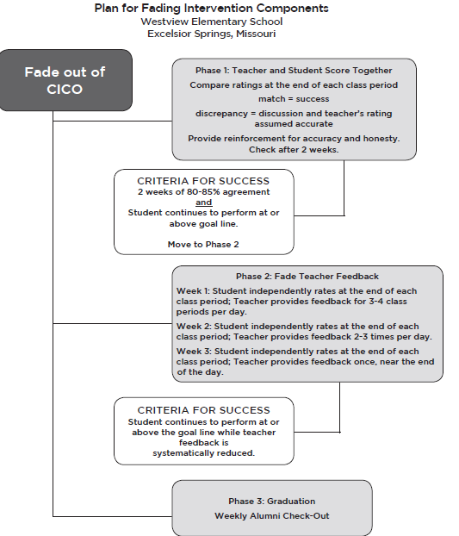
Westview Elementary School Excelsior Springs School District
146-147
Notes:
This slide is an example of how a school in Missouri implements a CICO fading process. Additional examples are the in T2 Workbook, pages 177-180.

Slide 106
Fading Example
Student rates and completes DPR with teacher (student states opinion and teacher confirms or discusses difference).
Student rates and completes DPR during ½ the periods, teacher randomly checks.
Periods in which the student independently rates increases gradually.
Check-in and Check-out is last thing to be removed.
Notes:
Discuss how to move a student from teacher rating to self-monitoring

Slide 107
Fading to Self-Monitoring
Student gives opinion on rating before teacher rates student for every recording period.
Student rates behavior independently 1 out of 5 days a week, teacher checks 4 days.
Student rates behavior independently 2 out of 5 days a week, teacher checks 3 days.
Student rates behavior independently 3 out of 5 days a week, teacher checks 2 days.
Student rates behavior independently 4 out of 5 days a week, teacher checks 1 day.
146-148
Notes:
Once the student is independently rating themselves, teachers should randomly check for accuracy

Slide 108
Fading to Self-Monitoring
Points are still totaled and graphed.
Student still participates in checking in and checking out until Self-Monitoring has shown positive results.
Frequency of Self-Monitoring is adjusted as needed.
Notes:
Teams should determine the rate of fading which may be individualized for a specific student

Slide 109
Supporting Students After Graduation from CICO
It is suggested that you provide students with incentives for continued success.
Help with some aspect of the CICO program
Quarterly Alumni Party
Establish criteria such as no ODRs during quarter
Weekly alumni Check-Outs
Small reinforcer for continuing to be successful without CICO
Notes:
After students graduate from CICO, consider ways for them to periodically receive continued reinforcement. Students should be provided continuing positive feedback and, possibly, incentives for managing their own behavior and for continuing to be successful without the support of CICO.

Slide 110
Discussion: Self-Management, Fading and Graduation
What is your criteria to begin the fading process?
What is your criteria for graduation from CICO?
When will students graduate? After a certain length of time or on a quarterly basis?
What is your graduation procedure?
How will you check on those students who have graduated?
Will you provide periodic rewards or incentives?
Notes:
Allow teams 10 minutes for discussion.

Slide 111
Discussion: Self-Management, Fading and Graduation Planning
CICO Intervention Development Checklist
With your team, discuss the six indicators on the Plans for Self-Management, Fading and Graduation section of the CICO Intervention Development Checklist.
Notes:
Allow 10 minutes for team discussion

Slide 112
Lesson 7: CICO Training Staff, Students, and Families

Slide 113
Lesson 7: CICO Training Staff, Students, and Families
Outcomes
By the end of this lesson, you will be able to:
Develop implementation training for staff, students, and families.

Slide 114
Training for Staff, Students, and Families
It’s important to Teach members how to perform tasks associated with their role in the program. To ensure maximum effectiveness, explicit instruction should occur with each participant.
Notes:
Before beginning implementation of CICO, the Tier 2 team will need to make plans to train all stakeholders regarding the CICO process and their specific responsibilities.
Refer participants to “Responsibilities Associated with the CICO Intervention” form in the workbook on page 193.

Slide 115
Plan for Staff/Teacher Training
Topics for training:
Understanding the DPR.
Value of Positive/Corrective Feedback.
Consider use of video samples to show positive and corrective feedback with the DPR.
Data decisions for identification and monitoring.
Notes:
Initial training should include basic information about the DPR, how to sign and rate. It should also include a list of positive feedback statement examples.
Show Positive Feedback video (After viewing, ask teams to discuss what they saw and heard)
Show Corrective Feedback video (After viewing, ask teams to discuss what they saw and heard)
Discuss: Will teams use these videos for training or develop their own?
NOTE: The DPR rating scale for this school’s CICO Intervention is 0, 1, 2.

Slide 116
Plan for Staff/Teacher Training
Resources in T2 Workbook:
Implementation Script-Classroom Teacher – page 197
Manual resource list- page 194
Initial Training Checklist-Teachers
Frequently Asked Questions
Tips for providing feedback
Notes:
Refer participants to Implementation Script – Classroom Teacher on page 197 of workbook.
The Manual Resource List on page 194 of the workbook provides the page numbers in the BEP manual of ideas and topics that might be included in the training.
Other resources that you might find helpful are the Initial Training Checklist for Teachers, Frequently Asked Questions, and Tips for Providing Feedback. (These are not in Workbook – provide paper or electronic copies)

Slide 117
Teacher Positive
Notes:
Positive Feedback Video Clip is a sample of providing positive recognition. (After viewing, ask teams to discuss what they saw and heard).

Slide 118
Teacher Corrective
Notes:
Corrective Feedback Video Clip is a sample of providing corrective feedback. (After viewing, ask teams to discuss what they saw and heard).
How might you use these video clips when training staff?

Slide 119
Discussion: Teaching Staff to Implement the Program
When will our CICO staff training take place?
Same training for all staff, or more intensive training only for those with students currently in the intervention?
Will we have a separate training for those involved with our CICO pilot?
How will we provide support and follow-up for staff after the training?
How will we communicate with and receive feedback from participating classroom teachers on a weekly basis?
How will we provide updates to all staff about CICO?
Notes:
Allow 10 minutes for team discussion

Slide 120
Discussion: Teaching Staff to Implement the Program
CICO Intervention Development Checklist
With your team, discuss the four indicators on the Teaching Staff to Implement the Program section of the CICO Intervention Development Checklist.
Notes:
Allow 10 minutes for team discussion

Slide 121
Plan for Student Training
Topics for training:
Overview of the program
Explanation of student goal
Where to check-in and check-out
Adding up daily point totals
Progress monitoring
Accepting positive and corrective feedback
Procedures for taking the DPR home
Initial Training Checklist-Student
Notes:
Participating students must understand the purpose of the CICO intervention and receive training on how to engage in the intervention.
-Students are responsible for checking in with the CICO facilitator in the morning and checking out in the afternoon.
-Students are responsible for obtaining a new DPR from the CICO facilitator if they lose one during the school day.
The primary responsibility for students on the CICO is to take ownership of their behavior.
Training of students is typically conducted by the CICO coordinator or facilitator and takes 15-30 minutes. In addition to where/when to check-in and check-out, they should be trained about the goals they have, the points they earn and how to accept both positive and corrective feedback. Also, procedures for taking the DPR home and returning it. Be sure they realize this is a support for them and as they reach their goal, they will be faded off CICO.

Slide 122
Discussion: Teaching Students to Participate in the Program
Who will be in charge of training students?
What topics will be covered in the training?
When and where will this training take place?
Notes:
Allow 10 minutes for team discussion

Slide 123
Discussion: Teaching Students to Participate in the Program
CICO Intervention Development Checklist
With your team, discuss the two indicators on the Teaching Students to Participate in the Program section of the CICO Intervention Development Checklist.
Notes:
Allow 10 minutes for team discussion

Slide 124
Plan for Parent Training
Topics for Training:
Overview of the program (emphasize positive and time-limited nature of the program).
Selection process
Explanation of expected goal/outcome.
How to provide positive and corrective feedback.
Procedures for signing and returning the DPR summary sheet.
Generate a list of activities that can be earned for meeting daily point goal.
Initial Training Checklist-Parent
Notes:
Parents should receive training on the purpose of CICO, the expectations for their child and the expectations for themselves. Optimally, parents will come to school for a 20-30 minute training with the CICO coordinator. The student can receive training at the same time the parents are trained.
(BEP Manual, p.69)
The positive feedback and time-limited nature of the program should be emphasized. Parents should be encouraged to write positive or neutral comments on the DPR before it returns to school. Encourage parents to generate a list of activities that can be earned at home for meeting daily point goals.
There are times when parents are not available to meet or to fulfill the responsibilities of this important part CICO. It is suggested that if this is the case, a surrogate parent be assigned. This could be a family member, or a favorite teacher.
Refer to Implementation Script – Parent on page 198 Of the workbook.

Slide 125
Discussion: Teaching Parents to Participate in the Program
Who will be in charge of training parents?
What topics will be covered in the training?
When and where will the training take place?
How will support and follow-up be provided to parents?
How will we communicate with and receive feedback from parents on a weekly basis?
Notes:
Recall your decisions made in CICO session 1 about notifying parents about their child’s participation in the intervention. Who will do this using what?
Allow 10 minutes for team discussion

Slide 126
Discussion: Teaching Parents to Participate in the Program
CICO Intervention Development Checklist
With your team, discuss the two indicators on the Teaching Parents to Participate in the Program section of the CICO Intervention Development Checklist.
Notes:
Will you inform parents of student participation or ask for permission? Who will do this using what?
Allow 10 minutes for team discussion

Slide 127
Lesson 8: CICO Evaluate Program Outcomes

Slide 128
Lesson 8: CICO Evaluate Program Outcomes
Outcomes
By the end of this lesson, you will be able to:
Develop a system for monitoring fidelity of CICO implementation.
Develop a system for monitoring CICO social validity.
Develop a system for monitoring intervention outcomes.
Develop Intervention Essential Features documentation to provide a clear description of all CICO intervention components.

Slide 129
Were All Parts of the Intervention Provided Accurately?
Fidelity of Intervention Implementation
Social Validity of Interventions
Intervention Outcomes
Intervention Features
Notes:
Once an intervention is developed and being implemented full scale several aspects will need regular attention and consideration to ensure maximal effects and benefits from the selected treatment. A system should be in place to provide on going monitoring of four areas:
-Intervention implementation
-Social Validity of Interventions
-Intervention Outcomes
-Intervention features

Slide 130
Monitoring Fidelity of Intervention Implementation
Definition
Delivery of the intervention in the way in which it was designed to be delivered.
(Gresham, MacMillan, Boebe-Frankenberger, & Bocian, 2000)
When should fidelity be assessed?
Fidelity checks should be designed and conducted on a regular basis.
Fidelity checks should be conducted when data indicates a poor or questionable response to an intervention.

Slide 131
Fidelity of Intervention Implementation
Three simple methods to assess CICO implementation are:
DPR Review
Direct Observation
Facilitator/Teacher Implementation Script Checklist
Notes:
School teams will need to develop a process that provides evidence the intervention is being implemented as intended, but at the same time also is not too time consuming to complete.

Slide 132
Fidelity of Intervention Implementation
DPR Review
Did the student check-in?
Were points awarded for each class period?
Did the student check-out?
Was student data totaled and recorded?
Did the parent sign and are return DPR?
Notes:
If student data indicates a questionable or poor response, the first question the team should ask is whether all the elements in the program are occurring. An easy way to do this is to review the student’s DPR. The CICO coordinator along with the support team can examine 3-5 of the most recent progress reports to verify several elements.

Slide 133
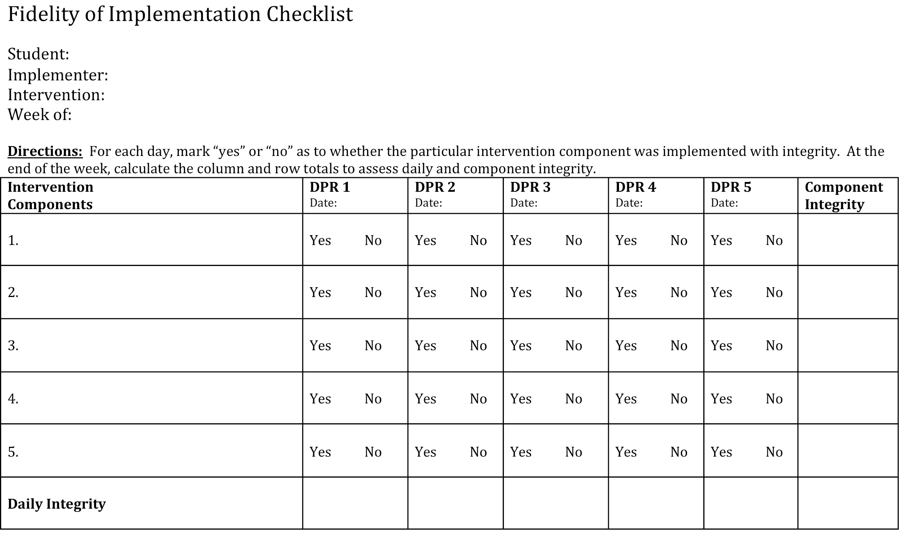
Measuring Fidelity of Implementation
Notes:
Direct participants to review Monitoring Fidelity of Implementation DPR Review on page 207 of the workbook. What are the 5 intervention components?

Slide 134
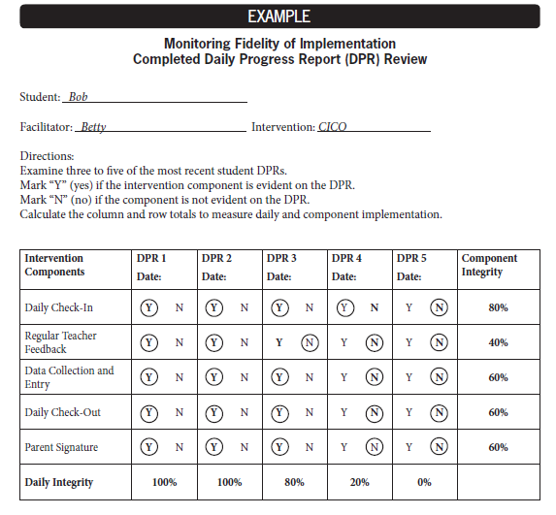
Measuring Fidelity of Implementation
Notes:
The team calculated the percentage that each component was implemented with fidelity as well as calculating by day. Is CICO for this student being implemented with fidelity? The answer is, “No.”
What should the team do to increase fidelity?
Retrain the teacher on providing feedback and completing the DPR throughout the day.
Retrain Bob on checking-out at the end of the day.
Increase fidelity in data collection.
Retrain parent on providing positive feedback, signing the DPR.
Was Bob absent on Friday or lost his DPR? The team might want to review data for several Fridays to see if this is a pattern.

Slide 135
Fidelity of Intervention Implementation
Direct Observation- tips for feedback:
Provide consistent feedback and fill out DPR at the end of each interval.
Feedback should be positive and corrective.
Points should not be taken away prior to feedback.
Notes:
A second method for verifying accuracy of the CICO implementation is by conducting observations. The use of an Observation checklist (page 219 in Workbook) may be helpful. It has been highly recommended that observations of teacher feedback when a new student first enters the program. Several errors that commonly occur include:
Providing feedback inconsistently.
Waiting until the end of the day to fill out the DPR
Failure to provide any positive feedback
Taking student points away prior to the feedback session
Making negative comments with reminding the student what to do.

Slide 136
Fidelity of Intervention Implementation
Facilitator/Classroom Teacher Implementation Script- an indirect method for monitoring implementation fidelity, which includes:
List of steps for implementing CICO
Space for facilitators/teachers to mark each feature when completed.
Mechanism for receiving assistance if the facilitators/teachers have difficulty in implementation of specific steps.
Notes:
There are examples of Implementation Scripts in your T2 Workbook for Facilitator (page 195-196), Classroom Teacher (page 197), and Parent (page 198).

Slide 137
Social Validity
Definition
Social validity focuses on whether the goals and the achieved outcomes are acceptable, socially relevant, and useful to the individual and to those who care about the individual.
(Carr, Austin, Britton, Kellum, & Bailey, 1999)
Notes:
Social Validity, which is sometimes also referred to as treatment acceptability, focuses on whether the goals, the intervention elements, and the anticipated outcomes are acceptable, socially relevant and useful to the individual and to those who care about the individual.
Social Validity provides a picture of the extent to which particular stakeholders (students, families and teachers) value the identified practice or program. This data is commonly collects via a survey or asking personnel to respond to items on a questionnaire

Slide 138
Social Validity
Why assess social validity?
“It matters very little whether or not the intervention achieves the intended behavior change if those members of society who will maintain the behavior change do not value the change or the way that the change was achieved.”
(Schwartz & Baer, 1991)
Notes:
Organizing efforts to assess and review social validity data provides an opportunity for participating staff, students and family members to identify an agree on target areas for intervention, attainable goals and determine environmental supports which will reinforce the use of new skills.
Although there are several options for on going monitoring of social validity, the simple procedures such as a self – made survey, structured interviews and /or rating scales work best. Although teams may conduct the Social Validity survey one/two times a year, a more meaningful approach may be to monitor social validity throughout all phases of the intervention process (before, during and after).

Slide 139
Social Validity
Provides an opportunity to:
Identify and agree on the target area for intervention.
Agree on appropriate, acceptable and attainable goals.
Determine environmental supports that will reinforce use of new skills.
Improved likelihood of commitment to implement and continue intervention until goal is met.
MO SW-PBS
Notes:
Page 211 in the Workbook shows a Social Validity measure for teachers specifically for CICO.
Refer to Teacher Check-In, Check-Out Social Validity Questionnaire on page 211 of the Workbook.

Slide 140
Monitoring Intervention Outcomes
“A fundamental question after implementation of a new practice or program is considering the extent to which it worked. In other words, how well did the practice meet an identified need and for whom was the practice most effective?”
Notes:
To answer these questions the Tier 2 team will need to determine what changes have occurred across the variables or behaviors of interest. Data about the overall CICO program are used to improve resource use and fidelity of implementation.

Slide 141
Monitoring Intervention Outcomes
At a minimum, Tier 2 Teams should consider the following at the end of each school year or intervention cycle:
# of Students who Participated
# of Students that Graduated
# of Students that Required More Intensive Support

Slide 142
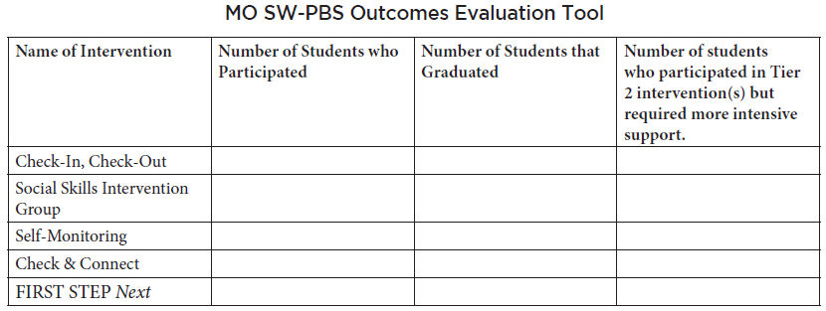
Monitoring Intervention Outcomes
Notes:
Shown here is one simple format that provides basic information. All MO SW-PBS Tier 2 schools will submit this information. Schools that choose to apply for MO SW-PBS recognition at the Silver or Gold Levels will submit data in this format.
The MO SW-PBS Outcomes Evaluation Tool can be found on pbismissouri.org in the Tier 2 Data Tools section. It can also be found in Chapter 4 (page 148) of your Tier 2 workbook.

Slide 143
Intervention Outcomes
Data Sources:
Intervention monitoring data (DPR, Advanced Data Spreadsheet, SWIS)
Existing Data (Attendance, Achievement, ODR)
181-184
Notes:
At first glance, we use the data collected through the intervention itself- DPR and spreadsheet data (or SWIS). However, to determine true success, a closer look at existing data will be helpful. The attendance, achievement and ODR data for students participating in CICO can provide a bigger picture of success. This data can also help when needed to intensify the intervention or show successes and future goal reinforcers.

Slide 144
Discussion: Fidelity, Social Validity, Outcomes
CICO Intervention Development Checklist
With your team, discuss the four indicators on the Evaluate Program Outcomes section of the CICO Intervention Development Checklist.
Notes:
Allow 10 minutes for team discussion

Slide 145
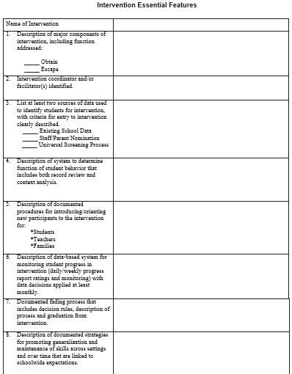
Intervention Essential Features (IEF)
Provides a written description of important intervention attributes.
Tool for communicating with team members, staff, and other important stakeholders.
Promotes sustainability of interventions.
Key item for Tier 2 Handbook.
Complete an IEF for every research-based Tier 2 Intervention that is implemented.
Notes:
After your team has developed and piloted the Check-In, Check-Out Intervention, an Intervention Essential Features (IEF) form will be completed to describe the important attributes of the intervention that are specific to your site. Remember, the information on the IEF can be a valuable communication tool among the stakeholders (team members, staff, administration, district) and should be included in your Tier 2 Staff Handbook along with information about your team, student identification process, teacher nomination form, and other relevant information.
It clearly outlines the intervention purpose, staff facilitators, methods/procedures in place and resources. An IEF will be developed for each Tier 2 Intervention that is implemented in your building.
Some of the items on the IEF should not be completed until after the intervention is solidly in place, but there are a few that can be recorded as we go through the intervention training.

Slide 146
Intervention Essential Features (IEF)
Provides a written description of important intervention attributes.
Tool for communicating with team members, staff, and other important stakeholders.
Promotes sustainability of interventions.
Key item for Tier 2 Handbook.
Complete an IEF for every research-based Tier 2 Intervention that is implemented.
Notes:
Review: This is a requirement for Silver and Gold recognition. But, more importantly, after completing the template, the information can be a valuable communication tool among the stakeholders (team members, staff, administration, district). It clearly outlines the intervention purpose, staff facilitators, methods/procedures in place and resources needed.
Note: The IEF Form in the T2 Workbook is not the most recent version. Make sure each team has an electronic version of the Updated IEF Form (in CICO S2 Handout Folder)

Slide 147
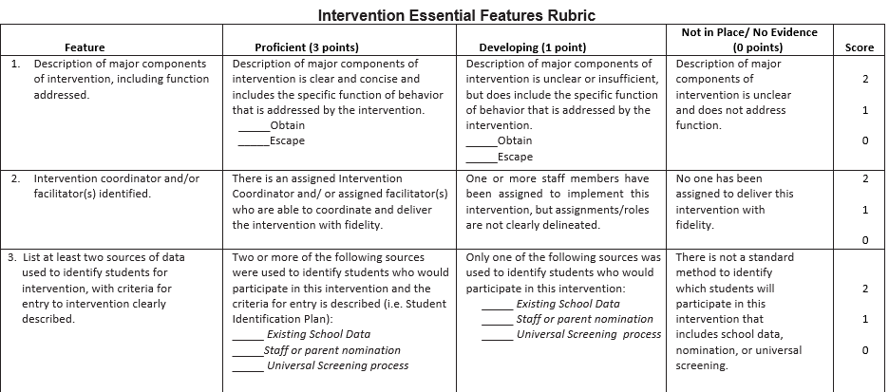
Notes:
The Intervention Essential Features Rubric is designed to help the team “flesh out” their IEF to ensure it contains all critical information for best-practice implementation of the intervention. IEF documents that score Proficient for each feature reflect thorough planning and will likely result in successful implementation when followed as planned.
Note: The IEF Rubric in the T2 Workbook is not the most recent version. Make sure each team has an electronic version of the Updated IEF Rubric (in CICO S2 Handout Folder)

Slide 148
Activity: Tier 2 Staff Handbook
Team
-Tier 2 Team list/roles
-Schedule of meeting dates
-Standard agenda format
Identification
-Data Decision Rules
-Teacher Nomination Form
-Social/Behavioral Screener Function Matching
-System for collecting student information/data
-System to identify function
-System to match intervention
with function
Intervention Descriptions
-CICO IEF
Monitor Progress
-Copy of Sample Monitoring Tools:
CICO DPR and example student graph
Social Validity Surveys
Communication Plan
-System for communicating/receiving feedback
-Professional Learning plan with schedule, topics and coaching procedures.
Notes:
Be sure to make a plan update your Tier 2 Staff Handbook! Remember that this handbook will be used as a resource for all staff in your building as they go about the business of implementing Tier 2 systems, data and practices. This handbook will be the basis for the Tier 2 Professional Learning that takes place in your building, as well. The Tier 2 Staff Handbook Organizer (Workbook page 323) is a great tool to help you decide what will go into your handbook, but you may decide to add or omit items to best meet your needs. You probably completed the first three items on the Organizer during your Tier 2 Systems training (Team, ID, and Function Matching), so now is the time to add your documents that are specific to CICO implementation (IEF, monitoring tools, communication plan).

Slide 149
Discussion: Tier 2 Handbook
Who will gather documents and materials for your CICO chapter?
What materials will be included?
How will it be disseminated to staff?
Where will handbooks be kept? (or will each staff member have their own?)
When is the target date for this to be completed?
Notes:
Teams should be specific in assigning responsibilities
Give teams some time to work on their Handbook, if needed.

Slide 150
Lesson 9: Modifying CICO for Some Students

Slide 151
Lesson 9: Modifying CICO for Some Students
Outcomes
By the end of this lesson, you will be able to:
Develop modifications to CICO based on student needs.
Understand key issues to consider when CICO is identified as a support for students receiving special education services.

Slide 152
How Do We Intensify the Intervention?
Provide more frequent feedback.
Individualize the feedback procedure.
Add a self-monitoring component.
Individualize the reinforcer.
Match features of intervention to function of behavior.
Notes:
Remember, in a Tier 2 Intervention, the team should have developed a standard system to provide feedback to students in the intervention. The team should also have reinforced students receiving Tier 2 intervention by utilizing the schoolwide reinforcement system. The team will intensify an intervention by individualizing the feedback procedure or individualizing the reinforcement.

Slide 153
How Do We Intensify the Intervention?
Provide more frequent feedback
Implement additional feedback session with the intervention facilitator (i.e. noon check-in).
Allow for more frequent interactions between the student and his or her teachers (i.e. shorten the time periods for ratings).
Notes:
If the intervention facilitator meets with all students in an intervention before and after school, an additional meeting could be scheduled in the middle of the day for students who require more frequent feedback.
Often, the teachers specifically interact with students in an intervention before and after class, additional interactions could be planned for students who require more frequent feedback.

Slide 154
How Do We Intensify the Intervention?
Individualize the feedback procedure
Allow the student to select the adult with whom he or she will regularly meet to review progress.
Cross out behaviors on the DPR which are not problematic for the student.
Be more specific with behaviors which are problematic.
Make sure time periods which are problematic are monitored on the DPR.
Notes:
Can the student select the adult to check in and check out with? If some behaviors on the DPR are almost always at or above 80%, cross them off so student is concentrating on only those behaviors which are problematic. If student has difficulty in unstructured times such as recess or lunch, add those time frames to the DPR

Slide 155
How Do We Intensify the Intervention?
Add a Self-Monitoring Component
Identify target behavior
Define the target behavior
Collect baseline data
Design procedure and materials
Teach student to Self-Monitor
Monitor progress
Follow up and fade
Notes:
These are the essential features of Self-Monitoring. If staff have been implementing as instructed, they have already begun the student’s understanding and ability to self-monitor this intervention. Other interventions may need this to be added.

Slide 156
How Do We Intensify the Intervention?
Individualize the reinforcer
Collaboratively develop an individualized contract that specifies the reinforcers the student will earn.
Allow the student to select an adult with whom he or she can spend additional time.
Notes:
Sample Individualized Contract; BEP Manual; page 102
What will the team do if the student does not respond positively to the intensified intervention?
-Conduct a simple FBA (BEP Manual; page 104)

Slide 157
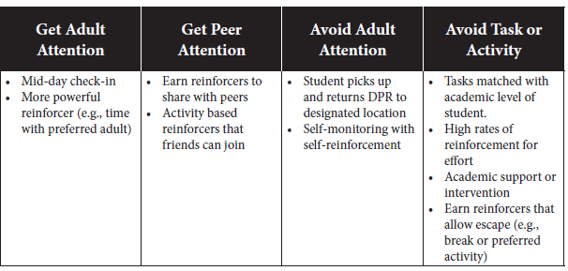
Example Modifications for the CICO Intervention
Notes:
The team will need to consider which modification(s) best match the student’s needs. Listed are several example modifications suggested by authors of the intervention manual (Crone, Hawken, & Horner, 2010). (Workbook page 183)

Slide 158
Lesson 10: CICO Adaptations for Preschool

Slide 159
Lesson 10: CICO Adaptations for Preschool
Outcomes
By the end of this lesson, you will be able to:
Develop CICO Adaptations for Preschool implementation.

Slide 160
Preschool Implementation
Many key features remain the same even within Preschool implementation.
Intervention is continuously available.
Students receive intervention quickly.
Daily check-in
Daily check-out
Copy of DPR sent home for signature and returned the following day.
(Crone, Hawken & Horner, p. 152)
Notes:
Optional Slide – Use only if applicable
While some features remain the same, others can create a challenge. Some modification will need to be made for the DPR design, feedback sessions and identifying students.
For preschool teams – hand out the separate information sheet where they can find more specific guidelines and useful information for implementation.)

Slide 161
Early Childhood DPR
Notes:
Example of a DPR for EC.
There are some additional examples of DPRs for different levels in your workbook – pages 170-171

Slide 162
Lesson 11: CICO Adaptations for High School

Slide 163
Lesson 11: CICO Adaptations for High School
Outcomes
By the end of this lesson, you will be able to:
Develop CICO Adaptations for High School Implementation.

Slide 164
Middle School Implementation
Can be challenging in following ways:
They are now in a Secondary world.
Reinforcers are different from elementary.
DPR carries a stigma.
Notes:
Optional Slide – Use only if applicable
They are no longer the upper classmen as they were their last year of elementary school. The social rules have changed. In Middle School, students are making decisions about who they are. They fight internal emotions about loyalty- to peers, to parents, to adult authority.
The sticker will no longer carry ‘clout’ and may seem childish as would a pencil or piece of candy. The reinforcers for recognizing appropriate behavior will now be more effective if it is a privilege or adult attention or attached to socializing.
They will no longer want to carry the DPR around with them, in fact they will most likely ‘lose it’. In MS, anything that will call attention to them that makes them appear different an assumed negative way, tends not to be effective. Instead, find a way for teachers to keep the DPR or use a Google doc (check tip on the High School handout).

Slide 165
High School Implementation
More complex because…
Peer attention is more reinforcing than adult attention.
Students are expected to self-manage both social and academic behaviors.
Size of school makes coordination among adults more complex.
(Crone, Hawken & Horner, p. 124)
Notes:
Optional Slide – Use only if applicable
(for high school teams – hand out the separate information sheet where they can find more specific guidelines and useful information for implementation.)

Slide 166
Lesson 12: CICO Cultural Considerations

Slide 167
Lesson 12: CICO Cultural Considerations
Outcomes
By the end of this lesson, you will be able to:
Understand the core components of cultural competence.
Develop modifications to culturally adapt Tier 2 Systems and CICO for intended consumers.

Slide 168
Culture Considerations
Know your own cultural background.
Know the cultural background of students.
Culturally appropriate Intervention process.
Notes:
Before we can understand the cultural background of our students, we need to understand our own culture. It is our background that effects the way we interact.
Learn about the cultural background of your students. Make a commitment to learn more about their culture. Consider a culture coach – someone who is familiar with a particular culture and can help the team’s learning process.
Assess intervention to see if it is culturally appropriate. Most are based on the values, beliefs and biases of the mainstream European American culture. Just the fact you are addressing the issue shows cultural awareness. Knowing more about the culture and comparing to intervention process should become the norm.

Slide 169
Cultural Adaptations to Consider
Tier 2 Team makeup
Referral System
School-home communication
Reinforcement System
Data-based decision making
Behavior expectations and teach feedback
Notes:
Do we have team members from a variety of cultural backgrounds? Do we have team members who are familiar with issues of poverty?
Is our referral system objective (and does our data support this)? Are most students in CICO students of color? Are there some student groups (Asian Americans, Caucasian Americans) that are highly underrepresented in CICO? Is our referral system objective (and does our data reflect this)?
Have we asked families which mode of communication they prefer (written or in person)?
Are the incentives we offer students culturally appropriate? Do we offer incentives which may be insulting to families from different cultural groups (books/games that perpetuate stereotypes of American Indians)? Does our student store offer meaningful reinforcers for students living in poverty? Do we offer incentives that don’t make sense for children living in poverty (video games when children don’t have the technology to play them)?
Have we asked students and families what they think of CICO?
Do we have schoolwide and/or classroom expectations that may be culturally inappropriate (make direct eye contact; participate in class by sharing comments frequently; every parent must contribute $15 for the class party fund; every family must list an email address)?

Slide 170
Resources
Crone, D. C. & Horner, R. H. (2003). Building Positive Behavior Support Systems in Schools: Functional Behavioral Assessment. New York: The Guilford Press.
Crone, D. A., Hawken, L. S.. & Horner, R. H. (2010). Responding to Problem Behavior in Schools: The Behavior Education Program. New York: The Guilford Press.
Crone, D. A., Horner, R. H. & Hawken, L. S. (2004). Responding to Problem Behavior in Schools: The Behavior Education Program. New York: The Guilford Press.
Hawken, L.S., Pettersson, H., Mootz, J. & Anderson, C. (2005). The Behavior Education Program: A Check-in, Check-out Intervention for Students at Risk. New York: Guilford Publications.

Slide 171
Resources
Bohanon-Edmonson, H., Flannery, K. B., Eber, L., &Sugai, G. (2004). Positive Behavior Support in High Schools: Monograph from the 2004 Illinois High School Forum of Positive Behavioral Interventions and Supports. University of Oregon.
Crone, D. C. & Horner, R. H. (2003). Building Positive Behavior Support Systems in Schools: Functional Behavioral Assessment. New York: The Guilford Press.
Crone, D. A., Hawken, L. S.. & Horner, R. H. (2010). Responding to Problem Behavior in Schools: The Behavior Education Program. New York: The Guilford Press.
Crone, D. A., Horner, R. H. & Hawken, L. S. (2004). Responding to Problem Behavior in Schools: The Behavior Education Program. New York: The Guilford Press.
Hawken, L.S., Pettersson, H., Mootz, J. & Anderson, C. (2005). The Behavior Education Program: A Check-in, Check-out Intervention for Students at Risk. New York: Guilford Publications.

Slide 172
Resources
Bohanon-Edmonson, H., Flannery, K. B., Eber, L., &Sugai, G. (2004). Positive Behavior Support in High Schools: Monograph from the 2004 Illinois High School Forum of Positive Behavioral Interventions and Supports. University of Oregon.
Crone, D. C. & Horner, R. H. (2003). Building Positive Behavior Support Systems in Schools: Functional Behavioral Assessment. New York: The Guilford Press.
Crone, D. A., Hawken, L. S.. & Horner, R. H. (2010). Responding to Problem Behavior in Schools: The Behavior Education Program. New York: The Guilford Press.
Crone, D. A., Horner, R. H. & Hawken, L. S. (2004). Responding to Problem Behavior in Schools: The Behavior Education Program. New York: The Guilford Press.
Hawken, L.S., Pettersson, H., Mootz, J. & Anderson, C. (2005). The Behavior Education Program: A Check-in, Check-out Intervention for Students at Risk. New York: Guilford Publications.

Slide 173
Resources
Horner, R., Hawken, L. and March, R. Targeted Interventions. Powerpoint Presentation.
Secondary Interventions: Applying Function-based Support. Powerpoint Presentation adapted from Crone, Horner, & Hawken, 2004. Responding to Problem Behavior in Schools: The Behavior Education Program (BEP).
Sprague, J., Cook, C. R., Browning Wright, D., & Sadler, C. (2008). RTI and behavior: A guide to integrating behavioral and academic supports. Horsham, PA: LRP Publications.
Walker, H., Horner, R.H., Sugai, G., Bullis, M., Sprague, J., Bricker, D., & Kaufman, M. (1996). Integrated approaches to preventing antisocial behavior patterns among school aged youth. Journal of Emotional and Behavioral Disorders, 4(4), 194- 209.

Slide 174
Contact Information
Remember to follow MO SW-PBS on social media
Consultant Contact Information:
pbismissouri.org
facebook.com/moswpbs
@MOSWPBS

