Slide 1
Team Workshop for Preparation Phase SW-PBS Teams: Session - Encouraging Expected Behavior MO SW-PBS Training

Slide 2
Facilitator Notes
Materials:
MO SW-PBS Tier 1 Workbook 19-20
Blank Schoolwide System to Encourage Expected Behavior
School-wide Staff Recognition System Plan Template

Slide 3
Team Workshop for Preparation Phase SW-PBS Teams: Session - Encouraging Expected Behavior MO SW-PBS Training

Slide 4
Working Agreements
Be Respectful
Be an active listener—open to new ideas
Use notes for side bar conversations
Be Responsible
Be on time for sessions
Silence cell phones—reply appropriately
Be a Problem Solver
Follow the decision making process
Work toward consensus and support decisions of the group
Notes:
“These will be the Working Agreements we will honor during all our training sessions this year.”

Slide 5
Attention Signal Practice
Select and teach an attention signal.
Notes:
“One of our agreements is to follow the attention signal.”
“Your team will work with your school to develop an attention signal you will use in every setting.”
“In order to get all of you focused after discussions, activities or breaks, I will ________________________.”
(Insert your attention signal here.)
“Your task will be to finish your sentence, quiet your voice and ____________________________.”
(Insert what you want participants to do.)

Slide 6
Introduction

Slide 7
Session Outcomes
At the end of the session, you will be able to…
Understand and explain to others the importance and impact of both contingent and non-contingent attention on student behavior and school climate.
Use preferred adult behaviors to build relationships and positive school climate and effectively interact with students when talking about behavior.
Demonstrate specific, positive feedback that explicitly describes behavior and uses rationales.
Develop a tangible reinforcement system to enhance your use of specific, positive feedback.
Develop and implement an effective menu or continuum of positive reinforcement that serves to motivate all students across settings.
Monitor staff ’s use of encouragement strategies with students.
Notes:
Read the slide or direct participants to read the slide, then say,
“Clarifying and teaching expectations alone are not sufficient. We must also encourage student use of those behaviors. Today we’ll focus on developing a system to encourage expected behaviors.”

Slide 8
Reflective Questions
How do you recognize student academic performance?
What similar systems could be put into place to recognize appropriate behavior?

Slide 9
Session Outcomes
At the end of the session, you will be able to…
Understand and explain to others the importance and impact of both contingent and non-contingent attention on student behavior and school climate.
Use preferred adult behaviors to build relationships and positive school climate and effectively interact with students when talking about behavior.
Demonstrate specific, positive feedback that explicitly describes behavior and uses rationales.
Develop a tangible reinforcement system to enhance your use of specific, positive feedback.
Develop and implement an effective menu or continuum of positive reinforcement that serves to motivate all students across settings.
Monitor staff ’s use of encouragement strategies with students.
Notes:
Read the slide or direct participants to read the slide, then say,
“Clarifying and teaching expectations alone are not sufficient. We must also encourage student use of those behaviors. Today we’ll focus on developing a system to encourage expected behaviors.”

Slide 10
Reflective Questions
Why is providing feedback for appropriate academic responses important?
How does feedback influence future occurrences of a behavior?

Slide 11
“Teacher praise has been supported as among one of the most empirically sound teacher competencies.”
John Maag
MO SW-PBS
Notes:
Read the slide, then say,
“Recognizing the academic and social behavioral accomplishments of students has been found to be a powerful strategy to positively impact achievement.”

Slide 12
Adult Attention
Two types of adult attention:
Non-contingent – attention provided regardless of performance
Greetings, proximity, smiles, conversations, jobs, etc.
Contingent – provided based upon student performance of an identified expectation or behavior
Praise, Specific Positive Feedback, reinforcement, tangible item.
MO SW-PBS
Notes:
Read the slide, then say,
“Both non-contingent and contingent attention have a positive impact on teacher-student and student-student interactions in schools. Together, both types of attention create a positive school climate and build rapport and relationships, and help students learn social behavioral expectations.”

Slide 13
Non-Contingent Attention
Provides time and attention that is not tied to performance.
Helps fulfill students’ needs to be noticed and valued.
Sufficient non-contingent attention may decrease frequency of attention-seeking misbehavior.
Provides role-model of positive social interactions.
Antecedents that help establish positive relationships between staff and students and set the stage for students to display desired academic and behavioral expectations and receive correction when needed.
MO SW-PBS
Notes:
Read the slide, then say,
“In the ABC’s of behavior, non-contingent attention serves as an antecedent. Given that some instances of inappropriate behavior are based on a need for attention, providing sufficient non-contingent attention can result in reducing the frequency of problem behavior.”

Slide 14
Non-Contingent Attention
Proximity – Communicate privately at 20” with individual students; communication across the room reserved for information intended for entire group only.
Listening – Pause, attend thoughtfully to the student.
Pleasant Voice – Use calm voice when talking with, praising, and correcting students
Smiles – Pleasant facial expression and frequent smiles
Use Student’s Name – Begin interactions with student name and use frequently during interactions
Notes:
Say, “How do we provide effective non-contingent attention?”
Read the slide or direct participants to read the slide.

Slide 15
Non-Contingent Attention
As teachers report that positive student-teacher relationships increase, the number of suspensions students receive decreases.
As students report an increase in positive emotional quality in the student-teacher relationship, the number of behavior referrals received decreases and the amount of time on task increases. Decker, Dona, & Christenson, 2007
MO SW-PBS
Notes:
Read the slide or direct participants to read the slide, then say,
“Non-contingent positive adult attention impacts both academic and social behavioral achievement. It also sets the stage for positive interactions between students.”

Slide 16
Discussion: Non-Contingent Attention
Turn to a shoulder partner…
Give the definition of non-contingent attention.
Explain why it may act as an antecedent for appropriate behavior.
List as many examples as you can of non-contingent attention that are presently in place in your school.
Notes:
Read the slide.
Provide approximately 5 minutes for this discussion.

Slide 17
Activity: The Science of Behavior
Read the final paragraph on page 22 and the first paragraph on page 23 in your Workbook.
Write a definition of “consequence”.
Share your definition with your team. Write a team definition from your discussion.
Be ready to share!
22
Notes:
Provide access to 2018-19 Workbook pp. 22 & 23.
“Before beginning to develop specific practices for encouraging behavior, it is important to revisit the A-B-C’s of behavior. Up to now our work has focused on altering antecedents. We now turn to look at consequences, making adult attention contingent on the performance of the expected behavior. The consequences of behavior affect future performance of that behavior.”

Slide 18
The Science of Behavior: Making Adult Attention Contingent on Performance of Desired Behaviors
A B C
Antecedent | Behavior | Consequence
Events that happen immediately before and trigger the behavior. | An observable act. What the student does. The actions or reactions to the antecedents. | The resulting event or outcome that occurs immediately following the behavior. Impacts future occurrence of the behavior.
MO SW-PBS
Notes:
Read the slide, then say,
“Remember the ABC’s of behavior – We studied the A, Antecedents, and the B, Behavior, when we focused on the development of the Schoolwide Expectations Matrix and the lessons to teach matrix behaviors. Clarifying the behavior you want your students to exhibit, teaching that behavior and providing non-contingent attention increases the likelihood that students will be able to demonstrate the appropriate behavior. Now we’ll focus on studying the consequences that will maintain appropriate behavior.”

Slide 19
The Science of Behavior: Making Adult Attention Contingent on Performance of Desired Behaviors
A B C
Antecedent | Behavior | Consequence
Hallway expectations are clarified and taught. Teachers use prompts/pre-corrects to remind students to walk in the hallway and use quiet voices. | Students keep voices quiet and walk. | You observe the students following hallway expectations and say, “Great job of being respectful and safe in the hall by keeping your voices quiet and walking.”
MO SW-PBS
Notes:
Read the slide or direct participants to read the slide, then say,
“The contingent or specific, positive feedback you provide will increase the likelihood that the behavior(s) you’ve identified will be maintained or used consistently.”

Slide 20
Contingent Attention
The student must perform the expected behavior before the teacher responds with attention.
Increases academic performance (Good, et al. 1981).
Increases on-task behavior (Sutherland, Wehby, & Copeland, 2000)
Increases likelihood students will continue to use the desired behavior in the future.
Helps students to discern correct or “right” responses from incorrect or “wrong.”
MO SW-PBS
Notes:
Read the slide, then say,
“Contingent attention is attention given after the desired behavior takes place. The student must perform the expected behavior before a teacher responds with attention. How does this differ from non-contingent attention?”

Slide 21
Low Rates of Contingent Attention on Social Behavior
Average teacher fails to take advantage of the power of attention.
Approval statements for academic responses far outweigh those for social behavior.
Highest rates of attention for social behavior occur in 2nd grade and decrease dramatically after that.
Teachers respond more frequently to inappropriate social behavior than to appropriate social behavior.
This attention inadvertently maintains or increases the misbehavior.
MO SW-PBS
Notes:
Read the slide or direct participants to read the slide, then say,
“You get what you pay attention to. So you must highlight what you want more of. What have you been highlighting in your classroom?”

Slide 22
Comparison: Academic Attention vs. Social Attention
MO SW-PBS
Notes:
Say,
“We’ve just emphasized the power of positive recognition of appropriate behavior. What is the current state of this practice in schools? In all grade levels, teachers responded to correct academic performance (20.36 per hour average) more frequently than disapprovals (7.56 per hour average). Statements of disapproval for social behavior (19.20 per hour) were always more frequent than approvals (1.52 per hour). Here is a summary of the findings.”
Direct participants to read the slide.

Slide 23
Contingent Attention = Encouraging Expected Behavior
Similar to encouraging academic behavior.
Motivates students as they are initially learning expected behavior, and maintains them as students become more fluent with use.
Essential to changing student behavior and creating a positive school environment.
MO SW-PBS
Notes:
Read the slide or direct participants to read the slide, then say,
“There are many terms associated with encouraging student behavior: ‘acknowledgement,’ ‘teacher approval,’ ‘recognition,’ ‘encouragement,’ ‘reinforcement,’ ‘praise,’ ‘reward,’ and ‘specific positive feedback.’ While there are slight differences in the meaning of these terms, the most commonly used terms are reinforcement and specific positive feedback. Reinforcement is an over-arching term for a contingently delivered positive consequence that is associated with an increase of future behavior. Reinforcement can take many forms (social or attention, tangible items, or activities). Specific positive feedback is perhaps the most common term for verbal reinforcement, which provides students with social attention along with specific information on their performance. Together they increase the likelihood of students using the desired behavior again in the future.”

Slide 24
Preferred Adult Behaviors
Proximity
Listening
Eye Contact
Pleasant Voice
Smiles
Use of Student Names
Notes:
Adult behaviors that build relationship include: 1) communicating privately, in close proximity with the student, 2) listening, 3) eye contact, 4) pleasant voice tone, 5) smiles, 6) appropriate professional touch and 7) use of students’ names.
These behaviors express warmth, care and concern for students while also communicating respect. They increase student affect (the likelihood that they will say they like school or their teacher), compliance (the likelihood that they will do as asked) and also enhance learning. Not only do these adult behaviors impact relationships, but they also set the stage for effectively interacting with students and delivering genuine feedback.

Slide 25
Discussion: Encouraging Expected Behavior
Read Terms Related to Encouraging Expected Behavior on page 163, then respond to the following:
What are some of the misconceptions or confusion surrounding the use of praise, or reinforcement?
Why do you think this powerful practice is so underused in our schools?
Begin to consider ways to increase the use of encouragement in your school.
What clarifications are needed?
163
Notes:
Direct teams to respond to the questions on the slide. Ask teams to list their questions.
Provide approximately 10 minutes for this discussion.
Ask volunteers to share their thoughts and address any questions they have listed.

Slide 26
Session Outcomes
At the end of the session, you will be able to…
Understand and explain to others the importance and impact of both contingent and non-contingent attention on student behavior and school climate.
Use preferred adult behaviors to build relationships and positive school climate and effectively interact with students when talking about behavior.
Demonstrate specific, positive feedback that explicitly describes behavior and uses rationales.
Develop a tangible reinforcement system to enhance your use of specific, positive feedback.
Develop and implement an effective menu or continuum of positive reinforcement that serves to motivate all students across settings.
Monitor staff ’s use of encouragement strategies with students.
Notes:
Read the slide or direct participants to read the slide, then say,
“Clarifying and teaching expectations alone are not sufficient. We must also encourage student use of those behaviors. Today we’ll focus on developing a system to encourage expected behaviors.”

Slide 27
Reflective Questions
How does positive feedback on your job performance impact your future work?
What types of feedback do you provide to students on academic work? How does this compare to the types of feedback you provide to students on behavioral expectations?

Slide 28
Specific Positive Feedback
Contingent attention.
Essential in order to change and sustain behavior.
Recognizes effort or successes at tasks that are difficult for the child.
While general praise contributes to a pleasant classroom, it is insufficient to build and sustain desired behavior.
Students need clear specific feedback on school-wide expectations as well as other behaviors that are extensions of those expectations.
MO SW-PBS
Notes:
Read the slide or direct participants to read the slide, then say,
“By using specific positive feedback you are recognizing attainment of specified performance criteria, effort, or successes at tasks that are difficult for the child. Students need clear, specific feedback on their use of the schoolwide expectations and rules.”

Slide 29
Notes:
Provide access to 2018-19 Workbook pp. 25-27.
When considering the ABCs of behavior, teachers may assert they do not believe in giving prompts, positive feedback, or tangible rewards for behaviors students should already know and display. Additionally, some teachers fear providing external regulation, in the form of antecedent or consequential supports, will undermine students’ intrinsic motivation. Such statements indicate a lack of understanding regarding the fundamental principles of motivation and the differentiation between motivation and regulation. Beyond infancy and early childhood, the motivation for the majority of human behavior is externally motivated (Ryan & Deci, 2000).
In the diagram Ryan and Deci (2000) articulate the continuum of human motivation including: amotivation, extrinsic motivation, and intrinsic motivation. Amotivation denotes a complete lack of motivation for or value of the activity or knowledge in consideration, or perceived lack of competence with the activity. Extrinsic motivation means an individual engages in an activity to attain a separable outcome (e.g., to receive an external item or activity of preference, to fit into a group, to master a skill or gain knowledge needed for later). Intrinsic motivation refers to participating in an activity simply for the enjoyment of the activity itself. Many factors influence where an individual falls on the continuum, with regard to a specific behavior. Additionally, an individual’s location on the continuum may be fluid and individuals may move in either direction along the continuum.

Slide 30
Benefits of Specific Positive Feedback
“When we focus our praise on positive actions, we support a sense of competence and autonomy that helps students develop real self-esteem.” Davis, 2007
Helps adults and students focus on positive social behaviors and actions.
The most powerful behavior change tool teachers have in their repertoire.
Increases likelihood students will use the recognized behaviors and skills in the future.
Decreases inappropriate behavior, and reduces the need for correction.
Enhances self-esteem and helps build internal locus of control.
MO SW-PBS
Notes:
Read the slide or direct participants to read the slide, then say,
“If you were offered $10,000 for increasing appropriate behavior in your classroom, what single action would you take to achieve this result?”
Allow participants to consider the question, then say,
“How many of you believe that you would increase your use of punishment to increase appropriate behavior and, thus, earn the $10,000?”
“How many of you believe that you would increase your use of specific positive feedback? If you chose the specific positive feedback option, research indicates, you’d have a greater likelihood of increasing appropriate behavior.”

Slide 31
Characteristics of Effective Specific Positive Feedback
Contingent
Immediate
Frequent (then Intermittent)
Notes:
Provide time for participants to read the characteristics.
“Contingent means it should be provided only when the student(s) has demonstrated the desired behavior.”
“ “Immediate - Specific positive feedback must be provided immediately so the student can remember what he or she did that was correct. If the feedback is provided at a later time, the student may not remember exactly what he or she did and, thus, may not be able to remember how to replicate the appropriate behavior.”
“Frequent (then Intermittent) – It is critical to provide feedback on a continuous schedule when students are learning new skills. This means that every time the student displays the desired behavior, they receive specific positive feedback. Once the skill or behavior has been learned, you can shift to use of general praise and occasional or intermittent use of specific positive feedback.

Slide 32
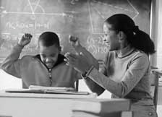
Effective Specific Positive Feedback
1. State the expectation
“Thank you for being responsible by following directions and getting started right away.”
Notes:
Read the slide, then say,
“Here are other examples of stating the expectation:
Good job of being respectful by actively listening while Pat was talking!
Turning in your work on time shows that you’re being very responsible!”
“Think of a time this week you’ve provided specific positive feedback. Write it down and try stating the expectation.”

Slide 33
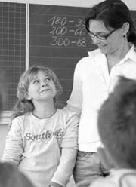
Effective Specific Positive Feedback
Specifically describe the behavior:
Explicitly describe the behavior you want to continue.
Describe like a videotape replay.
Use the words of your expectations.
“When I said it was time to begin, you cleared off your desk, got your materials out immediately, and began working quickly.”
Notes:
Read the slide, then say,
“Other examples from today’s workshop include:
“Thank you for being responsible by returning to our session on time after the break.”
“You did a good job of silencing your cell phones before our session began.”
“Can you provide an example of a specific description of behavior during our workshop today?”

Slide 34
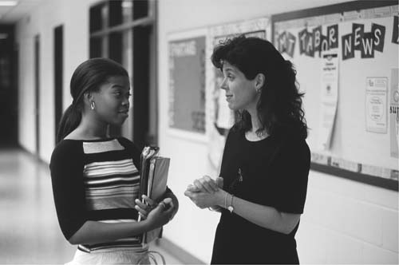
Effective Specific Positive Feedback
Can include a positive consequence:
Specific Positive Feedback alone may not be sufficiently reinforcing.
When behavior requires a great deal of effort, pairing verbal feedback with tangible or activity reinforcement may be helpful.
When using a positive consequence, always pair with Specific Positive Feedback.
Promote ownership; student “earns,” teachers do not “give.”
“Because you got started so quickly, you have earned a Cardinal Card.”
Notes:
Read the slide, then say, “Including a positive consequence when using specific positive feedback is not always required, however, you must always include specific positive feedback when delivering a positive consequence.”
“Here are other examples of including a positive consequence:
You’ve been responsible by being on time to class and bringing your materials! You’ve earned a Tiger ticket that will be put in the drawing for free admission to the game next week.
You’ve done a great job of following directions to get out your materials and start work. You’ve earned free choice time at the end of the class.”
“Think of a time during this school year that you have paired a positive consequence with specific positive feedback.”

Slide 35
Putting It All Together
“When I said it was time to begin, you were responsible and followed directions by clearing off your desk, getting out your materials and starting work. Because you followed directions you have earned a Cardinal Card.”
Notes:
This example includes all 3 features of specific positive feedback:
State the expectation
Specific description of the behavior
Positive consequence
This may seem lengthy and awkward at first but with practice it will become more natural. Once you become fluent, you will discover that you will save time by providing specific positive feedback because you will have fewer problem behaviors.”

Slide 36
More Examples
“Dwayne, you disagreed with Sam, but you stopped and took some time to think, used appropriate language and settled the disagreement peacefully. That was very respectful to Sam and to the rest of our class.”
“Hey Oscar, thanks for using materials appropriately by putting them away at the end of the project. That shows respect for our classroom. You earned a Bee ticket to add to our class hive!”
“Jasmine, thanks for being responsible by being on time to class. That’s important at school and when you are on the job.”
Notes:
Say, “Here are more examples that include the features of specific positive feedback,” then direct participants to read the slide.

Slide 37
Activity: Effective Specific Positive Feedback
Partner with someone on your team.
One person becomes the “teacher”, one the “student.”
Practice providing SPF using rules or expectations from your School-wide Expectations Matrix.
Switch roles and repeat. Be aware of the preferred adult behaviors along with your words.
Notes:
Read the directions for the activity.
Provide approximately 10 minutes for role play; Provide additional time if you wish to include modeling with the large group.
If a team does not bring the School Expectations Matrix, direct participants to use the matrices on pp. 101-103 of the Workbook.

Slide 38
Encouraging Expected Behavior Positive to Negative Ratio
Over the past decade, scientists have explored the impact of positive to negative interaction ratios in our work and personal life. They have found that this ratio can be used to predict—with remarkable accuracy—everything from workplace performance to divorce.
Notes:
Say, “We have discussed how to use adult attention (specific positive feedback) contingent upon performing a specific behavior to build or maintain that behavior. Another important point in building positive school-wide and classroom environments is to ensure that appropriate behavior receives much more attention than problem behavior – approximately 4 positives:1 negatives or corrections,” then read the slide.
Say, We’re going to read the information on the next slide to see how this concept was tested.”

Slide 39
Encouraging Expected Behavior Positive to Negative Ratio
This work began with noted psychologist John Gottman's exploration of positive-to-negative ratios in marriages.
Using a 5:1 positive to negative ratio, Gottman and his colleagues predicted whether 700 newlywed couples would stay together or divorce by scoring their positive and negative interactions in one 15-minute conversation between each husband and wife. Ten years later, the follow-up revealed that they had predicted divorce with 94 percent accuracy.
Notes:
Read the slide or direct participants to read the slide.
Gottman, J.M., Coan, J., Carrere, S., and Swanson, C. (1998). Predicting marital happiness and stability from newlywed interactions, Journal of Marriage and the Family, 60(1), 5-22.

Slide 40
Encouraging Expected Behavior Positive to Negative Ratio
As teacher praise to reprimand ratios improved, student on-task levels increased for all classrooms.
After withdrawing praise from a classroom, off-task behavior increased from 8.7% to 25.5%
When the rate of criticism was increased, off-task behavior increased from 25.5% to 31.2% with over 50% off-task behavior on some days
Notes:
Ask, “Why should the rate of positive recognition exceed negative comments?” Read the slide.
Source: Becker, W., Engelmann, S., & Thomas, D. (1975). Teaching 2:Cognitive learning and instruction. Chicago: Science Research Associates.

Slide 41
Encouraging Expected Behavior 4:1 Ratio
Teachers should interact with students 4 times more often when they are behaving appropriately than when they are behaving inappropriately (4:1 ratio)
Interactions with students are considered positive or negative based on the behavior in which the student is engaged at the time attention is given
Negative interactions are not wrong and are sometimes necessary; the key is the ratio
Notes:
Say, “At what rate should we deliver positive recognition to negative comments or corrections? Read the first bullet.
Read the 2nd bullet, then say,
“While polite and respectful corrections contribute to a positive environment, they are not considered to be positives.”
Read the 3rd bullet.
(Reavis, Jenson, Kukic & Morgan, 1993)

Slide 42
Activity: Encouraging Expected Behavior
Encouraging
Academic Behavior Social Behavior
Think-Write-Share
Appoint a recorder. Take one minute and individually list as many ways as you can that you and your school reinforce academic behavior.
Share the thoughts generated by each team member and list them on the left side of your chart paper.
Now, list the ways that you and your school recognize social behavior. Again, share with the team and list them on the right side of your chart paper. What do you notice?
MO SW-PBS
Notes:
Read the directions.
Provide approximately 15 minutes for this activity.

Slide 43
Discussion: Specific Positive Feedback
With your team, reflect on the power of Specific Positive Feedback and discuss the following:
How extensively is effective Specific Positive Feedback being used in our school?
Is there a ratio of at least 4:1?
What are some ways that we can share what we have learned about the role of Specific Positive Feedback with our staff?
MO SW-PBS
Notes:
Provide approximately 10 minutes for this discussion. After the discussion, ask for volunteers to share their thoughts.
Option to distribute Encouraging Teacher Tool found on Google Drive>Mo SWPBS State Team>CDR files >3_Training>Tier 1 > Prep>Prep Session 4>Handouts>Handouts from 2018-19 Workbook

Slide 44
Action Planning: Encouraging Expected Behavior
Add the following to your Action Plan:
Review feature 1 on the ‘Encouraging Expected Behavior’ component 5 of your Action Plan.
Staff use specific positive feedback to encourage expected behaviors at a high rate (4:1) in all settings.
Notes:
“Add the following to your Action Plan:
Staff use specific positive feedback to encourage expected behaviors at a high rate (4:1) in all settings. How steps will you take to address this goal?”

Slide 45
Session Outcomes
At the end of the session, you will be able to…
Understand and explain to others the importance and impact of both contingent and non-contingent attention on student behavior and school climate.
Use preferred adult behaviors to build relationships and positive school climate and effectively interact with students when talking about behavior.
Demonstrate specific, positive feedback that explicitly describes behavior and uses rationales.
Develop a tangible reinforcement system to enhance your use of specific, positive feedback.
Develop and implement an effective menu or continuum of positive reinforcement that serves to motivate all students across settings.
Monitor staff ’s use of encouragement strategies with students.
Notes:
Read the slide or direct participants to read the slide, then say,
“Clarifying and teaching expectations alone are not sufficient. We must also encourage student use of those behaviors. Today we’ll focus on developing a system to encourage expected behaviors.”

Slide 46
Reflective Questions
In what way are you extrinsically motivated?
Why should you consider developing and using tangible reinforcers in your school?”

Slide 47
Discussion: Is Specific Positive Feedback Enough?
When extrinsic motivators are closely tied to specific standards of performance and to success, they can enhance intrinsic motivation, particularly if measured as time on task.
Cameron & Pierce, 1994
Turn to a shoulder partner and discuss ways in which you might be extrinsically motivated.
Notes:
Read the slide. Provide approximately 3 minutes for this discussion, then say,
“In what ways are you extrinsically motivated?
Completing a difficult task early so you can go out to dinner with friends
Working out so that you can eat dessert
Reward points for frequent flying
The goal of any reinforcement system is not to manage or control behavior, but to help students improve behavior and move students to intrinsic motivation and reinforcement.”

Slide 48
“The purpose of school-wide recognition is to acknowledge and show appreciation to students who have provided positive demonstrations of the school-wide behavior expectations.”
Geoff Colvin, 2007
MO SW-PBS
Notes:
Direct participants to read the slide.

Slide 49
A Schoolwide System to Encourage Expected Behavior
Notes:
“How will you systematically deliver feedback to increase the likelihood that appropriate behavior will be maintained?
You’ll develop a entire system to encourage expected behaviors you have defined in your matrix and in procedures to use by all staff with all students.”

Slide 50
Why a Variety of Ways to Encourage?
Not all students are reinforced by the same things or in the same ways.
Some students desire or seek social attention.
Others do not like or avoid social attention.
Include social attention, activities, and tangible items to appeal to all student needs.
MO SW-PBS
Notes:
Read the slide or direct participants to read the slide, then say,
“Not all students or adults are reinforced by the same things or in the same ways. Some students desire or try to get or seek social attention, activities or tangible items, while others try to avoid or escape social attention. For these ‘avoiders’ who do not like social attention, they may be reinforced by activities, privileges or tangibles. Therefore, it is recommended that a menu of ways to encourage students include social attention, activities, or tangible items that appeal to all student needs in your school (Lane, Kahberg & Menzies, 2009). Reinforcers can be
Social reinforcers (e.g. praise, recognition, time to hang out with friends)
Activity reinforcers (e.g. special privileges, jobs, computer time, free time)
Material reinforcers (e.g. tangible items)
Token reinforcers (i.e., items exchanged for other reinforcers).”

Slide 51
Tangible Reinforcers
“I have not worked with a school that has been able to give enough feedback to students to maintain positive behavior without using a tangible item like a Pride Ticket. The tangible helps staff remember to give positive recognition to students.”
Tim Lewis
Notes:
Read the slide, then say,
“Now you know the secret behind using tangibles! Tangibles provide a visual reminder for the adults to recognize the positive behavior of the students. The tangible is typically in the form of a ticket or coupon (e.g., Compliment Cards, Bulldog Bucks, Braggin’ Dragon Cards, Bee Tickets, etc.). These tangibles may be reinforcing in and of themselves to collect, but typically have further reinforcing value because they can be exchanged for items or privileges. The benefits to students may be obvious, but another reason schools choose to use a tangible along with specific positive feedback is to ensure teachers’ use of high rates of praise. Tangibles serve as a visual reminder for staff to watch and deliver specific positive feedback.”

Slide 52
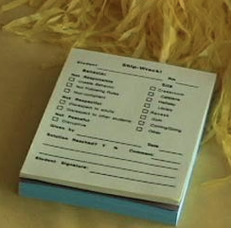
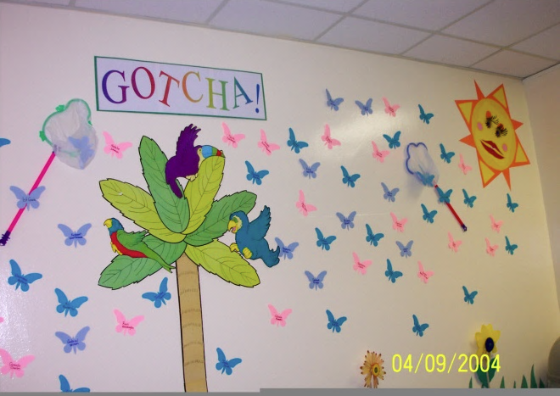
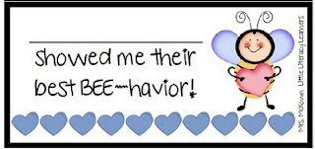
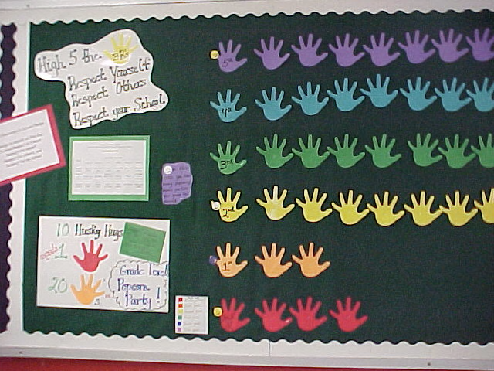
School-Wide System…
… a hallmark of SW-PBS
Notes:
“Here are some examples of materials developed by schools in Missouri to deliver and track tangible reinforcers.”
****Insert other examples as you see fit.***

Slide 53
“Using a reward system is not the same as bribing a student to behave appropriately.
A bribe is something offered or given a person in a position of trust to influence or corrupt that person’s views or conduct.
SW-PBS acknowledges and rewards students for following school-wide expectations and rules.
Appropriate behavior is acknowledged after it occurs. Rewards are earned, not offered as payoff in exchange for good behavior.”
Florida PBS
MO SW-PBS
Notes:
Read the slide, then say,
“Some of the staff in your school may not agree with the use of tangibles. The work from Florida PBS may provide your team with information to address the concerns of those staff.”
“Here is additional research evidence of the efficacy of using tangible reinforcement:
Reinforcement can increase intrinsic motivation (Cameron, Banko, Pierce, 2001).
…programs that show increased intrinsic motivation are those programs that incorporate the elements of good, comprehensive behavioral intervention…” Akin-Little, Little, Eckert, & Lovett, 2004.”
Akin-Little, K., Eckert, T., Lovett, B., & Little, S. (2004). Extrinsic reinforcement in the classroom: Bribery or best practice. School Psychology Review, 33, 344–362.
Cameron, J., Banko, K.M. & Pierce, D.W. (2001). Pervasive negative effects of rewards on intrinsic motivation: The myth continues. Behavior Analysis 24(1), 1-44.

Slide 54
Tangible Reinforcers:
Help staff be accountable for recognizing student behavior and providing Specific Positive Feedback.
Provide all staff with an efficient and always-available system for providing reinforcement.
Give staff a tool to engage in positive interactions with any student in school.
Are a universal sign to students–both those receiving and those watching.
MO SW-PBS
Notes:
Say, “Why should you consider developing and using tangible reinforcers in your school?”, then, read the slide.
Continues on next slide.

Slide 55
Tangible Reinforcers–Continued
Build a sense of community through common class, grade, or school goals.
Enhance staff-student relationships.
Offer a gross measure of the frequency of Specific Positive Feedback being provided; can help guide staff to increase use of Specific Positive Feedback.
MO SW-PBS
Notes:
Read the slide, then say,
“One of the most powerful motivators for human behavior is goal setting. Setting goals as individuals, as a class and as a school will increase the likelihood all staff and students will participate in developing a system of positive reinforcement to maintain appropriate behavior. Tracking and reporting the number of tangibles delivered (i.e. counting the number of tickets earned within a specific context or time) may result in increasing the likelihood that all staff and students will work to maintain appropriate behavior.”

Slide 56
Considerations for Development of Schoolwide System to Encourage
Incorporate school mascot, school theme, or slogan
Easy to distribute
Minimal writing at time of awarding
How to ensure a steady supply to staff
How “tickets” will be used
Who will be responsible for arranging back-up reinforcers (e.g., raffle items, trophies, awards, etc.)
Who will handle collecting, counting, reporting data
MO SW-PBS
Notes:
Say, “It is not sufficient to identify the reinforcers you will use. You must develop a system of delivery. Here are some considerations for developing the system,” then read the slide.

Slide 57
Creative Ways to Use “Tickets”
Set class or school goals
Write name on ticket and drop in raffle box
Competition between grade levels
Chart and graph tickets earned
Roaming trophy for most tickets each month
Display tickets outside classroom door
Post tickets on bulletin board
Names of students earning specified number of tickets go on “Celebrity Board”
MO SW-PBS
Notes:
Say, “These ideas are being implemented in Missouri preschools, elementary schools, middle schools and high schools,” then, read the slide.

Slide 58
Discussion: Schoolwide Tangible Reinforcers
With your team, review the example on page 170-171 and reflect on what you have learned about tangible reinforcement:
What are some ideas for a creative school-wide tangible system in your school?
How might you incorporate your school mascot or other school themes or slogans?
How can you use the small work group process to engage school staff in the development of a school-wide tangible system for your school?
170
Notes:
Say, “Remember, you should involve all staff, perhaps by using the work group process, to generate ideas and develop your system of creating and delivering tangibles.”
Provide approximately 15 minutes for this discussion.

Slide 59
Schedules of Reinforcement
How often should students be reinforced?
Students learning new behaviors need a frequent schedule of reinforcement.
Students who have demonstrated mastery respond to an intermittent schedule of reinforcement.
Students who have maintained appropriate behavior respond to a occasional schedule.
Notes:
Read the slide, then say, “The definition and examples of each schedule of reinforcement are provided on the following slides.”

Slide 60
Schedules of Reinforcement
Frequent | Intermittent | Occasional
Instances of behavior are reinforced at a high rate to quickly build new behaviors | Timing of reinforcement is unplanned and is delivered less frequently to maintain appropriate behavior | Reinforcement is delivered following a predetermined amount of time that the target behavior is exhibited
Notes:
Say, “Your team will have to develop a schedule of reinforcement before you develop your menu of reinforcers. The schedule should include frequent reinforcement, intermittent reinforcement and occasional or long-term reinforcement to develop and maintain appropriate behavior.”
Read the slide.

Slide 61
Schedules of Reinforcement
Frequent | Intermittent | Occasional
Specific Positive Feedback Schoolwide Tangible / Tickets Thumbs up Notes Home | Phone Calls Post Cards Special Privileges Extra Computer Time | Special Projects Recognition from the Principal Student of the Week
Notes:
Say, “Here are examples of free & frequent, intermittent and strong and long-term recognition.” Then, direct participants to read the slide.

Slide 62
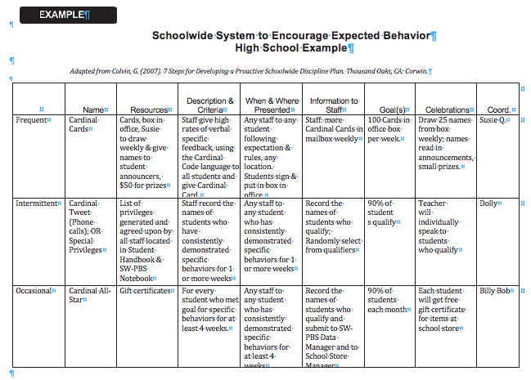
Example Schoolwide System to Encourage Expected Behavior
175
Notes:
Provide access to the Example Schoolwide System to Encourage Expected Behavior found on Google Drive>Mo SWPBS State Team>CDR files>3_Training>Tier 1 >Prep>Prep Session 4>Handouts>Handouts from 2018-19 Workbook
Direct participants to look at p. 175 of the workbook, then say,
“You will respond to the information on p. 174 of the Workbook to complete a schoolwide system to encourage like the one you see on this slide.
Please, read this overview of a system and check to see if reinforcement is delivered frequently, intermittently and occasionally.
Also note if this school described this schoolwide system to encourage in sufficient detail to easily implement with students.”

Slide 63
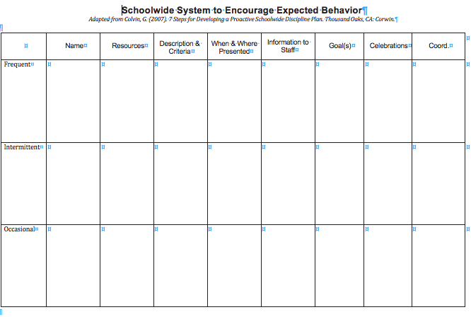
Blank Schoolwide System to Encourage Expected Behavior
179
Notes:
Provide access to the Blank Schoolwide System to Encourage Expected Behavior found on Google Drive>Mo SWPBS State Team>CDR files >3_Training>Tier 1 > Prep>Prep Session 4>Handouts>Handouts from 2018-19 Workbook
Say, “This is a blank template you can use with your staff to develop a schoolwide system for students.”

Slide 64
Cautions When Developing Your Menu
Be cautious if your reinforcement system:
Is so difficult or cumbersome that staff will not consistently use. Keep the system simple, doable, and yet effective.
Is based on an “all or nothing” criteria. “No Tardy Party” vs. “Goal Achieved or Improved On-Time Behavior”
Requires students to prolong their effort for extended periods of time. e.g., no absences for entire semester.
Fails to motivate students at-risk or consistently recognizes those students whose behavior is consistently appropriate for long periods of time.
Becomes boring and predictable. Tweak and keep it fresh.
MO SW-PBS
Notes:
Say, “These are key points for avoiding common mistakes so that you and your staff can effectively use positive consequences,” then, read the slide.

Slide 65
Discussion: Schoolwide System to Encourage Expected Behavior
Review the information about a Schoolwide System to Encourage Expected Behavior on pages 173 - 178. Discuss with your team and be prepared to share:
What questions do we have about a schoolwide system to encourage students?
How will we engage staff in the creation of a schoolwide system to encourage students?
How could we use the small work group process and their draft work to gain consensus from staff?
Notes:
Provide approximately 15 minutes for this discussion.
Have teams list their questions to be answered when their discussion is concluded.
Call on each team to report out their ideas.

Slide 66
Schoolwide System to Encourage Teachers to Implement SW-PBS
Notes:
“In order to maintain positive student behavior, we must increase staff use of positive consequences.
How can we teach and encourage our staff to increase their use of positive consequences?
Implement a system of encouragement with teachers and staff.”

Slide 67
Ideas to Encourage Staff
Recognition during staff meeting or assembly
Ticket to school event
Preferred parking spot
School t-shirt
Lunch delivered
Release from duty
Principal teaches class
Pass to leave work early or arrive late
Notes:
More ideas to encourage staff are described on page 180 in the 2018-19 workbook.
Read this list and ask participants what would encourage them. Share ideas.
“Let’s look at a system of encouraging teachers utilized by a school in southeast Missouri.”

Slide 68
Teacher Tangible
1
1
Franklin Elementary School
ONE
1
1
DR. DUNHAM DOLLAR
Notes:
“This school uses tangibles called ‘Dr. Dunham Dollars’ with their staff. Teachers must disseminate approximately 50 tickets to recognize students for demonstrating expected behavior. When the teachers go to the office to receive more student tickets, they receive a Dunham Dollar. Teachers can collect the Dunham Dollars, or give them to another teacher to recognize him/her for displaying positive behavior. The SW-PBS team often uses the Dunham Dollars (earned by recognizing students) to recognize the good work of other teachers in promoting a positive climate. Teachers throughout the school report the positive actions of their peers, then the SW-PBS team members place Dunham Dollars in that staff person’s mailbox with a note indicating exactly what the person did to earn the recognition.”

Slide 69
Dr. Dunham’s Dollars
10 | 15 | 20 | 25 | 30 | 40 | 50
Take and pick up students from Encore classes for 1 day | Free pass for one duty | Dust a classroom | Free pass for duty (2 days) | Reserve parking spot for 1 week | Leave 30 minutes early on Friday | Jean Pass for entire staff for 1 day
Copy 3 class sets of papers | Extra time for lunch (15 minutes) | Jean pass for a day | 1 day of graded and filed papers | Papers copied for one week | Jean pass for entire week | Flip Flop pass for entire staff for 1 day
Favorite snack or candy bar | Read to a class | Sweatpants pass for a day |  |  |  | Sweatpants pass for entire staff for one day
Free 32 oz. soda |  | Flip flop pass for a day
Notes:
“Here is the Teacher ‘Menu of Reinforcers.’ Teachers can work with other teachers to combine their dollars for a bigger prize. Sometimes they save up for the whole staff to wear jeans during the week.”
“Is it working? Read the response of the staff on the next slide.”

Slide 70
“This is definitely working! We talk a lot about students needing recognition and positive reinforcement but too many times we forget about the teachers needing it, also. When a teacher's morale goes south, we need to find some way to change the direction. By recognizing the teachers we see a lot more student recognition so we try to do everything we can to have teachers recognize the students. We're not perfect and it's not always 100% upbeat, but those down times are few and far between. During our back to school night/open house we did rotations for the parents every 20 minutes. One of those rotations was SW-PBS. Teachers had a powerpoint/flipchart, gave out discipline handbooks, discussed SW-PBS and let the parents see an actual lesson.
It was great!!”
Notes:
Direct participants to read the slide.

Slide 71
Schoolwide System To Encourage Staff
Example
Adapted from Colvin, G. (2007). 7 Steps for Developing a Proactive School-wide Discipline Plan. Thousand Oaks, CA: Corwin.
 | Name | Resources | Description & Criteria | When & Where Presented | Information to Staff | Goal(s) | Celebrations | Coord.
Frequent | Dunham Dollars | Cards, box in office, Susie to draw weekly & give names to student announcers, $50 for prizes | Staff (or SW-PBS Team)give high rates of verbal specific feedback, using the Grr Matrix language to all staff and give a Dunham Dollar | Any staff to any staff following expectation & rules, any location. Teachers sign & put in box in office. | More Dunham Dollars put in mailboxes weekly | 50 Dunham Dollars in office box per week. | Draw 5 names from box weekly; names read in announce- ments, small prizes, | Susie Q.
Intermittent | Special Privileges | List of privileges generated and agreed upon by all staff | Office record the names of staff who have consistently demonstrated specific behaviors for 1 or more weeks | Any SW-PBS Team Member to any staff who has consistently demonstrated specific behaviors for 1 or more weeks | Record the names of staff who qualify; Randomly select from qualifiers | 90% of staff qualify | Principal will individually speak to staff who qualify | Dolly
Occasional | Dunham All Star | Gift certificates | For every staff who met goal for specific behaviors for at least 4 weeks. | Any SW-PBS Team Member to any staff who has consistently demonstrated specific behaviors for at least 4 weeks | Record the names of staff who qualify and submit to Principal | 90% of staff each month | Each staff will get free gift certificate for various items | Billy Bob
Schoolwide System to Encourage Staff Example
Notes:
Provide access to the Schoolwide System to Encourage Staff Example found in Google Drive>Mo SWPBS State Team>CDR files>3_Training>Tier 1 > Prep>Prep Session 4>Handouts>Handouts in Addition to Workbook
Disseminate the Schoolwide System to Encourage Staff Example .
Direct the participants to review it.
71

Slide 72
Schoolwide System To Encourage Staff
Adapted from Colvin, G. (2007). 7 Steps for Developing a Proactive School-wide Discipline Plan. Thousand Oaks, CA: Corwin.
 | Name | Resources | Description & Criteria | When & Where Presented | Information to Staff | Goal(s) | Celebrations | Coord
Frequent
Intermittent
Occasional
School-wide Staff Recognition System Plan Template
Notes:
Provide access to the Schoolwide System to Encourage Staff Blank found in Google Drive>Mo SWPBS State Team>CDR files >3_2018-19 Training>Tier 1 > Prep>Prep Session 4>Handouts>Handouts in Addition to Workbook
Say, “This is a blank template for you to use with your staff to develop a schoolwide system to encourage all the adults in your building.”
72

Slide 73
Action Planning: Encouraging Expected Behavior
Add the following to your Action Plan:
Review feature 3 on the ‘Encouraging Expected Behavior’ component of your Action Plan.
A schoolwide recognition system to encourage appropriate behavior has been developed.
MO SW-PBS
Notes:
“Add Feature 3 on the ‘Encouraging Expected Behavior’ component of your Universal Support Checklist:
You will use the verb tense that reflects the goal on which you’ll be working. You will be working to develop a schoolwide system to encourage appropriate student behavior.”

Slide 74
Session Outcomes
At the end of the session, you will be able to…
Understand and explain to others the importance and impact of both contingent and non-contingent attention on student behavior and school climate.
Use preferred adult behaviors to build relationships and positive school climate and effectively interact with students when talking about behavior.
Demonstrate specific, positive feedback that explicitly describes behavior and uses rationales.
Develop a tangible reinforcement system to enhance your use of specific, positive feedback.
Develop and implement an effective menu or continuum of positive reinforcement that serves to motivate all students across settings.
Monitor staff ’s use of encouragement strategies with students.
Notes:
Read the slide or direct participants to read the slide, then say,
“Clarifying and teaching expectations alone are not sufficient. We must also encourage student use of those behaviors. Today we’ll focus on developing a system to encourage expected behaviors.”

Slide 75
Reflective Questions
How will you know that all staff in both classroom and non-classroom settings are providing high rates of specific positive feedback?
Why is it important to collect data to monitor the fidelity of implementation of your schoolwide recognition system?

Slide 76
Monitoring Implementation
Peer Coaching/Observation
Staff work with each other to observe a specific classroom practice and provide feedback.
Principal ‘Walk-Through’
Data collected on effective practices.
Conversation focused on improvement.
Self-Assessment
An assessment tool designed for a teacher to rate him or herself.

Slide 77
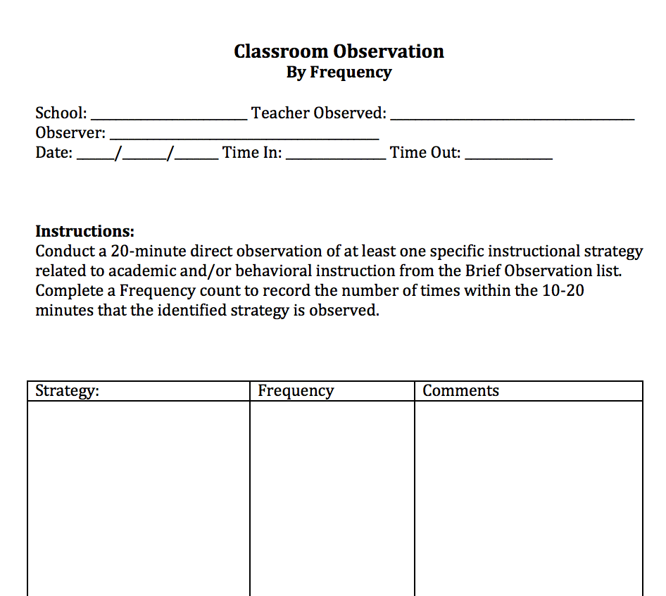
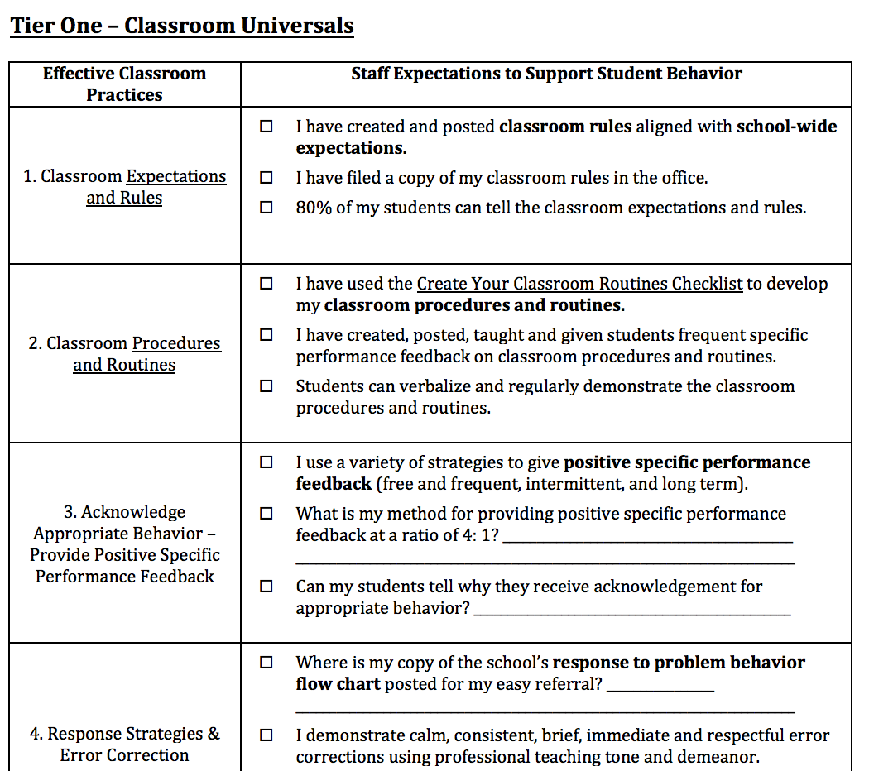
Monitoring Implementation Fidelity
Self-Assessment
Observation

Slide 78
Goals of Monitoring Implementation
Assessment of current practice.
Drives supports for teachers.
Goal setting opportunity for building and individual teachers.
Verify additional Tier 2 and/or 3 Support are needed.
Verify interventions are being implemented as designed.

Slide 79
Contact Information
Remember to follow MO SW-PBS on social media
Consultant Contact Information:
pbismissouri.org
facebook.com/moswpbs
@MOSWPBS

