Slide 1
Missouri Collaborative Work and Effective Teaching/Learning Practices
An Overview
This work is licensed under a Creative Commons Attribution-NonCommercial-NoDerivatives 4.0 International License.
Notes:
To Know/To Say: This presentation is designed to provide an overview of Missouri Collaborative Work and Effective Teaching/Learning Practices.

Slide 2
Notes to Presenter
The purpose this package is to introduce the Missouri Collaborative Work and DESE approved Effective Teaching and Learning Practices. The intended audience is one of teachers and administrators who are new to Missouri CW Schools for the 2016-17 school year.
The Pre-Reading activity for this package is to preview the online CW Magazine, found at MoEdu-sail.org. Directions to access should be sent to participants prior to the presentation date.
Placeholder slides are provided for the presenter to insert introductions and norms with the content/format of choice.
The DESE created voice-over PowerPoint, used as an introduction to Missouri CW and the work of Dr. John Hattie, may be utilized by the presenter as part of the overview. The link for the DESE presentation is: https://desemo.adobeconnect.com/_a754202577/p4wxtxrlgx8/
Notes:
To Know/To Do: This slide informs the presenter and is hidden within the presentation. The link to MoEdu-sail should be provided in advance to participants, so that they can preview the CW Magazine. The link to the DESE voice over PowerPoint may be utilized during the actual presentation by the presenter.

Slide 3
Introductions
This slide is a place holder for the presenter to insert text or an activity to introduce himself/herself and to find out who the audience members are. This can also serve as a time for table-mates or shoulder-partners to introduce themselves.
Notes:
To Know/To Do: Place a slide here to utilize a presenter chosen introduction activity.

Slide 4
Training Norms
Begin and end on time
Be an engaged participant
Be an active listener – open to new ideas
Use electronics respectfully
Notes:
To Know/To Say: These are suggested building norms (presenter may choose to individualize with participant input).

Slide 5
Learner Objectives
By the end of the Missouri Collaborative Work (CW) Overview the participant will:
Understand the purpose of Missouri CW
Understand the relevance of John Hattie’s research to Missouri CW
Know the names and functions of the approved CW foundational packages
Understand the basic concepts of the approved CW Effective Teaching/Learning Practices packages
Notes:
To Know/To Say: The overall purpose of this learning package is for participants to gain foundational knowledge of Missouri Collaborative Work. The learner objectives for the package are listed on the slide.

Slide 6
Why are we doing Collaborative Work?
Recent research has shown us that there are some teaching/learning practices that are highly effective.
To maximize these effects and reach every child, we need to work in collaborative teams to assist one another and to learn and use these practices well.
The Collaborative Work is aligned to the Missouri Teacher/Leader Standards and supports implementation of the Missouri Learning Standards.
Notes:
To Know/To Say: Collaborative work incorporates the effective teaching and learning practices research of John Hattie, as he conducted a meta-analysis of over 800 pieces of research.
Recent research includes:
Hattie, J. (2008). Visible learning: A synthesis of over 800 meta-analyses relating to achievement. Routledge.
Hattie, J. (2012). Visible Learning For Teachers: Maximizing Impact On Learning, Routledge.

Slide 7
Hattie’s “Barometer of Influence”
Medium
0.4
hp= 0.40
0.15
Low
0.7
High
Teacher Effects
Desired
Effects
0.0
Developmental
Effects
Negative
1.0
Reverse Effects
-0.2
1.2
© John Hattie
(Hattie, 2009)
Notes:
To Know: Effect Size
“An effect size is a useful method for comparing results on different measures (such as standardized, teacher-made tests, student work), or over time, or between groups, on a scale that allows multiple comparisons independent of the original test scoring (for example, marked out of 10, or 100), across content , and over time. This independent scale is one of the major attractions for using effect sizes, because it allows relative comparisons about various influences on student achievement.” (Hattie, 2012)
To Say: John Hattie’s 2009 book, Visible Learning, was based on more than 800 meta-analyses of 50,000 research articles, about 150,000 effect sizes, and about 240 million students.
Effect size is a standard measure that can be calculated from any number of statistical outputs. (Biddix, 2009)
Perhaps the most significant discovery from evidence was almost any intervention can stake a claim to making a difference to student learning.
Any effect above zero means that achievement has been raised by the intervention. The average effect size is 0.40; there are just as many influences on achievement above the average as there are below the average.
For any particular intervention to be considered worthwhile, it needs to show an improvement in student learning of at least an average gain – that is, an effect size of at least 0.40, referred to as the hinge-point for identifying what is and what is not effective.
Half of the influences on achievement are above this hinge-point. This is a real-world, actual finding and not an aspiration claim. That means that about half of what we do to all students has an effect of 0.4 or greater, while half get less than the 0.4 effect. (Hattie, 2012)
Hattie’s Barometer of Influence represents a summary of the effect size from the studies that were reviewed. The average effect size, 0.40, may be viewed as a typical one year of growth in student learning in one year’s time. Missouri’s Collaborative Work has identified from Hattie’s research Effective Teaching and Learning Practices which are in the high rank of desired effects for student learning outcomes.
To Do: Explain Hattie’s Barometer of Influence.
References:
Biddix, P. (2009, July). Effect Size. Retrieved from https://researchrundowns.wordpress.com/quantitative-methods/effect-size/. Hattie, J. (2009). Visible learning: A synthesis of over 800 meta-analyses relating to achievement. New York, NY: Routledge.
Hattie, J. (2009). Visible learning: A synthesis of over 800 meta-analyses relating to achievement. New York, NY: Routledge.

Slide 8
Effect Size Exercise
Using the handout, predict the level of positive influence on student achievement for each educational practice listed.
Notes:
To Say: Now we will look at some of the influences on student achievement addressed in Dr. Hattie’s meta-analysis. Using the handout, make a determination of the level of positive influence of each educational practice listed. Do this as an independent activity, making your best educated guess.
To Do: Give all participants the handout (without the key) for the Effect Size Exercise activity. Allow 5-7 minutes to complete (or time as needed by the group).
Handouts: Effect Size Exercise
Key for Effect Size Exercise (presenter should keep the key handout until participants have completed the activity or put the key handouts upside down on the participant tables)

Slide 9
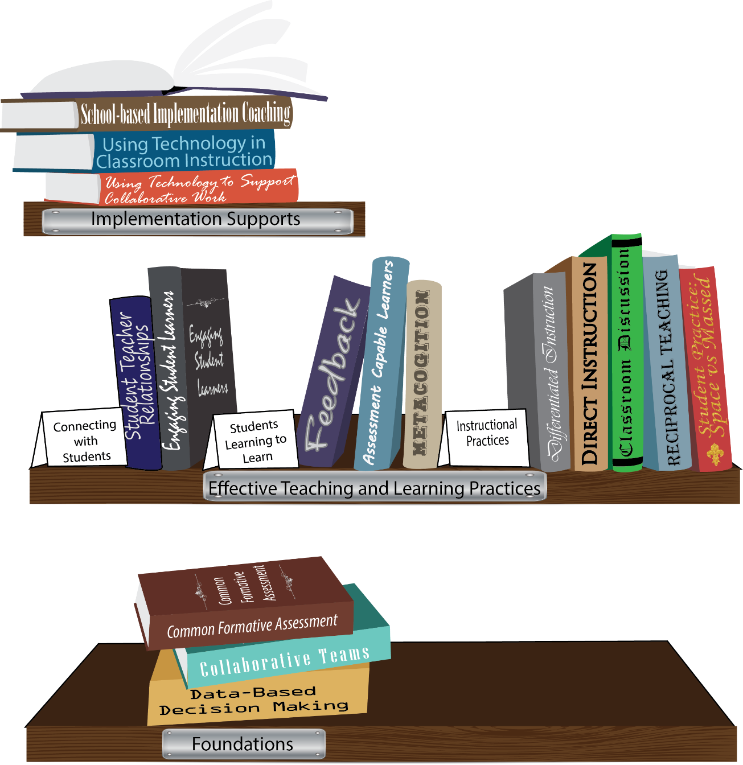
Notes:
To Know/To Say: Missouri’s professional development learning packages are organized in three categories: Foundations, Effective Teaching & Learning Practices, and Implementation Supports. All schools begin their professional development journey with the Foundations, as these learning packages provide foundation knowledge in three key areas: Common Formative Assessment, Collaborative Teams, and Data-Based Decision Making. Effective Teaching & Learning Practices encompass research-based instructional practices for deepened learning. These learning packages address ways of connecting with students, ways of helping students learn how to learn, and feature specific instruction practices. Implementation Supports are learning packages designed to help school staff support and enhance the Implementation of Effective Teaching & Learning Practices through using technology and peer coaching supports.
Let’s take a closer look at each of the packages using the charts in the Three Categories of Learning Packages handout.
To Do: Use the handouts to orally explain the structure of packages for the CW.
Handouts: CW Three Categories of Learning Packages handout with charted information pertaining to each package.
To Know/To Say: Continue to explain how the graphic depicts professional development in Missouri, using the charts in the handouts to explain each package as they align with the visual representation on this slide.

Slide 10
Why Use Effective Teaching/Learning Practices?
“To make teaching and learning visible requires an accomplished ‘teacher as evaluator and activator’, who knows a range of learning strategies to build the students’ surface knowledge, deep knowledge and understanding, and conceptual understanding”
(Hattie, 2012)
Notes:
To Know/To Say: Hattie argues that “when teaching and learning are visible, there is a greater likelihood of students reaching higher levels of achievement” (Visible Learning for Teachers, p. 18).
Hattie, J. (2012). Visible learning for teachers: Maximizing impact on learning. London, UK: Routledge.

Slide 11
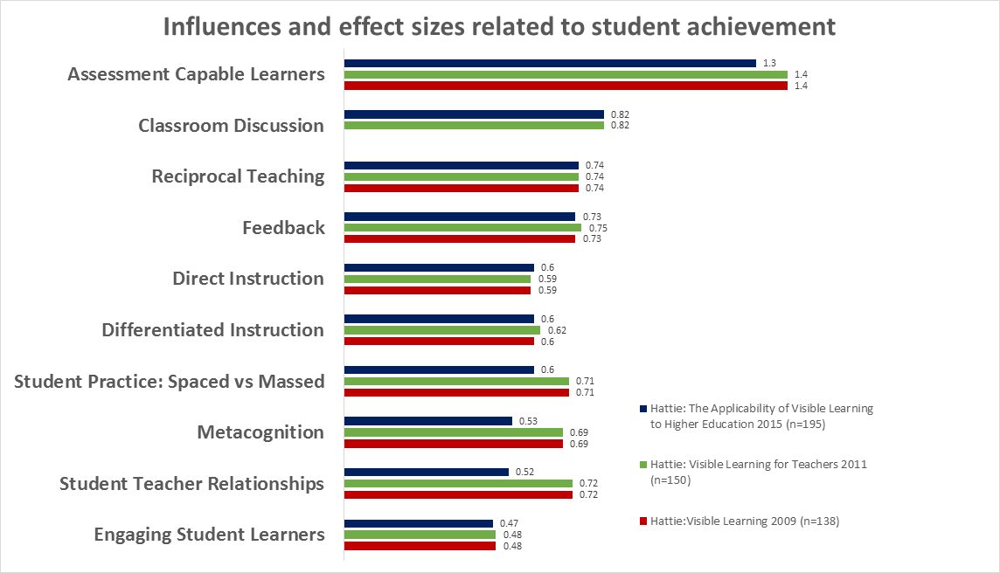
http://www.visiblelearning.org
Notes:
To Know/To Say: Learning packages for the effective teaching and learning practices were created for the CW. Some of the packages are depicted on this slide, with effect sizes indicated. As Dr. Hattie has conducted more research, the effect size data has changed slightly. The red line shows the effect size from Hattie’s 2009 analysis. The green shows effect size from 2011, and the blue shows the most recent results from 2015.
Next, we will look at some sample slides found in CW Learning Packages, using Assessment Capable Learners as the example.
Chart retrieved from http://www.visiblelearning.org

Slide 12
Assessment Capable Learners (Self-Reported Grades)
Definition
Hattie Barometer
Alignment to Missouri Teacher Standards
Practice Profile & Next Steps
Notes:
To Know/To Say: This section is an example of content found within each learning package. ACL is used as the example of an effective teaching and learning practice. Consultants can choose to replace this section with similar slides from a different effective teaching/learning practice.

Slide 13
Assessment Capable Learners (Self-Reported Grades) Definition
Assessment Capable Learners (Self-Reported Grades) is an effective teaching/learning practice and is defined as students regulating and facilitating their own learning by accurately and appropriately answering the following questions:
Where am I going?
Where am I now?
How do I close the gap?
Adapted from S. Brookhart, (2012); J. Chappuis (2009); J. Hattie (2012), and J. Atkin, P. Black, &J. Coffey, (2001).
Notes:
To Know/To Say: Self-Reported Grades involves students’ estimates of their own performance; students typically are accurate in understanding their achievement levels and chances of success.
Moss, C. & Brookhart, S. (2012). Learning targets: Helping students aim for understanding in today's lesson. Alexandria, VA: ASCD.
Chappuis, J. (2009). Seven strategies of assessment for learning. Boston, MA: Allyn & Bacon.
Hattie, J. (2012). Visible learning for teachers: Maximizing impact on learning. London, UK: Routledge.
Atkin, J. M., Black, P., & Coffey, J. (2001). Classroom assessment and the National Science Education Standards. Washington, DC: National Academy Press.

Slide 14
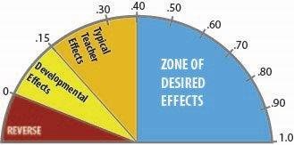
Assessment-Capable Learners (Self-Reported Grades)
(1.33 effect size)
Hattie, J. (2009). Visible Learning. New York: Routledge
Hattie, J. (2012). Visible Learning for Teaachers. New York: Routledge
Notes:
To Know/To Say: Of the 195 influences studied by Hattie, Self-Reported Grades ranked very high in its impact on student achievement with an effect size of 1.44 (Hattie, 2009), and most recently, an effect size of 1.33 (Hattie, 2015).
In his meta-analyses, the average effect size was d=0.40. According to Hattie (Visible Learning, p. 16), “This average summarizes the typical effect of all possible influences in education and should be used as the benchmark to judge effects in education.” On Hattie’s barometer, this is labeled as the “Zone of Desired Effects”.
“The typical effects from teachers are between d=0.15 and d=0.40 . . . . Any influences in this zone are similar to what teachers can accomplish in a typical year of schooling.” (Visible Learning, p. 20)
“The zone between d=0.0 and d=0.15 is what students could probably achieve if there was no schooling.” (Visible Learning, p. 20)
“The final category includes the reverse effects – those that decrease achievement.” (Visible Learning,. P. 20)
Hattie, J. (Ed.). (2009). Visible learning: A synthesis of over 800 meta-analyses relating to achievement. London, UK: Routledge.

Slide 15
Assessment Capable Learners (Self-Reported Grades) and Missouri Teacher Standards
Standard 2: Student Learning, Growth and Development
2.2: Student Goals
Standard 6: Effective Communication
6.4: Technology and media communication tools
Standard 7: Student Assessment and Data Analysis
7.2: Assessment data to improve learning
7.3: Student-led assessment strategies
(Missouri Department of Elementary and Secondary Education, 2013)
Notes:
To Know/To Say: Self-Reported Grades aligns with these Missouri Teacher Standards and Quality Indicators.
More detailed information about the Missouri Teacher Standards can be found at:
http://dese.mo.gov/eq/documents/TeacherStandards.pdf
http://dese.mo.gov/eq/Standards.htm
Partnership for 21st Century Skills
1 MASSACHUSETTS AVENUE NW, SUITE 700 WASHINGTON, DC 20001 (202) 312-6429
http://www.p21.org

Slide 16
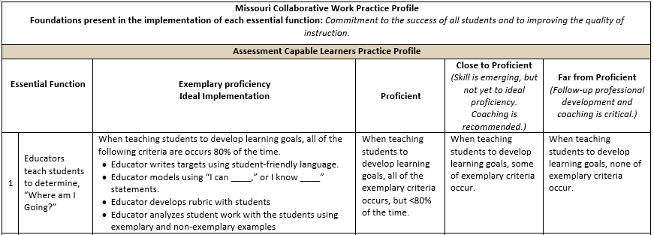
Assessment Capable Learners (Self-Reported Grades) Practice Profile
Notes:
To Know/To Say: Each package has a Practice Profile that describes the essential functions with descriptors of exemplary, proficient, close to proficient, and far from proficient implementation of practices. This tool is used by school level teams, teacher teams, and/or individual teachers to reflect on actual practice in relation to expectations for implementation.

Slide 17
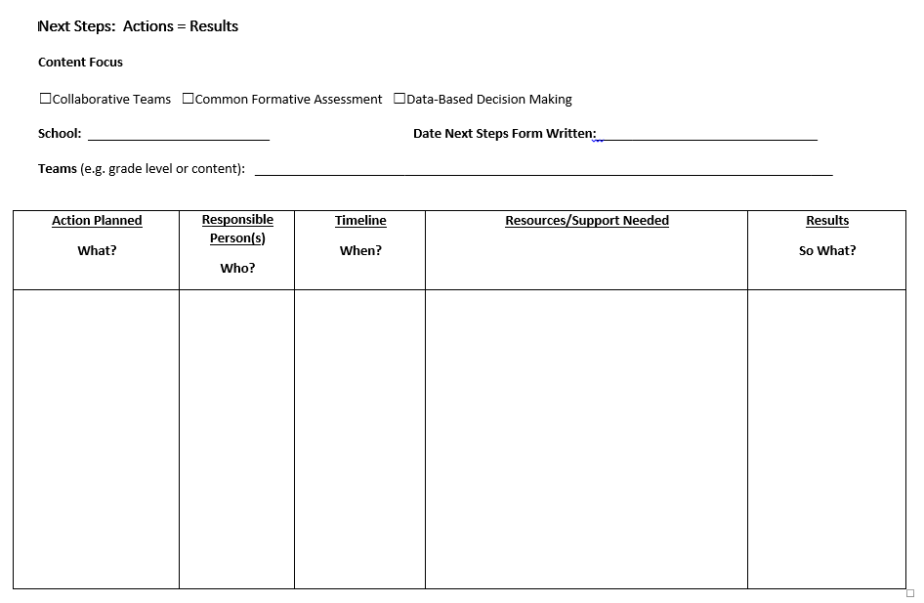
Next Steps: Action=Results
What steps will you take to start implementing?
Notes:
To Know/To Say: The example Next Steps template is provided in all packages for implementation planning. Presenters may use any format/tool for next steps planning, but planning must be included as part of the process within all packages.

Slide 18
Only when effective practices are fully implemented should we expect positive outcomes. Implementation matters.
(Blase & Fixsen, 2005)
Notes:
To Know/To Say: As you are starting to plan for the Effective Teaching/Learning Practices in your school, consider from the outset how you will monitor fidelity of implementation. By carefully monitoring fidelity of implementation, “implementation and fidelity drift” will be avoided.
Blase, K. A., Fixsen, D. L., Naoom, S. F., & Wallace, F. (2005). Operationalizing implementation: Strategies and methods. Tampa, FL: University of South Florida, Louis de la Parte Florida Mental Health Institute.
Blase, K. A., & Fixsen, D. L. (2005, Summer). The National Implementation Research Network: Improving the science and practice of implementation. American Psychological Association, CYF News, pp. 8-12.

Slide 19
The Teacher Will:
Select the appropriate teaching/learning practice that meets the instructional needs of all students in his/her classroom based on data.
Demonstrate proficiency (knowledge and skills) to implement the selected teaching/learning practice.
Implement the selected teaching/learning practice with fidelity.
Monitor learning and make changes to the teaching/learning practice as needed.
Notes:
To Know/To Say: When implementing an effective practice in the classroom, these are the steps that teachers will take.
Using student and classroom data, the teacher will select one of the practices that meets the needs of his/her students.
The teacher will receive training on the selected practice that will include a demonstration of proficiency.
The practice will be implemented in the classroom and monitored for fidelity.
The teacher will monitor data to make instructional changes as appropriate.

Slide 20
Teacher/Classroom Level
What data will teachers use to select the instructional practice for classrooms?
How will we know:
that teachers have proficiency in the instructional practice?
that the instructional practice is implemented with fidelity?
that appropriate changes are made based on data?
Notes:
To Know/To Say: Give participants time to reflect on the focus questions and share with a shoulder partner or in table groups.
As a follow-up the presenter may want to familiarize participant with DESE online CFA submission process and tool.

Slide 21
For further information or coaching please contact the presenter at:
Notes:
Presenter should add contact information here.

