Slide 1
LINK TO MOEDU-SAIL MATERIAL
http://www.moedu-sail.org/technology-classroom-instruction-materials/
or
goo.gl/5BCkTD

Slide 2
Survey before meeting…
Send out the attached survey to all participants prior to the training date.
The results can be used via tagxedo as an introduction to “where participants are currently at” in regard to technology- see slides 4-6
Notes:
Note to presenters: If questions arise regarding specific programs or websites being blocked at school districts, you need to defer those participants to look over their acceptable use policy and/or schedule a meeting with administrators and IT personnel. Since every district uses its own set of firewall settings, this isn’t something that the presenters would be able to address. Most acceptable use policies are incredibly broad and don’t go in depth about any specific programs or websites. Furthermore, some participants might comment about bandwidth or WiFi access being limited or slow in certain districts, or even limited amount of devices available for use in the classroom. Again, these are concerns that need to be addressed with the district administrators and IT personnel. This presentation provides an overview for technology integration as a means to improve teacher instruction for the 21st century, and may not address every concern that arises in regards to technology usage.

Slide 3
Participants need to bring
Laptop or Tablet
Pacing Charts
Missouri Learning Standards for their grade level
Notes:
For training on technology, it is important for participants to bring laptops or tablets to the training. Ask participants if they are a one-computer per classroom school or a 1:1 school, then you can tailor examples to meet the needs of your learners.

Slide 4

Using Technology in Classroom Instruction
Introductions
This work is licensed under a Creative Commons Attribution-NonCommercial-NoDerivatives 4.0 International License.
Notes:
Introduction of trainers.

Slide 5
Acknowledgements
Using Technology in Classroom Instruction was rolled-out for use by Regional Professional Development Center (RPDC) Consultants in July 2014. The collection of learning packages and infographics was developed through efforts funded by the Missouri State Personnel Development Grant (SPDG). The following individuals/groups are thanked immensely for their hard work in developing this package:
Content Development Expertise Stephanie Kuper, Southeast RPDC
Content Development Support UMKC Institute for Human Development:
Carla Williams
Ronda Jenson
Stefanie Lindsay
SPDG Management Team
Artwork UMKC Institute for Human Development:
Jodi Arnold

Slide 6
Norms
Be Respectful
  Be an active listener—open to new ideas
  Use notes for side bar conversations
Be Responsible
  Be on time for sessions
  Silence cell phones—reply appropriately
Be a Problem Solver
  Ask questions as needed to clarify concepts or directions

Slide 7
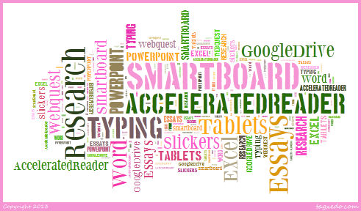
What technology do you currently use in your classroom?
Notes:
Note: This is a question that is from the survey sent prior to this training. This is an example of survey responses from Tagxedo. It can also be created using Wordle.
Quickly list a few of the most common answers. This serves as a platform for discussion about tech tools that people aren’t familiar with.
Idea taken from Larry Edelman

Slide 8

Tech Tools/Websites used Personally
Notes:
Note: This is a question that is from the survey sent prior to this training. This is an example of survey responses from Tagxedo. It can also be created using Wordle.
Quickly list a few of the most common answers. This serves as a platform for discussion about tech tools that people aren’t familiar with.
Idea taken from Larry Edleman

Slide 9

Tech Tools/Websites currently being used in Classrooms
Notes:
Note: This is a question that is from the survey sent prior to this training. This is an example of survey responses from Tagxedo. It can also be created using Wordle.
Quickly list a few of the most common answers. This serves as a platform for discussion about tech tools that people aren’t familiar with.
Idea taken from Larry Edleman

Slide 10
Learner Outcomes
Participants will:
Gain awareness of how the International Society for Technology in Education (ISTE) standards for teachers and students and the 21st Century Skills impact the implementation of technology in the classroom.
Examine the three pyramids for technology integration.
Begin planning for implementation of using technology in classroom instruction.
Notes:
International Society for Technology in Education (ISTE) Standards are the current technology standards for education.
The Framework for 21st Century Education is provided by the Partnership for 21st Century Education

Slide 11
Using Technology in Classroom Instruction Overview
Pre-assessment
Socrative.com
Student Login
Room Number:
Notes:
Give the pre-assessment at this point. Have participants use Socrative to complete the pre-assessment. Socrative is a free website, or a free app for tablets. Participants will click “Sign in as student” and enter the room number provided by the presenter. Before training, the presenter must set up his or her own Socrative account, which is free, and enter the assessment in the “create assessment” section. This will give the presenter a “room number” to give to participants. Simply select “Start quiz” and “student paced” for participants to quickly complete the pre-assessment.
After the pre-assessment, explain that this is similar to clickers in the classroom, but it is free. This is an especially good website to use in the classroom for 1:1 schools.

Slide 12
Why Use Technology in Classroom Instruction?

Slide 13
Why Technology?
“Using Technology with Classroom Instruction that Works”
Three-Part Task:
Task 1: Find three people not sitting at your table to form a group of four
Task 2: Number off 1-4 for silent reading
  Person 1 will read paragraph 1
  Person 2 will read paragraph 2 (with quote)
  Person 3 will read paragraph 3 & 4
  Person 4 will read paragraph 5 -end
Task 3: Summarize the research from your paragraph for the group. Then as a group, choose three of the best statements overall to write on the paper at your table.
Pitler, et. al. (2012). pp 2-4
Notes:
Using page 2-4 of Using Technology with Classroom Instruction that Works by Howard Pitler, et al. – Permission from ASCD is needed to print and distribute to participants.
Reference: Pitler, H., Hubbell, E. R., & Kuhn, M. (2012). Using technology with classroom instruction that works. ASCD.

Slide 14
Why Technology page 2-4
What’s wrong with this activity?
No Technology!!!!
Now that you’ve already read and summed up the paragraphs with your group, go to the class blog and individually answer the question: “Why Technology?”
Blog: http://kuperedtech.blogspot.com/
Notes:
Using page 2-4 of Using Technology with Classroom Instruction that Works. Now give participants time to navigate to the blog and post a comment to this blog. Participants can quickly and easily set up a free account at this time. This blog is an example created by Stephanie Kuper. Presenters at each RPDC might want to set up their own blog. Some other blogging options are listed on the next slide.
Reference: Kuper, S. (2014). Using Technology with classroom instruction that works [blog]. Retrieved from http://kuperedtech.blogspot.com/.

Slide 15



Why Blogs?
Blogging in the classroom:
  Student reflection on content
  All students are given a voice
  Content stays up for review
  Conversations can carry on past the lesson/unit
  Learning becomes 24/7
Notes:
Using a blog to have students post their discussion, questions, thoughts, etc. is especially beneficial because teachers have flexibility with assessing and ensuring that all students are participating in the discussion. Furthermore, this can be beneficial for students who need to go back and review the information before an upcoming quiz or test. A last benefit for using the blog format is that oftentimes a class discussion never continues outside of the classroom, but with a blog students can carry on the conversation for much longer.
Some participating schools might prohibit the use of blogging, considering it “social media”. I would direct teachers to their districts acceptable use policy, and possibly make a note to ask administrators or IT people about enabling the use of blogs for education.

Slide 16
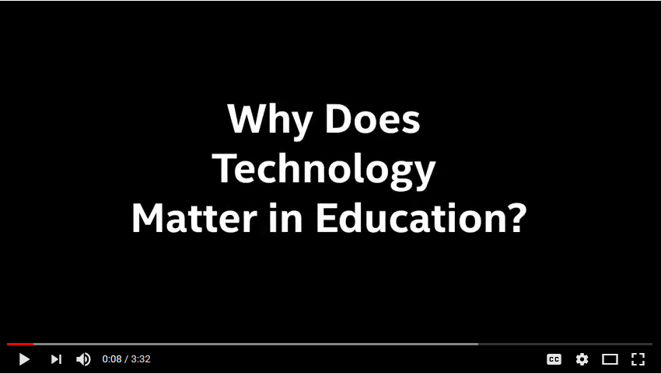
https://www.youtube.com/watch?v=hgfCGbBUtfQ
Notes:
Talk time: why is technology important as educators? Why is it important to expose students to multiple types of technology, not just computers, just iPads, just kindles, etc.? *Remember that the video states that we are preparing students for careers that don’t exist and using technologies that haven’t yet been invented. Therefore, the more exposure students have to different types of technology, the more knowledge students can pull from to apply towards new, unfamiliar technologies.
Reference: Semingson, P. (2015, April 5). Why does technology matter in education [video file]. YouTube. Retrieved from https://www.youtube.com/watch?v=hgfCGbBUtfQ.

Slide 17
Technology in Classroom Instruction Defined
The use of hardware and software to enhance and provide opportunities for critical thinking, communicating clearly, collaborative learning, creative thinking, and problem solving in the classroom.
Fish (2013)
Notes:
Fish, Jay (2013, November 7). Doniphan Elementary Principal, Doniphan R-I School District.

Slide 18


National Technology Standards
http://www.iste.org/standards/for-educators
http://www.iste.org/standards/nets-for-students
Notes:
Presenters can quickly go the links at the bottom of the slides to show participants a sample of the standards for using technology. These can also be printed off and given to participants for further reading. The focus of the presentation is to help participants implement technology, so they just need to be aware of the existence of these standards.
Bring participants attention to the ISTE standards for students, three of the six listed are “Communication & Collaboration, Creativity & Innovation, and Critical Thinking.” These are the “Four C’s of 21st Century Skills” that was mentioned in the pre-assessment. These Four C’s are directly embedded into both the Common Core Standards and the ISTE Technology Standards.
These standards are provided by the International Society for Technology in Education
References:
International Society for Technology in Education (2017). ISTE standards for educators. Retrieved from http://www.iste.org/standards/for-educators.
International Society for Technology in Education (2017). ISTE standards for students. Retrieved from http://www.iste.org/standards/nets-for-students.

Slide 19
Today’s Meet:
The Critical Question
Todaysmeet.com/rpdc
What do students
need to learn
to be successful
in the 21st Century?
Notes:
One or two days prior to training, create a forum on todaysmeet.com. This is a website for participants to access quickly and easily to post discussion instead of actually sharing out. The address above is an example of what you might want to call your meeting space. On today’s meet, you create a free forum and title it whatever you’d like. For example, rpdc might be what you want title your forum, so the URL address would be todaysmeet.com/rpdc.
Allow approximately 5 minutes for participants to post answers to the question on todaysmeet.com.

Slide 20
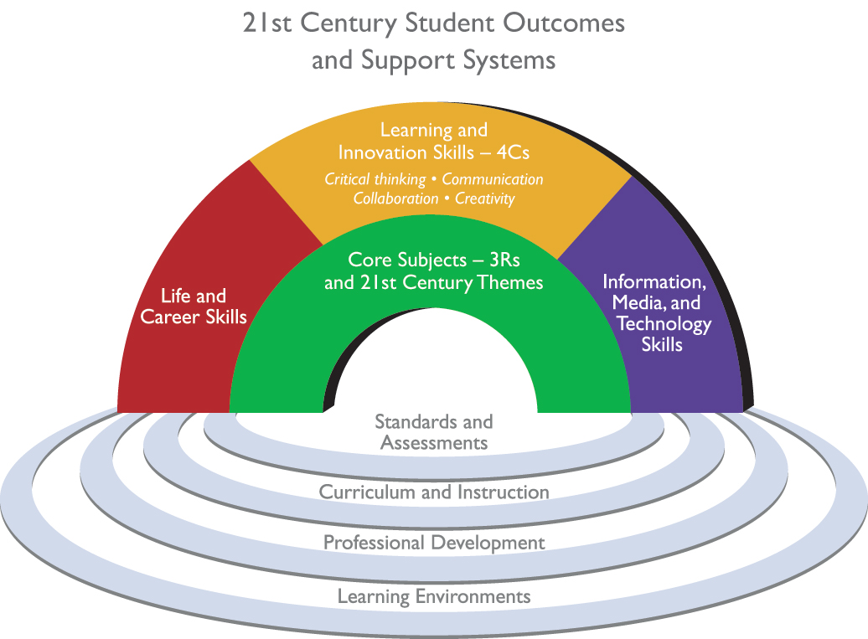
P21 (n.d.)
Notes:
This is the Framework of 21st Century education. This model answers the questions “What do students need to be successful in the 21st century?”
Life and career skills
Learning and innovation skills
Information, Media, and Technology skills
And these three should all be embedded in the core subjects (three Rs= reading, writing, arithmetic)
Our focus for this training will be on 1. Learning and Innovation Skills, and 2. Information, Media, and Technology Skills in the Core subjects.
The Focus of this module “Using Technology in the Classroom” will be on the Learning and Innovation Skills and Information, Media, and Technology Skills.
The Framework presents a holistic view of 21st century teaching and learning that combines a discrete focus on 21st century student outcomes (a blending of specific skills, content knowledge, expertise and literacies) with innovative support systems to help students master the multi-dimensional abilities required of them in the 21st century and beyond.
The key elements of 21st century learning are represented in the graphic and descriptions below. The graphic represents both 21st century student outcomes (as represented by the arches of the rainbow) and 21st century learning support systems (as represented by the pools at the bottom).
This model comes from p21.org. The Partnership for 21st Century Skills, whose mission is “to serve as a catalyst to position 21st century readiness at the center of US K12 education by building collaborative partnerships among education, business, community and government leaders.”
Reference: Partnership for 21st Century Learning [P21] (n.d.) Framework for 21st century learning. Retrieved from http://www.p21.org/our-work/p21-framework.

Slide 21
21st Century Skills
Learning & Innovation
  Critical Thinking & Problem-solving
  Creativity & Innovation
  Communication
  Collaboration
Information, Media, and Technology
Information Literacy
Media Literacy
ICT Literacy
P21 (n.d.)
Notes:
Partnership for 21st Century Skills drills those three necessary components for 21st Century education down a bit further.
Learning and innovation focuses on the 4 Cs listed in gold
Information, Media, and Technology focuses on the skills in blue
*ICT stands for Information, Communication, Technology.
Reference: Partnership for 21st Century Learning [P21] (n.d.) Framework for 21st century learning. Retrieved from http://www.p21.org/our-work/p21-framework.

Slide 22
4 C’s of Learning and Innovation Skills
The four C’s are important for students to learn as they prepare for 21st Century careers
Learning & Innovation
  Critical Thinking & Problem-solving
  Creativity & Innovation
  Communication
  Collaboration
P21 (n.d.)
Notes:
The teacher should model these four skills and provide ample opportunities for students to demonstrate while using technology.
Reference: Partnership for 21st Century Learning [P21] (n.d.) Framework for 21st century learning. Retrieved from http://www.p21.org/our-work/p21-framework.

Slide 23
Critical Thinking & Problem Solving: What it means
Students reason effectively, use systems thinking and understand how parts of a whole interact with each other.
They make judgments, decisions and solve problems in both conventional and innovative ways.
P21 (2011)
Notes:
Reference: Partnership for 21st Century Learning [P21] (2011). 21st Century skills map designed in cooperation with the nation’s math educators [PDF]. Retrieved from http://www.p21.org/storage/documents/P21_Math_Map.pdf.

Slide 24
Communication: What it means
Students know how to articulate thoughts and ideas effectively using oral, written and nonverbal communication.
They listen effectively to decipher meaning, such as knowledge, values, attitudes and intentions, and use communication for a wide range of purposes in diverse teams and environments.
P21 (2011)
Notes:
Reference: Partnership for 21st Century Learning [P21] (2011). 21st Century skills map designed in cooperation with the nation’s math educators [PDF]. Retrieved from http://www.p21.org/storage/documents/P21_Math_Map.pdf.

Slide 25
Collaboration: What it means
Two or more students cooperate in a learning experience to share and contribute to each member's understanding of a topic and to complete a given task.
P21 (2011)
Notes:
Reference: Partnership for 21st Century Learning [P21] (2011). 21st Century skills map designed in cooperation with the nation’s math educators [PDF]. Retrieved from http://www.p21.org/storage/documents/P21_Math_Map.pdf.

Slide 26
Creativity and Innovation:
What it Means
Students use a wide range of techniques to create new and worthwhile ideas, elaborate, refine, analyze and evaluate their own ideas in order to improve and maximize creative efforts, and demonstrate originality and inventiveness, in both an individual as well as group settings.
P21 (2011)
Notes:
Reference: Partnership for 21st Century Learning [P21] (2011). 21st Century skills map designed in cooperation with the nation’s math educators [PDF]. Retrieved from http://www.p21.org/storage/documents/P21_Math_Map.pdf.

Slide 27
Processing the Four Cs
What do you currently do to encourage the four Cs in your classroom?
Critical Thinking
Communication
Collaboration
Creativity
Todaysmeet.com/rpdc
Notes:
Give participants time to brainstorm how they use the Four Cs in their classroom. Either have participants write ideas on paper or post-it notes to share out, or create a blog for participants to respond to. Using a blog allows participants to have access to those ideas after the meeting. Blogspot.com by Google is an excellent choice.

Slide 28

P21 (n.d.)
Notes:
Now we are going to move into the Information, Media, and Technology Skills to support the Core subjects.
Reference: Partnership for 21st Century Learning [P21] (n.d.) Framework for 21st century learning. Retrieved from http://www.p21.org/our-work/p21-framework.

Slide 29
Information, Media, and Technology Skills
The Information, Media, and Technology
skills are important for students to learn as they prepare for 21st Century careers
Information, Media, and Technology
Information Literacy
Media Literacy
ICT Literacy
Notes:
The teacher should model these three skills and provide ample opportunities for students to demonstrate using technology.
*ICT stands for Information, Communication, and Technology

Slide 30
Information, Media, and Technology Skills : What it means
Information Literacy: Students are able to access and evaluate information effectively and use and manage that information purposefully for the issue or problem at hand.
  Students exhibit awareness and application of knowledge on the ethical/legal issues surrounding the use of information.
P21 (2011)
Notes:
Reference: Partnership for 21st Century Learning [P21] (2011). 21st Century skills map designed in cooperation with the nation’s math educators [PDF]. Retrieved from http://www.p21.org/storage/documents/P21_Math_Map.pdf.

Slide 31
Information, Media, and Technology Skills : What it means
Media Literacy: Understanding how, why, and for what purposes, media messages are constructed, and how individuals interpret messages differently.
  Students create media utilizing the most appropriate media creation tools, characteristics and conventions in diverse, multi-cultural environments.
P21 (2011)
Notes:
Reference: Partnership for 21st Century Learning [P21] (2011). 21st Century skills map designed in cooperation with the nation’s math educators [PDF]. Retrieved from http://www.p21.org/storage/documents/P21_Math_Map.pdf.

Slide 32
Information, Media, and Technology Skills : What it means
Information, Communications, and Technology Literacy: Students use digital technologies to manage, integrate, evaluate and create information, and to apply technology effectively, using it as a tool to research, organize, evaluate and communicate.
P21 (2011)
Notes:
Reference: Partnership for 21st Century Learning [P21] (2011). 21st Century skills map designed in cooperation with the nation’s math educators [PDF]. Retrieved from http://www.p21.org/storage/documents/P21_Math_Map.pdf.

Slide 33
Processing the Information, Media, and Technology Skills
What do you currently do to encourage Information, Media, and Technology Skills in your classroom?
Information Literacy
Media Literacy
ICT Literacy
Todaysmeet.com/rpdc
Notes:
Give participants time to brainstorm how they use the digital literacy skills in their classroom. Either have participants write ideas on paper or post-it notes to share out, or create a blog for participants to respond to. Using a blog allows participants to have access to those ideas after the meeting. Blogspot.com by Google is an excellent choice.

Slide 34
Integrating Technology in Classroom Instruction

Slide 35
Three Pyramids for Technology Integration
Ease of Use (Teachers & Students)
Age Appropriate-ness
Digital Citizenship Issues
Notes:
Three Pyramids to drive technology integration

Slide 36

Ease of Use
Technology chosen needs to be a challenge for students.
However, students and teachers need to be able to figure the program out with a reasonable amount of ease.
If you need to spend a significant amount of time showing students how to use the application, make sure this is a program or application that students will use multiple times.
Notes:
Slides 35-38 can be presented fairly quickly. This doesn’t need a lot of processing time.

Slide 37
Successful Implementation
The most successful plan for technology will try to include both familiar and unfamiliar technology applications for students.
We should strive to teach students new tricks for old tools and new tools for new tricks!
Why?
Notes:
Give participants a few moments to contemplate, and then ask for some suggestions.
Answer: If we are preparing students for jobs not yet created, and to use technology not yet invented, then we need to teach kids how to use a variety of technology applications so they have a wider knowledge base to work with.

Slide 38

Ease of Use- Teachers
Teachers need to feel comfortable with the technology they are using in their classrooms. If students encounter problems, teachers need to be able to trouble shoot and resolve the issue.
Therefore, take into consideration the ease of use for the teachers involved.
This can be very subjective based on
the teachers in a building, so be
mindful of your staff when selecting
programs or applications.

Slide 39

Ease of Use- Students
Remember that students are usually quick to learn technology, so you might not need to walk students through using every single button.
Encourage students to “explore on their own”- that is the quickest way for them to learn a program.
If it is going to take longer to show students how to use the application than the task
itself, maybe you should consider a
more user friendly alternative.

Slide 40
Digital Citizenship
What is Digital Citizenship?
Digital citizenship is the norms of appropriate, responsible technology use. Too often we are seeing students as well as adults misusing and abusing technology but not sure what to do. The issue is more than what the users do not know but what is considered appropriate technology usage.
Rible (2017)
Notes:
Ask participants to post on today’s meet their personal definition of digital citizenship. Then click to take away the blue square to reveal the definition of Digital Citizenship. Ask participants why it is important to teach digital citizenship to students.
Reference: Ribble, M. (2017). Digital citizenship: Using technology appropriate [web page]. Retrieved from http://www.digitalcitizenship.net/.

Slide 41
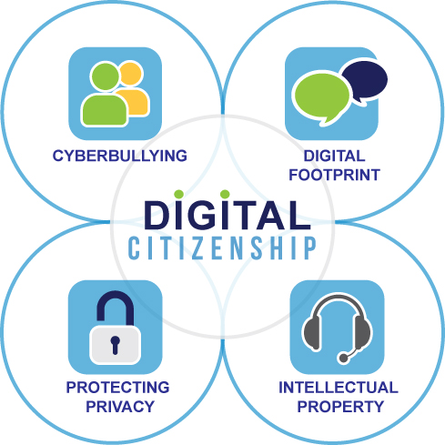
Four Areas of Digital Citizenship
EGUSD Digital Citizenship (2017)
Notes:
Ask participants and move into groups of four and number off 1-4. (1-Cyberbulling; 2-Digital Footprint; 3- Protecting Privacy; 4-Intellectual Property). Individually ask participants to first write a definition their topic and then explain why it is important to teach students about this topic.
[Example, Intellectual property could be defined as material that a person has put time and effort to create, like a blog, for instance. While it is available to read on the internet, it isn’t right to copy and paste the text of a blog and pass it off as one’s own work. It is important to teach students so they won’t run in to copyright issues.]
Reference: EGUSD Digital Citizenship (2017). EGUSD digital citizenship: Resources for 21st century teaching and learning [blog post]. Edublogs Campus. Retrieved from: http://blogs.egusd.net/digitalcitizenship/about/.

Slide 42
Digital Citizenship Pledge
I will not share personal information about myself or others such as home address, telephone number or age.
I will not use bad language including acronyms or abbreviations.
I will not have conversations or create posts that would be inappropriate in the classroom.
I will not threaten, insult, gossip, tease or be mean to others.
I will not add pictures or videos that would not be appropriate to share in the classroom.
I will respect the feelings and ideas of others.
I will flag inappropriate content I find.
I will not share my login information with anyone or allow anyone else to use my account because I will be held responsible for anything that they do.
I will not spam others.
I will try to use correct grammar and spelling.
I understand that using ALL CAPITALS is considered yelling and may offend others.
I will check with my teacher when I have questions about any of the rules.
My Big Campus (2013)
Notes:
Provide this digital citizenship pledge as a handout for participants. This is just a sample pledge that participants could use. For PBS Schools, they might take time to make these positive statements instead of using the words “I will not…” Also, participants might want to create their own pledge for their schools, or work with a team of teachers and students to create one that fits their school best.
Give participants time to read over the pledge and ask if they feel anything has been left out or if something should be omitted.
Reference: My Big Campus (2013, October 15). My big campus digital citizenship pledge [blog post]. Retrieved from http://digitalcitiz.blogspot.com/.

Slide 43
Digital Citizenship by Grade Level
4th Grade | 8th Grade | 12th Grade
Understand when technology will enhance their learning. Make practical decisions in selecting the use of technology. Illustrate respect for others online. Act with respect for others when using cellular phones, text messaging, and digital cameras. | Apply responsible research practices to avoid plagiarism. Understand the global nature of technology and understand the sensitivity of information posted electronically. | Make responsible decisions about use of material based on the rules of intellectual property, copyright, and plagiarism. Take responsibility for personal comm. and websites. Be aware of fraudulent practices and threats to personal information. Understand the implication of technology for their future careers.
Partnership for 21st Century Skills (2004)
Notes:
Take a moment and go over these expectations of digital citizenship by grade-level.
4th grade:
Not every assignment needs technology, help students to understand when to use and when not to use technology.
Instead of telling students to go to PowerPoint, assign students to “create a presentation”- some might choose Microsoft PowerPoint, others might choose Prezi, other might choose Google Slides. It’s alright to allow students to have the freedom to choose which program fits best for their learning outcome.
Especially address respect for people when using blogs in the classroom (no demeaning of other students’ ideas, etc.)
Address what is and is not acceptable use of these devices.
8th Grade-
Research and Plagiarism needs to be taught as young as the 8th grade, if not younger.
Again talk to students about posting personal information and how anyone has access to even your “private” Facebook account. Never give out your address, phone number, or SS number online!
12th Grade-
Really hit on Copyright, intellectual property, etc.
Students are responsible for anything they say online, whether it is a personal website, personal Facebook page, or a comment bad mouthing a product they purchased from Amazon. What is and is not ok?
Going a step past plagiarism is fraudulent practices and threats on the internet, Spamming another person, sending viruses, etc.
Students sometimes have a hard time understand that pictures and comments being made on Facebook can be seen by many people, despite privacy settings. Student athletes have been taken off teams because of inappropriate pictures on social media sites. Things like this can even sway potential employers in the future.
Reference: Partnership for 21st Century Skills (2004). 4th grade 8th grade 12th grade [PDF]. Learning skills for interpersonal and self-directional skills: Social Responsibility. pp. 10. Retrieved from http://docplayer.net/21730727-4th-grade-8th-grade-12th-grade.html.

Slide 44






Determining Age Appropriateness
Notes:
When you look at specific programs or applications to download and begin using, always consider age appropriateness.

Slide 45
Determining Age Appropriateness
The next few slides contain websites or programs that are useful in education.
Briefly describe the website or program using the description in the notes, and then ask participants at which grade level that would recommend the website or program.
These are all programs the participants can spend time on their own learning.
Notes:
Note: Presenters can spend time learning these website tools if unfamiliar. Remember, the point of this exercise if for participants to determine age appropriateness, not to train participants on the websites. These are just sample programs/websites that teachers can implement.

Slide 46
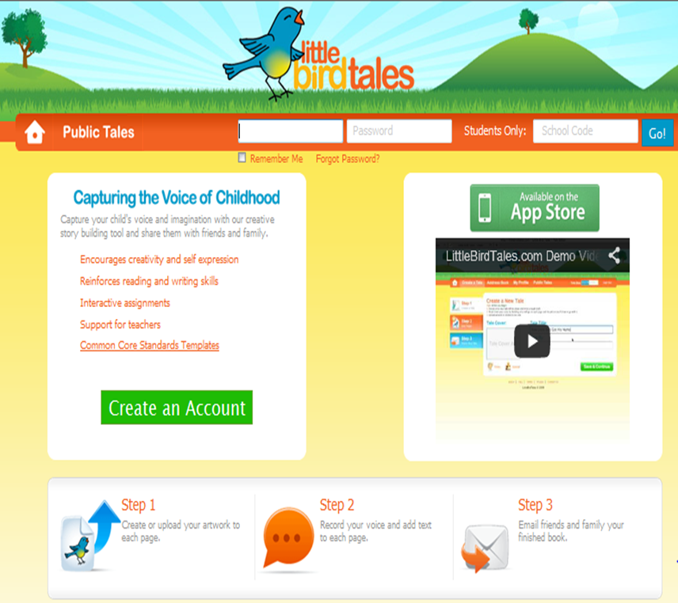
Little Bird Tales
Elementary
https://littlebirdtales.com/
Notes:
Little Bird Tales is a free website where students can create digital stories. Little Bird Tales walks users through each step of creating a multimedia story. Users can upload images, draw images, or record from their webcams. Stories can be written with text or narrated by students using microphones connected to their computers.
Think-pair-share: Ask participants which level they would suggest this website.
This website would be most suitable for young students, elementary and even early middle school level- allow participants to justify their reasons if different.

Slide 47
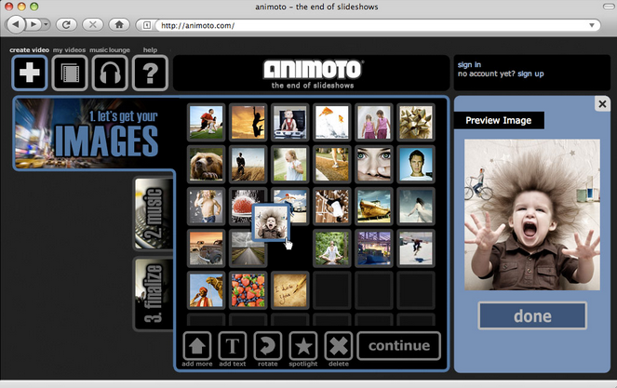
Animoto
Middle, HS, Teachers
https://animoto.com/
Notes:
Show participants that Animoto is free moviemaking video website. Teachers can create free accounts for self or student use. Users upload images to Animoto, rearrange pictures, add text, add music from Animoto’s library, and then finalize. At that point Animoto put the video together matching transitions to the tempo of the music selected for you.
Think-pair-share: Ask participants which level they would suggest this website.
This website could easily be used by teachers, high school, middle, and even elementary (depending on the rigor of the assignment)- allow participants to justify their reasons if different.

Slide 48
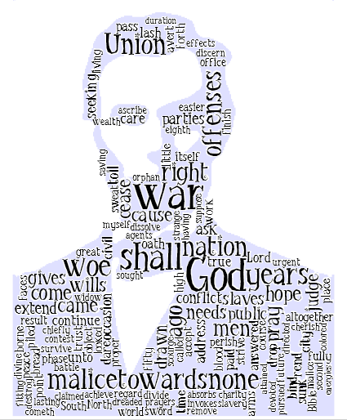
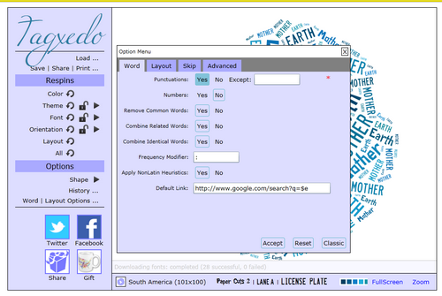
Wordle/Tagxedo
Teachers & All Grades
http://www.tagxedo.com/
http://wordle.net
Notes:
Wordle and Tagxedo are both free websites to create original word clouds. Users add text, designate font and color preferences, and watch their words come to life.
Think-pair-share: Ask participants which level they would suggest this website.
This website is recommended for use by teachers, or students in high school, middle school, or elementary students.

Slide 49

Comic Master
Upper Elementary- HS
Notes:
Comic Master is an online comic creator. It is geared toward students use with a fun look and an embedded music player. Using the Graphic Novel Creator, students can create their own multi-page graphic novels with interesting backgrounds, characters, props, and customized text. The graphic novels can be saved and printed out.
Think-pair-share: Ask participants which level they would suggest this website.
This website could easily be used by teachers, high school, middle, and even elementary - allow participants to justify their reasons if different.

Slide 50
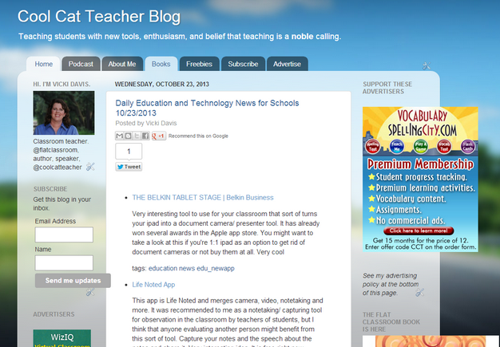
Blogspot
Middle School-HS & Teachers
https://www.blogspot.com
Notes:
Blogspot is an online Blogging website provided by Google that quickly and easily allows users to design and create blogs to post publically.
Think-pair-share: Ask participants which level they would suggest this website.
This website is recommended for use by teachers, or students in high school or some middle school

Slide 51
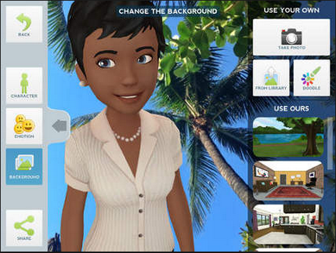
Tellagami
Teachers & All Grades
https://tellagami.com/
Notes:
Tellagami is the newest animation video creating tool. A lite version of the former “Extranormal Videos”, Tellagami allows users to create a character, alter his or her appearance and setting, and then use a microphone to speak text.
Think-pair-share: Ask participants which level they would suggest this website.
This website is recommended for use by teachers, or students in high school, middle school, or some elementary students.

Slide 52
Application to Classroom Instruction
Putting the Pieces Together
What does this look like in the classroom?

Slide 53
Putting the Pieces Together
Missouri Learning Standards
Framework for 21st Century Education
  Learning and Innovation Skills
  Information, Media, and Technology Skills
Three Pyramids
  Ease of Use
  Digital Citizenship
  Age Appropriateness
Notes:
This is just a review of all the components discussed.

Slide 54
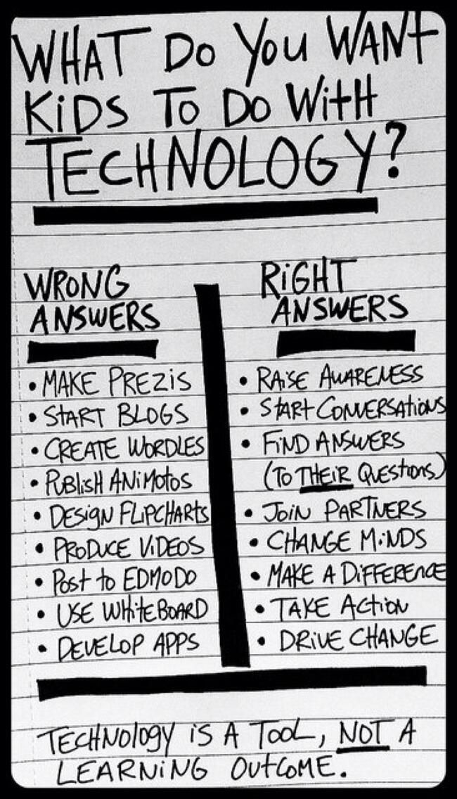
Notes:
It isn’t about what technology tool or program is being used. It is all about the skills being used, the level of rigor the skills are being used at, and the expectations of the outcomes.
Remember, technology changes so rapidly. Specific programs such as Prezi, Wordle, Animoto, and Edmodo can quickly become outdated.

Slide 55
Effective Use of Technology in Classroom Instruction
Task A:
Get into groups of four.
Using whatever technology is available to you, create one hand written list of the 50 states and capitals in alphabetical order.
Notes:
Give participants approximately 5-10 minutes to work on this task. They don’t have to complete all fifty states, that isn’t the goal. You just need a sample for participants to get the idea.

Slide 56
Effective Use of Technology in Classroom Instruction
Task B:
  Individually, list three criteria that would make a state a perfect home.
  Share your criteria with your team and categorize the criteria into social studies terms: (climate, economics, etc.).
  Then search for the state that meets that criteria using whatever technology available.
  Identify the best state based on your criteria.
Notes:
This may take 10-15 minutes.
Tell participants that the State of Missouri is being closed for the next four years for road repair. They need to decide which state they want to move to. Then have them begin task B. Keep the group moving so they don’t get off topic.

Slide 57
Effective Use of Technology in Classroom Instruction
Which task was more rigorous?
Which task did you enjoy more?
Which task made better use of technology?
Notes:
Which task was more rigorous?
Participants should see that Task B challenged them more. The thinking stopped in Task A once participants found a website that had all fifty states listed in order. Task B required participants to continue thinking throughout the whole activity.
Which task did you enjoy more?
Student activities should be both rigorous and relevant to students. Now that there have been a few minutes since they completed Task A, ask how many people could still list all of the states in alphabetical order with the capitols. Probably not many. Ask how many could tell you what three criteria they came up with, and which state best matched that criteria, many more would be able to answer. Students need to see the learning objective as being a “real world” problem.
Which task made better use of technology?
Remember Task A could have been accomplished without using technology at all. Task A required one quick search on Google to find a website, whereas Task B required multiple searches, reading of websites to find information, and evaluate how well the information aligns to the original criteria.

Slide 58
Which task is linked to a Missouri Learning Standard?
Categorizing
Academic Vocabulary
Using technology for research
Collaborating to speak and listen to others
Notes:
Note: memorizing all fifty states and capitols in alphabetical order is not a standard for the majority of states in the US. Task A did use technology to research, and collaboration with your group, but was it effective? Was technology required? –No! Did everyone HAVE to participate? –No!
Task B does meet all of these standards.

Slide 59

Which task is linked to the 21st Century Standards?
Learning & Innovation
  Critical Thinking & Problem-solving
  Creativity & Innovation
  Communication
  Collaboration
Information, Media, and Technology
Information Literacy
Media Literacy
ICT Literacy
Task B:
Critical Thinking
Communication
Collaboration
Information Literacy
ICT Literacy
Task A:
Communication
ICT Literacy
Notes:
Task A links to:
Communication
ICT Literacy
Task B Links to:
Critical Thinking
Communication
Collaboration
Information Literacy
ICT Literacy

Slide 60
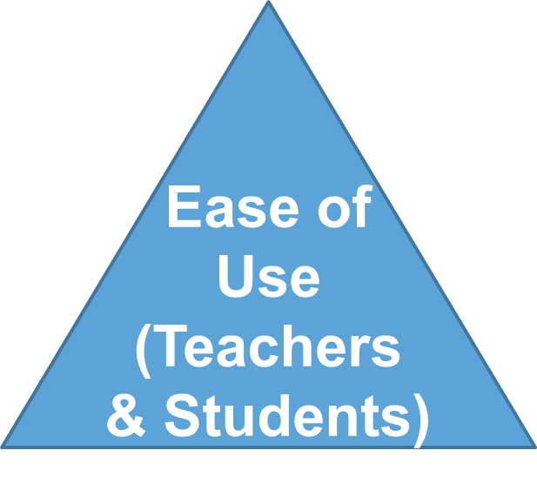
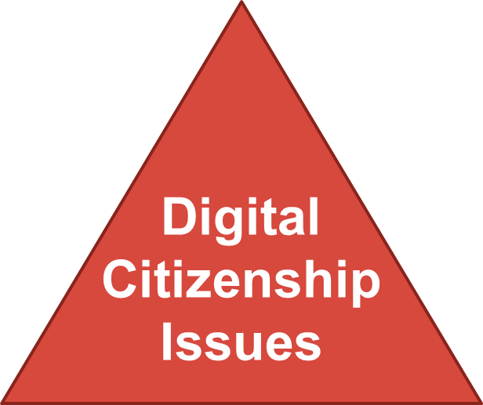
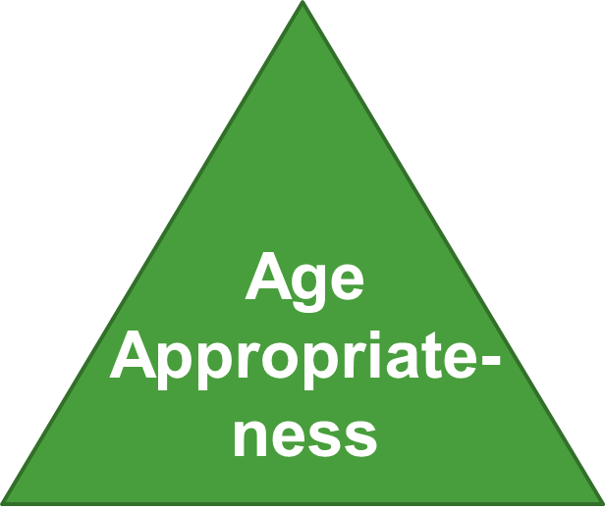
Three Pyramids for Technology Integration
Did the tasks require trouble shooting for using the technology asked? Could both students and teachers use the tools needed?
What Digital Citizenship issues could and should be addressed in this lesson?
At what grade level would a task like this be appropriate?
Notes:
The ease of both tasks above was at a level that even the novice student and teacher users would be able to complete. Trouble-shooting for a task such as these might be help typing in searchable terms or choosing which links to click on after the search is complete.
Digital Citizenship issues might be how to assess if content is valuable, correct, or biased. Using correct searchable terms that won’t bring up inappropriate material. Not giving out information in surveys or pop-ups.
The content would lend itself to fourth or fifth grade, but research could be done at even earlier grade levels.

Slide 61
Planning Effective Use of Technology
Missouri Learning Standard/Learning Objective
  Instructional Practice
    Technology Tool
      21st Century Skills
        Three Pyramids
Notes:
Teachers should start first with the MLS they are working with, then an instructional strategy they’d like to work with, next select a technology tool that could meet all of those necessary components, then identify the 21st Century Skills met, and finally check the three pyramids for alignment.

Slide 62
Grade 5 Math Example
Missouri Learning Standard- NBT.B.6 & 7 (division of decimals)
Instructional Practice- Formative Assessment/Assessment Capable Learners/Feedback
Technology Tool- iPad App Explain everything for $2.99
21st Century Skills- Communication, Critical Thinking, Information Literacy, ICT Literacy
Three Pyramids- easy to use and set up, opportunity to discuss the importance of leaving other students’ work saved on the device and not delete, appropriate for all grades
Notes:
The iPad app explain everything is the option that is used in the example of the next slide. A free app that would also work is called “Educreations”.

Slide 63
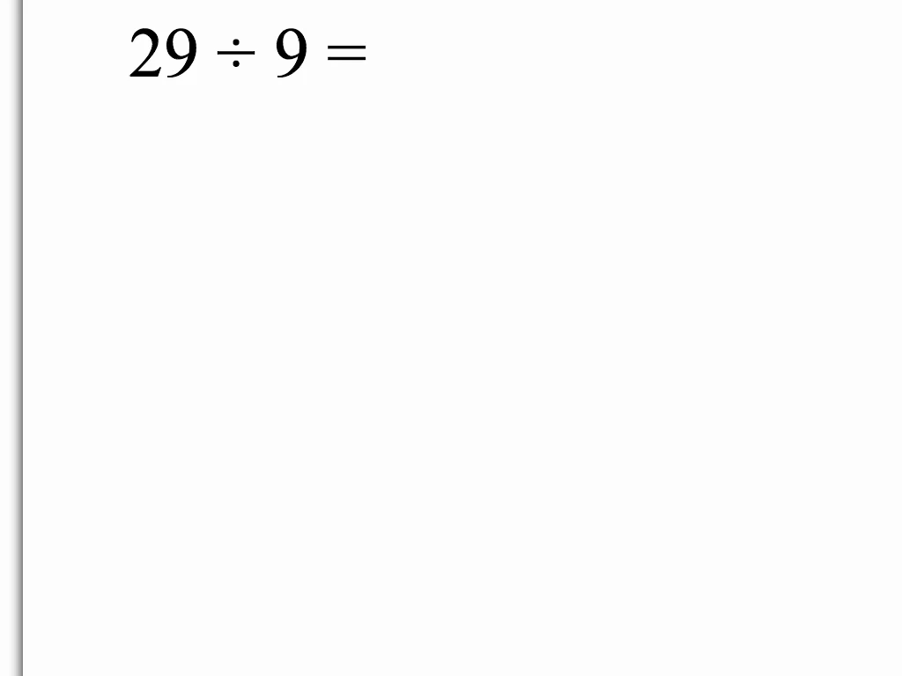
Grade 5 Math Example
Click the image to begin the video
Notes:
Click the image to begin the video. Is the problem solved correctly? – Yes. If a student turned this finished product in to the teacher, he or she would receive all credit.
What opportunity does using this piece of technology allow teachers? – We are able to see misconceptions and vocabulary that the students doesn’t understand.
Point out:
The student started off saying “nine divided by 29,” which is a very different equation.
Then it was obvious she didn’t know her multiple of nine.
Finally, she called the decimal point a period.

Slide 64
ELA Example
(Could be grade 4+ in English, History, Science)
Missouri Learning Standard- Multiple
Instructional Practice- Summative Assessment/Assessment Capable Learners/Feedback
Technology Tool- Google Sites (other technology embedded in this website includes Prezi, YouTube, and Google Drive)
21st Century Skills- Communication, Critical Thinking, Collaboration, Creativity, Information Literacy, ICT Literacy
Three Pyramids- Moderately easy to use and set up, opportunity to discuss main components of digital citizenship, appropriate for all grades

Slide 65
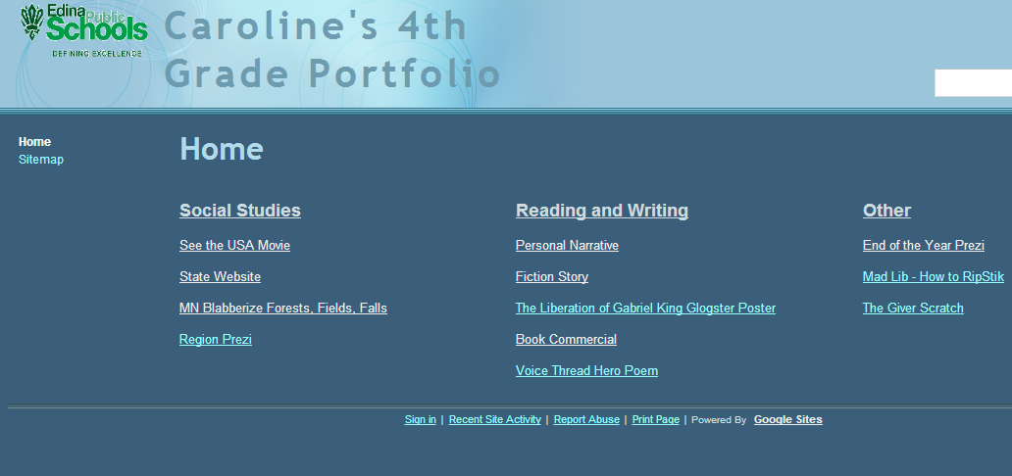
ELA Example
(Grade 4 Portfolio on Google Sites)
https://sites.google.com/a/apps.edina.k12.mn.us/caroline-s-4th-grade-portfolio/
Notes:
You can navigate to the 4th grade Portfolio by clicking on the hyperlink or the image.
Once you are on the site, you can click on the links below to show participants.
Things to point out:
USA Movie is a link to YouTube
State Website is a collaborative website Caroline completed with a group of students.
Blabbarize uses a free website.
Personal Narrative and Fiction story link to her Google Docs
Book Commercial is a group assignment
Voice thread assignment uses the free website to record an original poem
End of the year Prezi reflects on all work
The Giver Scratch uses a free website to reflect on the novel “The Giver”
And all of this is completed by a fourth grade student!!
Reference: Edina Public Schools (n.d.). Caroline’s 4th grade portfolio [web page]. Retrieved from https://sites.google.com/a/apps.edina.k12.mn.us/caroline-s-4th-grade-portfolio/.

Slide 66
Your turn…
Pull out your Missouri Learning Standards and Pacing Guides
Choose a standard(s)
Choose an instructional strategy
Research/brainstorm technology tools
Identify 21st Century Skills practiced
Check three pyramids for alignment and opportunities for teaching digital citizenship.
Notes:
This is the process participants will complete to implement technology. Give participants time to complete the process for one standard. (10-15 minutes would be ideal) Then ask participants to share out.
This activity can be completed in small groups.

Slide 67
Technology in Classroom Instruction
Implementation

Slide 68
The Teacher Will:
Model and create opportunities for students to demonstrate effective critical thinking, communication, collaboration, and creativity skills using technology.
Select the appropriate technology tool that meets the instructional needs of all students in his/her classroom considering ease of use, and age of students.
Model and communicate expectations of digital citizenship continuously during the instruction of each technology tool.
Demonstrate personal proficiency (knowledge and skill) to implement instructional technology tools.
Monitor learning and make changes to the instructional technology tools as needed.

Slide 69
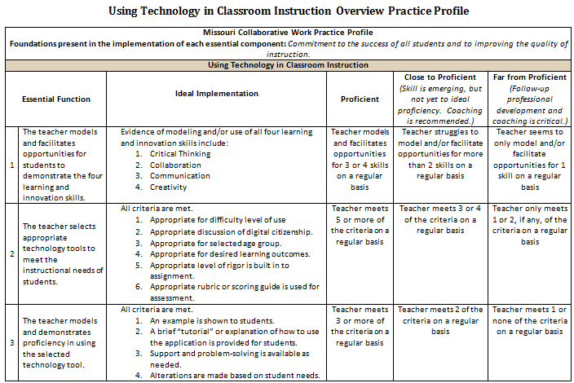
Practice Profile
Notes:
Review Practice Profile with participants.

Slide 70
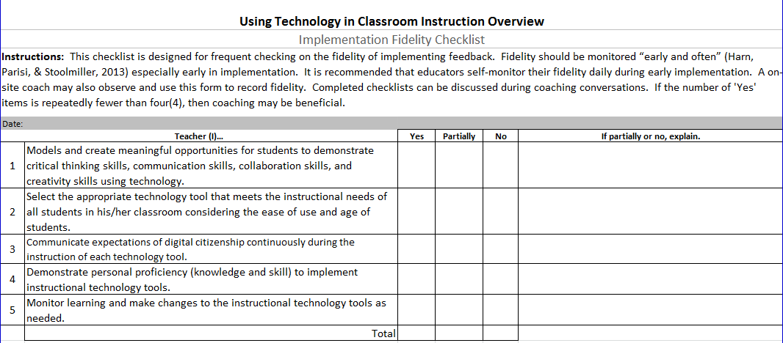
Fidelity Checklist
Notes:
Review Fidelity Checklist with participants.

Slide 71
Implementation
How will you know:
  How will we present the information about using technology in classroom instruction to our staff?
  How much time will be needed to present the technology overview to our staff?
  How will we know that teachers are proficient in using the technology?
  How will we know that technology tools are being selected with age of students and ease of use in mind?
  How will we monitor that digital citizenship is being taught to all students?
Notes:
HO Planning Guide: Give participants time to reflect and discuss with their building-level teams.

Slide 72
Implementation
How will you know:
  How will we assess that teachers are proficient in the instructional technology tools used in class?
  How will we monitor that teachers model and facilitate situations for students to utilize critical thinking, communication, collaboration, and creativity in technology.
  How will we know that appropriate changes are made based on data?
  How soon can we expect teachers to begin using technology in their classroom instruction?
  How will we know that technology is being implemented in classroom instruction?
Notes:
HO Planning Guide: Give participants time to reflect and discuss with their building-level teams.

Slide 73
Using Technology in Classroom Instruction Overview
Post-assessment
Socrative.com
Student Login
Room Number:
Notes:
This post-assessment would occur just like the pre-assessment. You would have participants use the same room number, and you would use the same assessment as on slide 9.

Slide 74
Next Steps: Action=Results
What steps will you take to start implementing?
Notes:
Complete the Next Steps template. Example is included in the learning package materials.

Slide 75
Resources for Further Learning
Using Technology with Classroom Instruction That Works, 2nd Edition by: Howard Pitler, Elizabeth R. Hubbell, and Matt Kuhn (2012)
Best Practices for Teaching with Emerging Technologies by: Michelle Pacansky-Brock (2012)
Leading 21st-Century Schools: Harnessing Technology for Engagement and Achievement by: Lynne Schrum and Barbara B. Levin (2009)

Slide 76
Web Resources for Further Learning
eSchool News- http://www.eschoolnews.com/
Ed Tech Magazine- http://www.edtechmagazine.com/
Edudemic- http://www.edudemic.com/
Edutopia- http://www.edutopia.org/

