Slide 1
Hidden Slide #1
Presenter notes information
Tools and documents
Helpful suggestions
Notes:
To Know: The Engaging Student Learners package is divided into four sections:
Defining Engagement
Motivating Students Leads to Engagement
Identifying Qualities of Engagement
Enhance Lessons Using Strategies for Engaging Student Learners
The CW Content Fidelity Checklist aligned to each learning package includes all critical items for a training session. The CW HQPD Training Checklist and Coaching Checklist contain process elements to be used as guidance when designing, revising, or coaching high quality professional development.
Important notes:
A script of presenter notes is included in the PowerPoint. Background information for the presenter is shown as “To Know.” Statements to be shared with participants are shown as “To Say.” In some instances, the “To Know/To Say” are the same material. For fidelity of content and consistency among presenters, the “To Say” information should be presented with minimal paraphrasing. The presenter notes also include “To Do” prompts and cues for “Handouts”.
A presenter may add slides to supplement the content. For example, a slide of essential questions may be added since only objectives have been included.
A presenter may choose to differentiate a presentation to meet the needs of the participants. For example, another form may be substituted for the Next Steps template if the district or building already uses a similar form or protocol.
Additional activities, examples, videos, etc. are being developed. A presenter may interchange the additional material for the corresponding PowerPoint content.
An Implementation Fidelity Checklist is available for frequent monitoring by a teacher or observer.
A print Practice Profile and an electronic Self-Assessment Practice Profile (SAPP) tool are available for use by individuals, teams, or schools for periodic self-assessment and monitoring of implementation of practice or to identify training or coaching needs.
The presenter should download onto a hard drive or a flash drive any video intended for use in a training. The links shown on slides may not be able to be accessed online at the school sites.
Breaks should be inserted at the discretion of the presenter based on the needs of participants.

Slide 2
Hidden Slide #2
Supplies needed:
Suitcase with contents
Index cards
Post-it notes
Chart paper
Markers
Notes:
To Know: These supplies are needed for the Engaging Student Learners learning package training.

Slide 3
Hidden Slide #3
Handouts needed:
Pre-reading, Engage Kids With 7 Times the Effect
Engaging Student Learners (infographic)
Goal Orientation
Igniting Student Engagement: A Roadmap for Learning
Twitter Card
Engagement Dos and Don’ts
Lesson Design Qualities
Schlechty Organizer 1 & 2
Engaging Student Learners Practice Profile
Next Steps: Action = Results
Notes:
Handouts: Handouts are available on MOEDUSAIL.

Slide 4
Pre-Reading
Send a copy of Engage Kids With 7 Times the Effect to participants prior to training.
Also, ask participants to bring a current lesson to training.
(Finley, 2014)
Notes:
To Do: Send the pre-reading out ahead of the workshop.
Ask participants to bring a current lesson to revise during the training.
Reference: Finley, T. (2014). [edutopia]. Retrieved from https://www.edutopia.org/blog/engage-with-7x-the-effect-todd-finley.

Slide 5
Engaging Student Learners
This work is licensed under a Creative Commons Attribution-NonCommercial-NoDerivatives 4.0 International License.
Notes:
To Know/To Say: Good morning/afternoon! We will begin in _____ minutes.
To Do: Greet participants.
Purpose: Participants will learn about and plan to effectively implement the practice of Engaging Student Learners in their classroom to increase student learning.
Content: Introductory slides

Slide 6
Acknowledgements Special thanks to all contributors to the development and revision of this module. The original collection of learning packages was rolled-out for use by Regional Professional Development Center (RPDC) Consultants in July 2013 after being developed by a team of content experts. The collection of learning packages was developed through efforts funded by the Missouri State Personnel Development Grant (SPDG). The following individual/groups are thanked immensely for their hard work in developing this package.
Content Development and Revision Support
2015 Initial Content Developer Liz Condray, SC RPDC
UMKC Institute for Human Development
Ronda Jenson, Director Arden Day Jodi Arnold
Stefanie Lindsay Carla Williams
SPDG Management Team
2017 Revision Team
Julie Germann, SW RPDC Ginger Henry, DESE
Stephanie Kuper, SE RPDC Julie McClung, C RPDC
Heidi Newlon, KC RPDC Linda Shippy, C RPDC
Sarah Spence, C SIS Nancy Steele, Facilitator, NE SIS
Terri Steffes, Hook Center
Notes:
To Know/To Say: Special thanks to all contributors to the development and revision of this module.

Slide 7
Opening & Introductions
Notes:
To Know/To Say: Welcome to Engaging Student Learners.
The introductions may be formal or informal depending on how well you know the group. Trainers should use whatever process is comfortable for introductions. I am/we are _______________ (provide some background about trainers.) Please introduce yourself to the group (name, district, position.)
To Do: (optional) Consultant develops an ice-breaker or introductory activity.

Slide 8
Session-at-a-Glance
Introductory materials
Exploring motivation and student engagement
Identifying the qualities of engagement
Apply the qualities of engagement
Assessment and reflection
Closing and next steps
Notes:
To Know/To Say: Engagement can be viewed through many different lenses; rather than trying to address cognitive, behavioral, and affective aspects too broadly and without depth, this learning package focuses on instruction, in keeping with Hattie’s Visible Learning.
At the end of the training, action planning is provided for teams to determine their next steps.

Slide 9
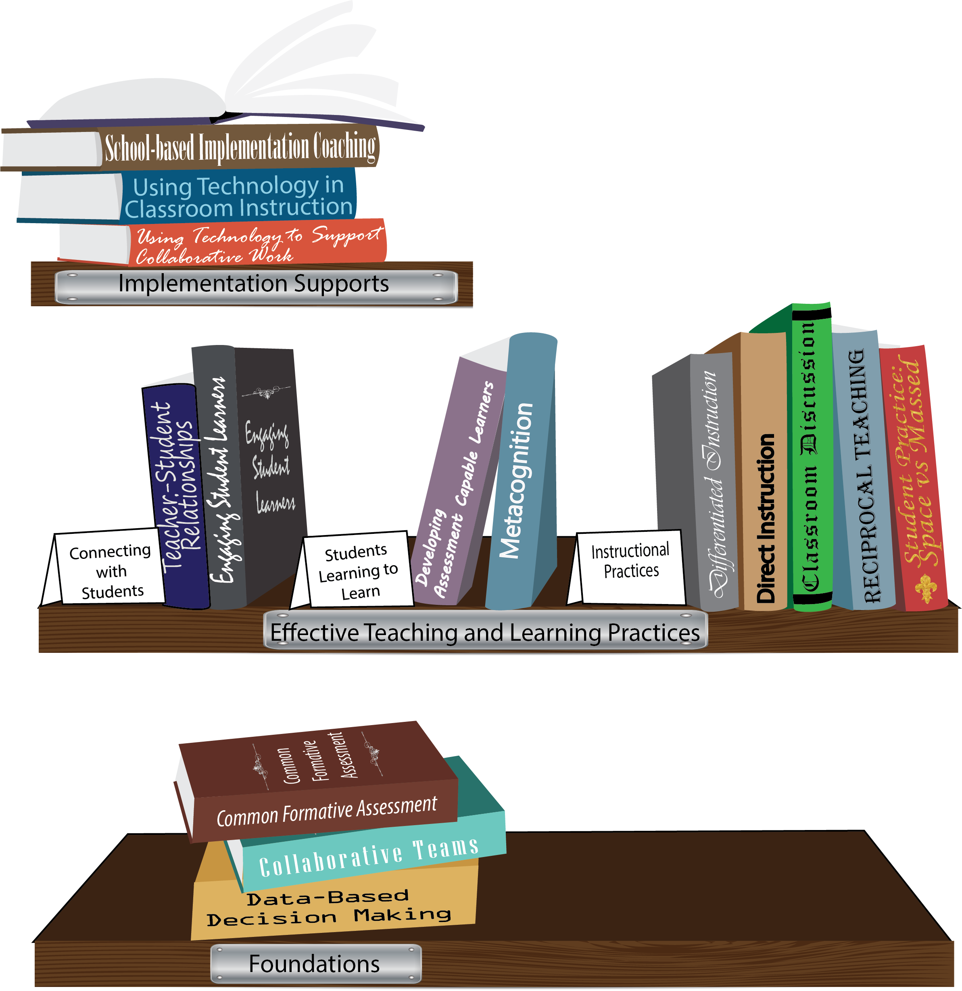
Notes:
To Know: This slide is animated.
To Know/To Say: Missouri’s professional development learning packages are organized in three categories: Foundations, Effective Teaching & Learning Practices, and Implementation Supports. All schools begin their professional development journey with the Foundations, as these learning packages provide foundation knowledge in three key areas: Collaborative Teams, Data-based Decision-making, and Common Formative Assessment. Effective Teaching & Learning Practices encompass research-based instructional practices for deepened learning. These learning packages address ways of connecting with students, ways of helping students learn how to learn, and feature specific instruction practices. Implementation Supports are learning packages designed to help school staff support and enhance the Implementation of Effective Teaching & Learning Practices through using technology and peer coaching supports.
To Do: Explain how the graphic depicts professional development in Missouri.

Slide 10
Engaging Student Learners
1. Define Engagement with Schlechty’s Design Qualities
2. Define and Clarify Motivation
3. Identify the Qualities of Engagement
4. Enhance lessons using strategies for engaging students
Notes:
To Know/To Say: Today’s agenda shows the four major sections of Engaging Student Learners:
Define engagement with Schlechty’s Design Qualities
Define and clarify motivation and how it relates to student engagement
Identify the Qualities of Engagement
Enhance lessons using strategies for engaging student learners.

Slide 11
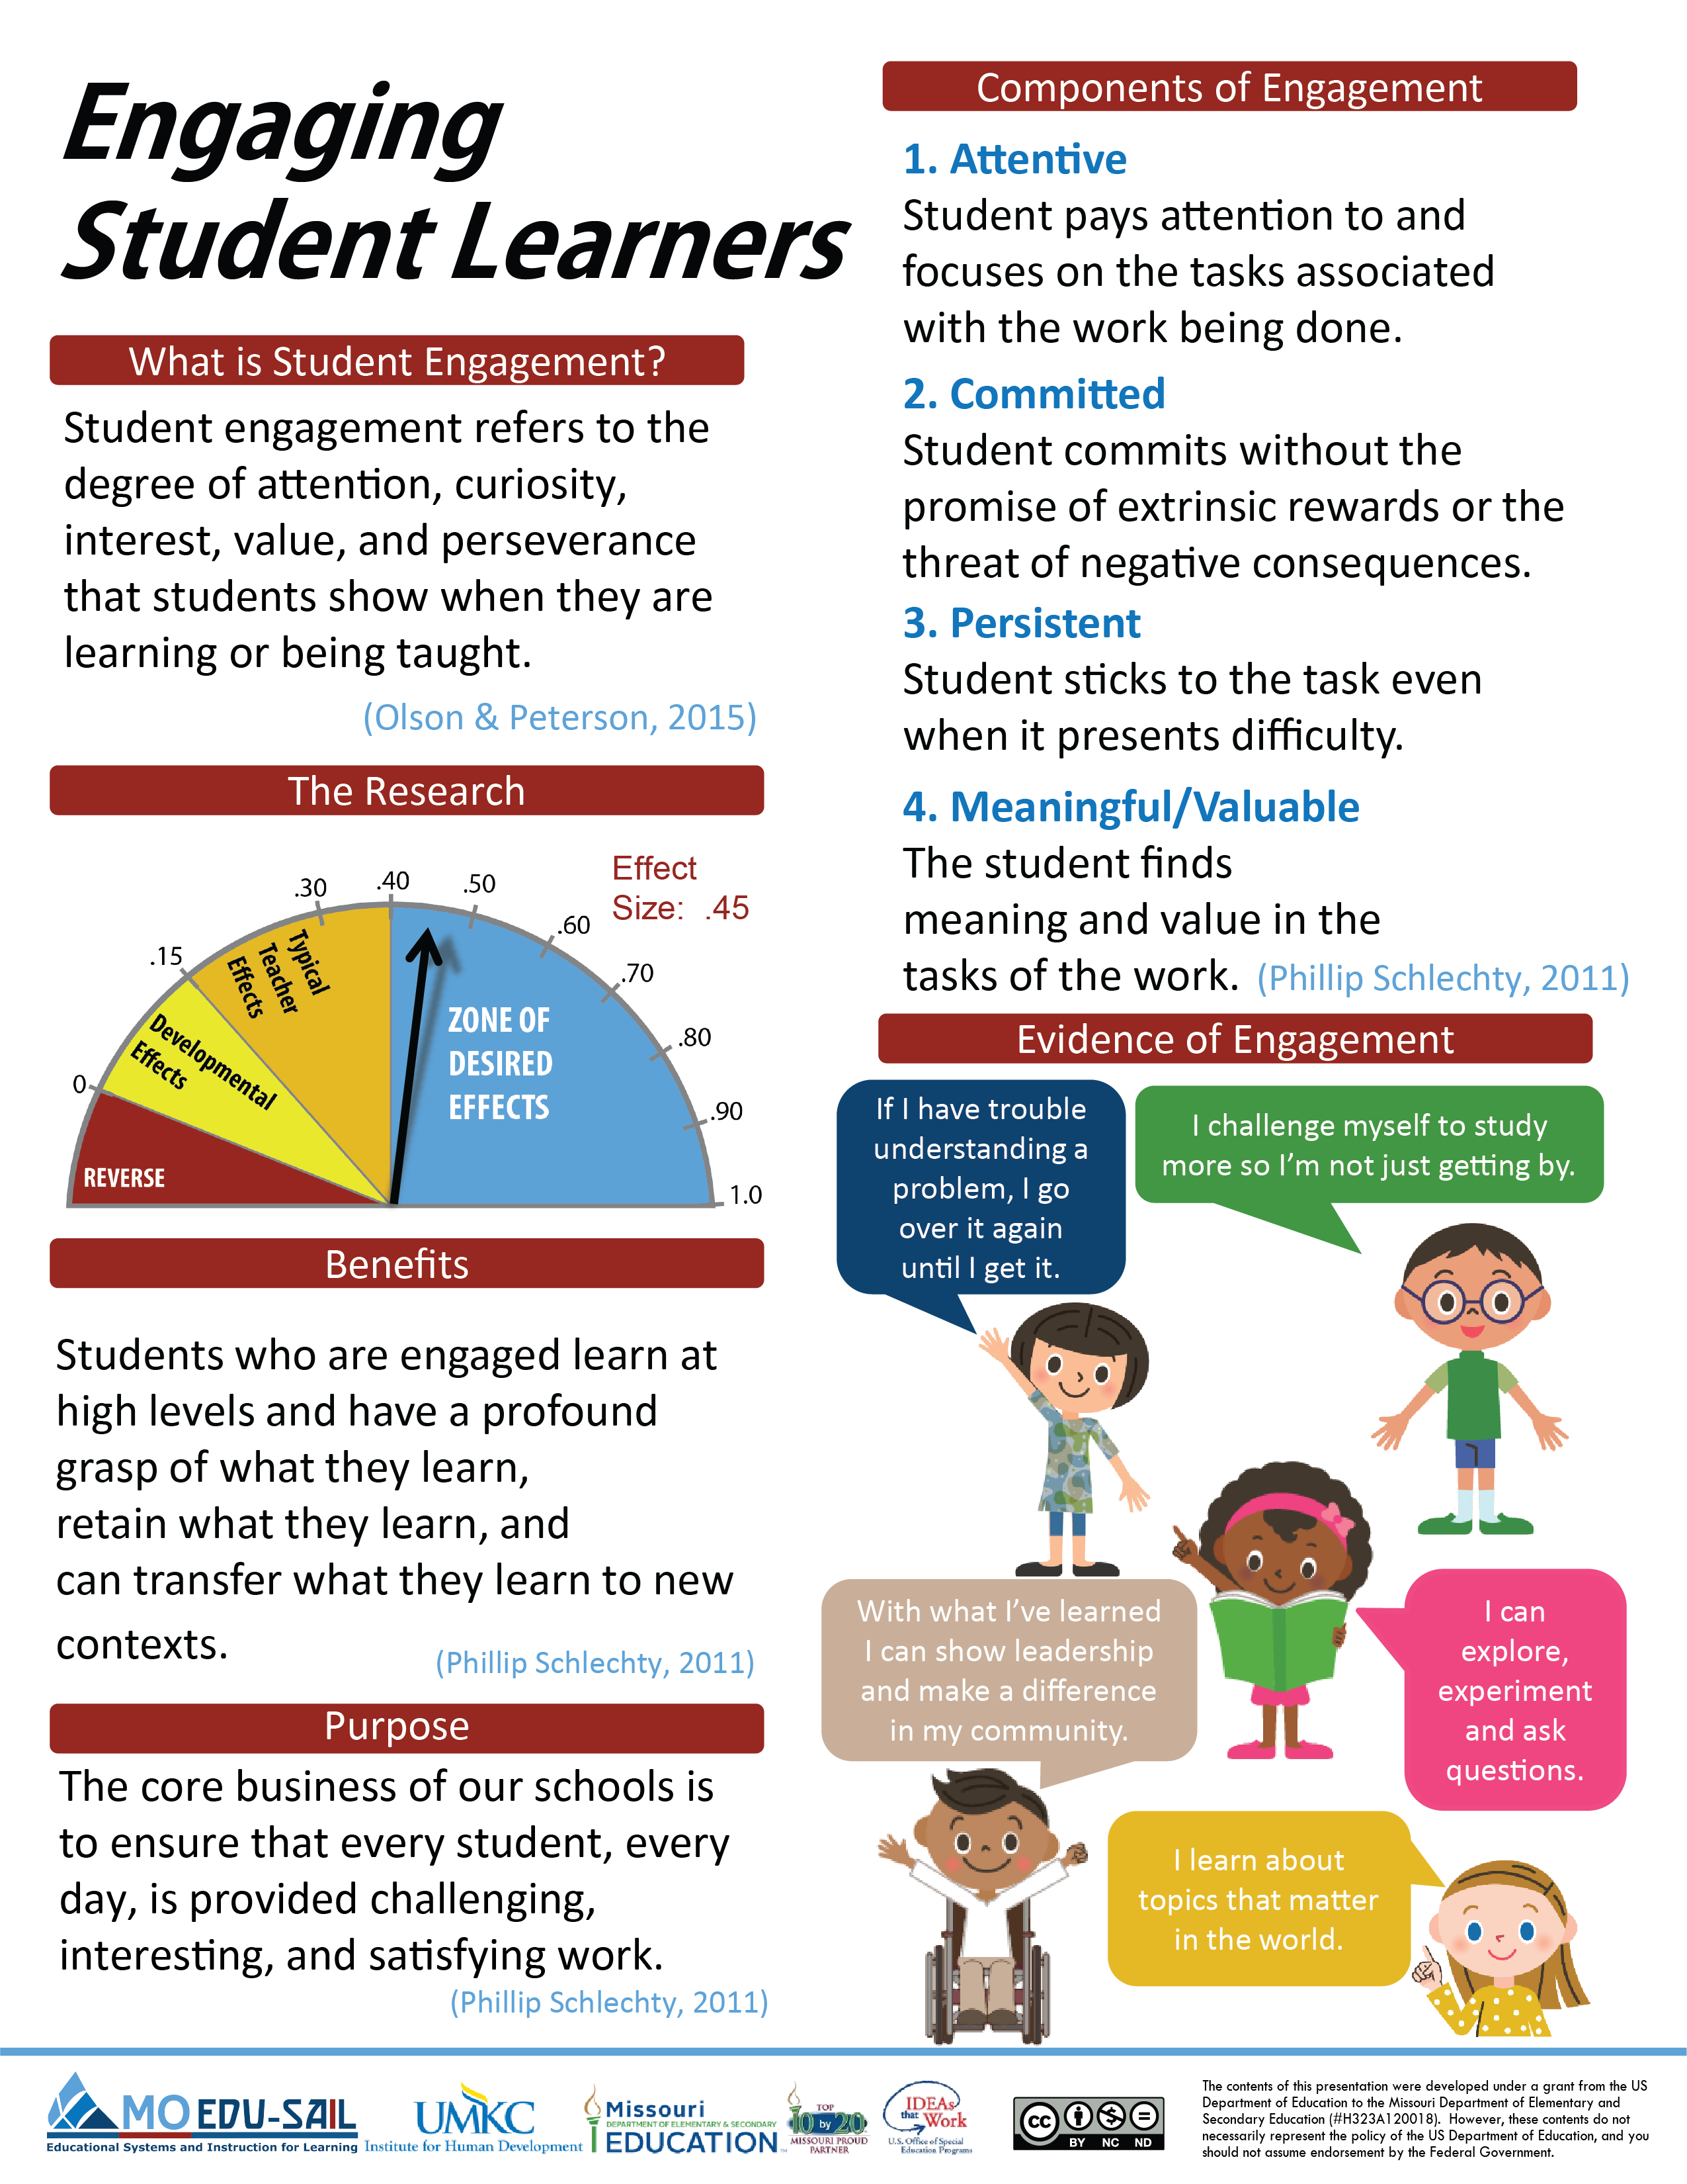
Notes:
To Know/To Say: The Engaging Student Learner infographic summarizes key content from the learning package.
Handout: Engaging Student Learners (infographic).

Slide 12
Hattie’s “Barometer of Influence”
Medium
hp= 0.40
Low
High
Negative
(Hattie, 2012)
Notes:
To Know: EFFECT SIZE
“An effect size is a useful method for comparing results on different measures (such as standardized, teacher-made tests, student work), or over time, or between groups, on a scale that allows multiple comparisons independent of the original test scoring (for example, marked out of 10, or 100), across content , and over time. This independent scale is one of the major attractions for using effect sizes, because it allows relative comparisons about various influences on student achievement.” (Hattie, 2012)
To Know/To Say: John Hattie’s 2009 book, Visible Learning, was based on more than 800 meta-analyses of 50,000 research articles, about 150,000 effect sizes, and about 240 million students.
“Effect size is a standard measure that can be calculated from any number of statistical outputs.” (Biddix, 2009)
Perhaps the most significant discovery from evidence was almost any intervention can stake a claim to making a difference to student learning.
Any effect above zero means that achievement has been raised by the intervention. The average effect size is 0.40; there are just as many influences on achievement above the average as there are below the average.
For any particular intervention to be considered worthwhile, it needs to show an improvement in student learning of at least an average gain – that is, an effect size of at least 0.40, referred to as the hinge-point for identifying what is and what is not effective.
Half of the influences on achievement are above this hinge-point. This is a real-world, actual finding and not an aspiration claim. That means that about half of that we do to all students has an effect of greater than 0.4 or greater, while half are in classes that get less than the 0.4 effect. (Hattie, 2012)
Hattie’s Barometer of Influence represents a summary of the effect size from the studies that were reviewed. The average effect size, 0.40, may be viewed as a typical one year of growth in student learning. Missouri’s Collaborative Work has identified from Hattie’s research Effective Teaching and Learning Practices which are in the high rank of desired effects for student learning outcomes.
To Do: Explain Hattie’s Barometer of Influence.
References: Biddix, P. (2009). Effect Size. Retrieved from: https://researchrundowns.wordpress.com/quantitative-methods/effect-size/.
Hattie, J. (2009). Visible learning A synthesis of over 800 meta-analyses relating to achievement. New York, NY: Routledge.
Hattie, J. (2012). Visible learning for teachers Maximizing impact on learning. New York, NY: Routledge.

Slide 13
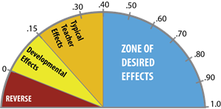
Engaging Student Learners (.45 Effect Size)
(Hattie, 2015)
Notes:
To Know/To Say: John Hattie’s most recent meta-analysis determined Concentration/Engagement has a .45 Effect Size. The learning package is titled Engaging Student Learners.
Reference: Hattie, J. (2015). Hattie Ranking: 195 Influences and Effect Sizes Related to Student Achievement. Retrieved from: https://visible-learning.org/hattie-ranking-influences-effect-sizes-learning-achievement/.

Slide 14
Engaging Student Learners and Missouri Teaching Standards
Standard 1: Content knowledge aligned with appropriate instruction.
Standard 4: Critical Thinking
Standard 5: Positive Classroom Environment
(Missouri Department of Elementary and Secondary Education, 2013)
Notes:
To Know: This is an animated slide.
To Know/To Say: Engaging Student Learners aligns with Missouri Teacher Standards.
Standard #1: Content Knowledge and Perspectives Aligned with Appropriate Instruction: The teacher understands the central concepts, structures and tools of inquiry of the discipline(s) and creates learning experiences that make these aspects of subject matter meaningful and engaging for all students.
Standard #4: Critical Thinking: The teacher uses a variety of instructional strategies and resources to encourage students’ critical thinking, problem solving, and performance skills.
Standard #5: Positive Classroom Environment: The teacher uses an understanding of individual/group motivation and behavior to create a learning environment that encourages active engagement in learning, positive social interaction, ad self-motivation. .
References: Missouri Department of Elementary and Secondary Education (MO DESE). (2013). Teacher Standards: Missouri's educator evaluation system. Retrieved from: http://dese.mo.gov/sites/default/files/TeacherStandards.pdf.

Slide 15
Essential Question Pre-Assessment
How do teachers effectively engage students?
Notes:
To Know/To Say: This is the question that we hope to answer by the end of today’s training.
To Do/To Say: The Blanket the Table activity will be used as a pre-assessment. Write one effective strategy per post-it-note which has been used in your classroom. After three minutes, tables organize strategies into categories (of the groups choosing). During today’s training, track ideas that you might add to this list.

Slide 16
Guiding Questions
What connects student motivation and engagement?
What are components of high student engagement?
What actions, practices, strategies, and techniques promote high engagement for all learners?
How can teachers assess lessons and units for engaging qualities?
Notes:
To Know/To Say: Let’s begin the work of learning a strategic and consistent understanding of what student engagement is with these essential questions in mind.

Slide 17
Norms
Begin and end on time.
Be an engaged participant.
Be an active listener—open to new ideas.
Use notes for sidebar conversations.
Use electronics respectfully.
Notes:
To Know/To Do: Consider including a check mid-way through trainings to assess a norm or norms. The presenter may want to use norms printed on agenda handouts, in addition to or in place of presentation slides, so the norms are always available in print for participants. Norms may be added to address specific school needs. Some schools already have established norms for all PD. In that case, adapt to their norms.

Slide 18
Introductions: Antiques Roadshow
Your team has two minutes to locate the oldest item brought by one of your team members today. It might be a coin, picture, ring, etc.
The owner of the oldest item will introduce him/herself first, sharing name, school district, and what his/her duties are. Give a brief history of the “antique” being shared.
Notes:
To Know: The icebreaker/get-to-know-you activity is optional. Follow the directions on the previous slide.
To Say: Ask participants how engaged they were with selecting their “antique”. Then ask how engaged they were listening to other people share their antiques. What makes a person engaged in a topic?

Slide 19
Which picture best represents your confidence in engaging students?
Notes:
To Know: This activity or the Suitcase Activity may be used next. There is no need to do both.
To Say: Which picture best represents your confidence in engaging students. What reasons would you give for your choice?
To Do: If in person, you may tape a 1, 2, 3, and 4 and have participants move to the number that represents their choice. In a virtual setting, you might use breakout rooms for each of the choices and have them discuss commonalities. Group should designate their group reporter. Then return to the main room and have a designated person from each group share out their commonalities.

Slide 20
Suitcase Mystery
Preparation is required beforehand; a suitcase will need to be packed with around a dozen items. For a large group, you may need two suitcases. If the group is very large, this activity is not appropriate.
The goal is to describe the suitcase and its contents as accurately as possible, because this case has been left behind at the airport in the baggage claim area.
In order to help the baggage handlers unite the bag with its owner, participants need to describe the items inside as clearly as possible and match them to the type of person who would use them. The goal is NOT trying to find a name, just the type of person.
After describing the outside of the case, open it and have participants select an item for their team to describe. If they choose a pair of jeans, they might record, “They’re light-colored jeans. They are old and worn. They have a tear on the back pocket. The pants are ragged on the bottom.” Have them sketch the item also. They will be talking and trying to surmise who this might be.
Ask teams, one by one, to show the item to everyone and read their description. When everyone is finished, come to consensus about who this might be.
Collect the index cards and place them in the suitcase.
(Activity adapted from Culham, 2005)
Notes:
To Know: This activity or the Suitcase Activity may be used next. There is no need to do both.
This slide is hidden and provides the directions for this optional activity on slides 21 - 25
To Know/To Do: Fill an interesting-looking suitcase with clothing and toiletries or whatever the presenter can use to tell a story. (WWII memorabilia, outdoor clothes and fishing gear, bird-watching items and appropriate clothing). Include enough items so that participants can work in pairs or quads, so everyone is attached to an item from the suitcase.
Reference: Culham, R. (2005). 6+1 traits of writing: The complete guide for the primary grades (pp. 193-194). Portland, OR: Scholastic Inc.

Slide 21
Suitcase Mystery
Imagine this suitcase was left at the airport or train station without identification.
In order for the baggage handlers to return the suitcase to its owner, you are going to have to describe the suitcase and contents as precisely as you can in order to determine the owner.
(Activity adapted from Culham, 2005)
Notes:
To Know/To Do: Participants will first describe the exterior of the suitcase as accurately as possible. Provide index cards or paper for this activity. Participants will use the flip side of an index card for recording what’s inside.
Reference: Culham, R. (2005). 6+1 traits of writing: The complete guide for the primary grades (pp. 193-194). Portland, OR: Scholastic Inc.

Slide 22
Suitcase Mystery
What words can be
used to describe this
suitcase? Write a description
on your index card, and be as specific as possible.
Notes:
To Know/To Say/To Do: The first task is to describe the case itself. On one side of the index card participants will accurately describe the outside of the case. Ask them to sketch the suitcase if they wish.
Reference: Culham, R. (2005). 6+1 traits of writing: The complete guide for the primary grades (pp. 193-194). Portland, OR: Scholastic Inc.

Slide 23
Suitcase Mystery
Partner up.
Choose something from the suitcase.
Write a description of this item on the other side of your index card.
Draw a picture of the item next to the description.
Begin to consider who might own this suitcase.
Notes:
To Know/To Say: Work in pairs, quads, whatever is appropriate. Open the suitcase. There will be plenty of conversation, thinking out loud, processing. By the time they are ready to share out they will have come up with an idea, and usually a story as well.
Reference: Culham, R. (2005). 6+1 traits of writing: The complete guide for the primary grades (pp. 193-194). Portland, OR: Scholastic Inc.

Slide 24
Who owned this suitcase?
Notes:
To Know/To Say: Time to share out their thinking.
Reference: Culham, R. (2005). 6+1 traits of writing: The complete guide for the primary grades (pp. 193-194). Portland, OR: Scholastic Inc.

Slide 25
Processing the Mystery Suitcase Activity
What kinds of thinking and collaboration skills did you use?
Did you change your mind when you began to articulate your thinking? Why?
Were you motivated? Engaged?
Notes:
To Do: Allow time for participants to process with a partner, or as a table, before sharing big ideas from the activity. Ask participants to brainstorm how this activity might work within the content they currently teach.
Reference: Culham, R. (2005). 6+1 traits of writing: The complete guide for the primary grades (pp. 193-194). Portland, OR: Scholastic Inc.

Slide 26
Defining Engagement Section 1
Notes:
Purpose: Provide information for participants to develop their understanding of engagement.
Content: The perspectives of Abbott, Schlechty, and Hattie are used for defining engagement.

Slide 27
Defining Student Engagement
Student engagement refers to the degree of attention, curiosity, interest, optimism, and passion that students show when they are learning or being taught.
The concept of “student engagement” is based on the belief that learning improves when students are inquisitive, interested, or inspired, and that learning tends to suffer when students are bored, dispassionate, disaffected, or otherwise “disengaged.”
(Abbot, 2016)
Notes:
To Do/To Say: Ask participants to read silently and process. Ask them to choose 2 or 3 words that stand out. Link back to participants’ favorite teachers. Why is student engagement a difficult task to master as a teacher in today’s classroom?
Reference: Abbott, S. (Ed.) (2016, February 18). Student Engagement. The glossary of education reform. Retrieved from http://http://edglossary.org/student-engagement.

Slide 28
Components of Engagement
Engaged
Attentive
Persistent
Connected
Committed
(Schlechty, 2011)
Notes:
To Say: There are four components that are always present when students are engaged. Those four components are:
The engaged student is attentive. In the sense that he/she pays attention to and focuses on the tasks associated with the work being done.
The engaged student is committed. He/she voluntarily (without the promise of extrinsic awards or the threat of negative consequences) deploys scarce resources under his/her control (time, attention, and effort) to support the activity called for by the task.
The engaged student is persistent. He/she sticks with the task even when it presents difficulties.
The engage student is connected. He/she finds meaning and value in the tasks that make up the work.
The main difference between students who are engaged and those who are not is the way they respond to the situation or tasks at hand.
Reference: Schlechty, P. C. (2011). Engaging Students: The Next Level of Working on the Work, San Francisco: Jossey-Bass.

Slide 29
Student Response to Work
Engagement: High Attention and Commitment to the tasks at hand
Strategic Compliance: High Attention and Low Commitment the tasks at hand
Ritual Compliance: Low Attention and Low Commitment to the tasks at hand
Retreatism: No Attention and No Commitment
Rebellion: Diverted Attention
(Francis, 2014)
Notes:
To Know/To Say: Teachers should be aware of certain response indicators that will help them determine the level of student engagement.
1. Engagement: The student volunteers resources under his/her control (time, effort, and attention). The student is attentive to the task because he/she finds personal meaning and value in the task. The student sees the task as responding to motives and values he/she brings to the work. The student persists with the task even when he/she experiences difficulty and does not compromise personal standards for the completion of the task.
2. Strategic Compliance: The student allocates only as much time, energy, and resources as are required to get the reward offered or desired. The student is attentive to the task because he/she perceives the receipt of some desired extrinsic reward which is conditionally available to those who pay attention to the task and do what is required of them. The student persists with the task only up to the point of ensuring that the desired reward is offered, and the student is willing to accept the reward and abandon the task even though he/she may not be personally satisfied that the work done is of the quality that he/she could produce.
3. Ritual Compliance: The student does only those things that must be done and does little or nothing outside the context of direct supervision by the teacher. The student pays minimal attention to the work, is easily distracted, and is constantly seeking alternative activities to pursue. For example, it appears that texting has now become a favorite pastime for those who are ritually compliant. The student is easily discouraged from completing the task and regularly tries to avoid the task or get the requirements of the work waived or compromised.
4. Retreatism: The student does nothing and, when forced through direct supervision to do the task, either engages in ritual behavior or rebellion. The student does not attend to the work, but does not engage in the activities that distract others. The student employs strategies to conceal his/her lack of involvement, sleeping with eyes wide open and smiling from time to time.
5. Rebellion: The student overtly refuses to comply with the requirements of the task. This refusal may involve cheating, refusing to do the work, or even doing other work in place of what is expected. Alienation rather than commitment is evident. Unlike the retreaters, students who rebel are likely to be active in their rejection of the task, up to and including efforts to sabotage the work, cheat, and build negative coalitions of other students around the work and the rejection of the values the work suggests.
Reference: Francis, S. (2014, February 28). Five Levels Of Student Engagement [blog post]. Retrieved from http://www.happyschool.com.au/five-levels-of-student-engagement/

Slide 30
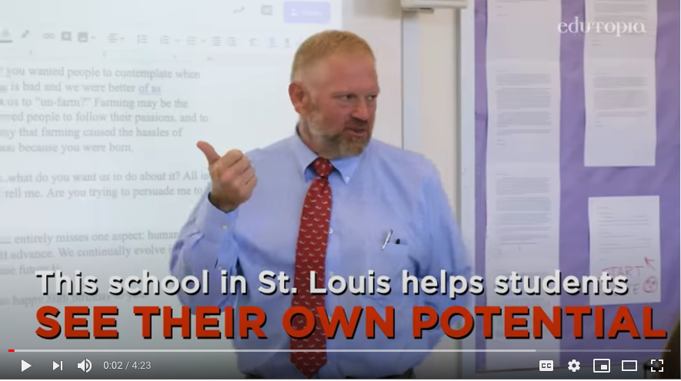
Raising the Bar for Student Work
Maplewood Richmond Heights School District – St. Louis, Mo.
https://www.youtube.com/watch?v=b4Id1CTQpks&feature=youtu.be
Notes:
To Know: The title links an Edutopia video from Maplewood Richmond Heigths School Disctrict – St. Louis, Mo. found at: https://www.youtube.com/watch?v=b4Id1CTQpks&feature=youtu.be
The video is hyperlinked on the slide.
To Do/Say: This video is a short 4 minute and 23 second video sharing how and urban high school uses exemplar writing samples to promote a greater understanding of work expectations. After watching the video, discuss:
•How does this strategy help students learn from each other?
•How could this strategy be adapted for different activities?
•How can this strategy work in your classroom?
Reference: Edutopia, (2020, March 20). Raising the bar for student work [video file]. https://www.youtube.com/watch?v=b4Id1CTQpks&feature=youtu.be

Slide 31
The core business of our schools is to ensure that every student, every day, is provided challenging, interesting, and satisfying work.
--Phillip Schlechty
(Schlechty, 2011)
Notes:
To Know/To Say: This is Schlechty’s mantra. Teachers can deliberately design engaging lessons—teachers can help ensure students are engaged. Think about the “Wingman” video on the previous slide. How did that teacher ensure that every student was being engaged?
Reference: Schlechty, P. C. (2011). Engaging Students: The Next Level of Working on the Work, San Francisco: Jossey-Bass.

Slide 32
Motivating Students Leads to Engagement Section 2
Notes:
Purpose: The second section of this learning package focuses primarily on motivation as a way to increase student engagement.
Content:
Jan Chappuis’ Learning Orientations
Research
Engage Kids With 7 Times the Effect (pre-reading discussion)
Igniting Student Engagement: A Roadmap for Learning
To Know/To Say: Discuss the pre-reading article, Engage Kids With 7 Times the Effect.
Student engagement decreases as a student ages; early grades 8 out of 10 are engaged, by middle school 6 out of 10, and by high school 4 out of 10 are engaged.
Connective instruction is seven times as effective as lively teaching or academic rigor.

Slide 33
Thinking About Motivation
On a post-it-note, first answer the following questions solo:
Who was your favorite teacher?
Why was he/she your favorite?
Share your findings with your table team:
What characteristics do your favorites have in common?
Notes:
To Know/To Do: The facilitator makes a list of all of the characteristics generated by the groups and asks participants to explain their choices. Usually items such as “relevant,” “did lots of activities,” “hands-on learning,” “cared about me” or “something I could apply” are given. Some may remark that they were “motivated” to learn in that classroom. Make the point that these characteristics are ones that we appreciate, and that many of us try to emulate. You may be remembering this teacher after many years! Post the list. Those descriptors will resurface throughout the upcoming work.

Slide 34
What Motivates Your Students?
A performance or ego orientation, where the student’s goal is to prove ability or hide a perceived lack of ability.
A task-completion orientation, where the student’s goal is to get it done and get a grade.
A learning orientation, where the student’s goal is to get better.
(Chappuis, 2015)
Notes:
To Know/To Do: Provide participants with a copy of the handout, Goal Orientations. Ask participants to number off by 3. Then form like-groups to read information about their one orientation. They will brainstorm what it looks like, sounds like, and feels like. Then role play for the rest of the group, showing what this goal orientation is.
To Know/To Say:
Performance Level
Works to exceed performance of others or to hide learning needs
Believes initial lack of success indicates lack of ability
Quits, cheats, or chooses easier work when faced with difficulty
“I don’t know what I’m doing, so I’m not smart enough to do this”
“How do I get the highest ‘A’?”
“How do I avoid being seen as not smart enough?”
Task Level
Works just hard enough to get assignments turned in and/or to get points
Believes that effort in school is about getting points- it matters less who does the work
Looks for alternative ways to get points when faced with difficulty
“When is it due?” or “How much is this worth?”
Learning Level
Develops willingness to try and persistence to keep trying
Believes that effort will lead to eventual success
Exhibits “Failure tolerance” when faced with difficulty--initial failure can be overcome by a change in strategy
“What can I learn from this mistake?”
Handout: Goal Orientation
Reference: Chappuis, J. (2015). Seven Strategies of Assessment for Learning (2e). Boston: Pearson.

Slide 35
Motivating Students
Student motivation refers to a student’s willingness, need, desire and compulsion to participate in, and be successful in, the learning process.
(Brewster & Fager, 2000)
Notes:
To Say: This is a rough definition of “student motivation” What would you add or delete?
Reference: Brewster, C., & Fager, J. (2000). Increasing student engagement and motivation: From time-on-task to homework. Portland, OR: Northwest Regional Educational Laboratory. Retrieved from http://educationnorthwest.org/sites/default/files/byrequest.pdf.

Slide 36
Motivating Students
It only makes sense that the more interesting an assignment is, the more likely students are to immerse themselves in the task and stick with it through completion.
Even highly motivated students need school-work that actively engages them by building on their interests and prior knowledge.
(Brewster & Fager, 2000)
Notes:
To Do/To Say: What does this mean to you? Turn to the person sitting next to you and discuss ways to make assignments and/or lessons more “interesting” for students.
Reference: Brewster, C., & Fager, J. (2000). Increasing student engagement and motivation: From time-on-task to homework. Portland, OR: Northwest Regional Educational Laboratory. Retrieved from http://educationnorthwest.org/sites/default/files/byrequest.pdf.

Slide 37
Igniting Student Engagement: A Roadmap for Learning
The most important sentence. Why?
The most important word. Why?
How can you incorporate this into your classroom?
(McCarthy, J., 2015)
Notes:
To Know: It is best to put participants in groups that share a common content area, grade band or level and ask them to read and share through that lens.
To Know/To Say/To Do: Place participants in workable teams. Good “chunks” of the article are:
Section 1 – Practice One: Be Real
Section 2 – Practice Two: Launch Events That Matter
Section 3 – Practice Three: Keep the End in Mind
Ask participants to
Summarize their section of the text by sharing out what they find to be the:
Most important sentence. Why?
Most important word. Why?
How can you incorporate this into your classroom?
Record on chart paper to share with the whole group.
What will you take back to your classroom and try?
Handout: Igniting Student Engagement: A Roadmap for Learning
Reference: McCarthy, J. (2015). Igniting Student Engagement: A Road map for Learning. [Blogpost]/ Retrieved from https://www.edutopia.org/blog/ignite-student-engagement-roadmap-learning-john-mccarthy.

Slide 38
Motivation: Igniting Student Engagement
“To be motivated means to be moved to do something. A person who feels no impetus or inspiration to act is unmotivated, whereas someone who is energized or activated toward an end is considered motivated.
In the classroom setting, student motivation refers to the degree to which a student puts effort into and focus on learning in order to achieve successful outcomes.”
(Saeed & Zyngier, 2012)
Notes:
To Know/To Say: Take 1-2 minutes to reflect and write a “Tweet” on the Twitter card. Again, reiterate the importance of the KINDS of activities in the article. We need to look at our practice, not at what motivation students bring with them to school.
Handout: Twitter Card
Reference: Saeed, S., & Zyngier, D. (2012). How motivation influences student engagement: A qualitative case study. Journal of Education and Learning, 1(2), 252.

Slide 39
John Hattie’s Concerns
“No manner of school reform will be successful until we first face and resolve the engagement problem–
Too many students are ‘physically present but psychologically absent’.
Students can be easily confused.
Many are bored.
Students spend 85% of their time listening to a teacher talking.”
(Hattie, 2008)
Notes:
To Do/To Say: Read aloud this slide, noting the bullet points. Ask: What is the link between “Engagement” that Hattie talks about here and “Motivation” that we have been discussing from the pre-reading, Engage Kids With 7 Times the Effect, and the John McCarthy blog, Igniting Student Engagement: A Roadmap for Learning? Allow time for brief discussion.
Reference: Hattie, J. (2008). Visible learning: A synthesis of over 800 meta-analyses relating to achievement. Routledge.

Slide 40
Identifying Qualities of Engagement
Section 3
Notes:
Purpose: Provide opportunity for learners to discuss what application in the classroom looks like.
Content:
Detailed description of what implementation looks like
Group discussion on what implementation looks like in a variety of contexts
This is a section that can be altered to best address your audience. Videos from Teaching Channel, or choose your own favorites from another source.

Slide 41
What does student engagement look and sound like?
How is engagement different from a classroom whose students are merely compliance?
Notes:
To Say: Yes, there is a time to be compliant. For example, when students are asked to follow directions or a teacher uses a “quiet signal” as a behavior management technique. However, when learning, students need to be engaged in their learning.
To Say/To Do: Find a “sole” mate (someone whose shoes are similar to your own). When you find your sole-mate, discuss what the differences are in classrooms that students are engaged during versus a classroom where students are merely compliant.

Slide 42
Students Who Are Engaged
learn at high levels and have a profound grasp of what they learn,
retain what they learn, and
can transfer what they learn to new contexts.
(Schlechty, 2011)
Notes:
To Know/To Say: This is taken from the Introduction to the Schlechty Center. We now see action verbs; learn, retain, transfer. This connects with Visible Learning which is Hattie’s goal!
Reference: Schlechty, P. C. (2011). Engaging Students: The Next Level of Working on the Work. San Francisco: Jossey-Bass.

Slide 43
Dos & Don’ts of Engagement
Don’t | Do
(Thompson, 2009)
Notes:
To Know/To Do: Before the training, cut the handout, Engagement Dos and Don’ts, so each box is separate. Give participants the strips of paper. Ask participants to organize the strips into two categories: 1) strategies that will engage students and 2) strategies that will not engage students. After most table groups have completed the task, show the following slide.
Handout: Engagement Dos and Don’ts
Reference: Thompson, J. G. (2009). First Year Teacher's Survival Guide: Ready-To-Use Strategies, Tools & Activities for Meeting the Challenges of Each School Day (Vol. 30). John Wiley & Sons.

Slide 44
Dos & Don’ts of Engagement
Don’t | Do
Talk more than your students. | Design activities that encourage your students to speak with each other.
Create lessons that allow your students to be passive. | Skip the worksheets and ask students to solve puzzles, debate points, engage in other open-ended thinking activities.
Let the push for accountability cause you to neglect those “teachable moments”. | Turn any occasion into a learning event in your classroom.
Allow yourself to drift when it comes to finding the correct pace for delivery of instruction. | Plan alternate lessons in case the pace you initially set for a lesson needs adjustment.
Allow your students to sit around with nothing to do while they wait for class to begin or end. | Plan more work than you think your students will be able to accomplish.
Confuse your students by giving hurried or unclear directions. | Deliver a combination of written and verbal directions and check for student understanding.
(Thompson, 2009)
Notes:
To Know: Briefly discuss the content of this slide and ask participants to provide examples of some of the statements. Also allow participants to discuss why a statement is listed as a “do” or a “don’t”.
Reference: Thompson, J. G. (2009). First Year Teacher's Survival Guide: Ready-To-Use Strategies, Tools & Activities for Meeting the Challenges of Each School Day (Vol. 30). John Wiley & Sons.

Slide 45
Students Who Are Strategically Compliant
learn at high levels but have a superficial grasp of what they learn,
do not retain what they learn, and
usually cannot transfer what they learn from one context to another.
Notes:
To Know/To Say: One of the biggest reasons why students need to be engaged in classroom activities is because engagement leads to a deep learning of the content, ability to retain information and transfer information to other contexts.
It is important that we do not mistake students being compliant as students who are engaged.

Slide 46
Notes:
To Know: This is an option slide, depending on the group of participants. (ex. Secondary teachers are more likely to use lecture than elementary teachers.) The presenter may wish to provide this information as a handout or possibly even completing an activity with the content.
To Know/To Say: In what ways do you engage students during lecture/teacher-led instruction?
From time to time, it may be necessary to deliver important information through a lecture. This can be a tricky situation; sometimes, teachers assume their students are paying attention, only to find out later that several students have missed many of the key points of the lesson. To help keep students on track during a lecture, try some of these solutions:
Tell students a specific number of facts they will learn throughout the lesson. Check them off as you address them during the lecture.
Let the students know up front how much time you have to address a topic. Share a time so students are aware of the time remaining.
Give students an outline of the lecture.
Stop periodically and call on students to share a fact that they learned earlier in the lesson.
Have students share their notes with each other at points during the lesson to fill in missing information.
If a lecture involves events in a particular order, hand out a sheet at the beginning of the lesson with the events in a random order. As the lesson progresses, have the students rearrange the events in the correct order.
Put 10 key words from the lecture on a handout. Ask the students to mark them off as you speak. Tell them you will discuss nine of the words, and that they are responsible for telling you which one was not included in the lecture.

Slide 47
Lesson Design Qualities
Framework for Lesson Design Qualities
1. Design Qualities of Context
These are must-haves
2. Design Qualities of Choice
Not all must be present in a lesson
(Schlechty, n.d.)
Notes:
To Know: Additional information for each of the lesson design qualities is provided as supplemental resources within the package materials.
To Say: Schlechty has two lesson design qualities of context and of choice.
To Know/To Do: Provide the two handouts of the lesson design qualities to participants and then use the next two slides to briefly discuss each of the ten qualities.
Handouts: Lesson Design Qualities and Schlechty Organizer 1 & 2
Reference: Schlechty Center. (2017). Introduction to the Schlechty Center. Retrieved from https://schlechtycenter.app.box.com/s/v0q4o9j9il36w17py9mjkxpgggq0gqyw.
Accessed 16 August 2017.
A supplemental resource on Schlechty’s design qualities is also posted with presenter resources on moedu-sail.org.

Slide 48
Design Qualities of Context
Content and Substance
Organization and Knowledge
Clear and Compelling Product Standards
Protection from Adverse Consequences
(Schlechty Center, 2017)
Notes:
To Say/To Do: This slide shows Schlechty’s Design Qualities of Context. The four items should be present in lessons.
Give a brief statement about each quality.
Handouts: Lesson Design Qualities and Schlechty Organizer 1 & 2.
Reference: Schlechty Center. (2017). Introduction to the Schlechty Center. Retrieved from https://schlechtycenter.app.box.com/s/v0q4o9j9il36w17py9mjkxpgggq0gqyw.
Accessed 16 August 2017.
A supplemental resource on Schlechty’s design qualities is also posted with presenter resources on moedu-sail.org.

Slide 49
Design Qualities of Choice
Product Focus
Affirmation of Performance
Affiliation
Novelty and Variety
Choice
Authenticity
(Schlechty, 2017)
Notes:
To Say: This slide shows Schlechty’s Design Qualities of Choice. These don’t ALL have to be present in lessons/units, but one or more should be.
Give a brief statement about each quality.
Ask participants to individually highlight or underline key terms or phrases in the definitions (handout #8) for each design quality then share and discuss their selections with a shoulder partner.
Handouts: Lesson Design Qualities and Schlechty Organizer 1 & 2.
Reference: Schlechty Center. (2017). Introduction to the Schlechty Center. Retrieved from https://schlechtycenter.app.box.com/s/v0q4o9j9il36w17py9mjkxpgggq0gqyw.
Accessed 16 August 2017.
A supplemental resource on Schlechty’s design qualities is also posted with presenter resources on moedu-sail.org.

Slide 50
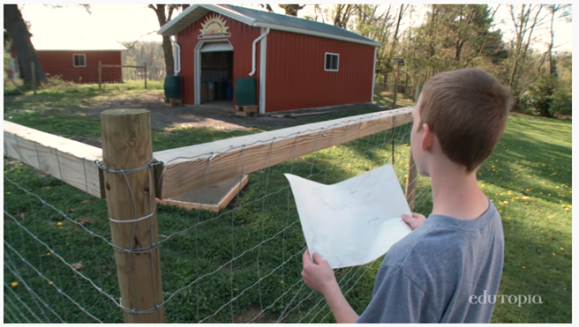
Real-World Problem Solving: Finding Solutions Through Projects
Crellin Elementary School
https://www.youtube.com/watch?v=sD7CZL9PpF4
Notes:
To Know/To Do: Pass out or direct attention to the “Schlechty Organizer 1 & 2”. Review its structure and purpose. It contains the 10 elements of design, and has spaces to note and remark whether the design elements are present. Participants will view the video, then comment on the presence of all the critical design elements. Allow participants to view, mark the organizer, and pair-share with colleagues or their team. Spend 3-5 minutes debriefing the video. Obviously we’re not all going to do a project that elaborate, but it has engagement-plus!
To Say: What one would expect to see and hear from engaged students?
Evaluate the video using the “Schlechty Organizer 1 & 2”.
Does the video contain the design concepts of context? Mark all you observe.
Does it contain design concepts of choice? Which ones?
Does it exemplify an engaging lesson?
How could you use projects in other situations
Handout: Schlechty Organizer 1 & 2
Reference: Edutopia, (2015, Nov. 11). Real-world problem solving: finding solutions through projects. [Video 5:23 min.] https://www.youtube.com/watch?v=sD7CZL9PpF4

Slide 51
A Student-Centered Model of Blended Learning
Eastern High School, Washington, D.C., 2019
https://youtu.be/zrR-KIoggf4
Notes:
To Know/To Do: Pass out a second Schlechty Organizer 1 & 2. Participants will view the video, then comment on the presence of all the critical design elements. Allow participants to view, mark the organizer, and pair-share with colleagues or their team. Spend 3-5 minutes debriefing the video.
To Say: Once again, look for Schlechty’s Critical Design Elements.
•On an organizer, mark all the design qualities you observe.
•Compare your organizer with that of a table partner or team member.
•What necessary elements were missing, if any?
•How could the lesson be improved?
Handout: Schlechty Organizer 1 & 2
Video Reference: Edutopia. (2019, May 9). A Student-Centered model for Blended Learning [Video file 5:48 min.] https://youtu.be/zrR-KIoggf4
Time and audience may dictate the best choice. Presenter knows the audience and can best make an appropriate choice for the second video.

Slide 52
Engaging Design Qualities Goals
The goal is not to redesign each lesson, or to present an alternate plan for writing lesson plans.
The goal is to purposely incorporate qualities that will enhance and promote student engagement.
Notes:
To Know/To Say: Can we begin with what teachers already have as lessons and incorporate the design qualities to create more engaging lessons? It’s important not to throw out everything, but learn how to enhance lessons and units with what we KNOW impacts student learning. Then we can consider the degree of attention, curiosity, interest, value, and perseverance that students show when they are learning or being taught. An engaged student is a motivated student.
Instead of “throwing the baby out with the bath water”, let’s look back at the lesson we brought with us and discussed while we looked at Schlechty’s design qualities.
To Do: Ask participants to pull out the lesson they were asked to bring prior to the workshop and as they read evaluate their lesson to see if their lesson meets Schlechty’s Critical Design Qualities using the organizer.
Handout: Schlechty Organizer 1 & 2

Slide 53
Enhance Lessons Using Strategies for Engaging Students Learners
Section 4
Notes:
Purpose: Provide opportunity for learners to discuss what application in the classroom looks like.
Content: Group discussion on what implementation looks like in a variety of contexts. This is a section that can be altered to best address your audience. Videos from Teaching Channel, or choose your own favorites from another source.

Slide 54
Strategies to Engage Students
When selecting strategies to engage students, consider if the student will be:
Working independently
Working in a small group of students
Working as a whole class
Working with technology
Notes:
To Know/To Say: Depending on the classroom setting, engagement may look a little different. We will spend a little time sharing ideas for each of these four classroom settings.
To Do: Use a consensus placemat with “student engagement” in the center and the four corners: “independent, small group, whole class, technology”. Pass the placemat out the participants in small groups to brainstorm common strategies that they use in their classrooms for each of the four settings. After sufficient time has passed, ask groups to share out the strategies on each placemat. As the presenter, keep a running list of strategies that can be compiled and shared with the entire group (either on the board or electronically).

Slide 55
Strategies to Engage Students
Use Questioning Strategies
Create a Culture of Explanation
(de Frondeville, 2009)
Notes:
To Say: Two strategies that are in the heart of engaging students are questioning and explanation. These two can lead to many other tried and true teaching strategies that support student engagement.
1. Use Questioning Strategies that make all students think and answer. Pay a visit to many classrooms and you'll see a familiar scene: The teacher asks questions and, always, the same reliable hands raise up. This pattern lends itself to student inattention. Every day, include some questions you require every student to answer. Find a question you know everyone can answer simply, and have the class respond all at once.
You can ask students to put a finger up when they're ready to answer, and once they all do, ask them to whisper the answer at the count of three. They can answer yes, no, or maybe with a thumbs-up, thumbs-down, or thumbs-sideways gesture. That also works for "I agree," "I disagree," or "I'm not sure."
Numerical answers under ten are easy to show with fingers, but don't limit yourself to math questions. For instance, if you're teaching time management, have students let you know what their progress is halfway through the class by putting up one or more fingers to show whether they are one-, two-, or three-quarters done with the assignment, or finished. Do these exercises at least two or three times per class.
2. Create a Culture of Explanation Instead of a Culture of the Right Answer. You know you have created a rich learning event when all students are engaged in arguing about the best approach to the assignment. When you use questions and problems that allow for multiple strategies to reach a successful outcome, you give students the opportunity to make choices and then compare their approaches. This strategy challenges them to operate at a higher level of thinking than when they can share only the "correct" answer. Avidly collect problems and tasks that have multiple paths to a solution. As a math teacher, I create problems that have a lot of numbers instead of the usual two. For example, I can present this problem:
5 + 13 + 24 - 8 + 47 - 12 + 59 - 31 - 5 + 9 - 46 - 23 + 32 - 60
Then I can say, "There are at least three fundamentally different strategies for doing the following problem. Can you find them all?“
To Say: What strategies did you list on your placemat that would fall into one of these two categories?
Reference: de Frondeville, T. (2009). Ten steps to better student engagement [blog post]. Retrieved from https://www.edutopia.org/project-learning-teaching-strategies.

Slide 56
Student Engagement: Resources Roundup
Keeping students captivated and ready to learn is no small task. This list of articles, videos, and other resources offers strategies and advice that can help.
https://www.edutopia.org/student-engagement-reources
(Cronin, 2011)
Notes:
To Do/To Say: This website on Edutopia provides a list of resources that teachers can explore. There are many strategies that can be used and this website only offers some of the many options. Participants can take time to explore the list either during training to share out ideas after 15 minutes; or this list can be used during coaching.
Website: https://www.edutopia.org/student-engagement-resources
Reference: Cronin, A. (2011). Student Engagement: Resource Roundup. Retrieved from: https://www.edutopia.org/student-engagement-resources, 2011
Schlechty Center. (n.d.). Introduction to the Schlechty Center. Retrieved from https://schlechtycenter.app.box.com/s/v0q4o9j9il36w17py9mjkxpgggq0gqyw.
Accessed 16 August 2017.

Slide 57
Student Engagement Digital Strategies
(SC Web Resources for Schoolwork)
Notes:
To Know/To Say: This website is by the Schlechty Center and spotlights the digital tools that are showing popularity by students and teachers around the country. Most of these sites have free use options. Most have an upgrade option for a cost.
There are many strategies that can be used and this website only offers some of the many options. Participants can take time to explore the list either during training to share out ideas after 15 minutes; or this list can be used during coaching.
Reference: Schlechty Center. SC Web Resources for Schoolwork. Retrieved from: http://learningtechno.weebly.com. Accessed 16 August 2017.

Slide 58
Engaging Student Learners Assessment and Reflection
Notes:
Purpose: Provide opportunity for the learners to reflect on their learning and potential implementation.
Content: Post-assessment learner knowledge; Reflect on personal teaching context and implementation

Slide 59
Revisiting: Guiding Questions
What connects student motivation and engagement?
What are components of high student engagement?
What actions, practices, strategies, and techniques promote high engagement for all learners?
How can teachers assess lessons and units for engaging qualities?
Notes:
To Say: These are the guiding questions from the beginning of training. Let’s take a moment and see how well we have answered each of the questions.

Slide 60
Assess Your Learning
How do teachers effectively engage students?
Notes:
To Know/To Do: Blanket the Table, take post-it notes and write one effective strategy that has been used in their classroom per post-it in 3 minutes. Tables organize strategies into categories (of the groups choosing).
This is a post-assessment, so participants should be encouraged to add ideas gathered from the day’s learning.

Slide 61
Engaging Student Learners Closing & Next Steps
Notes:
Purpose: Provide opportunity for learner to outline their implementation steps and plans for follow-up coaching.
Content:
Practice Profile
Self Assessment Practice Profile Workbook
Next Steps: Action = Results
Presenter Contact Information

Slide 62
Practice Profile
Engaging Student Learners Practice Profile
Essential Function |  | Exemplary Implementation | Proficient | Close to Proficient (Skill is emerging, but not yet to proficiency. Coaching is recommended.) | Far from Proficient (Follow-up professional development and coaching are critical.)
1 | Educator understands and plans for optimum student engagement. | All of the following criteria are met: Educator develops engaging lessons with clear learning targets and transparent success criteria. Educator plans for a range of instructional strategies in each lesson. Educator plans and implements lessons in which effective practices are used. Educator plans lessons that that require students to persevere. Educator implements lessons that require students to problem solve. | 4/5 criteria are met | 3/5 criteria are met | Fewer than three criteria are met
2 | Educator practices techniques that foster student engagement. | All of the following criteria are met: All Design Qualities of Context are present. One or more of the Design Qualities of Choice are evident in instruction. Educator consistently monitors and observes levels of student engagement during instruction and makes adjustments when needed. Educator provides opportunities for students to engage in self-assessment and reflection about their learning. | 3/4 criteria are met | 2/4 criteria are met | Fewer than two criteria are met
3 | Educator assesses and reflects on student engagement. | All of the following criteria are met: Educator provides formal opportunities for student input on their levels of engagement with lessons. Educator reflects on student engagement and plans for improvement based on observational notes. Educator reflects on student conversations and input for plans to improve student engagement. Educator expands on personal assessment and student input by using this information as a measure of personal growth and may share with colleagues, parents, and protégés. | 3/4 criteria are met | 2/4 criteria are met | Fewer than two criteria are met
Notes:
To Do: Review the practice profile with the participants. Suggest all stake-holders complete a self-analysis three or four times a year and engage in collaborative conversation.
To Know/To Say: The Practice Profile template includes four pieces and is anchored by the essential functions. First, as a header is the foundation of implementation that philosophically grounds implementation. Then moving from left to right across the template are the essential functions of the practice, implementation performance levels, and lastly, evidence which provides data or documentation for determining implementation levels.
The essential functions align with the teaching/learning objectives for each learning package. Four levels of implementation are described for each teaching/learning objective: exemplary, proficient, close to proficient, and far from proficient. The professional development provider should walk through the practice profile with the educator-learners, referring to the data and artifacts listed as suggested evidence. It is an important tool for self-monitoring their own implementation because it serves as a reminder as to the implementation criteria and is also aligned with the fidelity checklists and the electronic practice profile self-assessment tool. These sources provide data regarding further training or coaching.
To Do/To Say: The Red/Yellow/Green Reflection is an optional activity, if you want participants to learn more about the information in the profile.
1. Read through the Exemplary Implementation column.
2. Use three colored pencils or markers (red, green and yellow) to do the following.
If you feel an action stated may be challenging for you, underline it in red.
If you feel an action stated may be somewhat challenging but not too difficult, underline it in yellow.
If you feel an action stated may be easy for you underline it in green.
3. Share with a shoulder partner what you feel may be easy and challenging and tell why. Consider how to address the challenging items.
Handout: Engaging Student Learners Practice Profile

Slide 63
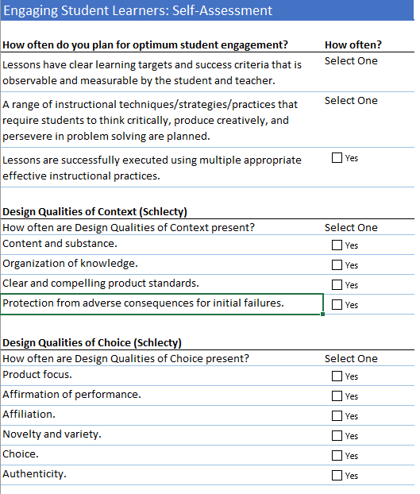
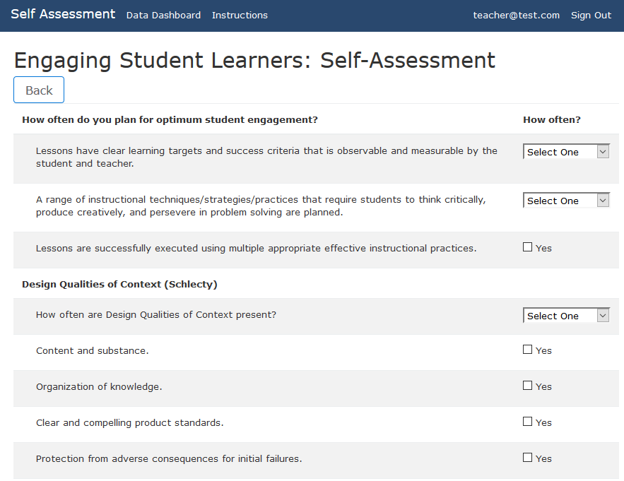
Self-Assessment Practice Profile
Excel Workbook
http://sapp.missouripd.org
Notes:
To Know/To Say: The Self Assessment Practice Profile Workbook is an excel document allowing individuals to determine their implementation level for a specific learning package topic. The self assessment is also available online at http://sapp.missouripd.org/. This self-monitoring tool may be utilized at the beginning, mid-points, and end of the year. These results from the staff may be compiled onto a Practice Profile and may be utilized for team discussion.
Reference: Available online at http://sapp.missouripd.org/

Slide 64
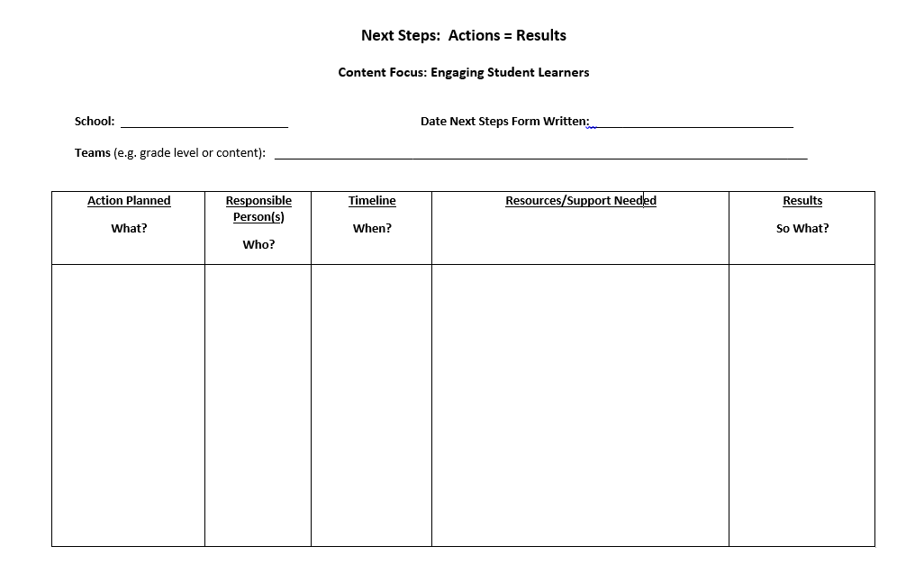
Next Steps: Action=Results
What steps will you take to start implementing?
Notes:
To Know: This template or another template may be used for planning next steps.
To Know/To Say: The Next Steps template is used for planning either today or back in your building. What resources do you need to begin focusing on Engaging Student Learners. What might be included in your timeline?
To Do: Complete the Next Steps template. Example is included in the learning package materials.
Handout: Next Steps: Action = Results

Slide 65
Contact Information
Please contact me to schedule follow-up coaching and/or additional professional development.
Notes:
To Know/To Say/To Do: Include presenter’s contact information.
Please contact me to schedule follow-up coaching and/or additional professional development. Thank you.

