Slide 1
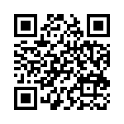
Access the Module
https://goo.gl/iUTmhc

Slide 2
Note to Trainers
This presentation is set up to accompany the following learning packages: CFAs and the selected Four Effective Learning Practices.
It is recommended to chunk this technology learning package by learning package content (plus intro and implementation slides)
HIDDEN SLIDE

Slide 3
Note to Trainers
Presenters need to look over each section before presenting to set up accounts and examples as needed.
Each participant needs to have access to a computer for the training, it is recommended for participants to also have earbuds. (*Computers are recommended over iPads)
Each section has different items that presenters/ participants need, since most sections will be presented separate from each other.
HIDDEN SLIDE

Slide 4
Note to Trainers
Before presenting this module, check to see technology available at the school and location of presentation.
If a school has no devices for student use and little to no wifi, they probably aren’t ready for this learning package.
If a school has some devices and some wifi, accommodations can be made using the Implementation Guide handout.
Check the access needed to present the topics in each chunk.
HIDDEN SLIDE
Notes:
Most chunks require the presenter to have internet access, Google Drive access, and speakers set up to the computer for audio.
While most videos are downloaded and in the file folder, the Spaced v. Massed chunk does require access to Youtube.
These are all things the check when considering the location of this presentation.

Slide 5

“Transforming Education with Technology”
by Marge Scherer (ASCD, February 2011)
Then respond to the Blog Post titled “Transforming Education with Technology” at kuperedtech.blogspot.com
Notes:
This article should be sent out as a pre-reading a couple of days prior to training. In addition to sending the article, also send the link ahead of time for posting prior to the training. The blog can be accessed anytime for participants to comment on the post using a Google Account. If your RPDC has a blog set up, please change the blog location.
About the Article: “Transforming Education with Technology” by Marge Scherer. February 2011, ASCD. http://www.ascd.org/publications/educational-leadership/feb11/vol68/num05/Transforming-Education-with-Technology.aspx

Slide 6

Using Technology to Support
Collaborative Work
Assessments, Collaboration, and Learning Practices
Notes:
Introduction of trainers.

Slide 7
Acknowledgements
Using Technology to Support Collaborative Work was rolled-out for use by Regional Professional Development Center (RPDC) Consultants in September 2015. The collection of learning packages and infographics was developed through efforts funded by the Missouri State Personnel Development Grant (SPDG). The following individuals/groups are thanked immensely for their hard work in developing this package:
Content Development Expertise Stephanie Kuper, Southeast RPDC
Content Development Support UMKC Institute for Human Development:
Carla Williams
Ronda Jenson
Stefanie Lindsay
SPDG Management Team
Artwork UMKC Institute for Human Development:
Jodi Arnold

Slide 8
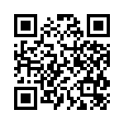
Pre Assessment
Complete the Pre-Assessment at:
https://goo.gl/FBJOAd
Notes:
The pre/post- assessment is applicable for all chunks of this module, providing that each chunk is accompanied with the introductory chunk (slides 3-14), and the implementation chunk (slides 100-end).
This is a link to a Google Form for the pre/post assessment. Making the pre/post online enhances the “technology” aspect of the package. The presenter would need to create their own Form since this links to Stephanie Kuper’s Google Drive. If the presenter is unable to create a form for the pre/post assessment, it is available in the module handouts.

Slide 9
Notes about Introduction Section
This section includes the Norms and Outcomes.
This section, along with the implementation section (slides 100-end) should be included with any of the other chunks presented.

Slide 10
Introductions
Meet the Presenter
Meet the Participants: Navigate to todaysmeet.com/kuper.
  Use your real name
  Give a brief introduction of your position at school and your experience with using technology. ** Watch your character count!
Notes:
First introduce yourself and give a brief biography about your experience in education and technology.
Then have participants complete the activity. This getting to know you activity will help the presenter assess the knowledge of the participants quickly. It will also help participants see that they aren’t the only person at a particular level. After posts and a brief discussion, the presenter can rearrange participants based on position in their schools or experience using technology.
Presenters need to create a free, 1 day room to use during training. Before moving on, show participants how to create a room and under “room tools” to ability to print the discussion.
Why use TodaysMeetin in the classroom:
Students can brainstorm collaboratively
Students can ask questions (C3B4ME) to other students
Students can post for immediate feedback

Slide 11
Norms
Be Respectful
  Be an active listener—open to new ideas
  Use todaysmeet.com/kuper for side bar conversations
Be Responsible
  Be on time for sessions and present until the end
  Silence cell phones—reply appropriately
Be a Problem Solver
  Ask questions as needed to clarify concepts or directions

Slide 12
Learner Outcomes
Participants will:
Examine and practice technology application to support Collaborative Work, including common formative assessments and the four selected effective learning practices.
Consider adjustments and accommodations necessary for implementation of technology.
Begin planning for effective implementation using technology in classroom instruction.
Notes:
These three outcomes are the focus of all chunks.

Slide 13
Missouri Teacher Standards
Standard 1: Content knowledge aligned with appropriate instruction.
  1.2: Student engagement in subject matter
Standard 2: Student Learning, Growth and Development
  2.2: Student goals
  2.4 Differentiated lesson design
  2.5: Prior experiences, learning styles, multiple intelligences, strengths and needs
Standard 3: Curriculum Implementation
3.2 Lessons for diverse learners
Standard 4: Critical Thinking
4.2 Appropriate use of instructional resources to enhance student learning
Standard 6: Effective Communication
  6.4: Technology and media communication tools
Standard 7: Student Assessment and Data Analysis
  7.1: Effective use of assessments
  7.2: Assessment data to improve learning
MO DESE (2013)
Notes:
Highlight that many of the standards can apply to different chunks throughout this learning package. Student engagement, lessons for diverse learners, enhancing student learning, differentiating instruction apply to most technology use, while “setting student goals” applies more to the ACL chunk, and Standard 7 applies more to the CFA chunk.
Reference: Missouri Department of Elementary and Secondary Education (2013). Missouri teacher standards: Missouri’s educator evaluation system. Retrieved from https://dese.mo.gov/sites/default/files/TeacherStandards.pdf.
More detailed information about the Missouri Teacher Standards can be found at:
https://dese.mo.gov/educator-quality/educator-effectiveness/educator-standards/teacher-standards

Slide 14
Teachers know that they must integrate technology into their lessons, and they finally have the equipment at their disposal.
Understanding why it should happen and how best to do it are often less clear.
Notes:
Teachers know it should happen, but why and how aren’t as easily answered.
“As a teacher who had 12 iPads in thrown at me one year to use in my classroom, I wasn’t told why iPads were the device of choice or even how to integrate it. So they sat unused for half the year until I started learning about the iPad on my own. All I needed to know what why and how- hopefully we will help answer those questions.”

Slide 15
Reasons to Integrate Technology
When done effectively, technology has a positive impact on student learning. It can:
Increase student motivation for learning
Improve communication of learning goals
Facilitate higher-order thinking skills
Build valuable skills that students will use in college and in the workplace
Expand students' understanding from novice to mastery
Notes:
Here is the “why”- fairly comprehensive list that highlights reasons to integrate technology. **Time permitting, ask participants to add any other reasons they can think of to todaysmeet.com.
This list links directly to the pre-reading article by Marge Scherer.
http://www.glencoe.com/sec/teachingtoday/subject/tech_integration.phtml

Slide 16
Integrating Technology
Technology is most beneficial when it facilitates learning and provides activities that couldn’t occur without the technology. It also provides more flexibility for the time, place, and pace at which learning can occur. Paraphrased from (Naidu, 2008).
An analysis by the U.S. Department of Education (Means et al., 2010) also found that blended learning environments are more effective than either online learning or face-to-face learning alone.
U.S. Department of Education (2010)
Notes:
Highlight: “Facilitates learning and activities that couldn’t occur without technology”- this was one of the questions on the pre-assessment.
Highlight: “Blended learning environments are more effective than either online or face-to-face alone.”- this was also on the pre-assessment.
Handbook of Research on Educational Communications and Technology: A Project of the Association for Educational Communications and Technology. David Jonassen, et al. First Published in 2008.
Reference: U.S. Department of Education, Office of Planning, Evaluation, and Policy Development (2010). Evaluation of evidence-based practices in online learning: A meta-analysis and review of online learning studies. Washington, D.C. Retrieved from http://www2.ed.gov/rschstat/eval/tech/evidence-based-practices/finalreport.pdf

Slide 17
According to research on strategies that help students who are struggling, computer- assisted instruction contributes to the learning of at-risk students because it is nonjudgmental and motivational, provides frequent and immediate feedback, can individualize learning to meet students’ needs, allows for more student autonomy, and provides a multisensory learning environment.
-Barley et al., 2002
Using Technology with Classroom
Instruction that Works
Notes:
Ask participants to read silently. Highlight that this is a quote from 2002- but is it still relevant? ABSOLUTELY! This is what the Collaborative Work Project is all about- helping to close the gap with our SWD. This is one consideration we should always think about when beginning to implement any new tool: How am I going to accommodate this for my struggling learners and how am I going to help them if they struggle with the tool?– This relates directly to on of the pre-assessment questions.
Using Technology with Classroom Instruction that Works, pg. 169

Slide 18
Technology Lesson Guidelines
Remember to remain focused on the purpose of each activity. Use the following tips to guide you in your technology integration efforts:
Clearly define learning objectives for each lesson.
Align lessons with content standards.
Prepare learning assessment tools in advance.
Share assessment methods with students.
Familiarize yourself with the technology before using it in the classroom.
Be prepared with a back-up lesson in case technology malfunctions.
Notes:
We should always clearly define our objectives with any lesson, but especially with technology. Kids need to understand WHY they are using these tools- they aren’t toys for playing games, they are tools for learning.
Always align lessons with content standards
Always decide how the objective will be assessed- is the technology tool the assessment or do you need a scoring guide or rubric prepared to assess the end result. ALSO Share the assessment method with students so they know the expectations. (This relates to on of the pre-assessment questions)
Familiarize yourself with technology. Teachers do NOT have to know every think about a tool they are using. They need to know the BASICS! Be able to show students an example, give a brief tutorial, and be able to problem-solve if students are struggling (these three points are on the pre-assessment). Kids are going to show teachers new cool tricks, no matter how big of an expert you may think you are.
Always be prepared with a back-up plan. Why? What if the school’s server is down? What if it is storming outside? What if it is testing time and teacher’s need to be off the bandwidth? What if the tool is a total flop? – don’t scratch technology altogether, maybe just try a different tool (For example change Google Forms for Socrative that might be a littles easier for students to navigate.)
This slide “Lesson Guidelines” is somewhat of a reference to the first Technology Learning Package “Using Technology in Classroom Instruction” which discusses how to plan lessons to include technology, technology standards, etc. For more information on lesson planning, please refer to that learning package. It is by no means a “prerequisite” for this presenting this learning package.
This article was contributed by Elizabeth Melville, an eLearning consultant and editor of Teaching Today. http://www.glencoe.com/sec/teachingtoday/subject/tech_integration.phtml

Slide 19
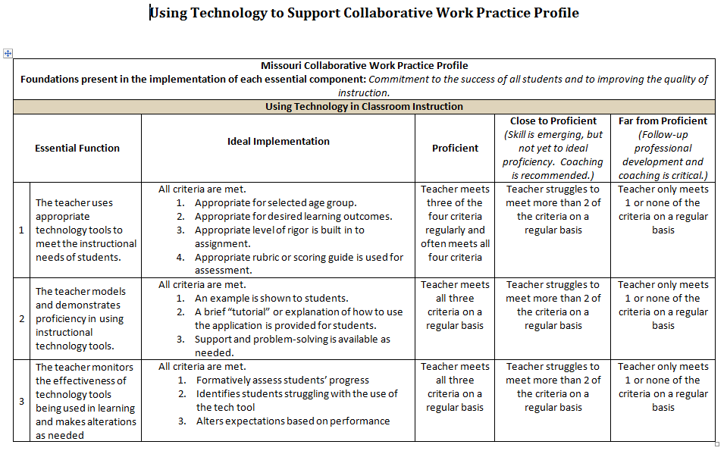
Practice Profile
Notes:
Review Practice Profile with participants.
Essential Function 1,2, 3 were all discussed in the notes on slide 16 and will be addressed in each of the “chunks” throughout the package.

Slide 20
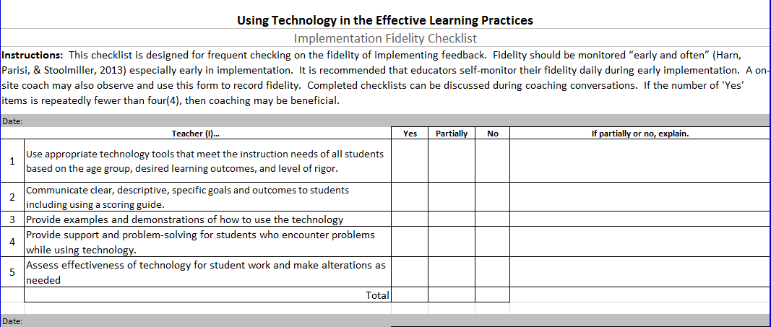
Fidelity Checklist
Notes:
Review Fidelity Checklist with participants.
This alights hand-in-hand with the practice profile and notes from slide 16.

Slide 21
Using Technology to Support
Collaborative Work
Common Formative Assessments
Notes:
In assessment, participants will need a Google Account. Most of this section utilizes Google Forms. Participants should also be encouraged to bring at least one assessment to use during this section of the training.

Slide 22
Notes about CFA Chunk
This chunk should take approximately 1-2 hours (depending on how much time participants are allowed to create their own forms on Google.)
Before delivering this chunk, check with schools and/or presentation location to ensure that Google Drive will be available for participants to use.
Presenter should have knowledge of OpenEd, Socrative, and Google Forms.
HIDDEN SLIDE
Notes:
Tools/Website in this chunk include:
OpenEd.com (need an account)
Socrative.com/ Socrative App (need an account)
Google Forms (need Google account)
All free tools and free accounts

Slide 23
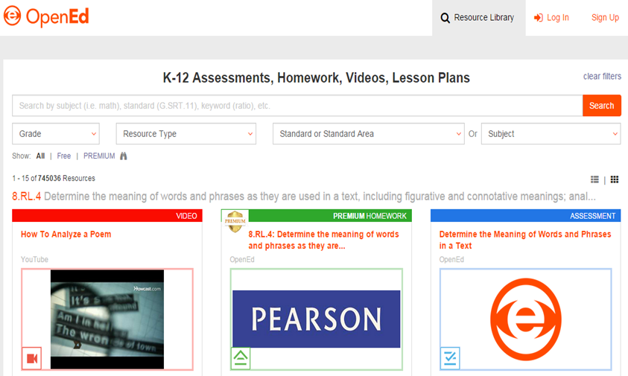
OpenEd
OpenEd allows teachers to create online classes for students and access to the free resource library of videos and assessments, sorted by content and standard.
Notes:
*This is a tool for teachers to use, not for students to use!
Have participants navigate to opened.com and walk them through the basic features of the resource library. Since this is the CFA section, limit the content to searching for assessment items.
To access content. Navigate to “resource library” on the top and then search by grade level, content area, standards, and resource type (videos or assessment). This is a huge library of free content for teachers to use. If the resource is marked “Premium” it is a paid resource. Look over one example of an assessment item in ELA, there is a reading passage and questions to go with.
This tool helps teachers find and create CFAs. The next tools shown help teachers assess CFAs digitally.

Slide 24

Socrative
Easy to use free website and app for taking quick assessments and pre-planned assessments.
Notes:
*This is a tool for students to take assessments. It can be taken on desktops, laptops, macbooks, iPads, phones, etc. It works best in a 1:1 setting, but can be adapted for classrooms with limited devices. For example, Socrative can be use as a “center” in the elementary classroom, or a “station” in the secondary classroom. It can also be used by putting one device with three or four students and ask them to discuss the questions and come to a consensus on the answer before entering the answer.
Socrative can be used at www.socrative.com or using the teacher/student apps on the iPad.
Presenters should create a basic socrative quiz to show as an example. Ask the participants to log in as “students” to experience what Socrative is like for students, while projecting the teacher dashboard. After participants take a “quick assessment” made up on the spot then do “start a quiz” for participants to take quiz, finally engage a brief discussion about the ease with which the “student” side of Socrative works. *Note: students get immediate feedback, which is important for all students, but especially SWD. Ask, “how easy is socrative to navigate on the “student” side?
As the presenter, click “finish quiz” and show participants the report that is generated by downloading the report and opening the Excel file that is automatically created for you. This file shows student answers, the questions that students struggled with the most, etc. This allows teachers to quickly assess the effectiveness of instruction, identify students for grouping, and quickly and easily complete the CFA Data form!
Then have participants to go back to Socrative.com and set up teacher accounts. Walk participants through the basic features on the dashboard “room name” can be changed under settings, user profile. The main four tiles: start quiz and quick quiz you showed then as they were students. Space race allows students to take the quiz but there is a “race” on the board- no student names, only colors (This can be chosen instead of “start quiz”.) And “exit ticket” is a standard couple of questions.
Under the tab at the top left side of the screen, click on “Manage quizzes”. The four tiles here are “create quiz”- show participants the ease with which teachers can create a quiz, move questions around, and trash questions. During this time, allow teachers to enter a few questions on their own devices. *Note: the CFA Learning Package has items on developing high-quality multiple choice items! Another tile is “import quiz” where they can import from another teacher or from an excel file. “My quizzes” allows you to see and edit the quizzes you have entered”. And “Reports” allows teachers to view reports from all assessments.
Ask, “how easy is socrative to navigate on the “teacher” side?

Slide 25
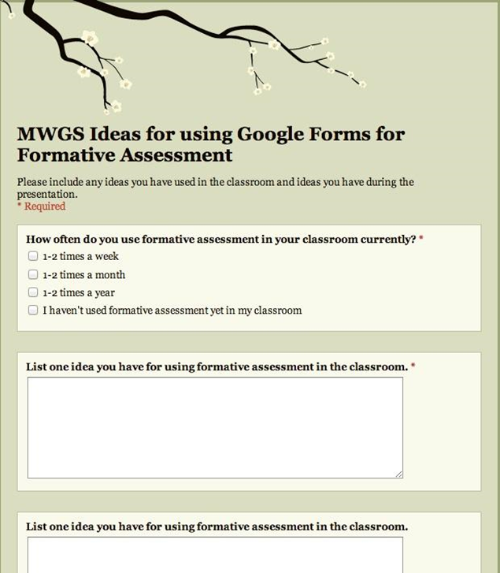
Using Google Forms for Formative Assessment
allows for test to be used as formative or summative depending on how data is used
feedback is immediate
learning can move forward quickly
learners can take responsibility for own learning through formative assessment
Notes:
Originally Google Forms was created as a “survey tool” but as educators, we can use it to collect data and use as formative or even summative assessments.
*Note: students get immediate feedback, which is important for all students, but especially SWD.
*Note: students can take responsibility for their own learning by seeing immediate results, which relates to the Assessment Capable Learner learning package.

Slide 26
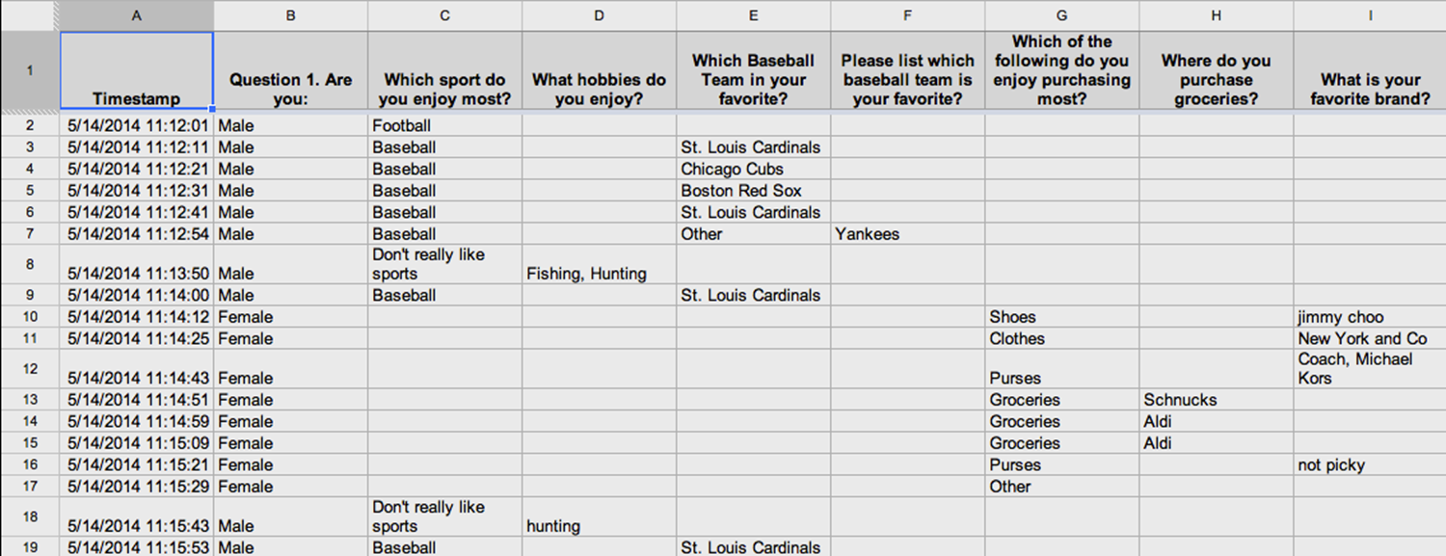
Results in Spreadsheet Format
Notes:
Once a form – or assessment- has been completed by students, Google automatically creates a spreadsheet with results of the form.

Slide 27
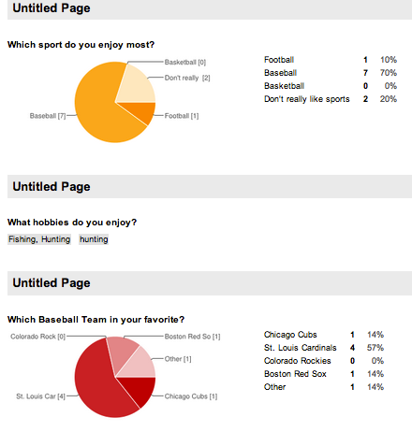
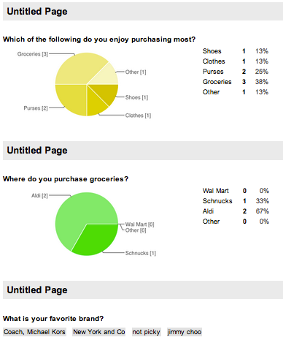
Results in Graphic format
Notes:
When in the Google Form, you can access graphics by going to “summary of responses” in the form.

Slide 28
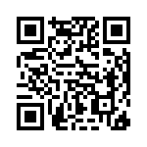
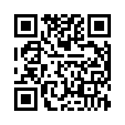
Lets Try it Out
Switching to Computer Adaptive Testing Article
Article:
http://goo.gl/E7KQmL
Assessment:
http://goo.gl/BApoyZ
Notes:
These links/QR codes take the participants to an article to read and then an assessment on Google Forms. Participants to need to open TWO tabs on their browser and type in the links on each tab. The Google shortened URL is case sensitive!
After participants complete this process, discuss the need for students to practice testing online, and scrolling through reading passages online, and toggling back and forth across multiple tabs. This a skill that students need to be taught in the classroom.
Discuss: Google Forms works best in a 1:1 environment, but adaptions can always be made for classrooms with limited devices. If there is an iPad or Chromebook or laptop cart that teachers have access to for a day, that would work well too; likewise a computer lab. Otherwise, if there are just a few devices in the classroom, teachers can set the Form up on a computer for “center” work or a “station” for students to rotate to in order to complete their assessment.

Slide 29
Form Overview
Building your first form:
- Title your assessment
- Basic “tour” of Forms
- Question Types
- Required Responses
- Confirmation Settings
- Sharing the Form
Notes:
Have participants open Google Drive, go to “Create” and select “form”. Walk participants through the basics of the building a form.
Start in the top left corner of the screen and work across and then down (like you are reading a book)- this is the best and easiest way to discuss a website. *Note: you don’t have to discuss what every button or menu will do, just focus on the basic tool bar, and the points listed.
As the presenter, create a form for your favorite movie with different question types, explaining as you go. Be sure to insert one video and a question about the video so participants can see that option.
For a quick refresher, visit a tutorial on Google Forms at: https://www.youtube.com/watch?v=8NNTGlwh11k – a “live tutorial” during the presentation is more helpful than watching a video tutorial with participants.

Slide 30
Time to Practice
Everyone has 15 minutes to create a form with the following features:
Title
Three questions (different question types)
Use any pre-made theme you want
Share the link with 2 other people in sitting close to you, for them to complete (you will also need to complete 2 for others)
Notes:
Try to give participants around 15 minutes to create an assessment. As the presenter, judge how the participants are doing. They may need more or less time here.
Ideas for teachers to create a form: a student survey, an assessment they know will be coming up soon, or a fun assessment about their “favorite movie” if they can’t think of anything else.

Slide 31
Using Technology
On Your Own:
  Take a few moments to think of how you can use these applications for Common Formative Assessments.
  What will need to be tailored for your classroom?
  What differentiation is needed for SWD and advanced students?
  How will the applications be assessed?
Notes:
Hand out the document for implementation titled “Implementing Technology”. Allow participants some time to deepen this discussion and take notes.
Note: This form is the last slide on each of the “chunks” in this learning package. It relates directly to the pre-assessment:
Making accommodations for age/maturity of students, and consider how to use technology whether they are 1:1 with technology or have limited technology to use with students. Also, note that accommodations need to be identified for SWD and advanced level students- not necessarily grade-level since the tool is geared towards to middle-of-the-road students already.

Slide 32
Using Technology to Support
Collaborative Work
Effective Learning Practices
Notes:
The four effective learning practices can also be broken into separate sections based on participant needs. If a school is only implementing two of the practices, then only those two should be presented.

Slide 33

Assessment-Capable Learners
Students have a clear understanding of the learning target; know where they are relative to mastery of the target based on descriptive feedback; set and monitor their own achievement goals; and know how they can revise or refine their performance to achieve that target.
Adapted from S. Brookhart, (2012); J. Chappuis (2009); J. Hattie (2012), and J. Atkin, P. Black, &J. Coffey, (2001).
Notes:
Hattie (Visible Learning, p. 31) relates a caution: “Students are very adept at knowing how to rate their performance. If these ratings are too low, then such expectations of performance can set limits of what students see as attainable. Hence, there is power in teachers setting more challenging goals, engaging students in the learning towards these goals, and giving students the confidence to set and attain their goals. A student’s own predictions of their performance should not be the barriers to exceeding them, as they are for too many students.”
Moss, C. & Brookhart, S. (2012). Learning targets: Helping students aim for understanding in today's lesson. Alexandria, VA: ASCD.
Chappuis, J. (2009). Seven strategies of assessment for learning. Boston, MA: Allyn & Bacon.
Hattie, J. (2012). Visible learning for teachers: Maximizing impact on learning. London, UK: Routledge.
Atkin, J. M., Black, P., & Coffey, J. (2001). Classroom assessment and the National Science Education Standards. Washington, DC: National Academy Press.

Slide 34
Notes about ACL Chunk
This chunk should take approximately 1 hour (depending on how much time participants are allowed to play with the specified tools.)
Before delivering this chunk, check with schools and/or presentation location to ensure that Google Drive will be available for participants to use.
Presenter should have knowledge of Microsoft Word, Excel, Google Drive, and the portfolio apps.
HIDDEN SLIDE
Notes:
Tools used in this chunk:
Excel
Word
Google Drive – need a free Google account
Evernote website/app- need a free account
LiveBinder website-need a free account
Seesaw App- need a free account
Three Ring website/app- need a free account
Weebly website- need a free account
Personality and Social Behavior Bulletin: 1995.
Low Need Achievers' Performance: The Positive Impact of a Self-Determined Goal
Harry L. Hom Jr.
Marilyn D. Murphy
Also featured in: “Seven Strategies of Assessment FOR learning” by Jan Chappuis (2009)

Slide 35
Using Technology with Assessment Capable Learners
Research shows that allowing students to set some of their own learning goals increases their motivation to learn (Hom & Murphy).
Technology enhances this process by helping students to organize, clarify, and communicate learning objectives.
Technology also provides teachers with access to resources that can help them to identify and refine standards and objectives.
Notes:
This slide refers to the “WHY” on slides 12 and 13 in the Introduction section.
Personality and Social Behavior Bulletin: 1995.
Low Need Achievers' Performance: The Positive Impact of a Self-Determined Goal
Harry L. Hom Jr.
Marilyn D. Murphy
Also featured in: “Seven Strategies of Assessment FOR learning” by Jan Chappuis (2009)

Slide 36
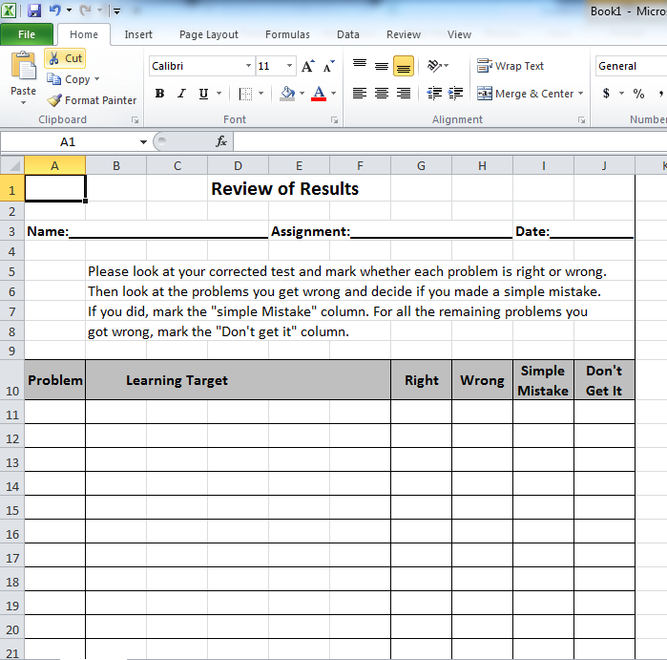
Review of Results using Excel
A review of results spreadsheet can be created on Microsoft Excel or Google Sheets.
Notes:
Allow time for participants to follow along with the directions on the next few slides. (The Review of Results is available in the handouts section, so participants can take time to re-create this document on Microsoft Excel or Google Sheets. *It can also be created on Mac computers using the Numbers App, but it will look different and formulas are different as well.)
While the document itself can be create on Microsoft Word or Google Docs, Excel allows for automatic calculating with formulas (shown on the next few slides)
Form adapted from “Seven Strategies of Assessment for Learning” by Jan Chappuis (2009), pg. 212

Slide 37
Review of Results on Spreadsheet Software
An added benefit of using Spreadsheet software, such as Microsoft Excel, is that students and/or teachers can create automatic formulas to calculate totals of students evaluations.
Notes:
Note the formula entries on the next slide are the same for both Microsoft Excel and Google Sheets.

Slide 38
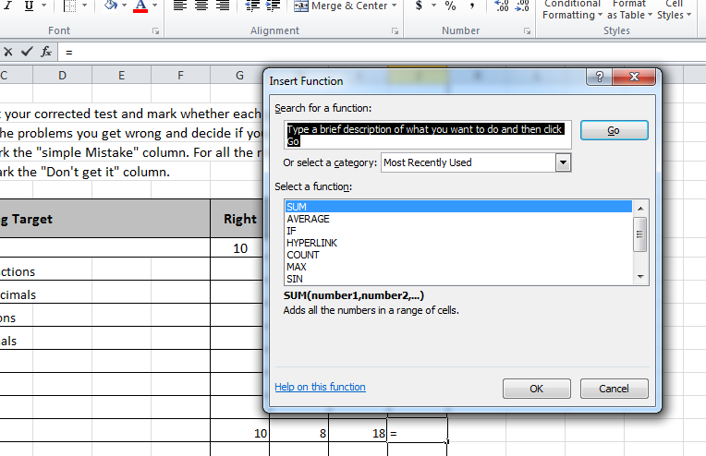
Creating Formulas to Auto Calculate
To set a formula for the cell circled at the bottom, you select the cell and then click the “fx” button above the spreadsheet
SUM is already selected, so click “OK”
Notes:
Walk participants through this process on slides 36-38 and then give a few moments for participants to practice, if needed.
Sum and Average are both at the top of the opened window.

Slide 39
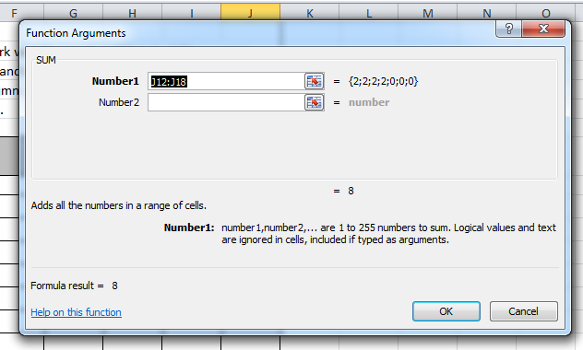
Creating Formulas to Auto Calculate
After Clicking “OK” on the previous box, this box will appear. This is simply asking which cells need to be included in the SUM. Then Click “OK”.
Notes:
Walk participants through this process on slides 36-38 and then give a few moments for participants to practice, if needed.

Slide 40
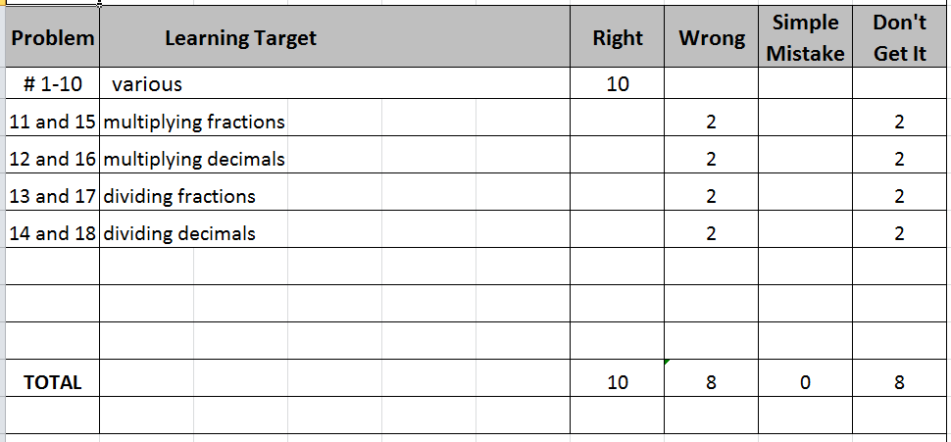
Example of the Review of Results Document with Calculations
Notes:
This document requires students to think about more than just if the answer is wrong, it makes students questions why they got it wrong. Teachers and students can easily see patterns for using a document like this.
Form adapted from “Seven Strategies of Assessment for Learning” by Jan Chappuis (2009), pg. 212

Slide 41
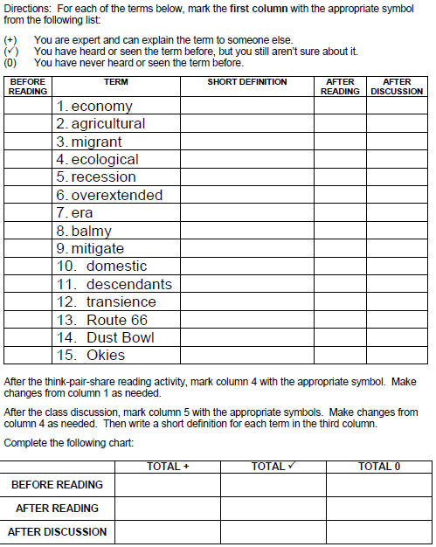
Self-Assessment with Vocab
This is a sample document that was created in Microsoft Word.
How might a document like this help guide student learning?
Notes:
Students look over the list of vocabulary words and gauge their knowledge before the reading activity, after the reading activity, and after a discussion of the reading and words. Ideally, the number of words students feel proficient in will increate in each column.

Slide 42
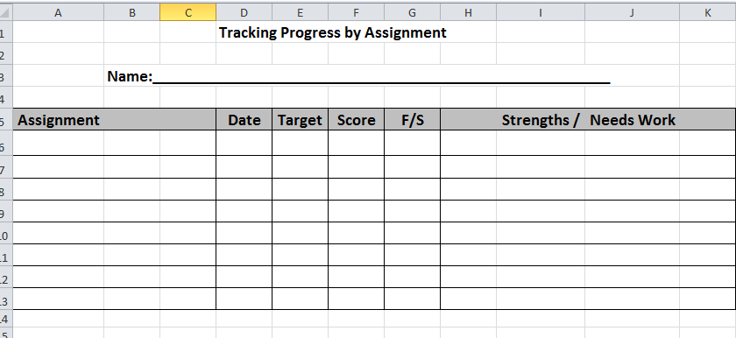
Progress Tracker using Spreadsheet Software
This spreadsheet is created using very basic functions for teachers and students who are new to spreadsheet software.
Notes:
While this was create on Microsoft Excel, it could also be created in Microsoft Word using the “Charts” functions for those participants who feel more comfortable using Word.
Form adapted from “Seven Strategies of Assessment for Learning” by Jan Chappuis (2009), pg. 243
“F/S” on the fifth column stands for Formative or Summative Assessment

Slide 43
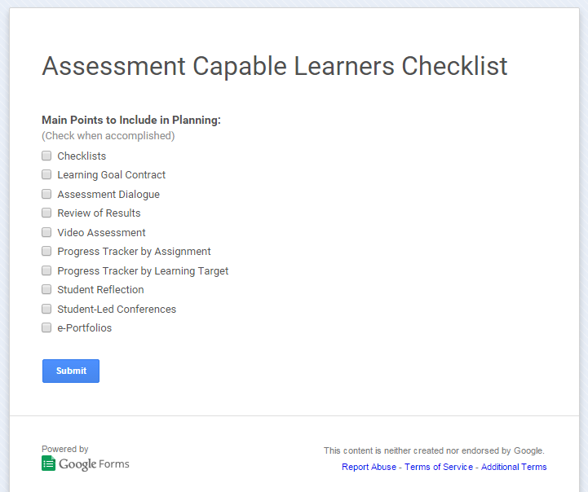
Google Forms Student Checklist
Create a Google Form for students to assess their learning on a checklist.
Notes:
Using a check list allows students to check and make sure they have completed all aspects of the assignment before turning it in.
For slides on creating a Google Form, please see slides 23-27 and use as needed.

Slide 44
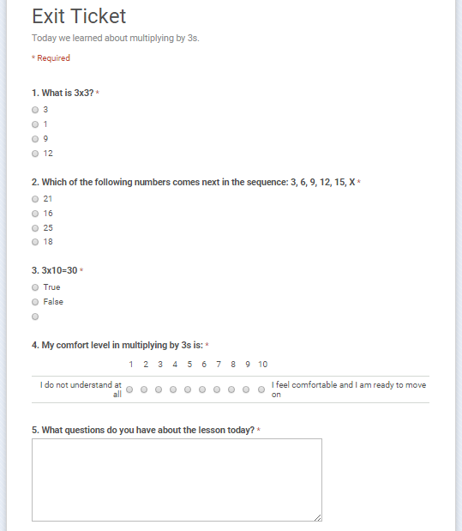
Google Forms Student Exit Slips
Create a Google Form for students to assess their learning on an exit ticket.
Notes:
For slides on creating a Google Form, please see slides 23-27 and use as needed.

Slide 45
Student ePortfolios
Students can create digital portfolios using:
Evernote
LiveBinder
Seesaw
Three Ring
Weebly
“The real contents of a portfolio are the child’s thoughts and his or her reasons for selecting a particular entry ... We need to discover the ever growing metacognitive voices of our children – voices that we (teachers) train to become competent and thoughtful tellers of the stories of their learning” (Herbert, 1998, p. 584).
Notes:
Note: The quote is from 1998, but is still completely relevant to the use of student portfolios. *This also ties to the metacognition learning package.
Quote from: http://www.edu.gov.on.ca/eng/literacynumeracy/inspire/research/studentselfassessment.pdf

Slide 46
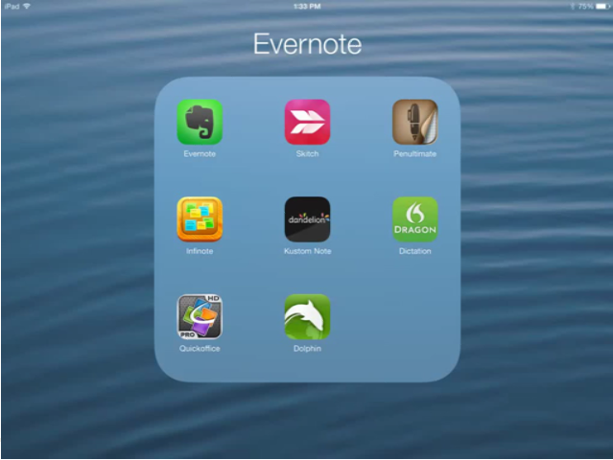
Evernote.com Free website/app
https://www.youtube.com/watch?v=l1jEJtdk2JY&app=desktop
Notes:
To access this video, the image on the slide is hyperlinked or you can click on the web address below.
Video: https://www.youtube.com/watch?v=l1jEJtdk2JY&app=desktop

Slide 47
Evernote.com Student Example
Notes:
Student Example:
After viewing the example, give participants 5-10 minutes to explore the website and/or app. The discuss the questions below.
As the facilitator, pose questions to deepen participant discussion:
What grade levels would you recommend this program be used?
Would this be an easy program for students to use?
Which features seemed to be user-friendly/unfriendly?
Did you notice any security features like passwords and sharing?
What requirements are necessary for students to be able to use the program?
How much time would you imagine it would take to set up your students on the program?

Slide 48

Livebinder.com Free website
https://www.youtube.com/watch?v=9hK6BeE9HCQ
Notes:
To access this video, the image on the slide is hyperlinked or you can click on the web address below.
Video: https://www.youtube.com/watch?v=9hK6BeE9HCQ

Slide 49
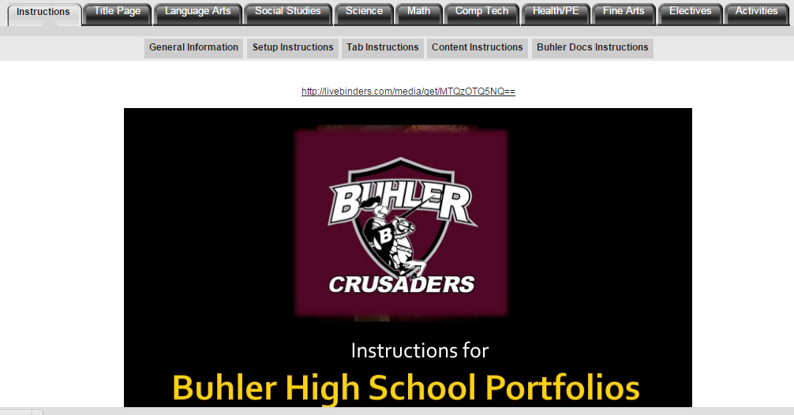
Livebinder.com Student Example
Buhler High School Electronic Portfolio Instructions
http://www.livebinders.com/play/play?id=214871
Notes:
Student Example: http://www.livebinders.com/play/play?id=214871
Basic: http://www.livebinders.com/play/play?id=10342
After viewing the example, give participants 5-10 minutes to explore the website and/or app. The discuss the questions below.
As the facilitator, pose questions to deepen participant discussion:
What grade levels would you recommend this program be used?
Would this be an easy program for students to use?
Which features seemed to be user-friendly/unfriendly?
Did you notice any security features like passwords and sharing?
What requirements are necessary for students to be able to use the program?
How much time would you imagine it would take to set up your students on the program?

Slide 50

Seesaw App Free website/app
https://www.youtube.com/watch?v=IGsqBf0ImE4&feature=youtu.be&list=PLb__lPS6CQsBXEFRgRoTv4_a26C4fYhvN
Notes:
To access this video, the image on the slide is hyperlinked or you can click on the web address below.
Video: https://www.youtube.com/watch?v=IGsqBf0ImE4&feature=youtu.be&list=PLb__lPS6CQsBXEFRgRoTv4_a26C4fYhvN
After watching the video, give participants 5-10 minutes to explore the website and/or app. The discuss the questions below.
As the facilitator, pose questions to deepen participant discussion:
Would this be an easy program for students to use?
Which features seemed to be user-friendly/unfriendly?
Did you notice any security features like passwords and sharing?
What requirements are necessary for students to be able to use the program?
How much time would you imagine it would take to set up your students on the program?

Slide 51
Seesaw App Student Example
Notes:
Student Example:
After viewing the example, give participants 5-10 minutes to explore the website and/or app. The discuss the questions below.
As the facilitator, pose questions to deepen participant discussion:
What grade levels would you recommend this program be used?
Would this be an easy program for students to use?
Which features seemed to be user-friendly/unfriendly?
Did you notice any security features like passwords and sharing?
What requirements are necessary for students to be able to use the program?
How much time would you imagine it would take to set up your students on the program?

Slide 52
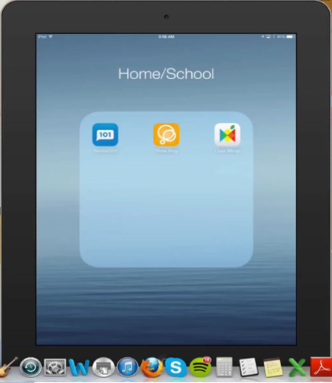
Three Ring Free website/app
https://www.youtube.com/watch?v=ZXzqusSGCFc&app=desktop
Notes:
To access this video, the image on the slide is hyperlinked or you can click on the web address below.
Video: https://www.youtube.com/watch?v=ZXzqusSGCFc&app=desktop

Slide 53
Three Ring Student Example
Notes:
Student Example:
After viewing the example, give participants 5-10 minutes to explore the website and/or app. The discuss the questions below.
As the facilitator, pose questions to deepen participant discussion:
What grade levels would you recommend this program be used?
Would this be an easy program for students to use?
Which features seemed to be user-friendly/unfriendly?
Did you notice any security features like passwords and sharing?
What requirements are necessary for students to be able to use the program?
How much time would you imagine it would take to set up your students on the program?

Slide 54

Weebly Free Website
https://www.youtube.com/watch?v=_aQSo1fB6W0&app=desktop
Notes:
To access this video, the image on the slide is hyperlinked or you can click on the web address below.
Video: https://www.youtube.com/watch?v=_aQSo1fB6W0&app=desktop

Slide 55
Weebly Student Example
Notes:
Student Example:
After viewing the example, give participants 5-10 minutes to explore the website and/or app. The discuss the questions below.
As the facilitator, pose questions to deepen participant discussion:
What grade levels would you recommend this program be used?
Would this be an easy program for students to use?
Which features seemed to be user-friendly/unfriendly?
Did you notice any security features like passwords and sharing?
What requirements are necessary for students to be able to use the program?
How much time would you imagine it would take to set up your students on the program?

Slide 56
Using Technology
On Your Own:
  Take a few moments to think of how you can use these applications for Assessment Capable Learners.
  What will need to be tailored for your classroom?
  What differentiation is needed for SWD?
  How will the applications be assessed?
Notes:
Hand out the document for implementation titled “Implementing Technology”. Allow participants some time to deepen this discussion and take notes.
Note: This form is the last slide on each of the “chunks” in this learning package. It relates directly to the pre-assessment:
Making accommodations for age/maturity of students, and consider how to use technology whether they are 1:1 with technology or have limited technology to use with students. Also, note that accommodations need to be identified for SWD and advanced level students- not necessarily grade-level since the tool is geared towards to middle-of-the-road students already.

Slide 57
Feedback
Feedback is an effective teaching/learning practice and is defined as an integral aspect of instruction and learning utilizing information provided by an agent (e.g. teacher, peer, book, parent, self/experience, computer) regarding aspects of one’s performance or understanding.
Feedback includes feedback to students as well as FROM students in terms of what students know, what they understand, and when they have misconceptions.
visiblelearningplus.com
Notes:
“To be effective, feedback needs to be clear, purposeful, meaningful and compatible with students’ prior knowledge, and to provide logical connections” (Visible Learning, p. 177-178)
Hattie, J. (Ed.). (2009). Visible learning: A synthesis of over 800 meta-analyses relating to achievement. London, UK: Routledge.

Slide 58
Note about Feedback Chunk
This chunk should take approximately 1 hour (depending on how much time participants are allowed to play with the specified tools)
Before delivering this chunk, check with schools and/or presentation location to ensure that Google Drive will be available for participants to use.
Presenter should have knowledge of Kahoot, Socrative, Google Drive, Blogspot, and Screencast-o-matic.
HIDDEN SLIDE
Notes:
Technology used in this package:
Kahoot- free account
Socrative- free account
Google Docs-free Google account
Blogspot/Blogger- free Google account
Screencast-O-Matic- free account

Slide 59
Why use Technology for Providing Feedback?
Research shows that the more immediate the feedback is in classroom settings, the greater its impact on student behavior (Kulik & Kulik, 1988).
Technology is especially effective when it comes to providing this kind of feedback. Games and simulations, for example, allow teachers and students to get near-instantaneous feedback during the learning process, allowing for immediate redirection or correction of misconceptions.
Notes:
This slide refers to the “WHY” on slides 12 and 13 in the Introduction section.
Using Technology with Classroom Instruction that Works http://www.ascd.org/publications/books/112012/chapters/Setting-Objectives-and-Providing-Feedback.aspx

Slide 60
Socrative
Easy to use free website and app for taking quick assessments and pre-planned assessments.
Notes:
*This is a tool for students to take assessments. It can be taken on desktops, laptops, macbooks, iPads, phones, etc. It works best in a 1:1 setting, but can be adapted for classrooms with limited devices. For example, Socrative can be use as a “center” in the elementary classroom, or a “station” in the secondary classroom. It can also be used by putting one device with three or four students and ask them to discuss the questions and come to a consensus on the answer before entering the answer.
Socrative can be used at www.socrative.com or using the teacher/student apps on the iPad.
Presenters should create a basic socrative quiz to show as an example. Ask the participants to log in as “students” to experience what Socrative is like for students, while projecting the teacher dashboard. After participants take a “quick assessment” made up on the spot then do “start a quiz” for participants to take quiz, finally engage a brief discussion about the ease with which the “student” side of Socrative works. *Note: students get immediate feedback, which is important for all students, but especially SWD. Ask participants “how easy is socrative to navigate on the “student” side?
As the presenter, click “finish quiz” and show participants the report that is generated by downloading the report and opening the Excel file that is automatically created for you. This file shows student answers, the questions that students struggled with the most, etc. This allows teachers to quickly assess the effectiveness of instruction, identify students for grouping, and quickly and easily complete the CFA Data form!
Then have participants to go back to Socrative.com and set up teacher accounts. Walk participants through the basic features on the dashboard “room name” can be changed under settings, user profile. The main four tiles: start quiz and quick quiz you showed then as they were students. Space race allows students to take the quiz but there is a “race” on the board- no student names, only colors (This can be chosen instead of “start quiz”.) And “exit ticket” is a standard couple of questions that can be used quickly to gather feedback from students to teachers about their understanding of the lesson on any given day.
Under the tab at the top left side of the screen, click on “Manage quizzes”. The four tiles here are “create quiz”- show participants the ease with which teachers can create a quiz, move questions around, and trash questions. During this time, allow teachers to enter a few questions on their own devices. *Note: the CFA Learning Package has items on developing high-quality multiple choice items! Another tile is “import quiz” where they can import from another teacher or from an excel file. “My quizzes” allows you to see and edit the quizzes you have entered”. And “Reports” allows teachers to view reports from all assessments.
Ask, “how easy is socrative to navigate on the “teacher” side?

Slide 61
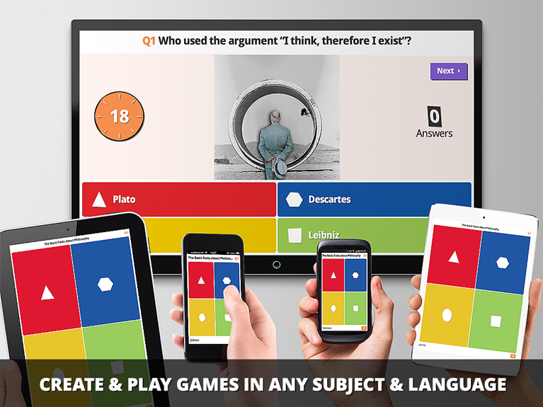
Kahoot!
Add videos and quizzes for students to take in a fun, interesting way!
Notes:
Presenters should create a basic kahoot to show as an example by going to getkahoot.com. Participants will experience a kahoot as a student by navigating to “kahoot.it” in their web browser.
Teachers create accounts at getkahoot.com
Students log in to teachers rooms using the URL: kahoot.it
After participants experience the “student” side of Kahoot, ask “how easy is Kahoot to use as a student?” Then ask participants to navigate to “getkahoot.com” and create their free teacher accounts. Discuss how teachers can give immediate feedback after each question about why each question was incorrect.
With the teacher dashboard will be displayed on the screen, the presenter can explain the basics of the Kahoot page-(start explaining from the top left side of the screen, across to the right, and then down – just like reading a book. The points to highlight are: “Create Kahoot” buttom, “My Kahoot’s Tab”, “Public Kahoots”- searching public Kahoots and “duplicating” public Kahoots.
Then ask, “How easy it Kahoot to navigate on the “teacher” side?

Slide 62
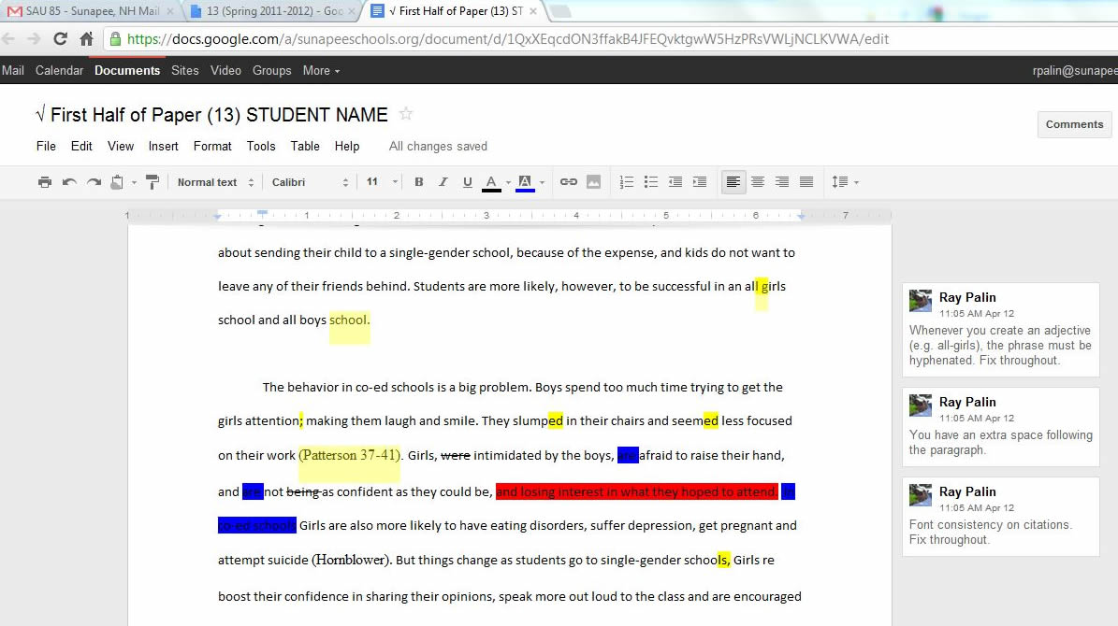
Feedback in Google Docs
Notes:
This example shows how teachers using Google Docs can give feedback to students by using the “Comments” feature in documents.
Notice that a section of the student’s text is highlighted and the comments are over to the right side of the screen. Also point out the “comments” button in the top right corner of the screenshot.

Slide 63
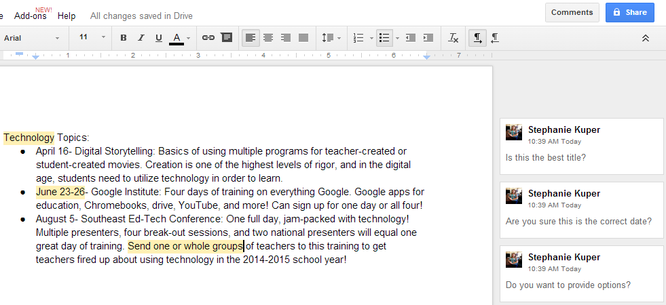
Commenting in Google Docs
Notes:
Comments can be used like the example on the previous slide as teacher feedback to student feedback. Students can then reply to teacher comments, thus allowing student-teacher feedback. Also, students can share their work with other students to allow for peer collaboration and feedback from student to student.
More about sharing and permission suggestions on the next slide.

Slide 64
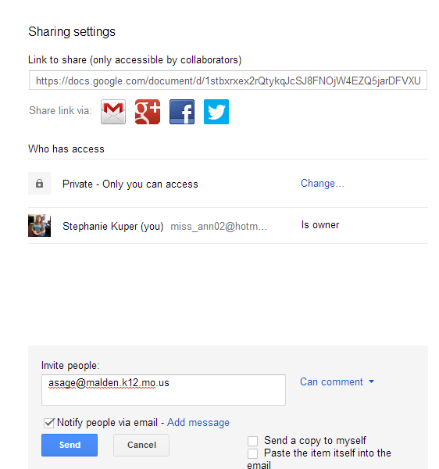
Sharing a Document for Comments
When in the “share” screen, you can change a person’s permission levels from “Can edit” to “Can comment” or “Can view”
Notes:
When sharing a document, the owner of the doc can decide at which level of permission to give people they are sharing with. The three levels are “Edit rights”, “comment only rights”, and “view only rights”.
Ask participants:
Which level of permission should a teacher share an assignment with students? – View only! – We don’t want students to edit the assignment due dates, length, etc.
Which level of permission should a student share work with teachers? – Either comment only or edit!- teachers need to be able to at least make comment, if not have more access to student work.
Which level of permission should a student share work with another student? – Comment Only! We want students to give feedback via comments, but we don’t want a student to “rewrite” an assignment.

Slide 65
Practice Using Google Comments
Create a generic Google Doc. Write 4-5 sentences about why you became an educator.
Share it with a person sitting next to you, give them “comment only” permissions.
When you receive a shared document, make at least three comments for the owner.
Notes:
If not all participants have a Google account, ask them to partner up.

Slide 66
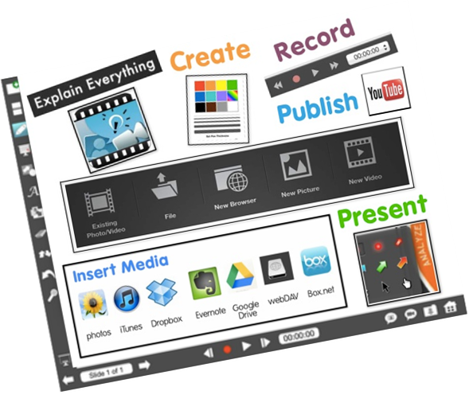
Recording for Feedback
Explain Everything ($2.99) or Educreation (free) allow students to write on a document, video, voice record, and save work that can be directly uploaded to a Google Drive, Dropbox, or YouTube.
Notes:
Example on next slide.
Allowing a student to record thoughts or processes, allows teachers identify struggling learners who might otherwise go unnoticed.

Slide 67
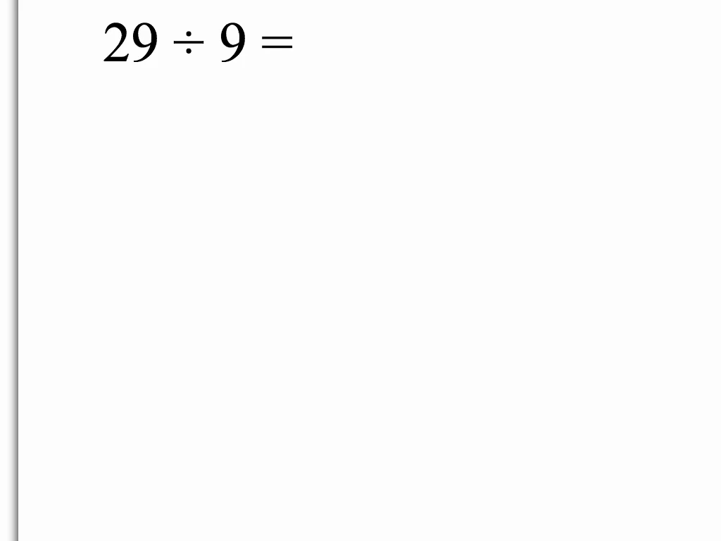
Division Example Using Explain Everything
Notes:
After video, ask participants to discuss what all misconceptions or problems were highlighted in the video.
Is the answer correct? –Yes. But there are still problems that need to be addressed. Fist she said 9 divided by 29, which is backwards, and then she went through the steps correctly but misuse vocabulary and general understandings. Just because a student can arrive at the correct answer doesn’t mean that he or she understands what he or she is doing on a conceptual level.
Using a recording tool, such as “explain everything” allows a deeper level of feedback from the teacher to the student on student thinking. Furthermore, teachers get feedback about student understanding of important concepts. This tool also relates to metacognition.

Slide 68
Blogging in the Classroom
Blogs are revolutionizing the classroom by allowing 24/7 creation and reflection for students. Once posted on a blog, users to easily add and edit content.
The comment feature on blogs is a bit different since those comments reside only at the bottom of the individual posts. However, teachers can make reflective blogging part of the learning process, and then use the comment feature to help clarify student thinking, plan next steps and ask for more details.
Notes:
As the trainer, create a sample blog at blogspot.com, edublog, or kidsblog for participants to go an respond to a post. Show participants how quick and easy it is to respond and provide feedback using a blog.
Note: In a blog, feedback can be given teacher to student, student to student, or student to teacher– usually all at the same time.
For Blogging, teachers should create Norms that would be restated with every blogging activity:
Use your real name
Since this is a school blog, school rules apply
No bullying or making fun of other students,etc.

Slide 69
Let’s Post!
Navigate to southeastrpdc.blogspot.com/
Answer the post titled “Rewrite” in 2-3 sentences.
Comment on at least two other people’s answers.
Notes:
This uses Google blogspot. It is set up with access to the presenter’s Google drive so the presenter doesn’t have to log in to a separate account. The presenter might consider creating their own blog to show participants the “owner” side of blogspot.
As the presenter, assume the roll of the “teacher” also and add comments to some of the participants’ responses.
Allow a few minutes for participants to complete the activity. Then bring the group back together and discuss:
The teacher gained feedback from students about the students ability to complete the assignment
The student gained feedback from the teacher about the depth of their work
The student gained feedback from other students about the clarity or their work.

Slide 70
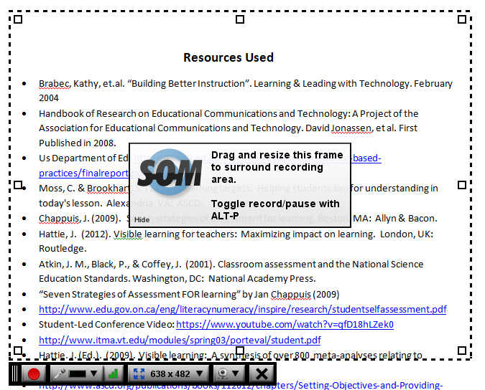
Screencasts to provide feedback
Screencast-o-Matic allows teachers to record feedback while looking at a student’s work and then send the recording directly to students.
It’s more than just comments, it is also your voice!
Notes:
Feedback given by a red pen on a paper sometimes can get thrown in the trash, overlooked, or even misinterpreted. When a teacher is verbally giving feedback to students, it has more of an impact. However, teachers usually do not have the time to conference with every student about their work in a class period. Screen casting allows teachers to record and send audio feedback to students via email, teacher websites, or have it available for students to listen to at the beginning of class.

Slide 71
Create your own screencast
Open a document or website that you want to give feedback on.
Open a second tab and go to http://www.screencast-o-matic.com/
Click “Start Recording”- You may have to enable the plug-in to work, and click run.
Once the recording box appears, click back on the document/website, when you are ready click the red record button.
When you are finished, click done to preview and select how to save your recording.
Notes:
As the presenter, walk participants through this entirely before they try it on their own. Give a few minutes for participants to create a short screen cast giving feedback on a news story they find online.

Slide 72
Using Technology
On Your Own:
  Take a few moments to think of how you can use these applications for Feedback.
  What will need to be tailored for your classroom?
  What differentiation is needed for SWD?
  How will the applications be assessed?
Notes:
Hand out the document for implementation titled “Implementing Technology”. Allow participants some time to deepen this discussion and take notes.
Note: This form is the last slide on each of the “chunks” in this learning package. It relates directly to the pre-assessment:
Making accommodations for age/maturity of students, and consider how to use technology whether they are 1:1 with technology or have limited technology to use with students. Also, note that accommodations need to be identified for SWD and advanced level students- not necessarily grade-level since the tool is geared towards to middle-of-the-road students already.

Slide 73
Reciprocal Teaching
Reciprocal Teaching is an effective teaching/learning practice and is defined as students summarizing, questioning, clarifying, and predicting; they take turns being the teacher.
Notes:
Hattie (Visible Learning, p. 204) states that the aim is to “help students actively bring meaning to the written word, and assist them to learn to monitor their own learning and thinking.” Effects were greater when there was explicit teaching of the cognitive strategies before beginning the reciprocal teaching dialogue.
Example: Cognitive strategies that are introduced, modeled and monitored by the teacher for the students, according to Palinscar and Brown (1986) could be: To begin with, students make predictions and hypothesize what the author will discuss next in the text. This leads to question generating, which gives the students the opportunity to evaluate the components of a good question, then phrase their own question, and finally engage in self-testing using questions. Summarizing integrates the information present in the text from passage to passage. Lastly is clarifying, which helps them to reflect back on what was read and look for any difficulties that will interfere with comprehension. The students take turns being the teacher while the teacher becomes the student. http://www.ncrel.org
Hattie states that “the explicit teaching of cognitive strategies and deliberative practice with content when using these strategies makes a major difference.”
Hattie, J. (Ed.). (2009). Visible learning: A synthesis of over 800 meta-analyses relating to achievement. London, UK: Routledge.

Slide 74
Notes about Rec. Teach Chunk
  This chunk should take approximately <1 hour (depending on how much time participants are allowed to create their own blogs.)
  Before delivering this chunk, check with schools and/or presentation location to ensure that Blogger will be available for participants to use.
  Presenter should have adequate knowledge of Blogspot/Blogger, Explain Everything, and Actively Learn.
HIDDEN SLIDE
Notes:
Technology used in this package:
Blogspot/Blogger- free Google account
Explain everything- paid app (since it is a paid app, there is a screen shot of it, so that presenter doesn’t necessarily have to download it. Plus participants were asked to bring laptops instead of iPads.)
Actively Learn- free website

Slide 75
Reciprocal Teaching
Operating around the principles of:
  Predicting
  Questioning
  Clarifying
  Summarizing

Slide 76
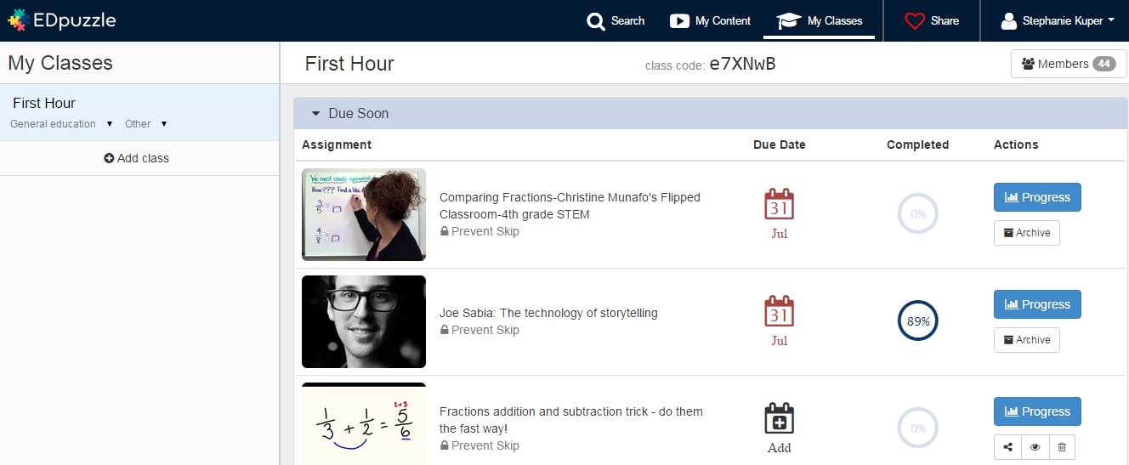
EdPuzzle
  Take existing videos from the internet Enable self-paced learning with questions along the video.
Notes:
Video tutorial:https://www.youtube.com/watch?v=AV66e9z-fr8&app=desktop
Participants should navigate to edpuzzle.com and log in as a student first. Give participants the class code “e7XNwB” and ask them to use their headphones to watch the video and answer the questions long the way. After participants experience EdPuzzle as a student, ask how easy it was to use as a student.
*Note: EdPuzzle, can be used to ask students to clarify concepts, summarize sections of the video, predict what will happen next, and ask questions of their own.
Then ask participants to logout and create a free teacher account. Then walk participants through the basics by starting at the top left corner and go across and then down the page describing the teacher account. You can search for other content that has already been created. You can view the videos that you have already created, create a new EdPuzzle lesson, and then look at your classes and progress reports (who has watched the videos, who didn’t watch, if questions were answered correctly, and you can also reset a student if the teacher feels they need to try again).
Then look at creating a video lesson. And embedding questions. Then ask, how easy is EdPuzzle to use as a teacher?

Slide 77
Blogging in the Classroom
Blogs are revolutionizing the classroom by allowing 24/7 creation and reflection for students. Once posted on a blog, users to easily add and edit content.
The comment feature on blogs is a bit different since those comments reside only at the bottom of the individual posts. However, teachers can make reflective blogging part of the learning process, and then use the comment feature to help clarify student thinking, plan next steps and ask for more details.
Notes:
As the trainer, create a sample blog at blogspot.com, edublog, or kidsblog for participants to go an respond to a post. Show participants how quick and easy it is to respond and provide feedback using a blog.
Note: In a blog, feedback can be given teacher to student, student to student, or student to teacher– usually all at the same time.
For Blogging, teachers should create Norms that would be restated with every blogging activity:
Use your real name
Since this is a school blog, school rules apply
No bullying or making fun of other students,etc.

Slide 78
Let’s Practice!
Independently read the article by Drew Hendricks:
Navigate to southeastrpdc.blogspot.com/
Click on the post titled “Reciprocal Teaching”.
Complete three separate posts:
1. Summarize your assigned section of the article.
2. Ask two questions to clarify your thoughts about the article.
3. The article ends saying: "With a supportive community and teachers who are willing to be trained and embrace technology in their classes, students of every age are sure to benefit from the many tools and skills technology can offer." Make a prediction about the future of education or the future of our country.
Notes:
This uses Google blogspot. It is set up with access to the presenter’s Google drive so the presenter doesn’t have to log in to a separate account. The presenter might consider creating their own blog to show participants the “owner” side of blogspot. *Note: The directions are posted on the blog post.
About the Article: “A Look at Recent Findings on Technology in the Classroom” by Drew Hendricks, May 14, 2013. http://www.huffingtonpost.com/drew-hendricks/technology-education_b_2867458.html

Slide 79
Blogs provide a very effective way to implement the strategy of reciprocal teaching.
Students summarize information from the text.
Students ask the class questions in order to highlight important sections of the text.
Students ask classmates to clarify confusing information.
Students make predictions about what will follow the passage they just read.
Notes:
After the activity is complete, engage participants in a discussion about what they liked and didn’t like about using the blog for this activity.
Some things to point out: All students must respond, students can dig deeper into the text, students can interact with each other and with the teacher.

Slide 80
Recording thought process & role-playing
Explain Everything ($2.99) or Educreation (free) allow students to write on a document, video, voice record, and save work that can be directly uploaded to a Google Drive, Dropbox, or YouTube.
Notes:
Example on next slide.
Allowing a student to record thoughts or processes, allows teachers identify struggling learners who might otherwise go unnoticed.

Slide 81
Division Example Using Explain Everything
Notes:
After video, ask participants to discuss what all misconceptions or problems were highlighted in the video.
Is the answer correct? –Yes. But there are still problems that need to be addressed. Fist she said 9 divided by 29, which is backwards, and then she went through the steps correctly but misuse vocabulary and general understandings. Just because a student can arrive at the correct answer doesn’t mean that he or she understands what he or she is doing on a conceptual level.
Using a recording tool, such as “explain everything” allows a deeper level of feedback from the teacher to the student on student thinking. Furthermore, teachers get feedback about student understanding of important concepts. This tool also relates to metacognition.

Slide 82
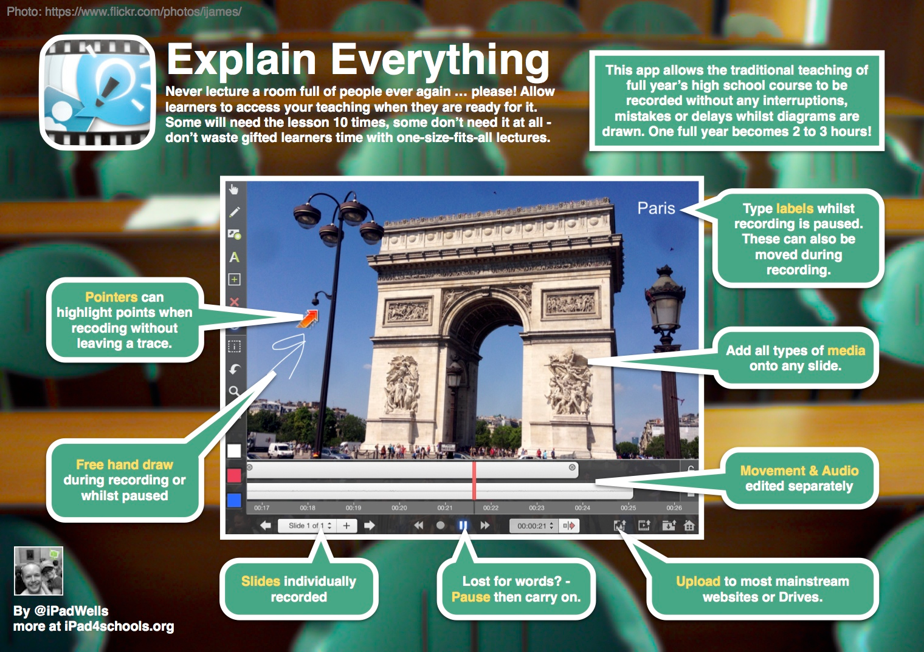
Notes:
This is a screenshot of Explain Everything. On the left is a bar for formatting options. Underneath the picture are the audio additions. And across the bottom shows slides, recording buttons, and uploading/saving option. **Note this is a paid app!

Slide 83
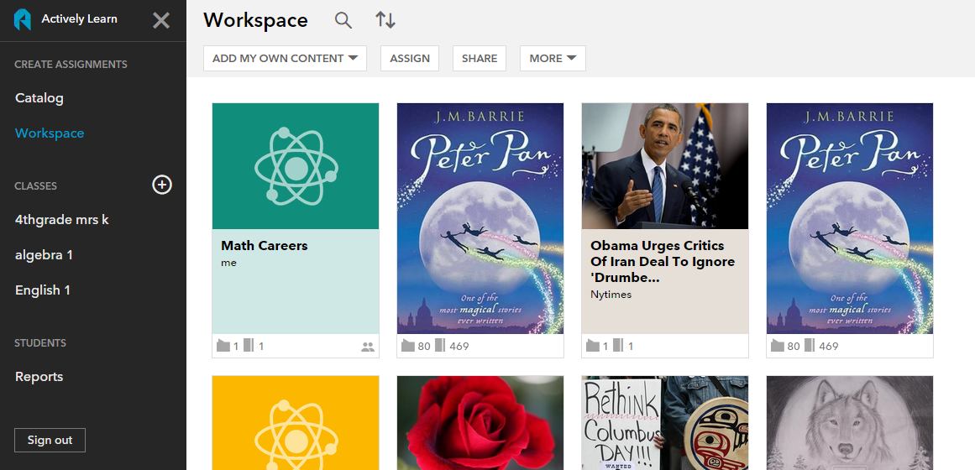
Actively Learn
Actively Learn Basic allows teachers to use pre-loaded texts or import their own texts and embed questions or reflections in the texts.
Notes:
Participants should navigate to activelylearn.com and create a free account. Presenters should also have an account and walk participants through the basics of Actively Learn. When logged in, walk participants through the layout of Actively learn- going down the menu on the left and then on the catalogue to show an example of Peter Pan and then awesome questions and comments embedded in the text. Then show how to add it to your workspace. Also to add my own content on my workspace to bring in an article and create my own questions, videos, etc.
There is an “Pro version” which gives teachers more access to reports, but the basic version is fine for our purposes.
The questions embedded can lead itself to reciprocal teaching nicely.
Video tutorial: https://www.youtube.com/watch?v=3GfoEE6eoHI&app=desktop

Slide 84
Using Technology
On Your Own:
  Take a few moments to think of how you can use these applications for Reciprocal Teaching.
  What will need to be tailored for your classroom?
  What differentiation is needed for SWD?
  How will the applications be assessed?
Notes:
Hand out the document for implementation titled “Implementing Technology”. Allow participants some time to deepen this discussion and take notes.
Note: This form is the last slide on each of the “chunks” in this learning package. It relates directly to the pre-assessment:
Making accommodations for age/maturity of students, and consider how to use technology whether they are 1:1 with technology or have limited technology to use with students. Also, note that accommodations need to be identified for SWD and advanced level students- not necessarily grade-level since the tool is geared towards to middle-of-the-road students already.

Slide 85
Using Technology with Spaced vs. Massed Practice
According to Marzano, students need about 24 practice sessions with a skill in order to achieve 80% proficiency- need quick feedback to insure errors do not slip in!
What does this mean for technology?
Notes:
Ask participants what this means in regards to technology. Explain that technology provides learning experiences to differentiate instruction for students and provide multiple exposures to skills learned previously.
Using Technology with Classroom Instruction that Works, Pilter et al

Slide 86
Notes about SvM Chunk
This chunk should take approximately 1-2 hours (depending on how much time participants are allowed to explore the specified websites)
Before delivering this chunk, check with schools and/or presentation location to ensure that YouTube will be available for presenter and participants to use.
Presenter should have knowledge of Kahoot, Socrative, EdPuzzle, Actively Learn, and YouTube.
HIDDEN SLIDE
Notes:
Technology used in this chunk:
Khan Academy and Brainpop are mentioned only
Kahoot- free account
Socrative- free account
EdPuzzle- free account
Actively Learn-free account
YouTube- free Google Account

Slide 87
Khan Academy
With over 2,400 videos covering K–12 math, biology, chemistry, and physics, and even finance and history, it is easily the most exhaustive free collection of instruction on the Internet.
Content is presented in 10- to 20-minute chunks. In addition, the conversational style of the videos is the opposite of what people traditionally associate with math and science instruction. There is even a teacher dashboard that allows the teacher to track how students are doing.
Notes:
Khan Academy is a free website that allows teachers to assign lessons to students and monitor progress. This is also available as an app. This website/app allows students to continue practicing skills learned in class.

Slide 88
BrainPop
BrainPOP (www.brainpop.com) and BrainPOP Jr. (www.brainpopjr.com) contain hundreds of short, flash-based movies covering English, social studies, mathematics, science, health, art, and technology.
Each movie is followed by a 10-question quiz that can be printed or emailed to the teacher. Most content is available in both English and Spanish.
Notes:
There is also a Brain-POP app for the iPad that provides a free movie every day. Although the sites are subscription-based, they are worth considering.

Slide 89
Kahoot!
Add videos and quizzes for students to take in a fun, interesting way!
Notes:
Presenters should create a basic kahoot to show as an example by going to getkahoot.com. Participants will experience a kahoot as a student by navigating to “kahoot.it” in their web browser.
Teachers create accounts at getkahoot.com
Students log in to teachers rooms using the URL: kahoot.it
After participants experience the “student” side of Kahoot, ask “how easy is Kahoot to use as a student?” Then ask participants to navigate to “getkahoot.com” and create their free teacher accounts.
With the teacher dashboard will be displayed on the screen, the presenter can explain the basics of the Kahoot page-(start explaining from the top left side of the screen, across to the right, and then down – just like reading a book. The points to highlight are: “Create Kahoot” buttom, “My Kahoot’s Tab”, “Public Kahoots”- searching public Kahoots and “duplicating” public Kahoots.
Then ask, “How easy it Kahoot to navigate on the “teacher” side?

Slide 90
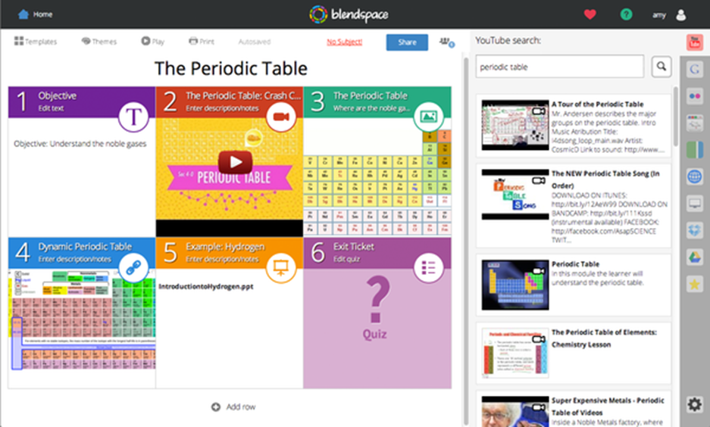
BlendSpace
  Blendspace is a free website that houses content from Google Drive, videos from YouTube, and websites together for students to access.
goo.gl/WcHM88
Notes:
Have participants navigate to: goo.gl/WcHM88 to experience BlendSpace as a student. The presenter should highlight what the participants are looking at: text, videos, images, links, etc- all able to be walked through by students.
Participants should navigate to blendspace.com and create a free account. Presenters should also have an account and walk participants through the basics of BlendSpace. Starting at the top left and going across the options at the top and then down the page. Be sure to show participants how to find public Blendspace lessons to copy for your own use. Then show participants how easy it is to search and bring in content.
This allows teachers to continuously give students practice with concepts and skills learned.

Slide 91
EdPuzzle
  Take existing videos from the internet Enable self-paced learning with questions along the video.
Notes:
Video tutorial:https://www.youtube.com/watch?v=AV66e9z-fr8&app=desktop
Participants should navigate to edpuzzle.com and log in as a student first. Give participants the class code “e7XNwB” and ask them to use their headphones to watch the video and answer the questions long the way. After participants experience EdPuzzle as a student, ask how easy it was to use as a student.
Then ask participants to logout and create a free teacher account. Then walk participants through the basics by starting at the top left corner and go across and then down the page describing the teacher account. You can search for other content that has already been created. You can view the videos that you have already created, create a new EdPuzzle lesson, and then look at your classes and progress reports (who has watched the videos, who didn’t watch, if questions were answered correctly, and you can also reset a student if the teacher feels they need to try again).
Then look at creating a video lesson. And embedding questions. Then ask, how easy is EdPuzzle to use as a teacher?

Slide 92
Actively Learn
Actively Learn Basic allows teachers to use pre-loaded texts or import their own texts and embed questions or reflections in the texts.
Notes:
Participants should navigate to activelylearn.com and create a free account. Presenters should also have an account and walk participants through the basics of Actively Learn. When logged in, walk participants through the layout of Actively learn- going down the menu on the left and then on the catalogue to show an example of Peter Pan and then awesome questions and comments embedded in the text. Then show how to add it to your workspace. Also to add my own content on my workspace to bring in an article and create my own questions, videos, etc.
There is an “Pro version” which gives teachers more access to reports, but the basic version is fine for our purposes.
This is a tool that can be used to continuously allow students to practice skills learned previously within new texts.
Video tutorial: https://www.youtube.com/watch?v=3GfoEE6eoHI&app=desktop

Slide 93
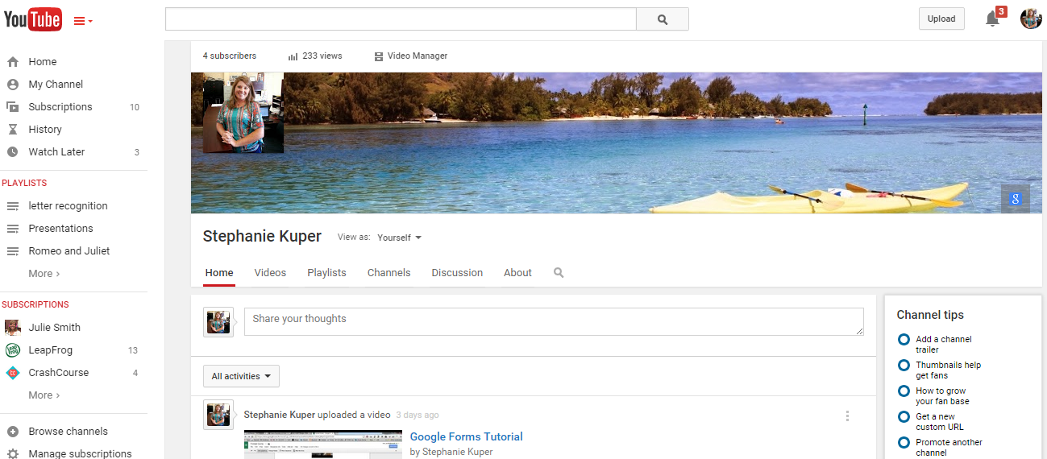
YouTube
Notes:
Start by having participants sign in to in the top right corner of youtube.com. If they see their Google profile picture, they are already signed in.
Beginning at the top left side of the menu, there are three bars and a drop down menu (this opens the menu pane on the left side of the screen, as shown in the image above.
Home- navigate to YouTube.com home
My Channel- set up your own teacher channel (show yours as an example- which is the screenshot above)
Subscriptions allows you to subscribe to a person/company’s channel if you think you are interested in all of their videos.
History- shows videos you have watched in the past.
Watch later is videos that you mark to watch later.
Playlists is where all of the playlists you have created are listed
Subscriptions at the bottom allows you to quickly get to your subscribed channels.
The fifth circle shows where a person can upload their own videos to edit and adjust privacy settings.
In the middle of your “Channel” is where you can look at your videos, create and manage your playlists, and manage your subscriptions.
Note navigate to any video and show participants how they would subscribe to a person’s channel or save their video to your play list by clicking below the video.

Slide 94
YouTube
YouTube provides an excellent way to enhance the learning experience for students by reinforcing concepts and skills previously taught or prior to teaching.
Can be used for:
  Inspiration
  Vocabulary
  Start conversations
  Reinforce Concepts
Notes:
On the next few slides, there are examples of each of these in action

Slide 95
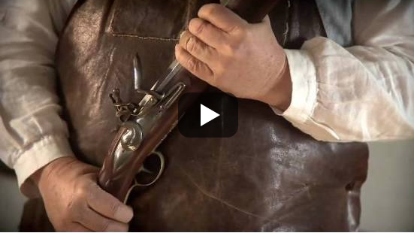
Videos to Teach &
Inspire Student Creations
https://www.youtube.com/watch?v=uZfRaWAtBVg
Notes:
This video is a remix of the song “Too Late to Apologize” originally done by OneRepublic. This version is “Too Late to Apologize (Declaration of Independence)”- This is an example video to help teach kids about historical events. This could be used as an introductory activity with students and then see how much students know about the reasons for the declaration of independence after watching the video. This video could also be used as an example of the teacher’s expectations for students writing their own songs to show understanding of topics.
To access this video, the image on the slide is hyperlinked or you can click on the web address below.
Video: https://www.youtube.com/watch?v=uZfRaWAtBVg

Slide 96
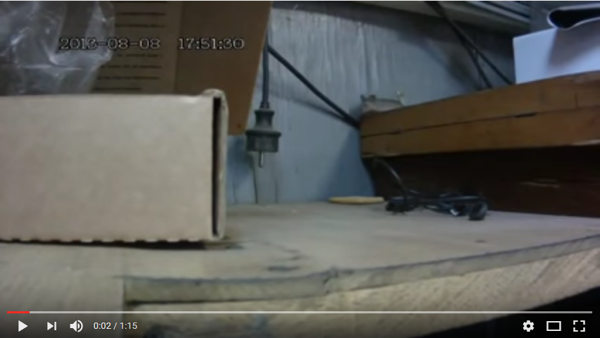
Videos to Teach Vocabulary & Spark Conversation
https://www.youtube.com/watch?v=VE2An9NSawU
Notes:
This video is about “perseverance” – Teachers could show a video, such as this one, to help kids define what it means to be persevere. It could also be used to teach a lesson to students about not giving up.
To access this video, the image on the slide is hyperlinked or you can click on the web address below.
Video: https://www.youtube.com/watch?v=VE2An9NSawU

Slide 97

Videos to Reinforce Concepts
Notes:
This video teaches ratios to students. This would be an excellent video to show to students before learning about ratios. After watching the video, ask students how to girl in the video arrived at the solution that if the girl spoke 36 words for every 6 words the man spoke, that means it was a 6:1 ratio. Let students take some time to “figure it out” before “teaching ratios”. It can also be used to reinforce the concept at a later date.

Slide 98
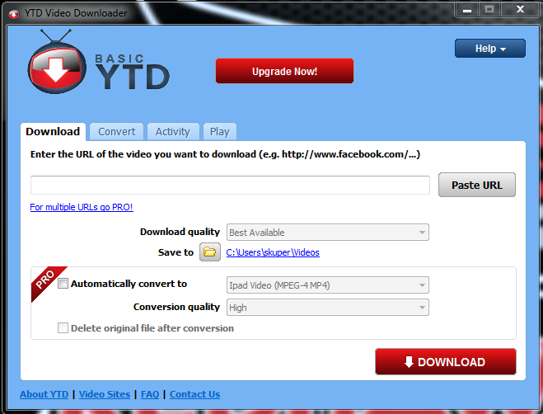
What if YouTube is Blocked at School?
Download the program “YTD Video Downloader”.
Copy and Post the URL of the video you want to the YTD seen to the left.
Choose the location to save the video.
Notes:
If a school has YouTube for Teachers Blocked. They can download YTD on a home computer to download and save videos to their computer/flash drive in order to bring and show at school.
Also, they could try searching the video on Teacher Tube or School Tube, which sometimes has similar videos that aren’t blocked.

Slide 99
Interactive Websites and Apps
Many websites and apps provide the opportunity for students to practice skills over extended periods of time.
Take a look at websites and apps available for students practice
Notes:
Direct participants to the handout titled “Websites and Apps”. These apps and websites were compiled in the summer of 2015, so it will need to be updated as needed.
Give participants time to look over the list and search some of websites/apps before bring participants to a discussion about any websites or apps they would like to add to the list. (plan to make this approximately 5-10 minutes- assess participation level before moving on. Participants might need more or less time.)

Slide 100
Using Technology
On Your Own:
  Take a few moments to think of how you can use these applications for Spaced vs. Massed Practice.
  What will need to be tailored for your classroom?
  What differentiation is needed for SWD?
  How will the applications be assessed?
Notes:
Hand out the document for implementation titled “Implementing Technology”. Allow participants some time to deepen this discussion and take notes.
Note: This form is the last slide on each of the “chunks” in this learning package. It relates directly to the pre-assessment:
Making accommodations for age/maturity of students, and consider how to use technology whether they are 1:1 with technology or have limited technology to use with students. Also, note that accommodations need to be identified for SWD and advanced level students- not necessarily grade-level since the tool is geared towards to middle-of-the-road students already.

Slide 101
Implementing Technology
Building, Grade Level, and Teacher Implementation

Slide 102
Notes about the Implementation Section
This section includes the Practice Profile and Fidelity Checklist.
This section, along with the introduction section (slides 3-18) should be included with any of the other chunks presented.
HIDDEN SLIDE

Slide 103
Successful Implementation
Appropriate for selected age group.
Appropriate for desired learning outcomes.
Appropriate level of rigor is built into the assignment.
Appropriate rubric or scoring guide is used for assessment.
Notes:
Stress that not every website or app is appropriate for students at all grade levels. So teachers need to have researched the app well enough to know if it will be appropriate for the students at that grade level.
Learning outcomes should always be the first thing addressed when deciding to include technology in instruction.
Remember the assignment, not the tool or device decides the level of rigor.
Before including technology in a lesson, know how the learning outcome will be assessed. Will students be assessed on the outcome of the product created from using technology? Make sure you have a rubric for it!
This correlates directly to the pre/post assessment and implementation activity at the end of each chunk.

Slide 104
The Teacher Will:
Use appropriate technology tools that meet the instructional needs of all students in his/her classroom.
  Appropriate for selected age group.
  Appropriate for desired learning outcomes.
  Appropriate level of rigor is built into the assignment.
  Appropriate rubric or scoring guide is used for assessment.
Notes:
Ask participants to brainstorm at tables:
How is rigor built in to the use of technology?
Will the team create rubrics for technology usage?
Who will ensure that these things are being done?

Slide 105
The Teacher Will:
Model and Demonstrate proficiency (knowledge and skills) to implement instructional technology tools.
  An example is shown to students.
  A brief “tutorial” or explanation of how to use the application is provided for students.
  Support and problem-solving is available as needed.
Notes:
Ask participants to brainstorm at tables:
How will we train our teachers on technology tools?
Will the team become “experts” to assist teachers as problems arise? If not them, who? Maybe students.
Who will ensure that these things are being done?

Slide 106
The Teacher Will:
Monitor the effectiveness of technology tools being used in learning and makes alterations as needed.
  Formatively assess students’ progress
  Identify students struggling with the use of the tech tool
  Alter expectations based on performance
Notes:
Ask participants to brainstorm at tables:
How will teachers assess if the tech tool used is effective? Will there be some sort of checklist?
What indicators will help teachers identify struggling students?
How can teachers alter expectations for using the tech tool for struggling students (without ditching the tool or lowering the rigor)?
Who will ensure that these things are being done?

Slide 107
Practice Profile
Notes:
Review Practice Profile with participants.

Slide 108
Fidelity Checklist
Notes:
Review Fidelity Checklist with participants.

Slide 109
Eight Fundamentals for Successful integration of technology into the classroom
Fear of change
Training in basics
Personal use
Teaching models
Learning based
Climate
Motivation
Support
“Integrating Technology into the Classroom:
Eight Keys to Success”, Bitner & Bitner
Notes:
“The fear of change happens because adults often get anxiety when a change is made. This needs to be addressed so teachers are comfortable using technology in their classrooms.
Training is important so teachers understand the technology their using in their classrooms. We don’t ask teachers to teach subjects their not qualified to teach, so why ask them to use technology without first training them?
The more a teacher used technology for personal use, the more comfortable she/he becomes with that technology and the more proficient in its use.
Teaching models provide teachers with examples on how to use the different technologies in their classrooms, so the technology is used to its full potential.
Learning should drive the use of technology, plain and simple.
The classroom’s climate and the motivation students have for using technology play a big part in students’ use of different technologies in the classroom. If a teacher is comfortable with the technology, then the classroom will be more technology savvy and students will be more apt to try new things. Teachers need to feel comfortable trying new things without the risk of being penalized for failure.
Support is also important not just for students but for teachers, too. Teachers need ongoing training in the up and coming technologies available and for new ways to use the technology they have.”
http://technoblogeduu564.blogspot.com/2010/12/integrating-technology-into-classroom.html?m=1

Slide 110
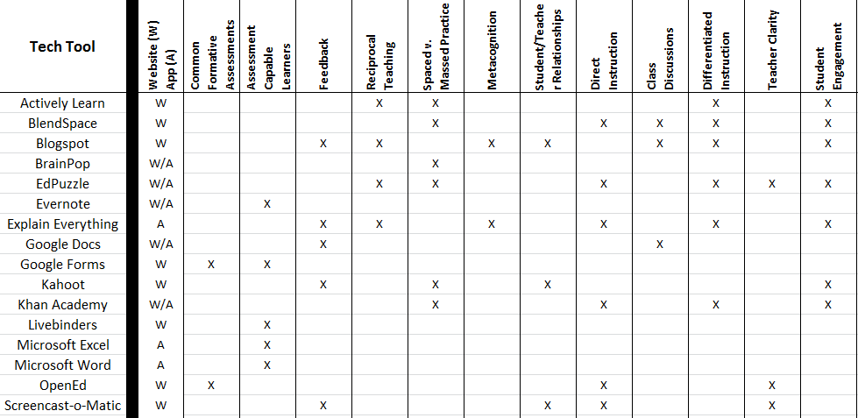
Tech Tools Crosswalk
Notes:
Direct Participants to the Tech Tools Crosswalk Hand out– This should be printed on 11x17 or legal sized paper. Show participants how the tech tools learned in any of the sessions may align with other CW Learning Packages. Some tools may align to more learning packages than others, so as a next step, they may want to consider which tools are the most efficient as they look to further their learning.

Slide 111
Next Steps: Action=Results
What steps will you take to start implementing?
Notes:
Complete the Next Steps template. Example is included in the learning package materials.

Slide 112
Post Assessment
Complete the Post-Assessment at:
https://goo.gl/FBJOAd
Notes:
This is a link to a Google Form for the pre/post assessment. Making the pre/post online enhances the “technology” aspect of the package. The presenter would need to create their own Form since this links to Stephanie Kuper’s Google Drive. If the presenter is unable to create a form for the pre/post assessment, it is available in the module handouts.

Slide 113
Resources for Further Learning
Flip Your Classroom: Reach Every Student in Every Class Every Day by: Jonathan Bergmann and Aaron Sams (2012)
Blogs, Wikis, Podcasts, and Other Powerful Web Tools for Classrooms by: Will Richardson (2010)
Google Apps Meets Common Core by: Michael J. Graham (2013)
Going Google: Powerful Tools for 21st Century Learning by: Jared Covili (2012)

Slide 114
Resources for Further Learning
Apps for Learning: 40 Best iPad/iPod Touch/iPhone Apps for High School Classrooms by: Harry Dickens and Andrew Churches (2011)
Apps for Learning, Middle School: iPad, iPod Touch, iPhone by: Harry Dickens and Andrew Churches (2012)
Apps for Learning - Elementary School Classrooms by: Harry Dickens and Andrew Churches (2013)

Slide 115
Web Resources for Further Learning
50 Important Links for Common Core Educators: http://www.onlinecolleges.net/2012/06/27/50-important-links-for-common-core-educators/
eSchool News- http://www.eschoolnews.com/
Ed Tech Magazine- http://www.edtechmagazine.com/
Edudemic- http://www.edudemic.com/
Edutopia- http://www.edutopia.org/

