Slide 1
Defining Equity
Notes:
Next three slides denote the ongoing discussion of what constitutes equity. Table discussion here about the difference between equality and equity

Slide 2
Version II

Slide 3
III

Slide 4
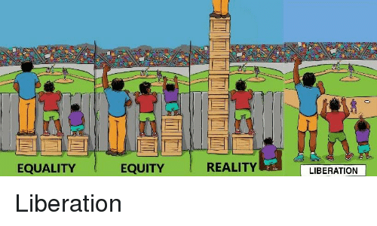
Reality

Slide 5
