Slide 1
Presenter Notes ONLY
Pre-readings:
  http://www.parentcenterhub.org/wp-content/uploads/repo_items/10steps.pdf
  http://www.projectidealonline.org/v/special-education-public-policy/
Agency Referral Flowcharts:
  https://dese.mo.gov/special-education/compliance/evaluation-flowcharts
Notes:
TO KNOW:
This training is intended for school district personnel who have limited knowledge about special education and its processes.
NO slides may be hidden, removed, or changed unless specifically indicated on the slide.
TO DO:
Send the links to the pre-readings and agency referral flowcharts to the participants prior to the date of training.
Review this presentation and make sure that you are comfortable with all material you will be presenting. Please ask a DESE colleague if you are unsure of any content being presented.
* Hide this slide before presenting*

Slide 2
Presenter Notes ONLY
Timeline
Opening activities (35 minutes)
Laws (approximately 40-50 minutes)
Process (approx. 110 minutes—separated into sub sections)
Notes:
TO KNOW: This slide gives you a rough estimate of the amount of time needed for each section of this presentation. Please plan accordingly.
Throughout the training, participants will be asked to “fish” for information. Please make sure the participants take turns looking up information.
TO DO: * Hide this slide before presenting*

Slide 3
Presenter Notes Only
Materials Included in the Packet
PowerPoint Presentation
Handout Packet:
  Pre-Training Exercise Continuum of Expertise Directions
  Pre and Post Test
  Getting Started Activity Handout
  Glossary of Key Terms
  Special Education Laws and Process Reflection Placemat
  Referral Flow Charts
  Activity Sheets: Case Study
Resources:
    Standards & Indicators Manual
    Missouri State Plan
    IEP Forms
Notes:
TO KNOW: It is important to have all of the items listed below completed prior to the scheduled start time of this training.
TO DO:
**HIDE THIS SLIDE PRIOR TO BEGINNING TRAINING**
Make a folder for each participant with all handouts included. Please see PDF titled “Handouts.” In addition to the “handouts” document, you will also need to print the Special Education Process Reflections Placemat for each participant and put it on the OPPOSITE SIDE of the folder from the handouts.
Make table notebooks with all required documents included. The resource notebooks should include: Program Review Standards and Indicators, Missouri State Plan and all model forms. Please see folder labeled “Notebooks.”
Make sure each table has a resource notebook.
Make sure each participant has a folder with handouts.
To prepare for the pre-training activity, create a wall chart with the title “Continuum of Expertise.” Draw a long line across the middle of the paper. On the left side of the paper, label it as “Just beginning my journey” the next benchmark will be “I don’t know what I don’t know”, next benchmark would be “I know I need to know more” next “ I’m comfortable with my Knowledge but I need a refresher” the last benchmark would be “I could help do this workshop”.
The purpose of this activity is to get a quick assessment of your audience’s knowledge.
Provide copies of the explanation on participants’ table
Provide stickers or colored markers at the table.
To prepare for the pre-reading activity, create a chart that says “Pre-Reading Reflection” and place sticky notes on the participants'’ tables.
ADD CONTACT INFORMATION TO LAST SLIDE PRIOR TO PRESENTING.

Slide 4
The Special Education Process
PRESENTER NAME AND DATE
Notes:
TO SAY:
Thank you for joining me today for the Special Education Process module where the special education process and the laws for implementing special education will be presented.
As we proceed through the presentation, we will reference certain forms that you will find located in the notebook on your table. These are forms are easily located on DESE’s Compliance website. We have placed the most current versions of these forms in a single notebook on each table to share because these forms are periodically updated. We ask that these notebooks remain on the tables at the end of this presentation.
We will also ask that you pull various handouts out of the folder that you were given when you came in to training today. The handouts are labeled to make them easy to find. Each handout will have a yellow box with a number on the top right corner. The slide that this handout corresponds with will also have a small box in the top right corner.

Slide 5


Welcome
NCLB
LEA
IDEA
FERPA
IEP
ME
Notes:
TO DO: Welcome participants, introduce trainers and ask each participant to tell their name and position. If there are a large number of participants or there is not much time, a “That’s Me” activity may be done instead of having each person introduce him/herself. That’s Me is simply ask the group who is an administrator – if they are – they stand up – that’s me! Ask for teachers, general and special education – counselors – speech and language therapist – parents... Etc.
TO SAY: (After the welcome,) As we go through today’s training, please keep in mind that we will be speaking in “SPED”. This means we will be sharing many acronyms that are frequently used when referring to the laws and regulations that govern the special education process. The first time acronyms are shared in today’s presentation, what it is representing will be spelled out but from there on it will be the acronym. Some examples of common acronyms includes LEA for Local Education Agency or IEP for Individualized Special Education Program.
Also remember that there is a wide‐range of experience in the room ‐ some of the information will be new to you and some information you will be very familiar with. Please be patient and flexible as we try to cover all ranges of experience.
Throughout today’s training, we will be referencing the Missouri State Plan for Special Education and the Standards and Indicators. In order to ensure that all participants have an opportunity to use these reference tools, please make sure that all participants have an opportunity to locate the requirements as requested.

Slide 6

Working Norms
Engagement
Respect
Choice and Responsibility
Enjoy your learning
Notes:
TO KNOW: If your RPDC has specific working norms that are used with every training, the wording on this slide may be replaced with the norms typically used at your center.
TO SAY: These are the professional norms that we will be using today in order to ensure learning for all.
The first one is Engagement. Please silence your cell phones and avoid side conversations, to avoid distracting your colleagues from learning.
The second norm is Respect. Your background and expertise are essential, and therefore your contribution to discussion, questions, challenges, and stories will be an integral part of this learning experience. Collective wisdom of all participants is valuable.
The third norm is Choice and Responsibility. Some people work best alone, while others work better in groups. There will be times we ask you to work as a group and in other situations it will be your choice. Please complete the activities and be ready to share your work when called upon. Each time we engage in group activities, we will have clearly defined time limits.
Housekeeping: (Explain these items and any other applicable housekeeping items.)
The restrooms are located _______________.
You should have parked ________________.
We will be taking a break at approximately ___________.
We will be having lunch at approximately ___________.

Slide 7
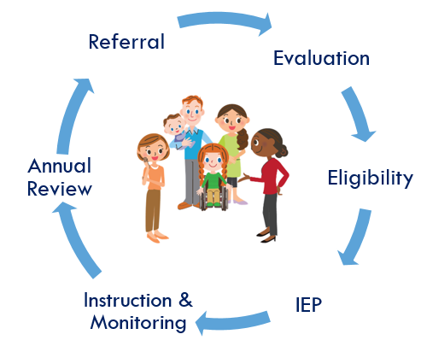
Session-at-a-Glance
Opening Activities: Pre-Test, Reflection, Norms & Objectives
Special Education Laws
Special Education Process & Content
Closing Activities: Post-Test, Resources, Evaluation
Notes:
TO SAY: Today, we will be covering the special education process and the laws for implementation. If at any time you have questions or comments, we encourage you to share with the group. This will increase your learning, as well as those around you.

Slide 8
Pre-Training Exercise
1
Where are you on the Continuum of Knowledge?
I’m comfortable with my knowledge but need a refresher.
Just beginning my journey. I don’t know what I don’t know.
I could help do this workshop.
See the Pre-Session Continuum of Knowledge Activity directions on your table
Notes:
TO DO: Prior to beginning the training, you should have created a wall chart titled “Continuum of Expertise.” The purpose of this activity is to get a quick assessment of your audience’s knowledge.
TO SAY: This training is intended for school district personnel who have limited knowledge about special education and its processes. As you can see, this slide has a yellow box with the number one in the top right corner. This slide corresponds with the handout in your folder labeled number one. Please pull out this handout and take a look at it to determine where you believe you are on the continuum of knowledge. (allow one minute for participants to remove handout and review it) Now let’s assess your current knowledge about the special education processes. Each table has colored dots. Please select a colored dot and place it on the Continuum of Knowledge chart located in the front of the room (or wherever your chart is located).

Slide 9


Pre-Test
2
Notes:
TO SAY: Let’s take a few minutes to take a pre-test about the Special education process and the laws for implementation. Please take the pre-test out of your folder, labeled as handout #2, and complete it now.
After completing the module, a post-test will be given. At that time, we will review all answers to assess your learning.

Slide 10



Pre-reading Reflection
3
Turn to your shoulder partner and share the points that you found most interesting from the pre-read activity.
Together, put 3 main points on a post-it note from the pre-read that you want to share with the large group.
Parent Center Hub Pre-Read
Available on line at: http://www.nichcy.org/schoolage/steps
Notes:
TO KNOW: Presenter should have already reviewed the pre-reading articles.
TO SAY: We hope everyone had the opportunity to read the pre-reading articles that were sent to you upon registration for this training. If needed you can find copies of these articles in your handout folder.
In the NICHCY document, it refers to IEP, which is the acronym for Individualized Education Program.
For this activity, please take a few minutes to share the ideas from the pre-reading that you found most interesting with your shoulder partner. Then together select three main points to share out with the large group. You can record your key points on the sticky notes located on your table; we will place these key points on the Pre-Reading Reflection chart (at the front of the room) (describe where you have hung the prepared chart)
(Allow approximately 3 minutes for conversation—if several have not read the articles, allow up to 10 minutes.)
Now that we’ve all had an opportunity to come up with the three main points of these articles, who would like to share first? (Call on someone, allow them to explain their reasoning for selecting these topics as main points. Take their sticky notes and put them on the chart. Call on someone else. Repeat this process until no one else is willing to share.)

Slide 11

Learner Objectives
  As a result of training, participants will:
  Have a basic understanding of the laws for implementing the special education process
  Have a basic understanding of the Special Education Process from referral to annual review
Notes:
TO SAY:
As a result of this training, participants will have a basic understanding of special education laws that focus on the implementation of the special education process, which is the process used for referring students for evaluation, finding children eligible for services, establishing an Individualized Education Program for them, and continued review of services and progress of and for the child. As the overall special education process is the focus of this module, we will provide basic knowledge today. There are other training modules offered by the RPDC that deliver in-depth knowledge and practice related to components of the special education process, such as the Standards Based IEP training, and the Accommodations and Modifications training.
11

Slide 12
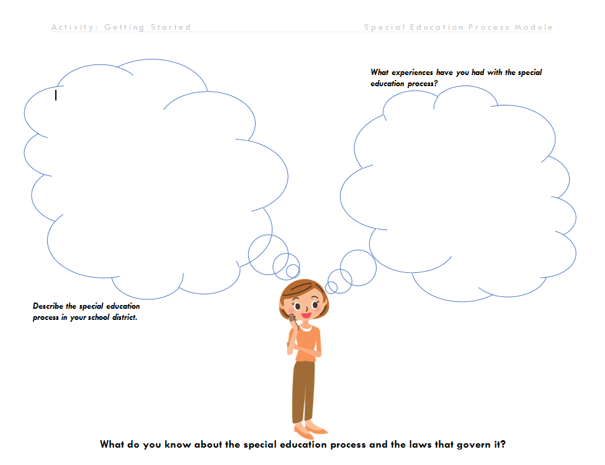
Activity: Getting Started
4
What do you know about the Special Education process and the laws for implementation?
Notes:
HANDOUT: “Activity: Getting Started”
TO SAY:
To continue thinking about our own experiences and prior knowledge regarding the special education process, we will use the handout titled “Getting Started” located in your folders to guide a reflection on what you know about the special education process and the laws for implementation of this process. Please spend a few minutes reflecting and then share with your shoulder partner.
TO DO:
Allow approximately 3-5 minutes for self reflection and then encourage sharing with their shoulder partners. Allow approximately 3-5 minutes for sharing.
TO SAY (after sharing opporutnity with partner):
The special education process that we will discuss today is defined and mandated through special education laws. Terms and vocabulary that you will hear today, reflect the directives given in the laws. In general, special education is defined as instruction that is specially designed, at no cost to parents, to meet the child’s unique needs. Specially designed instruction means adapting the content, methodology, or delivery of instruction:
to address the unique needs of the child that result from his or her disability, and
to ensure the child’s access to the general education curriculum so that he or she can meet the educational standards that apply to all children within the jurisdiction of the school system.
Special education can include instruction conducted in the classroom, in the home, in hospitals and institutions, and in other settings.
In the most current amendments to the special education laws, the mandates that direct the special education process ensures that all children receive the most from their educative experiences.

Slide 13
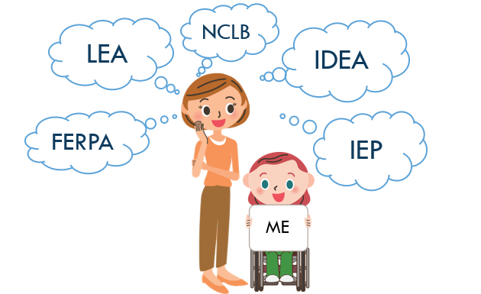
Glossary of Key Terms
5
Special Education (SPED)
Referral
Evaluation
Eligibility
Free and Appropriate Public Education (FAPE)
Individualized Education Program (IEP)
Instruction and Monitoring
Least Restrictive Environment (LRE)
Placement
Present Level of Academic Achievement and Functional Performance (PLAAFP)
Accommodations and Modifications
Source: Missouri State Plan for Special Education and Missouri Special Education Compliance Standards and Indicators
Notes:
HANDOUT: Glossary of Key Terms
TO SAY: Part of understanding the special education process, is becoming familiar with the terminology and frequent vocabulary used to talk about the laws that influence the process, and the process components themselves. Here is a listing of some of the terms you will hear throughout the presentation. You will be introduced to these terms throughout the presentation today. In your folder, you have a handout titled “Glossary of Key Terms.” Please pull out handout number 5 and keep it next to you as we go through this training to refer to as needed.

Slide 14
Special Education Process &
Missouri State Teacher Standards
Meeting the needs of every student (Standard 2, Quality Indicator 4)
Building on learners’ strengths and needs (Standard 2, Quality Indicator 4 & 5)
Developing appropriate curriculum and instruction for all learners (Standard 3; Quality Indicators 2 & 3)
Considering diverse perspectives and diverse learners (Standard 6; Quality Indicator 2)
Using student assessment data to analyze and modify instruction (Standard 7, Quality Indicators 2, 4, 5 & 6)
Notes:
What to say: It is also important to understand how this module on the Special Education Process aligns with the MO State Teacher Standards: Of course there may be other standards that the module might also apply but here are the key standards.
Standard 2 Student learning growth and development
Quality Indicator 4: Meeting the needs of every student
Quality Indicator 5 Prior experiences, multiple intelligences, strengths and needs.
Standard #3: Implementing the Curriculum
Quality Indicator 2: Develop lessons for diverse learners
Quality Indicator 3: Analyze instructional goals and differentiated instructional strategies
Standard #6: Utilizing Effective Communication
Quality Indicator 2: Sensitivity to culture, gender, intellectual and physical differences
Standard #7: Use of Student Assessment Data to Analyze and Modify Instruction
Quality Indicator 2: Assessment data to improve learning
Quality Indicator 4: Effect of instruction on individual/class learning
Quality Indicator 5: Communication of student progress and maintaining records
Quality Indicator 6: Collaborative data analysis process

Slide 15
The Special Education Process
Laws Protecting Students With Disabilities
Notes:
What to say:
Compliance with IDEA and the Missouri State Plan for Special Education is the basis or foundation of your district’s special education program. Compliance includes both PROCESS and CONTENT. The Program Review Standards and Indicators address the compliance requirements of the Special Education process and aligns with the federal regulations and Missouri State Plan for Special Education. Process includes following all of the required steps, in the correct order and within the timelines. Content includes documenting correctly (your evidence of following the process) and implementing the IEP as written for a quality special education program for special education students.
The Process and Content requirements are organized and determined by laws protecting students with disabilities. This section of today’s presentation will provide information about the federal laws that govern the education of students with disabilities.
15

Slide 16
Education for All Handicapped Children Act (Public Law 94-142)
Amendments
Individuals with Disabilities Education Act (IDEA)
IDEA Improvement Act of 2004 (IDEIA)
Brown v. Board of Education of Topeka
1954
1975
1990
1972
1973
Pennsylvania Association for Retarded Children (PARC) v. Commonwealth of Pennsylvania and Mills v. Board of Education, District of Columbia
1986
1997
2004
Rehabilitation Act of 1973, Section 504
NCLB alignment
Birth – 2 years
IEP Process, Content & Components
Amendments
Notes:
TO SAY: The history of the current federal laws regulating the special education process began in 1954 with the historic landmark Brown V. Board of Education of Topeka case, when the supreme court determined it was unlawful to discriminate against groups of individuals. Two cases followed in 1972, Pennsylvania Association for Retarded Children (PARC) v. Commonwealth of Pennsylvania and Mills v. Board of Education, District of Columbia. Around the same time, The Rehabilitation Act of 1973, Section 504 was enacted to prohibit discrimination to individuals in any program that receives federal funding.
The Education for All Handicapped Children Act (Public Law 94-142) was signed into law on November 29, 1975 by President Gerald Ford. This legislation is considered the “Bill of Rights” for children with disabilities and their families. The legislation incorporated six major components or guarantees that have forever changed the landscape of education across the United States. These components include:
A free appropriate public education (FAPE). All children, regardless of the severity of the disability, must be provided an education appropriate to their unique needs at no cost to the parent(s)/guardian(s). Included in this principle is the concept of related services, which requires that children receive other services as determined educationally necessary to benefit from special education. These related services may include occupational therapy, physical therapy, orientation and mobility instruction, and a host of other support services for the student.
The least restrictive environment (LRE). Children with disabilities are to be educated, to the maximum extent appropriate, with students without disabilities. Placements must be consistent with the pupil’s education needs. Each state is required to provide a full continuum of alternate placements.
An individualized education program (IEP). This document, developed with the parent(s)/guardian(s), is an individually tailored statement describing an educational plan for each learner with exceptionalities. The IEP is required to address: (1) the present level of academic functioning; (2) annual goals and accompanying instructional objectives; (3) educational services to be provided; (4) the degree to which the pupil will be able to participate in general education programs; (5) plans for initiating services and the length of service delivery; and (6) an annual evaluation procedure specifying objective criteria to determine if instructional objectives are being met.
Procedural due process. The Act affords parents or guardians several safeguards pertaining to the child’s education. Briefly, parents or guardians have the right to confidentiality of records; to examine all records; to obtain an independent evaluation; to receive written notification (in the parents’ native language) of proposed changes to the child’s educational classification or placement; and the right to an impartial hearing whenever disagreements arise regarding educational plans for the child. Furthermore, the student’s parents or guardians have the right to representation by legal counsel.
Nondiscriminatory assessment. Prior to placement, a child must be evaluated by a multidisciplinary team in all areas of suspected disability by tests that are not racially, culturally, or linguistically biased. Students are to receive several types of assessments, administered by trained personnel. A single evaluation procedure is not permitted for either planning or placement purposes.
Parental participation. P.L. 94-142 mandates meaningful parent involvement. This legislation requires that parents participate fully in the decision-making process that affects the child’s education.
In 1982, a case called Board of Education of Hendrick Hudson Central School District vs. Amy Rowley, by her parents, Rowley et al. was called before the Supreme Court. This case established the first official interpretation of “appropriate” in FAPE.
Since then, several amendments to PL 94-142 have assisted in developing the special education process as we know it today.
In 1986, the first amendment provided special education coverage to children birth through age 2.
The 1990 Amendment renamed the law to Individuals with Disabilities Act, known as IDEA which adopted person first language to reduce the stigma associated with disability labels
The 1997 Amendment updated IEP process, content and components
The 2001 Amendment added language from NCLB act of 2001 (core subjects, limited English proficiency, highly qualified teachers).
The 2004 Amendment (IDEA Improvement Act) added language and alignment to NCLB and further IEP changes.
SOURCE: http://www.projectidealonline.org/v/special-education-public-policy/

Slide 17
What is the Difference?
6
 | SECTION 504 | IDEA | ADA | ESEA
TYPE | Civil Rights Act | Education Act | Civil Rights Law | Education Act
TITLE | The Rehabilitation Act of 1973 | Individuals with Disabilities Education Act | Americans with Disabilities Act of 1990 | Elementary and Secondary Education Act
RESPONSIBILITY | Public and Private Schools; Employment | Special Education | Public and Private Schools; Employment | Public Schools
Notes:
TO SAY: The next two slides review the differences amongst Section 504, IDEA, ADA and ESSA. Handout number 6 in your folder has this information on it. Section 504, IDEA and ESSA are all acts. ADA is a law. Section 504 and ADA are related to civil rights, while IDEA and ESSA are focused on education. All four are the responsibility of public schools. Section 504 and ADA are also the responsibility of employers.

Slide 18
6
 | SECTION 504 | IDEA | ADA | ESEA
PURPOSE | Provides protection for all people that have impairments in one or more major life activities | Provides aid to ensure that students with disabilities receive appropriate services | Provides protection against people with disabilities in education and employment | Increases the academic achievement of all students by helping districts improve teacher quality
POPULATION | Any person who has a physical or mental impairment which substantially limits a major life event | Any person who has been identified as being eligible under one of the 16 categories of disability | Any person who meets the definition of being disabled | All students
Notes:
TO SAY: The purpose of each of these is slightly different, as you see here. Section 504 provides protection for all people that have impairments in one or more major life activity. IDEA provides aid to ensure students with disabilities receive appropriate services. ADA provides protection against people with disabilities in education and employment. ESSA increases the academic achievement of all students by helping districts improve teacher quality.

Slide 19
Education for All Children Act of 1975 (Public Law 94-142)
Required public schools to make a free appropriate public education available to all eligible children with disabilities in the least restrictive environment appropriate to their individual needs.
Notes:
TO SAY: The Education for All Children Act of 1975, or Public Law 94-142, required public schools to make a free appropriate public education available to all eligible children with disabilities in the least restrictive environment appropriate to their individual needs.

Slide 20

  Individuals with Disabilities Education Improvement Act of 2004 (IDEA or IDEIA)
  Establishes eligibility criteria
    Students must meet criteria for 1 of 16 categories of disability, and students must need specialized instruction to benefit from education.
  Establishes specialized instruction and related services
  Establishes the Individualized Education Program (IEP)
    IEP must be individualized to meet a student’s unique needs resulting from their disability.
IDEA
Notes:
TO KNOW: IDEA 2004 is Formerly the Education for All Children Act of 1975 & IDEA 1990
TO SAY:
All individuals involved with students with disabilities MUST be familiar with the provisions of the Individuals with Disabilities Education Improvement Act-IDEIA or IDEA. This is the federal law for implementation of special education that ensures students with special needs have an IEP and established services to meet the student’s unique learning needs.
The Missouri State Plan for Special Education is based on the IDEA and documents how Missouri will be in compliance with the requirements of the federal regulations. Missouri’s plan is revised as changes are made in the IDEA, Federal Regulations or OSEP guidance documents/letters. All public education agencies responsible for providing special education services to students with disabilities are required to develop a Local Compliance Plan for Special Education that aligns with the IDEA and the Missouri State Plan for Special Education. In addition, each school year, the school board of every local education agency responsible for providing services to students with disabilities must have an assurance statement indicating that they will comply with the state and federal laws regarding to students with disabilities.
20

Slide 21
IDEA: Purpose
Congress identified that:
  Disabilities are a natural part of the human experience
  Education must improve educational outcomes for children with disabilities
  IDEA ensures that all children with disabilities have free and appropriate public education, meeting unique needs of all learners, and preparing children for a successful future
Notes:
TO SAY:
The 2004 IDEA Amendment placed an increased emphasis on improving results for children with disabilities. More emphasis was made for preparing students with disabilities for postsecondary experiences in education, employment and independent living. The purpose of IDEA 2004 is to reauthorize IDEA to be consistent with No Child Left Behind and update education legislation. Several things changed in Special Education with this act. IQ achievement discrepancy is no longer required for the determination of a specific learning disability. The individualized education program (IEP) planning teams base services on peer-reviewed literature. Student progress is regularly monitored based on written measurable goals. Transition services begin at age 16. A student with a disability may be removed to an interim alternative setting up to 45 school days, if the behavior involved a weapon, illegal drugs or bodily harm, without the determination of whether the behavior is a manifestation of the disability. Dispute-resolution system model for education was clarified. Changes in special education eligibility and evaluation process.
21

Slide 22
IDEA: 6 Core Principles
  Free & Appropriate Public Education (FAPE)
  Child Find/Evaluation/Assessment
  Individualized Education Program (IEP)
  Least Restrictive Environment (LRE)
  Parent (and student if appropriate)
  participation in the decision-making process
  6. Procedural Safeguards
Notes:
TO SAY:
IDEA makes provisions for students with disabilities and has 6 core principles to guide those provisions
The principles outline the following components:
Students shall receive an education at no cost to parent that is designed to meet the child’s needs so they receive educational benefit.
The district has an obligation to locate children suspected of having a disability by conducting child find activities and evaluation.
An individualized program is developed for each student identified as needing special education.
The student will be educated in the educational environment that is the least restrictive in that they are to be educated with peers without disabilities if at all possible.
The statute also provides for parent, and student when appropriate, participation.
Parents are made aware of the rights afforded to parents and their children through a procedural safeguards notice.
22

Slide 23

Free Appropriate Public Education
FAPE
A free appropriate public education (FAPE) is defined to include regular and special education and related services which:
are provided at public expense, under public supervision and direction, and without charge to the parent;
meet the educational standards of the State Education Agency pertaining to the education of students with disabilities;
includes preschool, elementary school, and secondary school education; and,
are provided in conformity with the individualized education program (IEP).
Source: Missouri State Plan for Special Education and Missouri Special Education Compliance Standards and Indicators
Notes:
TO SAY:
FAPE or Free Appropriate Public Education is defined to include regular and special educations. FAPE refers to services which are freely provided, meet the educational needs of students from preschool through secondary education and are services provided in conformity with an IEP.

Slide 24

  Family Educational Rights & Privacy Act of 1974 (FERPA)
  Applies to ALL students.
  Right to inspect and review any and all records the district keeps
  Right to request correction of records
  Right to consent to disclosure of personally identifiable information contained in education records
Notes:
TO SAY:
FERPA, the Family Educational Rights and Privacy Act of 1975 or the Buckley Amendment is a federal law that protects the confidentiality of student education records. The law applies to all schools that receive funds under an applicable program of the U. S. Department of Education.
It applies to all students, not just students with disabilities.
FERPA gives parents certain rights with respect to their children’s education records. These rights transfer to the student when he or she reaches the age of 18 or attends a school beyond the high school level. The Individuals with Disabilities Education Act (IDEA) specifically references FERPA as it applies to students with disabilities. FERPA is the reason that LEA’s have policies, practices and procedures for release of information as well as the annual confidentiality training for school staff.
The FERPA regulations are linked on the Department’s website if your would like to download a copy.
24

Slide 25
  No Child Left Behind (NCLB) 2002
  Federal Education Law
ALL students with a focus on underserved students
School accountability
Increase school performance/outcomes
Highly-qualified teachers and paraprofessionals
Notes:
TO SAY:
NCLB’s mandate was for ALL students to reach high standards, at a minimum attaining proficiency or better in reading and mathematics by 2013-2014.
NCLB did not assert a national achievement standard. Standards are set by each individual state.
By 2013-2014, all students were to be proficient in reading by the end of the third grade.
All limited English proficient students were to become proficient in English.
By 2005-2006, all students would be taught by highly qualified teachers.
All students would be educated in learning environments that are safe, drug free and conducive to learning.
All students would graduate from high school.
To help schools and districts meet these goals, the law provides a blend of requirements, incentives and resources. The requirements include:
Annual testing of all students against state standards in reading and mathematics in grades 3-8 and in science at three times in a student’s school career (including once in high school).
Verification of each state’s assessment system via required participation (every other year) by selected districts in the NAEP test.
Aggregate and disaggregate analysis and reporting of student achievement results.
A state definition and timeline for determining whether a school, district and the state are making “adequate yearly progress” (AYP) toward the goal of 100 percent of students meeting state standards by the 2013-2014 school year.
Technical assistance and then sanctions for schools, districts and the state for failure to make AYP.
Highly qualified teachers in core academic subjects by 2005-2006.
Highly qualified aides or paraprofessionals.
Support for students not meeting standards and/or for those who have special needs (e.g., homeless, limited-English-proficiency, students with disabilities).
The use of “scientifically-based” programs and strategies.
25

Slide 26

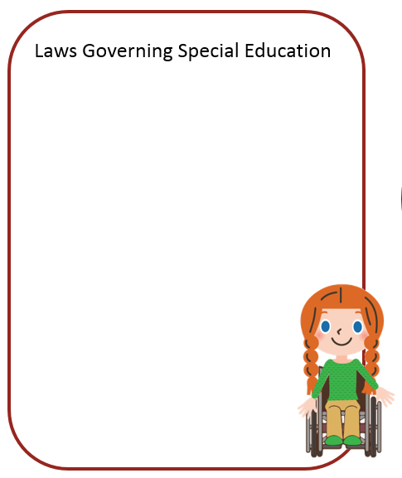
Checkpoint: Special Education Laws
    What federal statutes govern special education in local education agencies?
    What is the purpose of each of these statutes?
    Who and what do the statutes protect?
Notes:
TO DO:
Ask for participants to take out their Special Education Process Reflection Placemat. Using the questions on the slide as a guide; instruct participants to record their reflections about the statutes just discussed. Give time for the participants to share with each other and a few shout outs to the large group. Conclude the sharing with key ideas listed below.
Reflection time—5 minutes
Large Group Share Out—3-4 minutes
Sharing Key Ideas—3 minutes.
TO SAY: Please take out your Special Education Process Reflection Placemat. It is located in your folder on the opposite side of your handout packet.
The key points of the Special Education Law section that we just reviewed were:
IDEA mandates all the current methodology that comprises the Special Education Process.
All children and their families who meet eligibility requirements established by the statute and attend federally funded school settings are protected by these statutes.
These statutes are critically important for maintaining a promoting best practices and optimal educational experiences for all children.

Slide 27
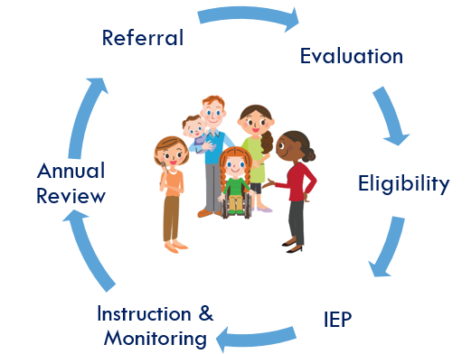
The Special Education Process
Notes:
What to say:
This next section will address the Special Education Process from Referral to Annual Review.

Slide 28

Activity: Case Study
7
Jennifer
10-year-old, 5th grader
Academic difficulties in reading and writing
Falling behind
Research-based interventions were unsuccessful
Notes:
TO SAY: Throughout this section of our training, we will be using a case study format to follow the Special Education process. Please direct your attention to the handout titled “Case Study.”
TO DO: Read the below introduction of the case study:
INTRODUCTION: Jennifer is a ten-year-old, fifth grade student at ABC Elementary School. She has a history of academic difficulties, specifically in the areas of reading and writing. Jennifer’s challenges in these areas were less apparent early in her schooling, however as school has become more difficult in the last few years, she has begun to fall further behind. Jennifer’s teacher, Mrs. Smith, has tried various research-based interventions with her which have been unsuccessful. Mrs. Smith has collected multiple work samples over the course of the school year.

Slide 29


Referral
Evaluation
Eligibility
IEP
Instruction & Monitoring
Annual Review
Referral
Source: Missouri State Plan for Special Education and Missouri Special Education Compliance Standards and Indicators
Notes:
TO SAY:
The Referral is the first step in the special education process. A referral is a formal (oral or written) notification to the local public school system regarding concerns about a child’s learning or development. A referral can be made by either a parent or the local education agency. The official referral begins the formal process of determining eligibility for special education services. Once a referral is provided, the school must obtain consent from the parent(s) or legal guardian(s) to begin the evaluation phase of the referral process.

Slide 30


Parent Referral
8
Initial Evaluation Process PARENT REFERRAL Flow Chart
Indicator: 200.10
Notes:
TO SAY:
When a parent makes a request for their child to be evaluated to the local public school system, they are expressing concerns about their child’s development and learning. Parent referrals for evaluation may be verbal or written requests. Once made, the LEA staff must determine if they suspect a disability. At this point, procedural safeguards must be given to the parent within 5 school days of the referral.
Let’s take a closer look at what happens when a referral is made to the LEA by the parents. Refer to your standards and indicators in the resource notebook located on your table and the Initial Evaluation Process PARENT REFERRAL Flow Chart handout in your packet. Take a few minutes to discuss 200.10 indicator and review the flow chart. Discuss the time increments outlined in the parent referral process.
TO DO: Allow 5 minutes for table discussion surrounding indicator 200.10 and the parent referral flow chart.
TO SAY: Let’s review the steps listed on the flow chart. When an LEA receives a verbal or written parent referral, they must provide procedural safeguards within FIVE SCHOOL DAYS of the parent’s request. The LEA staff then must determine if there is a reason to suspect a disability. If there is no reason to suspect a disability, the LEA should provide the parent with a Notice of Action-Refused within THIRTY CALENDAR DAYS of the referral. If there IS a reason to suspect a disability, a Review of Existing Data must be conducted within THIRTY CALENDAR DAYS of parent’s referral. This starts the evaluation process. We will discuss the rest of this flow chart as we continue throughout the training today.

Slide 31



Agency Referral
9
Initial Evaluation Process Agency Referral Flow Chart
Indicator: 200.10
Notes:
TO SAY:
Now let’s take a look at the copy of the Initial Evaluation Process Agency Referral flow chart in your packet.
Indicator 200.10 applies to agency referrals and is the same indicator we reviewed for parent referrals.
This is the process when the LEA (Teacher Support Team, Care Team, Student Success Team, etc.) makes a request for consideration of a initial evaluation.
The agency examines the student’s progress in the general education classroom including interventions, attendance, and other relevant information from a team mentioned previously
If the agency suspects a disability, parents are provided Procedural Safeguards within 5 school days and the evaluation process begins

Slide 32
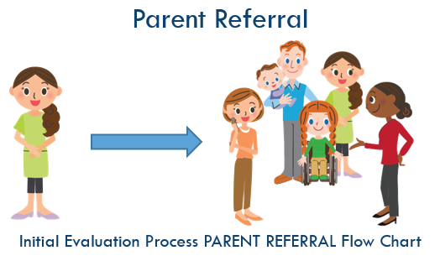
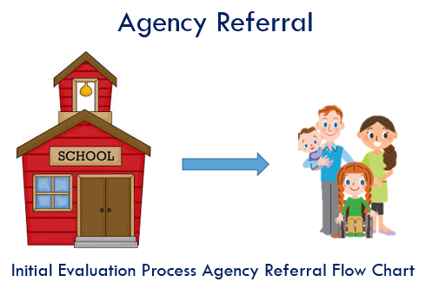
Differences in Referrals
8-9
Indicator: 200.10
Notes:
TO DO: Have participants get out flowchart handouts.
TO SAY:
Now let’s take a look at the differences between the two pathways of referrals.
The parent referral process is slightly different from the local education agency referral process in that if the parent has made the referral and if the local education agency does not suspect a disability the parents are provided with a Notice of Action—Refused within 30 days.
When the agency makes the referral and there is no disability suspected the LEA continues to provide interventions but a Notice of Action—Refused is not required.

Slide 33
Notice of Procedural Safeguards
The LEA must provide procedural safeguards to parents within 5 school days of receipt of any referral. These explain the parent/guardian’s rights under IDEA in regards to:
  Written Notice and Consent
  Independent Educational Evaluation
  Access to Records, Confidentiality of Information & Destruction of Records
  Parent Participation
  Mediation prior to filing due process
  Discipline
  Private School placement by Parents
  The Complaint System (Mediation, Child Compliant, Due Process, Civil Action)
Indicator: 200.20
Notes:
TO SAY:
One of the basic requirements of the IDEA is the provision of the Procedural Safeguards to parents/guardians. A copy of the most recent procedural safeguards is included in the notebook on your table as well as on the DESE website.
Procedural Safeguards are the policies related to parent rights within the special education process and provide protections in the 8 categories listed on this slide.
A copy of procedural safeguards must be given to parents at least one time each school year. In addition, a copy shall also be given for the additional reasons stated on this slide. As noted on the previous slide, one of the times the procedural safeguards must be given to parents is within 5 school days of any referral.
The most recent update for procedural safeguards was made August, 2009.

Slide 34

Review of Existing Data
Qualified team of professionals meet
Team reviews all relevant existing child data
Must be completed within 30 calendar days of referral date
Indicator: 200.30
Notes:
TO SAY:
After a referral for an evaluation is made, the LEA staff determines if there is a reason to suspect a disability. If a disability is suspected, a group of qualified professionals (meeting the requirements of an IEP team) must review existing data on the child within 30 calendar days. The purpose of the Review of Existing Data is to decide whether or not additional information is needed in order to determine if the child has a disability under IDEA.
Documentation of the review includes a description of all data reviewed and a summary of the information gained. A sample form is available to document this process on the DESE website and in the notebook at your table. Please turn to the form in the notebook as we discuss this process.
As you can see on the Missouri sample form, the IEP team members and other qualified professionals must meet or confer to review all relevant existing evaluation information in order to determine what additional data, if any was needed to determine:
Whether the child has a particular category of disability or, in the case of a reevaluation, whether the child continues to have a disability.
The present levels of performance and educational needs of the student.
Whether the child needs special education and related services, or in the case o fa reevaluation, whether the child continues to need special education and related services.
Whether any additions or modifications to the special education and related services are needed to enable the child to meet the measureable annual goals set out in the individualized education program of the child and to participate, as appropriate in the general curriculum.
The team must review data in the following areas:
Vision
Hearing
Health/Motor
Speech
Language
Intellectual/Cognitive
Adaptive Behaviors
Social/Emotional/Behavioral
Academic Achievement
Post-Secondary Transition for students age 16 and older, or younger students as appropriate.
Assistive Technology
With each area, the team must document the data reviewed and determine if further assessment information is needed. If it is known, the assessment instruments to be used, must also be documented.

Slide 35

Notice of Action for Evaluation and Parental Consent
Written notice is provided
Written parental consent is obtained for all initial evaluations (with or without assessment) or reevaluation with assessment.
Indicator: 200.50
Indicator: 200.70
Notes:
TO SAY:
Another important part of the process is providing a written notice to parents before the local education agency initiates, changes, or refuses the identification, evaluation, educational placement of the student.
The date of the Notice (m/d/y) is not more than 30 calendar days from date of referral and includes:
1. Consent—which is obtained from the parent prior to administration of any tests or assessment instruments, if applicable.
2. Parent signature and date (m/d/y):
3. Indicates parent has been fully informed in her/his native language or other mode of communication for all activities for which consent is sought.
Indicators 200.50 and 200.70 give directions for written notice. Please turn to Indicators 200.50 and 200.70 in the Special Education Compliance Standards and Indicators. Take two minutes at your table to review these indicators and discuss the difference between these indicators.
TO DO: Allow the participants 2-3 minutes at their table to discuss Indicators 200.50 and 200.70.
TO SAY: What is the difference between these two indicators? (Allow a participant to answer)
TO KNOW: Answer: 200.50 refers to when additional data is NOT needed. 200.70 refers to when additional data IS needed.

Slide 36
Activity: Case Study
7
What was the basis of Jennifer’s referral and by whom was it made?
What type of information was collected in order to complete the Review of Existing Data (RED)?
What is the purpose of the RED?
What is the purpose of the Notice of Action for evaluation?
Notes:
To Say: Going back to our case study of Jennifer, please read the referral, review of existing data, and notice of action for evaluation and parental consent sections.
TO DO: Allow 10-15 minutes for reading. Once reading is complete, discuss the questions on the slide as a group.
What was the basis of Jennifer’s referral and by whom was it made?
Jennifer is struggling in reading and writing. Research-based interventions have been provided but were not successful. Jennifer’s teacher, Mrs. Smith, referred her for an initial special education evaluation.
What type of information was collected in order to complete the Review of Existing Data (RED)?
Mrs. Jones collected information from Jennifer’s school files, her current and previous teachers, and parents. Additionally, the team reviewed information in the areas of vision, hearing, health/motor, speech/language, intellectual/cognitive, adaptive behavior, social/emotional, academic achievement, transition and assistive technology. From review of the data, the team determined that assessment was needed in the areas of intellectual/cognitive and academic achievement.
What is the purpose of the RED?
The Review of Existing Data is completed in order to review all relevant existing evaluation information in order to determine what additional data, if any, is needed to determine whether the child has a particular category of disability.
What is the purpose of the Notice of Action for evaluation?
A written notice must be given to parents before the local education agency initiates, changes, or refuses the identification, evaluation, or educational placement of the student. In this case, Jennifer was referred for an evaluation and the LEA suspected a disability for which an evaluation was determined to be necessary. After completing the RED, a notice of action was provided to the parent to obtain consent for conducting the evaluation.

Slide 37

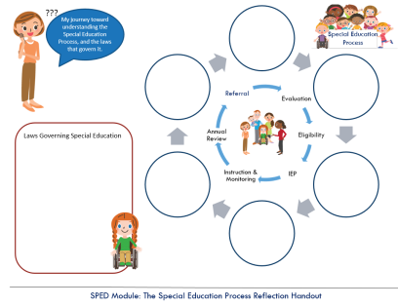
Checkpoint
Record key points regarding the referral process on your Special Education Process Reflection Placemat
Discussion:
Describe what a parent referral might sound like
How are parent referrals and agency referrals the same and different?
Notes:
TO KNOW: This slide should take approximately 10 minutes.
TO SAY:
Please remove the Special Education Process Reflection Placemat from your folder. Take a few minutes (3) to record key points about the parent and agency referral process. Afterwards, there will be time to discuss what a parent referral might sound like and how the two types of referrals are the same and different
After participants have completed their recordings (a few minutes) have them discuss the statement and question in the blue text box.
After a few minutes (3) for discussion ask for volunteers to share out.

Slide 38

Evaluation
Eligibility
IEP
Instruction & Monitoring
Annual Review
Referral
Source: Missouri State Plan for Special Education and Missouri Special Education Compliance Standards and Indicators
Notes:
TO SAY:
Our next step in the special education process is the Initial Evaluation.

Slide 39

Evaluation
An Evaluation is the process of collecting information about a referred student’s learning needs through a series of individual tests, observations, and talks with the student, the family and others.
Source: Missouri State Plan for Special Education and Missouri Special Education Compliance Standards and Indicators
Notes:
TO SAY:
The evaluation provides information that is used to determine whether or not the child has a disability under IDEA.
The evaluation is conducted at no cost to parents.

Slide 40
Eligibility Staffing
The Eligibility Staffing is held within sixty (60) calendar days of the date of Notice to Evaluate, if no consent required OR within sixty (60) calendar days of the date consent is received
The determination of eligibility for special education services is made during the eligibility staffing based on evaluation results.
Indicator: 200.180
Notes:
TO SAY:
The eligibility staffing is held within SIXTY calendar days of the date of notice to evaluate, if no consent was required OR within SIXTY calendar days of the date consent was received.
The determination of eligibility for special education services is made during the eligibility staffing based on evaluation results.

Slide 41
Evaluation Report
The evaluation report addresses the results of all assessed areas generally related to the suspected disability. This should include, if appropriate, any or all of the following areas:
  (1) Health, (2)Vision, (3) Hearing, (4) Social and emotional status, (5) General Intelligence, (6) Academic performance (including results of state and agency-wide assessments), (7)Communicative status, and/or (8) Motor abilities
  The evaluation report documents the determination of eligibility
Indicator: 200.190-200.270
Source: Missouri State Plan for Special Education and Missouri Special Education Compliance Standards and Indicators
Notes:
TO SAY:
The evaluation information is sufficiently comprehensive to identify all of the child’s special education and related services needs. The report should be a synthesis of information from the evaluation in order to make a determination of eligibility.
Please open your table notebooks and pull out the DESE evaluation report form.
Indicator 200.210a states “The evaluation report addresses the results of all assessed areas generally related to the suspected disability. This should include, if appropriate, any or all of the following areas:
Health,
Vision,
Hearing,
Social and emotional status,
General Intelligence
Academic Performance (including results of state and agency-wide assessments),
Communicative status, and/or
Motor abilities.
Indicator 200.10.b states “The evaluation information is sufficiently comprehensive to identify all of the child’s special education and related services needs.”
If you take a look at the sample evaluation form, you will notice that the first page is for demographic information and case history. The second page begins with a continuation of case history, followed by a list of evaluation procedures. It is necessary to include the name and date of the assessment given, as well as the name and role of the person conducting assessment.
The next section is the part of the evaluation report that is referred to in Indicator 200.10. As you can see, the evaluation report has sections for vision, hearing, health/motor, speech, language, intellectual/cognitive, adaptive behavior, social/emotional/behavioral, academic achievement, post-secondary transition, assistive technology and observation if required.
Indicator 200.220.a discusses the need for observation for certain suspected disabilities. It states “Documentation of the required observation conducted during the evaluation process includes all required components as addressed in the eligibility criteria for Autism, Emotional Disturbance, and Specific Learning Disability (refer to Eligibility Criteria 600 Autism, 800 Emotional Disturbance, and 1400 Specific Learning Disability).

Slide 42

Checkpoint
Record key points regarding evaluation on your Special Education Process Reflection Placemat
Notes:
TO SAY:
Take a few minutes (2) to record key points regarding the initial evaluation aspect of the special education process.
TO DO: After a few minutes (2) of recording have participants share their key points with one another

Slide 43
Evaluation
Eligibility
IEP
Instruction & Monitoring
Annual Review
Referral
Source: Missouri State Plan for Special Education and Missouri Special Education Compliance Standards and Indicators
Notes:
TO SAY:
After the evaluation, we can determine eligibility.

Slide 44
Eligibility
The student is eligible for special education services if:
The student has a disability as defined by IDEA which adversely impacts his/her educational performance, and
The student needs special education services in order to benefit from education.
Notes:
TO SAY:
The student is eligible for special education services if the student has a disability as defined by IDEA which adversely impacts his/her educational performance and the student needs special education services in order to benefit from education.
The student must meet both requirements in order to be eligible for special education services. A student could meet the eligibility criteria for a specific disability category but not require specially designed instruction to benefit from their education. In this case, a student would not be eligible for special education services.

Slide 45

Eligibility Timeline
Eligibility for special education and related services must be determined within 60 calendar days of the agency’s receipt of the parent’s signed consent.
Source: Missouri State Plan for Special Education and Missouri Special Education Compliance Standards and Indicators
Notes:
TO SAY:
Eligibility for special education and related services must be determined within SIXTY calendar days of the agency’s receipt of the parent’s signed consent. If the evaluation process exceeds 60 days, an explanation for the extension is documented (e.g., snow days, agency vacation days, child’s absence because of illness, and summer break, etc.).

Slide 46
Missouri Eligibility Identification
Autism
Deaf-Blind
Emotional Disturbance
Hearing Impairment
/Deafness
Intellectual Disability
Multiple Disabilities
Orthopedic Impairment
Other Health Impairment
Specific Learning Disability
Language Impairment
Sound System Disorder
(Articulation and/or Phonology)
Speech Fluency
Speech Voice
Traumatic Brain Injury
Visual Impairment/Blindness
Young Child with a Developmental Delay
Indicators: 600-2100
Source: Missouri State Plan for Special Education and Missouri Special Education Compliance Standards and Indicators
Notes:
TO SAY:
All states do not necessarily recognize the same categories of disabilities. Missouri has identified 16 categories of disability. In order to be determined eligible for special education services, a student must meet the eligibility criteria in at least one of these categories and require specialized instruction in order to benefit from their education.
According to the Missouri State Plan for Special Education, “No child may be determined to be eligible if the determinant factor for that eligibility determination is lack of appropriate instruction in reading, including the essential components of reading instruction (as defined by section 1208(3) of the ESEA), or lack of appropriate instruction in math or limited English proficiency 34 CFR 300.306(b)(1). “
Please look at the Special Education Compliance Standards and Indicators Manual. Beginning at Indicator 600, you will find the Eligibility Criteria for each of the 16 categories of disabilities Missouri has identified. Take a few moments and look at the disability criteria.
TO DO: Allow 5-10 minutes to review the indicators, depending on participant engagement.

Slide 47
Independent Educational Evaluation
If a parent disagrees with the evaluation conducted by the LEA, they have the right to request an independent educational evaluation (IEE) conducted by a qualified person who does not work for the school as specified in the LEA’s policy.
Indicators: 100.420-100.440
Source: Missouri State Plan for Special Education and Missouri Special Education Compliance Standards and Indicators
Notes:
TO SAY:
What happens if a parent doesn’t agree with the evaluation performed by the LEA?
Parents may request that the school pay for the IEE. However, the school may ask for a due process hearing to show that its initial evaluation is appropriate. A parent is entitled to only one independent evaluation at public expense each time the local education agency conducts an evaluation with which the parent disagrees.
If an IEE is conducted and shared with the LEA, the LEA is required to consider the results.

Slide 48
Activity: Case Study
7
Discuss at your table:
Which disability categories require observations as part of the eligibility criteria?
Using pages 3-13 of the Missouri State Plan for Special Education, review the eligibility criteria and note the similarities and differences across the sixteen (16) disability categories.
Using the eligibility criteria for Specific Learning Disability in the Standards and Indicators Manual at your table, review 1400.20 (discrepancy) to determine what criteria Jennifer had to meet to be eligible for special education under the disability category of Specific Learning Disability.
Notes:
To Say: Going back to our case study of Jennifer, please read the evaluation and eligibility sections.
TO DO: Allow 5-10 minutes for reading. Once reading is complete, discuss the questions on the slide as a group.
Which disability categories require observations as part of the eligibility criteria?
Autism, Emotional Disturbance, and Specific Learning Disability
Using Regulation III-Identification and Evaluation in the Missouri State Plan for Special Education, review the eligibility criteria and note the similarities and differences across the sixteen (16) disability categories.
Similarities: All categories require the disability to have an adverse impact on the student’s educational performance
Differences: Some require student observation; some require IQ measures to be used; some require discrepancy between IQ measure and the academic achievement; some require adaptive behavior measurement; some have no specific numeric measurement requirements and rely on informant measures
Using the eligibility criteria for Specific Learning Disability in the Standards and Indicators Manual at your table, review 1400.20 (discrepancy) to determine what criteria Jennifer had to meet to be eligible for special education under the disability category of Specific Learning Disability.
Jennifer’s FSIQ was 104. Jennifer’s written expression achievement level was 76 and reading comprehension was 81. In order to be eligible under the discrepancy model, Jennifer would need to score at or below a criterion level of 82.

Slide 49

Checkpoint
Record key points regarding eligibility on your Special Education Process Reflection Placemat
Notes:
TO SAY:
Take a few minutes (2) to record key points about eligibility in the special education process.
TO DO:
After a few minutes (2) of recording have participants share their key points with one another.

Slide 50

Individualized Education Program (IEP)
Evaluation
Eligibility
IEP
Instruction & Monitoring
Annual Review
Referral
Source: Missouri State Plan for Special Education and Missouri Special Education Compliance Standards and Indicators
Notes:
TO SAY:
The next step in our cycle is writing the IEP.

Slide 51


Individualized Education Program
The IEP is a written document describing the specially designed program developed to meet the needs of the individual child.
I am the I in IEP
Source: Missouri State Plan for Special Education and Missouri Special Education Compliance Standards and Indicators
Notes:
TO SAY:
The Individual Education Program (IEP) is the heart and soul of the Individuals with Disabilities Education Act (IDEA). The single most important principle of the IEP process is it must appropriately address all the student's unique needs.

Slide 52
IEP guiding questions & sections
Where is the student now?
Where is the student going?
How will the student get there?
What evidence will demonstrate success?
How and when will progress be reported?
PLAAFP
Measureable Goals and Objectives
Services and Instruction
Data collection of progress toward the goals
Progress Reports
Source: Missouri State Plan for Special Education and Missouri Special Education Compliance Standards and Indicators
Notes:
TO SAY:
The IEP includes provisions for establishing the student’s current functioning level, setting annual goals, evaluating progress, and determining the appropriate services and placement needed to ensure a free and appropriate public education for the student with the disability. Determine the sections of the IEP where you would find information that addresses the questions in the slide.
Please take a moment to flip to the sample IEP form in the notebook on your table. Which section of the IEP answers the following questions:
Where is the student now? (Click for PLAAFP to fly in)
Where is the student going? (Click for Measureable Goals and Objectives to fly in)
How will the student get there? (Click for Services and Instruction to fly in)
What evidence will demonstrate success? (Click for Data collection of progress toward the goals to fly in)
How and when will progress be reported? (Click for Progress Reports to fly in)
52

Slide 53
Required Participants in the IEP Meeting
  Parent (at least 1) or Guardian
  Local Education Agency representative (LEA)
  Regular Education teacher
  Special Education teacher
  Individual who can interpret instructional implications of evaluation results
  Child (if appropriate)
  Others, at parent or District invitation
Indicator: 200.670-200.720
Source: Missouri State Plan for Special Education and Missouri Special Education Compliance Standards and Indicators
Notes:
TO SAY:
Parent or legal guardian must be invited to the IEP meeting. However, if the parent is unable to attend after two attempts by the LEA to invite them to come, the IEP team may proceed with the meeting.
In order for a member of the IEP team to be excused, in whole or in part, documentation must be present that both parent and LEA agree in writing to the excusal.
Indicators 200.670 through 200.720 give specific information regarding the required participants.

Slide 54
Present Level of Academic Achievement and Functional Performance (PLAAFP)
The IEP includes a statement of the child’s PLAAFP that:
Is consistent with evaluation/reevaluation results in the evaluation report.
Reflects changes in current functioning of the child since the initial/prior IEP.
Addresses how the child’s disability affects her/his involvement and progress in the general education curriculum.
Considers the results of the initial or most recent evaluation of the child.
Addresses the strengths of the child and the concerns of the parent for enhancing the education of their child.
Addresses the academic, developmental and functional needs of the child.
Indicator: 200.740
Source: Missouri State Plan for Special Education and Missouri Special Education Compliance Standards and Indicators
Notes:
TO SAY: (Read Slide)
Indicator 200.740 gives specific information about the present level of academic achievement and functional performance.

Slide 55
IEP GOALS
Measurable Annual Goals
  To meet INDIVIDUALIZED needs so the student can be involved & make progress in the General Education curriculum.
  To meet other INDIVIDUALIZED education-related needs that result from disability.
  For students participating in Alternate Assessments,
  IEP goals must include benchmarks or short-term objectives.
Indicator: 200.810
Source: Missouri State Plan for Special Education and Missouri Special Education Compliance Standards and Indicators
Notes:
What to say:
IEP goals are established to guide the instruction and services for the student with special needs. Goals include benchmarks and address academic and functional skills.
Please look at the Special Education Compliance Standards and Indicators. Look at Indicator 200.810. As you can see, there are very specific instructions related to IEP goals. Goals must demonstrate consistency with the content of the present level of performance. Goals are written as Specific, Measurable, Attainable, Results-oriented, Time-Bound goals and enable the child to be involved in the general education curriculum, as appropriate. IEP goals must address the child’s other educational needs resulting from his/her disability and must be present for each special education and related service. For children taking alternate assessments, description of benchmarks or short-term objectives aligned to alternate achievement standards.
55

Slide 56
SMART Goals
SPECIFIC | to a particular skill or behavior
MEASURABLE | Can be counted or observed
ATTAINABLE | Can be reasonably accomplished within the duration of the IEP
RESULTS ORIENTED | Describes how the goal will be measured
TIME BOUND | Generally will happen over the course of one year
Indicator: 200.810.b
Notes:
What to say:
Goals should be written for the student’s needs prioritized by assessment and PLAAFP.
Goals must be clearly stated in order for everyone working with the child to know how to deliver the services specified in the IEP. Goals drive the needed services. Decisions about services needed to help the student reach the goal(s) of the IEP are determined by the IEP team.
Indicator 200.810.b states “The IEP includes goals that are written in terms that are:
Specific to a particular skill or behavior to be achieved.
Measurable.
Attainable (can reasonably be accomplished within the duration of the IEP).
Results oriented.
Time-bound (generally happen within one year).”
The acronym for this is SMART. SMART goals assure that the IEP team can determine if the student is making progress within his/her individualized educational program.
56

Slide 57
Services
Special Education AND related services, and any other individualized supports are provided to the child in order to:
Make progress toward annual goals.
Make progress in the General Ed curriculum
Participate in extracurricular and non-academic activities.
It’s not enough to benefit from a service. It must be needed to provide FAPE.
Indicator: 200.820
Source: Missouri State Plan for Special Education and Missouri Special Education Compliance Standards and Indicators
Notes:
TO SAY:
As discussed on Slide 23, all students are entitled to FAPE. Schools are required to provide special education services to children with disabilities. Recall that the law defines special education as "specialized instruction, at no cost to the parents, to meet the unique needs of the child with a disability..." (20 U.S.C. Section 1401 (29) . The services must be necessary for the student to receive benefit from their education.
Indicator 200.820 states, “Documentation includes a statement of the special education services based on peer reviewed research to the extent practicable to be provided to the child or on behalf of the child to advance appropriately toward obtaining the annual goals:
Specific special education service(s).
Amount of time (e.g., minutes, hours, periods, percentage) to be committed to each service that must be:
Appropriate to the specific service
Stated in a manner clear to all involved in the development and implementation of the IEP.
Duration (i.e., beginning and ending dates for the services).
Location (states the type of environment for provision of the services-e.g., regular education classroom, special education classroom, community worksite, community child care center, etc.).
Frequency (states how often the service will occur—e.g., daily, weekly, monthly).”
57

Slide 58
Related Services
Developmental, corrective, or supportive services for the child to benefit from special education may include:
  Occupational therapy
  Physical therapy
  Transportation
  Counseling
  Speech and language therapy
  Audiology services
  Interpreting services
  Psychological services
  Parent counseling and training
  School health/nurse services
  Social work services
  Crisis Intervention
  Assistive technology
  Non-academic services
  Extra curricular activities
  Orientation/mobility training
  Rehabilitation counseling
Indicator: 200.830
Source: Missouri State Plan for Special Education and Missouri Special Education Compliance Standards and Indicators
Notes:
TO SAY:
Related services is the term for those services a child with disabilities needs in order to benefit from special education.
Related services include speech therapy, occupational therapy, physical therapy, and rehabilitation counseling are related services. Related services means transportation and such developmental, corrective, and other supportive services as are required to assist a child with a disability to benefit from special education.
The IEP team will need to make the following decisions about related services:
Which services are needed and why?
How often are they needed?
What length of time?
Who will provide the services?
Please review Indicator 200.830 in the Special Education Compliance Standards and Indicators Manual. What documentation is required for related services?
TO DO: Call on a volunteer to read Indicator 200.830 from the Special Education Compliance Standards and Indicators Manual.
Indicator 200.830: Documentation includes a statement of the related services based on peer reviewed research to the extent practicable to be provided to the child or on behalf of the child:
Specific related service(s).
Amount of time (e.g., minutes, hours, periods, percentage) to be committed to each service that must be:
Appropriate to the specific service.
Stated in a manner clear to all involved in the development and implementation of the IEP.
Duration (i.e., beginning and ending dates for services).
Location (states the type of environment for provision of the services-e.g., regular classroom, resource classroom, etc.).
Frequency (states how often the service will occur-e.g., daily, weekly, monthly).

Slide 59
Least Restrictive Environment
Students with disabilities are to be educated, to the maximum extent possible, with children who do not have a disability. This is called the “least restrictive environment” or LRE.
A placement decision is made at the IEP meeting – identifying the amount of time
spent with their peers without disabilities to determine the appropriate services needed to meet the child’s goals on the IEP.
Source: Missouri State Plan for Special Education and Missouri Special Education Compliance Standards and Indicators
Notes:
What to say:
The IDEA includes two fundamental requirements:
the child will receive a free appropriate public education (FAPE)
in the least restrictive environment (LRE).
It is important to know that special education is a service for children rather than a place.
A placement decision is made at the IEP meeting – identifying the amount of time spent with their peers without disabilities to determine the appropriate school program and services needed to meet the child’s goals on the IEP.
Students with disabilities are to be educated, to the maximum extent possible, with children who do not have a disability. This is called the “least restrictive environment” or LRE.
The IEP team can consider placement options on the continuum to make the LRE decision:
Inside regular class at least 80% of time
Inside regular class 40% to 79% of time
Inside regular class less than 40% of time
Public separate school (day) facility
Private separate school (day) facility
Public residential facility
Private residential facility
Homebound/hospital

Slide 60

Notice of Action-Consent for Services
Date of Consent for Initial Services is prior to implementation of the IEP: 300.503(a)(1); SP(V)
Parent consent (date of signature) is prior to implementation of IEP (initiation date).
Standard: 200.1050
Source: Missouri State Plan for Special Education and Missouri Special Education Compliance Standards and Indicators
Notes:
What to say:
Documentation is present that Written Notice was provided to the parents of a child with a disability prior to
proposing or refusing to initiate or change the identification, evaluation, educational placement of the child or the
provision of FAPE to the child:
200.1050.a. A written notice is provided to the parent prior to provision of services.
200.1050.b. Prior Written Notice to parents for their consent to initiate services in education must include the
eligibility category of disability and subcategories, if appropriate, under which the child for those
services.
AND
200.1050.c. Signed parental consent for the initial services is obtained prior to provision of services.
Activity: (SAY): Use the Program Review Standards and Indicators Manual at your table to locate the standard shown on the slide. With your table partners, discuss where the Notice of Action-Consent for Services occurs in the special education process.
Answer: The Notice of Action-Consent for Services is provided to parents at the Initial IEP meeting, prior to implementation of special education services.

Slide 61
Amending or Modifying the IEP
A child’s IEP may be amended or modified after the annual IEP meeting.
Source: Missouri State Plan for Special Education and Missouri Special Education Compliance Standards and Indicators
Notes:
What to say:
What happens when we need to make a change in the IEP? Do we have to wait for the annual review or can we amend at any time?
In making changes to a child's IEP after the annual IEP Team meeting, the parent of a child with a disability and the LEA may agree not to convene an IEP Team meeting for the purposes of making such changes and instead may develop a written document to amend or modify the child's current IEP.
Which Standard #___ discusses requirements for IEP Amendments?
Answer: 200.640
A child’s IEP may be amended or modified after the annual IEP meeting. Documentation of any
amendment/modifications is present as follows:
200.640.a. Date of annual IEP meeting,
200.640.b. Date of agreement to amend the IEP,
200.640.c. Date amendments to be implemented,
200.640.d. Individuals participating in the agreement are listed by name and role,
200.640.e. How agreement made, and
200.640.f. Changes to the IEP include all required components for compliance.

Slide 62
Post Secondary Transition Planning
Transition planning is careful preparation by the student, parents, educators, and other service providers for post-secondary experiences in education/training, employment and independent living, if appropriate.
Required to be in the IEP by the age of 16 – or younger if appropriate
The plan is written on Form C of the IEP
Source: Missouri State Plan for Special Education and Missouri Special Education Compliance Standards and Indicators
Notes:
What to say: (34) Transition Planning is an important part of the discussion during the IEP process by the time the student turns age 16. The discussion by the IEP team is about preparing the student for their employment, education or training experiences, or to live as independently as possible after they leave the high school setting. Documentation of post secondary goals are recorded on Form C of the IEP.

Slide 63

Post Secondary Transition Services
Post-Secondary Transition services must relate to goals in the following areas:
- Education
- Training
- Employment
- Independent living skills (if appropriate)
The transition services must take into account a student’s strengths, preferences and interests.
The transition services include courses of study that focus on improving the academic and functional achievement of the child to facilitate their movement from school to post-school.
Standard: 200.800
Source: Missouri State Plan for Special Education and Missouri Special Education Compliance Standards and Indicators
Notes:
What to say: By age 16, the IEP team must develop a transition plan which includes helping to make the linkage for students and parents with post-secondary community resources. The term `transition services' means a coordinated set of activities for a child with a disability that:
(A) are designed to be a results-oriented process, that is focused on improving the academic and functional achievement of the child with a disability to facilitate the child's movement from school to post-school activities, including post-secondary education, vocational education, integrated employment (including supported employment), continuing and adult education, adult services, independent living, or community participation;
(B) is based on the individual child’s needs, taking into account the child's strengths, preferences, and interests; and
(C) includes instruction, related services, community experiences, the development of employment and other post-school adult living objectives, and, when appropriate, acquisition of daily living skills and functional vocational evaluation.
The transition services must include a course of study that focuses on improving the academic and functional achievement of the child to facilitate their movement from school to post-school. The course of study listed must align with the student’s identified post-secondary goal(s). The course of study is a multi-year description of coursework from the student’s current grade to anticipated exit year that is designed to help achieve the student’s
desired post-school goal(s).

Slide 64
Activity: Case Study
7
Using the information that has been reviewed this far in the case study:
What academic goals would you suggest for Jennifer’s IEP for this year?
As Jennifer approaches middle school, how would you find out what job interests she has for the future?
What possible accommodations would you anticipate Jennifer may need upon entering the workforce?
Notes:
TO SAY: As you know, Jennifer is in fifth grade and transition planning is not required at this age. However, transition planning may begin prior to age sixteen, if the IEP team deems appropriate.
Please turn to your shoulder partner and discuss the questions on the screen.
TO DO: Allow approximately 5 minutes for discussion.

Slide 65

Checkpoint
Record key points regarding the IEP on your Special Education Process Reflection Placemat
Notes:
What to say:
Take a few minutes (2) to record key points about the IEP process in the special education process
What to do: After a few minutes (2) of recording have participants share their key points with one another

Slide 66

Instruction & Monitoring Progress
Evaluation
Eligibility
IEP
Instruction & Monitoring
Annual Review
Referral
Source: Missouri State Plan for Special Education and Missouri Special Education Compliance Standards and Indicators
Notes:
TO SAY:
The IEP must include assessment information pertaining to the student’s individual needs, educational programming that addresses those needs, and a system for monitoring student progress.
The IEP begins to be delivered according to what is documented in the IEP for services and where they are to be delivered, whether in special education classroom, or general education classroom. It is important for students with disabilities to be educated with their peers without disabilities to the greatest extent possible. This concept is referred to as educating students in the Least Restrictive Environment (LRE).

Slide 67

Instruction & Monitoring Progress
Work together with parents
Keep parents regularly informed
Communicate student progress on IEP goals with regular progress reports
Standard: 200.940
Source: Missouri State Plan for Special Education and Missouri Special Education Compliance Standards and Indicators
Notes:
What to say:
Parents and school personnel must work together to make the IEP and placement work for the child.
Parents are to be kept regularly informed of their child’s progress as defined in the IEP.
IEP goal progress must reported as often as progress is reported for students without disabilities.

Slide 68
Instruction & Monitoring Progress
Accommodations
  individual support
  creates equal access and equal opportunity
  reduces discriminatory barriers
  Examples of Accommodations:
  Grading Text Lectures
  Environment Assignments Pacing
  Reinforcement Tests
Source: Missouri State Plan for Special Education and Missouri Special Education Compliance Standards and Indicators
Notes:
What to say:
Providing accommodations during instruction and assessment will promote equal access to the general curriculum.
Accommodations do not change what the student is expected to learn but rather how he/she learns the curriculum. Accommodations are not intended to give an advantage, but rather provide a level playing field to the student with a disability compared to their peers without disabilities. Accommodations can take the form of individual support, creating equal access and equal opportunity to reduce barriers to learning.
68

Slide 69

Instruction & Monitoring Progress
Modifications:
the curriculum is adjusted or reduced, or an alternative achievement standard is used.
Source: Missouri State Plan for Special Education and Missouri Special Education Compliance Standards and Indicators
Notes:
What to say:
At times modifications are needed to help students make progress on functional and academic goals. A modification is different from an accommodation in that a modification is a change in what the student is expected to learn that is different from the general education curriculum.
Not all students with an IEP need modifications.
Accommodations and modifications are documented in the IEP on Form F. Please find Form F in the notebook on your table and take a few minutes to review the types of accommodations and modifications available.

Slide 70

Checkpoint
Record key points regarding Instruction and Monitoring on your Special Education Process Reflection Placemat
Notes:
What to say:
Take a few minutes (2) to record key points about Instruction and Monitoring in the special education process
What to do: After a few minutes (2) of recording have participants share their key points with one another

Slide 71
Annual Review
Evaluation
Eligibility
IEP
Instruction & Monitoring
Annual Review
Referral
Source: Missouri State Plan for Special Education and Missouri Special Education Compliance Standards and Indicators
Notes:
What to say:
The Annual Review is a meeting held at least once a year to look at, talk about, and study a student’s IEP. The purpose of the Annual Review is to make decisions about changes in the IEP, review the placement, and develop a new IEP for the year ahead.
Triennial and Re-evaluation: the IEP team must consider doing a reevaluation of the student at least every three years, unless the parent and school personnel agree that a reevaluation is not necessary Or If a child is not making expected progress and a parent or teacher requests one (unless the specific evaluation requested is less than a year old).

Slide 72

Remember!
Special Education is a SERVICE provided to the student through specially designed instruction in order to CLOSE THE GAP between the student’s Present Level of Academic Achievement and Functional Performance (PLAAFP) and the student’s Expected Level of Performance
Notes:
What to say: We have a few final things to wrap up our discussion today. (read slide)
72

Slide 73
What drives what?
Evaluation/ Reevaluation
Present Level
Goals
Services
Notes:
What to say: Remember the Special Education process is cyclical. Students are evaluated to determine eligibility and then a program is developed to address their needs and services are provided. Students continue to have their program adjusted based on progress and their needs that are identified ongoing through annual IEP review of progress and reevaluation, if needed.

Slide 74

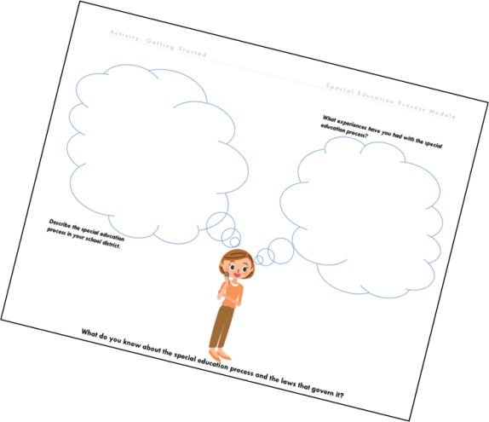

Closing Reflections
What do you feel is the most important thing you learned today?
How will the information provided today impact your practice?
Notes:
This slide: 5 minutes
What to say: Take a look at your special education process reflection placemat; reflect on what you have learned today by thinking about the questions on the slide. Discuss with your shoulder partner.
After shoulder partners’ discussions--Ask for volunteers to share out.
TO SAY: (after share out) If we were to do this activity again (point at the chart completed during the pre-training activity), how many of you would be able to move your colored dot? Are there any lingering questions that I can answer?

Slide 75
Resources
Missouri State Plan for Special Education: http://dese.mo.gov/governmental-affairs/dese-administrative- rules/incorporated-reference-materials/IDEAPartB-2014
Missouri Special Education Compliance Standards and Indicators: http://dese.mo.gov/special-education/compliance/standards-indicators
Missouri Parents’ Guide to Special Education: http://dese.mo.gov/sites/default/files/ParentGuide.pdf
Parent Center Hub and NICHCY
http://www.parentcenterhub.org/
I’m Determined http://www.imdetermined.org/resources/detail/determined_student_involvement_in_iep_oc
Wrightslaw
http://www.wrightslaw.com/nclb/rbi.htm#sthash.tJ85uy3v.dpuf
Notes:
What to say: This slide lists resources that may be valuable as you continue to learn about the special education process.

Slide 76
Please take a moment to complete the post-test. Thank you!
Notes:
TO DO: Hand out post-test.
TO SAY: Please complete the post-test.

Slide 77

Question #1
Which law has as its main purpose to ensure all students with disabilities receive a free and appropriate public education in the least restrictive environment?
  A. No Child Left Behind
  B. Federal Educational Rights and Privacy Act
  C. Individuals with Disabilities Education Act
  D. Rehabilitation Act, Section 504
Notes:
Answer: C

Slide 78
Question #2
Which law influenced the Individuals with Disabilities Improvement Act of 2004, ensuring students with disabilities are taught by highly qualified teachers through the use of “scientifically-based” programs and strategies.
A. No Child Left Behind 2002
B. IDEA 1990
C. 504 Section of the Rehabilitation Act
D. Family Educational Rights & Privacy Act of 1974 (FERPA)
Notes:
Answer A

Slide 79

Question #3
What are the steps in the special education process
A. Annual Review, Referral, Eligibility
B. Annual Evaluation, IEP, Annual Review
C. Referral, Eligibility, Placement
D. Referral, Evaluation, Eligibility, IEP, Instruction & Monitoring, Annual Review
Notes:
Answer D

Slide 80

Question #4
When is prior written notice with parent consent required?
  A. When any changes are made to the IEP
  B. Initial services, Initial evaluation, Reevaluation with assessment
  C. Initial placement, Initial evaluation, when any changes are made to the IEP
  D. Initial evaluation and Reevaluation with assessment
Notes:
Answer B

Slide 81

Question #5
After a parent referral, if the local education agency suspects a disability a Review of Existing Data must be conducted within how many days?
  A. 10
  B. 20
  C. 30
  D. 60
Notes:
Answer C

Slide 82
CONSULTANT CONTACT INFO HERE
Notes:
TO DO: Prior to presenting, enter contact information on this slide.
TO SAY: We thank you for attending our session. If you have any questions, my contact information is listed on this slide.

