Slide 1
Quality Eligibility Determinations
Notes:
To Know: Review all content before beginning the presentation.
To Do:
See next slide for presenter “to do” list prior to training.
Hide this slide.

Slide 2
To Do Prior to Training
2
Gather the necessary materials listed below:
  Chart paper
  Supply boxes
Prepare a copy of the handout packet, PowerPoint, and a copy of the pretest for each participant.
Prepare one copy of the Standards and Indicators and Missouri State Plan to be placed on each table for reference throughout the presentation.
Prior to training send email with link to the pre-reading materials listed below:
  https://dese.mo.gov/special-education/compliance/standards-indicators
  Specifically, sections 600-2100 should be sent out as prereading materials.
Notes:
To Know: This is for the presenter – hide this slide prior to presenting
To Do:
Presenters should review the PowerPoint, handouts and table copies prior to presenting. It is vital that presenters are familiar with all materials and where they are referenced throughout the presentation.
Copies to be made:
One copy per participant:
Pretest
Handouts
Posttest
One copy per table:
State Plan
Standards & Indicators
Additional Presenter “To Dos” prior to training:
Create a Parking Lot for additional questions
Put together supply boxes (one per table) that include highlighters, post-it notes, pens and markers.
Send email to participants one week prior to training:
Include link to Standards & Indicators manual with instructions to read/review the 600-2100 section.
Remind participants that they should be aware of the eligibility requirements for each specific category in order to have a foundational knowledge base regarding the requirements for each category of disability so they can apply the material learned in this training to each of the disability categories.

Slide 3
Quality Eligibility Determinations
Consultant Name/Info
Notes:
To Say: Welcome participants.
To Do: Add consultant name and information and date to customize presentation each time.

Slide 4

Pre-Assessment
Notes:
To Do: Decide whether you want to send the pre-assessment ahead of time or have participants do it at the beginning of the session. You could use some type of electronic format or do a four corners group assessment if you prefer not to do a paper pencil assessment.
To Know: This slide can be moved to wherever you want it in the presentation….possibly at the beginning as participants enter the room, after the introduction of the topic, wherever you so choose.
To Say: Good learning starts with an assessment of where your students are in their knowledge of the particular topic you are about to introduce (actually, if you’re doing this in a classroom, you will probably want to assess student knowledge of a topic or a skill way before you are ready to introduce it for good lesson planning!) so that you know which areas or skills may need more emphasis than others. (Direct participants to either take paper pencil quiz or follow directions for however you have decided to assess their prior knowledge.)

Slide 5
Opening and Introductions
Notes:
To Do: Introduce yourself and if you choose to do something to get a feel for who is in your audience, that would be done here as well.
See next slide for one optional audience introduction activity.

Slide 6

6
Notes:
To Do: This is an optional audience introduction activity. Stand up, Touch Down
To Say: In order for us to get an understanding of who all is in the room today we are going to do an activity called “Stand Up, Touch Down”. When I call your specific role in your school district, please stand up. If you have more than one role, please stand up for each role you play within your school district.
Stand up if you are a school psychologist….Touch Down
Stand up if you are a psych examiner….Touch Down
Stand up if you are a diagnostician…..Touch Down
Stand up if you are a school counselor….Touch Down
Stand up if you are a special education teacher…Touch Down
Stand up if you are the Director of special education….Touch Down
Stand up if you stood up more than once….Touch Down
Any others I missed???

Slide 7
Why the Topic is Important
Notes:
To Say: When considering how students actually ‘get in’ to special education, it’s imperative that we realize just how important it is that we conduct high quality evaluations and make evidence based decisions from those evaluations. Labeling a child as ‘disabled’ is not something to be done lightly or without much thought. Over the course of the last several years, through on-site visits and discussions with the DESE supervisors at our monthly meetings, it has become increasingly evident that we have some pretty big gaps in knowledge and practice in the area of eligibility decisions around the state. That is what has led to the development of this training module. We have to do a better job of getting the information to you guys, the stakeholders, in this process. Again, determining that a child truly has a disability should be a decision that is based on hard core evidence and fact, not speculation, guesswork or gut feelings.
That is what we are going to spend the next several hours talking about today….how do we decide whether or not we suspect a disability, how do we look at whether or not a student qualifies for services and what should our documentation of this process really look like.

Slide 8
Learner Intentions
8
Review the efficacy of special education.
Use a problem solving model to generate quality referrals.
Know the difference between parent referrals and agency referrals.
Conduct a review of existing data.
Implement quality assessment practices.
Use many sources of data to make quality eligibility determinations.
Write evaluation reports to synthesize all observed and assessed information.
Make quality eligibility determinations.
Notes:
To Say: Read the slide

Slide 9
Essential Questions
9
Why use high quality interventions prior to referring a student for assessment?
How does one use a problem solving model to generate quality referrals?
What is the difference between parent referrals and agency referrals?
How does one conduct a quality review of existing data?
What needs to be included in a written evaluation report to synthesize all observed and assessed information?
How does one use many sources of data to make quality eligibility determinations?
Notes:
To Say: Read the slide

Slide 10
Missouri Teacher Standards
Standard 1: Content Knowledge
Standard 2: Student Learning, Growth, and Development
Standard 7: Student Assessment and Data Analysis
Notes:
To Say: This slide lists the teaching standards that apply to the knowledge and skills taught in this training. The Missouri Teaching Standards convey the expectations of performance for professional teachers in Missouri. To see the complete wording of these standards, please go to the DESE website.

Slide 11
Overview of the Day
8:00 a.m.-noon: Pre-referral, Referral and Review of Existing Data
Noon-12:45 p.m.: Lunch on Your Own
12:45 p.m.-2:30 p.m.: Evaluation Report and Eligibility
2:30 p.m.-3:00 p.m.: Questions and Closing
Notes:
To Say: Read slide to participants.
To Do: Adjust times to your agenda based upon audience need.

Slide 12

Norms
12
Begin and end on time
Use technology for learning
Take care of personal needs
Ask for clarification (utilize parking lot for questions)
Be present
Notes:
To Know: Change norms to fit your presentation style, needs of audience or RPDC guidelines.
To Do: Use parking lot for additional questions
To Say: These are the working norms for the day. Are there others that we should add to ensure that today’s training is beneficial for all?

Slide 13
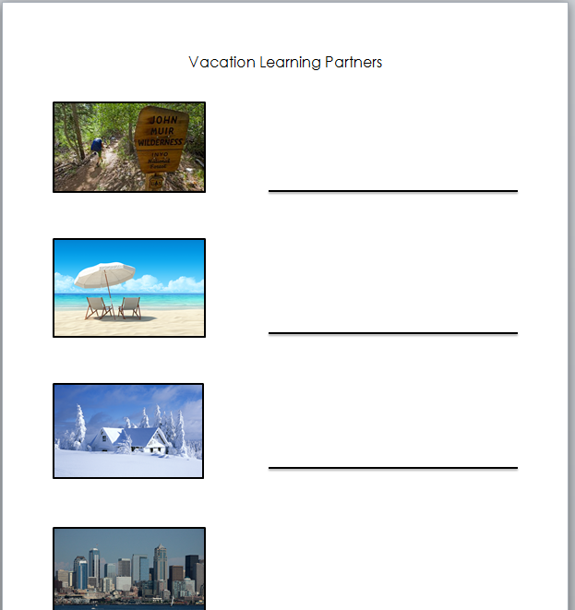
Learning Partners
13
Please use this sheet to
choose four partners to go on vacation
with periodically today.
HO #1
Notes:
To Know: Handout 1 – The HO # _ on the slide of the PPT indicates which handout is to be used with the slide.
To Say: Throughout today, you are going to be given numerous times to think about and process through the information being shared. Best practice for this involves sharing that information with someone else in order to help commit it to your long term memory. Use your Vacation Learning Partners handout to find 4 people to be partners with throughout the session. Two of them can be people you know, two need to be people you don’t know. Example: When you find someone to be your Winter partner, put your name on their sheet and put their name on your sheet. Do the same for the other 3 locations as well.
To Do: Use any introduction and/or processing Handout/procedure that fits the needs of their audience and preference.

Slide 14
Gaming the System
14
Use the yellow sheet at your table to have a discussion around each of the questions.
Jot down a few notes and prepare to share out.
HO #2
Notes:
To Know: Often people share that they make kids eligible because they feel pressured from general education or administration. Other times they say things like ‘we do it because no one else is going to help them’. Schools are supposed to be places of learning. Just because kids don’t learn at the same rate, the same pace and the same level as other students in the room, doesn’t mean they need to be educated somewhere else or that it isn’t anyone other than ‘special education’s” job to educate them. This is too often a culture shift that is going to need to be made in a school or system
To Do: Handout 2: “Gaming the System” Run on yellow paper or change the paper color on the slide
To Say: As mentioned earlier, today we are going to talk about making quality eligibility determinations, but first we need to do some reflection on our current practices
Allow tables to discuss the questions for about 5 minutes. Then read through the questions, asking for volunteers to share out what they had discussed.
As we talk through today, it is going to be imperative for evaluations to use the data and the criteria to make good, high-quality eligibility decisions.

Slide 15
Incidence Rates
15
2014-15
13% of school population
classified as ‘disabled’
Trend went down for
awhile in late 1990’s
but since then its on a
trajectory back up.
Why??
1976-77
8.3% of school population
classified
as ‘disabled’
U.S. Dept. of Ed, National Center for Education Statistics 2015
Notes:
To Know: special education incidence rates have increased over the past few years. Some possible reasons for this trend could include the following: more medical information, the funnel for general education has become more narrow…. mentality of “if kids don’t ‘get it’ in the way a particular teacher teaches it, they must be disabled” and/or possibly because there is a feeling that no one else is going to help students who struggle so special education is the only avenue for assistance for struggling learners.
To Say: Take a look at the information on this slide. Turn to your neighbor and share two reasons why you think the trend towards placing more students in special education has happened. (Give participants a few minutes to do this)
To Do: Have participants share some of their thoughts out loud with the group.

Slide 16
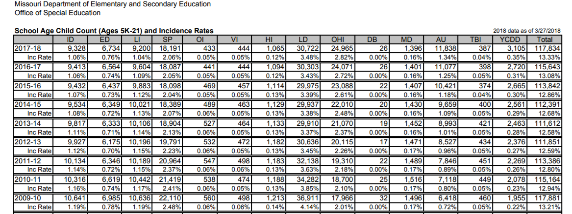
Incidence Rates MO
16
HO #3
Notes:
To Do: Copy this slide as a handout so all can see the numbers to be used for discussion.
Handout 3: Incidence Rates MO
To Say:
Take a look at the incidence rate chart for the state of MO over the last ____ years. (Presenter can choose to go to the link noted below and only pull in whatever number of years he/she prefers) Which disability categories have seen an increase in the last 3 years? Which ones have seen a decrease? Which ones have the highest increase, highest decrease? Have a conversation at your table about why you think this is happening.
Do you know what the incidence rate is in your own district? How does it compare with the current state average? If it’s higher than that, it may be worthwhile to consider ‘why’ that might be and as we go through this presentation today, we will be giving you any number of possibilities that you can go back to your district to explore.
To Know: presenter can also run individual district data and use it as an optional handout.
This information will need to be updated each year. It can be found on the DESE website by clicking on the MCDS Portal link, then the special education Data box and then the Incidence_Rate_90-present tab

Slide 17
What Do We Know About
Special Education?
Notes:
To Say: Given our discussions regarding the incidence rates of special education in our own districts, in our state and nationally, it’s worthwhile to do a little reflection on what we know about special education as an ‘intervention’. Special education is not a remedial program such as Title 1.
When discussing whether or not a student could possibly be eligible for special education teams should always consider this important question: Is it DISABILIBY or DISADVANTAGE? These are two very different concepts.

Slide 18


18
Notes:
To Say: What we know for sure is that special education is an expensive program to maintain. It is a common for people to think that districts are running their special education programs exclusively on the federal dollars they get from the Individuals with Disabilities Education Act (IDEA). That is an untrue myth. Very few districts are able to run their special education programs with only those dollars. So where is the money coming from to make up the difference? State and local funds, which are the same funds that pay for virtually everything else in the district. Most districts only receive 10-20% of their special education funding from their IDEA allocation, which means their budgets include about 80% state and local money. (I give the example of my own district, we received approximately 1.5 million in IDEA funds toward a special education budget of almost $10 million dollars)
And, there is no magic to it….there is very often nothing ‘special’ that happens just because a student gets identified. Sometimes there is very little ‘specialness’ in special education.
Numerous reasons for this…limited staff, limited time, no real formal training in special education (took a test to get certified without any coursework), poor teacher preparation programs, etc.
So does it make sense to identify MORE kids for special education?? Or should we be very sure that the kids we do identify truly qualify and NEED services that can only be provided by a special education professional?

Slide 19
Increased Dependence
Lowered Expectations and Rigor
Notes:
To Say: So now that we know there is nothing magical about special education, let’s take a look at some of what we do know about it. We know that there tends to be a lowering of expectations and a lowering of the rigor required in academic work for students who get identified as ‘disabled’. We also know that there tends to be an increase on these students dependence on others….often due to no fault of their own. We tend to be very ‘helpful’ people and don’t like to watch kids struggle to do anything so we often over compensate…we also tend to feel like there is never enough time to do what needs to be done, therefore, we often default to ‘doing it for a student….just this once’ so that the task gets done. ‘Just this once’ sometimes morphs into ‘all the time’ to the detriment of the student. We also need to remember that the provisions within the Individuals with Disabilities Education Act (IDEA), which is the federal law that ensures students with disabilities are provided with a free and appropriate public education (FAPE) designed to meet their unique needs, ends after the child either graduates or ages out of the educational system. So we have to be careful not to set a student up for post secondary failure when they no longer have the provisions and protections of IDEA.
Would this be ok for your personal children? Is this how you would choose for their educational career to go?

Slide 20
Efficacy of Special Education
20
The effectiveness of special education is not universally documented. Very little research exists to support its effectiveness, generally due to the variances in implementation.
According to the 2015 National Assessment of Educational Progress (NEAP) report:
 | 8th grade | 12th grade
With disabilities | Math = 8% Reading = 8% | Math = 6% Reading = 12%
Non disabled | Math = 33% Reading = 34% | Math = 25% Reading = 37%
Notes:
To Say: Let’s take a look at some other facts about special education. There is very little research out there specifically about the effectiveness of ‘special education’ in general because it’s like trying to capture lightning in a bottle. There are so many variables to the delivery of instruction, what is being instructed, how often, etc. that it makes it very difficult to actually do research studies about the effectiveness. However, there is definitely research available about various types of intervention programs that, if implemented with fidelity, could give you some information about how effective certain types of instruction might be AND there is research available from an ‘outcomes’ standpoint that possibly gives some insight into the effectiveness of what we do with children who have been identified as needing special education.
Some of the most recent research is noted on this slide and the next two slides.
To Do: Read the slides….then after each one ask “Would you be happy with these results if these were your personal children?”

Slide 21
Efficacy of Special Education
21
10-year longitudinal study done by the National Center for Special Education Research (2011) found the following:
 | With Disabilities | Without Disabilities
Ever enrolled in any postsecondary school | 55% | 62%
Graduated or completed a postsecondary program | 38% | 51%
Notes:
To say: Take a minute to look at the information on the next two slides What are your thoughts? As mentioned earlier, we can’t draw exact correlations between these lower (or higher in the case of being arrested) numbers and the experiences these students had while in school, centered on their learning, but we also can’t say it didn’t have the effect of creating these results. So you have to wonder, why do so many parents and teachers WANT students to be identified as disabled?? Do you think they realize what a curse that might actually be?
The ‘take away’ here should not be that we never want to identify students as disabled, BUT we do want to make sure that we have done EVERYTHING possible to see if this student can learn and make progress within the general education world BEFORE we evaluation them AND we want to make sure that we make high quality, data based eligibility decisions when we do get to the point of evaluation. Labeling a student as ‘disabled’ is a REALLY BIG DEAL and we need for parents and staff in our schools to understand the life long implications that potentially could occur.

Slide 22
22
 | With Disabilities | Without Disabilities
Average hourly wage | $9.40 | $13.20
Residential Independence | 36% | 42%
Arrested at some time | 28% | 12%

Slide 23

23
The “IDEA is not a panacea for all of life’s ills.”
Maricus W. v. Lanett City Bd. Of Educ.,
141 F. Supp. 2nd 1064 (M.D. Ala. 2001)
Notes:
To Say: What does this mean?
To Do: Further explain the meaning of this quote to the participants by sharing the following information, “special education was created to give access to public education to children who had previous been denied access because their disabilities were too severe or schools felt they were not equipped to handle their needs. However, over time, the perception in some schools of who should be receiving special education services has changed. It often appears that if children are not learning at exactly the same rate, on exactly the same day, and in exactly the same way as other students in the class, they must have a disability and special education should be educating them. The goal should not be to see how many kids we can get into special education. It should be to see how many kids we can keep out of special education by providing accommodations, interventions and supports within the general education world.”

Slide 24

Talk to Your Wilderness Partner
24
Your reaction to those claims
How effective do you think special education is?
HO #1
Notes:
To Say: Let’s have a little time to process the information we have gone over to this point. In just a minute when I say “Go” you are going to get up and find your Wilderness partner. When you have reunited with your Wilderness partner, you and your partner need to discuss your reaction the research findings on the previous slides and your thoughts about how effective special education is overall. Then we will come back together as a large group to discuss your thoughts.”
To Do
Give the participants 5-7 minutes to regroup with their Wilderness partner to discuss the prompt on the slide. When time is up, gather group back together and ask them to share out their conversation highlights.

Slide 25
So, now what?
If we know special education wasn’t designed to be the panacea for all the woes of education, how do we keep this in check?
Notes:
To Say: So now what? If we know the intent of special education was not to be the panacea for all the woes of education, how to we stop the trend of finding more and more students eligible?

Slide 26

Start Early
26
Prevention
Early Intervention
Prevention and early intervention are more effective than treatment of academic or social/behavioral problems after they have existed for several years.
Notes:
To Say: What we do know for sure is that prevention and early intervention can make all the difference in future learning for students. And we also know that the earlier we intervene, the better. It is much harder to make gains with older students than it is with younger students. We know from brain research that there are ‘windows’ of development where certain skills develop at a more rapid pace and it is in these windows that learning is critical. We also know from brain research that people CAN learn those skills outside of those windows, but….it is much harder and will take much more time with the task than it would have if it had been learned within the window. (Example: language skills….the window of opportunity for students to effectively learn ‘language’ is from birth up until about 8-10 years old. After that, in order to really make a big difference in language development, it would take many hours of therapy. We can certainly provide accommodations and modifications both through the use of technology and just as a matter of how we do business, but…is it likely that we have the staff and the available time to provide hours and hours of therapy within the week? Likely not. Again, early intervention is the key for most of the academic and social/behavioral problems students exhibit.)

Slide 27

Prevention
and Early Intervention
  The response to individualized intervention data in general education is critical to determining special education need and to measuring adverse educational impact.
Notes:
To Do: Ask the large group audience the following questions and acknowledge any share outs participants may give.
How many of you have some sort of intervention system in place in your districts? What is the purpose? Are they done with intensity, duration and fidelity? Do you notice fewer referrals?
To Say: We need documented data from general education based on district screeners, authentic classroom work, results of interventions, etc. in order to make high quality decisions about whether children have been given a real opportunity to learn these skills and what that rate of learning looks like.
The data is the evidence needed to make these decisions. Think for a minute about the kind of data you’re getting when you receive referrals in your district. We will talk about that in a minute.

Slide 28
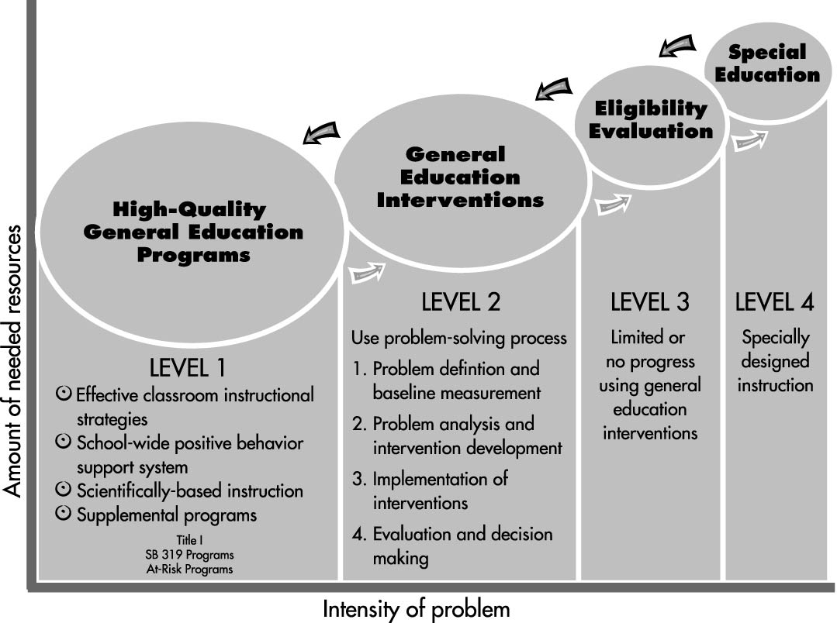
Problem-Solving Process
28
HO #4
Notes:
To Do: Handout 4 is to be discussed while reviewing this slide. The handout further clarifies the concepts covered by this slide.
To Say: We’re including this slide as a graphic representation of what a problem solving process could look like in your district. We know some of you already have some type of process that you’re using but some others of you may not. This is just a model you may want to take back to share with others in your district.
The idea here is that everything starts with high quality instruction in general education. When students seem to be struggling in that high quality, research based instruction, the logical thing to do would be to embark on some sort of a problem solving process to try to figure out why he/she is struggling. (This is where the arrow is pointing) That process involves defining the problem and gathering some data to support what the problem appears to be. From there, interventions should be developed and implemented that MATCH the identified problem. You would not identify that a student has a problem with decoding skills and put them in an intervention that focused on comprehension. Although that does happen on a pretty regular basis!) From there, you would need to gather data (called progress monitoring data) on how well the intervention seems to be working. For those of you who already have a system like this in place, I’m assuming you have decided in your care teams or student assistance teams how often that data would be collected (there are some recommended time frames which we will talk about in a minute). From that data then, you would be making decisions regarding the rate of improvement this student is having with the skill, taking into account whether or not the intervention had been done with fidelity. At some point, IF the student is not progressing at a rate that would allow the student to make significant gains within a year, it might be time for the team to consider making a request for consideration of a special education evaluation. These decisions should ALWAYS be based on data, not someone’s gut feeling.

Slide 29
Intervention Model
80%
Core
instruction
Very little progress
Core instruction + intervention
15%
Core instruction + intensive intervention
5%
special education referral
Notes:
To Do: Bring audience’s attention to intervention model graphic on slide.
To Say: Read each section of the graphic. Looking at the model you can see the first step for all students should be research based “core instruction”. This is the instruction that every child at a particular grade level receives. When little progress is made in the core instruction, students are then provided interventions. “interventions” are discreet and skill specific instructional activities provided to the child in his/her area of weakness. If the student is still demonstrating little progress in skill acquisition then the interventions are intensified. If after receiving, skill based intensive interventions over a period of time and the student fails to demonstrate progress, this may be the appropriate time to consider a special education referral. This is just another graphic representation of a model many districts are using in their intervention process. There is no right or wrong model or way to represent what is happening. The important thing is that prevention and early intervention are part of the conversation in your district. Remember, special education should be the LAST resort, not the first.

Slide 30
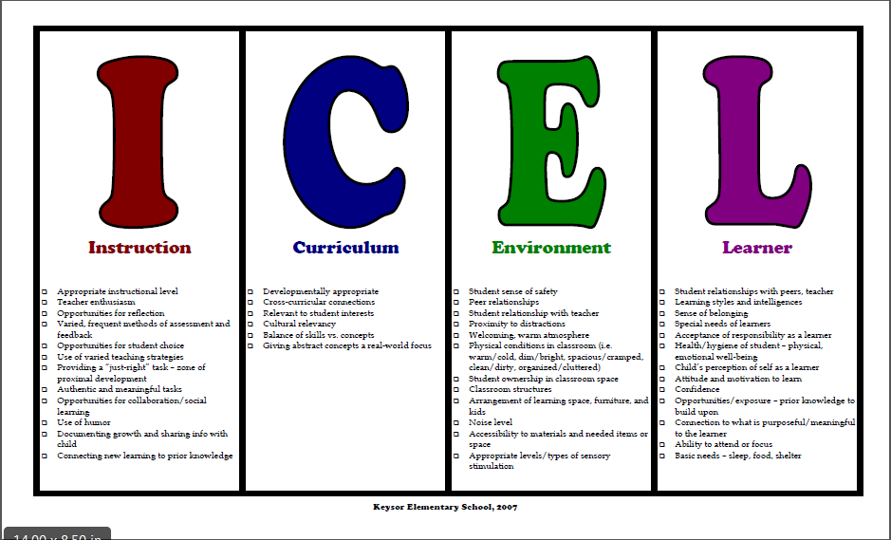
30
HO #5
Notes:
To Do: Copy this as a handout. Print in landscape - Handout 5
To Say: Take a look at this handout.
This handout represents a mind shift from the LICE thinking (this same information re-ordered to have the learner first) where the learner was the first to be blamed when he/she did not pick up on the material at the same pace, rate or level as other students.
This is just another resource your teams might want to use when considering why students are struggling. Teams should be looking at all aspects of learning and definitely not looking to blame the learner first. Considering each of these areas will help teams determine what types of interventions may need to be put into place for a particular student. Each of these areas are worth looking at in your problem solving process for students.
To Know: An optional activity could be for participants to review each of the sections of this handout and discuss the importance of each section and reflect to see if they have any alignment to these topics in their district.

Slide 31
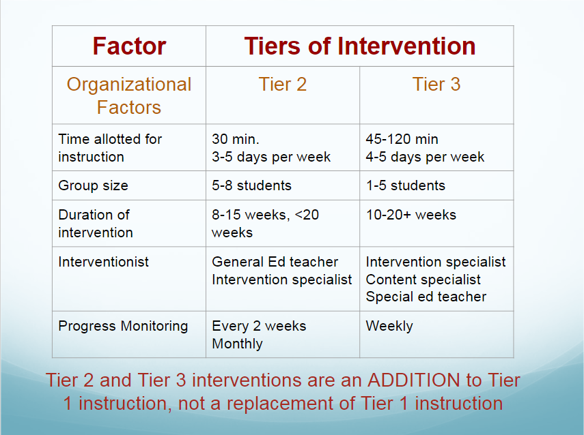
31
Notes:
To Say: As mentioned earlier, if you’ve embarked on an intervention system within your district or school, these are the recommended (through research) amounts of time, group sizes, etc. for each of the tiers or levels. You may see various versions of these recommendations but they are all similar in their components. Following this type of protocol helps to ensure the fidelity of the system you using.
To Do: Read slide….ask Is this similar to what you are doing, if you have some type of system of interventions going on? Allow for discussions or questions from participants.

Slide 32
Referral ‘Red Flags’
32
Academic concerns in school
Behavior concerns in school
Outside concerns
Teacher or other service provider suggests evaluation
Parent requests an evaluation
HO #6
Notes:
To Do: Handout 6 goes with this slide.
To say: Whether you’re using some type of a formal intervention system or not, those in your schools who are in charge of accepting or rejecting requests for special education evaluations need to have a good working knowledge of what might trigger an actual referral that would move on into the testing process. These are some of the ‘red flags’ that deserve some investigation before a blanket decision to reject the request is made. You have a handout that breaks these big areas down into more specific pieces. Take a minute to read through it. What questions or comments do you have about this list (which is not all inclusive, by the way)?

Slide 33



Referral ‘Red Flags’
33
“Remember, however, that not one of these
‘red flags’ alone would typically be sufficient to
trigger the child-find duty, but that the more that
exist in a particular situation, the more likely it is
that the duty would be triggered.”
Julie Weatherly, ESQ
Notes:
To Say: Keep in mind that any one item alone may not be reason enough to suspect a disability. It is up to you and/or your team to make that determination based on ALL the information you have or can find. The responsibility on the general education side of this is to provide lots of rich information upon which a decision can be made. The responsibility on the special education side is to make sure that you get that data somehow. And, if it doesn’t exist, perhaps its time for some professional development with your general education staff regarding what information you are going to be asking for and why it’s needed for you to make a truly informed decision about evaluations.

Slide 34
Characteristics of Good Referrals
34
Data based from general education interventions
Shows amount of responsiveness to academic and behavior interventions
Helps define needs to be explored
Helps determine what does and does not seem to work
This data helps to determine if there is a reason to suspect a disability
Notes:
To Say: This slide represents the rich information we can get from the interventions done is general education. What we want to work toward in our schools is the ability to make really good decisions about using our testing resources. When we just automatically test every child for whom a request is made, are we really using our resources wisely? How many of you have ever taken a look at the number of kids who qualify for special education vs. the number of kids you evaluation? That can be eye opening when determining whether or not you are actually evaluating the right students.
Ideally, the higher your percentage of kids who qualify when compared to the number of students you test, the more likely it is that you are truly making good decisions about which students to move through the evaluation process. Read each section of the slide aloud to audience.
To Do: Have participants think back to their pre-reading and have them look at the Specific Learning Disability (SLD) eligibility criteria in the Missouri Compliance Standards and Indicators (S&I) manual on their table. Mention to participants that the SLD criteria (and possibly speech/language categories, dependent on outcome of state board approval at the time of this publication, please include reference to speech/language criteria as well as SLD if the speech/language criteria in this activity if they have been updated post publication date of this training module) all REQUIRE that the student has been through interventions and those results are documented as part of the evaluation for these eligibility areas. Give participants time to look at the specific standards that require this in the S&I manual on their table.

Slide 35

Find Your Winter Vacation Partner
35
What triggers requests/referrals in your district/school? The things on the previous slide or something else? What is the approximate ratio of evaluations to those who qualify in your setting?
HO #1
Notes:
To Say: Time for some reflection. Find your winter partner. Discuss how requests for testing are done in your district. Discuss who makes the decisions regarding ‘suspecting a disability’ and how are those decisions made. What do you know about the ratio of evaluations done to the number of students who actually qualify?
TO Do: Allow 5-7 minutes for this discussion.

Slide 36

Now what?
Notes:
To Say: We’ve now spent some time talking about what makes a good ‘request’ for a special education evaluation so let’s back up for just a bit to look at the documentation needed for this request.

Slide 37


Request for Consideration of a
Special Education Evaluation
Parent
Agency
Date of referral is the date the agency decides there is enough evidence to suspect a disability-no timeline for this.
If agency determines there isn’t enough evidence to suspect a disability, nothing is required.
If agency suspects a disability, 30 days to do Review of Existing Data (RED).
Date agency receives request is the date of the referral.
If agency determines there isn’t enough evidence to suspect a disability, a Notice of Action Refused (NOA) goes to parent.
If agency suspects a disability, 30 days to do Review of Existing Data (RED).
Notes:
To Say: We’re going to do a quick review of the differences in the process when a parent vs. a staff member makes a request for an evaluation. There is some confusion with the difference in the terms ‘referral’ and ‘request for consideration’ of a special education evaluation and most of that confusion comes from these differences.
Let’s start with a parent ‘request’. Read aloud the bullet points on the slide. It is extremely important to train your general education staff about parent requests because unlike agency requests, the timeline for action starts immediately upon the receipt of the parent request. Parents make requests in many different ways. We cannot require them to put their requests in writing. If we want to have them fill out the request for consideration form, we can certainly ask them to do that, but we have to start our timeline count on the day the person spoke about, texted about, emailed about or wrote a letter about their request for a special education evaluation for their student. Parents can make these requests to any certified staff member and our timelines begin on the date that staff member received that request. So if during parent teacher conferences, a parent mentions to the second grade teacher that she thinks her son has a disability and she would like him tested, the general education teacher needs to immediately get that information to whomever is designated as the person to act on these requests in that particular building this may be the counselor, may be the special education teacher, may be the principal….can be anyone who is assigned to that duty. The date we receive a parent request, either verbally or in writing, becomes the day of the referral and starts our timelines. That person has 5 school days to send the Procedural Safeguards to that parent and the school/district gets 30 calendar days to determine whether or not they suspect a disability. If within that timeframe, the agency determines there is not a reason to suspect a disability, the parent must receive a notice of action refusing that request. If it is determined that there is a reason to suspect something might be going on, then the agency has 30 calendar days to schedule a review of existing data meeting. From there, the process is the same no matter where the request came from.
Ask the participants: If it is someone within the agency who makes the request, do we have 5 days to send Procedural Safeguards and 30 days to hold an RED meeting?? The answer is NO. We actually are under NO timeline requirement at this point. And this is an important distinction between a parent request and an agency request. There is NO timeline requirement for agency requests UNTIL someone or a team of people decide that there IS a reason to suspect a disability. At that time, the 30 calendar days to hold a RED meeting has begun. If you determine, based on an agency request, that there is no reason to suspect a disability, there is actually nothing required. It would certainly be best practice to let the staff member know that you determined no reason to suspect and why that was the determination, but you are under no obligation to document any of that in any way. So you can see that there are some very important differences between an agency request for evaluation and a parent request. It is critical that all of the building staff know and understand those differences.

Slide 38
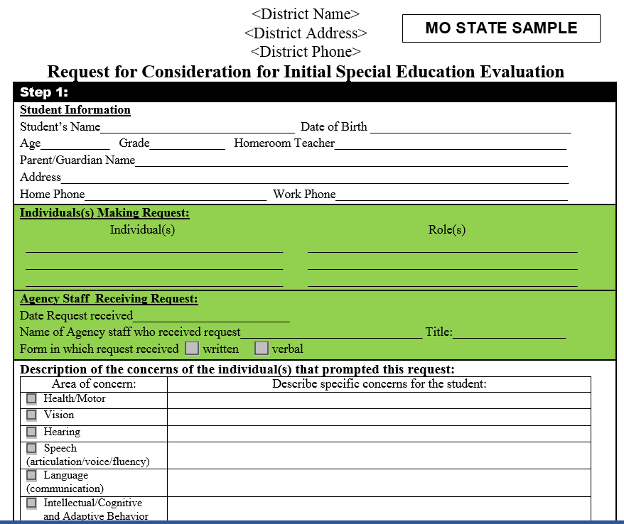
Request for Consideration of a
Special Education Evaluation
38
Notes:
To Say: Hopefully everyone is familiar with this form or something similar to it. This is the DESE model form. Districts are not required to use this particular form but they are required to document, in some way, all the things that are on this form. We are not going to spend time today walking step by step through it. Any of the compliance consultants across the state can provide additional training to a district on using this form and what needs to be provided to make a good determination of whether or not a disability is suspected so if that is something you are interested in, please let your compliance consultant know. This form helps us answer this question: What evidence do we have to support the suspicion of a disability?
When we are looking at the data to determine whether or not there is a reason to suspect that a particular student may have a disability, we need to look at each student from a 360 degree view. This means we should not just be looking at this from an academic standpoint. Students can be moving right along academically, or at least holding their own but could be greatly compromised either behaviorally, socially, or emotionally. While those things may not be affecting academics at this time, it may be causing the student great difficulty making and keeping friends, staying out of trouble, dealing with the environmental issues at school (not being able to focus, not being able to stay in one spot, etc.)
Ask the audience: If a staff member is making a request for consideration on a student, what types of supporting documentation do you require? Do you expect this evidence to be included with this document? Do you or someone else on your team gather this information as a part of your consideration of the requests? These are all parts of a process that it is good to have written down to refer back to when questioned about who’s doing what in the process.
To Do: Optional activity, print off a copy of this form to discuss with participants.

Slide 39
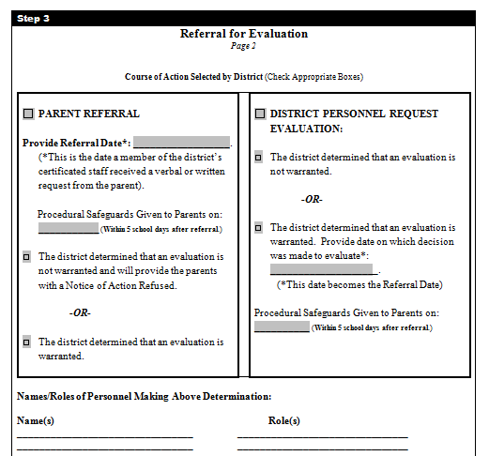
Making a Determination: Step 3
39
Notes:
To Say:
It is VERY IMPORTANT that your Local Educational Agency (LEA) have a set procedure for considering ALL requests and making a decision in regard to suspecting a disability.
In some LEAs, this decision is made solely by the special education Director; in other LEAs there is a team of school staff that make the decision. But no matter who makes the decision, there should be documentation of the request, the factors considered, and the decision.
This is where intervention data and evidence is critical…. If no reason to suspect a disability, do not move forward in the process.
The last page of the request form is the perfect place to document the relevant dates, especially the referral dates. It is from that date that everything else in the process flows.
If the LEA concludes there is reason to suspect a disability, they must proceed to the Review of Existing Data (RED), within 30 calendar days, to determine if additional assessment is necessary in order to make an eligibility determination. If a disability is not suspected from a parent referral, we must provide the parent with a Notice of Action refusing an evaluation. If there is no disability suspected from an agency request, no Notice of Action is required. This page of the Request form will help you follow the correct process no matter what decision is made.

Slide 40
Request for Consideration of a
Special Education Evaluation
Parent Referral
Agency Request for a Referral
LEA must determine if there is reason to suspect a disability and the need for special education and related services.
Notes:
To Say: This slide is just a reminder that while both a parent and an agency can make a referral there has to be evidence of a suspected disability before proceeding with an evaluation. A decision regarding reason to suspect a disability must be made. We can’t just leave requests or referrals from parents hanging out in space indefinitely.

Slide 41

LEA Consideration = RED
41
This decision is NOT a REVIEW OF EXISTING DATA (RED) to determine if there is enough information to determine eligibility,
but rather,
an EXAMINATION of factors (evidence) to ascertain if there is reason to suspect a disability and proceed to a RED.
Notes:
To Say: It is also VERY IMPORTANT to note that this decision is NOT a REVIEW OF EXISTING DATA (RED) to determine if there is enough information to determine eligibility but rather an EXAMINATION of factors to ascertain if there is reason to suspect a disability and proceed to a RED, which is actually part of the evaluation. So once you are doing an RED, you are in essence, beginning to evaluation the student. You don’t want to go anywhere near a Review of Existing data if you have no reason to suspect the child has a disability. That part of the process IS NOT used to determine the suspicion of a disability.
For example, if a parent makes a referral for his/her son because the child is making a C in calculus class, or because the student got in trouble once at school, you would NOT schedule an RED meeting to decide if there is a reason to suspect a disability. That decision has to be made way before that. Once you are in the RED, your only outcome choices are that you need to gather additional info to determine eligibility, that you don’t need to gather any additional info be cause you have enough existing info to make an eligibility determination.

Slide 42

Evaluation Data
Notes:
To Say: Now we’re at the point of moving into the actual evaluation part of the special education process. We’ve determined that there is a reason to suspect a disability based on all the evidence that we have looked at up to this point. You have 30 calendar days from the date of the referral to complete this part of the process.

Slide 43

Review of Existing Data (RED)
43
Participants
Meet in person or confer
Purposes
Contents
Date conclusions and decisions are finalized
Identify what additional data, if any, are needed
Prior Written Notice
Notes:
To Say: The first step in the evaluation process is the Review of Existing Data (RED). Remember this is the “foundation” of the eligibility determination and what you include in this document is very important to the determination of eligibility.
Participants- A group of individuals meeting the requirements of an IEP Team and other qualified individuals as appropriate to review of all relevant existing data on the child. Remember that the parent is a required member of this team. Document the participation of all required team members.
Meet in person or confer: This review may be conducted without a meeting. However, all participants must review all the same data and provide input into the conclusion/decision.
Purposes: The RED has four distinct purposes. The team needs to review all relevant existing data in order to determine what additional data, if any, is needed to determine the following:
Whether the child has a particular category of disability or in the case of a reevaluation, whether the child continues to have a disability.
The present levels of performance and education needs of the student.
Whether the child needs special education and related services.
Whether any additions of modifications to the special education and related services are needed to enable the child to meet the measurable annual goals set out in the individualized education program (IEP) of the child and to participates, as appropriate, in the general curriculum.
Contents- The Review of Existing Data must include a description of all data reviewed (such as previous evaluations, teacher observations or interviews, classroom performance, and state and agency assessments). In addition it must document a summary of the information gained from the review of the data. Please don’t use phrases like ‘no concerns’ or ‘not relevant’ when completing this document. Putting what the student CAN do and IS doing on this document is just as important as putting what the student has difficulty doing.
Date of Conclusions: The RED must also include the decisions that you made and the date that you made it as well as identify what additional data are needed, if any, to determine eligibility.
Identify additional data:. Remember the RED is the end of the first 30 days in the evaluation process. The RED process always ends with a Notice of Action and an evaluation report for all initial evaluations.
Prior Written Notice: Before moving on to actually evaluating the student, there must be a Notice of Action signed.

Slide 44
Where do we get this information?
Previous evaluations
Info provided by parents
Observations by others
Classroom data
District and State testing
Current classroom based assessment
Observations
by others
Classroom
data
Notes:
To Say: You want to make sure you are getting data from VARIOUS/MULTIPLE sources over time. And it’s certainly best practice to have this data available in visible, hands on form and not just from someone’s memory or what they ‘think’ or ‘feel’ is the information. Read each section of this slide. You also want to make sure that you keep in mind the purpose of the referral. What was the original reason a request or a referral was made? Consider all things that might be a concern about this child. Classroom grades are NOT the sole determining factor!

Slide 45
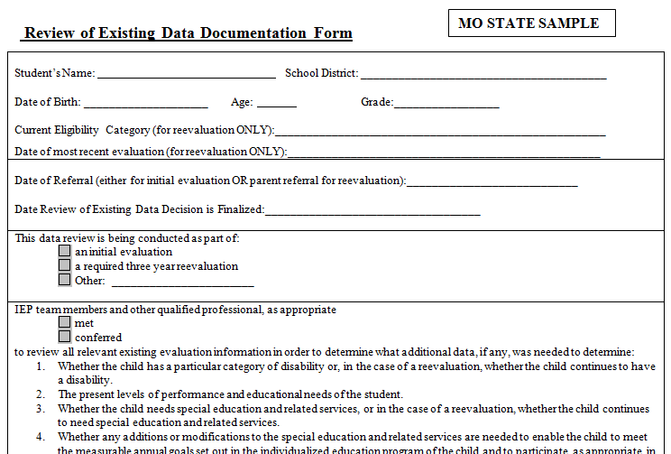
Model Form: Review of Existing Data
45
HO #7
Notes:
To Do: Handout 7
Have participants take out Handout 7 and tell them that right now we will just be going to look at the form CONTENT – not the examples written in the boxes. This discussion will happen a little later.
To Say: This is a portion the model state form to help the team document the data reviewed and a summary of the information gained from the review of existing data. This information helps the team determine what additional data, if any, is needed to make an eligibility determination. The model state form also helps document this decision. There are many different versions of the RED form out there, depending on the IEP vendor a district is using. Please make sure the one you are using has all the required components on it.
Let’s take some time to look at the RED form. Read over each section of the form and ask the audience for questions after each section. Tell participants to pay particular attention to the 4 reasons we are determining if any additional data will be necessary section on the from page of the RED.

Slide 46
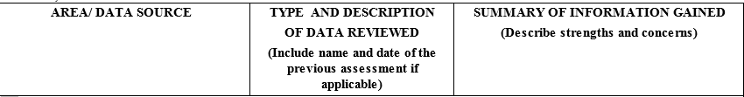
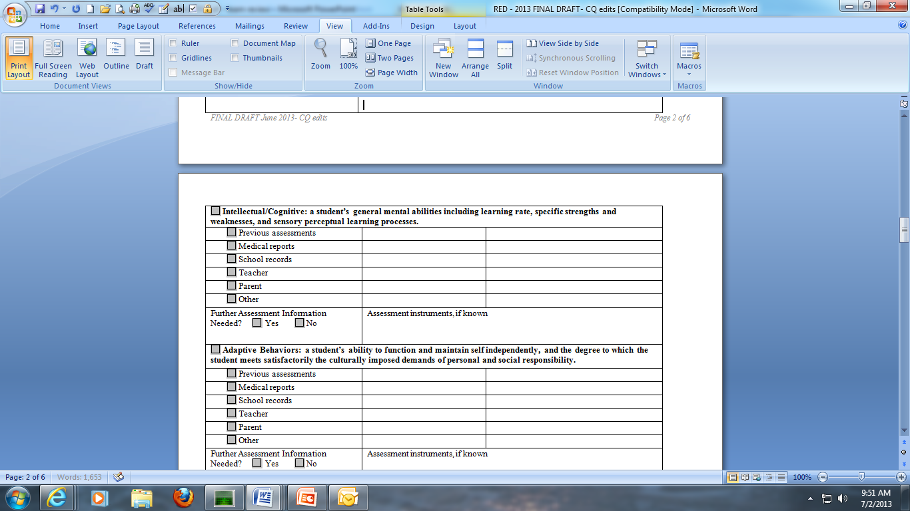
Tips for Completion of the RED
USE DESCRIPTIVE TERMS
COMPLETE EVERY SECTION
ADDRESS EVERY AREA
INCLUDE PARENT AND TEACHER INPUT
Notes:
To Say: Often times, as consultants, we see REDs that don’t meet standards and don’t have much useful information. Remember this is the cornerstone of your evaluation. Use descriptive phrases that summarize what you know. One example is, “child’s functioning or achievement or behavior is within normal limits or age-appropriate or commensurate with peers.”
To Do: Point out the headings for each column…this is what is expected to be put in these columns. Don’t need to have something from every data source. Best practice would be at least 2.
We are going to look at a few sample REDs. You help us decide if these are good examples or not so good examples.

Slide 47
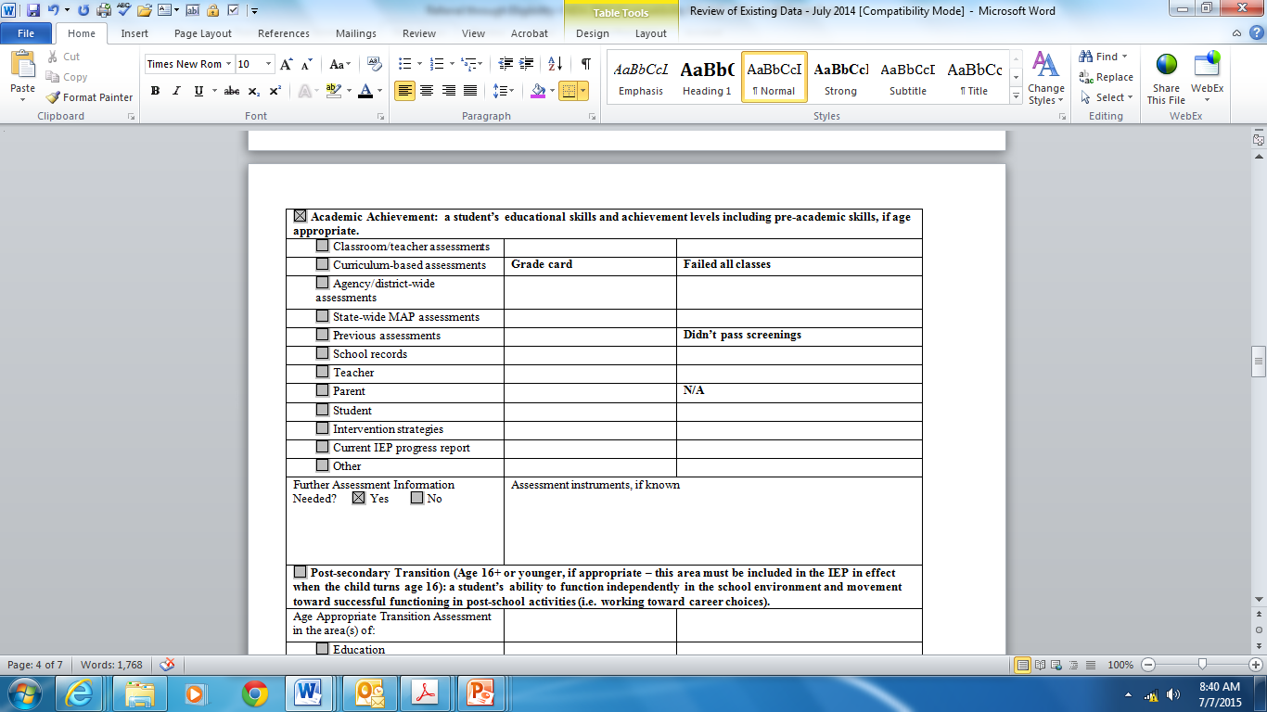
RED Example 1
47
Notes:
To Do: Allow participants the opportunity to read the example.
Read each section of the RED aloud and then ask the participants to give a thumbs up if they think it is a compliant example of a RED or thumbs down if it is not a compliant example.
To Say: State that this is not a compliant example.
There is not enough information on this RED to be considered compliant. There is no date or title of screening, no date for grade card, the teacher had no input on a kid who is failing all classes?? How can the parent input be not applicable?

Slide 48
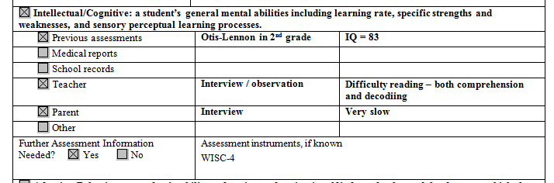
RED Example 2
48
Notes:
To Do: Read aloud each section of the RED aloud and then ask the participants to give a thumbs up if they think it is a compliant example of a RED or thumbs down if it is not a compliant example.
To Say: This would be a minimally compliant RED as it contains more information than the previous example, but one would question if it has “enough” information in order for the team to make decisions regarding continuing or establishing eligibility, determining services or determining what additional data might be necessary to collect. State the the following think aloud questions “ If this were a re-evaluation RED, would this give you enough information to determine goals and write a present level? Again, where are the dates? What is meant by ‘very slow’…walking? thinking? processing? What is the evidence of that?”

Slide 49
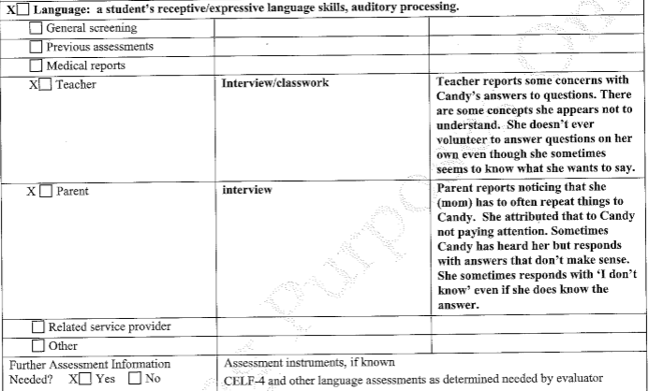
RED Example 3
49
HO #7
Notes:
To Do: Refer participants back to Handout 7. Let participants read each section and now consider the examples in each section of the RED and then ask the participants to give a thumbs up if they think it is a compliant example of a RED or thumbs down if it is not a compliant example. Give enough time for participants to read through.
To Say: This example has elements of the best practice things we’ve been pointing out. This would be an “A” example of compliance. This one is a good example of a RED because there are dates for the data sources, both parent and teacher have provided input which is specific and detailed. When you compare the example to the two previous examples you can see how this one gives us a much better picture of the things this student both can and cannot do at this point?
We have given you an example of a Review of Existing data that would meet compliance requirements. It is in your packet.

Slide 50
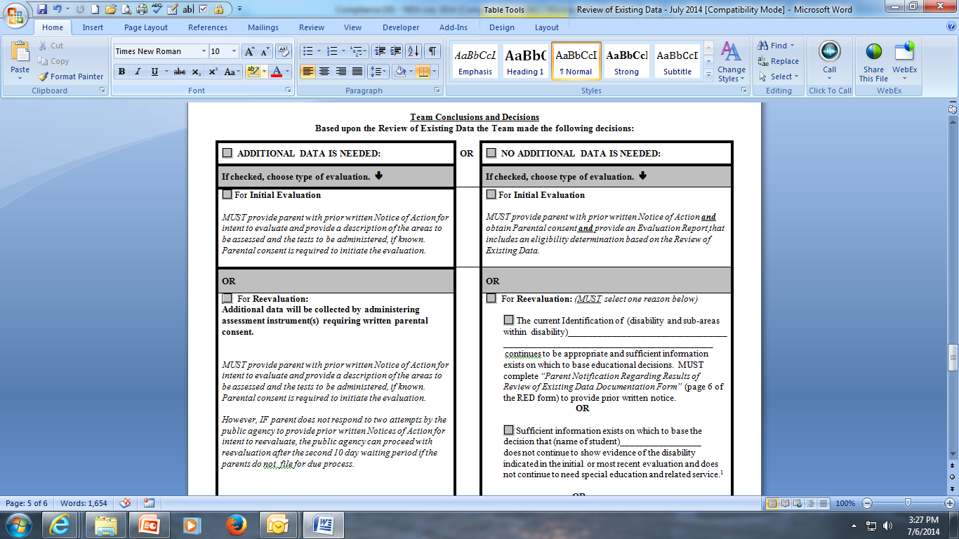
Team Conclusions and Decisions
50
Notes:
To Say: Once all areas of this document have been addressed, it’s time to make some decisions. The Team Conclusions and Decisions are based upon the information in the previous pages of the Review.
The first decision to be made is whether additional data is needed in order to make an eligibility determination. The form divides this first decision into two separate columns.
The second decision to be made is whether this is an initial or a reevaluation. An initial evaluation is the first evaluation that results in determining a child is eligible for special education. If the child is evaluated and, found NOT eligible, and then subsequently evaluationd again, that second evaluation is still considered an initial evaluation as the child MUST meet the INITIAL eligibility standards.
Please note how the model RED form provides compliance reminders about the next steps in the process based upon the decisions of the team. And also note that no matter what the decision, the RED steps for an initial evaluation ALWAYS end with the parent being provided prior written notice and an evaluation report.
It is required to document the date conclusions and decisions are finalized indicating the month, day, and year at the bottom of this page. This is also where you document the team participants. (Process more important than form but have to make sure compliant items are included)
If you have determined that you need additional data, this is the point in the process at which you need parent consent to move forward. This would be done by completing the Notice of Action and getting a parent or guardian signature. You must provide the parents with information about the areas in which the team decided needed to be assessed and what tests were decided upon, if known. That can either be done by writing that under the ‘Explanation of the Action’ part of the NOA or by including the Description of Areas to Be Assessed form with the NOA. You cannot move forward with the process at this point until you have consent from the parent or guardian to do so.
While your district may chose not to use the Missouri model forms, this is an example of how using the model forms can help guide a team’s thinking and decision making process.

Slide 51
Assessment Practices and Procedures
Notes:
To Say: We’ve now determined that we need additional information and in what areas we need it, as well as what assessments we want to do. We need to talk just a little bit about good, high quality assessment practices.

Slide 52

Your Turn
52
With the people at your table, use the piece of chart paper given to you to make and fill out a T-Chart that looks like the one below:
Good assessment practices
Poor assessment practices
Notes:
Activity
To Do: Pass out chart paper and markers. Participants need to stay with their tables. If there are singletons, they need to join another table. Give 5-7 minutes to complete the activity.
To Say: Read the slide aloud.
Brainstorm with your group some things that we know are good assessment practices and what are some “not so good” assessment practices. Then capture those ideas on a T chart. Groups will then share out

Slide 53
IDEA Evaluation Requirements
53
  Each public agency shall conduct a full and individual initial evaluation, in accordance with 34 CFR 300.532 and 34 CFR 300.533, before the initial provision of special education and related services to a student with a disability. This may or may not include additional testing as determined by the evaluation team members.
    Tests and other evaluation materials used to assess a student are not discriminatory.
    A variety of assessment tools and strategies are used.
    Standardized tests have been validated.
    Tests and other evaluation materials assess specific areas of educational need.
Notes:
To Do: Read the slide
To Say: IDEA speaks specifically to what practices should take place during the evaluation process. The bolded items on this slide and the next are ones districts should really examine when conducting evaluations, as these are items are ones that we have found through compliance reviews to be ones that districts tend to over look.
The next two slides state the specific requirements for evaluations per IDEA. Compare the IDEA requirements to the list you and your group wrote on your T-chart.

Slide 54
IDEA Evaluation Requirements
54
  A test for a student with impaired sensory, manual, or speaking skills accurately reflect the student’s aptitude or achievement level.
  No single procedure is used as the sole criterion.
  Assessment is conducted in all areas related to the suspected disability.
  The evaluation is sufficiently comprehensive to identify all of the student’s special education and related services needs.
  Technically sound instruments are used.
  Assessment tools and strategies provide relevant information in determining educational needs.
Notes:
To Do: Read the slide
To Say: Keep in mind the bolded statements are ones that districts tend to struggle with when conducting a comprehensive and individualized evaluation. You may want to highlight these on your paper so that you can use these as a reference sheet to remind you of the compliance requirements per IDEA.

Slide 55

Testing Best Practices
HO #8
Be sensitive to when pulling kids out
Test in a quiet, non-distracting setting
Consider building rapport with students prior to
evaluating them
Administrative Factors to Consider from Virginia Dept. of Ed.
  Environment
  Time
  Non standard conditions
  Materials
Notes:
To Do: Handout 8 (Administrative Factors to Consider should be in packet)
To Say: Do you have qualified examiners giving your assessments.? Do they know ‘best practices’ when it comes to evaluating kids?
This slide just represents some of the many testing considerations that need to be thought about in order to make sure students are given the best opportunities possible to show what they know.
The Virginia Department of Education has created a whole handbook relevant to the evaluation process in special education. You have a handout in your packet that address the 4 bulleted items on the slide. At some point, please make sure all of your evaluators have this information and are considering these things when they are evaluating students throughout your district and schools.

Slide 56
Consider this
Evaluations are often poorly related to referral concerns; the same battery with little variation is used in most eligibility evaluations.
Data collected in an eligibility evaluation is poorly related
to information needed on what to teach, how to teach it, and how to assess progress.
(Ysseldyke, Vanderwood, & Shriner, 1997)
Notes:
To Say: Read these two statements to yourselves.
Take a few minutes to think through each of these sentences with your district in mind.
(go to next slide for the activity)

Slide 57

Rate Your Experience
57
HO #1
On a scale of 1-5, rate how likely these things
(previous slide) are to occur in your district.
1 being never…5 being all the time
Find your summer partner, discuss how you rated your district on these two questions.
Notes:
To Do: Participants are going to rate their experiences with the statements on the previous slide. They are going to share their experiences with their summer partner. Refer back to the two statements on the previous slide by clicking back to that slide after you give the activity directions.
To Say: Do you always use the same battery of tests for everyone? Are the areas noted as concerns on the RED being addressed through an assessment? Can the teachers use the evaluation reports to write good, quality IEP’s for students because the reports are very detailed regarding what the students really can and cannot do? Are the people at the table even qualified to know whether the report truly relates to the students referral concerns or not?
In just a minute when I say “go”, you are going to regroup with your summer partner to complete this activity. In a few moments, I will return to the previous slide and display it on the screen for you and your team to rate your experiences with these two statements. On a scale of 1-5, rate how likely the statements on the previous slide are to occur in your district. 1 being never…5 being all the time. If you or your partner rate either statements as a 5, discuss possible ways to change this process.
Have a conversation with your summer partner about how you rated your district and why.

Slide 58

Determination of Eligibility
Notes:
To Say: As we keep moving forward in the evaluation process, the last piece that occurs is determining whether or not the student being evaluationd actually meets the eligibility requirements to be identified as a student with a disability under one of the 16 categories in MO.

Slide 59
Determination of Eligibility
59
“Upon completing the administration of tests and other evaluation materials, a group of qualified professionals, which includes the parent of the child, must determine whether the child is a child with a disability.”
300.306(a)(1)
200.270 (a)
Notes:
To Say: Within 60 days from the date of parental consent to evaluation, a group of qualified professionals, including the parent of the child, has to meet to determine whether or not the child is a child with a disability under IDEA. The members of this ‘group’ do not have to meet the requirements of an IEP team, but districts have the flexibility to determine that they want this team to resemble an IEP team if they so choose. However, if SLD is considered as a possible eligibility category, pay attention to the requirements for a general education teacher and a person qualified to conduct individual diagnostic examinations of children to be a part of this meeting.

Slide 60

Data Based Decision Making in
Eligibility Determinations
60
Notes:
To Say: We are going to talk about the contents of the report in just a few minutes, but because we are talking about the actual meeting right now, we need to note that it is not required that a report be complete before the meeting. As a matter of fact, the report or the information brought to the table should not have an eligibility already determined. Making that determination is actually the purpose of the meeting and should be determined by the team based on all of the information that is discussed. Eligibility is NOT determined by the evaluator(s). It is determined by the input of all involved. The discussion should center on the evidence you have from the RED (which should be included in your report), the assessments and observations that were done and how all of this adversely impacts the student.
To Know: This Photo by Unknown Author is licensed under CC BY-NC

Slide 61
Determination of Eligibility
61
Child with a disability
Properly evaluated
Meets criteria
Needs special education
Includes adverse
educational impact
Even if meets criteria for eligibility, they MUST need special education and related services
Notes:
To Say: When we look at who is actually eligible to be a child with a disability, we are not only looking at numbers on an assessment. In order to be eligible for special education, 3 criteria must be met: 1. Child must be properly evaluated…(the child who walks in the door with the prescription for special education because of ADHD and automatically becomes eligible for special education. Did we properly evaluate that child?? 2. Child must meet the eligibility criteria for one of the eligibility categories. The one thing each of those categories has in common is that the disabling condition must be adversely impacting the student in some way. We will talk more about this prong of eligibility in just a minute. And the 3rd criteria that must be met is that the child must NEED special education and related services. Special education is specially designed instruction to meet the unique needs of the child. Specially designed instruction is not just the provision of accommodations and modifications. All 3 of these criteria have to be present in order for a child to be found eligible as a child with a disability under IDEA.
Having evidence to support the last criteria is critical in the determination of whether or not a child actually qualifies for special education.

Slide 62
62
Let’s Take a Closer Look at the Criteria
for the 16 Eligibility Categories
Autism
Deaf/Blind
Emotional Disturbance
Hearing Impairments/Deafness
Intellectual Disability
Language Impairment
Multiple Disabilities
Orthopedic Impairments
Other Health Impaired
Specific Learning Disabilities
Sound System Disorder(Artic/Phonology)
Speech-Fluency
Speech-Voice
Traumatic Brain Injury
Visual Impairment/Blindness
Young Child with Developmental Delay
Notes:
To Say: We are not going to go in-depth with these eligibility categories today. However, meeting these outlined criteria are the first leg of the special education stool that you will see on the next slide. As you discovered in your prereading of these eligibility criteria, each of the categories listed has a specific set of criteria that must be met. While our focus today is not in depth training on each of the eligibility criteria for these categories of disabilities, you can contact your RPDC’s special education compliance consultant for some follow up coaching or technical assistance related to understanding these specific eligibility criteria. For our purposes today, you just need to be aware of the fact that each category of disability has specific eligibility criteria that needs to be met. You also need to be aware that these criteria can be found by following the prereading link we sent to you or in the copy of the S&I manual on your table.

Slide 63
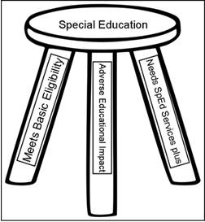
Who Qualifies for Special Education Services?
63
NOT the child who just needs accommodations
Notes:
To Say: This is a more memorable graphic representation of these three criteria. This is our 3 legged special education stool and as mentioned before, you need all three legs of the stool to be present before we can say that you are actually a student with a disability under IDEA. As mentioned before, the third leg of this stool is critical. There are many kids who are struggling in school but when you look carefully at their needs, classroom accommodations can be implemented that would take care of those needs. If a student does not need some kind of special education intervention, then it doesn’t matter if they meet the other two criteria…they do not qualify for special education services. The classic example of this is the student with ADHD who has difficulty staying focused to complete work. When the student does do the work, he/she demonstrates good or at least adequate ability. This student does have a medical diagnosis and parent does have copies of it. This issue is causing him some adverse educational impact when he doesn’t complete the work, but the question has to become, does this student NEED special education services. The team needs to ask, ‘what would special education do for him?” If the things that keep coming up are just good general education accommodations, then the student is NOT a student with a disability under IDEA.

Slide 64
What Does this Mean?
64
“adversely affects the child’s
educational performance”
    No definition of “adversely affecting” or “adverse educational impact” within IDEA regulations or Missouri state regulations. OSEP has declined to define this. Circuit courts are starting to define it.
    Need to take a 360 degree view of the child.
Notes:
To Say: Let’s go back to the 2nd leg of the “eligibility” stool for a bit. Ask the participants: “ What does ‘adversely affects the child’s educational performance’ mean to you? Hold that thought. We will come back to it in a minute in the next slide.

Slide 65

360 View of Adverse Impact
65
  Academic skills
  Social/emotional/behavioral skills
  Educational performance involves both of these things. Teams are required to look at the ‘whole’ child, not just grades or ability to do the work.
Notes:
To Say: An adverse affect does not have to strictly be academic. Adverse affects can be social, emotional, behavioral or academic and we have to consider the relationship the disability has on all of these things when determining whether or not the student qualifies. Example: The student with a medical diagnosis of ADHD who is getting mostly B’s and C’s, has lots of friends, is very social and only gets in trouble for being off task or not where he’s supposed to be at a rate similar to other students of his age/grade. Is this student adversely affected by his medically diagnosed ADHD? The team has to consider all of that when making an eligibility determination. And then you would move on to the question of whether or not the student requires special education to make progress in the general education curriculum.

Slide 66

Find Your City Partner
66
HO #1
Discuss with your partner how you and your teams determine ‘adverse educational impact’. Also discuss how you are documenting this in your evaluation reports.
Notes:
To Say: In your brain go back to the slide where I asked you to define ‘adverse educational impact’ in your own words. In just a minute, you are going to get up and regroup with your city partner and discuss these two things:
How do your teams determine ‘adverse educational impact’?
How is this being documented in your reports?
To Do: Give 5-7 minutes for this discussion with their partner. Have a few people share out when get back to seats.

Slide 67
Evaluation Reports
67
HO #9
200.210 A synthesis of information from the evaluation is present
  See Note 2 on pg. 6 of 35 in Standards & Indicators
200.210.b. The evaluation information draws upon information from a variety of sources and is sufficiently comprehensive to identify all of the child’s special education and related services needs.
  See pg. 6 of 35 in Standards & Indicators
200.220 Observation information
  See pg. 6-7 in Standards & Indicators
200.230 Description of any variations from standard assessment conditions
  See pg. 7 of 35 in Standards & Indicators
Notes:
To Do: Refer participants to get out Handout 9 and turn to the pages of the S & I where these indicators are located. Read the slide to the participants.
To Know: Presenter must know the information for each of these indicators and anticipate questions from audience.
To Say: Now we are ready to take a look at what is actually required to be included in the evaluation report. The next few slides have the indicators noted that determine whether or not your evaluation reports are in compliance or not. You also have a copy of the actual standards and indicator pages where these are located. We are going to take some time to read each one so that everyone here is clear about what is expected when your reports are reviewed.

Slide 68
Evaluation Report
68
200.240 Statement of the existence and nature of the categorical disability
  See pg. 7 of 35 in Standards & Indicators
200.250 Basis for the determination of eligibility and need for special education and related services (for initial eligibility)
  See pg. 7 of 35 in Standards & Indicators
200.260 A statement that the disability is not a result of lack of appropriate instruction in reading or math, or limited English proficiency
  This has changed.
  See pg. 7 of 35 in Standards & Indicators
Notes:
To Do: Continue reading each indicator on the slide
To Say: Read each standard and any of the indicators under them.

Slide 69
Evaluation Reports
69
Be sure to pay attention to other exclusionary statements per eligibility category.
200.270 Names and roles of the individuals making the eligibility determination
  Who?
  Special Circumstances? (pg. 8 of 35)
Copy must be provided to parents within a reasonable amount of time (recommended within 20 days of meeting).
Notes:
To Do: Refer participants to the table copy of the 600-1700’s of the Standards and Indicators. Point out to participants that the criteria for both Language and LD have additional exclusionary statements that must be included in the report by reading the specific standards and indicators out loud.
To Say: While we are not going to have time to go through each of the eligibility criteria today, I do want to point out that there are occasionally additional exclusionary statements that must be included in your reports for specific categories of eligibility. Two examples of this are Language and SLD.

Slide 70

What About Professional Judgment?
70
Definition:
  Decisions made by qualified individuals with knowledge and experience regarding appropriate courses of action about matters that are not prescribed precisely by legal requirements or other authority.
Can only be used in the following categories
  Language Impairment
  Sound System Disorder
  Fluency
  Specific Learning Disabilities
  Traumatic Brain Injury
  Young Child with Developmental Disability
Notes:
To Know: Professional judgment can only be used in the following categories in Missouri. The categories are listed on the slide. Professional judgment should be made by a group of qualified individuals and based upon data.
To Say: We cannot talk about finding students eligible for special education without discussing the use of professional judgment. Professional judgment should ONLY be used when students are close to meeting the eligibility criteria AND when there is a preponderance of evidence to suggest that the student truly does struggle in the area being considered for eligibility. The definition on this slide states that ‘individuals with knowledge and experience regarding appropriate courses of action when matters are not prescribed by legal requirements’. Professional judgment should be done with individuals at the table who have a good understanding of the criteria and who can speak to the ways in which the particular student, even though not meeting those specific criteria, still demonstrate the characteristics of that eligibility category. Professional Judgment in Missouri is only allowed in the eligibility areas noted on the slide. And, for Language and Sound System Disorder, that is subject to change when the new criteria goes into effect.

Slide 71
Characteristics of
Quality Professional Judgment
71
Based on data, evidence and best professional practices
Explicit statements outlining support of the decision to vary from the criteria
Decisions are tailored to specific eligibility criteria
Based on multiple sources, settings and data collection methods
Notes:
To Do: Read slide
To Say: As mentioned a few minutes ago, there are some very specific things that must be present in order for a team to use professional judgement, in the categories where it is allowed, to identify a student as eligible for special education. Being able to speak to each of these alternate means of determining a student eligible for special education services will require someone with a good working knowledge of the criteria and what it looks like to truly require services even when the criteria are not met. The characteristics listed on this slide are characteristics associated with quality professional judgment.

Slide 72

Professional Judgment is Not…
72
  Based on random choice or personal whim, rather than reason or evidence
  Based on hunches or “clinical” insight
  Not “I feel...” or “I think...”
  Not a way to get around addressing and applying the criteria
Notes:
To Do: Read slide
To Say: Just as there are some very specific things that must be used to determine eligibility with professional judgement, there are some very specific things that professional judgement is NOT. Please remember that the use of professional judgement to qualify students should be a ‘few and far between’ circumstance. Not the way you do business on a regular basis.

Slide 73
Assessment & Reflection
Notes:
To Do: Read slide

Slide 74
Post-Assessment
Notes:
To Do: Have the pre/post assessment copied and ready to hand out. Or…provide a link for participants to take it via Kahoot or some other on line platform.
To Say: As we wrap up today, it will be interesting to see whether or not your answers to the assessment have changed as a result of the information shared and the activities you’ve done. Please take a few minutes to answer the questions on the post assessment.

Slide 75
75
For students with behavioral or academic concerns, the first step in getting help for the student should be:
  Special education classroom
  Regular classroom interventions
  The Review of Existing Data (RED) process
Notes:
To Do: Read slide
To Say: The answer is “B”, “regular classroom interventions. The first step in providing help for struggling students is to provide interventions within the regular classroom setting. Teachers should try interventions within the regular classroom prior to referring students for special education.

Slide 76
76
Which of the following is correct?
  All of the processes are the same for parent referrals as for agency referrals.
  Parent referrals are not allowed in Missouri.
  There are a few differences between parent referrals and agency referrals.
Notes:
To Do: Read slide
To Say: The answer is “C” . The differences are that there is NO timeline requirement for agency requests UNTIL someone or a team of people decide that there IS a reason to suspect a disability. At that time, the 30 calendar days to hold a RED meeting has begun, whereas with a parent referral the date we receive a parent request, either verbally or in writing, becomes the day of the referral and starts our timelines. That person has 5 school days to send the Procedural Safeguards to that parent and the school/district gets 30 calendar days to determine whether or not they suspect a disability. If within that timeframe, the agency determines there is not a reason to suspect a disability, the parent must receive a notice of action refusing that request. If it is determined that there is a reason to suspect something might be going on, then the agency has 30 calendar days to schedule RED meeting.

Slide 77
77
On the Review of Existing Data form:
  Every area should be addressed with a summary of information from various members of the team, including the parent.
  Only the applicable areas should be completed using descriptive language with input from the parent and the teacher.
  Only the previously assessed areas should be completed using descriptive language with input from the parent and the teacher.
Notes:
To Do: Read slide
To Say: The answer is “A”. The team should address every area on the review of existing data (RED). The RED should also include input from various members of the team including the parents so that the team can get a wholistic view of the student.

Slide 78
78
Assessment should be conducted:
  In all areas related to the suspected disability/disabilities.
  In cognition, motor, and academic areas on all evaluations as those areas are always related to the suspected disability.
  In cognition and adaptive behavior on all evaluations to rule out cognitive impairment.
Notes:
To Do: Read the slide
To Say: The correct answer is “A”. Teams should assess students in ALL areas related to the suspected disability/disabilities to ensure a comprehensive evaluation is completed.

Slide 79
79
Professional judgment is used when:
  The student does not meet any of the eligibility categories
  The team feels like the student will get no help unless in special education
  Only when the student was close to meeting the criteria (in allowed categories) and there is sufficient and significant evidence to determine that the student truly does struggle in the area being considered and would benefit from special education
Notes:
To Do: Read slide
To Say: The correct answer is “C”. Professional judgment should only be used when a student is close to meeting the criteria and there is sufficient evidence to determine that the student is a student with a disability and needs special education.

Slide 80
80
A copy of the written evaluation report should be provided to the parent within:
  5 days of the eligibility determination meeting.
  20 days of the eligibility determination meeting.
  10 days of the eligibility determination meeting.
Notes:
To Do: Read slide
To Say: The correct answer is “B”. The evaluation report should be provided to the parent within 20 days.

Slide 81
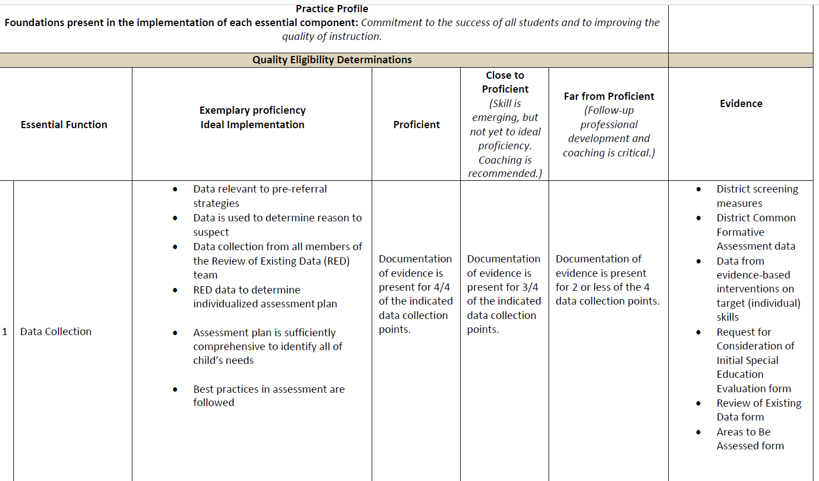
Practice Profile
81
HO #10
Notes:
To Do: Handout 10 - Let the participants review the Practice Profile.
To Say: This Practice Profile can be used as an evaluation tool by you and/or others in your district to help determine what your next steps need to be as you work toward implementing high quality eligibility determinations. As you can see, it works like a typical rubric with each of the big areas of the process on the left hand side and the evidence you could use as documentation of where you would fall on the scale. This tool is not meant to be a one shot evaluation. It’s designed to be used repeatedly as you make changes in your practices.

Slide 82
Next Steps
HO #11
Three things you learned
Two things you can commit to doing immediately
One question you still have
Notes:
To Do: Handout 11 -3-2-1 self-reflection tool for action planning
To Say: Based on the Practice Profile you just looked at, use the self-reflection triangle in your packet and answer the three questions. Even if you are not the person who has control over making sweeping changes, if needed, in this process in your district, what can you individually commit to doing to help make the eligibility determinations you are a part of better.

Slide 83
Closing & Follow Up

Slide 84

84
Notes:
To Say: You have been given a lot of information today. Does anyone have any burning questions that you need answered before we adjourn? We wanted to make sure that you all had the opportunity to leave here today with a good example of an evaluation report that would meet compliance in every area so if you would like one, please take a copy from the stack on the back table (or wherever).
To Do: Make sure to have addressed any parking lot issues

Slide 85
Questions? Please contact:
Add Consultant Information
Notes:
To Do: Put in your consultant information and discuss coaching opportunities you can provide
To Say: We also wanted to remind you that your RPDC Compliance Consultant is available to come to your district for follow up in this area if that is something in which you might have an interest.
.

