Slide 1
Trainer Notes (Remove before training.)
Approximate Time Estimates:
Active Supervision 1.5 hours
Active Supervision 90 minutes

Slide 2
Active Supervision

Slide 3
Working Agreements
Be Respectful
Be an active listener—open to new ideas
Use notes for side bar conversations
Be Responsible
Be on time for sessions
Silence cell phones—reply appropriately
Notes:
To do: Read and clarify all expectations. Answer any questions, and take suggestions if offered.
To say: “These will be the Working Agreements we will honor during this training session.”

Slide 4
Attention Signal Practice
Select and teach an attention signal.
Notes:
To do: Choose an attention signal.
To say:
“One of our agreements is to follow the attention signal.”
“Your team will work with your school to develop an attention signal you will use in every setting.”
“In order to get all of you focused after discussions, activities or breaks, I will ________________________.”
(Insert your attention signal here.)
“Your task will be to finish your sentence, quiet your voice and ____________________________.”
(Insert what you want participants to do.)

Slide 5
Introductions
Insert an Introductions Activity.
Notes:
To do: Choose an Introductions Activity appropriate for your group size and context.

Slide 6
Session Outcomes
At the end of this session, you will be able to…
List and describe the three practices used in active supervision
Connect active supervision with encouraging expected behavior and discouraging unexpected behavior
Notes:
To do: Read the slide
To say:
“During this session, your team will focus on evaluating the implementation of your system, study a mechanism for measuring the impact of implementation on student outcomes and learn another antecedent strategy to promote appropriate behavior.”

Slide 7
Effective Classroom Practices
Classroom Expectations
Classroom Procedures & Routines
Encouraging Expected Behavior
Discouraging Inappropriate Behavior
Active Supervision
Opportunities to Respond (OTR)
Activity Sequencing & Choice
Task Difficulty
Notes:
To say: “Here is the list of research-based effective classroom practices. Today we are going to focus on Active Supervision.”

Slide 8
Active Supervision
Once you have clarified and taught expectations, it is crucial to monitor students closely through active supervision and provide feedback, both positive and corrective, on how their behavior aligns with the expectations.
MO SW-PBS
Notes:
To say:
“Why do we need to address active supervision? While supervision seems to be an apparent teacher duty, using active supervision may not be intuitive and is essential to creating effective learning environments. It is much more complex than simply standing in the hall or classroom and watching students, then telling them what they should be doing.”
“There is a relationship between the number of supervisor - to - student interactions and the instances of problem behavior.” (Simonsen, Fairbanks, Briesch, Myers & Sugai, 2008)

Slide 9
The Value of Active Supervision
Reduces inappropriate behavior; increases appropriate behavior.
Provides knowledge on whether students are using expectations.
Allows for frequent use of encouragement.
Allows for timely correction of behavioral errors.
Builds positive adult-student relationships.
Allows for the provision of immediate learning assistance to students.
Increases student engagement.
MO SW-PBS
Notes:
To say:
“Supervision allows you to monitor learning and to identify students who may have questions or need your assistance. Active supervision can increase student task engagement. We know that when adults are present and actively supervising, student behavior is better (Simonsen, et al., 2008).
Your physical presence itself tends to reduce the occurrence of student misbehavior. We have all experienced how we are more likely to honor traffic regulations when a police officer is around. So it is with students.”
“Additionally, monitoring students closely is the only way you will know if students are meeting your expectations. Having clearly defined expectations and teaching them has a limited impact without consistently upholding those expectations through supervision paired with encouragement and correction. Supervision will, of course, allow you to ensure student safety and possibly prevent problematic or even perhaps dangerous situations. Possibly most important, supervision provides an opportunity to establish positive relationships. Adult attention is one of the most powerful ways to impact student positive affect, increase compliance, and meet student needs for attention. Finally, all of the above help to improve the quality of instructional time.”

Slide 10
“The goal of effective classroom management is not creating “perfect” children, but providing the perfect environment for enhancing their growth and using research-based strategies that guide students toward increasingly responsible and motivated behavior.” Sprick, et al., 2006
Notes:
To do: Direct participants to read the slide.

Slide 11
How to Actively Supervise
Monitor any school setting using three practices:
Moving
Scanning
Interacting
MO SW-PBS
Notes:
To say:
“Active supervision is the process of monitoring any school setting that incorporates three practices:
moving,
scanning, and
interacting
(DePry & Sugai, 2002).”

Slide 12
Activity: Features of Active Supervision
With a partner, read and discuss the classroom scene on the handout, Features of Active Supervision.
Underline each Active Supervision practice and note whether it is an example of moving (M), scanning (S), or interacting (I).
Be prepared to share your answers.
Features of Active Supervision
Notes:
To do:
Provide access to the following material: Features of Active Supervision Read the slide.
Provide approximately 3 minutes for this activity.
Answers are provided on the next slide.

Slide 13
Activity: Features of Active Supervision
The teacher, Ms. Hailey, directed the class to finish writing a paragraph by themselves. She then moved slowly down the aisles(M) looking from side to side (S) quietly acknowledging (I ) the students for starting quickly. She stood beside (M) Enrico for a moment, as he usually does not do well with independent work, and praised him (I) for getting started. Ms. Hailey then stopped, turned around, and watched (S) the front half of the class. She continued to loop (M) around the class, checking the students’ work, and making compliments (I) here and there. (Colvin, 2009, p. 46)
Notes:
To do: Direct participants to check their work using the answer key on this slide.
To say:
“How did your answers compare to these?”
Let’s take a more in-depth look at the practices used in Active Supervision.

Slide 14
Moving
When supervising work or activities, circulate among students.
Continuously move.
Maintain proximity with students.
Random or unpredictable.
Include moving close to students who struggle with expected behavior and possible problem areas.
Demonstrate interest in students, assist with learning tasks, provide feedback–both positive and corrective.
Periodically move and supervise when providing individual or small group instruction.
Notes:
To say:
“Effective teachers use their body positioning purposefully to ensure student engagement.
Supervision of work or activities includes moving or circulating among students with whom you are working.
When you are circulating, you will keep moving and avoid spending the majority of your time in any one location.
Continuous movement and proximity with all students makes your presence known and heightens their attention to tasks and the expected behaviors.
This movement should be random or unpredictable so students are unsure of when you will be in proximity.
It should also include moving close to noncompliant students as needed and more frequent contacts with possible targeted problem areas (Lampi, Fenty, & Beaunae, 2005).
Movement can be a challenge when working with a small group or providing individual instruction. You can still build in ways to periodically and unpredictably supervise the entire group. For example, during small group writing instruction, you can give students a brief task to complete while you get up and move among the large group of students, then resume working with the small group.”

Slide 15
Moving
Think about a non-classroom area where active supervision is needed:
Hallway
Cafeteria
Bus/Pick Up Area/Parking Lot
Playground
What are the current expectations for staff movement? Is there a specific expectation?
Notes:
To do: Direct participants to the slide and give participants time to read the questions.
To say:
“In a moment I will show you an example of the way one school decided to think about movement during active supervision of the playground."

Slide 16
Active Supervision – Moving on the Playground
Notes:
To do: Have participants describe the graphic.
To say:
” The building determined it would be most effective for the staff doing supervision on the playground to move around in specific areas. The “red” teacher moves from the swings to the benches and monitors students walking around on the blacktop by the flagpole. The “purple” teacher moves between the slide and the ‘big toy’, and the “blue” teacher moves around the four-square and the open field. This places an adult in proximity to students at all times.”

Slide 17
Moving
Now consider classroom situations where active supervision is needed:
Whole group instruction – when the teacher is working with all students
Small group instruction – when the teacher is working with a group, but monitoring all students
Individual instruction/Assessment – when the teacher is working with a single student, but monitoring all students
How can the teacher use movement to engage in active supervision?
Classroom Active Supervision Assessment
Notes:
To do: Direct participants to the slide and have them consider their own classrooms.
To say:
Take a moment and do a basic sketch of your classroom, like the playground diagram. Is the arrangement conducive to efficient movement for each situation above? Draw arrows or otherwise represent how you currently move through the classroom in each of the situations above.
Use the Effective Classroom Practice – Active Supervision Personal Reflection handout to make notes about what you’re doing now to continue, what you’d like to add, and what you’d like to eliminate.
Provide about 3 minutes for this activity.

Slide 18
Scanning
Frequently and intentionally look around at students:
Look students in the eye.
Visually sweep all areas of the room as well as look directly at students nearest you.
If working with individual, position self so as to scan the entire room or get up and scan occasionally.
Notes:
To say:
“Whether you are moving around the room, working with a small group or individual, or leading the group from the front of the room, you should frequently and intentionally look around at the students. This visual scanning includes establishing eye contact with students. Visually sweep all areas of the room as well as looking at the students nearest you. If you are working with an individual student, position yourself so you scan the entire room simultaneously.
This visual scanning allows you to watch for instances of appropriate or inappropriate behavior so you can respond as soon as possible. It will also help you to identify students who may need your assistance.”

Slide 19
Scanning
Frequently and intentionally look around at students:
Look students in the eye.
Visually sweep all areas of the room as well as look directly at students nearest you.
If working with individual, position self so as to scan the entire room or get up and scan occasionally.
Notes:
To say:
“Whether you are moving around the room, working with a small group or individual, or leading the group from the front of the room, you should frequently and intentionally look around at the students. This visual scanning includes establishing eye contact with students. Visually sweep all areas of the room as well as looking at the students nearest you. If you are working with an individual student, position yourself so you scan the entire room simultaneously.
This visual scanning allows you to watch for instances of appropriate or inappropriate behavior so you can respond as soon as possible. It will also help you to identify students who may need your assistance.”

Slide 20
Scanning
Let’s return to classroom situations where active supervision is needed:
Whole group instruction – when the teacher is working with all students
Small group instruction – when the teacher is working with a group, but monitoring all students
Individual instruction/Assessment – when the teacher is working with a single student, but monitoring all students
How can the teacher use scanning to engage in active supervision?
Classroom Active Supervision Assessment
Notes:
To do: Direct participants to the slide and have them consider their own classrooms.
To say:
Refer to the sketch of your classroom. Does the classroom arrangement allow for visual monitoring of all areas where students might engage in each situation above? Are there visual obstacles when the teacher is engaged in small group or individual instruction? Is the classroom arranged so the teacher can see the students while using technology (like an interactive whiteboard or video)?
Provide about 2 minutes for participants to reflect.

Slide 21
Interacting
While moving and scanning you should also frequently interact with students. Interacting…
Communicates care, trust, and respect, and helps build relationships.
Creates positive climate and increases likelihood of accepting correction if needed.
Remains the same when teaching, encouraging or addressing problem behavior.
Includes: proximity, listening, eye contact, smiles, pleasant voice tone, and use of student’s name.
Notes:
To say:
“While moving and scanning you should also frequently interact with students. A friendly, open and helpful demeanor communicates care, trust, and respect and helps build relationships.”

Slide 22
Interacting may also include…
Proximity, signals and non-verbal cues
Pre-correction
Non-contingent attention
Specific positive feedback
The continuum of responses to address unexpected behavior
Notes:
To say: “Interacting also includes proximity, signals and non-verbal cues to help manage and correct behavior errors. Interactions should also include high rates of general and specific positive feedback.”

Slide 23
Interacting
Let’s return to classroom situations where active supervision is needed:
Whole group instruction – when the teacher is working with all students
Small group instruction – when the teacher is working with a group, but monitoring all students
Individual instruction/Assessment – when the teacher is working with a single student, but monitoring all students
How can the teacher use interaction to engage in active supervision?
Classroom Active Supervision Assessment
Notes:
To do: Direct participants to the slide and have them consider their own classrooms.
To say:
Refer to the sketch of your classroom. What signals have you already developed for use to engage in non-verbal interaction with students? How do you use precorrects to interact (e.g., "Two more minutes to finish up your sentences, then you will need to put it in your project folder”)? What ideas do you have for making interaction effective and efficient for your classroom?
Provide about 2 minutes for participants to reflect.

Slide 24
Active Supervision…
Verbally and non-verbally communicates to students the certainty that you do inspect what you expect.
Notes:
To say:
“A culminating thought…”
To do: Direct participants to quote on slide.

Slide 25
Active Supervision
Notes:
To say:
This video from a Missouri classroom shows the teacher engaged in active supervision. Let’s watch for examples of moving, scanning, and interacting.
To do:
Play the 1:34 video. Can be accessed at https://youtu.be/r08yOBZYKIA
To say:
What examples of active supervision did you notice? How did the teacher use the following?
Proximity, signals and non-verbal cues
Pre-correction
Non-contingent attention
Specific positive feedback
The continuum of responses to address unexpected behavior
How would this look similar or different in your context?

Slide 26
Discussion: Active Supervision
With a partner or your team, use your notes from the previous reflections to discuss the following:
What am I currently doing that I want to continue?
What practices do I need to add?
Are there things I am doing that I need to eliminate?
How can we develop supports to encourage the practice?
Active Supervision Personal Reflection
Notes:
To do:
Have participants use their Active Supervision Personal Reflection
Read the slide.
Provide about 10 minutes for small group or partner discussions, and then 10 minutes to share and discuss as a whole group.

Slide 27
Active Supervision: Assessing Implementation
Peer observations can support teachers to develop and routinely use the practices of Active Supervision.
Especially helpful in fostering relatively simple practices that require awareness and thought to build new habits and implement consistently.
Notes:
To say:
“Once your team has ensured that professional development has been developed to teach Active Supervision, how will your school monitor the implementation of Active Supervision? Remember the activity you completed this morning to answer the question, ‘What evidence do we have to determine that each practice within our system is actually in place?’ ”
“Peer observation can be an effective way to support teachers to develop and routinely use the practices of active supervision.
On the next slide, you will study a structured assessment tool that can be used by peers to objectively note and review practices observed with a partner. The tool is especially helpful in fostering relatively simple practices that require awareness to build new habits and consistent implementation.”

Slide 28
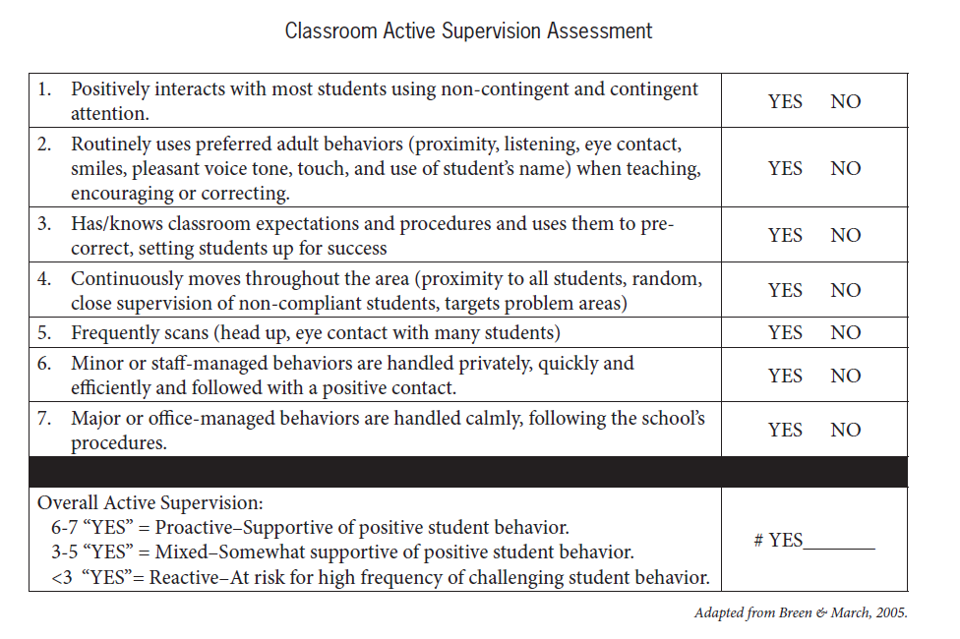
Classroom Active Supervision Assessment
Notes:
To do: Direct participants to the Classroom Active Supervision Assessment Handout
To say:
This can be used as a peer-observation feedback tool.
Your team will want to address these questions:
How could teachers select a peer partner to conduct observations and use this assessment tool?
What might need to be done to build a collaborative environment and establish trust so teachers will be able to allow and benefit from peer observation?”
Provide approximately 5 minutes for this activity.

Slide 29
Session Outcomes
At the end of today’s session, you will be able to…
List and describe the three practices used in active supervision
Connect active supervision with encouraging expected behavior and discouraging unexpected behavior
MO SW-PBS
Notes:
To say:
Consider how you will plan for implementing Active Supervision in your own classroom, and how you might support others in your building to learn the practices and use them. Remember…
‘Planning without action is futile, action without planning is fatal’ – Author Unknown”

Slide 30
Contact Information
Remember to follow MO SW-PBS on social media
Consultant Contact Information:
pbismissouri.org
facebook.com/moswpbs
@MOSWPBS

