Slide 1
Staff Mini-Module Active Supervision
Notes:
Please note the 2018-19 MO SW-PBS Tier 1 Team Workbook can be found at http://pbismissouri.org

Slide 2
Effective Classroom Practices
Classroom Expectations
Classroom Procedures & Routines
Encouraging Expected Behavior
Discouraging Inappropriate Behavior
Active Supervision
Opportunities to Respond (OTR)
Activity Sequencing & Choice
Task Difficulty
Notes:
TO say:
“Here is the list of research-based effective classroom practices. Today we are going to focus on Active Supervision.”

Slide 3
Active Supervision
Once you have clarified and taught expectations, it is crucial to monitor students closely through active supervision and provide feedback, both positive and corrective, on how their behavior aligns with the expectations.
MO SW-PBS
Notes:
To say: “Why do we need to address active supervision? While supervision seems to be an apparent teacher duty, using active supervision may not be intuitive and is essential to creating effective learning environments. It is much more complex than simply standing in the hall or classroom and watching students, then telling them what they should be doing.”
“There is a relationship between the number of supervisor - to - student interactions and the instances of problem behavior.” (Simonsen, Fairbanks, Briesch, Myers & Sugai, 2008)

Slide 4
“The goal of effective classroom management is not creating “perfect” children, but providing the perfect environment for enhancing their growth and using research-based strategies that guide students toward increasingly responsible and motivated behavior.” Sprick, et al., 2006
Notes:
TO do: Direct participants to read the slide.

Slide 5
How to Actively Supervise
Monitor any school setting using three practices:
Moving
Scanning
Interacting
MO SW-PBS
Notes:
To say:
“Active supervision is the process of monitoring any school setting that incorporates three practices:
moving,
scanning, and
interacting
(DePry & Sugai, 2002).”

Slide 6
Moving
When supervising work or activities, circulate among students.
Continuously move.
Maintain proximity with students.
Random or unpredictable.
Include moving close to noncompliant students and possible targeted problem areas.
Demonstrate interest in students, assist with learning tasks, provide feedback–both positive and corrective.
Periodically move and supervise when providing individual or small group instruction.
Notes:
To say:
“Effective teachers use their body positioning purposefully to ensure student engagement.
Supervision of work or activities includes moving or circulating among students with whom you are working.
When you are circulating, you will keep moving and avoid spending the majority of your time in any one location.
Continuous movement and proximity with all students makes your presence known and heightens their attention to tasks and the expected behaviors.
This movement should be random or unpredictable so students are unsure of when you will be in proximity.
It should also include moving close to noncompliant students as needed and more frequent contacts with possible targeted problem areas (Lampi, Fenty, & Beaunae, 2005).
Movement can be a challenge when working with a small group or providing individual instruction. You can still build in ways to periodically and unpredictably supervise the entire group. For example, during small group writing instruction, you can give students a brief task to complete while you get up and move among the large group of students, then resume working with the small group.”

Slide 7
Scanning
Frequently and intentionally look around at students:
Look students in the eye.
Visually sweep all areas of the room as well as look directly at students nearest you.
If working with individual, position self so as to scan the entire room or get up and scan occasionally.
Notes:
To say:
“Whether you are moving around the room, working with a small group or individual, or leading the group from the front of the room, you should frequently and intentionally look around at the students. This visual scanning includes establishing eye contact with students. Visually sweep all areas of the room as well as looking at the students nearest you. If you are working with an individual student, position yourself so you scan the entire room simultaneously.
This visual scanning allows you to watch for instances of appropriate or inappropriate behavior so you can respond as soon as possible. It will also help you to identify students who may need your assistance.”

Slide 8
Interacting
While moving and scanning you should also frequently interact with students. Interacting…
Communicates care, trust, and respect, and helps build relationships.
Creates positive climate and increases likelihood of accepting correction if needed.
Remains the same when teaching, encouraging or addressing problem behavior.
Includes: proximity, listening, eye contact, smiles, pleasant voice tone, and use of student’s name.
Notes:
To say:
“While moving and scanning you should also frequently interact with students. A friendly, open and helpful demeanor communicates care, trust, and respect and helps build relationships.”

Slide 9
Active Supervision…
Verbally and non-verbally communicates to students the certainty that you do inspect what you expect.
Notes:
To say:
“A culminating thought…”
To do: Have participants read the slide.

Slide 10
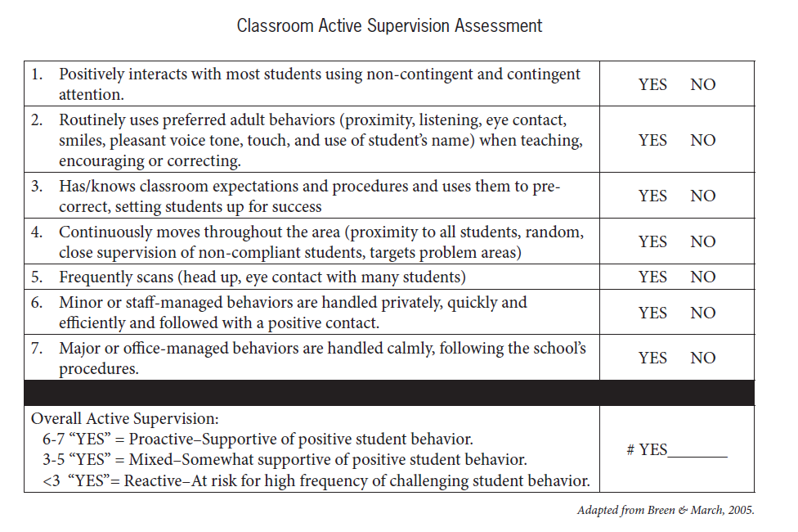
Classroom Active Supervision Assessment
Notes:
To do: Provide access to the following material: Classroom Active Supervision Assessment.
Provide approximately 5 minutes for this activity.
To say: “Address these questions:
How could teachers select a peer partner to conduct observations and use this assessment tool?
What might need to be done to build a collaborative environment and establish trust so teachers will be able to allow and benefit from peer observation?”

