Slide 1
Clarifying Expected Behavior Expectations and Rules
Notes:
To know: The page numbers in this presentation refer to the 2018-19 MO SW-PBS Tier 1Team Workbook and can be found at http://pbismissouri.org

Slide 2
Session Outcomes
At the end of today’s session, you will be able to…
Review the three to five schoolwide expectations that define success for all students and are applicable in all settings.
Create a matrix of specific behaviors/rules to further clarify each schoolwide expectation for the classroom.
Notes:
To say: “Once you’ve developed an efficient and effective system to accomplish the work of your SW-PBS team and effectively engaged staff in all development work, you’ll begin work on these tasks,”
To do: Then read the slide.

Slide 3
Social Competence &
Academic Achievement
OUTCOMES
Supporting
Data
Decision
Making
Supporting
Staff
Behavior
SYSTEMS
DATA
PRACTICES
Supporting Student Behavior
Notes:
To say: One of the practices we put in place to help support student behavior in the classroom is the clarification of classroom expectations and rules. Just as expectations and rules were developed for schoolwide and non-classroom areas, expectations and rules will be developed for classroom settings and routines.

Slide 4
Science of Behavior
Behavior is learned
Students do not learn what to do when they are given only adverse consequences
To learn social behavior, students must be directly taught.
To retain new behaviors, students must be given specific, positive feedback and opportunities to practice.
Notes:
To say: “The science of behavior is the foundation of SW-PBS.
What are some of the principles of the science of behavior?
Students are not born with bad (or good) behavior. Behavior is learned. The good news is that as educators, we can help students learn new behaviors.
Students don’t learn appropriate behavior if all we do is use a “get tough” approach. Punishment (by definition) reduces the misbehavior targeted; however, it does not teach the student what to do instead of misbehaving.
Students learn behavior through direct instruction of social skills. They must also receive ongoing feedback about what they are doing correctly so they can exhibit the correct behavior again.
The Components of SW-PBS are based on the principles of the science of behavior – and this equally applies to the classroom.”

Slide 5
The Science of Behavior
A B C
Antecedent | Behavior | Consequence
Events that happen immediately before and trigger a behavior. Example: Hallway rules and procedures are established and taught. | An observable act. What the student does. The actions or reactions to the antecedents. Example: Student keeps voice quiet, body to self and walks on the right. | The resulting event or outcome that occurs immediately following the behavior. Impacts future occurrence of the behavior. Example: Teacher gives specific verbal recognition. Appropriate hall behavior increases.
Notes:
TO say: “Antecedents are the actions/events that occur before the behavior. Anything in the students’ environment that sets the stage or triggers the behavior is considered to be an antecedent. Antecedents include the physical setting, type of activity, materials, person or people present, as well as how and what directions are given.”
“Behavior is any observable act that the student does–the actions or reactions of the student to the environment or antecedents.”
“Consequences are the results, actions or events that directly follow the behavior. Consequences either increase (reinforce) or decrease (punish) the probability that the behavior will occur again in the future (Alberto & Troutman, 2012).”

Slide 6
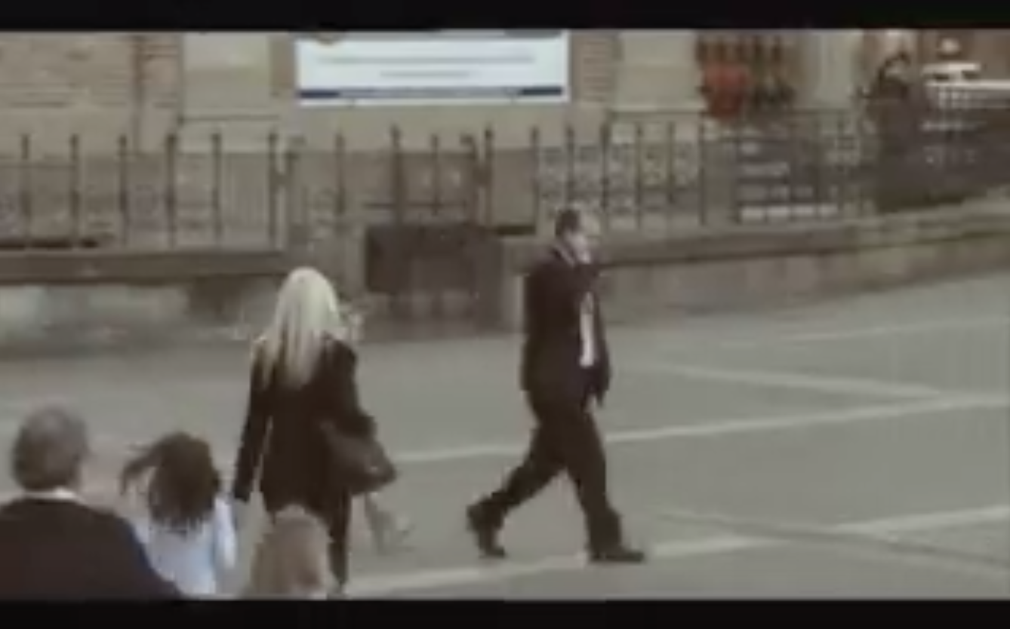
Video: Children See
Children See, Children Do
https://www.youtube.com/watch?v=KHi2dxSf9hw
Notes:
To Do: Show Participants the following YouTube video: Children See, Children Do
To say:
“Children are always learning – we don’t always know what or where. Think about the video and some of the behavior children were learning. What would we want them to do instead? Have a conversation with people near you and consider:
Instead of becoming frustrated on the telephone, what would be the replacement behavior?
Instead of being impatient for the train, what would be the replacement behavior?
Instead of smoking and littering, or dropping soda cans on the ground, what would be the replacement behavior?
Instead of ignoring a person struggling to get the stroller up the stairs, what would be the replacement behavior?
Instead of being inebriated and sick on the street, what would be the replacement behavior?
Instead of screaming at other drivers or behaving hatefully toward someone of a different race or ethnicity, what would be the replacement behavior?
Instead of mistreating pets and screaming at babies, what would be the replacement behavior?
Instead of physical violence, what would be the replacement behavior?”
To do: Allow groups to discuss and have them record the replacement behaviors they come up with. Are there patterns in what groups are identifying? (e.g. treat others with respect, be helpful, make safe and healthy choices, be responsible and clean up our own mess, deal with anger in a healthy way)
To say:
“Now – how can we increase the likelihood of children learning and using the desired replacement behaviors rather than the problem behaviors? We can teach them. By identifying and teaching behaviors that promote pro-social interaction, respect for self and others, responsibility, safe choices, and other important characteristics of success, we can provide opportunities for children to learn skills and habits that will lead to academic and behavioral success. ”

Slide 7
Notes:
To say: “This graphic depicts the process used to develop social behavioral curriculum. The leadership team works with all staff to develop a common philosophy and purpose of discipline, emphasizing addressing social behavior to achieve your school’s vision and mission. This will lead you to begin the process of developing classroom expectations and rules. Review the schoolwide and non-classroom expectations and rules for your school.”

Slide 8
Defining Behaviors/Rules
Specifically Identified Behaviors should be:
Observable – Behaviors we can see
Measurable – We can count occurrences
Positively Stated – What we do to be successful
Understandable – Student-friendly language
Always Applicable – The same everyday
Notes:
To do: Direct participants to read the slide
To say:
“We use the acronym, “OMPUA” to help us to remember how to specifically define behaviors.”
“Observable means that we can see or hear the behavior. Observable behaviors are described by action words.
Measurable indicates that the behavior can be counted or the duration of the behavior can be timed.
Positively stated – the behavior is a DO message (telling someone what TO do instead of what NOT to do)
Understandable indicates that the description of the expected behavior must be developmentally appropriate and culturally relevant.
Always Applicable means that the expected behavior must be applicable under all conditions.”

Slide 9
All Settings
What?
Why?
Rules that are expected in each and every school location and are connected to the 3-5 schoolwide expectations identified.
Expectations often not clear or agreed upon by all staff.
Supervisors change day by day.
Need to state behavior only once on Matrix, fewer rules on Matrix.
Notes:
To do: Read the slide.

Slide 10
Non-Classroom Areas
What?
Why?
Any area of the school not under the direct and consistent supervision of one adult.
Expectations often not clear or agreed upon by all staff.
Supervisors change day by day.
Allows staff to teach expectations prior to entering the setting and consistently supervise.
Increases staff and student comfort when in these areas.
Notes:
To say: “Non-classroom areas are settings outside the classroom. Non-classroom areas are those areas of the school that may be under the direct supervision of a variety of differing adults depending on the day or time. Often these non-classroom settings also have fewer staff supervising larger numbers of students. Clarifying expected behavior in these settings sets the stage for appropriate behavior in the class room.”
To do: then direct participants to read the slide.

Slide 11
Classroom Behaviors/Rules
What?
Why?
Rules that apply in your classroom.
Expectations often not clear or agreed upon by all.
Students spend the majority of their day in the classroom.
Prevents problem behaviors.
Increases instructional time.
Provides language for teaching and feedback for students, staff and parents.
Notes:
To say: “Clarity and consistency are the keys to increasing instructional time and increasing each student’s responsibility for his or her behavior.”
To do: Then direct participants to read the slide.

Slide 12
Discussion: Defining Expectations and Rules
With your staff discuss:
What will be some benefits of having common expectations and rules in all settings, non-classroom areas and in classrooms in the school?
What are some specific behaviors and rules for the classroom that mirror those for schoolwide and non-classroom settings?
Notes:
To do: Read the slide, then provide approximately 10 minutes for this discussion.

Slide 13
Session Outcomes
At the end of today’s session, you will be able to…
Review the three to five schoolwide expectations that define success for all students and are applicable in all settings.
Create a matrix of specific behaviors/rules to further clarify each schoolwide expectation for the classroom.
Notes:
To say: “Once you’ve developed an efficient and effective system to accomplish the work of your SW-PBS team and effectively engaged staff in all development work, you’ll begin work on these tasks,”
To do: Then read the slide.

