Slide 1
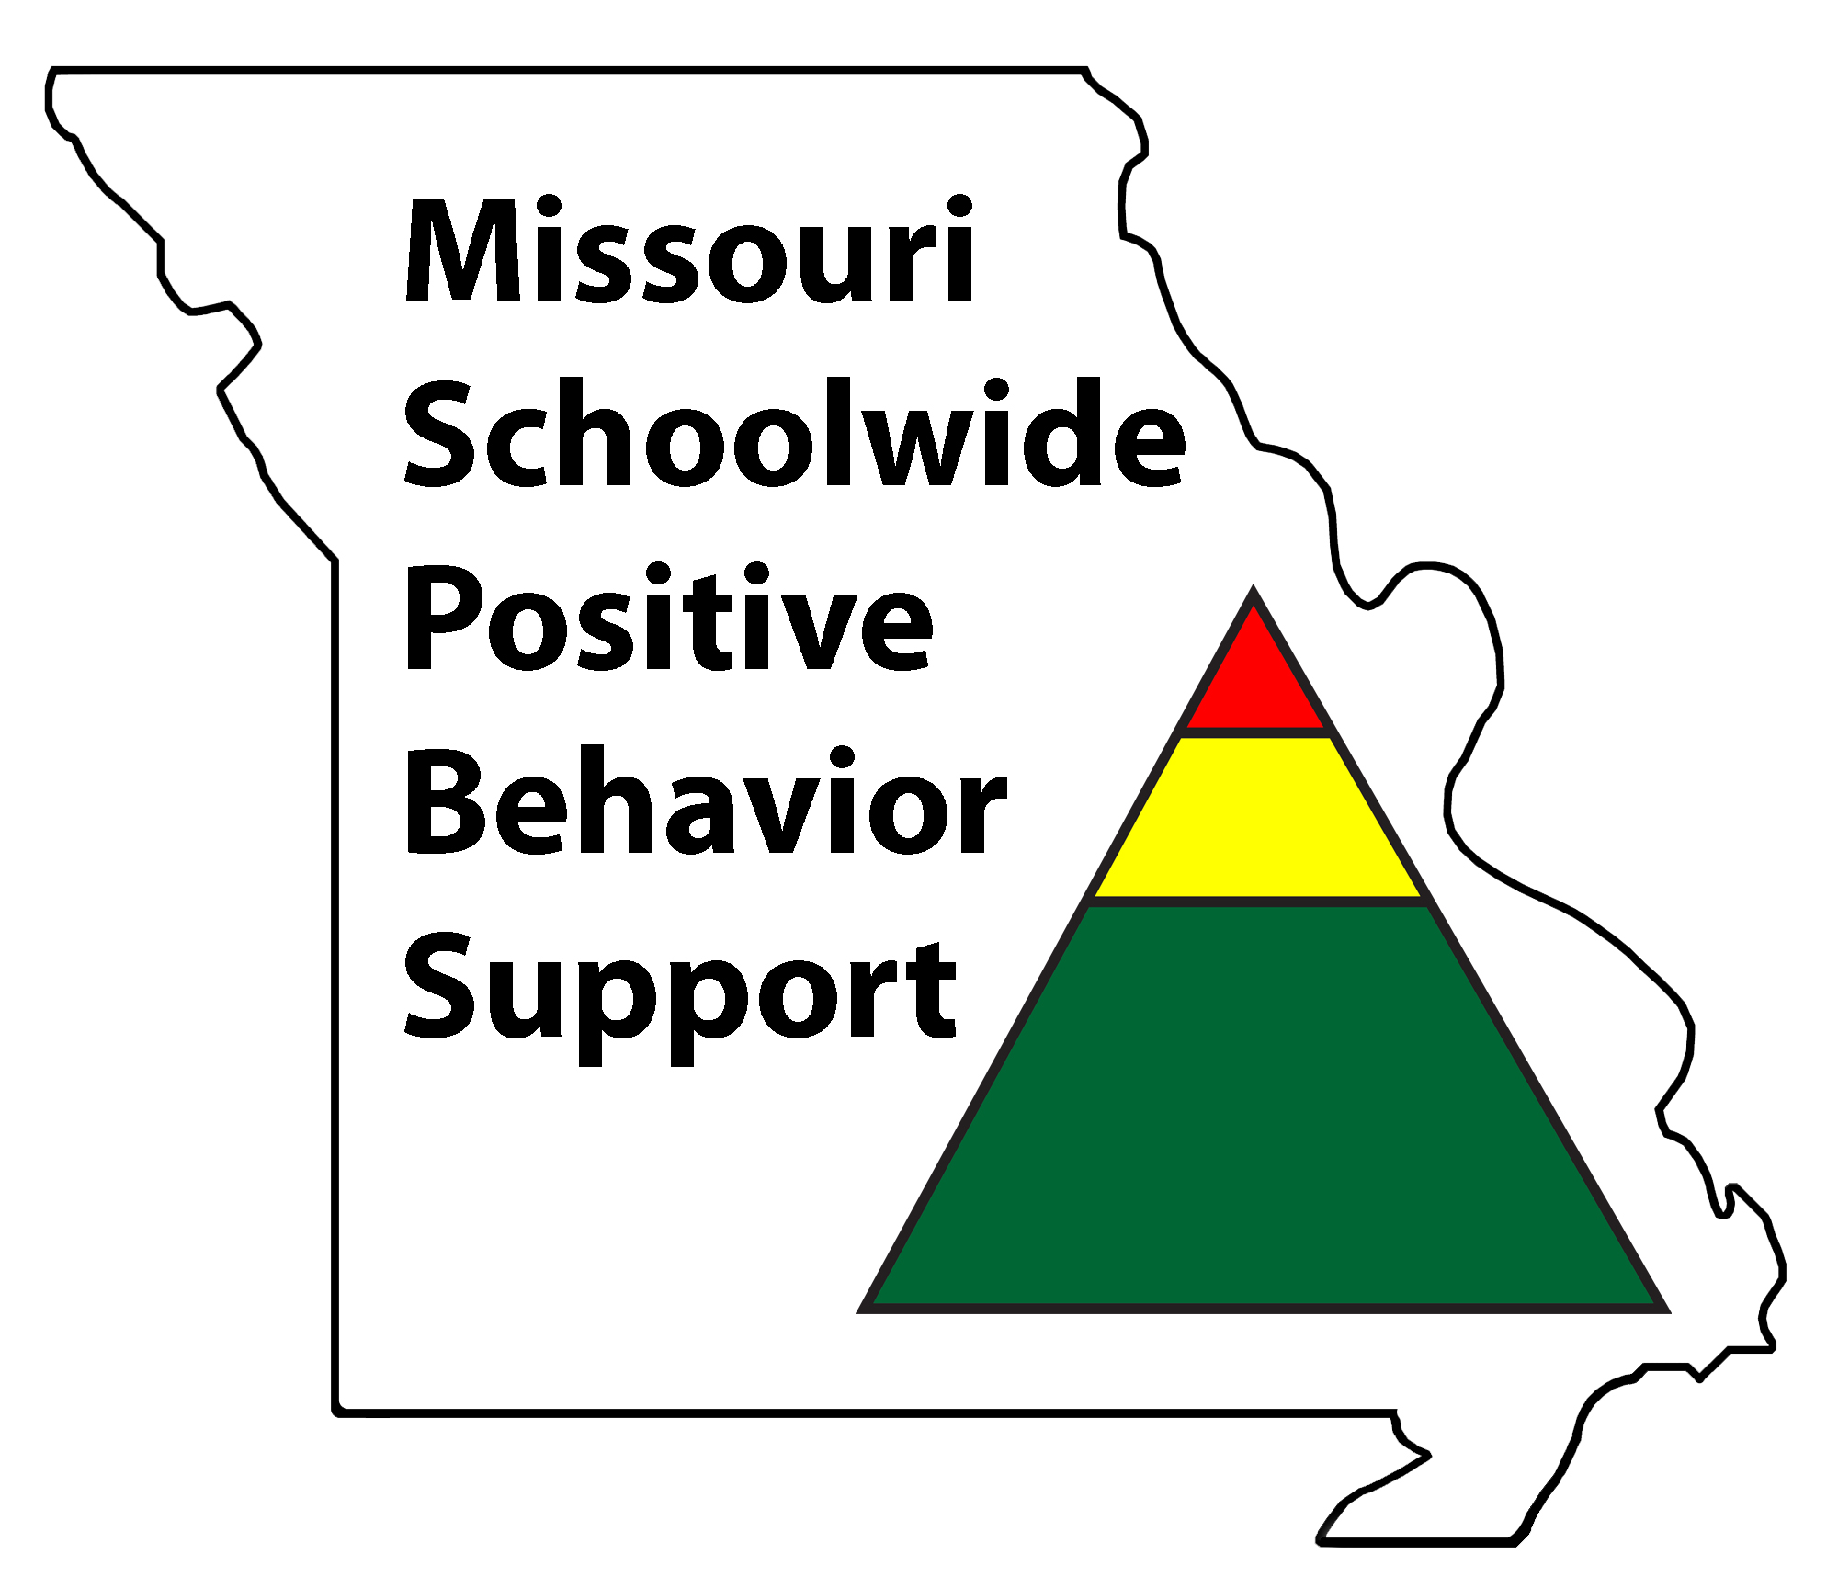
Staff Mini-Module Procedure and Routines
Notes:
Please note the page numbers in this powerpoint refer to the 2018-19 MO SW-PBS Tier 1Team Workbook and can be found at http://pbismissouri.org

Slide 2
What Are Procedures & Routines?
Procedures are patterns for accomplishing classroom and nonclassroom tasks.
Procedures explain the accepted process for carrying out a specific activity, such as sharpening pencils, turning in completed work, using lockers, attending an assembly, going to the restroom.
Procedures form routines that help students meet expectations as stated in school-wide and classroom rules.
Notes:
Read the slide or direct participants to read the slide, then say,
“Procedures are the steps we take to complete a task. Routines are the habits we form by repeating the same set of steps over and over.”
“Procedures are how we do something. Routines develop from consistent use of procedures.
Procedures and routines are important because they help students follow rules and meet expectations.”

Slide 3
Why Focus on Procedures and Routines?
“When students can predict the events throughout their school day, they are more likely to be engaged and less likely to display problem behavior. One way to increase predictability in a classroom is to establish routines, particularly early in the school year.” Kern & Clemens, 2007, p. 67
“As students become more familiar with classroom routines and procedures, additional instructional formats and more challenging work can be incorporated.”
Evertson, Emmer & Worsham, 2003; Good & Brophy, 2003
Notes:
Say, “Research tells us… then read the slide.

Slide 4
Having Classroom Procedures
Increases instructional time by preventing problem behavior.
Frees teachers from correcting misbehavior.
Improves classroom climate.
Creates shared ownership of the classroom.
Develops self-management.
Notes:
TO Say:
Having classroom procedures…
1. Increases instructional time by preventing problem behavior. Procedures show students how to behave, minimizing amount of non-academic time while increasing time for academic instruction.
2. Frees teachers from correcting misbehavior. When students perform routines smoothly, teachers can focus on recognizing the expected behavior, and are freed to take care of instructional tasks, review student work, while having to provide less correction.
3. Improves classroom climate. When you take time to explain how things are to be done, you appear fair and concerned. Students then experience higher rates of success and satisfaction, ensuring a positive learning environment.
4. Creates shared ownership of the classroom. Involving students in management of the learning environment empowers them, helping them to feel a partnership for their success and that of others.
5. Develops self-management. Procedures provide students with productive work habits that lead to personal accountability and effectiveness later in life.

Slide 5
Effective Procedures & Routines
Effective procedures should be. . .
Positively stated
As brief and concise as possible
Worded in age and context appropriate terms
Notes:
Read the slide.
“Effective procedures should provide students with the information about what TO do. Positively stated procedures leave little room for confusion. When procedures are clear and simple, there is a higher likelihood of success, as opposed to multi-step or complex procedures, which provide many more opportunities for error. Finally, procedures should be communicated in a way that supports learners.”

Slide 6
Classroom: Elementary Example
Lining Up
Sit quietly when you hear the signal.
Neatly place books and materials in your desk.
Quietly stand when your name (or row) is called.
Push your chair under your desk.
Quietly walk to the line.
Stand with your hands at your sides, facing forward, voice at 0 level.
Notes:
Say, “Notice each step is positively stated, telling the student what to do, when to do it and how to do it. If these procedures are posted, modeled, taught, and acknowledged, it increases the likelihood they will become the routine for lining up in this classroom.”
(Newcomer, 2008)

Slide 7
Classroom: Secondary Example
Entering and Starting Class
Enter the classroom before the bell rings.
Take your seat and get out the materials listed on the board.
Talk quietly until the bell rings.
After the bell rings, get quiet and respond to the challenge question on the board.
Notes:
Read the slide or direct participants to read the slide, then say,
“The teacher developed this procedure after having a class meeting with all students. After agreeing on these steps, the teacher and the students identified a specific location on the board to list materials required for each day’s work and a specific location to post the daily challenge question. The students stated that posting the procedure, required materials and daily challenge question would be very helpful because they had to keep track of procedures, materials and assignments in 8 different classes in their block schedule.”

Slide 8
Classroom: Elementary Example
During Lessons
Sit in a learning position.
Raise your hand for a turn to talk, if you have a question or if you need help.
Finish all of your work.
Choose an activity from the “Extension Activities List” if you finish your work early.
Take restroom or water breaks during independent time.
Notes:
Say, “The teacher worked with the students to develop this classroom procedure,” then direct participants to read the slide.
“The teacher addressed the expected behavior at the beginning of the lesson, in the middle of the lesson and at the conclusion of the lesson. The teacher and students created a list of activities from which students choose to extend their learning when assigned tasks are completed. Attending to personal needs was also addressed.“
(Newcomer, 2008)

Slide 9
Classroom: Secondary Example
Class Discussion
Prepare for discussion by reading the required assignment in advance.
Stay on topic.
Wait until the other person is finished speaking before you talk.
Use appropriate expressions of disagreement.
Notes:
Say, “You will notice the procedures are positively stated and tell what the student is to do, when to do it and how to do it, but the language in the secondary procedure is more sophisticated.”
(Newcomer, 2008)

Slide 10
Activity: Developing a List of Classroom Procedures
Think through the activities of your day.
Review the list of classroom procedures.
Put a Check Mark ✓ by any that you currently utilize that are efficient and effective.
Put an × by any that you think you need to develop.
Add any that might be missing.
Share with a partner.
MO SW-PBS
129
Notes:
Direct participants to p. 129 of the 2018-19 Tier 1 Workbook.
Introduce this activity by saying, “You can use the List of Classroom Procedures with this activity and the Procedure Writing activity to work with your staff to develop procedures for each classroom.”

Slide 11
Activity: Procedure Writing
With a partner . . .
Select one of the procedures you identified on the list as not being in place.
Identify the desired outcome of the procedure.
Sequentially list each step required to complete an activity (each step must contain an observable action to be performed by the student).
Describe what to do, when to do and how to do it.
MO SW-PBS
129
Notes:
Direct participants to p. 129 of the 2018-19 Tier 1 Workbook.
Introduce this activity by saying, “Select one of the procedures you identified on the list as not being in place. Then, remember the steps involved in writing well-defined procedures introduced previously.”
Provide approximately 10 minutes for this activity.

Slide 12
Developing Procedures is Not Sufficient…. Procedures Must Become Routine
Procedures must be taught!
Post, teach, and acknowledge
student performance of procedures.
When?
Teach procedures before they’re needed.
Teach at the beginning of the year, when a new procedure is needed, and throughout the year as needed.
MO SW-PBS
Notes:
Read the slide, then say,
“After the classroom procedures have been defined and taught, they should be posted in the classroom in a prominent spot where you and your students can refer to them regularly and frequently. Another important step in teaching is acknowledging students when they perform the classroom procedures. Giving positive feedback that is specific will help increase the likelihood students will engage in the expected behavior in the future. An example of positive feedback might be ”Marisol, thanks for putting your make up work in the folder. That was very responsible, and makes sure you get credit for your work!”

