Slide 1
Combined Efforts = Success Class Meetings
Notes:
To do: Have blank classroom matrices available for people to take notes and create drafts, as well as index cards for the activity.
To say: We’re going to look at how students can be involved in the development of the classroom matrix.

Slide 2
Henderson Elementary School (Francis Howell)
557
90
7
3
Henderson Elementary includes all students in the construction of its building-wide matrix of expectations through the classroom meeting process.
The first seven days of the school year serve as a foundation for identifying, defining and establishing common vocabulary and behaviors for the school.
Contact: Dr. Jennette Barker ~jennette.barker@fhsdschools.org
Notes:
TO say: Henderson Elementary did a wonderful job of utilizing the strategy of classroom meeting introduced in Character Ed to include all students in the completion of the building-wide expectations
Here are few statistics:
557 students
90 Staff (43 teachers)
7 areas of the building/matrix
3 core values

Slide 3
Building the Matrix with Students
Notes:
To say: This giant matrix is ready for student ideas. Teachers and students start building the Matrix at “Eagle Camp”

Slide 4
Building the Matrix with Students
Notes:
To say: Eagle Camp takes place during the first 7 days of the school year. Every classroom participates for around 30 minutes each day. Class meetings occur where teachers and students talk about their goals for the class for the year, and what behaviors can help them get there.

Slide 5
Building the Matrix with Students
Notes:
To say: “Here’s how it works
-Classrooms focus on 1 area each day
-Teachers use chart paper to record student responses
-When the class meeting is complete, the class takes the ideas down to the Principals”

Slide 6
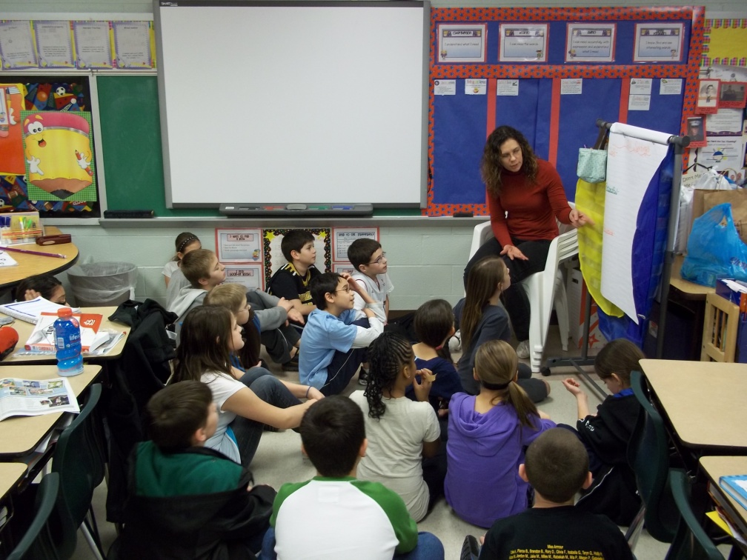
Class Meetings
Notes:
To say: Here’s an example of a class meeting where 2nd grade is developing behaviors and rules for all settings.

Slide 7
Building the Matrix with Students
Notes:
TO say: The Principals look over the all of the ideas for expectations, and begin posting the matrix .

Slide 8
Building the Matrix with Students
Notes:
To say: The expectations for that area are read on the daily announcements the following day and posted on the large matrix in the hallway

Slide 9
Giving Students a Voice
What are some ways you currently involve students in decision-making?
Could this be expanded to include matrix development?
Think- Pair - Share
Notes:
TO do: Read the slide. Give participants about 3 minutes to discuss.

Slide 10
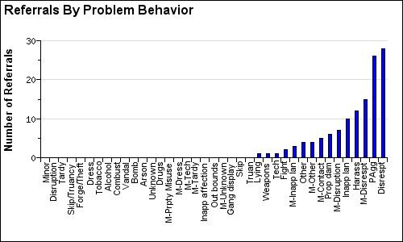
Utilizing Data to Guide Classroom Meeting Discussions Problem Behavior
Notes:
To say: Another way that they use class meetings is to address their data concerns. So first the team would review the data and as you can see from this chart the problem behavior they were having a concern with was disrespect. They would provide this information to teachers to share with students.

Slide 11
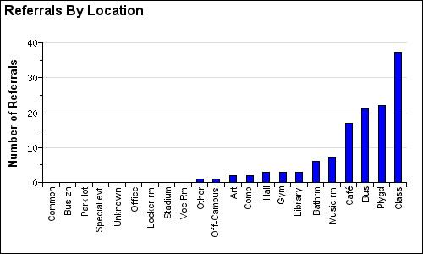
Utilizing Data to Guide Classroom Meeting Discussions
Notes:
To say: The next step then is to determine where the behavior is occurring most frequently by looking at locations. You can see here that the behavior of disrespect is occurring most frequently in the classroom. This is also shared.

Slide 12
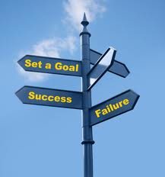
By June 20XX, the number of office discipline referrals in the area of disrespect will decrease by 10% or more.
Notes:
To say: Sharing the data allows everyone to be informed and set a goal. Once there is a schoolwide goal, and a classroom goal, the behaviors and rules are the tools that will get there.

Slide 13
Class Meetings
Notes:
To say: At Henderson, they brought the data to the class meeting process. They will also discuss their responsibilities and develop a plan to address the focus of the meeting which in this case was disrespect in the classroom.

Slide 14
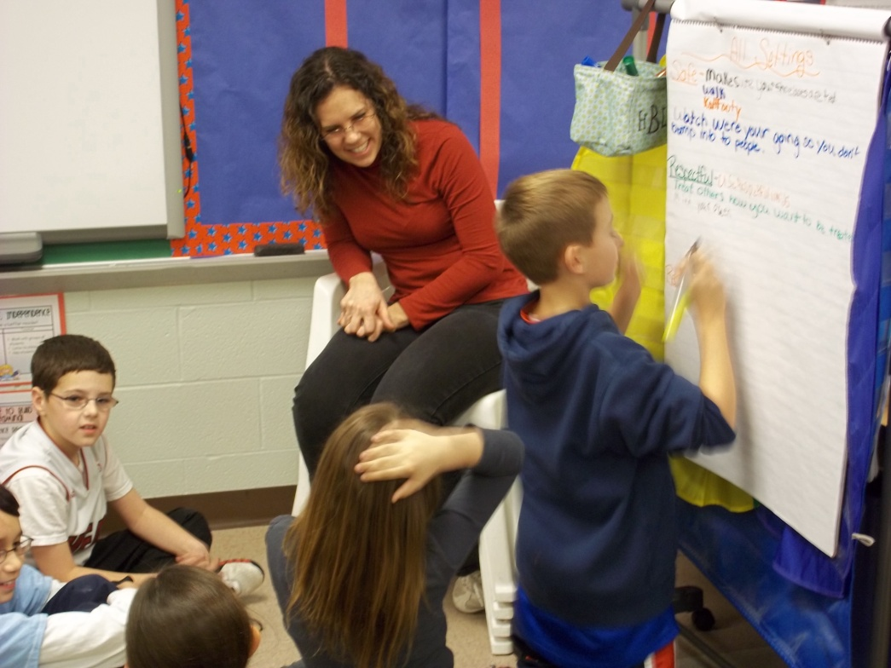
Class Meetings
Notes:
To say:
Class Meetings include students taking on Responsibilities and being actively engaged in the conversation.
Every Meeting has a specific focus with the intention of the students demonstrating problem resolving skills.

Slide 15
ONE-YEAR ACHIEVEMENT GOAL By June 2012 the number of office discipline referrals in the area of disrespect will decrease by 10% or more.
Notes:
To say: At Henderson, their measure of success is revisiting their data to see if they met their goals - and they did!

Slide 16
Idea Swap
Write your idea for using class meetings to create behaviors/rules on an index card.
Use this sentence starter:
I will use class meetings in my school to……
Notes:
To do: Independently have them write down how they might use class meetings in their school on the index card provided.

Slide 17
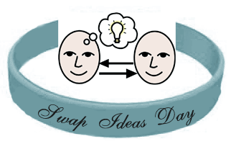
Idea Swap
When the music begins find a partner
When the music stops share your ideas and then swap index cards
When the music starts find a new partner
When the music stops share your new idea
Notes:
To do: Have participants complete this activity to share their ideas on how they might be able to use class meetings.

