Slide 1
Delete this Slide.
Notes to Consultants
Slides with a red background indicate that you can select an activity from a PowerPoint with the same title as the slide (e.g. The Introductions slide indicates that you will select an activity from a PowerPoint titled, Introductions Activities.)
Slides with the pencil icon denote an activity that may also include discussion.
Slides with the group icon denote a discussion.
Slides with a yellow star denote accompanying materials must be accessed.
Slides with this icon denote a video.
Slides with the check icon denote action planning.

Slide 2
Trainer Notes (Remove before training.)
Approximate Time Estimates:
Opportunities to Respond ___
Opportunities to Respond Content 60 min
Videos, Discussions, and Activities 60 min
2 Hours

Slide 3
Effective Teaching and Learning Practices
ETLP 6: Opportunities to Respond

Slide 4
Working Agreements
Be Respectful
Be an active listener—open to new ideas
Use notes for side bar conversations
Be Responsible
Be on time for sessions
Silence cell phones—reply appropriately
Be a Problem Solver
Follow the decision making process
Notes:
To say: These will be the Working Agreements we will honor during training.

Slide 5
Attention Signal Practice
Select and teach an attention signal.
Notes:
To do: Select an attention signal appropriate for your context and audience.
To say:
“One of our agreements is to follow the attention signal.”
“Your team will work with your school to develop an attention signal you will use in every setting.”
“In order to get all of you focused after discussions, activities or breaks,
I will ________________________________________.”
(Insert your attention signal here.)
“Your task will be to finish your sentence, quiet your voice and ____________________________.”
(Insert what you want participants to do.)

Slide 6
Introductions
Insert an Introductions Activity.
MO SW-PBS
Notes:
To do: Choose an Introductions Activity

Slide 7
Session Outcomes
At the end of today’s session, you will be able to…
Explain the benefits of providing students with Opportunities to Respond (OTR)
List and describe verbal and non-verbal strategies teachers can use to prompt student response
View and discuss examples of OTR in the classroom
Notes:
To Say: “Once you’ve developed an efficient and effective system to accomplish the work of your SW-PBS team and effectively engaged staff in all development work, you’ll begin work on these tasks,” then read the slide.

Slide 8
Opportunities to Respond (OTR)
Handout Guided Notes for OTR
Notes:
To do: *Disseminate the Handout Guided Notes for OTR
To say:
“This handout will provide a guide or outline for our study of Opportunities to Respond.”

Slide 9
Effective Classroom Practices
Classroom Expectations
Classroom Procedures & Routines
Encouraging Expected Behavior
Discouraging Inappropriate Behavior
Active Supervision
Opportunities to Respond (OTR)
Activity Sequencing & Choice
Task Difficulty
Notes:
To say: “Here is the list of research-based effective classroom practices. This session will focus on Opportunities to Respond or OTR.”

Slide 10
Opportunities to Respond (OTR)
Teacher behavior that prompts or solicits a student response (verbal, written, gesture).
Notes:
To say:
“Most teachers allocate sufficient time for learning, but fail to ensure that students are actively responding. What, then, are appropriate opportunities to respond?”
To do: Read the slide or direct participants to read the slide.
Then say:
This addresses the number of times the teacher provides academic requests that require students to actively respond.
And includes strategies for presenting materials, asking questions, and correcting students’ answers to increase the likelihood of an active response.

Slide 11
The Value of Providing OTR
Opportunities to Respond
On-task behavior and academic performance
Disruptions
Notes:
To say:
The benefits of planning rich and frequent opportunities to respond include:
More time students are actively involved, more learned.
Increased rates of responding and subsequent improved learning tend to increase the amount that can be covered.
On-task behavior behavior and correct responses increase while disruptions decrease.
Shown to improve reading and math performance.
Provides continual feedback for the teacher on student learning and the effectiveness of teaching strategies.

Slide 12
Guidelines for Response Rates
Teacher talk
$≤$40% – 50%
New > 4-6/minute
80% accuracy
Review > 8-12/minute
90% accuracy
Notes:
To say:
What is the optimal rate for opportunities to respond? Here are some guidelines provided by the Council for Exceptional Children .
Teacher talk should be no more than 40-50% of instructional time.
New material – a minimum of 4-6 responses per minute with 80% accuracy.
Review of previously learned material – 8-12 responses per minute with 90% accuracy.

Slide 13
Response Strategies
Verbal Non-verbal
Notes:
TO say: Varied and creative strategies exist; however, generally fall into one of 2 categories:
Verbal strategies – Students respond orally to teacher prompts or questions.
Non-verbal strategies – Students use a signal, card, writing or movement to respond.

Slide 14
Response Strategy Consideration
Notes:
TO say:
“Think time is simply pausing after asking a question and counting for a specified amount of time. The challenge of providing more think time for most teachers is the perception that students will begin to lose focus or behave inappropriately if responses are not given quickly. The opposite, however, is true. When only 1 or 2 seconds of think time is provided, only those students who process more quickly remain engaged in the task; therefore, providing a longer period of think time of at least 3 seconds increases participation and decreases disruptions.” (Casteel and Stahl, 1973; Rowe, 1972; Stahl, 1990)
Wait Time or Think Time–the time lapse when delivering a question before calling on a student or cueing a group response.
Engages students in thinking.
Increases participation.
Increases quality of responses.
Results in fewer redirects of students and fewer discipline problems.
Rowe, 1987

Slide 15
Using Wait Time or Think Time
3 seconds
Notes:
TO say:
Teachers, on average, provide only 1.5 seconds or less of think time (Rowe, 1972). Most of us do not accurately assess the amount of think time we actually provide because our perception of the amount of time that has passed is different than the actual amount of time that has passed. Therefore, using strategies like those listed may help you and your staff increase the amount of think time provided.
Simply pause after asking a question for three seconds.
Count inaudibly, use a stopwatch or follow second hand on a clock.
Peer coaching or video-taping can help to develop awareness.

Slide 16
Activity: Wait Time/Think Time
Partner A will ask partner B one of the following:
What are the benefits of providing more think time?
What are possible challenges of providing more think time?
What strategy will you use to insure you are providing adequate wait time?
Count the seconds giving partner B a complete 3 seconds of think time to respond.
Reverse roles
How much time did you feel had elapsed?
Notes:
To do: Determine how you will direct participants to partner.
Read the directions on the slide.
Provide approximately 5 minutes for this activity, then ask participants to share out about their perception of elapsed time during the activity.

Slide 17
Verbal Response Strategies
Choral Individual
Notes:
To say:
Verbal response strategies focus on students orally answering a question, sharing ideas, reviewing or summarizing prior learning, or simply repeating a new concept after the teacher.
Two types of Verbal Response Strategies
Individual Questioning
Choral Response

Slide 18
Engaging Students and Individual Response
Notes:
To say:
Many teachers default to calling on students who volunteer often which results in having only a few students actively participating while others disengage. These strategies may increase participation among all students. What other strategies have you or your staff used to randomly select students to respond?
Individual Questioning – Calling on students randomly increases student attention.
Ask the question first, then pause before calling on the student to respond.
Use seating chart, tallying to monitor rate of questions presented to each student.
Student names on strips of paper, drawn as questions asked.
Use above random strategy, and call on a student to repeat or summarize what the student just said.
**It is important to note that random selection may cause anxiety or difficulty for some students. If you know certain students find this aversive, talk to the student about how they might be more comfortable sharing. One consideration is to use think-pair-share or other models where individual students respond to each other, then pairs may share out with the group. This way all students have the opportunity to make an individual response, and it may be less of a barrier for some students.

Slide 19
Verbal Response Strategies - Individual Response
Random Solicitation of Responses
Calling on one student at a time during small group reading = an average of 72% on-task behavior. Some students were on-task only 50% of the time.
Calling on students randomly and reinforcing correct responding = an average of 88% on-task behavior. Lowest student on-task behavior was 76%.
Notes:
To do: Read the slide.

Slide 20
Verbal Response Strategies – Choral Response
Notes:
To do: Read the slide.
To say:
Choral responding has been demonstrated at all levels–elementary, middle and secondary grades for students with and without disabilities (Cavanaugh, Heward, & Donelson, 1996; Godfrey, Grisham-Brown, Hemmeter, & Schuster, 2003; Heward, 2006).
Choral Responding – All students in class respond in unison to a teacher question.
Suitable for review, to teach new skills, as a drill, or as a lesson summary.

Slide 21
Ms. Finch’s first graders have just finished listening to a story about a young boy named Howard.
Ms. Finch puts the book on her lap, holds up her hand, and says, “Class, get ready to tell me the main character in today’s story. Think 3, 2, 1,” drops her hand as a signal, and the students chime in, “Howard!” “Howard is correct,” exclaims Ms. Finch. “Way to go!”
She asks ten more quick questions–some about the setting and main idea. “Last one. The problem Howard faced today was finding his lost dog. Is that true or false? Think 3, 2, 1.”
She signals and the student eagerly respond, “False!” The students laugh and so does Ms. Finch. “You got it, that’s false. Tell me why that’s false.” She waits 3 seconds, then calls on James who often requires more think time and who has just raised his hand to answer.
Notes:
Say, “Here is an example of a teacher using choral responding,” then direct participants to read the slide.

Slide 22
Not Tonight but Tomorrow (1978) BY MIGUEL ALGARÍN Not tonight but tomorrow when the light turns the peach tree green and the Earth sprouts its young leaves looking to repeat the magical mystery tour of photosynthetic conversion of light and moisture into life— Not tonight but tomorrow when my body will have shed its fear of turning old and soft will I turn my speeding mind into the tunnels of your psyche to melt the calcium that constipates your synapses into a lubricating powder— | Not tonight but tomorrow when the Universe moves on beyond the field of action that is the Earth to me and you will I discover the interplanetary clues that signal the roots of my moment to you— Not tonight but tomorrow will I throw my feelings into New York streets to stew in the violence and despair of our planet— Not tonight but tomorrow will the Earth turn green again. Miguel Algarin, "Not Tonight but Tomorrow (1978)" from Survival Supervivencia. Copyright © 2009 by Miguel Algarin. Reprinted by permission of Arte Público Press.
Notes:
To say:
This is another example of using choral response with older students. The whole class will recite the red line “Not tonight but tomorrow”, and the teacher or a volunteer student will read the remainder of each stanza.
TO do: Have participants act as the students and read the red lines as the facilitator or volunteer participants read the remainder of each stanza. (This is also a handout)

Slide 23
Considerations for Using Choral Responding
Develop questions with only one right answer that can be answered with short, 1-3 word answers.
Provide a thinking pause or wait time of at least three seconds between asking the question and prompting students to respond.
Use a clear signal or predictable phrase to cue students to respond in unison.
Use a brisk, lively pace.
Provide immediate feedback about the group response.
Notes:
To do: Direct participants to read the slide
Then say:
Choral response is appropriate for all content areas, however, it is important to use it when there are clear, correct answers. For example, the teacher might ask, “Everyone, the Americans with Disabilities Act was signed into law in what year? 1990 While, “Everyone, how does the Americans with Disabilities Act relate to schools,” would not be appropriate as people would have a variety of answers.

Slide 24
Using Choral Responding
Preparation is key!
Notes:
TO say:
Some additional considerations for using choral responding include:
Prepare questions in advance.
Can be visually presented on PowerPoint
Best used with individual questions interspersed to assess individual learning.
Use thorough pre-correction regarding listening, the response signal, appropriate voice tone, etc.
Intentionally plan for students who might find barriers to this type of response strategy

Slide 25
Discussion: Choral Response
Think of a lesson you will be teaching soon.
What are some ideas for using choral response in this lesson?
Remember :
Develop questions with only one right answer that can be answered with short, 1-3 word answers.
Be prepared to share your ideas with the group.
Notes:
Read the slide or direct participants to read the slide.

Slide 26
Non-Verbal Response Strategies
Notes:
To say:
Non-verbal response strategies use signaling, movement, or other means for students to respond without talking.
Have the same benefits as verbal response strategies.
Every student actively answers or responds to each question or problem posed by the teacher.
Use low-tech or high-tech non-verbal response strategies

Slide 27
Non-Verbal Response Strategies
Low Tech – Low Effort
White boards
Response cards
Signaling or movement activities
Low Tech – Moderate Effort
Guided notes
Peer Assisted Learning Strategies
High Tech
Clickers/Cell phone
Shared documents (e.g., Google Docs)
Notes:
To say:
“Low-tech strategies will involve using materials you probably already have in your school. Using guided notes will require very few materials, but will require some time to prepare. High-tech response strategies will require you to ascertain availability of the technology for each student.”

Slide 28
Non-Verbal Response Strategies - Whiteboard
Notes:
To say:
“You will have to teach the procedures to access and use the white boards. There are lots of different choices available for use in the classroom.
White Boards – Each student has his or her white board on which to write answers to teacher’s questions with an erasable marker.
Letters, words, numbers, draw symbols, or solve problems.
When cued, hold up board to display answers.
Students use an eraser, sponge, or cloth to erase their answer and await next question.

Slide 29
Non-Verbal Response Strategies – Response Cards
https://www.plickers.com/
Free and subscription accounts
Notes:
To say:
Response Cards are Pre-printed cards that have single words or letters on each side.
Yes/No, True/False, Odd/Even
Set of few choices (e.g., solid, liquid, gas; root word, prefix, suffix)
Plickers use individual QR codes for each student, and can be used for multiple types of questions. The teacher will need a smartphone and will need to set up information on the website for the class.

Slide 30
Using White Boards or Response Cards
Teachers should…
Teach the response procedures, including when to select the card or write the response, when to share, and when to clean boards or reposition cards for next question.
Prepare questions to carefully match your response option.
Assess student responses and provide clear, specific feedback.
Provide the correct answer and a brief explanation if a significant number of students did not respond accurately, then re-present the question.
Work with a partner to develop response procedures when using a white board or response cards in your class.
Notes:
To say:
“Here is a list of tasks that must be accomplished before utilizing white boards or response cards. Read the tasks, then work with a partner to develop response procedures when using a white board or response cards .”
Example Response Procedure:
Teacher will ask a question
Count to 3
Direct students to select the card or write the response. Turn the card you chose or the white board face down on your desk.
Teacher will count to 2, then say, “Show me your answer.”

Slide 31
Non-Verbal Response Strategies Signaling or Movement Activities
Notes:
To say:
Teaching response procedures is very critical when using movement activities. Movement activities may be most meaningful when the movement is linked to the concept being taught (e.g. Divide the classroom into 4 corners – 1,2,3,4, and have students move to the corner matching their answer).
To do: Ask participants to consider other movement activities that could be used as response strategies.
Possible Answers:
Students repeat a word presented to them, then clap the syllables of a word
Two numbers are written on the board, students are directed to use their arms to make a greater than, less than or equal to sign to indicate the relationship between the numbers.

Slide 32
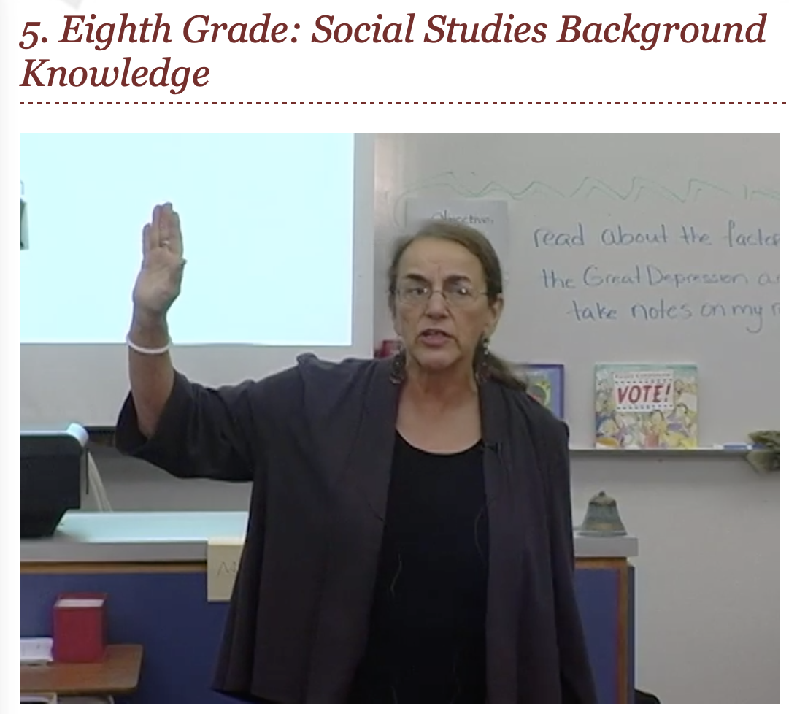
https://explicitinstruction.org Dr. Anita Archer
Notes:
To say:
Now we’re going to watch a video from the website explicitinstruction.org with Dr. Anita Archer demonstrating a variety of OTR strategies. At the end of the video, write down what you think her rate of OTR/minute is and we will compare as a group.
To do:
Go https://explicitinstruction.org/video-secondary-main/secondary-video-5/ and click play. If you are concerned about having internet access, you can download the video at the link given ahead of time.

Slide 33
6 OTR/Minute
52 Verbal
14 Non-verbal
Notes:
To say:
What did you estimate for OTR/minute? The rate of OTR/minute in the video was 6/minute – 52 Verbal, 14 Non-verbal.
To do: Animated slide - click to show rate on the screen

Slide 34
Non-Verbal Response Strategies
Notes:
To say:
You can also use technology to create opportunities to respond.
Student Response Systems–Commonly called “clickers” can be used with a range of age groups and content areas.
During class discussion, the teacher displays or asks a question.
All students key in their answer using a hand-held keypad or other web-based device.
Responses are received and displayed on the teacher’s computer monitor as well as on a overhead projector screen.

Slide 35
Non-Verbal Response Strategies: Using Technology
Notes:
To say:
Classroom clickers can be separate from SMART Board systems or can be integrated into those systems. Your staff will require PD and tech support to effectively use clickers. Ultimately, the success or failure in using the clickers hinges on the quality of the questions developed.
Teachers immediately see each student’s answer.
Helps to guide teacher instruction.
Devices are numbered so that individual responses can be downloaded for recordkeeping or further analysis once the session has ended.
Student engagement and motivation or student satisfaction seems to be enhanced.
All can respond anonymously using a familiar game approach.

Slide 36
Non-Verbal Response Strategies
Notes:
TO say:
Guided Notes are teacher prepared handouts leading students through a presentation or lecture with visual cues or prepared blank spaces to fill in key facts or concepts.
Increases attention and engagement.
Provides a standard set of notes.
Helps with outlining skills.
Lessons must follow the guided notes.
You were provided guided notes when we began our study of Opportunities to Respond. Please take time now to review these. Notice that key vocabulary words are used to fill in the blanks. How did using these notes impact your attention, engagement, learning?

Slide 37
Non-Verbal Response Strategies: Developing Guided Notes
Identify key facts, concepts, or relationships that could be left blank for students to fill in.
Consider inserting concept maps or a chart, diagram, or graph to help with understanding.
Provide students with formatting clues such as blank lines, numbers, bullets, etc.
Plan for small amounts of writing throughout to ensure students can attend to the instruction and take notes.
Notes:
Read the slide or direct participants to read the slide, then say,
“Guided notes uses the concept of ‘Gestalt’. The ‘gestalt’ is a concept meaning ‘closure.’ Because our brains seek closure, using guided notes increases the attention and participation of all students by focusing on discovering the missing key concepts. Remember, this strategy is effective when adequate information is already included so that students can identify the missing information.”

Slide 38
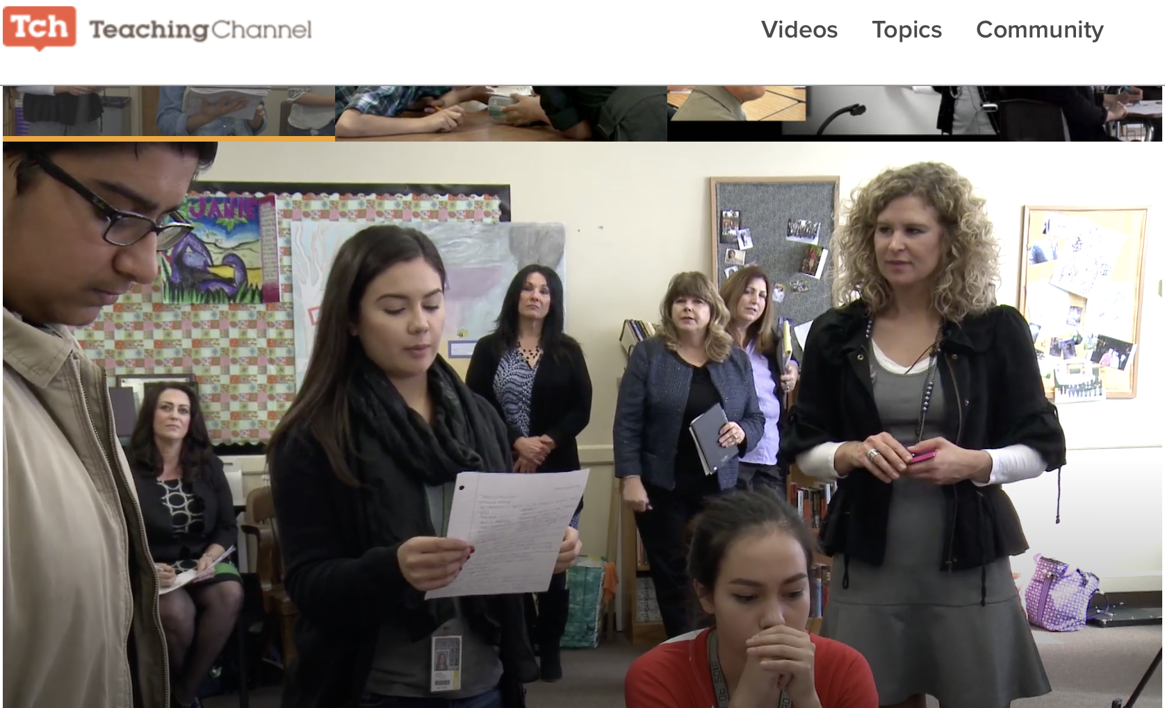
The Stand-Up Game
Notes:
To say:
TeachingChannel.org has some excellent resources for all grade levels, subject areas, and topics. This is a video from a high school classroom combining verbal and non-verbal responses. https://www.teachingchannel.org/video/stand-up-game
TO do: click the link in the notes, or click the image above to connect to teachingchannel.org and play the video.

Slide 39
Activity: Identify OTR
Read the following scenario and identify OTR.
Shortly after science class started, the teacher announced, “We have a small block of ice and the same sized block of butter. Tell your neighbor which one would melt first.” A few seconds later the teacher said, “Please write down in one sentence an explanation for your answer.”
A few minutes later, the teacher told students to share with their neighbor what they had written. Shortly thereafter, the teacher called on one student to tell the class her answer. The teacher then asked the class to raise their hand if they agreed with the answer. Then the teacher asked students to give a thumbs down if anyone disagreed.
Colvin, 2009
Notes:
Say,
“Providing multiple opportunities to respond is a powerful tool to increase appropriate behavior.
This scenario is an example of a teacher providing many and varied opportunities to respond.
Read the scenario and determine how many opportunities to respond were provided.
Also look for the various strategies used to get students to respond.”

Slide 40
Activity: Identify OTR
Shortly after science class started, the teacher announced, “We have a small block of ice and the same sized block of butter. Tell your neighbor which one would melt first.” A few seconds later the teacher said, “Please write down in one sentence an explanation for your answer.”
A few minutes later, the teacher told students to share with their neighbor what they had written. Shortly thereafter, the teacher called on one student to tell the class her answer. The teacher then asked the class to raise their hand if they agreed with the answer. Then the teacher asked students to give a thumbs down if anyone disagreed.
Colvin, 2009
Notes:
“How many opportunities to respond were provided?” (six)
“What were the various strategies used to get students to respond?”
talk to neighbor (twice)
write
individual oral response
non-verbal responses (raised hand, thumbs down)

Slide 41
Session Outcomes
At the end of today’s session, you will be able to…
Explain the benefits of providing students with Opportunities to Respond (OTR)
List and describe verbal and non-verbal strategies teachers can use to prompt student response
View and discuss examples of OTR in the classroom
Notes:
To Say: “Once you’ve developed an efficient and effective system to accomplish the work of your SW-PBS team and effectively engaged staff in all development work, you’ll begin work on these tasks,” then read the slide.

Slide 42
Contact Information
Remember to follow MO SW-PBS on social media
Facilitator Contact Information:
Email:
Phone:
pbismissouri.org
facebook.com/moswpbs
@MOSWPBS

