Slide 1
ETLP 7: Activity Sequencing and Choice Staff Mini Module

Slide 2
Session Outcomes
At the end of the session, you will be able to…
Discuss and plan for using Activity Sequencing in the classroom including:
Task Interspersal
Behavior Momentum
Discuss and plan for using Student Choice in the classroom.
MO SW-PBS
Notes:
To do:
Read the slide

Slide 3
Effective Classroom Practices
Classroom Expectations
Classroom Procedures & Routines
Encouraging Expected Behavior
Discouraging Inappropriate Behavior
Active Supervision
Opportunities to Respond
Activity Sequencing & Offering Choice
Task Difficulty
Notes:
To say:
Here is the list of research-based effective classroom practices. Today we are going to focus on Activity Sequencing and Choice.

Slide 4
Activity Sequencing & Choice
For students who can do the work but don’t, activity sequencing and choice strategies may be helpful.
MO SW-PBS
Notes:
To say:
The other effective classroom practices have addressed increasing instructional time and student engaged time. However, the element of personal motivation or, “I just don’t want to do the task,” may not be sufficiently addressed through the earlier engagement strategies and can be an issue for some students. For those students who can do the assigned academic work, but do not choose to do it, activity sequencing and choice strategies may be helpful. Researchers have found students are more likely to engage with tasks and are less likely to engage in refusal or other unproductive or unexpected behavior when they perceive the assignments as doable and are provided choices regarding their assignments (Kern & Clemens, 2007). Using Activity Sequencing and Choice strategies can increase student engagement and personal motivation.

Slide 5
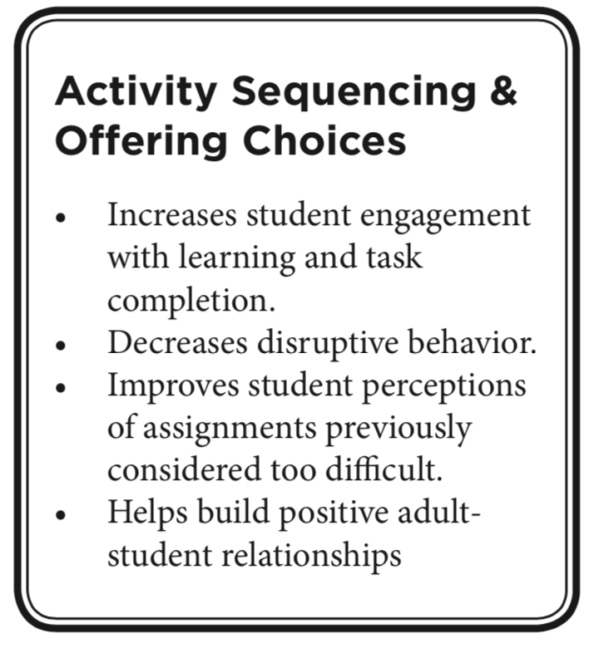
MO SW-PBS
Notes:
To do: Read the bullet points on the slide.
To say:
Self-determination theory includes three needs individuals must fulfill to behave with intrinsic motivation:
Competence: succeeding in what is to be done, belief in one’s ability to succeed, self-efficacy
Relatedness: connecting with others, belonging
Autonomy: being in control of ones’ life, self-determination
When teachers intentionally plan for students to have opportunities to experience success, gain confidence, make choices, and have a degree of autonomy in their own learning, students are more likely to engage in the learning.
Ask participants how they think activity sequencing and offering choice can help build a positive relationship between students and teachers.

Slide 6
Activity Sequencing
Intentionally planning instructional tasks, activities, or requests to promote learning and encourage expected behavior
MO SW-PBS
Notes:
To do: Read the slide.
To say:
First, we will examine activity sequencing. Effective educators know that it is important to consider how the daily activities are sequenced. Teachers often choose what subjects occur at certain times in the day to ensure student attentiveness. Research shows that even within subject matter, there are a variety of ways to sequence content to promote learning and appropriate behavior. Interspersing easier tasks among more difficult tasks and using simple instructions to precede more difficult instructions, or “behavior momentum,” are two strategies that have demonstrated increased student willingness to do the task or task engagement.

Slide 7
Activity Sequencing
Sequencing content to promote learning and encourage expected behavior.
Two strategies:
Task Interspersal–Intermingle easier tasks among longer or more difficult tasks.
Behavior Momentum–Using simple instructions to precede more difficult instructions.
MO SW-PBS
Notes:
To say:
These are two strategies to change the order of academic tasks: task interspersal and behavior momentum. We are going to talk about each.
To do: Read the slide.

Slide 8
Task Interspersal
Word Sort
-ad -am -at
Write 5 words for each
-ad -am -at
Read your list to a partner
-ad -am -at
Definition
A simple strategy of interspersing tasks that have already been mastered with new and/or more challenging material
MO SW-PBS
Notes:
To say:
Here is a definition of task interspersal. Read the slide.
The tasks here are arranged to provide an easy warm up, a more rigorous assignment, and then a less rigorous one. This allows the student to warm up with an “easier” task, expend a little more effort on something more rigorous, and then immediately have another successful less intense activity to follow. Avoiding frustration by ensuring students don’t feel overwhelmed by the work assigned increases the likelihood they will attempt and complete the more challenging tasks.
Ask a few participants to share the content their students have mastered. Then ask the participant how they know when a student has mastered the content. Notice we asked about student mastery and not what was covered in class….there is a difference. Participants should mention things like assignment grades, rubric scores, end of unit tests, etc.
Task interspersal helps all students but particularly those students who often experience frustration and poor task completion. It allows for review of previously learned content while heading off frustration. It is well worth the time and effort to incorporate this strategy into material development.

Slide 9
Task Interspersal
MO SW-PBS
Notes:
To say: When do you use activity sequencing and for whom?
When preparing materials for all students – proactively plan to identify possible barriers in the lesson, and plan ways to sequence tasks to reduce them. For example, consider Review > New > Review > New as a strategy.
Used as an individual intervention for a student experiencing frustration and poor task completion.
For some students, presenting difficult tasks back-to-back often sets the occasion for frustration, failure and problem behavior. Varying the sequence of tasks may not be necessary for average students, but can be very important for students who are at-risk for learning or behavior concerns (Darch & Kame’enui, 2004).

Slide 10
Emily
MO SW-PBS
Notes:
To say: Lets look at an example of task interspersal.
To do: Provide Activity Sequencing Scenarios Handout to participants.
To say:
Emily is an average math student, but when given more difficult problems she works for a while, then quits and refuses teacher help. She has already mastered multiplication with one and two-digit numbers. To help Emily, the teacher arranges her work to include a mix of three-digit, two-digit, and one-digit problems. The assignment includes more two- and one-digit problems than three-digit. When she finishes a series of problems, Emily is asked to raise her hand. The teacher praises Emily for effort and work completion. This series is repeated and the teacher increases the number of harder problems, checking to see that Emily is successful each time. Eventually, Emily is able to complete a full series of three-digit problems with accuracy. (Colvin, 2009)

Slide 11
Guideline for Using Task Interspersal
An item must be truly at mastery level before using for interspersing.
Students prefer assignments when up to 30% of items are new.
Intersperse in a ratio of 1:3; one mastered to every three new items.
Slowly fade the mastered items as fluency builds with new content.
Eventually eliminate the already mastered items.
Logan and Skinner (1998)
MO SW-PBS
Notes:
To say:
These guidelines will help you plan for using task interspersal in your classroom.

Slide 12
Session Outcomes
At the end of the session, you will be able to…
Discuss and plan for using Activity Sequencing in the classroom including:
Task Interspersal
Behavior Momentum
Discuss and plan for using Student Choice in the classroom.
MO SW-PBS
Notes:
To do:
Read the slide

Slide 13
Behavioral Momentum
Word Sort
-ad -am -at
Read your list to a partner
-ad -am -at
Write 5 words for each
-ad -am -at
Definition
Using the momentum of easier tasks or requests to build energy or motion to complete requests or activities of greater difficulty.
MO SW-PBS
Notes:
TO say:
Now we are ready to talk about the second strategy to assist with activity sequencing….behavioral momentum.
Another way to plan for sequencing activities is using the momentum of easier tasks or requests to build up to those that present greater difficulty. In es­sence, it is a behavioral strategy that entails making requests that are easy for the child before making requests that are more challenging or difficult (Scott, Anderson, & Alter, 2012). The same principles explained above im­pact the likelihood that the more diffi­cult task will be completed. For exam­ple a difficult transition to a new activ­ity can be facilitated by preceding that transition with simple instruc­tions just prior to the transition re­quest. Behavioral momentum can be used with individual students or with an entire class.
Using the same tasks as before, they are now arranged from least demanding to most demanding/challenging for the student in order to produce success and build confidence as the student progresses toward the task most likely to be a barrier.

Slide 14
Michael
MO SW-PBS
Notes:
To say: Let’s look at an example of using behavior momentum.
To do: Direct participants to refer to the Handout Activity Sequencing Scenarios.
To say:
Michael does not like to read, and in the past when asked to read he hangs his head and closes his eyes. Today, his teacher begins the small group reading by reading to him briefly. Then she asks him to follow along and read with her. When he does she praises him then asks him to read every other sentence on his own. She praises him again and now asks him to continue reading by himself.

Slide 15
Behavior Momentum
Identify behaviors that have a high probability of completion.
Then precede more difficult requests with three or more requests the student can readily do.
After successful completion, reinforce the student.
Then present the task that is known to have a lower probability of being completed.
Again, reinforce the student.
Gradually reduce the number of easier requests.
MO SW-PBS
Notes:
TO say: Here are things to consider when planning and using behavior momentum.

Slide 16
Offering Choice
Intentionally planning for providing options to students such as method of response, tools and supplies, working independently or with peers, order of tasks, location for working, etc.
Notes:
To do: Read the slide.
To say:
Another tool to use to increase student engagement and personal motivation is providing choice. While all lessons or activities do not need to incorporate choices, using choice as a way to address possible barriers in your lessons will have broad impact.

Slide 17
Student Choice
MO SW-PBS
Notes:
TO say: What does it mean to provide choice?
Providing students with a choice of activities, materials, grouping, etc . You will notice in this picture students are using different materials, working alone or with others, some are using technology. Standards-based teaching lends itself to offering choice. Think about the learning objective – if the goal is for the students to identify the states of matter, describe and give examples of each, could some students choose to write a short essay, while another might create in infographic, another record a podcast called, “What’s the matter?” and another create a video/narrated powerpoint? Creating a rubric and ensuring students know the criteria, but have choices in how to meet it can be very effective.
As with the other practices and strategies introduced in this session, choice can be used classwide or with individual students. Choice has frequently been used with individual at-risk students who are provided choice on the sequence of their work for the day. It is also commonly used with the student that has multiple unfinished tasks. In these situations, offering choice on which task to do first will sometime empower the student and increase the likelihood that work will be completed. Used class-wide, choice can have a powerful group effect. Still there will remain a small number of students who will not respond to these efforts and may require an individual approach.

Slide 18
Student Choice
Type of activity or mode of the task (e.g., written, oral, project, etc.).
Materials used to complete an assignment.
Order or sequence in which tasks are completed.
How the work will be done or with whom to work (e.g., work in a group, pairs, individually).
Where to work.
What to do when task is done.
MO SW-PBS
Notes:
To say:
Here are some possibilities for offering choice.
Because we want to increase the likelihood that students will engage in learning and complete tasks, we should become skillful at selectively using student choice of activities, materials used to complete a task, or choice of the order in which tasks are completed. Students can also be given choices for whom they work with, where they will work, and what they can do once their task is complete. Choice appears to help both with compliance and affect or positive feelings students have for school and their teacher (Kern, et al., 1998). The teacher offers the choices that are acceptable.

Slide 19
Mr. Franklin Offers Choice
Mr. Franklin knows that his students enjoy project-based activities that relate to their everyday lives. He also knows of students who love using technology rather than paper and pencil tasks. He considers his resources (e.g., available computers, physical space, staff and time) and develops his plan carefully.
When presenting the new unit on recycling, Mr. Franklin offers students a choice of two activities: 1) develop a recycling survey or 2) plan a recycling program. He has students vote on what activity they want to pursue that day. Students then divide into two groups according to their choice.
MO SW-PBS
Notes:
To do: Read the slide.
To say: Let’s look at the choices Mr. Franklin offered. The first is obviously a choice in the activity – either a survey or a plan for a program.

Slide 20
Mr. Franklin Offers Choice - Continued
Mr. Franklin allows group one to develop a recycling plan for either their classroom or neighborhood; group two could develop their own survey questions or browse the internet to search for other surveys to use as an example. He further allows students to select whether they prefer to work in their group, pairs, or individually. After these decisions are made, Mr. Franklin guides them to choose if they want to handwrite the survey or recycling plan or prepare it on the computer.
When the work is complete and shared, Mr. Franklin asks students to write on a piece of paper what parts of the lesson they enjoyed most and why. He plans to use the feedback for future lesson planning.
(Adapted from Kern & State, 2009)
MO SW-PBS
Notes:
To do: Read the slide.
To say:
The next choices he offers are in the activity. Then he allows students to decide with whom they work. Finally he gives students a choice of how their work will be completed.
Thinking about this scenario with Mr. Franklin, these were choice he offered to all students – thinking about possible preferences and barriers in the planning, and intentionally planning to address them. How might this look in your classroom or context?

Slide 21
Steps for Using Choice in the Classroom
Create a menu of choices you couldto provide to students.
Look through your choice menu before planning each lesson.
Decide what types of choice are appropriate and where they fit best in the lesson.
Provide choices as planned while teaching the lesson.
Solicit student feedback and input.
MO SW-PBS
Notes:
To say: Here are steps that can help teachers plan to use choice with students.
To do: Read the slide

Slide 22
Session Outcomes
At the end of the session, you will be able to…
Discuss and plan for using Activity Sequencing in the classroom including:
Task Interspersal
Behavior Momentum
Discuss and plan for using Student Choice in the classroom.
MO SW-PBS
Notes:
To do:
Read the slide

