Slide 1
Preface:
This learning package can be presented in 3 hours.
The afternoon could be used by the school team to work if they desire to do so.
You may want to have them stay and begin to develop a EWS tool using school data/evidence OR having them explore what is already available in their system.
Have copies of the following articles (one per table):
PRE-READ: Falling Off Track During the Transition to High School: What We Know and What Can Be Done.
Parent’s Guide https://jsri.msu.edu/upload/resources/FEHS.pdf
Send an email asking them to bring data on students in transitional grades, OCRs, course failures, absences, etc. Include the pre-read in the email to participants
Notes:
TO KNOW: This slide will be hidden. TO DO: TO SAY:

Slide 2
Presenter Materials
Handouts:
Pre-read
Pre-test
Practice Profile
Fidelity Checklist
Materials:
Table tents (one per participant)
Chart paper (one per table)
Markers
6 steps from slide 36—written on chart paper and hung throughout the room (one step per piece of chart paper)
Notes:
This slide should be hidden.

Slide 3
Pre-Read
Falling Off Track During the Transition to High School: What We Know and What Can Be Done.
Ruth Neild
Updated: Fall 2014
Notes:
TO KNOW: This slide should be hidden.
TO DO: This article (available as a PDF in the materials for this training) should be sent via email to participants prior to the training. One copy per table should also be available on each table.

Slide 4
Developing an Early Warning System
Consultant name
date
Notes:
TO DO: Insert consultant name and date prior to training.
TO SAY: “Developing an Early Warning System is a process. The first part of today will be spent on why an EWS is important and that it should be implemented K-12. Looking at signs of students who are thinking of exiting school; using interventions to engage students and prevent them from exiting school. Latest findings indicate students begin contemplating exiting school as early as Grade 3. Therefore, the earlier we identify students and begin appropriate interventions, the more likely they will stay on track to graduate.”

Slide 5
Early Warning Systems (EWS)
Notes:
TO SAY : “This is a process for developing an EWS within your school district. This is not just for high school, but developing an early warning system in elementary or whenever there is a transition to a new building.”

Slide 6
Introductions and Welcome!
Who is here?
Why are you here?
What are you hoping to gain from today’s presentation?
Notes:
TO DO: Have participants introduce themselves sharing their name, district/school, & role. Can be a table share or whole group if small gathering. Participants can introduce themselves using name tents or other strategy. (If participants teach within same district/school, assume they know each other in which case, you might want to do a short energizer such as “What am I doing?”.)
TO SAY: “Please write your name on one side of the table tent. On the other, write your district or school and the role you have. Then take a few moments to introduce yourselves to others at your table. “
(Presenter tip: After introductions, ask participants to respond individually by recording their responses to the remaining two questions. These can be collected by the presenter to ensure participant needs are addressed.)

Slide 7
Essential Questions:
Where am I now?
Where am I going?
How am I going to get there?
Notes:
TO SAY: “These three questions are key questions to ask as you consider your focus and the students attending your school. As we go through the day, you may write down some other questions that may drive your school or district to an EWS.”

Slide 8
Norms:
Be an ACTIVE learner.
Be PRESENT.
Limit sidebar conversations, please.
Monitor your technology.
Ask questions.
Be RESPONSIBLE for your own learning.
Notes:
TO KNOW: Have these also posted on chart paper; be prepared to clarify what each is and make additions if necessary based on participant suggestions. (Need chart paper, markers.)
TO SAY: “Are these norms acceptable for our learning today? Do we need to add any additional norms?”

Slide 9
Learning Objectives:
Today, you will
develop an EWS for identifying and monitoring students who are at-risk of exiting school,
help engage students in their learning thereby increasing student engagement,
elicit information regarding family involvement, and
develop a plan for persistence to graduation.
Notes:
TO KNOW: This is a process with the goal for all students to graduate.
TO SAY: “We will discuss these 4 bullets today. However, it will be up to your school or district to implement or develop more student engagement, family involvement, and persistence to graduation.”

Slide 10
Table Talk
Was there anything in the article that was surprising to you?
What questions do you have?
Notes:
TO KNOW: When participants walk in, there will be one copy of this article, per table, as you should have sent it to them before the training.
TO DO: Participants will read the article and underline 5 words or phrases that either stand out or were new information to them. Then, they will share out with each other and to the group; allow 5 minutes to read silently.
TO SAY: “After reading the article, each table will select a ‘reporter’ for their group who will share something that was new or stood out to their table. Allow 5 minutes for table discussion & 5 minutes for whole group share-out. Facilitator will chart comments on paper for whole group.”

Slide 11
Pre-Test
Notes:
TO KNOW: Copies are needed of the pre-test. One per participant.
TO DO: Hand out pre-test.
TO SAY: “We will now take a brief Pre-test to see where you are in understanding Early Warning Systems.”

Slide 12
Teacher Standards:
#2 Student Learning Growth and Development
Indicator 6 Language, culture, family and knowledge of community values
#6 Effective Communication
Indicator 4 Technology and media communication tools
#7 Student Assessment and Data Analysis
Indicator 5 Communication of student progress monitoring records
Indicator 6 Collaborative data analysis
Notes:
TO SAY: “Take a look at this slide. These are the Teacher Standards that EWS impacts.”

Slide 13
Purpose:
The Missouri Systemic Transition Model is designed to use the Early Warning Systems (EWS) as the umbrella for determining transition services for ALL students. It looks at several areas of student’s school progress to determine what areas might be a barrier to graduation.
Identified areas list specific evidence-based interventions available to teachers, buildings or districts to affect students moving through the transition process. The use of these interventions by a collaborative team of educators can make positive impacts on students.
Notes:
TO SAY: “Read the Slide. Turn and talk with your shoulder partner about what this slide ‘says’ to you. You may want to pick out a phrase or word that stands out or causes you to wonder.”

Slide 14
WHAT WE KNOW IS...
The act of leaving school is a process, not an event.
Notes:
TO SAY: “This slide is to gather insight into the thoughts of why students leave school and it is a process in the student’s thought process. Read the slide to yourself and begin thinking of why students leave school. We will continue this on the next slide.”

Slide 15
Why Do Students Exit?
What are some of the reasons for students exit early?
Individually, take 2 minutes to make a list of reasons students say WHY they exit before graduating using the sticky notes provided.
At your table, share your reasons students exit before graduating..
Notes:
TO SAY: “Students give various reasons for exiting school. Let’s see what you gave as reasons: student or school related. “(Maybe determine school/personal related after looking at next slide.)
Take 2 minutes to list the reasons individually. Then as a table group, list your reasons on the sticky notes and place the reasons on the quadrant that aligns with your reason.

Slide 16
School
Student
Life Course Changes
Transition: New Level of Schooling
Reasons students leave
Inadequate Preparation
HS Organization & Climate
Notes:
TO SAY: “Now that you have made a list of reasons and have placed them in the quadrant, let’s see how you did.”

Slide 17
Student
School
Life Course Changes
Greater autonomy (less parental supervision)
Increased peer influence
Attraction to risky behaviors
May lead to decreasing attendance, vulnerability, academic difficulty
Transition: New Level of Schooling
New school/new rules
New social relationships
New practices (credits)
May lead to weaker attendance, behavior problems, poor course grades
4 Reasons Students Dropout
From Ruth Neild
Inadequate Preparation
Unprepared academically (reading and math)
Inadequately challenged (learned to “get by”)
Misconceptions about diligence for credits
May lead to truancy, overwhelmed academically, withdrawal
HS Organization & Climate
Bureaucratically organized
Teachers’ allegiance to subject-matter departments
Classmates & teachers change each period
No one shepherds student
May lead to sense of anonymity, alienation, lack of community (attendance, behavior, course challenges)
Notes:
TO SAY: “How does your list compare to this list? This sets the foundational work for having an EWS system in place.”

Slide 18
How Can We Prevent Students
From Exiting School Early?
Notes:
Transition Slide

Slide 19
Schools that adopt and use Early Warning Systems (EWS)
Pennsylvania SSIP Coherent Strategies: Early Warning Systems
Notes:
TO SAY : “This is an example from Pennsylvania SSIP Coherent Strategies: Early Warning Systems. The graph clearly focuses on monitoring and analyzing the High Yield Indicators and analyzing the data collected to begin the implementation process in order to improve outcomes for students. This slide ties to all teachers in all content! It is the foundation of DBDM and MTSS/RTI.”

Slide 20
Handout for MO/Nation
Alliance for Excellent Education
https://all4ed.org/wp-content/uploads/2013/09/Missouri_hs.pdf.
Notes:
TO KNOW: OPTIONAL ACTIVITY AND SLIDE. Please make sure that you have participants go to the electronic version of this document, as the data changes and it is important to show the most up to date information.
TO DO: pull up website on slide.
TO SAY: “Let’s look at the rationale of the Alliance for Excellent Education.”

Slide 21
Rationale
Notes:
TO KNOW: OPTIONAL ACTIVITY AND SLIDE.
TO SAY: “This is what the HANDOUT looks like. Was there anything that you were surprised at or wonder or had ahas?”

Slide 22
Three Key Components
Notes:
TO KNOW: In this section, we will be looking at the three key components: Attendance, Behavior and Course Proficiency.
TO SAY: “In this section, we will be looking at the three key components: Attendance, Behavior and Course Proficiency, and its impact on students who are at risk of exiting school.”

Slide 23
Data indicates that three key components are guiding forces when identifying students who are at-risk of exiting school.
Notes:
TO DO: Read the slide aloud.

Slide 24
High Yield Indicators Also Known as the ABC’s
Attendance
Behavior
Course proficiency
Fr. azaelle and Nagel, REL Jan. 2015, p. 7
A practitioner’s guide to implementing early warning systems
Notes:
TO KNOW: Data indicates that three key components are guiding forces when identifying students who are at-risk of exiting school.
TO SAY: “ Over the course of the next few slides, we are going to focus on Aspects of Attendance, Behavior and Course Proficiency. Eventually, your team will look to see if any students in your district fall into these three key components. “

Slide 25
A Attendance
What does the research say?
If students miss two days in first full month of school,
they are 65% more likely to have problems with
chronic absenteeism.
What data sources are helpful?
Daily attendance
Number of Tardies
Notes:
TO DO: Read the slide aloud
TO SAY: ” Let’s keep this in mind when we look at your own school’s data. Can you think of students who fall into this component? “

Slide 26
Attendance Flags
<80%
85%
90%+
Notes:
TO SAY: “If a student attends less than 80% of the time, we have a problem and need to investigate. Also, when a student is absent more than 85% of the time, there is a reason for not attending on a regular basis. 90% or more attendance puts a student in good stance of getting the Core I instruction.”

Slide 27
B Behavior
What does the research say?
A key metric to review, but difficult to establish specific flags
because of variation in data collection.
What data sources are helpful?
Office disciplinary referrals that impact 80/85/90% attendance.
Suspension and expulsion events that impact course fails.
Notes:
TO SAY: “This is the second key component that EWS focuses on. We know that students who attend school less than 90% due to suspension or expulsion has an impact on course credit. Students who are expelled from school are more likely to graduate late or not at all. A student who is suspended three or more times by the sophomore year is five times more likely to not graduate than other students (Dignity in Schools, 2010). Suspended students are more likely not to do well due to class time missed. Those students who have been suspended are an average of five grade levels in reading skills after two years (DIgnity in Schools, 2010). Racial and Socioeconomic differences exist in the use of suspension and expulsion. Zero tolerance in these policy areas do not improve student behavior (Skilba & Rausch, 2006). Your team will need to look at the behavior of the child and even look at the rules of the district. Sometimes the rules play a part of the behavior and thus cause students to exit school. A good resource is Kristin Souer’s Fostering Resilient Learners.”

Slide 28
Office Disciplinary Referral Flags
6+
2-5
0-1
Notes:
TO SAY: “Any time a student has more than 6 Office Disciplinary Referrals, he/ she will be at high risk for exiting school. 2-5 OCRs by October is a tipping point for students and is one to watch. However, 1 or less (OCR) is a student with a blimp on the screen. Another piece of the puzzle is to look at what hour they occur, subject, teacher, etc.”

Slide 29
C Course Proficiency
What does the research say?
GPA and course proficiency are key data points
What data sources are helpful?
GPA (2.0 GPA on a 4.0 scale)
Course proficiency (1+ in the first marking period)
Elective course fails (1+ in the first marking period)
Age/credit discrepancy
Notes:
TO DO: ALLOW TABLES TO HAVE DISCUSSION TIME TO DISCUSS COURSE PROFICIENCY- LOOK AT THE MS AND ELEMENTARY, WHAT DOES IT LOOK LIKE AT YOUR SCHOOL?”
TO SAY: “ This is the last of the key components. Course grades and failure rates are highly predictive of which students will or will not graduate from high school. Students who fail one or more courses in the fall semester of their first year of high school are significantly more likely to eventually exit.
Here are some other facts: *85% of students with 0 semester failures in their freshmen year graduated in 4 years
70% of students with one semester F during 9th grade graduate in 4 years
Only 55% of students with two semester Fs in 9th grade graduated in 4 years
Students with 3 or more semester Fs are not likely to graduate from high school
Later this afternoon, we will look at your district data to see if there is a problem or will a student(s) have a pattern that is developing . You may need to go back to the MS or Elementary level to see a pattern

Slide 30
GPA
(on a 4 point scale)
Below a 2.0
2.0–2.9
Above a 3.0
Notes:
TO SAY: “Students with below a 2.0 on a 4 pt.scale are at risk of exiting school. Students with a 2.0 -2.9 are at a tipping point with the possibility of going over and those with a 3.0 or above are on track to graduate in 4 years. In some schools, summer school is there to make up ½ a year not the full year of credit. Look at your system of credits and what do you offer in your district?”

Slide 31
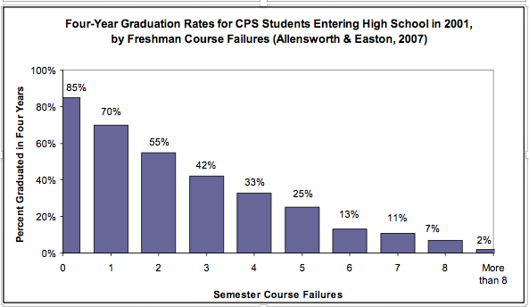
“High-Yield” Academic Indicators: Course Failures
Notes:
TO SAY: “Even though this data is older, the pattern remains the same today. Math and ELA are courses that are predictors of students exiting school.”

Slide 32
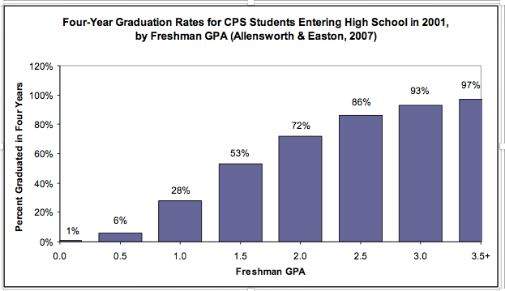
“High-Yield” Academic Indicators: GPA
Notes:
TO SAY: “This slide illustrates that students who have above a 2.0 GPS have a much higher percentage of graduating.”

Slide 33
“High Yield” 9th Grade: Indicators
Indicators | Benchmark (red flag)
Attendance | Missing 20% or more of instructional time
Behavior | 6 or more office disciplinary referrals
Course failures | 1 or more failed core courses 2 or more failed elective courses
GPA | 2.0 or lower (on a 4-point scale)
“Off-track” | Fail 1 or more semester core courses, or accumulate fewer credits than the number required for promotion to the 10th grade
Notes:
TO SAY: “To recap, Look at the 9th grade Indicators. Are these some of the areas you also see in your data?
Attendance: If a student is missing 20% of instructional time, this might be an indicator.
Behavior: Look at the OCRs of a student you have identified, how many OCRs? Is there a pattern?
Course Proficiency: Look at the Freshman Course Failures, particularly in core academic courses. If you are looking at your freshmen for the first time, you may want to begin looking at them as 8th graders, but also at the end of 3-4 weeks of school and every 3-4 weeks thereafter.
At the end of each marking period, identify the number of Fs earned by each student
Include both Fs in core academic courses and elective courses.
Freshman Grade Point Average (GPA)
At the end of each marking period and at the end of the cumulative year, identify students who earn a 2.0 or lessCredits earned in each term
Include the total number of credits accumulated per term for each student.
Identify students who fail to earn enough credits to be promoted to 10th grade (typically 5)
¼ of the total number of credits required for graduation minus 1
Off track: failure of 1 or more semester core courses to be in 10th grade.
One other indicator although not documented as much is being involved in school activities.”

Slide 34
ABC’s Interact with Each Other
More current sources of data can be helpful and improve reliability.
Look at attendance, behaviors, and course proficiency together.
Notes:
TO SAY: “Remember the ABCs-attendance, behavior and course proficiency -work with each other. The EWS team in a district or building needs to looks at key pieces of each to decide who is in danger of exiting school.”

Slide 35
Six Steps to Developing an EWS
Notes:
TO SAY: “We are now going to go look at six steps to developing an EWS.”

Slide 36
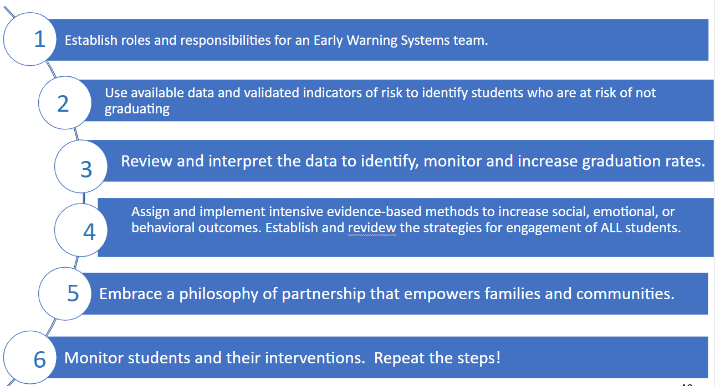
Steps for an Effective EWS
Notes:
TO DO: The presenter should have a chart with each step listed posted throughout the room. Participants may want to go to the charts and list what their team or table talked about or thought about doing in their district. Then , do a Gallery Walk.
TO SAY: “We will now discuss the Six Steps of an Effective EWS . We will discuss each step independently and then you will take a post-it-note with what your district may use or might use to identify students who might be at risk. There are six steps posted and you are to go to each poster and list what your team is going to do in your district.”

Slide 37
Step One:
Establish roles and responsibilities for an EWS team.
Notes:
TO SAY: “This is modified from the National High School Center at the American Institute for Research www.betterhighschools.org
Team members should include an administrator, feeder school personnel (transition of students), counselor, content area teachers, and special education teacher, ELL teacher, school-level technology specialist, district technology specialist, and a district office representative, and/or a parent stakeholder.. Once teams are established they should meet to discuss their roles and responsibility. Teams should establish a regular meeting time-at a minimum of 3 times a year. The team should meet before school begins and then again within the first 20-30 days of school. Teams should reconvene at the end of every grading period to discuss the data. Provide PD training to EWS members about the EWS system. Designate someone to imput or enter student information and incoming risk indicators.”

Slide 38
Step Two:
Use of available student data and validated indicators of risk to identify students who are at risk of not graduating.
Notes:
TO SAY: “This step is important for the team to review the student data once the criteria for monitoring is set. This also could include assigning who in the district/building is responsible for the data to be imported and disseminated to the team. The technology specialist at the district or building level could set up customizing the settings to reflect the criteria (grades failed, absences, tardies, OCRs,state assessments, suspensions, etc.), identifying the students who may be at risk of needing support, and begin the process of importing and exporting student level data.”

Slide 39
Step Three:
Review and interpret the data to identify, monitor, and increase graduation rates.
Notes:
TO SAY: “Once students have been identified, then set up the process for monitoring and keeping students on track to graduate. The EWS team will need to look at attendance, academics, behavior, tardies, procedures within the district that may be creating the exiting of students.”

Slide 40
Step Four:
Assign and implement intensive evidence-based methods to increase social, emotional or behavioral outcomes and to establish strategies for engagement of ALL students. Also, review the intervention used to see its effectiveness.
Notes:
TO SAY: “In this step, it is important to monitor and adjust students’ assignments to supports and interventions within the school, and as the students move between tiers. Tier I is Universal, Tier II is Targeted, and Tier III is individualized.
Tier I includes all students, with interventions at a low cost per individual student. Examples include student advisory programs, efforts to engage students in extracurricular activities, school to work programs, or systemic positive discipline programs.
Tier II includes students who are identified (flagged) as being at risk for dropping out, with interventions at a moderate cost per individual
student. Examples include mentoring and tutoring programs that work to build specific skills (MPSS).
Tier III includes students exhibiting clear signs of dropping out, with interventions at a higher cost per individual student. Example programs include specific individualized behavior plans, intensive services with mentoring and academic support, and alternative programs.
www.betterhighschools.orh Page 22 HIGH SCHOOL EARLY WARNING INTERVENTION MONITORING SYSTEM IMPLEMENTATION GUIDE
At this stage, the team or individual teacher may need to begin using intervention strategies available and keep track of how they work or do not work.
Once a strategy is chosen for use, it should remain in place to see if it is working-3 weeks of use.”

Slide 41
Step Five:
Embrace a philosophy of partnership that empowers families and communities.
Notes:
TO SAY: “Schools can not do this work alone. It is vital to have gathered parent support as well as the community. Parents need to be partners with the school and work together in this endeavor. It might be a idea to also ask your local chamber of commerce to speak to the economic contributions of someone who graduates vs. the economic impact a non diploma students has on the economy of the area.”

Slide 42
Step Six:
Monitor students and interventions. When the team meets to discuss each student’s progress, the team discussion should center on the interventions used and decide if they are working or do you need to change and note the change. Repeat the process!
Notes:
TO SAY: “Depending on your district’s grading cycle, might determine when you might have to run reports to check on students’ grades. For example, if you have a 6 week grading cycle, you would run grades in 3 week cycles. Also, you might establish a system for daily checks or begin to establish an RTI time for students to work on their missing assignments. Keep in mind students will move in and move out as the material will vary in intensity.”

Slide 43
Work Time
Given the various models to monitor students’ ABCs (PBIS, SIS, NTACT GRADEBOOK, etc.), decide how YOUR model might look. Remember, this is a living document!
Your Data-Based Decision Making (DBDM) Team may decide to change elements to fit the needs of your students at risk of exiting.
Notes:
TO SAY: “Given the various models to monitor students’ ABCs (PBIS, SIS, NTACT GRADEBOOK, etc.), decide how YOUR model might look. Remember, this is a living document! Your DBDM Team may decide to change elements to fit the needs of your students at risk of exiting. We also have some other forms for you and your team to look at that you may find helpful.”

Slide 44
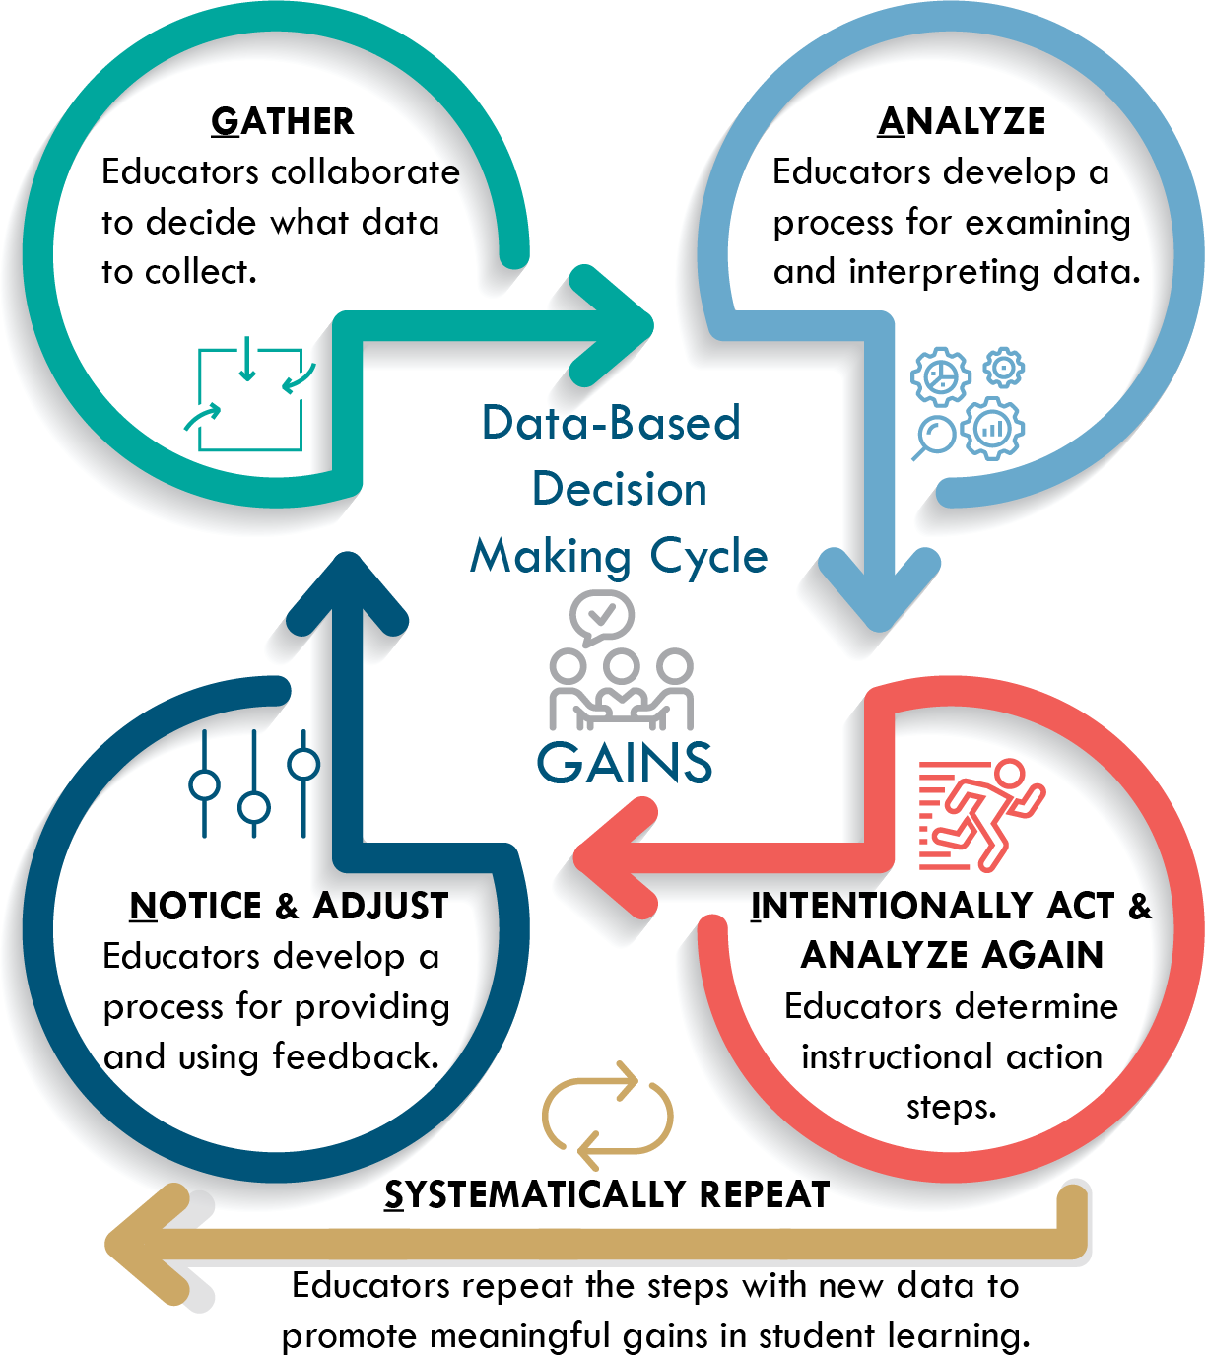
Notes:
TO SAY: “Here is an example of how a data-based decision making cycle works.”

Slide 45
Your Next Steps
How can we support your district in developing interventions for persistence to graduation?
Check and Connect
Developing Assessment Capable Learners (DACL)
Positive Behavior Inventions and Supports (PBIS)
Using Your Early Warning System to Target Interventions
Using the Early Warning System to Monitor Progress
Developing an Early Warning System at the District Level
Notes:
TO SAY: “If you are a MMD/DCI school, you could use DACL, DBDM and Student Engagement
If you are a PBIS school, you already have access to Check and Connect (Do all schools have access to Check & Connect? Is it free to PBIS in Missouri or do they have to pay for materials only?) How can we support your district in developing Interventions for persistence to graduation?
PBIS
Check and Connect
DACL
Using Your Early Warning System to Target Interventions
Using the Early Warning Systems to Monitor Progress
Developing an Early Warning System at the District Level”

Slide 46
The Value of Student Engagement
Notes:
TO SAY: “We will now look at the impact of student engagement. The Value of Student Engagement.”

Slide 47
What is The Difference Between
Engagement vs. Compliance?
What does a student who is engaged look like/ sound like….?
What does a student who is compliant look like/sound like…?
Notes:
TO DO: Ask the participants to answer these two questions.
TO SAY: “ I am going to read the first question. We are going to get up and do an activity-Stand UP, Hand Up and Pair Up. Stand up and push in your chairs. Hand Up-You will raise your hand and find a partner and pair up. Repeat this twice. Now let’s go to the second question. Repeat Stand Up Hand Up and Pair Up.”

Slide 48
Motivation and Engagement
“To assess student motivation researchers also have to examine engagement in and as part of learning, understanding or mastery of the knowledge…high levels of engagement show high levels of motivation.”
Saeed, Zyngier 2012
Notes:
TO KNOW: Journal of Education and Learning; Vol. 1, No. 2; 2012
ISSN 1927-5250 E-ISSN 1927-5269
Published by Canadian Center of Science and Education 252
How Motivation Influences Student Engagement: A Qualitative Case Study
Sitwat Saeed & David Zyngier
Faculty of Education Monash University, Melbourne Australia
Correspondence: David Zyngier, Faculty of Education, Monash University, PO Box 527 Frankston 3199
TO DO:Read the slide aloud.

Slide 49
Components of Engagement
Attentive
Committed
Engaged
Persistent
Connected
Notes:
TO SAY: “There are four components that are always present when students are engaged. Those four components are:
The engaged student is attentive. In the sense that he/she pays attention to and focuses on the tasks associated with the work being done.
The engaged student is committed. He/she voluntarily (without the promise of extrinsic awards or the threat of negative consequences) deploys scarce resources under his/her control (time, attention, and effort) to support the activity called for by the task.
The engaged student is persistent. He/she sticks with the task even when it presents difficulties.
The engages student is connected. He/she finds meaning and value in the tasks that make up the work.
The main difference between students who are engaged and those who are not is the way they respond to the situation or tasks at hand.
Reference: Schlechty, P. C. (2011). Engaging Students: The Next Level of Working on the Work, San Francisco: Jossey-Bass.

Slide 50
Student Response to School Work
Engagement: High Attention and Commitment to the tasks at hand
Strategic Compliance: High Attention and Low Commitment the tasks at hand
Ritual Compliance: Low Attention and Low Commitment to the tasks at hand
Retreatism: No Attention and No Commitment
Rebellion: Diverted Attention
Notes:
To Know/To Say: Teachers should be aware of certain response indicators that will help them determine the level of student engagement.
1. Engagement: The student volunteers resources under his/her control (time, effort, and attention). The student is attentive to the task because he/she finds personal meaning and value in the task. The student sees the task as responding to motives and values he/she brings to the work. The student persists with the task even when he/she experiences difficulty and does not compromise personal standards for the completion of the task.
2. Strategic Compliance: The student allocates only as much time, energy, and resources as are required to get the reward offered or desired. The student is attentive to the task because he/she perceives the receipt of some desired extrinsic reward which is conditionally available to those who pay attention to the task and do what is required of them. The student persists with the task only up to the point of ensuring that the desired reward is offered, and the student is willing to accept the reward and abandon the task even though he/she may not be personally satisfied that the work done is of the quality that he/she could produce.
3. Ritual Compliance: The student does only those things that must be done and does little or nothing outside the context of direct supervision by the teacher. The student pays minimal attention to the work, is easily distracted, and is constantly seeking alternative activities to pursue. For example, it appears that texting has now become a favorite pastime for those who are ritually compliant. The student is easily discouraged from completing the task and regularly tries to avoid the task or get the requirements of the work waived or compromised.
4. Retreatism: The student does nothing and, when forced through direct supervision to do the task, either engages in ritual behavior or rebellion. The student does not attend to the work, but does not engage in the activities that distract others. The student employs strategies to conceal his/her lack of involvement, sleeping with eyes wide open and smiling from time to time.
5. Rebellion: The student overtly refuses to comply with the requirements of the task. This refusal may involve cheating, refusing to do the work, or even doing other work in place of what is expected. Alienation rather than commitment is evident. Unlike the retreaters, students who rebel are likely to be active in their rejection of the task, up to and including efforts to sabotage the work, cheat, and build negative coalitions of other students around the work and the rejection of the values the work suggests.
Reference: Francis, S. (2014, February 28). Five Levels Of Student Engagement [blog post]. Retrieved from http://www.happyschool.com.au/five-levels-of-student-engagement/

Slide 51
Don’ts & Dos of Engagement
Don’t | Do
Talk more than your students. | Design activities that encourage your students to speak with each other.
Create lessons that allow your students to be passive. | Skip the worksheets and ask students to solve puzzles, debate points, engage in other open-ended thinking activities.
Let the push for accountability cause you to neglect those “teachable moments”. | Turn any occasion into a learning event in your classroom.
Allow yourself to drift when it comes to finding the correct pace for delivery of instruction. | Plan alternate lessons in case the pace you initially set for a lesson needs adjustment.
Allow your students to sit around with nothing to do while they wait for class to begin or end. | Plan more work than you think your students will be able to accomplish.
Confuse your students by giving hurried or unclear directions. | Deliver a combination of written and verbal directions and check for student understanding. (Thompson, 2009)
Notes:
TO DO: Briefly discuss the content of this slide and ask participants to provide examples of some of the statements. Also allow participants to discuss why a statement is listed as a “do” or a “don’t”.
TO SAY: “Briefly discuss the content of this slide and ask participants to provide examples of some of the statements. Also allow participants to discuss why a statement is listed as a “do” or a “don’t”.”
Reference: Thompson, J. G. (2009). First Year Teacher's Survival Guide: Ready-To-Use Strategies, Tools & Activities for Meeting the Challenges of Each School Day (Vol. 30). John Wiley & Sons.

Slide 52
Student Engagement: Resources Roundup
Keeping students captivated and ready to learn is no small task. This list of articles, videos, and other resources offer strategies and helpful advice.
https://www.edutopia.org/student-engagement-resources
(Cronin, 2011)
Notes:
TO KNOW: Be familiar with the website.
TO DO/TO SAY: This website on Edutopia provides a list of resources that teachers can explore. There are many strategies that can be used and this website only offers some of the many options. Participants can take time to explore the list either during training to share out ideas after 15 minutes; or this list can be used during coaching.
Website: https://www.edutopia.org/student-engagement-resources
Reference: Cronin, A. (2011). Student Engagement: Resource Roundup. Retrieved from: https://www.edutopia.org/student-engagement-resources, 2011
Schlechty Center. (n.d.). Introduction to the Schlechty Center. Retrieved from https://schlechtycenter.app.box.com/s/v0q4o9j9il36w17py9mjkxpgggq0gqyw.
Accessed 16 August 2017.

Slide 53
Student Engagement
Lack of engagement is the primary theoretical model for understanding dropout and is, quite frankly, the bottom line in interventions to promote school completion.
Student engagement has emerged as the cornerstone of high school reform initiatives.
Both academic and social aspects of school life are integral for student success; engagement at school and with learning are essential intervention considerations.
Christenson, et.al. 2008
Notes:
TO DO: Read the slide.
TO SAY: “Lack of engagement is the primary theoretical model for understanding dropout and is, quite frankly, the bottom line in interventions to promote school completion.
Student engagement has emerged as the cornerstone of high school reform initiatives.
Both academic and social aspects of school life are integral for student success; engagement at school and with learning are essential intervention considerations.”

Slide 54
Disengagement
Most students dropout mentally before ever physically leaving the school.
A lack of engagement with school is a precursor to exiting school.
Indicators of disengagement:
Attendance problems
Behavior marks
Classroom/School engagement scales
Notes:
TO SAY: “Students most often cite school-related reasons for exiting school.”

Slide 55
How to Identify Socially Engaged Students
List all students’ names at grade levels
Have adults put their initial next to students with whom they have a personal relationship.
Identify the students with no initials by their names (may be socially disengaged).
Notes:
TO SAY: ”We have looked at the ABCs of exiting school, but we haven’t looked at the disengagement of students as a possibility. With your team, make a list of students who are disengaged with school.”

Slide 56
Early Intervention is the Answer
Disengagement is a gradual process that includes impaired or reduced participation, less successful outcomes, and reduced identification and belonging.
Identifying students at the first sign of withdrawal significantly improves the likelihood of re-engagement and successful school completion.
Move beyond a focus of preventing negative outcomes, such as dropout, to promoting student competence and support.
Notes:
TO SAY: “Disengagement is a gradual process that includes impaired or reduced participation, less successful outcomes, and reduced identification and belonging.
Identifying students at the first sign of withdrawal significantly improves the likelihood of re-engagement and successful school completion.
Shift from a focus of preventing negative outcomes, such as dropout, to promoting student competence and support.”

Slide 57
Resources for Interventions
Check and Connect www.checkandconnect.org
Intervention Central www.interventioncentral.org
What Works Clearinghouse www.whatworksclearinghouse.org
NTACT www.transitionta.org
PBIS www.pbis.org/pbis-network/missouri
Illustrative Math www.illustrativemathematics.org
Read Theory www.readtheory.org
Notes:
TO DO: “Here are just a few websites that might be useful. You will have the afternoon to explore these sites and also find others that will best fit your school’s needs.”

Slide 58
Helping Parents Support Their Child
Notes:
TO KNOW:Be familiar with the Parents guide on the next slide.
TO SAY: “Schools can not do this alone. We need your parents to feel and be part of the solution. This guide gives tips on how to stay involved with your child.”

Slide 59
Parent Guide
Develop a partnership working directly with families and communities to become more supportive.
https://jsri.msu.edu/upload/resources/FEHS.pdf
Notes:
TO KNOW: You may want the participants to download this to their computer. It is over 100 pages.
TO SAY: “Spend time with this document and have participants go to this document. Have them highlight/discuss pieces that they think would be beneficial for their districts. Maybe place this document on the school’s website.”

Slide 60
Review Six Steps to Developing an EWS
Notes:
TO SAY: “We are now going to go look at six steps to developing an EWS.”

Slide 61
Six Steps for an Effective EWS
Notes:
TO DO: The presenter should have a chart with each step listed posted throughout the room. Participants may want to go to the charts and list what their team or table talked about or thought about doing in their district. Then , do a Gallery Walk.
TO SAY: “We will now take a few minutes to Review the Six Steps of an Effective EWS . There are six steps posted and you are to go to each poster and list what your team is going to do in your district.”

Slide 62
Post-Test
Notes:
TO DO: Have participants get out their Pre-Test handout
TO SAY: Please take a look at the pre-test that you completed earlier. If there are answers that you would like to change, please do so now and then we will review.

Slide 63
Pre-Test
T or F Schools need to begin dropout interventions at the middle school level.
T or F One of the reasons schools have a hard time preventing drop out is for most students exiting out is an impulsive decision made with little thought or consideration.
T or F More students suffer the sophomore slump and fail 10th grade more often than any other grade.
T or F Classroom teachers do not have the expertise or education necessary to identify students who they believe may be disengaged from school. It is best left to counselors.
Notes:
TO SAY: “Let’s look at your Pre-Test and compare your answers.”

Slide 64
Pre -Test
5. T or F The ABC’s of Early Warning System refers to: Attendance, Behavior and Course Proficiency.
6. Which is not true of Early Warning Systems?
Uses predictive data to identify students at-risk of exiting out.
Allow districts and schools to uncover patterns and causes to drop out rates.
Requires additional at-risk checklists to be completed on targeted groups.
Focuses on targeted interventions that support students before they exit out.

Slide 65
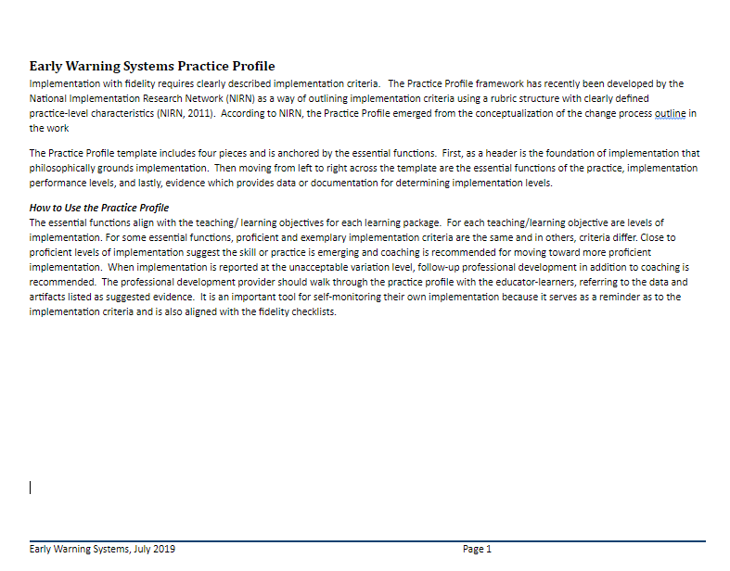
Practice Profile
Notes:
TO DO: Make copies of the Practice Profile for each participant. TO SAY: “ Please take a look at the Practice Profile that is in your packet (or at your table). This is provided to see where you are at the moment and also to guide you develop a strong EWS and use the six steps to EWS.”

Slide 66
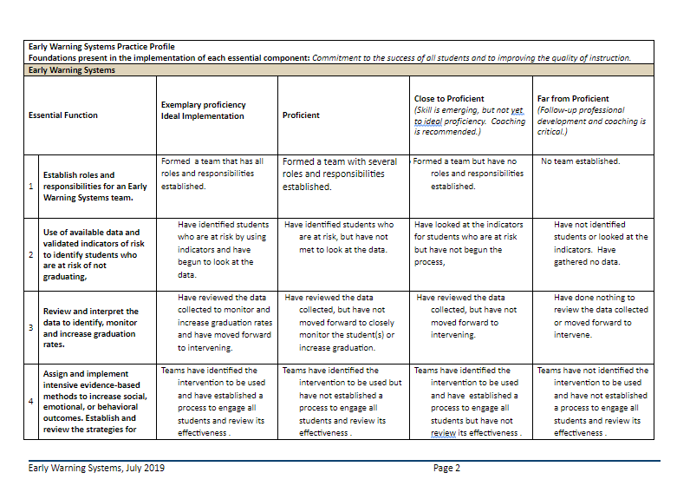

Slide 67
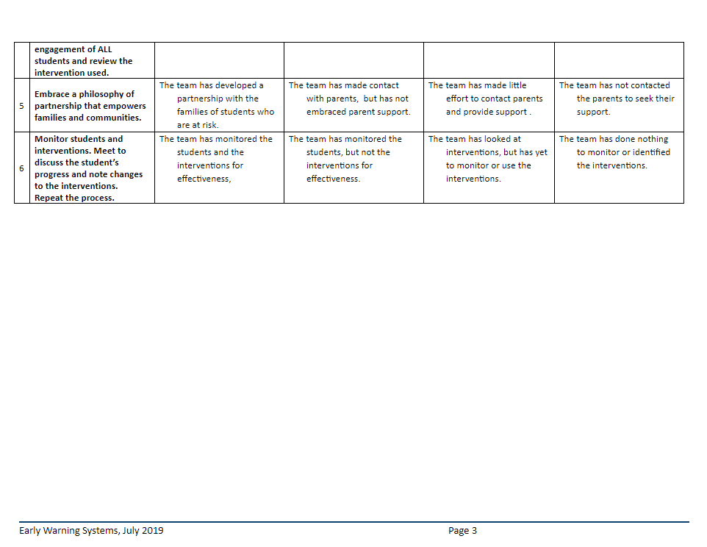

Slide 68
Checklist for Fidelity
Did the team identify student(s) for EWS? Yes No
2. Did the team meet to discuss a student identified within the first three weeks of school? Yes No
3. Did the team use the monitoring form to identify the student (s)?
Yes No
Notes:
TO SAY: On this screen and the next is the fidelity checklist. These questions can be used by the team in order to ensure that implementation is occurring with fidelity.

Slide 69
Checklist for Fidelity
4. Did the team decide on evidence based interventions to provide strategies for engagement of ALL students? Yes No
5. Was contact made to offer families support for students at risk of not graduating? Yes No
6. Did team reconvene to check on student’s progress and monitor grade?
Yes No

Slide 70
Resources

Slide 71
Resources
Student Engagement Digital Strategies
www.goSynth.com
www.autodraw.com
www.loc.gov
www.smmry.com
https://www.loebigink.com/how-does-social-media-effect-youth/
Video Notes http://www.videonot.es
https://www.interventioncentral.org
https://www.iris.Peabody.Vanderbilt.edu
Notes:
TO SAY: “Here are some websites that have some useful engagement strategies. There are so many more out there. You will need to find the ones that best fit the needs of your students.”

Slide 72
Resources
Dropout
www.betterhighschools.org
https://all4ed.org/wp-content/uploads/2013/09/Missouri_hs.pdf.
American Institute for Research
https://www.air.org/resource/early-warning-systems-education
Issue Brief: Early Warning Systems
https://www2.ed.gov/rschstat/eval/high-school/early-warning-systems-brief.pdf
Parent Guide
https://jsri.msu.edu/upload/resources/FEHS.pdf
Notes:
TO SAY: “Here are some other websites for your journey in developing an Early Warning System.”

Slide 73
Resources
Check and Connect
www.checkandconnect.org
Notes:
TO SAY: Here is an additional resource that is offered through the RPDC.

Slide 74
Closing & Follow-up
Notes:
TO SAY: We hope that today’s technical assistance has lead you to think about implementing an EWS and provide ideas of ways for student engagement and parent and community support."

Slide 75
CONTACT INFORMATION
Consultant’s Name
Consultant’s Email
Consultant’s Phone
Notes:
TO DO: Fill in with your own email and contact information.

