Slide 1
Team Workshop for SW-PBS Teams: Session – Discouraging Inappropriate Behavior MO SW-PBS Training

Slide 2
Facilitator Notes
(Remove before training.)
Items for Teams to Bring:
Office Discipline Referral Form
School Handbook (Student Code of Conduct)
Action Plan
Workbook
Laptop or iPad
MO SW-PBS

Slide 3
Team Workshop for SW-PBS Teams: Session – Discouraging Inappropriate Behavior MO SW-PBS Training

Slide 4
Working Agreements
Be Respectful
Be an active listener—open to new ideas
Use notes for side bar conversations
Be Responsible
Be on time for sessions
Silence cell phones—reply appropriately
Be a Problem Solver
Follow the decision making process
Work toward consensus and support decisions of the group
Notes:
“These will be the Working Agreements we will honor during all our training sessions this year.”

Slide 5
Attention Signal Practice
Select and teach an attention signal.
Notes:
“One of our agreements is to follow the attention signal.”
“Your team will work with your school to develop an attention signal you will use in every setting.”
“In order to get all of you focused after discussions, activities or breaks, I will ________________________.”
(Insert your attention signal here.)
“Your task will be to finish your sentence, quiet your voice and ____________________________.”
(Insert what you want participants to do.)

Slide 6
Introductions
Insert an Introductions Activity.
Notes:
Choose an Introductions Activity found in the Introduction Activities PowerPoint located in . . .
Google Drive>2015-2016 CDR>3_Training>Standard Activities>Introductions

Slide 7
Session Outcomes
At the end of the session, you will be able to…
Explain the role of teaching in response to student social errors.
Define for your school what constitutes a “major” or office-managed behavior that warrants an office referral.
Develop an office referral form with all essential data fields and clarify procedures surrounding the use of office referrals.
Use respectful strategies for staff-managed “minor” inappropriate behavior.
Demonstrate instructional strategies for responding to inappropriate behavior.
Select and use additional consequences effectively.
Notes:
Read the outcomes or direct participants to read the outcomes.
You may choose to list outcomes on a poster or table placemat.

Slide 8
Reflective Questions
What happens in your building when an inappropriate behavior occurs?
Do all staff respond in a similar way?
Do staff view inappropriate behavior as a teaching opportunity?

Slide 9
Session Outcomes
At the end of the session, you will be able to…
Explain the role of teaching in response to student social errors.
Define for your school what constitutes a “major” or office-managed behavior that warrants an office referral.
Develop an office referral form with all essential data fields and clarify procedures surrounding the use of office referrals.
Use respectful strategies for staff-managed “minor” inappropriate behavior.
Demonstrate instructional strategies for responding to inappropriate behavior.
Select and use additional consequences effectively.
Notes:
Read the outcomes or direct participants to read the outcomes.
You may choose to list outcomes on a poster or table placemat.

Slide 10
Reflective Questions
What does it mean to take an instructional approach to inappropriate behavior?
Do teacher typically treat behavioral errors in the same manner that they treat academic errors?

Slide 11
Activity: Discouraging Inappropriate Behavior
Think-Write-Share
Reflect and list your ideas individually; be prepared to share with the group…
What do you know about discouraging inappropriate behavior?
What questions would you like answered by the end of our session?
Notes:
Direct participants to read the first question on the slide, then say,
“Think-write for one minute – list what you know about discouraging inappropriate behavior. Include things on your list that may have proven to be effective or ineffective. At the end of the minute, please volunteer to share one of the things you’ve written.”
You may choose to list the answers on chart paper, then pose the second question. Provide approximately 2 minutes for participants to write questions they may have. Again, you may choose to list the questions on chart paper and reference them throughout the training session.

Slide 12
Punishment Is Not the Solution
Punishing problem behavior without a positive, proactive, and instructional approach results in increased:
Aggression
Vandalism
Truancy
Dropouts
Mayer & Sulzer-Azaroff, 1990; Skiba, Peterson, & Williams, 1997
MO SW-PBS
Notes:
Read the slide or direct participants to read the slide, then say,
“Schools have a long history of using punitive push-out approaches for misbehavior (e.g., removal from class, in-school suspension, detention, expulsion, etc.). However, exclusion and punishment are ineffective at producing long-term reduction in problem behavior (Costenbader & Markson, 1998) and punishing problem behavior without a positive, proactive, educative approach has been shown to actually increase aggression, vandalism, truancy, and dropouts (Mayer & Sulzer-Azaroff, 1990; Skiba, Peterson, & Williams, 1997).” Over time, data has shown that harsher punishments, suspensions and expulsions are not effective. This is shown even in our prison population (1 in 99) of our citizens is incarcerated. This is second only to the Soviet Union.
Costenbader, V., & Markson, S. (1998). School suspension: A study with secondary school students. Journal of School Psychology, 36, 59–82.
Mayer, G.R., & Sulzer-Azaroff, B. (1990). Interventions for vandalism. In G. Stoner, M.R. Shinn, & H.M. Walker (Eds.), Interventions for achievement and behavior problems (monograph). Washington, DC: National Association of School Psychologists.
Skiba, R.J., Peterson, R.L., & Williams, T. (1997). Office referrals and suspension: Disciplinary intervention in middle schools. Education & Treatment of Children, 20(3), pp 295-316.

Slide 13
“Punishing students doesn’t teach them the right way to act.”
George Sugai
MO SW-PBS
Notes:
Read the slide, then say, “If punishment does not teach appropriate behavior, what should schools do to correct inappropriate behavior? First, we must have a better understanding of deficits that may impact student behavior.”

Slide 14
Why Students Make Social/Behavioral Errors
Skill Deficit – Absence of knowledge or insufficient understanding of when to use the expected behavior
Performance Deficit– Absence of effective reinforcement to support consistent use of the skill
“Additional teaching and practice are required to help students who have a skill deficit or performance deficit learn the desired behaviors and when to appropriately use them.”
Lewis & Sugai, 2009
MO SW-PBS
Notes:
Read the first 2 bullets, then say,
“Even with the most consistent implementation of school-wide practices, some students will still make social behavioral learning errors. Generally, learners fail to use expected behaviors for one of two reasons:
Skill deficit – The student does not have the skill in their repertoire.
Performance Deficit – The student has learned that a competing behavior is more efficient or easier to perform and leads to more reliable and immediate reinforcement (e.g. A student raises his hand, but often is not called on, so he ‘calls out’ answers which consistently results in the teacher responding to him.)”
Read the last statement, then say, “An effective system of discipline must include instruction and increased opportunities to practice desired behavior in order to effectively correct social/behavioral errors.”
Lewis, T. J., & Sugai, G. (1999). Effective behavior support: A systems approach to proactive schoolwide management. Focus on Exceptional Children, 31(6), 1-24.

Slide 15
Activity: Discipline Defined
Individually reflect on your definition of discipline and write it down.
Share your definition with a shoulder partner.
Notes:
Say,
“You began the process of ‘rethinking your approach to discipline’ when you engaged in the work of creating your school’s common philosophy and purpose. You will have to revisit the definition of discipline to guide the work of developing your system to discourage inappropriate behavior.”
Read the directions on the slide. Provide approximately 2 minutes for this activity, then say, “Compare what you wrote to the definitions provided on the next 2 slides. “
Optional Activity: Have participants write their personal definition of discipline on a piece of paper (no identifying information) and have them wad up the paper. They will have a “snowball” fight. Each person will pick up someone else’s paper. Everyone takes a turn reading the definition on their “snowball”. Whole group discussion on commonalities or AH-HA’s.

Slide 16
Discipline is Teaching
dis•ci•pline n.
teaching to act in accordance with rules;
activity, exercise, instruction, or a regimen that develops or improves a skill; training.
Random House Unabridged Dictionary
dis•ci•pline (fr. Latin disciplina; teaching, learning) Instruction that corrects, molds or perfects character and develops self-control.
Webster’s New Collegiate Dictionary
MO SW-PBS
Notes:
Read the slide or direct participants to read the slide, then say,
“Is discipline concerned with punishing misconduct or with preventing it? According to the dictionary, discipline refers to prevention and instruction.”

Slide 17
“Discipline is training that is expected to produce a specific character or pattern of behavior.”
Gary Pinkel
MO SW-PBS
Notes:
Say, “Gary Pinkel, former University of Missouri football coach, has provided this definition of discipline,”
Read the quote, then say, “In this context, discipline refers to the training and practice required to perfect a skill so that it becomes habitual or automatic. Examples include a basketball player receiving instruction on the correct form to shoot a free throw and repeatedly practicing that form or a musician who receives instruction on how to breathe correctly to perform a musical piece and repeatedly practicing the piece to perfect the performance.”

Slide 18
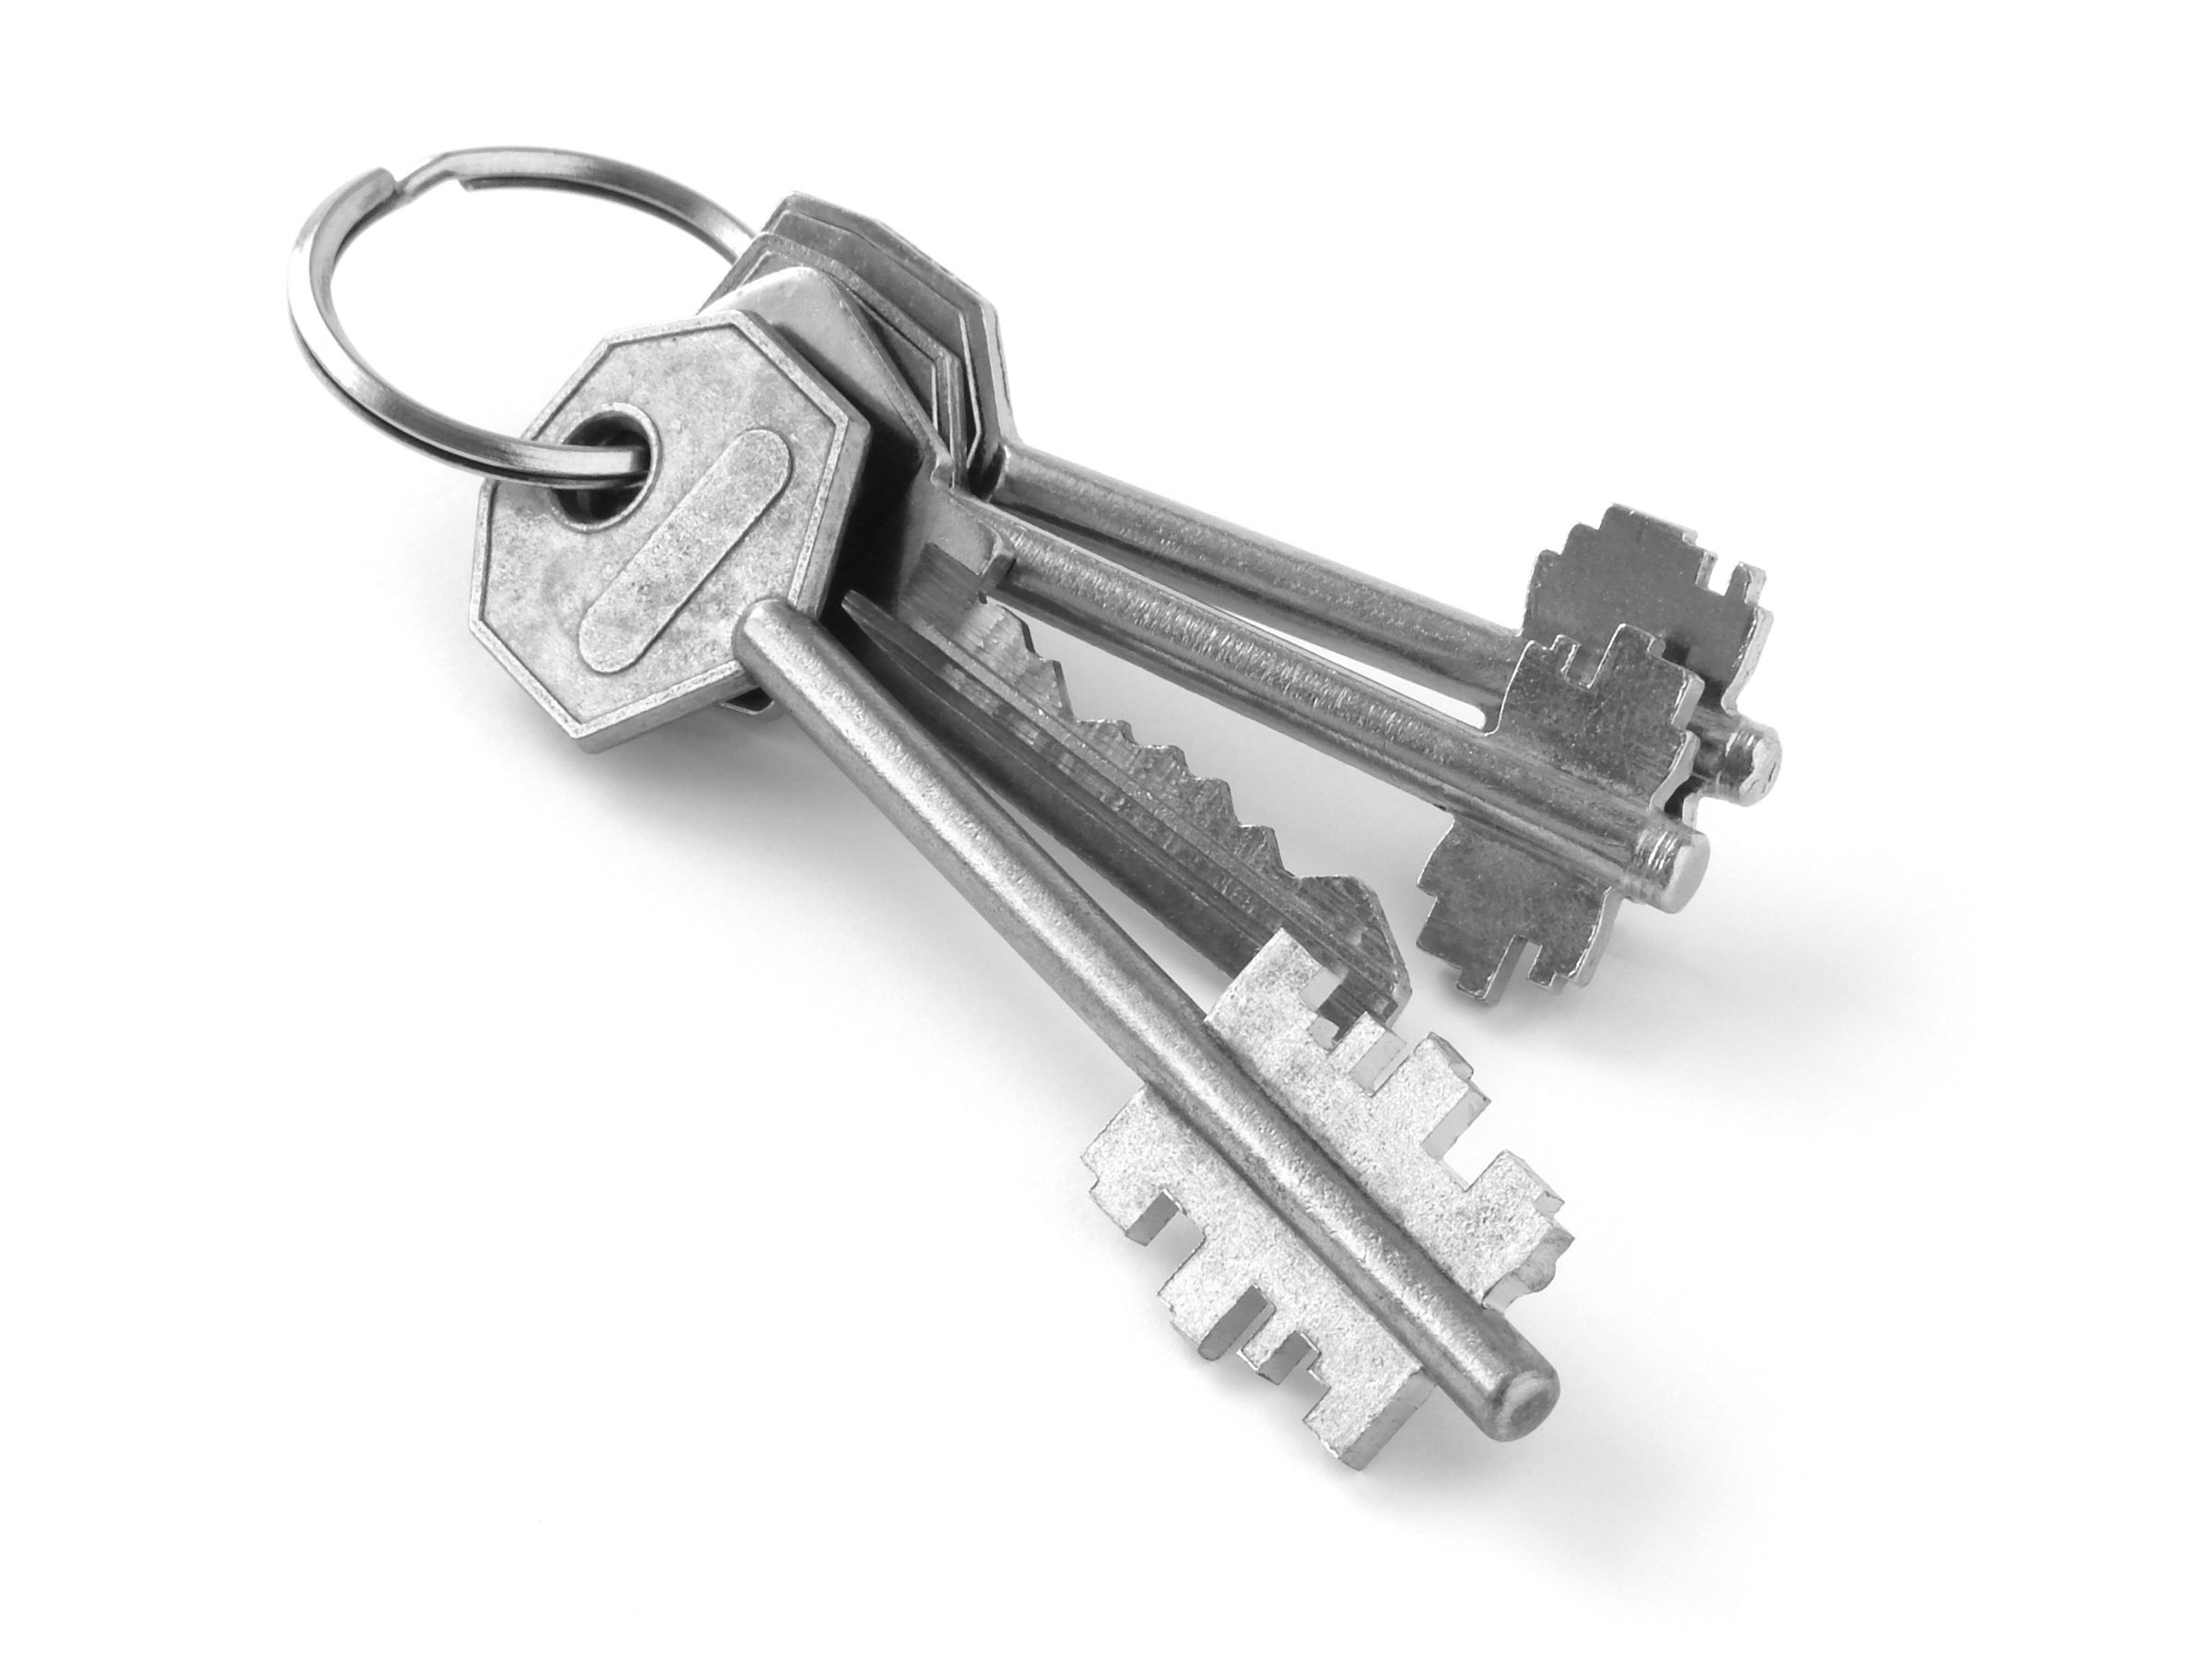
Prevention is Key
When inappropriate behaviors occur, assess antecedent events and ask:
Do we have clear expectations?
Have they been thoroughly taught?
Are we consistently using strategies to encourage desired behaviors?
The best defense is always a great offense.
MO SW-PBS
Notes:
Read the slide, then say, “Always ensure that the expectation has been defined, thoroughly taught and encouraged before planning the application of corrective responses.”

Slide 19
A B C
Antecedent | Behavior | Consequence
Students are working on assigned tasks in small groups. | 45% of 6th Grade Students are speaking disrespectfully to peers in the classroom. | Students are reprimanded for speaking disrespectfully. Some receive a referral to the office.
Is there a classroom rule that indicates students are to use respectful language with peers?
Has the use
of respectful language with peers been encouraged using tangibles and specific positive feedback?
Has the rule to use respectful language with peers been taught and practiced in the classroom?
MO SW-PBS
Notes:
This slide has animation. Read the notes carefully in order to advance the slide at the appropriate time.
Say, “A typical A-B-C sequence of problem behavior is described in the A-B-C chart,” then direct participants to read the A-B-C sequence.
“In order to change the inappropriate behavior, remember to always ask the following questions before planning the application of corrective responses:
Advance the slide to reveal the first question.
Do we have clear expectations?
Advance the slide again to reveal the second question.
Have they been thoroughly taught?
Advance the slide a final time to reveal the third question.
Are we consistently using strategies to encourage desired behaviors?”

Slide 20
A B C
Antecedent | Behavior | Consequence
Classroom Rule: Use appropriate tone and language with peers and adults The rule has been taught using Smart Board lesson written by teacher work group and videos produced by students. | 90% of 6th Grade Students use respectful language with peers in the classroom. | Staff used tangibles and specific positive feedback to recognize students for using appropriate tone and language with peers
Students who use disrespectful tone or language are corrected and retaught the use of appropriate tone and language.
MO SW-PBS
Notes:
Say, “In order to increase the use of respectful language with peers in the classroom, the staff created a rule to use appropriate tone and language with peers and adults. Staff members then taught the rule using lessons developed by a staff work group and videos produced by a student work group. Staff used tangibles and specific positive feedback to recognize students for using appropriate tone and language with peers.”
Advance the slide to reveal the response to discourage inappropriate behavior, then say,
“The staff clarified, taught and recognized appropriate behavior, then developed practices to correct inappropriate behavior.”

Slide 21
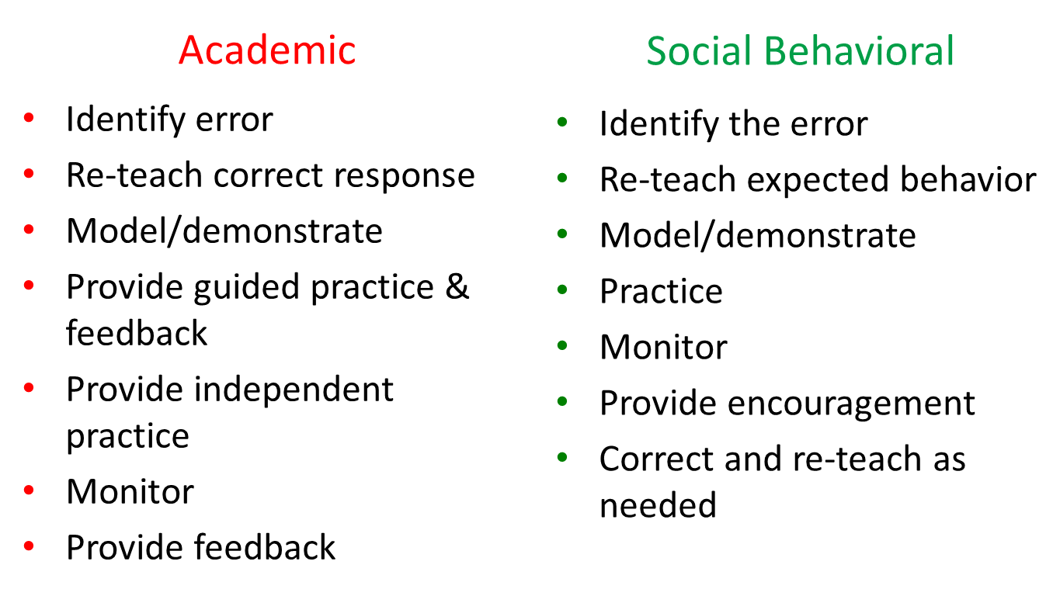
Activity: Teaching in Response to Errors
Notes:
Say, “Compare the steps used to respond to academic errors to the steps used to respond to social behavioral errors. Discuss similarities with a shoulder partner.”
Provide approximately 2 minutes for this activity, then say,
“The same calm instructional approaches used when students make academic errors should be used to correct social behavioral errors. Identifying the error, re-teaching, providing guided and independent practice, and follow-up feedback to indicate progress are steps used to respond to both academic and social behavioral errors.”

Slide 22
The Power of Correcting Social Errors Through Teaching
Upholds and demonstrates the importance of expectations.
Restores order to the environment so that learning can occur.
Interrupts the inappropriate behavior, preventing practice of that behavior.
Gives the child a chance to learn to be successful.
Increases probability of future correct behavior.
Builds relationships with students.
Maintains a positive learning climate.
Notes:
Direct participants to read the slide, then say,
“Effective social correction provides the same benefits as effective academic correction.”

Slide 23
Discussion: Instructional Approaches
With your team, reflect on what you have learned.
How does a teaching approach to discourage inappropriate behavior align with the present thinking of your staff?
Does your staff view inappropriate behavior as a teaching opportunity?
MO SW-PBS
Notes:
Provide approximately 5 minutes for this discussion. Ask for volunteers to summarize and share the main points of their discussion.

Slide 24
Action Planning: Discouraging Inappropriate Behavior
Guiding Question:
What activities will your team develop to work with your staff to view social/behavioral errors or inappropriate behavior as opportunities to correct and teach?”
Add the following to your Action Plan:
Feature #1 on the ‘Discouraging Inappropriate Behavior’ component of your Action Plan.
Notes:
Read the slide, then say, “What activities will your team develop to work with your staff to view social/behavioral errors or inappropriate behavior as opportunities to correct and teach?”

Slide 25
Session Outcomes
At the end of the session, you will be able to…
Explain the role of teaching in response to student social errors.
Define for your school what constitutes a “major” or office-managed behavior that warrants an office referral.
Develop an office referral form with all essential data fields and clarify procedures surrounding the use of office referrals.
Use respectful strategies for staff-managed “minor” inappropriate behavior.
Demonstrate instructional strategies for responding to inappropriate behavior.
Select and use additional consequences effectively.
Notes:
Read the outcomes or direct participants to read the outcomes.
You may choose to list outcomes on a poster or table placemat.

Slide 26
Reflective Questions
What types of student inappropriate behaviors do you or would you refer to the office?
Would all staff list the same inappropriate behaviors?
Would administration agree?

Slide 27
A Schoolwide System to Discourage Inappropriate Behavior: A Continuum of Responses
Less Disruptive
More
Severe
Indirect Strategies
Direct Strategies
Additional Consequences
Staff Managed
(Minor)
Office Managed
(Major)
Notes:
This slide has animation.
Say, “A schoolwide response to inappropriate behavior must be systematic…consistent across all staff and settings. A ‘continuum’ or range of responses must be developed to manage the range of inappropriate behaviors from less intensive to more intensive. At the beginning of the continuum, you have worked with your staff to more fully develop staff-managed responses such as:
Advance the slide, then say,
“Indirect strategies. Write 2 indirect strategies on a post-it note, now.”
Answers: Physical proximity, Nonverbal cues, Ignore, attend, praise
Advance the slide, then say,
“Direct strategies. Write 3 direct strategies on a post-it note, now.”
Answers: Redirect, Re-Teach, Offer Choice, Conference
Advance the slide, then say,
“Additional Consequences. What additional consequences have you and your staff considered?”
“In the next section of today’s session, we’ll focus on developing a consistent system to respond to more serious inappropriate behavior.”
27

Slide 28
To develop your schoolwide system, you will need to:
Know and use effective strategies to respond to staff-managed behaviors or “minors”.
Define what constitutes office-managed behavior or “majors”.
Develop data collection tools.
MO SW-PBS
Notes:
Read the slide, then say, “In order to develop a consistent system to respond to more serious inappropriate behavior, you will begin the work by defining behaviors that will be managed by staff and behaviors that will be managed by administrators. Again, you will involve the entire school staff to complete this work.”

Slide 29
Activity: Defining Inappropriate Behaviors
Each participant will choose a card that has the name of an inappropriate behavior written on it.
Keep it secret from the other members of your team.
Write your definition of that inappropriate behavior.
When given the signal, share your word and your definition with your team.
Notes:
Copy and cut the ‘Defining Inappropriate Behaviors Activity Cards’ found in Google Drive>MO SWPBS State Team>CDR Files>3_Training>2018-19Tier 1 >2018-19 Prep>Prep Session 5>Handouts
Note: Each card has the word, ‘disrespect’ written on it.
Provide 5 minutes for this activity, then say,
“Did each member of your team describe disrespect in exactly the same way? When there is no standard agreement on the definition or description of behavior, it is impossible to provide consistent responses. Now let’s begin the work of differentiating staff-managed and office-managed behaviors.”

Slide 30
Office-Managed Behavior
“Teachers and administrators are often at odds on what constitutes an appropriate referral and what should happen during and after the referral.”
Cotton, 1995
Notes:
Read the slide.

Slide 31
Defining Office-Managed or ‘Major’ Behavior
Potentially illegal behavior, serious disruptions to learning, or unsafe behavior that poses danger to the student or others.
Staff-Managed or “Minor” behavior that has become chronic and has not responded to repeated efforts to teach and correct by staff.
MO SW-PBS
Notes:
Say, “One of the most confusing and often frustrating issues in school discipline is the use of office referrals. Administrators often state that students are sent to the office for a wide range of misbehaviors from “minor” ones such as not having a pencil to those that are more “major” such as physical aggression. If a school’s goal is for staff to be more consistent in upholding their expectations, the staff must determine what behavior is typically staff-managed and what is office-managed,”
then read the slide.

Slide 32
Possible Office-Managed Behaviors
Possession of weapons
Fighting or assault
Possession of controlled substances
Theft
Vandalism
Abusive language
Major disruption to the learning environment
Major Non-compliance
Leaving the school grounds without permission
Chronic behaviors not responding to teacher interventions
Intensity Level | Description
Level 1 | Behavior impacts only the focus student.
Level 2 | Behavior disrupts others in the student’s immediate area.
Level 3 | Behavior disrupts everyone in the class.
Level 4 | Behavior disrupts other classrooms or common areas of the school.
Level 5 | Behavior causes or threatens to cause physical injury to student or others.
MO SW-PBS
Notes:
Say, “This Behavior Rating Rubric can be helpful to teams when determining the intensity level of problem behavior that will result in a direct referral to the office. Your staff may determine that behaviors that meet criteria for Levels 4 and 5 or Levels 3, 4 and 5 may be office-managed. The scale may provide a starting point for this discussion.”

Slide 33
Activity: Card Sort
With your team…
Sort the cards into Staff-Managed and Office-Managed.
Discuss only those behaviors where there is significant disagreement.
Consider using this activity with your staff to assist with the identification of office-managed behaviors.
Notes:
Copy and cut the ‘Defining Inappropriate Behaviors Card Sort Activity Cards’ found in Google Drive>MO SWPBS State Team>CDR Files >3_Training>2018-19 Tier 1 > Prep>Prep Session 5>Handouts
Read the slide. Provide approximately 10 minutes for this activity.

Slide 34
Activity: Defining Office-Managed Behavior
With your team…
Read through the example definitions of office-managed behavior on pages 191-192. Consider your district policy. On page 190, list the behaviors that might be office-managed for your school. Then define one or two major behaviors to ensure full understanding by team members.
Now that you have an idea about what office managed behavior may look like, take this activity back to your school and work with your staff to complete the process of identifying and defining office-managed behavior.
MO SW-PBS
191-192
Notes:
Provide access to Workbook, pp. 191-192.
Provide approximately 15 minutes for this activity.

Slide 35
To develop your schoolwide system, you will need to:
Know and use effective strategies to respond to staff-managed behaviors or “minors”.
Define what constitutes office-managed behavior or “majors”.
Develop data collection tools.
MO SW-PBS
Notes:
Say, “Once you’ve identified and defined office-managed behaviors, you’ll need to review and possibly revise your current office discipline referral form to accurately record the type and context of problem behavior.”

Slide 36
Office Discipline Referral Form– Essential Contextual Factors
Student name
Referring staff name
Date of incident
Time of incident
Location of incident
Inappropriate behavior with designation of office-managed or staff-managed
Others involved
Possible motivation
Administrative decision/action
MO SW-PBS
Notes:
Read the slide, then say, “ODR forms provide a count of the number of behavior incidents, the types of inappropriate behaviors that take place, the time of day of incidents, the location or where incidents occur, the possible function of the behavior, and the students who are involved.”

Slide 37
Activity: Revising Your ODR Form
With your team, review your current office discipline referral form and the examples on pages 194-196:
Does our current form include the nine essential contextual factors?
How does it need to be revised?
Who will be responsible for completing revisions?
What approvals are required? Will revisions require changes to school or district manuals, materials, websites, etc.?
MO SW-PBS
194
Notes:
*Provide access to Workbook, pp. 194-196
Provide approximately 15 minutes for this activity.

Slide 38
Discussion: Preparing Staff
Read page 197 and then discuss with your team:
How does the description of the teacher’s role in ODRs align with our current staff expectations?
How can we help staff to understand their role in office discipline referrals and the correct use of our ODR form?
What plans need to be made in order to effectively handle students referred to the office?
MO SW-PBS
197
Notes:
Provide access to 2018-19 Workbook, p. 197.
Provide approximately 20 minutes for this discussion. Ask for volunteers to share big ideas.

Slide 39
To develop your schoolwide system, you will need to:
Know and use effective strategies to respond to staff-managed behaviors or “minors”.
Define what constitutes office-managed behavior or “majors”.
Develop data collection tools.
MO SW-PBS
Notes:
Say, “Once you’ve worked with the whole staff to develop your continuum of strategies to respond to inappropriate behavior, you may find it helpful to develop a graphic representation of the continuum. This graphic will provide a quick and easy reference for staff, family and possibly community agencies working with the school to consistently apply corrective strategies. Let’s look at the examples on the next 2 slides.”

Slide 40
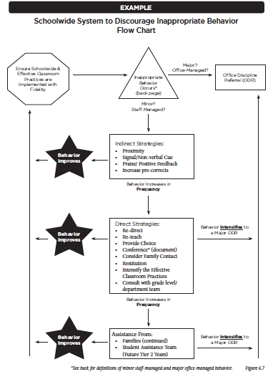
Schoolwide System to Discourage Inappropriate Behavior Flow Chart
MO SW-PBS
210
Notes:
This flowchart is on page 210 in the 2018-19 Tier 1 Workbook.
Say, “You may choose to develop a flow chart to represent your schoolwide system like the one depicted here.”

Slide 41
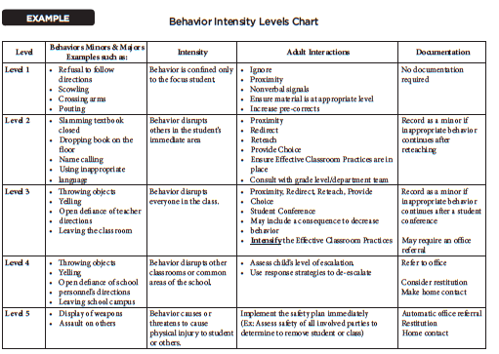
212
Notes:
This chart is on page 212 in the 2018-19 Tier 1 Workbook.
Say, “You may choose to develop a table to represent your schoolwide system like the one depicted here.”

Slide 42
Activity: Schoolwide System to Discourage Inappropriate Behavior
With your team . . .
List the adult responses you and your staff have identified thus far in developing your school’s Schoolwide System to Discourage Inappropriate Behavior.
How might you depict that Schoolwide System to Discourage Inappropriate Behavior?
How will you provide training for your staff on this continuum?
MO SW-PBS
Notes:
Read the directions. Provide approximately 15 minutes for this activity. Have each team report out at the conclusion of their work.

Slide 43
Action Planning: Discouraging Inappropriate Behavior
Add the following to your Action Plan:
Review feature #2 on the ‘Discouraging Inappropriate Behavior’ component of your Action Plan.
“There is a clear framework for staff to determine what behaviors they manage and what behaviors should be office-managed.”
Add items as needed.

Slide 44
Session Outcomes
At the end of the session, you will be able to…
Explain the role of teaching in response to student social errors.
Define for your school what constitutes a “major” or office-managed behavior that warrants an office referral.
Develop an office referral form with all essential data fields and clarify procedures surrounding the use of office referrals.
Use respectful strategies for staff-managed “minor” inappropriate behavior.
Demonstrate instructional strategies for responding to inappropriate behavior.
Select and use additional consequences effectively.
Notes:
Read the outcomes or direct participants to read the outcomes.
You may choose to list outcomes on a poster or table placemat.

Slide 45
Reflective Questions
Does inappropriate behavior in your building get the same response from all staff members?
Why is consistency important?

Slide 46
“Unfortunately, most of the practical techniques used by teachers to respond to acting-out children are only of limited effectiveness and some, such as reprimands, arguing, and escalated hostile interactions, can actually strengthen the behaviors they are intended to suppress or terminate.”
Hill Walker, 1995
The Acting-Out Child: Coping With Classroom Disruption
MO SW-PBS
Notes:
Read the slide or direct participants to read the slide.
Provide time for participants to consider the information.

Slide 47
“The single most commonly used but least effective method for addressing undesirable behavior is to verbally scold and berate a student.”
Alberto & Troutman
High rates of teacher attention to inappropriate behavior is prevalent in our schools. This attention for misbehavior exceeds attention to appropriate behavior, and contributes to the continuation of much problem behavior.
White, 1975
MO SW-PBS
Notes:
Read the slide, then say,
“Providing more attention for inappropriate behavior than appropriate behavior contributes to increased incidences of problem behavior. Remember, you get more of the behaviors you highlight. Is your staff highlighting appropriate behavior or inappropriate behavior?”

Slide 48
Instructional Strategies to Discourage Inappropriate Behavior:
Non-Examples
How many times do I have to tell you to work quietly?
Didn’t I just tell you to get started?
Why are you talking while I‘m talking?
Do you want me to send you to the office?
What do you think you are doing?
Quit it right now…stop being so antsy!
MO SW-PBS
Notes:
Read the slide or direct participants to read the slide, then say,
“Raise your hand if you have ever used one of these statements. Statements such as the ones included here do not change inappropriate behavior and may serve to reduce the effectiveness of our interactions with students. So how should we interact with students to effectively respond to inappropriate behavior?”

Slide 49
General Considerations: Discouraging Inappropriate Behavior
Active supervision
Consistency
Calm, immediate response
Specific, yet brief
Quiet, respectful contact with student
Refocus class, if needed
MO SW-PBS
Notes:
Say,
“Active Supervision – Move, visually scan and interact so you can provide immediate encouragement or immediate discouragement.
Consistency – It is less important what the consequence is; more important that the consequence is delivered consistently
Calm, Immediate response – Deliver the correction message calmly (body, hands, voice) and immediately after the error is made.
Specific, yet brief – Tell the person specifically and quickly what he or she should be doing, then step away to give the person time to comply.
Quiet, respectful contact – Tell the person privately and respectfully what should be done.
Refocus the class on the instructional activity before delivering correction if the inappropriate behavior disrupted the instruction or if the correction will require more than a brief interaction.”

Slide 50
Strategies for Staff to Discourage Inappropriate Behavior
Indirect Strategies | Direct Strategies | Additional Consequences
Proximity Control Signal/Non-Verbal Cue Ignore/Attend/ Praise | Redirect Reteach Provide Choice Student Conference | A menu of mild educational responses that require student effort and leave little incentive to repeat the inappropriate behavior.
Notes:
Say, “Here is a continuum of strategies that provide additional teaching and practice required to help students who have a skill deficit or performance deficit learn the desired behaviors and when to appropriately use them.”

Slide 51
Discouraging Inappropriate Behavior
Indirect Strategies
Actions to minimize the misbehavior before it gets out of hand and requires more extensive intervention:
Proximity Control
Signal or Non-Verbal Cue
Ignore/Attend/Praise
Unobtrusive • Carried out quickly during instruction
MO SW-PBS
Notes:
Direct participants to read the slide, then say,
“These three strategies can be used by teachers to respond swiftly to minor misbehavior. A more thorough teaching of these strategies is provided on the following slides.”

Slide 52
Discouraging Inappropriate Behavior
Indirect Strategies
Proximity Control | The strategic placement/movement by the teacher in order to encourage positive behavior. The teacher is a source of protection and strength, helping the student to control impulses.
Signal or Non-verbal Cue | Non-verbal techniques such as sustained eye contact, hand gestures, picture cues, etc. suggesting that the teacher is aware of the behavior and prepared to intervene if it continues.
Ignore/Attend/Praise | Uses the power of praise or positive feedback. The teacher praises an appropriately behaving student in the proximity of the inappropriately behaving student. The praise serves as a prompt. When the student exhibits the desired behavior, attention and praise are then provided.
Notes:
Model and demonstrate these as you teach.
Here are more examples of signals that can be used to nonverbally direct students to begin engaging in appropriate behavior:
Establish eye contact with the student, walk to the classroom expectations matrix and discreetly point to the rule the student should be following.
If rules are numbered, signal the number of the rule the student(s) should be following.
Refocus behavior by reemphasizing the instructional objective. Point to the instructional objective, then pose a question to the class regarding the objective.

Slide 53
Discouraging Inappropriate Behavior
Things to remember . . .
Address behaviors quickly and calmly.
When the student demonstrates the desired behavior, always follow with praise or positive feedback.
Use strategically; these indirect techniques are basic stopgap measures and not a substitute for the more in-depth teaching strategies. Re-teach or conference when time permits.
MO SW-PBS
Notes:
Say, “Here are some cautions in using the basic indirect strategies,” then direct participants to read the slide.

Slide 54
Activity: Discouraging Inappropriate Behavior – Indirect Strategies
Read-Reflect-Teach
Number off by 3s in your team. Read the technique associated with your number. Teach your team how to use the technique and offer examples of its use, sharing when it might be most appropriate.
#1 – Proximity Control
#2 – Signal or Non-verbal Cue
#3 – Ignore/Attend/Praise
Notes:
Read the directions, then say,
“There are 3 techniques described on page 200. We are focusing only on the first three at this time. We’ll address restitution as a strategy to discourage inappropriate behavior later during this session.”
Provide approximately 10 minutes for this activity.

Slide 55
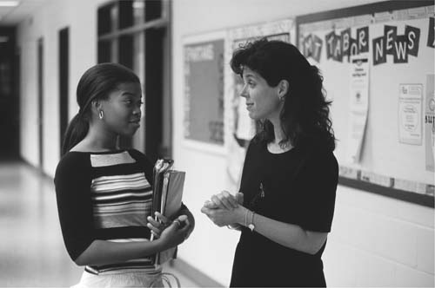
Discouraging Inappropriate Behavior
Direct Strategies
A continuum of direct error correction strategies for inappropriate behaviors that continue or do not respond to basic management techniques.
Re-Direct
Re-Teach
Provide Choice
Student Conference
• Direct Interaction using language from the matrix
• Match to frequency & severity of behavior • Done privately
• Increase rates of teaching and praise
MO SW-PBS
Notes:
Say, “The strategies presented earlier do not involve direct verbal interaction as they are being utilized (although, they should be explicitly taught prior to use.) The error correction strategies presented here do involve direct verbal interaction with the student(s) being addressed. These strategies emphasize teaching appropriate behavior.” Reminder that common language comes and we use the wording for re-directing, re-teaching etc. from our matrix.

Slide 56
Four Direct Error Correction Strategies
Re-Direct | Brief, clear, private verbal reminder of the expected behavior. A re-statement of school-wide and non-classroom behavior, or classroom procedure.
Re-Teach | Builds on the re-direct by specifically describing the steps required to instructing the student on exactly what should be done.
Provide Choice | Can be used when a re-direct or re-teaching have not worked. A statement of two alternatives–the preferred or desired behavior or a less preferred choice.
Student Conference | Lengthier re-teaching or problem solving. Discusses the behavior of concern, teaches the desired behavior, provides reasons why it is important, and a plan is made for future use. Can include role-play or practice.
Notes:
Say, “Each of these strategies requires direct interaction with the student(s),” then direct participants to read the definitions of each strategy.
Examples of each strategy are provided on the following slides and on p. 201 of the Workbook.

Slide 57
Re-Direct
Julia is talking to the student beside her instead of working on an independent writing assignment.
Quietly walk to Julia and say, “Remember to be responsible by following directions and starting on your writing task. Thank you.” Walk away to give Julia time to comply.
The teacher assigns work on p. 182 in the math book. Austin takes out paper and begins drawing.
Quietly walk to Austin and respectfully say, “Please, follow directions by getting out your math book and opening to p. 182. You can finish drawing at the end of the day.” Walk away to give Austin time to comply.
Notes:
Direct participants to read the examples of redirection, then say,
“Each re-direct includes a specific restatement of the classroom rule.

Slide 58
Re-Teach
Julia continues to talk after the teacher redirects her to begin working.
The teacher returns to Julia and quietly says, “Please show me how you will follow directions by first getting out your writing materials. Now show me how you work quietly. Please let me know if you need help.” Thank Julia after she begins working.
Austin gets out his book, but continues to draw.
The teacher returns to Austin and quietly says, “Thank you for getting out your book. Now remember, to complete your work, clear your desk of everything but the book and math notebook, begin working right away and continue working until done. If you need help, raise your hand.” (Pause and look away to give Austin time to comply.)
MO SW-PBS
Notes:
Say, “The next step in the correction process is to re-teach. In each interaction, the skill is labeled and the student is given an immediate opportunity to practice demonstrating the behavior. Here are examples of re-teaching.”
Direct participants to read the slide.

Slide 59
Provide Choice
“Julia, you are having difficulty working by _______. You can choose to work at the writing center or in the student office. I’ll be back in a few seconds to hear your decision.”
“Austin, you are having difficulty starting your math work. You can choose to work on the assignment or on an alternate math activity. I’ll be back in a few seconds to hear your decision.”
MO SW-PBS
Notes:
Say, “Providing Choice is frequently an effective strategy for managing inappropriate behavior. Choice can address location, order of completion, type of tool or type of activity. You must generate and teach the choices before students engage in inappropriate behavior,” then read the examples of providing choice.

Slide 60
Student Conference
“Julia, can you please tell me what you need to do to start writing as directed? (If Julia can tell you, provide specific positive feedback. If not, restate the steps, one at a time:
Keep mouth and body quiet so you can hear the directions.
Get out needed materials.
Think about what you will write, and create a graphic organizer.
Ask for help if you need it to finish the work.)
“Julia, tell me what you’ll do the next time you’re directed to work on a writing assignment. “ (Julia responds.)
“Tell me what I can do to help you to follow directions to start and complete the writing assignment. (Julia responds.)
“We’ll practice again after lunch.”
MO SW-PBS
Notes:
Say, “A student conference is a lengthier re-teaching or problem solving opportunity that should occur when behavior is more frequent or intense. Schedule the conference to occur as soon as possible so the student will have opportunities to problem solve and practice the appropriate behavior,”
Then direct participants to read the slide.

Slide 61
Student Conference
“Austin, several times today you have been drawing during work time.”
Austin, can you tell me the steps you need to follow when you’re directed to work on an assignment? (If Austin can tell you the steps, provide specific positive feedback. If he cannot, restate the steps one at a time.) When you follow directions to start and finish work, you can get done what you have to do quickly and then move on to things you enjoy. You may also have less homework. Austin, tell me what you will do next time you are given an assignment. (Austin responds)
MO SW-PBS
Notes:
Direct participants to read the slide. Remember this is done with a smile! These are encouraging words and a positive interaction with your student!

Slide 62
Student Conference cont.
How can I help you to do that? (Austin responds) You’re going to have another opportunity to practice this later this afternoon. Do I have your commitment to do what we’ve talked about?
Thanks for listening. You did a nice job accepting some feedback. I’m going to be watching to see if I can catch you on-task.”

Slide 63
Activity: Discouraging Inappropriate Behavior – Direct Strategies
Read-Reflect-Teach
Once again, number off by 4s in your team. Read the strategy associated with your number. Teach your team how to use the strategy and offer examples of its best use. Be prepared to model your strategy with the larger group.
#1 – Re-Direct
#2 – Re-Teach
#3 – Provide Choice
#4 – Student Conference
Notes:
Direct teams to turn to p. 201 in the Workbook, then complete the activity.
Provide approximately 15 minutes for this activity.

Slide 64
Considerations for Corrective Feedback
Always correct privately; use preferred adult behaviors that maintain respect for the student.
Use the strategy that is the least intrusive for the behavior and its frequency or severity.
Create an environment where corrective feedback is used to improve behavior in a positive manner.
When inappropriate behavior occurs, increase teaching (lessons, pre-corrects) and rates of encouragement (positive feedback).
MO SW-PBS
Notes:
Read the slide, then say, “Please, remember these considerations when correcting inappropriate behavior and share them with your staff.”

Slide 65
Activity: Discouraging Inappropriate Behavior
Read and reflect on each of the scenarios on page 202. As a team, respond to the following:
Which technique or strategy is the best response for each scenario?
Explain the rationale for selecting the technique for each scenario.
Select four of the scenarios to demonstrate the strategy you selected using your school’s expectations or procedures.
Notes:
*Provide access to p. 202 of the Workbook.
Provide approximately 15 minutes to read, reflect and choose a technique or strategy for each scenario.
Provide an additional 5 minutes to prepare demonstrations and 5-10 minutes more for teams to demonstrate the use of a strategy.
Go through the 13 scenes on page 202 first, calling on volunteers to provide the strategy selected and the reason it was selected. Then ask each team to demonstrate the strategy selected to respond to one of the scenarios.
Possible Responses:
1. Fred is blurting out answers during a review of yesterday’s lesson. REDIRECT
2. Burke pushes the swing and almost hits Chloe. He had difficulty using the swings correctly at the last recess. CONFERENCE
3. Betty is digging in her purse during an independent seatwork assignment. SIGNAL OR NONVERBAL CLUE
4. After re-directing Jake for being off-task, he is again turned around, trying to get Marc’s attention. RETEACH
5. Jane barked at the cafeteria server, saying, “Yuk! I hate that!” RETEACH
6. Amy is daydreaming and looking out the window during instruction. SIGNAL or NONVERBAL CLUE
7. Wilma does not have a pencil again today to complete the class activity. CONFERENCE
8. Aaron has been sighing, rolling his eyes, and complaining when he is assisted with his work for the last couple of days. CONFERENCE
9. The class is getting loud during their paired group work activity. REDIRECT
10. Jason walks into class after the bell has rung again today; he has been tardy three days this week. CONFERENCE
11. During small group work, Talia calls out, “Hey, Jackson took my marker!” RETEACH Jackson and Talia
12. Fred and Jose run to line up at the door when the teacher announces time for lunch. RETEACH
13. Zach has his cell phone out during class. The teacher re-directed Zach about his phone use several times recently. CHOICE OR CONFERENCE

Slide 66
Activity: Practice Selecting Techniques
Using Handout entitled “Practice Selecting Techniques to Effectively Address Inappropriate Behavior”, answer the following questions for each scenario:
Which technique or strategy is the best response for each scenario?
Why?
Notes:
Use handout Practice Selecting Techniques to Effectively Address Inappropriate Behavior found in Google Drive>Mo SW-PBS State Team>CDR files 2018-2019>3_Training>Tier 1 18-19>18-19 Prep>Prep Session 6>Handouts
Approximately 10 minutes to reflect on scenes, choose a technique or strategy and discuss answers.
Note to presenter:
There is no one, right answer to the scenarios in this activity. Accept all answers from participants that are instructional in nature. If participants bring up instances when inappropriate behaviors are repetitive, redirect them and tell them we will look at that later in our presentation.

Slide 67
Session Outcomes
At the end of the session, you will be able to…
Explain the role of teaching in response to student social errors.
Define for your school what constitutes a “major” or office-managed behavior that warrants an office referral.
Develop an office referral form with all essential data fields and clarify procedures surrounding the use of office referrals.
Use respectful strategies for staff-managed “minor” inappropriate behavior.
Demonstrate instructional strategies for responding to inappropriate behavior.
Select and use additional consequences effectively.
Notes:
Read the outcomes or direct participants to read the outcomes.
You may choose to list outcomes on a poster or table placemat.

Slide 68
Reflective Questions
When you use a consequence in your classroom, what is the goal?
How do you know if consequences are effective?

Slide 69
“When everyone handles infractions with consistent feedback, students learn that what happens when they misbehave is procedure not personal.”
Bob Algozzine, 2000
MO SW-PBS
Notes:
Read the slide.

Slide 70
Discouraging Inappropriate Behavior: Additional Consequences
A menu of mild responses that can be readily used
Instructional; help the student to learn and practice the desired behavior
Relevant/logically connected to infraction
Individually selected; matched to the frequency & severity of the behavior
It is not the severity of the consequence, but the inevitability (consistency) that a response will occur which affects behavior
MO SW-PBS
Notes:
Say, “Consequences paired with teaching of the alternative or desirable behavior can heighten behavior change. Effective consequences result in greater learning and should often involve learning tasks or opportunities directly related to the inappropriate behavior,”
Then read these key points for using additional consequences. Emphasize the last concept by saying,
“It is not the size of the consequence that promotes behavior change, but the certainty that something will be done.”

Slide 71
Consequences: Responses that Occur Following Behavior
A B C
Antecedent | Behavior | Consequence
Conditions or circumstances that alter the probability of a behavior occurring. | An observable act. What the student does. The actions or reactions to the antecedents. | The resulting event or outcome that occurs immediately following the behavior. Impacts future occurrence of the behavior.
MO SW-PBS
Notes:
Say, “Remember, consequences are responses that occur following a behavior. They can serve to increase the occurrence of a behavior or decrease the occurrence of a behavior.”

Slide 72
A B C
Antecedent | Behavior | Consequence
Establish positively stated rules to clarify expected behavior. Establish procedures to increase structure to efficiently complete all tasks. Teach the rules and procedures and provide opportunities to practice the rule in all settings. | Engage in appropriate behavior | Use tangibles and specific positive feedback to recognize students who engage in appropriate behavior.
Correct and re-teach students who engage in inappropriate behavior.
Provide additional consequences for students who do not respond to re-teaching.
MO SW-PBS
Notes:
This slide has animation.
Advance the slide to reveal the information about additional consequences then say,
“Additional consequences should be considered, particularly when inappropriate behavior is repetitive or not responding to teaching strategies alone.”

Slide 73
Some Possible Additional Consequences
Restitution
Make up missed work
Teach others
Mediation essay
Alter activity
Make amends to others
Phone call to parents
Loss of privilege
Contract
Office referral
Parent conferences
Notes:
Say, “Developing a menu of consequences specific to each non-classroom area or for each classroom task will help you to avoid illogical consequences such as the removal of recess or detentions, which tend to be overused in many schools. These additional consequences need to be logically connected to the infraction (e.g. a child who disrupts class and takes time from learning can pay back the time before school, a child who pushes other students can teach a lesson on how to start interaction by using specific phrases rather than by using physical contact.”
Read the possible additional consequences, then say,
“Restitution is a logical consequence, and is one that is a logical outcome of the student’s behavior, allowing the behavior and consequence to be easily linked.”

Slide 74
Restitution
Restitution permits the student to help to restore or improve the school environment by directly addressing the problems caused by the student’s inappropriate behavior.
Restorative practices work to address the needs of those harmed and works to put right the harm through restorative processes.
Notes:
Read the slide, then say, “Restitution is a practice most of us would choose for ourselves. For example, if you forgot to bring materials you needed to school and you needed to borrow those materials from a colleague, would you want your colleague to punish you or lecture you about being responsible or would you want your colleague to provide the materials with the understanding that you’d replace the materials used? This is an example of restitution we practice almost everyday.”
The following resources were used to provide the definitions of restitution used on this slide. You can provide participants with these research citations:
Lewis, S. (2009). Improving school climate: findings from schools implementing restorative practices. Bethlehem, Pennsylvania: International Institute on Restorative Practices.
Walker, H., Ramsey, E., & Gresham, F. (2004). Antisocial behavior in school: Evidenced-based practices. Florence, KY: : Cengage.
Latimer, J. & Dowden, C. (2005). The effectiveness of restorative justice practices: A meta-analysis. Danielle Muisethe Prison Journal, 85(2), 127-144.

Slide 75
Activity: Identifying Additional Consequences
Think-Write-Share
As a team, select a non-classroom area or classroom procedure from the list below.
Individually list possible additional consequences for inappropriate behavior in that setting. Be specific. List as many as you can.
Compile your ideas and post on chart paper for all to review.
Large Group Instruction • Independent Seatwork
Small Work Groups • Cafeteria • Hallways • Being On Time, etc.
Notes:
Provide approximately 15 minutes for this activity. When done, possibly do a gallery walk to view others’ work.

Slide 76
Discussion: Using Additional Consequences
With your team, reflect on what you have heard:
How does this information change your thinking about the use of additional consequences?
What current practices used in your school need to be changed or adjusted?
How can you help staff to re-think their use of additional consequences?
MO SW-PBS
Notes:
Provide approximately 10 minutes for this discussion. When teams are done discussing, ask each of the questions one at a time and call on volunteers to share.

Slide 77
MO SW-PBS Teacher Tools
Practice
Research
Definition
Examples
Implementation
Monitoring
Notes:
***Provide access to the handout ”MO SW-PBS Teacher Tool: Discouraging Inappropriate Behavior in the Classroom” found in Google Drive>MO SWPBS State Team>CDR Files>3_Training>2018-19 Tier 1 > Prep>Prep Session 6>Handouts.
Say, “MO SW-PBS Teacher Tools have been created to support the development and implementation of the 8 effective classroom practices identified through the review of research literature.
Each tool provides the following information:
Research supporting the development and use of the classroom practice
Definition of the classroom practice
Examples of the classroom practice
Guidelines for developing and utilizing the classroom practice
Teacher Self-Assessment and Observation Tool
List of MO Teacher Leader Standards addressed by the classroom practice
List of complete references found on the back of the Teacher Tool

Slide 78
Action Planning: Discouraging Inappropriate Behavior
Guiding Questions:
How will techniques to discourage inappropriate behavior be shared with staff?
What current practices used in your school need to be changed or adjusted?
Do you need to adjust your document (e.g. flowchart) that defines schoolwide system to discourage inappropriate behavior?
Add the following to your Action Plan:
Review features #2, #3 & #4 on the ‘Discouraging Inappropriate Behavior’ component of your Universal Support Checklist.
Add items to your Action Plan.
Notes:
Direct participants to read the Action Plan items, then direct participants to read the guiding questions. To help guide the discussion they may ask themselves the following:
Which of the techniques to discourage inappropriate behavior do you already use and want to continue?
What could you add to your repertoire?
What behavior(s) might you need to eliminate when responding to inappropriate behavior?
Which of these techniques are staff currently using?
Provide approximately 20 minutes for Action Planning.

Slide 79
Contact Information
Remember to follow MO SW-PBS on social media
Consultant Contact Information:
pbismissouri.org
facebook.com/moswpbs
@MOSWPBS

