Slide 1
Teaching Expected Behavior
MO SW-PBS Tier 1 Training
Notes:
Trainer Notes:
To Know/To Say:

Slide 2
Developer Notes: Delete this Slide
Use this slide deck to develop the entire PLM (course)
Delete sections for lessons that will not be used
If there are not enough sections for the number of lessons required, create new lesson as appropriate and paste in slide templates
Right click on Lesson Section to change name to match the title of the lesson
Salmon colored slides are slides that will be personalized by the presenter
Incorporate at least one activity for every 10 minutes of instruction

Slide 3
Facilitator Notes: Delete This Slide
Handouts that will be needed for this PLM:
HO1 Example Preschool Lesson Follow Directions
HO2 Example Elementary Lesson Follow Directions
HO3 Example Middle School Lesson Follow Directions
HO4 Example High School Lesson Follow Directions
HO5 Example Elementary Cafeteria Procedures Lesson Plan
HO6 Example Secondary Cafeteria Procedures Lesson Plan
HO7 Acquisition Lesson Plan Template
HO8 Example Maintenance Middle Lesson Follow Directions
HO9 Example Maintenance High School Lesson Follow Directions
HO10 Example Maintenance Secondary Cafeteria Procedure Lesson Plan
HO11 Maintenance Lesson Plan Template
HO12 Example Teaching Schedule
HO13 Teaching Schedule Activity

Slide 4
Teaching Expected Behavior
MO SW-PBS Tier 1 Training
Notes:
Trainer Notes:
To Know/To Say:

Slide 5
Working Agreements
Be Respectful
Be an active listener—open to new ideas
Use notes for side bar conversations
Be Responsible
Be on time for sessions
Silence cell phones—reply appropriately
Be a Problem Solver
Follow the decision making process
Work toward consensus and support decisions of the group
Notes:
Trainer Notes:
To Know/To Say: “These will be the Working Agreements we will honor during all our training sessions this year.”

Slide 6
Attention Signal
Notes:
Trainer Notes: Facilitator: Select an attention signal.
To Know/To Say: “One of our agreements is to follow the attention signal.”
“Your team will work with your school to develop an attention signal you will use in every setting.”
“In order to get all of you focused after discussions, activities or breaks,
I will ________________________________________.”
(Insert your attention signal here.)
“Your task will be to finish your sentence, quiet your voice and ____________________________.”
(Insert what you want participants to do.)

Slide 7
Introductions
Notes:
Trainer Notes: Facilitator: Select an introductions activity
To Know/To Say:

Slide 8
PLM Description
This module describes the process for…
writing lesson plans,
developing a teaching schedule, and
providing special activities and events
…that guide the ongoing teaching of expected behaviors.
Notes:
Trainer Notes:
To Know/To Say:
Once expectations have been defined, systematic teaching of those expected behaviors must be a routine part of the school day. Effective instruction of social behavioral skills requires more than simply providing the rule–it requires instruction, practice, feedback, reteaching, and encouragement^{1,2}. This module describes the process for writing lesson plans, developing a teaching schedule, and providing special activities and events that guide the ongoing teaching of expected behaviors.
Sprague, J. & Golly, A. (2005). Best behavior: Building positive behavior support in schools. Boston, MA: Sopris West Educational Services.
Sugai, G., Hagan-Burke, S., & Lewis-Palmer, T. (2004). Schoolwide discipline and instructional classroom management: A systems approach. In C. B. Darch & E. J. Kame’enui (Eds.) Instructional classroom management: A proactive approach to behavior management, 2nd Ed. (pp. 218-248). Upper Saddle River, NJ: Pearson Education, Inc.

Slide 9
PLM Outcomes
At the end of this session, you will be able to…
Develop a system to teach expected behavior in the social behavioral curriculum, that includes:
understand why teaching social behavioral skills is important;
engaging all staff in a process of writing lesson plans;
creating a set of lesson plans to initially teach acquisition of expected behaviors;
creating a set of booster lessons for maintenance of expected behaviors; and
developing and sharing a schedule for teaching expected behaviors.
Notes:
Trainer Notes:
To Know/To Say:

Slide 10
Reflective Questions
How will you plan initial teaching of social skills at the beginning of the school year?
How will you arrange for regular, ongoing teaching throughout the school year?
Notes:
Trainer Notes:
To Know/To Say:
How will you plan initial teaching of social skills at the beginning of the school year?
How will you arrange for regular, ongoing teaching throughout the school year?

Slide 11
Teacher Leader Standards
Standard #2 Student Learning, Growth & Development
Standard #3 Curriculum Implementation
Standard #5 Positive Classroom Environment
Standard #6 Effective Communication
Standard #7 Student Assessment and Data Analysis
Reference: Missouri Department of Elementary and Secondary Education (MO DESE), (2013). Teacher Standards: Missouri's educator evaluation system. Retrieved from: http://dese.mo.gov/sites/default/files/TeacherStandards.pdf.
Notes:
Teaching Expected Behavior Additional Resources: Missouri Teacher Standards
Standard #2 Student Learning, Growth and Development. The teacher understands how students learn, develop and differ in their approaches to learning. The teacher provides learning opportunities that are adapted to diverse learners and support the intellectual, social, and personal development of all students. [SB 291 Section 160.045.2 (1) Students actively participate and are successful in the learning process; (5) The teacher keeps current on instructional knowledge and seeks and explores changes in teaching behaviors that will improve student performance.]
Standard #3 Curriculum Implementation. The teacher recognizes the importance of long-range planning and curriculum development. The teacher develops, implements, and evaluates curriculum based upon student, district and state standards data. [SB 291 Section 160.045.2 (1) Students actively participate and are successful in the learning process; (2) Various forms of assessment are used to monitor and manage student learning; (3) The teacher is prepared and knowledgeable of the content and effectively maintains students’ on-task behavior; (5) The teacher keeps current on instructional knowledge and seeks and explores teaching behaviors that will improve student performance.]
Standard #5 Positive Classroom Environment. The teacher uses an understanding of individual/group motivation and behavior to create a learning environment that encourages active engagement in learning, positive social interaction, and self-motivation. [SB 291 Section 160.045.2 (3) The teacher is prepared and knowledgeable of the content and effectively maintains students’ on-task behavior; (5) The teacher keeps current on instructional knowledge and seeks and explores changes in teaching behaviors that will improve student performance.]
Standard #6 Effective Communication. The teacher models effective verbal, nonverbal, and media communication techniques with students, colleagues and families to foster active inquiry, collaboration, and supportive interaction in the classroom. [SB 291 Section 160.045.2 (4) The teacher uses professional communication and interaction with the school community; (6) The teacher acts as a responsible professional in the overall mission of the school.]
Standard #7 Student Assessment and Data Analysis. The teacher understands and uses formative and summative assessment strategies to assess the learner’s progress and uses both classroom and standardized assessment data to plan ongoing instruction. The teacher monitors the performance of each student, and devises instruction to enable students to grow and develop, making adequate academic progress. [SB 291 Section 160.045.2 (2) Various forms of assessment are used to monitor and manage student learning; (5) The teacher keeps current on instructional knowledge and seeks and explores changes in teaching behaviors that will improve student performance.]
Reference: Missouri Department of Elementary and Secondary Education (MO DESE), (2013). Teacher Standards: Missouri's educator evaluation system. Retrieved from: http://dese.mo.gov/sites/default/files/TeacherStandards.pdf.

Slide 12
Essential Functions
The building leadership team has engaged all staff in a process of writing lesson plans to teach expected behavior in the social behavioral curriculum.
The building leadership team has developed a set of lesson plans to initially teach acquisition of expected behavior in the social behavioral curriculum.
The building leadership team has developed a set of booster lessons for maintenance of expected behavior in the social behavioral curriculum.
The building leadership team has a schedule for teaching expectations in the social behavioral curriculum.
Notes:
Trainer Notes:
To Know/To Say:

Slide 13
Plan the Process of Writing Lessons
Teaching Expected Behavior
Notes:
Trainer Notes:
To Know/To Say:

Slide 14
Working Agreements
Be Respectful
Be an active listener—open to new ideas
Use notes for side bar conversations
Be Responsible
Be on time for sessions
Silence cell phones—reply appropriately
Be a Problem Solver
Follow the decision making process
Work toward consensus and support decisions of the group
Notes:
Trainer Notes: Hide or delete this slide if presenting the entire PLM
To Know/To Say: “These will be the Working Agreements we will honor during all our training sessions this year.”

Slide 15
Attention Signal
Notes:
Trainer Notes: Hide or delete this slide if presenting the entire PLM; Facilitator: Select an attention signal.
To Know/To Say: “One of our agreements is to follow the attention signal.”
“Your team will work with your school to develop an attention signal you will use in every setting.”
“In order to get all of you focused after discussions, activities or breaks,
I will ________________________________________.”
(Insert your attention signal here.)
“Your task will be to finish your sentence, quiet your voice and ____________________________.”
(Insert what you want participants to do.)

Slide 16
Introductions
Notes:
Trainer Notes: Hide or delete this slide if presenting the entire PLM; Select an introductions activity.
To Know/To Say:

Slide 17
Essential Functions
The building leadership team has engaged all staff in a process of writing lesson plans to teach expected behavior in the social behavioral curriculum.
Notes:
Trainer Notes:
To Know/To Say:

Slide 18
Lesson Outcomes
At the end of this session, you will be able to…
Develop a system to teach expected behavior in the social behavioral curriculum, that includes:
understand why teaching social behavioral skills is important.
engaging all staff in a process of writing lesson plans.
Notes:
Trainer Notes:
To Know/To Say:
This lesson focuses on developing a common understanding of why teaching social behavioral skills in schools is important and how to plan the process of engaging staff in writing lesson plans for all components of the social behavioral curriculum.

Slide 19
Importance/Overview of Planning the Process of Writing Lesson Plans
Notes:
Trainer Notes:
To Know/To Say:

Slide 20
“Teaching behavior as relentlessly as we teach reading or other academic content is the ultimate act of prevention, promise and power underlying PBS and other preventive interventions in America’s schools.”
Algozzine, Wang & Violette
Notes:
Read the slide, then say,
“We also teach social behavior skills because we know there is a close connection between academic and social competence (Algozzine, Wang & Olivette, 2011; Horner & Sugai, 2005). Successful students and adults have both competencies. Just as we consider what to teach and how to structure the content based on what is age and developmentally appropriate for academic subject matter, we determine what is developmentally and age appropriate for teaching social behavior skills.”

Slide 21
Why Teach Expected Behavior?
IT WORKS!
Notes:
Why teach? We teach because it works. Teaching is an efficient process for clarifying what all members of a community should know and be able to do, as well as where, when and to what criteria to demonstrate the behavior. Leaving students to guess what they should do, and where they should do it is a sure-fire plan for student misbehavior.

Slide 22
Teaching Expected Behavior
Integrates the notion of what students should know and be able to do (your matrix) with how you will be sure they can do it.
To learn better ways of behaving, students must be directly taught the expected behaviors.
To retain new behaviors, students must practice in a variety of settings where the behaviors should be used.
Notes:
Teaching expected behavior is a cornerstone because it integrates the notion of what students should know and be able to do (your matrix) with how you will be sure they can do it.
Reaching today’s students requires a teaching focus–teaching students how to be successful and behave responsibly in school. This is based on the belief that social behavior is learned and therefore can be taught. Students can be taught socially acceptable ways of behaving just as one would teach any academic subject. Discipline should be based on the very same instructional concepts used to facilitate academic learning. Direct instruction in social behaviors can be provided to students, and practice, encouragement, and correction given as needed.

Slide 23
Once you have developed school-wide expectations, it is not enough to have them, post them or simply tell them to students….
You must TEACH.
Notes:
Direct participants to read the slide, then say,
“Have you ever heard the saying, ‘Tellin ain’t teachin’ and teachin’ ain’t taught? This saying emphasizes that teaching is much more complex than simply telling someone about a concept or skill.”
Once expectations have been defined, systematic teaching of those expected behaviors must be a routine part of the school day. Teaching social behavioral skills calls upon the same methods used to teach academics — direct instruction, modeling, practice, and feedback. At the beginning of the school year and in an ongoing fashion throughout the year, students should be taught how to behave responsibly in each school setting. Effective teachers spend up to one-third of their time during the first days or weeks of the new school year teaching their expectations, and frequently review or remind students of their expectations all year long².

Slide 24
Teaching Social Behavior Skills
Ensures that students know the expectations and are able to demonstrate appropriate social behavior.
Provides the foundation of Tiers 1, 2, and 3.
Requires instruction, practice, feedback, re-teaching, and encouragement.
If we think of the connections to academic instruction, we are more likely to embrace teaching social behaviors.
Notes:
Read the slide, then say, “Once you have identified the expected behaviors for your school community, you will instruct and provide opportunities to practice the expected behaviors. Effective teaching of the behaviors will also include the provision of feedback, reteaching and encouragement.”
“You will design more explicit teaching opportunities for students who require more intensive intervention based on the lessons you’ve developed to teach ALL students. Engaging in these teaching activities will increase the likelihood that ALL students will know and be able to engage in the behaviors you have identified.”
In summary, teaching social skills is the vehicle educators use to reach their goal of a more positive social culture in school. Teaching goes a long way to ensure students have a common experience at school.
Lesson plans, teaching schedules, and special activities and events are planned to guide the ongoing teaching of expected behaviors. Teaching of expectations should also include a plan to ensure that new students and staff are provided the opportunity to learn the behaviors that will lead to success in their new school.

Slide 25
Lesson Needs
Behaviors/rules on your school’s matrix
Non-classroom procedures (arrival, cafeteria, playground rules, dismissal, etc.)
Classroom rules
Classroom procedures
Notes:
To support all staff and guide them to teach social skills, the SW- PBS Leadership Team will need to guide the development of lesson plans. In general, the SW-PBS Leadership Team will want to ensure you have lessons for all components of your social behavioral curriculum as described in the Clarifying Expected Behavior course. Lessons will be needed for:
Behaviors/rules on your school’s matrix
Non-classroom procedures (arrival, cafeteria, playground rules, dismissal, etc.)
Classroom rules
Classroom procedures
Non-classroom rules from the matrix and other non-classroom procedures are usually the first focus of teaching and therefore lesson writing. Focusing on teaching in non-classroom settings helps all staff practice using common language and learn the steps of directly teaching social behavior skills. Getting everyone involved in teaching in non-classroom settings can build a sense of course and common purpose.
Full implementation of teaching lessons, starting with lessons for non-classroom rules and procedures first, will begin to leverage implementation efforts for fidelity and sustainability over time³.

Slide 26
Discussion: The Importance of Teaching
Discuss with your team and be prepared to share with the large group:
What are the parallels between teaching academic skills and social behavior skills?
How might we help our staff to understand the importance of teaching social behavior?
Notes:
Direct participants to read the slide. Provide approximately 5-7 minutes for the discussion.

Slide 27
Unpacking Planning the Process of Writing Lesson Plans
Notes:
Trainer Notes:
To Know/To Say:

Slide 28
Prioritizing Lesson Writing
Lessons for “All Settings” behaviors is the logical place to start.
Consider combining 2-3 specific behaviors from your matrix for lessons.
Notes:
Below are some ideas of how the SW-PBS Leadership Team might prioritize which lessons to write first:
Consider guiding the staff to write lessons for the All Settings behaviors first. Your team and school will have determined those skills as needed throughout the school; therefore, this might be considered a good place to start lesson writing.
Non-classroom procedures need to be explicitly taught with fidelity, consistency, and equity. An overview of procedures for the most common settings needs to be introduced at the beginning of every year (e.g., hallways, cafeteria, etc.). Once introduced, more detailed lessons on specific behaviors (e.g., how to treat cafeteria servers) can be taught.
Review your draft matrix to decide if there are 2-3 rules listed that could logically be combined into one lesson. For example, an elementary matrix may list “flush” and “wash hands with soap and water” on the matrix. Both of these could be included in one lesson. A high school matrix may list “walk,” “use quiet voice,” and “take care of items in the hallways,” which could all be addressed in one lesson.
Review your office discipline referral data. What unexpected behaviors occur most frequently? What skill from your matrix do you want students to do instead? For example, if physical aggression was a frequent unexpected behavior, the specific be- havior of keeping hands and feet to self would be an important lesson to write.
Review your office discipline referral data to determine the non-classroom location of frequent unexpected behaviors. What skill from your matrix do you want students to do instead in that location? If unexpected behaviors take place in the hallways, do specific lessons need to be written to address getting to class on time?

Slide 29
Procedures for Writing Process
Write DRAFT on all lessons to indicate feedback is needed.
Include THE DATE on lessons to track versions.
Templates are available from MO SW-PBS.
Notes:
As your team begins to think about developing lessons to teach social skills you will want to be purposeful in involving others. Whoever is involved in lesson writing should be instructed to write DRAFT on lessons they develop to indicate feedback will be asked for. Also instruct lesson planners to write THE DATE on the lesson to help you keep track of various versions. In the next few lessons, you will learn about the templates used to write the lessons.

Slide 30
Sharing Responsibility for Writing Social Behavior Lesson Plans
Small work group of volunteers write draft lessons.
Vertical teams write lessons.
The SW-PBS Team writes draft lessons and gets feedback from staff.
At secondary level, departmental teams write lessons.
Notes:
“Involving all staff in writing the lesson plans will increase the likelihood that they will be utilized by all stakeholders. Here are suggestions to involve stakeholders in writing social behavioral lessons.”
Your team can involve students as well as staff in the development of teaching or training materials to increase the viability and relevancy of the desired behaviors. Family and community members can also be recruited to not only teach expected behaviors in school and community settings, but can also be tremendous resources for providing a compelling rationale for schoolwide expectations in the context of life outside or beyond the school setting.
There are a number of ways to get input from others but the most important thing to do is to seek and consider the feedback you get. Following are a few suggestions:
Ask vertical/grade level/department teams for lesson suggestions.
Ask ALL support staff (cafeteria supervisors, resource officers, secretaries, custodians, bus drivers) for lesson suggestions.
During a designated class period, discuss lesson ideas with all students. Have students turn in their suggestions.
Create a SW-PBS Advisory Council to both advise the Leadership Team and to gather input from the student body.
Ask for family input at Back to School Night, in school newsletter, and during parent conferences (a task to do while they are waiting).
Build a system of regularly scheduled opportunities to send information home to families (weekly folders, school newsletter with regular feature of “lesson of the week,” information about how to use lesson content at home, updates from the building administrator, district updates).
Conduct short surveys to ask staff, students and families to share their questions, ideas and views about SW-PBS lessons.
Ask drama classes to write, direct and act in video lessons.
Provide information to local newspapers, TV and radio stations.
Ask communication classes to write and broadcast daily/weekly lessons and announcements. It is important to remember that regardless of who writes them, lessons are drafts until reviewed, understood and approved by the appropriate stakeholders.

Slide 31
Planning the Process of Writing Lesson Plans in Action
Notes:
Trainer Notes:
To Know/To Say:

Slide 32
Topic in Action
Discuss the following with your SW-PBS Leadership Team…
Which lessons should your school write first?
What will be your plan for how other lessons will be written in the future?
What are possible ways your school could share the work of writing lessons with all staff, and additional stakeholders?

Slide 33
Planning the Process of Writing Lesson Plans Closing and Next Steps
Notes:
To Know/To Say: So, let’s take a moment to briefly review where we’ve been, and where to next.
At first it may seem overwhelming to teach students social behavior. Yet it is hard to deny that social skills are critical for success throughout life⁴. It may be helpful to remember that students learn appropriate behavior in the same way they learn academic skills–through instruction, practice, feedback, re-teaching, and encouragement. It may also be helpful to remember that teaching these proactively can increase the likelihood students will follow the expectations, thereby also increasing academic instructional time⁵.

Slide 34
Closing and Next Steps
Develop action steps for planning the process of writing lesson plans.
Notes:
To Know/To Say:
During this lesson, you learned why teaching social behavioral skills is important and how to plan a process for engaging all staff in prioritizing and writing lesson plans.
How will you engage all staff in prioritizing and writing lesson plans for all components of your social behavioral curriculum? Lessons will be needed for:
Behaviors/rules on your school’s matrix
Non-classroom procedures (arrival, cafeteria, playground rules, dismissal, etc.)
Classroom rules
Classroom procedures
Next steps include updating your action plan. Develop action steps for planning the process of writing lesson plans.
Additional information about <Topic> can be found in the MO SW-PBS Handbook and the MO SW-PBS Tier 1 Implementation Guide.

Slide 35
References
Algozzine, B., Wang, C., & Violette, A. S. (2011). Reexamining the relationship between academic achievement and social behavior. Journal of Positive Behavior Interventions, 13(1), 3-16.
Cotton, K. (1995) Effective schools research summary: 1995 update. Portland, OR: Northwest Regional Educational Laboratory.
Mathews, S., McIntosh, K., Frank, J. L., & May, S. L. (2014). Critical features predicting sustained implementation of school-Wide positive behavioral interventions and supports. Journal of Positive Behavior Interventions, 16(3), pp 168-178.
Willingham, D. T. (2011). Can teachers increase students’ self-control? American Educator, 35(2), 22-27.
Scheuermann, B. K., & Hall, J. A. (2012). Positive behavioral supports for the classroom, 2nd Ed. Upper Saddle River, NJ: Pearson Education, Inc.
Notes:
Trainer Notes:
To Know/To Say:

Slide 36
Develop Lessons to Initially Teach all Expected Behavior
Teaching Expected Behavior
Notes:
Trainer Notes:
To Know/To Say:

Slide 37
Working Agreements
Be Respectful
Be an active listener—open to new ideas
Use notes for side bar conversations
Be Responsible
Be on time for sessions
Silence cell phones—reply appropriately
Be a Problem Solver
Follow the decision making process
Work toward consensus and support decisions of the group
Notes:
Trainer Notes: Hide or delete this slide if presenting the entire PLM
To Know/To Say: “These will be the Working Agreements we will honor during all our training sessions this year.”

Slide 38
Attention Signal
Notes:
Trainer Notes: Hide or delete this slide if presenting the entire PLM; Facilitator: Select an attention signal.
To Know/To Say:
“One of our agreements is to follow the attention signal.”
“Your team will work with your school to develop an attention signal you will use in every setting.”
“In order to get all of you focused after discussions, activities or breaks,
I will ________________________________________.”
(Insert your attention signal here.)
“Your task will be to finish your sentence, quiet your voice and ____________________________.”
(Insert what you want participants to do.)

Slide 39
Introductions
Notes:
Trainer Notes: Hide or delete this slide if presenting the entire PLM; Select an introductions activity.
To Know/To Say:

Slide 40
Essential Functions
The building leadership team has developed a set of lesson plans to initially teach acquisition of expected behavior in the social behavioral curriculum.
Notes:
Trainer Notes:
To Know/To Say:

Slide 41
Lesson Outcomes
At the end of this session, you will be able to…
Develop a system to teach expected behavior in the social behavioral curriculum, that includes:
creating a set of lesson plans to initially teach acquisition of expected behaviors.
Notes:
Trainer Notes:
To Know/To Say:

Slide 42
Importance/Overview of Lessons to Initially Teach all Expected Behavior
Notes:
Trainer Notes:
To Know/To Say:

Slide 43
If a child doesn’t know how to read, we teach.
If a child doesn’t know how to swim, we teach.
If a child doesn’t know how to multiply, we teach.
If a child doesn’t know how to drive, we teach.
If a child doesn’t know how to behave, we…teach? …punish?
Why can’t we finish the last sentence as automatically as we do the others?
T. Herner
Notes:
Read the slide. Provide approximately 1 minute for participants to consider the last question.

Slide 44
Teaching Encourages Common Language
Notes:
Directly teaching social skills encourages use of a common language among all staff. By using common language, we ensure consistency for all students which is especially important for students who are at-risk and high-risk of behavior incidents.

Slide 45
Key Terms
Acquisition: first phase of learning when a student is learning a new skill. This phase is followed by fluency, maintenance and generalization.
Re-teach: providing additional instruction and practice on each of the steps required to correctly exhibit the behavior.
Notes:
Trainer Notes:
To Know/To Say:

Slide 46
Unpacking Lessons to Initially Teach all Expected Behavior
Notes:
Trainer Notes:
To Know/To Say:

Slide 47
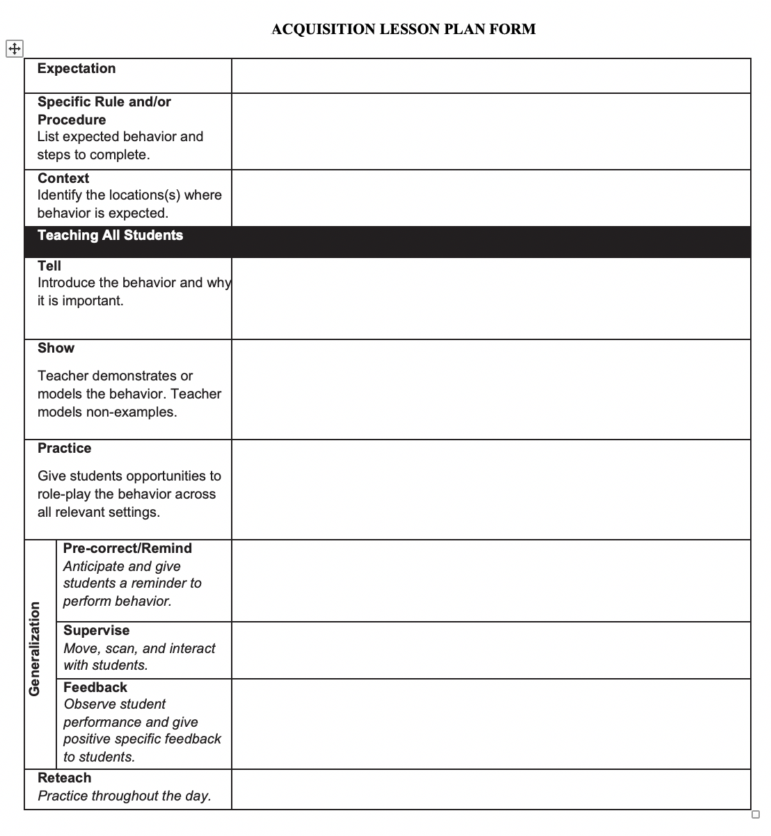
Acquisition Lesson Plan Format
Notes:
It is important for schools to write lesson plans that meet the needs of their students. To assist with the task of writing lesson plans for students who are at the acquisition phase, MO SW-PBS has developed a lesson plan template that can be utilized.
The rest of this lesson will describe all sections of the acquisition lesson plan format/template and provide examples that span grade levels.

Slide 48
Teaching Considerations
Skill Definition and Context–the Expectation from your schools matrix to help staff see how the lesson ties to the common language. The Specific Behavior(s) or Procedures defined. Context to identify the location(s) where the behavior is expected.
E.g., “Explain what Respect means in all settings of school.” Or, “Specify what students will have to do to actively listen in the classroom.”
Notes:
Skill Definition and Context
The first items that every lesson plan should include are:
The Expectation from your schools matrix to help staff see how the lesson ties to the common language.
Specific Behavior(s) and/or Procedures which is a clear description of the skill to be taught.
Context to identify the location(s) where the behavior is expected.
This information gives those teaching the lesson a clear understanding of the purpose of the skill and where the skill will be expected to be used.

Slide 49
Teaching Considerations
Acquisition Phase/Direct Teaching–includes tell, show, practice.
Tell–teacher provides definition, specific steps needed to correctly perform the skill and the location in which the skill will be expected.
Show–demonstrate or model expected behavior; include examples and non-examples.
Practice–guided practice ensures students can demonstrate the steps; best when practice occurs in the setting.
Notes:
Direct Teaching or Orientation
Each lesson plan for initial learning of a skill, regardless of the age of the students, will include ideas for teachers to directly teach the skill. Instruction of social behaviors for younger students in initial lessons for Acquisition includes tell, show and practice.
Tell means introducing the skill or behavior by directly telling the student the definition, the specific steps needed to correctly perform the skill and the location in which the skill will be expected.
Show means the teacher demonstrates or models the expected behavior. The teacher clarifies the difference between following the behavior and not following the behavior by providing positive examples and a negative example (non- example). Remember only an adult should demonstrate the non-example. Students in the class then demonstrate the examples.
The guided practice component of the lesson is a pivotal part of every lesson. Guided practice ensures that students can accurately and appropriately demonstrate the skill steps². Optimally, practice should occur in the appropriate setting(s) to effectively teach expected behaviors and procedures.

Slide 50
Teaching Considerations
Fluency Phase/Orientation Plan–for older students or new students to a building (e.g. 9th grade in high school) or transfer students. Provides a description of how students will receive instruction about skills as they pertain to the particular building.
Notes:
The acquisition lesson plan for older students provides a section for Orientation. These lesson plans will include information about how students new to a building receive instruction about the skill as it pertains to the particular building. An orientation plan for new 6th graders to a middle school or freshman in high school will describe how those students will learn all the behaviors and procedures unique to that building (e.g. cafeteria procedures, arrival and dismissal, use of electronic devices).
Orientation also includes information about how new students who transfer in during the year will receive instruction and guidance to help them feel welcome so they can become a member of the school community. The orientation plan also helps provide a rationale for why these skills are important for school success and life after graduation.

Slide 51
Teaching Considerations
Generalization Strategies–to help students maintain skills being taught and to encourage use of the skills in a variety of situations. Include:
Pre-correct or Remind – after students have been taught skill and when the teacher can anticipate students may have difficulty
Supervise – move, scan and frequent interaction strategies for staff
Feedback – positive to reinforce use of the skill and corrective to teach the student what the expected behavior is
Notes:
Generalization Strategies
Generalization is the fourth phase of learning where behavior occurs under different conditions other than those taught (people, settings, etc.). To help students maintain skills being taught and to encourage use of the skills in a variety of situations, generalization strategies are included in the lesson plan. These generalization strategies include: 1) pre-corrects or reminders, 2) supervision, and 3) feedback on performance.
Pre-Correct/Remind = Reminders before entering a setting or performing a task to promote successful demonstration of expected behaviors. Pre-corrects are best used after students have been formally taught and reminded of the correct behavior and procedures for a given setting. When a teacher can anticipate students may have difficulty, a pre-correct is given to them about the expected behavior^{3,4}. A pre-correct is different from a teacher directive. A pre-correct tells the students what to do and how to do it using the behaviors/rules that have already been taught. For example, if a teacher knows students will have trouble moving in the class without bumping into each other, the teacher might pre-correct students of the expected classroom behavior of maintaining personal space. Or before the students are asked to move into groups, the teacher would pre- correct by saying, “Remember to move safely and maintain your personal space.” Just before exiting school for the day, the teacher would pre-correct by saying, “Remember to walk in the hallways and into the parking lot.” In these examples, the pre-correct sets the stage for opportunities for the teacher to recognize students for walking quietly and safely.
Supervise = Monitor student performance or compliance in all settings. To have a positive impact on student behavior, to prevent problem behaviors from occurring and to monitor student performance, teachers must actively supervise students. Active supervision includes: 1) Moving = constantly, randomly, and targeting problem areas, 2) Scanning = observe all students, make eye contact, look and listen, and 3) Interacting Frequently = positive contact, frequent feedback, correct errors, deliver consequence.
Feedback = Information provided to students by adults and other students about how well students are performing the expected behaviors. Feedback can be categorized as positive (reinforcing the expected behavior), corrective (telling the student what the expected behavior is for the situation), and negative (giving the student a message to stop their current behavior with no information about a replacement behavior). Staff are encouraged to provide feedback, non-contingent and contingent, including specific positive feedback. To help students learn and maintain social behaviors teachers must recognize student effort. The least expensive and readily available way to recognize students is to provide specific verbal feedback and regularly recognize the efforts of students who correctly exhibit the behavior. When giving specific verbal feedback the teacher precisely states the skill the student displays so the student has no doubt about what he or she did correctly. An example would be, “Thank you Bob for being responsible by being on time and having your assignment ready to turn in.”

Slide 52
Teaching Considerations
Generalization Strategies–guided by purpose, age of student and prior learning history; vary strategies and modalities.
Writing activities–students describe the behaviors or illustrate through narrative, poetry, plays, songs, etc.
Artistic representation–performing skits, songs, posters, paintings, etc.
Sports teams, student organizations–connections to operational rules for these student groups.
Notes:
Read the slide, then say,
“These are examples of generalization strategies that involve different modalities to help students become fluent with the skill.”

Slide 53
Teaching Considerations
Reteaching
Provide additional instruction and practice on each of the steps required to correctly exhibit the behavior.
May include extension activities using other modalities through activities and games.
Important for staff to recognize “almost there” behavior as an instructional step toward perfect performance.
Notes:
Re-teaching is the process of providing additional instruction and practice on each of the steps required to correctly exhibit the behavior. As some students struggle to learn the expected social behavior, it is important to provide additional practice and recognition to them as they make progress toward correctly exhibiting the behavior (e.g. “Nice work, Ted, turning in your homework. Let me show you which bin you should place it in as you come in the door of the classroom.”). Re-teaching can also be supported through extension activities using other modalities. For example, if the class has been taught how to follow directions, the instructor could provide independent practice for the students through an art activity or game where they apply the steps in following directions. Sometimes teachers need to recognize “almost there” behavior as an incremental step toward perfect performance of a social behavior.

Slide 54
Putting It All Together: Acquisition Lesson Plan
Expectation
Specific Behavior(s) or Procedure
Context
Orientation Plan
Tell, Show, Practice
Generalization
Pre-Correct
Supervise
Feedback
Reteach
Notes:
Provide access to Workbook p. 154.
“Here is a template your team will use to write lessons to teach the expectations and rules/behaviors on your matrix.
First you will specify the behavior(s) you will teach.
Then you will identify the context or setting(s) in which the behavior should be exhibited (i.e. All settings, only nonclassroom settings or classrooms.)
You will define what the behavior will look or sound like and why it is important for your school community.
The orientation plan would be applicable for underclassmen and new students to the building.
Effective teaching will also include demonstrations of the behavior. Demonstrations will include an example, nonexample, then another example. Adults or students can provide examples of the appropriate behavior. Only adults should provide nonexamples.
Students should be provided multiple opportunities to practice the behavior in all settings in which the behavior is expected.
Help student generalize by reminding the students of the expected behavior before the students must exhibit the behavior and provide adequate supervision to increase the likelihood the behavior will be maintained. Provide performance feedback to all students.
Reteach when feedback indicates it is required, when new students join the class, or after extended breaks.

Slide 55
Lessons to Initially Teach all Expected Behavior in Practice
Notes:
Trainer Notes:
To Know/To Say:

Slide 56
Topic In Practice
Review the following sample lessons and look for commonalities and differences according to the age/grade levels they represent in relation to purpose, format, content, and setting.
Notes:
Review the following sample lessons and look for commonalities and differences according to the age/grade levels they represent in relation to purpose, format, content, and setting.
Provide access to different level example handouts.

Slide 57
Lessons to Initially Teach all Expected Behavior in Action
Notes:
Trainer Notes:
To Know/To Say:

Slide 58
Topic In Action
Use the Acquisition Lesson Plan template provided to practice writing a lesson for one of the topics your team previously chose as a priority lesson. You can write a lesson for a schoolwide procedure (similar to cafeteria) or for a behavior on your school’s matrix.
Make plans to complete all needed acquisition plans.

Slide 59
Lessons to Initially Teach all Expected Behavior Closing and Next Steps
Notes:
To Know/To Say: So, let’s take a moment to briefly review where we’ve been, and where to next.
During this lesson, you learned the process of developing high quality lesson plans to initially teach acquisition of the expected behaviors outlined in the social behavioral curriculum that your school developed.

Slide 60
Closing and Next Steps
Develop action steps for the creation of acquisition lessons on schoolwide, non-classroom, and classroom expectations and procedures have been developed and shared with all staff.
Notes:
To Know/To Say: During this lesson, you learned
How will you engage all staff in developing lesson plans that include all components of high quality acquisition teaching and cover all necessary components of your social behavioral curriculum?
Next steps include updating your action plan. Develop action steps for the creation of acquisition lessons on schoolwide, non-classroom, and classroom expectations and procedures have been developed and shared with all staff.
Additional information about <Topic> can be found in the MO SW-PBS Handbook and the MO SW-PBS Tier 1 Implementation Guide.

Slide 61
References
Herner, T. (1998). Counterpoint. NASDE, p. 2.
Sugai, G., & Horner, R. H. (1999). Discipline and behavioral support: practices, pitfalls and promises. Effective School Practices, 17(4), 10-22.
Colvin, G., Sugai, G., & Patching, B. (1993). Precorrection: An instructional approach for managing predictable problem behaviors. Intervention in School and Clinic, 28(1), 143-150.
Lewis, T. J., Newcomer, L. L., Trussell, R., & Richter, M. (2006). Schoolwide positive behavior support: Building systems to develop and maintain appropriate social behavior. In C. M. Everston & C. S. Weinstein (Eds.) Handbook of classroom management: Research, practice, and contemporary issues (pp. 833-854). Mahwah, NJ: Lawrence Erlbaum Associates, Inc.
Notes:
Trainer Notes:
To Know/To Say:

Slide 62
Develop “Booster” Lessons for Maintenance of Expected Behavior
Teaching Expected Behavior
Notes:
Trainer Notes:
To Know/To Say:

Slide 63
Working Agreements
Be Respectful
Be an active listener—open to new ideas
Use notes for side bar conversations
Be Responsible
Be on time for sessions
Silence cell phones—reply appropriately
Be a Problem Solver
Follow the decision making process
Work toward consensus and support decisions of the group
Notes:
Trainer Notes: Hide or delete this slide if presenting the entire PLM
To Know/To Say: “These will be the Working Agreements we will honor during all our training sessions this year.”

Slide 64
Attention Signal
Notes:
Trainer Notes: Hide or delete this slide if presenting the entire PLM; Facilitator: Select an attention signal.
To Know/To Say:
“One of our agreements is to follow the attention signal.”
“Your team will work with your school to develop an attention signal you will use in every setting.”
“In order to get all of you focused after discussions, activities or breaks,
I will ________________________________________.”
(Insert your attention signal here.)
“Your task will be to finish your sentence, quiet your voice and ____________________________.”
(Insert what you want participants to do.)

Slide 65
Introductions
Notes:
Trainer Notes: Hide or delete this slide if presenting the entire PLM; Select an introductions activity.
To Know/To Say:

Slide 66
Essential Function
The building leadership team has developed a set of booster lessons for maintenance of expected behavior in the social behavioral curriculum.
Notes:
Trainer Notes:
To Know/To Say:

Slide 67
Lesson Outcomes
At the end of this session, you will be able to…
Develop a system to teach expected behavior in the social behavioral curriculum, that includes:
creating a set of booster lessons for maintenance of expected behaviors.
Notes:
Trainer Notes:
To Know/To Say:

Slide 68
Importance/Overview of Developing Booster/Maintenance Lessons
Notes:
Trainer Notes:
To Know/To Say:

Slide 69
“”Booster” lessons are lessons taught periodically and are intended to help students maintain the skill over time and in a variety of setting and situations.”
MO SW-PBS
Notes:
Read the slide, then say,
“”Booster” lessons are lessons taught periodically and are intended to help students maintain the skill over time and in a variety of settings and situations.”¹
After you have developed acquisition level lesson plans for your social behavioral curriculum, it is important to consider ways to help students maintain the newly acquired skills. When students show fluency in their use of social behaviors from your matrix, teaching may transfer to more periodic maintenance or “booster” lessons.

Slide 70
Key Terms
Maintenance is the ability to perform a behavior over time.
Notes:
“Booster” lessons are lessons taught periodically and are intended to help students maintain the skill over time and in a variety of settings and situations. Maintenance is the ability to perform a behavior over time. These lessons would consist of reminders of when, where, and how expected behaviors are to be performed. Staff continue to actively supervise giving students feedback to maintain skill usage.
Understanding the skill level of students will ensure staff members design lessons that articulate the purpose of each lesson and use an understandable format to address student needs.

Slide 71
Unpacking Developing Booster/Maintenance Lessons
Notes:
Trainer Notes:
To Know/To Say:

Slide 72
Maintenance “Booster” Lessons
Periodically taught
Intended to help students maintain the skills over time and in a variety of settings and situations
Notes:
In preschool and elementary school, the focus is on directly teaching students the expected social behavior through the tell, show, practice, monitor, and reteaching steps described earlier. Instruction takes place each day, throughout the day, all year long. With consistent and ongoing instruction throughout the year in elementary school, the focus of instruction in middle school and high school may change².

Slide 73
Putting It All Together: Maintenance “Booster” Lesson Plan
Expectation
Specific Behavior(s)
Context
Generalization
Pre-Correct
Supervise
Feedback
Reteach
Notes:
The focus of lessons for older students includes the components of Pre-Correct/Remind, Supervise, and Feedback and assumes:
faculty and staff have agreement on expectations and specific behaviors from their schoolwide matrix;
older students have had an orientation to these commonly held procedures and routines; and
it will be sufficient for supporting expected student behaviors of returning students or upperclassmen at the beginning of the year by the adult actions of Remind, Supervise, and Feedback.

Slide 74
Lesson Demonstration
[Insert expectation or behavior for which you will demonstrate a lesson. Conduct an example 5-7 minute lesson.]
Notes:
Select a lesson from Workbook pp. 143 – 148 to demonstrate.

Slide 75
Teaching Older Students
Beginning of School Year Orientation Day for underclassmen.
Time built in during first weeks of school and boosters later in year.
Advisory period, weekly throughout the year.
Assemblies followed with group practice.
New Student Orientation when needed.
Student Ambassadors to serve as support/models for newly enrolled students.
Notes:
“Here are more example activities your school can use to teach older students.”

Slide 76
Maintenance Still Involves Teaching
Telling and expecting students to “know it” is insufficient for students to be fluent and competent in performing the social behaviors expected at school.
Notes:
Regardless of the age of students being taught, the critical idea is that consistent, ongoing, and planned instruction does indeed take place until students become fluent using the expected social skills. Telling and expecting students to “know it” is insufficient for students to be fluent and competent in performing the social behaviors expected at school.

Slide 77
Developing Booster/Maintenance Lessons in Practice
Notes:
Trainer Notes:
To Know/To Say:

Slide 78
Topic In Practice
Review the following sample lessons and look for commonalities and differences according to the age/grade levels they represent in relation to purpose, format, content, and setting.

Slide 79
Developing Booster/Maintenance Lessons in Action
Notes:
Trainer Notes:
To Know/To Say:

Slide 80
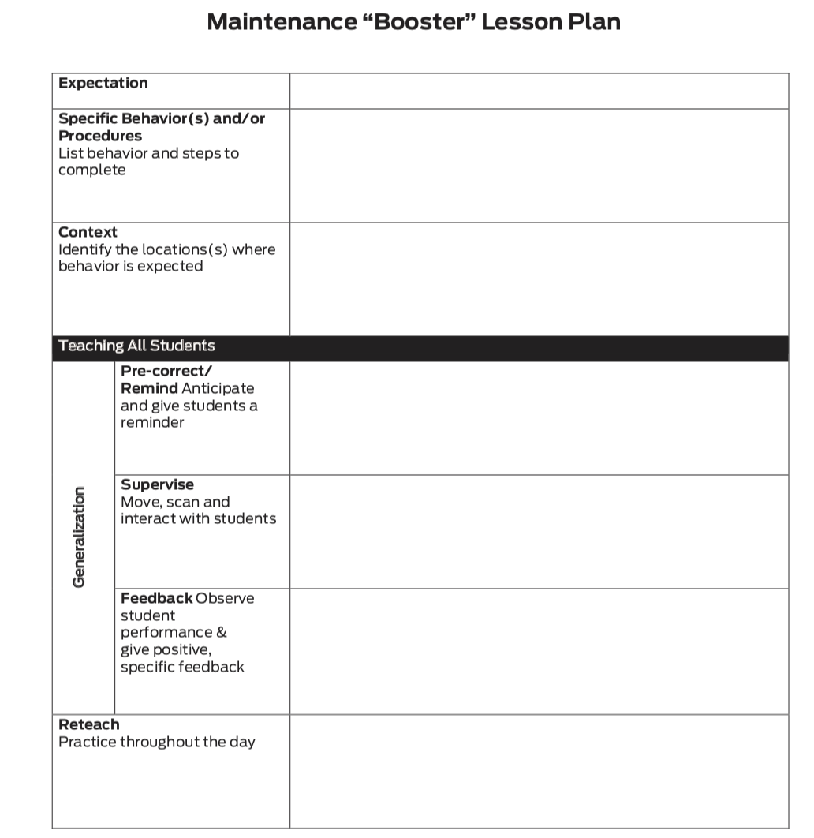
Topic In Action
Review monthly office discipline data to determine a skill your students are fluent in performing. Come to consensus on a skill for which a maintenance “booster” lesson is needed, and write that lesson using the Blank Maintenance “Booster” Lesson Plan form.

Slide 81
Topic In Action
Discuss what behaviors/rules or procedures you need possible maintenance “booster” lesson plans for. Then decide on ways your school could share the work of writing “booster” lessons.

Slide 82
Developing Booster/Maintenance Lessons Closing and Next Steps
Notes:
To Know/To Say: So, let’s take a moment to briefly review where we’ve been, and where to next.
During this lesson, you learned about “booster” lessons that are taught periodically and are intended to help students maintain the skill over time and in a variety of settings and situations

Slide 83
Closing and Next Steps
Develop action steps for developing “booster” or maintenance lessons based on your school’s social behavioral curriculum.
Notes:
To Know/To Say: Next steps include updating your action plan. Develop action steps for developing “booster” or maintenance lessons based on your school’s social behavioral curriculum.
Additional information about <Topic> can be found in the MO SW-PBS Handbook and the MO SW-PBS Tier 1 Implementation Guide.

Slide 84
References
MO SWPBS Tier 1 Implementation Guide
Colvin, G. (2007). 7 steps for developing a proactive school discipline plan: A guide for principals and Leadership Teams. Thousand Oaks, CA: Corwin Press.
Notes:
Trainer Notes:
To Know/To Say:

Slide 85
Developing a Schedule for Teaching Expectations
Teaching Expected Behavior
Notes:
Trainer Notes:
To Know/To Say:

Slide 86
Working Agreements
Be Respectful
Be an active listener—open to new ideas
Use notes for side bar conversations
Be Responsible
Be on time for sessions
Silence cell phones—reply appropriately
Be a Problem Solver
Follow the decision making process
Work toward consensus and support decisions of the group
Notes:
Trainer Notes: Hide or delete this slide if presenting the entire PLM
To Know/To Say: “These will be the Working Agreements we will honor during all our training sessions this year.”

Slide 87
Attention Signal
Notes:
Trainer Notes: Hide or delete this slide if presenting the entire PLM; Facilitator: Select an attention signal.
To Know/To Say:
“One of our agreements is to follow the attention signal.”
“Your team will work with your school to develop an attention signal you will use in every setting.”
“In order to get all of you focused after discussions, activities or breaks,
I will ________________________________________.”
(Insert your attention signal here.)
“Your task will be to finish your sentence, quiet your voice and ____________________________.”
(Insert what you want participants to do.)

Slide 88
Introductions
Notes:
Trainer Notes: Hide or delete this slide if presenting the entire PLM; Select an introductions activity.
To Know/To Say:

Slide 89
Essential Function
The building leadership team has a schedule for teaching expectations in the social behavioral curriculum.
Notes:
Trainer Notes:
To Know/To Say:

Slide 90
Lesson Outcomes
At the end of this session, you will be able to…
Develop a system to teach expected behavior in the social behavioral curriculum, that includes:
developing and sharing a schedule for teaching expected behaviors.
Notes:
Trainer Notes:
To Know/To Say:

Slide 91
Importance/Overview of Developing a Teaching Schedule
Notes:
Trainer Notes:
To Know/To Say:

Slide 92
“For a child to learn something new you need to repeat it an average of eight times.”
Harry Wong
MO SW-PBS
Notes:
“For a child to learn something new, you need to repeat it an average of eight times.
For a child to unlearn an old behavior and replace it with a new behavior, you need to repeat the new behavior an average of 28 times.
Twenty of those times are used to eliminate the old behavior, and eight of the times are used to learn the new behavior.”
Madeline Hunter

Slide 93
Common Language Requires Teaching
Notes:
Words are powerful. When all staff members use common language, we ensure consistency for all students which is especially important to ensure equitable implementation of practices. The consistency and predictability of a common language is also a critical support for students who are at-risk and at high-risk of behavior incidents, promoting a safe environment where students know the expectations and can predict how others will respond.
In order to establish this common language, the lessons plans that have been developed must be taught by all staff members to all students.

Slide 94
Unpacking Developing a Teaching Schedule
Notes:
Trainer Notes:
To Know/To Say:

Slide 95
“For a child to learn something new you need to repeat it an average of eight times.”
Harry Wong
MO SW-PBS
Notes:
“For a child to learn something new, you need to repeat it an average of eight times.
For a child to unlearn an old behavior and replace it with a new behavior, you need to repeat the new behavior an average of 28 times.
Twenty of those times are used to eliminate the old behavior, and eight of the times are used to learn the new behavior.”
Madeline Hunter

Slide 96
Teaching Schedule
A significant amount of teaching is needed at the beginning of the year.
Teach just prior to needing to use the behavior (e.g., assembly behavior taught right before the first assembly).
Review should be planned throughout the year, particularly following breaks or holidays.
Teaching focus should reflect student needs; more teaching when problem behavior surfaces.
Develop a perpetual teaching schedule–what will be taught by whom, when.
A schedule for teaching helps to ensure accountability.
MO SW-PBS
Notes:
Direct participants to read the slide, then say,
“Teaching social behavior must be ongoing in order to increase the likelihood that all students will display appropriate behavior in all settings. You should consider reserving time now in the schedule for the teaching of lessons for the next school year.”
When developing a teaching schedule, the following points may need to be considered:
Instruction takes place each day, all day, throughout the entire school year for young students or for those students who continue to demonstrate they are at the acquisition level.
Focused lessons at the beginning of the year to teach all schoolwide and classroom expectations, rules, and procedures. This includes direct instruction the first few weeks of school in the setting where the skills or procedures are used.
Beginning of the school year orientation period, such as a day for underclassmen before all students attend school.
Weekly lessons in advisory period, homeroom, or classroom.
New Student Orientation using student ambassadors as orientation models for newly enrolled students.
Review lessons after school breaks (e.g., long weekends, winter and spring breaks). Weeklong or short reminder lessons as appropriate for the skill level and age of students.
Quarterly assemblies followed with group practice for students who have acquired the skill but need maintenance or an “extra dose” of instruction.

Slide 97
Arranging Time for Teaching
School orientation activities
“Boot camp” the first few weeks of school
Homeroom
Daily class meetings
School-wide announcements over intercom followed by 10-minute lessons
Daily or weekly web announcements
Embedding in academic subjects
Designated time for all to teach (e.g., class right before lunch to teach cafeteria behaviors)
MO SW-PBS
Notes:
“Here are suggestions for scheduling specific times to teach or reteach expectations and behaviors.”
Schools need to decide when lessons will be taught during the day or week. Some typical examples of how to arrange time for teaching social behavior skills might include: homeroom, daily class meetings, schoolwide announcement over the intercom, daily or weekly web announcements, embedding in academic subjects, and older students leading younger students through school orientation activities.

Slide 98
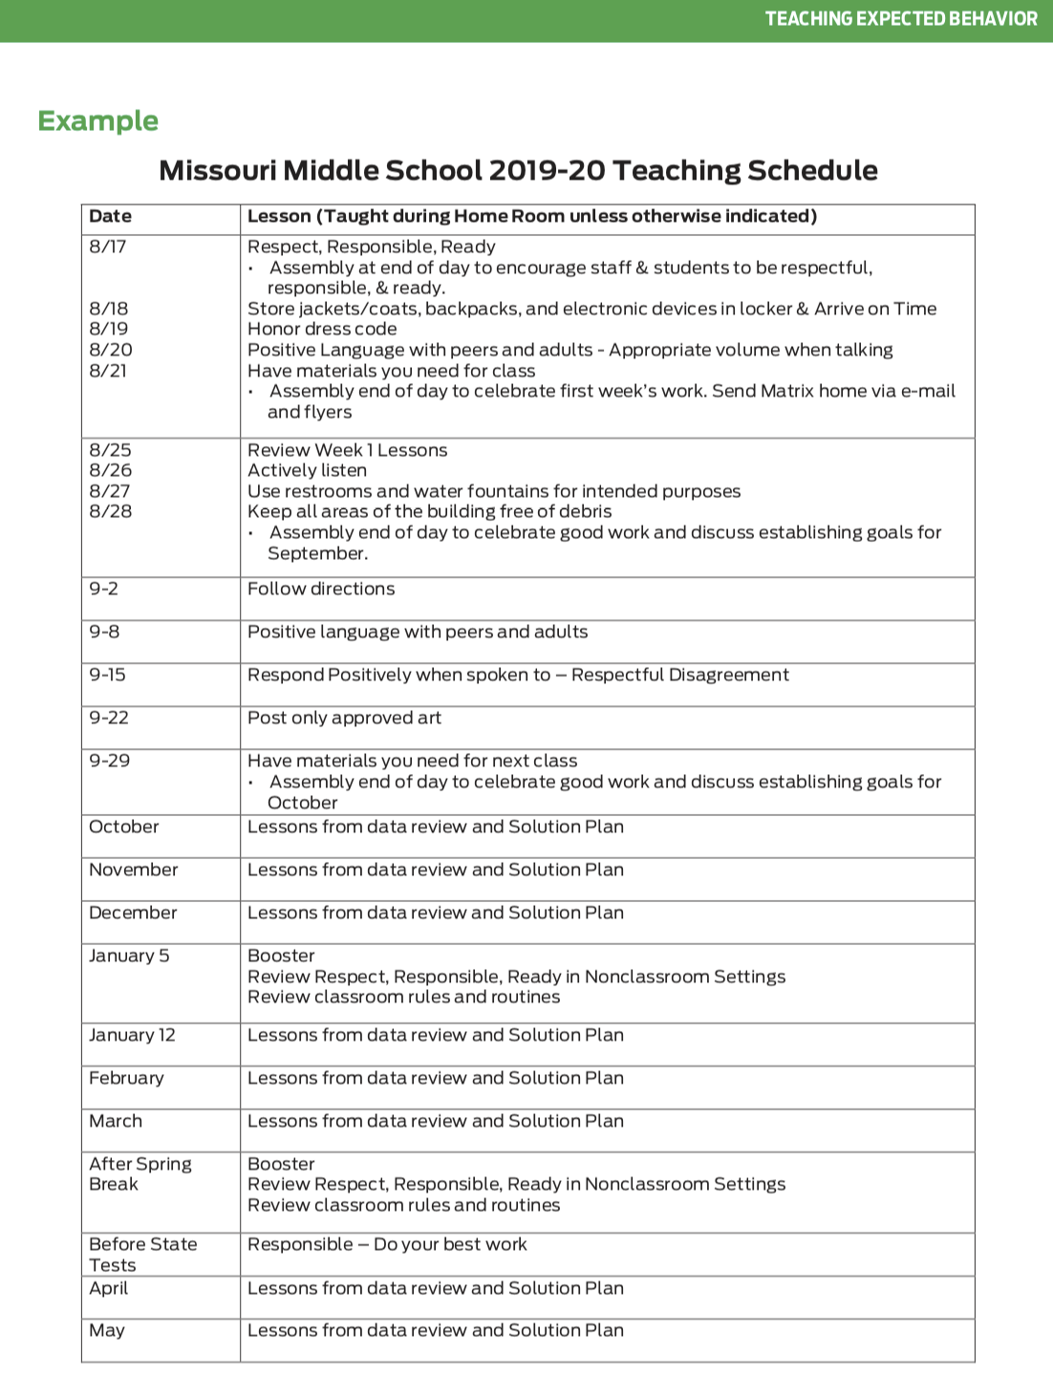
Teaching Schedule Example
Notes:
It is recommended that schools create a teaching calendar that schedules when lessons are to be taught all year long. When developing a teaching calendar, schools may consider devoting a significant amount of teaching at the beginning of the year. Reviews should be planned throughout the year, particularly following breaks or holidays. Teaching just prior to needing to use the behavior (e.g., assembly behavior taught right before the first assembly) should also be scheduled. The year long teaching schedule should provide an outline for the year, but allow for flexibility based on data.

Slide 99
Important Considerations
Schedule is acceptable to stakeholders.
Teaching schedule can be sustained.
Lessons are long enough to teach the skill, but doable.
Adequate staff are available to teach.
Notes:
There are many, many ways teaching can be accomplished. Some important considerations are : 1) making sure the schedule is acceptable to stakeholders, educators, and students teaching lessons, 2) ensuring the teaching schedule can be sustained throughout the year, 3) lessons are long enough to adequately teach the skill but short enough that staff will actually make time to teach and 4) adequate staff are available to teach in the identified settings.

Slide 100
Discussion: Scheduling Teaching
Discuss with your team and be prepared to share with the large group:
How will we arrange for initial teaching of social behaviors at our school?
How will we arrange for regular, ongoing teaching throughout the school year?
What are some creative ways to weave the school-wide teaching of social behavior into our school day and year?
Notes:
Direct participants to read the questions.
Then say,
“Your school may decide to reserve time in the schedule for teaching now, then during Emerging Training Session 1, specifically determine which lessons will be taught during each time.”
Provide approximately 10-15 minutes. Call on volunteers to respond to each of the questions

Slide 101
Developing a Teaching Schedule in Practice
Notes:
Trainer Notes:
To Know/To Say:

Slide 102
Topic In Practice: Schedule
Review and discuss the teaching schedule example.
Based on the grade levels of students in your school, what might be some logical ways to weave initial schoolwide teaching of social behavioral skills into your school day and year?

Slide 103
Developing a Teaching Schedule in Action
Notes:
Trainer Notes:
To Know/To Say:

Slide 104
Topic in Action: Schedule
How will you engage staff, students, and families to make decisions about your initial teaching schedule?
Use the lesson schedule form to practice writing a lesson schedule.

Slide 105
Developing a Teaching Schedule Closing and Next Steps
Notes:
To Know/To Say: So, let’s take a moment to briefly review where we’ve been, and where to next.

Slide 106
Closing and Next Steps
Develop action steps for the creation of an annual plan for the ongoing teaching of all expectations, rules, and procedures.
Notes:
To Know/To Say: During this lesson, you learned how to create an annual teaching schedule that allows for all developed lessons to be taught and also allows time for teaching based on data indicated needs.
Next steps include updating your action plan. Develop action steps for the creation of an annual plan for the ongoing teaching of all expectations and rules. Additional information about developing a teaching schedule can be found in the MO SW-PBS Handbook and the MO SW-PBS Tier 1 Implementation Guide.

Slide 107
References
Algozzine, B., Wang, C., & Violette, A. S. (2011). Reexamining the relationship between academic achievement and social behavior. Journal of Positive Behavior Interventions, 13(1), 3-16.
Notes:
Trainer Notes:
To Know/To Say:

Slide 108
Contact Information
Check Out MO SW-PBS on Social Media:
Facilitator Contact Information:
pbismissouri.org
facebook.com/moswpbs
@MOSWPBS

