Slide 1
Hidden Slide #1
The CTE Module was designed to be used in the following manner.
The audience for this Module is Leadership Teams, including district and building leaders. This Module is not meant for whole staff presentations.
Participants complete the Base Module, Collective Teacher Efficacy: An Introduction to Developing CTE in Schools.
Following this training, participants should complete the Flow Chart or the CTE Planning Reflection Questions document to determine next steps.
There are four Focus Modules. Teams are not required to complete all four Focus Modules. Instead, participants will complete only those Focus Modules that fit the needs of their school. Both the Flow Chart and CTE Planning Reflection Questions document were designed to direct a group to a starting Focus Module.
Notes:
The Base Module is designed to be completed in 2 to 2.5 hours and each Focus Module in 1 to 1.5 hours.

Slide 2
Hidden Slide #2
CTE in-person training suggestions
Presenter notes information
Notes:
CTE in-person training suggestions
The CTE Social Networks Module is designed to be completed in 1 to 1.5 hours.
This presentation provides the basic information regarding how social networks can enhance CTE. You may want to add or enhance portions with visuals and examples that will resonate with your audience. As a reminder, always be sure to include appropriate citations when adding resources. Also, you might look to the coaching companion for additions that may be helpful.
In summary
This module outlines the basics of CTE and Social Networks
It can be adapted to individual contexts
The training should last about 1 to 1.5 hours
Presenter notes information
Presenter notes are included in the PowerPoint. Background information for the presenter is shown as “To Know.” Statements to be shared with participants are shown as “To Say.” In some instances, the “To Know/To Say” are combined. The presenter notes also include “To Do” prompts and cues for “Handouts” (illustrated by icons – see slide 13 for icon glossary).
Additional activities, examples, videos, etc. are being developed as a CTE Coaching Companion. A presenter may add material from the Coaching Companion to corresponding PowerPoint content.
A printed Practice Profile and an electronic Self-Assessment Practice Profile (SAPP) tool are available for use by individuals, teams, or schools for periodic self-assessment and monitoring of implementation of practice or to identify training or coaching needs.
The presenter should download onto a hard drive or a flash drive any video intended for use in a training. You might not have internet access at the school sites.
Breaks should be inserted at the discretion of the presenter based on the needs of participants.

Slide 3
Hidden Slide #3
Supplies needed
WIFI access for presenter and participants
Access to videos (through WIFI if available, but download to flash drive as a back-up)
Chart paper
Markers
Post-it-Notes
Notes:
To Know
These supplies are needed for the CTE Professional Learning Modules.

Slide 4

Hidden Slide #4
Handouts:
Pre or Post Reading Brinson, D., & Steiner, L. (2007). Building collective efficacy: How leaders inspire teachers to achieve (Issue Brief). Retrieved from https://files.eric.ed.gov/fulltext/ED499254.pdf
CTE Infographic
CTE Graphic Organizer
Middle School High Five: Strategies Can Triumph. Retrieved from https://www.ncte.org/library/NCTEFiles/Resources/Journals/VM/0132-dec05/VM0132Middle.pdf
CTE Flow Chart
CTE Planning Reflection Questions
CTE Practice Profile
CTE Action Plan
Notes:
To Know
The CTE Participant and Presenter Materials are located on the Moedu-SAIL website in the CTE Handout Packet. Due to copyright, some materials are linked to their original source and must be downloaded from the link.
Go to: http://www.moedu-sail.org/mmd-professional-development/mmd-content/
References
Brinson, D., & Steiner, L. (2007). Building collective efficacy: How leaders inspire teachers to achieve (Issue Brief). Washington, DC: Center for Comprehensive School Reform and Improvement. Retrieved from https://files.eric.ed.gov/fulltext/ED499254.pdf
Goodman, A. (2005). Middle school high five: Strategies can triumph. Voices from the Middle, 13(2), 12-19. Retrieved from https://www.ncte.org/library/NCTEFiles/Resources/Journals/VM/0132-dec05/VM0132Middle.pdf

Slide 5
Hidden Slide # 5
CTE Key Terms
Collective Teacher Efficacy (CTE) is a perception of teachers in a school that the efforts of the faculty as a whole will have a positive effect on students.
Efficacy is a capacity for producing a desired result or effect.
Self-Efficacy is an individual's belief in his or her capacity to execute behaviors necessary to produce specific performance and goal attainment.
Teacher Efficacy is one’s confidence in his/her ability to promote students’ learning.
Collective Efficacy is a group’s shared belief in its combined capabilities to attain their goals and accomplish desired tasks.
Mastery Experience is when you experience success firsthand. It requires experience in overcoming obstacles through perseverant effort.
Vicarious Experience is seeing people similar to oneself succeed.
Notes:
To Know
These are the key terms used throughout the module.

Slide 6
Hidden Slide # 6
CTE Key Terms
Social Persuasion is when a trusted source gives feedback and encouragement.
Affective State is when people rely partly on their emotional state to judge their capabilities.
A Social Network is a network of individuals (e.g. friends, acquaintances, coworkers) connected by interpersonal relationships.
Collaboration means to work jointly with others.
Teacher Leadership refers to other roles teachers, who work directly with students, participate in that have an influence extending beyond their own classroom/caseloads.
Decision Making means the act or process of deciding something important, especially in a group of people or an organization.
Notes:
To Know
These are the key terms used throughout the module.

Slide 7
Hidden Slide # 7
CTE Key Terms
Teacher Voice refers to the values, opinions, beliefs, perspectives, expertise, and cultural backgrounds of the teachers working in a school/district.
Teacher Inquiry is a process used by educators to explore teaching practices that enables the identification of successful approaches to improving learning and outcomes for students.
Professional Learning refers to activities educators engage in to stimulate their thinking and professional knowledge to ensure that their practice is informed and current.
Notes:
To Know
These are the key terms used throughout the module.

Slide 8

Pre/Post-Reading Opportunity
Notes:
To Know
This article may be used as a pre or a post reading. This post provides ideas for ways teachers might connect more with colleagues. As teams are planning for increased opportunities for teacher social networks at the end of this module, challenge them to use some of these ideas or ideas of their own to create formal supports that will encourage social networks.
Handout
You will need to be downloaded from the original source due to Copyright.
https://www.bestcollegesonline.com/blog/25-ways-teachers-can-connect-more-with-their-colleagues/
References
Best Colleagues Online (n.d.). 25 ways teachers can connect more with their colleagues. Retrieved from https://www.bestcollegesonline.com/blog/25-ways-teachers-can-connect-more-with-their-colleagues

Slide 9
Collective Teacher Efficacy
Collaboration and Social Networks
Focus Module

Slide 10
Acknowledgements
Special thanks to all contributors to the development and revision of this Professional Learning Module.
The original collection of Professional Learning Modules was rolled-out for use by Regional Professional Development Center (RPDC) Consultants in July 2013 after being developed by a team of content experts through efforts funded by the Missouri State Personnel Development Grant (SPDG).
Content Development and Revision Support Team, 2019
  Carla Williams, UCM Marcia Clark, SE RPDC
  Liz Condray, SCRPDC Jan Davis, MoEdu-SAIL
  Janie Pyle, Raytown School District Cheryl Wrinkle, SW RPDC
  Marilyn Cannon, Raytown School District
Institute for Human Development
Ronda Jenson Jodi Arnold
Sarah Marten Arden Day
Chelie Nelson Cynthia Beckmann
SPDG Management Team
Notes:
To Know/To Say
Special thanks to all contributors to the development and revision of this Professional Learning Module.

Slide 11
Welcome and Introductions
Our trainers for the day

Slide 12
Norms
Begin and end on time
Be an engaged participant
Be an active listener - open to new ideas
Use notes for side bar conversations
Use electronics respectfully
Notes:
To Know
It is important to establish norms for training. Trainers are free to adjust this list of norms.
To Do
Consider including a check mid-way through trainings to assess a norm or norms. The presenter may want to use norms printed on agenda handouts in addition to or in place of presentation slides, so the norms are always available in print for participants. Norms may be added to address specific school needs. Some schools already have established norms for all PD. In that case, adapt to their norms.
To Say
Please review the norms for this training. Are there any additions that need to be made to the norms at this time?

Slide 13





Icon Glossary
Collective Teacher Efficacy
Step-by-Step Guide
Reflection/Activities
Handout Packet
Essential Questions
Blueprint
Notes:
To Know/To Say
You will see these icons on slides and handouts throughout the presentation.

Slide 14
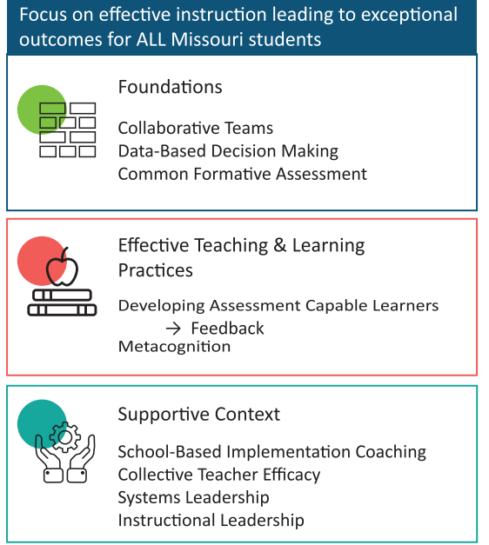
District Continuous Improvement Framework (MMD/DCI)
Notes:
To Know
Missouri’s Professional Learning Modules are organized in the same three categories as defined in the District Continuous Improvement Framework (MMD/DCI). All schools begin their professional development journey with the Foundations, as these professional learning modules provide foundational knowledge in three key areas: Collaborative Teams, Data-Based Decision Making, and Common Formative Assessment. Effective Teaching & Learning Practices encompass research-based instructional practices for deepened learning. These professional learning modules address ways of connecting with students, ways of helping students learn how to learn, and feature specific instructional practices. Supportive Context contains Professional Learning Modules designed to help school staff support and enhance the implementation of Effective Teaching & Learning Practices through technology, leadership, and coaching supports.
To Do/To Say
Before we delve into CTE, let’s take a few minutes to review the MMD/DCI Framework graphic, looking specifically at where CTE falls into the larger content.
As you see, the focus of MMD/DCI is on effective instruction leading to exceptional outcomes for all Missouri students.
The Content Framework has three main components:
Foundations (consisting of Collaborative Teams, Data-Based Decision Making, and Common Formative Assessment)
Effective Teaching and Learning Practices (Developing Assessment Capable Learners with Feedback and Metacognition)
Supportive Context (School Based Implementation Coaching, Collective Teacher Efficacy, and Leadership)
References
District Continuous Improvement (MMD/DCI) Blueprint, Third Edition, (2019). Missouri Department of Elementary and Secondary Education: Northern Arizona University, Institute for Human Development.

Slide 15
CTE Alignment with
MO Leader Standards
Standard #2 Teaching and Learning
Educational leaders have the knowledge and ability to ensure the success of all students by promoting a positive school culture, providing effective instructional program that applies best practice to student learning, and designing comprehensive professional growth plans for staff.
Notes:
To Know/To Say
The CTE module aligns with the Missouri Learning Standards because it addresses
teacher collaboration,
reflection,
data analysis,
action planning, and
feedback.

Slide 16
CTE Alignment with
MO Teacher Standards
This CTE module supports the following MO Teacher Standards.
#2 Student Learning, Growth, and Development: Teachers can adapt instruction in order to effectively teach all learners
#7 Student Assessment and Data Analysis: Teachers uses formative and summative assessment strategies to assess learner progress
#8 Professionalism: Teachers are reflective practitioners and use data to inform reflection
#9 Collaboration: Teachers collaborate with a shared goal of effective instruction and student learning
Notes:
To Know
Detailed information about the MO Teacher Standards is provided below for your review only.
Standard #2 Student Learning, Growth and Development: The teacher understands how students learn, develop, and differ in their approaches to learning. The teacher provides learning opportunities that are adapted to diverse learners and support the intellectual, social, and personal development of all students. [SB 291 Section 160.045.2 (1) Students actively participate and are successful in the learning process; (5) The teacher keeps current on instructional knowledge and seeks and explores changes in teaching behaviors that will improve student performance.]
Standard #7 Student Assessment and Data Analysis: The teacher understands and uses formative and summative assessment strategies to assess the learner’s progress and uses both classroom and standardized assessment data to plan ongoing instruction. The teacher monitors the performance of each student, and devises instruction to enable students to grow and develop, making adequate academic progress. [SB 291 Section 160.045.2 (2) Various forms of assessment are used to monitor and manage student learning; (5) The teacher keeps current on instructional knowledge and seeks and explores changes in teaching behaviors that will improve student performance.]
Standard #8 Professionalism: The teacher is a reflective practitioner who continually assesses the effects of choices and actions on others. The teacher actively seeks out opportunities to grow professionally in order to improve learning for all students. [SB 291 Section 160.045.2 (2) Various forms of assessment are used to monitor and manage student learning; (5) The teacher keeps current on instructional knowledge and seeks and explores changes in teaching behaviors that will improve student performance; (6) The teacher acts as a responsible professional in the overall mission of the school.]
Standard #9 Professional Collaboration: The teacher has effective working relationships with students, parents, school colleagues, and community members. [SB 291 Section 160.045.2 (4) The teacher uses professional communication and interaction with the school community; (6) The teacher acts as a responsible professional in the overall mission of the school.] Quality Indicator 1: Induction and collegial activities. Quality Indicator 2: Collaborating to meet student needs. Quality Indicator 3: Cooperative partnerships in support of student learning.

Slide 17
Session-at-a-Glance
Introduction and Learner Outcomes
Review of Collective Teacher Efficacy
Developing a Common Understanding of Social Networks and Collaboration
Understanding the Impact of Social Networks in Schools
Analyzing our own Social Networks and Action Planning
Notes:
To Know
There is an agenda
To Do/Say
Show the slide to participants
Please look over the slide. We are addressing CTE and Social Networks and the effect they have on school culture and student outcomes.

Slide 18
Learning Targets
By the end of the session, the learner will know how to
describe how CTE can improve student outcomes,
explain the impact of social networks and collaboration on CTE,
Identify strategies for the promotion of social networks and collaboration, and
design intentional support and opportunities for establishing CTE through social networks and collaboration.
Notes:
To Know/To Do
Go over the learning targets listed
To Say
As a learner, today you will develop an understanding of CTE and social networks and how both can impact student outcomes.
Following the training, you will have time to plan how to incorporate supports for CTE and Social Networks in your school/district.

Slide 19
Essential Questions
What is CTE and how does it impact student learning?
What is happening in my school now that facilitates CTE through social networks and collaboration?
Where do I go from here?
Notes:
To Know/To Say
Let’s begin the work of CTE and Social Networks with these essential questions in mind.

Slide 20

Notes:
To Know/To Say
The CTE infographic summarizes key content from the learning package.
Handout
CTE InfoGraphic

Slide 21
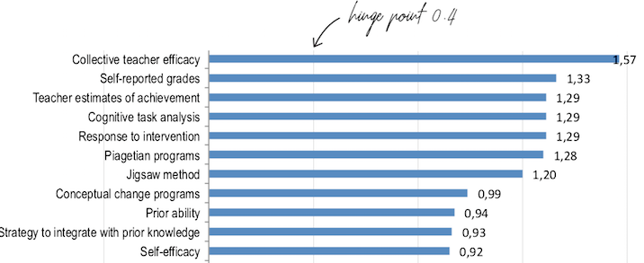
John Hattie 2018 Effect Size of Factors Influencing Student Achievement
(https://visible-learning.org/hattie-ranking-influences-effect-sizes-learning-achievement)
Notes:
To Know
This slide is hidden and can be used if participants need a review.
John Hattie shows the effect sizes of the factors that most impact student achievement.
To Do/Say
Show the slide
This chart serves as a reminder of why we are talking about ways to build CTE and illustrates the most recent effect size as John Hattie adds studies to his meta-analyses. Collective Teacher Efficacy is currently ranked first; it was second a year ago. It is advisable to check the rankings on a yearly basis.
References
Visible-Learning. (n.d.). Hattie’s ranking: 252 influences and effect sizes related to student achievement. Retrieved from https://visible-learning.org/hattie-ranking-influences-effect-sizes-learning-achievement

Slide 22
Impact of High and Low Collective Teacher Efficacy
Notes:
To Know
This slide is hidden and may be used if participants need a review. It is important that school leaders know the impact of high and low Collective Teacher Efficacy.

Slide 23
When CTE is high in schools, teachers…
Find new ways to tackle difficult challenges
Set more difficult group goals and are more committed to those goals
Put more effort into planning
Are more open to new ideas
Are more willing to experiment
Are more resilient
Work collaboratively
Welcome parent participation
Are more committed
(Brinson & Steiner, 2007; Donohoo, 2018 )
Notes:
To Know
This slide is hidden and may be used if participants need a review.
High CTE within schools has a positive impact on how teachers work.
To Do/To Say
Show slide
When schools have a high degree of CTE, teachers give greater effort and show passion about teaching. They are persistent in the face of challenges and are more resilient when faced with failures.
Within your table groups discuss how these teacher characteristics could impact both student and teacher outcomes? Please share out after a few minutes.
After listening to the share out, make sure they noted the following.
Increased student achievement
Other affected outcomes linked are dropout/attendance rates
College attendance
Student course selection
Teacher satisfaction
Teacher learning & innovation
.
References
Brinson, D., & Steiner, L. (2007). Building collective efficacy: How leaders inspire teachers to achieve (Issue Brief). Washington, DC: Center for Comprehensive School Reform and Improvement. Retrieved from https://files.eric.ed.gov/fulltext/ED499254.pdf
Donohoo, J. (2018). Collective teacher efficacy research: Productive patterns of behaviour and other positive consequences. Journal of Educational Change, 19(3), 323–345.

Slide 24
When CTE is low in schools, teachers…
Extend less effort
Give up more easily
Perform at lower levels
Experience burnout
Feel isolated
Have greater apathy
Experience more uncertainty
(Donohoo, 2017)
Notes:
To Know
This slide is hidden and may be used if participants need a review.
There are also consequences of having low CTE for teachers.
To Do/To Say
Show Slide
These are things that lead to teachers not wanting to be involved in the decision making/problem solving process in schools. Can you think of others? This will lead to the opposite of having high CTE.
References
Donohoo, J. (2017). Collective efficacy: How educators’ beliefs impact student learning. Thousand Oaks, CA: Corwin.

Slide 25
Consequences of high CTE in schools
Improves student performance
Improves the negative effects of low SES
Enhances parent-teacher relationships
Creates a work environment that builds teacher commitment to the school
(Brinson & Steiner, 2007; Donohoo, 2018)
Notes:
To Know
This slide is hidden and may be used if participants need a review.
High CTE within schools has a positive impact.
To Do
Show slide
Principals and district leaders should turn their attention to improving CTE because it has an impressive list of positive consequences, including…
References
Brinson, D., & Steiner, L. (2007). Building collective efficacy: How leaders inspire teachers to achieve (Issue Brief). Washington, DC: Center for Comprehensive School Reform and Improvement. Retrieved from https://files.eric.ed.gov/fulltext/ED499254.pdf
Donohoo, J. (2018). Collective teacher efficacy research: Productive patterns of behaviour and other positive consequences. Journal of Educational Change, 19(3), 323–345.

Slide 26
How Do We Develop CTE Capacity?
Collaboration and Social Networks
Teacher Leadership
Teacher Voice in Decision Making and Problem-Solving
Collaborative Teacher Inquiry
Notes:
To Know
Each of these topics will be covered in focus modules but we are concentrating on A – Collaboration and Social Networks, which are ways to develop CTE.
To Do/Say
Show slide
We will be discussing how Collaboration and Social Networks will have an impact on developing CTE.

Slide 27
Efficacy
Efficacy
Self-Efficacy
Teacher Efficacy
Collective Efficacy
Collective Teacher Efficacy
Notes:
To Know
It is important to know/review the definitions on this slide and think about how Social Networks impact the different levels of efficacy. Depending on how recently the team has been through the base module, the presenter may use this slide only to review definitions and hide the following slides related to definitions. If using only this slide, please stop after each definition to have participants reflect on Social Networks as they relate to the different levels of efficacy.
To Do/Say
Distribute the handout “Efficacy Definitions and Decisions” to participants who will use it to document their initial thoughts on how Social Networks impact the different levels of efficacy.
We will go through the next slides and review quickly the definitions of efficacy. As you listen, think about how Collaboration and Social Networks relate to the different efficacy levels. You will then write your initial thoughts on how collaboration and social networks impact the different levels of efficacy.

Slide 28
Defining Efficacy
Efficacy is…
a Latin word that refers to a capacity for producing a desired result or effect;
a predictor of individual behavior; and
suggestive of strength and fortitude, resulting in effectiveness.
(Merriam-Webster, 2019)
Notes:
To Know
The general definition of efficacy
To Do/Say
Make sure teachers complete the handout as they go through the definitions. Discuss the definition.
Please complete the handout describing your initial thoughts on how Collaboration and Social Networks impact efficacy.

Slide 29
Self-Efficacy
An individual's belief in his or her capacity to execute behaviors necessary to produce specific performance and goal attainment.
Reflects confidence in the ability to exert control over one's own motivation, behavior, and social environment.
(Bandura, 1986)
Notes:
To Know
The definition of self-efficacy
To Do/Say
Make sure teachers complete the handouts as we go through the definitions.
Please complete the handout describing your initial thoughts on how Collaboration and Social Networks impact self-efficacy.
References
Bandura, A. (1986). The explanatory and predictive scope of self-efficacy theory. Journal of Social and Clinical Psychology, Special Issue: Self-Efficacy Theory in Contemporary Psychology, 4, 359-373.

Slide 30
Teacher Efficacy
A teacher’s confidence in his/her ability to promote students’ learning.
(Donohoo, 2017)
Notes:
To Know
The definition of teacher efficacy
To Do/Say
Make sure teachers complete the handouts as we go through the definitions.
Teachers with a stronger sense of efficacy
tend to exhibit greater levels of planning and organization;
are more open to new ideas and are more willing to experiment with new methods to better meet the needs of their students;
are more persistent and resilient when things do not go smoothly;
are less critical of students when they make errors; and
are less inclined to refer a difficult student to special education.
Please complete the handout describing your initial thoughts on how Collaboration and Social Networks impact teacher efficacy.
References
Donohoo, J. (2017). Collective efficacy: How educators’ beliefs impact student learning. Thousand Oaks, CA: Corwin.
Hoy, A. W. (2004). Self-efficacy in college teaching. Essays on Teaching Excellence; Toward the Best in the Academy, 15(7). Retrieved from https://cft.vanderbilt.edu/wp-content/uploads/sites/59/vol15no7_self_efficacy.htm

Slide 31
Collective Efficacy
A group or team’s shared belief in its combined capabilities to attain their goals and accomplish desired tasks; involves the belief or perception that an effective collective action is possible to address a problem.
(Bandura, 1986)
Notes:
To Know
The definition of collective efficacy
To Do/Say
Make sure teachers complete the handouts as we go through the definitions.
Please complete the handout describing your initial thoughts on how Collaboration and Social Networks impact collective efficacy.
References
Bandura, A. (1986). The explanatory and predictive scope of self-efficacy theory. Journal of Social and Clinical Psychology, Special Issue: Self-Efficacy Theory in Contemporary Psychology, 4, 359-373.

Slide 32
Collective Teacher Efficacy
Collective teacher efficacy (CTE) is a perception of teachers in a school that the efforts of the faculty as a whole will have a positive effect on students.
CTE has the potential to explain the differential effect schools have on student achievement.
(Goddard, Hoy, & Woolfolk Hoy, 2000; Donohoo, 2018)
Notes:
To Know
The definition of CTE
To Do/To Say
Show slide
Read slide and definition of CTE
Teacher belief
Perception of teachers in a school that the efforts of the faculty will have an effect on student learning (Brinson & Steiner)
Has the potential to explain the differential effect schools have on student achievement. Goddard, Hoy, and Woolfolk Hoy found that a one-point increase on a schools’ CE score is associated with an 8.5 point increase on student achievement scores (moderate effect).
Talk about how CTE can be achieved through
building instructional knowledge and skills;
creating opportunities for teachers to collaboratively share skills and experience;
interpreting results and providing actionable feedback on teacher performance; and
involving teachers in school decision making.
References
Goddard, R. D., Hoy, W. K., & Hoy, A. W. (2000). Collective teacher efficacy: Its meaning, measure, and impact on student achievement. American Educational Research Journal, 37(2), 479-507.
Donohoo, J. (2018). Collective teacher efficacy research: Productive patterns of behaviour and other positive consequences. Journal of Educational Change, 19(3), 323–345.

Slide 33

Collaboration, Social Networks, and Efficacy
Notes:
To Know
Participants will reflect on the handout
To Do/Say
Group activity: Split the participants into 5 groups. Have them number off by 5s. Have 5 posters around the room and assign each group a definition of efficacy.
Group #1: Efficacy
Group #2: Self Efficacy
Group #3: Teacher Efficacy
Group #4: Collective Efficacy
Group #5: CTE
Go to the poster paper with your number around the room and
discuss your thoughts on how Collaboration and Social Networks impact the different levels of efficacy,
write your ideas on the paper, and
when finished we will share out, so pick a spokesman to share out
Alternate Reflection Activity: Depending on when this module is presented in the sequence of focus modules, alternative activities are described below to add variety.
Find a partner and then find another pair. In this group of four, discuss how you believe Social Networks would impact efficacy. After a few minutes designate a person (#3, birthday closest to that day, etc.) that moves to the group on the right and provide some time for the new group to share ideas.
Use chart paper and do a whole group brainstorm of how Social Networks would impact CTE, recording responses on the chart paper.
Concentric Circles – Have participants form two circles, one inside circle and one outside circle, facing each other. Pairs discuss how Social Networks impact a different level of CTE, then outside circle mores one person to the right, and the new pairs discuss the next level.

Slide 34
Collaboration and Social Networks
Notes:
To Know
This is a transition slide

Slide 35
A Social Network is a network of individuals (e.g. friends, acquaintances, coworkers) connected by interpersonal relationships.
Collaboration means to work jointly with others.
(Merriam-Webster, 2019)
Notes:
To Know
This slide provides an introduction to the topic and an opportunity to clarify definitions.
To Do/Say
Review the definitions with participants and put in the context of schools.

Slide 36




Four Main Sources of Efficacy
Mastery Experience
Experience success firsthand
Vicarious Experience
Success is modeled
Social Persuasion
Trusted source gives feedback & encouragement
Affective State
Physiological effect
(Bandura, 1994)
Notes:
To Know
This slide is here to review the four main sources of efficacy in order to make the connection to how Social Networks are useful to providing these experiences.
These are the four main sources of efficacy.
Mastery experience is when you experience success firsthand. This is the most effective way of creating a strong sense of self-efficacy. Successes build a robust belief in one’s personal efficacy. A resilient sense of efficacy requires experience in overcoming obstacles through perseverant effort.
Vicarious experience occurs when success is modeled. Seeing people similar to oneself succeed by sustained effort raises observers' beliefs that they too possess the capabilities to master comparable activities required to succeed.
Social persuasion is when a trusted source gives feedback and encouragement. People who are persuaded verbally that they possess the capabilities to master given activities are more likely to mobilize greater effort and sustain it than if they harbor self-doubts and dwell on personal deficiencies when problems arise. To the extent that persuasive boosts perceived self-efficacy leads people to try hard enough to succeed, promote development of skills, and a sense of personal efficacy.
Affective state is the actual physiological effect. People also rely partly on their emotional state to judge their capabilities. Positive mood enhances perceived self-efficacy, despondent mood diminishes it. The fourth way of modifying self-beliefs of efficacy is to reduce people's stress reactions and alter their negative emotional proclivities and interpretations of their physical states. People who have a high sense of efficacy are likely to view their state of affective arousal as an energizing facilitator of performance, whereas those who are beset by self-doubt regard their arousal as a debilitating.
To Do/Say
Show slide
You may remember this information from the Base Module. These are the four main ways that people build efficacy.
Mastery experience is when you experience success firsthand.
Vicarious experience occurs when you see others succeed and it raises your belief that you too could do something.
Social persuasion is when someone motivates you to believe you can achieve a goal.
Affective state is how your emotional state affects your belief in your ability.
References
Bandura, A. (1994). Self-efficacy. In V. S. Ramachaudran (Ed.), Encyclopedia of human behavior (Vol. 4, pp. 71-81). New York: Academic Press. (Reprinted in H. Friedman [Ed.], Encyclopedia of mental health. San Diego: Academic Press, 1998).

Slide 37
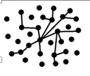

Collaboration and Social Networks
Think about the social and collaborative networks in your building. What do they look like? What would staff say about the social networks?
Weak Network
Strong Network
Notes:
To Know
Schools have different organizational structures. Such differences in organization impact teachers’ social networks. For example, teachers may have substantively different conversations with content peers, as compared to those who teach the same grade level. These interactions are of particular importance as social networks tend to be important to reform initiatives. Social capital is an economic analogy, suggesting that people invest in and profit from their social connections. Specifically in a school context, social networks connect teachers to both knowledge and resources. Social networks are particularly important in school settings as many reforms seek to make teaching a more collaborative field.
To Do/Say
In 2012 Moolenaar, Sleegers, and Daly published a paper on a study they conducted examining the interplay of teacher collaboration networks, collective efficacy, and student achievement. They found well-connected teacher networks were associated with strong teacher collective efficacy, which in turn supported student achievement. The more dense the network, the more likely it was for teachers to take risks to improve their school, adopt a learning culture, and improve their teaching.
Take a minute to talk about the social networks you see in your building. Where are they stronger and where are they weaker?
References
Moolenaar, N. M., Sleegers, P. J. C., & Daly, A. J. (2012). Teaming up: Linking collaboration networks, collective efficacy, and student achievement. Teaching and Teacher Education, 28(2), 251-262.

Slide 38
Pygmalion Effect
Belief Influences Efficacy
Efficacy beliefs directly affect the diligence and resolve with which groups choose to pursue their goals.
If educators’ realities are filtered through the belief that there is very little they can do to influence student achievement, then it is very likely these beliefs will be manifested in their practice.
(Goddard, Hoy, & Hoy, 2004)
Notes:
To Know
The Pygmalion Effect is the phenomenon whereby others’ expectations of a target person affect the target person’s performance. Two popular theories of motivation are the Self-Efficacy Theory and the Pygmalion Effect. Both of these approaches to motivation are self-fulfilling and heavily depend on an individual’s belief in themselves. Therefore, the more a person believes in themselves, the greater they increase their chances for succeeding and accomplishing their goals. Self-efficacy refers to an individual’s belief that he or she is capable of performing a task. The higher your self-efficacy, the more confidence you have in your ability to succeed. For example, in difficult situations, people with low self-efficacy are more likely to lessen their effort or give up altogether, whereas those with high self-efficacy will try harder to master the challenge. The Pygmalion Effect is a form of self-fulfilling prophecy in which believing something can make it true. For example, in one study, teachers were told their students had very high IQ scores when in fact they spanned in a range from low to high. As a result, the teachers spent more time with the students they believed were “smarter,” gave them more challenging assignments, and expected more from them. As a result, those specific students who were perceived as “the smartest” performed with higher self-efficacy and scored better grades.
To Do/Say
Show slide
Explain the Pygmalion Effect – believing something can impact what we do, which in turn creates a self-fulling condition. We see this in the CTE literature.
Goddard, Hoy, and Hoy (2004) noted that efficacy beliefs directly affect the diligence and resolve with which groups choose to pursue their goals. They concluded that if educators’ realities are filtered through the belief that there is very little they can do to influence student achievement, then it is very likely these beliefs will be manifested in their practice.
References
Goddard, R.D., Hoy, W. K., Hoy, A. W. (2004). Collective efficacy beliefs: Theoretical developments, empirical evidence, and future directions. Educational Researcher, 33(3), 3-13.
Summermgmt. (2011, July 07). Re: Self-Efficacy Theory and the Pygmalion Effect [Web log comment]. Contemporary Theories of Motivation. Retrieved from https://summermgmt.wordpress.com/2011/07/07/self-efficacy-theory-the-pygmalion-effect/

Slide 39
Pygmalion Effect Amplified
Teacher beliefs about their students
(x 20 students)
Teacher actions towards their students
(x 20 students)
Student beliefs about their own capabilities
(x 20 students)
Student actions in school and life
Student outcomes in school and life
1 Teacher
with
Self-Efficacy
= 20 students
Notes:
To Know
This is the first slide in a series of three slides showing how CTE could have a multiplied effect on student outcomes. If a school staff shares a sense of collective efficacy then they have a greater likelihood of positively impacting student learning over and above other influences. CTE is greater than three times more powerful and predictive of student achievement than socio-economic status (0.52). It has more than double the effect of prior achievement (0.65) and more than triple the effect of home environment and parental involvement (0.52 & 0.49). It is also greater than three times more likely to influence student achievement than student motivation and concentration, persistence, and engagement (0.48).
To Do/Say
Show slide
Let’s think about how CTE could have an effect on student outcomes. Talk through the cycle, beginning with teacher beliefs about their students. At the student level are 20 students, each with beliefs about their own capabilities.

Slide 40
Pygmalion Effect Amplified
Teacher beliefs about their students
(x 60 students)
Teacher actions towards their students
(x 60 students)
Student beliefs about their own capabilities
(x 60 students)
Student actions in school and life
Student outcomes in school and life
3 Teachers
1 Team
with CTE
= 60 students
Notes:
To Know
This is the second slide in a series of three slides showing how CTE could have an multiplied effect on student outcomes. If a school staff shares a sense of collective efficacy then they have a greater likelihood of positively impacting student learning over and above other influences. CTE is greater than three times more powerful and predictive of student achievement than socio-economic status (0.52). It has more than double the effect of prior achievement (0.65) and more than triple the effect of home environment and parental involvement (0.52 & 0.49). It is also greater than three times more likely to influence student achievement than student motivation and concentration, persistence, and engagement (0.48).
To Do/Say
Show slide
Let’s think about how CTE could have an effect on student outcomes. Talk through the cycle, beginning with teacher beliefs about their students. At the student level there are 60 students, each with beliefs about their own capabilities.

Slide 41
Pygmalion Effect Amplified
Teacher beliefs about their students
(x 360 students)
Teacher actions towards their students
(x 360 students)
Student beliefs about their own capabilities
(x 360 students)
Student actions in school and life
Student outcomes in school and life
18 Teachers
1 School
with CTE
= 360 students
Notes:
To Know
This is the third slide in a series of three slides showing how CTE could have an multiplied effect on student outcomes. If a school staff shares a sense of collective efficacy then they have a greater likelihood of positively impacting student learning over and above other influences. CTE is greater than three times more powerful and predictive of student achievement than socio-economic status (0.52). It has more than double the effect of prior achievement (0.65) and more than triple the effect of home environment and parental involvement (0.52 & 0.49). It is also greater than three times more likely to influence student achievement than student motivation and concentration, persistence, and engagement (0.48).
To Do/Say
Show slide
Let’s think about how CTE could have an effect on student outcomes. Talk through the cycle, beginning with teacher beliefs about their students. At the student level there are 360 students, each with beliefs about their own capabilities.

Slide 42
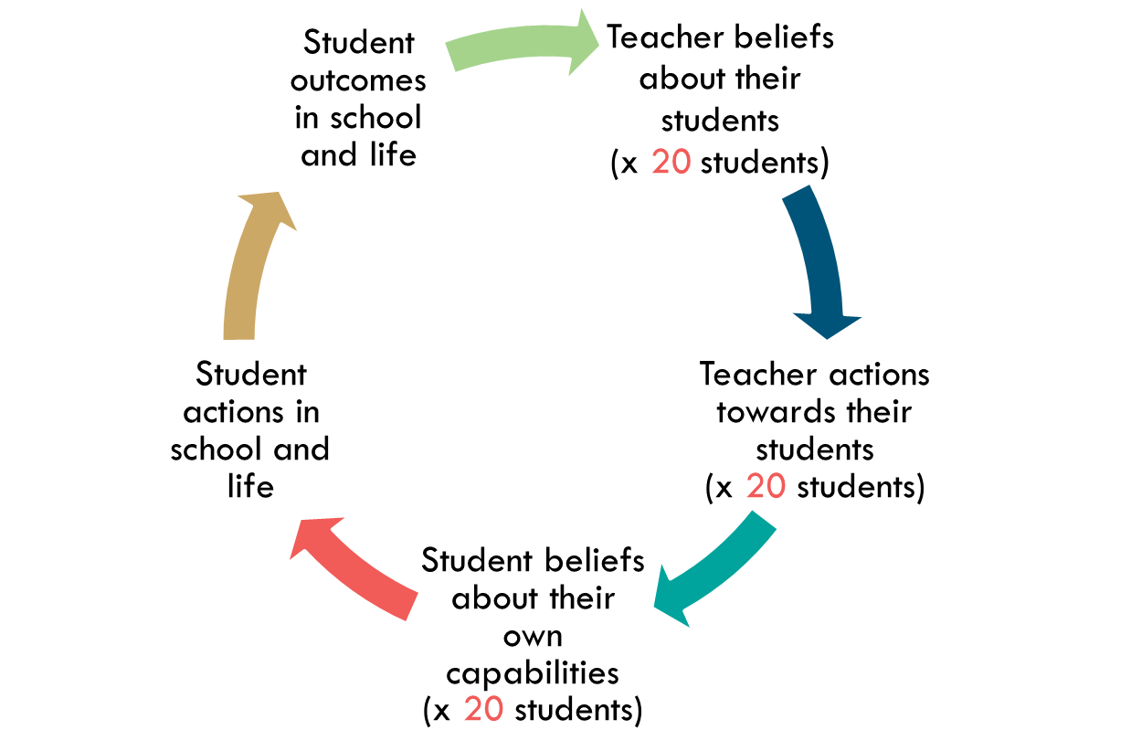

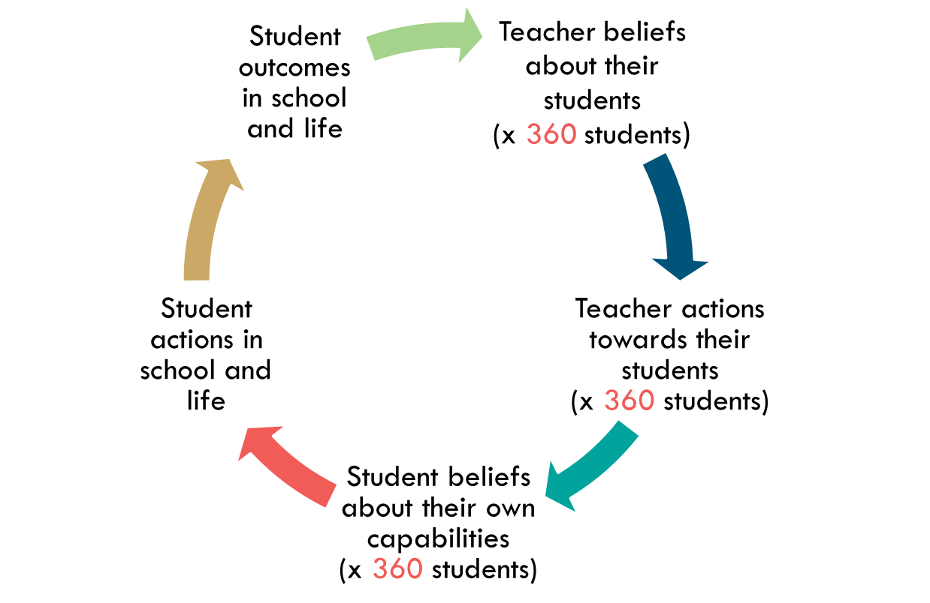
Pygmalion Effect Amplified
1 Teacher
3 Teachers:
1 Team
18 Teachers:
1 School
The Power of Belief is amplified as it moves from
1 teacher to 1 teacher team to 1 school.
Notes:
To Know/Say
If a school staff shares a sense of collective efficacy then they have a greater likelihood of positively impacting student learning over and above other influences. CTE is greater than three times more powerful and predictive of student achievement than socio-economic status (0.52). It has more than double the effect of prior achievement (0.65) and more than triple the effect of home environment and parental involvement (0.52 & 0.49). It is also greater than three times more likely to influence student achievement than student motivation and concentration, persistence, and engagement (0.48).

Slide 43
Social Networks Impact
Student Achievement
Well Connected Teacher Network Structure
Strong Teacher Collective Efficacy
Improved Student Achievement
(Math and ELA)
(Moolenaar, Sleegers, & Daly, 2012)
Notes:
To Say
Moolenaar, Sleegers, and Daly (2012) conducted a large scale research study to examine the interplay of teacher collaborative networks, collective efficacy, and student achievement. They found that schools with well connected, dense networks (many relationships) tend to have high levels of collective efficacy, which in turn supported improved student achievement.
Dense networks appear to support and nurture teachers’ confidence in the capacity of their team to impact students’ learning and achieve school goals. They also have the potential to build both personal and work related advice relationships. The greater the number of possible ties, the more likely it is for teachers to take risks to improve their school, continuously learn, and try to improve their teaching. In less dense networks, teachers do not tend to share much more than routine information.
To Know
This finding corroborates earlier studies that emphasized the significance of densely connected teacher teams for school organizational characteristics, such as teacher trust, innovative school climate, perceived involvement in decision making, and the implementation of reform (Coburn, & Russell, 2008; Daly, 2010; Penuel, Riel, Krause, & Frank, 2009). The social environment that results from teachers’ interdependency on advice exchange seems to affect teachers’ beliefs in the capacity of their team. Network centralization was not related to teachers’ collective efficacy beliefs, which implies that these beliefs are more likely influenced by the exchange of advice throughout the whole team, rather than the centralization of advice around certain focal individuals.
References
Moolenaar, N., Sleegers, P. J. C, & Daly, A. J. (2012). Teaming up: Linking collaboration networks, collective efficacy, and student achievement. Teaching and Teacher Education, 28(2), 251-262.
Coburn, C. E., & Russell, J. L. (2008). District policy and teachers’ social networks. Education Evaluation and Policy Analysis, 30(3), 203e235.
Daly, A. J. (2010). Social Network Theory and Educational Change. Cambridge, MA: Harvard University Press.
Penuel, W. R., Riel, M. R., Krause, A., & Frank, K. A. (2009). Analyzing teachers’ professional interactions in a school as social capital: a social network approach. Teachers College Record, 111(1), 124e163.

Slide 44
Examining Our Social Networks
Names
Leslie
Judy
Craig
Mary
Mom
Terry
Karen
Ruth
Lisa
Jen
Relationship
Sister
Coworker
Coworker
Coworker
Parent
Friend
Friend
Boss
Sister
Coworker
Who Introduced
Mom
Craig
Ruth
Craig
Parent
Karen
Dan
Barb
Mom
Ruth
Notes:
To Say/To Do
This activity is intended to help participants visualize their own social networks. This slide is a visual for steps 1 – 5.
Have participants fold a paper blank sheet of paper into 3 columns.
In their left most column, each person lists the names of the last 10 people with whom they have talked or texted.
In the second column to the right, ask them to write their relationship to each person on their list. For example, was that your husband, your brother, your best friend, your trainer?
In the third column, ask them to write out the name of the person who introduced them to that person (if someone did and they could remember who it was). For example, if the person in your list is your child’s teacher, and your husband introduced you to your child’s teacher, you would write down “husband” in the 3rd column for that entry.
Creating this list will take about 5-7 minutes. Ask if there are any insights from the list they have just created. Are there any patterns in who they talk with, who introduced them to other people, etc? Discuss how there is often an individual that brings the different groups together. Can the identify this person?
Continued on next slide…

Slide 45
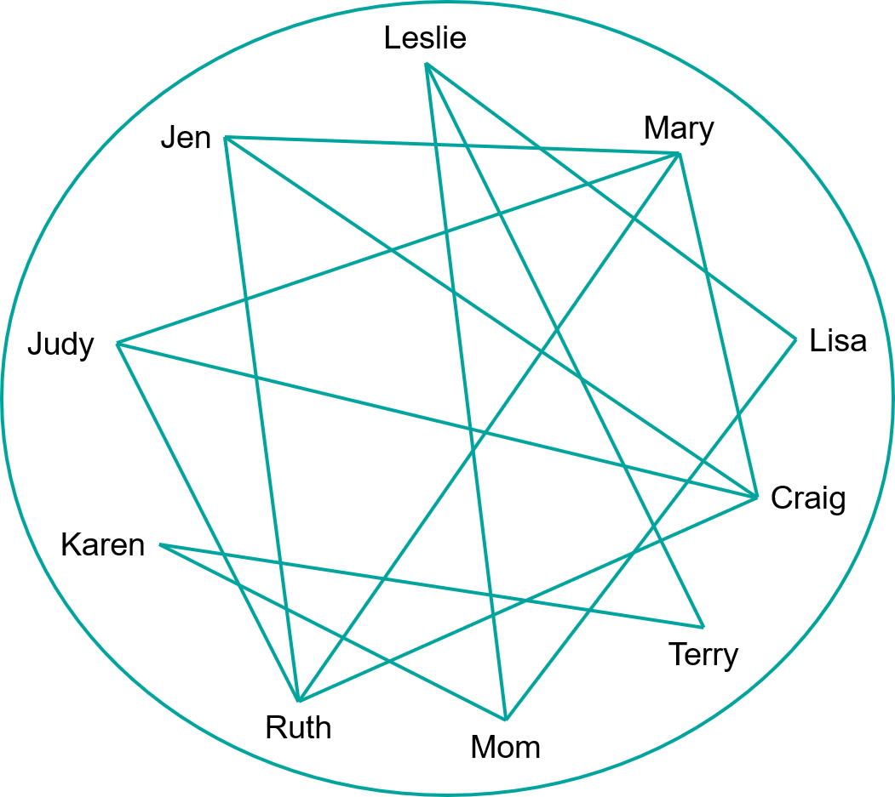
Examining Our Social Networks
Notes:
To Say/To Do
Activity continued from previous slide. This slide illustrates step 6
Ask participants to flip over their paper. On the other side, ask them to draw a large circle taking up the size of the paper and list the 10 people they had last spoken to (the same 10 that are on in the first column on the other side of the sheet) so that they are spread out all over the circle.
Next have them draw lines between people who know each other. This slide illustrates that many people in this person’s network are connected to each other. Little clusters or small groupings will most likely emerge within their circles. Mom, Lisa, Leslie, Terry, and Karen are all connected. Ruth, Craig, Mary, Jen, and Judy are connected.
Ask then to look at their groupings. How connected are the different people. Remind them, this is an exercise and we only have listed the last 10 people they talked to and not the 10 most important people. It may be that some networks are not as connected, but this is not a reflection on how connected the person’s social network really is.

Slide 46
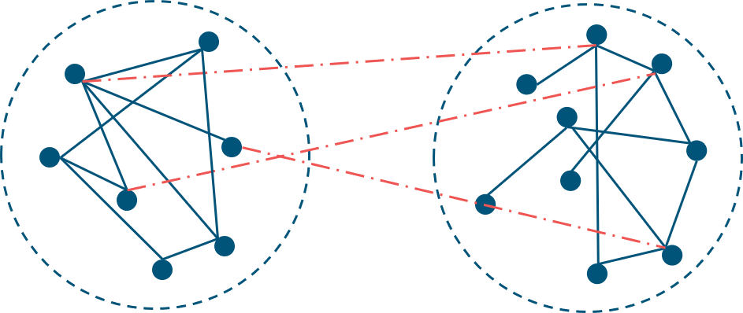
Examining Our Social Networks
Notes:
To Say/To Do
Activity continued from previous slide. This slide illustrates step 7 & 8
7. Form groups of two, 3 or 4 participants. Ask them to place their networks side-by-side and draw lines between people across the networks. This should take about 5 minutes or less.
8 Ask participants to look at how interconnected their networks are – who are the people who bridge the networks? How dense are the networks? Again, remind them, this is an exercise and may not reflect their actual social networks. Later, they will think about the actual social networks in their building.
Reiterate: Schools with dense networks (many relationships) tend to have high levels of collective efficacy.

Slide 47
Building Efficacy Through Teachers’ Social Networks
Mastery Experiences
Successful teaching
Problem solving
Vicarious Experiences
Success of others
Observation of mastery teaching
Social Persuasion
Encouragement
Feedback
Affective State
Excitement
Desire for greater growth
Notes:
To Know
Although all interactions are not equally important, social interactions and the social networks that surround a person, provide opportunities to build efficacy. The more connections between staff members, the larger the number of possible interactions. This slide illustrates a dense social network and the efficacy building experiences it might provide. There are more opportunities to 1) problem solve and have mastery experiences, 2) see other people having success (vicarious experiences), 3) receive feedback and encouragement (social persuasion), 4) become excited or develop a desire to grow as a teacher (affective state). that will influence both CTE and professional learning.
Building social networks is one way to increase experiences that will build CTE.
To Do/Say
A teacher’s social network is a prime way for teachers to have the experiences that will build CTE. The more connections a teacher has to others in the building, the more opportunities they have to
see others model effective instructional practices,
practice mastery of new skills in safe environments,
be encouraged,
be persuaded, and
share success.
Through encouragement, success, observing others succeed, and desire for growth, we are simultaneously building our social networks.

Slide 48
School Leaders as the Architects of Social Networks
Notes:
To do/Say
Change is dependent on relationships within a system and to promote change it is helpful for school leaders to to consider ways to purposefully connect teachers with one another. Well connected teacher networks are associated with stronger CTE, which in turn supports student achievement. The more dense the network (i.e. the grater the number of existing links or ties in a network) the more likely it is for teachers to take risks. School leaders have an opportunity to encourage the development of teacher networks and provide opportunities to connect educators in a variety of ways with the purpose of increasing their knowledge about each other’s work and their effective use of evidence-based practices.
References
Donohoo, J. (2017). Collective efficacy: How educators’ beliefs impact student learning. Thousand Oaks, CA: Corwin.

Slide 49
Schools with Dense Social Networks have Higher Levels of CTE
Dense Social Networks
Provide more opportunities for teachers to turn to colleagues for advice regarding instruction
Facilitate quicker and more efficient sharing of resources and knowledge
Provide more opportunities for verbal persuasion and vicarious experience
(Berebitsky & Salloum, 2017)
Notes:
To Know
Berebitsky and Salloum examined school social networks in 20 middle school mathematics departments in two large, urban districts across 3 years. They found the density of teacher networks was positively and significantly related to levels of collective efficacy across three years of data. In other words, when more teachers turn to more colleagues for advice regarding instruction, collective efficacy tends to be higher. Although we cannot conclude a causal relationship between the measures, network characteristics may directly influence the formation of collective efficacy. For example, a dense network has the potential to facilitate quicker and more efficient dissemination of resources and knowledge, which can increase both mastery and vicarious, thus raising collective efficacy. In addition, prior research has shown that teacher self-efficacy, via the mechanisms of verbal persuasion and vicarious experience, can be built through teachers’ social networks Researchers have also hypothesized that aspects of the school social network can influence student achievement indirectly.
To Do/Say
Berebitsky and Salloum examined school social networks in 20 middle school mathematics departments in two large, urban districts across 3 years. They found the density of teacher networks was positively and significantly related to levels of collective efficacy. In other words, Schools with more dense social networks had higher levels of CTE. They theorize that this was due to the fact that dense social networks
provide more opportunities for teachers to turn to colleagues for advice regarding instruction;
facilitate quicker and more efficient sharing of resources and knowledge; and
provide more opportunities for verbal persuasion and vicarious experience.
References
Berebitsky, D., & Salloum, S. J. (2017). The relationship between collective efficacy and teachers’ social networks in urban middle schools. American Educational Research Association, 3(4), 1-11. Retrieved from https://journals.sagepub.com/doi/pdf/10.1177/2332858417743927

Slide 50
Building Networks
Determine which people or groups are isolated and identify ways to encourage greater interactions with those who are committed to the school culture.
Are there policies or practices in the school that support or hinder the building of networks?
Can technology be used more effectively to build networks?
Notes:
To Know
This is a summary slide that will move to action planning.
To Say
As the architects, what are some considerations for how you encourage the building of social networks? What are some other ideas you have for building social networks between staff? Have individuals share out.
References
Shafer, L. (2018, Sept. 9). Re: Building a strong school culture [Web log comment]. Harvard Graduate School of Education Blog. Retrieved from https://www.gse.harvard.edu/news/uk/18/09/building-strong-school-culture

Slide 51
Social Networks and collaboration that build CTE look like…
A variety of organizational structures (e.g. teams, committees, professional development opportunities) available for staff participation
Membership in groups is linear rather than all groups being hierarchical
Teachers sharing knowledge and ideas freely and with a variety of colleagues
Teachers having the opportunity to talk to other colleagues every day
Teachers having multiple, safe avenues for giving and receiving advice and feedback

Slide 52
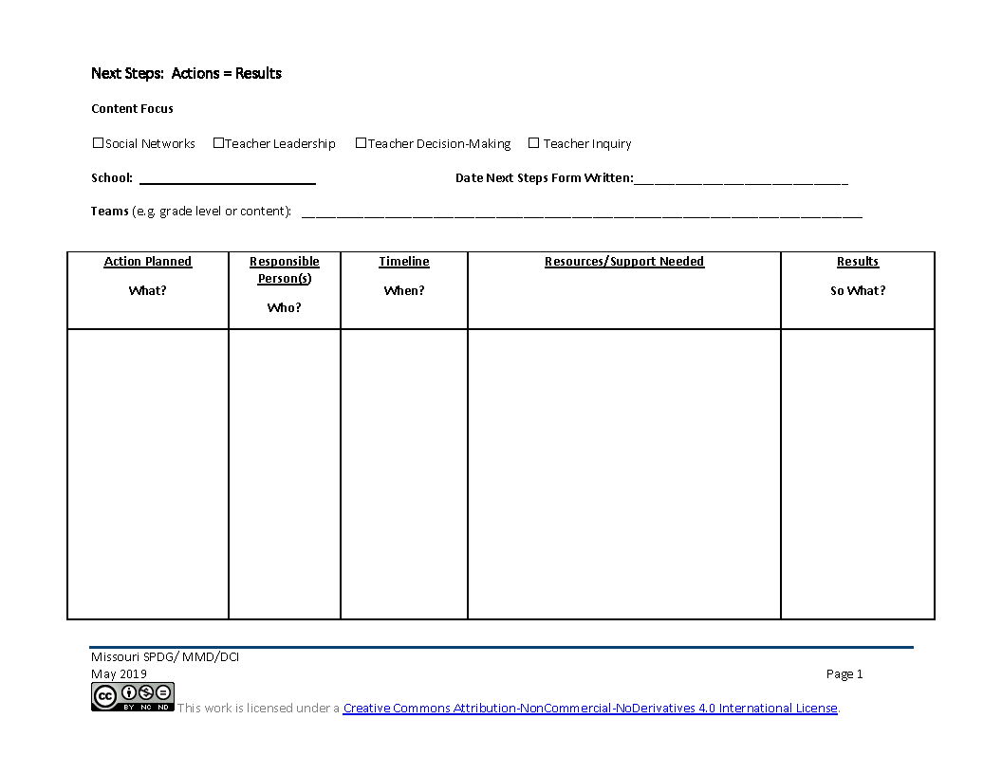
Next Steps: CTE Action = Results
What are social networks like in my school?
What are actionable steps I can take to build social networks?
Notes:
To Know
Action planning is a critical component for change. The action plan document is a living document that will be updated as needed after each focus module.
To Do/Say
Provide a copy of the action plan handout to participants. You may choose to provide one per team or one per participant.
Provide participants an overview of the action plan process by stating that the action plan process is critical to deeper implementation of practice - as what gets planned is what gets done. It is also a communication piece guaranteeing that everyone is on the same page.
Dependent on the time structure for completion of the form, the following guiding questions can be posed per section.
Statement of vision Take a minute to self-reflect. What key words related to CTE Social Networks resonated with you? What would you like social networks to look like in 3 years? What are social networks like in your school right now?
Where are we going? From your vision statement, what is your short term goal for the end of this school year? (If mid school year, you may want to frame at the end of the school year. If beginning of the year, you may want to frame it as first semester. You might also frame it as when we meet again. It is, however, important to frame it in a time line.
How will I close the gap? Beginning with the short term target, what are the actions/next steps you can take to build social networks in your school? (Dependent on the group, you may want to randomly list all actions on chart paper and then prioritize.) Everyone take a minute to review our steps, have we covered key points, do we have the right supports, structure, and people? Do our proposed actions align with our gaps and address our vision? (Utilize a fist to five or other methods to obtain consensus from those present.) Do we need to get consensus or buy in from others to move forward? What else?
Now that we have our first actions, let’s go back to the big picture. Looking again at our vision statement, where do we want to be in a year? What should our long range target be for CTE social network implementation?
Remind participants that CST support is available throughout implementation.

Slide 53
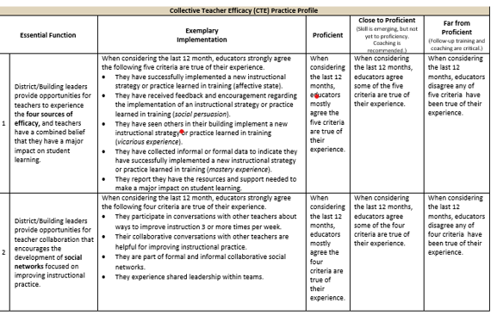
Practice Profile
Notes:
To Know/ To Do/ To Say:
This is a screen shot of the Practice Profile which you have as a handout. It is a rubric that will help you determine where you are in regards to implementing CTE in your building. Please take a moment to see what is looks like to be proficient.

Slide 54
Where Do We go From Here?
Notes:
To Know
This slide is provided as a handout. It is too small to read and participants will need a copy to use in their planning.
From here, schools may use the flowchart to see which focus module is the best fit for their building. As an alternative to the flowchart, there are Planning Reflection Questions on the next slide or the SAPP, which could be used to prioritize training.
Either the flowchart of reflection questions can be used, but there is no need to use both.
To Do/Say
Use the flowchart to make some decisions about next steps.

Slide 55
Where Do We go From Here?
Notes:
To Know
This slide is provided as a handout. It is too small to read and participants will need a copy to use in their planning. From here, schools may use the flowchart or the reflection questions to see which, if any focus module might be a next consideration. Teams would use the decision tree or the reflection questions to consider the other focus modules they might want to consider and develop next steps.
As an alternative to the reflection questions, there is a flow chart on the previous slide, or the SAPP could be used to prioritize which focus module might be next. Participants will do either the flowchart or the Planning Reflection Questions but do not need to do both. If there are checkboxes left unchecked, participants should consider going through the focus module for that area.
To Do/Say
Use the reflection questions to make some decisions about next steps. Is there another focus module that you need to explore? What would be the best timeline for the next module? Remember, it will be more beneficial to fully implement the plan you have just developed before moving to the another module.

Slide 56
References
Adams, C. M., Forsyth, P. B. (2006). Proximate sources of collective teacher efficacy. Journal of Educational Administration, 44(6), 625-642.
Bandura, A. (1986). The explanatory and predictive scope of self-efficacy theory. Journal of Social and Clinical Psychology, Special Issue: Self-Efficacy Theory in Contemporary Psychology, 4, 359-373.
Bandura, A. (1994). Self-efficacy. In V. S. Ramachaudran (Ed.), Encyclopedia of human behavior (Vol. 4, pp. 71-81). New York: Academic Press. (Reprinted in H. Friedman [Ed.], Encyclopedia of mental health. San Diego: Academic Press, 1998).
Berebitsky, D. & Salloum, S. J. (2017). The relationship between collective efficacy and teachers’ social networks in urban middle schools. American Educational Research Association, 3(4), 1-11. Retrieved from https://journals.sagepub.com/doi/pdf/10.1177/2332858417743927
Best Colleges Online. (n.d.). 25 Ways Teachers Can Connect More With Their Colleagues. Retrieved from https://www.bestcollegesonline.com/blog/25-ways-teachers-can-connect-more-with-their-colleagues/
Brinson, D., & Steiner, L. (2007). Building collective efficacy: How leaders inspire teachers to achieve (Issue Brief). Washington, DC: Center for Comprehensive School Reform and Improvement. Retrieved from https://files.eric.ed.gov/fulltext/ED499254.pdf

Slide 57
References
Cobb, P., & Jackson, K. (2011). Towards an empirically grounded theory of action for improving the quality of mathematics teaching at scale. Mathematics Teacher Education and Development, 13(1), 6-33. Retrieved from https://files.eric.ed.gov/fulltext/EJ960944.pdf
DeWitt, P. (2017, March 12). Why can’t teachers make decision on their own. [Education Week’s Web log post, Finding Common Ground]. Retrieved from http://blogs.edweek.org/edweek/finding_common_ground/2017/03/why_cant_teachers_make_decisions_on_their_own.html
Donohoo, J. (2017). Collective efficacy: How educators’ beliefs impact student learning. Thousand Oaks, CA: Corwin.
Donohoo, J. (2018). Collective teacher efficacy research: Productive patterns of behaviour and other positive consequences. Journal of Educational Change, 19(3), 323–345.
Ermeling, B. A. (2010). Tracing the effects of teacher inquiry on classroom practices. Teaching and Teacher Education, 26(3), 377-388.
Goddard, R. D., Hoy, W. K., & Hoy, A. W. (2000). Collective teacher efficacy: Its meaning, measure, and impact on student achievement. American Educational Research Journal, 37(2), 479-507.

Slide 58
References
Goddard, R.D., Hoy, W. K., Hoy, A. W. (2004). Collective efficacy beliefs: Theoretical developments, empirical evidence, and future directions. Educational Researcher, 33(3), 3-13.
Hoy, A. W. (2004). Self-efficacy in college teaching. Essays on Teaching Excellence; Toward the Best in the Academy, 15(7). Retrieved from https://cft.vanderbilt.edu/wp-content/uploads/sites/59/vol15no7_self_efficacy.htm
Massachusetts Department of Elementary and Secondary Education. (2015). Building a school culture that supports teacher leadership [Online report]. Retrieved from www.doe.mass.edu/edeval/leadership/BuildingSchoolCulture.pdf
MoEdu-Sail. (2019). District Continuous Improvement Framework (MMD/DCI): Blueprint for district and building leadership, Third Edition. Missouri Department of Elementary and Secondary Education: Northern Arizona University, Institute for Human Development.
Moolenaar, N. M., Sleegers, P. J. C., & Daly, A. J. (2012). Teaming up: Linking collaboration networks, collective efficacy, and student achievement. Teaching and Teacher Education, 28(2), 251-262.
Reeves, D. B. (2006). The learning leader. Alexandria, VA: ASCD. Retrieved from http://www.ascd.org/publications/books/105151/chapters/The-Dimensions-of-Leadership.aspx

Slide 59
References
Shafer, L. (2018, Sept. 9). Re: Building a strong school culture [Web log comment]. Harvard Graduate School of Education Blog. Retrieved from https://www.gse.harvard.edu/news/uk/18/09/building-strong-school-culture
Summermgmt. (2011, July 07). Re: Self-Efficacy Theory and the Pygmalion Effect [Web log comment]. Contemporary Theories of Motivation. Retrieved from https://summermgmt.wordpress.com/2011/07/07/self-efficacy-theory-the-pygmalion-effect/
Visible-Learning. (n.d.). Hattie’s ranking: 252 influences and effect sizes related to student achievement. Retrieved from https://visible-learning.org/hattie-ranking-influences-effect-sizes-learning-achievement
York-Barr, J., & Duke, K. (2004). What do we know about teacher leadership? Findings from two decades of scholarship. Review of Educational Research, 74(3), 255-316.

