Slide 1
Collaborative Teams
Overview
This work is licensed under a Creative Commons Attribution-NonCommercial-NoDerivatives 4.0 International License.
Notes:
Time: This is designed to be a 45 -60 min. introductory presentation.
To Do: (Preparation Activities: These activities should occur before the training)
Pre-assessment: This brief, selected response assessment would be emailed to participants in advance of training. It would be designed to assess knowledge of the content in this presentation. The results should then be reviewed by the trainer in order to adapt the presentation, and results should be presented to the audience, in order to engage them with the learning.
Handouts: Pre-reading/reflection: Send the “Quotable Quotes” handout to individuals before the session. (Instructions are at the top of the paper – “As you prepare for our initial overview training next week, we invite you to consider the following quotable quotes. As we begin our work, there will be opportunities to discuss these quotes. We look forward to seeing you next week.”)
Handout: The infographic “Collaborative Data Teams” can also be used at the beginning of the session as a pre –reading.
To Know: This package is organized with an overview / introduction with 6 mini modules addressing processes necessary for effective teams. You need to be aware of the self assessments that can guide you to whether the participants need to go through all mini modules or need to focus on specific modules. Teams may have taken the team functioning survey and school implementation scales which are available and can identify needs. There are also online self assessments and the practice profile which can be used to identify training needs.
.

Slide 2
Acknowledgements
Special thanks to all contributors to the development and revision of this module.
The original collection of learning packages was roll-out for use by Regional Professional Development Center (RPDC) Consultants in July 2013 after being developed by a team of content experts. The collection of learning packages was developed through efforts funded by the Missouri State Personnel Development Grant (SPDG). The following individual/groups are thanked immensely for their hard work in developing this package:
Content Development Support
Ronda Jenson, Carla Williams, Stefanie Lindsay, Jodi Arnold and Arden Day, UMKC
Institute for Human Development
SPDG Management Team

Slide 3
Team Members
Initial Content Development Team, 2013
Michelle Smith, Team Leader, MO PLC
Betty Ennis, DESE
Tiffiney Smith, SE RPDC
Marlow Barton, StL RPDC
Mary Gage, C RPDC
Sheila Thurman, NE RPDC
Rebecca Baldwin, NW RPDC
Bertha Richardson, StL RPDC
Karen Wigger, NW RPDC
Mary Ann Burns, DESE
Tom Robb, KC RPDC
2016 Revision Team
Mary Dell Black, Facilitator, SC SIS
Jamie Mehring, Ed Plus/StL RPDC
Sheila Thurman, NE RPDC
Marisa Bowen, SE SIS
Tiffani Muessig, DESE
Judy Wartick, KC SIS
Jeanie Carey, SC RPDC
Connie Schweiss, SC RPDC
Pam Williams, DESE
Joy Fairley, KC RPDC

Slide 4
Hidden Slide
Presenter notes information
Tools and documents
Helpful suggestions
Notes:
The Collaborative Teams (CT) learning package is organized in seven modules. The first is an Overview. The other six modules address each of the processes that contribute to effective teams.
The CT Content Fidelity Checklist aligned to each learning package includes all critical items for a training session (draft, pending approval). The CT HQPD Training Checklist and Coaching Checklist contain process elements to be used as guidance when designing, revising, or coaching high quality professional development.
Important notes:
A script of presenter notes is included in the PowerPoint. Background information for the presenter is shown as “To Know.” Statements to be shared with participants are shown as “To Say.” In some instances, the “To Know/To Say” are the same material. For fidelity of content and consistency among presenters, the “To Say” information should be presented with minimal paraphrasing.
There is one pre/post assessment for the entire CT package (all seven modules).
An Implementation Fidelity Checklist is available for frequent monitoring by a teacher or observer.
A print Practice Profile and an electronic Practice Profile Self-Assessment tool are available for use by individuals, teams, or schools for periodic self-assessment and monitoring of implementation of practice or to identify training or coaching needs.
The presenter should download onto a hard drive or a flash drive any video intended for use in a training. The links shown on slides may not be able to be accessed online at the school sites.
Breaks should be inserted at the discretion of the presenter based on the needs of participants.
A presenter may add slides to supplement the content. For example, a slide of essential questions may be added since only objectives have been included.
A presenter may choose to differentiate a presentation to meet the needs of the participants. For example, another form may be substituted for the Next Steps template if the district or building already uses a similar form or protocol.
Additional activities, examples, videos, etc. may be found _____. (The details are in progress.) A presenter may interchange the additional material for the corresponding PowerPoint content.

Slide 5
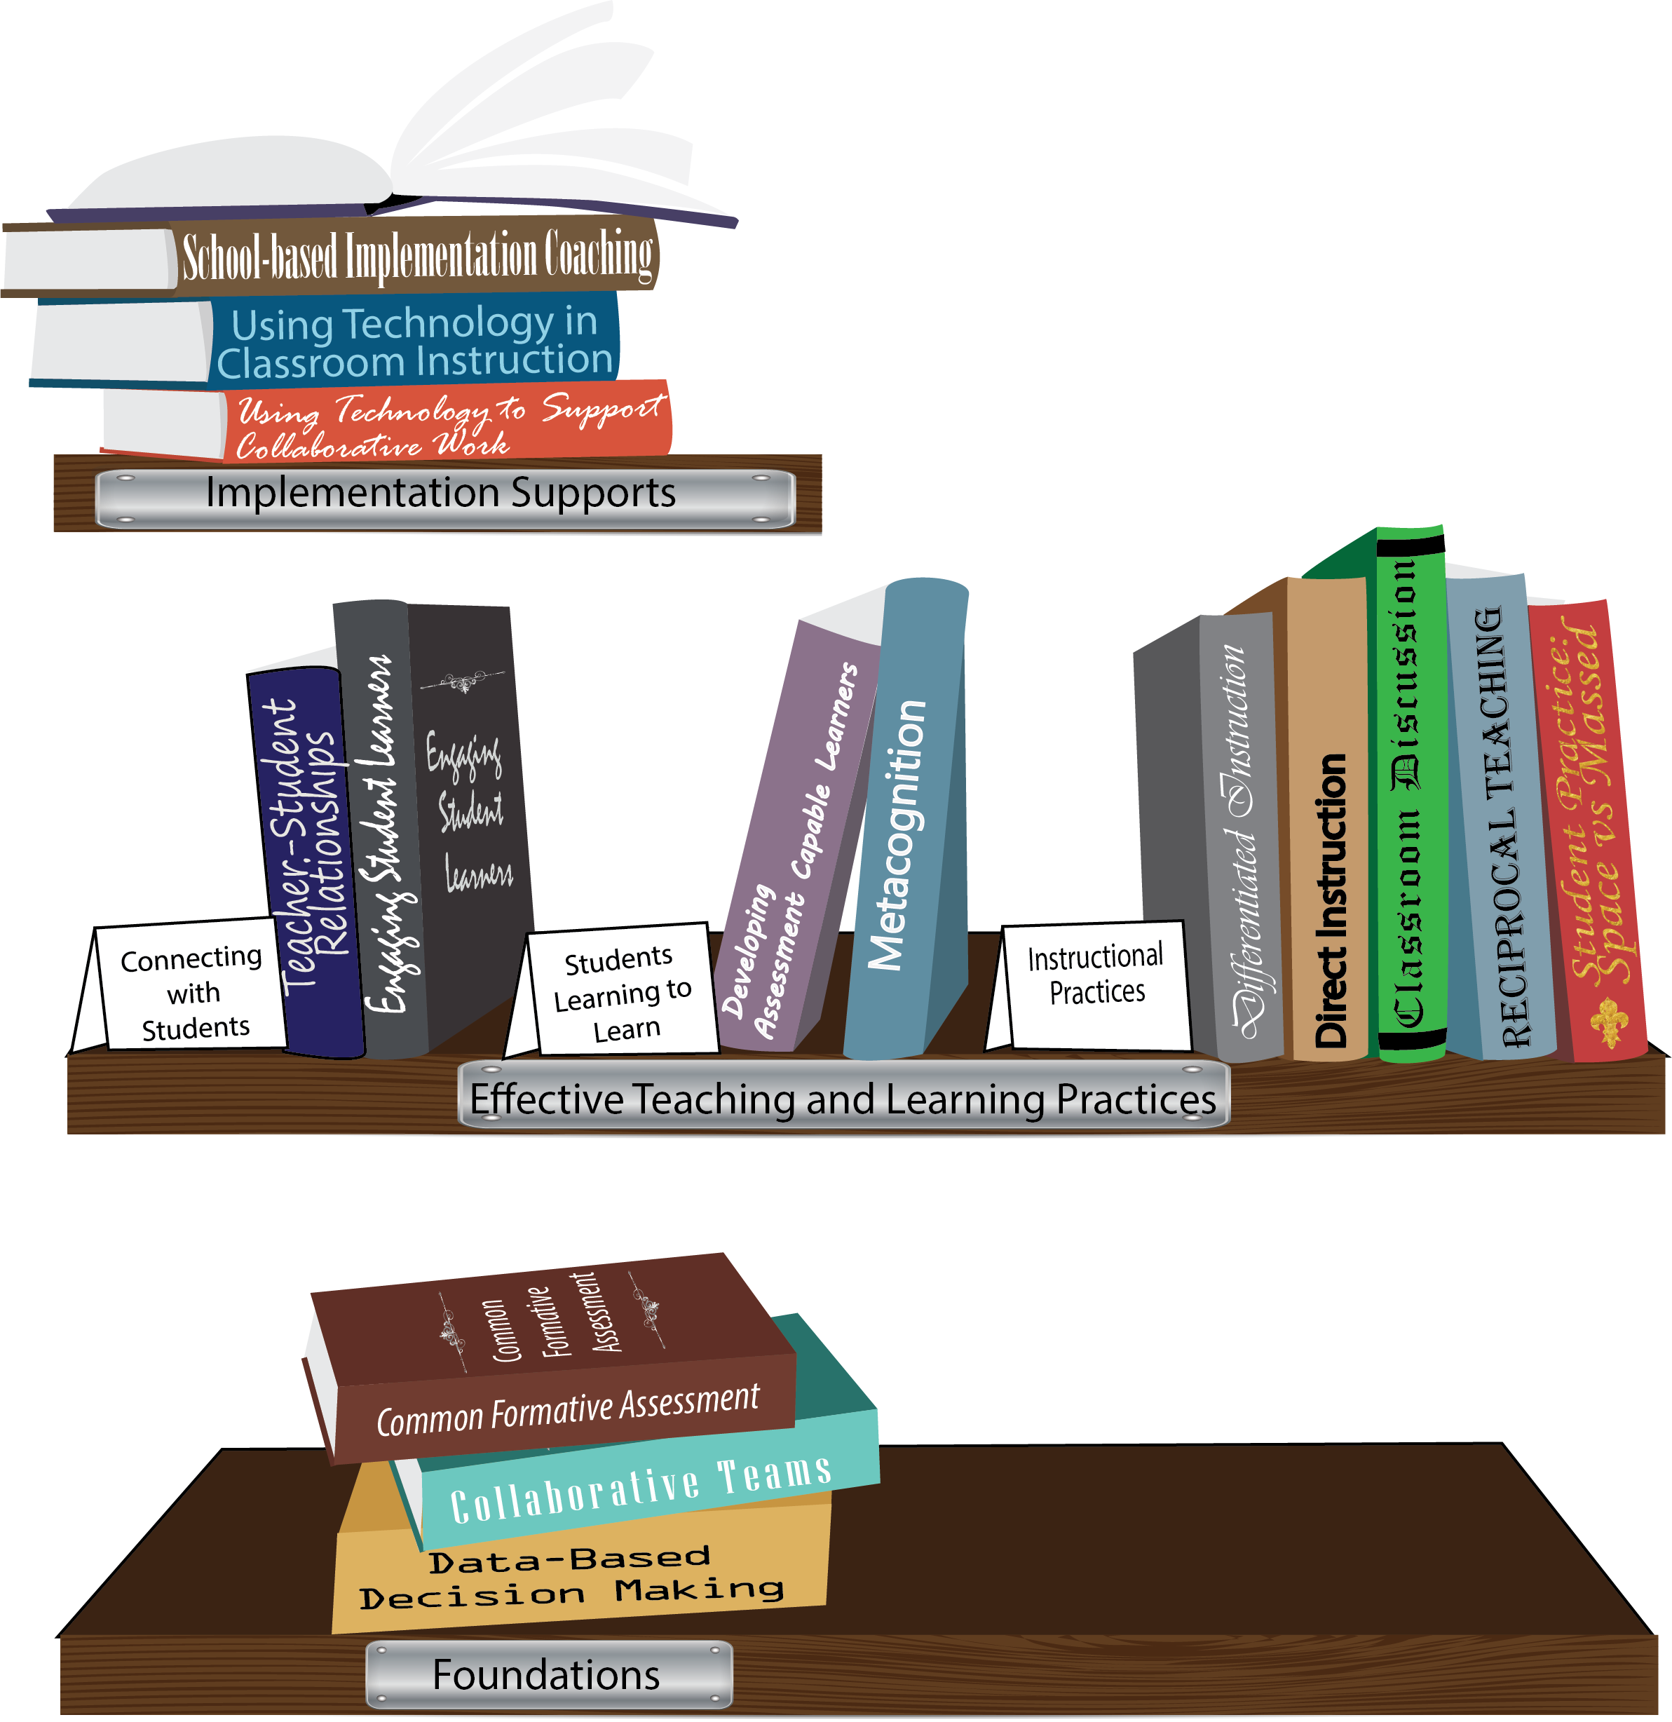
Notes:
To Know/To Say: Missouri’s professional development learning packages are organized in three categories: Foundations, Effective Teaching & Learning Practices, and Implementation Supports. All schools begin their professional development journey with the Foundations, as these learning packages provide foundation knowledge in three key areas: Collaborative Teams, Data-based Decision-making, and Common Formative Assessment. Effective Teaching & Learning Practices encompass research-based instructional practices for deepened learning. These learning packages address ways of connecting with students, ways of helping students learn how to learn, and feature specific instruction practices. Implementation Supports are learning packages designed to help school staff support and enhance the Implementation of Effective Teaching & Learning Practices through using technology and peer coaching supports.
To Do: Explain how the graphic depicts professional development in Missouri.

Slide 6
Collaborative Work Foundations
3 Key Areas
Collaborative Teams
Common Formative Assessment
Data-Based Decision Making
CFA – utilize
Quality assessments
as feedback to improve teaching & learning.
DBDM – utilize data for continuous improvement through dialogue about teaching & learning
CT – utilize team processes to improve teaching & learning.
Notes:
To Know/To Say: The learning packages forming the foundation knowledge of the Collaborative Work are Collaborative Teams, Data-Based Decision Making, and Common Formative Assessment.
Collaborative Teams (CT) utilize team processes to improve teaching and learning.
Common Formative Assessment (CFA) utilize quality assessments as feedback to improve teaching & learning.
Data-Based Decision Making (DBDM) utilize data for continuous improvement through dialogue around instruction.

Slide 7
Collaborative Teams
Foundational Processes
Agendas & Minutes Norms Roles
Overview and Purpose of Collaborative Teams
Advanced Collaborative Processes
Consensus
Collaborative Skills
Protocols
Notes:
To Know: The learning package Collaborative Teams consists of Three Sections: Overview, Foundational Processes and Advanced Collaborative Process. There are seven presentations: Overview, Agenda and Minutes, Norms, Roles, Consensus, Collaborative Skills and Protocols.
To Say: Today we will focus on Overview and Purpose of Collaborative Teams.

Slide 8
Collaborative Teams
Overview and Purpose of
Collaborative Teams
Foundational Processes
Agendas & Minutes Norms Roles
Overview and Purpose of Collaborative Teams
Advanced Collaborative Processes
Consensus
Collaborative Skills
Protocols
Notes:
To Know: The learning package Collaborative Teams consists of Three Sections: Overview, Foundational Processes and Advanced Collaborative Process. There are seven presentations: Overview, Agenda and Minutes, Norms, Roles, Consensus, Collaborative Skills and Protocols.
To Say: Today we will focus on Overview and Purpose of Collaborative Teams.

Slide 9
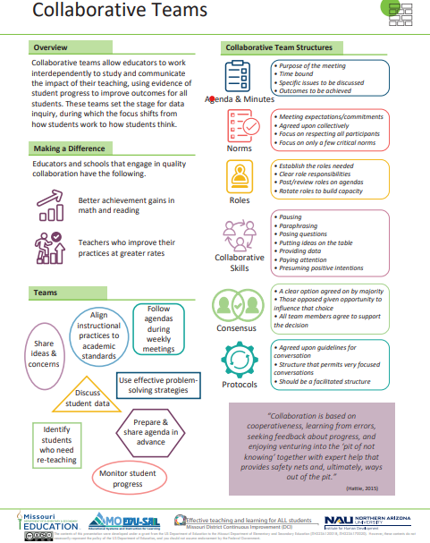
Notes:
To Know / To Say: This info graphic for Collaborative Teams can be used as either a pre reading before or at the beginning of the training. The consultant may want to use reflective questions or protocols to generate thinking prior to the training.
For example, you could pose a question to have them reflect on 1 thing they want to be able to implement or improve following the training. Or you may ask them to reflect on 1 thing they want to learn from the training about collaborative teams.
You may also want to use a protocol such as a 3-2-1 or K-W-L chart identifying what they know, what they need to know, where they need to improve, etc.
Handout: Collaborative Teams

Slide 10
Missouri Teacher and Leader Standards
Missouri Teacher Standards:
8 (Professional Practice)
9 (Professional Collaboration)
Missouri Leader Standards:
2 (Teaching and Learning)
3 (Management of Organizational Systems)
(Missouri Department of Elementary and Secondary Education, 2013)
Notes:
To Know: This slide shows how the use of Collaborative Teams relates to the
Missouri Teacher and Leader Standards.
To Say:
Teacher Standard #8 Professionalism The teacher is a reflective practitioner who continually assesses the effects of choices and actions on others. The teacher actively seeks out opportunities to grow professionally in order to improve learning for all students. [SB 291 Section 160.045.2 (2) Various forms of assessment are used to monitor and manage student learning; (5) The teacher keeps current on instructional knowledge and seeks and explores changes in teaching behaviors that will improve student performance; (6) The teacher acts as a responsible professional in the overall mission of the school.]
Teacher Standard #9 Professional Collaboration The teacher has effective working relationships with students, parents, school colleagues, and community members. [SB 291 Section 160.045.2
(4) The teacher uses professional communication and interaction with the school community; (6) The teacher acts as a responsible professional in the overall mission of the school.]
Leader Standard #2 Teaching and Learning Education leaders have the knowledge and ability to ensure the success of all students by promoting a positive school culture, providing an effective instructional program that applies best practice to student learning, and designing comprehensive professional growth plans for staff.
Leader Standard #3 Management of Organizational Systems Education leaders have the knowledge and ability to ensure the success of all students by managing the organizational structure, personnel, and resources in a way that promotes a safe, efficient, and effective learning environment.

Slide 11
Objectives for the Training
Understand foundational concepts and definitions of classroom-level collaborative teams.
Reflect on the team practices and processes currently in place.
Consider the challenges and potential barriers to becoming a high functioning team.
Explore resources to support the implementation of effective teams.
Notes:
(opening and introductions).
To Say: If we don’t know where we are headed, we won’t know when we get there. Read/paraphrase these intended outcomes for this work. (Pause)

Slide 12
Essential Questions
What are the adult behaviors of an effective team?
What are you doing right now in your collaborative data teams?
What challenges or barriers have you faced?
Notes:
To Say: Now, consider these questions. You may want to jot down some thoughts on your handout or just reflect: (provide a little time for reflection on each of these questions)
We ALL want to do whatever it takes to “put kids first” and high functioning, effective teams GET RESULTS! That’s the bottom line for this training.

Slide 13
Team Norms
Begin and end on time
Be an engaged participant
Be an active listener—open to new ideas
Use electronics respectfully
Notes:
To Say: Meetings, regardless of size or length, are more effective when meeting norms are established, practiced and monitored. These are the most common norms (read the list – paraphrasing the intent of the norm – especially noting the use of electronics indicating that if folks need to respond to calls immediately, please step out of the room; otherwise, there will be a break for checking messages/emails later). We need to be clear about our expectations in large groups and in small groups, so today, for the sake of time, these will be the norms we will follow today.”
In your Collaborative Teams, you may choose to use this list or create your own to better meet your needs. Sometimes schools create school-wide norms so that whenever small or larger groups in the school meet, the norms are the same. The point is – norms are an important part of effective teams WHEN they are honored and monitored. Creating table tents used at every meeting, or norm posters in every meeting room, or included on each agenda are ways to remind teams of the meeting norm.
Activity: Table discussion: Some schools have already established meeting norms. If you have meeting norms, are they working? Of these or your own norms, which one do you feel is the most important? Which of your norms or these listed above is the hardest one to maintain/monitor? What prompts do you use when norms in your meetings are violated? (Give the example of using a picture of Norm Peterson to hold up when a norm is not being respected.)
Big Idea: If a team is not functioning effectively – the first step is to revisit the meeting norms. Are team members following the norms? If not, how can you get back on track?

Slide 14
Effective Collaborative Cultures
Dedicated weekly block of collaborative time
Inclusion of all instructional staff
Monitoring and feedback
Support and training for teams to develop:
a climate of trust
structures for effective data teams
Notes:
To Say: These are structural components and processes that must be in place in order for teams to collaborate effectively, and in order to participate in this work. Effective structures support collaborative cultures.
(paraphrased bullet points)
1. Teams need focused time each week to work on student outcomes.
2. Teams must include the appropriate personnel - including general ed and special ed teachers and special subject teachers working together on classroom level collaborative data teams. Who is responsible for the learning of the children? Everyone, right? Then “everyone” needs to be included on the classroom collaborative data team.
Do teachers need training on how to be effective members of a team? Do teams need support to work effectively? Yes.
The work of the team must be supported and monitored by administrators to ensure they have the skills and resources needed to be effective.

Slide 15
Reflection Questions
Are these effective structures included in every classroom level collaborative data team:
A regular, protected block of time?
All instructional personnel who impact student outcomes serving on a collaborative data team?
Training for team members to support the tasks and functions of effective collaborative data teams?
Regular feedback from leadership (administrators, internal and external coaches)?
Notes:
To Say: Reflect on these questions: (provide time for participants to read)
Are these effective structures included in every classroom level collaborative data team:
A regular, protected block of time
All instructional personnel who impact student outcomes serving on a collaborative data team;
Training for team members to support the tasks and functions of effective collaborative data teams
Regular feedback from leadership, (administrators, internal and external coaches)
Table Activity – Establish a recorder in your group to take notes as you discuss each of these criteria one by one. Which ones do you have firmly established, which ones are in need of support and how might you envision getting these elements strengthened?
Share out – Presenter should take note of elements not in place and use that information for future work.
(Open discussion of the question below).
To Say: Let’s share out your thoughts on why and/or how can we fully involve and integrate special ed teachers, as well as other specialists, who are providing instruction to struggling learners to be vital members of every classroom level collaborative data team?

Slide 16
Collaborative Teaming
Collaborative teaming at the classroom level is educators working interdependently to learn about and communicate the impact of their teaching, using evidence of student progress to improve outcomes for all students.
Notes:
To Say: This definition guides the work. Three learner objectives have been developed from this definition and will be explored in this session.
Educators is bold, discuss using this definition: Educators are all relevant school personnel (teachers, paraprofessionals, specialized teachers, special education teachers, counselors, administrators, social workers, etc.). Every school setting is different, but when appropriate, any or all of these educators must be actively engaged in the work of Collaborative Data Teams.
Discussion: What does interdependent mean? What does it mean to communicate the impact of teaching? What evidence of student progress might be used? Depending on the size of the group, these questions can be addressed in pairs or could be an open discussion with all participants engaged in the dialogue.
To Do: If the participants are currently organized in collaborative data teams, have them rate their effectiveness and discuss which areas of this definition they are doing best and in which area they are struggling most. (Share out.)

Slide 17
Why Collaborative Skills?
“The messages in ‘Visible Learning’ are not another recipe for success, …There is no recipe, no professional development set of worksheets, no new teaching method, and no band-aid remedy.
It is a way of thinking: ‘My role, as teacher, is to evaluate the effect I have on my students.’ It is to ‘know thy impact’, it is to understand this impact, and it is to act on this knowing and understanding…and hold collaborative discussions with colleagues and students about this evidence, this making the effect of their teaching visible to themselves and others.”
(Hattie, 2011)
Notes:
To Say: Take a minute and reflect on this quote by John Hattie. The “why” we collaborate aligns to knowing the impact we have on student learning…..that impact becomes visible and we strengthen our practices.

Slide 18
Why Collaborate?
“Quality teaching is not an individual accomplishment, it is the result of a collaborative culture that empowers teachers to team up to improve student learning beyond what any one of them can achieve alone.”
(Carroll, 2009)
Notes:
Reference: Carroll, T. (2009). The next generation of learning teams. Phi Delta Kappan, 91(2), 8-13.
To Say: Effective collaboration enhances results. The Collaborative Work will be positively impacted by the development of truly collaborative, effective teams.
Rhetorical question: Is anyone of us smarter by ourselves than we can be when we engage the thinking of others in the problem-solving process?

Slide 19
Collaborative Teams Learning Objectives
Educators collaboratively develop common purposes and goals for improved student outcomes within a culture that embraces continuous school improvement.
The why…
Notes:
To Say: These objectives will be explored during this training session.
To Do: At this time, briefly describe the outcomes, focusing on powerful words and phrases. These phrases may be bolded through transitions/ emphasis in powerpoint.
To Do: Activity: Engage participants in several paired conversations and invite them to restate the objective in their own words.
(Unpacking objectives: Emphasize that these objectives have been carefully crafted. Connect these objectives to some of the quotes in the preparation activity.)
Obj. 1: The WHY - Detailed description of the core components: Common purposes and goals; improved student outcomes; culture of continuous school improvement. To Say: As a collaborative team, why are we here? (To improve outcomes for students through improved teaching and learning practices. To improve future student outcomes by becoming more skilled educators).

Slide 20
Learning Objectives (cont.)
Educators intentionally collaborate about the most effective practices within curriculum, instruction, assessment, and climate.
The what…
Notes:
Obj. 3: The WHAT -- Emphasize “intentionally collaborate” and also that the four foci listed are all about student outcomes.
To Say: Just a word about climate – the physical space, the social & emotional behaviors of the students and the adults in your building – are critical elements of effective schools. For purposes of our focused Collaborative Work initiative, however, we are beginning with a few of the research-based effective teaching and learning practices that have the biggest impact on student learning. Understand - this is just a starting point. Effective practices in all four of these areas will continue to be addressed and developed. Key words are “intentionally” and “effective practices.”

Slide 21
Learning Objectives (cont.)
Educators effectively utilize team processes (agendas, minutes, dialogue and discussion, norms, logistics, consensus, roles, decision-making skills, protocols).
The how…
Notes:
Obj. 2: The HOW -- Utilizing team processes – To Say: as mentioned earlier when we introduced our norms for today – are the structures – the tangibles that make our meetings productive. Have you ever been part of a meeting when you didn’t have an agenda so you didn’t know the plan for the meeting? Have you ever wondered “who’s in charge of getting this meeting started and moving along”? Have you been part of a team where it seemed no one knew how to make a decision or reach consensus? Team processes are critical!

Slide 22
What Makes an Effective Team?
Teams have a clear, worthwhile purpose.
Team meetings occur regularly with sufficient time set aside.
Administrators offer, engaged support and attention.
Teams have trained teacher leaders to facilitate.
Teams have an integrated approach
(Johnson, Reinhorn, and Simon, 2016)
Notes:
To Say: These are key factors found in a recent research study on what makes an effective team, many of these we will go into more detail with as we learn more about Collaborative Data Teams. Reflect for a 2-3 seconds on this list.

Slide 23
School Leader Support
Successful teams have ongoing, engaged support from Administrators.
(Johnson et. al, 2016)
Notes:
To Say: We noted on the prior slide that successful teams have ongoing support from administrators keeping abreast of meetings and providing support and feedback. Do you agree with these points? Are there other ways in which you think administrator support is critical to effective teams?

Slide 24
The WHY – Metaphors for Collaboration
Reflect: Are your teams focused on the “right things”? Are your team meetings focused on improved student outcomes?
Activity: Think about a situation in which you have participated where collaboration was supposed to occur. How did it go?
Think of a metaphor or image that describes this situation.
Notes:
To Know: Activity: (Purpose is to cause participants to reflect on current practices and previous experiences of collaboration. What does “good” collaboration look like?)
Provide an example:
Our last meeting was like a surgical team performing an operation on a patient’s left foot. The surgery (think “meeting”) went well, but the patient needed surgery on the right foot instead of the left, so the operation was a failure. The surgical team was not focused on the right thing!
To Do: Activity – Think of a metaphor or image that describes a collaborative situation in which you participated. Share your metaphor or image with a partner. (After 2 – 3 minutes ask if anyone had or heard a metaphor they would like to share with the group.)
Big idea: To Say: For improved outcomes for all students it is necessary for educators to individually and collaboratively reflect on their instructional practices and make adjustments based on data.

Slide 25
The WHAT –
Collaboration is intentional with a clear purpose and utilizes effective processes. (Collaborative Teams)
Collaboration is focused around the discussion of high impact practices. (Effective teaching and learning practices.)
Collaboration uses data effectively to improve student outcomes. (Data Based Decision Making and Common Formative Assessment.)
Notes:
To Say: What we do in Collaborative Data teams is around being intentional in our purpose, focused on high impact instruction, and using data effectively. The “what” ties the foundational pieces together----Collaborative Data Teams, Formative Assessment, Data Based Decision Making and then a focus on effective teaching and learning practices.

Slide 26
The HOW – A Closer Look at Team Processes
Foundational Processes
Agendas
Minutes and Communication
Norms
Roles
Collaborative Skills
Seven Norms of Collaboration
Consensus
Meeting Protocols
Notes:
To Say: This is an outline of the team processes mentioned earlier. The foundational pieces are critical for teams to know and implement to get started. They are not really debatable – should we or should we not – they are the expectation for all teams. Certainly there are levels for proficiency in these team processes, and - in your buildings, not all teams may be at the same place – and that’s okay. The point is – all teams must embrace these concepts and begin to perfect them.
The advanced collaborative processes are those elements which will be developed over time. Knowledge and skill in the “norms of collaboration” (not to be confused with the meeting norms) and how to reach consensus and what protocols we can use to make our meetings run more efficiently and be more productive are all processes that are important – but cannot be taught in just one setting. They will evolve and your need and desire to be higher functioning teams will drive that on-going training. Team assessment tools will be used to help identify “where you are as a team” and help to determine what additional support and trainings you will need.
To Know: (Please note that more information on these processes/topics is found in the mini-modules. These mini-modules should be used when team functioning assessment indicates the need.)

Slide 27
Agendas
Teams utilize agendas which include:
Team/Group Name
Date/Time/Location
Outcomes (includes required materials)
Past items to review (if necessary)
New items
Celebrations
Norms (often included in the footer as a reminder)
Next meeting date(s)
Notes:
Just to quickly go through a checklist of those 4 foundational pieces of effective collaborative data teams, please notice – what should be included on our collaborative data team meeting agendas?
To Say: A simple meeting agenda, distributed in advance, is perhaps the most important tool in ensuring a successful productive meeting. A sample template is included at the end of this presentation, but make your agendas work for YOU. Have at least one example of an agenda with these labels in the handouts
To Know: (Many of these are obvious, but it would be good to explain the significance of outcomes, as opposed to topics. Also important to stress the value of celebrations. )

Slide 28
Minutes and Communication
Meeting Minutes include:
Purpose for the meeting
Where and when held
List of the attendees
Decisions that were made - including the actions that were agreed upon
Actions that require follow-up should include to whom it was assigned and the expected completion date
Notes:
To Say: Succinct minutes that capture the purpose of the meeting and its agreed outcomes are a record that can be referred back to and be used for follow up purposes later.
BIG IDEA: Good minutes are concise and to the point, but at the same time, they do not leave out critical information.

Slide 29
Minutes and Communication
Communication:
Distribute notes to all members of the team and determine a protocol for vetting the notes (i.e. – corrections should be sent to _____ by _______)
Determine a place to store the vetted meeting notes (i.e. - shared drive for electronic filing or file cabinet/notebook for paper copies)
NOTE: The agenda serves as template for minutes and should be attached to the minutes.
Notes:
To Say: Effective communication AFTER the meeting is just as important as communication BEFORE the meeting. Meeting minutes “document” the progress and actions of the team decisions. We will get into more detail with this later but it is recommended that you can use the same template for agendas and minutes thus capturing your meeting minutes on the agenda format.

Slide 30
Norms are…
Simple, powerful statements about the way meetings can be run.
Commitments agreed upon collectively.
Consistent reminder of fundamental meeting guidelines.
Focus on respecting all participants.
Brief in number (Teams should focus on a few critical norms rather than an extensive laundry list).
Notes:
To say: Remember the norms we reviewed at the beginning of this training? Norms aren’t just for workshops, they are especially important for teams that collaborate. As your team works together regularly, effectiveness is improved when you agree to and follow basic rules (norms) for working together. How do the people on your team behave toward one another? Consider these criteria, and reflect on how your team currently works together. Do you follow norms? Is your team behaving in a manner that positively impacts your work?

Slide 31
Roles
Facilitator
Data Manager
Recorder/Reporter
Timekeeper
Norms-minder
NOTE: It is the responsibility of every team member to be prepared for the meeting and be an engaged participant!
Notes:
To Say: Clearly assigned roles and responsibilities clarify expectations for those in the meeting. They increase the engagement of all members and help the team build internal capacity for planning and holding effective and focused meetings.
Roles listed above are just examples. In small groups, a norms-minder may not be an assigned role, but rather the responsibility of all participants. Other roles may be needed – particularly as the work of the collaborative data team becomes more focused. Additional roles might include: “Expert Witness” when a teaching/learning practice is being reviewed in greater detail, or a particular common formative assessment is showing greater results by one teacher.
Additionally, the principal or instructional coach may be assigned a role as the “Guide on the Side” with the expectation of leading a discussion on a particular practice. Because these positions will serve on many collaborative data teams, they should not run nor facilitate the meeting. Define their role and expectation appropriately.
Big Idea: No matter the size of your collaborative data team, determine the roles your team needs, be intentional about assigning those roles and be specific about the expectations/duties of those roles.

Slide 32
Results of Pre-Assessment
(This is where the results of the pre-assessment would appear and where the correct answer would be highlighted.)
Notes:
To Do: (For this closing activity, the results of the pre-test should be shown. The post-test (same questions that were emailed in advance) is handed out to each participant in paper copy.
(The post-test questions are put up on the screen, read aloud and the correct answer is highlighted. After each question, ask for a show of hands for how many got the answer correct.) Participants are asked to leave their papers on the tables when they leave as the results will be collected and tabulated to assess the impact of today’s training.
Activity -- Share out as time allows:
What were some “aha’s” from today’s presentation?
What are some things that you are going to go home and do – or possibly NOT do - as a result of today’s training?

Slide 33
Now You Know…
Collaborative Teams :
Why you have them.
What they are.
How you work within them.
Reflect:
Where are we now?
Where do we need to be?
How will we get there?
Notes:
To Say: A practice profile for Collaborative Data Teams has been created.
Handout: Missouri Collaborative Work – Collaborative Data Teams Practice Profile
To Say: Take a look at the handout labeled Missouri Collaborative Work – Collaborative Data Teams Practice Profile. You will see that there are 3 Essential Functions (left side column). Then you will see that there are 4 categories describing the implementation levels of each of those functions. AND, at the far right, you will see an Evidence column – sometimes referred to as the “artifacts” – or the documents that provide evidence of the implementation level.
This practice profile is a guide for you to reference periodically. You can self-assess your progress. It will be used by the internal and external coaches and consultants who are providing support for you in this process of continuous improvement. Keep it close at hand and set your sights on being an “exemplary” team!

Slide 34
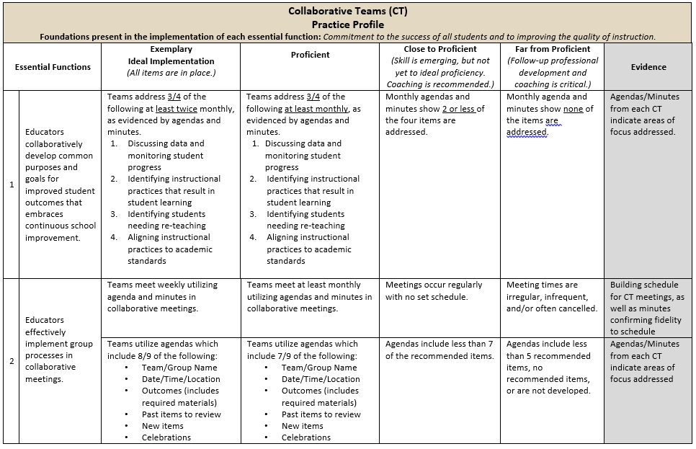
Practice Profile
Notes:
To Do: Share Practice Profile in Handouts
TO KNOW:
Full practice Profile is in Handouts
Collaborative Data Team Practice Profile
Implementation with fidelity requires clearly described implementation criteria. The Practice Profile framework has recently been developed by the National Implementation Research Network (NIRN) as a way of outlining implementation criteria using a rubric structure with clearly defined practice-level characteristics (NIRN, 2011). According to NIRN, the Practice Profile emerged from the conceptualization of the change process outline in the work of Hall and Hord’s (2006) Innovation Configuration Mapping (NIRN, 2011).
The Practice Profile template includes four pieces and is anchored by the essential functions. First, as a header is the foundation of implementation that philosophically grounds implementation. Then moving from left to right across the template are the essential functions of the practice, implementation performance levels, and lastly, evidence which provides data or documentation for determining implementation levels.
How to Use the Practice Profile
The essential functions align with the teaching/ learning objectives for each learning package. For each teaching/learning objective are levels of implementation. For some essential functions, proficient and exemplary implementation criteria are the same and in others, criteria differ. Close to proficient levels of implementation suggest the skill or practice is emerging and coaching is recommended for moving toward more proficient implementation. When implementation is reported at the unacceptable variation level, follow-up professional development in addition to coaching is recommended. The professional development provider should walk through the practice profile with the educator-learners, referring to the data and artifacts listed as suggested evidence. It is an important tool for self-monitoring their own implementation because it serves as a reminder as to the implementation criteria and is also aligned with the fidelity checklists.

Slide 35
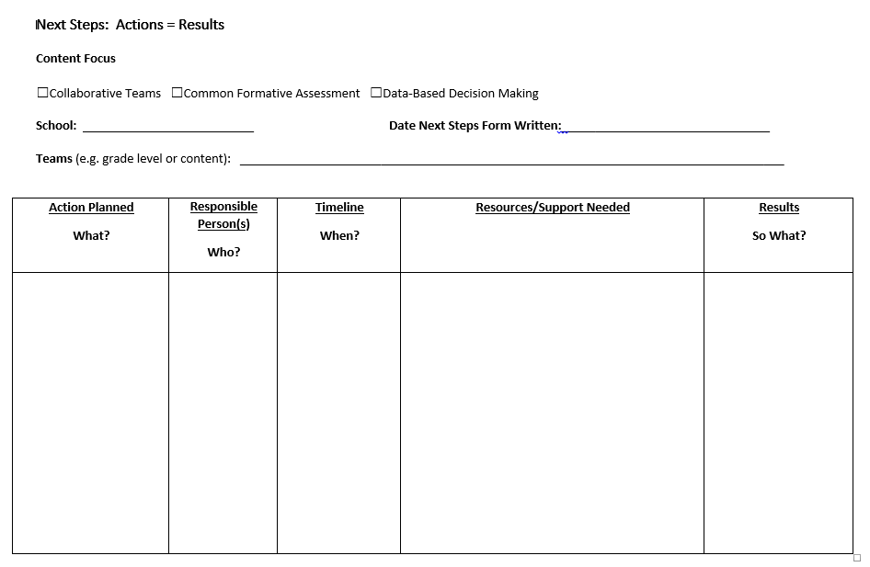
Next Steps: Action=Results
What steps will you take to begin implementing?
Notes:
To Do: Complete the Next Steps template. Example is included in the learning package materials.

Slide 36
Next Steps
Based on today’s presentation, and using the Collaborative Teams Practice Profile and the Next Steps handout, where does your collaborative data team need to begin?
What action will be done (short-term)?
Who will do it?
When will it be done?
What do we need (resources/support) to get it done?
Notes:
Handout: Next steps
To Say: See Next Steps handout. The action plan should align with the needs of the building as a whole, but should address individual classroom teams specifically.
To Do: Activity: If your classroom-level collaborative team is with you, spend some time looking over the components of this Next Steps tool. Individually or collectively jot down some beginning actions and what resources and supports you need from the regional consultants working with your building and/or the support you need within your building. The last column – “Results” – will be filled in when the action is completed. This tool serves to get your team moving, holding team members accountable and then documenting the results of the actions taken. It also helps inform the consultant working with your team how he/she can best provide the support you need.
To Know: (It is suggested that this next steps template should be on carbonless paper, so that a copy is available for the school to keep as well as a copy to be collected by the RPDC consultant following this training OR this template should also be shared electronically and used by the teams and the consultant/coaches working with each team to guide the future trainings/support needed.)
To Know: If the Team Functioning Survey (whole staff survey which was emailed to participants from KU evaluators) has been completed, this data may also be shared with teams as an assessment of current reality. A blank copy of this survey is included in the overview packet.

Slide 37
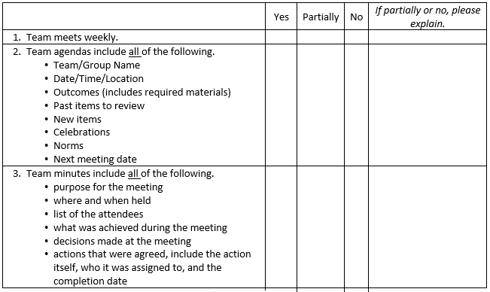
Implementation Fidelity
Notes:
To Do: Review the implementation fidelity checklist.
Handout: CT Implementation Fidelity Checklist

Slide 38
In Summary: Implementation of Collaborative Teams
Get the right people to your team’s table
Train for and commit to processes and structures to make your team effective
Monitor your team’s work
Maintain the focus of improved student outcomes
Notes:
Closing and Follow up:
To Say: There is no greater challenge than to make our schools great places for kids to learn. There is no work more important than making sure EVERY child is successful. This Collaborative Work in which your school has engaged is powerful work. We are here to help you make a difference!

Slide 39
Contact Information
Please contact me to schedule follow-up coaching and/or additional professional development.
Notes:
To Know/To Say/To Do: Include presenter’s contact information.
Please contact me to schedule follow-up coaching and/or additional professional development. Thank you.

