Slide 1
Collaborative Teams
Using Agendas and Minutes
This work is licensed under a Creative Commons Attribution-NonCommercial-NoDerivatives 4.0 International License.
Notes:
To Know: If participants are engaged in this work, they do so because data indicates they should. Participants will have a basic understanding of agendas from the overview presentation, and will have a reason to engage in this training. In some cases, teams may not have been meeting collaboratively, agendas may not have been used, or used effectively. Either participants and/or consultants will determine a need for this training.
To Do: IF participants are currently meeting, have them bring an agenda from their past meetings to use as a reference point throughout the training.
A simple meeting agenda, distributed in advance, is perhaps the most important tool in ensuring a successful productive meeting, even when the meeting is between only you and one other person.

Slide 2
Acknowledgements
Special thanks to all contributors to the development and revision of this module.
The original collection of learning packages was roll-out for use by Regional Professional Development Center (RPDC) Consultants in July 2013 after being developed by a team of content experts. The collection of learning packages was developed through efforts funded by the Missouri State Personnel Development Grant (SPDG). The following individual/groups are thanked immensely for their hard work in developing this package:
Content Development Support
Ronda Jenson, Carla Williams, Stefanie Lindsay, Jodi Arnold and Arden Day, UMKC
Institute for Human Development
SPDG Management Team

Slide 3
Team Members
Initial Content Development Team, 2013
Michelle Smith, Team Leader, MO PLC
Betty Ennis, DESE
Tiffiney Smith, SE RPDC
Marlow Barton, StL RPDC
Mary Gage, C RPDC
Sheila Thurman, NE RPDC
Rebecca Baldwin, NW RPDC
Bertha Richardson, StL RPDC
Karen Wigger, NW RPDC
Mary Ann Burns, DESE
Tom Robb, KC RPDC
2016 Revision Team
Mary Dell Black, Facilitator, SC SIS
Jamie Mehring, Ed Plus/StL RPDC
Sheila Thurman, NE RPDC
Marisa Bowen, SE SIS
Tiffani Muessig, DESE
Judy Wartick, KC SIS
Jeanie Carey, SC RPDC
Connie Schweiss, SC RPDC
Pam Williams, DESE
Joy Fairley, KC RPDC

Slide 4
Hidden Slide
Presenter notes information
Tools and documents
Helpful suggestions
Notes:
The Collaborative Teams (CT) learning package is organized in seven modules. The first is an Overview. The other six modules address each of the processes that contribute to effective teams.
The CT Content Fidelity Checklist aligned to each learning package includes all critical items for a training session (draft, pending approval). The CT HQPD Training Checklist and Coaching Checklist contain process elements to be used as guidance when designing, revising, or coaching high quality professional development.
Important notes:
A script of presenter notes is included in the PowerPoint. Background information for the presenter is shown as “To Know.” Statements to be shared with participants are shown as “To Say.” In some instances, the “To Know/To Say” are the same material. For fidelity of content and consistency among presenters, the “To Say” information should be presented with minimal paraphrasing.
There is one pre/post assessment for the entire CT package (all seven modules).
An Implementation Fidelity Checklist is available for frequent monitoring by a teacher or observer.
A print Practice Profile and an electronic Practice Profile Self-Assessment tool are available for use by individuals, teams, or schools for periodic self-assessment and monitoring of implementation of practice or to identify training or coaching needs.
The presenter should download onto a hard drive or a flash drive any video intended for use in a training. The links shown on slides may not be able to be accessed online at the school sites.
Breaks should be inserted at the discretion of the presenter based on the needs of participants.
A presenter may add slides to supplement the content. For example, a slide of essential questions may be added since only objectives have been included.
A presenter may choose to differentiate a presentation to meet the needs of the participants. For example, another form may be substituted for the Next Steps template if the district or building already uses a similar form or protocol.
Additional activities, examples, videos, etc. may be found _____. (The details are in progress.) A presenter may interchange the additional material for the corresponding PowerPoint content.

Slide 5
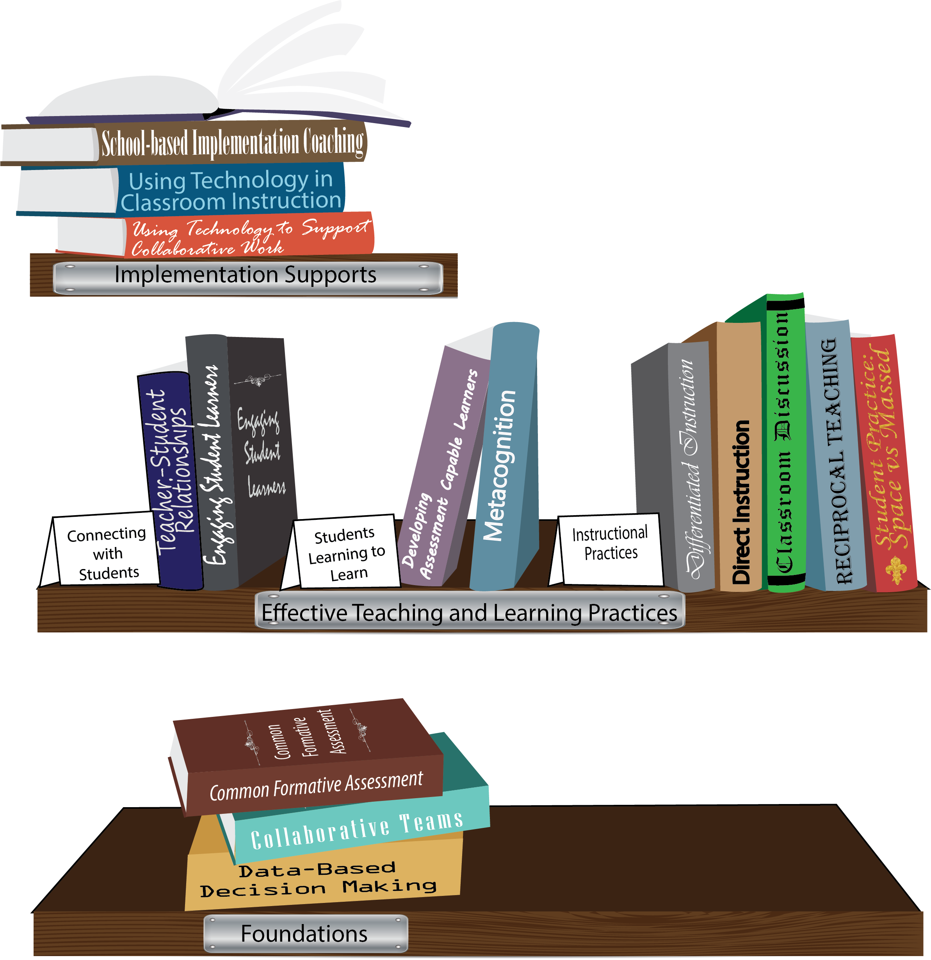
Notes:
To Know/To Say: Missouri’s professional development learning packages are organized in three categories: Foundations, Effective Teaching & Learning Practices, and Implementation Supports. All schools begin their professional development journey with the Foundations, as these learning packages provide foundation knowledge in three key areas: Collaborative Teams, Data-based Decision-making, and Common Formative Assessment. Effective Teaching & Learning Practices encompass research-based instructional practices for deepened learning. These learning packages address ways of connecting with students, ways of helping students learn how to learn, and feature specific instruction practices. Implementation Supports are learning packages designed to help school staff support and enhance the Implementation of Effective Teaching & Learning Practices through using technology and peer coaching supports.
To Do: Explain how the graphic depicts professional development in Missouri.

Slide 6
Collaborative Work Foundations
3 Key Areas
Collaborative Teams
Common Formative Assessment
Data-Based Decision Making
CFA – utilize
Quality assessments
as feedback to improve teaching & learning.
DBDM – utilize data for continuous improvement through dialogue about teaching & learning
CT – utilize team processes to improve teaching & learning.
Notes:
To Know/To Say: The learning packages forming the foundation knowledge of the Collaborative Work are Collaborative Teams, Data-Based Decision Making, and Common Formative Assessment.
Collaborative Teams (CT) utilize team processes to improve teaching and learning.
Common Formative Assessment (CFA) utilize quality assessments as feedback to improve teaching & learning.
Data-Based Decision Making (DBDM) utilize data for continuous improvement through dialogue around instruction.

Slide 7
Collaborative Teams
Overview and Purpose of
Collaborative Teams
Foundational Processes
Agendas & Minutes Norms Roles
Foundational Processes
Agendas & Minutes
Advanced Collaborative Processes
Consensus
Collaborative Skills
Protocols
Notes:
To Know: The learning package Collaborative Teams consists of Three Sections: Overview, Foundational Processes and Advanced Collaborative Process. There are seven presentations: Overview, Agenda and Minutes, Norms, Roles, Consensus, Collaborative Skills and Protocols.
To Say: Today we will focus on Agendas and Minutes. Both are important in the foundational process of Collaborative Teams.

Slide 8
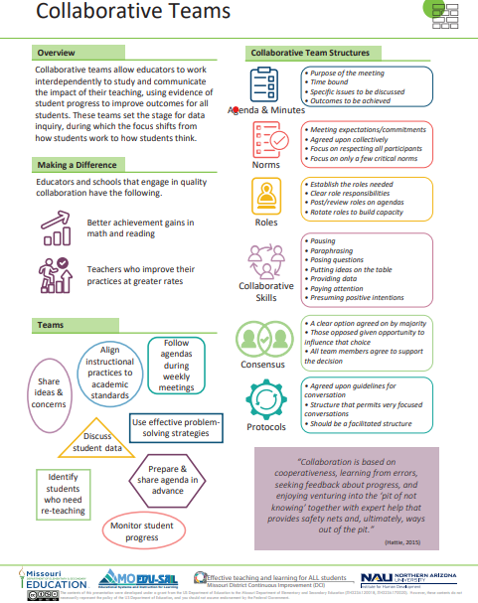
Notes:
To Know / To Say: This info graphic for Collaborative Teams can be used as either a pre reading before or at the beginning of the training. The consultant may want to use reflective questions or protocols to generate thinking prior to the training.
For example, you could pose a question to have them reflect on 1 thing they want to be able to implement or improve following the training. Or you may ask them to reflect on 1 thing they want to learn from the training about collaborative teams.
You may also want to use a protocol such as a 3-2-1 or K-W-L chart identifying what they know, what they need to know, where they need to improve, etc.
Handout: Collaborative Teams

Slide 9
Missouri Teacher and Leader Standards
Missouri Teacher Standards:
8 (Professional Practice)
9 (Professional Collaboration)
Missouri Leader Standards:
2 (Teaching and Learning)
3 (Management of Organizational Systems)
(Missouri Department of Elementary and Secondary Education, 2013)
Notes:
To Know: This slide shows how the use of Collaborative Teams relates to the
Missouri Teacher and Leader Standards.
To Say:
Teacher Standard #8 Professionalism The teacher is a reflective practitioner who continually assesses the effects of choices and actions on others. The teacher actively seeks out opportunities to grow professionally in order to improve learning for all students. [SB 291 Section 160.045.2 (2) Various forms of assessment are used to monitor and manage student learning; (5) The teacher keeps current on instructional knowledge and seeks and explores changes in teaching behaviors that will improve student performance; (6) The teacher acts as a responsible professional in the overall mission of the school.]
Teacher Standard #9 Professional Collaboration The teacher has effective working relationships with students, parents, school colleagues, and community members. [SB 291 Section 160.045.2
(4) The teacher uses professional communication and interaction with the school community; (6) The teacher acts as a responsible professional in the overall mission of the school.]
Leader Standard #2 Teaching and Learning Education leaders have the knowledge and ability to ensure the success of all students by promoting a positive school culture, providing an effective instructional program that applies best practice to student learning, and designing comprehensive professional growth plans for staff.
Leader Standard #3 Management of Organizational Systems Education leaders have the knowledge and ability to ensure the success of all students by managing the organizational structure, personnel, and resources in a way that promotes a safe, efficient, and effective learning environment.

Slide 10
Objectives
Educators will design (revise) and implement an agenda template aligned with these teacher and leader guidelines.
Effectively implement meeting minutes and communication structures.
Notes:
To Say: It is recommended that all teams in a single building use the same agenda template, to facilitate participation in multiple or changing groups by educators, and to enable easier communication of minutes to all stakeholders.

Slide 11
Team Norms
Begin and end on time
Be an engaged participant
Be an active listener—open to new ideas
Use electronics respectfully
Notes:
Meetings, regardless of size or length, are more effective when meeting norms are established, practiced and monitored. These are the most common norms (read the list – paraphrasing the intent of the norm – especially noting the use of electronics indicating that if folks need to respond to calls immediately, please step out of the room; otherwise, there will be a break for checking messages/emails later). We need to be clear about our expectations in large groups and in small groups, so today, for the sake of time, these will be the norms we will follow today.”
In your Collaborative Data Teams, you may choose to use this list or create your own to better meet your needs. Sometimes schools create school-wide norms so that whenever small or larger groups in the school meet, the norms are the same. The point is – norms are an important part of effective teams WHEN they are honored and monitored. Creating table tents used at every meeting, or norm posters in every meeting room, or included on each agenda are ways to remind teams of the meeting norm.
Table discussion: Some schools have already established meeting norms. If you have meeting norms, are they working? Of these or your own norms, which one do you feel is the most important? Which of your norms or these listed above is the hardest one to maintain/monitor? What prompts do you use when norms in your meetings are violated? (Give the example of using a picture of Norm Peterson to hold up when a norm is not being respected.)
Big Idea: If a team is not functioning effectively – the first step is to revisit the meeting norms. Are team members following the norms? If not, how can you get back on track?

Slide 12
“Before anything else, preparation is the key to success.”
(Alexander G. Bell)
Notes:
To Say: Think of your most recent collaborative meeting. Now consider these points:
-What was the level of preparation?
-How did it impact the meeting?
- Was there an agenda?
- If so, was it effective?
Agendas are about preparation on the part of the facilitator/leader and the members. Turn to someone close by and reflect on the current practices of meetings in your building. Could they be more effective? Do you feel adequate preparation is being made for these meetings?

Slide 13
Definition of Agendas
A document that is used to let team members know the purpose for the meeting. It is time-bound with specific issues to be discussed and outcomes to be achieved.

Slide 14
Why Agendas?
Setting the right tone
Identifies outcomes
Encourages prepared participation
Focuses on priority items
Notes:
To Say: Why the topic is important:
a)Meeting agendas let the participants know that there’s a legitimate business purpose for meeting, with specific issues to be discussed and outcomes to be achieved. It conveys your interest in getting down to business and not wasting time.
b) Agendas let attendees know what issues are going to be discussed, and keep them from placing other issues on the table. They also eliminate guesswork as to whether or not a particular issue is going to be discussed.
c) Meeting agendas can focus participants in ways that verbal guidance cannot. Participants have a written reminder of what needs to be accomplished during the meeting, allowing them to help drive each discussion toward conclusion.
d) Following the agenda items will help keep meeting on track and avoid missing important discussions

Slide 15
Keys to Effective Agendas
Team/Group Name
Date/Time/Location
Outcomes (includes required materials)
Review past items
New items
Celebrations
Notes:
To Say: Why are each of these items important?
- time/date/group name/location :These are just logistics necessary for any meeting when you want full participation. People need to know the time, date, and location of meeting.
- Outcomes- bringing required materials: When you place the outcomes/goals of the meeting on the agenda, you are sending a gentle reminder to come prepared. This can also help focus the meeting.
- Review past items: By including a time for past items, it provides an opportunity to reflect, update or report on prior business.
- New items: New topics should be placed on the agenda so members will have time to bring ideas to the table.
- Norms: Meeting norms should be on every agenda. It is a constant reminder of collaboration.
To Know/To Do: A suggestion to think about is including a time allotment and person responsible for each outcome when applicable. It can be a helpful reminder of time and responsibility. For more information, reference the Garmston article, “Results Oriented Agendas.” It emphasizes the value of outcomes.
Activity: Topic in practice: Provide groups of participants with sample agendas. These may be past agendas or agendas written just for this activity. Allow time to briefly examine these agendas for evidence of the above items.

Slide 16
Effective Agenda
Deliver to participants at least 48 hours in advance
Consider the impact of a consistent agenda for all team
Utilize team member input and feedback
It is very effective to use the agenda template to record minutes, then the agenda and minutes become one document after the meeting.
Each topic needs an outcome
Topic: Math assessment
Outcome: Develop a common formative assessment for current math standard.
Notes:
To Say: When agendas are delivered early- preferably at least 48 hours in advance, members have time to review items for discussion. They have time to think about the items, organize ideas, suggestions or questions- which will make for a more productive meeting.
It is suggested that the use of outcomes, instead of topics sets a tone for desired accomplishment and goals. Using the word topic suggests items for discussion, whereas outcomes promotes action.
To Know/To Do: As teams progress through the CW over time, if consultants note issues with focused agenda items, the article “Results Oriented Agendas Transform Meetings into Valuable Collaborative Events,” may be useful. It is included as a supplemental resource in this packet. After reading and discussing the article, teams should practice transforming agenda items into objectives.

Slide 17
Create an Agenda
At this time, revise or create an agenda template for your use
Notes:
Activity: Create an agenda of an upcoming meeting. Or, refer to the agenda you brought and recreate that agenda. Include important components you have learned about or reviewed in this session. Customize if you choose.
To Do: Use the guidelines in “Keys to Effective Agendas” slide as a checklist to design your agenda template.

Slide 18
Reflection
Partner with one other team and provide feedback on each other’s agendas
Notes:
Activity: Exchange the agenda template you have just created with someone. Take some time to reflect and provide feedback. Use this time as a discussion of what works and what needs to be revised. Important- discuss why the revisions should take place.

Slide 19
Next Steps with Agendas
Agree on how you will utilize the agenda developed
Agree on when/how you will evaluate the agenda, as well as how it is being used
Notes:
To Say: Now it is time to come to some agreement regarding your team’s use of agendas.
Reflect back over the information you have just been given. Some things were not new to you, but maybe other ideas were new. Make note of things you feel would improve your next agenda.
As a team, come to an agreement of a created agenda template- it should be simple and efficient in meeting your team’s needs.
Agree on a system to evaluate the effectiveness of your agenda from time to time.
Remind participants of the tools available to self assess.
A reminder that an agenda is documentation of outcomes discussed. They can help establish timelines and a way to monitor when important discussions took place. Always keep past agendas for important follow-up.
Throughout the Collaborative Work, effectiveness will be impacted by structures and processes of collaborative teams, buildings, and networks established across schools. For SPDG purveyors, and RPDC consultants, access to both agendas and minutes from ongoing work of teams will provide a way to monitor and support school teams.
Consultants should establish expectations for how often and in what manner agendas are passed along to them, in addition to regular data reports.

Slide 20
Minutes
Succinct minutes that capture the purpose of the meeting and its agreed outcomes are a record that can be referred back to and be used for follow up purposes later. Good minutes are concise and to the point, but at the same time, they do not leave out critical information.
Notes:
To Do: Share definition with participants. Discuss the need for record keeping.
To Say: An agenda is a plan for a meeting; the minutes are what actually happened. It is very effective to use the agenda template to record minutes, then the agenda and minutes become one document after the meeting.
Agendas and minutes are addressed separately because teams may very well be using agendas, and not minutes, or vice versa. Think of a group in your school that meets regularly. Does the group regularly keep minutes that accurately reflect what happened at the meeting?

Slide 21
Characteristics of Effective Minutes
Agenda also serves as template for minutes:
Where and when the meeting held
List of the attendees
Outcomes for the meeting – what was achieved
Actions agreed upon at the meeting
Who is responsible for the action
Completion date for the action (completed, monitored, or reviewed)
Notes:
Activity: Review the characteristics on this slide.
Think about your meeting minutes and compare to the above characteristics.
How do your minutes compare?
See sample meeting minutes in this packet.

Slide 22
Characteristics of Effective Communication
Central place to store documents (minutes won’t get lost in inbox or on server)
Easy access for all participants to provide updates and comments
Distributed to and utilized by all appropriate stakeholders
Attention drawn to action items and follow up
Notes:
To Say: Now, go back to your group minutes. Who sees these minutes after the meeting? Discuss these criteria in some detail, and provide opportunities for participants to reflect on current communication structures.
Make a list of all who are impacted by this group, even those who aren’t on the team. Do they receive meeting minutes? Do they attend to meeting minutes when they receive them?
Depending upon the setting, either electronic or traditional means of communication may be most appropriate. For example, in some settings, minutes received via email may be quickly read, then saved easily, if those in the system are savvy with electronic storage. Conversely, some email communication may simply be deleted. In that case, a bulletin board posted in a conspicuous place with all meeting minutes may be a better strategy.
Attention should be given to setting expectations for the attention given to follow up. What responsibilities do principals have to provide feedback and demonstrate awareness of what has happened in meetings? What are the responsibilities for district personnel? Or for those building personnel responsible for coordinating assessment timelines? This is about an effective communication structure, and a culture that values shared responsibility.

Slide 23
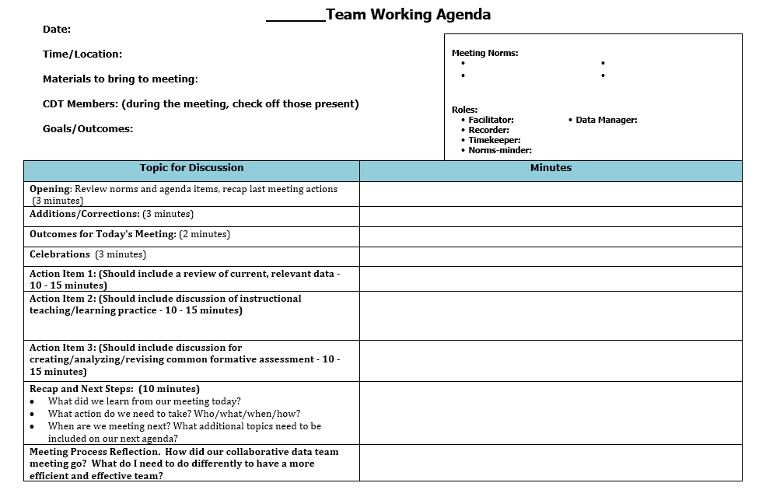
Notes:
To Say: Here is an example template for an effective agenda. Space is left to take notes right on the agenda. Electronic note taking during meeting will save time. This example is also a handout.

Slide 24
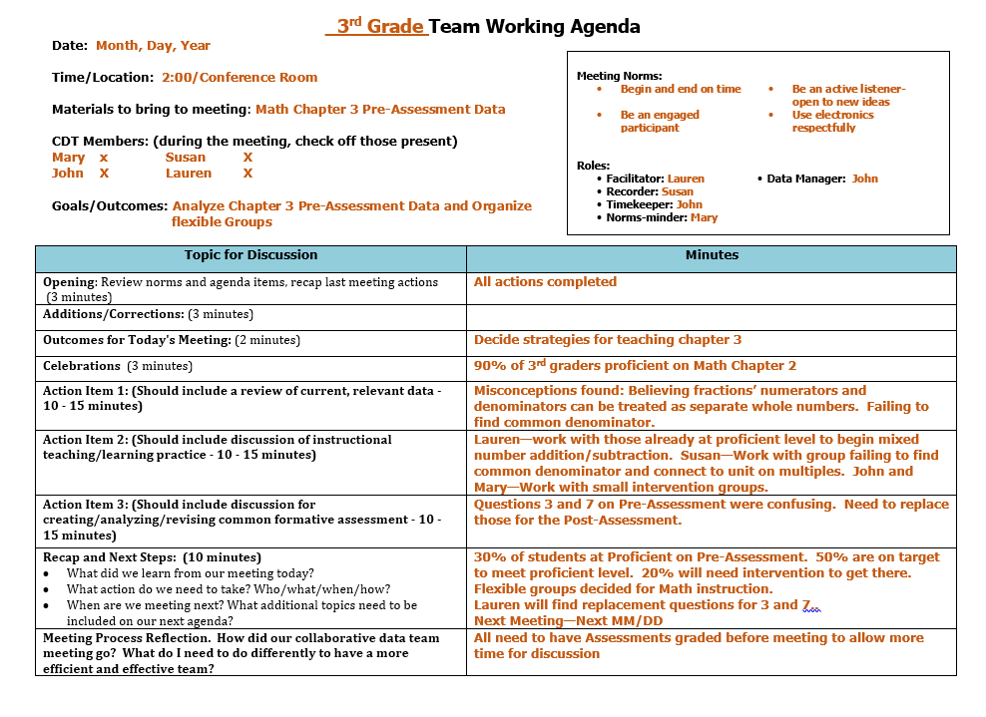
Notes:
To Say: Here is the same agenda with minutes/notes added. Team member names and Norms can be added to be part of template. This example is also a handout.

Slide 25
Technology Resources
Wiggio - Free account, ability to upload all file types.
Dropbox – Free account, limited space-2GB
Google Drive (Google Apps) - Free account, no storage limits if you use their products, i.e. Docs, Sheets, Slide, Sites. Easy to share & collaborate on documents.
Weebly – Free website- very easy to drag & drop files. Templates are easy to use. Here’s an example: http://nordoniaplcresources.weebly.com/
Padlet - Free, can upload files, links, etc.
Live Binders: Free, it’s a virtual binder! Example of a school data tem binder: http://www.livebinders.com/play/play?id=1398686
Notes:
To Say: File sharing is easier than ever! There are several free options for a team to use to share not only minutes, but also agendas and other documents. A little pre-planning is recommended before you choose which option is best for your team.
To Know:
Wiggio is designed for groups/teams. Offers other tools such as a calendar, survey and meeting scheduler.
DropBox is designed for file storage and file sharing. Files are synced across devices.
Google Drive is designed for file storage, file sharing, and editing. Files are automatically saved.
Weebly is a website creator. You can add pages to the site to store and share your data.
Padlet is a digital canvas shared with a team or group. Add documents, links, pictures, videos, and audio clips to the canvas.
Livebinders: Get rid of the bulky binders on your desk and make them digital! Easy to create a data binder and add tabs to organize your uploads.
Example websites:
http://nordoniaplcresources.weebly.com/
http://www.livebinders.com/play/play?id=1398686

Slide 26
https://www.symbaloo.com/mix/technologypd
Notes:
To Know/Do: Clink on the link on this slide. This link takes you to a technology resource page on MO Edu-Sail. These are additional resources participants might find useful and have easy access to by clicking the tiles icons on this page.

Slide 27
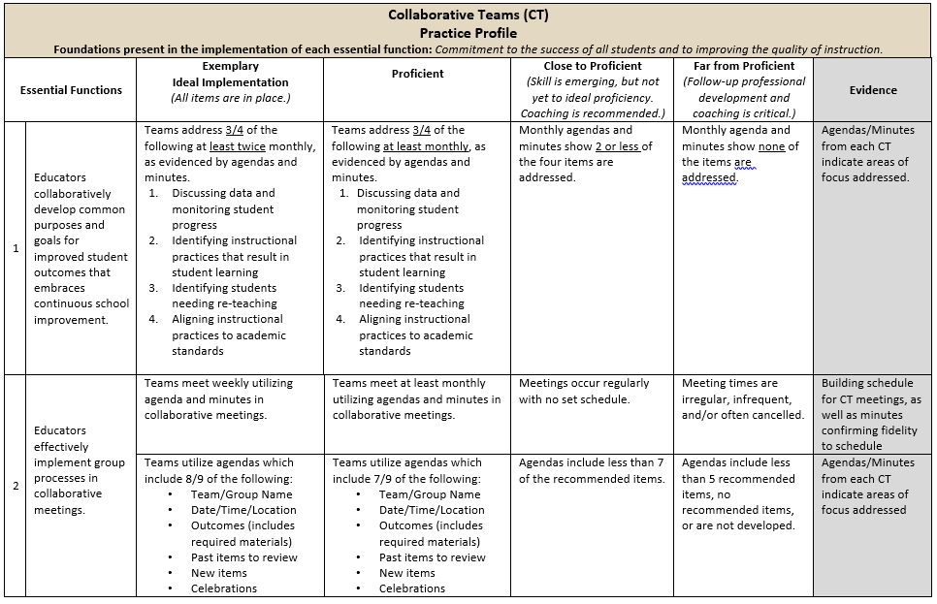
Practice Profile
Notes:
To Do: Share Practice Profile in Handouts
TO KNOW:
Full practice Profile is in Handouts
Collaborative Data Team Practice Profile
Implementation with fidelity requires clearly described implementation criteria. The Practice Profile framework has recently been developed by the National Implementation Research Network (NIRN) as a way of outlining implementation criteria using a rubric structure with clearly defined practice-level characteristics (NIRN, 2011). According to NIRN, the Practice Profile emerged from the conceptualization of the change process outline in the work of Hall and Hord’s (2006) Innovation Configuration Mapping (NIRN, 2011).
The Practice Profile template includes four pieces and is anchored by the essential functions. First, as a header is the foundation of implementation that philosophically grounds implementation. Then moving from left to right across the template are the essential functions of the practice, implementation performance levels, and lastly, evidence which provides data or documentation for determining implementation levels.
How to Use the Practice Profile
The essential functions align with the teaching/ learning objectives for each learning package. For each teaching/learning objective are levels of implementation. For some essential functions, proficient and exemplary implementation criteria are the same and in others, criteria differ. Close to proficient levels of implementation suggest the skill or practice is emerging and coaching is recommended for moving toward more proficient implementation. When implementation is reported at the unacceptable variation level, follow-up professional development in addition to coaching is recommended. The professional development provider should walk through the practice profile with the educator-learners, referring to the data and artifacts listed as suggested evidence. It is an important tool for self-monitoring their own implementation because it serves as a reminder as to the implementation criteria and is also aligned with the fidelity checklists.

Slide 28
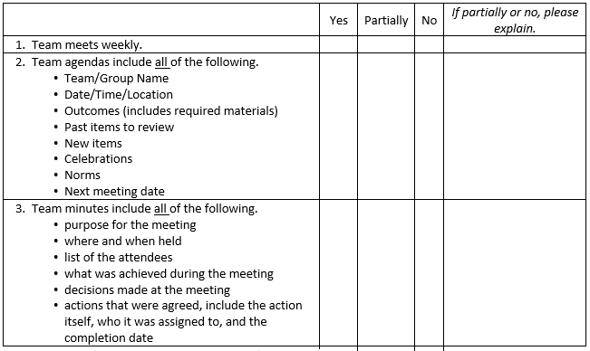
Implementation Fidelity
Notes:
To Do: Review the implementation fidelity checklist.
Handout: CT Implementation Fidelity Checklist

Slide 29
Next Steps with Minutes
Develop an effective structure for recording and saving meeting minutes, and a communication structure that ensures communication to team members, as well as others.
Notes:
To Know: The outline of meeting minutes will most likely be determined by the agenda that the building has agreed to use. The communication structure established will also be specific to the building/district. RPDC facilitators should also outline expectations for communication by buildings with them, as well as sharing of information with other buildings in the cohort.

Slide 30
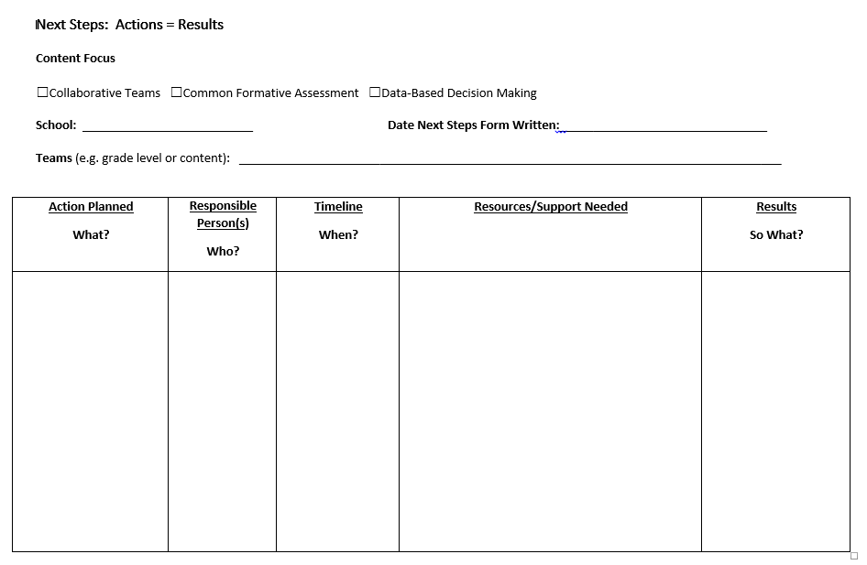
Next Steps: Action=Results
What steps will you take to begin implementing?
Notes:
To Do: Complete the Next Steps template. Example is included in the learning package materials.

Slide 31
Contact Information
Please contact me to schedule follow-up coaching and/or additional professional development.
Notes:
To Know/To Say/To Do: Include presenter’s contact information.
Please contact me to schedule follow-up coaching and/or additional professional development. Thank you.

