Slide 1
Collaborative Teams
Norms
This work is licensed under a Creative Commons Attribution-NonCommercial-NoDerivatives 4.0 International License.

Slide 2
Acknowledgements
Special thanks to all contributors to the development and revision of this module.
The original collection of learning packages was roll-out for use by Regional Professional Development Center (RPDC) Consultants in July 2013 after being developed by a team of content experts. The collection of learning packages was developed through efforts funded by the Missouri State Personnel Development Grant (SPDG). The following individual/groups are thanked immensely for their hard work in developing this package:
Content Development Support
Ronda Jenson, Carla Williams, Stefanie Lindsay, Jodi Arnold and Arden Day, UMKC
Institute for Human Development
SPDG Management Team

Slide 3
Team Members
Initial Content Development Team, 2013
Michelle Smith, Team Leader, MO PLC
Betty Ennis, DESE
Tiffiney Smith, SE RPDC
Marlow Barton, StL RPDC
Mary Gage, C RPDC
Sheila Thurman, NE RPDC
Rebecca Baldwin, NW RPDC
Bertha Richardson, StL RPDC
Karen Wigger, NW RPDC
Mary Ann Burns, DESE
Tom Robb, KC RPDC
2016 Revision Team
Mary Dell Black, Facilitator, SC SIS
Jamie Mehring, Ed Plus/StL RPDC
Sheila Thurman, NE RPDC
Marisa Bowen, SE SIS
Tiffani Muessig, DESE
Judy Wartick, KC SIS
Jeanie Carey, SC RPDC
Connie Schweiss, SC RPDC
Pam Williams, DESE
Joy Fairley, KC RPDC

Slide 4
Hidden Slide
Presenter notes information
Tools and documents
Helpful suggestions
Notes:
The Collaborative Teams (CT) learning package is organized in seven modules. The first is an Overview. The other six modules address each of the processes that contribute to effective teams.
The CT Content Fidelity Checklist aligned to each learning package includes all critical items for a training session (draft, pending approval). The CT HQPD Training Checklist and Coaching Checklist contain process elements to be used as guidance when designing, revising, or coaching high quality professional development.
Important notes:
A script of presenter notes is included in the PowerPoint. Background information for the presenter is shown as “To Know.” Statements to be shared with participants are shown as “To Say.” In some instances, the “To Know/To Say” are the same material. For fidelity of content and consistency among presenters, the “To Say” information should be presented with minimal paraphrasing.
There is one pre/post assessment for the entire CT package (all seven modules).
An Implementation Fidelity Checklist is available for frequent monitoring by a teacher or observer.
A print Practice Profile and an electronic Practice Profile Self-Assessment tool are available for use by individuals, teams, or schools for periodic self-assessment and monitoring of implementation of practice or to identify training or coaching needs.
The presenter should download onto a hard drive or a flash drive any video intended for use in a training. The links shown on slides may not be able to be accessed online at the school sites.
Breaks should be inserted at the discretion of the presenter based on the needs of participants.
A presenter may add slides to supplement the content. For example, a slide of essential questions may be added since only objectives have been included.
A presenter may choose to differentiate a presentation to meet the needs of the participants. For example, another form may be substituted for the Next Steps template if the district or building already uses a similar form or protocol.
Additional activities, examples, videos, etc. may be found _____. (The details are in progress.) A presenter may interchange the additional material for the corresponding PowerPoint content.

Slide 5
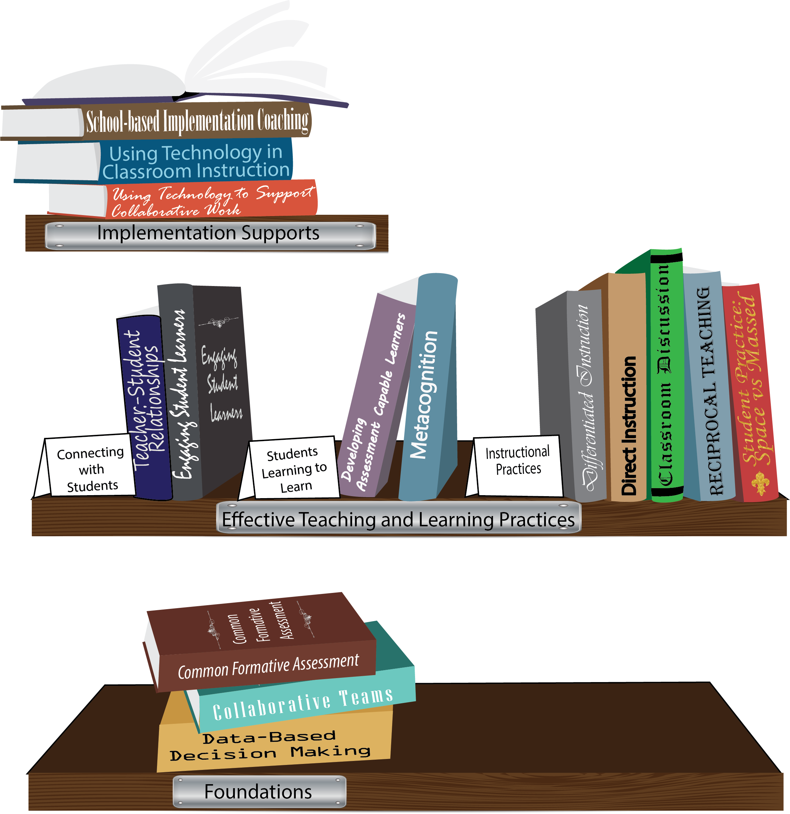
Notes:
To Know/To Say: Missouri’s professional development learning packages are organized in three categories: Foundations, Effective Teaching & Learning Practices, and Implementation Supports. All schools begin their professional development journey with the Foundations, as these learning packages provide foundation knowledge in three key areas: Collaborative Teams, Data-based Decision-making, and Common Formative Assessment. Effective Teaching & Learning Practices encompass research-based instructional practices for deepened learning. These learning packages address ways of connecting with students, ways of helping students learn how to learn, and feature specific instruction practices. Implementation Supports are learning packages designed to help school staff support and enhance the Implementation of Effective Teaching & Learning Practices through using technology and peer coaching supports.
To Do: Explain how the graphic depicts professional development in Missouri.

Slide 6
Collaborative Work Foundations
3 Key Areas
Collaborative Teams
Common Formative Assessment
Data-Based Decision Making
CFA – utilize
Quality assessments
as feedback to improve teaching & learning.
DBDM – utilize data for continuous improvement through dialogue about teaching & learning
CT – utilize team processes to improve teaching & learning.
Notes:
To Know/To Say: The learning packages forming the foundation knowledge of the Collaborative Work are Collaborative Teams, Data-Based Decision Making, and Common Formative Assessment.
Collaborative Teams (CT) utilize team processes to improve teaching and learning.
Common Formative Assessment (CFA) utilize quality assessments as feedback to improve teaching & learning.
Data-Based Decision Making (DBDM) utilize data for continuous improvement through dialogue around instruction.

Slide 7
Collaborative Teams
Overview and Purpose of
Collaborative Teams
Foundational Processes
Agendas & Minutes Norms Roles
Foundational Processes
Norms
Advanced Collaborative Processes
Consensus
Collaborative Skills
Protocols
Notes:
To Know: The learning package Collaborative Teams consists of Three Sections: Overview, Foundational Processes and Advanced Collaborative Process. There are seven presentations: Overview, Agenda and Minutes, Norms, Roles, Consensus, Collaborative Skills and Protocols.
To Say: Today we will focus on group norms. Establishing norms are an important part in the foundational process of Collaborative Teams.

Slide 8
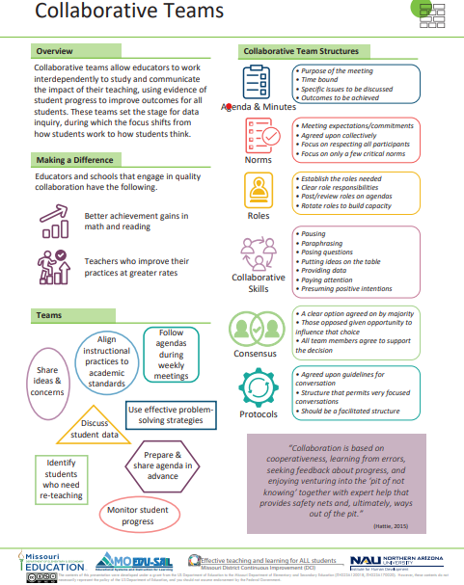
Notes:
To Know / To Say: This info graphic for Collaborative Teams can be used as either a pre reading before or at the beginning of the training. The consultant may want to use reflective questions or protocols to generate thinking prior to the training.
For example, you could pose a question to have them reflect on 1 thing they want to be able to implement or improve following the training. Or you may ask them to reflect on 1 thing they want to learn from the training about collaborative teams.
You may also want to use a protocol such as a 3-2-1 or K-W-L chart identifying what they know, what they need to know, where they need to improve, etc.
Handout: Collaborative Teams

Slide 9
Missouri Teacher and Leader Standards
Missouri Teacher Standards:
8 (Professional Practice)
9 (Professional Collaboration)
Missouri Leader Standards:
2 (Teaching and Learning)
3 (Management of Organizational Systems)
(Missouri Department of Elementary and Secondary Education, 2013)
Notes:
To Know: This slide shows how the use of Collaborative Teams relates to the Missouri Teacher and Leader Standards.
To Say:
Teacher Standard #8 Professionalism The teacher is a reflective practitioner who continually assesses the effects of choices and actions on others. The teacher actively seeks out opportunities to grow professionally in order to improve learning for all students. [SB 291 Section 160.045.2 (2) Various forms of assessment are used to monitor and manage student learning; (5) The teacher keeps current on instructional knowledge and seeks and explores changes in teaching behaviors that will improve student performance; (6) The teacher acts as a responsible professional in the overall mission of the school.]
Teacher Standard #9 Professional Collaboration The teacher has effective working relationships with students, parents, school colleagues, and community members. [SB 291 Section 160.045.2
(4) The teacher uses professional communication and interaction with the school community; (6) The teacher acts as a responsible professional in the overall mission of the school.]
Leader Standard #2 Teaching and Learning Education leaders have the knowledge and ability to ensure the success of all students by promoting a positive school culture, providing an effective instructional program that applies best practice to student learning, and designing comprehensive professional growth plans for staff.
Leader Standard #3 Management of Organizational Systems Education leaders have the knowledge and ability to ensure the success of all students by managing the organizational structure, personnel, and resources in a way that promotes a safe, efficient, and effective learning environment.

Slide 10
Objective
Teams will effectively use norms to productively collaborate around student data.
Notes:
To Know: If participants are engaged in this work, they do so because data indicates they should. Either participants and/or consultants will determine a need for this training, in that they do not utilize norms in their meetings. Participants will have a basic understanding of norms from the overview presentation.

Slide 11
Team Norms
Begin and end on time
Be an engaged participant
Be an active listener—open to new ideas
Use electronics respectfully
Notes:
To Say: Meetings, regardless of size or length, are more effective when meeting norms are established, practiced and monitored. These are the most common norms (read the list – paraphrasing the intent of the norm – especially noting the use of electronics indicating that if folks need to respond to calls immediately, please step out of the room; otherwise, there will be a break for checking messages/emails later). We need to be clear about our expectations in large groups and in small groups, so today, for the sake of time, these will be the norms we will follow today.
In your Collaborative Data Teams, you may choose to use this list or create your own to better meet your needs. Sometimes schools create school-wide norms so that whenever small or larger groups in the school meet, the norms are the same. The point is – norms are an important part of effective teams WHEN they are honored and monitored. Creating table tents used at every meeting, or norm posters in every meeting room, or included on each agenda are ways to remind teams of the meeting norm.
To Say/Do: Some schools have already established meeting norms. If you have meeting norms, are they working? Of these or your own norms, which one do you feel is the most important? Which of your norms or these listed above is the hardest one to maintain/monitor? What prompts do you use when norms in your meetings are violated? (Give the example of using a picture of Norm Peterson to hold up when a norm is not being respected.)
Big Idea: If a team is not functioning effectively – the first step is to revisit the meeting norms. Are team members following the norms? If not, how can you get back on track?

Slide 12
Why?
Norms can help clarify expectations, encourage open dialogue, and provide a powerful tool for holding members accountable.

Slide 13
Why Should We Create Norms?
Read over the quotes on the page.
Select one that resonates with you.
Stand up, Hand up, Pair up to find a partner to discuss your choice.
Switch when directed to do so.
Notes:
Activity: Use the document, “Why Should We Create Norms?” in the packet of materials.
It may also be downloaded at: http://files.solution-tree.com/pdfs/Reproducibles_LBD2nd/whyshouldwecreatenorms.pdf
Follow the directions on the slide to guide participants through the quotes on the page. This activity should generate discussion of norms and the impact they can have on a meeting and the working relationship of a group.

Slide 14
Norms are…
simple, powerful statements about the way meetings should be run.
commitments agreed upon collectively.
consistent reminder of fundamental meeting guidelines.
focus on respecting all participants.
brief in number. (Teams should focus on a few critical norms rather than an extensive laundry list.)
Notes:
To Say: REMEMBER, fewer, more direct norms should positively affect the group! Too many may lead to some unwillingness of ownership of norms by individuals.

Slide 15
Developing Team Norms
Notes:
To Say: This is an example of how group norms develop. As each individual considers what is important to them in group meetings, it will be the sharing of these ideas, and coming to group consensus that brings all participants ideas together in a list of norms that all agree to accept and follow.

Slide 16
Developing Team Norms
Write 5-7 ideas about how you would like to see us work together
Pair share
Pair Square
Square Pair or/whole group
Collapse and select which ones are absolutely essential to keep
Notes:
Activity: This is a process we will use today. Guide participants in the steps listed on the slide. Give sufficient time to each person to individually write in the initial step. Then as they share these norms with first a partner, then as two partners sharing, be sure to have them listen actively, and not fall into the trap of word smithing. If two proposed norms say the same thing, they are powerful because multiple people thought of them, so just agree on one and move on. Note: these groups will be dealing with student data and student work. Respect for students, including privacy, should be part of every groups norms.
The outcome of this activity should be a concise list of norms that can be utilized by all teams in the building. Each team in the building should operate under the same norms, to facilitate those staff who might need to serve on multiple teams, or switch teams. The power is in adhering to the norms, and becoming willing to hold each other accountable for following the norms.

Slide 17
Significance of Team Norms
When all is said and done, the norms of a group help determine whether it functions as a high-performing team or becomes simply a loose collection of people working together.
(Goleman, 1998)
Notes:
To Know: Goleman, D. (1998). Working with emotional intelligence. Bantam.
To Know/Say: Emphasize this slide. Norms work if they are used. If group behaviors are unproductive, it is likely because they have developed norms and aren’t adhering to them, or their norms need to be adapted. The role of “norms-minder” is important to the work of collaborative teams, see section on roles for additional information.

Slide 18
Now that we have norms…
Evidence
Copy of norms
Agenda with norms listed
Norms posted in the room, building, etc.
Norms mentioned in the minutes
Verbal reference in meetings
Notes:
Activity: Assessment and Reflection: How do we demonstrate we are using norms?
Do teams operate by developed norms?
Do teams review norms before each meeting (i.e. verbally, on minutes, posted, etc.)?
Do members reflect on their adherence to the norms at the end of the meeting and identify next steps if needed?
Have agreed upon norms been internalized (requiring no reminders of references)?
Are reminders of agreed upon norms included?
These questions are useful to wrap up this training. Reinforce to participants that there should be evidence in their work that norms have been developed and are being utilized.

Slide 19
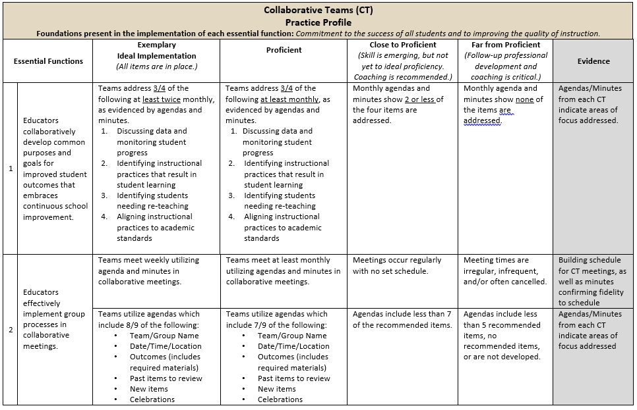
Practice Profile
Notes:
To Do: Share Practice Profile in Handouts
TO KNOW:
Full practice Profile is in Handouts
Collaborative Data Team Practice Profile
Implementation with fidelity requires clearly described implementation criteria. The Practice Profile framework has recently been developed by the National Implementation Research Network (NIRN) as a way of outlining implementation criteria using a rubric structure with clearly defined practice-level characteristics (NIRN, 2011). According to NIRN, the Practice Profile emerged from the conceptualization of the change process outline in the work of Hall and Hord’s (2006) Innovation Configuration Mapping (NIRN, 2011).
The Practice Profile template includes four pieces and is anchored by the essential functions. First, as a header is the foundation of implementation that philosophically grounds implementation. Then moving from left to right across the template are the essential functions of the practice, implementation performance levels, and lastly, evidence which provides data or documentation for determining implementation levels.
How to Use the Practice Profile
The essential functions align with the teaching/ learning objectives for each learning package. For each teaching/learning objective are levels of implementation. For some essential functions, proficient and exemplary implementation criteria are the same and in others, criteria differ. Close to proficient levels of implementation suggest the skill or practice is emerging and coaching is recommended for moving toward more proficient implementation. When implementation is reported at the unacceptable variation level, follow-up professional development in addition to coaching is recommended. The professional development provider should walk through the practice profile with the educator-learners, referring to the data and artifacts listed as suggested evidence. It is an important tool for self-monitoring their own implementation because it serves as a reminder as to the implementation criteria and is also aligned with the fidelity checklists.

Slide 20
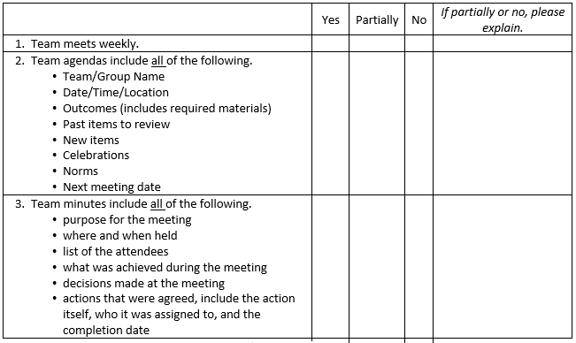
Implementation Fidelity
Notes:
To Do: Review the implementation fidelity checklist.
Handout: CT Implementation Fidelity Checklist

Slide 21
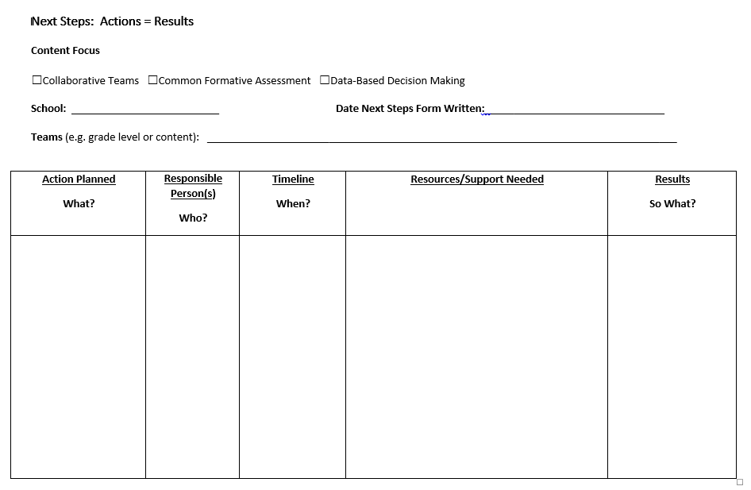
Next Steps: Action=Results
What steps will you take to begin implementing?
Notes:
To Do: Complete the Next Steps template. Example is included in the learning package materials.

Slide 22
Contact Information
Please contact me to schedule follow-up coaching and/or additional professional development.
Notes:
To Know/To Say/To Do: Include presenter’s contact information.
Please contact me to schedule follow-up coaching and/or additional professional development. Thank you.

