Slide 1
Hidden Slide #1
The CTE Module was designed to be used in the following manner.
The audience for this Module is Leadership Teams, including district and building leaders. This Module is not meant for whole staff presentations.
Participants complete the Base Module, Collective Teacher Efficacy: An Introduction to Developing CTE in Schools.
Following this training, participants should complete the Flow Chart or the CTE Planning Reflection Questions document to determine next steps.
There are four Focus Modules. Teams are not required to complete all four Focus Modules. Instead, participants will complete only those Focus Modules that fit the needs of their school. Both the Flow Chart and CTE Planning Reflection Questions document were designed to direct a group to a starting Focus Module.
Notes:
The Base Module is designed to be completed in 2 to 2.5 hours and the each Focus Module 1 to 1.5 hours.

Slide 2
Hidden Slide #2
CTE in-person training suggestions
Presenter notes information
Notes:
CTE in-person training suggestions
The CTE Teacher Inquiry Focus Module is designed to be completed in 1 to 1.5 hours.
This presentation provides the basic information regarding how social networks can enhance CTE. You may want to add or enhance portions with visuals and examples that will resonate with your audience. As a reminder, always be sure to include appropriate citations when adding resources. Also, you might look to the coaching companion for additions that may be helpful.
In summary
This module outlines the basics of CTE and Teacher Inquiry
It can be adapted to individual contexts
The training should last about 1 to 1.5 hours
Presenter notes information
Presenter notes are included in the PowerPoint. Background information for the presenter is shown as “To Know.” Statements to be shared with participants are shown as “To Say.” In some instances, the “To Know/To Say” are combined. The presenter notes also include “To Do” prompts and cues for “Handouts”
Additional activities, examples, videos, etc. are being developed as a CTE Coaching Companion. A presenter may add material from the Coaching Companion to corresponding PowerPoint content.
A printed Practice Profile and an electronic Self-Assessment Practice Profile (SAPP) tool are available for use by individuals, teams, or schools for periodic self-assessment and monitoring of implementation of practice or to identify training or coaching needs.
The presenter should download onto a hard drive or a flash drive any video intended for use in a training. You might not have internet access at the school sites.
Breaks should be inserted at the discretion of the presenter based on the needs of participants.

Slide 3
Hidden Slide #3
Supplies needed:
Wi-Fi access for presenter and participants
Access to videos (through WIFI if available, but download to flash drive as a back-up)
Chart paper
Markers
Post-it-Notes
Notes:
To Know
These supplies are needed for the CTE Professional Learning Modules.

Slide 4

Hidden Slide #4
Handouts:
CTE Infographic
Efficacy Definitions and Decisions
David, J. L. (2008). What research says about collaborative inquiry. Educational Leadership, 66(4), 87-88. Retrieved from http://www.ascd.org/publications/educational-leadership/dec08/vol66/num04/Collaborative-Inquiry.aspx
CTE Flow Chart
CTE Planning Reflection Questions
CTE Practice Profile
CTE Action Plan
Notes:
To Know
The CTE Participant and Presenter Materials are located on the Moedu-SAIL website in the CTE Handout Packet. Due to copyright, some materials are linked to their original source and must be downloaded from the link.
Go to: http://www.moedu-sail.org/mmd-professional-development/mmd-content/
References
David, J. L. (2008). What research says about collaborative inquiry. Educational Leadership, 66(4), 87-88. Retrieved from http://www.ascd.org/publications/educational-leadership/dec08/vol66/num04/Collaborative-Inquiry.aspx

Slide 5
Hidden Slide # 5
CTE Key Terms
Collective Teacher Efficacy (CTE) is a perception of teachers in a school that the efforts of the faculty as a whole will have a positive effect on students.
Efficacy is a capacity for producing a desired result or effect.
Self-Efficacy is an individual's belief in his or her capacity to execute behaviors necessary to produce specific performance and goal attainment.
Teacher Efficacy is one’s confidence in his/her ability to promote students’ learning.
Collective Efficacy is a group’s shared belief in its combined capabilities to attain their goals and accomplish desired tasks.
Mastery Experience is when you experience success firsthand. It requires experience in overcoming obstacles through perseverant effort.
Vicarious Experience is seeing people similar to oneself succeed.
Notes:
To Know
These are the key terms used throughout the module.

Slide 6
Hidden Slide # 6
CTE Key Terms
Social Persuasion is when a trusted source gives feedback and encouragement.
Affective State is when people rely partly on their emotional state to judge their capabilities.
A Social Network is a network of individuals (e.g. friends, acquaintances, coworkers) connected by interpersonal relationships.
Collaboration means to work jointly with others.
Teacher Leadership refers to other roles teachers, who work directly with students, participate in that has an influence extending beyond their own classroom/caseloads.
Decision Making means the act or process of deciding something important, especially in a group of people or an organization.
Notes:
To Know
These are the key terms used throughout the module.

Slide 7
Hidden Slide # 7
CTE Key Terms
Teacher Voice refers to the values, opinions, beliefs, perspectives, expertise, and cultural backgrounds of the teachers working in a school/district.
Teacher Inquiry is a process used by educators to explore teaching practices that enables the identification of successful approaches to improving learning and outcomes for students.
Professional Learning refers to activities educators engage in to stimulate their thinking and professional knowledge to ensure that their practice is informed and current.
Notes:
To Know
These are the key terms used throughout the module.

Slide 8

Pre/Post Assignment
Introduction to Collaborative Inquiry
https://www.youtube.com/watch?v=brBce5STwWA
Notes:
This video may be used as a pre or a post activity. Jennifer Donohoo provides an introduction to Collaborative Inquiry.
References
MISA London. (2015, April 10). Introduction to collaborative inquiry [Video file]. Retrieved from https://www.youtube.com/watch?v=brBce5STwWA

Slide 9
Collective Teacher Efficacy
Collaborative Teacher Inquiry
Focus Module
Notes:
Welcome and introductions:

Slide 10
Acknowledgements
Special thanks to all contributors to the development and revision of this Professional Learning Module.
The original collection of Professional Learning Modules was rolled-out for use by Regional Professional Development Center (RPDC) Consultants in July 2013 after being developed by a team of content experts through efforts funded by the Missouri State Personnel Development Grant (SPDG).
Content Development and Revision Support Team, 2019
  Carla Williams, UCM Marcia Clark, SE RPDC
  Liz Condray, SCRPDC Jan Davis, MoEdu-SAIL
  Janie Pyle, Raytown School District Cheryl Wrinkle, SW RPDC
  Marilyn Cannon, Raytown School District
Institute for Human Development
Ronda Jenson Jodi Arnold
Sarah Marten Arden Day
Chelie Nelson Cynthia Beckmann
SPDG Management Team
Notes:
To Know/To Say
Special thanks to all contributors to the development and revision of this Professional Learning Module.

Slide 11
Welcome and Introductions
Our trainers for the day

Slide 12
Norms
Begin and end on time
Be an engaged participant
Be an active listener - open to new ideas
Use notes for side bar conversations
Use electronics respectfully
Notes:
To Know
It is important to establish norms for training. Trainers are free to adjust this list of norms.
To Do
Consider including a check mid-way through trainings to assess a norm or norms. The presenter may want to use norms printed on agenda handouts in addition to or in place of presentation slides, so the norms are always available in print for participants. Norms may be added to address specific school needs. Some schools already have established norms for all PD. In that case, adapt to their norms.
To Say
Please review the norms for this training. Are there any additions that need to be made to the norms at this time?

Slide 13





Icon Glossary
Collective Teacher Efficacy
Step-by-Step Guide
Reflection/Activities
Handout Packet
Essential Questions
Blueprint
Notes:
To Know/To Say
You will see these icons on slides and handouts throughout the presentation.

Slide 14
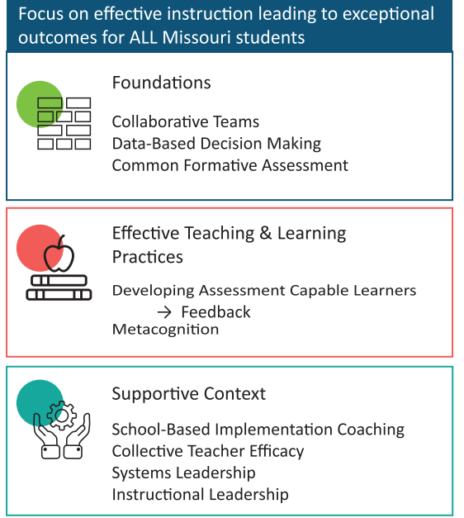
District Continuous Improvement Framework (MMD/DCI)
Notes:
To Know
Missouri’s Professional Learning Modules are organized in the same three categories as defined in the District Continuous Improvement Framework (MMD/DCI). All schools begin their professional development journey with the Foundations, as these professional learning modules provide foundational knowledge in three key areas: Collaborative Teams, Data-Based Decision Making, and Common Formative Assessment. Effective Teaching & Learning Practices encompass research-based instructional practices for deepened learning. These professional learning modules address ways of connecting with students, ways of helping students learn how to learn, and feature specific instructional practices. Supportive Context contains Professional Learning Modules designed to help school staff support and enhance the implementation of Effective Teaching & Learning Practices through technology, leadership, and coaching supports.
To Do/To Say
Before we delve into CTE, let’s take a few minutes to review the MMD/DCI Framework graphic, looking specifically at where CTE falls into the larger content.
As you see, the focus of MMD/DCI is on effective instruction leading to exceptional outcomes for all Missouri students.
The Content Framework has three main components:
Foundations (consisting of Collaborative Teams, Data-Based Decision Making, and Common Formative Assessment)
Effective Teaching and Learning Practices (Developing Assessment Capable Learners with Feedback and Metacognition)
Supportive Context (School Based Implementation Coaching, Collective Teacher Efficacy, and Leadership)
References
Edu-Sail. (2019). District Continuous Improvement Framework (MMD/DCI): Blueprint for district and building leadership, Third Edition. Missouri Department of Elementary and Secondary Education: Northern Arizona University, Institute for Human Development.

Slide 15
CTE Alignment with
MO Leader Standards
Standard #2 Teaching and Learning
Educational leaders have the knowledge and ability to ensure the success of all students by promoting a positive school culture, providing effective instructional program that applies best practice to student learning, and designing comprehensive professional growth plans for staff.
Notes:
To Know/To Say
The CTE module aligns with the Missouri Learning Standards because it addresses
teacher collaboration,
reflection,
data analysis,
action planning, and
feedback.

Slide 16
CTE Alignment with
MO Teacher Standards
This CTE module supports the following MO Teacher Standards.
#2 Student Learning, Growth, and Development: Teachers can adapt instruction in order to effectively teach all learners
#7 Student Assessment and Data Analysis: Teachers uses formative and summative assessment strategies to assess learner progress
#8 Professionalism: Teachers are reflective practitioners and use data to inform reflection
#9 Collaboration: Teachers collaborate with a shared goal of effective instruction and student learning
Notes:
To Know
Detailed information about the MO Teacher Standards is provided below for your review only.
Standard #2 Student Learning, Growth and Development: The teacher understands how students learn, develop, and differ in their approaches to learning. The teacher provides learning opportunities that are adapted to diverse learners and support the intellectual, social, and personal development of all students. [SB 291 Section 160.045.2 (1) Students actively participate and are successful in the learning process; (5) The teacher keeps current on instructional knowledge and seeks and explores changes in teaching behaviors that will improve student performance.]
Standard #7 Student Assessment and Data Analysis: The teacher understands and uses formative and summative assessment strategies to assess the learner’s progress and uses both classroom and standardized assessment data to plan ongoing instruction. The teacher monitors the performance of each student, and devises instruction to enable students to grow and develop, making adequate academic progress. [SB 291 Section 160.045.2 (2) Various forms of assessment are used to monitor and manage student learning; (5) The teacher keeps current on instructional knowledge and seeks and explores changes in teaching behaviors that will improve student performance.]
Standard #8 Professionalism: The teacher is a reflective practitioner who continually assesses the effects of choices and actions on others. The teacher actively seeks out opportunities to grow professionally in order to improve learning for all students. [SB 291 Section 160.045.2 (2) Various forms of assessment are used to monitor and manage student learning; (5) The teacher keeps current on instructional knowledge and seeks and explores changes in teaching behaviors that will improve student performance; (6) The teacher acts as a responsible professional in the overall mission of the school.]
Standard #9 Professional Collaboration: The teacher has effective working relationships with students, parents, school colleagues, and community members. [SB 291 Section 160.045.2 (4) The teacher uses professional communication and interaction with the school community; (6) The teacher acts as a responsible professional in the overall mission of the school.] Quality Indicator 1: Induction and collegial activities. Quality Indicator 2: Collaborating to meet student needs. Quality Indicator 3: Cooperative partnerships in support of student learning.

Slide 17
Session-at-a-Glance
Introduction and Learner Outcomes
Review of Collective Teacher Efficacy
Developing a Common Understanding of Teacher Inquiry
Understand the Steps in Teacher Inquiry
Analyzing our own Teacher Inquiry and Action Planning
Notes:
To Know
There is an agenda
To Do
Show the slide to participants
To Say
Please look over the slide. We are addressing teacher inquiry and the effect it has on CTE. This agenda will address this topic and how it reflects learning outcomes, high and low CTE, and teacher inquiry.

Slide 18
Learning Targets
By the end of the session, the learner will know how to
describe how CTE can improve student outcomes,
explain the impact of teacher inquiry on CTE,
identify strategies for the promotion of teacher inquiry, and
design intentional support and opportunities for establishing CTE through teacher inquiry.
Notes:
To Know/To Do
Go over the learning targets listed
To Say
As a learner, today you will develop an understanding of what CTE is, how it can impact student outcomes, and how teacher inquiry plays a role in these outcomes.
Following the training, you will have time to plan how to incorporate supports for CTE in your school/district.

Slide 19
Essential Questions
What is CTE and how does it impact student learning?
What is happening in my school now that facilitates CTE through teacher inquiry?
Where do I go from here?
Notes:
To Know/To Say
Let’s begin the work of CTE with these essential questions in mind.

Slide 20

Notes:
To Know/To Say
The CTE infographic summarizes key content from the learning package.
Handout
CTE InfoGraphic

Slide 21
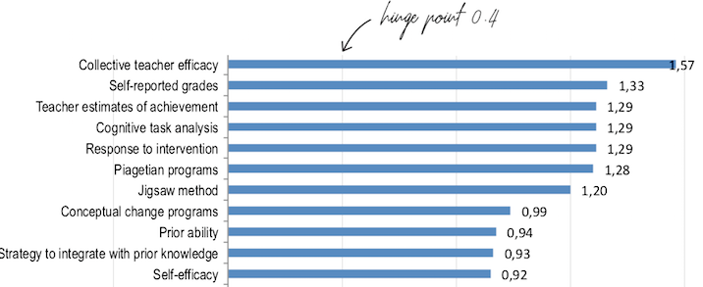
John Hattie 2018 Effect Size of Factors Influencing Student Achievement
(https://visible-learning.org/hattie-ranking-influences-effect-sizes-learning-achievement)
Notes:
To Know
This slide is hidden and can be used if participants need a review.
John Hattie shows the effect sizes of the factors that most impact student achievement.
To Do/Say
Show the slide
As a reminder of why we are talking about ways to build CTE. This chart reflects the continual shifts in effect size as John Hattie adds studies to his meta-analyses. Collective teacher efficacy is currently ranked first; it was second a year ago. It is advisable to check the rankings on a yearly basis.
References
Visible-Learning. (n.d.). Hattie’s ranking: 252 influences and effect sizes related to student achievement. Retrieved from https://visible-learning.org/hattie-ranking-influences-effect-sizes-learning-achievement

Slide 22
Impact of High and Low Collective Teacher Efficacy
Notes:
To Know
This slide is hidden and may be used if participants need a review.
It is important that school leaders know the impact of high and low Collective Teacher Efficacy.

Slide 23
When CTE is high in schools, teachers…
Find new ways to tackle difficult challenges
Set more difficult group goals and are more committed to those goals
Put more effort into planning
Are more open to new ideas
Are more willing to experiment
Are more resilient
Work collaboratively
Welcome parent participation
Are more committed
(Brinson & Steiner, 2007; Donohoo, 2018)
Notes:
To Know
This slide is hidden and may be used if participants need a review.
High CTE within schools has a positive impact on how teachers work.
To Do/To Say
Show slide
When schools have a high degree of CTE, teachers give greater effort and show passion about teaching. They are persistent in the face of challenges and are more resilient when faced with failures.
Within your table groups discuss how these teacher characteristics could impact both student and teacher outcomes? Please share out after a few minutes.
After listening to the share out, make sure they noted the following.
Increased student achievement
Other affected outcomes linked are dropout/attendance rates
College attendance
Student course selection
Teacher satisfaction
Teacher learning & innovation
References
Brinson, D., & Steiner, L. (2007). Building collective efficacy: How leaders inspire teachers to achieve (Issue Brief). Washington, DC: Center for Comprehensive School Reform and Improvement. Retrieved from https://files.eric.ed.gov/fulltext/ED499254.pdf
Donohoo, J. (2018). Collective teacher efficacy research: Productive patterns of behaviour and other positive consequences. Journal of Educational Change, 19(3), 323–345.

Slide 24
When CTE is low in schools, teachers…
Extend less effort
Give up more easily
Perform at lower levels
Experience burnout
Feel isolated
Have greater apathy
Experience more uncertainty
(Donohoo, 2017)
Notes:
To Know
There are also consequences of having low CTE for teachers.
To Do/To Say
Show Slide
These are things that lead to teachers not wanting to be involved in the decision making/problem solving process in schools. Can you think of others? This will lead to the opposite of having high CTE.
References
Donohoo, J. (2017). Collective efficacy: How educators’ beliefs impact student learning. Thousand Oaks, CA: Corwin.

Slide 25
Consequences of high CTE in schools
Improves student performance
Improves the negative effects of low SES
Enhances parent-teacher relationships
Creates a work environment that builds teacher commitment to the school
(Brinson & Steiner, 2007; Donohoo, 2018)
Notes:
To Know
This slide is hidden and may be used if participants need a review.
High CTE within schools has a positive impact.
To Do
Show slide
Principals and district leaders should turn their attention to improving CTE because it has an impressive list of positive consequences, including…
References
Brinson, D., & Steiner, L. (2007). Building collective efficacy: How leaders inspire teachers to achieve (Issue Brief). Washington, DC: Center for Comprehensive School Reform and Improvement. Retrieved from https://files.eric.ed.gov/fulltext/ED499254.pdf
Donohoo, J. (2018). Collective teacher efficacy research: Productive patterns of behaviour and other positive consequences. Journal of Educational Change, 19(3), 323–345.

Slide 26
How Do We Develop CTE Capacity?
Collaboration and Social Networks
Teacher Leadership
Teacher Voice in Decision Making and Problem-Solving
Collaborative Teacher Inquiry
Notes:
To Know
Each of these topics will be covered in focus modules but we are concentrating on D – Teacher Inquiry, which is one way to develop CTE.
To Do/Say
Show slide
We will be discussing how Teacher Inquiry will have an impact on developing CTE.

Slide 27
Efficacy
Self-Efficacy
Teacher Efficacy
Collective Efficacy
Collective Teacher Efficacy
Notes:
To know
It is important to know/review the definitions on this slide and think about how Teacher Inquiry impacts the different levels of efficacy. Depending on how recently the team has been through the base module, the presenter may use this slide only to review definitions and hide the following slides related to definitions. If using only this slide, please stop after each definition to have participants reflect on Teacher Inquiry as it relates to the different levels of efficacy.
To Do/Say
Distribute the handout “Efficacy Definitions and Decisions” to participants who will use it to document their initial thoughts on how Teacher Inquiry impacts the different levels of efficacy.
We will go through the next slides and review quickly the definitions of efficacy. As you listen, think about how Teacher Inquiry relates to the different efficacy levels and write down your thoughts.

Slide 28
Defining Efficacy
Efficacy is…
a Latin word that refers to a capacity for producing a desired result or effect;
a predictor of individual behavior; and
suggestive of strength and fortitude, resulting in effectiveness.
(Merriam-Webster, 2019)
Notes:
To Know
The general definition of efficacy
To Do/Say
Make sure teachers complete the handout as they go through the definitions. Discuss the definition.
Please complete the handout describing your initial thoughts on how Teacher Inquiry impacts efficacy.

Slide 29
Self-Efficacy
An individual's belief in his or her capacity to execute behaviors necessary to produce specific performance and goal attainment.
Reflects confidence in the ability to exert control over one's own motivation, behavior, and social environment.
(Bandura, 1986)
Notes:
To Know
An individual’s belief in their own capacity is important to execute behaviors necessary to reach goals.
To Know
The general definition of self-efficacy
To Do/Say
Make sure teachers complete the handout as they go through the definitions. Discuss the definition.
Please complete the handout describing your initial thoughts on how Teacher Inquiry impacts self-efficacy.
References
Bandura, A. (1986). The explanatory and predictive scope of self-efficacy theory. Journal of Social and Clinical Psychology, Special Issue: Self-Efficacy Theory in Contemporary Psychology, 4, 359-373.
To Do/Say: Make sure teachers complete the handouts as we go through the definitions.
Self-Efficacy is an individual's belief in his or her capacity to execute behaviors necessary to produce specific performance and goal attainment and reflects confidence in the ability to exert control over one's own motivation, behavior, and social environment.
Please complete the HO describing your initial thoughts on how teacher inquiry impacts self-efficacy. ]

Slide 30
Teacher Efficacy
A teacher’s confidence in his/her ability to promote students’ learning.
(Hoy, 2004; Donohoo, 2017)
Notes:
To Know
The definition of teacher efficacy
To Do/Say
Make sure teachers complete the handouts as we go through the definitions.
Teachers with a stronger sense of efficacy
tend to exhibit greater levels of planning and organization;
are more open to new ideas and are more willing to experiment with new methods to better meet the needs of their students;
are more persistent and resilient when things do not go smoothly;
are less critical of students when they make errors; and
are less inclined to refer a difficult student to special education.
Please complete the handout describing your initial thoughts on how teacher efficacy can affect/enhance Teacher Inquiry in schools.
References
Donohoo, J. (2017). Collective efficacy: How educators’ beliefs impact student learning. Thousand Oaks, CA: Corwin.
Hoy, A. W. (2004). Self-efficacy in college teaching. Essays on Teaching Excellence; Toward the Best in the Academy, 15(7). Retrieved from https://cft.vanderbilt.edu/wp-content/uploads/sites/59/vol15no7_self_efficacy.htm

Slide 31
Collective Efficacy
A group or team’s shared belief in its combined capabilities to attain their goals and accomplish desired tasks; involves the belief or perception that an effective collective action is possible to address a problem.
(Bandura, 1986)
Notes:
To Know
The definition of collective efficacy
To Do/Say
Make sure teachers complete the handouts as we go through the definitions.
Please complete the handout describing your initial thoughts on how Teacher Inquiry impacts collective efficacy.
References
Bandura, A. (1986). The explanatory and predictive scope of self-efficacy theory. Journal of Social and Clinical Psychology, Special Issue: Self-Efficacy Theory in Contemporary Psychology, 4, 359-373.

Slide 32
Collective Teacher Efficacy
Collective teacher efficacy (CTE) is a perception of teachers in a school that the efforts of the faculty as a whole will have a positive effect on students.
CTE has the potential to explain the differential effect schools have on student achievement.
(Goddard, Hoy, & Woolfolk Hoy, 2000; Donohoo, 2018)
Notes:
To Know
The definition of CTE
To Do/To Say
Show slide
Read slide and definition of CTE
Teacher belief
Perception of teachers in a school that the efforts of the faculty will have an effect on student learning (Brinson & Steiner)
Has the potential to explain the differential effect schools have on student achievement. Goddard, Hoy, and Woolfolk Hoy found that a one-point increase on a schools’ CE score is associated with an 8.5 point increase on student achievement scores (moderate effect).
Talk about how CTE can be achieved through
building instructional knowledge and skills;
creating opportunities for teachers to collaboratively share skills and experience;
interpreting results and providing actionable feedback on teacher performance; and
involving teachers in school decision making.
References
Goddard, R. D., Hoy, W. K., & Hoy, A. W. (2000). Collective teacher efficacy: Its meaning, measure, and impact on student achievement. American Educational Research Journal, 37(2), 479-507.
Donohoo, J. (2018). Collective teacher efficacy research: Productive patterns of behaviour and other positive consequences. Journal of Educational Change, 19(3), 323–345.

Slide 33

Teacher Inquiry and Efficacy
Notes:
To Know
Participants will reflect on the handout
To Do/Say
Group activity: Split the participants into 5 groups. Have them number off by 5s. Have 5 posters around the room and assign each group a definition of Efficacy
Group #1: Efficacy
Group #2: Self Efficacy
Group #3: Teacher Efficacy
Group #4: Collective Efficacy
Group #5: CTE
Go to the poster paper with your number around the room and
discuss your thoughts on how Teacher Inquiry impacts the different levels of efficacy,
write your ideas on the paper, and
when finished we will share out, so pick a spokesman to share out
Alternate Reflection Activity: Depending when in the sequence this module is provided, alternative activities are described below to add variety.
Find a partner and then find another pair. In this group of four, discuss how you believe Teacher Inquiry would impact efficacy. After a few minutes designate a person (#3, birthday closest to that day, etc.) moves to the group on the right and provide some time for the new group to share ideas.
Use chart paper and do a whole group brainstorm of how Teacher Inquiry would impact CTE, recording responses on the chart paper.
Concentric Circles – Have participants form two circles, one inside circle and one outside circle, facing each other. Pairs discuss how Teacher Inquiry impacts a different level of CTE, then outside circle mores one person to the right, and the new pairs discuss the next level.

Slide 34
Collaborative Teacher Inquiry and Professional Learning
Notes:
To Know
This is a transition slide

Slide 35
Definitions
Teacher Inquiry is a process used by educators to explore teaching practices that enables the identification of successful approaches to improving learning and outcomes for students.
Collaboration means to work jointly with others.
Professional Learning refers to activities educators engage in to stimulate their thinking and professional knowledge to ensure that their practice is informed and current.
Notes:
To Know
This is an introduction to the topic and an opportunity to clarify definitions.
To Do/Say
Review the definitions and put in the context of schools.

Slide 36




Four Main Sources of Efficacy
Mastery Experience
Experience success firsthand
Vicarious Experience
Success is modeled
Social Persuasion
Trusted source gives feedback & encouragement
Affective State
Physiological effect
(Bandura, 1994)
Notes:
To Know
This slide is here to review the four main sources of efficacy in order to make the connection to how Teacher Inquiry can be useful to providing these experiences.
These are the four main sources of efficacy.
Mastery experience is when you experience success firsthand. This is the most effective way of creating a strong sense of self-efficacy. Successes build a robust belief in one’s personal efficacy. A resilient sense of efficacy requires experience in overcoming obstacles through perseverant effort.
Vicarious experience occurs when success is modeled. Seeing people similar to oneself succeed by sustained effort raises observers' beliefs that they too possess the capabilities to master comparable activities required to succeed.
Social persuasion is when a trusted source gives feedback and encouragement. People who are persuaded verbally that they possess the capabilities to master given activities are more likely to mobilize greater effort and sustain it than if they harbor self-doubts and dwell on personal deficiencies when problems arise. To the extent that persuasive boosts perceived self-efficacy leads people to try hard enough to succeed, promote development of skills, and a sense of personal efficacy.
Affective state is the actual physiological effect. People also rely partly on their emotional state to judge their capabilities. Positive mood enhances perceived self-efficacy, despondent mood diminishes it. The fourth way of modifying self-beliefs of efficacy is to reduce people's stress reactions and alter their negative emotional proclivities and interpretations of their physical states. People who have a high sense of efficacy are likely to view their state of affective arousal as an energizing facilitator of performance, whereas those who are beset by self-doubt regard their arousal as a debilitating.
To Do/Say
Show slide
You may remember this information from the Base Module. These are the four main ways that people build efficacy.
Mastery experience is when you experience success firsthand.
Vicarious experience occurs when you see others succeed and it raises your belief that you too could do something.
Social persuasion is when someone motivates you to believe you can achieve a goal.
Affective state is how your emotional state affects your belief in your ability.
References
Bandura, A. (1994). Self-efficacy. In V. S. Ramachaudran (Ed.), Encyclopedia of human behavior (Vol. 4, pp. 71-81). New York: Academic Press. (Reprinted in H. Friedman [Ed.], Encyclopedia of mental health. San Diego: Academic Press, 1998).

Slide 37

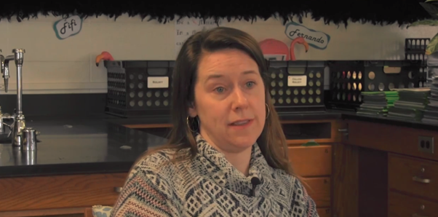
Exploring Teacher Inquiry
Notes:
To Know
Link to video https://www.youtube.com/watch?v=BXJ8taZgwiE&feature=youtu.be
Link to article http://www.ascd.org/publications/educational-leadership/dec08/vol66/num04/Collaborative-Inquiry.aspx
The article uses the term collaborative inquiry – in this module we use Teacher Inquiry to mean the same thing.
To Do/Say
Watch the clip from a school in the KC area.
Pass out copies of this brief article and have participants read silently to themselves.
Either in large of small groups ask participants to discuss How might the school featured in the video use collaborative inquiry to expand what is currently happening in their building? How might that build CTE?
References
David, J. L. (2008). What research says about collaborative inquiry. Educational Leadership, 66(4), 87-88.
Raytown Schools. (2018, May 1). Collective efficacy training interview clip 1 [Video file]. Retrieved from https://www.youtube.com/watch?v=BXJ8taZgwiE&feature=youtu.be

Slide 38
Collaborative Teacher Inquiry involves…
examining teacher and student learning in search of deeper understanding and evidence of impact;
teachers working together to tackle challenges of professional practice by questioning what they already know/do in an area student need; and
reflection on evidence and what it says about impact to student learning.
Notes:
To Know
Most of the instructionally-oriented models adhere to a common definition of teacher inquiry as “The search for knowledge and solutions through the “systematic, intentional” study of practice” (Cochran-Smith & Lytle, 1993, pp. 23–24).
In other words, teacher inquiry is about solving problems that are job-embedded and relevant.
Make the connection and distinction with DBDM. Teacher Inquiry focuses on the concerns of teachers and engages teachers in the design, data collection, and interpretation of data around a question. Termed “action research” by Carr and Kemmis (1986), this approach has many benefits: (1) Theories and knowledge are generated from research grounded in the realities of educational practice, (2) teachers become collaborators in educational research by investigating their own problems, and (3) teachers play a part in the research process, which makes them more likely to facilitate change based on the knowledge they create.
DBDM is a focus on understanding data and using it to improve instruction.
To Do/Say
Show slide
When we are talking about Collaborative Teacher Inquiry, we are talking about teachers (elaborate on bullet points).
References
Cochran-Smith, M., & Lytle, S. L. (1993). Inside/outside: Teacher research and knowledge. New York: Teachers’ College Press.
Carr, W., & Kemmis, S. (1986). Becoming critical: Education, knowledge and action research. London: Falmer.

Slide 39
Connecting Collaborative Teacher Inquiry and CTE
“Teacher inquiry is the search for knowledge and solutions through systematic, intentional study of practice.”
- Cochran-Smith & Lytle, 1993
Notes:
To Know
This activity is designed to help connect how Teacher Leadership would result in stronger CTE.
To Say/To Do
Ask small groups to reflect on what they know about CTE and Teacher Inquiry and how Teacher Inquiry would result in increased CTE. Have groups share out.
References
Cochran-Smith, M., & Lytle, S. L. (1993). Inside/outside: Teacher research and knowledge. New York: Teachers’ College Press.

Slide 40
Critical Components of
Collaborative Teacher Inquiry
Groups of teachers
  identify and define a compelling, recurring problem of instruction,
  develop and document instructional solutions,
  ensure collective commitment to the plan,
  implement instructional solutions,
  collect a variety of forms of evidence/data, and
  reflect on the data and revise plan.
(Ermeling, 2010)
Notes:
To Know
While there are a variety of models of Teacher Inquiry, they all share some critical components that makes Teacher Inquiry distinct from other collaborative practices. Teacher Inquiry is a collaborative effort through which teachers
identify and define a compelling and recurring problem of instruction;
work to develop and implement instructional plans which act as working hypotheses for addressing the area of need and assisting students to learn. Thinking through specific details is critical because the details are where the complexities of teaching reside;
develop a collective commitment to the entire inquiry process. Collective commitment is critical because it shifts the focus of the investigation from the individual teacher to the instructional plans developed by the group and the impact of these jointly developed plans on student learning; and
use a variety of forms of evidence and data to conduct the study of a problem (this could be student questionnaires, checklists, self-assessments, portfolios, systematic classroom observations, test results, audio or video recordings from the classroom).
Each of the teacher inquiry models reviewed highlight the need for a goal-oriented persistence as teachers work over a period of time to understand/resolve a dilemma and discover specific cause-effect findings about teaching and learning.
To Do/Say
Talk through the critical components of teacher inquiry.
References
Ermeling, B. A. (2010). Tracing the effects of teacher inquiry on classroom practices. Teaching and Teacher Education, 26(3), 377-388. Retrieved from https://www.sciencedirect.com/science/article/pii/S0742051X09000559

Slide 41
Collaborative Teacher Inquiry
Identify and define a compelling, recurring problem of instruction
Develop and document instructional solutions
Ensure collective commitment to the plan
Implement instructional solutions
Collect a variety of forms of evidence/data
Reflect on the data and revise plan
(Ermeling, 2010)
Notes:
To Know
This is the same as the previous slide, with some elements highlighted in red.
To Do/Say
Ask groups to work together to identify and create an instructional plan to address the problem and think about what data they might collect.
Think about examples that could be studied in your building - that could be the focus of teacher or principal inquiry?
If time, share out.
Remind them for their plan to have impact, they will need to go back and implement their plan, collect evidence, and reflect on that data.
References
Ermeling, B. A. (2010). Tracing the effects of teacher inquiry on classroom practices. Teaching and Teacher Education, 26(3), 377-388. Retrieved from https://www.sciencedirect.com/science/article/pii/S0742051X09000559

Slide 42
Strategies for Success
Job-Alike Teams
Distributed Leadership Model
Inquiry-Focused Protocols
Regular and Protected Meeting Times
(Ermeling, 2010)
Notes:
To Know
Teacher Inquiry is effective when the following strategies are followed.
Job-Alike Teams provide the opportunity for common ground discussions which are beneficial.
Distributed Leadership Model involves having a trained leader dedicated to the work of guiding the process, moderating discussion, probing for deeper understanding, providing a balance of support and pressure, and helping create a safe and productive environment where participants could focus on the work of improving instruction. Teacher leaders are identified, trained, and compensated to perform this role.
Inquiry-Focused Protocols guide effective discussion.
Regular and Protected Meeting Times places a priority on the work.
To Do/Say
Talk through the bullet points that were made from the article linked above.
References
Ermeling, B. A. (2010). Tracing the effects of teacher inquiry on classroom practices. Teaching and Teacher Education, 26(3), 377-388. Retrieved from https://www.sciencedirect.com/science/article/pii/S0742051X09000559

Slide 43

Watch and Describe
Describe the protocol for conducting this inquiry team.
Notes:
To Know
This slide is meant to expand on the inquiry-focused protocol from the previous slide.
To Do/Say
Watch this clip - https://www.edutopia.org/video/teacher-labs-making-professional-development-collaborative (5:15 min.)
Have participants talk in teams about the protocol observed. How is this protocol similar/different to steps for teacher inquiry? Make the connection to DMDB, differentiating between teacher inquiry and DBDM.
References
Easton, L. B. (2009). Protocols for professional learning. Alexandria, Virginia: Association for Supervision and Curriculum Development
Edutopia (2017, April 6). Teacher Labs: Making Professional Development Collaborative [Video file]. Retrieved from https://www.edutopia.org/video/teacher-labs-making-professional-development-collaborative

Slide 44
Collaborative Teacher Inquiry that Builds CTE, Looks Like…
Teachers, collaboratively,
meet in role-alike or grade-like teams,
identify problem(s)/need(s),
analyze data in relation to problem(s)/need(s),
ask questions about the data to drive the inquiry,
identify actionable steps to address problem(s)/need(s), and
evaluate growth and revise as necessary.

Slide 45
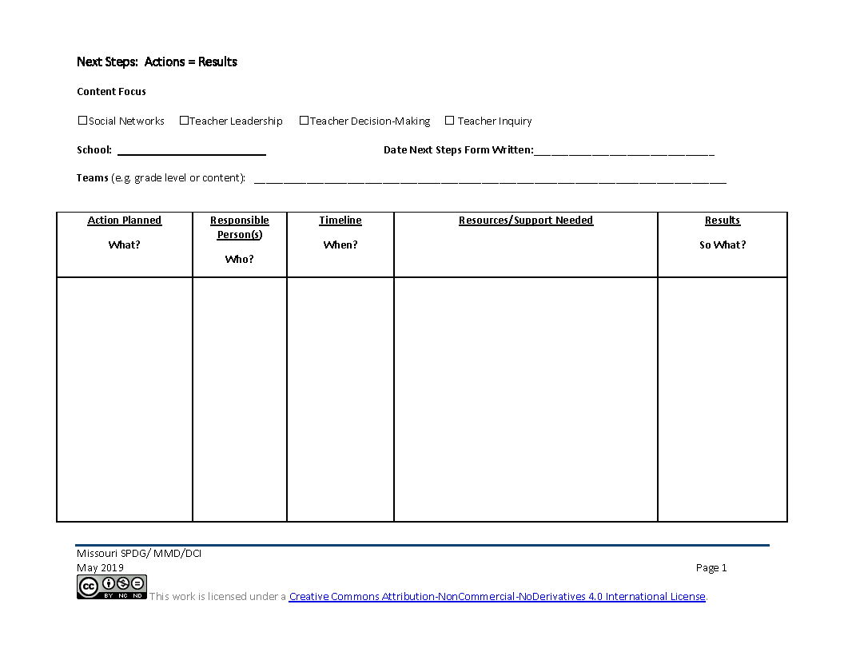
Next Steps: CTE Action = Results
What is teacher inquiry like in my school?
What are actionable steps I can take to build teacher inquiry?
Notes:
To Know: Action Planning is a critical component for change. The action plan document is a living document that will be updated as needed after each focus module.
To Do/Say: : Provide a copy of the action plan handout to participants. You may choose to provide one per team or one per participants.
Provide participants an overview of the action plan process by stating that the action plan process is a critical element to deeper implementation of practice as what gets planned is what gets done. It is also a communication piece to make sure that everyone is on the same page (dependent on the time structure for completion of the form, the following guiding questions can be posed per section).
Statement of vision - Take a minute to self-reflect. What key words related to CTE teacher inquiry resonate with you as work to deepen any areas of weakness? What will it look like in 3 years? What does teacher inquiry look like in my building/district? What do I want it to look like?
Where are we going? - From your vision statement, what is your short term goal for the end of this school year? (If mid school year, may want to frame at the end of the school year, if beginning of the year, may want to frame it as first semester, or frame it when we meet again, etc., but important to frame it in a time line.)
How will I close the gap? Beginning with the short term target, what are the actions/next steps that we need to take to implement teacher inquiry. (Dependent on the group, may want to randomly list all actions on chart paper and then prioritize.) Everyone take a minute to review our steps, have we covered key points, do we have the right supports, structure, and people? Do our proposed actions align with our gaps and address our vision? (Utilize a fist to five or other methods to obtain consensus from those present.) Do we need to get consensus or buy in from others to move forward? What else?
Now that we have our first actions, let’s go back to the big picture. Looking again at our vision statement, where do we want to be in a year? What should our long range target be for CTE teacher inquiry implementation?
Remind participants that CST support is available throughout implementation.

Slide 46
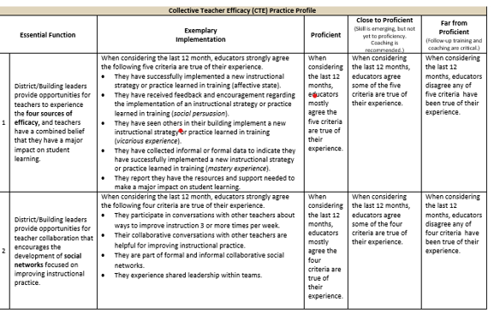
Practice Profile
Notes:
To Know/ To Do/ To Say:
This is a screen shot of the Practice Profile which you have as a handout. It is a rubric that will help you determine where you are in regards to implementing CTE in your building. Please take a moment to see what is looks like to be proficient.

Slide 47
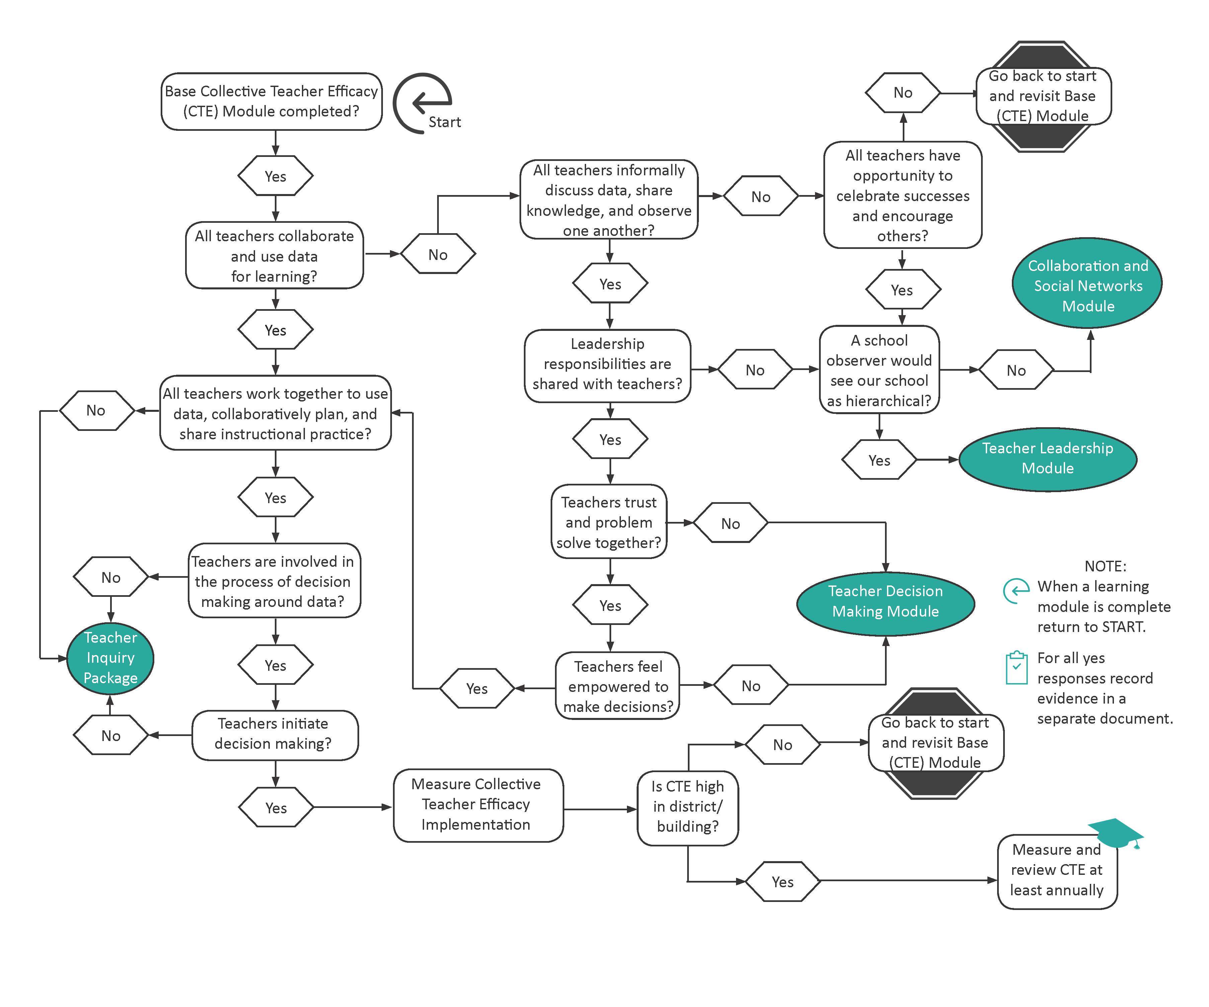
Where Do We go From Here?
Notes:
To Know
This slide is provided as a handout. It is too small to read and participants will need a copy to use in their planning.
From here, schools may use the flowchart to see which focus module is the best fit for their building. As an alternative to the flowchart, there are Planning Reflection Questions on the next slide or the SAPP could be used to prioritize training.
Either the flowchart of reflection questions can be used, but there is no need to use both.
To Do/Say
Use the flowchart to make some decisions about next steps.

Slide 48
Where Do We go From Here?
Notes:
To Know
This slide is provided as a handout. It is too small to read and participants will need a copy to use in their planning. From here, schools may use the flowchart or the reflection questions to see which, if any focus module might be a next consideration. Teams would use the decision tree or the reflection questions to consider the other focus modules they might want to consider and develop next steps.
As an alternative to the reflection questions, there is a flow chart on the previous slide, or the SAPP could be used to prioritize which focus module might be next. Participants will do either the flowchart or the Planning Reflection Questions but do not need to do both. If there are checkboxes left unchecked, participants should consider going through the focus module for that area.
To Do/Say
Use the reflection questions to make some decisions about next steps. Is there another focus module that you need to explore? What would be the best timeline for the next module? Remember, it will be more beneficial to fully implement the plan you have just developed before moving to the another module.

Slide 49
References
Adams, C. M., Forsyth, P. B. (2006). Proximate sources of collective teacher efficacy. Journal of Educational Administration, 44(6), 625-642.
Bandura, A. (1986). The explanatory and predictive scope of self-efficacy theory. Journal of Social and Clinical Psychology, Special Issue: Self-Efficacy Theory in Contemporary Psychology, 4, 359-373.
Bandura, A. (1994). Self-efficacy. In V. S. Ramachaudran (Ed.), Encyclopedia of human behavior (Vol. 4, pp. 71-81). New York: Academic Press. (Reprinted in H. Friedman [Ed.], Encyclopedia of mental health. San Diego: Academic Press, 1998).
Berebitsky, D. & Salloum, S. J. (2017). The relationship between collective efficacy and teachers’ social networks in urban middle schools. American Educational Research Association, 3(4), 1-11. Retrieved from https://journals.sagepub.com/doi/pdf/10.1177/2332858417743927
Brinson, D., & Steiner, L. (2007). Building collective efficacy: How leaders inspire teachers to achieve (Issue Brief). Washington, DC: Center for Comprehensive School Reform and Improvement. Retrieved from https://files.eric.ed.gov/fulltext/ED499254.pdf
Carr, W., & Kemmis, S. (1986). Becoming critical: Education, knowledge and action research. London: Falmer.
Cobb, P., & Jackson, K. (2011). Towards an empirically grounded theory of action for improving the quality of mathematics teaching at scale. Mathematics Teacher Education and Development, 13(1), 6-33. Retrieved from https://files.eric.ed.gov/fulltext/EJ960944.pdf

Slide 50
References
Cochran-Smith, M., & Lytle, S. L. (1993). Inside/outside: Teacher research and knowledge. New York: Teachers’ College Press.
David, J. L. (2008). What research says about collaborative inquiry. Educational Leadership, 66(4), 87-88. Retrieved from http://www.ascd.org/publications/educational-leadership/dec08/vol66/num04/Collaborative-Inquiry.aspx
DeWitt, P. (2017, March 12). Why can’t teachers make decision on their own [Education Week’s Web log post, Finding Common Ground]. Retrieved from http://blogs.edweek.org/edweek/finding_common_ground/2017/03/why_cant_teachers_make_decisions_on_their_own.html
Donohoo, J. (2017). Collective efficacy: How educators’ beliefs impact student learning. Thousand Oaks, CA: Corwin.
Donohoo, J. (2018). Collective teacher efficacy research: Productive patterns of behaviour and other positive consequences. Journal of Educational Change, 19(3), 323–345.
Ermeling, B. A. (2010). Tracing the effects of teacher inquiry on classroom practices. Teaching and Teacher Education, 26(3), 377-388.
Goddard, R. D., Hoy, W. K., & Hoy, A. W. (2000). Collective teacher efficacy: Its meaning, measure, and impact on student achievement. American Educational Research Journal, 37(2), 479-507.

Slide 51
References
Edutopia (2017, April 6). Teacher Labs: Making Professional Development Collaborative [Video file]. Retrieved from https://www.edutopia.org/video/teacher-labs-making-professional-development-collaborative
Goddard, R.D., Hoy, W. K., Hoy, A. W. (2004). Collective efficacy beliefs: Theoretical developments, empirical evidence, and future directions. Educational Researcher, 33(3), 3-13.
Hoy, A. W. (2004). Self-efficacy in college teaching. Essays on Teaching Excellence; Toward the Best in the Academy, 15(7). Retrieved from https://cft.vanderbilt.edu/wp-content/uploads/sites/59/vol15no7_self_efficacy.htm
Massachusetts Department of Elementary and Secondary Education. (2015). Building a school culture that supports teacher leadership [Online report]. Retrieved from www.doe.mass.edu/edeval/leadership/BuildingSchoolCulture.pdf
MISA London. (2015, April 10). Introduction to collaborative inquiry [Video file]. Retrieved from https://www.youtube.com/watch?v=brBce5STwWA
MoEdu-Sail. (2019). District Continuous Improvement Framework (MMD/DCI): Blueprint for district and building leadership, Third Edition. Missouri Department of Elementary and Secondary Education: Northern Arizona University, Institute for Human Development.
Moolenaar, N. M., Sleegers, P. J. C., & Daly, A. J. (2012). Teaming up: Linking collaboration networks, collective efficacy, and student achievement. Teaching and Teacher Education, 28(2), 251-262.

Slide 52
References
Raytown Schools. (2018, May 1). Collective efficacy training interview clip 1 [Video file]. Retrieved from https://www.youtube.com/watch?v=BXJ8taZgwiE&feature=youtu.be
Reeves, D. B. (2006). The learning leader. Alexandria, VA: ASCD. Retrieved from http://www.ascd.org/publications/books/105151/chapters/The-Dimensions-of-Leadership.aspx
Visible-Learning. (n.d.). Hattie’s ranking: 252 influences and effect sizes related to student achievement. Retrieved from https://visible-learning.org/hattie-ranking-influences-effect-sizes-learning-achievement
York-Barr, J., & Duke, K. (2004). What do we know about teacher leadership? Findings from two decades of scholarship. Review of Educational Research, 74(3), 255-316.

