Slide 1
Collaborative Teams
Roles
This work is licensed under a Creative Commons Attribution-NonCommercial-NoDerivatives 4.0 International License.

Slide 2
Acknowledgements
Special thanks to all contributors to the development and revision of this module.
The original collection of learning packages was roll-out for use by Regional Professional Development Center (RPDC) Consultants in July 2013 after being developed by a team of content experts. The collection of learning packages was developed through efforts funded by the Missouri State Personnel Development Grant (SPDG). The following individual/groups are thanked immensely for their hard work in developing this package:
Content Development Support
Ronda Jenson, Carla Williams, Stefanie Lindsay, Jodi Arnold and Arden Day, UMKC
Institute for Human Development
SPDG Management Team

Slide 3
Team Members
Initial Content Development Team, 2013
Michelle Smith, Team Leader, MO PLC
Betty Ennis, DESE
Tiffiney Smith, SE RPDC
Marlow Barton, StL RPDC
Mary Gage, C RPDC
Sheila Thurman, NE RPDC
Rebecca Baldwin, NW RPDC
Bertha Richardson, StL RPDC
Karen Wigger, NW RPDC
Mary Ann Burns, DESE
Tom Robb, KC RPDC
2016 Revision Team
Mary Dell Black, Facilitator, SC SIS
Jamie Mehring, Ed Plus/StL RPDC
Sheila Thurman, NE RPDC
Marisa Bowen, SE SIS
Tiffani Muessig, DESE
Judy Wartick, KC SIS
Jeanie Carey, SC RPDC
Connie Schweiss, SC RPDC
Pam Williams, DESE
Joy Fairley, KC RPDC

Slide 4
Hidden Slide
Presenter notes information
Tools and documents
Helpful suggestions
Notes:
The Collaborative Teams (CT) learning package is organized in seven modules. The first is an Overview. The other six modules address each of the processes that contribute to effective teams.
The CT Content Fidelity Checklist aligned to each learning package includes all critical items for a training session (draft, pending approval). The CT HQPD Training Checklist and Coaching Checklist contain process elements to be used as guidance when designing, revising, or coaching high quality professional development.
Important notes:
A script of presenter notes is included in the PowerPoint. Background information for the presenter is shown as “To Know.” Statements to be shared with participants are shown as “To Say.” In some instances, the “To Know/To Say” are the same material. For fidelity of content and consistency among presenters, the “To Say” information should be presented with minimal paraphrasing.
There is one pre/post assessment for the entire CT package (all seven modules).
An Implementation Fidelity Checklist is available for frequent monitoring by a teacher or observer.
A print Practice Profile and an electronic Practice Profile Self-Assessment tool are available for use by individuals, teams, or schools for periodic self-assessment and monitoring of implementation of practice or to identify training or coaching needs.
The presenter should download onto a hard drive or a flash drive any video intended for use in a training. The links shown on slides may not be able to be accessed online at the school sites.
Breaks should be inserted at the discretion of the presenter based on the needs of participants.
A presenter may add slides to supplement the content. For example, a slide of essential questions may be added since only objectives have been included.
A presenter may choose to differentiate a presentation to meet the needs of the participants. For example, another form may be substituted for the Next Steps template if the district or building already uses a similar form or protocol.
Additional activities, examples, videos, etc. may be found _____. (The details are in progress.) A presenter may interchange the additional material for the corresponding PowerPoint content.

Slide 5
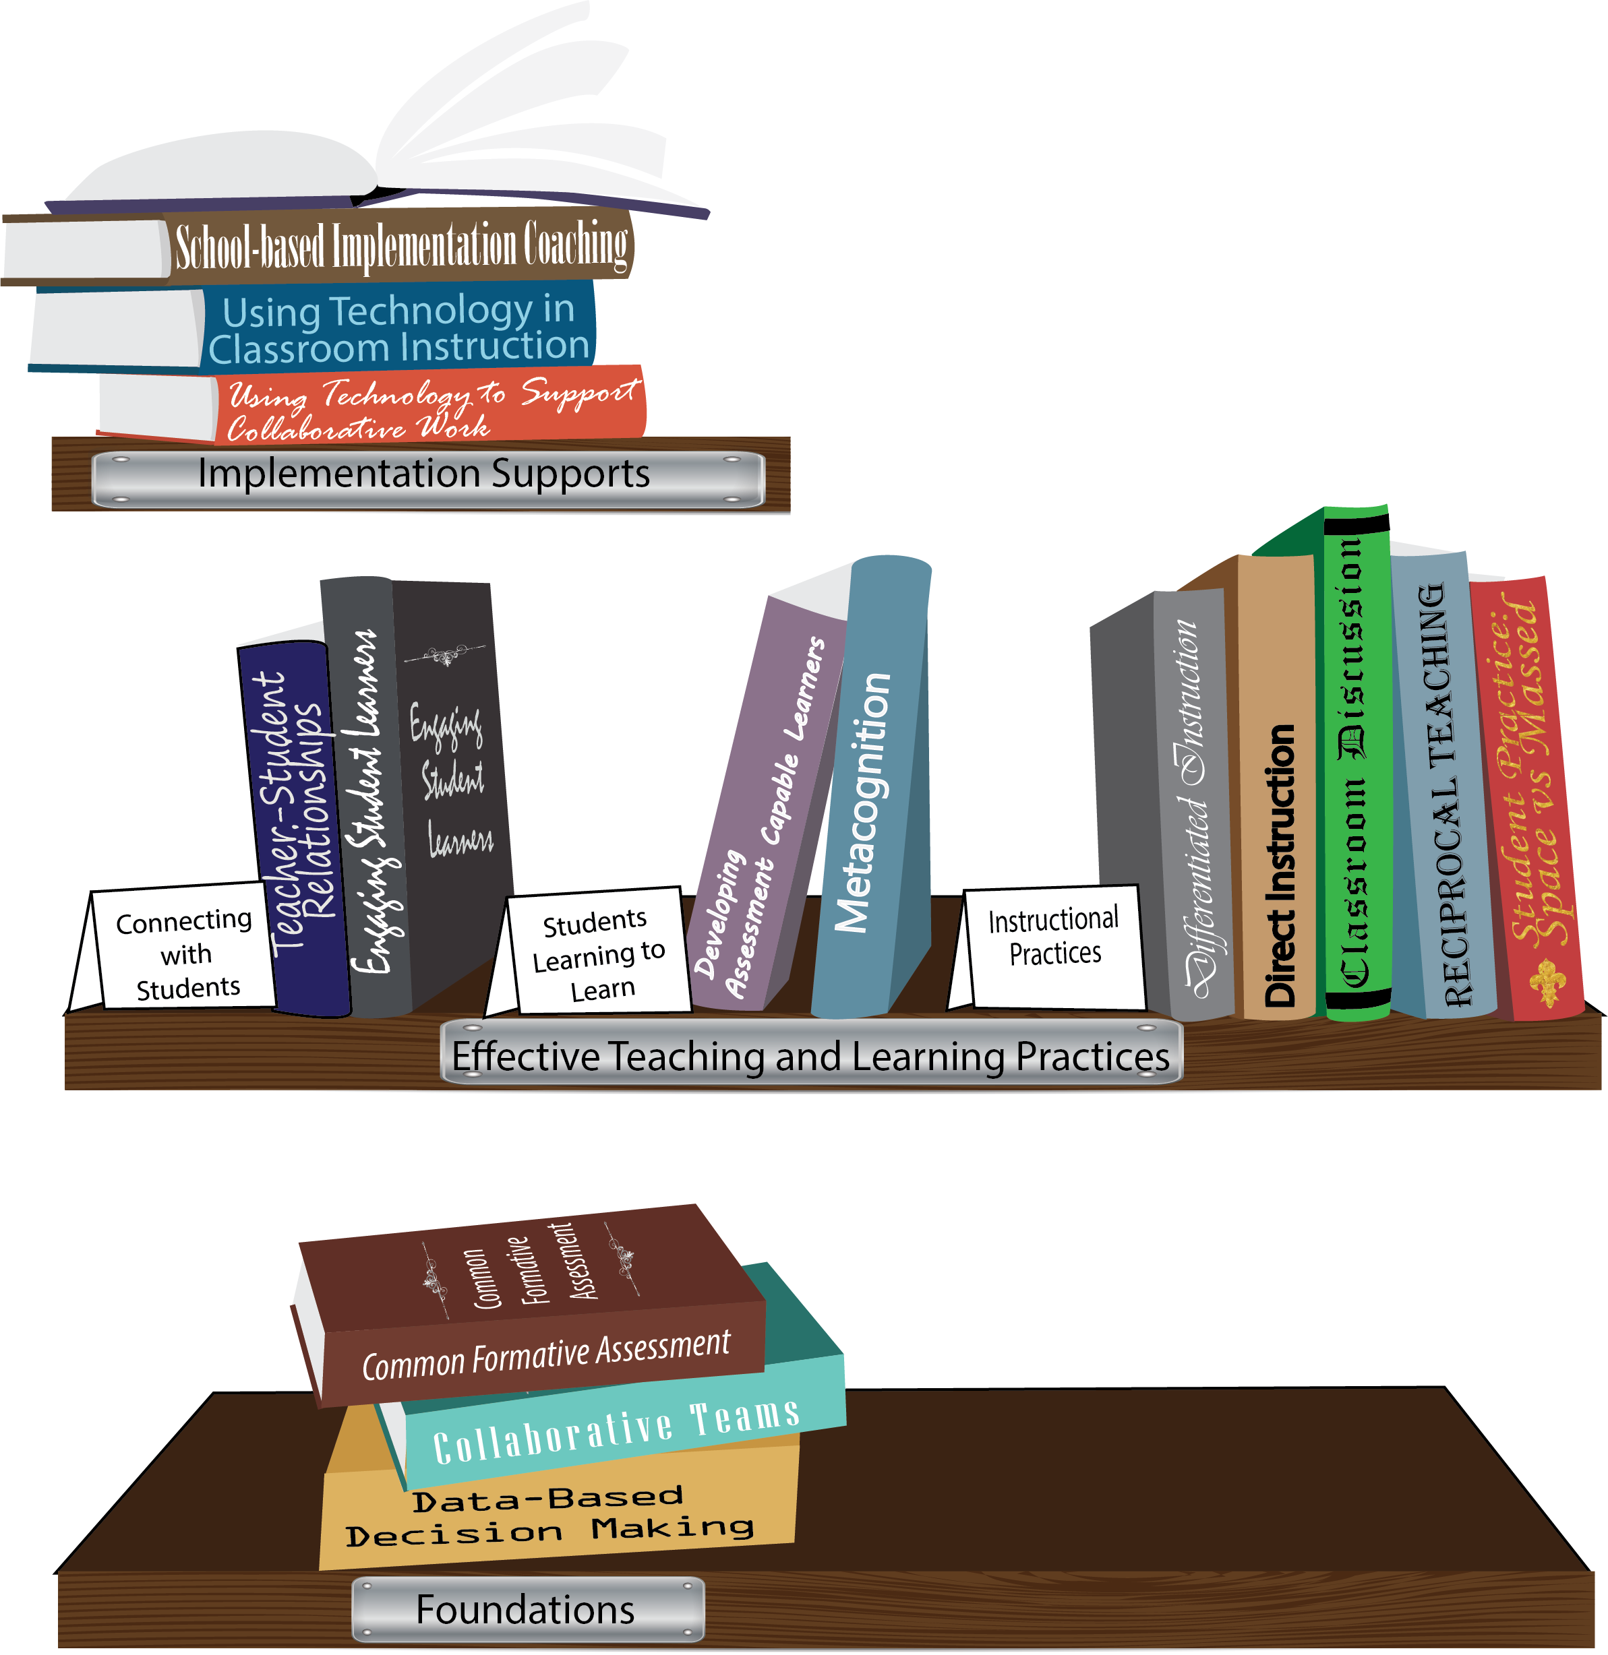
Notes:
To Know/To Say: Missouri’s professional development learning packages are organized in three categories: Foundations, Effective Teaching & Learning Practices, and Implementation Supports. All schools begin their professional development journey with the Foundations, as these learning packages provide foundation knowledge in three key areas: Collaborative Teams, Data-based Decision-making, and Common Formative Assessment. Effective Teaching & Learning Practices encompass research-based instructional practices for deepened learning. These learning packages address ways of connecting with students, ways of helping students learn how to learn, and feature specific instruction practices. Implementation Supports are learning packages designed to help school staff support and enhance the Implementation of Effective Teaching & Learning Practices through using technology and peer coaching supports.
To Do: Explain how the graphic depicts professional development in Missouri.

Slide 6
Collaborative Work Foundations
3 Key Areas
Collaborative Teams
Common Formative Assessment
Data-Based Decision Making
CFA – utilize
Quality assessments
as feedback to improve teaching & learning.
DBDM – utilize data for continuous improvement through dialogue about teaching & learning
CT – utilize team processes to improve teaching & learning.
Notes:
To Know/To Say: The learning packages forming the foundation knowledge of the Collaborative Work are Collaborative Teams, Data-Based Decision Making, and Common Formative Assessment.
Collaborative Teams (CT) utilize team processes to improve teaching and learning.
Common Formative Assessment (CFA) utilize quality assessments as feedback to improve teaching & learning.
Data-Based Decision Making (DBDM) utilize data for continuous improvement through dialogue around instruction.

Slide 7
Collaborative Teams
Overview and Purpose of
Collaborative Teams
Foundational Processes
Agendas & Minutes Norms Roles
Foundational Processes
Roles
Advanced Collaborative Processes
Consensus
Collaborative Skills
Protocols
Notes:
To Know: The learning package Collaborative Teams consists of Three Sections: Overview, Foundational Processes and Advanced Collaborative Process. There are seven presentations: Overview, Agenda and Minutes, Norms, Roles, Consensus, Collaborative Skills and Protocols.
To Say: Today we will focus on Roles. Establishing and sharing roles are an important part in the foundational process of Collaborative Teams.

Slide 8
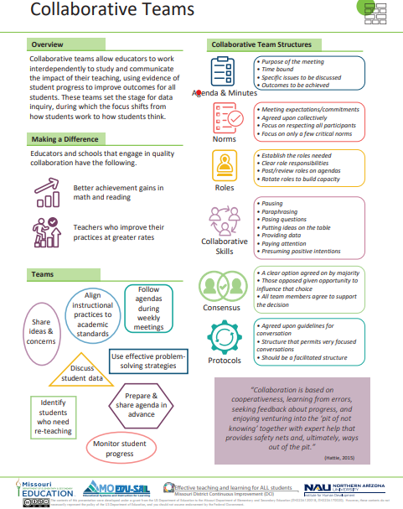
Notes:
To Know / To Say: This info graphic for Collaborative Teams can be used as either a pre reading before or at the beginning of the training. The consultant may want to use reflective questions or protocols to generate thinking prior to the training.
For example, you could pose a question to have them reflect on 1 thing they want to be able to implement or improve following the training. Or you may ask them to reflect on 1 thing they want to learn from the training about collaborative teams.
You may also want to use a protocol such as a 3-2-1 or K-W-L chart identifying what they know, what they need to know, where they need to improve, etc.
Handout: Collaborative Teams

Slide 9
Missouri Teacher and Leader Standards
Missouri Teacher Standards:
8 (Professional Practice)
9 (Professional Collaboration)
Missouri Leader Standards:
2 (Teaching and Learning)
3 (Management of Organizational Systems)
(Missouri Department of Elementary and Secondary Education, 2013)
Notes:
To Know: This slide shows how the use of Collaborative Teams relates to the Missouri Teacher and Leader Standards.
To Say:
Teacher Standard #8 Professionalism The teacher is a reflective practitioner who continually assesses the effects of choices and actions on others. The teacher actively seeks out opportunities to grow professionally in order to improve learning for all students. [SB 291 Section 160.045.2 (2) Various forms of assessment are used to monitor and manage student learning; (5) The teacher keeps current on instructional knowledge and seeks and explores changes in teaching behaviors that will improve student performance; (6) The teacher acts as a responsible professional in the overall mission of the school.]
Teacher Standard #9 Professional Collaboration The teacher has effective working relationships with students, parents, school colleagues, and community members. [SB 291 Section 160.045.2
(4) The teacher uses professional communication and interaction with the school community; (6) The teacher acts as a responsible professional in the overall mission of the school.]
Leader Standard #2 Teaching and Learning Education leaders have the knowledge and ability to ensure the success of all students by promoting a positive school culture, providing an effective instructional program that applies best practice to student learning, and designing comprehensive professional growth plans for staff.
Leader Standard #3 Management of Organizational Systems Education leaders have the knowledge and ability to ensure the success of all students by managing the organizational structure, personnel, and resources in a way that promotes a safe, efficient, and effective learning environment.

Slide 10
Objective
Educators will effectively utilize meeting roles (specific responsibilities that support meeting outcomes).
Notes:
To Know: This is designed to be a 20-30 minute presentation.

Slide 11
Team Norms
Begin and end on time
Be an engaged participant
Be an active listener—open to new ideas
Use electronics respectfully
Notes:
To Know/Say: If presenting this Roles module and Norms are needed for team effectiveness then consider the following:
Meetings, regardless of size or length, are more effective when meeting norms are established, practiced and monitored. These are the most common norms (read the list – paraphrasing the intent of the norm – especially noting the use of electronics indicating that if folks need to respond to calls immediately, please step out of the room; otherwise, there will be a break for checking messages/emails later). We need to be clear about our expectations in large groups and in small groups, so today, for the sake of time, these will be the norms we will follow today.”
In your Collaborative Teams, you may choose to use this list or create your own to better meet your needs. Sometimes schools create school-wide norms so that whenever small or larger groups in the school meet, the norms are the same. The point is – norms are an important part of effective teams WHEN they are honored and monitored. Creating table tents used at every meeting, or norm posters in every meeting room, or included on each agenda are ways to remind teams of the meeting norm.
Activity: Table discussion: Some schools have already established meeting norms. If you have meeting norms, are they working? Of these or your own norms, which one do you feel is the most important? Which of your norms or these listed above is the hardest one to maintain/monitor? What prompts do you use when norms in your meetings are violated? (Give the example of using a picture of Norm Peterson to hold up when a norm is not being respected.)
To Say: Big Idea: If a team is not functioning effectively – the first step is to revisit the meeting norms. Are team members following the norms? If not, how can you get back on track?

Slide 12
Why?
Clearly assigned roles and responsibilities:
clarify expectations for those in the meeting.
increase the engagement of all members.
help the team build internal capacity for planning and holding effective focused meetings.
Notes:
To Say:
Why?
In order for team meetings to be effective and efficient we must… Define Roles And Responsibilities Of Team Members.
Roles are as significant as norms or agendas in ensuring meetings are effective. Shared roles help insure all members take ownership of the group’s work. If a person has a job to do, they are more likely to be engaged, and to support decisions and products of the group.
Identifying, explaining, assigning, and executing roles is important to collaborative organizations. Imagine needing to assemble a professional orchestra. You advertise for and hire musicians that are talented, experts in musical theory, skilled in their craft, experienced in public performance, and dedicated to producing a quality musical experience for the public. You find enough applicants meeting these qualifications to fill all of the chairs. On the day to begin rehearsal you excitedly rush to the concert hall only to find your conductor in a frustrated tizzy! Yes, your musicians fit all of the qualifications you outlined, but your job description was not specific to the roles each position needed to develop a successful orchestra! You discover that your new orchestra consists mainly of highly skilled tuba and banjo players! Your chances of a successful orchestra are slim no matter how talented they are in their given role or how hard they work. They are skilled, but not in the roles they need to perform. This same scenario would apply to: a baseball team (all pitchers?) a restaurant ( all pastry chefs?) a school (all Latin teachers?) a hospital (all neurologists)
Collaborative teacher teams, any successful organized team, require players to understand, assume and execute their roles and responsibilities. Establishing, practicing, refining and sustaining the practice of roles on a team will make it part of your collaborative culture; the way we do business.

Slide 13
Step by Step
Establish the roles teams need.
Make clear the responsibilities of each role.
Post and review reminders of roles on the agenda at each meeting.
Rotate roles on a consistent basis to build capacity.
Notes:
To Do: Read the Overview and provide the following details.
To Say: Establish roles teams need. We will review basic roles for a team. Those described here are the most fundamental and are suggested as a starting point for teams beginning the collaborative team process. Based on the purpose and desired meeting content, roles may need to be added or eliminated. Team roles must have a purpose or the value of the strategy will be lost.
Make clear the responsibilities of each role. Assuming a role on a team in name only can cause confusion and frustration in a beginning team. For example, the role of “team facilitator” may have many different meanings to people on the team. Clarify the meaning and describe the responsibilities of each role for the team. Practice using roles in a safe environment with an easy topic.
Roles should be defined at the first meeting with all members of the team having a clear understanding of each role. Team members can commit to a role per month, semester, and year. It is important to actually record who has each responsibility for each meeting.

Slide 14
Types of Roles
Facilitator
Recorder/Reporter
Timekeeper
Data Manager
Norms Minder
NOTE: It is the responsibility of every team member to be prepared for the meeting and be an engaged participant!
Notes:
To Know: See reference sheet for descriptions of roles. This should be used as a handout. Describe the purpose of each role in more detail using the descriptors below.
To Say:
Facilitator
Focuses group energy
Keeps group on task
Encourages everyone to participate
Helps set agenda for next meeting
Facilitators are not expected to:
Serve as pseudo-administrators
Shoulder the responsibilities of the whole team or department
Address peers and colleagues who do not want to cooperate
Evaluate colleagues’ performance
Recorder/Reporter
Records basic ideas/input from meeting
Uses participants language
Asks group for feedback on accuracy of what has been recorded
Communicates final record to group and others, as necessary
Timekeeper
Divides time to tasks and gets approval of group
Gives periodic signals as to how time allotment is progressing
Data Manager
Collect/retrieve data by an identified date
Provide graphic representations or data summaries when appropriate
Norms Minder
Insures the group follows its norms (with fun and respect)
Engaged Participant
NOTE: It is the responsibility of every team member to be prepared for the meeting and be an engaged participant!
Collaborates with others
Seeks and provides data/input
Monitors own and others’ adherence to the norms
an active part of the collaborative team. Members support the work of the team by staying focused on the agenda, purpose, and goal of the team. They actively engage in the team’s work and monitor their own behavior(s) so that they adhere to the team’s agreements. They assist the facilitator and other team members to accomplish the work of the team. They recognize that they have a responsibility for the team’s success.
To Know: Adapted from: Collaborative professional learning in school and beyond: A tool kit for New Jersey educators, p. 90-91.
Retrieved from http://flboe.com/modules/groups/homepagefiles/cms/1607061/File/Teacher_Tools_PD/CHAPTER%206%20Facilitating%20collaborative%20teams%20&%20Biblio.pdf?sessionid=%3D on March 12, 2013.
To Know: Initially, the coach models the creation of norms with the team and clarifies roles and responsibilities for team members. The coach refers to norms and roles throughout the early meetings as necessary, provides descriptive feedback regarding their use, and encourages the team to evaluate effectiveness of using norms and roles at the end of the meeting.
Build further capacity in your team by sharing roles. The same person need not be the time keeper all the time or the facilitator, or any other role.
The roles list above is an example. In small groups, a norms-minder may not be an assigned role, but rather the responsibility of all participants. In two person teams, roles may be very simple, but both members should predetermine how the responsibilities for their meeting work will be divided. On larger teams, other roles may be needed – particularly as the work of the collaborative data team becomes more focused. Additional roles might include: “Expert Witness” when a teaching/learning practice is being reviewed in greater detail, or a particular common formative assessment is showing greater results by one teacher. Besides a recorder taking electronic or paper and pencil minutes for meeting minutes, a “Chart Recorder” may be needed to display meeting details or talking points on large chart paper or on Additionally, the principal or instructional coach may be assigned a role as the “Guide on the Side” with the expectation of leading a discussion on a particular practice. Because these positions will serve on many collaborative data teams, they should not run nor facilitate the meeting. Define their role and expectation appropriately. Perhaps the sentence in the last paragraph should say “Besides a recorder taking electronic or paper and pencil minutes for meeting minutes, a “Chart Recorder” may be needed to display meeting details or talking points on large chart paper. Another option would be to have the principal or instructional coach assigned as the “Guide on the Side”…

Slide 15
Defined Roles Activity
Self-reflection:
Which role best fits with the strengths you bring to the team?
Team reflection:
If we used (name the role), what would it look and sound like?
What resources do we need to utilize roles?
Notes:
Activity: Topic in Action: Invite participants to explore the topic through dialogue at their tables. This activity is designed to engage groups in dialogue about the use of roles in their meetings. Refer back to the previous slide and the definitions you described.
To Say/To Do:
Please take a moment to self-reflect. Which role to you think best fits your strengths as you work in collaborative teams?
Next, have a table, or team, discussion and reflect on the next two questions. How would you use these roles in your team meetings? Are there resources you could utilize to make the best use of the roles. Remember to think back on the discussion of the roles.

Slide 16
Reflect and Apply
Think about the purposes and context of your meetings… what roles are essential?
Will all teams have the same roles?
Which roles need to be kept by the same person, and which will be rotated among members?
Notes:
To Know/To Do/ To say: (Application): Teams should articulate a plan for the use of roles within their teams. Each action plan should include answers to the questions on this slide, at a minimum, and may also include information about timelines. For example, the Data Manager may have that role at all times, but will need a person to back them up in case of absences. The recorder is a role that may be more easily rotated. In your table groups, please take a moment to answer these questions. In a moment, we will share out.

Slide 17
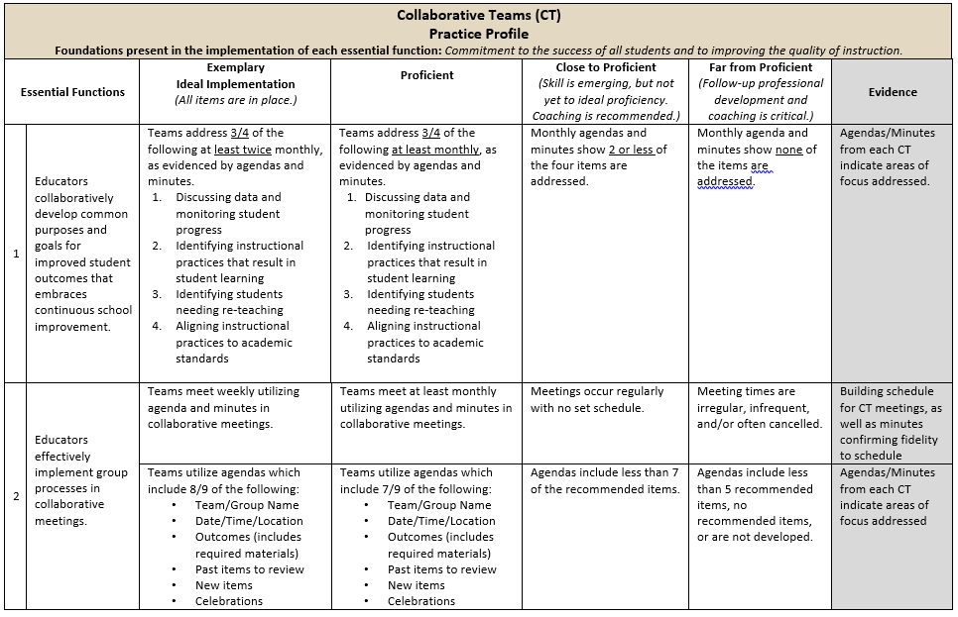
Practice Profile
Notes:
To Do: Share Practice Profile in Handouts
TO KNOW:
Full practice Profile is in Handouts
Collaborative Data Team Practice Profile
Implementation with fidelity requires clearly described implementation criteria. The Practice Profile framework has recently been developed by the National Implementation Research Network (NIRN) as a way of outlining implementation criteria using a rubric structure with clearly defined practice-level characteristics (NIRN, 2011). According to NIRN, the Practice Profile emerged from the conceptualization of the change process outline in the work of Hall and Hord’s (2006) Innovation Configuration Mapping (NIRN, 2011).
The Practice Profile template includes four pieces and is anchored by the essential functions. First, as a header is the foundation of implementation that philosophically grounds implementation. Then moving from left to right across the template are the essential functions of the practice, implementation performance levels, and lastly, evidence which provides data or documentation for determining implementation levels.
How to Use the Practice Profile
The essential functions align with the teaching/ learning objectives for each learning package. For each teaching/learning objective are levels of implementation. For some essential functions, proficient and exemplary implementation criteria are the same and in others, criteria differ. Close to proficient levels of implementation suggest the skill or practice is emerging and coaching is recommended for moving toward more proficient implementation. When implementation is reported at the unacceptable variation level, follow-up professional development in addition to coaching is recommended. The professional development provider should walk through the practice profile with the educator-learners, referring to the data and artifacts listed as suggested evidence. It is an important tool for self-monitoring their own implementation because it serves as a reminder as to the implementation criteria and is also aligned with the fidelity checklists.

Slide 18
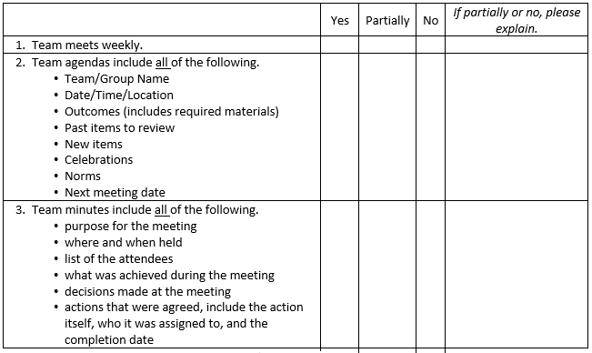
Implementation Fidelity
Notes:
To Do: Review the implementation fidelity checklist.
Handout: CT Implementation Fidelity Checklist

Slide 19
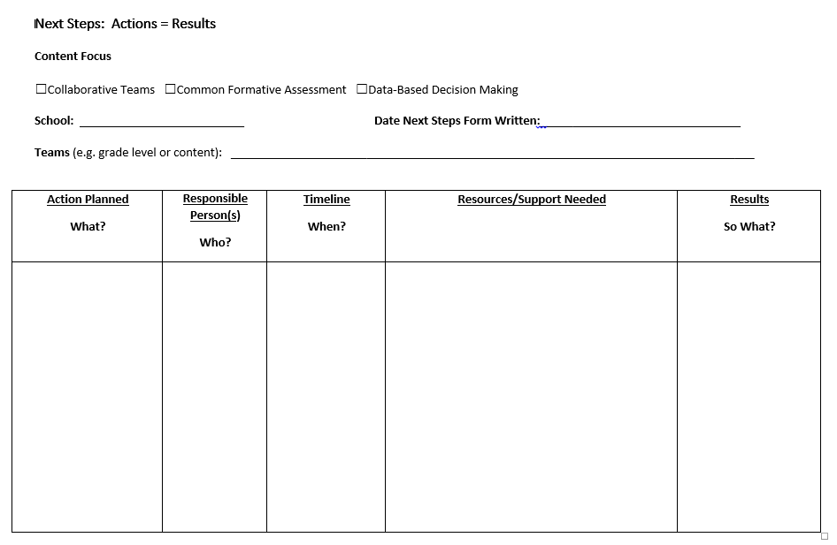
Next Steps: Action=Results
What steps will you take to begin implementing?
Notes:
To Do: Complete the Next Steps template. Example is included in the learning package materials.

Slide 20
Contact Information
Please contact me to schedule follow-up coaching and/or additional professional development.
Notes:
To Know/To Say/To Do: Include presenter’s contact information.
Please contact me to schedule follow-up coaching and/or additional professional development. Thank you.

