Slide 1
Collaborative Teams
Consensus
This work is licensed under a Creative Commons Attribution-NonCommercial-NoDerivatives 4.0 International License.

Slide 2
Acknowledgements
Special thanks to all contributors to the development and revision of this module.
The original collection of learning packages was roll-out for use by Regional Professional Development Center (RPDC) Consultants in July 2013 after being developed by a team of content experts. The collection of learning packages was developed through efforts funded by the Missouri State Personnel Development Grant (SPDG). The following individual/groups are thanked immensely for their hard work in developing this package:
Content Development Support
Ronda Jenson, Carla Williams, Stefanie Lindsay, Jodi Arnold and Arden Day, UMKC
Institute for Human Development
SPDG Management Team

Slide 3
Team Members
Initial Content Development Team, 2013
Michelle Smith, Team Leader, MO PLC
Betty Ennis, DESE
Tiffiney Smith, SE RPDC
Marlow Barton, StL RPDC
Mary Gage, C RPDC
Sheila Thurman, NE RPDC
Rebecca Baldwin, NW RPDC
Bertha Richardson, StL RPDC
Karen Wigger, NW RPDC
Mary Ann Burns, DESE
Tom Robb, KC RPDC
2016 Revision Team
Mary Dell Black, Facilitator, SC SIS
Jamie Mehring, Ed Plus/StL RPDC
Sheila Thurman, NE RPDC
Marisa Bowen, SE SIS
Tiffani Muessig, DESE
Judy Wartick, KC SIS
Jeanie Carey, SC RPDC
Connie Schweiss, SC RPDC
Pam Williams, DESE
Joy Fairley, KC RPDC

Slide 4
Hidden Slide
Presenter notes information
Tools and documents
Helpful suggestions
Notes:
The Collaborative Teams (CT) learning package is organized in seven modules. The first is an Overview. The other six modules address each of the processes that contribute to effective teams.
The CT Content Fidelity Checklist aligned to each learning package includes all critical items for a training session (draft, pending approval). The CT HQPD Training Checklist and Coaching Checklist contain process elements to be used as guidance when designing, revising, or coaching high quality professional development.
Important notes:
A script of presenter notes is included in the PowerPoint. Background information for the presenter is shown as “To Know.” Statements to be shared with participants are shown as “To Say.” In some instances, the “To Know/To Say” are the same material. For fidelity of content and consistency among presenters, the “To Say” information should be presented with minimal paraphrasing.
There is one pre/post assessment for the entire CT package (all seven modules).
An Implementation Fidelity Checklist is available for frequent monitoring by a teacher or observer.
A print Practice Profile and an electronic Practice Profile Self-Assessment tool are available for use by individuals, teams, or schools for periodic self-assessment and monitoring of implementation of practice or to identify training or coaching needs.
The presenter should download onto a hard drive or a flash drive any video intended for use in a training. The links shown on slides may not be able to be accessed online at the school sites.
Breaks should be inserted at the discretion of the presenter based on the needs of participants.
A presenter may add slides to supplement the content. For example, a slide of essential questions may be added since only objectives have been included.
A presenter may choose to differentiate a presentation to meet the needs of the participants. For example, another form may be substituted for the Next Steps template if the district or building already uses a similar form or protocol.
Additional activities, examples, videos, etc. may be found _____. (The details are in progress.) A presenter may interchange the additional material for the corresponding PowerPoint content.

Slide 5
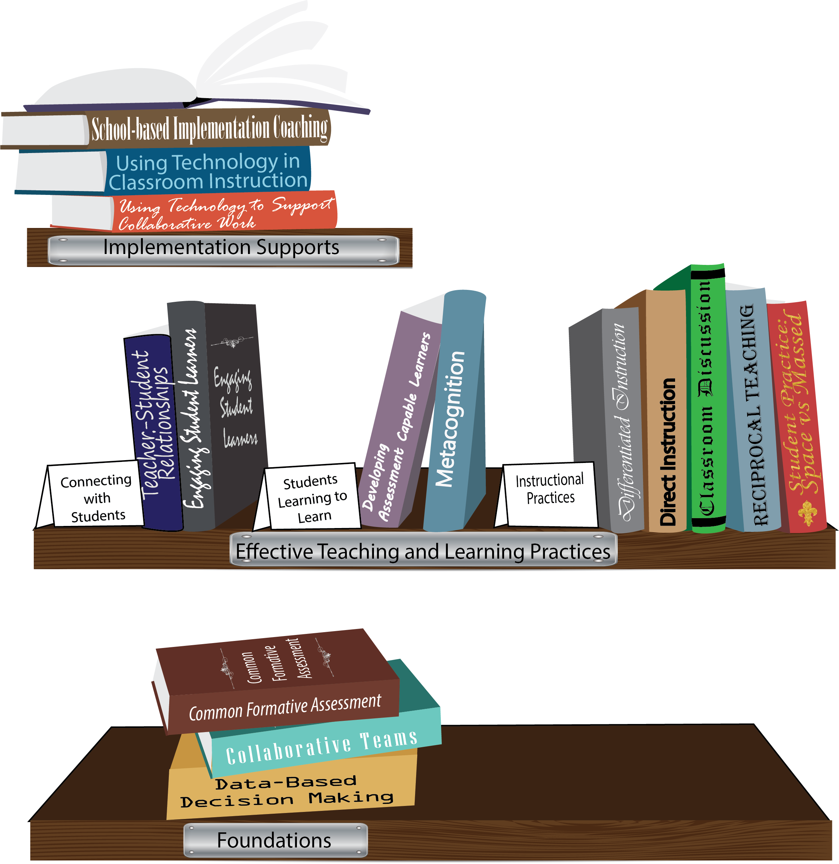
Notes:
To Know/To Say: Missouri’s professional development learning packages are organized in three categories: Foundations, Effective Teaching & Learning Practices, and Implementation Supports. All schools begin their professional development journey with the Foundations, as these learning packages provide foundation knowledge in three key areas: Collaborative Teams, Data-based Decision-making, and Common Formative Assessment. Effective Teaching & Learning Practices encompass research-based instructional practices for deepened learning. These learning packages address ways of connecting with students, ways of helping students learn how to learn, and feature specific instruction practices. Implementation Supports are learning packages designed to help school staff support and enhance the Implementation of Effective Teaching & Learning Practices through using technology and peer coaching supports.
To Do: Explain how the graphic depicts professional development in Missouri.

Slide 6
Collaborative Work Foundations
3 Key Areas
Collaborative Teams
Common Formative Assessment
Data-Based Decision Making
CFA – utilize
Quality assessments
as feedback to improve teaching & learning.
DBDM – utilize data for continuous improvement through dialogue about teaching & learning
CT – utilize team processes to improve teaching & learning.
Notes:
To Know/To Say: The learning packages forming the foundation knowledge of the Collaborative Work are Collaborative Teams, Data-Based Decision Making, and Common Formative Assessment.
Collaborative Teams (CT) utilize team processes to improve teaching and learning.
Common Formative Assessment (CFA) utilize quality assessments as feedback to improve teaching & learning.
Data-Based Decision Making (DBDM) utilize data for continuous improvement through dialogue around instruction.

Slide 7
Collaborative Teams
Overview and Purpose of
Collaborative Teams
Foundational Processes
Agendas & Minutes Norms Roles
Advanced Collaborative Processes
Consensus
Advanced Collaborative Processes
Consensus
Collaborative Skills
Protocols
Notes:
To Know: The learning package Collaborative Teams consists of Three Sections: Overview, Foundational Processes and Advanced Collaborative Process. There are seven presentations: Overview, Agenda and Minutes, Norms, Roles, Consensus, Collaborative Skills and Protocols.
To Say: Today we will focus on Consensus. Reaching consensus with decisions is an important part of effective Collaborative Teams.

Slide 8
Norms
Begin and end on time
Be an engaged participant
Be an active listener—open to new ideas
Use notes for side bar conversations
Use electronics respectfully
Notes:
To Know/To Say: Norms may be added for schools with specific needs.
Some schools might have established norms for all their pd. In that case adapt to their norms.
To Say: Possible table discussion: Which norm is hardest for you? Which has the biggest impact? What does “use electronics respectfully mean?” How might we remind someone to follow the norms in a fun way?
To Do: As an example, a card with a photo of Norm Peterson can be on the table for people to raise as needed.
Consider including a check mid way through training to assess a norm or norms.
It may be that we want to use norms printed on all agendas for trainings, rather than in PowerPoint, so people will always see them on paper.

Slide 9
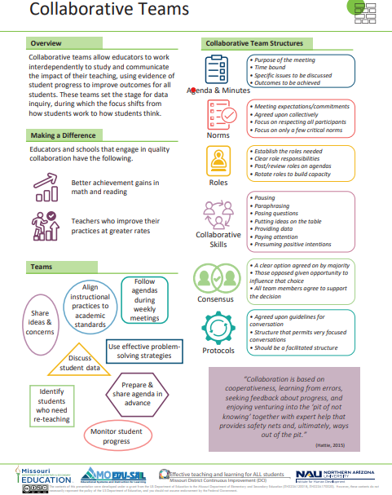
Notes:
To Know / To Say: This info graphic for Collaborative Teams can be used as either a pre reading before or at the beginning of the training. The consultant may want to use reflective questions or protocols to generate thinking prior to the training.
For example, you could pose a question to have them reflect on 1 thing they want to be able to implement or improve following the training. Or you may ask them to reflect on 1 thing they want to learn from the training about collaborative teams.
You may also want to use a protocol such as a 3-2-1 or K-W-L chart identifying what they know, what they need to know, where they need to improve, etc.
Handout: Collaborative Teams

Slide 10
Missouri Teacher and Leader Standards
Missouri Teacher Standards:
8 (Professional Practice)
9 (Professional Collaboration)
Missouri Leader Standards:
2 (Teaching and Learning)
3 (Management of Organizational Systems)
(Missouri Department of Elementary and Secondary Education, 2013)
Notes:
To Know: This slide shows how the use of Collaborative Teams relates to the
Missouri Teacher and Leader Standards.
To Say:
Teacher Standard #8 Professionalism The teacher is a reflective practitioner who continually assesses the effects of choices and actions on others. The teacher actively seeks out opportunities to grow professionally in order to improve learning for all students. [SB 291 Section 160.045.2 (2) Various forms of assessment are used to monitor and manage student learning; (5) The teacher keeps current on instructional knowledge and seeks and explores changes in teaching behaviors that will improve student performance; (6) The teacher acts as a responsible professional in the overall mission of the school.]
Teacher Standard #9 Professional Collaboration The teacher has effective working relationships with students, parents, school colleagues, and community members. [SB 291 Section 160.045.2
(4) The teacher uses professional communication and interaction with the school community; (6) The teacher acts as a responsible professional in the overall mission of the school.]
Leader Standard #2 Teaching and Learning Education leaders have the knowledge and ability to ensure the success of all students by promoting a positive school culture, providing an effective instructional program that applies best practice to student learning, and designing comprehensive professional growth plans for staff.
Leader Standard #3 Management of Organizational Systems Education leaders have the knowledge and ability to ensure the success of all students by managing the organizational structure, personnel, and resources in a way that promotes a safe, efficient, and effective learning environment.

Slide 11
Our focus: Consensus
Consensus is a decision that has been reached when most members of the team agree on a clear option and the few who oppose it think they have had a reasonable opportunity to influence that choice. All team members agree to support the decision.
(Dufour, Dufour, Eaker and Many, 2006)
Notes:
To Know/To Say: Definition from MOPLC materials.
To Say: Consensus is a form of decision-making, different than taking a simple majority vote. There are times to use consensus, and times not to use consensus.
A condition in a group in which every member is willing to “go along” with the decision without sabotaging it is called CONSENSUS. This does not mean that the decision gives everyone his or her first choice. It only means that a sufficient number of people are sufficiently in favor of a decision to get it carried out and no one will make himself or herself an obstacle to carrying it out.

Slide 12
When and why use consensus
Consensus is most appropriate when…
The decision has a broad impact.
You need everyone’s support for successful implementation.
The decision is highly critical or important.
There is no one right answer.
Everyone is accountable.
(The group should agree to use consensus for a decision).
Notes:
To Say: An example: Deciding what effective practice to engage with during the course of a semester is a decision appropriately made by consensus.

Slide 13
Main reasons to use consensus
Ensure high quality decisions
Builds connection among members
Increase effective implementation
Notes:
To Know: Additional consensus information can be found at: http://treegroup.info/topics/handout-consensus.pdf
6 pages, including:
Consensus Decision Making
Steps of the Consensus Process
Decision Point Structure
Working with Blocks & Concerns
Consensus Process Steps Flow Chart
Consensus Queries
To Say: There are many reasons to use consensus. The main three are to ensure high quality decisions, build connection among members, and increase effective implementation. Can you think of any other reasons?

Slide 14
Objective
Utilize consensus appropriately and effectively.
Notes:
To Say: This is key to the topic of this training. We want the districts and teams to utilize consensus appropriate and effectively when making decisions about student and data.

Slide 15
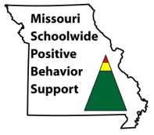
Key Guidelines for Consensus
Come to the discussion with an open mind.
Listen to other people's ideas and try to understand their reasoning.
Describe your reasoning briefly so other people can understand you.
Avoid changing your mind only to reach agreement and avoid conflict.
View differences of opinion as helpful rather than harmful.
Notes:
To Say:
Come to the discussion with an open mind. This doesn't mean not thinking about the issue beforehand, but it does mean being willing to consider any other perspectives and ideas that come up in the discussion.
Listen to other people's ideas and try to understand their reasoning. Describe your reasoning briefly so other people can understand you. Avoid arguing for your own judgments and trying to make other people change their minds to agree with you. Avoid changing your mind only to reach agreement and avoid conflict. Do not "go along" with decisions until you have resolved any reservations that you consider important. View differences of opinion as helpful rather than harmful.
Avoid conflict-reducing techniques such as majority vote. Stick with the process a little longer and see if you can't reach consensus after all.

Slide 16
Steps in the Process
First, work to clearly define the issue.
Can each member of the group state the issue?
Articulate a proposal.
Assess group understanding of issue and proposal.
Poll the group (rule of thumbs)
Consensus is reached when roughly 80% of the group is at thumbs up or sideways.
Notes:
To Say: If the group agreed to decision by consensus, then individuals should be willing to support a position different from their own. Now we will take a look at the steps in the consensus process. Is there a step that is not listed, you would like to add?

Slide 17
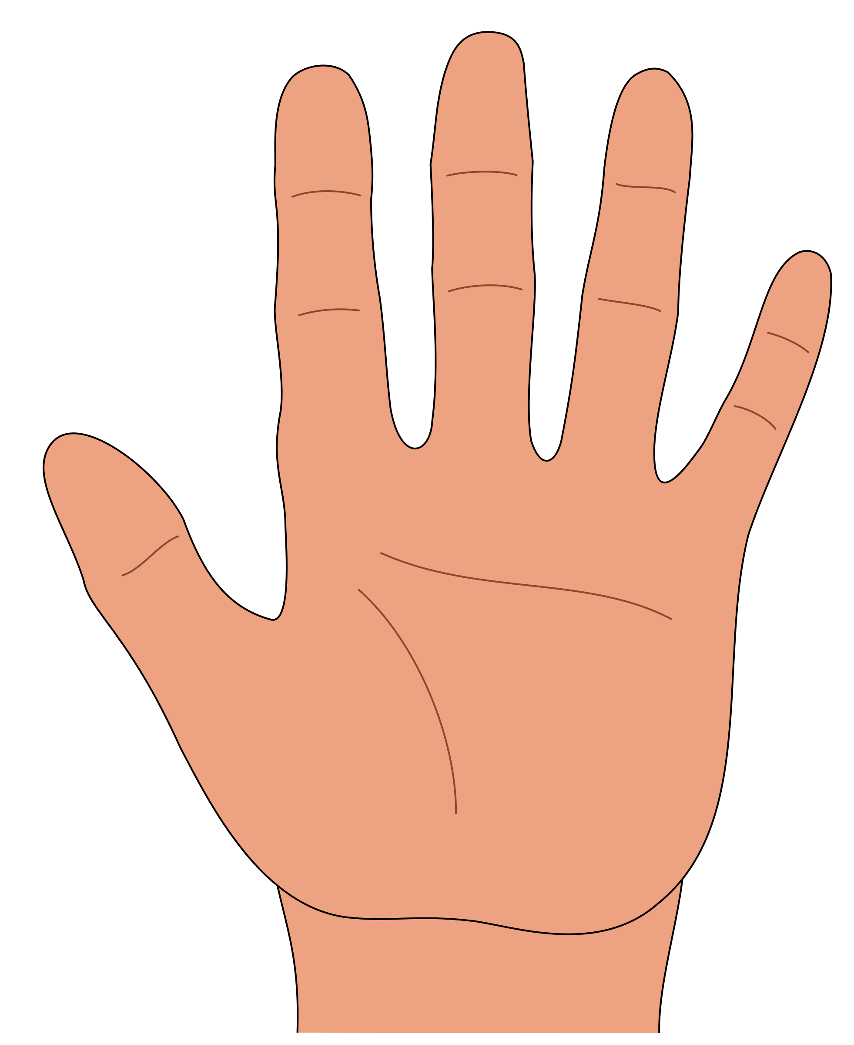
Rule of Thumbs
Notes:
To Know/To Say: Adapted from Leadership Academy, (OLE). This is one way gauge is there is consensus in a team.

Slide 18
Fist to Five
5 = Absolutely!
4 = Yes
3 = OK
2 = I’d rather not, but if...
1 = No
0 = Never!
Notes:
Activity--Fist to Five
To Say:
Fist to Five is a consensus-building visual gesture tool. It allows for quicker communication to minimize the time spent collaborating and coming to consensus on elements of a project. If 3 or below: Come back together and have dialogue.
Fist To Five can be applied to any consensus-building situation, where consensus is important and time is valuable. Essentially, individual team members can quickly provide their input on support for project issues by simply raising their hands and showing either a specific number of fingers, or a closed fist. The support scale goes from 0 to 5, with five being full support, and a fist signifying total opposition. Typically, two fingers would represent a few minor objections, while one finger represents a more significant objection or concern.
To Do:
Steps to Reaching Consensus- Fist to Five Activity:
'Fist to Five' Activity | NASCO

Slide 19
Reflection
As a group, reflect on a past decision in your building where consensus was needed. Did the decision have true consensus? How did that impact implementation of the decision?
Is there an upcoming decision that is best decided utilizing consensus?
Notes:
Activity
To Know/To Say: Assessment & Reflection : Work with teams to engage them in dialogue regarding both past practices and upcoming practices. Depending upon group size, ask groups to report out.

Slide 20
Discussion Rules for Participating in an Academic Controversy:
I am critical of ideas, not people.
I focus on making the best possible decision, not winning.
I encourage everyone to participate and master all relevant information.
I listen to everyone’s ideas, even if I do not agree.
I restate (paraphrase) what someone has said if it is not clear.
I bring out all the ideas and facts supporting both sides, then try to put them together in a way that makes sense.
I try to understand both sides of the issue.
I change my mind when the evidence indicates that I should do so.
Notes:
Activity:
To Know: Closing and follow up: This slide includes additional, related information. These points could be used alone or together, depending upon needs of teams, and in some cases may provide reinforcement of the Collaborative Skills Module. If you use this slide, emphasize connectedness.

Slide 21
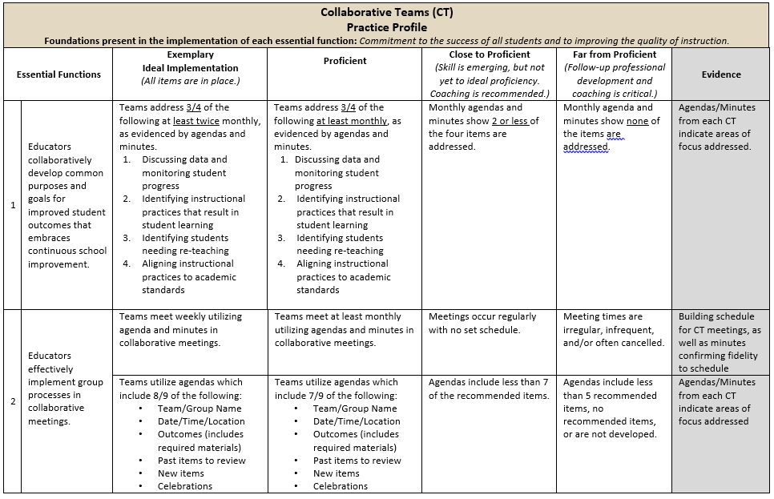
Practice Profile
Notes:
To Do: Share Practice Profile in Handouts
TO KNOW:
Full practice Profile is in Handouts
Collaborative Data Team Practice Profile
Implementation with fidelity requires clearly described implementation criteria. The Practice Profile framework has recently been developed by the National Implementation Research Network (NIRN) as a way of outlining implementation criteria using a rubric structure with clearly defined practice-level characteristics (NIRN, 2011). According to NIRN, the Practice Profile emerged from the conceptualization of the change process outline in the work of Hall and Hord’s (2006) Innovation Configuration Mapping (NIRN, 2011).
The Practice Profile template includes four pieces and is anchored by the essential functions. First, as a header is the foundation of implementation that philosophically grounds implementation. Then moving from left to right across the template are the essential functions of the practice, implementation performance levels, and lastly, evidence which provides data or documentation for determining implementation levels.
How to Use the Practice Profile
The essential functions align with the teaching/ learning objectives for each learning package. For each teaching/learning objective are levels of implementation. For some essential functions, proficient and exemplary implementation criteria are the same and in others, criteria differ. Close to proficient levels of implementation suggest the skill or practice is emerging and coaching is recommended for moving toward more proficient implementation. When implementation is reported at the unacceptable variation level, follow-up professional development in addition to coaching is recommended. The professional development provider should walk through the practice profile with the educator-learners, referring to the data and artifacts listed as suggested evidence. It is an important tool for self-monitoring their own implementation because it serves as a reminder as to the implementation criteria and is also aligned with the fidelity checklists.

Slide 22
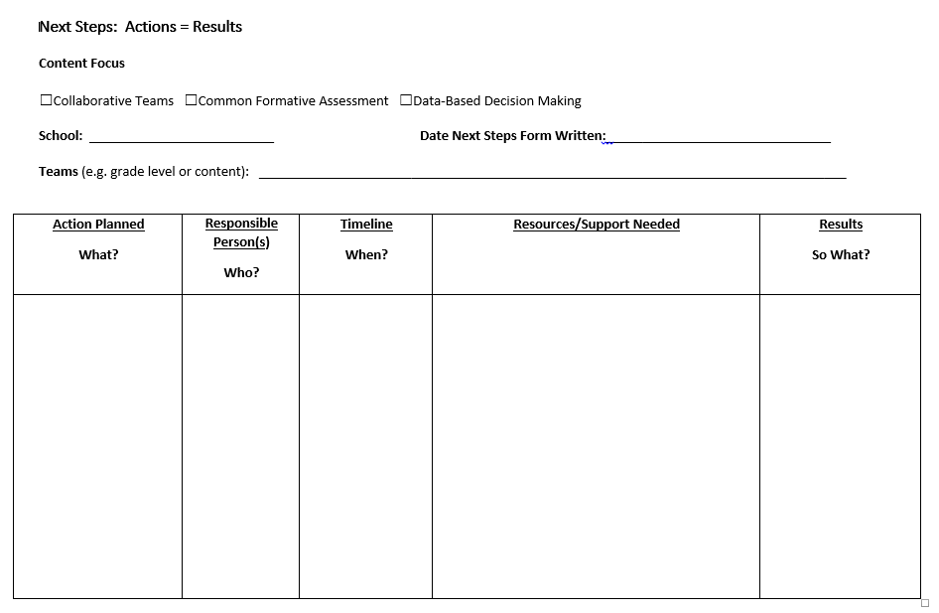
Next Steps: Action=Results
What steps will you take to begin implementing?
Notes:
To Do: Complete the Next Steps template. Example is included in the learning package materials.

Slide 23
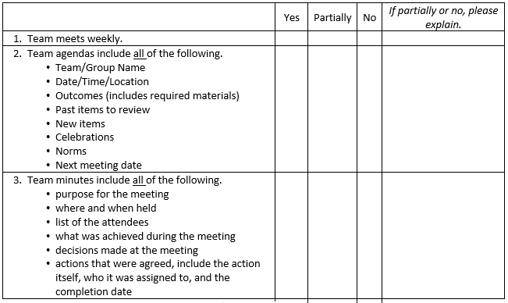
Implementation Fidelity
Notes:
To Do: Review the implementation fidelity checklist.
Handout: CT Implementation Fidelity Checklist

Slide 24
Contact Information
Please contact me to schedule follow-up coaching and/or additional professional development.
Notes:
To Know/To Say/To Do: Include presenter’s contact information.
Please contact me to schedule follow-up coaching and/or additional professional development. Thank you.

