Slide 1
Collaborative Teams
Collaborative Skills
This work is licensed under a Creative Commons Attribution-NonCommercial-NoDerivatives 4.0 International License.
Notes:
To Know: This presentation is 30 to 60 minutes based on activities used.

Slide 2
Acknowledgements
Special thanks to all contributors to the development and revision of this module.
The original collection of learning packages was roll-out for use by Regional Professional Development Center (RPDC) Consultants in July 2013 after being developed by a team of content experts. The collection of learning packages was developed through efforts funded by the Missouri State Personnel Development Grant (SPDG). The following individual/groups are thanked immensely for their hard work in developing this package:
Content Development Support
Ronda Jenson, Carla Williams, Stefanie Lindsay, Jodi Arnold and Arden Day, UMKC
Institute for Human Development
SPDG Management Team

Slide 3
Team Members
Initial Content Development Team, 2013
Michelle Smith, Team Leader, MO PLC
Betty Ennis, DESE
Tiffiney Smith, SE RPDC
Marlow Barton, StL RPDC
Mary Gage, C RPDC
Sheila Thurman, NE RPDC
Rebecca Baldwin, NW RPDC
Bertha Richardson, StL RPDC
Karen Wigger, NW RPDC
Mary Ann Burns, DESE
Tom Robb, KC RPDC
2016 Revision Team
Mary Dell Black, Facilitator, SC SIS
Jamie Mehring, Ed Plus/StL RPDC
Sheila Thurman, NE RPDC
Marisa Bowen, SE SIS
Tiffani Muessig, DESE
Judy Wartick, KC SIS
Jeanie Carey, SC RPDC
Connie Schweiss, SC RPDC
Pam Williams, DESE
Joy Fairley, KC RPDC

Slide 4
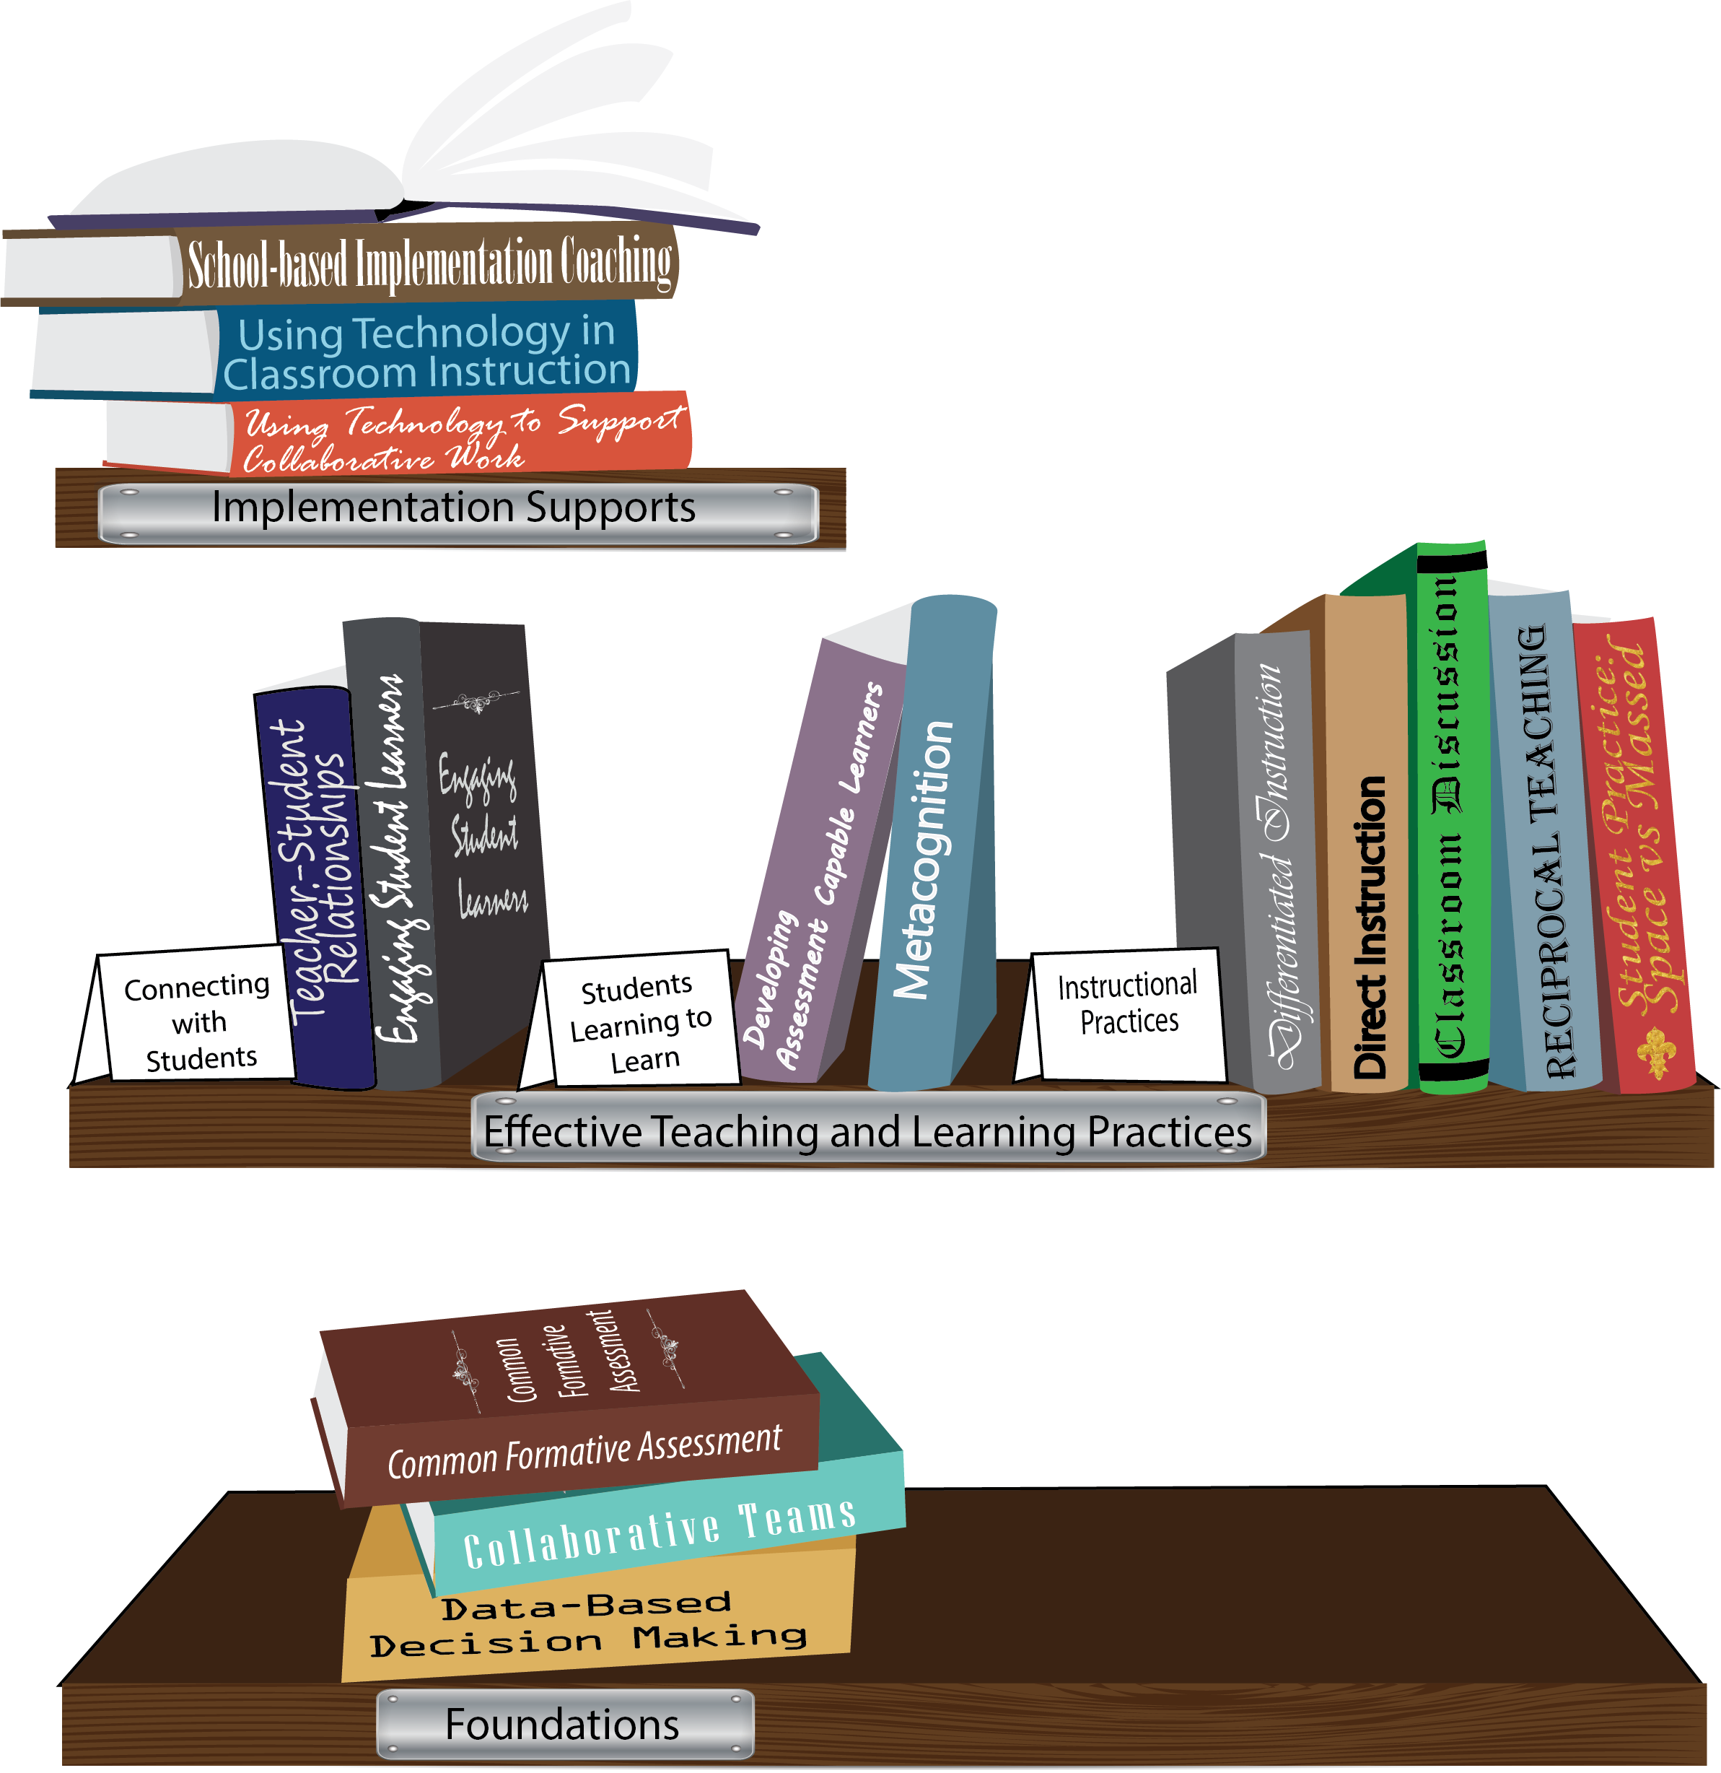
Notes:
To Know/To Say: Missouri’s professional development learning packages are organized in three categories: Foundations, Effective Teaching & Learning Practices, and Implementation Supports. All schools begin their professional development journey with the Foundations, as these learning packages provide foundation knowledge in three key areas: Collaborative Teams, Data-based Decision-making, and Common Formative Assessment. Effective Teaching & Learning Practices encompass research-based instructional practices for deepened learning. These learning packages address ways of connecting with students, ways of helping students learn how to learn, and feature specific instruction practices. Implementation Supports are learning packages designed to help school staff support and enhance the Implementation of Effective Teaching & Learning Practices through using technology and peer coaching supports.
To Do: Explain how the graphic depicts professional development in Missouri.

Slide 5
Collaborative Work Foundations
3 Key Areas
Collaborative Teams
Common Formative Assessment
Data-Based Decision Making
CFA – utilize
Quality assessments
as feedback to improve teaching & learning.
DBDM – utilize data for continuous improvement through dialogue about teaching & learning
CT – utilize team processes to improve teaching & learning.
Notes:
To Know/To Say: The learning packages forming the foundation knowledge of the Collaborative Work are Collaborative Teams, Data-Based Decision Making, and Common Formative Assessment.
Collaborative Teams (CT) utilize team processes to improve teaching and learning.
Common Formative Assessment (CFA) utilize quality assessments as feedback to improve teaching & learning.
Data-Based Decision Making (DBDM) utilize data for continuous improvement through dialogue around instruction.

Slide 6
Collaborative Teams
Overview and Purpose of
Collaborative Teams
Foundational Processes
Agendas & Minutes Norms Roles
Advanced Collaborative Processes
Collaborative Skills
Advanced Collaborative Processes
Consensus
Collaborative Skills
Protocols
Notes:
To Know: The learning package Collaborative Teams consists of Three Sections: Overview, Foundational Processes and Advanced Collaborative Process. There are seven presentations: Overview, Agenda and Minutes, Norms, Roles, Consensus, Collaborative Skills and Protocols.
To Say: Today we will focus on Collaborative Skills..

Slide 7
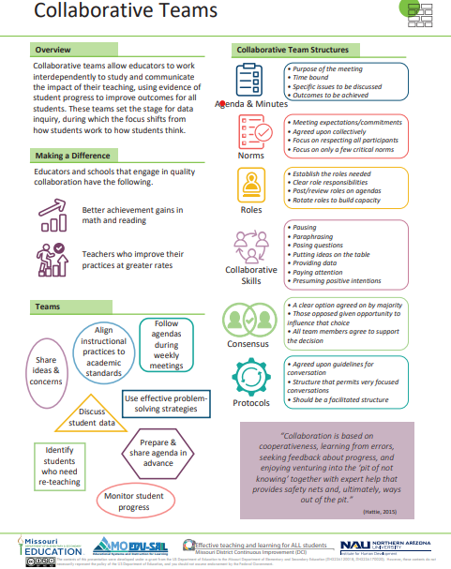
Notes:
To Know / To Say: This info graphic for Collaborative Teams can be used as either a pre reading before or at the beginning of the training. The consultant may want to use reflective questions or protocols to generate thinking prior to the training.
For example, you could pose a question to have them reflect on 1 thing they want to be able to implement or improve following the training. Or you may ask them to reflect on 1 thing they want to learn from the training about collaborative teams.
You may also want to use a protocol such as a 3-2-1 or K-W-L chart identifying what they know, what they need to know, where they need to improve, etc.
Handout: Collaborative Teams

Slide 8
Missouri Teacher and Leader Standards
Missouri Teacher Standards:
8 (Professional Practice)
9 (Professional Collaboration)
Missouri Leader Standards:
2 (Teaching and Learning)
3 (Management of Organizational Systems)
(Missouri Department of Elementary and Secondary Education, 2013)
Notes:
To Know: This slide shows how the use of Collaborative Teams relates to the
Missouri Teacher and Leader Standards.
To Say:
Teacher Standard #8 Professionalism The teacher is a reflective practitioner who continually assesses the effects of choices and actions on others. The teacher actively seeks out opportunities to grow professionally in order to improve learning for all students. [SB 291 Section 160.045.2 (2) Various forms of assessment are used to monitor and manage student learning; (5) The teacher keeps current on instructional knowledge and seeks and explores changes in teaching behaviors that will improve student performance; (6) The teacher acts as a responsible professional in the overall mission of the school.]
Teacher Standard #9 Professional Collaboration The teacher has effective working relationships with students, parents, school colleagues, and community members. [SB 291 Section 160.045.2
(4) The teacher uses professional communication and interaction with the school community; (6) The teacher acts as a responsible professional in the overall mission of the school.]
Leader Standard #2 Teaching and Learning Education leaders have the knowledge and ability to ensure the success of all students by promoting a positive school culture, providing an effective instructional program that applies best practice to student learning, and designing comprehensive professional growth plans for staff.
Leader Standard #3 Management of Organizational Systems Education leaders have the knowledge and ability to ensure the success of all students by managing the organizational structure, personnel, and resources in a way that promotes a safe, efficient, and effective learning environment.

Slide 9
Team Norms
Begin and end on time
Be an engaged participant
Be an active listener—open to new ideas
Use electronics respectfully
Notes:
To Say: Meetings, regardless of size or length, are more effective when meeting norms are established, practiced and monitored. These are the most common norms (read the list – paraphrasing the intent of the norm – especially noting the use of electronics indicating that if folks need to respond to calls immediately, please step out of the room; otherwise, there will be a break for checking messages/emails later). We need to be clear about our expectations in large groups and in small groups, so today, for the sake of time, these will be the norms we will follow today.”
In your Collaborative Teams, you may choose to use this list or create your own to better meet your needs. Sometimes schools create school-wide norms so that whenever small or larger groups in the school meet, the norms are the same. The point is – norms are an important part of effective teams WHEN they are honored and monitored. Creating table tents used at every meeting, or norm posters in every meeting room, or included on each agenda are ways to remind teams of the meeting norm.
Table discussion: To Say: Some schools have already established meeting norms. If you have meeting norms, are they working? Of these or your own norms, which one do you feel is the most important? Which of your norms or these listed above is the hardest one to maintain/monitor? What prompts do you use when norms in your meetings are violated? To Do: (Give the example of using a picture of Norm Peterson to hold up when a norm is not being respected.)
To Say: If a team is not functioning effectively – the first step is to revisit the meeting norms. Are team members following the norms? If not, how can you get back on track?

Slide 10
Outcomes
Understand and implement the necessary skills to collaborate effectively in team meetings.

Slide 11
Why Collaborative Skills?
Hattie refers to the importance of teachers to “ ‘know thy impact’, it is to understand this impact, and it is to act on this knowing and understanding. It requires that teachers gather defensible and dependable evidence from many sources, and hold collaborative discussions with colleagues and students about this evidence, this making the effect of their teaching visible to themselves and others.”
(Hattie, 2011)
Notes:
(P19-20, ‘Visible Learning for Teachers’ by John Hattie)
To Say: Collaborative skills are behaviors that help two or more people work effectively together to realize shared goals. Teachers can teach their students to use collaborative skills to accomplish group tasks.

Slide 12
Quotable Quotes
“There is no such thing as group behavior. All ‘group behavior’ results from the decisions and actions of individuals. When individual choices align in productive patterns, the group produces positive results.”
(Garmston and Wellman, 1999)
Notes:
To Know/To Say: More and more, learning is viewed as a social process, not simply individuals accumulating information on their own. If learning is social, then collaboration is essential. Both communicative and collaborative skills are essential to function effectively in the modern world.

Slide 13
What? Norms of Collaboration
Pausing
Paraphrasing
Posing Questions
Putting Ideas on the Table
Providing Data
Paying Attention to Self and Others
Presuming Positive Intentions
Notes:
To Know/To Say:
The seven norms of collaboration are essential capacities and skills for high-performing groups. They operate within several practical frameworks that help groups to develop shared meaning and gracefully reach decisions.
The original “Norms of Collaboration” were first articulated by Garmston and Wellman in 1999. These seven norms of collaboration, (pausing , paraphrasing, probing, putting ideas on the table, paying attention to self and others, presuming positive intentions, and pursuing a balance between advocacy and inquiry), have been widely used, and multiple materials are available online to support their use.
This training module will utilize a revision to these norms of collaboration. The revised norms are:
Pausing
Paraphrasing
Posing Questions
Putting Ideas on the Table
Providing Data
Paying Attention to Self and Others
Presuming Positive Intentions
Source: The Adaptive School: A Sourcebook for Developing Collaborative Groups (Garmston and Wellman, 2009, pp. 27-43).
Note: Should you seek additional resources online, please be aware of the two different versions.

Slide 14
Exploring Collaborative Norms
Activity: Jigsaw Experts
# 1-7, each # reads their assigned norm piece
Join alike #s and share understanding of norm
Form groups of 7, #’s 1-7 in each group
Teach assigned norm to group members
Notes:
Activity
This activity depends on the size of the group. It can be used as a review for groups with some knowledge of the Norms of Collaboration (Garmston). Small groups will need to become an expert on more than one collaboration norm. Multiple smaller pieces may be assigned to a team instead of assigning individual pieces.
Handout:
Norms of Collaboration Poster: 1. Pausing, 2. Paraphrasing, 3. Posing Questions, 4. Putting Ideas on the Table, 5. Providing Data, 6. Paying Attention to Self and Others, 7. Presuming Positive Intentions

Slide 15
Reflection
Consider your current collaborative meetings.
Which of these skills are currently practiced? Which is missing?
Notes:
To Do: Topic in practice: Engage participants in reflection and conversation about some of these skills. Include examples from meetings you have attended, or invite them to share examples.
Suggestions: offer a time when you left a meeting without summarizing the group’s thoughts. Then at the next meeting, people return to find the work they have done in the interim has been disconnected. Or, consider a time when a decision has been made without examining data thoroughly. Another possibility may be meetings where decisions are rushed, and participants do not take time to pause and consider the implications.

Slide 16
How? Implementing Norms of Collaboration
Introduce the Norms
Post Norms in meeting
Sustain engagement with Norms
Assess consistency with Norms
Notes:
To Say: Developing proficiency with applying the 7 Norms of Collaboration all at once may be too demanding. Suggest that the team decide on the norm they want to focus and continue focusing on proficiency of norm use over several team meetings or until the team members feel they use the norm with automaticity. Seek opportunities in daily communication experiences to practice a particular norm, you will be able to overlearn that tool so that it is available to you when you need it the most in a meeting. Then select the next norm for focus.
To Do: Share Norms Poster, Bookmark Prompts, Table Tents. Table tents may be printed and placed on tables at each of the meetings for reflective use. (The table tents link can be opened with Microsoft Publisher.)

Slide 17
Norms of Collaboration
Any group
that is too busy to reflect on its work
is too busy to improve.
(Garnston and Wellman, 2007)
Notes:
To Say: If you are too busy to reflect, you are too busy to improve. This about this. Has there been a time when you were too busy to improve?

Slide 18
Assessing Behaviors
Reflect and consider how behaviors impact the collaborative work of a group.
Handouts: Norms Inventories for Rating the Consistency of Personal Behavior and Rating Consistency of Group Member Behavior
Continued application of these skills…. Plan and hold each other accountable.
Notes:
Activity
Handouts:
Norms Inventory Rating the Consistency of Group Member Behavior
Norms Inventory Rating the Consistency of My Personal Behavior in a Specific Group of Which I am a Member
Seven Norms of Collaboration: A Supporting Toolkit
Found at: http://moedu-sail.org/collab-teams-materials/ (Collaborative Data Teams--Presenter and Participant Materials)
To Know/To Say: The language in the slide is designed to be flexible. If you have an audience of individuals who represent different teams, or if you have an audience of a single team in a coaching situation, you will need to structure the activity in slightly different ways. Participants should consider their own behavior, and also the collective behavior of the group. See the Norms of Collaboration Toolkit for complete directions and suggestions for both evaluating self and group behavior. Facilitators/Coaches, please be thoroughly familiar with the Toolkit, which explains how to use both of the norms inventories.
. As time allows, it is beneficial to consider both individual and group behaviors. You may wish to use these materials over time, evaluating individual behavior first, allowing time for application during group meetings, and then evaluating the collective behavior of the group. Emphasize the need for continued reference to and engagement with these skills.

Slide 19
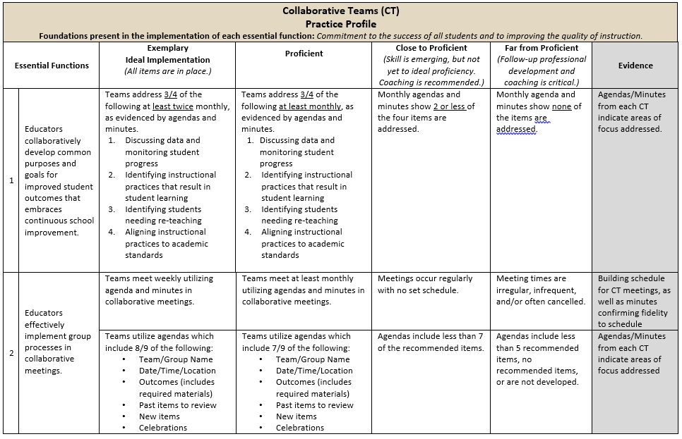
Practice Profile
Notes:
To Do: Share Practice Profile in Handouts
TO KNOW:
Full practice Profile is in Handouts
Collaborative Data Team Practice Profile
Implementation with fidelity requires clearly described implementation criteria. The Practice Profile framework has recently been developed by the National Implementation Research Network (NIRN) as a way of outlining implementation criteria using a rubric structure with clearly defined practice-level characteristics (NIRN, 2011). According to NIRN, the Practice Profile emerged from the conceptualization of the change process outline in the work of Hall and Hord’s (2006) Innovation Configuration Mapping (NIRN, 2011).
The Practice Profile template includes four pieces and is anchored by the essential functions. First, as a header is the foundation of implementation that philosophically grounds implementation. Then moving from left to right across the template are the essential functions of the practice, implementation performance levels, and lastly, evidence which provides data or documentation for determining implementation levels.
How to Use the Practice Profile
The essential functions align with the teaching/ learning objectives for each learning package. For each teaching/learning objective are levels of implementation. For some essential functions, proficient and exemplary implementation criteria are the same and in others, criteria differ. Close to proficient levels of implementation suggest the skill or practice is emerging and coaching is recommended for moving toward more proficient implementation. When implementation is reported at the unacceptable variation level, follow-up professional development in addition to coaching is recommended. The professional development provider should walk through the practice profile with the educator-learners, referring to the data and artifacts listed as suggested evidence. It is an important tool for self-monitoring their own implementation because it serves as a reminder as to the implementation criteria and is also aligned with the fidelity checklists.

Slide 20
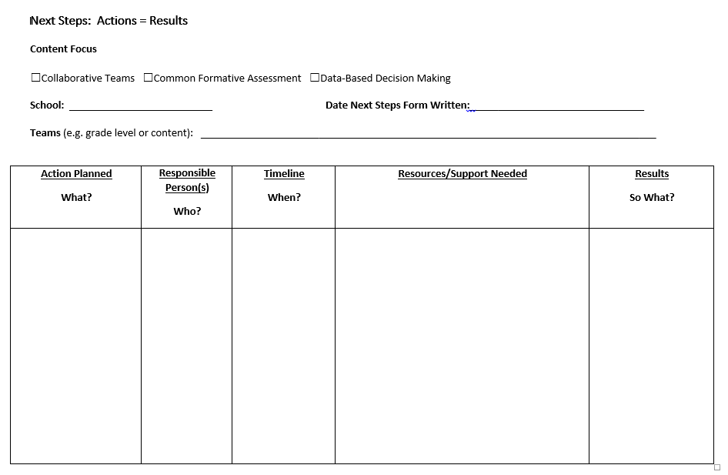
Next Steps: Action=Results
What steps will you take to begin implementing?
Notes:
To Do: Complete the Next Steps template. Example is included in the learning package materials.

Slide 21
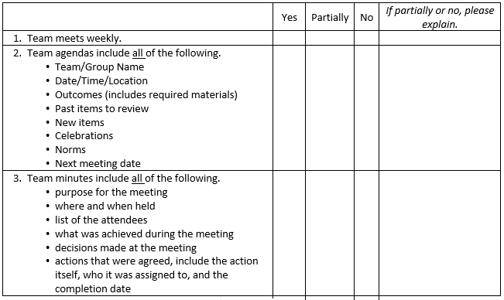
Implementation Fidelity
Notes:
To Do: Review the implementation fidelity checklist.
Handout: CT Implementation Fidelity Checklist

Slide 22
Reflection
These norms help ground our talk in constructive conversations that lift everyone's professional growth as we work with a sense of urgency to accelerate student achievement within the means of a collaborative culture.
How will you start implementing these Collaborative Skills?
Notes:
To Know/To Do/To Say: As we reflect on what we have learned about collaborative skills, how will you start implementing these skills, or if how will you improve your skills?

