Slide 1
Collaborative Teams
Protocols
This work is licensed under a Creative Commons Attribution-NonCommercial-NoDerivatives 4.0 International License.

Slide 2
Acknowledgements
Special thanks to all contributors to the development and revision of this module.
The original collection of learning packages was roll-out for use by Regional Professional Development Center (RPDC) Consultants in July 2013 after being developed by a team of content experts. The collection of learning packages was developed through efforts funded by the Missouri State Personnel Development Grant (SPDG). The following individual/groups are thanked immensely for their hard work in developing this package:
Content Development Support
Ronda Jenson, Carla Williams, Stefanie Lindsay, Jodi Arnold and Arden Day, UMKC
Institute for Human Development
SPDG Management Team

Slide 3
Team Members
Initial Content Development Team, 2013
Michelle Smith, Team Leader, MO PLC
Betty Ennis, DESE
Tiffiney Smith, SE RPDC
Marlow Barton, StL RPDC
Mary Gage, C RPDC
Sheila Thurman, NE RPDC
Rebecca Baldwin, NW RPDC
Bertha Richardson, StL RPDC
Karen Wigger, NW RPDC
Mary Ann Burns, DESE
Tom Robb, KC RPDC
2016 Revision Team
Mary Dell Black, Facilitator, SC SIS
Jamie Mehring, Ed Plus/StL RPDC
Sheila Thurman, NE RPDC
Marisa Bowen, SE SIS
Tiffani Muessig, DESE
Judy Wartick, KC SIS
Jeanie Carey, SC RPDC
Connie Schweiss, SC RPDC
Pam Williams, DESE
Joy Fairley, KC RPDC

Slide 4
Hidden Slide
Presenter notes information
Tools and documents
Helpful suggestions
Notes:
The Collaborative Teams (CT) learning package is organized in seven modules. The first is an Overview. The other six modules address each of the processes that contribute to effective teams.
The CT Content Fidelity Checklist aligned to each learning package includes all critical items for a training session (draft, pending approval). The CT HQPD Training Checklist and Coaching Checklist contain process elements to be used as guidance when designing, revising, or coaching high quality professional development.
Important notes:
A script of presenter notes is included in the PowerPoint. Background information for the presenter is shown as “To Know.” Statements to be shared with participants are shown as “To Say.” In some instances, the “To Know/To Say” are the same material. For fidelity of content and consistency among presenters, the “To Say” information should be presented with minimal paraphrasing.
There is one pre/post assessment for the entire CT package (all seven modules).
An Implementation Fidelity Checklist is available for frequent monitoring by a teacher or observer.
A print Practice Profile and an electronic Practice Profile Self-Assessment tool are available for use by individuals, teams, or schools for periodic self-assessment and monitoring of implementation of practice or to identify training or coaching needs.
The presenter should download onto a hard drive or a flash drive any video intended for use in a training. The links shown on slides may not be able to be accessed online at the school sites.
Breaks should be inserted at the discretion of the presenter based on the needs of participants.
A presenter may add slides to supplement the content. For example, a slide of essential questions may be added since only objectives have been included.
A presenter may choose to differentiate a presentation to meet the needs of the participants. For example, another form may be substituted for the Next Steps template if the district or building already uses a similar form or protocol.
Additional activities, examples, videos, etc. may be found _____. (The details are in progress.) A presenter may interchange the additional material for the corresponding PowerPoint content.

Slide 5
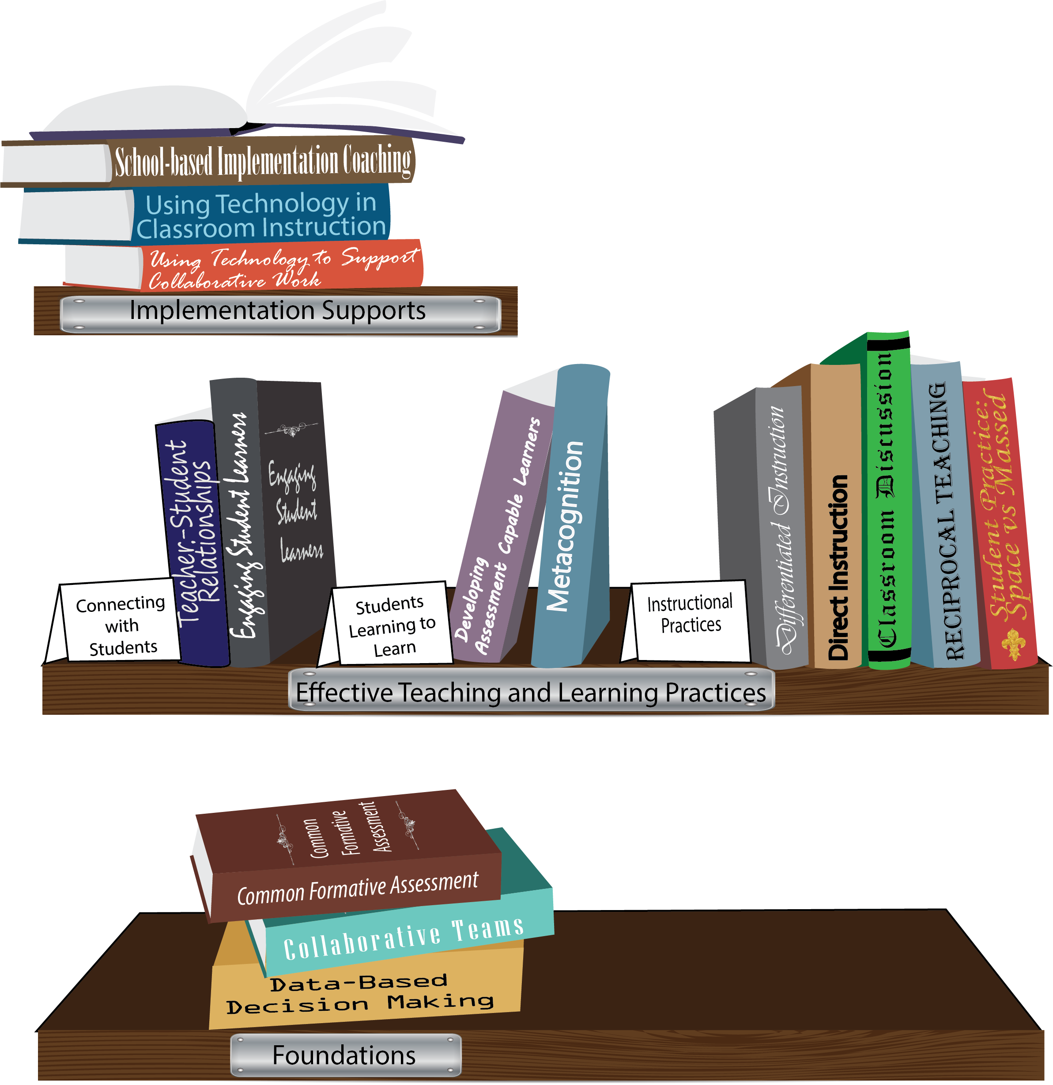
Notes:
To Know/To Say: Missouri’s professional development learning packages are organized in three categories: Foundations, Effective Teaching & Learning Practices, and Implementation Supports. All schools begin their professional development journey with the Foundations, as these learning packages provide foundation knowledge in three key areas: Collaborative Teams, Data-based Decision-making, and Common Formative Assessment. Effective Teaching & Learning Practices encompass research-based instructional practices for deepened learning. These learning packages address ways of connecting with students, ways of helping students learn how to learn, and feature specific instruction practices. Implementation Supports are learning packages designed to help school staff support and enhance the Implementation of Effective Teaching & Learning Practices through using technology and peer coaching supports.
To Do: Explain how the graphic depicts professional development in Missouri.

Slide 6
Collaborative Work Foundations
3 Key Areas
Collaborative Teams
Common Formative Assessment
Data-Based Decision Making
CFA – utilize
Quality assessments
as feedback to improve teaching & learning.
DBDM – utilize data for continuous improvement through dialogue about teaching & learning
CT – utilize team processes to improve teaching & learning.
Notes:
To Know/To Say: The learning packages forming the foundation knowledge of the Collaborative Work are Collaborative Teams, Data-Based Decision Making, and Common Formative Assessment.
Collaborative Teams (CT) utilize team processes to improve teaching and learning.
Common Formative Assessment (CFA) utilize quality assessments as feedback to improve teaching & learning.
Data-Based Decision Making (DBDM) utilize data for continuous improvement through dialogue around instruction.

Slide 7
Collaborative Teams
Overview and Purpose of
Collaborative Teams
Foundational Processes
Agendas & Minutes Norms Roles
Advanced Collaborative Processes
Protocols
Advanced Collaborative Processes
Consensus
Collaborative Skills
Protocols
Notes:
To Know: The learning package Collaborative Teams consists of Three Sections: Overview, Foundational Processes and Advanced Collaborative Process. There are seven presentations: Overview, Agenda and Minutes, Norms, Roles, Consensus, Collaborative Skills and Protocols.
To Say: Today we will focus on Protocols. Reaching consensus with decisions is an important part of effective Collaborative Teams.

Slide 8
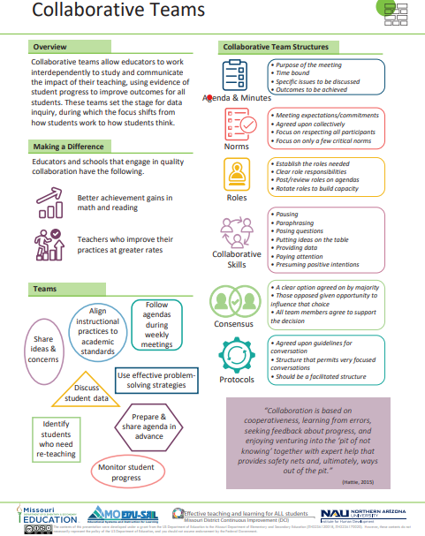
Notes:
To Know / To Say: This info graphic for Collaborative Teams can be used as either a pre reading before or at the beginning of the training. The consultant may want to use reflective questions or protocols to generate thinking prior to the training.
For example, you could pose a question to have them reflect on 1 thing they want to be able to implement or improve following the training. Or you may ask them to reflect on 1 thing they want to learn from the training about collaborative teams.
You may also want to use a protocol such as a 3-2-1 or K-W-L chart identifying what they know, what they need to know, where they need to improve, etc.
Handout: Collaborative Teams

Slide 9
Missouri Teacher and Leader Standards
Missouri Teacher Standards:
8 (Professional Practice)
9 (Professional Collaboration)
Missouri Leader Standards:
2 (Teaching and Learning)
3 (Management of Organizational Systems)
(Missouri Department of Elementary and Secondary Education, 2013)
Notes:
To Know: This slide shows how the use of Collaborative Teams relates to the Missouri Teacher and Leader Standards.
To Say:
Teacher Standard #8 Professionalism The teacher is a reflective practitioner who continually assesses the effects of choices and actions on others. The teacher actively seeks out opportunities to grow professionally in order to improve learning for all students. [SB 291 Section 160.045.2 (2) Various forms of assessment are used to monitor and manage student learning; (5) The teacher keeps current on instructional knowledge and seeks and explores changes in teaching behaviors that will improve student performance; (6) The teacher acts as a responsible professional in the overall mission of the school.]
Teacher Standard #9 Professional Collaboration The teacher has effective working relationships with students, parents, school colleagues, and community members. [SB 291 Section 160.045.2
(4) The teacher uses professional communication and interaction with the school community; (6) The teacher acts as a responsible professional in the overall mission of the school.]
Leader Standard #2 Teaching and Learning Education leaders have the knowledge and ability to ensure the success of all students by promoting a positive school culture, providing an effective instructional program that applies best practice to student learning, and designing comprehensive professional growth plans for staff.
Leader Standard #3 Management of Organizational Systems Education leaders have the knowledge and ability to ensure the success of all students by managing the organizational structure, personnel, and resources in a way that promotes a safe, efficient, and effective learning environment.

Slide 10
Objectives
Understand what protocols are and identify key elements of protocols.
Examine and evaluate examples of protocols.
Reflect on current practice and plan for use of protocols in Collaborative Team meetings.
Notes:
To Say: If we don’t know where we are headed, we won’t know when we get there. Read/paraphrase these intended objectives for this work.

Slide 11
Team Norms
Begin and end on time
Be an engaged participant
Be an active listener—open to new ideas
Use electronics respectfully
Notes:
To Say: Meetings, regardless of size or length, are more effective when meeting norms are established, practiced and monitored. These are the most common norms (read the list – paraphrasing the intent of the norm – especially noting the use of electronics indicating that if folks need to respond to calls immediately, please step out of the room; otherwise, there will be a break for checking messages/emails later). We need to be clear about our expectations in large groups and in small groups, so today, for the sake of time, these will be the norms we will follow today.”
In your Collaborative Teams, you may choose to use this list or create your own to better meet your needs. Sometimes schools create school-wide norms so that whenever small or larger groups in the school meet, the norms are the same. The point is – norms are an important part of effective teams WHEN they are honored and monitored. Creating table tents used at every meeting, or norm posters in every meeting room, or included on each agenda are ways to remind teams of the meeting norm.
Table discussion: To Say: Some schools have already established meeting norms. If you have meeting norms, are they working? Of these or your own norms, which one do you feel is the most important? Which of your norms or these listed above is the hardest one to maintain/monitor? What prompts do you use when norms in your meetings are violated?
To Do: (Give the example of using a picture of Norm Peterson to hold up when a norm is not being respected.)
To Say: If a team is not functioning effectively – the first step is to revisit the meeting norms. Are team members following the norms? If not, how can you get back on track?

Slide 12
Protocols
Thinking about the term Protocols:
Complete the What I Know and What I Want To Know columns of your KWL Chart (two minutes) and
When instructed, stand and find a partner you do not know or with whom you rarely get an opportunity to talk. Decide on who will be “A” and “B”.
A shares his/her ideas from the chart with B (no talking) (one minute)
B summarizes A’s main points back to A. (30 seconds)
B shares his/her ideas from the chart with A (no talking) (one minute)
A summarizes B’s main points back to B. (30 seconds)
3) Return to seats and add / revise your ideas to any column
Notes:
Activity
To Do:
Ask participants to create a chart with three columns:
What I know… What I want to know… What I learned…
To Know: This should be done individually on a sheet of paper. See directions on the slide. Use a visual timer, or ask participants to use a clock or watch.
To Know/To Say: Following the A/B Partner Protocol, ask participants to share their feelings about the structure of this protocol as they went through it and what they see as its purpose. Emphasize that this is an example of a quick discussion protocol which would be used in a collaborative meeting, not just a workshop. Depending upon the conversation, make the point that because participants were not allowed to discuss freely, participation is equal. Discuss this impact. For example, one person can’t monopolize the conversation, and each person needs to have done the work in order to make this successful. Also consider the regular use of a protocol like this. Using this strategy once will have little impact using it repeatedly will.

Slide 13
Definition
Protocols look at student and adult work, giving and receiving feedback, solving problems or dilemmas, observing classrooms or peers, to push thinking on a given issue, and to structure a discussion around a text.
Consists of agreed upon guidelines/norms for a conversation.
A structure that permits very focused conversations to.
Is a facilitated structure.
(Brown, 2009)
Notes:
To Say: Ask participants to evaluate the A/B protocol using this definition.
To Know: Even though it was a short protocol, it meets these criteria.
To Say: Invite discussion about their past use or non-use of protocols in meetings. Is there a time when a structure was particularly helpful, or when one would have been helpful?
National School Reform Faculty / Harmony Education Center, www.nsrharmony.org
Protocols for Professional Learning, Easton

Slide 14
“Whenever talk has important consequences, we deserve a chance to think through what we want to say, and in an environment where what we choose to say can be heard and respected.”
“In forcing transparency, protocols again teach us habits that we wish we already had; to take time to listen and notice, to take time to think about what we want to say, to work without rushing, to speak less (or speak up more).”
(McDonald, 2007)
Notes:
To Say: Add these quotes to the definition.
Discuss the impact protocols may have on a conflict ridden group, or a topic that the group knows will be contentious. Emphasize the need for planning a preparation by the facilitator, especially in beginning, to use protocols. The definition and quotes go a long way toward emphasizing “why” a group should bother to alter their behavior.
Also emphasize that protocols are beneficial to all groups, and are not a remediation strategy for ineffective groups.
The Power of Protocols: An Educator’s Guide to Better Practice, McDonald, Joseph P. (2007)

Slide 15
Read: A Rationale for Protocols:
Using the reading strategy “Left Margin / Right Margin”
As you read:
In the left margin, summarize each section of reading in 10-words or less.
In the right-hand margin, ask questions you have about the reading.
When you are finished reading, choose one key idea from your left margin and choose one key question from the right margin to share.
Notes:
Activity
To Know: 15 Minutes
Handout: A Rationale for Protocols
rationale_for_protocols.pdf (schoolreforminitiative.org)
Reference:
School Reform Initiative(2017, March 30) A rational for protocols developed by southern maine partnership[PDF] rationale_for_protocols.pdf (schoolreforminitiative.org)
To Do: The reading can be downloaded from this site, and is included with the materials.
To Know/To Say: Depending on the number of participants, you may have them share out with the whole group or at their table in a Round-Robin. Everyone talks when it is their turn, all others listen. They may share out either a main idea or question. (15 minutes)
Emphasize that Left Margin/Right Margin is another example of a protocol. Ask participants how the focused conversations used in a protocol could impact both student and teacher learning. Both should benefit.

Slide 16
Examining a Protocol
Return to the definition and quotes. Read each and underline key points you would see as standards you would look for in a protocol. (2 minutes) Then read:
The Constructivist Tuning Protocol
and
Peeling the Onion: Developing a Problem Protocol
2) As you read,
Determine if each meets the standards.
Add to your KWL Chart
Write a summary statement of your learning
Notes:
Activity
To Do: Provide participants a cop of both articles.
Handouts: Use the two protocols provided as part of the participant materials. They can be downloaded from the links below:
Constructivist Tuning Protocol
constructivist_tuning.pdf (schoolreforminitiative.org)
Peeling the Onion: Developing the Problem Protocol
peeling_onion.pdf (schoolreforminitiative.org)
To Say: Have participants share out their “What I have learned” statements from the KWL chart they created. Reflect on the knowledge gained through these materials.
Reference:
National School Reform Faculty(2009, January 1) Constructionist tuning protocol[PDF] constructivist_tuning.pdf (schoolreforminitiative.org)
National School Reform Faculty(2009, January 1) Peeling the onion developing a problem protocol[PDF] peeling_onion.pdf (schoolreforminitiative.org)

Slide 17
Tips for Effective Use of Protocols
A responsive and attentive facilitator
Protected meeting time
Norms
Make the purpose meaningful
Purposefully aligning the protocol and the purpose
Build background knowledge for all participants on the purpose and use of protocols
Model and review the protocol with participants
Follow the steps of the protocol
Allow time to reflect on the effectiveness of the protocol
(McDonald, 2007)
Notes:
To Know/To Say: Use this slide to emphasize best practice for using protocols. Allow participants time to discuss.
For those with additional questions about facilitation, this link may also be used an optional handout:
Considerations for Responsive Facilitation
responsive_facilitation.pdf (schoolreforminitiative.org)

Slide 18
Next Steps: Action=Results
Where are we in the use of protocols?
Would the use of protocols improve our collaboration?
How do we use this information?
What more do we need to know?
What are our next steps?
How should we structure our conversations?
Notes:
To Do: Participants should refer to the Next Steps Action=Results Handout to process the days training and plan for future application of this work. Documents should be shared with RPDC facilitators, and possibly other teams in the room, depending upon the audience.

Slide 19
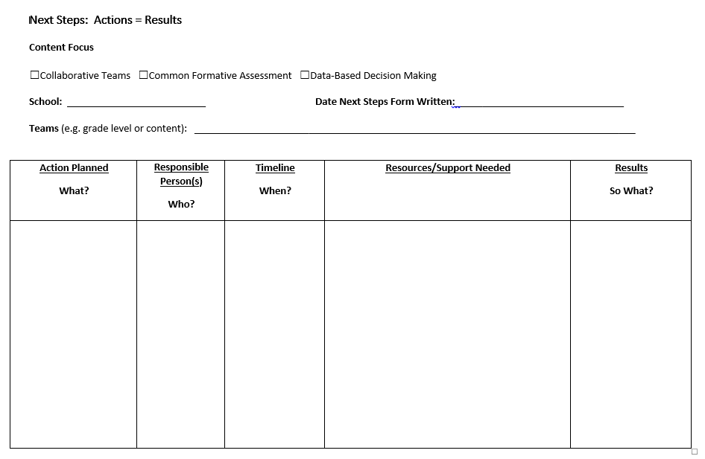
Next Steps: Action=Results
What steps will you take to begin implementing?
Notes:
To Do: Complete the Next Steps template. Example is included in the learning package materials.

Slide 20
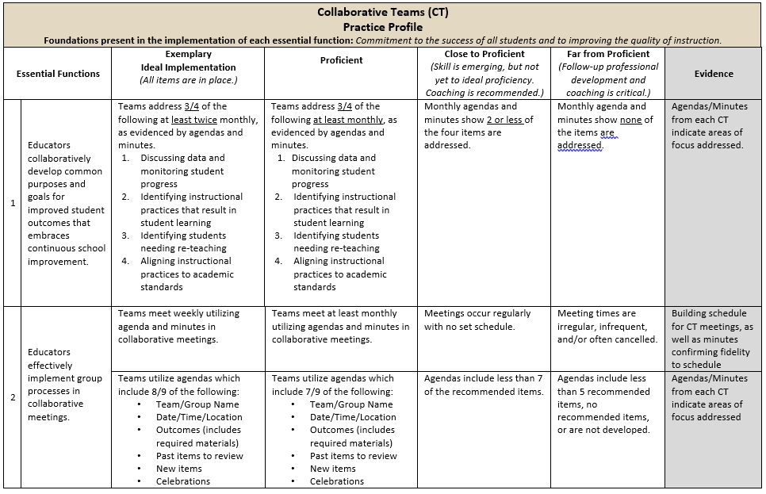
Practice Profile
Notes:
To Do: Share Practice Profile in Handouts
TO KNOW:
Full practice Profile is in Handouts
Collaborative Data Team Practice Profile
Implementation with fidelity requires clearly described implementation criteria. The Practice Profile framework has recently been developed by the National Implementation Research Network (NIRN) as a way of outlining implementation criteria using a rubric structure with clearly defined practice-level characteristics (NIRN, 2011). According to NIRN, the Practice Profile emerged from the conceptualization of the change process outline in the work of Hall and Hord’s (2006) Innovation Configuration Mapping (NIRN, 2011).
The Practice Profile template includes four pieces and is anchored by the essential functions. First, as a header is the foundation of implementation that philosophically grounds implementation. Then moving from left to right across the template are the essential functions of the practice, implementation performance levels, and lastly, evidence which provides data or documentation for determining implementation levels.
How to Use the Practice Profile
The essential functions align with the teaching/ learning objectives for each learning package. For each teaching/learning objective are levels of implementation. For some essential functions, proficient and exemplary implementation criteria are the same and in others, criteria differ. Close to proficient levels of implementation suggest the skill or practice is emerging and coaching is recommended for moving toward more proficient implementation. When implementation is reported at the unacceptable variation level, follow-up professional development in addition to coaching is recommended. The professional development provider should walk through the practice profile with the educator-learners, referring to the data and artifacts listed as suggested evidence. It is an important tool for self-monitoring their own implementation because it serves as a reminder as to the implementation criteria and is also aligned with the fidelity checklists.

Slide 21
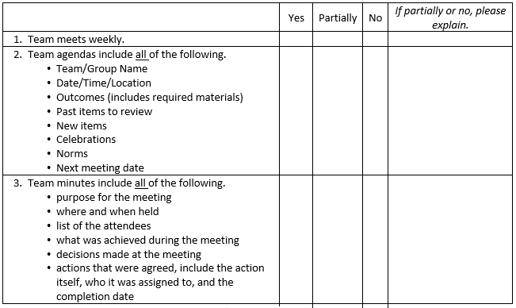
Implementation Fidelity
Notes:
To Do: Review the implementation fidelity checklist.
Handout: CT Implementation Fidelity Checklist

Slide 22
Additional Protocol Resource
http://www.tcpress.com/pdfs/mcdonaldprot.pdf

