Slide 1
Data-Based Decision Making
Behavior

Slide 2
Facilitator Notes: Delete This Slide
This slide deck contains four lessons, each separated by a section break.
The third lesson includes a “choose your own adventure;” Select the option that is best for your organization.
It is recommended that you read through the activities prior to the session; you may substitute activities that achieve the same goal (i.e., substitute one activation activity for another)
Some activities have handouts; be sure to read through the activity to decide whether you want to run off handouts, or make the information available in some other way.
Some of the DESE alignment slides are included in all lessons. These slides are redundant if presenting the lessons in order. They are therefore hidden. If presenting the slides out of order, consider unhiding these slides.

Slide 3
Data-Based Decision-Making
For Behavior
Notes:
To Know/To Say: This PLM provides instruction for using Data-Based Decision-Making to improve school climate and student behavior.

Slide 4
Table of Contents
Overview of DBDM
Schoolwide DBDM/Solution Plan
Collaborative Teams: Integrating Academic and Behavioral DBDM
Improving School Climate with DBDM
Notes:
To do/To Say: This presentation is part of facilitator materials to be used by district leadership to build capacity among district staff. This presentation provides an overview of data based decision making, provides specific adaptations for Building Leadership Teams to use Office Discipline Referral Data to develop a plans to address schoolwide behavior patterns, and adaptations for grade or content alike collaborative teams to address minor, staff managed behaviors as a grade or content alike collaborative team, or to monitor and address patterns between academic and behavioral data.

Slide 5
Attention Signal
Notes:
Trainer Notes: Select an attention signal.
To Know/To Say:
“One of our agreements is to follow the attention signal.”
“Your team will work with your school to develop an attention signal you will use in every setting.”
“In order to get all of you focused after discussions, activities or breaks,
I will ________________________________________.”
(Insert your attention signal here.)
“Your task will be to finish your sentence, quiet your voice and ____________________________.”
(Insert what you want participants to do.)

Slide 6
Working Agreements
Be Respectful
Be an active listener—open to new ideas
Use notes for side bar conversations
Be Responsible
Be on time for sessions
Silence cell phones—reply appropriately
Be a Problem Solver
Follow the decision making process
Work toward consensus and support decisions of the group
Notes:
To Know/To Say: “These will be the Working Agreements we will honor during all our training sessions this year.”

Slide 7

Welcome and Introductions
Our trainers for the day are:
Notes:
Trainer Notes: Add the name(s) of the trainer(s) to the slide.
To Know/To Say: : The introductions may be formal or informal depending on how well you know the group. Trainers should use whatever process is comfortable for introductions. I am/we are _______________ (provide some background about trainers). Please introduce yourself to the group (name, district, position).

Slide 8
Data-Based Decision Making
Overview
Notes:
To Know/To Say: This section provides a general overview of data-based decision-making, particularly as it applies to behavioral outcomes.

Slide 9
Facilitator Notes: Delete This Slide
It is recommended that you read through the activities prior to the session; you may substitute activities that achieve the same goal (i.e., substitute one activation activity for another)
Some activities have packets; prepare the activities prior to the presentation
  Activity Kit 1 Results Indicator Card Sort
Some activities have handouts; be sure to read through the activity to decide whether you want to run off handouts, or make the information available in some other way.
  HO1 DBDM-Practice-Profile-Behavior
  HO2 DBDM Protocol Matching Activity
  HO3 Essential Functions Exemplary Checklist
  HO4 Compass Points
Some of the DESE alignment slides are included in all lessons. These slides are redundant if presenting the lessons in order. They are therefore hidden. If presenting the slides out of order, consider unhiding these slides.

Slide 10

Session at a Glance
Importance
Alignment
Essential Functions
Example
Guidance
Notes:
Trainer Notes: This slide has 6 animated bullet points
To Know/To Say: This session provides an overview of questions that all good Data-Based Decision Making processes must answer, as well as Essential Functions that must be in place for schools to engage in Data-Based Decision-Making. It is applicable to all levels of decision making, from grade or content alike collaborative teams making instructional decisions to District Leadership Teams using data to develop a strategic plan. During this session, we will discuss <click> why the topic is important, <click> how it aligns with teacher/ leader standards, <click>and the essential functions of Data-Based Decision-Making, and follow with a deep dive into each of the Essential Functions. In addition, we will provide <click> an example of a collaborative team engaging in DBDM. Finally, <click> we will offer guidance for beginning DBDM in your own organization

Slide 11
Essential Questions
What makes good data-based decision-making?
How can data-based decision-making improve outcomes for students in your organization?
Notes:
Trainer Notes: Consider giving participants a chance to write down their answers or to share out their thinking.
To Know/To Say: Take a moment to review the Essential Questions on the slide. How would you answer these questions at this time?

Slide 12

Session Outcomes
At the end of this session, you will…
know how DBDM fits within the DCI Framework.
know and assess the prerequisites of DBDM.
understand the purpose of DBDM.
understand the essential features of any DBDM process.
Notes:
To Know/To Say: The purpose of this session is to provide an overview of data-based decision making, so that know what systems must be in place prior to implementing DBDM, to understand the purpose of DBDM in improving academic and behavioral outcomes, and to understand what features must be a part of any DBDM process, and use this information as you select a standard DBDM process for your organization. Future sessions will provide more detailed information of DBDM with behavior data at the schoolwide and grade or content level as the level of analysis.

Slide 13
Importance of Data-Based Decision-Making
Notes:
Trainer Notes:
To Know/To Say: Data-Based Decision-Making is important. Not only is it aligned with Missouri Teacher/Leader Standards, but, more importantly it improves outcomes for students!

Slide 14

Start with the “Why”
Mostly, it’s about creating safe, orderly places for kids to learn and grow, and…
Giving kids the soft-skills they need to be successful in life.
Decisions are more likely to be effective and efficient when they are based on data.
Establish cycles of continuous improvement.
Adapted from PBIS APPS (2016)
Notes:
Trainer Notes: This is a slide adapted from PBIS APPS SWIS facilitator Training. This slide has animations.
To Know/To Say: It is important to remember why this content is important. When a decision is based upon information, especially data, it is more likely to effectively address the true problem.
A good analogy of the importance of using data is that of the patient who visits the doctor because he is losing weight and his hair is falling out. The doctor does not immediately start the patient on chemotherapy! Rather, she runs some tests. After running the tests, she determines that the patient is not getting enough protein. Had she gone with her first impression, she would have been solving the wrong problem!
The bottom line is that when we continuously use data to solve academic and behavioral challenges, we improve outcomes for our students!

Slide 15
DCI Content Framework
Notes:
To Know: Missouri’s professional learning modules are organized in the same three categories as defined in the Content Framework. All schools begin their professional development journey with the Foundations, as these professional learning modules provide foundation knowledge in three key areas: Collaborative Teams, Data-Based Decision Making, and Common Formative Assessment. Effective Teaching & Learning Practices encompass research-based instructional practices for deepened learning. These professional learning modules address ways of connecting with students, ways of helping students learn how to learn, and feature specific instructional practices. Supportive Context contains professional learning modules designed to help school staff support and enhance the implementation of Effective Teaching & Learning Practices through using technology, leadership, and coaching supports. Data-Based Decision Making is part of the Foundations.
To Do/To Say: Before we delve into DBDM, let’s take a few minutes to review the DCI Content Framework graphic, looking specifically at where DBDM falls into the larger content.
As you see, the focus of DCI is on effective instruction leading to exceptional outcomes for all Missouri students.
The Content Framework has three main components:
Foundations (consisting of Collaborative Teams, Data-Based Decision Making, and Common Formative Assessment)
Effective Teaching and Learning Practices
Expectations & Rules;
Procedures & Routines;
Encouraging Expected Behavior;
Discouraging Unexpected Behavior;
Active Supervision;
Opportunities to Respond;
Activity Sequencing & Choice;
Adjusting Task Difficulty
Supportive Context (School Based Implementation Coaching, Collective Teacher Efficacy, and Leadership)
Reference: MoEdu-Sail. (2018). Missouri model districts framework: Blueprint for district and building leadership, second edition.

Slide 16
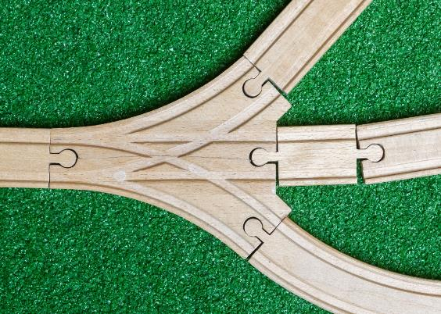
DBDM Alignment with
MO Learning Standards
Ensures students learn essential and higher order knowledge and skills as identified by the MO Learning Standards through:
  Teacher Collaboration
  Reflection
  Data Analysis
  Action Planning
  Feedback
Notes:
Trainer Notes: Hide this slide if presenting the entire PLM in one setting, or presenting along with the PLM Course Overview.
To Know/To Say: The Data-Based Decision Making module aligns with the Missouri Learning Standards because it addresses these components:
teacher collaboration
reflection
data analysis
action planning
feedback

Slide 17

DBDM Alignment with
MO Teacher Standards
This DBDM module supports the following MO Teacher Standards:
#2 Student Learning, Growth, and Development: Teachers can adapt instruction in order to effectively teach all learners
#5 Positive Classroom Environment: The teacher creates a learning environment that encourages active engagement in learning, positive social interaction, and self-motivation
#7 Student Assessment and Data Analysis: Teachers uses formative and summative assessment strategies to assess learner progress
#8 Professionalism: Teachers are reflective practitioners and use data to inform reflection
#9 Collaboration: Teachers collaborate with a shared goal of effective instruction and student learning
Notes:
Trainer Notes: Hide this slide if presenting the entire PLM in one setting, or presenting along with the PLM Course Overview.
To Know/To Say: Data-based decision making aligns with 5 of the 9 MO Teacher Standards.
Standard #2 Student Learning, Growth and Development: The teacher understands how students learn, develop, and differ in their approaches to learning. The teacher provides learning opportunities that are adapted to diverse learners and support the intellectual, social, and personal development of all students. [SB 291 Section 160.045.2 (1) Students actively participate and are successful in the learning process; (5) The teacher keeps current on instructional knowledge and seeks and explores changes in teaching behaviors that will improve student performance.]
Standard #5 Positive Classroom Environment
The teacher uses an understanding of individual/group motivation and behavior to create a learning environment that encourages active engagement in learning, positive social interaction, and self-motivation. [SB 291 Section 161.380.2 (3) The teacher is prepared and knowledgeable of the content and effectively maintains students’ on-task behavior; (5) The teacher keeps current on instructional knowledge and seeks and explores changes in teaching behaviors that will improve student performance.]
Standard #7 Student Assessment and Data Analysis: The teacher understands and uses formative and summative assessment strategies to assess the learner’s progress and uses both classroom and standardized assessment data to plan ongoing instruction. The teacher monitors the performance of each student, and devises instruction to enable students to grow and develop, making adequate academic progress. [SB 291 Section 160.045.2 (2) Various forms of assessment are used to monitor and manage student learning; (5) The teacher keeps current on instructional knowledge and seeks and explores changes in teaching behaviors that will improve student performance.]
Standard #8 Professionalism: The teacher is a reflective practitioner who continually assesses the effects of choices and actions on others. The teacher actively seeks out opportunities to grow professionally in order to improve learning for all students. [SB 291 Section 160.045.2 (2) Various forms of assessment are used to monitor and manage student learning; (5) The teacher keeps current on instructional knowledge and seeks and explores changes in teaching behaviors that will improve student performance; (6) The teacher acts as a responsible professional in the overall mission of the school.]
Standard #9 Professional Collaboration: The teacher has effective working relationships with students, parents, school colleagues, and community members. [SB 291 Section 160.045.2 (4) The teacher uses professional communication and interaction with the school community; (6) The teacher acts as a responsible professional in the overall mission of the school.] Quality Indicator 1: Induction and collegial activities. Quality Indicator 2: Collaborating to meet student needs. Quality Indicator 3: Cooperative partnerships in support of student learning.

Slide 18
DBDM Practice Profile
Notes:
Trainer Notes: This is HO1: The DBDM for Behavior Practice Profile.
To know/To Say: The Missouri DESE has developed a practice profile to guide teams as they develop DBDM, and to assist them in a self-reflective process whereby they can evaluate their level of proficiency, and identify next steps toward continuous improvement. The Practice Profile is divided into Essential Functions, Proficiency levels, and criterial that define the essential function at each proficiency level.
Practice Profiles are designed to assist teams to implement the evidence based practice, and to self-reflect on the quality of this implementation

Slide 19

DBDM Practice Profile Essential Functions
Educators establish collaborative process for collecting data.
Educators implement a process for examining and interpreting data.
Educators determine action steps.
Educators use implementation and student outcome data to determine next steps.
Notes:
Trainer Notes: Hide this slide if presenting the entire PLM in one setting, or presenting along with the PLM Course Overview.
To Know/To Say: In addition, notice that the Essential Functions of the Practice Profile are directly aligned with the questions that every DBDM process must address, as well as the steps of the GAINS decision-making framework.

Slide 20



Partner Activity/Team Activity
Review the exemplary criteria for each of the Essential Functions.
Put a “+” next to each that you feel is in place.
Put a “-” next to each that you feel is not in place.
Put a “?” next to those that you are unsure what is meant.
As we go through the presentation, place a “✓” next to those that we discuss.
Notes:
Trainer Notes: Provide individuals with HO1: The DBDM for Behavior Practice Profile. Instruct them to individually, with a partner or as a team to mark indicate whether each item is in place, and their familiarity with what is meant. They can also refer back to the practice profile to mark off items that are discussed as we go through the presentation.
To Know/To Say: Individually or with a partner, take a moment to look over the criteria for “Exemplary” on the DBDM Practice Profile.
For each of the criterion:
Put a “+” next to each that you feel is in place
Put a “-” next to each that you feel is not in place
Put a “?” next to those that you are unsure what is meant
As we go through the presentation, place a “✓” next to those that we discuss

Slide 21
Reflective Questions
What are the areas that provide opportunities for improvement in your school? How did you identify them? What criteria did you use to select them?
How do you identify action steps most likely to result in achieving important school or district goals?
How do you know if your plans are having the desired impact on important student outcomes?
What do you do if your efforts are not having the desired effect?
Notes:
To Know/To Say: Take a moment to look over these questions. For the next 5-minutes, turn to a shoulder partner and discuss how you would answer the question at this time.

Slide 22
Overview of Data-Based Decision Making
Notes:
Trainer Notes:
To Know/To Say: Before we dig into DBDM, let’s take a moment to remind ourselves just how much we already know!

Slide 23

DATA COLLECTION
  MORE THAN JUST RECORD KEEPING;
  IT’S ABOUT MAKING DECISIONS WITH THE DATA!
Notes:
Trainer Notes: This slide has animations
To Know/To Say: If you leave with nothing else from today’s session, it is that this is NOT about collecting more data! Rather, the Big Idea is that we need to collect Actionable Data and use this data to make decisions that improve outcomes for students!

Slide 24

Pre-Requisites
Establish Collaborative Teams.
Utilize Efficient and Effective Team Processes.
Select a Data Management System.
Develop and implement procedures for
  Collecting data.
  Entering data.
  Running reports.
Notes:
To Know/To Say: Before we go any further, there are several prerequisites that need to be in place in order to make good decisions with data. First, you have to establish teams that can make effective decisions for their level of analysis. A building level team makes decisions with the school as the level of analysis, while a collaborative team uses data specific to their grade level or content area to identify common problems or challenges affecting student outcomes, and make decisions that address these problems.
In addition, you have to have the data readily available. We strongly recommend that schools select an electronic data management system that collects and reports both academic and behavioral data. While these can be separate systems, if necessary, it is probably best to select an integrated system. When selecting a system, consider price, ease of data entry, ease of reporting, and the capacity of the system to filter out irrelevant data in order to simplify data analysis. Also, consider using PBIS Assessments. This online survey site allows your team or your staff to take surveys that measure implementation fidelity. Furthermore, the students can take school climate surveys. The site allows for school-based team members to pull a variety of reports
Finally, once you have such a system, you will need to identify procedures and persons responsible for collecting the data, entering it into the electronic data management system, and running reports.

Slide 25

Think, Pair, Share
Do teams meet regularly and frequently?
Do your teams use efficient and effective team processes?
Does your school have a data management system?
Do you have procedures for collecting, entering and reporting data?
Notes:
To Know/To Say: With a partner, discuss the prerequisites currently operating at your school. Do you have a building leadership team in place? Do grade or content alike collaborative teams meet regularly to problem solve around improving student outcomes? Does your school have a data management system or systems that allow for the collection and reporting of academic and behavioral data? Finally, do you have efficient and effective procedures in place for entering and reporting academic and behavioral outcome data, and implementation data.

Slide 26

Activity: Head Bands
triangualte
Notes:
Trainer Notes:
This activity is an adaptation of the children’s game, “Headbands.” In this game, participants pair up. Partner 1 describes a component of the main topic to his or her partner, without actually naming it. Partner 2 must name the component based on these clues. When Partner 2 guesses the correct component, the pair moves on to the next component on the list. This game can be used to activate prior knowledge, to honor what the participants already know about the topic, or as a closing activity to solidify session learnings.
Identify components related to the topic of the presentation
Divide the components into two lists, with half of the components on one list, and half on the other
Put each of the two lists on two different PowerPoint slides
Partner 2 will stand with his or her back to the slides
Partner 1 stands so he or she can see the slides
The first list will flash on the screen. Partner 1 describes the component to his or her partner without saying the word. When Partner 2 names the correct component, the pair moves on to the next item on the list and repeats the process. Once Partner 2 names all of the components on the list, both partners turn and face the screen. A variation is to set a time limit.
Once time is called, or all pairs have made it through the list, partners trade places, and the game is played again, using the second list.
To Know/To Say: Those of you who have ever been related to young children may be familiar with the game of headbands. We are going to play a variation of this game.
Select a partner.
One partner will have his or her back to the powerpoint. The other partner faces the slide
The partner facing the powerpoint will describe the first word without actually naming it.
The partner with his or her back to the slide must name the word.
Once the partner with her back to the slide correctly identifies the key term, move on to the next word.
Keep track of how many words you name before time is up. You have 5 minutes!
We will then trade places and go through the words on the second slide.

Slide 27
Key Terms
Analyze:
Contextual Data:
Contextual Fit:
Data-Based Decision-Making (DBDM):
DBDM/Meeting Protocol:
Effective Teaching and Learning Practice (ETLP):
Evaluate:
Evidence-based Practice:
Notes:
Trainer Notes:
To Know/To Say: Take a moment to read through the key terms on this and the next slide. Most should be familiar to you. Are there any that are unfamiliar?

Slide 28
Key Terms
Fidelity Data:
Implementation Data:
Office Discipline Referral (ODR):
Outcome Data:
Problem:
Progress Monitor:
Results Indicators:
Notes:
Trainer Notes: Show this powerpoint when the partners change positions, so that partner 2 now has his or her back to the slide.
To Know/To Say:

Slide 29

We need
The Right Data
At the Right Time
For the Right People
In the Right Format
Adapted from Thomas Gilbert, 1978
Notes:
To Know/To Say: To use data for decision making, we cannot keep collecting all possible data. However, we do need to have available certain high leverage, actionable data that can lead to better decisions, and we need it when we need it! The teams that make decisions for a given level of analysis need access to the data pertinent to that level of analysis. Finally, the data needs to be reported in easy to read, graphic format

Slide 30
Cause
Effect
Notes:
Trainer Notes: This slide is animated.
To Know/To Say: Data based decision making is empowering! It rejects the idea that student outcomes are rooted in something inherent in the student or otherwise outside of our control! Rather, it is based on the notion that adult actions influence student outcomes. To truly leverage DBDM, we cannot just monitor student outcomes, we also have to monitor the actions of adults that impact those outcomes. After all, how will we know whether our plan is working if we do not know whether we are implementing our plan?

Slide 31
Types of data
Implementation
Outcomes
PBIS Apps 2016
Notes:
Trainer Notes: This slide is animated; This slide was adapted from PBIS Apps Swift at SWIS training
To Know/To Say: Therefore, there are two kinds of data we want to pay attention to:
Implementation or the extent to which implement action steps identified in the plan. In other words, Adult Behaviors or cause data.
a. Fidelity Data is a special case of implementation data; fidelity data refers evidence that a program, initiative, practice or intervention has been implemented as designed.
Outcome data tells us about the impact that our current systems and practices are having on students. In other words, Kid Behaviors or effect data

Slide 32

Leadership for Learning Framework
Lucky High results Low understanding of antecedents Unlikely to replicate results | Leading High results High understanding of antecedents Replication of results likely Continued improvement likely
Losing Ground Low results Low understanding of antecedents Replication of failure is likely | Learning Low but improving results High understanding of antecedents Continued improvement likely
Leadership for Learning Framework
Lucky High results Low understanding of antecedents Unlikely to replicate results | Leading High results High understanding of antecedents Replication of results likely Continued improvement likely
Losing Ground Low results Low understanding of antecedents Replication of failure is likely | Learning Low but improving results High understanding of antecedents Continued improvement likely
Adapted from Reaves (2006)
Notes:
Trainer Notes: This slide was adapted from Reeves, 2006
To Know/To Say: Some of you may be familiar with this 4x4. It came out of the PLC literature, and was adopted by PBIS Apps for their SWIFT at SWIS training. This captures the idea behind data based decision making. Schools that do not use data for decision making tend to fall in the lucky or losing ground quadrant. Either they are getting poor results and don’t know why or what to do to change turn things around, or they are getting good results, but they don’t know why and cannot replicate them. When we start using our data, hopefully we move into the learning and leading quadrants. In the learning quadrant, we are beginning to understand the causal relationships that our data help us to identify, but we aren’t getting the results we want, yet. Once we move into the leading category, we are effectively using data to identify causal relationships, identify strategies that will help us to achieve the desired outcomes, and to begin to achieve those results.

Slide 33
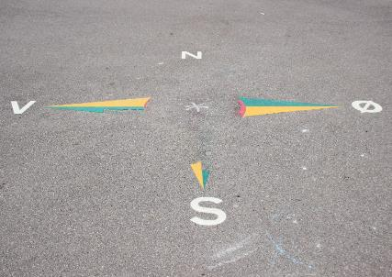
Activity: 4 Corners
Is your school losing ground, lucky, learning or leading?
  Go to the corner that best describes where you feel your school/organization falls.
  Have a group discussion with your corner mates describing your rationale/evidence for your determination.
Leading
Lucky
Learning
Losing
Notes:
Trainer Notes: Designate a corner or area of the room for each of the four quadrants. It is helpful to place signs up ahead of time.
To Know/To Say: On my signal, go to the corner where you feel that your school or district is on the Leadership for Learning Framework. Once there, have a group discussion with your corner mates describing your rationale or evidence for placing your school or district in that quadrant. If you have time, discuss what your organization needs to do to move to the next quadrant, unless you are in the Leading Quadrant. In that case, discuss what your next steps are.

Slide 34
PBIS Logic Model/Interconnected Elements
OUTCOMES
SYSTEMS
DATA
PRACTICES
Notes:
Trainer Notes: This slide has animations
To Know/To Say: This diagram is often used in SW-PBS to describe the relationship between Systems, Data, Practice, and Outcomes. They are often described as interconnected. However, one way to think about or interpret it is as a cyclical, iterative process. We start with our desired outcomes; what is it we want for our students? A safe and orderly learning environment? Positive behavioral outcomes? Next, we review our data to determine whether there is a disconnect between what we want for our students, and what we are currently experiencing. Furthermore, we analyze the data to determine causal relationships between what we are currently doing and the results we are currently experiencing. Based on this analysis, we select the practices that will help us to achieve the desired results for our students. Next, we develop systems to support staff as they implement practices. Finally, we review our data, again, to determine if a) we actually implemented the practices, and b) our efforts produced the desired outcomes.

Slide 35
Is there a problem?
Why is the problem happening?
What can be done about the problem?
Did the intervention work?
Is there a problem?
Why is the problem happening?
What can be done about the problem?
Did the intervention work?
Tilly 2008
Notes:
Trainer Notes: This slide is animated.
To Know/To Say: We encourage all schools to use a Data-Based Decision Making protocol. A DBDM protocol are the standard steps or process that a team takes to make decisions from data. In 2008, Tilly identified 4 questions that must be answered through a decision making protocol. This is similar to the way I just described the systems, data, practices, and outcomes graphic we just discussed.
The first of these four questions is: Is there a problem? A more positive way of asking this question might be: “Is there an opportunity to improve?” Answering this question typically requires a review of data related to meaningful student outcomes.

Slide 36
Is there a problem?
Why is the problem happening?
What can be done about the problem?
Did the intervention work?
Tilly 2008
Notes:
To Know/To Say: The second question that all good DBDM processes must ask is “Why is the problem happening?” Answering this question typically requires an analysis of the data, particularly in relation to adult actions.

Slide 37
Is there a problem?
Why is the problem happening?
What can be done about the problem?
Did the intervention work?
Tilly 2008
Notes:
To Know/To Say: The third question of any good DBDM process is “What can be done about the problem?” Answering this question typically involves identifying evidence based practices or strategies that directly address the cause of the problem.

Slide 38
Is there a problem?
Why is the problem happening?
What can be done about the problem?
Did the intervention work?
Tilly 2008
Notes:
To Know/To Say: The final question that must be answered is, “Did the intervention work?” Implied in this question is a formative process of determining whether the intervention is working, as well as a final evaluation to determine whether the intervention worked as intended. Both the formative and evaluative functions involve collecting data on the progress students are making toward the desired outcome, as well as data on the extent to which adults are implementing the plan as intended.

Slide 39
DBDM Practice Profile Essential Functions
Educators establish collaborative process for collecting data.
Educators implement a process for examining and interpreting data.
Educators determine action steps.
Educators use implementation and student outcome data to determine next steps.
Notes:
To Know/To Say: Notice that the Essential Functions of the Practice Profile align pretty closely with the questions that every DBDM process must address.

Slide 40
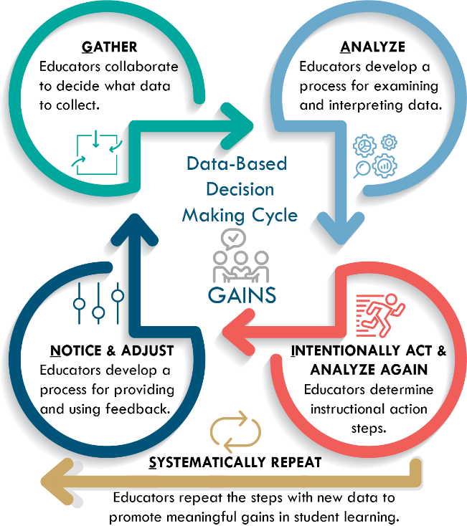
GAINS
Notes:
To Know/To Say: In addition, DESE has adopted the GAINS acronym as a teaching tool to help individuals to learn and understand the Essential FUnctions. Each of the four steps of GAINS aligns with the Essential Functions. The four components of GAINS are:
Gather as a team and gather data relevant to the question you are trying to answer
Analyze the data to identify the cause of observations
Intentionally Act and Analyze again refers to selecting a strategy that addresses the root cause, implementing the strategy, monitoring the strategies impact, and modifying the plan as needed.
Notice and Adjust refers to using data evaluate the plan and determine next steps
Systematically Repeat to establish cycles of continuous improvement

Slide 41
Is there a problem?
Why is the problem happening?
What can be done about the problem?
Did the intervention work?
Notes:
To Know/To Say: Essential Function 2 requires that team’s use a standard protocol for making Data-Based Decisions. Remember, any standard protocol must answer these questions. Also, keep in mind that the essential functions align with these questions.

Slide 42
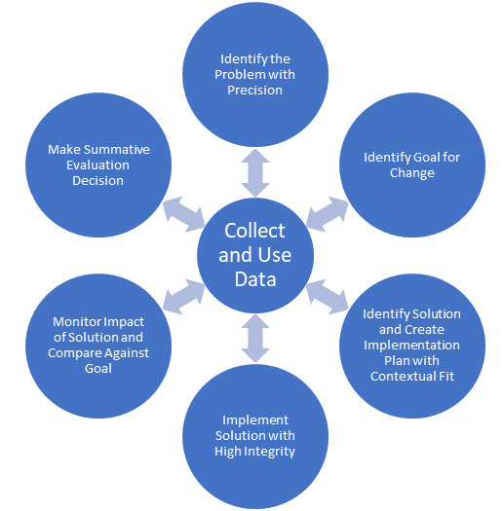
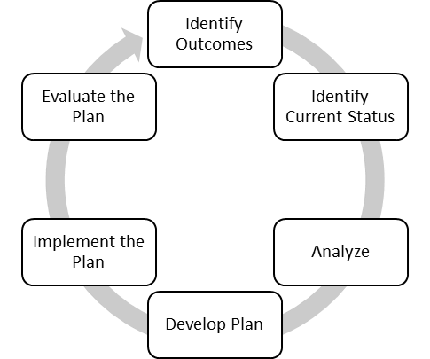
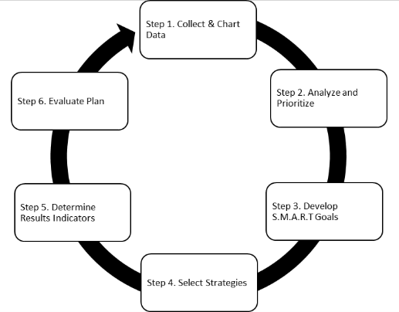
DBDM Protocols
MO SW-PBS Decision Making Model
National Center on PBIS T.I.P.S.
Leadership and Learning Data Teams
Notes:
Trainer Notes: Participants can work individually or in pairs to complete HO2 DBDM Protocol Matching Activity. An alternative is to have each individual or pair select one of the three protocols, and complete the matching activity for that protocol, only.
To Know/To Say: There are many different DBDM protocols that you can choose from. Three are shown on the screen. Using HO2 DBDM Protocol Matching Activity, match the Essential Function and the 4 questions that Tilly identified with the steps on the DBDM protocols.

Slide 43

Think, Pair, Share
Does your school or district currently use a DBDM?
Does your DBDM lead to answers of the following questions?
  Is there a problem?
  Why is there a problem?
  What can be done about the problem?
  Did the intervention work?
Notes:
To Know/To Say: Turn to a partner and discuss the following: Does your school or district currently use a data-based decision making decision-making framework? Does your model address the 4 questions:
Is there a problem?
Why is there a problem?
What can be done about the problem?
Did the intervention work?

Slide 44
Unpacking Data Based Decision Making
For Behavior
Notes:
Trainer Notes:
To Know/To Say: In this section, we will use the Essential Functions and GAINS as a structure for better understanding Data-Based Decision-Making

Slide 45
EF1: Educators establish collaborative process for collecting data.
Notes:
To Know/To Say: The first essential function is “Educators establish collaborative process for collecting data.” This aligns with the first
step of the GAINS decision-making framework: “Gather”. This refers to gathering as a team, and gathering data relevant to the question that you are trying to answer. We review data and identify the challenge or problem to solve.

Slide 46

Gather as a Team
Notes:
To Know/To Say: The first part of Essential Component 1 is gather as a team. This refers to any collaborative team, including grade or content alike teams, building leadership teams, or district leadership teams. Gathering together as a team involves utilizing effective team processes to make meetings efficient and effective. This information is covered in detail in the Collaborative Team PLM on the VLP. Therefore, we won’t spend any time on it, here. Please refer to the Collaborative Team PLM for more information.

Slide 47

Gather Relevant Data
Notes:
To Know/To Say: The second part of the first essential function deals with gathering data! Gilbert (1978) tells us we need the Right data at the Right time and in the Right format.

Slide 48

Enter with a Question
Do students feel safe at school?
Are all students disciplined equitably?
Are we over-relying on exclusionary discipline?
Are students attending school at high rates?
Are students graduating on time?
Notes:
To Know/To Say: The right data will depend on what questions you want to answer. Select data sources that will answer the question.

Slide 49

Think, Write, Pair, Share
What Data?
Do students feel safe at school?
Are all students disciplined equitably?
Are we over-relying on exclusionary discipline?
Are students attending school at high rates?
Are students graduating on time?
Notes:
To Know/To Say: Read the questions on the slide. What data sources could help you to answer each of these questions? Write your answers on a piece of paper. Turn to a shoulder partner and share your answers.

Slide 50
EF2: Educators implement a process for examining and interpreting data.
Notes:
To Know/To Say: The second essential function is “Educators implement a process for examining and interpreting data.” This essential function corresponds to the GAINS component of “analyze,” and involves two steps: Use the data to identify a problem or opportunity for growth, and utilize a standard protocol to analyze the data in order to identify a possible root cause of the problem.

Slide 51

Identify Opportunities
Do students feel safe at school?
Are all students disciplined equitably?
Are we over-relying on exclusionary discipline?
Are students attending school at high rates?
Are students graduating on time?
Notes:
To Know/To Say: To identify an opportunity for growth, review the data that you gathered to help you answer your questions. How does your current reality compare to your desired outcomes. What are some areas that present opportunities for improvement?

Slide 52
Select an Opportunity for Growth
Important for students in school and in life
Moves toward an important school or district goal
Contextual fit
Small in number
Biggest change for the effort
Horner 2011
Notes:
To Know/To Say: Even in the best run organizations, there are opportunities for improvement. In most cases, there are many such opportunities. There is a saying that when everything is a priority, nothing is. Where should we focus our attention, first?
There can be many factors that you consider when selecting this opportunity for improvement on which you want to focus your efforts. Would achieving this goal result in an outcome that is important for students in terms of school or life success. Is it related to an important state, district or school goal. Is it contextually relevant? In other words, is it personally important to the students and their families.
Whatever you select, it is probably wise to keep your goals small in number. You don’t want to take on more goals than you or your staff can handle at a given time.
Finally, consider Dr. Rob Horner’s advice to select a goal that will give you the biggest change for the least amount of effort. This can give you some early wins that will help motivate the staff.

Slide 53

Data Analysis
Notes:
To Know/To Say: Once you have used data to identify an opportunity to improve, you will want to analyze data related to the problem. Analysis is a detailed examination of the structure or elements of something. Data analysis involves using filters to remove extraneous data, so as to identify or better define a problem, and to compare different sources of data to gain a clearer picture of why a problem is occurring.

Slide 54

Partner Activity
Think of a time when you analyzed data:
  Did you use data to understand why something was happening?
  Did you use a specific data analysis technique or protocol? What was it?
Notes:
To Know/To Say: With a partner, discuss a time when each of you were engaged in some sort of data analysis. It does not have to be school related, but can be. Did the data analysis help you to understand why something was happening? Did you use a specific data analysis technique or protocol? What was it? Be prepared to share out.

Slide 55
EF 3: Educators determine action steps.
Notes:
To Know/To Say: Once the team has a fairly good idea of the root cause, they are ready for Essential Function 3: Educators determine action steps. This aligns with the third component of GAINS: intentionally act, and analyze again. The purpose of this step is to select evidence based strategies or practices that address the root cause of the problem or challenge that the team is trying to solve, and frequently review implementation and outcome data to monitor progress and make any necessary mid-course corrections.

Slide 56

Select Change
Evidence-based
Directly addresses root cause
Contextual fit
Capacity
Notes:
To Know/To Say: When selecting an action step to address the problem, look for a practice or strategy for which there is evidence to support its use in solving the specific problem, preferably with a population similar to your target population. In addition, you will want to consider “Contextual Fit.” In other words, do the individuals who will implement the strategy or practice values. Finally, do you have the capacity (time, skills, knowledge base, resources) to implement the action steps?

Slide 57

Develop Systems
Communicate
Train
Coach
Reinforce
Correct
Resources
Notes:
To Know/To Say: As you consider action steps or tasks that need to be completed to put the strategy or practice in place, you may want to consider systems that will support those individuals responsible for implementing the new practice or strategy. How will you communicate plans? How will you train and coach implementers? How will you reinforce implementers as they learn new skills? What resources will you provide them to make implementing easier and more efficient?

Slide 58



Create a Plan
Goal
Practice/strategy
Action steps
Resources
Person(s) responsible
Timeline
Evidence of completion
Notes:
To Know/To Say: Once you have identified a goal and selected an appropriate practice or strategy, it is important to put it into an action plan format. While there are a variety of action plan formats you can select, a good action plan identifies what you are trying to do, how you will do it, who is responsible for what, and when will it be accomplished. In addition, you may want to consider what additional resources will be needed and identify how you will know when a given action step or series of action steps have been completed.

Slide 59

Implement Change
Notes:
To Know/To Say: The number one reason why a plan fails is that it was never implemented! Implement the plan! As you implement, hold yourselves accountable to your action plan by meeting periodically to monitor plan implementation and progress toward your goal.

Slide 60
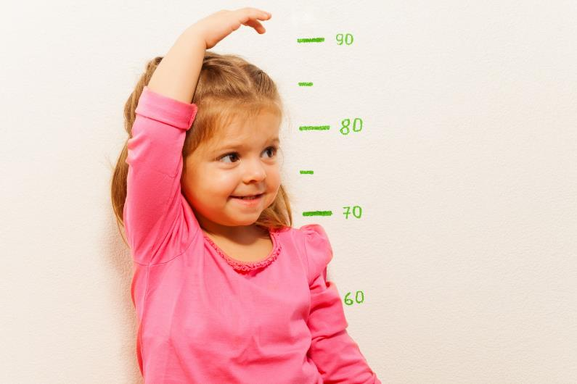
Monitor Progress
Notes:
To Know/To Say: Progress monitoring involves reviewing two pieces of data, one that measures whether the adults are implementing important components of the plan, and whether students are making adequate progress toward the goal.

Slide 61
Did we implement the plan?
Yes
No
Did we find the right root cause?
Did we address the right root cause?
Are there obstacles to implementation?
Yes
No
Yes
Modify plan to better address cause.
No
Go back to data to determine root cause.
Address obstacles.
Implement plan.
Notes:
To Know/To Say: If you are not making adequate progress toward your goal, you can use this decision tree to guide next steps.
Are we making adequate progress?
Yes: keep doing what we are doing
No: Did we implement the plan?
Yes
Did we find the right root cause?
Yes
Modify the plan to better address the root cause
No
Go back to data to identify the correct root cause
No
Are there obstacles to implementation
Yes: address the obstacles
No: Implement the plan

Slide 62
Implementation Data | Outcome Data
Provide opportunities to respond
Count of unexpected behavior
Teaching Lesson Plan
Count of unexpected behavior
Provide performance Feedback
Modeling
Assignment Completion
Assignment Completion
Reading Comprehension Scores
Scores on a Common Formative Assessment
Time on Task
Rate of Positive Reinforcement
Actively Supervise
Rate of Positive Reinforcement
Average Daily Attendance
Notes:
Trainer Notes: Prepare Activity Kit 1: Results Indicator Card Sort Activity (one for set for every participant)
To Know/To Say: Sort the list into the appropriate category: is this implementation data (what the adults do) or outcome data (what you observe in students). Compare your list with that of a partner.
Variation: Have them work in teams or pairs

Slide 63

EF4: Educators use implementation and student outcome data to determine next steps.
Notes:
To Know/To Say: The fourth essential function, Educators use implementation and student outcome data to determine next steps, corresponds to the 4th and 5th components of GAINS: Notice and Adjust, and Systematically repeat. This refers to using data to evaluate the effectiveness of our plan, and select next steps based on this evaluation

Slide 64
Evaluate Plan
 | Goal not met | Goal met
Plan not implemented | Are there obstacles to implementation? Yes: Modify plan to eliminate the obstacles. No: Implement the plan. | Look at data to determine why the goal was achieved, so you can replicate.
Plan implemented | Re-analyze data; develop an alternate hypotheses; modify the plan to address the alternative hypothesis. | Plan for sustained implementation. Return to data to identify a new problem to address.
Notes:
To Know/To Say: This table shows a decision making rubric for evaluating the plan and determining next steps. This will work with any plan, academic or behavior. It is based on two questions: Did we meet our goal? And Did we implement our plan?
If the Goal was not met and the team did not implement with fidelity, then the team must determine whether there were obstacles to implementation. If so, they should modify the plan and try again. If there were no obstacles, then the team needs to implement their plan.
If the goal was not met and the team implemented the action steps with fidelity, then they should reanalyze the data and reassess whether they identified the correct problem and whether their action steps were aligned with the problem
If they met their goal, but they did not implement their plan, they may want to go back to the data to determine why the goal was met. This may help them to avoid or solve problems in the future.
Finally, if the goal was met, and they implemented the plan with fidelity, then they should go back to the data and begin the cycle again with a new focus problem. This proactive approach to solving problems will help the team to establish cycles of continuous improvement.

Slide 65
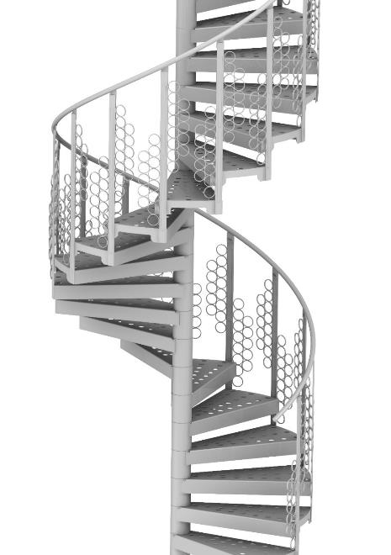
Then we systematically repeat…
Creating cycles of continuous improvement.
Notes:
To Know/To Say: Once the team has evaluated the plan, they start the cycle again, reviewing data to identify the next problem to solve. This usually occurs at the next data meeting following the end of a data cycle. Thus establishing cycles of continuous improvement.

Slide 66
DBDM in Practice
Notes:
To Know/To Say: Now lets eavesdrop on a collaborative data team at work!

Slide 67
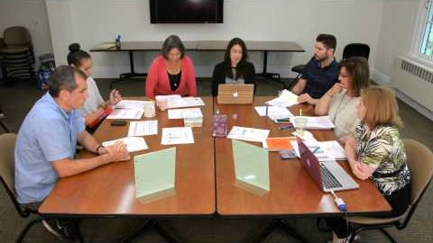
A Team Using TIPS: Tier 1 Coordination Meeting. Institute of Educational Sciences, University of Oregon.
Notes:
Trainer Notes: Provide teams with HO3 Essential Functions Exemplary Checklist. Provide the team with 5 minutes to read over it. Depending on the sophistication of the team, you may want them to focus on the first two essential functions, to narrow their focus.
To Know/To Say: Read through the HO3 Essential Functions Exemplary Checklist. As you watch this video, use the HO1: The Essential Functions Checklist to check off components of each of the Essential Functions that you see.

Slide 68
DBDM in Action
Notes:
To Know/To Say: Now that we know something about data teams, what are our next steps for using data to make decisions in our organization?

Slide 69

Compass Points
Excites | Worries
Need to Know | Next Steps
Adapted from Ritchhart, R., Church, M., and Morrison, K. (2011).
Notes:
Trainer Notes: For this activity, participants can write in HO4 Compass Points, type in a google form or answer the questions with a partner. Alternatively, you can provide a piece of chart paper to each team. They divide their paper into four quadrants, labeling them E, W, N, and S. As a team, they fill in each segment with what Excites them, what Worries them, what they Need to know, and what their next Steps are.
To Know/To Say: As a team, complete compass points activity on a piece of chart paper. In the East quadrant, write what excites you; in the West Quadrant write what worries you. In the North Quadrant, write what you still need to know, and in the South quadrant, record your team’s next steps.

Slide 70
DBDM Closing and Next Steps
Notes:
To Know/To Say: No that you have an overview of DBDM, what are your next steps?

Slide 71

Closing and Next Steps
Notes:
To Know/To Say: During this lesson, you learned general information about Data-Based Decision-Making
How will you get staff at all levels of the organization to engage in Data-Based Decision-Making?
Next steps include updating your action plan. Develop action steps for engaging in DBDM at all levels of the organization.
Additional information about Data-Based Decision-Making can be found in the MO SW-PBS Handbook and the MO SW-PBS Tier 1 Implementation Guide.

Slide 72

Additional Training Opportunities
Schoolwide DBDM to Improve Behavioral Outcomes for Students
Using Academic and Behavioral Data for DBDM in Grade or Content Alike Collaborative Teams
Achieving District/School Climate and Behavior Improvement Goals through DBDM
Coming Soon!
Notes:
To Know/To Say: There are a number of training opportunities related to DBDM around behavior that you can take advantage. All are available on the DESE VLP. Materials are also available for download for your to use to train staff in your school or district.

Slide 73

Make a Commitment
What will you commit to?
Tell a partner.
Notes:
To Know/To Say: Based on the information you have received, take a moment to share with a partner something you are willing to commit to, now. It can be as simple as gathering more information or assessing your data management system

Slide 74

Questions & Contacts
Name(s) and Contact Information
Notes:
Trainer Notes: Add names and contact information of the presenter(s) in the text box. Use this time to check for understanding and questions

Slide 75
References
Bernhardt, V. (1998) . Data Analysis for Comprehensive School Improvement. Eye on Education: Larchmont, New York.
Gilbert, T.F. (1978). Human competence: Engineering worthy performance. New York : McGraw-Hill.
Gresham, F. M., Sugai, G., & Horner, R. H. (2001). Interpreting outcomes of social skills training for students with high-incidence disabilities. Exceptional Children, 67(3), 331-344.
Horner, R. (March 8, 2016). Personal Communication.
Horner, R.H. (2011). Moving PBS forward with quality, equity and efficiency. Keynote: Eighth International Conference of the Association for Positive Behavior Support. Denver: CO.
Metz, A. & Louison, L. (2018) The Hexagon Tool: Exploring Context. Chapel Hill, NC: National Implementation Research Network, Frank Porter Graham Child Development Institute, University of North Carolina at Chapel Hill. Based on Kiser, Zabel, Zachik, & Smith (2007) and Blase, Kiser & Van Dyke (2013).retrieved on 5-13-2020 from https://nirn.fpg.unc.edu/resources/hexagon-exploration-tool.
PBIS Apps (2016). Swift at SWIS. University of Oregon.
Ritchhart, R., Church, M., Morrison, K. (2011). Making Thinking Visible: How to promote engagement, understanding, and independence for all learners. San Francisco, California: Josey-Bass
Reaves, D.A. (2006). The learning leader: How to focus school improvement for better results. Association for Supervision and Curriculum Development:Alexandria, Virginia.
Scott, T., Anderson, C., Alter, P. (2012). Managing classroom behavior using positive behavior supports. Pearson:Upper Saddle River, New Jersey.
Sugai, G., Sprague, J.R., Horner, R.H., & Walker, H.M. (2000). Preventing school violence. The use of office discipline referrals to assess and monitor schoolwide discipline interventions. Journal of Emotional and Behavioral Disorders, 9(2), 94–101.
Tilly, W. D. (2008). The evolution of school psychology to science-based practice: Problem-solving and the three-tiered model. In A. Thomas & J. P. Grimes (Eds.), Best practices in school psychology V (pp. 17-36). Bethesda, MD: National Association of School Psychologists.

Slide 76
Schoolwide Data Based Decision-Making
To Improve Behavioral Outcomes for Students
Notes:
To Know/To Say: This lesson focuses on using office discipline referral (ODR) data to plan schoolwide interventions that improve student behavior and school climate, overall.

Slide 77
Facilitator Notes: Delete This Slide
It is recommended that you read through the activities prior to the session; you may substitute activities that achieve the same goal (i.e., substitute one activation activity for another).
Some activities have handouts; be sure to read through the activity to decide whether you want to run off handouts, or make the information available in some other way.
  HO5 3, 2, 1, Bridge
  HO6 DBDM-Solution Plan (Draft 5-20-19)
  HO7 ODR Checklist
  HO8 Replacement Behaviors
  HO9 Results Indicators
  HO10 DBDM-Solution Planning Video Guided Notes
  HO11 SWOT
Some of the DESE alignment slides are included in all lessons. These slides are redundant if presenting the lessons in order. They are therefore hidden. If presenting the slides out of order, consider unhiding these slides.

Slide 78
Session at a Glance
Importance
Alignment
Essential Functions
Example
Guidance
Notes:
Trainer Notes: This slide has 6 animated bullet points
To Know/To Say: This session provides information about how a schoolwide team can use Office Discipline Data (ODR) for data-based decision-making (DBDM) leading to improved school climate and schoolwide student behavior. We will begin by discussing <click> why this is important for students. We will briefly review how Schoolwide DBDM using ODR data <click> aligns with Missouri Teacher/Leader Standards. We will then <click> use the Essential Functions of DBDM and the GAINS acronym to dig into how Schoolwide DBDM with ODR data is used in schools. We will provide an example of DBDM in a real school. Finally, we will offer guidance for starting to use schoolwide DBDM to improve student behavior and school climate in your school.

Slide 79
Working Agreements
Be Respectful
Be an active listener—open to new ideas
Use notes for side bar conversations
Be Responsible
Be on time for sessions
Silence cell phones—reply appropriately
Be a Problem Solver
Follow the decision making process
Work toward consensus and support decisions of the group
Notes:
Trainer Notes: Hide or delete this slide if presenting the entire PLM
To Know/To Say: “These will be the Working Agreements we will honor during all our training sessions this year.”

Slide 80
Attention Signal
Notes:
Trainer Notes: Hide or delete this slide if presenting the entire PLM; Facilitator: Select an attention signal.
To Know/To Say: “One of our agreements is to follow the attention signal.”
“Your team will work with your school to develop an attention signal you will use in every setting.”
“In order to get all of you focused after discussions, activities or breaks,
I will ________________________________________.”
(Insert your attention signal here.)
“Your task will be to finish your sentence, quiet your voice and ____________________________.”
(Insert what you want participants to do.)

Slide 81
Welcome and Introductions
Our trainers for the day are:
Notes:
Presenter Notes: Add the name(s) of the trainer(s) to the slide.
To Say: The introductions may be formal or informal depending on how well you know the group. Trainers should use whatever process is comfortable for introductions. I am/we are _______________ (provide some background about trainers). Please introduce yourself to the group (name, district, position).

Slide 82

Essential Question
How can schools use Office Discipline Data to improve school climate and student behavior, schoolwide?
Notes:
Trainer Notes:
To Know/To Say: The essential question that will drive today’s session is “How can schools use Office Discipline Data to improve school climate and student behavior, schoolwide?”

Slide 83

By the end of this session, you will…
review Office Discipline Referral (ODR) Data for Schoolwide Patterns.
analyze schoolwide ODR data to define context.
select targeted, evidence based practices to address the problem.
review data to monitor and adjust plans.
evaluate plan success.
Notes:
To Know/To Say: By the end of this lesson, you will know what contextual data is important to collect and review to select a problem to solve, be able to analyze this data to narrow your focus so as to select a targeted intervention that is more likely to succeed, know what data to monitor so as to be able to make any necessary midcourse adjustments, and evaluate the plan so as to inform future decisions.

Slide 84
Importance of Schoolwide Data Based Decision-Making
Using Office Discipline Referral Data
Notes:
Trainer Notes:
To Know/To Say: It may seem obvious, but lets review why it is important to use ODR data to improve student behavior and school climate schoolwide.

Slide 85
“Patterns of office discipline referrals may prove a simple, available, and useful data source to aid in assessment, monitoring, and planning.”
George Sugai, Jeffrey Sprague, Robert Horner, and Hill Walker (2000)
Notes:
To Know/To Say: So far, we have reviewed the data cycle, and how it aligns with the DCI process and the DESE teacher standards. Now, however, we are going to dig into a special case of data-based decision making: using patterns of Office Discipline Referrals to systematically improve school climate and social/behavioral outcomes for students.

Slide 86

A Behavior Improvement Plan for the School
Notes:
To Know/To Say: This special case uses the logic of a functional assessment and behavior improvement plan and applies it to the entire school. The school is the unit of implementation and analysis. This is a Tier 1 or universal approach to improving school climate and student behavior, meaning that all students in all settings have access to schoolwide interventions. Students who need additional, more intensive supports should be referred to the Tier 2 or Tier 3 team, whichever is more appropriate.

Slide 87
Data puts the problem in the context, not in the student!
Horner (2011)
Notes:
To Know/To Say: By looking at data that shows the connection between adult behaviors and kid behaviors, we begin to see how kid behavior is influenced by adult actions and the surrounding context. When we do this, we are less likely to take these behaviors personally, and are therefore less likely to act in ways that escalate the behavior. Instead, we look objectively at how the environment influences student behavior. This allows us to put some emotional distance between us and the behavior, even as it humanizes the student.

Slide 88
DBDM Alignment with
MO Learning Standards
Ensures students learn essential and higher order knowledge and skills as identified by the MO Learning Standards through:
  Teacher Collaboration
  Reflection
  Data Analysis
  Action Planning
  Feedback
Notes:
Trainer Notes: Hide this slide if presenting the entire PLM in one setting, or presenting along with the PLM Course Overview.
To Know/To Say: The Data-Based Decision Making module aligns with the Missouri Learning Standards because it addresses these components:
teacher collaboration
reflection
data analysis
action planning
feedback

Slide 89
DBDM Alignment with
MO Teacher Standards
This DBDM module supports the following MO Teacher Standards:
#2 Student Learning, Growth, and Development: Teachers can adapt instruction in order to effectively teach all learners
#5 Positive Classroom Environment: The teacher creates a learning environment that encourages active engagement in learning, positive social interaction, and self-motivation
#7 Student Assessment and Data Analysis: Teachers uses formative and summative assessment strategies to assess learner progress
#8 Professionalism: Teachers are reflective practitioners and use data to inform reflection
#9 Collaboration: Teachers collaborate with a shared goal of effective instruction and student learning
Notes:
Trainer Notes: Hide this slide if presenting the entire PLM in one setting, or presenting along with the PLM Course Overview.
To Know/To Say: Data-based decision making aligns with 5 of the 9 MO Teacher Standards.
Standard #2 Student Learning, Growth and Development: The teacher understands how students learn, develop, and differ in their approaches to learning. The teacher provides learning opportunities that are adapted to diverse learners and support the intellectual, social, and personal development of all students. [SB 291 Section 160.045.2 (1) Students actively participate and are successful in the learning process; (5) The teacher keeps current on instructional knowledge and seeks and explores changes in teaching behaviors that will improve student performance.]
Standard #5 Positive Classroom Environment
The teacher uses an understanding of individual/group motivation and behavior to create a learning environment that encourages active engagement in learning, positive social interaction, and self-motivation. [SB 291 Section 161.380.2 (3) The teacher is prepared and knowledgeable of the content and effectively maintains students’ on-task behavior; (5) The teacher keeps current on instructional knowledge and seeks and explores changes in teaching behaviors that will improve student performance.]
Standard #7 Student Assessment and Data Analysis: The teacher understands and uses formative and summative assessment strategies to assess the learner’s progress and uses both classroom and standardized assessment data to plan ongoing instruction. The teacher monitors the performance of each student, and devises instruction to enable students to grow and develop, making adequate academic progress. [SB 291 Section 160.045.2 (2) Various forms of assessment are used to monitor and manage student learning; (5) The teacher keeps current on instructional knowledge and seeks and explores changes in teaching behaviors that will improve student performance.]
Standard #8 Professionalism: The teacher is a reflective practitioner who continually assesses the effects of choices and actions on others. The teacher actively seeks out opportunities to grow professionally in order to improve learning for all students. [SB 291 Section 160.045.2 (2) Various forms of assessment are used to monitor and manage student learning; (5) The teacher keeps current on instructional knowledge and seeks and explores changes in teaching behaviors that will improve student performance; (6) The teacher acts as a responsible professional in the overall mission of the school.]
Standard #9 Professional Collaboration: The teacher has effective working relationships with students, parents, school colleagues, and community members. [SB 291 Section 160.045.2 (4) The teacher uses professional communication and interaction with the school community; (6) The teacher acts as a responsible professional in the overall mission of the school.] Quality Indicator 1: Induction and collegial activities. Quality Indicator 2: Collaborating to meet student needs. Quality Indicator 3: Cooperative partnerships in support of student learning.

Slide 90
DBDM Practice Profile
Notes:
Trainer Notes: Hide this slide if presenting the entire PLM in one setting, or presenting along with the PLM Course Overview.
To know/To Say: The Missouri DESE has developed a practice profile to guide teams as they develop DBDM, and to assist them in a self-reflective process whereby they can evaluate their level of proficiency, and identify next steps toward continuous improvement. The Practice Profile is divided into Essential Functions, Proficiency levels, and criterial that define the essential function at each proficiency level.
Practice Profiles are designed to assist teams to implement the evidence based practice, and to self-reflect on the quality of this implementation

Slide 91
DBDM Practice Profile Essential Functions
Educators establish collaborative process for collecting data.
Educators implement a process for examining and interpreting data.
Educators determine action steps.
Educators use implementation and student outcome data to determine next steps.
Notes:
Trainer Notes: Hide this slide if presenting the entire PLM in one setting, or presenting along with the PLM Course Overview.
To Know/To Say: In addition, notice that the Essential Functions of the Practice Profile are directly aligned with the questions that every DBDM process must address, as well as the steps of the GAINS decision-making framework.

Slide 92
Prerequisites
Take the Academic Collaborative Teams PLM.
Take the Behavior DBDM Overview PLM.
Establish a building Leadership Team.
Develop and implement an ODR form that collects contextual information.
Select a data collection and reporting management system with filters.
Procedures for collecting ODR data and running reports.
Notes:
To Know/To Say: In order to use ODR data to make schoolwide decisions, there are a few prerequisites that must be in place. You need to have a Building Leadership Team that meets regularly. You need an ODR form that collects contextual information critical for decision-making. You need a data collection management system, preferably one that is electronic and allows you to apply filters to the data. Finally, you need to have procedures in place for entering data and running reports.

Slide 93

Activity: 3, 2, 1, Bridge
3 words about Schoolwide DBDM to improve student behavior and school climate.
2 questions regarding Schoolwide DBDM to improve student behavior and school climate.
A simile or analogy for Schoolwide DBDM to improve student behavior and school climate.
Adapted from Ritchhart, R., Church, M., and Morrison, K. (2011).
Notes:
Trainer Notes: Provide participants with HO5 3, 2, 1, Bridge. Give instructions. At the end of the allotted time, ask 1-3 participants to share out
To Know/To Say: Use HO5 3, 2, 1, Bridge to
Generate 3 words that immediately come to mind when thinking about Schoolwide DBDM to improve student behavior and school climate.
Generate 2 questions you have regarding the Schoolwide DBDM to improve student behavior and school climate.
Come up with a simile or analogy for Schoolwide DBDM to improve student behavior and school climate.
As we go through the day, compare how closely what you wrote matches what we discuss

Slide 94

Unpacking Schoolwide DBDM
To Improve Behavioral Outcomes for Students
Notes:
Trainer Notes:
To Know/To Say: So, let’s dig into just how a team would use ODR data to improve schoolwide behavior and climate.

Slide 95
EF1: Educators establish collaborative process for collecting data.
Notes:
To Know/To Say: The first Essential Function is Educators establish collaborative process for collecting data. This aligns with the first component of THE GAINS decision-making framework “Gather”. This refers to gathering as a team, and gathering data relevant to the question that you are trying to answer. We review data and identify the challenge or problem to solve.

Slide 96

Gather as a Team
Notes:
Trainer Notes: This is a good point to introduce HO6: The DBDM/Solution Plan
To Know/To Say: The first component of essential function one refers to gathering together as a team. The important thing to keep in mind here is that for this special case of DBDM, we are referring to a Schoolwide Behavior Team. This could be a buildings Positive Behavior Support Team, Discipline Committee, or even the Building Leadership Team (BLT). The level is important because this team is using schoolwide data to make decisions about the entire school.
HO6: The DBDM/Solution Plan is a document developed by MO SW-PBS to guide teams through this process. Keep in mind that Essential Function 1 occurs prior to entering into the DBDM Solution Plan. Steps 1 and 2 of the DBDM Solution Plan correspond to Essential Function 2. Step 3 of the DBDM Solution Plan corresponds to Essential Function 3. And Step 4 of the DBDM Solution Plan corresponds to Essential Function 4

Slide 97
Gather Relevant Data
Notes:
To Know/To Say: The second part to the first essential function deals with gathering data! Gilbert (1978) tells us we need the Right data at the Right time and in the Right format.

Slide 98

What is the Right Data
How often?
What?
Where?
When?
Who?
The Big-5
Notes:
Trainer Notes: This slide is animated
To Know/To Say: As we will see, the right data for schoolwide decision making will come from your Office Discipline Referrals (ODRs). This data answers five questions: <click>
How often (per day per month)? <click>?
What are the most frequent behaviors we are seeing? <click>
Where are most of our behavior incidents occurring? <click>
When are most behavior incidents occurring (date and time)? <click>
Who are the students most often engaged in the unexpected behaviors? <click>?
Because this data answers these five questions, we often refer to both the questions and the corresponding reports as the Big-5!

Slide 99
Office Discipline Referral
Student name
Grade Level
Time and Date
Referring teacher
Behavior
Location of Incident
Notes:
To Know/To Say: This means, you will need an office discipline referral that captures this information! This slide contains recommendations of the minimum information that should be included on your ODR. Other useful information for making schoolwide decisions includes: Possible motivation, others involved (by category: Teacher, substitute, peers, etc.), and administrator decision. More information about developing an efficient ODR form can be found in the PLM Discouraging Unexpected Behavior

Slide 100

Think, Write, Pair, Share
Student Name
Student Grade Level
Referring Teacher
Behavior
Date and Time
Location
Possible motivation
Others Involved
Administrative Consequence
Notes:
Trainer Notes: Provide participants with HO7 ODR Checklist
To Know/To Say: Does your school have an Office Discipline Referral Form. Think about the information that you record on your school’s Office Discipline Referral Form. What data do you collect? What data is missing? If you consider the information in bold the minimum for making good data-based decisions, are any of the bolded items missing?
Share with a shoulder partner.
If you do not yet have an ODR form, take the handout back to your school and use it to guide.

Slide 101
EF2: Educators implement a process for examining and interpreting data.
Notes:
To Know/To Say: The second Essential Function is Educators implement a process for examining and interpreting data. This corresponds to the “Analyze” component of GAINS. This step involves digging into the data to determine a root cause of the problem that we are trying to solve. We are answering the question: Why is the problem occurring?

Slide 102

To make good decisions, we must…
Find the problem
Define the problem
Adapted from PBIS APPS (2014)
Notes:
Trainer Notes: This is a slide is animated; this slide is adapted from PBIS APPS SWIS facilitator Training
To Know/To Say: This Essential component has two components: review data to find a problem or opportunity for growth, and analyze the data to define the problem or opportunity for growth.

Slide 103
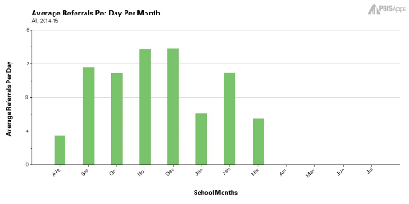
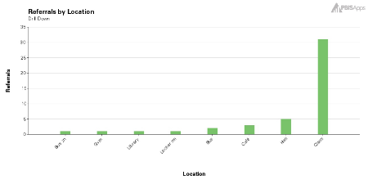
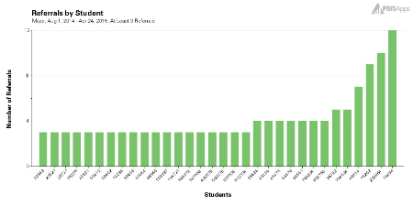
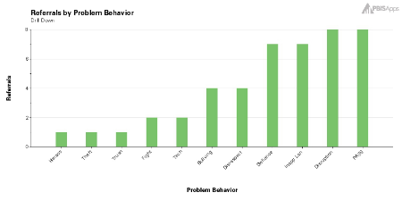
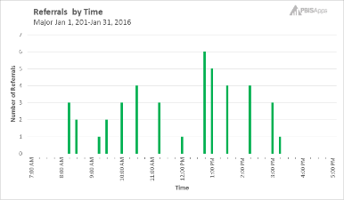
The Initial Big 5 Data Report
Per Day/Per Month
Location
Students
Select a red flag as a focus
Problem Behavior
Time of Day
Notes:
Trainer Notes: This slide has animations
To Know/To Say: The initial Big 5 data report is a frequency report on all ODRs since the last DBDM meeting (usually a monthly cycle; Note: the per day per month report is a cumulative report). We can use all but the per day per month chart of the initial Big 5 data report to identify a problem that we would like to solve. <Click> This report tells us our most frequent behaviors, locations, times, and students. We will select one problem from one of these areas. The key here is that we will select one problem in one of the Big 5 categories to solve. We are taking a bite of the elephant, not eating the whole thing at one setting.

Slide 104
Simple Problem Statements
Per Day Per Month: 1.5 ODRs in January
Behavior(s): Physical Aggression and Disruption (14 each)
Location: Classroom (16)
Our most frequent time of day was 12:45 PM (6)
Students: 42 ODRs evenly distributed among 31 students
Students: 6th Grade (16)
Notes:
To Know/To Say: We can summarize the data from the initial Big-5 data report into a series of simple problem statements.
The school averaged 1.5 ODRs per day in January
Physical aggression and Disruption were the most frequently referred problem behaviors
Most problem behaviors occurred in the classroom
Most problem behavior in January occurred at 12:45 PM
42 ODRs were evenly distributed among 31 students
Finally, most of the problem behaviors came from 6th grade students
At this point, the team can select a problem from this list on which to focus. This can be a behavior, a specific location, a time of day, or a group of students. While frequencies should be a consideration, they are not the only factor that the team should consider when selecting a problem to solve.

Slide 105

Selecting a Problem on which to Focus
Consider the number of ODRs potentially impacted.
Select a Focus problem that will give you the biggest change for the least amount of effort.
Focus area should involve 10 or more students.
  10+ = Systems Issue
Consider student safety.
Rob Horner, 2011
Personal Communication with Rob Horner, 2016
Notes:
Trainer Notes: This slide is animated
To Know/To Say: First, <click> you want to consider how many ODRs would be impacted if the problem were solved (frequency). However, this should not be the only factor. <click>When selecting a focus problem to target, we want to follow Rob Horner’s advice and select a focus that will lead to the biggest change for the least amount of effort.
Also, keep in mind that the school is our unit of analysis. <click>Try to find a focus problem that involves 10 or more students, as this is indicative of a systems issue. Problems involving fewer than 10 students might be best addressed by referring individual students to the tier 2 or tier 3 team.
Last but far from least, <click>teams should give extra weight to problems that may affect student safety.

Slide 106

To make good decisions, we must…
Find the problem
Define the problem
Adapted from PBIS APPS (2016)
Notes:
Trainer Notes: Trainer Notes: This is a slide adapted from PBIS APPS SWIS facilitator Training
To Know/To Say: The simple problem statements merely help us to identify a potential problem to solve. Once we have identified the problem, we must define it. Defining the problem helps us to get a better understanding of the context in which the problem occurs so that we problem solve around the right problem! In addition, defining the problem gives us clues as to the possible root cause of the problem we are trying to solve, helping us to better target our action steps so that they are most likely to solve the problem.

Slide 107

Sort/Filter
Isolate data related to your inquiry (the problem)
  Sort
    Separate relevant from irrelevant
  Filter
    Remove irrelevant
Notes:
To Know/To Say: We define the problem by isolating the relevant data from irrelevant data. The easiest way to think about this is to physically separate ODRs that are directly related to the problem you are trying to solve from the rest of the ODRs, and then reviewing the contextual information on this subset. Remember, looking at aggregate data can obscure what is really going on! For example, the team is concerned about the spike in instances physical aggression and want to know where, when and who are engaged in this behavior. Including data on tardies or classroom disruption would confuse this inquiry. So, the team simply pulls out the ODRs related to physical aggression, and analyzes this subset.
It is easier to create this subset If you have entered your ODR data into an electronic data management system, such as SWIS or an Excel spreadsheet. Most such systems allow you to use filters to accomplish the same thing. In these cases you usually select the category you want to include in the subset, and the electronic data management system will remove data that is unrelated to your problem.
However, if you do not have an electronic data management system that has filters, you can physically sort the ODRs to separate those that are directly related to the problem you are solving from all others.

Slide 108
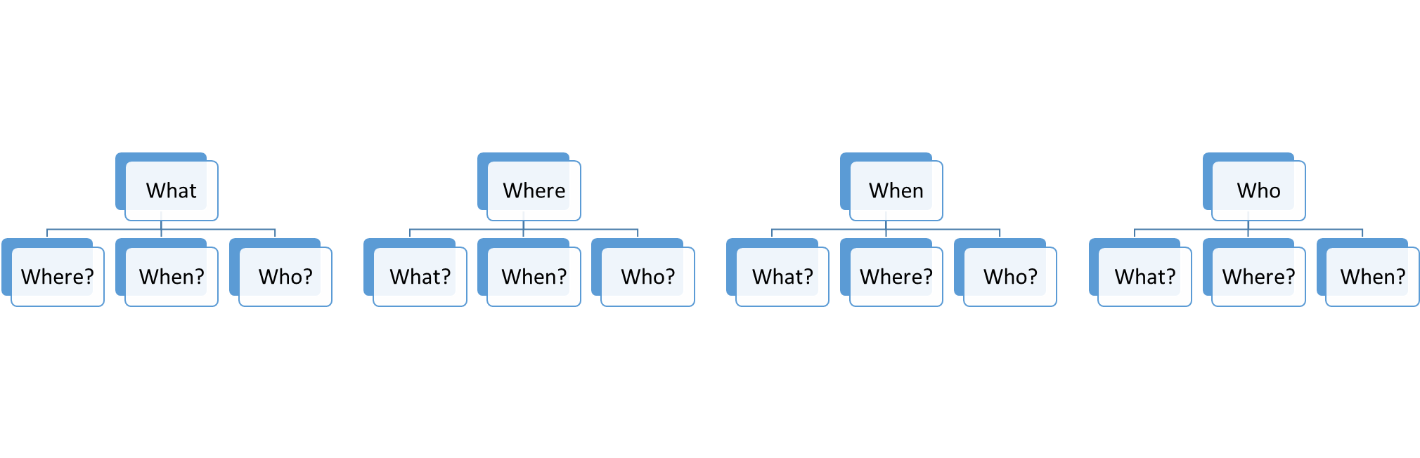
Disaggregate
Notes:
To Know/To Say: Once you have isolated data related to the problem you are solving, you will look at the contextual information to answer the remaining “WH” questions. So, keeping in mind that frequency (how often) is a part of all of the questions we are answering, and our focus problem answers one of the questions, there will always be three remaining questions to answer. For example, lets say you see a spike of behaviors at noon, and you use filters to separate out all ODRs from at or around noon. You have already answered the question when (noon), so you need the frequencies (how often) of behaviors that occur at noon (what), the location where most problems are occurring at noon (where), and the students who are engaging in most unexpected behaviors at noon (who).

Slide 109
The Initial Big 5 Data Report
Per Day/Per Month
Location
Students
Select a red flag as a focus
Problem Behavior
Time of Day
Notes:
Trainer Notes: This slide is animated
To Know/To Say: Of all the red flags that we identified, we can choose any that meet our criteria of involving more than 10 students, giving us the biggest bang for the effort, or involving student safety. For purposes of our example, we are choosing to focus on physical aggression, because it involves student safety. At this point, we are ready for a deeper analysis to determine possible cause of physical aggression

Slide 110
Focus Problem: Behavior
What
Physical Aggression
Where?
When?
Who?
Notes:
To Know/To Say: Once the team selected their focus, they are ready to further analyze the problem by asking the remaining Big-5 questions as they relate specifically to the problem behavior: Physical Aggression.
So the team either manually or electronically separates the ODRs for physical aggression from ODRs for all other behaviors. They use this filtered data set to answer frequency questions for the remaining wh questions:
Where is physical aggression happening (frequency by location)
When is physical aggression happening (frequency by time of day)
And who are the students engaged in physical aggression (frequency by grade).
The following slides demonstrate this procedure, using our example data set.

Slide 111
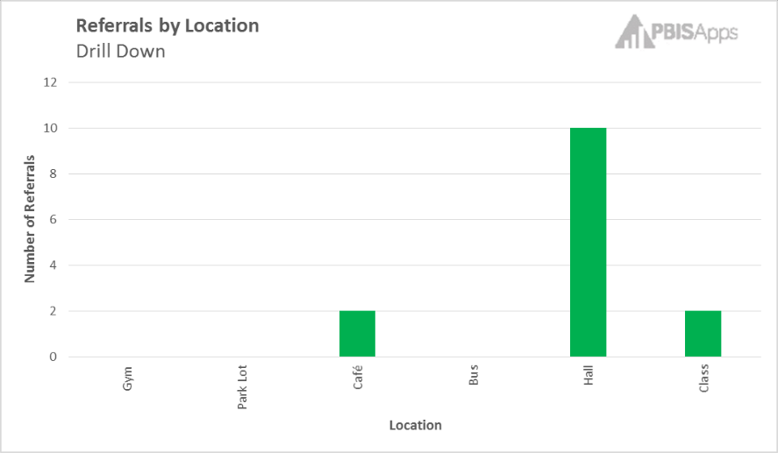
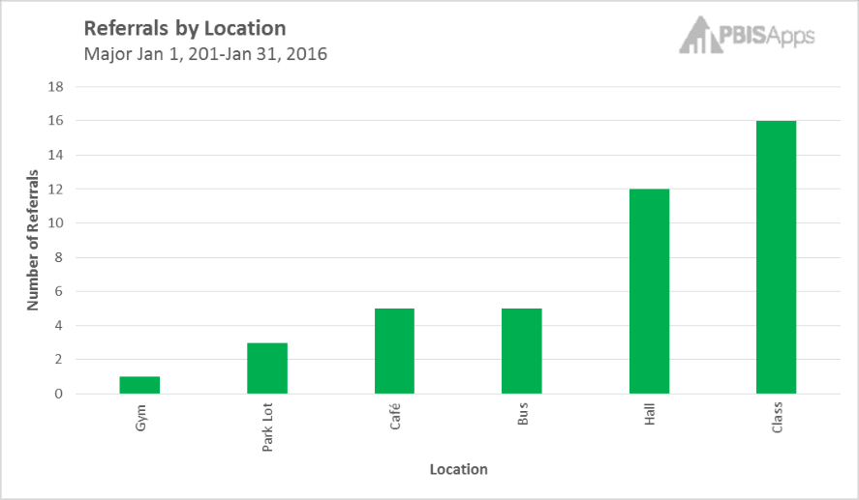
Notes:
Trainer Notes: This slide is animated
To Know/To Say: So, most of our ODRs are coming from the classroom. However, if we ask where the physical aggression is occurring, <click> we find that nearly all of them are coming from the hall. Had we started by asking what was going on in the classroom that was leading to all this physical aggression, we might get a very different answer than if we asked what was going on in the halls!

Slide 112
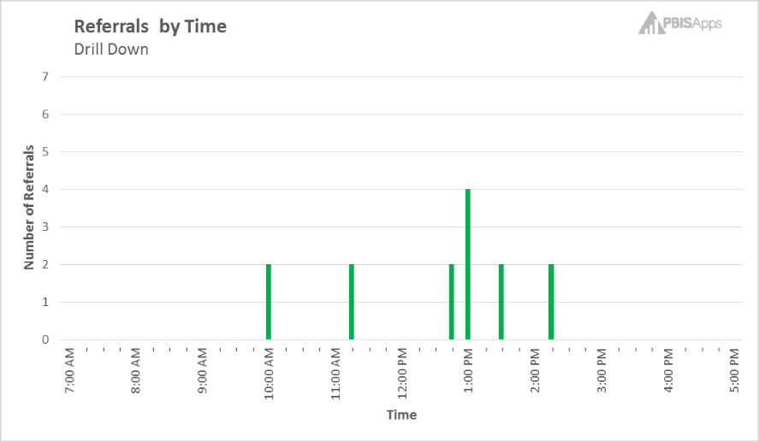

Notes:
Trainer Notes: This slide is animated
To Know/To Say: Same is true for time of day. Most of the ODRs are coming at 12:45. However, <click> when we ask when most of the ODRs for Physical aggression are occurring, we find they are happening at 1:00, with a smattering throughout the day.

Slide 113
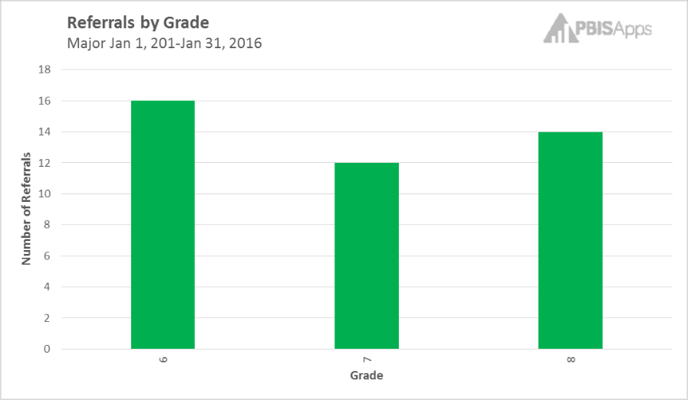
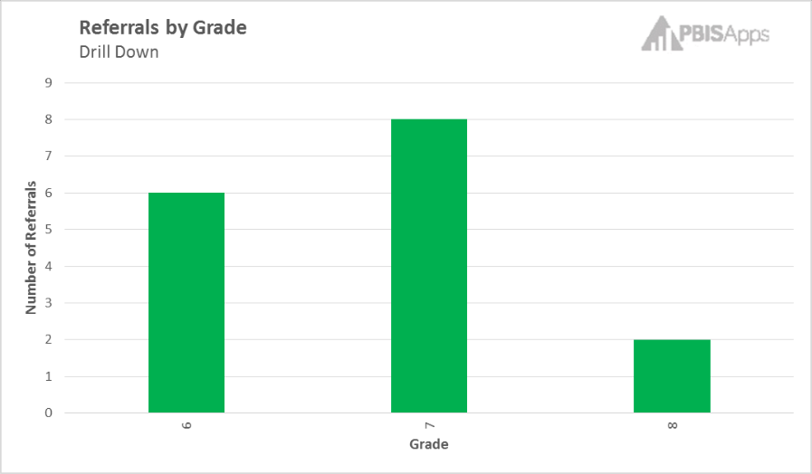
Notes:
Trainer Notes: This slide is animated
To Know/To Say: Likewise, 6th and 8th graders have received the majority of the ODRs, with 7th graders holding their own. However, <click> when we look just at ODRs for physical aggression, we find that the majority of them are coming from 7th graders, with only 2 from the 8th grade.

Slide 114
Focus Problem: Physical Aggression
Hall
1:00 PM
7th Graders (8)
Precision Statement
The focus problem for the month of January was Physical Aggression in the Halls at 1:00 PM O'clock, and performed by 6th and 7th graders.
Notes:
Trainer Notes: This slide is animated
To Know/To Say: Now, the team is ready to write a precision problem statement. This statement reads, “The focus problem for the month of January was Physical Aggression in the Halls at 1:00 PM O’clock, and involving primarily 6th and 7th graders.”
Note that this statement more accurately defines the context surrounding the physical aggression, and allows us better information on which to problem solve.

Slide 115

Activity: Think, Pair, Share
6th graders are engaging in physical aggression is occurring in the classrooms at 12:45 PM.
7th graders are engaging in physical aggression in the Halls at 1:00 PM.
Would you take the same or different proactive measures to prevent these two problems from occurring?
What factors influenced your answer and why?
Notes:
Animation
To Know/To Say: Consider two problem statements. The first is based off of what we knew when we looked at the data in aggregate, and is slightly misleading. The second is based on what we know after analyzing the same data.
Would you take the same or different proactive measures to prevent these two problems from occurring? What factors influenced your answer and why?
Discuss your answer with a shoulder partner. Be prepared to share out.

Slide 116
EF 3: Educators determine action steps.
Notes:
To Know/To Say: Which leads us to the next step in the GAINS decision-making framework: intentionally act, and analyze again. The purpose of this step is to select evidence based strategies or practices that address the root cause of the problem or challenge that we are trying to solve. Once we have implemented the plan, we continuously review implementation and outcome data to monitor progress toward achieving the desired outcome. In this way we can make timely midcourse corrections, as needed.

Slide 117

Why Do Kids Engage in Unexpected Behavior?
They do not know the expectation.
They are not fluent in the expected behavior.
The unexpected behavior works for them.
  It gets them something they want or need.
Gresham, Sugai, & Horner (2001)
Notes:
Trainer Notes: This slide is animated
To Know/To Say: To solve a problem, we need to understand why the problem is occurring.
The science of behavior teaches us that when students engage in unexpected behavior, it is generally because…
they don’t know what behavior is expected;
they are not fluent in the expected behavior;
the unexpected behavior serves a student need.
Knowing this and understanding the context in which the unexpected behavior occurs can help us target our approach to addressing the problem.

Slide 118
Why Do Kids Engage in Unexpected Behavior?
Don’t know Expectations
Have we clarified expectations?
Not Fluent
Adequate practice?
Functional Relationship
Gain?
Avoid?
Have we taught expectations?
Have we reinforced?
Have we corrected?
Different settings?
Gresham, Sugai, & Horner (2001)
Notes:
To Know/To Say: Therefore, if students behave in unexpected ways, we need to first determine the replacement behavior, what do we want them to do instead, and then teach this to the student. If the student is engaging in unexpected behaviors because he or she is not fluent in the expected replacement behavior, we need to practice this behavior in the settings where it is to be used. Finally, we know that students engage in unexpected behavior because the consequences to that behavior are reinforcing. So our job becomes finding ways to reinforce the student for engaging in the expected behavior and to avoid inadvertently reinforcing the unexpected behavior when we must correct the student.

Slide 119
Makings of a Schoolwide Intervention
Identify replacement behavior.
Intensify active supervision.
Teach replacement behavior.
Reinforce replacement behavior.
Consistently correct unexpected behavior.
Notes:
To Know/To Say: To put this simply, there are 5 steps to developing a positive and proactive schoolwide intervention that is evidence-based, and that address the reasons students engage in unexpected behaviors, and can be adapted to all settings. These steps are:
Identify replacement behavior, or “what you want them to do instead.”
Teach replacement behavior
Reinforce replacement behavior
Consistently correct unexpected behavior
Intensify active supervision

Slide 120
Unexpected Behavior | Replacement Behavior
Physical Aggression
Hitting
Fighting
Pushing
Biting
Keep hands, feet, and objects to self.
Use conflict resolution strategy.
Use words to solve problems.
Notes:
Trainer Notes: This slide is animated
To Know/To Say: Because identifying a replacement behavior is critical to addressing unexpected behaviors, let’s take a moment to practice. Consider our middle school example involving Office Referrals for physical aggression. What are some behaviors that you want students to do instead?
[Give participants a chance to respond]
<Click> these are examples of replacement behaviors to physical aggression. Keep in mind that there is no one right answer.
Also, notice that all of the replacement behaviors that are listed here are positive actions that students do. They are positively stated, and you can see them and count them when they occur.

Slide 121
Unexpected Behavior | Replacement Behavior
Notes:
Trainer Notes: Give participants time to do the activity. Ask 2-3 to share out. Alternatively, you can have them work as a team with chart paper.
To Know/To Say: On HO 8 Replacement Behaviors, take a moment to think about an office managed unexpected behavior that is common at your school. In the left half of the T chart, write different forms that this behavior might take. In the right half of the T Chart, write the replacement behavior(s) you want students to do, instead.

Slide 122
The Solution Plan
Action Plan Format
  Solution Component
  Action Steps
  Person Responsible
  Target Date
  Communication/PD
  Evidence action step completed
  Results Indicators
Adapted from PBIS Apps (2016)
Notes:
To Know/To Say: A Solution Plan is a variation of an action plan that guides the team toward the 5 steps of developing a schoolwide intervention. It provides a space for the team to write the replacement behavior. Then guides the team toward preventing, teaching, and reinforcing the replacement behavior, and correcting the unexpected behavior. In addition, it has components of an action plan that help a team hold themselves accountable. These include:
Action Steps
Person Responsible
Target Date
Communication/PD
Evidence action step completed
Results Indicators

Slide 123
Adapted from PBIS Apps (2016)
Notes:
To Know/To Say: This is a completed Solution Plan using our Middle School Physical Aggression example.

Slide 124
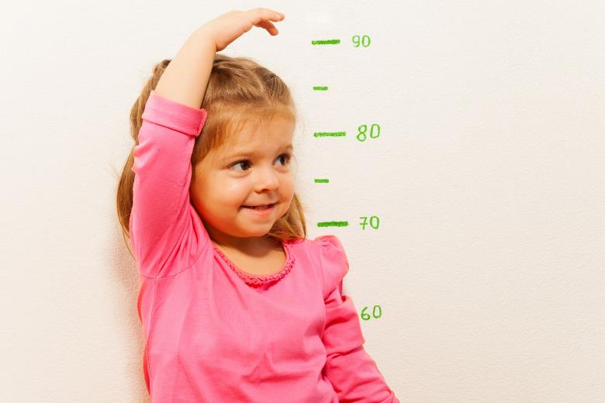
Are we making adequate progress?
Notes:
To Know/To Say: As you implement the plan, you will want to progress monitor results indicators. Results indicators are measures that are quick and easy to collect that provide a reliable measure of whether the adults are doing what they committed to doing, and whether the plan is having the desired impact on student outcomes. Teams can quickly review these measures during a monitoring meeting, and make decisions, accordingly.
Thinking about our physical aggression example, if the staff is asked to present students with a special tangible along with positive specific feedback when they catch students using one of the replacement behaviors, the team can count tickets given as a measure of whether the adults are giving high rates of positive feedback. They can then monitor ODRs for physical aggression on a weekly basis to monitor whether they are on a trajectory to achieve their goal.
The team can schedule a brief meeting every week to quickly review these results indicators, and make any necessary midcourse corrections.

Slide 125
Monitoring Data: How will you know?
Implementation Results Indicator
Outcome Results Indicator
Teacher lesson accountability sheet
Count of tickets given to students with specific positive feed back
Duty assignment attendance
Count of students for using conflict resolution strategy
Count of office referrals for physical aggression
Notes:
To Know/To Say: Here are some examples of implementation and outcome data points for progress monitoring our middle school physical aggression example. Notice that the implementation results indicator monitors whether the adults are implementing the plan; the student outcomes results indicators monitors whether students are making incremental progress toward the goal

Slide 126
Activity: Results Indicators
Goal: Become Fluent in Spanish.
Action Step: Spend 10 minutes per day using the Duolingo App.
Implementation Results Indicator | Outcome Results Indicator
Keep a log of every day that I spend at least 10 minutes on Duolingo. | Take vocabulary quiz to monitor progress toward goal of fluency.
Notes:
Trainer Notes: Have participants individually complete the HO 9 Results Indicators worksheet on the front side. Trade papers. Use the guide on the (Back) Side to check to make sure that your partner’s implementation results indicator monitors the action step and the outcome results indicator monitors incremental progress toward goal
To Know/To Say: Consider the following scenario: My goal is to learn to speak Spanish fluently. To achieve this goal, I settle on the action step of spending at least 10 minutes per day using the Duolingo Language App. I select implementation and outcome results indicators. To monitor whether I am implementing my plan, I keep a calendar where I put a check mark on every day that I use the app for 10 minutes. To monitor progress toward the desired outcome, I take a brief vocabulary test each week.
Notice 2 things:
1- My Implementation results indicator directly measures whether I implemented my action step.
2- My Outcome results indicator directly measures incremental progress toward my goal! My goal is to be fluent. I am measuring intermediate progress by monitoring vocabulary.
Now, individually or in pairs, complete page 1 of “Handout 7 Results Indicators” for the different non-education goals. Remember, an implementation results indicator monitors the action step and an outcome results indicator monitors incremental progress toward the goal. Trade papers. Use the “Guide on the (Back) Side” (p. 2) to make sure that your partner’s implementation outcome

Slide 127
Did we implement the plan?
Yes
No
Did we find the right root cause?
Did we address the right root cause?
Are there obstacles to implementation?
Yes
No
Yes
Modify plan to better address cause.
No
Go back to data to determine root cause.
Address obstacles.
Implement plan.
Notes:
To Know/To Say: If you are not making adequate progress toward your goal, you can use this decision tree to guide next steps.
Are we making adequate progress?
Yes: keep doing what we are doing
No: Did we implement the plan?
Yes
Did we find the right root cause?
Yes
Modify the plan to better address the root cause
No
Go back to data to identify the correct root cause
No
Are there obstacles to implementation
Yes: address the obstacles
No: Implement the plan

Slide 128
EF4: Educators use implementation and student outcome data to determine next steps.
Notes:
To Know/To Say: The fourth essential function, Educators use implementation and student outcome data to determine next steps, corresponds to the 4th and 5th components of GAINS: Notice and Adjust, and Systematically repeat. This refers to using data to evaluate the effectiveness of our plan, and select next steps based on this evaluation

Slide 129
Evaluate Plan
 | Goal not met | Goal met
Plan not implemented | Are there obstacles to implementation? Yes: Modify plan to eliminate the obstacles. No: Implement the plan. | Look at data to determine why the goal was achieved, so you can replicate.
Plan implemented | Re-analyze data; develop an alternate hypotheses; modify the plan to address the alternative hypothesis. | Plan for sustained implementation. Return to data to identify a new problem to address.
Notes:
To Know/To Say: This table shows a decision making rubric for evaluating the plan and determining next steps. This will work with any plan, academic or behavior. It is based on two questions: Did we meet our goal? And Did we implement our plan?
If the Goal was not met and the team did not implement with fidelity, then the team must determine whether there were obstacles to implementation. If so, they should modify the plan and try again. If there were no obstacles, then the team needs to implement their plan.
If the goal was not met and the team implemented the action steps with fidelity, then they should reanalyze the data and reassess whether they identified the correct problem and whether their action steps were aligned with the problem
If they met their goal, but they did not implement their plan, they may want to go back to the data to determine why the goal was met. This may help them to avoid or solve problems in the future.
Finally, if the goal was met, and they implemented the plan with fidelity, then they should go back to the data and begin the cycle again with a new focus problem. This proactive approach to solving problems will help the team to establish cycles of continuous improvement.

Slide 130
Then we systematically repeat…
Creating cycles of continuous improvement.
Notes:
To Know/To Say: Once the team has evaluated the plan, they start the cycle again, reviewing data to identify the next problem to solve. This usually occurs at the next data meeting following the end of a data cycle. Thus establishing cycles of continuous improvement.

Slide 131
Schoolwide DBDM in Practice
Notes:
To Know/ to Say: Now, let’s peek in on a real team engaging in DBDM using ODR to improve student behavior schoolwide.

Slide 132
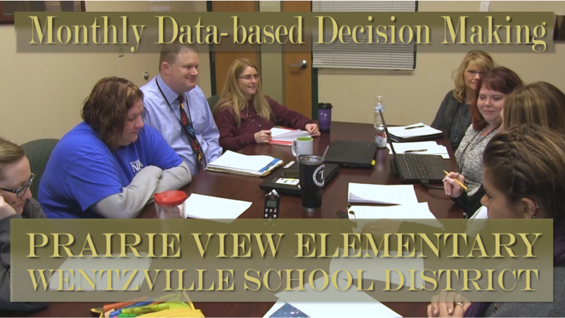
Notes:
Video Link: https://vimeo.com/203334284/845aa77613
Trainer Notes: Provide all participants with HO10 DBDM-Solution Planning Video Guided Notes
To Know/To Say: This video shows a Missouri school’s schoolwide behavior leadership team reviewing ODR data, and selecting appropriate action steps based on this data. Before we start, I would like to quickly clarify some of the language used in the video:
Solution Plan: an action plan that guides teams toward using ETLPs
SPF: Specific Positive Feedback; this is a term that the team uses to refer to “Acknowledging Expected Behavior.”
The Guiding Hand: This is an acronym that the team uses to remind staff of their agreed upon strategies to “discourage unexpected behavior.”
As you view this video, use HO10 DBDM-Solution Planning Video Guided Notes to identify the following:
What is the problem?
Why is there a problem?
What will they do about the problem?
How will they know whether they are making adequate progress?

Slide 133
Schoolwide DBDM in Action
Notes:
To Know/To Say: So, what does all this mean for you and your school?

Slide 134
SWOT: Are you Ready for Schoolwide DBDM?
Strengths | Weaknesses
Opportunities | Threats
Notes:
Trainer Notes: Copy the HO11 SWOT for each participant
To Know/To Say: If you are here as a team, use the chart paper to answer the SWOT questions as they relate establishing a schoolwide team to engage in DBDM using ODR data to improve student behavior and school climate, schoolwide. Otherwise, you may use the HO11 SWOT form.
What are your team’s strengths that will set you up for success as you implement schoolwide DBDM using ODR data? What do you do well that could assist you in implementing DBDM?
What are your team’s weaknesses? What are your personal opportunities for growth? What obstacles must be overcome to implement Schoolwide DBDM?
What are some opportunities that Schoolwide DBDM using ODR data present to you and your school? How can you turn your strengths into opportunities?
What are some of the threats that implementing Schoolwide DBDM exposes you to?

Slide 135
Team Talk
Based on the SWOT activity, what are your next steps toward implementing Schoolwide DBDM?
Notes:
To Know/To Say: Based on the SWOT activity you just completed, what are your logical next steps toward implementing Schoolwide DBDM using ODR data. Pay special attention to prerequisites that must be completed, obstacles that must be overcome, and structures that must be put in place.

Slide 136

Schoolwide DBDM Closing and Next Steps
Notes:
To Know/To Say: So, let’s take a moment to briefly review where we’ve been, and where to next.

Slide 137
Closing and Next Steps
Notes:
To Know/To Say: During this lesson, you learned about a special case of Data-Based Decision-Making: Schoolwide behavior teams utilizing ODR data to improve school climate and schoolwide behavior.
How will you engage the schoolwide leadership team to begin using ODR data in a DBDM process?
Next steps include updating your action plan. Develop action steps for engaging in schoolwide DBDM utilizing ODR data.
Additional information about Schoolwide DBDM can be found in the MO SW-PBS Handbook and the MO SW-PBS Tier 1 Implementation Guide.

Slide 138
Additional Training Opportunities
Overview of DBDM for Behavior
Using Academic and Behavioral Data for DBDM in Grade or Content Alike Collaborative Teams
Achieving District/School Climate and Behavior Improvement Goals through DBDM
Coming Soon!
Notes:
To Know/To Say: There are a number of training opportunities related to DBDM around behavior that you can take advantage. All are available on the DESE VLP. Materials are also available for download for your to use to train staff in your school or district.

Slide 139
References
Gilbert, T.F. (1978). Human competence: Engineering worthy performance. New York : McGraw-Hill.
Gresham, F. M., Sugai, G., & Horner, R. H. (2001). Interpreting outcomes of social skills training for students with high-incidence disabilities. Exceptional Children, 67(3), 331-344.
Horner, R. (March 8, 2016). Personal Communication.
Horner, R.H. (2011). Moving PBS forward with quality, equity and efficiency. Keynote: Eighth International Conference of the Association for Positive Behavior Support. Denver: CO.
Metz, A. & Louison, L. (2018) The Hexagon Tool: Exploring Context. Chapel Hill, NC: National Implementation Research Network, Frank Porter Graham Child Development Institute, University of North Carolina at Chapel Hill. Based on Kiser, Zabel, Zachik, & Smith (2007) and Blase, Kiser & Van Dyke (2013).retrieved on 5-13-2020 from https://nirn.fpg.unc.edu/resources/hexagon-exploration-tool.
PBIS Apps (2016). Swift at SWIS. University of Oregon.
Ritchhart, R., Church, M., Morrison, K. (2011). Making Thinking Visible: How to promote engagement, understanding, and independence for all learners. San Francisco, California: Josey-Bass
Reaves, D.A. (2006). The learning leader: How to focus school improvement for better results. Association for Supervision and Curriculum Development:Alexandria, Virginia.
Ritchhart, R., Church, M., and Morrison, K. (2011). Making thinking visible” How to promote engagement, understanding, and independence for all learners. San Francisco, California: Josey-Bass.
Scott, T., Anderson, C., Alter, P. (2012). Managing classroom behavior using positive behavior supports. Pearson:Upper Saddle River, New Jersey.
Sugai, G., Sprague, J.R., Horner, R.H., & Walker, H.M. (2000). Preventing school violence. The use of office discipline referrals to assess and monitor schoolwide discipline interventions. Journal of Emotional and Behavioral Disorders, 9(2), 94–101.
Tilly, W. D. (2008). The evolution of school psychology to science-based practice: Problem-solving and the three-tiered model. In A. Thomas & J. P. Grimes (Eds.), Best practices in school psychology V (pp. 17-36). Bethesda, MD: National Association of School Psychologists.

Slide 140
Using Academic and Behavioral Data
In Data-Based Decision-Making
Notes:
To Know/To Say: The purpose of this module is to demonstrate to grade or content alike collaborative data teams how incorporating behavior data with academic data in a DBDM cycle can enhance both academic and behavioral outcomes for students. In addition, this module is designed to assist data teams to incorporate behavior data into academic DBDM cycles. It is NOT intended to replace DBDM lessons that focus solely on improving academic outcomes.

Slide 141
Facilitator Notes: Delete This Slide
It is recommended that you read through the activities prior to the session; you may substitute activities that achieve the same goal (i.e., substitute one activation activity for another).
Some activities may have kits that need to be prepared ahead of time. The following activity kit goes with this presentation:
  Activity Kit 2 Make an Inference
Some activities have handouts; be sure to read through the activity to decide whether you want to run off handouts, or make the information available in some other way.
  HO12 Recipe Card
  HO13 Fishbone
  HO14 Progress Monitoring Decisions
  HO15 5th Grade Collaborative Team in Practice
  HO16 Got it-Need it
  HO17 Academic and Behavior Patters Inferences and Solutions
  HO18 Example 9th Grade Social Studies
  HO19 Got it-Need it
Some of the DESE alignment slides are included in all lessons. These slides are redundant if presenting the lessons in order. They are therefore hidden. If presenting the slides out of order, consider unhiding these slides.

Slide 142
Working Agreements
Be Respectful
Be an active listener—open to new ideas
Use notes for side bar conversations
Be Responsible
Be on time for sessions
Silence cell phones—reply appropriately
Be a Problem Solver
Follow the decision making process
Work toward consensus and support decisions of the group
Notes:
Trainer Notes: Hide or delete this slide if presenting the entire PLM
To Know/To Say: “These will be the Working Agreements we will honor during all our training sessions this year.”

Slide 143
Attention Signal
Notes:
Trainer Notes: Hide or delete this slide if presenting the entire PLM; Facilitator: Select an attention signal.
To Know/To Say: “One of our agreements is to follow the attention signal.”
“Your team will work with your school to develop an attention signal you will use in every setting.”
“In order to get all of you focused after discussions, activities or breaks,
I will ________________________________________.”
(Insert your attention signal here.)
“Your task will be to finish your sentence, quiet your voice and ____________________________.”
(Insert what you want participants to do.)

Slide 144
Welcome and Introductions
Our trainers for the day are:
Notes:
Presenter Notes: Add the name(s) of the trainer(s) to the slide.
To Say: The introductions may be formal or informal depending on how well you know the group. Trainers should use whatever process is comfortable for introductions. I am/we are _______________ (provide some background about trainers). Please introduce yourself to the group (name, district, position).

Slide 145
Session at a Glance
Importance
Overview
Option A: alternating between academic and behavior collaborative team meetings
Option B: integrating academic and behavior data in collaborative team meetings
In practice
In action
Closing
Notes:
Trainer Notes:
To Know/To Say:

Slide 146
Essential Questions
How does alternating academic and behavior DBDM account for the interrelationship between academic skills and behavior?
Why would you want to consider both academic and behavior data when engaged in DBDM?
What impact would engaging in DBDM with both academic and behavioral data have on your students?
Notes:
Trainer Notes:
To Know/To Say: Read the essential questions. Use these questions to guide your learning, today.

Slide 147
Session Outcomes
At the end of this session, you will…
review the science of behavior, and how academic skills and behavior are interrelated.
review and analyze behavioral data to make decisions that improve academic and/or behavioral outcomes for students.
select evidence-based practices that address student needs identified from data analysis.
monitor progress toward academic and/or behavioral goals.
evaluate effectiveness of interventions, and make decisions about next steps.
Notes:
To Know/To Say: By the end of this session, you will…
Review the science of behavior, and how academic skills and behavior are interrelated.
Review and analyze behavioral data to make decisions that improve academic and/or behavioral outcomes for students.
Select evidence-based practices that address student needs identified from data analysis.
Monitor progress toward academic and/or behavioral goals.
Evaluate effectiveness of interventions, and make decisions about next steps.

Slide 148
Overview of Integrating Academic and Behavior Data
In grade or content alike collaborative teams
Notes:
Trainer Notes:
To Know/To Say:

Slide 149

Overview
Review of Science of Behavior.
Demonstrate interconnection between academic skills and behavior.
Provide two options for utilizing academic and behavior data for decision making.
Notes:
To know/To say: This lesson will provide a brief review of the science of behavior, and how this science explains the interrelationship between academic skills and student behavior. It will then provide two options for grade or content alike collaborative teams to use a data-based decision-making process to improve academic and behavior outcomes for students. The first of these options is to address academic and behavioral problems separately, on an alternating schedule. The second option is to review and analyze academic and behavioral data concurrently, and address the interrelationship between the two.

Slide 150

Key Concepts/Big Ideas
Academic skills and behavior are interrelated.
Problems in one can cause problems in the other.
Both must be addressed.
Notes:
Trainer Notes:
To Know/To Say: The key concept of this lesson is that academic skills and behavior are interrelated, such that problems in one area can cause problems in the other. Teams must address both.

Slide 151
Key Terms
Academic Data: Assessments of academic knowledge and skills, including formative assessments, common formative assessments, benchmark assessments, diagnostic assessments, and summative assessments.
Behavior Data: Information about incidents of unexpected behaviors, including classroom managed/ minor behaviors and/or office managed/major behaviors, as well as associated contextual information (behavior, location, time and date, student, possible motivation, etc.,).
Grade or Content Alike Collaborative Teams: A collaborative team that shares a common interest, and meets to make data-based decisions.
Results Indicators: Quick and easily measured data points used for progress monitoring. Includes at least one measure of implementation and one measure of student outcomes.
Notes:
Trainer Notes:
To Know/To Say: Here is a list of important terms that we will be using, today. Take a moment to read through the definitions.

Slide 152
Recipe
Topic:
Integrating Academic and Behavior Data in DBDM
Sample Word Bank:
cup, pint, teaspoon, pinch, chop, mince, blend, fold, stir, bake, sauté, chill, grill, broil, serve over, spoon in, garnish with.
Collaborative Teams
1 Cup “The Right People”
1Tbs “Common Goal”
3 Tbs Data
1 whole Common Agenda
½ cup Heavy Roles
Mix the right people with agendas. roles, norms, a common goal. Fold in Data. Bake 12 times each year.
Adapted from Lipton, L., and Wellman, B. (2011).
Notes:
Trainer Notes: Provide teams with chart paper, or the HO12 Recipe Card Template
To Know/To Say: As a teamwrite a recipe for integrating academic data and behavior data in a DBDM process to improve outcomes for kids. You can use the word bank provided, or incorporate your own cooking terms for your recipe. Be prepared to share. The example is a recipe for collaborative teams. If participants attend without a team, they may use , use HO12 Recipe Card.

Slide 153

Importance of Using Academic and Behavior Data
In Data-Based Decision-Making
Notes:
Trainer Notes:
To Know/To Say: Why is it important to consider both academic and behavior data to make decisions in grade or content alike collaborative data teams?

Slide 154
Academic and behavioral success may be symbiotic, as an effective behavioral system allows effective academic instruction to take place.
Putnam, Horner, and Algozzine (2010)
Notes:
To Know/To Say: It is important to utilize both academic and behavior data because academic skills and behaviors are interconnected. As McIntosh and Goodman point out, “unaddressed challenges in one area may lead to challenges in the others.” Let’s explore this further.

Slide 155
As we have discussed, unaddressed challenges in one area may lead to challenges in others.
McIntosh and Goodman, 2016 p. 114
Notes:
Trainer Notes:
To Know/To Say: It is important to utilize both academic and behavior data because academic skills and behaviors are interconnected. As McIntosh and Goodman point out, “unaddressed challenges in one area may lead to challenges in the others.” Let’s explore this further.

Slide 156
Academic Skills
Behavior
Notes:
Presenter Notes: This slide is animated
To Know/To Say: Student behavior affects academic skills development and outcomes, and academic skills affect behavioral outcomes.

Slide 157

Unexpected Behaviors…
Deny Students Opportunity to
Learn.
Gregory, Bell, and Pollock (2014); Skiba, Arredondo, and Williams (2014)
Notes:
To Know/To Say: Unexpected behaviors disrupt instruction: disruptive behavior distracts the student who is engaged in the unexpected behavior and other students from learning; the teacher must stop instruction to address the problem behavior; unexpected behaviors result in exclusionary discipline, including sending the student to time out, a buddy room, the intervention room, or the office. In addition, the student may be suspended in or out of school. All of these consequences can disrupt instruction not only for the student who engages in the behavior, but other students, as well, denying students opportunity to learn!

Slide 158
Disrupted Learning…
Impacts academic skill.
May reinforce unexpected behavior.
Notes:
To Know/To Say: When unexpected behavior disrupts learning, it negatively impacts academic skills. Students who find academic tasks difficult may engage in escape motivated unexpected behavior. Escape motivated unexpected behavior is reinforced when learning is disrupted or the student is removed from instruction. This further erodes academic skill, setting the student up in a vicious, self reinforcing cycle that potentially impacts everyone in the class.

Slide 159
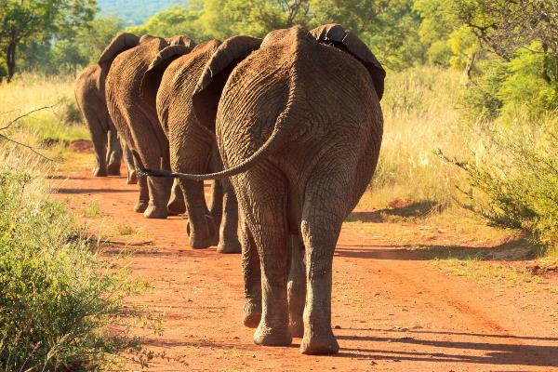
The Bottom Line
Unexpected behaviors impact academic knowledge and skills.
Poor academic knowledge and skills increase unexpected behaviors.
Both must be addressed!
Notes:
To Know/To Say: So, the bottom line is unexpected behaviors may prevent the development of academic knowledge and skills, and poor academic knowledge and skills may increase unexpected behaviors. Both academics and behavior must therefore be addressed if we want positive outcomes in either.
.

Slide 160
DCI Content Framework
Notes:
To Know: Missouri’s professional learning modules are organized in the same three categories as defined in the Content Framework. All schools begin their professional development journey with the Foundations, as these professional learning modules provide foundation knowledge in three key areas: Collaborative Teams, Data-Based Decision Making, and Common Formative Assessment. Effective Teaching & Learning Practices encompass research-based instructional practices for deepened learning. These professional learning modules address ways of connecting with students, ways of helping students learn how to learn, and feature specific instructional practices. Supportive Context contains professional learning modules designed to help school staff support and enhance the implementation of Effective Teaching & Learning Practices through using technology, leadership, and coaching supports. Data-Based Decision Making is part of the Foundations.
To Do/To Say: Before we delve into DBDM, let’s take a few minutes to review the DCI Content Framework graphic, looking specifically at where DBDM falls into the larger content.
As you see, the focus of DCI is on effective instruction leading to exceptional outcomes for all Missouri students.
The Content Framework has three main components:
Foundations (consisting of Collaborative Teams, Data-Based Decision Making, and Common Formative Assessment)
Effective Teaching and Learning Practices
Expectations & Rules;
Procedures & Routines;
Encouraging Expected Behavior;
Discouraging Unexpected Behavior;
Active Supervision;
Opportunities to Respond;
Activity Sequencing & Choice;
Adjusting Task Difficulty
Supportive Context (School Based Implementation Coaching, Collective Teacher Efficacy, and Leadership)
Reference: MoEdu-Sail. (2018). Missouri model districts framework: Blueprint for district and building leadership, second edition.

Slide 161
DBDM Alignment with
MO Learning Standards
Ensures students learn essential and higher order knowledge and skills as identified by the MO Learning Standards through:
  Teacher Collaboration
  Reflection
  Data Analysis
  Action Planning
  Feedback
Notes:
Trainer Notes: Hide this slide if presenting the entire PLM in one setting, or presenting along with the PLM Course Overview.
To Know/To Say: The Data-Based Decision Making module aligns with the Missouri Learning Standards because it addresses these components:
teacher collaboration
reflection
data analysis
action planning
feedback

Slide 162
DBDM Alignment with
MO Teacher Standards
This DBDM module supports the following MO Teacher Standards:
#2 Student Learning, Growth, and Development: Teachers can adapt instruction in order to effectively teach all learners
#5 Positive Classroom Environment: The teacher creates a learning environment that encourages active engagement in learning, positive social interaction, and self-motivation
#7 Student Assessment and Data Analysis: Teachers uses formative and summative assessment strategies to assess learner progress
#8 Professionalism: Teachers are reflective practitioners and use data to inform reflection
#9 Collaboration: Teachers collaborate with a shared goal of effective instruction and student learning
Notes:
Trainer Notes: Hide this slide if presenting the entire PLM in one setting, or presenting along with the PLM Course Overview.
To Know/To Say: Data-based decision making aligns with 5 of the 9 MO Teacher Standards.
Standard #2 Student Learning, Growth and Development: The teacher understands how students learn, develop, and differ in their approaches to learning. The teacher provides learning opportunities that are adapted to diverse learners and support the intellectual, social, and personal development of all students. [SB 291 Section 160.045.2 (1) Students actively participate and are successful in the learning process; (5) The teacher keeps current on instructional knowledge and seeks and explores changes in teaching behaviors that will improve student performance.]
Standard #5 Positive Classroom Environment
The teacher uses an understanding of individual/group motivation and behavior to create a learning environment that encourages active engagement in learning, positive social interaction, and self-motivation. [SB 291 Section 161.380.2 (3) The teacher is prepared and knowledgeable of the content and effectively maintains students’ on-task behavior; (5) The teacher keeps current on instructional knowledge and seeks and explores changes in teaching behaviors that will improve student performance.]
Standard #7 Student Assessment and Data Analysis: The teacher understands and uses formative and summative assessment strategies to assess the learner’s progress and uses both classroom and standardized assessment data to plan ongoing instruction. The teacher monitors the performance of each student, and devises instruction to enable students to grow and develop, making adequate academic progress. [SB 291 Section 160.045.2 (2) Various forms of assessment are used to monitor and manage student learning; (5) The teacher keeps current on instructional knowledge and seeks and explores changes in teaching behaviors that will improve student performance.]
Standard #8 Professionalism: The teacher is a reflective practitioner who continually assesses the effects of choices and actions on others. The teacher actively seeks out opportunities to grow professionally in order to improve learning for all students. [SB 291 Section 160.045.2 (2) Various forms of assessment are used to monitor and manage student learning; (5) The teacher keeps current on instructional knowledge and seeks and explores changes in teaching behaviors that will improve student performance; (6) The teacher acts as a responsible professional in the overall mission of the school.]
Standard #9 Professional Collaboration: The teacher has effective working relationships with students, parents, school colleagues, and community members. [SB 291 Section 160.045.2 (4) The teacher uses professional communication and interaction with the school community; (6) The teacher acts as a responsible professional in the overall mission of the school.] Quality Indicator 1: Induction and collegial activities. Quality Indicator 2: Collaborating to meet student needs. Quality Indicator 3: Cooperative partnerships in support of student learning.

Slide 163
DBDM Practice Profile
Notes:
Trainer Notes: Hide this slide if presenting the entire PLM in one setting, or presenting along with the PLM Course Overview.
To know/To Say: The Missouri DESE has developed a practice profile to guide teams as they develop DBDM, and to assist them in a self-reflective process whereby they can evaluate their level of proficiency, and identify next steps toward continuous improvement. The Practice Profile is divided into Essential Functions, Proficiency levels, and criterial that define the essential function at each proficiency level.
Practice Profiles are designed to assist teams to implement the evidence based practice, and to self-reflect on the quality of this implementation

Slide 164
DBDM Practice Profile Essential Functions
Educators establish collaborative process for collecting data.
Educators implement a process for examining and interpreting data.
Educators determine action steps.
Educators use implementation and student outcome data to determine next steps.
Notes:
Trainer Notes: Hide this slide if presenting the entire PLM in one setting, or presenting along with the PLM Course Overview.
To Know/To Say: In addition, notice that the Essential Functions of the Practice Profile are directly aligned with the questions that every DBDM process must address, as well as the steps of the GAINS decision-making framework.

Slide 165
Unpacking Academic and Behavior Data
In Data-Based Decision-Making
Notes:
Trainer Notes:
To Know/To Say:

Slide 166

DBDM in Collaborative Teams
Academic Data
  Academic Assessments
Behavioral Data
  Classroom managed/minor unexpected behaviors
  Office managed Office Discipline Referral Data
Universal
  Differentiation
Notes:
To Know/To Say: A grade or content alike collaborative team analyzes academic data and behavioral data using a data based decision making process to differentiate instruction in ways that improve both academic and behavioral outcomes for students. Academic data often includes data from common formative assessments, but can also include summative and benchmark data. Behavioral data most likely will include classroom managed or minor behavior data, but can also include office discipline referral data. It should be noted that this data is not intended to provide Tier 2 or Tier 3 academic or behavioral Interventions and supports. Rather, it is to inform differentiation at the Tier 1, universal level. In other words, teams use this information to differentiate instruction for all students!

Slide 167

Prerequisites
Complete the Function Based Thinking PLM.
Establish Collaborative Teams.
Collaborative teams meet regularly & frequently.
Team establish systems and procedures.
Teams select or create quality academic assessments.
Establish system to collect and report classroom managed behaviors.
Establish a system to collect and report office managed behaviors
Notes:
To Know/To Say: Before we get started, let’s review some of the things that must be in place before a collaborative data team can integrate academic and behavior data in decision making. First, collaborative teams must be established, they should be meeting regularly, and they should have good team systems and procedures in place to ensure efficient and effective meetings. In addition, the teams must select or create quality assessments that are designed to differentiate knowledge or skill gaps in students. Furthermore, there must be systems in place to collect and report classroom managed behavior and related contextual information (what, where, when, and who); finally, there needs to be systems in place to collect and report office managed behavior and related contextual information (what, where, when and who).

Slide 168

Choose your own adventure
  A. Solve academic and behavior problems separately.
    Dedicate at least one meeting per month to solving for behavior.
    Solve a common problem using Big 5 behavior patterns and “Solution Components.”
  B. Look for patterns between academic and behavior data.
Notes:
To Know/To Say: We are offering two options for incorporating academic and behavior data into your collaborative team data cycles. The first is to address academic and behavior data cycles, separately, on alternating dates. Due to the interrelatedness of academic and behavior problems, this is probably not ideal. However, it may be easier for a team to address behavior and academic problems separately until they are fluent in the DBDM process. We will focus on how a collaborative data team can make decisions based on classroom managed behavior data. Academic data cycles are addressed elsewhere in the MO DESE VLP.
The other option is to review behavior and academic data concurrently. In this case, you will look for patterns between your academic and behavior data, and select strategies based, accordingly.
The following slides are grouped into sections based on whether your team wants to focus solely on behavior or to integrate academic and behavior data. Select the slide deck that best address your needs.

Slide 169

Option A: Alternating Academic and Behavior DBDM
In grade or content alike collaborative teams
Notes:
To Know/To Say: This slide deck is the first of two options for incorporating behavior data into you collaborative team DBDM cycle. In this option, teams analyze and make decisions on behavior data and academic data, separately. This lesson focuses on analyzing behavior data. You can find more information about data-based decision-making around academic assessment data on the DESE VLP or the MO EduSail Website.

Slide 170
EF1: Educators establish collaborative process for collecting data.
Notes:
To Know/To Say: The first essential function, Educators establish collaborative process for collecting data aligns with the first component of the GAINS decision-making framework is to “gather”. This refers to gathering as a team, and gathering data relevant to the question that you are trying to answer.

Slide 171

Collaborative Teams
Meet weekly
  Week 1: DBDM/Instructional Plan over CFA data
  Week 2: DBDM/Solution Plan over Behavior Data
  Week 3: Monitoring Meeting over Instructional Plan
  Week 4: Monitoring Meeting over Behavioral Plan
Adapted from The MU Classroom Problem Solving Manual (2011)
Notes:
To Know/To Say: Option 1 involves “gathering” to DBDM around academic and behavior data, separately. Conducting separate academic and behavior data cycles is probably easier for a team that is new to collaborative teaming and DBDM. It also has the advantage of allowing a team to start with either academic or behavior data and layering in the other as the team gains proficiency in working with data.
The MU Center for Positive Behavior Support provided the following suggested schedule for collaborative data teaming around academic and behavior data for a one month cycle:
Week 1: DBDM/Instructional Plan over CFA data
Week 2: DBDM/Solution Plan over Behavior Data
Week 3: Monitoring Meeting over Instructional Plan
Week 4: Monitoring Meeting over Behavioral Plan
This remainder of this lesson will focus on the behavior data cycles. For more information about academic DBDM, refer to the DESE VLP.

Slide 172

Gather Relevant Data
Notes:
To Know/To Say: Each collaborative team serves a number of students in common, and focus on specific classes. Your team will be making a decision based on behaviors that occur when students are in the classes around which you are meeting. Therefore, you will want to collect data on classroom managed, minor unexpected behaviors, and related contextual information, associated with the classes that you are data teaming around. In addition, you will be more effective if you analyze behavior from the current data cycle (say, the last month), and compare this with the data from the previous data cycle. This allows you to chart progress, but prevents current problems from being obscured by data around problems that the team has already solved. For example, say you had a large number of tardies early in the Fall. The team met and addressed the problem. But in the spring, if they chose to review cumulative data as opposed to data from the last data cycle, tardies may continue to show as the most frequently occurring problem behavior!

Slide 173

Contextual Data
What was the most frequent behavior?
Where did most unexpected behaviors occur?
When did most unexpected behaviors occur?
Who were the students engaged in the unexpected behavior?
Why did the students engage in unexpected behavior?
Notes:
To Know/To Say: Behavior is functionally related to the learning environment. As such, it is helpful to gather some information about the context of the behaviors
The basic information we need answer the questions what, where, when and who.
Frequency of incidents by type of behavior
Frequency of incidents by location
Frequency of incidents by time of day/activity
Frequency of incidents by student subgroups
Possible root cause of the unexpected behavior

Slide 174
Minor Infractions Log
Student Name: Teacher/Grade:
Date/Time | Location | Antecedent Events that happen immediately before and trigger the behavior. Involving others. | Behavior (Observable/Measurable) What the student does. | Consequence/Adult Action The resulting event or outcome that occurs immediately following the behavior. | Possible Function Obtain/Avoid What?
Notes:
To Know/To Say: To have the data when you need it, you need to collect it as you go. The form on the slide gives an example of a classroom managed behavior log that is fairly easy to use. Notice that it collects information on who (the student), what (the behavior), where (the location), when (date and time) and why (consequence and possible function). Regardless of the method of data collection, you cannot record every time a student engages in a minor behavior. The team will need to establish and practice a clear decision rule regarding when a classroom managed minor behavior is serious or disruptive enough to warrant recording. More information about how to efficiently collect data on classroom managed/minor behaviors can be found in the “Discouraging Unexpected Behavior” PLM on the VLP. Or, visit the pbismissouri.org website.

Slide 175

Team Talk
Do you have a system for collecting staff managed/minor unexpected behaviors?
Does it include contextual data (who, what, where, when)?
Do you have a “decision rule” for when to record staff managed/minor unexpected behavior?
What are your next steps?
Notes:
To Know/To Say: Take a moment to turn to your team and make sure that you have systems in place to collect staff managed/minor unexpected behaviors.

Slide 176
EF2: Educators implement a process for examining and interpreting data.
Notes:
To Know/To Say: The second essential function, Educators implement a process for examining and interpreting data, corresponds to the second component of GAINS: Analyze. This essential function involves two parts: reviewing data to select a problem to solve, and digging into the data related to this problem in order to determine a possible root cause.

Slide 177
Select a problem
What
Where
When
Who
Notes:
To Know/To Say: We are recommending that you select a problem from the following categories:
Most frequent behavior, or
The location where unexpected behaviors tend to occur, or
The time of day/activity during which most unexpected behaviors occur, or
Or the student group that is engaged in most unexpected behaviors
Activity may be more helpful than time of day. Use time of day to help you to identify common activities that students are engaged in in different classes. For example, a high school team may notice several times throughout the day when they experience increases in unexpected behaviors. A closer analysis shows that these times correspond with independent seat work.
Also, remember, if you choose to focus on students involved that this is a Universal intervention: focus on a group of students (grade level, demographic group, proficiency group) rather than on individual students who may benefit from targeted or intensive support.

Slide 178

Selecting a Problem on which to Focus
Results in biggest change for the effort
Number of incidents potentially impacted
Multiple classrooms
Involves 10 or more students
  10+ = Systems Issue
Safety of students
Rob Horner, 2011
Personal Communication with Rob Horner, 2016
Notes:
To Know/To Say: When selecting a focus problem to target, we want to follow Rob Horner’s advice and select a focus that will lead to the biggest change for the least amount of effort. With this in mind, consider how many incidents would be impacted if the problem were solved.
Also, keep in mind that the grade or content area is the unit of analysis. Try to find a problem that cuts across classrooms served by members of the collaborative team, and that involves 10 or more students, as this is indicative of a systems issue. Problems involving fewer than 10 students might be best addressed by referring individual students to the tier 2 or tier 3 team.
Last but far from least, teams should give extra weight to problems that may affect student safety.

Slide 179
Disaggregate
Notes:
To Know/To Say: Once you have selected a problem on which to focus, it is helpful to further disaggregate by answering the remaining “W” questions specifically as they relate to the problem you are trying to solve. So, there are 4 questions: What, where, when and who. For example, if the team decides to solve for a specific behavior, say minor disrespect, the team will remove data related to all of the other behaviors, then answer the remaining questions as they relate to disrespect: where is disrespect occurring? When is disrespect occurring, who are the students that are engaging in disrespectful behavior.
Similarly, if you are solving for problems that are occurring during a specific time or activity, you would separate these out from the incidents involving all other times, then answer the remaining questions for that time/activity (what is the behavior, where is it happening, who is doing it).

Slide 180
Focus Problem: Behavior
When?
Reading
What?
Where?
Who?
Notes:
To Know/To Say: For example, let’s say the team notices a spike in unexpected behavior between 9:15 and 10:00 AM, corresponding with reading block.
What is the most frequent problem during reading block?
Where are incidents occurring during reading block?
Who are students engaged in behavior incidents during reading block?

Slide 181

When: 9:15-10:00 AM
What: Minor disruption
Where: In the classroom
Who: Primarily students in the lower two proficiency groups
Notes:
To Know/To Say: So, if we play out the analysis of our example of focusing on minor disruption and count frequencies of minor disruption by location, frequency of minor disruption by time/activity, and students involved in the minor disruption, we might find something like this:
Minor disruptions are primarily occurring in the classroom
Minor disruptions are primarily occurring during independent reading
The lower two proficiency groups are engaged in most of the minor disruptions.

Slide 182
When: 9:15-10:00
What: Minor Disruption
Where: Classroom
Who: Lower two proficiency groups
Notes:
Trainer Notes: Have participants work in groups to complete the activity. They can draw the fishbone diagram on chart paper or butcher paper. If they are taking the lesson without their team, they can use HO13 Fishbone handout.
To Know/To Say: We know that minor disruptive behavior is occurring between 9:15 and 10:00 during independent reading block. This is happening primarily in the classroom, and the students involve are mostly the lower two proficiency groups on the social studies CFA.
As a team, brainstorm possible reasons for the problem along the top row of bones. Circle all those over which you have control. For each circled item, on the corresponding bottom row of bones, brainstorm possible changes adults can make that would address the cause of the problem to either prevent the problem from occurring or respond to it after it occurs.

Slide 183
EF 3: Educators determine action steps.
Notes:
To Know/To Say: Which leads us to the third essential function: Educators determine action steps. This corresponds with the GAINS component: intentionally act, and analyze again. The purpose of this step is to select evidence based strategies or practices that address the root cause of the problem or challenge that we are trying to solve. Once we have implemented the plan, we continuously review implementation and outcome data to monitor progress toward achieving the desired outcome. In this way we can make timely midcourse corrections, as needed.

Slide 184

What do you want them to do, instead?
Notes:
To Know/To Say: Before you can select appropriate instructional action steps, you have to determine a replacement behavior: what do you want students to do instead of the unexpected behavior in this specific context?

Slide 185
Why Do Kids Engage in Unexpected Behavior?
Don’t know Expectations
Not Fluent
Functional Relationship
Have we clarified expectations?
Have we taught expectations?
Adequate practice?
Different settings?
Gain?
Have we reinforced?
Have we corrected?
Avoid?
Gresham, Sugai, & Horner (2001)
Notes:
To Know/To Say: Once we have selected the replacement behavior, we need to plan to teach or re-teach this behavior and provide students with lots of opportunities to practice in the context that we want them to use this skill. In addition, we should plan for how we will acknowledge the students for engaging in the expected behaviors, and how we will correct the students when they engage in the unexpected behavior. We will plan instructional action steps to teach and practice the replacement behavior, reinforce students for engaging in the replacement behavior, and consistently use instructional responses to correct the unexpected behavior.

Slide 186
Intensify ETLPs
Expectations and Rules
Procedures and Routines
Encouraging Expected Behavior
Discouraging Unexpected Behaviors
Active Supervision
Notes:
To Know/To Say: The team intensifies these 5 ETLPs. They do so by teaching and encouraging desired replacement behaviors and discouraging the unexpected behavior in the context(time and place) in which the unexpected behaviors have been occurring. In addition, they intensify active supervision within this context.

Slide 187
When: 9:15-10:00
What: Minor Disruption
Where: Classroom
Who: Lower two proficiency groups
Notes:
Trainer Notes:
To Know/To Say: Pull out the fishbone activity that you complete earlier. Knowing what you now know, would you change any of the possible causes of the unexpected behavior on the top row of your fishbone? What about the prevention/response changes you wrote on the bottom row of your fishbones?

Slide 188



Create a Plan
Goal
Practice/strategy
Action steps
Resources
Person(s) responsible
Timeline
Evidence of completion
Action Plan
Notes:
To Know/To Say: We then plan action steps for implementing these practices, and put them into an action plan format. By identifying action steps, persons responsible, and due dates, an action plan helps us to hold ourselves accountable for implementing our plan.

Slide 189

Implement Change
Notes:
To Know/To Say: The number one reason why a plan fails is that it was never implemented! Implement the plan! As you implement, hold yourselves accountable to your action plan! Monitor implementation, and progress toward your goal.

Slide 190
Are we making adequate progress?
Notes:
To Know/To Say: As you implement the plan, you will want to progress monitor results indicators. Results indicators are data points that are quick to administer and gather that provide a reliable measure of whether the adults are doing what they committed to doing, and whether the plan is having the desired impact on student outcomes. Teams can quickly review these measures during a monitoring meeting, and make decisions, accordingly. We can use our minor classroom disruption to demonstrate. Instead of causing disruptions during independent reading, we want students to read quietly, ask for help, or ask for a break. The team teaches the students in the lower two proficiency groups these expectations. The plan to reinforce the students with a tangible accompanied by specific positive feedback. The tangible can be exchanged for a preferred activity at certain times of the day. They plan to correct the students by reteaching the expected behaviors. The teachers in the collaborative data team will monitor whether they have done what they said they would do by indicating when they have taught the replacement behavior to the students. They will count the number of tangibles that they have given out to the students by subtracting the number of tickets they have left at the end of the week from the number of tickets that they started with. To monitor whether they are consistently correcting the students, they will mark the consequence given on their classroom managed behaviors monitoring.
They will monitor whether the students are making adequate progress by counting the number of classroom managed minor disruptions during the intervention period.
These data points can be quickly reviewed each week, and the plan adjusted if needed.

Slide 191
Did we implement the plan?
Yes
No
Did we find the right root cause?
Did we address the right root cause?
Are there obstacles to implementation?
Yes
No
Yes
Modify plan to better address cause.
No
Go back to data to determine root cause.
Address obstacles.
Implement plan.
Notes:
To Know/To Say: If you are not making adequate progress toward your goal, you can use this decision tree to guide next steps.
Are we making adequate progress?
Yes: keep doing what we are doing
No: Did we implement the plan?
Yes
Did we find the right root cause?
Yes
Modify the plan to better address the root cause
No
Go back to data to identify the correct root cause
No
Are there obstacles to implementation
Yes: address the obstacles
No: Implement the plan

Slide 192
Activity: Progress Monitoring Decisions
Work with a partner to complete the Progress Monitoring Decisions Handout.
Notes:
Trainer Notes: Make copies of the HO14 Progress Monitoring Decisions Scenarios. Provide a copy to each participant.
Variation: Type the scenarios on slides. Ask participants to respond on signal (1, 2, 3 go!) to each slide with the number of the option they think appropriate. They may write their response on a piece of paper, small individual white board, use numbered response cards, or hold up the number of fingers (1-5) corresponding to the number of the option they select.
To Know/To Say: Based on the decision making flow chart on the last slide, use HO 14 to identify next steps for each of the scenarios. You may enter the number of the correct option in the last column. Use the copy of the progress monitoring decision making flow chart on the back to help you determine your next step.

Slide 193
EF4: Educators use implementation and student outcome data to determine next steps.
Notes:
To Know/To Say: The fourth essential function, Educators use implementation and student outcome data to determine next steps, corresponds to the 4th and 5th components of GAINS: Notice and Adjust, and Systematically repeat. This refers to using data to evaluate the effectiveness of our plan, and select next steps based on this evaluation

Slide 194
Evaluate Plan
 | Goal not met | Goal met
Plan not implemented | Are there obstacles to implementation? Yes: Modify plan to eliminate the obstacles. No: Implement the plan. | Look at data to determine why the goal was achieved, so you can replicate.
Plan implemented | Re-analyze data; develop an alternate hypotheses; modify the plan to address the alternative hypothesis. | Plan for sustained implementation. Return to data to identify a new problem to address.
Notes:
To Know/To Say: This table shows a decision making rubric for evaluating the plan and determining next steps. This will work with any plan, academic or behavior. It is based on two questions: Did we meet our goal? And Did we implement our plan?
If the Goal was not met and the team did not implement with fidelity, then the team must determine whether there were obstacles to implementation. If so, they should modify the plan and try again. If there were no obstacles, then the team needs to implement their plan.
If the goal was not met and the team implemented the action steps with fidelity, then they should reanalyze the data and reassess whether they identified the correct problem and whether their action steps were aligned with the problem
If they met their goal, but they did not implement their plan, they may want to go back to the data to determine why the goal was met. This may help them to avoid or solve problems in the future.
Finally, if the goal was met, and they implemented the plan with fidelity, then they should go back to the data and begin the cycle again with a new focus problem. This proactive approach to solving problems will help the team to establish cycles of continuous improvement.

Slide 195
Then we systematically repeat…
Creating cycles of continuous improvement.
Notes:
To Know/To Say: Once the team has evaluated the plan, they start the cycle again, reviewing data to identify the next problem to solve. This usually occurs at the next data meeting following the end of a data cycle. Thus establishing cycles of continuous improvement.

Slide 196
Alternating Academic and Behavior DBDM in Practice
Notes:
Trainer Notes:
To Know/To Say:

Slide 197

Activity: 5th Grade Collaborative Team
Read HO15 5th Grade Collaborative Team in Practice.
Answer the questions at the bottom of the page.
Notes:
Trainer Notes: Copy HO15 5th Grade Collaborative Team in Practice, one for each participant
To Know/To Say: Read HO15 5th Grade Collaborative Team in Practice. Work with a partner to answer the questions on the bottom of the page

Slide 198
Alternating Academic and Behavior DBDM in Action
Notes:
Trainer Notes:
To Know/To Say:

Slide 199
Activity: Got It/ Need It
Got It! | Need It
Adapted from Lipton, L. and Wellman, B. (2011)
Notes:
Trainer Notes: Provide the HO16 Got It/Need It handout to participants. Ask them to first complete individually, then complete as a team. Be prepared to share out.
To Know/To Say: Thinking about your current status as a team in relation to alternating behavior and academic DBDM, what do you currently have in place? What do you need to put in place. I am going to give you 5 minutes to work on the HO16 Got It/Need It Handout, individually. You will then get together with your team and complete as a team. Select someone to facilitate, someone to record, and someone to share out.

Slide 200

Closing and Next Steps
Notes:
Trainer Notes:
To Know/To Say: So, let’s take a moment to briefly review where we’ve been, and where to next.

Slide 201
Closing and Next Steps
Notes:
To Know/To Say: During this lesson, you learned about one option for utilizing academic and behavior data in decision making: using an alternating format for making decisions about academic and behavior data, respectively.
How will you get staff at all levels of the organization to engage in collaborative teams utilizing behavior data in a process of DBDM?
Next steps include updating your action plan. Develop action steps for engaging in DBDM utilizing behavior data in grade or content alike collaborative teams.
Additional information about how grade or content alike collaborative teams can utilize behavior data in a process of DBDM can be found in the MO SW-PBS Tier 1 Implementation Guide.

Slide 202
Make a Commitment
What will you commit to?
Tell a partner.
Notes:
To Know/To Say: Based on the information you have received, take a moment to share with a partner something you are willing to commit to, now. It can be as simple as gathering more information or assessing your data management system

Slide 203
Questions & Contacts
Name(s) and Contact Information
Notes:
Trainer Notes: Add names and contact information of the presenter(s) in the text box. Use this time to check for understanding and questions

Slide 204
References
Gilbert, T.F. (1978). Human competence: Engineering worthy performance. New York : McGraw-Hill.
Gresham, F. M., Sugai, G., & Horner, R. H. (2001). Interpreting outcomes of social skills training for students with high-incidence disabilities. Exceptional Children, 67(3), 331-344.
Horner, R. (March 8, 2016). Personal Communication.
Horner, R.H. (2011). Moving PBS forward with quality, equity and efficiency. Keynote: Eighth International Conference of the Association for Positive Behavior Support. Denver: CO.
Metz, A. & Louison, L. (2018) The Hexagon Tool: Exploring Context. Chapel Hill, NC: National Implementation Research Network, Frank Porter Graham Child Development Institute, University of North Carolina at Chapel Hill. Based on Kiser, Zabel, Zachik, & Smith (2007) and Blase, Kiser & Van Dyke (2013).retrieved on 5-13-2020 from https://nirn.fpg.unc.edu/resources/hexagon-exploration-tool.
PBIS Apps (2016). Swift at SWIS. University of Oregon.
Ritchhart, R., Church, M., Morrison, K. (2011). Making Thinking Visible: How to promote engagement, understanding, and independence for all learners. San Francisco, California: Josey-Bass
Reaves, D.A. (2006). The learning leader: How to focus school improvement for better results. Association for Supervision and Curriculum Development:Alexandria, Virginia.
Scott, T., Anderson, C., Alter, P. (2012). Managing classroom behavior using positive behavior supports. Pearson:Upper Saddle River, New Jersey.
Sugai, G., Sprague, J.R., Horner, R.H., & Walker, H.M. (2000). Preventing school violence. The use of office discipline referrals to assess and monitor schoolwide discipline interventions. Journal of Emotional and Behavioral Disorders, 9(2), 94–101.
Tilly, W. D. (2008). The evolution of school psychology to science-based practice: Problem-solving and the three-tiered model. In A. Thomas & J. P. Grimes (Eds.), Best practices in school psychology V (pp. 17-36). Bethesda, MD: National Association of School Psychologists.

Slide 205
Option B: Integrating Academic and Behavior Data
In Data-Based Decision-Making
Notes:
To Know/To Say: This slide deck is the second of two options for incorporating behavior data into you collaborative team DBDM cycle. In this option, teams analyze and make decisions on behavior data and academic data, separately. This lesson focuses on analyzing behavior data. You can find more information about data-based decision-making around academic assessment data on the DESE VLP or the MO EduSail Website.

Slide 206
EF1: Educators establish collaborative process for collecting data.
Notes:
To Know/To Say: The first step of the GAINS decision-making framework is to “gather”. This refers to gathering as a team, and gathering data relevant to the question that you are trying to answer. We review data and identify the challenge or problem to solve.

Slide 207

Start with a Question
What do you want students to know and be able to do related to the standards?
What skill or knowledge gaps do students have?
Are there relationships between skill or knowledge gaps, and the context surrounding behavior data?
Notes:
To Know/To Say: As we integrate academic and behavior data-based decision-making, three questions determine the data we need to gather:
What do you want students to know and be able to do related to the standards?
What skill or knowledge gaps do students have?
Are there relationships between skill or knowledge gaps, and the context surrounding behavior data?

Slide 208

Gather Relevant Data
Assessments of standard(s)
Diagnostic of skill or knowledge gaps
Behavior Data (Classroom Minors and ODR)
  Students in specific grade/content
  During academic cycle of interest
Notes:
To Know/To Say: To answer these questions, you will need academic assessment data on relevant standards, and assessment data that assess for common misconceptions, skill or knowledge gaps related to the standards being assessed.
In addition, you will need to have access to classroom managed/minor behavior data and related contextual information, as well as ODR reports. This data should be sorted or filtered to include only data related to the grade or content area represented by the collaborative team, and should only include behavior events that occurred during the window of the academic cycle. This allows the team to make inferences related to the relationship between the academic demands and student behaviors, and allows the team to compare data from the current data cycle to data from the last data cycle. If using academic pre mid and post assessments, this may mean that the initial plan is based solely on academic data, and behavior data is layered in during a mid cycle monitoring meeting.

Slide 209
Activity: Think, Pair, Share
Do all staff participate in grade or content alike collaborative teams?
Do you have a system for collecting and reporting academic data?
Do you have a system for collecting and reporting staff managed/minor behavior data?
Notes:
To Know/To Say: Individually, think through the questions on the slide. Then turn to a partner and discuss your answers.

Slide 210
EF2: Educators implement a process for examining and interpreting data.
Notes:
To Know/To Say: The second essential function, Educators implement a process for examining and interpreting data, corresponds to the second component of GAINS: Analyze. This essential function involves two parts: reviewing data to select a problem to solve, and digging into the data related to this problem in order to determine a possible root cause.

Slide 211

Look for the Pattern
Notes:
To Know/To Say: For this step, we are going to analyze data by looking for patterns. These patterns can give us clues as to whether or not there is a relationship between academic skills and student behavior. Keep in mind, that one of the patterns we may find is no pattern. In this case, we will need to address academic and behavior data, separately.

Slide 212
Why Do Kids Engage in Unexpected Behavior?
Don’t know Expectations
Not Fluent
Functional Relationship
Gresham, Sugai, & Horner (2001)
Notes:
To Know/To Say: In this step, we will look for patterns between academic and behavior data to infer a possible root cause. As we do this, it helps to review what the science of behavior tells us about the reasons students engage in unexpected behavior:
They don’t know the expectation
They are not fluent in the expected behavior?
The unexpected behavior serves a purpose of function; it gets the student something that he or she needs.

Slide 213

Functional Relationship
Gain
Escape
Adult Attention
Peer Attention
Access to Object or Activity
Adult Attention
Peer Attention
Activity
Notes:
To Know/To Say: As you analyze the behavior and academic data, look for correlations and contextual clues that might suggest a possible motivation for the behaviors. Keep in mind, academic and behavioral data may not be related. In such cases, you will address academic and behavior separately. Also, keep in mind that we are treating the grade or content area as our unit of analysis. We are looking for patterns and making generalizations so that we can efficiently address problems. These generalizations WILL NOT apply to all individual students.
The following slides describe some common patterns between academic and behavior data, and some possible inferences that can be drawn from these patterns.

Slide 214
Look for Patterns
Is there a standard with which students or groups of students struggle?
What are the academic skill or knowledge gaps of students or groups of students.
Are there patterns of unexpected behaviors and related context that correlate with academic skill or knowledge gaps?
  What behaviors?
  When (time or activity)?
  Where?
  Who (demographic or proficiency group)?
  Why (what is the immediate consequence of the behavior)?
Notes:
To Know/To Say: As we begin looking for patterns between academic and behavior data, consider the following:
Is there a standard with which students or groups of students struggle?
What are the academic skill or knowledge gaps of students or groups of students?
Are there patterns of unexpected behaviors and related context that correlate with academic skill or knowledge gaps?
What behaviors?
When (time or activity)?
Where?
Who (demographic or proficiency group)?
Why (what is the immediate consequence of the behavior)?
As you look for patterns, it is important to keep in mind that sometimes the pattern will suggest that there is no relationship between academic skills and behavior incidents. In these cases, the team will address academic and behavioral skills separately.

Slide 215

Pattern:
There is no relationship between students engaged in unexpected behaviors and their scores on the academic assessment .
Possible Inference:
In general, student behavior is not caused by academic deficiency.
Notes:
To Know/To Say: When looking at academic assessment data, you will likely rank order the students by their overall score or separate them into proficiency groups. Your analysis may even reveal that students with similar rankings or who are at the same proficiency level make similar errors on the academic assessment. But when you compare this to the students who are engaging in classroom managed minor and office managed major behaviors, you find no pattern between the distribution of academic scores and the distribution of students engaged in unexpected behaviors.
While it may not be true for individual students, this pattern suggests that for the grade or content level as a whole, the unexpected behavior is unrelated to academic knowledge or skills.
We cannot rule out the possibility that students do not know or are not fluent in the behavioral expectations, nor can we rule out any possible function of behavior for individual students.
We can, however, look for patterns in the consequences immediately following the behavior. Do other students laugh at the behavior? Does the teacher reprimand the student? Is the student removed from the learning environment? Such consequences can provide clues as to why the students are engaging in unexpected behaviors.

Slide 216

Pattern:
Students who score low on the academic assessment are engaging in unexpected behavior.
There appears to be no relationship between the demands of the academic assessment and the demands of the activities when unexpected behaviors occur.
The consequences that follow the unexpected behaviors vary.
Possible Inference
Behavior does not yet appear to be escape motivated,
but may be interfering with learning.
Notes:
To Know/To Say: In this case, patterns of unexpected behavior correlate with scores on the academic assessment. However, there is no pattern between the demands of the academic assessment and the demands of the activity when unexpected behaviors occur or the consequences that follow these behaviors. A possible general inference is that the behaviors are currently not escape motivated. However, they may be contributing to the development of academic skills, which may eventually result in avoidance behavior.
Treat academic and behavior differentiation separately. Look for contextual and Antecedent, Behavior Response patterns to identify possible causes of the unexpected behaviors, and address accordingly.

Slide 217

Pattern:
There is a relationship between student scores on the academic assessment and the students who engage in unexpected behaviors.
There is a relationship between academic demands of the academic assessment and the academic demands of the activity during which unexpected behaviors occur.
Behaviors result in disruption of instruction and/or removal from instruction.
Inference
Lack of academic skills are resulting in avoidance motivated
behaviors.
Notes:
To Know/To Say: Another possible pattern is that there is a correlation between the students engaging in unexpected behaviors, the demands of the academic assessment, and the academic demands required during the activity in which the unexpected behaviors occur. This suggests that a lack of academic knowledge or skills is resulting in avoidance motivated behavior. This inference is strengthened if the behavior results in a disruption of instruction and/or the student is removed from instruction.

Slide 218

Pattern:
Students who engage in unexpected behavior score high on the academic assessment.
Unexpected behaviors occur at times when the academic task demands are low or are related to the academic assessment.
Inference
Students who are proficient may need extended
learning opportunities.
Notes:
To Know/To Say: The final pattern we will consider is one in which the students who engage in unexpected behaviors tend to score at the high end of the academic assessment. In this case, the student may already be academically proficient. Such behavior may be avoidance motivated, in this case because the student is not challenged by the academic tasks.

Slide 219
Activity: Make an Inference
When the music plays, walk around the room.
When the music stops, find a partner with a different lettered card.
Partner 1 read your scenario.
Partner 2 make an inference based on the data pattern.
Partner 1, agree with the inference, or suggest an alternative.
Trade roles and repeat.
Notes:
Trainer Notes: Optional processing/fluency building activity; Copy and cut out the cards in Activity Kit 2 Make an Inference so that there are enough for every participant to get one card. Provide the instructions on the slide. If time permits, instruct participants to find a new partner with a different card from their own and different from their former partner, and repeat the activity.
To Know/To Say: Each of you has a card with an academic and behavior data pattern described.
When the music plays, walk around the room
When the music stops, find a partner with a different lettered card
Partner 1 read your scenario
Partner 2 make an inference based on the data pattern
Partner 1, agree with the inference, or suggest an alternative
Trade roles and repeat

Slide 220
EF3: Educators determine action steps.
Notes:
To Know/To Say: Which leads us to the third essential function: Educators determine action steps. This corresponds with the GAINS component: intentionally act, and analyze again. The purpose of this step is to select evidence based strategies or practices that address the root cause of the problem or challenge that we are trying to solve. Once we have implemented the plan, we continuously review implementation and outcome data to monitor progress toward achieving the desired outcome. In this way we can make timely midcourse corrections, as needed.

Slide 221
Why Do Kids Engage in Unexpected Behavior?
Don’t know Expectations
Not Fluent
Functional Relationship
Have we clarified expectations?
Have we taught expectations?
Adequate practice?
Different settings?
Gain?
Have we reinforced?
Have we corrected?
Avoid?
Gresham, Sugai, & Horner (2001)
Notes:
To Know/To Say: In selecting these practices or strategies, it is also helpful to keep in mind why students engage in unexpected behaviors: They don’t know the behavior expectation(s), they are not fluent in the behavioral expectation, and/or they have learned that the consequences to the unexpected behavior, more often than not, helps them fulfill a want or need.

Slide 222

Effective Teaching and Learning Practices
Expectations and Rules
Procedures and Routines
Acknowledging Expected Behavior
Correcting Unexpected Behavior
Active Supervision
Opportunities to Respond
Activity Sequencing and Choice
Adjusting Task Difficulty
Notes:
To Know/To Say: The effective teaching and learning practices are evidence based practices that address all of the reasons students engage in unexpected behaviors! When implemented with fidelity, they prevent many unexpected behaviors. When intensified as part of an intervention, they provide needed supports for students to increase expectation following behavior and decrease unexpected behaviors

Slide 223
Summary
ETLP | Function/Root Cause
Expectation and Rules | Do not know expectation Not fluent in expected behavior
Procedures and Routines | Do not know expectation Not fluent in expected behavior
Encouraging Expected Behavior | Any function
Discouraging Unexpected Behavior | Any function
Active Supervision | Seek adult attention Avoid adult attention
Opportunities to Respond | Seek adult attention
Activity Sequencing and Choice | Seek preferred activity Avoid aversive activity
Task Difficulty | Avoid aversive activity
Notes:
To Know/To Say: While the ETLPs should be implemented with fidelity to prevent unexpected behavior and to encourage expected behavior, they can be manipulated or intensified to address classroom, grade, or content level unexpected behaviors. This table shows each of the ETLPs and the possible root causes of unexpected behavior that each specifically address.

Slide 224
Summary
ETLP | Function/Root Cause
Expectation and Rules | Do not know expectation Not fluent in expected behavior
Procedures and Routines | Do not know expectation Not fluent in expected behavior
Encouraging Expected Behavior | Any function
Discouraging Unexpected Behavior | Any function
Active Supervision | Seek adult attention Avoid adult attention
Opportunities to Respond | Seek adult attention
Activity Sequencing and Choice | Seek preferred activity Avoid aversive activity
Task Difficulty | Avoid aversive activity
Notes:
To Know/To Say: Because students have to know and be fluent in expected behaviors for any intervention to work, teaching and practicing expectations and rules, as well as classroom procedures and routines, should form the foundation of any classroom, grade or content area intervention. Beyond this, refer to the “Function/Root Cause” column to help you select an ETLP to intensify or manipulate that addresses the likely root cause of the unexpected behavior.
Note: HO17 Academic and Behavior Patters Inferences and Solutions presents academic and behavior patterns in column 1, possible inferences from each pattern, and suggested practices to use to address each inference.

Slide 225

Create a Plan
Goal
Practice/strategy
Action steps
Resources
Person(s) responsible
Timeline
Evidence of completion
Action Plan
Notes:
To Know/To Say: Once you have identified a goal and selected an appropriate practice or strategy, it is important to put it into an action plan format. While there are a variety of action plan formats you can select, a good action plan identifies what you are trying to do, how you will do it, who is responsible for what, and when will it be accomplished. In addition, you may want to consider what additional resources will be needed and identify how you will know when a given action step or series of action steps have been completed.

Slide 226
Implement Change
Notes:
To Know/To Say: The number one reason why a plan fails is that it was never implemented! Implement the plan!

Slide 227
Are we making adequate progress?
Notes:
To Know/To Say: As you implement the plan, you will want to progress monitor results indicators. Results indicators are data points that are quick to administer and gather that provide a reliable measure of whether the adults are doing what they committed to doing, and whether the plan is having the desired impact on student outcomes. Teams can quickly review these measures during a monitoring meeting, and make decisions, accordingly. We can use our minor classroom disruption to demonstrate. Instead of causing disruptions during independent reading, we want students to read quietly, ask for help, or ask for a break. The team teaches the students in the lower two proficiency groups these expectations. The plan to reinforce the students with a tangible accompanied by specific positive feedback. The tangible can be exchanged for a preferred activity at certain times of the day. They plan to correct the students by reteaching the expected behaviors. The teachers in the collaborative data team will monitor whether they have done what they said they would do by indicating when they have taught the replacement behavior to the students. They will count the number of tangibles that they have given out to the students by subtracting the number of tickets they have left at the end of the week from the number of tickets that they started with. To monitor whether they are consistently correcting the students, they will mark the consequence given on their classroom managed behaviors monitoring.
They will monitor whether the students are making adequate progress by counting the number of classroom managed minor disruptions during the intervention period.
These data points can be quickly reviewed each week, and the plan adjusted if needed.

Slide 228
Did we implement the plan?
Yes
No
Did we find the right root cause?
Did we address the right root cause?
Are there obstacles to implementation?
Yes
No
Yes
Modify plan to better address cause.
No
Go back to data to determine root cause.
Address obstacles.
Implement plan.
Notes:
To Know/To Say: If you are not making adequate progress toward your goal, you can use this decision tree to guide next steps.
Are we making adequate progress?
Yes: keep doing what we are doing
No: Did we implement the plan?
Yes
Did we find the right root cause?
Yes
Modify the plan to better address the root cause
No
Go back to data to identify the correct root cause
No
Are there obstacles to implementation
Yes: address the obstacles
No: Implement the plan

Slide 229
Activity: Partner Talk
It seems that several students take turns acting out during algebra. One day, it’s Stephen becoming defiant when Ms. Multiplier directs him to get his book out. Another time, Jenny puts her head down and goes to sleep during independent work time. Another day, Jose punches Martin in the shoulder right in front of Ms. Multiplier. All three of these students scored “Far from Proficient” on the last Algebra Common Formative Assessment.
What inference can you make?
What ETLPs would you select to address the problem?
Notes:
Trainer Notes: Participants will probably need HO17 Academic and Behavior Patters Inferences and Solutions to answer the two questions
To Know/To Say Read the scenario on the slide, then turn to a partner and discuss how you would answer the two questions.
Use HO17 Academic and Behavior Patters Inferences and Solutions to help you answer the questions.

Slide 230
EF4: Educators use implementation and student outcome data to determine next steps.
Notes:
To Know/To Say: The fourth essential function, Educators use implementation and student outcome data to determine next steps, corresponds to the 4th and 5th components of GAINS: Notice and Adjust, and Systematically repeat. This refers to using data to evaluate the effectiveness of our plan, and select next steps based on this evaluation

Slide 231
Evaluate Plan
 | Goal not met | Goal met
Plan not implemented | Are there obstacles to implementation? Yes: Modify plan to eliminate the obstacles. No: Implement the plan. | Look at data to determine why the goal was achieved, so you can replicate.
Plan implemented | Re-analyze data; develop an alternate hypotheses; modify the plan to address the alternative hypothesis. | Plan for sustained implementation. Return to data to identify a new problem to address.
Notes:
To Know/To Say: This table shows a decision making rubric for evaluating the plan and determining next steps. This will work with any plan, academic or behavior. It is based on two questions: Did we meet our goal? And Did we implement our plan?
If the Goal was not met and the team did not implement with fidelity, then the team must determine whether there were obstacles to implementation. If so, they should modify the plan and try again. If there were no obstacles, then the team needs to implement their plan.
If the goal was not met and the team implemented the action steps with fidelity, then they should reanalyze the data and reassess whether they identified the correct problem and whether their action steps were aligned with the problem
If they met their goal, but they did not implement their plan, they may want to go back to the data to determine why the goal was met. This may help them to avoid or solve problems in the future.
Finally, if the goal was met, and they implemented the plan with fidelity, then they should go back to the data and begin the cycle again with a new focus problem. This proactive approach to solving problems will help the team to establish cycles of continuous improvement.

Slide 232
Then we systematically repeat…
Creating cycles of continuous improvement.
Notes:
To Know/To Say: Once the team has evaluated the plan, they start the cycle again, reviewing data to identify the next problem to solve. This usually occurs at the next data meeting following the end of a data cycle. Thus establishing cycles of continuous improvement.

Slide 233

Integrating Academic and Behavior Data in Practice
Notes:
To Know/To Say: So, what does this look like in action?

Slide 234

9th Grade Social Studies
Notes:
Trainer Notes: Provide participants with HO18 Example 9th Grade Social Studies. Instruct them to read through the scenario, then answer the questions at the bottom of the page
To Know/To Say: Read the HO18 Example 9th Grade Social Studies handout and answer the questions at the bottom of the page

Slide 235
Integrating Academic and Behavior Data in Action
Notes:
Trainer Notes:
To Know/To Say:

Slide 236
Activity: Got It/ Need It
Got It! | Need It
Lipton, L., and Wellman, B. (2011)
Notes:
Trainer Notes: Provide the HO19 Got it-Need it handout to participants (Note, this is the same as HO15 Got it-Need it). Ask them to first complete individually, then complete as a team. Be prepared to share out.
To Know/To Say: Thinking about your current status as a team in relation to integrating academic and behavior data in a process of DBDM, what do you currently have in place? What do you need to put in place. I am going to give you 5 minutes to work on the HO18 Got it-Need it Handout, individually. You will then get together with your team and complete as a team. Select someone to facilitate, someone to record, and someone to share out.

Slide 237

Closing and Next Steps
Notes:
Trainer Notes:
To Know/To Say: So, let’s take a moment to review where we have been, and where we to next.

Slide 238
Closing and Next Steps
Notes:
To Know/To Say: During this lesson, you learned about integrating academic and behavior data in a process of DBDM
How will you get staff at all levels of the organization to engage in integrating academic and behavior data in a process of DBDM?
Next steps include updating your action plan. Develop action steps for grate or content alike collaborative teams to integrate academic and behavior data in DBDM.
Additional information about collaborative teams integrating academic and behavior data in DBDM can be found in the MO SW-PBS Tier 1 Implementation Guide. Additional information about the Effective Teaching and Learning Practices can also be found in the MO SW-PBS Tier 1 Implementation Guide, or in the Effective Teaching and Learning Practices Professional Learning Modules of the VLP.

Slide 239
Make a Commitment
What will you commit to?
Tell a partner.
Notes:
To Know/To Say: Based on the information you have received, take a moment to share with a partner something you are willing to commit to, now. It can be as simple as gathering more information or assessing your data management system

Slide 240
Questions & Contacts
Name(s) and Contact Information
Notes:
Trainer Notes: Add names and contact information of the presenter(s) in the text box. Use this time to check for understanding and questions

Slide 241
References
Gilbert, T.F. (1978). Human competence: Engineering worthy performance. New York : McGraw-Hill.
Gresham, F. M., Sugai, G., & Horner, R. H. (2001). Interpreting outcomes of social skills training for students with high-incidence disabilities. Exceptional Children, 67(3), 331-344.
Horner, R. (March 8, 2016). Personal Communication.
Horner, R.H. (2011). Moving PBS forward with quality, equity and efficiency. Keynote: Eighth International Conference of the Association for Positive Behavior Support. Denver: CO.
Metz, A. & Louison, L. (2018) The Hexagon Tool: Exploring Context. Chapel Hill, NC: National Implementation Research Network, Frank Porter Graham Child Development Institute, University of North Carolina at Chapel Hill. Based on Kiser, Zabel, Zachik, & Smith (2007) and Blase, Kiser & Van Dyke (2013).retrieved on 5-13-2020 from https://nirn.fpg.unc.edu/resources/hexagon-exploration-tool.
PBIS Apps (2016). Swift at SWIS. University of Oregon.
Ritchhart, R., Church, M., Morrison, K. (2011). Making Thinking Visible: How to promote engagement, understanding, and independence for all learners. San Francisco, California: Josey-Bass
Reaves, D.A. (2006). The learning leader: How to focus school improvement for better results. Association for Supervision and Curriculum Development:Alexandria, Virginia.
Sugai, G., Sprague, J.R., Horner, R.H., & Walker, H.M. (2000). Preventing school violence. The use of office discipline referrals to assess and monitor schoolwide discipline interventions. Journal of Emotional and Behavioral Disorders, 9(2), 94–101.
Tilly, W. D. (2008). The evolution of school psychology to science-based practice: Problem-solving and the three-tiered model. In A. Thomas & J. P. Grimes (Eds.), Best practices in school psychology V (pp. 17-36). Bethesda, MD: National Association of School Psychologists.

Slide 242
Achieving District/School Climate and Behavior Improvement Goals
Through Data-Based Decision-Making
Notes:
To do/To Say: This section provides a general overview of data-based decision-making, particularly as it applies to behavioral outcomes.

Slide 243
Facilitator Notes: Delete This Slide
It is recommended that you read through the activities prior to the session; you may substitute activities that achieve the same goal (i.e., substitute one activation activity for another).
Some activities have handouts; be sure to read through the activity to decide whether you want to run off handouts, or make the information available in some other way.
  HO20 Think Puzzle Explore
  HO21_A Missouri DLT Setting District Improvement Goals
  HO22 Got it-Need it
Some of the DESE alignment slides are included in all lessons. These slides are redundant if presenting the lessons in order. They are therefore hidden. If presenting the slides out of order, consider unhiding these slides.

Slide 244
Working Agreements
Be Respectful
Be an active listener—open to new ideas
Use notes for side bar conversations
Be Responsible
Be on time for sessions
Silence cell phones—reply appropriately
Be a Problem Solver
Follow the decision making process
Work toward consensus and support decisions of the group
Notes:
Trainer Notes: Hide or delete this slide if presenting the entire PLM
To Know/To Say: “These will be the Working Agreements we will honor during all our training sessions this year.”

Slide 245
Attention Signal
Notes:
Trainer Notes: Hide or delete this slide if presenting the entire PLM; Facilitator: Select an attention signal.
To Know/To Say: “One of our agreements is to follow the attention signal.”
“Your team will work with your school to develop an attention signal you will use in every setting.”
“In order to get all of you focused after discussions, activities or breaks,
I will ________________________________________.”
(Insert your attention signal here.)
“Your task will be to finish your sentence, quiet your voice and ____________________________.”
(Insert what you want participants to do.)

Slide 246
Welcome and Introductions
Our trainers for the day are:
Notes:
Presenter Notes: Add the name(s) of the trainer(s) to the slide.
To Say: The introductions may be formal or informal depending on how well you know the group. Trainers should use whatever process is comfortable for introductions. I am/we are _______________ (provide some background about trainers). Please introduce yourself to the group (name, district, position).

Slide 247

Session at a Glance
Using building and district level data to achieve climate and behavior improvement goals
Notes:
Trainer Notes:
To Know/To Say: In this lesson, we will explore using Building and District Level data to select and achieve climate and behavior improvement goals

Slide 248

Essential Questions
How do you identify climate and behavior improvement goals?
How do you use data to achieve climate and behavior improvement goals?
Notes:
Trainer Notes:
To Know/To Say: Before we begin, let’s consider some essential questions that we hope to answer during our time together.
How do you identify climate and behavior improvement goals?
How do you use data to achieve climate and behavior improvement goals?

Slide 249
Session Outcomes
At the end of this session, you will…
use data to identify needs and guide action planning to improve district or schoolwide behavior and climate.
Notes:
To Do/To Say: The purpose of this session is to provide an overview of data-based decision making, so that know what systems must be in place prior to implementing DBDM, to understand the purpose of DBDM in improving academic and behavioral outcomes, and to understand what features must be a part of any DBDM process, and use this information as you select a standard DBDM process for your organization. Future sessions will provide more detailed information of DBDM with behavior data at the schoolwide and grade or content level as the level of analysis.

Slide 250
Importance of Achieving District/School Improvement Goals
Through DBDM
Notes:
Trainer Notes:
To Know/To Say: So why is it important to use data to improve building or district climate and student behavior?

Slide 251
Start with the “Why”
Decisions are more likely to be effective and efficient when they are based on data.
Establish cycles of continuous improvement.
Mostly, it’s about creating safe, orderly places for kids to learn and grow, and…
Giving kids the soft-skills they need to be successful in life.
Adapted from PBIS APPS (2016)
Notes:
Trainer Notes: This is a slide adapted from PBIS APPS SWIS facilitator Training. This slide has animations.
To Know/To Say: When teams regularly use data to identify opportunities to improve, set goals, and identify and implement practices that are most likely to achieve these goals, the team establishes cycles of continuous improvement, systematically improving outcomes for students.

Slide 252
Academic and behavioral success may be symbiotic, as an effective behavioral system allows effective academic instruction to take place.
Putnam, Horner, and Algozzine (2010)
Notes:
To Know/To Say: Let’s face it, it is difficult to teach or learn in the midst of chaos. And while creating safe

Slide 253
PBIS Logic Model/Interconnected Elements
OUTCOMES
SYSTEMS
DATA
PRACTICES
Notes:
Trainer Notes: This slide has animations
To Know/To Say: This diagram is often used in SW-PBS to describe the relationship between Systems, Data, Practice, and Outcomes. They are often described as interconnected. However, one way to think about or interpret it is as a cyclical, iterative process. So, think about it this way:
The desired student outcome provides a reference point to which you compare data;
The discrepancy between the desired outcome and the data can help you to identify opportunities to improve.
Evidence-based practices are selected that are likely to lead to the desired outcome.
Systems are developed that support adults to engage in the evidence-based practices.
Implementation and outcome data points are used to monitor progress toward the desired outcome, and to evaluate the success of the plan.

Slide 254
DCI Content Framework
Notes:
To Know: Missouri’s professional learning modules are organized in the same three categories as defined in the Content Framework. All schools begin their professional development journey with the Foundations, as these professional learning modules provide foundation knowledge in three key areas: Collaborative Teams, Data-Based Decision Making, and Common Formative Assessment. Effective Teaching & Learning Practices encompass research-based instructional practices for deepened learning. These professional learning modules address ways of connecting with students, ways of helping students learn how to learn, and feature specific instructional practices. Supportive Context contains professional learning modules designed to help school staff support and enhance the implementation of Effective Teaching & Learning Practices through using technology, leadership, and coaching supports. Data-Based Decision Making is part of the Foundations.
To Do/To Say: Before we delve into DBDM, let’s take a few minutes to review the DCI Content Framework graphic, looking specifically at where DBDM falls into the larger content.
As you see, the focus of DCI is on effective instruction leading to exceptional outcomes for all Missouri students.
The Content Framework has three main components:
Foundations (consisting of Collaborative Teams, Data-Based Decision Making, and Common Formative Assessment)
Effective Teaching and Learning Practices
Expectations & Rules;
Procedures & Routines;
Encouraging Expected Behavior;
Discouraging Unexpected Behavior;
Active Supervision;
Opportunities to Respond;
Activity Sequencing & Choice;
Adjusting Task Difficulty
Supportive Context (School Based Implementation Coaching, Collective Teacher Efficacy, and Leadership)
Reference: MoEdu-Sail. (2018). Missouri model districts framework: Blueprint for district and building leadership, second edition.

Slide 255
DBDM Alignment with
MO Learning Standards
Ensures students learn essential and higher order knowledge and skills as identified by the MO Learning Standards through:
  Teacher Collaboration
  Reflection
  Data Analysis
  Action Planning
  Feedback
Notes:
Trainer Notes: Hide this slide if presenting the entire PLM in one setting, or presenting along with the PLM Course Overview.
To Know/To Say: The Data-Based Decision Making module aligns with the Missouri Learning Standards because it addresses these components:
teacher collaboration
reflection
data analysis
action planning
feedback

Slide 256
DBDM Alignment with
MO Teacher Standards
This DBDM module supports the following MO Teacher Standards:
#2 Student Learning, Growth, and Development: Teachers can adapt instruction in order to effectively teach all learners
#5 Positive Classroom Environment: The teacher creates a learning environment that encourages active engagement in learning, positive social interaction, and self-motivation
#7 Student Assessment and Data Analysis: Teachers uses formative and summative assessment strategies to assess learner progress
#8 Professionalism: Teachers are reflective practitioners and use data to inform reflection
#9 Collaboration: Teachers collaborate with a shared goal of effective instruction and student learning
Notes:
Trainer Notes: Hide this slide if presenting the entire PLM in one setting, or presenting along with the PLM Course Overview.
To Know/To Say: Data-based decision making aligns with 5 of the 9 MO Teacher Standards.
Standard #2 Student Learning, Growth and Development: The teacher understands how students learn, develop, and differ in their approaches to learning. The teacher provides learning opportunities that are adapted to diverse learners and support the intellectual, social, and personal development of all students. [SB 291 Section 160.045.2 (1) Students actively participate and are successful in the learning process; (5) The teacher keeps current on instructional knowledge and seeks and explores changes in teaching behaviors that will improve student performance.]
Standard #5 Positive Classroom Environment
The teacher uses an understanding of individual/group motivation and behavior to create a learning environment that encourages active engagement in learning, positive social interaction, and self-motivation. [SB 291 Section 161.380.2 (3) The teacher is prepared and knowledgeable of the content and effectively maintains students’ on-task behavior; (5) The teacher keeps current on instructional knowledge and seeks and explores changes in teaching behaviors that will improve student performance.]
Standard #7 Student Assessment and Data Analysis: The teacher understands and uses formative and summative assessment strategies to assess the learner’s progress and uses both classroom and standardized assessment data to plan ongoing instruction. The teacher monitors the performance of each student, and devises instruction to enable students to grow and develop, making adequate academic progress. [SB 291 Section 160.045.2 (2) Various forms of assessment are used to monitor and manage student learning; (5) The teacher keeps current on instructional knowledge and seeks and explores changes in teaching behaviors that will improve student performance.]
Standard #8 Professionalism: The teacher is a reflective practitioner who continually assesses the effects of choices and actions on others. The teacher actively seeks out opportunities to grow professionally in order to improve learning for all students. [SB 291 Section 160.045.2 (2) Various forms of assessment are used to monitor and manage student learning; (5) The teacher keeps current on instructional knowledge and seeks and explores changes in teaching behaviors that will improve student performance; (6) The teacher acts as a responsible professional in the overall mission of the school.]
Standard #9 Professional Collaboration: The teacher has effective working relationships with students, parents, school colleagues, and community members. [SB 291 Section 160.045.2 (4) The teacher uses professional communication and interaction with the school community; (6) The teacher acts as a responsible professional in the overall mission of the school.] Quality Indicator 1: Induction and collegial activities. Quality Indicator 2: Collaborating to meet student needs. Quality Indicator 3: Cooperative partnerships in support of student learning.

Slide 257
DBDM Practice Profile
Notes:
Trainer Notes: Hide this slide if presenting the entire PLM in one setting, or presenting along with the PLM Course Overview.
To know/To Say: The Missouri DESE has developed a practice profile to guide teams as they develop DBDM, and to assist them in a self-reflective process whereby they can evaluate their level of proficiency, and identify next steps toward continuous improvement. The Practice Profile is divided into Essential Functions, Proficiency levels, and criterial that define the essential function at each proficiency level.
Practice Profiles are designed to assist teams to implement the evidence based practice, and to self-reflect on the quality of this implementation

Slide 258
DBDM Practice Profile Essential Functions
Educators establish collaborative process for collecting data.
Educators implement a process for examining and interpreting data.
Educators determine action steps.
Educators use implementation and student outcome data to determine next steps.
Notes:
Trainer Notes: Hide this slide if presenting the entire PLM in one setting, or presenting along with the PLM Course Overview.
To Know/To Say: In addition, notice that the Essential Functions of the Practice Profile are directly aligned with the questions that every DBDM process must address, as well as the steps of the GAINS decision-making framework.

Slide 259
GAINS
Notes:
To Know/To Say: In addition, DESE has adopted the GAINS acronym as a teaching tool to help individuals to learn and understand the Essential FUnctions. Each of the four steps of GAINS aligns with the Essential Functions. The four components of GAINS are:
Gather as a team and gather data relevant to the question you are trying to answer
Analyze the data to identify the cause of observations
Intentionally Act and Analyze again refers to selecting a strategy that addresses the root cause, implementing the strategy, monitoring the strategies impact, and modifying the plan as needed.
Notice and Adjust refers to using data evaluate the plan and determine next steps

Slide 260
Reflective Questions
What are the areas that provide opportunities for improvement in your district or school? How did you identify them? What criteria did you use to select them?
How do you identify action steps most likely to result in achieving important school or district goals?
How do you know if your plans are having the desired impact on important student outcomes?
What do you do if your efforts are not having the desired effect?
Notes:
To Know/To Say: Take a moment to look over these questions. For the next 5-minutes, turn to a shoulder partner and discuss how you would answer the question at this time.

Slide 261

Pre-Requisites
Establish Collaborative Teams.
Utilize Efficient and Effective Team Processes
Select a Data Management System
Establish procedures for
  Collecting data.
  Entering data.
  Running reports.
Notes:
To Know/To Say: Before we go any further, there are several prerequisites that need to be in place in order to make good decisions with data. First, you have to establish teams that can make effective decisions for their level of analysis. A building level team makes decisions with the school as the level of analysis, while a collaborative team uses data specific to their grade level or content area to identify common problems or challenges affecting student outcomes, and make decisions that address these problems.
In addition, you have to have the data readily available. We strongly recommend that schools select an electronic data management system that collects and reports both academic and behavioral data. While these can be separate systems, if necessary, it is probably best to select an integrated system. When selecting a system, consider price, ease of data entry, ease of reporting, and the capacity of the system to filter out irrelevant data in order to simplify data analysis. Also, consider using PBIS Assessments. This online survey site allows your team or your staff to take surveys that measure implementation fidelity. Furthermore, the students can take school climate surveys. The site allows for school-based team members to pull a variety of reports
Finally, once you have such a system, you will need to identify procedures and persons responsible for collecting the data, entering it into the electronic data management system, and running reports.

Slide 262

Think, Pair, Share
Do Building and District Leadership Teams meet regularly and frequently?
Do your teams use efficient and effective team processes?
Does your organization have a data management system?
Do you have procedures for collecting, entering and reporting data?
Notes:
To Know/To Say: With a partner, discuss the prerequisites currently operating at your school. Do you have a building leadership team in place? Do grade or content alike collaborative teams meet regularly to problem solve around improving student outcomes? Does your school have a data management system or systems that allow for the collection and reporting of academic and behavioral data? Finally, do you have efficient and effective procedures in place for entering and reporting academic and behavioral outcome data, and implementation data.

Slide 263
Overview of Achieving District/School Improvement Goals
Through DBDM
Notes:
Trainer Notes:
To Know/To Say:

Slide 264
Organizations that use data to identify improvement goals, select evidence based strategies that are likely to achieve these goals, and monitor implementation and progress toward these goals are more likely to improve outcomes for students.
Notes:
Trainer Notes: This slide has animations
To Know/To Say: The big idea of this lesson is that organizations that use data to identify improvement goals, select evidence based strategies that are likely to achieve these goals, and monitor implementation and progress toward these goals are more likely to improve outcomes for students

Slide 265
Key Terms
Aggregate: Summary of an entire data set
Disaggregate: Smaller sub sets of data
District Systems Fidelity Inventory (DSFI): Survey taken by district leadership team (DLT) to assess a district’s capacity to support schools implementing systems of behavioral support.
PBIS Assessments: A free web based survey site to assist schools in evaluating systems of behavioral support.
School Climate Survey (SCS): Survey used to assess student, staff, and parents’ perceptions of different aspects of school climate.
School Safety Survey (SSS): Survey used to assess staff perceptions of risk and protective factors for students experiencing violence.
Self-Assessment Survey (SAS): A survey that is taken by school staff to assess implementation of schoolwide systems of behavioral support
Tiered Fidelity Inventory (TFI): A survey taken by the school leadership team(s) that is used to assess implementation fidelity of behavioral systems of support at all three tiers.
Triangulation: A data analysis technique that involves looking at 3 or more data points in order to infer possible cause.
Notes:
Trainer Notes:
To Know/To Say:

Slide 266



Activate
Think | Puzzle | Explore
What do you think you know about achieving school and district improvement goals through data-based decision-making? | What questions or puzzles do you have? | How can we explore these puzzles?
Adapted from Ritchhart, R., Church, M., and Morrison, K (2011)
Notes:
Trainer Notes: The purpose of this activity is to activate prior knowledge. Have teams do the activity on chart paper, or you can have individuals do it using the HO20 Think Puzzle Explore handout.
To Do/To Say: As a team, make 3 columns on a chart paper, labeled Think, Puzzle, and Explore, respectively. As a team, use the questions on the slide to add your ideas to the columns.

Slide 267
Unpacking Achieving District/School Improvement Goals
Through DBDM
Notes:
Trainer Notes:
To Know/To Say: So let’s unpack achieving district or school improvement goals through DBDM. We will use the essential functions of DBDM as our guide.

Slide 268
EF1: Educators establish collaborative process for collecting data.
Notes:
To Know/To Say: The first essential function is “Educators establish collaborative process for collecting data.” This aligns with the first
step of the GAINS decision-making framework: “Gather”. This refers to gathering as a team, and gathering data relevant to the question that you are trying to answer. We review data and identify the challenge or problem to solve.

Slide 269
Gather as a Team
Notes:
To Know/To Say: The first essential function and the first component of GAINS refers to gathering together as a team (District Leadership Team, Building Leadership Team, or grade or content alike Collaborative Team), and utilizing effective team processes to make meetings efficient and effective. This information is covered in detail in the Collaborative Team PLM on the VLP. Please refer to the Collaborative Team PLM for more information.

Slide 270
Gather Relevant Data
Notes:
To Know/To Say: The second part to the first essential function deals with gathering data! Gilbert (1978) tells us we need the Right data at the Right time and in the Right format.

Slide 271
Start with Broad Desired Outcomes
Provide a safe and orderly learning environment.
Achieve equitable, positive outcomes and experiences for all students.
Maximize time in instruction.
Teach students “soft skills” needed in school and in life.
Maximize graduation rates.
Notes:
To Know/To Say: When reviewing data, the team should anchor their inquiry in functions related to the important mission of the school or district. The list on this slide are examples of these functions that are related to behavior and climate.

Slide 272

Enter with a Question
Do students perceive school as safe?
Do students experience equitable outcomes (academic, suspensions, ODRs, etc.)?
Are students attending school? Are we over relying on exclusionary discipline?
Are students engaging in behavioral expectations?
Are students graduating at high rates?
Notes:
To Know/To Say: When reviewing data, the team “enters with a question” related to important organizational outcomes related to the organization's mission. Data sources that can provide answers to these questions are then selected.
Data sources can provide information about the extent to which practices are in place, whether systems exist and are implemented to support practices, other outcomes that are related to the question that might provide clues, and data related to the conditions or context within which the problem occurs.

Slide 273
Possible Sources of Outcome Data
School Climate Survey
Disproportionality metrics (Risk Indices, Risk Ratios, Composition Effects)
Average Daily Attendance (ADA); ISS, OSS counts and days out of instruction
Office Discipline Referral (ODR) data
4-Year graduation rates
Notes:
To Know/To Say: This slide lists possible data sources that can help us answer each of the questions on the previous slide.

Slide 274
EF2: Educators implement a process for examining and interpreting data.
Notes:
To Know/To Say: The second essential function is “Educators implement a process for examining and interpreting data.” This essential function corresponds to the GAINS component of “analyze,” and involves two steps: Use the data to identify a problem or opportunity for growth, and utilize a standard protocol to analyze the data in order to identify a possible root cause of the problem or current reality.

Slide 275
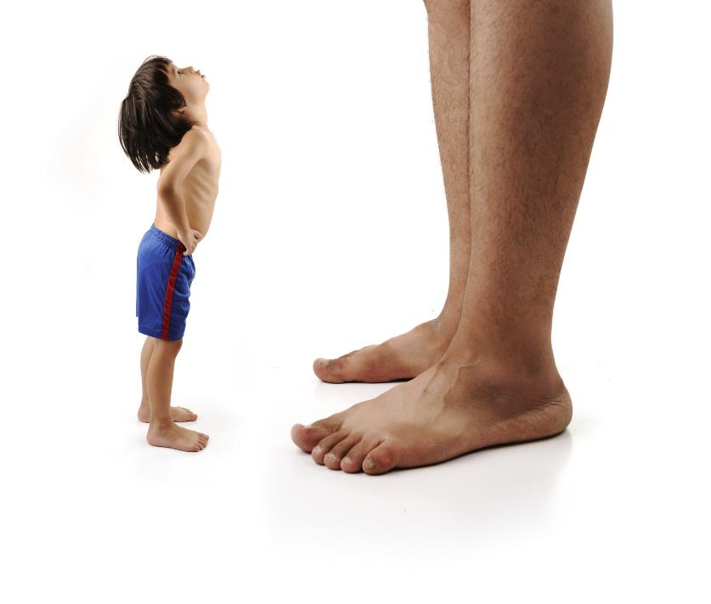
Identify Opportunities to Improve
Notes:
To Know/To Say: In essential function 1, the team gathered data to answer questions around important district or school functions. In essential function 2, the answers to these questions are compared to a conceptualized “desired reality” to identify potential improvement opportunities.

Slide 276
Select an Opportunity to Improve
Based on outcome data review
Aligned with the mission and essential functions of district or school
Important for students in school and in life
Social validity
Small in number
Biggest change for the effort
Horner 2011
Notes:
To Know/To Say: Even in the best run organizations, there are opportunities for improvement. Review your student outcome data that is related to the mission and essential functions of the district or school.
What are the opportunities to achieve better outcomes for students?
Is improving in this area important for students in school or in life?
Does pursuing this goal have social validity? In other words, is it meaningful and relevant to the students and their families?
Try to keep the number of school or district goals small in number, so that they are achievable.
Finally, consider Rob Horner’s advice that you select a goal that, if achieved, would result in the biggest change for the least amount of effort. This produces early wins that can provide much needed motivation for sustaining improvement efforts!

Slide 277

Analyze Data to Identify Possible Root Cause
Notes:
To Know/To Say: Once you have used data to identify an improvement goal, you will want to analyze data related to the problem. Analysis is a detailed examination of the structure or elements of something. When you conduct a data analysis, you are breaking down the data in such a way that you can define who is affected by the problem, and why the problem is occurring. This will allow you to select appropriate action steps that are most likely to produce the desired outcome.

Slide 278

Data Analysis
Disaggregate
Triangulate
Notes:
To Know/To Say: Two strategies for analyzing data are disaggregation and triangulation

Slide 279

Disaggregation
Use filters to remove extraneous information.
  Which students are involved?
    Classroom
    Gender
    Race and ethnicity
    With IEP/ without IEP
    Free & reduced price lunch
  Disaggregation is a problem finding strategy.
  Gets at the why the problem is occurring.
Notes:
To Know/To Say: Disaggregation basically involves applying filters to remove extraneous information that obscures or distorts what is happening. Disaggregation has been described as a problem finding strategy. And to the extent that it discovers specific problems that are otherwise hidden by aggregate data, it is. Think of a situation where the percentage of students who graduate within four years is relatively high. However, when graduation rates are disaggregated by demographic groups, the district discovers that lower SES students are not graduating on time or are dropping out. In this case, the team discovers a problem that they would have missed had they stopped after a review of aggregate data.
However, disaggregating data can also help the district or school to identify a possible cause of an outcome. Say there was a spike in suspensions. If the district stopped here, they might infer that something in the environment is causing an increase in unexpected behaviors. However, disaggregation by school reveals that one school in particular is suspending more students than the others. Further disaggregation discovers that African American and LatinX students are suspended at higher rates at this school. Additional disaggregation suggests that white students engaged in the same behavior are less likely to be suspended. Suddenly, a problem that originally appeared to be solely related to student behavior now appears to have a component of implicit or explicit bias! Such information can have profound effects on how the district responds to the problem!

Slide 280

Triangulation
Review 3 or more data sources related to the problem.
  At least 1 student outcome measure
  At least 1 measure of adult action/implementation
  At least 1 other source
Gets at Why the problem is occurring.
Notes:
To Know/To Say: The term triangulation comes from navigation, and refers to the practice of using three or more data points to determine one’s location on the globe. In social sciences, the term refers to using three or more data points to determine the root cause of a problem that you are trying to solve.

Slide 281

What Data Sources?
Hypotheses
  Adult activities
  Perspectives
  Other Outcomes
  Disaggregated data
  Diagnostics
Notes:
To Know/To Say: The data that you gather together to triangulate will depend upon the problem you are trying to solve. That said, here are some things you might consider as you are determining what data to triangulate:
Do you have any hypotheses that would explain what you are seeing? What data sources might confirm or refute these hypotheses?
Make sure that at least one of these data sources measures adult activities that may be contributing to the outcome
Are there sources of data that can provide different perspectives?
Student
Teacher
Admin
Parents
Can outcome sources be disaggregated to understand whether the problem affects all subgroups equally
Race and ethnicity
Classroom/teacher
Grade level
Are there sources of data that can help you to diagnose what you are observing?

Slide 282

Why? to Why!
Notes:
To Know/To Say: Data triangulation often leads to more inquiry. The team notices a relationship, and asks, “why is this happening?” This leads to a new hypothesis, and a review of additional data sources, and new questions, until the team feels like they have dug down to the root cause of the problem.
For example, a team is trying to get at the reason why students drop out. They triangulate data and notice a relationship between academic achievement, student attendance, and suspensions. This leads them to inquire whether poor academic skills are causing escape motivated behavior, or if students are engaging in escape motivated behavior because of poor student-adult relationships or because they don’t feel connected to school, which in turn leads to poor academic achievement. This might lead the team to review diagnostic assessment data, patterns of ODR data, and a survey of student perceptions of school climate.

Slide 283

Partner Activity
A school climate survey reveals that students do not feel safe at school.
  Identify 3 or more possible data sources that could help you understand why this is occurring.
  Use “why?” to identify additional data sources.
  Prepare to share.
Notes:
To Know/To Say: With a partner, identify at least three data points that would help you to determine why your students report that they don’t feel safe at school. Consider data that
Verify or refute Hypotheses
Measure Adult Activities or practices
Provide different Perspectives
Disaggregate the data
Diagnose student problems
How might these data sources lead to additional inquiry?

Slide 284
EF 3: Educators determine action steps.
Notes:
To Know/To Say: Once the team has a fairly good idea of the root cause, they are ready for Essential Function 3: Educators determine action steps. This aligns with the third step of GAINS: intentionally act, and analyze again. The purpose of this step is to select evidence based strategies or practices that address the root cause of the problem or challenge that the team is trying to solve, and frequently review implementation and outcome data to monitor progress and make any necessary mid-course corrections.

Slide 285
Select Change
Evidence-based
Directly addresses root cause
Contextual fit
Capacity
Notes:
To Know/To Say: When selecting action steps to address the problem, look for actions for which there is evidence to support their use in achieving the desired outcome, preferably with a population similar to your target population. In addition, you will want to consider “Contextual Fit.” In other words, do the individuals who will implement the strategy believe in the strategy? Finally, does the staff have the capacity in terms of skills, time, resources, etc., to implement the action steps.

Slide 286
Consider
Practices
Intensify Fidelity
Instructional
Organizational
Leadership
Programmatic
Leadership and Learning DMR
Notes:
To Know/To Say: Action steps teams can select and implement to address the problem can be an or some combination of the following:
Practices
Intensify Fidelity
Instructional
Organizational
Leadership
Programmatic

Slide 287

Alignment
NIRN Hexagon Tool
Evidence
Usability
Supports
Need
Fit with current initiatives
Capacity to Implement
Metz & Louison (2018)
Notes:
To Know/To Say: In addition, it is important that any new practices, strategies, or programs you adopt are a good fit for your organization. The National Implementation Research Network (NIRN) has developed The Hexagon Tool to help schools and districts assess whether a new program or initiative would be a good fit for your organization. The hexagon tool assesses fit over 8 parameters:
Evidence
Usability
Supports
Need
Fit with current initiatives
Capacity to Implement
More information is available at https://nirn.fpg.unc.edu/resources/hexagon-exploration-tool

Slide 288
Develop Systems
Communicate
Train
Coach
Reinforce
Correct
Resources
Notes:
To Know/To Say: As you consider action steps or tasks that need to be completed to put the strategy or practice in place, you may want to consider systems that will support staff in implementing the new practice or strategy. How will you communicate plans to staff? How will you train and coach staff? How will you reinforce staff as they learn new skills? What resources will you provide staff to make implementing easier and more efficient?

Slide 289
Create a Plan
Goal
Practice/strategy
Action steps
Resources
Person(s) responsible
Timeline
Evidence of completion
Notes:
To Know/To Say: Once you have identified a goal and selected an appropriate practice or strategy, it is important to put it into an action plan format. While there are a variety of action plan formats you can select, a good action plan identifies what you are trying to do, how you will do it, who is responsible for what, and when will it be accomplished. In addition, you may want to consider what additional resources will be needed and identify how you will know when a given action step or series of action steps have been completed.

Slide 290
Implement Change
Notes:
To Know/To Say: The number one reason why a plan fails is that it was never implemented! Implement the plan! As you implement, hold yourselves accountable to your action plan by meeting periodically to monitor plan implementation and progress toward your goal.

Slide 291
Monitor Progress
Notes:
To Know/To Say: Progress monitoring involves reviewing two pieces of data, one that measures whether the adults are implementing important components of the plan, and whether students are making adequate progress toward the goal.

Slide 292
Did we implement the plan?
Yes
No
Did we find the right root cause?
Did we address the right root cause?
Are there obstacles to implementation?
Yes
No
Yes
Modify plan to better address cause.
No
Go back to data to determine root cause.
Address obstacles.
Implement plan.
Notes:
To Know/To Say: If you are not making adequate progress toward your goal, you can use this decision tree to guide next steps.
Are we making adequate progress?
Yes: keep doing what we are doing
No: Did we implement the plan?
Yes
Did we find the right root cause?
Yes
Modify the plan to better address the root cause
No
Go back to data to identify the correct root cause
No
Are there obstacles to implementation
Yes: address the obstacles
No: Implement the plan

Slide 293

Activity
Think about the programs, initiatives, and practices you currently implement.
  Do you have data showing they are effectively achieving important goals?
  Does staff suffer from initiative overload or fatigue?
  Are there ineffective initiatives, programs, or practices that you could stop doing?
  Do staff currently have the knowledge and skills to implement them with fidelity?
  Are they aligned with other school or district activities?
Notes:
To Know/To Say: Think about the programs, initiatives, and practices you currently implement in your school or district.
Do you have data showing they are effectively achieving important goals?
Does staff suffer from initiative overload or fatigue?
Are there ineffective initiatives, programs, or practices that you could stop doing?
Do staff currently have the knowledge and skills to implement them with fidelity?
Are they aligned with other school or district activities?
With a partner, answer the following questions. Be prepared to share.

Slide 294
EF4: Educators use implementation and student outcome data to determine next steps.
Notes:
To Know/To Say: The fourth essential function, Educators use implementation and student outcome data to determine next steps, corresponds to the 4th and 5th components of GAINS: Notice and Adjust, and Systematically repeat. This refers to using data to evaluate the effectiveness of our plan, and select next steps based on this evaluation

Slide 295
Evaluate Plan
 | Goal not met | Goal met
Plan not implemented | Are there obstacles to implementation? Yes: Modify plan to eliminate the obstacles. No: Implement the plan. | Look at data to determine why the goal was achieved, so you can replicate.
Plan implemented | Re-analyze data; develop an alternate hypotheses; modify the plan to address the alternative hypothesis. | Plan for sustained implementation. Return to data to identify a new problem to address.
Notes:
To Know/To Say: This table shows a decision making rubric for evaluating the plan and determining next steps. This will work with any plan, academic or behavior. It is based on two questions: Did we meet our goal? And Did we implement our plan?
If the Goal was not met and the team did not implement with fidelity, then the team must determine whether there were obstacles to implementation. If so, they should modify the plan and try again. If there were no obstacles, then the team needs to implement their plan.
If the goal was not met and the team implemented the action steps with fidelity, then they should reanalyze the data and reassess whether they identified the correct problem and whether their action steps were aligned with the problem
If they met their goal, but they did not implement their plan, they may want to go back to the data to determine why the goal was met. This may help them to avoid or solve problems in the future.
Finally, if the goal was met, and they implemented the plan with fidelity, then they should go back to the data and begin the cycle again with a new focus problem. This proactive approach to solving problems will help the team to establish cycles of continuous improvement.

Slide 296
Then we systematically repeat…
Creating cycles of continuous improvement.
Notes:
To Know/To Say: Once the team has evaluated the plan, they start the cycle again, reviewing data to identify the next problem to solve. This usually occurs at the next data meeting following the end of a data cycle. Thus establishing cycles of continuous improvement.

Slide 297
Achieving District/School Climate and Behavior Improvement Goals Through DBDM
in Practice
Notes:
To Know/To Say: So, what does this look like in action?

Slide 298

Missouri DLT
Read the Scenario A Missouri DLT Setting District Improvement Goals.
Identify the Essential Features of the DBDM Practice Profile.
Notes:
Trainer Notes: Copy HO21_A Missouri DLT Setting District Improvement Goals for each participant
To Know/To Say: Read HO21_A Missouri DLT Setting District Improvement Goals. Use the 4x4 on the last page to identify evidence of each of the Essential Functions.

Slide 299
Achieving District/School Climate and Behavior Improvement Goals Through DBDM
in Action
Notes:
Trainer Notes:
To Know/To Say:

Slide 300
Activity:
Got It! | Need It
Adapted from Lipton, L., Wellman, B., (2011)
Notes:
Trainer Notes: Copy HO22 Got it-Need it for each participant, or have teams draw a T chart on chart paper, and label the left and right columns Got it and Need It, respectively.
To Know/To Say: Think about your own District or Building Leadership Team; what do you currently have in place that will support meeting as a team and using a Data-Based Decision-Making process to establish improvement goals? What does your organization still need to put in place to make this happen. Complete the HO22 Got it-Need it handout, then use it to determine next steps for your organization.

Slide 301
Closing and Next Steps

Slide 302
Closing and Next Steps
Notes:
To Know/To Say: During this lesson, you learned about engaging in DBDM to select and achieve district and school improvement goals.
How will you get district and building leadership teams to engage in DBDM to select and achieve improvement goals?
Next steps include updating your action plan. Develop action steps for engaging in DBDM at district and building levels.
Additional information about Data-Based Decision-Making can be found in the MO SW-PBS Handbook and the MO SW-PBS Tier 1 Implementation Guide

Slide 303
References
Gilbert, T.F. (1978). Human competence: Engineering worthy performance. New York : McGraw-Hill.
Gresham, F. M., Sugai, G., & Horner, R. H. (2001). Interpreting outcomes of social skills training for students with high-incidence disabilities. Exceptional Children, 67(3), 331-344.
Horner, R. (March 8, 2016). Personal Communication.
Horner, R.H. (2011). Moving PBS forward with quality, equity and efficiency. Keynote: Eighth International Conference of the Association for Positive Behavior Support. Denver: CO.
Lipton, L., and Wellman, B., (2011). Groups at work: Strategies and structures for professional learning. Sherman, Connecticut: MiraVia.
Metz, A. & Louison, L. (2018) The Hexagon Tool: Exploring Context. Chapel Hill, NC: National Implementation Research Network, Frank Porter Graham Child Development Institute, University of North Carolina at Chapel Hill. Based on Kiser, Zabel, Zachik, & Smith (2007) and Blase, Kiser & Van Dyke (2013).retrieved on 5-13-2020 from https://nirn.fpg.unc.edu/resources/hexagon-exploration-tool.
PBIS Apps (2016). Swift at SWIS. University of Oregon.
Ritchhart, R., Church, M., Morrison, K. (2011). Making Thinking Visible: How to promote engagement, understanding, and independence for all learners. San Francisco, California: Josey-Bass
Reaves, D.A. (2006). The learning leader: How to focus school improvement for better results. Association for Supervision and Curriculum Development:Alexandria, Virginia.
Scott, T., Anderson, C., Alter, P. (2012). Managing classroom behavior using positive behavior supports. Pearson:Upper Saddle River, New Jersey.
Sugai, G., Sprague, J.R., Horner, R.H., & Walker, H.M. (2000). Preventing school violence. The use of office discipline referrals to assess and monitor schoolwide discipline interventions. Journal of Emotional and Behavioral Disorders, 9(2), 94–101.
Tilly, W. D. (2008). The evolution of school psychology to science-based practice: Problem-solving and the three-tiered model. In A. Thomas & J. P. Grimes (Eds.), Best practices in school psychology V (pp. 17-36). Bethesda, MD: National Association of School Psychologists.

Slide 304
Questions & Contacts
Name(s) and Contact Information
Notes:
Trainer Notes: Add names and contact information of the presenter(s) in the text box. Use this time to check for understanding and questions

Slide 305
Contact Information
Check Out MO SW-PBS on Social Media:
Facilitator Contact Information:
pbismissouri.org
facebook.com/moswpbs
@MOSWPBS

