Slide 1
Hidden Slide #1
Presenter notes information
Tools and documents
Helpful suggestions
Notes:
To Know: Beginning in September 2017, Missouri replaced the term “learning package” with the term “professional learning module.”
The School-Based Implementation Coaching (SBIC) professional learning module is organized in five parts and the presenter may be flexible in the presentation order of the essential functions:
Educators develop and maintain coaching relationships.
Educators provide effective feedback.
Educators develop a strategic and differentiated coaching plan.
Educators use solution dialogue.
Educators progress monitor implementation of effective educational practices.
These five parts correspond to the five essential functions within the Practice Profile. This sequencing is used throughout the PowerPoint and the Practice Profile.
Each section of the presentation will take approximately 45 minutes to complete. This includes the introductory slides as one section and each essential function section starting with a blue transition slide.
The Content Fidelity Checklist aligned to each PowerPoint includes all critical items for a training session. The High Quality Professional Development (HQPD) Training Checklist and HQPD Coaching Checklist contain process elements to be used as guidance when designing, revising, or coaching high quality professional development.
Important notes:
A script of presenter notes is included in the PowerPoint. Background information for the presenter is shown as “To Know.” Statements to be shared with participants are shown as “To Say.” In some instances, the “To Know/To Say” are the same material. For fidelity of content and consistency among presenters, the “To Say” information should be presented with minimal paraphrasing. The presenter notes also include “To Do” prompts and cues for “Handouts.”
A presenter may add slides to supplement the content. For example, a slide of essential questions may be added since only learning targets have been included.
A presenter may choose to differentiate a presentation to meet the needs of the participants. For example, another form may be substituted for the Next Steps template if the district or building already uses a similar form or protocol.
Additional activities, examples, videos, etc. are being developed. A presenter may interchange the additional material for the corresponding PowerPoint content.
A print Practice Profile and an electronic Self-Assessment Practice Profile (SAPP) tool are available for use by individuals, teams, or schools for periodic self-assessment and monitoring of implementation of practice or to identify training or coaching needs.
The presenter should download onto a hard drive or a flash drive any video intended for use in a training. The links shown on slides may not be able to be accessed online at the school sites.
Breaks should be inserted at the discretion of the presenter based on the needs of participants.

Slide 2
Hidden Slide #2
Supplies needed:
Various colors of highlighters
Chart paper and markers
Post-it-Notes
Notes:
To Know: These supplies are needed for the School-Based Implementation Coaching professional learning module.

Slide 3

Hidden Slide #3
Handouts needed:
School-Based Implementation Coaching Key Terms
Synopsis of Coaching Principles
SBIC Infographic
SBIC Practice Profile
Benefits of SBIC
Discovering Your FRAME Activity Directions
Discovering Your FRAME
How Can a Coach Gain a Teacher’s Trust?
Find Someone Who Can Give a Tip
10 Steps to Building Trust
30 Second Feedback
7 Tools for Developing Teachers and Teaching, Tool 1: 30 Second Feedback
Criteria for Providing Feedback
Growth Goal Plan
Example DACL Practice Profile
Example DACL Growth Goal Plan
Example Solution Dialogue Script
Solution Dialogue Activity Cards
Types of Coach-Teacher Conversations
Next Steps Action Plan for SBIC
SBIC References
Notes:
To Know: The handouts are available on MOEDU-SAIL. They are combined into one pdf titled: SBIC 2018 Handouts Combined
The handout title for each slide is provided in the presenter notes. The handout icon is shown on the slide in the lower right-hand corner on appropriate slides.

Slide 4
Hidden Slide #4
Pre-Reading
Synopsis of Coaching Principles
Notes:
To Know: The pre-reading is a Synopsis of Coaching Principles taken from several experts. Early in the PowerPoint, the participants will compare the similarities found within the Synopsis of Coaching Principles handout. Send the SBIC 2018 Handouts Combined pdf specifying the pre-reading assignment to the attendees prior to the training.
Handout: Synopsis of Coaching Principles (included in the SBIC 2018 Handouts Combined pdf)

Slide 5
Hidden Slide #5
SBIC Key Terms:
Coaching
    A. Coach
    B. Coachee, Client, Educator, or Teacher
Effective educational practices
Effective teaching and learning practices
Feedback
Modeling
Practice Profile terminology
    A. Essential Functions
    B. Criteria
Solution dialogue
School-Based Implementation Coaching
Notes:
To Know/To Do: Participants should become familiar with key terms used within the SBIC professional learning module. Clarifying these terms will facilitate a better understanding of concepts. Send the SBIC 2018 Handouts Combined pdf suggesting participants review the SBIC Key Terms handout prior to the training.
Handout: School-Based Implementation Coaching Key Terms (included in the SBIC 2018 Handouts Combined pdf)

Slide 6

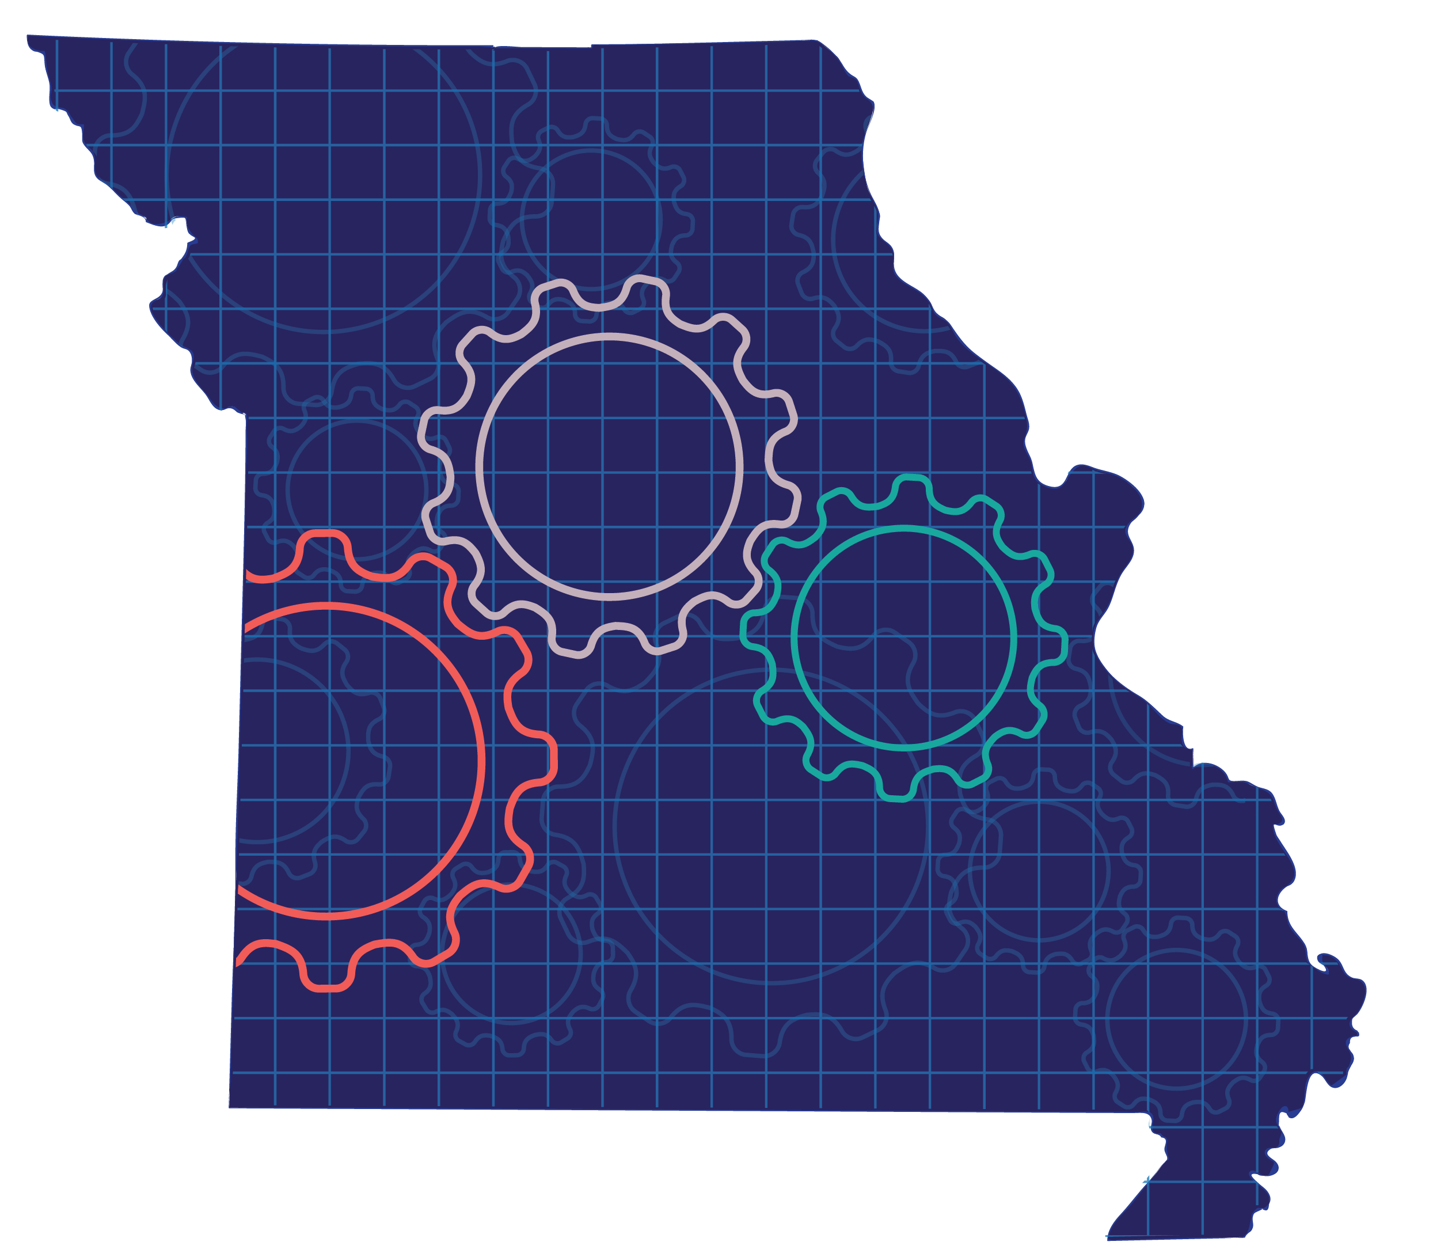
School-Based
Implementation Coaching
Notes:
To Know: This module is not promoting any specific coaching model. School districts may be using a specific coaching model, for example Marzano, Knight, Cognitive Coaching, etc. Since this module is intended to be an overview, participants are asked to make a connection between the specific model they may be implementing and the elements included in the overview.
To Know/To Say: Good morning/afternoon! We will begin the School-Based Implementation Coaching training in _____ minutes.
As we wait to begin, please write a definition of School-Based Implementation Coaching and save it for later in the session.
To Do: Greet participants.

Slide 7
Acknowledgements
Special thanks to all contributors to the development and revision of this professional learning module.
The original Internal Coaching learning package was vetted for use by Regional Professional Development Center (RPDC) Consultants in October 2014. This package was updated and given a new title, School-Based Implementation Coaching and was rolled out in June of 2015. A second revision was completed December of 2017. The collection of learning packages was developed through efforts funded by the Missouri State Personnel Development Grant (SPDG).
The following individuals/groups are thanked immensely for their hard work in developing this package:
Content Development and Revision Support
Institute for Human Development
Ronda Jenson Jodi Arnold
Arden Day Stefanie Lindsay
Sarah Marten Carla Williams
SPDG Management Team
Notes:
To Know/To Say: Special thanks to all contributors to the development and revision of this professional learning module.

Slide 8
Tammy Brotherton, SE RPDC Marsha Lay, Lead SIS
Liz Condray, SC RPDC Lisa McCarty, KC RPDC
Suzy Cutbirth, SW RPDC Chris Montgomery, StL, RPDC
Jennee Gregory, NW RPDC
Internal Coaching
Development Team, 2014
School-Based Implementation Coaching
Content Development, 2015
Suzy Cutbirth, SW RPDC
2017-18 Revision Team
Julie Antill, SE RPDC Cynthia Matthew, SE RPDC Andrea Rockney, SW RPDC
Pam Carte, NE RPDC Jamie Mehring, StL, RPDC Thea Scott, DESE
Janet Crafton, SC RPDC Heidi Newlon, KC RPDC Sarah Spence, Facilitator
Deb Drury, NE RPDC Janice Putman, StL RPDC Nancy Steele, Facilitator
Jeff Freeland, KC RPDC Carol Reimann, SE RPDC Sheila Thurman, NE RPDC
Bev Kohzadi, C RPDC Paige Roberts, KC RPDC Cheryl Wrinkle, SW RPDC
Notes:
To Know/To Say: Thank the contributors.

Slide 9
School-Based
Implementation Coaching
The contents of this presentation were developed under a grant from the US Department of Education to the Missouri Department of Elementary and Secondary Education (#H323A120018). However, these contents do not necessarily represent the policy of the US Department of Education, and you should not assume endorsement by the Federal Government.
This work is licensed under a
Creative Commons Attribution-NonCommercial-NoDerivatives 4.0 International License

Slide 10
Welcome and Introductions
Our trainers for the day are
Notes:
To Know: Add the name(s) of the trainer(s) to the slide.
To Know/To Say/To Do: The introductions may be formal or informal depending on how well you know the group. Trainers should use whatever process is comfortable for introductions. I am/we are _______________ (provide some background about trainers.) Please introduce yourself to the group (name, district, position.)
To Do: (optional) Consultant may develop an ice-breaker or introductory activity.

Slide 11
Norms
Begin and end on time
Be an engaged participant
Be an active listener—open to new ideas
Use notes for side bar conversations
Use electronics respectfully
Notes:
To Know/To Do: It is important to establish norms for training. Trainers are free to adjust this list of norms.
Consider including a check mid-way through trainings to assess a norm or norms. The presenter may want to use norms printed on agenda handouts, in addition to or in place of presentation slides, so the norms are always available in print for participants. Norms may be added to address specific school needs. Some schools already have established norms for all PD. In that case, adapt to their norms.
To Say: Please review the norms for this training. Are there any additions that need to be made to the norms at this time?

Slide 12




Icon Glossary
School-Based Implementation Coaching
Step-By-Step Guide
Reflection/Activities
Handout Packet
Essential Questions
Blueprint
Notes:
To Know/To Do/To Say: These icons will be used throughout the presentation. The icon should signal the type of content, appropriate activity, or materials to reference.

Slide 13
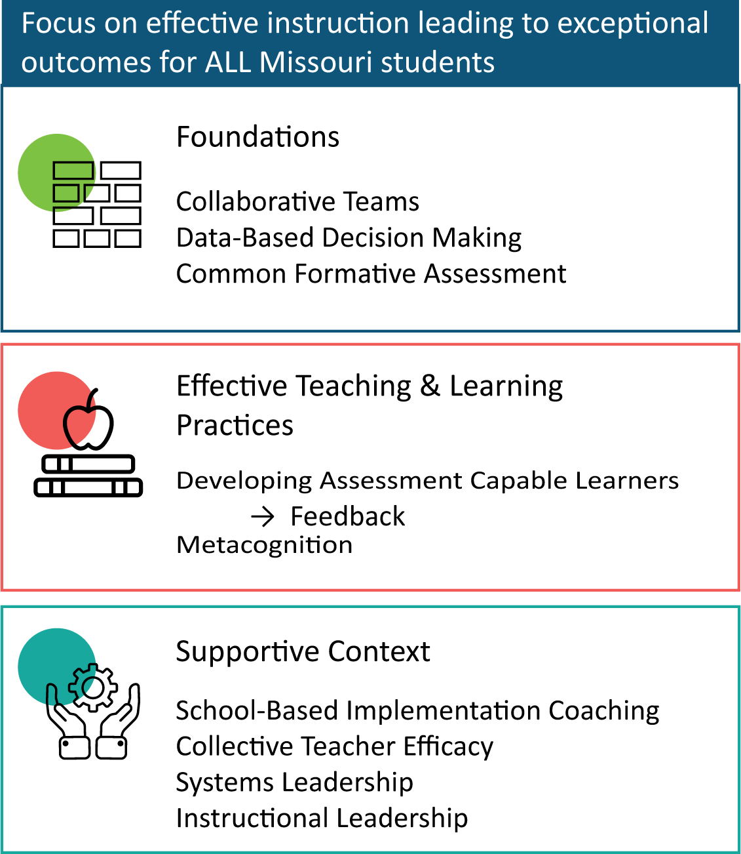
DCI Framework
(District Continuous Improvement framework: Blueprint for district and building leadership, sixth edition, p. 11)
Notes:
To Know: Missouri’s professional learning modules are organized in the same three categories as defined in the DCI Framework. All schools begin their professional development journey with the Foundations, as these professional learning modules provide foundation knowledge in three key areas: Collaborative Teams, Data-Based Decision Making, and Common Formative Assessment. Effective Teaching & Learning Practices encompass research-based instructional practices for deepened learning. These professional learning modules address ways of connecting with students, ways of helping students learn how to learn, and feature specific instructional practices. Supportive Context contains professional learning modules designed to help school staff support and enhance the implementation of Effective Teaching & Learning Practices through using technology, leadership, and coaching supports. School-Based Implementation Coaching is part of the Supportive Context.
To Do/To Say: Before we delve into SBIC, let’s take a few minutes to review the DCI Framework graphic, looking specifically at where SBIC falls into the larger content.
As you see, the focus of DCI is on effective instruction leading to exceptional outcomes for all Missouri students.
The DCI Framework has three main components:
Foundations (consisting of Collaborative Teams, Data-Based Decision Making, and Common Formative Assessment)
Effective Teaching and Learning Practices (Developing Assessment Capable Learners with Feedback and Metacognition), and
Supportive Context (where SBIC falls along with Collective Teacher Efficacy, Systems and Instructional Leadership)
Reference: MoEdu-Sail. (2022). District Continuous Improvement framework: Blueprint for district and building leadership, sixth edition.

Slide 14
Synopsis of Coaching Principles
What similarities are found within the various authors’ tips as listed on the Synopsis of Coaching Principles?
Record key terms
Using these terms, develop a list of considerations for coaching.
Notes:
To Know: If the pre-readings (Synopsis of Coaching Principles and Key Terms) were not sent prior to the training session, additional time may need to be allowed for this activity. The presenter may choose to shorten the activity by only addressing items #1 and #2 at this time. Item #3 can be utilized at a later time in the PowerPoint, possibly early in essential functions #3 or #4.
To Know/To Say: Work with a partner to review the Synopsis of Coaching Principles handout. Compare the similarities of the authors’ coaching tips or principles and record key terms on a sheet of paper. Discuss the lists at tables. The School-Based Implementation Coaching Key Terms handout may be used to build common understanding.
Handout: Synopsis of Coaching Principles (included in the SBIC 2018 Handouts Combined pdf)
School-Based Implementation Coaching Key Terms (included in the SBIC 2018 Handouts Combined pdf)

Slide 15
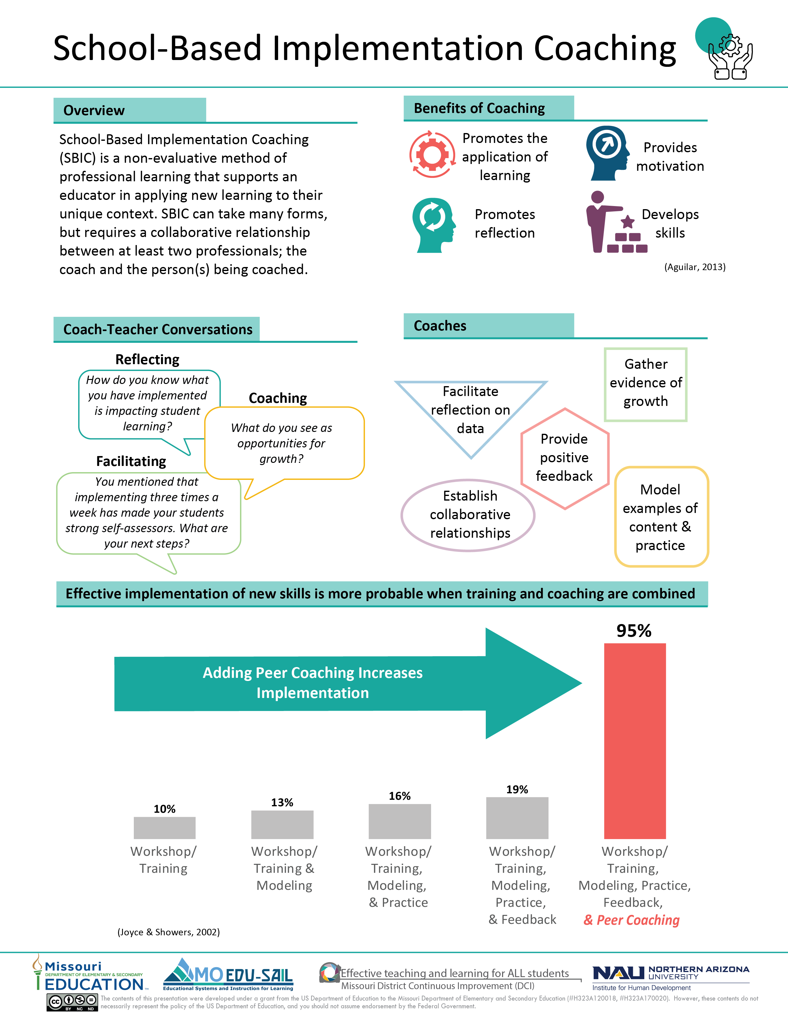
(Joyce & Showers, 2002)
Notes:
To Know: The infographic might be sent prior to the training. This is an opportunity for the presenter to provide a hook as to why SBIC is important.
To Know/To Say: The SBIC infographic summarizes key content from the professional learning module. Direct attention to each component with a quick overview.
Handout: School-Based Implementation Coaching (infographic) (included in the SBIC 2018 Handouts Combined pdf)
Reference: Joyce, B. R., & Showers, B. (2002). Student achievement through staff development (3rd ed.). Alexandria, VA: ASCD.

Slide 16
School-Based Implementation Coaching and
Missouri Teacher Standards
Standard 8: Professionalism
Standard 9: Professional Collaboration
(Missouri Department of Elementary and Secondary Education, 2013)
Notes:
To Know/To Say: School-Based Implementation Coaching aligns with the Missouri Teacher Standards.
Standard #8: Professionalism. The teacher is a reflective practitioner who continually assesses the effects of choices and actions on others. The teacher actively seeks out opportunities to grow professionally in order to improve learning for all students.
Standard #9: Professional Collaboration. The teacher has effective working relationships with students, parents, school colleagues, and community members.
References: Missouri Department of Elementary and Secondary Education (MO DESE). (2013). Teacher Standards: Missouri's educator evaluation system. Retrieved from: http://dese.mo.gov/sites/default/files/TeacherStandards.pdf

Slide 17
Session-at-a-Glance
The Why:
Purpose and Benefits of School-Based Implementation Coaching
The Process:
  Develop and maintain coaching relationships
  Provide effective feedback
  Develop a strategic and differentiated coaching plan
  Use solution dialogue
  Progress monitor implementation of effective educational practices
Next Steps:
Assessment, Reflection, and Action Planning
Notes:
To Know: The Session-at-a-Glance serves as an agenda for the session.
The five processes listed have been developed by using the essential functions from the SBIC Practice Profile. If the presenter wishes to explain the Practice Profile at this time, two hidden slides can be found later in this section that may be used: SBIC Practice Profile and SBIC Self-Assessment Practice Profile.
To Know/To Say: The School-Based Implementation Coaching professional learning module addresses The Why, The Process, and Next Steps for implementing SBIC. We will review the purpose and benefits of SBIC, as well as each essential function. Participants will also have an opportunity to reflect on their learning and begin action planning. The essential functions of SBIC are:
Educators develop and maintain coaching relationships.
Educators provide effective feedback.
Educators develop a strategic and differentiated coaching plan.
Educators use solution dialogue.
Educators progress monitor implementation of effective educational practices.

Slide 18
Learning Targets
I am learning to:
Understand the purpose and benefits of School-Based Implementation Coaching
Develop and maintain coaching relationships
Provide effective feedback
Develop a strategic and differentiated coaching plan
Use solution dialogue
Progress monitor implementation of effective educational practices
Notes:
To Know: The Learning Targets slide may be used instead of the Essential Questions slide.
To Know/To Do: If participants do not have a copy of the PowerPoint, learning targets may be posted on chart paper or printed on a handout. Review the learning targets.
To Know/To Say: The learning targets include the essential functions from the SBIC Practice Profile. This alignment will provide consistency.

Slide 19
Essential Questions
Why is School-Based Implementation Coaching beneficial?
Why are strong coaching relationships important and how can they be built?
How can feedback help improve instructional practices?
Why is a strategic and differentiated coaching plan necessary and how can it be developed?
How is solution dialogue used to help educators reach growth goals?
Why is progress monitoring implementation of effective educational practices important and how can it be done?
Notes:
To Know: The Essential Questions slide may be used instead of the Learning Targets slide.
To Know/To Do: Each Essential Question can be written on chart paper and placed around the room.
To Know: This is an optional activity. Write initial responses to these questions. As the training continues participants may add to the answers to these questions. If time permits, a carousel structure could be utilized to allow participants to respond, collaborate, and process the questions. This helps to activate thinking and access prior knowledge.
To Know/To Say: These questions will help activate thinking and access prior knowledge about what we already know about SBIC implementation. This will help us make connections as we learn more about School-Based Implementation Coaching.

Slide 20
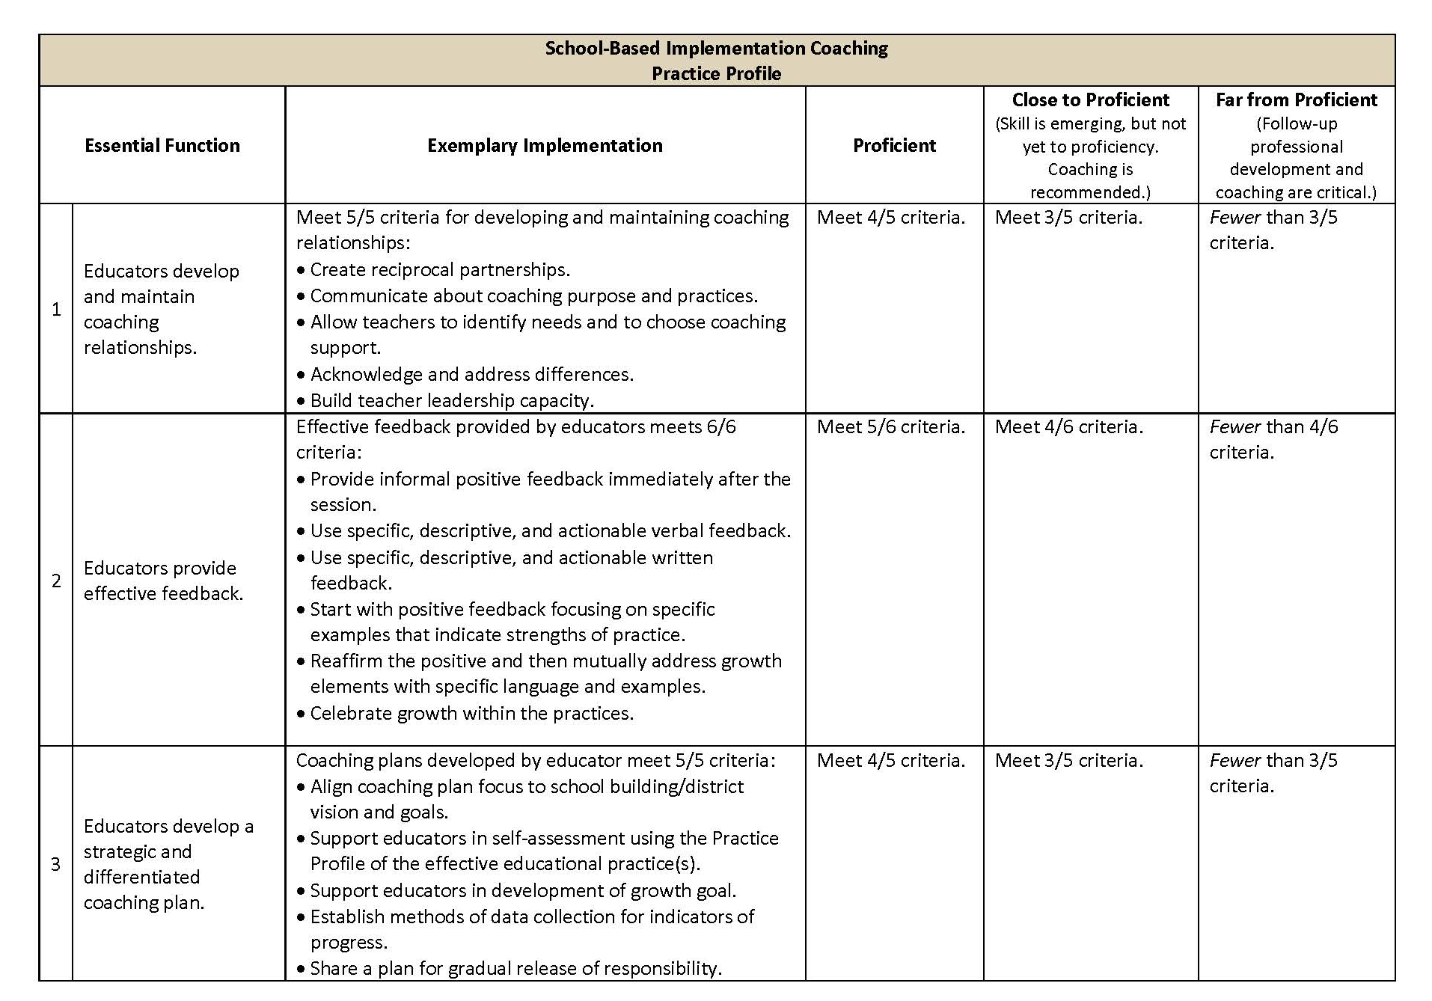
Practice Profile
Notes:
To Know: This is a hidden slide. It may be used now or later in the presentation depending on the presenter’s preference.
To Do: Review the practice profile with the participants. Suggest all stake-holders complete a self-analysis three or four times a year and engage in collaborative conversation.
To Know/To Say: The Practice Profile template includes four pieces and is anchored by the essential functions. First, as a header is the foundation of implementation that philosophically grounds implementation. Then moving from left to right across the template are the essential functions of the practice, implementation performance levels, and lastly, evidence which provides data or documentation for determining implementation levels.
The essential functions align with the teaching/learning objectives for each professional learning module. Four levels of implementation are described for each teaching/learning objective: exemplary, proficient, close to proficient, and far from proficient. The professional development provider should walk through the practice profile with the educator-learners, referring to the data and artifacts listed as suggested evidence. It is an important tool for self-monitoring their own implementation because it serves as a reminder as to the implementation criteria and is also aligned with the fidelity checklists and the electronic practice profile self-assessment tool. These sources provide data regarding further training or coaching.
To Do/To Say: The Red/Yellow/Green Reflection is an optional activity, if you want participants to learn more about the information in the profile.
1. Read through the Exemplary Implementation column.
2. Use three colored pencils or markers (red, green, and yellow) to do the following:
If you feel an action stated may be challenging for you, underline it in red.
If you feel an action stated may be somewhat challenging but not too difficult, underline it in yellow.
If you feel an action stated may be easy for you, underline it in green.
3. Share with a shoulder partner what you feel may be easy and challenging and tell why. Consider how to address the challenging items.
Handout: School-Based Implementation Coaching Practice Profile (included in the SBIC 2018 Handouts Combined pdf)

Slide 21
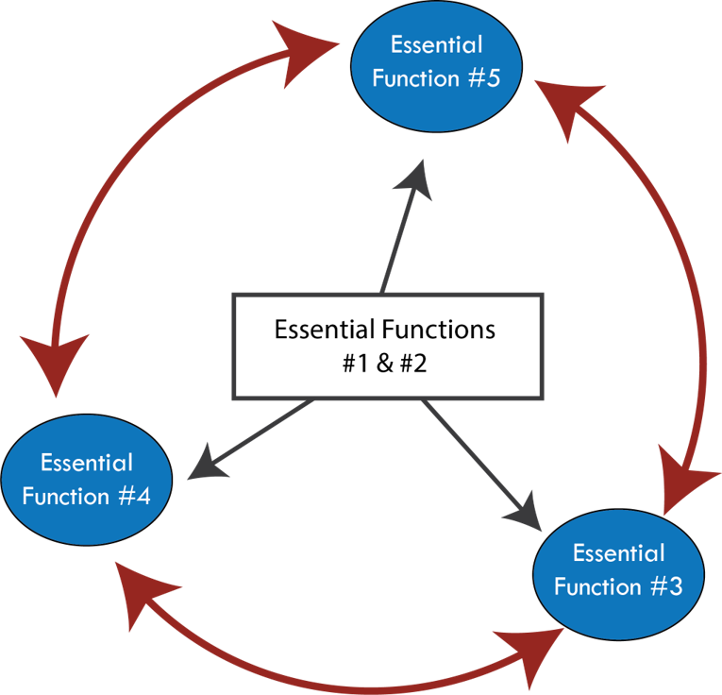
The School-Based Implementation Coaching Process
Notes:
To Know/To Say: This graphic shows how the five essential functions in the School-Based Implementation Coaching Practice Profile connect. Essential Functions #1 (Develop and maintain coaching relationships) and #2 (Provide effective feedback) are integral to the implementation of the other three essential functions.
The implementation of Essential Functions #3 (Develop a strategic and differentiated coaching plan), #4 (Use solution dialogue), and #5 (Progress monitor implementation of effective educational practices) is not linear but should be integrated throughout the coaching process.

Slide 22





Format of Professional Learning
95%
Know Thy Impact
Teacher Transfer Rate
19%
13%
16%
10%
Workshop/ Training
Workshop/ Training
& Modeling
Workshop/ Training, Modeling, &
Practice
Workshop/ Training, Modeling,
Practice, & Feedback
Workshop/Training, Modeling,
Practice, Feedback, &
Peer Coaching
Format of Professional Learning
(Adapted from: Joyce & Showers, 2002)
Notes:
To Know: If providing a handout of the PowerPoint slides, the presenter may not wish to include this slide since it provides the answers to the optional activity on the previous slide.
To Know/To Say: A take on John Hattie’s advice to teachers “Know thy Impact” also applies to professional development peer coaching. Compare your determined percentages to the chart.
To Do: Ask the participants to discuss their results with a shoulder partner or at their tables. Which percentages matched with your thinking? Which percentages surprised you?
References: Joyce, B. R., & Showers, B. (2002). Student achievement through staff development (3rd ed.). Alexandria, VA: ASCD.

Slide 23
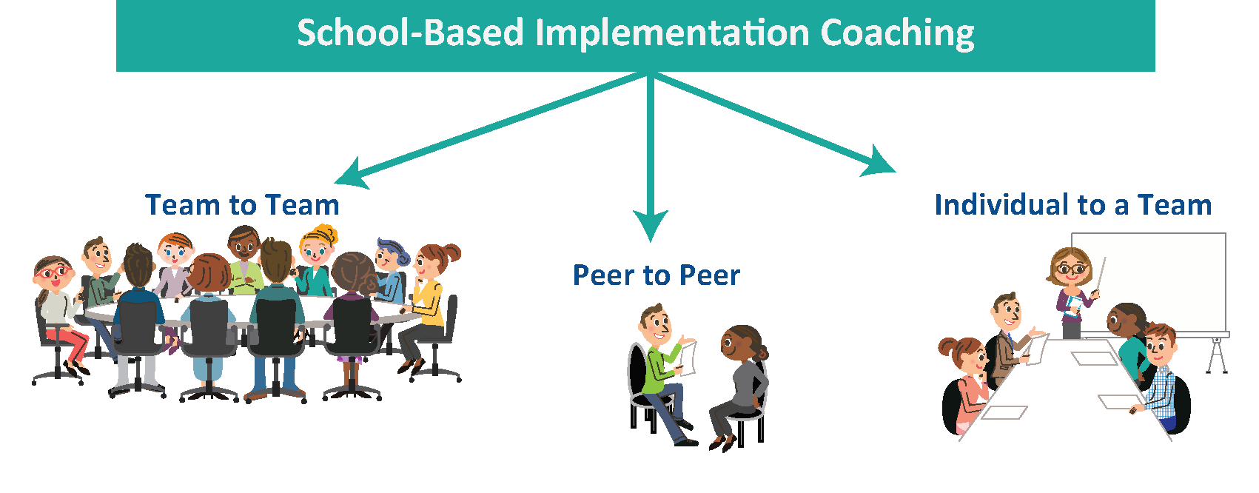
School-Based Implementation Coaching
Notes:
To Know: This professional learning module is an overview of School-Based Implementation Coaching. Its purpose is to provide an initial understanding of SBIC, its benefits, and a general framework for coaching. Additional staff development designed to address specific coaching needs of districts/buildings will follow this introductory module of SBIC.
SBIC has at least two people in a coaching relationship. The coach and the person(s) being coached. Terminology for these two entities is not consistent in this presentation due to the inclusion of the work of several authors. Sometimes the person(s) being coached is the coachee or the client. Frequently the terms “teacher” or “educator” are used. The presenter may want to clarify this terminology throughout the presentation.
To Know/To Say: School-Based Implementation Coaching (SBIC) is a non-evaluative process in which two or more professional colleagues work together for the purpose of improving instructional practice. The process involves a collaborative relationship, trusting culture, a clear purpose, and an agreed upon format which is solution-oriented and learner-centered.
Within Missouri District Continuous Improvement (DCI), School-Based Implementation Coaching may have a variety of structures depending on the district’s needs. DCI may use one of the following situations, but are not limited to these three examples:
Peer to Peer – A reciprocal coaching structure, one educator to another.
Individual Peer to a Team – One educator coaching a team of educators (grade level or content area team).
Team to Team
One grade level or content area team coaching another grade level or content area team within a building.
One building team coaching another building team within a district.
One team from District A coaching a team from District B.

Slide 24

What are the benefits of
School-Based Implementation Coaching?
Jot Your Thoughts
(Kagan & Kagan, 2009)
Notes:
To Know/To Say/To Do: What are the benefits of SBIC?
Jot your individual thoughts on post-it-notes (one thought per post-it-note). After you have exhausted your thoughts, place your notes in the center of the table. As a table group, categorize the notes.
The results from each table group can be verbally shared with the total group or a gallery walk can be conducted if the groups have placed their results on chart paper.
To Do/To Say: Distribute the handout Benefits of SBIC to each participant. Ask the participants to compare their table’s categories of benefits with the list on the handout. What could you add to the handout? What could you add to list generated at your table?
Handout: Benefits of SBIC (included in the SBIC 2018 Handouts Combined pdf)
Reference: Kagan, S., & Kagan, M. (2009). Kagan cooperative learning. San Clemente, CA: Kagan Publishing.

Slide 25
Extending Our Thinking
What coaching implementation supports exist in your school setting?
Share how you have received or provided coaching.
How might coaching enhance your teaching practices?
Notes:
To Know: This is a continuation of the Jot Your Thoughts activity on the previous slide. The answers to these prompts can serve as baseline information for ongoing discussion and future planning. This activity may be completed individually, by table, or by whole group.
To Say/To Do: Participants will take a few minutes to reflect on these three prompts, jot down answers on post-a-notes, and as a table collect answers on chart paper to post around the room. This will help to establish the background knowledge of coaching and posting for future reference.

Slide 26
The Implementation Coach
Essential Functions
Develop & maintain coaching relationships.
Provide effective feedback.
Develop a strategic and differentiated coaching plan.
Use solution dialogue.
Progress monitor implementation of effective educational practices.
Notes:
To Know: This slide shows the SBIC Practice Profile essential functions. If the Practice Profile has not been introduced, additional information is needed here and can be obtained on another slide.
To Know/To Say: As you can see, this slide lists five items to consider and do as a School-Based Implementation Coach. We will address the first essential function shown in red text.
To support consistency of practice, coaches and coachees need training in content for SBIC development and on-going coaching for implementation.

Slide 27
Essential Function #1
Educators develop and maintain coaching relationships.
Notes:
To Know/To Say: The SBIC Practice Profile has five main focus areas or essential functions. We will look at each essential function starting with the first essential function, Educators develop and maintain coaching relationships.
To Know: Essential Functions #2-#5:
Educators provide effective feedback.
Educators develop a strategic and differentiated coaching plan.
Educators use solution dialogue.
Educators progress monitor implementation of effective educational practices.

Slide 28

Discovering Your FRAME
Our FRAME is made from perceptions about:
Family Heritage Age Culture
Values Experiences Region Education
Abilities Gender Roles Hobbies
Other Influences
(Activity adapted from “Teaching Tolerance. (n.d.). Reflection: What's your frame? [Classroom Lesson]. Retrieved from https://www.tolerance.org/classroom-resources/tolerance-lessons/reflection-whats-your-frame”)
Notes:
To Know: This “valuing differences” activity is designed to help educators understand the importance of recognizing, respecting, and connecting to differences in others. This is especially important for those involved in coaching. After introducing the activity, have participants get in groups of 6-8. To be most effective, it would be best if groups were made up of individuals who were unfamiliar with one another.
To Say: In order for coaching to be successful, it is essential that you make connections and build relationships. The Discovering Your Frame activity is designed to emphasize the importance of (and ways of ) making connections to those you have things in common with, as well as to those who are different. This activity conveys the value of acquiring a “coaching lens” from which you can view things from the perspective of others.
All the things that make up who we are and how we view situations can be referred to as our FRAME. Our FRAME is made up of many things including: heritage, family, age, gender, education, physical abilities, values, roles, culture, region, experiences, values, hobbies, and other influences. We make connections to those having “things in common” within our FRAMES. We also make connections to differences. When we are reflective, ask questions, and respect the differences we see in others, those differences then become a part of our FRAME.
To Know: The handout The Discovering Your FRAME Activity Directions also includes space for participants to add additional information for each of the letters in FRAME at a later time.
Handouts:
Discovering Your FRAME Activity Directions (included in the SBIC 2018 Handouts Combined pdf)
Discovering Your FRAME (included in the SBIC 2018 Handouts Combined pdf)
To Say/To Do: Directions for the activity:
Think of words that describe you; words that make up your FRAME. (Example: mother, Hispanic, coach, pianist)
Choose four words to write on your FRAME; one on each side.
Get into groups of 4-6.
Each person takes a turn sharing their words to the group. If a word shared is one that could be a part of your FRAME, add the word somewhere on your frame.
If a word is different from one that might be part of your FRAME write it on the mirror.
When everyone has finished sharing their words, discuss things that people in the group have in common. These commonalities help us make connections and build trust.
Next, look at the differences written on your mirror. What questions might you pose to one another to help you have a better understanding of these differences and to help you see things from a different perspective? Connections are made through reflection, respect, and learning more about the differences of others. Once differences, these things now become a part of our FRAME.
To Do: Have participants stay in their groups and go to the reflection questions on the next slide.
Reference: Activity adapted from “Teaching Tolerance. (n.d.). Reflection: What's your frame? [Classroom Lesson]. Retrieved from https://www.tolerance.org/classroom-resources/tolerance-lessons/reflection-whats-your-frame”

Slide 29

Your FRAME - Reflections
How can recognizing commonalities help you make connections to others?
What can be done so “differences” seen in others become a part of your FRAME?
What learning can be taken from this activity and applied to coaching?
(Activity adapted from “Teaching Tolerance. (n.d.). Reflection: What's your frame? [Classroom Lesson]. Retrieved from https://www.tolerance.org/classroom-resources/tolerance-lessons/reflection-whats-your-frame”)
Notes:
To Do/To Say: Have participants return to their original groups and read/respond to the reflection questions.
Building strong coaching relationships is essential to being an effective coach. Seeking out commonalities is one way to connect to others, build, and strengthen relationships. You can also make connections by being respectful of differences, seeing things from the perspective of others, through reflection and questioning. Soon many of those differences will start to become a part of your FRAME and relationships will strengthen.
Reference: Activity adapted from “Reflection: What's your frame? (2017, September 27, 2017). [Classroom Lesson] Retrieved from https://www.tolerance.org/classroom-resources/tolerance-lessons/reflection-whats-your-frame”

Slide 30
Discovering Your Coaching FRAME
Valuing Differences
F – Figure out the facts
R – Reflect on reality
A – Challenge assumptions
M – Maintain an open mind
E – Expand your experiences
(Activity adapted from “Teaching Tolerance. (n.d.). Reflection: What's your frame? [Classroom Lesson]. Retrieved from https://www.tolerance.org/classroom-resources/tolerance-lessons/reflection-whats-your-frame”)
Notes:
To Know: Additional information for the FRAME is provided below. The presenter may choose to give this additional information and ask the participants to add notes to the handout, Discovering Your FRAME Activity Directions.
F — Figure out the facts: Not just what is apparent to you, but all the facts. Seek more information, ask questions, and listen.
R — Reflect on reality: Is it my reality or their reality? Am I looking at this through my FRAME or trying to see it through their FRAME?
A — Acknowledge and challenge assumptions: Think about your expectations and whether they are appropriate. Are you making assumptions based on your FRAME?
M — Maintain an open mind: Just because someone else’s FRAME differs from yours doesn’t make them wrong. What can you learn from them? What can they learn from you? What do you have in common?
E — Expand your experiences: Explore, expose yourself, and encounter differences; expand your comfort zone; increase your cultural competence.
To Say/To Do: Take a few minutes with a partner and discuss strategies for FRAME. These tips can help to forge strong partnerships while coaching.
Which strategies are your strengths? Which ones are opportunities for growth?
Reference: Teaching Tolerance. (n.d.). Reflection: What's your frame? [Classroom Lesson]. Retrieved from https://www.tolerance.org/classroom-resources/tolerance-lessons/reflection-whats-your-frame

Slide 31
“Without trust there can be no coaching”
(Echeverria & Olalla, as cited in Aguilar, 2013, p. 75)
Notes:
To Know/To Say: Trust is needed to establish positive coaching relationships. This was noted in Elena Aguilar’s book, The Art of Coaching.
Stephen Covey, author of The Speed of Trust (2008), defines trust as the feeling of confidence we have in another’s character and competence.
Reference: Aguilar, E. (2013). The art of coaching: Effective strategies for school transformation. San Francisco, CA: Jossey-Bass.

Slide 32
Pair/Share – Article Reflection
How Can a Coach Gain a Teacher’s Trust?
Guiding Questions:
Why is gaining trust essential in a coaching relationship and how might trust be built?
What preparatory steps should a coach take before engaging with a new client?
How can empathy and setting intentions be used for developing trust?
(Aguilar, 2013)
Notes:
To Know: This animated slide starts with the title, ‘How Can a Coach Gain a Teacher’s Trust’. Give directions about reading the article and determining which partner will read each passage. Allow time to read before the next click when ‘Guiding Questions:’ appears. Click through the questions allowing time between each question for individual reflection. Partners should then share their thoughts about each question. If time allows, ask for volunteers to share with the whole group.
To Know/To Say: We know how important trust is in a coaching relationship. Elena Aguilar suggests some preparatory steps a coach should take even before she begins engaging with her client. In the case of peer to peer, both are coaches, one for the other.
Take a couple of minutes to read the article How Can a Coach Gain a Teacher’s Trust?. Then read the introduction to the article. Find a partner. Partner A will read the section Start with Empathy and Partner B will read the Set an Intention passage. Individually reflect on the three questions appearing on the slide. With your partner discuss your thoughts about each of the three questions.
Handout: How Can a Coach Gain a Teacher’s Trust? (included in the SBIC 2018 Handouts Combined pdf)
Reference: Aguilar, E. (2013). How Can a Coach Gain a Teacher's Trust? Web Log Retrieved from http://blogs.edweek.org/teachers/coaching_teachers/2013/09/how_can_a_coach_gain_a_teacher.html

Slide 33
Ten Steps to Building Trust
Plan and prepare
Cautiously gather background information
Establish confidentiality
Listen
Ask questions
Connect
Validate
Be open about who you are and what you do
Ask permission to coach
Keep commitments
(Aguilar, 2013)
Notes:
To Know/To Say: Aguilar gives 10 steps or suggestions to coaches as they begin working with clients. These steps are not sequential and are ways to get clients to “buy in” to the coaching process. These suggestions are especially relevant during the initial period of working together. Trust, however, can’t be built and then left standing. These strategies should be applied across the duration of a coaching relationship.
Handout: Find Someone Who Can Give a Tip
To Say/To Do: What are some things you, as a professional, do to build trust with those you work with? What can be done for each of these trust building steps to take place?
Use the handout Find Someone Who Can Give a Tip to gather tips from other participants. Share specific examples of how these suggestions could be/have been implemented.
Handout: 10 Steps to Building Trust (included in the SBIC 2018 Handouts Combined pdf)
Following the activity, distribute the handout Ten Steps to Building Trust. Participants can work with a partner to review the handout and see if there are additional ideas to add to those that were recorded during the activity.
Resource: Aguilar, E. (2013). The art of coaching: Effective strategies for school transformation. San Francisco, CA: Jossey-Bass.

Slide 34
Building Coaching Relationships
(Teaching Channel, n.d.)
Notes:
To Do
Have teachers get in groups of 3 or 4 and jigsaw the article.
After sharing what they read to each other they will answer the reflective questions.
Reflective Questions
When it comes to building coaching-teaching relationships why is what you don’t do, just as important as what you do?
What kind of relationship would you want with a coach?
Teachers will share out to the group.
Record conversation from the group in a way that could be used later in implementation of SBIC.
To Know
The objective of this activity is to have teachers start to think about the qualities that make a coach successful, as well as what role a coach should have.
The article can be accessed at the following website https://knowlesteachers.org/kaleidoscope/building-relationships-instructional-coach
Reference: Fassio, C. (2017). Building relationships as an instructional coach. Kaleidoscope: Educator Voices and Perspectives, 4(1), 24–26.

Slide 35
Criteria for
Building Coaching Relationships
Create reciprocal partnerships
Communicate about coaching purpose & practices
Allow teachers to identify needs and to choose coaching support
Acknowledge and address differences
Build teacher leadership capacity
Notes:
To Know/To Say: The first essential function on the SBIC Practice Profile has six criteria for developing and maintaining strong, productive relationships. Review the criteria. You will have an opportunity to go into more depth with each of the six criteria during our future coaching sessions.

Slide 36
The Implementation Coach
Essential Functions
Develop & maintain coaching relationships.
Provide effective feedback.
Develop a strategic and differentiated coaching plan.
Use solution dialogue.
Progress monitor implementation of effective educational practices.
Notes:
To Know: This slide shows the SBIC Practice Profile essential functions. If the Practice Profile has not been introduced, additional information is needed here and can be obtained on another slide.
To Know/To Say: As you can see, this slide lists five items to consider and do as a School-Based Implementation Coach. We will address the second essential function shown in red text.
To support consistency of practice, coaches and coachees need training in content for SBIC development and on-going coaching for implementation.

Slide 37
Essential Function #2
Educators provide effective feedback.
Notes:
To Know/To Say: The second essential function is Educators provide effective feedback.
Please write your definition of feedback. You will refer to it on the next slide.

Slide 38
Definition of Feedback
Feedback is information provided by
an agent (e.g., teacher, peer, book, parent, self/experience) regarding aspects of
one’s performance or understanding.
(Hattie & Timperley, 2007, p. 102)
Notes:
To Know/To Say: This definition comes directly from John Hattie and Helen Timperley. Please take a couple of minutes to self-reflect and compare this definition to what you wrote a few minutes ago. Is there anything you might change?
Reference: Hattie, J. & Timperley, H. (2007). The power of feedback. Review of Educational Research, 77(1), 81-112.

Slide 39
-Dylan Wiliam
“If I had to reduce all of the research on feedback into one simple overarching idea … it would be this:
feedback should cause thinking.”
(Wiliam, 2011, p. 127)
Notes:
To Know/To Say: Dylan Wiliam says feedback should cause thinking. Missouri’s professional learning modules say feedback should be specific, descriptive, and actionable. Thoughts?
Reference: Wiliam, D. (2011). Embedded Formative Assessment. Bloomington, IN: Solution Tree Press.

Slide 40
Tools for Developing
Teachers and Teaching
7
30-Second Feedback
5-Minute Feedback
Reflective Planning
Positive Reinforcement Coaching
Instructional Coaching
Small Group Coaching
Teaching Studies
(Rutherford Learning Group, 2009)
Notes:
To Know/To Say: Mike Rutherford developed the Seven Tools for Developing Teachers and Teaching. These tools are a set of practices providing non-evaluative feedback and coaching to teachers. Many of these tools align with the goals of School-Based Implementation Coaching.
The Missouri Leadership Development System also uses Mike Rutherford’s 7 Tools for Developing Teachers and Teaching.
References: Rutherford Learning Group. (2009). Seven Tools for Developing Teachers and Teaching [Downloadable Resource]. Retrieved from http://www.rutherfordlg.com/new/wp/wp-content/uploads/2014/04/7toolsfordevelopingteachersandteaching.pdf

Slide 41
30-Second Feedback
Cushion
Teaching
Learning
Tag
Step 1
Step 2
Step 3
Step 4
(Rutherford Learning Group, 2009)
Notes:
To Know: This is an animated slide. Give the description after each step appears.
To Know/To Do: Participants will learn about and practice 30-Second Feedback in the following activity. The first handout, 30-Second Feedback, will be used for note taking as the consultant describes the process. After discussing the four steps, the consultant will distribute and briefly discuss the second handout, Additional Comments for the 4 Steps. The consultant will model this feedback process before giving the participants an opportunity to practice with a partner.
Handout: 30-Second Feedback (included in the SBIC 2018 Handouts Combined pdf)
To Know/To Say/To Do: Distribute the 30-Second Feedback handout. There are four steps in the 30-second feedback practice. Please take notes on your handout as we discuss each step.
Step 1: Cushion – A courtesy statement such as “thanks for having me in for a few moments today…”
Step 2: Teaching – Specifically identify a moment of teaching such as “When you knelt down and worked with Susan to correct her paper…” or “When you held the globe in your hand...”
Step 3: Learning – Specifically identify one positive learning effect that followed from the specific episode of teaching. For example, “She focused and gave extra effort in response to your attention,” or “Everyone’s eyes were on you anticipating what you might do next.”
Step 4: Tag – An upbeat finish/compliment such as “That really worked.” or “That was an effective way to deal with the situation.” or “Nice move!”
Ask for a volunteer to serve as the teacher. Model giving 30-Second Feedback for a fictional situation.
Handout: 7 Tools for Developing Teachers & Teaching, Tool 1: 30-Second Feedback
Distribute the second handout and complete a quick overview of possible comments for each step. Participants may want to use this handout when they practice 30 Second Feedback.
References: Rutherford Learning Group. (2009). Seven Tools for Developing Teachers and Teaching [Downloadable Resource]. Retrieved from http://www.rutherfordlg.com/new/wp/wp-content/uploads/2014/04/7toolsfordevelopingteachersandteaching.pdf

Slide 42
30-Second Feedback Practice
Choose a partner.
Partners determine which one will be Partner A and which one will be Partner B.
You will watch two videos of teachers in action.
Notes:
To Know: The presenter may want to select videos specific for a grade span and/or subject to generate the feedback. Two videos have been imbedded in this PowerPoint on slides 47 and 48.
To Know/To Say/To Do: Participants will have an opportunity to practice giving 30-Second Feedback with a partner. As a basis for the feedback, two videos of teachers presenting lessons will be shown. This will allow the participants to trade roles and practice with different sample video giving 30 Second Feedback.

Slide 43
30-Second Feedback Practice
After viewing video 1, partner A will assume the role of the observer and partner B will assume the role of the teacher. Partner A will provide 30-Second Feedback to the teacher (partner B) using the guidelines for effective feedback and the information presented in the 7 Tools article.
Complete the same task after video #2 with partner B becoming the observer providing feedback and partner A assuming the teacher role.
(Rutherford Learning Group, 2009)
Notes:
To Know: This slide gives more detailed directions for the activity.
To Say/To Do: Review the directions. Now it is your turn to practice giving 30 Second Feedback.
References: Rutherford Learning Group. (2009). Seven Tools for Developing Teachers and Teaching [Downloadable Resource]. Retrieved from http://www.rutherfordlg.com/new/wp/wp-content/uploads/2014/04/7toolsfordevelopingteachersandteaching.pdf

Slide 44

30-Second Feedback Practice
(High School Math Class Video 1)
Partner A provides 30-Second Feedback to partner B.
(https://www.youtube.com/watch?v=CH4IMgEM9og)
(Digital Harford, 2015)
Notes:
To Know: Depending the participants’ grade span and/or subject, the presenter may want to select a different video as the classroom scenario for providing feedback. The high school math class video is 7½ minutes and may be used for each partner to provide 30-Second Feedback. Select two short video segments, one for each partner to serve as the coach. Natural transitions within the video are:
0:00-1:32 lesson introduction
1:33-2:59 formative assessment with clickers
3:00-4:37 addition explanation using a student’s work
4:38-5:22 pairs of student work
5:23-6:18 teacher (standing) works with one student
6:19-6:29 student continues to work independently
6:30-7:30 teacher (kneeling) works with another student
To Say/To Do: After watching a portion of the high school math class video, Partner A will provide 30 Second Feedback to Partner B.
Reference: Digital Harford. (2015, April 16). C. Milton Wright High School Math Class - Potter [Video file]. Retrieved from https://youtu.be/CH4IMgEM9og

Slide 45
30-Second Feedback Practice
(High School Math Class Video 2)
Partner A provides 30-Second Feedback to partner A.
Nancy Steele;
Jamie Mehring <jmehring@edplus.org>
https://www.youtube.com/watch?v=CH4IMgEM9og
(https://www.youtube.com/watch?v=CH4IMgEM9og)
(Digital Harford, 2015)
Notes:
To Know: Select a different video segment from the high school math class video or use a different video of the presenter’s choosing.
To Say/To Do: After watching another segment of the video, Partner B will provide 30-Second Feedback to Partner A.
Share your thoughts about this experience.
Reference: Digital Harford. (2015, April 16). C. Milton Wright High School Math Class - Potter [Video file]. Retrieved from https://youtu.be/CH4IMgEM9og

Slide 46
Criteria for
Providing Effective Feedback
Provide informal, positive feedback immediately after the session.
Use specific, descriptive, and actionable verbal and written feedback.
Start with positive feedback, focusing on specific examples that indicate strengths of practice.
Reaffirm the positive, then address growth elements with specific language and examples.
Celebrate growth within the practices.
Notes:
To Know/To Say/To Do: The third essential function has five criteria for providing effective feedback. Distribute the handout Criteria for Providing Effective Feedback and review the criteria.
Individually highlight or circle the term(s) within each bullet point that may have the greatest emphasis for effective feedback. With a shoulder partner or as a table group, compare and discuss your highlighted terms.
Handout: Criteria for Providing Effective Feedback (included in the SBIC 2018 Handouts Combined pdf)

Slide 47
The Implementation Coach
Essential Functions
Develop & maintain coaching relationships.
Provide effective feedback.
Develop a strategic and differentiated coaching plan.
Use solution dialogue.
Progress monitor implementation of effective educational practices.
Notes:
To Know: This slide shows the SBIC Practice Profile essential functions. If the Practice Profile has not been introduced, additional information is needed here and can be obtained on another slide.
To Know/To Say: As you can see, this slide lists five items to consider and do as a School-Based Implementation Coach. We will address the third essential function shown in red text.
To support consistency of practice, coaches and coachees need training in content for SBIC development and on-going coaching for implementation.

Slide 48
Essential Function #3
Educators develop a strategic and differentiated coaching plan.
Notes:
To Know/To Say: Now let’s focus on the third essential function, Educators develop a strategic and differentiated coaching plan.

Slide 49
Why Develop a Growth Goal Plan?
Provides a road map toward goals
Provides a structure that holds the vision, goals, action steps, evidence, and outcomes
Enables coach and teacher to stay focused on intended practices and outcomes
Can serve as a communication tool
(Aguilar, 2013) (Marzano & Simms, 2013)
Notes:
To Know: This is an animated slide. The first click shows the question. Each following click reveals an item on the list and allows the presenter an opportunity to speak to each item.
To Do: Pose this question and have participants do a quick Turn & Talk. Then have them compare their responses to these.
To Know/To Say: Individual professional goals are powerful sources of motivation.
When teachers and coaches set goals on self-identified growth needs, the goals become more meaningful.
Having a structure to hold and organize the pieces of the coaching process allows professional growth to be more visible.
Both the teacher and coach are much more likely to stay on track toward intended outcomes when there is a plan in place.
Plans can also be a way to focus coaching discussions in directions that are needed.
Handout: Growth Goal Plan (included in the SBIC 2018 Handouts Combined pdf)
Resources:
Aguilar, E. (2013). The art of coaching: Effective strategies for school transformation. San Francisco, CA: Jossey-Bass.
Marzano, R. J., & Simms, J. A. (2013). Coaching classroom instruction. Bloomington, IN: Marzano Research Laboratory.

Slide 50
Who Needs a Plan?
Teacher/Team
Gives them a vision and roadmap of the work ahead
Engages them in the process
Serves as a reflection tool and archive of progress
Coach
Specifies support needed to meet each client’s needs
Defines coaching actions and resources needed
Provides a record of indicators of progress & outcomes
(Aguilar, 2013) (Marzano & Simms, 2013)
Notes:
To Know/To Say: Both the coach and the teacher or team being coached need plans for these reasons.
We will be looking at the plan the teacher develops with assistance from the coach. The Coaching Companion resource will have a sample plan that is just for the coach.
Resources:
Adapted from: Aguilar, E. (2013). The art of coaching: Effective strategies for school transformation. San Francisco, CA: Jossey-Bass.
Adapted from: Marzano, R. J., & Simms, J. A. (2013). Coaching classroom instruction. Bloomington, IN: Marzano Research Laboratory.

Slide 51
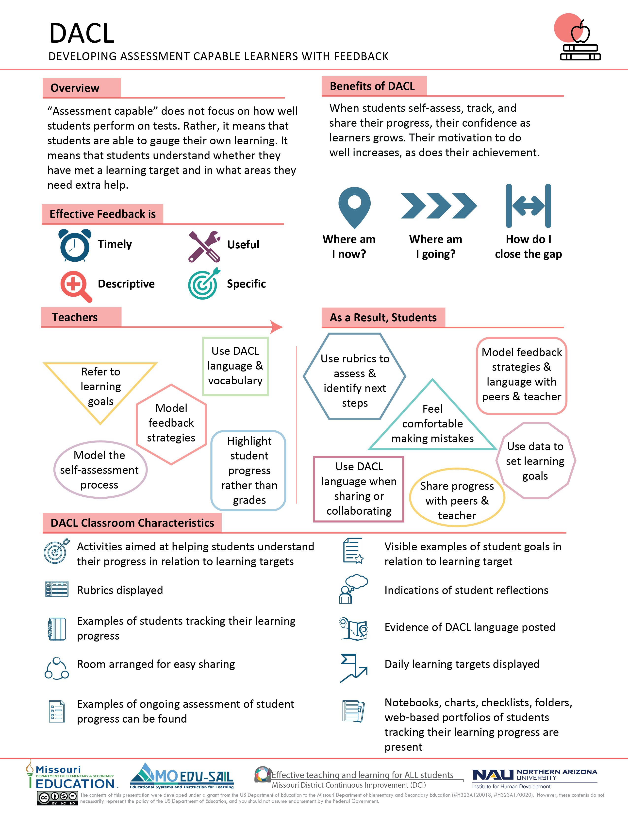
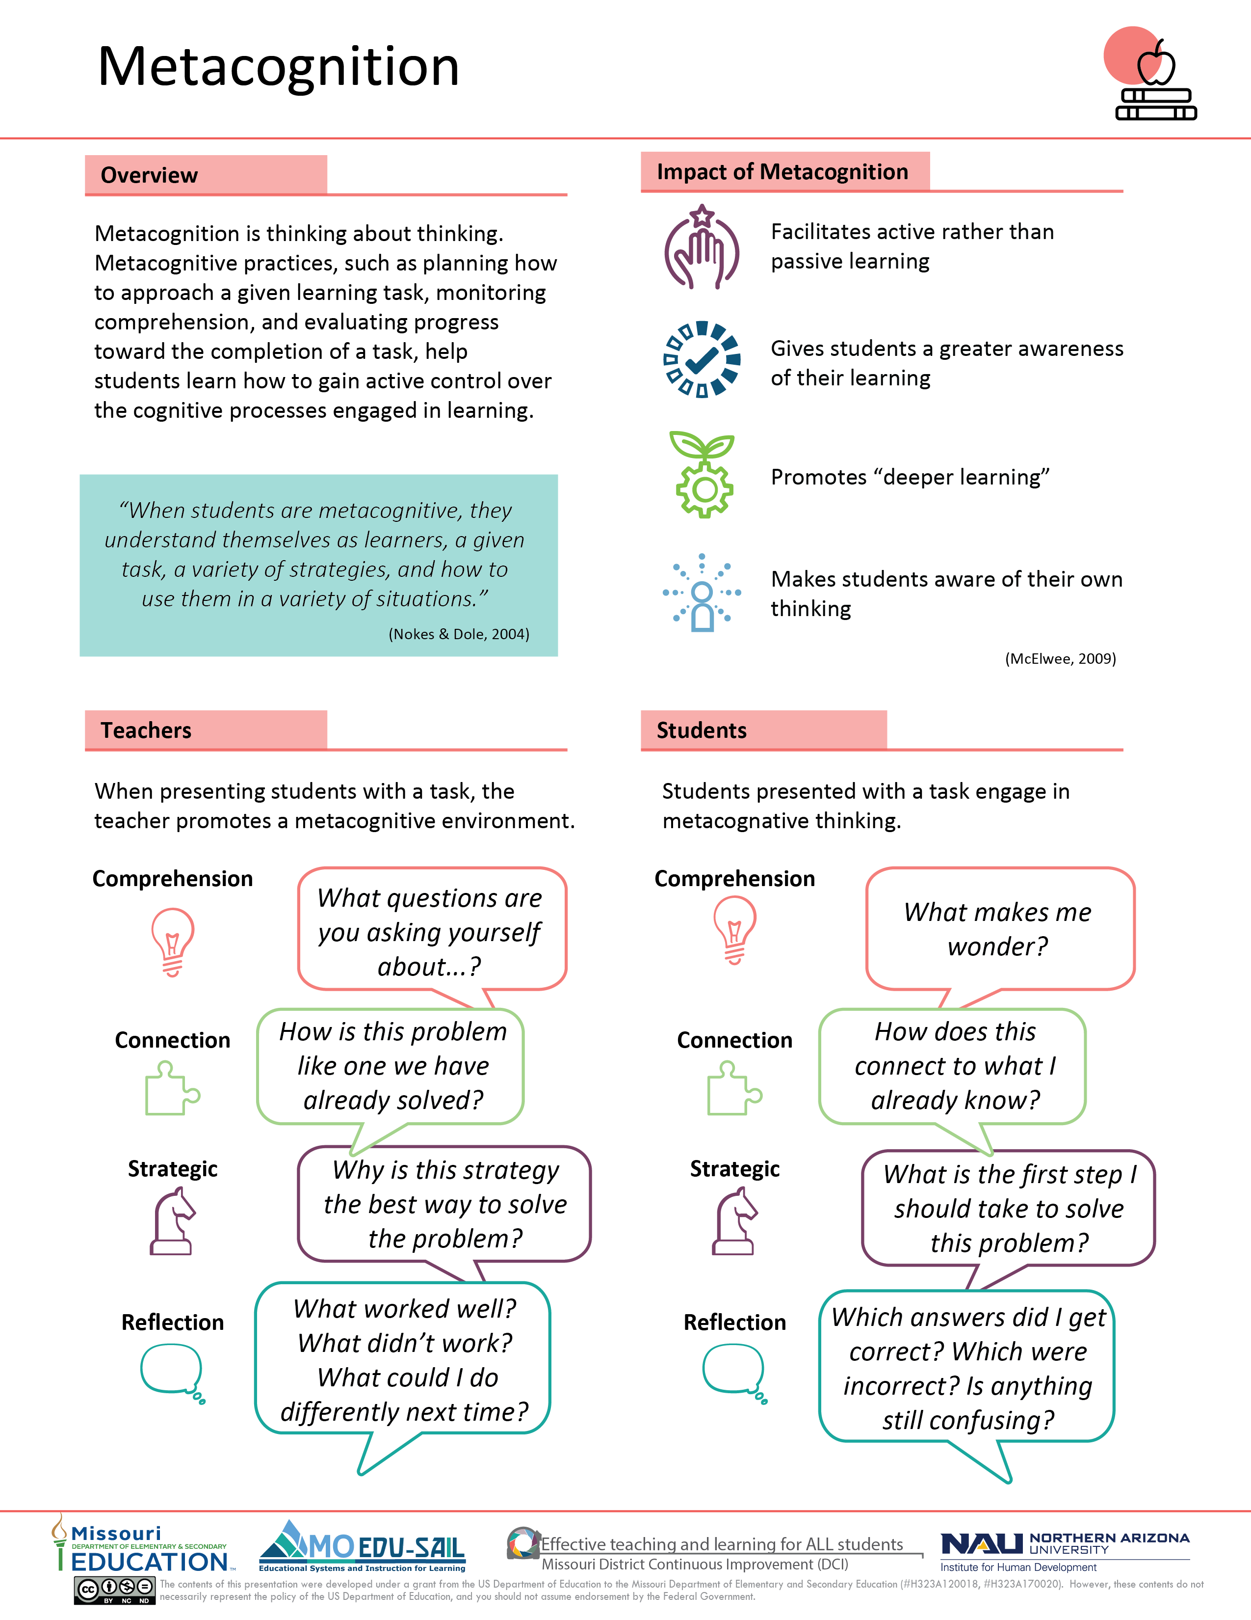
Effective Teaching and Learning Practices
(MoEdu-SAIL, 2022)
Notes:
To Know/To Say: Missouri has selected and developed professional learning modules focusing on effective educational practices. These modules were selected due to their high effect size, which comes from the John Hattie meta-analysis.
School-Based Implementation Coaching will focus on implementing the DCI effective educational practices. The slide shows two infographics:
On the left: The Developing Assessment Capable Learners (DACL) module centers around the three questions:
Where am I going?
Where am I now?
How can I close the gap?
On the right: Metacognition makes students aware of their own thinking.
Other DCI professional learning modules can be found at www.moedu-sail.org/
References: MoEdu-sail. (2022). District Continuous Framework: Blueprint for District and Building Leadership. [Online blueprint]. Retrieved from https://www.moedu-sail.org/getting-started/

Slide 52
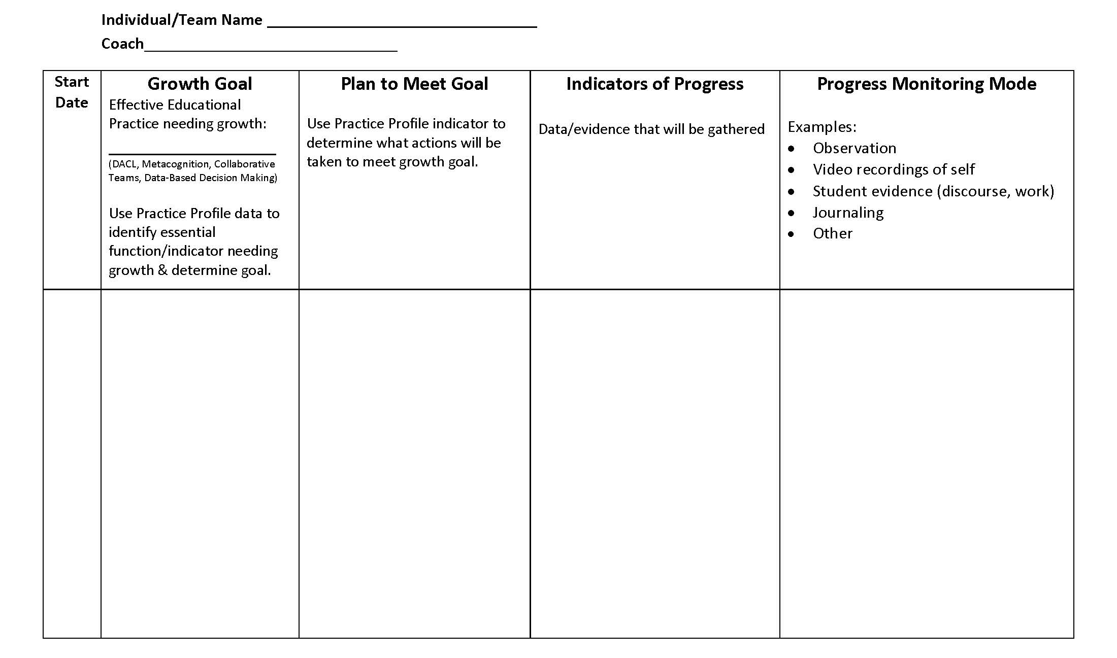
Growth Goal Plan
(Aguilar, 2013) (Marzano & Simms, 2013)
Notes:
To Know: Show and briefly explain the Growth Goal Plan as each part will be discussed again. Be sure to show and discuss both pages of the plan.
To Know/To Say: The Growth Goal Plan is developed by the teacher or team with support from the coach.
The teacher/team uses data from Practice Profile which is being addressed (ACL, Metacognition, Collaborative Teams, Data Based Decision Making…).
Next, the teacher/team identifies areas of growth by selecting a specific essential function(s) and criteria.
Jointly, the teacher/team and coach plan how best to meet the growth goal.
The teacher/team then determines the indicators of progress (data and evidence) that will be observed and collected.
The progress monitoring mode is described. Dated coaching observations can be recorded as well.
Reflections (solution dialogue) and next steps are included on the second page of the plan.
The plan provides a two-way feedback loop to the teacher and coach. The Growth Goal Plan can be put on a shared drive such as Google so all parties have access to it. This way it becomes a living document that can be ongoing. New goals can be set and monitored as accomplishments are archived.
Handout: Growth Goal Plan (page 1)
Resources:
Adapted from: Aguilar, E. (2013). The art of coaching: Effective strategies for school transformation. San Francisco, CA: Jossey-Bass.
Adapted from: Marzano, R. J., & Simms, J. A. (2013). Coaching classroom instruction. Bloomington, IN: Marzano Research Laboratory.

Slide 53
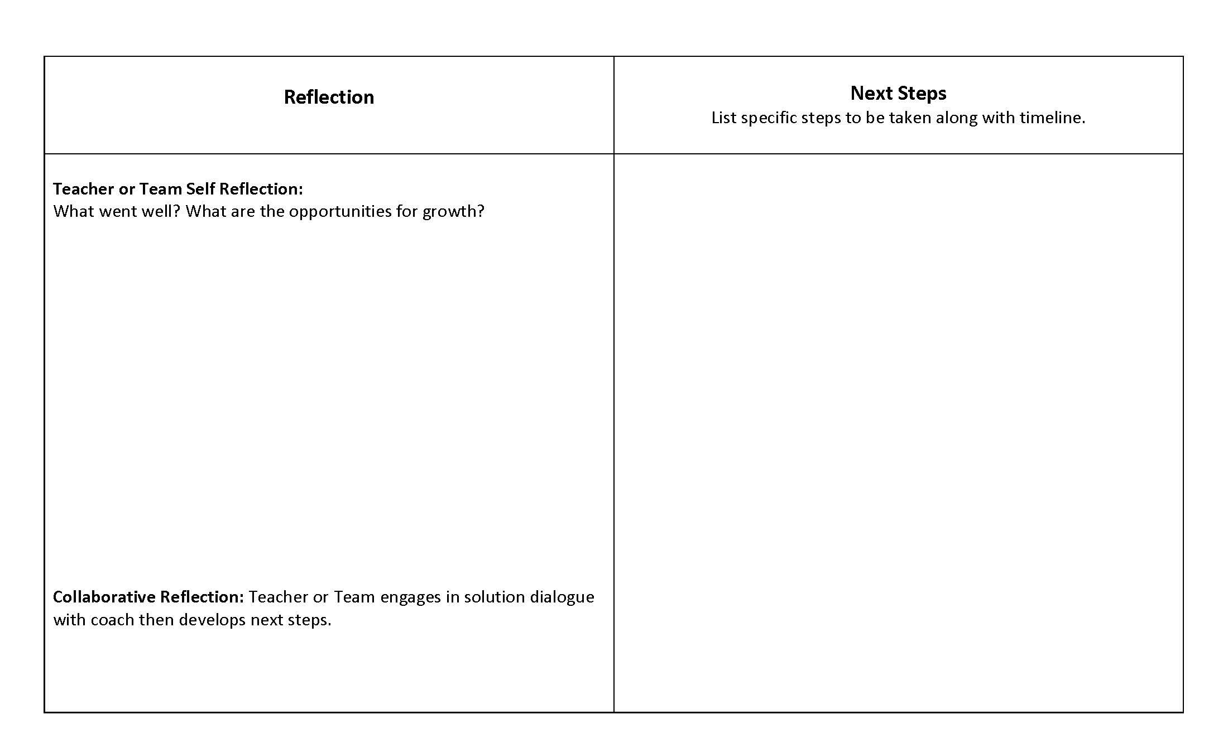
Page 2 Growth Goal Plan
(Aguilar, 2013) (Marzano & Simms, 2013)
Notes:
To Know/To Say: This is page two of the Growth Goal Plan. We will discuss page two in the next section, essential function #4.
Handout: Growth Goal Plan (page 2) (included in the SBIC 2018 Handouts Combined pdf)
Resources:
Adapted from: Aguilar, E. (2013). The art of coaching: Effective strategies for school transformation. San Francisco, CA: Jossey-Bass.
Adapted from: Marzano, R. J., & Simms, J. A. (2013). Coaching classroom instruction. Bloomington, IN: Marzano Research Laboratory.

Slide 54
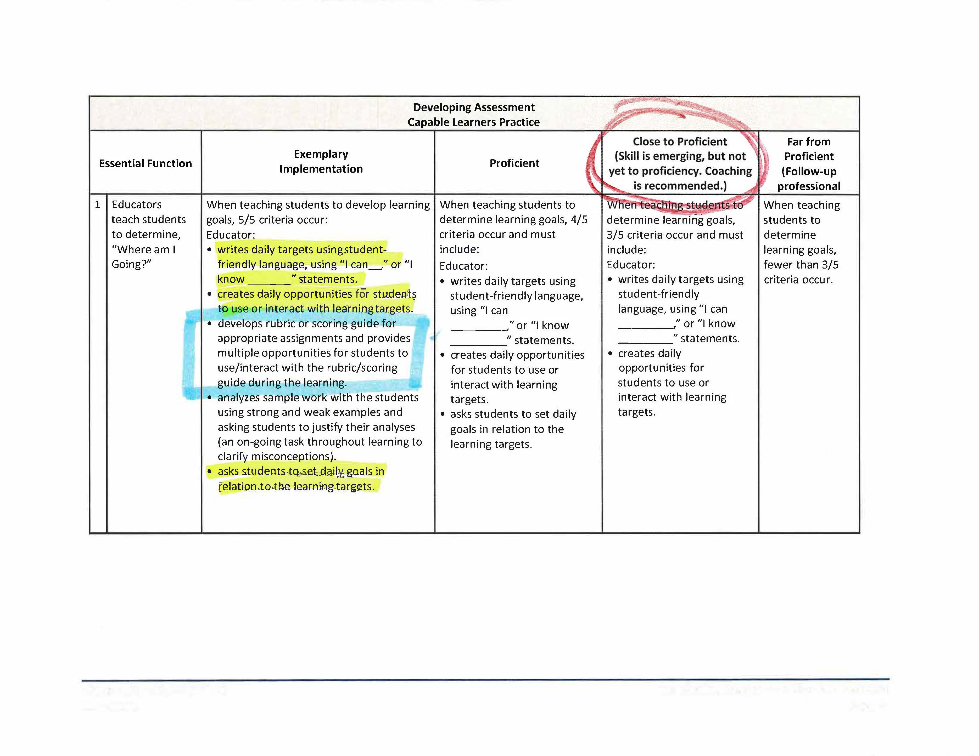
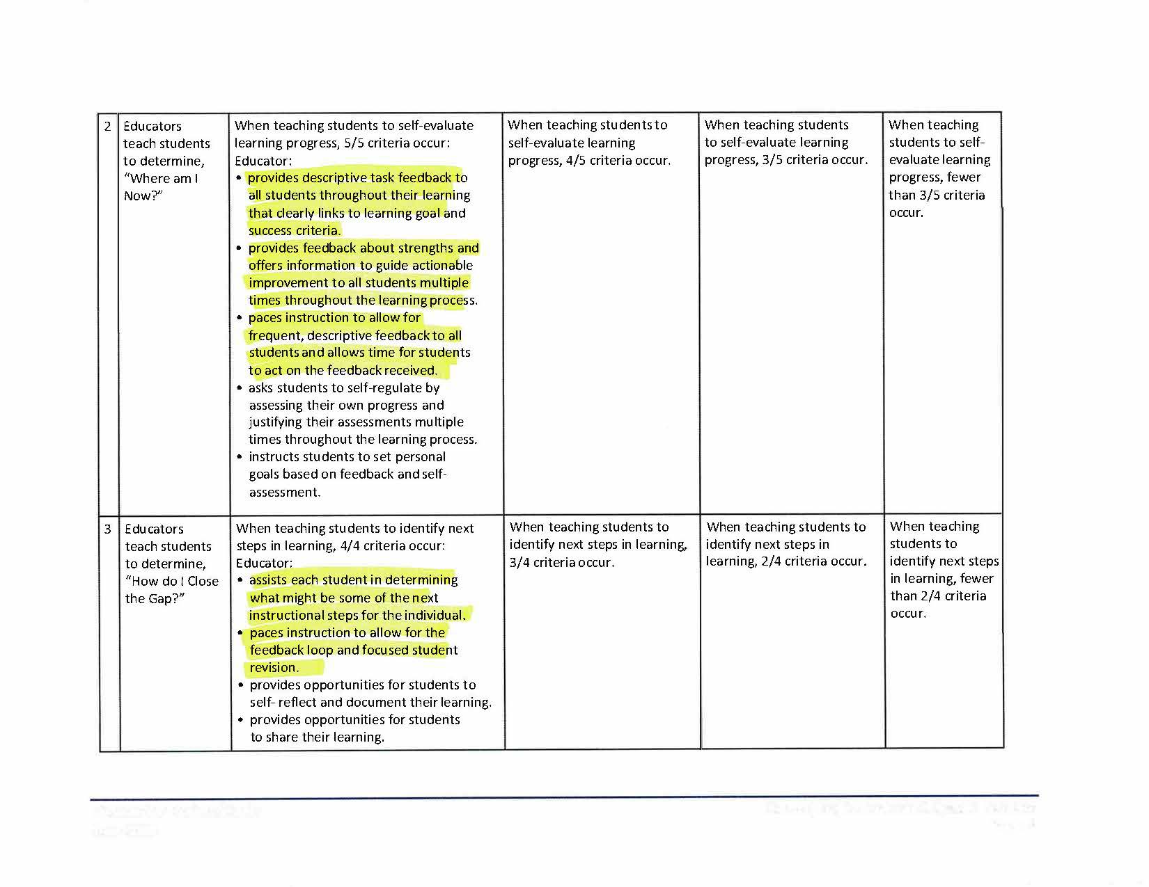
Example of self-assessment and identification of a growth goal using a Practice Profile
Notes:
To Know: The example information uses the Developing Assessment Capable Learners Practice Profile as the teacher’s/district’s focus.
Participants will need copies of the Practice Profile(s) that align with the district focus.
The purpose of the following slides is to provide modeling on how to self-assess using a practice profile and then develop a growth goal plan.
To Know/To Say: This is an example Practice Profile showing how a teacher self-assessed the Developing Assessment Capable Learners effective educational practice prior to completing their Growth Goal Plan. The scenario explains her thinking for identifying the goal she selected.
Her directions for completing the self-assessment:
Highlight all indicators currently being implemented.
Circle the proficiency level of implementation.
Place a square around the indicator selected for the growth goal.
Scenario: The teacher did a self-assessment using the DACL Practice Profile.
The highlighted areas indicate where she is now with implementation. She identified strengths as writing learning targets, students interacting with them, and setting daily goals.
She circled the Close to Proficient level as her current level of implementation, since she highlighted three criteria.
Although there are a number of indicators she could focus on, after careful reflection, she determined where she needed to go next. She decided to develop rubrics and scoring guides and have students interact with them outlined in a square.
Her choice of improving DACL essential function #1 will help set the stage for improvement on essential functions #2 & #3.
Handout: Example DACL Practice Profile (included in the SBIC 2018 Handouts Combined pdf)

Slide 55
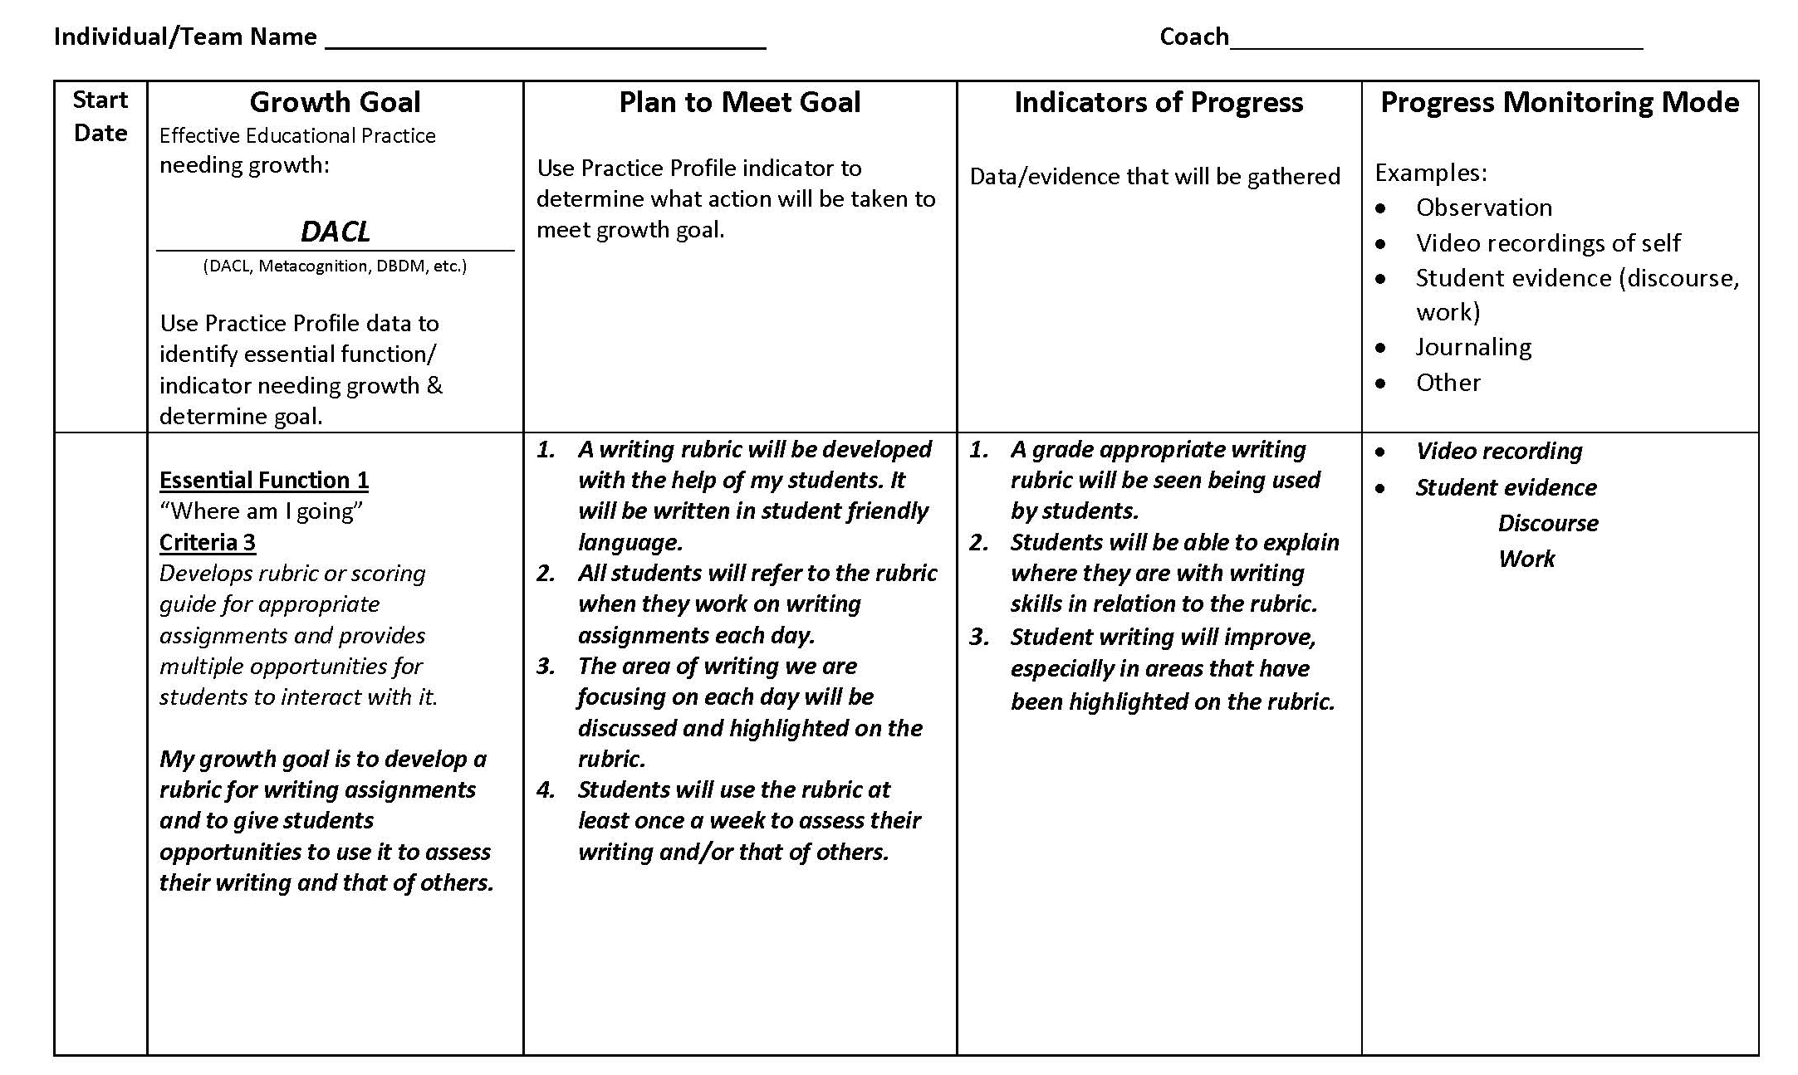
Example DACL Growth Goal Plan
Notes:
To Know/To Say: Please read through the Example Growth Goal Plan handout. Turn and talk to a partner and answer this question:
What connections from the Practice Profile have been made to create the growth goal plan?
Handout: Example DACL Growth Goal Plan (included in the SBIC 2018 Handouts Combined pdf)

Slide 56
Coaches in Action Activity!
Work with a partner to coach one another:
Self-assess with the Practice Profile.
Choose one partner’s Practice Profile and collaboratively identify an essential function and indicator needing growth.
Jointly write a growth goal.
Work together to determine a plan to meet the goal.
Discuss the kind of data and evidence that will be gathered.
Record this on the plan along with the mode used to monitor progress.
Switch roles and repeat so you both have a
growth plan!
Notes:
To Know: This partner activity will enable participants to begin to develop a Growth Goal Plan of their own while engaging in a collaborative coaching experience.
To Know/To Say:
First begin by self-assessing using a Practice Profile for an effective educational practice that aligns with your district focus.
Next, together look at one partner’s completed Practice Profile. Coach your partner by collaboratively identifying an essential function and indicator on that Practice Profile that indicates growth is needed.
Collaboratively determine a growth goal to address and write that goal.
Collaboratively discuss a plan to meet the goal and write it on the plan.
Then discuss the type of data and evidence needed to reach the goal. Record this under Indicators of Progress.
Record the mode that will be used to Progress Monitor.
Begin this process again by switching roles and making a Growth Goal Plan for the other partner.
Handout: Growth Goal Plan (included in the SBIC 2018 Handouts Combined pdf)
Optional Handout: Example Practice Profile and Example Growth Goal Plan (These can be given as examples if needed)

Slide 57
Coaching Plans as an Ongoing Tool
Plans should be flexible
Plans can change as coaching develops
Goals may need to be fewer and focused
Plans are dynamic, not sequential
(Aguilar, 2013) (Marzano & Simms, 2013)
Notes:
To Know: After participants complete their Growth Goal Plan these key ideas can be discussed.
To Know/To Say: Coaching plans can be adapted to best meet the needs of teachers, coaches, and their specific situations. The plan should be flexible and adapt to needs that arise. Always keep in mind that the coaching process is not linear, so different parts of the plan may be addressed at various times. The plan is a tool to focus on outcomes and indicators of success and to serve as a record of reflections and accomplishments.
Resource:
Adapted from: Aguilar, E. (2013). The art of coaching: Effective strategies for school transformation. San Francisco, CA: Jossey-Bass.
Adapted from: Marzano, R. J., & Simms, J. A. (2013). Coaching classroom instruction. Bloomington, IN: Marzano Research Laboratory.

Slide 58
Criteria for Developing a Strategic
And Differentiated Coaching Plan
Align coaching plan focus to school building/district vision and goals
Support educator(s) in self-assessment using the Practice Profile of effective educational practice(s)
Support educators in development of growth goal
Establish methods of data collection for indicators of progress
Share a plan for gradual release of responsibility
Notes:
To Know: This slide is keeping with the PowerPoint format, serving as a review before proceeding to the next essential function.
To Know/To Say: The third essential function on the SBIC Practice Profile has five criteria for developing a strategic and differentiated coaching plan. Review the criteria. You will have an opportunity to go into more depth with each of the five criteria during our future coaching sessions.

Slide 59
The Implementation Coach
Essential Functions
Develop & maintain coaching relationships.
Provide effective feedback.
Develop a strategic and differentiated coaching plan.
Use solution dialogue.
Progress monitor implementation of effective educational practices.
Notes:
To Know: This slide shows the SBIC Practice Profile essential functions. If the Practice Profile has not been introduced, additional information is needed here and can be obtained on another slide.
To Know/To Say: As you can see, this slide lists five items to consider and do as a School-Based Implementation Coach. We will address the fourth essential function shown in red text.
To support consistency of practice, coaches and coachees need training in content for SBIC development and on-going coaching for implementation.

Slide 60

Essential Function #4
Educators use solution dialogue.
Notes:
To Know/To Say: Now let’s focus on the fourth essential function, Educators use solution dialogue.

Slide 61
What is Solution Dialogue?
Facilitate conversation about what has gone well and where more support is needed
Facilitate conversation about relevant data
Respond to ideas for improvement by validating, adding suggestions, and providing rationale for changes in practice
Support suggestions for change in practice by modeling and/or examples of the content/practice in use
Provide opportunity for reflection and clarification of recommendations
Offer opportunity or resources for guided practice
Facilitate identifying next steps
(Jenson, Noonan, & Gaumer Erickson, 2013)
Notes:
To Know: The seven criteria for solution dialogue are taken from the Feedback and Solution Dialogue section of the Observation Checklist for High-Quality Regional Implementation Coaching. The 6th item from the observation checklist (Provide rationales for why changes are important and how changes will improve outcomes) is incorporated into #3 on this slide.
To Know/To Say: The seven criteria for the 4th essential function are shown on the screen. (Participants may want to refer to the Practice Profile for this list.) Ask participants to determine the meaning of solution dialogue by first reviewing these seven criteria. Then pose the following question: How does solution dialogue compliment the Growth Goal Plan developed in the last section of the training? Turn/Talk/Share at your tables.
Handout: Growth Goal Plan (included in the SBIC 2018 Handouts Combined pdf)
Resources: Jenson, R., Noonan, P. & Gaumer Erickson, A. (2013). Observation checklist for high-quality professional development regional implementation coaching. Kansas City, MO: UMKC Institute for Human Development.

Slide 62
Growth Goal Plan
(Aguilar, 2013) (Marzano & Simms, 2013)
Notes:
To Know: Show both pages of the Growth Goal Plan to indicate where/how solution dialogue connects to the process. Engage participants in the activity, Solution Dialogue Criteria Match. Each table team will need a copy of the Growth Goal Plan and a packet of 7 Criteria for Solution Dialogue activity cards.
To Know/To Say: Reflections (solution dialogue) and next steps are included on the second page of the plan. We will engage in an activity called Solution Dialogue Criteria Match to help us develop an understanding of how solution dialogue connects to the process.
Solution Dialogue Criteria Match Activity:
Each table team will need a set of Solution Dialogue activity cards and a copy of the Growth Goal Plan.
Each table team will collaboratively discuss where each solution dialogue criteria connects to the Growth Goal Plan and place the solution dialogue criteria card on that section of the Growth Goal Plan. One table team member will stay at the table to explain their placement of the solution dialogue cards while the rest of the table team members travel to the table to their right to hear about another view of card placements. (Teams may travel to more than one table/facilitator’s decision.) Team members return to their seats.
Discuss at your table similarities and differences of card placements and reasoning for the differences.
Handouts:
Solution Dialogue Activity Cards (included in the SBIC 2018 Handouts Combined pdf)
Growth Goal Plan (included in the SBIC 2018 Handouts Combined pdf)
Resources:
Adapted from: Aguilar, E. (2013). The art of coaching: Effective strategies for school transformation. San Francisco, CA: Jossey-Bass.
Adapted from: Marzano, R. J., & Simms, J. A. (2013). Coaching classroom instruction. Bloomington, IN: Marzano Research Laboratory.

Slide 63
Page 2 Growth Goal Plan
(Aguilar, 2013) (Marzano & Simms, 2013)
Notes:
Handout: Growth Goal Plan (page 2) (included in the SBIC 2018 Handouts Combined pdf)
Resources:
Adapted from: Aguilar, E. (2013). The art of coaching: Effective strategies for school transformation. San Francisco, CA: Jossey-Bass.
Adapted from: Marzano, R. J., & Simms, J. A. (2013). Coaching classroom instruction. Bloomington, IN: Marzano Research Laboratory.

Slide 64
Example DACL Growth Goal Plan
(Aguilar, 2013) (Marzano & Simms, 2013)
Notes:
To Know/To Say: This is the Example Growth Goal Plan developed in the previous section.
Handout: Example DACL Growth Goal Plan (included in the SBIC 2018 Handouts Combined pdf)
Resources:
Adapted from: Aguilar, E. (2013). The art of coaching: Effective strategies for school transformation. San Francisco, CA: Jossey-Bass.
Adapted from: Marzano, R. J., & Simms, J. A. (2013). Coaching classroom instruction. Bloomington, IN: Marzano Research Laboratory.

Slide 65

Solution Dialogue Activity
Kindergarten Rainbow Writing Rubric
(https://www.youtube.com/watch?v=i5yZxZtVFZE)
(GSD Literacy Coaches, 2015)
Notes:
To Know: To do this activity you will need the Example Growth Goal Plan (handout 16), the Example Solution Dialogue Script (handout 17) and the Solution Dialogue Activity Cards (handout 18) from the Handout Packet.
To Do:
Show participants the Kindergarten Rainbow Writing Rubric video. This video simulates the teacher implementing her growth goal plan.
Roleplay the example solution dialogue in handout 17 that is related to the video. (If another presenter is not present, select a volunteer to assist with the roleplay. The volunteer would be the teacher.)
Participants will need the Example Growth Goal Plan and Solution Dialogue activity cards for the roleplay.
To Say: We now know the criteria for a solution dialogue. So what does solution dialogue look like? Let’s watch an example solution dialogue for the Example Growth Goal Plan from our last section of the training. We are going to watch a YouTube video of a kindergarten teacher utilizing a rainbow writing rubric with her students as they practice self-assessing. After watching the video, you will observe a roleplay of the example solution dialogue. As you listen to the Example Solution Dialogue, you will hold up the solution dialogue activity cards that corresponds to the criteria you hear being applied.
Handouts:
16 Example Growth Goal Plan
17 Example Solution Dialogue Script (Only two copies are necessary, one for the coach and one for the teacher.)
18 Solution Dialogue Activity Cards
Resources:
GSD Literacy Coaches. (2015, September 4). Kindergarten Rainbow Writing Rubric [Video file]. Retrieved from https://www.youtube.com/watch?v=i5yZxZtVFZE
Adapted from: Aguilar, E. (2013). The art of coaching: Effective strategies for school transformation. San Francisco, CA: Jossey-Bass.
Adapted from: Marzano, R. J., & Simms, J. A. (2013). Coaching classroom instruction. Bloomington, IN: Marzano Research Laboratory.

Slide 66
Solution Dialogue
Why is solution dialogue necessary for us to reach the growth goal?
Notes:
To Do: Ask participants to reflect on the question, Why is solution dialogue necessary for us to reach the growth goal? Ask each table team to write a collaborative response to this question. Ask volunteers to share their response.
To Know/To Say: Take a minute to reflect on the question, Why is solution dialogue necessary for us to reach the growth goal? As a table team write a response to this question.
To further explore solution dialogue, types of coach-teacher conversations can be found in the Coaching Companion resource. These explain the various types of coaching questions and give specific example of question stems.

Slide 67

Types of Coach – Teacher Conversations
Reflecting
Facilitating
Coaching
(Marzano & Simms, 2013) (Sweeney & Harris, 2017)
Notes:
To Know/To Say: In coaching, it is important to consider various types of questioning. This handout provides examples of question stems to use in the coaching process.
Handout: Types of Coach-Teacher Conversation (included in the SBIC 2018 Handouts Combined pdf)
References:
Marzano, R. J., & Simms, J. A. (2013). Coaching classroom instruction. Bloomington, IN: Marzano Research Laboratory.
Sweeney, D., & Harris, L. S. (2017). Student-centered coaching: The moves. Thousand Oaks, CA: Corwin.

Slide 68
Criteria for Using Solution Dialogue
Facilitate conversation about what has gone well and where more support is needed
Facilitate conversation about relevant data
Respond to ideas for improvement by validating, adding suggestions, and providing rationale for changes in practice
Support suggestions for change in practice by modeling and/or examples of the content/practice in use
Provide opportunity for reflection and clarification of recommendations
Offer opportunity or resources for guided practice.
Facilitate identifying next steps
Notes:
To Know: Each PowerPoint section explaining a specific essential function ends with a list of the respective criteria. This section for essential function #4 started with a similar slide to begin the discussion of what is a solution dialogue.
The SBIC Coaching Companion contains supplemental materials and resources to develop the coaching plan. This allows for personalization of a plan to meet the needs of the individual.
To Know/To Say: The fourth essential function on the SBIC Practice Profile has seven criteria for using solution dialogue. At the beginning of this section you used these criteria to discuss how the solution dialogue compliments the Growth Goal Plan. Let’s review.
You will have an opportunity to go into more depth with each of the seven criteria during our future coaching sessions.

Slide 69
The Implementation Coach
Essential Functions
Develop & maintain coaching relationships.
Provide effective feedback.
Develop a strategic and differentiated coaching plan.
Use solution dialogue.
Progress monitor implementation of effective educational practices.
Notes:
To Know: This slide shows the SBIC Practice Profile essential functions. If the Practice Profile has not been introduced, additional information is needed here and can be obtained on another slide.
To Know/To Say: As you can see, this slide lists five items to consider and do as a School-Based Implementation Coach. We will address the fifth essential function shown in red text.
To support consistency of practice, coaches and coachees need training in content for SBIC development and on-going coaching for implementation.

Slide 70
Essential Function #5
Educators progress monitor implementation of effective educational practices.
Notes:
To Know: It is important to help the participants connect essential functions #3, #4, and #5. This module’s example of the SBIC process aligns essential functions #3, #4, and #5 to the Developing Assessment Capable Learners Professional Learning Module.
To Know/To Say: Now let’s focus on the fifth SBIC essential function, Educators progress monitor implementation of effective educational practices.

Slide 71
Essential Functions 3, 4, 5
Develop a strategic and differentiated coaching plan.
Use solution dialogue.
Progress monitor implementation of effective educational practices.
Notes:
To Know/To Say: As we direct our focus to essential function #5, we must also review essential functions #3 and #4. You need to apply all three essential functions to progress monitor effective implementation growth in the School-Based Implementation Coaching process.
We will continue to use the Developing Assessment Capable Learners professional learning module as an example within the School-Based Implementation Coaching process.
Essential Function #3: Educators develop a strategic and differentiated coaching plan.
Coaches provide feedback during this step for the purpose of greater opportunities for implementation success
(Where am I going? May want to date this step in the Growth Goal Plan.)
Essential Function #4: Educators use solution dialogue.
Coaches provide guiding questions during implementation of effective educational practice(s) for growth
(Where am I now? Date this step in the Growth Goal Plan. Plan for next steps based on coaching solution dialogue.)
Essential Function #5: Educators progress monitor implementation of effective educational practices.

Slide 72
How to Progress Monitor Implementation
Coaches provide guiding questions for reflection
Educators self-reflect on evidence
Educators determine a structure of collecting and storing evidence
Educators celebrate and share
Notes:
Essential Function #5: Educators progress monitor implementation of effective educational practices.
Coaches provide guiding questions for reflection of teachers’ growth in implementing the effective educational practice based on the practice profile and the educator Growth Plan, as well as the impact on student growth.
(How can I close the gap?) Educators may start with a focus goal. After solution dialogue, they add goals as needed. Progress monitoring will enable the educators and coaches to determine how to close the gap for effective implementation of the effective educational practice(s).
Educators self-reflect on evidence to determine growth toward implementation of the effective educational practice. At this time all goals implemented for the specific effective educational practice are reflected upon.
Educators will need to:
determine a structure for collecting/storing evidence for reflection toward growth with implementation. (Google folder, teacher/coach hard copy folder, other)
determine artifacts to save as evidence of growth.
Educators progress monitor to allow for celebration and sharing of educator and student growth throughout the implementation process.

Slide 73
Ideas for Celebration
Generate a list of celebration ideas.
At our table, collect those ideas to make a group poster.
How can you share your celebrations with the rest of the staff, school board, etc.?
Notes:
To Say/To Do: Let’s brainstorm ideas for celebration in your journey of implementation of the effective educational practices.
Ask participants to generate a table list of celebration ideas.
Collect those ideas to make a group poster.
Celebrate the educator’s growth by sharing her journey of implementing the effective educational practice with rest of staff, school board, etc.

Slide 74
DACL
(DACL, Metacognition, DBDM, etc.)
Notes:
To Know: Participants answer the progress monitoring questions by using the previous roleplay scenario.
To Say: Ask participants to find a partner and determine the coach’s and teacher’s next steps for the Example Growth Goal Plan. Participants share out next steps.
Handouts: Example Growth Goal Plan (included in the SBIC 2018 Handouts Combined pdf)

Slide 75
Criteria for Monitoring Progress of
Implementation of Effective Educational Practices
Gather evidence to monitor progress toward growth goal plan using four modes
  Observation
  Video recording themselves
  Student evidence (classroom discourse, student work)
  Journaling
  Other
Self-reflect on evidence to determine growth toward goal
Determine next steps
Notes:
To Know/To Say: The fifth essential function on the SBIC Practice Profile has three criteria for progress monitoring implementation of effective educational practices. Review the criteria. You will have an opportunity to go into more depth with each of the criteria during our future coaching sessions.

Slide 76
School-Based Implementation Coaching
Reflection and Closing
Notes:
To Know: This section will provide learners an opportunity to reflect on their learning and potential implementation.

Slide 77
Learning Targets
I am learning to:
Understand the purpose and benefits of School-Based Implementation Coaching
Develop and maintain coaching relationships
Provide effective feedback
Develop a strategic and differentiated coaching plan
Use solution dialogue
Progress monitor implementation of effective educational practices
Notes:
To Know: The Essential Questions slide may be used instead of the Learning Targets slide.
After reviewing the learning targets, the following questions may be used to help participants begin developing an action plan for SBIC implementation. Encourage collaborative discussion. Or an electronic exit ticket could be sent to participants to follow up on these questions. This would provide useful data to help plan future coaching sessions.
To Know/To Say: The learning targets include the essential functions from the SBIC Practice Profile.
How might these essential functions of SBIC be initiated or enhanced in your school?
What steps will be taken to get started or improve SBIC?

Slide 78
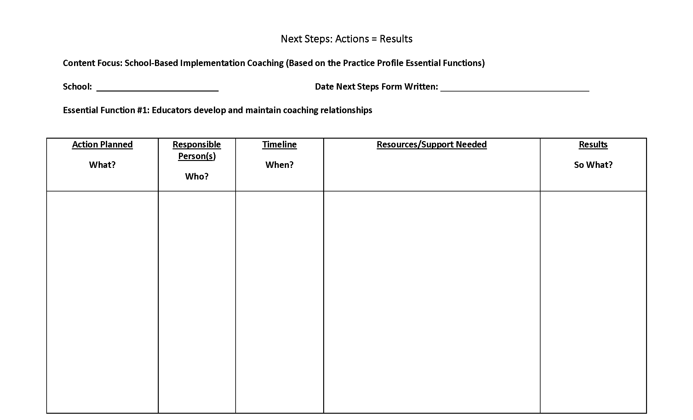
Next Steps: SBIC Action = Results
What steps will you take to start implementing School-Based Implementation Coaching?
Notes:
To Know: Presenters have a choice of the template or protocol in planning next steps. For the SBIC action research (or feedback loop), consultants are asked to utilize this form for consistency. The template may be completed towards the end of the training session or completed and/or revised in chunks with subsequent coaching session. This is a critical step in implementation so if time is short at the end of the training, you may need to split it up into the next coaching session. The action plan document will become a living document that will then be updated as needed at each coaching session.
To Do: Provide a copy of the action plan handout to participants. You may choose to provide one per team or one per participants.
To Say: Provide participants an overview of the action plan process by stating that the action plan process is a critical element to deeper implementation of practice as what gets planned is what gets done. It is also a communication piece to make sure that everyone is on the same page (dependent on the time structure for completion of the form, the following guiding questions can be posed per section).
Statement of vision - Take a minute to self-reflect. What key words related to SBIC resonate with you as to where you want to see implementation at the end of the school year? What will it look like in 3 years? Can you take those thoughts and develop a one to two sentence statement describing your vision for implementation of SBIC?
Where are we going? - From your vision statement, what is your short-term goal for the end of this school year? (If mid school year, may want to frame at the end of the school year, if beginning of the year, may want to frame it as first semester, or frame it when we meet again, etc., but important to frame it in a timeline.)
How will I close the gap? Beginning with the short-term target, what are the actions/next steps that we need to take. (Dependent on the group, may want to randomly list all actions on chart paper and then prioritize.) Everyone take a minute to review our steps, have we covered key points, do we have the right supports, structure, and people? Do our proposed actions align with our gaps and address our vision? (Utilize a fist to five or other methods to obtain consensus from those present.) Do we need to get consensus or buy in from others to move forward? What else?
Now that we have our first actions, let’s go back to the big picture. Looking again at our vision statement, where do we want to be in a year? What should our long-range target be for SBIC implementation?
Handouts: Next Steps (included in the SBIC 2018 Handouts Combined pdf)

Slide 79
Contact Information
Please contact me to schedule follow-up coaching and/or additional professional development.
Notes:
To Know/To Say/To Do: Include presenter’s contact information.
Please contact me to schedule follow-up coaching and/or additional professional development. Thank you.

