Slide 1
Hidden Slide #1
This learning package should take approximately 3-4 hours to present
Presenter notes information
Tools and documents
Helpful suggestions
Notes:
Important notes:
A script of presenter notes is included in the PowerPoint. Background information for the presenter is shown as “To Know”. Statements to be shared with participants are shown as “To Say”. In some instances, the “To Know/To Say” are the same material. For fidelity of content and consistency among presenters, the “To Say” information should be presented with minimal paraphrasing. The presenter notes also include “To Do” prompts and cues for “Handouts”.
A presenter may add slides to supplement the content. For example, a slide of essential questions may be added since only objectives have been included.
A presenter may choose to differentiate a presentation to meet the needs of the participants. For example, another form may be substituted for the Next Steps template if the district or building already uses a similar form or protocol.
Additional activities, examples, videos, etc. are being developed. A presenter may interchange the additional material for the corresponding PowerPoint content.
An Implementation Fidelity Checklist is available for frequent monitoring by a teacher or observer.
A print Practice Profile and an electronic Practice Profile Self-Assessment tool are available for use by individuals, teams, or schools for periodic self-assessment and monitoring of implementation of practice or to identify training or coaching needs.
The presenter should download onto a hard drive or a flash drive any video intended for use in a training. The links shown on slides may not be able to be accessed online at the school sites.
Breaks should be inserted at the discretion of the presenter based on the needs of participants.

Slide 2
Hidden Slide #2
Supplies needed
Handouts
Poster Paper
Sticky notes for participants
Pens
Notes:
To Know: These supplies are needed for the training.

Slide 3
For Presenter only
1
Resources to Provide in Participant Folder for Training
Handouts
Model of Self Determination
Model of Self-Determination: Notes Page
Self-Regulation Poster
Chair Yoga
Self-Efficacy Poster
Fixed vs Growth Mindset
Victory Log
Assertiveness Poster
Passive, Assertive and Aggressive
Word Wheel
Three-Part Assertiveness Document
Presenter Resources
Google Document
Appendix A (from last time), Pg. 3 Self-Determination
Appendix B (Practice Profile)
Notes:
To Know:
The materials needed for this training are listed on the slide. Chart paper, markers, and sticky notes are also necessary.
This is a 3-4 hour training. If possible, allow yourself enough time with the participants to ensure that there is time to cover everything in detail.
Parts of this training require internet usage. If there is Wi-Fi available for participants, have them bring their devices and use them for exploring the websites in greater detail.
To Do:
Print handouts and create T-Chart prior to training.
Watch video on previous slide prior to training.
Become familiar with the information prior to presenting. Ask questions of other consultants, DESE, etc., if there is information that you do not understand.
Make sure this slide is hidden prior to presenting.

Slide 4
For Presenter only
2
Resources to Provide Prior to Training for Pre-Reading
Determined Student Involvement in IEP video (16 minutes)
http://www.imdetermined.org/resources/detail/determined_student_involvement_in_iep_oc
Notes:
To Know: This video is a great resource for participants to view, prior to training. The video gives a preview of the content and gives several examples of how kids can and should be involved in the planning of their future. It also previews the PowerPoint template for student-led IEPs that we will present later in the training.
To Do:
Watch the video prior to presenting this training.
Send all participants an email, similar to the sample email on Presenter Resource #1, with the link to the video at least one week prior to the training.
Make sure this slide is hidden prior to presenting.

Slide 5
Self-Determination Increasing Student Involvement
Consultant Name
email

Slide 6
https://padlet.com/susan_hekmat/3vm6r1fa25lhqzag

Slide 7
Welcome Back!
Self-Determination
Notes:
To Know/To Say: Welcome to Self-determination.
The introductions may be formal or informal depending on how well you know the group. Trainers should use whatever process is comfortable for introductions. I am/we are _______________ (provide some background about trainers.) Please introduce yourself to the group (name, district, position.)
To Do: (optional) Consultant develops an ice-breaker or introductory activity.

Slide 8
Norms
Be present
Turn cell phones to silent
Minimize sidebar conversations
Use technology for workshop learning purposes
Ask questions
Take care of your personal needs with minimal distraction
Have open hearts and open minds!
Learning is mandatory; suffering is optional!
Have fun!
Notes:
To Know: Make these norms work for you. If your RPDC has a specific set of norms that are used, please use them.
To Do: If you have chosen to change this slide to make it fit with your RPDC’s specific set of norms, change the slide prior to training.
To Say: (If you have changed the norms on this slide, also change the “To Say” section of the notes). This training will take the entire time allotted to complete all of the information and activities. To get the full benefit, you will need to “Be a Learner” by “Being Present” at all times. No questions are too big or too small. If you are questioning something, there are probably others wondering the same thing. We would like you to ask any questions that pertain to the subject matter of this training. Please feel free to take care of your personal needs at any time. Some of the steps to this process may not have occurred to you before. Have open hearts and minds and finally, have fun.

Slide 9
Self-Determination and Missouri Teacher Standards
This Self-Determination module addresses the following Missouri Teacher Standards
Standard 2: Student Learning, Growth, and Development
Standard 6: Effective Communication
Standard 9: Professional Collaboration
(Missouri Department of Elementary and Secondary Education, 2013)
Notes:
Reference: Missouri Department of Elementary and Secondary Education [MO DESE] (2013, May). Teacher Standards: Missouri’s Educator Evaluation System. Retrieved from https://dese.mo.gov/sites/default/files/TeacherStandards.pdf.

Slide 10
Agenda
What is Self-Determination?
Why Self-Determination?
What does the research say?
Break
Model of Self-Determination
Social Emotional Learning for All (SELA)
Dignity of Risk
Reflection, Action Plan & Future Support
Notes:
To Know: This is a 3-4 hour training.
To Do: If you would like, you can put times into this section. It has been intentionally left without times in order to make it work for each RPDC and their schedule.
To Say: Here is our schedule for the day. As you can see, we do have a break scheduled, but again, feel free to take care of your personal needs as they arise.

Slide 11
Learning Targets
I Can
Define Self-Determination
Explain the importance of Self-Determination
List the steps of the Model of Self-Determination
Find resources and materials to assist in teaching Self-Determination
Notes:
To Say: Today, we will be discussing several aspects of self-determination. By the end of today’s training, you will be able to define self-determination, explain the importance of self-determination, list the steps of the Model of Self-Determination, and find curricula, resources, and materials to assist in teaching self-determination.

Slide 12
Essential Questions
What is Self-Determination?
Why is Self-Determination important?
How can I apply the steps of the Model of Self-Determination?
How can resources and materials help me plan for Self-Determination?
Notes:
To Know/To Say: Let’s begin the work of learning a strategic and consistent understanding of what Metacognition is with these essential questions in mind.

Slide 13
Reflection from Last Session
Take out the Transition Academy Action Plan that was created at our last session of Transition Academy Indicator 13 and Best Practices.
What have you been able to accomplish?
Share your comments, thoughts and questions.
Notes:
To Say: As we begin thinking about self-determination today, we want you to start thinking about the students that you work with on a daily basis. Please take two minutes to think about the question that is shown on the screen. What is the most important thing your students should know or be able to do to be successful in adult life?
AFTER 2-3 MINUTES, Say: Let’s come back together now. What is the most important thing your students should know or be able to do to be successful in adult life? (Get volunteers to share)
To Know: Possible answers to this question: obtain adult services and benefits, live independently, support themselves financially, know and explain their disability well to others, especially adult service providers, have dreams for their future, have friends who support them in their lives

Slide 14
Appendix A
Transition Academy Action Plan
Self-Determination - Pg. 3
Name(s): ______________________________________________________
Goal: _________________________________________________________
Activities | Person Responsible | Date | Reflection
Notes:
To Do: Appendix A is used here as page 3 for Self-Determination. Have extra copies in case someone doesn’t bring theirs.
To Know/To Say: Begin filling out Appendix A on what steps will you take and when.

Slide 15
Question of the Day
What is the most important thing your students should know or be able to do to be successful in adult life?
Notes:
To Say: As we begin thinking about self-determination today, we want you to start thinking about the students that you work with on a daily basis. Please take two minutes to think about the question that is shown on the screen. What is the most important thing your students should know or be able to do to be successful in adult life?
AFTER 2-3 MINUTES, Say: Let’s come back together now. What is the most important thing your students should know or be able to do to be successful in adult life? (Get volunteers to share)
To Know: Possible answers to this question: Obtain adult services and benefits, live independently, support themselves financially, know and explain their disability well to others, especially adult service providers, have dreams for their future, have friends who support them in their lives

Slide 16
Terms to Know Prior to Learning
Self-Advocacy: Have knowledge of self, knowledge of rights, communication skills and leadership ability
Self-Awareness: Awareness of own individuality, strengths, and areas of improvement
Self-Efficacy: Understanding that own actions have an impact-you are the causal agency in your own life
Self-Regulation: Controlling own behavior by being aware of one’s actions-planning, monitoring, adjusting and reflecting
Notes:
To Know/To Say: A review of this word list may be useful for terminology clarification.
Self-Determination vs Self-Advocacy: These are not synonymous terms. On the next slide we will discuss S-D in detail. The following terms are important to understanding S-D.
Self-Advocacy is when the student can and does speak for themselves.
Self-Knowledge is when the student knows his/her strengths and limitations.
Self-Worth is when the student knows that he/she is worthy of their work.

Slide 17
What is Self-Determination?
Notes:
Section slide

Slide 18
Self-Determination
Self-Determination refers to an individual’s awareness of personal strengths and weaknesses, the ability to set goals and make choices, to be assertive at appropriate times, and to interact with others in a socially competent manner.
(Serna & Lau-Smith, 1995)
Notes:
To Say: Look at the italicized words and what do they mean?

Slide 19
Self-Determination Defined
A combination of skills, knowledge, and beliefs that enable a person to engage in goal-directed, self-regulated, autonomous behavior.
An understanding of one’s strengths and limitations together with a belief in oneself as capable and effective are essential to self-determination.
When acting on the basis of these skills and attitudes, individuals have greater ability to take control of their lives and assume the role of successful adults in our society.
(Field, Martin, MIller,Ward & Wehmeyer, 1998)

Slide 20
Self-Determination Evolved
A dispositional characteristic manifested as acting a the causal agent in one’s life. Self-determined people (causal agents) act in service to freely chosen goal. Self-determined actions function to enable a person to be the causal agent in his or her life.
(Shogren, wehmeyer, Palmer, Riifenbark, & Little, 2015, p. 252)

Slide 21
What is Self-Determination?
Strengths & Challenges
Communication
Goal Setting
Notes:
To Say: These are the components that make up S-D. If students can do these things, we say that they are self-determined.

Slide 22
Components of Self-Determination
Choice-making: Appropriately choosing between a finite number of choices
Decision-making: Involves choosing between unlimited options
Goal-setting and Attainment: Ability to set appropriate goals for self and achieve the goals with actions
Problem-solving: Weigh pros & cons of potential actions, identify barriers to success
(Algozzine, Browder, Karvonen, Test, & Wood, 2001)

Slide 23
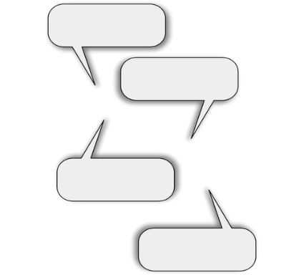
Why is Self-Determination Important?
Notes:
To Do: Presenter’s choice
Discussion - Jot down some ideas about why SD is important--use discussion and writing on sticky notes to engage participants in thinking, talking, and writing.

Slide 24
Why Is Self-Determination Needed?
Engaging in education
Planning for the future
Working toward goals
Providing lifelong skills
Promoting self-awareness
Preparing for adult environments
Transition Coalition (Lattin et. al., 2010)
Notes:
To Say: It is critical that students know who they are and what they want for their futures. It is also important for them to be able to know the accommodations they need. So how does self-determination help students?
Giving students self-determination skills and practice using the skills while they are in middle and high school helps them in many ways. It helps engage students in their education. Self-determination provides us, as educators, with a way to engage students in planning for their futures and working toward their goals. This is not only for educational goals. Self-determination skills should be used to set and work toward personal goals as well.
Self-determination also provides lifelong skills for a variety of environments. Self-determination provides students with lifelong skills they can use in social situations now and in the future. These skills can be used at school, job, home and community environments. For example, students who decide to go on to college or technical school need to be able to communicate their disability and need certain accommodations in school. Students still in high school can also talk to their teachers about their accommodations. What’s more, students also need to be able to appropriately communicate with their employers.
Self-determination promotes students’ self-awareness. We all do better in work, school, or social situations if we have an understanding of what works well for us and what doesn’t. Students who use self-determination skills are aware of how they may typically respond in a social situation and adjust as needed. A student who is very shy or soft spoken knows when and how she does need to speak out for herself.
Finally, self-determination prepares students for adult environments by helping students move from entitlement programs to eligibility programs. Special Education is an entitlement program, where schools are required to find students with disabilities and have the primary responsibility of ensuring students receive the supports and accommodations they need. Work, postsecondary education and training are all eligibility programs, where a person with a disability has to identify him or herself as having a disability, be able to explain it, and show necessary documentation in order to receive accommodations, and communicate what accommodations are needed.
Reference: Lattin, D.L., Morningstar, M.E, Field, S., Bjorkman Wade, D.K. & Hu, X. (2010). The essentials of self-determination [Online Training Module]. Lawrence, KS: University of Kansas, Department of Special Education. Retrieved from: www.transitioncoalition.org.

Slide 25
Students who Develop Self-Determination
Have increased engagement
More employment experiences
Have a higher rate of participation in IEP planning
Have enhanced skills
Improved quality of life
Have enhanced networks
(Allen, et. al., 2001; Arndt, Konrad, & Test, 2006; Bullis, et. al., 2002; German, Martin, Marshall & Sale, 2000; Martin et. al., 2006; O’Reilly, Lancioni, & O’Kane, 2000; Storey, 2002 Bowman & Marzouk, 1992; Wehmeyer & Palmer, 2003; Wehmeyer & Schwartz, 1997)
Notes:
To Say: Research on self-determination shows us that students who are self-determined exhibit behaviors and skills that impact the areas listed on the screen.
Research tells us that students who are self-determined have increased engagement. Youth with ED/BD increased time engaged with transition coordinators (Bullis, Moran, Benz, Todis & Johnson, 2002). Students showed positive educational achievement and increased time working academic tasks (Bullis, Moran, Benz, Todis & Johnson, 2002)
Self-determined individuals have more employment experiences. Students with high-self determination were found to be employed at a higher rate than their peers and earning more than their peers with low self-determination; they also made advances in obtaining job benefits such as vacation, sick leave, and health insurance (Wehmeyer & Schwartz, 1997; Wehmeyer & Palmer, 2003). Workplace social skills were improved (Wehmeyer & Schwartz, 1997). Students with emotional disturbance (ED) were more likely to obtain their desired employment outcomes and were more likely to positively engage in competitive employment activities (Bullis, Moran, Benz, Todis & Johnson, 2002).
Students who are self-determined have a higher rate of participation in IEP planning. Students increased their participation at IEP meetings using the Self-Directed IEP curriculum (Arndt, Konrad, & Test, 2006; Martin, Dycke, Christensen, Gardner, & Lovett, 2006; Allen, Smith, Test, Flowers & Wood, 2001). Youth with high self-determination were more likely to take a leadership role in their transitional planning process (National Longitudinal Transition Study-2).
Self-determined individuals have enhanced skills. They have a higher levels of goal completion (German, Martin, Marshall & Sale, 2000), an improved ability to plan activities related to goals and follow steps in a task (Cooper & Browder, 1998; Fullerton & Coyne, 1999), enhanced self-management and self-regulation skills, improved critical learning skills, classroom involvement, and on-task behaviors (Agran, Sinclai, Alper, Cavin, Wehmeyer & Hugher, 2005; Gilberts, Argran, Hugher, & Wehmeyer, 2001), and improved personal and social responsibility, enhanced social problem-solving skills, improved choice-making, problem-solving, self-regulation, self-esteem, and self-advocacy (O’Reilly, Lancioni, & O’Kane, 2000; Storey, 2002; Wehmeyer & Schwartz, 1997).
Self-determination affects quality of life. Students with high self-determination were more likely to live independently (Wehmeyer & Palmer, 2003). Students enhanced their participation and independence in accomplishing community activities (Sowers & Powers, 1995). Individuals with high self-determination were more likely to have expressed an interest in living outside the family home, having a checking or savings account, and being employed for pay (Wehmeyer & Schwartz, 1997). People who take greater control over their lives (i.e., are self-determined) are more likely to have a higher quality of life (Wehmeyer & Schwartz, 1998).
Finally, self-determined individuals have enhanced networks. Students showed an increase in size of support network and improved recruiting behaviors (actions made to obtain assistance with personal goals, making friends, and developing social networks) (Balcazar, Fawcett, & Seekins, 1991). Improved ability to obtain accommodations for employment, housing, academics, and leisure activities (Bowman & Marzouk, 1992).
As you can see, the research has a lot to offer. Students that show self-determination are more successful in many areas of their lives.

Slide 26
Zarrow Center https://www.ou.edu/education/centers-and-partnerships/zarrow/transition-resources/curriculum
https://www.teacherspayteachers.com/Store/Zarrow-Center/Price-Range/Free?ref=filter/price

Slide 27
11 Steps to the Self-Directed IEP
11 Sequential Lessons
Begin meeting by stating the purpose
Introduce everyone
Review past goals and performance
Ask for other’s feedback
State your school and transition goals
Ask questions if you don’t understand
Deal with differences of opinion
State the support you’ll need
Summarize your goals
Close meeting by thanking everyone
Work on IEP goals all year

Slide 28
More Ideas to Incorporate Self-Determination
Have students set daily goals in the classroom that tie to the learning targets
Allow them to monitor their own behavior
Wait for/teach them to ask for help
Offer opportunities throughout the day for students to make choices

Slide 29
Brief Recap
What is Self-Determination?
Reaching one’s potential; awareness of personal preferences, strengths and weaknesses; communicate; set goals and make choices.
How does it benefit children?
Prepare students for adult environments but also help engage them in their education.
What does the research say?
Better educational and adult outcomes.
What does IDEA say?
Required IEP transition planning and an invitation to the meeting.
Notes:
To Say: We have already covered a lot of information. Let’s summarize before we move forward and make sure that no one has any questions so far.
The key features of Serna & Lau-Smith’s definition of self-determination include reaching one’s own potential; having an awareness of personal preferences, strengths and weaknesses; the ability to communicate, collaborate and network; and, the capacity to set goals, make choices, and use resources without infringing on the rights of others.
Self-determination skills and practice using them in secondary schools help prepare students for adult environments, but also help engage them in their education, promote their lifelong skills for school/job/home/community, and promote their self-awareness to respond appropriately in a social situation and adjust as needed.
There is an expanding base of evidence suggesting that students with enhanced self-determination skills tend to have better educational and adult outcomes, including engagement with transition specialists, positive employment outcomes, active participation in IEP development, improved social skills, enhanced quality of life, and an increased support network.
IDEA implies students actively participate in their transition planning, but it’s not explicit. Self-determination training can help you meet the requirements and go above/beyond to meet the spirit of IDEA and the implications behind the requirements, while at the same time giving your students skills they will use throughout their lifetimes.
Are there any questions so far?

Slide 30
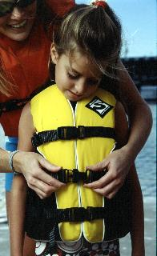
Model of Self-Determination
Notes:
To Say: If a student floated in a life jacket for 12 years, would he or she be expected to swim if the jacket were suddenly removed?
The special education system often shelters youth with disabilities, yet we know that we need to engage them in transition planning for their futures. Expecting students to be able to plan their future lives without self-determination skills and practice using the skills is like removing a life jacket without teaching someone to swim.
If we haven’t prepared students to know themselves, make goals and decisions, and communicate appropriately we can’t expect them to be able to actively participate in meaningful transition planning.
Understanding self-determination from a holistic perspective can help you analyze the parts of self-determination you currently cover with your students, as well as help you identify additional areas you want to enhance.
Over the next several slides, we will discuss an overview of the Model of Self-Determination developed by Alan Hoffman and Sharon Field who are leaders in the field of self-determination for students with disabilities. The Model of Self-Determination developed by Hoffman and Field will be used as a framework as we discuss teaching students self-determination skills. Hoffman and Field developed this model in the early-mid 1990s, basing it upon previous research, observations of over 1500 students, and interviews with more than 200 educators and others. The model was revised in 2005 and represents a holistic approach to self-determination. It is still valid today.

Slide 31
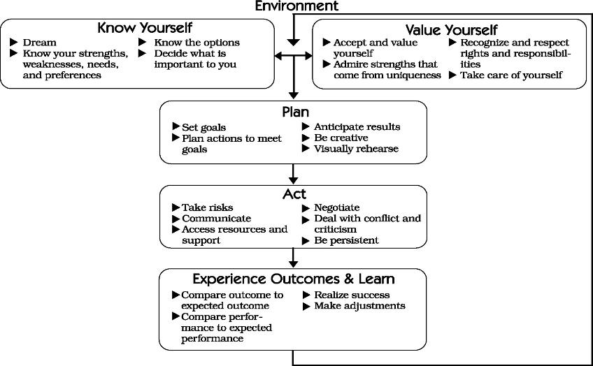
Use HO #1 & HO #2 for slides 32 - 40
Empowerment for Life: Teaching Self-Determination Strategies for Effective Transition
Notes:
To Say: This is one model of the process of teaching Self-Determination. Let’s look at the parts that make up this model. We will look at each part separately on the next several slides.
The entire outside is your environment and each individual environment is where you need to know yourself and have a plan.
Please refer to H.O. #1 & 2.

Slide 32
Environment
Notes:
To Say: The environment is the situation that the student might be in-church vs. work, school vs. work, etc. Following this process helps with preparing a student to be a part of their own IEP team or setting goal(s). How a student handles self-determination can be in an informal situation vs a formal situation. Table discussion of informal situation (being by self or time needed). What happens if you start in the middle of this process? You won’t get the results you wanted. THINK TIME AND PROCESSING TIME.

Slide 33
Know Yourself and Your Environment
Dreaming
Exploring strengths, weaknesses, needs and preferences
Learning about disabilities
Learning about environments
Environment
(Adapted from: Hoffman, A., & Field, S., 2005)
Notes:
To Say: Please pull out Handout #1 and #2. As we go through each portion of the Model of Self-Determination, you will be asked to write down two ideas that you want to remember.
Knowing yourself and your environment provides the foundation for students to learn and correctly practice self-determination skills.
Earlier today, we learned about the IDEA requirement to conduct age-appropriate assessments for youth with disabilities as part of their transition and IEP planning. These assessments can be helpful in teaching students to know themselves but other activities should be used as well. These additional activities can also contribute to the assessment materials you use for IEP planning.
Hoffman & Field, 2005, identify dreaming; exploring strengths, weaknesses, needs & preferences; learning about disabilities; and learning about environment as areas of content and instruction for teaching students to know themselves and their environments.
Initially, as students are younger and know less about themselves, it should be expected that they dream BIG! Expect to see ‘unrealistic’ dreams for younger students or students who haven’t been encouraged to dream before. As students get older and learn more about themselves, they will narrow their dreams to something that “fits”. Dreaming is a chance for students to discover what’s important to them. Dreams may not come true at the time they are dreamed, but students can use their dreams to set their short and long-term goals.
Exploring strengths, weaknesses, needs and preferences can be accomplished, in part, by using age-appropriate transition assessments. These can be informal such as interviews, picture assessments, learning styles inventories, and simple personality tests. You should ensure that what assessments you use really do help them to learn more about themselves. It must be meaningful for the students.
Part of students knowing themselves is knowing their disability. They should be able to describe how the disability impacts the way they complete tasks, manage their daily routine, etc. It is critical that students know and be able to explain their disabilities to others in real terms. This is especially true when they are navigating the adult service systems (e.g. service providers, college, employers, etc.). Often in our society, disability is seen as a weakness. Helping your students explore how their disabilities make them unique individuals and are a strength to them is an important exercise. If you or a family member have a disability, share this with your students. Share what you know of the disability and explain how the disability has had an impact.
Students need to know their different supports in different environments. Who is there to help them? Who should they go to for advice or help? How might this change in different environments of their lives such as school, home, in the community, and at work? People in different environments of our lives have different expectations for us. Help students understand this concept, identify what some of those differences are, and who the people are in the various environments of their lives. Help students explore how their parents, siblings, friends, teachers, and employers may have different expectations of and for them.

Slide 34
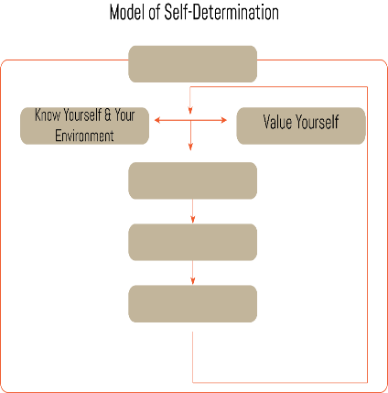
Value Yourself
Rights and
Responsibilities
Relationships
with others
Some strategies for
use in the classroom
Environment
(Adapted from: Hoffman, A., & Field, S., 2005)
Notes:
To Say: Valuing yourself includes valuing others, as well as rights and responsibilities and relationships with others.
Students should learn about the laws relating to people with disabilities, including IDEA, the ADA, and the Rehabilitation Act, which is now part of the Workforce Investment Act. The focus of the training on laws should be on how they apply to the students’ lives so that this is a functional exercise for them. Often students see the use of the term responsibility as something they should do. Within the context of self-determination, the focus is on what will help students get the results they want in the short-term (did they achieve the goal) and the long-term (did they build the type of relationships they want)? Another dimension of rights and responsibilities involve internal and external locus of control (LoC). Internal LoC is acknowledging and accepting personal responsibility for one’s actions or behaviors, while external LoC is inappropriately blaming others.
Learning about rights and responsibilities includes recognizing value in others, as well as nurturing positive relationships with others. It also includes teaching a student to value themselves enough to NOT get into relationships with people who don’t value them. These are lessons in promoting students; self-esteem and self-worth, and include recognizing the value of others.
There are several strategies that can be used for teaching this portion of the model of self-determination. Regularly tell your students, individually, how much you value them. Role play job interview or other situations where someone needs to present their skills and qualifications. Video these and have students identify what they did well. Take your class to an adventure challenge course at recreational center/park

Slide 35
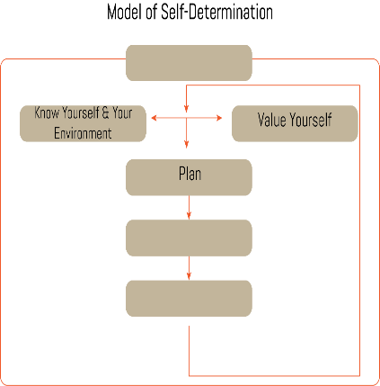
Plan
Make a plan
Monitor the plan
Adjust plan as
needed
Reflect on your plan cccframework.org
Environment
(Adapted from: Hoffman, A., & Field, S., 2005)
Notes:
To Say: Hoffman and Field (2005) identify the following as key elements of teaching students to plan: setting goals, being creative, practice, and leading their own IEP meetings.
Start small – students should start by setting small or short-term goals so that they can see how the process works in a relatively short period of time. Part of setting goals is identifying the steps needed to achieve the goal. Students must practice how to identify steps even for small, short-term goals. Learning to set goals should also include teaching students to anticipate possible results. Have them identify positive as well as negative results of their actions, so they see how different actions may affect the results.
Teaching students to be creative includes identifying different courses of action, identifying different people who might be helpful in completing the actions/steps, as well as other resources that would be helpful in meeting their goal. Being creative helps students identify new strategies to get around barriers to meeting their goals. Students can help one another in creative problem-solving.
This would include visual rehearsal as well as physical rehearsal and helps students gain confidence in the steps they plan to implement. Visual rehearsal is common with high caliber athletes – they review in their minds or imagine how they react or move in certain situations. Encourage students to review in their minds how they will implement their plan – also what it will be like when their goal is met! Physical rehearsal would be actually practicing some different scenarios with people. This would include some simple role-play based upon a student’s goal and steps to achieve the goal. A student would practice what he might say to someone and how he might say it. Another person, teacher or peer, could help him by responding in different ways.
Remember from last time, having students lead their own IEP meetings provides a great opportunity for them to showcase their new skills. Student-led IEP meetings, if the student is adequately prepared, can be an extremely positive experience for the entire team. Using a planning curriculum such as Steps to Self-Determination, NEXT Step, Self-Advocacy Strategy, and Student-Directed IEP which all include specific instruction and materials for teaching students to lead their IEP meetings. Again, one of the best things you can have students do is develop and share a product they’ve developed such as a PowerPoint presentation that reviews their strengths, preferences, limitations, and interests as well as their plans for their futures as a way to start the meeting. This gives the student an opportunity to share their knowledge of themselves, their priorities and their skills, and sets the tone for a positive student-focused IEP meeting.

Slide 36
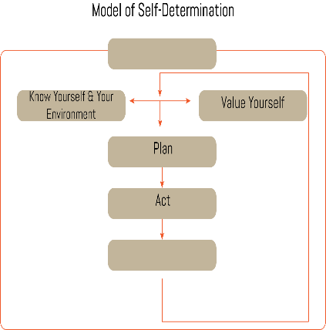
Act
Using good communication skills
Negotiating/dealing with conflict and criticism
Accessing resources and support
Being focused and persistent
Adjust plan as needed
Environment
(Adapted from: Hoffman, A., & Field, S., 2005)
Notes:
To Say: Taking action is where the rubber meets the road; it’s the point at which you JUST DO IT! This part of the model is where students take the skills and knowledge they’ve gained up to this point, and put it into action.
As we all know from personal experience, taking action involves also taking risks. Students should be allowed to take some risks in order to meet their goals; but it’s good to try to keep those ‘risk factors’ lowered. Lower risk factors would include things like having the student talk with their math teacher themselves about needing a specific accommodation, or tell a friend to stop teasing her. Risks and levels of risks are different for each student.
Hoffman and Field (2005) suggest using good communication skills, negotiating and dealing with conflict and criticism, accessing resources and support, and being focused and persistent are all skills that should be taught to students to act.
Students must learn communication skills so that they can express themselves, their needs and preferences appropriately. This goes back to a key part of the definition of self-determination which means getting what you need without infringing upon the rights of others. Learning about the various types of communication styles is critical for students to use good communication skills. These should include assertive, passive, and aggressive communication styles. Training on using communication skills should address these nuances. Remember that communication skills isn’t just about what is said – it’s also about using body language and listening. These need to be included in communication training as well.
These are skills that make us all better communicators! Learning to negotiate is a skill set that helps students work things out when things don’t go according to plan. Learning to deal with conflict and criticism involves teaching students to make choices about when to confront it and when to avoid it.
We all have support people and resources in our lives to help us achieve our goals. Teaching students to identify resources, people, services, or agencies helps students meet their goals. Prompting students to create this “safety-net” of people and resources helps the students practice being creative in their planning. Interviews with students and adults with and without disabilities have revealed that positive relationships with others contributes to enhanced self-determination and that people who have strong self-determination skills obtain support from others to meet their goals (Field, Hoffman & Sawilowsky, 1993).
Students should learn about persistence, and be supported in their persistence so that they don’t easily give up or rely on others to make decisions for them.

Slide 37
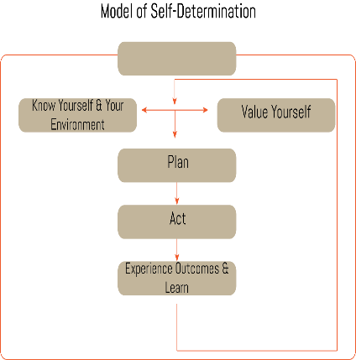
Experience Outcomes and Learn
Compare outcome to expected outcome
Compare performance to expected performance
Realize success and reflecting on the plan
Make adjustments
Environment
(Adapted from: Hoffman, A., & Field, S., 2005)
Notes:
To Say: Just like the IEP planning process is circular, Experiencing Outcomes and Learning is the part of the Model of Self-Determination that brings the process full circle. This step teaches students to reflect upon their experiences – the good, the bad, the ugly, the amazing – and it provides an opportunity to celebrate successes, no matter how small.
Guiding students to reflect upon their self-determination skills includes reflecting upon their self-knowledge, their self-worth, planning skills, and how they implemented their plans. This also gives students the chance to see how much they’ve grown in deciding their own paths.
It also offers an opportunity to refer students back to the planning and acting process in particular. They can compare their outcomes and performances with their expected outcomes and performances and ask themselves, “Where did things work well? Where did they go differently than expected?” Finally, students should ask themselves, “How should my plans and actions be adjusted?”
Hoffman and Field (2005) focus on the following four activities as critical to this element of self-determination:
Compare outcome to expected outcome;
Compare performance to expected performance;
Realize success; and
Make adjustments
Teachers can use the following strategies:
Reflection Questions for Self-Determination Evaluation from Self-Determination Strategies for Adolescents in Transition by Field, Hoffman & Spezia (1998) as a discussion guide with students
Have students interview each other about their experiences.
Hold monthly 'celebration' events to acknowledge students' efforts/successes .
Have a class discussion about newspaper/magazine articles which describe others' experiences being self-determined.
Review students' plans, strategize with them, and help them determine possible adjustments to their plans.
An important point to remember is that this process can be learned somewhat through direct instruction, but sometimes we all learn best from making our own mistakes. By experiencing successes as well as defeats, and actively reflecting on them, students may gain a deeper learning.

Slide 38
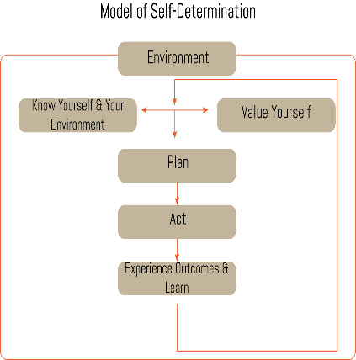
Environment
People
Agencies
Places
Schools Peer-to-Peer
Work Experience
(Adapted from: Hoffman, A., & Field, S., 2005)
Notes:
To Say: The environment component of this model is unique from other models of self-determination. The environmental context in which students express self-determination skills is critical to their success. Environmental context includes people, agencies, and places a student comes into contact with, and includes family, school, work, friends, and support staff. External factors play a role in how self-determined persons are able to exhibit within a particular setting. It’s not just that the individual needs to be aware of his/her environment, but each environment is a contributing factor that affects whether or not individuals are able to express greater self-determination. The more knowledge students have of the nuances of their various environments, the better able they will be to be self-determined within those environments. Environmental changes can either encourage or discourage self-determination.
Students’ ability to be self-determined will be strengthened to the degree that all of the key people in their lives support their efforts to learn and practice the knowledge, beliefs and skills that lead to greater self-determination. Students benefit from many opportunities to make decisions and choices accompanied by the level of support they need to do so. No matter how skilled students are in the knowledge, beliefs, and skills of self-determination, they will be limited in their ability to be self-determined if their environments don’t allow them to use those self-determination skills.
Family support for self-determination helps ensure that students can practice their skills at home as well as at school. Special considerations for involving families in self-determination efforts will be identified

Slide 39
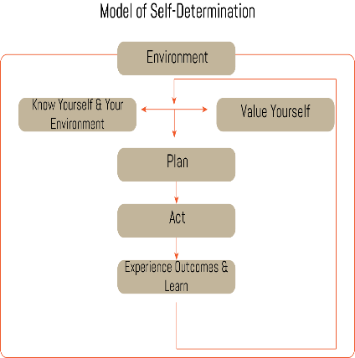
Environment: Involving Families
Being aware of the family culture
Sharing information with families
Engaging families in the process
(Adapted from: Hoffman, A., & Field, S., 2005)
Notes:
To Say: Involving Families in the self-determination process is a crucial component in supporting students to become more self-determined. This component is often overlooked. But, having family support for the self-determination training helps ensure that it will be supported at home.
Whether you use a curriculum with published materials and activities specifically for families, or you use your own materials, here are some things you can do to increase family involvement in your efforts to teach students to be more self-determined.
Being aware of the family culture. Being aware of the cultures of your students’ families is important. Culture does not only mean their nationality or heritage, but primarily the values of each family and how that family functions. Some families are more protective of their children with disabilities, others may be very excited for their children to make decisions about some things, but not others! It’s important to be aware of these issues and to do what you can to support students and families, but do so in a way that is respectful of their family.
Sharing information with families. At a minimum, if you are teaching students to be more self-determined, you should share information with their families, in particular, the parents or heads of the household. This can include sending a letter or email describing self-determination and the training you will be providing students, sending a brochure with similar information, speaking with them over the phone, or talking about it at a meeting.
Engaging families in the process. Engaging families in the process goes beyond sending information home but informing families of your plans to instruct their students self-determination skills. Some curricula include family support components. Some, like the Steps to Self-Determination and the N.E.X.T. Step curricula include specific materials and components designed specifically for working with families. Sometimes, parents don’t fully understand the impact of self-determination until they see their child using these skills in a productive way. One way this can be done is to have students actively participate at their IEP meeting by presenting information about their preferences, interests, strengths, needs, and plans for the future.

Slide 40
Brief Recap
Know Yourself and Your Environment
Value yourself
Plan
Act
Experience Outcomes & Learn
Environment
(Adapted from: Hoffman, A., & Field, S., 2005)
Notes:
To Say: To summarize: The Model of Self-Determination provides a nice framework for reviewing key elements for providing instruction on self-determination to youth with disabilities. It includes six major elements.
Know Yourself and Your Environment focuses on guiding the student to explore their own dreams for their lives and identify their priorities. It also focuses on guiding students to learn about their preferences, interests, weaknesses, and strengths as well as learn about their own disabilities and what they mean for them.
The importance of the Value Yourself element is teaching students to acknowledge and embrace their self-worth which is an ongoing process. It includes students knowing their rights and responsibilities, valuing others, and nurturing positive relationships with others.
Plan includes setting goals, even small ones, and the steps and creative resources needed to achieve those goals. In addition, it suggests that students have many opportunities to practice their planning skills and lead their own IEP meetings.
Act involves using good communication skills, negotiating, dealing with conflict and criticism, and accessing resources and support to meet the goal.
Experience Outcomes & Learn describes the importance of celebrating successes and reflecting on the skills used or knowledge gained to enhance student self-determination skills.
Environment addresses the fact that there are different environments in which students express their self-determination. Each environment may require differences in how students express themselves.
Furthermore, it is critical to involve families in efforts to teach students to be more self-determined. At a minimum, families should be informed of what self-determination is and how it can impact their lives. It is best practice to include them in as much of the activities as you can as well as providing information to them for how they can support their children at home and in the community.
Student-led IEPs are another key piece for teaching students to be more self-determined, however this activity alone will not increase students’ self-determination skills. Having students lead their own IEP meetings is one factor in enhancing student self-determination.

Slide 41
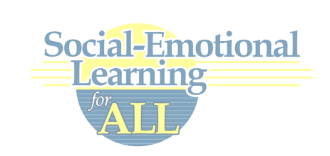
Self-Determination Practices
Using Social and Emotional Learning for All (SELA)
Notes:
To Say: Social and Emotional Learning for All is a joint project between The Missouri Department of Elementary and Secondary Education (DESE) and the University of Kansas Research Collaboration. They are partnering to offer the Social-Emotional Learning for All (SELA) training for all teachers. The project is not a separate initiative, stand-alone course/curriculum, or add-on; rather it aims to provide coaching, resources, and other supports to help schools build a sustainable culture of social-emotional learning (and as such, can be easily integrated with other initiatives/priorities). The project emphasizes three elements for success:
Collaboration between all stakeholders (e.g., administrators, general and special educators, counselors, service providers, families, community, etc.)
Multi-tiered instruction and interventions
Effective use of data to inform decision making at multiple levels

Slide 42
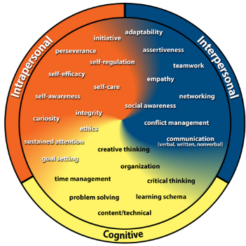
Social and Emotional Learning for All Foundational Competencies
Intrapersonal
Interpersonal
Self-Efficacy
Self-Regulation
Self-Awareness (integrated)
Assertiveness
Conflict Management
Empathy (integrated)
Notes:
To Say: An extensive literature review process by Dr. Amy Gaumier-Erickson and Dr. Pattie Noonan from KU resulted in the 26 competencies that you see on the wheel. You can find condensed versions of the review of research, assessments, and evidence-based instructional practices in the Teacher Guide for each competency, available in the Resources section of http://CCCframework.org.
The competencies are divided into three domains: Intrapersonal, Interpersonal and Cognitive. Historically, schools have focused on the cognitive domain. Social and Emotional skills are found in the Intrapersonal and Interpersonal domains. WE will talk more specifically about the definition of intrapersonal and intrapersonal competencies in the nest slide.
From a practical standpoint 26 competencies is still too much for a school to take on schoolwide, or for a teacher to try to teach. So, Dr. Gaumier-Erickson and Dr. Noonan further researched to determine foundational competencies that help students develop other competencies.
There are four main foundational competencies, two from intrapersonal - Self-efficacy and self-regulation - and two from interpersonal - assertiveness and conflict management. Self-Awareness is embedded in Self-Efficacy and Self-Regulation and Empathy is embedded in the training on assertiveness and conflict management. Today, we will do a brief review of self-regulation. self-efficacy, and assertiveness because these are competencies that work closely with self-determination. If you are interested in further training, contact your local RPDC.

Slide 43
Intrapersonal or Interpersonal
Intrapersonal
Exists within one’s self
Self-talk
Self-reflection
In touch with who you are
In touch with your needs
Interpersonal
Relationships, communication or interaction between people
Involving or occurring among several people
Understanding others
Notes:
To Say: Intrapersonal competencies are those that exist within one’s self, such as self-efficacy, self-regulation, self-awareness, etc. These competencies depend on our ability to be self-reflective, aware of our strengths/areas for growth, etc. In contrast, interpersonal competencies are those that revolve around relationships/communication and interaction with others, such as assertiveness, conflict management, empathy, etc. These competencies depend on our ability to understand and interact with others successfully. They both relate to a student’s ability to self-determine.

Slide 44
Essential Components
Essential components “make up” the competency.
Competencies are complex.
Teach the essential components and use the essential components to shape your instruction.
Essential components provide a checklist (learning schema) for our brains.
Notes:
To Say: All the competencies have specific components. When teaching a competency, the most important part is components! Essential components “make up” the competency.
Competencies are complex. For example, self-regulation is much more than just being able to sit quietly and wait your turn. To be able to self-regulate you must be able to make a plan, monitor the implementation of the plan and adjust as needed, and reflect on the success or failure of that plan. You don’t really teach “self-regulation”. You teach the students the components of self-regulation and when they are able to do all the steps we say a student is able to self-regulate.
For a student to gain the competency, we must both teach the essential components and provide opportunities to practice with feedback (all components, not just one).

Slide 45
Implementation Considerations
Competency development isn’t absorbed; it’s learned.
Like learning anything else, it takes practice over time.
While relatively simple to define, competencies are complex to teach and learn.
Competencies are addressed in school, but not typically in a systematic way for all students.
Notes:
To Say: If we want our students to learn the competencies that we know are vitally important to them, they have to be taught, we can’t just hope they pick it up somewhere along the way. We also know that for a student to really internalize a competency it can’t just be introduced once. Students need the opportunity to practice the competency in a variety of situations. Because the competencies are complex, we utilize the components to teach them. Many of you are doing things in your class to teach these competencies, but what we have been lacking in schools is a systematic, research-based way to address these competencies for all students.

Slide 46
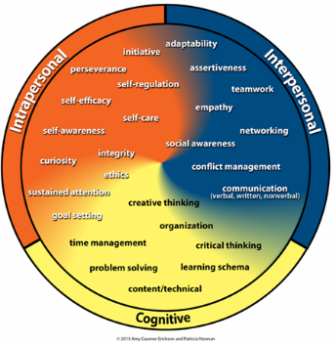
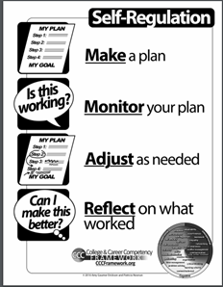
Self-Regulation
HO # 3
Notes:
To Say/To Do: You have seen this wheel before - it is the College and Career Competency Wheel. You will notice an arrow pointing to self-regulation, it is in the intrapersonal domain. Intrapersonal focuses on a student’s internal reflective capacities.
One of the most important things we do when we start teaching self-regulation to our students is have a common definition. This is the definition of self-regulation. A proactive, self-directed approach for attaining goals, learning skills, and accomplishing tasks. Many teachers choose to post the definition so they can refer to it consistently.
We have talked about how all competencies have components—when teaching a competency, the most important part is components! You can’t teach the competency without them. All the competencies has a components’ poster. Teachers also often post this in their room for reference. For self-regulation there are four components that we need to teach our students. They have to be able to not only develop a plan to address a goal, but they also have to monitor the plan to determine if the plan is moving them toward the goal. If it is not, they may need to make some changes to their plan. When they either achieve or do not achieve their goal, reflect on the plan by asking what was successful or what was not successful with the plan. Use that information to move forward and set other goals and develop plans to achieve those goals.

Slide 47
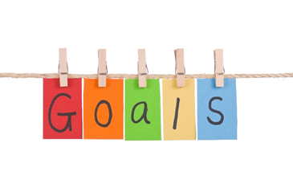
Top Student Outcomes
Identified by teachers who taught Self-Regulation
Improved student responsibility
Improved ability to set realistic goals, monitor progress, and evaluate results
Improved academic achievement
Increased reflection on successes and areas for improvement
Notes:
To Say: This is survey data from teachers who were trained and began to implement self-regulation instruction. This is what they saw approximately 6-8 weeks out from beginning to implement self-regulation instruction in their content area classrooms.
As we look at the list, is there anything that we would not want to see with our students?

Slide 48
First Steps in Self-Regulation
Introducing Self-Regulation
Using the vocabulary
Talking about how self-regulation has helped you
Watching and discussing a self-regulation video with your class.
https://padlet.com/ResearchCollaboration/self_regulation
Notes:
To Say/To Do: As you go through the definition it is important that we understand all the parts of the definition and have a class discussion regarding the definition, making sure they understand why it is important to be proactive vs. reactive and why self-directed is necessary and what it looks like to be self-directed. Help them understand that when it is a process it happens over time and there are steps (the components) to go through to make self-regulation happen. Understanding “attain” can help foster a discussion of things they have already attained and the process they went through to attain from making a competitive team to learning to tie their shoes.
Once you introduce those words in class ,it is important that you utilize those words so they get some concrete understanding of the words. Teachers often post the self-regulation poster in their room to help them remember to use the words. You can prompt your students to use the words and offer incentives or positive recognition when they use the words correctly. Some examples would be: I appreciate the way you were proactive and got all your supplies out before we started. What character in the story that we just read could you describe as self-directed.
Children love listening to their teachers tell stories. When you know you are trying to teach a difficult concept, teach your class with a story of how you managed to understand and remember the concept when you were in their shoes. Utilizing stories of how you were able to achieve your goals is powerful.
On the padlet are examples of videos that you can use for students of all ages regarding self-regulation. You can use the video to help facilitate a discussion in your classroom about self-regulation.

Slide 49
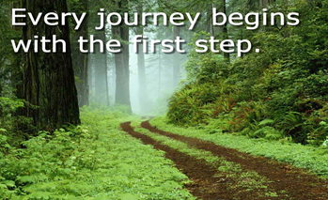
Additional First Steps
HO # 4
Prior to beginning a project, help students create a plan, monitor the plan, adjust the plan if needed, and reflect on the plan and follow it through all the steps together with the students (preparing for a test, working on a project, getting to lunch quietly).
For Example: Using yoga poses or breathing techniques as a strategy for calming emotional reactions.
Notes:
To Know: #4 Chair Yoga
To Say: Students need to understand how to make a plan that is detailed, realistic, and that takes into account potential obstacles/complications.
It includes activities to help students understand what a quality self-regulation plan looks like; how to incorporate the other components of self-regulation in the design of the plan; and how to create a plan for a specific scenario. There are resources on the ccc.framework.org website that can help with this. Some teachers opt to do a classroom plan first, then have students develop individual plans.
A new study from Eunice Kennedy Shriver National Institute of Child Health and Human Development, finds that when students experience an academic setback such as a bad grade, the amount of cortisol—the so-called stress hormone—in their bodies typically spikes. For most students it drops back down to normal levels quickly, but for some it stays high for a long period of time. These students remain fixated on the setback and have difficulty moving forward this can have negative impacts both educationally and behaviorally. Helping students learn how to self-calm in stressful situations will provide them with the resilience they need to be successful both in and out of school. Slow diaphragmatic breathing is a developed technique that involves slowing down the breath to communicate “safety” to the brain. While the science behind school-based yoga is relatively new, the initial evidence from a growing number of studies is promising. There are seven ways that integrating yoga in schools can support students and teachers, while helping schools address many of the challenges common in education today.
Emotion Regulation
Academic Performance
Reduced Anxiety and Tension
Resilience to Stress
Fewer Problem Behaviors
Physical Well-Being
Teacher well-being and classroom climate
Handout #4 provides examples of chair yoga that can be done in class with students.
http://www.yoga4classrooms.com/supporting-research

Slide 50
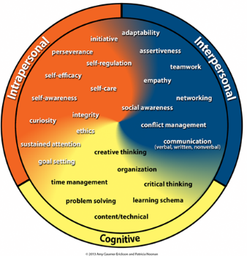
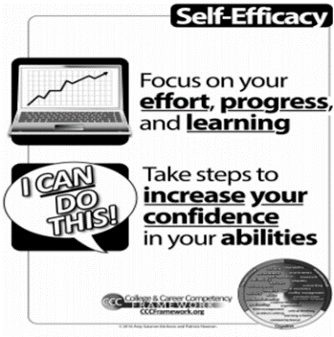
Self-Efficacy
HO # 5
Self-Efficacy refers to perceptions an individual has about his or her capabilities to perform at an expected level, achieve goals, and complete moderately challenging tasks.
Notes:
To Know: Handout #5 is a copy of the poster for Self-Efficacy.
To Say/To Do: The definition of Self-Efficacy is the perceptions an individual has about his or her capabilities to perform at an expected level, achieve goals, and complete moderately challenging tasks.
All students can learn and expand their intrapersonal and interpersonal competencies through instruction and integration within content-area learning and experiences. Self-Efficacy has two components. Remember when teaching the competency, we are focusing on the components. The components of Self-Efficacy are focus on effort, progress and learning and take steps to increase your confidence in your abilities.

Slide 51
Top 10 Self-Efficacy Outcomes
Increased confidence in their own abilities
Increased growth mindset
Increased willingness to take on and persist in challenging tasks
Increased ability to reflect on successes and areas for improvement
Increased ability to seek assistance and supports
Increased ability to see mistakes and constructive criticism as opportunities to learn
Increased self-reflection/self-awareness
Improved teamwork/group work
Improved quality of work
Improved Self-Regulation
Notes:
To Know/To Say: This is survey data from teachers who were trained and began to implement self-efficacy instruction. This is what they saw approximately 6-8 weeks out from beginning to implement self-efficacy instruction in their content area classrooms. At your table, talk about the ones that resonated the most with you and how it would impact your class. We will share out some of our thoughts after you have time to discuss at your table.
(This can be done in zoom meeting rooms)

Slide 52
First Steps in Self-Efficacy
HO # 6
Teaching about neuroplasticity
Explaining the difference between growth/fixed mindset
Using mistakes as opportunities for learning
Teaching The Power of YET!
https://www.youtube.com/watch?v=ELpfYCZa87g
Notes:
To Know: Handout #6 is Fixed vs. Growth Mindset
To Do/To Say: This is a short video you could share with your students. It is about two minutes long. Let’s watch it.
Ask: What are some key points?
The brain is adaptable, like plastic (hence the term neuroplasticity)
The process of rewiring your brain by forming new connections and weakening old ones in neuroplasticity in action
We all have the ability to learn and change by rewiring our brains; if you have ever changed a bad habit or thought about something differently, you have experienced neuroplasticity – first hand you have carved that new pathway in your brain.
You can talk with your students about the difference between a fixed and a growth mindset & how having a growth mindset will help them continue to grow and strengthen their ability to perform at an expected level, achieve goals, and complete moderately challenging tasks. There is a handout in your packet that addresses fixed and growth mindset.
What is a growth mindset? It’s much easier to grasp if you compare it to its opposite: a fixed mindset. Please follow along on handout #6 as we discuss it. Someone with a fixed mindset views his or her abilities as fixed and unchanging, whereas someone with a growth mindset thinks those abilities come from hard work, and therefore can grow and change and improve. These different views on skills lead to very different approaches to challenges. Those with a fixed mindset avoid challenges or give up quickly. But, those with a growth mindset embrace challenges. People with the growth mindset put forth more effort, they’re more open to feedback, and they’re less likely to blame others and get discouraged when things get tough.
Because shame is currently attached to mistakes, students are afraid to take chances, explore, and think for themselves. I believe that it's a mistake to think of mistakes as something bad. When mistakes become learning opportunities, everything changes. Students take more risks, think in new ways and cheat less.
Nine Ways to Teach with mistakes from Edutopia (https://www.edutopia.org/blog/use-mistakes-in-learning-process-richard-curwin)
Stop marking errors on tests and papers without explaining why they're wrong. Give enough explanation to help your student understand what went wrong and how to fix it. A big red X is insufficient.
Give students a chance to correct their mistakes and redo their work. This allows mistakes to become learning opportunities.
Improvement should be a significant factor in the evaluation process. The more a student improves, the higher his or her grade. Nothing shows learning from mistakes more than improvement.
When a student makes a mistake in a class discussion, don't say things like, "No, wrong, can anyone help him?" Don't just call on someone else without further comment. Instead, ask the student, "Why do you think so? Can you give an example? If you could ask yourself a question about your answer, what would it be?"
Educator, Madeline Hunter, suggested starting with what is right. If a teacher asks, "Who was the first president of the United States?" and a student answers, "Barack Obama," instead of saying, "You're wrong," try saying, "Barack Obama was the first black/bi-racial president, you are right about that. However, he wasn't the first president. Let's go further back in history." Even silly answers can be responded to in this way.
If a student needs help with an answer, let him or her choose a classmate to help. Call the helper something like a "personal consultant."
Instead of (or at least in addition to) walls filled with students' achievements, have a wall where students can brag about their biggest mistakes and what they learned from them.
Have biweekly class meetings where students share a mistake they made, what happened after, and what they learned.
Be sure to tell the class about your own mistakes, and what you learned from them. Unless your parent is a teacher, students assume teachers are born as fully formed teachers. They literally pop out of the womb with a red pen in one hand and a textbook in the other hand - or if a PE teacher a whistle around your neck. They assume you are a teacher because you are so smart and learning was easy for you. So sharing your struggles, the mistakes you made can be very powerful.
As students work on challenging tasks, there will be hesitation and mistakes. This is a great opportunity to emphasize the power of “yet.” Dr. Dweck coined the phrase “the power of yet.” This is a strategy that we can share with parents, and we can encourage students to start using it with each other. The power of “yet” is an idea that brings together several aspects of self-efficacy. As you might have already realized, it encourages a growth mindset approach and draws on both mastery experience and verbal persuasions. When educators or peers help remind students that they just aren’t skilled at something yet, they are using it as verbal persuasion.
When we teach students to reframe their own internal thinking to approach tasks in this way, we are helping them internalize the ideas of deliberate practice, building a history of achievement, and promoting positive self-talk. Support students in creating statements directly related to challenging content while adding the statement, “yet.” This will help them get used to reframing their thinking, so that eventually they’ll do it naturally when they encounter similar things.

Slide 53
Additional First Steps
HO # 7
Understanding the ways of developing self-efficacy
Utilizing an Academic Victory log
Understanding the power of praise
Learning how to handle our reactions to stress
Notes:
To Know: Handout #7 is an example of a victory log.
TO SAY: There are four main sources that influence students’ self-efficacy. Mastery experience is the most powerful and influential of all of the sources. Mastery experience is built through ongoing successes with moderately challenging tasks. We can talk with them about those four sources and provide examples and opportunities for them.
Repeated success is accomplished by repeated/sustained effort. Students’ ability to view a pattern of repeated success helps build a history of achievement, which reinforces their self-efficacy. The whole idea of success breeds success. Helping students understand when they practice they will get better and providing many opportunities to practice and that getting something wrong is just a part of the process. Be a classroom that allows failure as a part of learning.
Verbal persuasions refers to communication from teachers, peers, and even oneself that enables students to reflect on their successes and interpret failures as valuable steps toward learning and future success. Remind them constantly of that great Thomas Edison quote. “I have not failed. I've just found 10,000 ways that won't work.”
Physiological feedback refers to the emotions students feel when they’re preparing for or doing a challenging activity. It’s important to help students be aware of these and understand how to manage them to be able to move forward effectively. For example, anxiety about a challenging new task might be a hint that a student is in a low self-efficacy space, and might need to use specific strategies/exercises to reduce anxiety and therefore be able to approach the task with a more positive mindset. We have talked about the importance of breathing in self-regulation.
Vicarious experiences refers to learning from the modeling of peers or teachers. It’s particularly helpful for students with prior failure or limited experience with the skill – seeing others like themselves succeed at specific tasks can help build their self-efficacy for accomplishing the tasks. Talk with them about your experiences and struggles.
We have all had times when we have felt hopeless and frustrated and felt like a failure. At times like these a victory log can help you think back to a time that you did experience success, even if it was a small ones. You have a copy of a victory log in your packet. Be prepared to help students see the smaller victories. We often talk about things in terms like winning or losing, passing or failing. We need to help them see and celebrate the improvements and the learning not just grades and win/loss records.
According to praise research by Carol Dwek (Mueller and Dwek 1998), children who are praised for their natural intelligence chose easier problems in the future. Doing so means they are less likely to challenge themselves or learn as much, but they see it as ensuring they will continue to exhibit behavior that elicits praise.
Students who were praised for their effort chose more difficult problems. Doing so increases the possibility that they won’t always get things right on their first try, but they know they are praised for the effort not necessarily the outcome and it also serves to increase their likelihood of learning.
Thumbs up if praise supports self-efficacy thumbs down if it does not.
“You studied your spelling words for the test and it really shows.” Thumb Up
“You are just really good at math.” Thumb Down
“I like the way you used your resources to get the answer.” Thumb Up
“You are very talented in writing.” Thumb Down
Give permission and encourage students to acknowledge their feelings of anxiousness to focus or get started.
Let students know that feelings in themselves are natural, it is just how we handle and demonstrate those feelings can make things difficult for us. Model for them positive self -talk or have them do some mindfulness exercises to reinforce their beliefs in their own abilities. We have talked about the importance of breathing. You might want to do a little classroom yoga as mindfulness activities. I am not talking mats and downward dog for all your students. But, there are some simple chair yoga activities you can do with students to help them cope with stress. You can google chair yoga or classroom yoga and find lots of good examples.

Slide 54
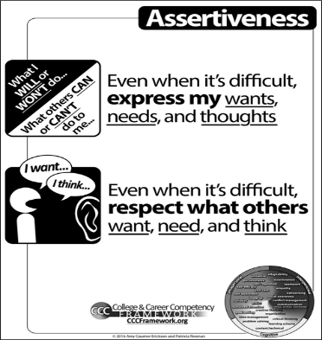
Assertiveness
HO # 8
Even when it’s difficult, expressing your wants, needs, and thoughts while respecting others.
Notes:
To Know: Handout #8 is the poster for Assertiveness
To Say/To Do: The definition of Assertiveness is even when it’s difficult, expressing your wants needs and thoughts while respecting others. This is a competency that we all can agree is important for our students. They can learn and practice this interpersonal skill through instruction and integration within content-area learning and having the opportunity to practice it through teacher-directed experiences.
Assertiveness has two components. Even when it’s difficult express my wants, needs and thoughts and even when it’s difficult respect what others want, need and think. It is important for students to be able to do both of the components.
If they can only do the first component, even when it’s difficult express my wants, needs and thoughts; but not the second, we say they are aggressive. If they can only do the second component, even when it’s difficult respect what others want, need and think; but not the first they are passive. The goal is being able to do both of the components.

Slide 55
Top 10 Student Outcomes
Identified by teachers who taught Assertiveness
Improved communication
Increased ability to express themselves
Increased self-reflection/self-awareness
Increased confidence in their own abilities
Increased ability to seek assistance and supports
Improved interactions among students
Improved conflict management skills
Improved ability to resist peer pressure
Improved behavior
Reduced incidents of bullying
Notes:
To Say: This is survey data from teachers who were trained and began to implement assertiveness instruction. This is what they saw approximately 6-8 weeks out from beginning to implement assertiveness instruction in their content area classrooms. Discuss at your tables and be prepared to share out the one that surprised you the most and why.
Allow 2-3 minutes for discussion before sharing

Slide 56
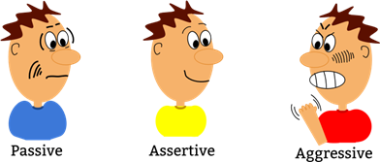
First Steps in Assertiveness
HO # 9
Understand the difference between passive, assertive, and aggressive
Understanding their emotions and how they are expressed
Developing protective assertions
Notes:
To Know: Handout #9 is the chart of indicating difference between passive, assertive and aggressive
To Say: In order to truly understand assertiveness, it’s important to understand the concepts of passive and aggressive communication. Explain that passive, assertive, and aggressive communication behaviors are all appropriate at various times. Aggressiveness is not always “yelling or punching,” but often much more subtle characteristics, which can be useful and necessary in certain situations. In the packet is a copy of Handout #9 that shows the difference between passive, assertive, and aggressive. At each table discuss a situation that it might make sense to be passive, a situation where it might make sense to be assertive, and a time where being aggressive may be the best option.
Or
Let’s predict how we would respond to the following situations. I will read a scenario (share out/move around to the chart with the appropriate word) your initial reaction (passive, assertive, aggressive) to each scenario. Given time to reflect, we can all be assertive, so only consider your initial reaction for this activity.
Your principal asks you to fill in for another teacher’s class during your prep time, but you want to call your mom and check in on her as she recently had surgery.
Your father just criticized your parenting style on Facebook.
Your colleague is constantly complaining about one student. You also work with that student and have had no problems with him.
Your spouse/significant other wants to watch the KU game; you want to watch a movie.
A student has asked three times to go to the bathroom and you tell them after they start the assignment they can go. They ask a fourth time and still have not started.
Your teenage child has started telling you where she is going instead of asking permission to go somewhere.
Your friend always makes plans to get together, but then cancels at the last minute.
We all favor different ways of communicating at various times. Assertiveness is a choice, and it may not be our natural response - how we respond often depends on how emotional we are about the event, and what those emotions are.
There are times where the right choice is to be assertive, passive, and even aggressive for both adults and adolescents. However, we should be able to be assertive when we want or need to. To do this, we need self-awareness about how well we are able to be assertive in various situations, some strategies for understanding others’ perspectives, and the ability to revise our aggressive or passive tendency into an assertive one when it benefits us to do so.
To be able to express their wants needs and thoughts students need to have the right words for their emotions. Using a word wheel can help them do that. You have a copy of the word wheel in the packet.
The things about emotions is that we can’t control them and must accept them; emotions are separate from actions/behaviors. How we do or don’t express our emotions appropriately is what can get our students in trouble. Reactions to events are often tied to past experiences and may make sense to the one expressing the emotion, but not always to others.
Failing to accept emotions can be harmful to relationships, and negatively impact physical and mental wellness. Emotions don’t make us innately bad or good—we all have emotions and they have a purpose. If we can understand our emotions about a given situation, we are better able to express ourselves.
Adolescents in particular make statements that don’t actually express feelings or emotions (but they think they do). I am going to share some statements. See if you can come up with one or two emotions that may be behind the statement.
This assignment stinks.
You are a jerk for posting that.
You don’t text me back.
She is so lucky she is smart.
Helping students find the words to express their emotions is key to helping them acquire assertiveness. They can, even when it is difficult, express their wants, needs and thoughts.
A protective assertion is a boundary statement and it lays out what you are not willing to tolerate. For instance, “People may not use my supplies without asking me first.”
Have students practice telling people their boundaries or articulating them on paper. The more students state their boundaries, the easier it is to stick to them. In other words, don’t just accept students saying, “I know what I’d do in this situation.” Set up activities where students hear opinions of others and actually practice stating their opinion and adhering to their boundaries.
As students work on developing, articulating, and maintaining boundaries, acknowledge that it can be difficult to stick to your boundaries sometimes; acknowledge that students should be prepared for pressure. Highlight examples in history, science, novels, work situations, and actions of well-known public figures where people stick to boundaries. Discuss how people and characters do this.
For instance, a great historical example to highlight is how Rosa Parks established and maintained her boundaries when she refused to give up her seat on the bus. Or, you could use an example from literature and discuss how Neville stuck to his boundaries even when it meant opposing his friends in Harry Potter and the Sorcerer’s Stone.

Slide 57
Additional First Steps
HO # 10 & 11
Identify the feelings others may be feeling
Listening and paraphrasing strategy
Three-Part Assertiveness Statements
Notes:
To Know: Handout #10 is the feelings word wheel and Handout #11 is the Three-Part Assertive Statements
To Say: Use scenarios and Handouts #10-Feelings Word Wheel and # 11-Three Part Assertiveness Statements to teach students how to better understand others’ emotions by considering how they feel, but then ALSO asking the person. We cannot guess what people truly feel about any given situation, and our understanding will be incomplete until we communicate with the person. We want to support students in identifying how a person might POSSIBLY be feeling, but then also engaging with the person to come to a better understanding. These two parts should be taught together. Students consider others’ emotions and then initiate communication to better understand. This is also foundational for conflict management.
Listen to these scenarios, consider how each person might be feeling. At your table, name one positive and one negative emotion the person may be feeling in each situation.
Parents getting divorced
Cell phone quits working
Older sibling moving away to go to college
Mother having a baby
Moving to a new school Talk with your student. Just because they may view something positively, someone else may not see it that way and part of being assertive is component number two - Even when it’s difficult respect the wants, needs and thoughts of others
Three-Part Assertive Statements provide a formula for putting it all together.
Part 1: An empathy statement, or indication that you understand the perspective and feelings of the other person.
Part 2: The rationale behind the action. Provide some reasons and your feelings to support your opinion. Do not blame others (e.g., don’t say “you make me feel angry”), but do share feelings (e.g., do say “I feel frustrated”).
Part 3: A coherent, direct statement of what you want to happen. Be clear and detailed.
Students can practice creating assertive statements for various scenarios. More importantly, students who are being aggressive or passive can be prompted to rephrase to assertive statements
Each of you write a three-part assertiveness statement telling your spouse you are tired of them interrupting you.
(Part 1) - I know that you get excited about talking about what is happening in the world right now, (Part 2) - but, I feel frustrated and devalued when you talk over me. (Part 3) - I need you to try to let me finish my sentence or thought before you start talking.
You can have students write assertive statements on notecards for situations that happen fairly often. Have them practice with you or other students. They need to realize they still may not always get what they want, but they come closer when they ask this way.

Slide 58
For More Information
cccframework.org
Notes:
To Say/To Do: Contact your local RPDC if you are interested in full trainings in Self-Regulation, Self-Efficacy or Assertiveness. They have staff available to provide the necessary training.

Slide 59
The Dignity of Risk
What if you never got to make a mistake.
What if your money was always kept in an envelope where you couldn’t get at it.
What if you were never given a chance to do well at something.
What if you were always treated like a child.
What if your chance to be with people different from you was with your own family.
What if the job you did was not useful.
What if you never got to make a decision.
What if the only risky thing you could do was to act out.
Notes:
To Do: Could be done through a chat or breakout rooms. You might want to copy this slide and the next and print back-to-back for table discussion.
To Say: Look over the next two slides and what statement resonates with you?
How could you use the SELA framework to provide or empower your student to not be at risk? For example -”what if you were always treated like a child”. How could SELA prevent this from being a part of the student’s behavior?

Slide 60
The Dignity of Risk
What if you couldn’t go outside because the last time you went it rained.
What if you took the wrong bus once and now you can’t take another one.
What if you got into trouble and were sent away and you couldn’t come back because they always remember you’re “trouble”.
What if you worked and got paid $.46 an hour.
What if you had to wear your winter coat when it rained because it was all you had.
What if you had no privacy.
Notes:
To Do: Could be done through a chat or breakout rooms.

Slide 61
The Dignity of Risk
What if you could do part of the grocery shopping but weren’t allowed to do any because you weren’t able to do all of the shopping.
What if you spent three hours every day just waiting.
What if you grew old and never knew adulthood.
What if you never got a chance.
(From a parent whose son is in a support work program in Richmond, VA; published by The Arc.)
Notes:
To Do: Could be done through a chat or breakout rooms.

Slide 62
Resources
https://bit.ly/31epLCX
The resource guide for I-13; Best Practices and Self-Determination
Notes:
To Do/To Know: Take them there and show what there is to offer.
To Say: Please go there and make a copy of the document. Do NOT add anything to the original, however, if you find additional resources, please send them and we will vet them before adding them.

Slide 63
Practice Profile Reflection
How will the Practice Profile direct your next steps?
Use the Transition Academy Action Plan-Appendix A-Self-Determination-p.3 to document your goals/next steps.
104
Notes:
To Say: Look at the Transition Academy Practice Profile-Appendix A-Self-Determination-p.3, and determine what you are currently doing, develop your next steps for improvement in your practice. You can document that on Appendix A-p.3.

Slide 64
Think and Make a Note
Which materials presented can help you address some of the areas of the Model of Self-Determination?
What next steps will you take to provide Self-Determination instruction and opportunities for your students?
Get out the action plan, commit to one step you will do in the next 30 days.
Notes:
To Say: We have talked a lot today about the Model of Self-Determination. As you take time to reflect on what you’ve learned today, take a few minutes to think about the questions on the screen. What materials presented can help you address some of the areas of the Model of Self-Determination? What next steps will you take to provide self-determination instruction and opportunities for your students? Take a few minutes and think about this and then share your thoughts with your shoulder partner.
AFTER 2 MINUTES, SAY: Please take a moment to share your thoughts with your shoulder partner.
AFTER 2 MINUTES, SAY: Let’s come back together. Which materials presented can help you address some of the areas of the Model of Self-Determination? (Take a few answers.) What next steps will you take to provide self-determination instruction and opportunities for your students? Take a few answers)

Slide 66
Further Coaching Contact
For further coaching contact:
Notes:
To Do: Presenter should add their own contact information.
To Say: Once you return to your districts, if you have questions or need additional coaching or technical assistance, please feel free to contact me. My information is on this slide.

Slide 67
References
Allen, S. K., Smith, A. C., Test, D. W., Flowers, C., & Wood, W. M. (2001). The effects of Self-Directed IEP on student participation in IEP meetings. Career Development for Exceptional Individuals, 24, 107-120.
Arndt, S.A., Konrad, M., & Test, D.W. (2006). Effects of the self-directed IEP on student participation in planning meetings. Remedial and Special Education, 27(4), 194-207
Balcazar, F. E., Fawcett, S. B., & Seekins, T. (1991). Teaching people with disabilities to recruit help to attain personal goals. Rehabilitation Psychology, 36(1), 31’41.
Bowman, O. J., & Marzouk, D. K. (1992). Using the American with Disabilities Act of 1990 to empower university students with disabilities. The American Journal of Occupational Therapy, 46(5), 450’456.

Slide 68
References
Bullis, M., Moran, T., Benz, M.R., Todis, B., Johnson, M.D. (2002). Description and evaluation of the ARIES project: Achieving rehabilitation, individualized education, and employment success for adolescents with emotional disturbance. Career Development for Exceptional Individuals, 25, 41-58.
Cooper, K.J., & Browder, D.M. (1998). Enhancing choice and participation for adults with severe disabilities in community-based instruction. Journal of the Association for Persons with Severe Handicaps, 23, 252-260.
Ezel, D., Klein, C., & Ezell-Powell, S. (1999). Empowering students with mental retardation through portfolio assessment: A tool for fostering self-determination skills. Education and training in mental retardation and developmental disabilities, 34(4), 453-463
Field, S., Hoffman, A., & Spezia, S. (1998.) Self-Determination strategies for adolescents in transition. Austin, TX: PRO-ED.

Slide 69
References
Field, S., & Hoffman, A. (2002). Preparing youth to exercise self-determination: Quality indicators of school environments that promote the acquisition of knowledge, skills and beliefs related to self-determination. Journal of Disability Policy Studies, 13(2), 114-119.
Martin, J.E., Dycke, J.L.V., Christensen, W.R., Greene, B.A., Gardner, J.E., & Lovett, D.L.(2006). Increasing student participation in IEP meetings: Establishing the self-directed IEP as an evidence-based practice. Exceptional Children, 72(3), 299-317.
National Longitudinal Transition Study-2 (2005). The self-determination of youth with disabilities. Retrieved from http://www.nlts2.org/fact_sheets/2005_06-2.html
National Secondary Transition Technical Assistance Center (2010). Evidence-based secondary transition practices. Retrieved from http://www.nsttac.org/ebp/evidence_based_practices.aspx

Slide 70
References
O’Reily, M.F., Lancioni, G.E., & O’Lane, N. (2000). Using a problem solving approach to teach social skills to workers with brain injuries in supported employment settings. Journal of Vocational Rehabilitation, 14(3), 187-194.
Sarver, M.D. (2000). A study of the relationship between personal and environmental factors bearing on self-determination and the academic success of university students with learning disabilities. Unpublished doctoral dissertation. University of Florida.
Serna, L. A., & Lau-Smith, J. (1995). Learning with a PURPOSE: Self-determination skills for students who are at risk for school and community failure. Intervention in School and Clinic, 30, 142-146.
Sowers, J., & Powers, L. (1995). Enhancing the participation and independence of students with severe physical and multiple disabilities in performing community activities. Mental Retardation, 33(4), 209-220.

Slide 71
References
Storey, K. (2002). Strategies for increasing interactions in supported employment settings: An updated review. Journal of Vocational Rehabilitation, 17(4), 231-237.
Wehmeyer, M. L. (1996). Self-determination as an educational outcome: Why is it important to children, youth and adults with disabilities? In D. J. Sands & M. L. Wehmeyer (Eds.), Self-determination across the life span: Independence and choice for people with disabilities (pp. 15-34). Baltimore,MD: Paul H. Brookes.
Wehmeyer, M., & Palmer, S. (2003). Adult outcomes for students with cognitive disabilities three years after high school: The impact of self-determination. Education and Training in Developmental Disabilities, 38(2), 131-144.
Wehmeyer, M. L. & Schwartz, M. (1997). Self-determination and positive adult outcomes: A follow-up study of youth with mental retardation or learning disabilities. Exceptional Children, 63, 245-255.

Slide 72
Acknowledgments
This module has been adapted from the Missouri version of the Self-Determined module located on the Transition Coalition website.
Lattin, D.L., Morningstar, M.E, Field, S., Bjorkman Wade, D.K. & Hu, X. (2010). The essentials of self-determination [Online Training Module]. Lawrence, KS: University of Kansas, Department of Special Education. Retrieved from: www.transitioncoalition.org
Notes:
To Say: This module has been adapted from the Missouri version of the Self-Determined module located on the Transition Coalition website. Additional information can be found at transitioncoalition.org.

