Slide 1
Hidden Slide #1
DCI Framework
THE DCI Framework is a cohesive, interactive system resulting in exceptional outcomes for all Missouri students. The framework is comprised of Content (DCI Practices and supporting materials), Professional Development (coaching, training and online learning), and Statewide Support (the people).
The nine Professional Learning Modules make up the DCI Practices (the content). These modules and supporting materials were developed from existing research identifying the high-leverage practices resulting in student achievement.
Two Leadership Modules
The DCI Practices contain two distinct modules on leadership. The original module on leadership, Becoming the Instructional Leader of Your Building, will be referred to/abbreviated as “Instructional Leadership.” The focus for that module is developing leaders within district buildings and is appropriate for all administrative and instructional staff. This second module on leadership, Leadership for Effective Implementation of District-Wide Evidence-Based Practices, has a more systems-based focus and will be referred to/abbreviated as “Systems Leadership.” This module delves more deeply in the capacities that any individual or organization can use to plan, enable, and support a process for systems-level change.
Notes:
You may look to the coaching companion for additional resources that may be helpful. As a reminder, always include appropriate citations when adding resources to the training materials.

Slide 2
Hidden Slide #2
The Leadership for Effective Implementation of District-Wide Evidence-Based Practices Module (Systems Leadership) was designed to be used in the following manner.
The audience for this module is Leadership Teams, including district and building leaders. The module is not meant for whole staff presentations.
Leadership for Effective Implementation of District-Wide Evidence-Based Practices is organized around the four essential functions of the accompanying Practice Profile; aligning, path setting, modeling, and empowering.
The introduction provides an overview of the module and systems thinking. The module is, as noted above, organized around each of the essential functions of the Practice Profile. There is capacity building content for each of the four sections: aligning, path setting, modeling, and empowering. The module then concludes with a section titled In Action, which contains content on implementation science, sustainability, and next steps/action planning. This material is designed to help teams understand, create, and implement a district-wide plan for continuous improvement.
It is recommended that the content of the entire module (broken into several sessions if necessary) is provided to leaders so they have a clear understanding of each component and how the practices are interrelated. Districts will then action plan and customize future professional learning to meet their district’s needs based on results from the Practice Profile or SAPP for Leadership for Effective Implementation of District-Wide Evidence-Based Practices.

Slide 3
Hidden Slide #3
In-person professional development suggestions
Estimated timeframe for module components
Introduction and Overview: 1 hour
Essential Function 1 Aligning: 2 hours
Essential Function 2 Path Setting: 1 hour
Essential Function 3 Modeling: 1 hour
Essential Function 4 Empowering: 1.5 hours
In Action: 1 hour +
Total = 7.5 hours +
Please be thorough when reading slide notes as they provide detailed information to assist you in preparation/delivery of the presentation. Estimated timeframes for each section are based on providing participants with ample time to process and reflect on content. Some reflection activities can be expanded by using the activities designated OPTIONAL.
Breaks can be added at the presenter’s discretion.
Notes:
Presenter notes information
Presenter notes are included in the PowerPoint. Background information for the presenter is shown as “To Know.” Statements to be shared with participants are shown as “To Say.” In some instances, the “To Know/To Say” are combined. The presenter notes also include “To Do” prompts and cues for “Handouts” (illustrated by icons – see slide #11 for icon glossary) and activities.
Additional activities, examples, videos, etc. are being developed as a Leadership Coaching Companion. A presenter may add material from the Coaching Companion to corresponding PowerPoint content.
A printed Practice Profile and an electronic Self-Assessment Practice Profile (SAPP) tool are available for use by individuals, teams, or schools for periodic self-assessment and monitoring of implementation of practice or to identify training or coaching needs.
The presenter should download any video intended for use in a training, as you may not have internet access in all school sites.
Breaks should be inserted at the discretion of the presenter based on the needs of participants.

Slide 4
Hidden Slide #4
SUPPLIES NEEDED
WIFI access for presenter and participants
Access to videos (through WIFI if available, but download to flash drive as a back-up)
Participants should bring an electronic device (tablet, computer, phone) to access websites
Chart paper
Markers
Post-it-Notes
Master list of handouts, web links, QR codes, and additional resources
Handouts – Many handouts can be accessed through the web link or QR code listed on both the master handout list and slide. Those without web links will be in the handout packet. Advise participants QR codes can be accessed by using the camera on their phone/tablet allowing fast and easy access to many of the documents.
Notes:
NOTE:
Because QR codes link to external sites, it is important to verify those pages are still active. While preparing your presentation, it is best to use your device camera to scan QR codes on slides 22, 37, 59, 75, 79, and 94 verifying those links are still accurate.

Slide 5
Hidden Slide #5
Handouts
Key Terms
Systems Leadership Infographic
Systems Leadership Practice Profile
Mental Models Process
G.A.I.N.S. Graphic
Next Steps Action Plan
EF4 Reflection Activity
EF4 Management-vs-Instructional Leadership
District Implementation Practice Profile
Notes:
To Know
The Leadership for Effective Implementation of District-Wide Evidence-Based Practices (Systems Leadership) participant and presenter materials are in the VLP and on the MoEdu-SAIL website. Due to copyright, some materials are linked to their original source and must be downloaded from the link.
There is a master list of handouts and additional resources. The master handout list is organized by module sequence: introduction, essential functions, and action planning. Many handouts can be accessed through a web link or QR code listed on both the master handout list and slide. Those without web links will be in the handout packet. Advise participants that having QR code reader will allow fast and easy access to many of the documents.

Slide 6
Hidden Slide #6
KEY TERMS
Change Leadership is the ability to influence and enthuse others through personal advocacy, vision, and drive and to access resources to build a solid platform for change (Higgs and Rowland, 2000). Leadership is often viewed as key to successful change.
Continuous Improvement refers to any school- or instructional-improvement process that unfolds progressively, that does not have a fixed or predetermined end point, and that is sustained over extended periods of time.
Educator Empowerment is the process by which educators individually and collectively activate their power to achieve their goals.
Interdependence describes the nature of and balance between interactions and interconnections between the individual parts of any dynamic system network. The focus is not on individual parts, but rather on the interactions and interconnections among the parts/components, resulting in patterns of interdependent behaviors that determine the nature of system outcomes.
Key Performance Indicator is a quantifiable measure used to evaluate the success of an organization, employee, etc. in meeting objectives for performance.
Mental Models are the beliefs, ideas, images, and/or verbal descriptions that consciously or unconsciously form from our experiences and which (when formed) guide our thoughts and actions. These representations of perceived reality lead individuals to expect certain results, give meaning to events, and predispose them to behave in certain ways.
System refers to a set of related components that work together in an environment to perform whatever functions are required to achieve the system’s objective.
Systemic Structures are rules, norms, policies, guidelines, power structures, distributions of resources, or informal ways of work that have been tacitly or explicitly institutionalized. Systemic structures are those structures that affect most or all of a system.
Systems Thinking: refers to a method of critical thinking by which you analyze the relationships between the system's parts in order to understand a situation for better decision making.
Notes:
To Know
It is advantageous to have knowledge of the key terms for this professional learning module. This is also available in a handout for participants (HO #1).

Slide 7
Hidden Slide #7
PRE/POST READING OPPORTUNITY
Tools for Systems Thinkers: The 6 Fundamental Concepts of Systems Thinking by Leyla Acaroglu
https://medium.com/disruptive-design/tools-for-systems-thinkers-the-6-fundamental-concepts-of-systems-thinking-379cdac3dc6a
Notes:
To Know/To Do
This article may be sent to participants to read prior to the training in order to provide a more in-depth understanding of its content. A jigsaw read and reflect activity can be used during the professional learning to discuss the article.
Reference
Acaroglu, L. (2017, Sept. 7). Tools for systems thinkers: The 6 fundamental concepts of systems thinking. Disruptive Design. https://medium.com/disruptive-design/tools-for-systems-thinkers-the-6-fundamental-concepts-of-systems-thinking-379cdac3dc6a

Slide 8
Leadership for Effective Implementation of District-Wide Evidence-Based Practices (Systems Leadership)
Notes:
To Know
This is the title slide for the training.
To Do
When you show this slide you may want to give a brief summary of the day’s content or you may want to wait until you show the slide for Course Outcomes.
To Say (if you choose)
This leadership training emphasizes key actions needed to implement district continuous improvement and support the implementation of effective practices that maximize student learning through the application of systems thinking. You will learn how to develop and support a culture of continuous improvement and develop collective responsibility of all staff. We will examine district-wide structures and processes that support collaboration and communication. Attention will be given on alignment of individual effort and goals to a district focus. Lastly, we will determine how to support and monitor the engagement of district staff in the implementation process.

Slide 9
Acknowledgements Special thanks to all contributors to the development of this Professional Learning Module. The original collection of Professional Learning Modules was rolled-out for use by Regional Professional Development Center (RPDC) Consultants in July 2013 after being developed by a team of content experts through efforts funded by the Missouri State Personnel Development Grant (SPDG).
Online Module Content Development 2019, Dr. Suzy Cutbirth
Training Material Adaptation 2020, Beverly Kohzadi
Institute for Human Development
Ronda Jenson Jodi Arnold
Cheryl Wrinkle Arden Day
Chelie Nelson Cynthia Beckmann
Notes:
To Know/To Say
Special thanks to all contributors to the development of this Professional Learning Module.

Slide 10
Welcome and Introductions
Our trainers for the day…
Notes:
To Do
Begin the session with a warm welcome which includes presenter and participant introductions.

Slide 11
Norms
Begin and end on time
Be an engaged participant
Be an active listener - open to new ideas
Use notes for side bar conversations
Use electronics respectfully
Notes:
To Know
It is important to establish norms for training. Trainers are free to adjust this list of norms. Trainers may also ask participants if there are other norms they would like to add.
To Do
Consider including a check mid-way through trainings to assess a norm or norms. The presenter may want to use norms printed on agenda handouts in addition to or in place of presentation slides, so the norms are always available in print for participants. Norms may be added to address specific school needs. Some schools already have established norms for all PD. In that case, adapt to their norms.
To Say
Please review the norms for this training. Are there any additions that need to be made to the norms at this time?

Slide 12
Icon Glossary
Step-by-Step Guide
Systems Leadership
Reflection/Activities
Handout Packet
Essential Questions
Blueprint
Notes:
To Know/To Say
You will see these icons on slides and handouts throughout the presentation.
Module: Whenever you see a module icon (system leadership) it indicates new learning pertinent for this module.
Reflection/Activities: Signifies slides used to facilitate activities or items of reflection.
Essential Questions: This icon calls attention to slides that contain essential questions.
Step-by-Step Guide: Connects items found in the Step-by-Step Guide.
Handout Packet: Indicates when connected items can be located in the handouts.
Blueprint: Connects to items in the Blueprint for District and Building Leadership.

Slide 13
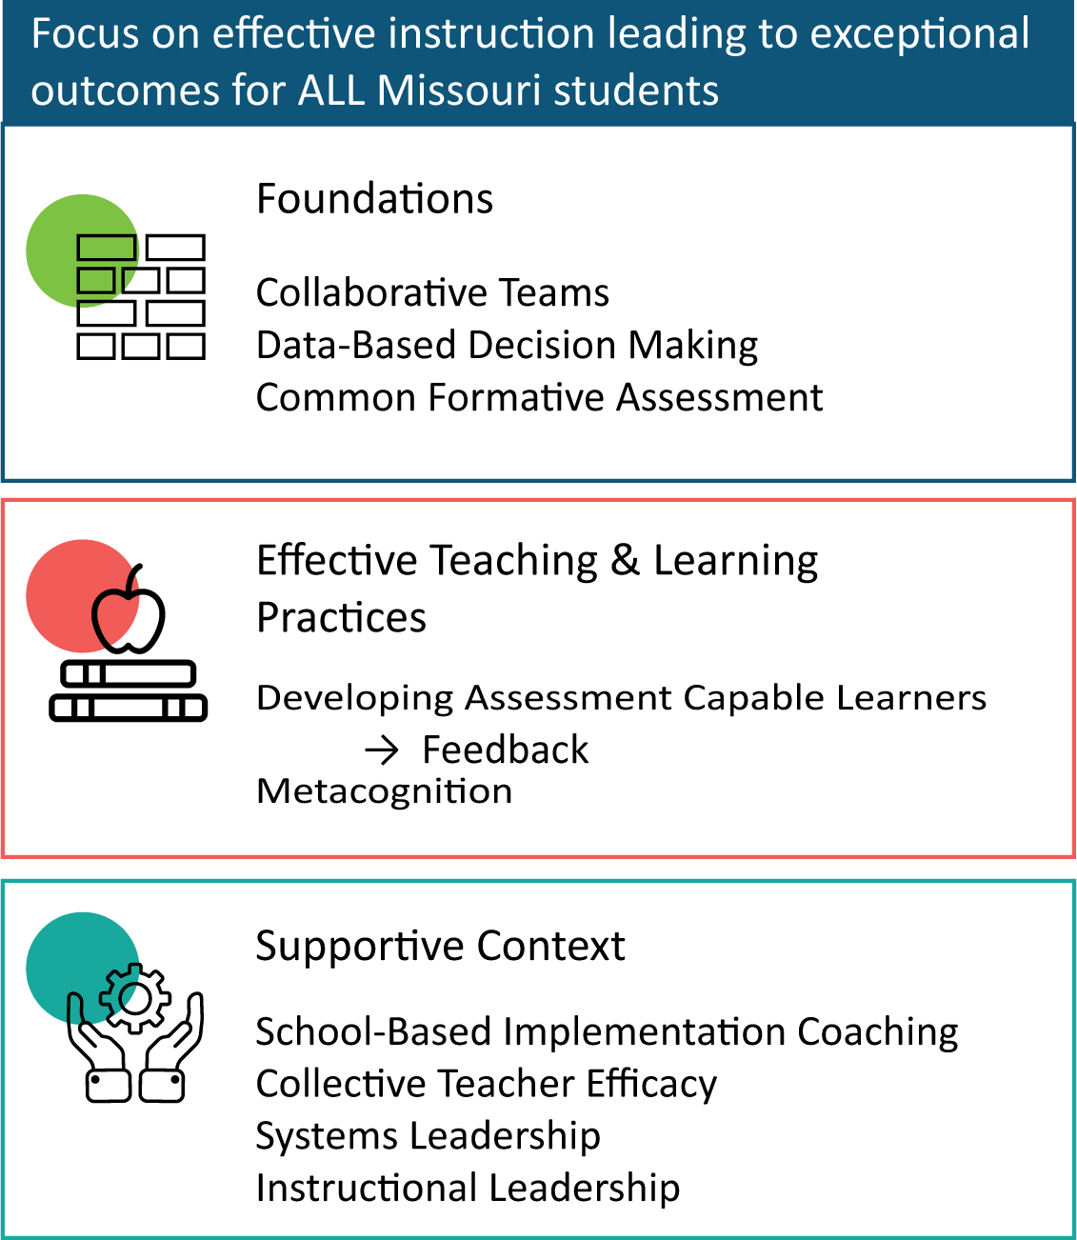
District Continuous Improvement Framework
Notes:
To Know
Missouri’s District Continuous Improvement (DCI) Professional Learning Modules are organized in three categories as defined in the DCI Framework. Districts generally begin their professional development journey with the Foundations, as these professional learning modules provide foundational knowledge in three key areas: Collaborative Teams, Data-Based Decision Making, and Common Formative Assessment. Effective Teaching & Learning Practices encompass research-based instructional practices for deepened learning. These professional learning modules address ways of connecting with students, ways of helping students learn how to learn, and feature specific instructional practices. Supportive Content contains Professional Learning Modules designed to help school staff support and enhance the implementation of Effective Teaching & Learning Practices through technology, leadership, and coaching supports. See the Blueprint for District and Building Leadership (https://www.moedu-sail.org/mmd-tools-resources/) for additional information on the DCI Framework.
To Do/To Say
Before we delve into Leadership for Effective Implementation of District-Wide Evidence-Based Practices (Leadership), let’s take a few minutes to review the DCI Framework Content, looking specifically at where both Leadership modules fall into the larger content.
As you see, the focus of DCI is on effective instruction leading to exceptional outcomes for all Missouri students.
The Content Framework has three main components
Foundations (consisting of Collaborative Teams, Data-Based Decision Making, and Common Formative Assessment)
Effective Teaching and Learning Practices (Developing Assessment Capable Learners with Feedback and Metacognition)
Supportive Content (School-Based Implementation Coaching, Collective Teacher Efficacy, and two Leadership modules)
References
MoEdu-SAIL. (2021). Blueprint for district and building leadership (5th ed). Missouri Department of Elementary and Secondary Education: Northern Arizona University, Institute for Human Development. https://www.moedu-sail.org/mmd-tools-resources

Slide 14
Alignment with MO Leader Standards
Standard #1 – Educational leaders have the knowledge and ability to ensure the success of all students by facilitating the development, articulation, implementation, and stewardship of a school/district vision of learning supported by the school community.
Standard #2 – Educational leaders have the knowledge and ability to ensure the success of all students by promoting a positive school culture, providing an effective instructional program, applying best practice to student learning, and designing comprehensive professional growth plans for staff.
Notes:
To Know/To Say
The Systems Leadership module aligns with the Missouri Learning Standards because it addresses the promotion of teaching and learning through alignment, path setting, modeling, and empowering.
DESE. (n.d.). Leader standards. Missouri Model Standards. https://dese.mo.gov/media/pdf/oeq-ed-leaderstandards

Slide 15
Session-at-a-Glance
Leadership: The Big Picture
Essential Function 1: Aligning
Essential Function 2: Path Setting
Essential Function 3: Modeling
Essential Function 4: Empowering
Leadership for Effective Implementation in Action
Closing and Follow-Up
Notes:
To Know
This module has 7 parts. You may divide the content of the module into smaller presentations to fit appropriate timeframes. It is recommended that the content of the entire module (broken into several sessions, if necessary) is provided to leaders so they have a clear understanding of each component and how the practices are interrelated. Districts will then action plan and customize future professional learning to meet their district’s needs based on results from the Practice Profile or SAPP for Leadership for Effective Implementation of District-Wide Evidence-Based Practices. Presenters should create an agenda slide for the session and review with participants.
To Say
This module has 7 parts. Review an agenda for the session.

Slide 16
Essential Questions
How do District Leadership Teams support the implementation of effective practices?
How does systems-thinking lead to a culture of continuous improvement?
Why is it important to align individual efforts and goals to a district focus?
How can districts engage staff in the implementation of effective teaching and learning practices?
Notes:
To Know/To Say
Let’s begin our Systems Leadership work by reflecting on these questions. Have participants reflect on these essential questions and discuss them with a partner. We will revisit these essential questions at the end of this module.

Slide 17
At the conclusion of this module, District Leadership Teams will understand the following.
Key actions in the implementation and support of effective practices to maximize impact on student growth and learning
The application of systems thinking to DCI
How to develop and support a culture of continuous improvement and collective responsibility
District-wide structures and processes that support collaboration and communication
Alignment of individual effort and goals to a district focus
How to support and monitor the engagement of district staff in the implementation process
Notes:
To Know/To Do
Go over the course outcomes.
To Say
As a learner, you will develop a deeper understanding of effective leadership, district continuous improvement, and how it impacts student outcomes. Following the completion of this module your team will have time to plan how to incorporate effective leadership for district-wide continuous improvement in your district. Have participants take a moment and read this slide to themselves or review the course outcomes.

Slide 18
Overview of Leadership for Effective Implementation of District-Wide Evidence-Based Practices

Slide 19
“A system is a set of related components that work together in a particular environment to perform whatever functions are required to achieve the system’s objective.”
Schools of Systems
(Meadows, 2008)
Notes:
To Know
Leaders who impact student outcomes understand their fundamental task is to create a system in which everyone is dedicated to student learning. Improved student learning should be the objective for a school leadership system.
To Do/To Say
As we begin, we are going to be considering why it is important to think of our district as a system. Read this quote by Meadows and take a few minutes to reflect on how this quote applies to your district. Next, divide participants into small groups to discuss the definition of a system in the context of school improvement, showing them the questions on the following slide to guide their discussion.
Reference
Meadows, D. H. (2008). Thinking in systems. White River Junction, VT: Chelsea Green Publishing Company.

Slide 20
Schools of Systems
What is the primary objective of a school system?
What are the components of a school system?
What are the functions of each of the components you named?
(Rouse, 2005)
Notes:
To Know
Leaders who impact student outcomes understand their fundamental task is to create a system in which everyone is dedicated to student learning. Improved student learning should be the objective for a school leadership system.
To Do/To Say
Review questions and give groups time to discuss. Key points can be shared with the entire group.
Reference
Rouse, M. (2005). Systems thinking. https://searchcio.techtarget.com/definition/systems-thinking

Slide 21
“Systems thinking is a method of critical thinking by which you analyze the relationships between the system's parts in order to understand a situation for better decision making.”
Schools of Systems
(Rouse, 2005)
Notes:
To Know
Systems thinking is a holistic way to look at factors and interactions that contribute to a possible outcome. It is a mindset. By examining a problem using a systems thinking approach, leaders better understand how to create the best possible processes to accomplish their goal. By viewing a district as a series of systems and understanding how each part contributes to the whole, leaders can make better decisions, form better teams and be more productive.
To Do/To Say
Discuss Margaret Rouse’s definition and have participants compare it with the ideas they discussed.
Educational leaders need to be systems thinkers. Schools consist of interrelated parts that impact one another, produce outputs, are always changing, and are impacted by other systems (communities, families, etc.). Systems thinking provides an organizing framework for understanding the interconnectedness of our educational system. To make educational systems more adaptive, innovative, collaborative, and effective, educational leaders can use a systems thinking approach to support continuous improvement.
References
Rouse, M. (2005). Systems thinking [Web log]. Retrieved from https://searchcio.techtarget.com/definition/systems-thinking
Ribeiro, J. (2016). Why school system leaders need to be systems thinkers. Getting Smart. https://www.gettingsmart.com/2016/03/school-system-leaders-need-systems-thinkers/

Slide 22
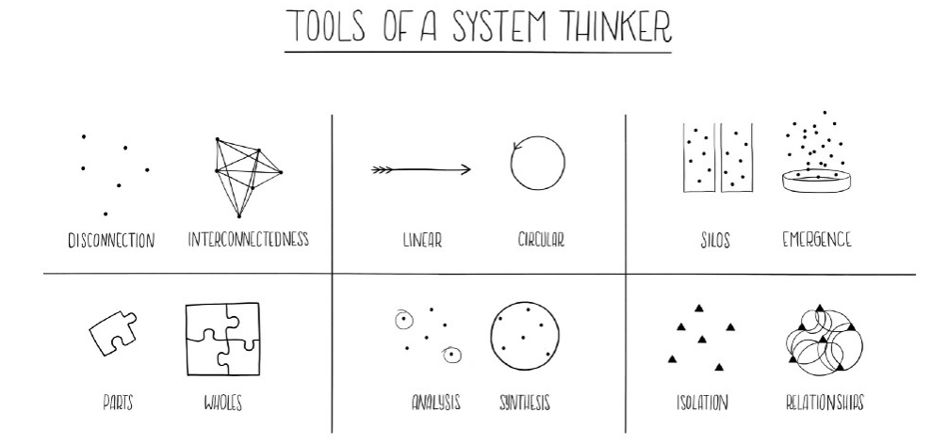
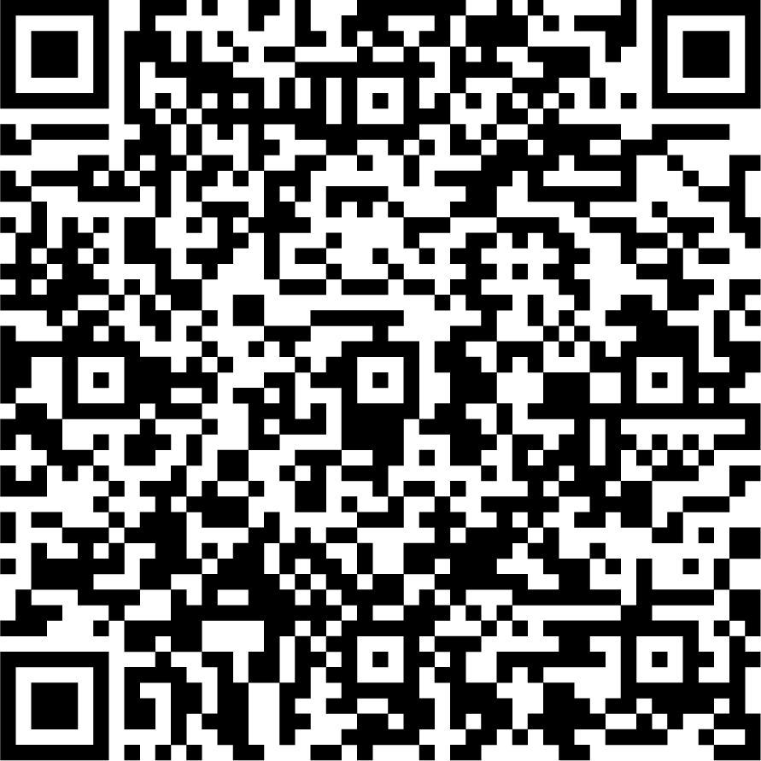
Jigsaw Read & Review: Tools Of A Systems Thinker
(Acaroglu, 2017)
Notes:
To Know
This is an activity. This article may be sent out as a pre-read.
To Do/To Say
Have participants access the article and divide them into six groups. Ask each group to read the introduction and assign a different key theme to each group to read and discuss its relation to schools as systems. (1.Interconnectedness, 2. Synthesis, 3. Emergence, 4. Feedback Loops, 5. Causality, and 6. System Mapping). Groups then share the information they discussed with the whole group (continued on next slide).
Reference
Acaroglu, L. (2017, Sept. 7). Tools for systems thinkers: The 6 fundamental concepts of systems thinking. Disruptive Design. https://medium.com/disruptive-design/tools-for-systems-thinkers-the-6-fundamental-concepts-of-systems-thinking-379cdac3dc6a

Slide 23
Reflections
As you consider your current district system, how would you describe the interconnectedness and interactions that currently exist across the district?
What are the strengths of your district system?
What are potential challenges to a system-wide approach to implementation within your district?
Notes:
To Do/To Say
This is a continuation of the previous slide’s activity. Encourage leaders to share their thoughts regarding these questions and what is currently happening in their districts as it relates to a system approach to school improvement. Use chart paper to list strengths and challenges that are being experienced across districts.

Slide 24
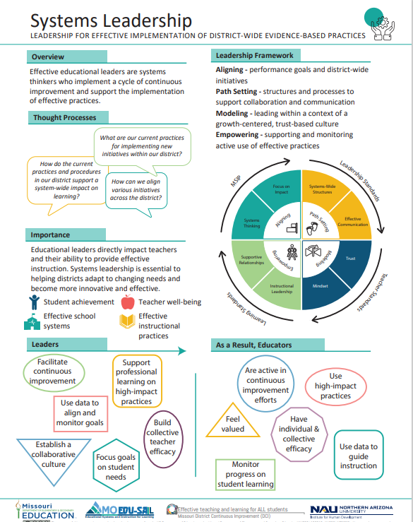
Notes:
To Know
The Systems Leadership Infographic summarizes key content from the learning package.
Effective leaders, at every level of an organization, influence the organization’s vision and direction. In school settings, effective leaders create and support a culture of continuous improvement. In order to lead continuous school improvement, leaders must understand school districts as a system, containing interconnected policies and practices. While each school in a district may have diverse needs, it is important for there to be alignment across a common set of district goals and agreement on instructional priorities. Strategies leaders can use for effective implementation of District Continuous Improvement include the following.
Aligning – Developing an implementation plan that aligns district-wide initiatives and performance goals in a common focus
Path Setting – Establishing structures and processes to support collaboration and communication across the district
Modeling – Leading within the context of a growth-centered, trust-based culture
Empowering – Supporting and monitoring active participation and the implementation of identified effective practices
To Do/To Say
Provide a copy of the Infographic handout (HO #2) to participants. Discuss the Systems Leadership graphic which depicts a continuous cycle. Provide specifics regarding the essential functions and the interconnectedness of the components in framework.

Slide 25
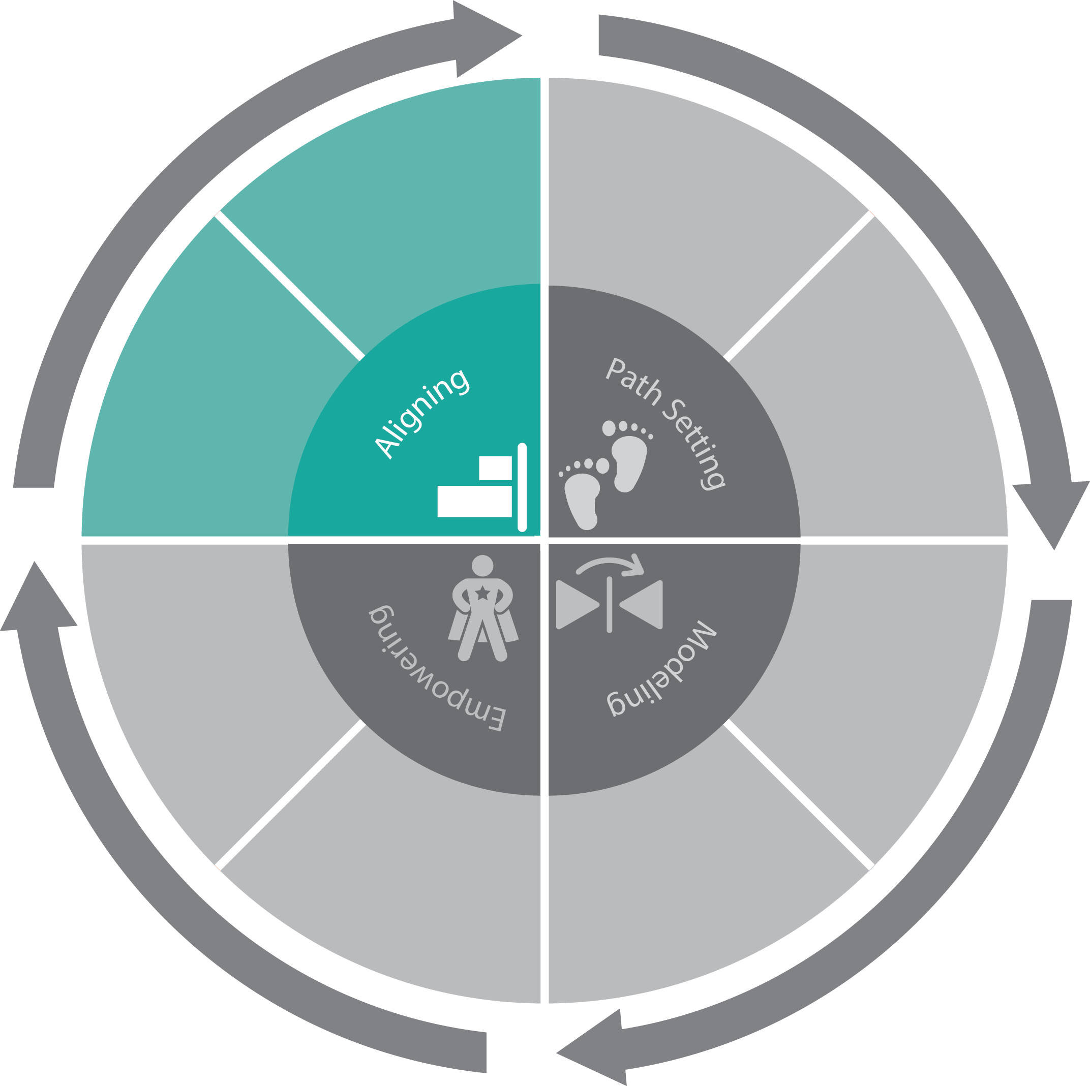
Essential Function 1: Aligning
Leadership develops, aligns, and monitors a system-wide plan for implementation focusing on impact within a cycle of continuous improvement.
Focus on Impact
Systems Thinking
Notes:
To Do
Refer participants to EF 1 on the Leadership for Effective Implementation Practice Profile (HO#3).
To Know/To Say
We are going to begin by focusing on Essential Function 1: Alignment. The focus for this essential function is the development of a district-wide continuous improvement plan that aligns all district initiatives and is monitored by a leadership team who uses data for ongoing problem solving. Look under EF1 on the Leadership for Effective Implementation of DCI Practice Profile (HO#3).
Emphasize the bolded specifics in the notes below.
Leadership develops, aligns, and monitors a system-wide plan for implementation focusing on impact within a cycle of continuous improvement.
There is a system-wide plan for continuous improvement that includes all of the criteria below.
Alignment with district-wide initiatives.
A district-wide common focus with specific and attainable goals.
Building goals aligned with the district-wide common focus.
A mechanism for feedback from all levels.
A year-long district-wide professional learning structure that is practice specific.
A process for the collection of multiple sources of data to inform progress toward district and building performance goals.
A schedule for the analysis of key performance indicators at all administrative/educator levels for the purpose of monitoring impact.
Specific practice-based strategies focused on increasing the impact that teachers are having on students collectively across the district.
Leadership Teams regularly engage in formal problem-solving using district/building level data.
Have participants review the EF1 indicators and discuss in small groups or between partners their thoughts about the importance of aligning initiatives and creating a systemwide plan.

Slide 26
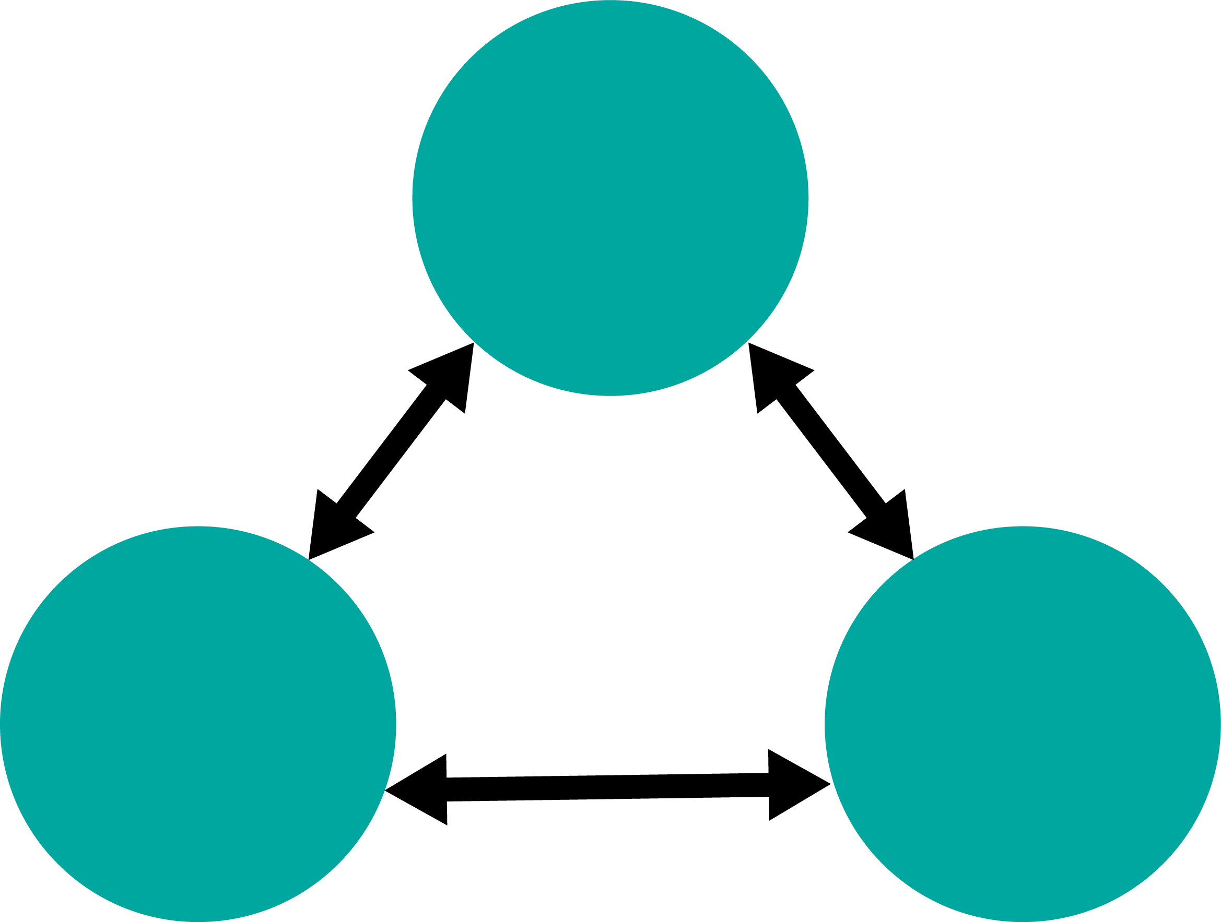
System Interdependence
Shared Values, Beliefs, Vision
Systems Structures/Policies/ Processes, Procedures
Individual Choice
Autonomous Individual
Others
Collegial Relationships
Notes:
To Know/To Say
Every system can be reduced to three major components: (1) Shared beliefs, values, vision, (2) Collective system members – staff, employees, etc., and (3) the individual system member.
The connectedness between these three components makes up the dynamics of system interdependence.
The connection between the system’s shared beliefs, values, vision and the collective system members is evidenced by the system structures, policies, and processes that are in place. These can be formal or informal.
The connection between the system’s shared beliefs, values, vision and the autonomous individual member is observable through the choices made by the individual on a daily basis.
The connection between the collective system members and the autonomous individual member are observable through the collegial relationships that exist within system functioning.
Reference
Senge, P. M. (1990). The fifth discipline: The art and practice of the learning organization. New York, NY: Doubleday/Currency.

Slide 27
Balance = Maximum Effectiveness
The system interdependence triangle must be balanced.
Each side needs to be as strong as the other.
Problems occur when one side “outweighs” the others.
Shared Values, Beliefs, Vision
Individual Choices Misaligned with Vision
Rigid Structures & Policies
Autonomous Individual
Others
Codependent Relationships Negatively Affecting Collaboration
Notes:
To Know/To Say
If the connection between the shared values, beliefs, and vision with the collective membership is weighed down by too many rigid structures, policies, and processes the system’s effectiveness will be impacted.
If the connection between the shared values, beliefs, and vision with the individual is weighed down by too many individual choices that are not aligned with the beliefs, the system does not function as a network.
If the connection between the collective membership and the individual member is weighed down by too many co-dependent relationships effective collaboration will not occur.
Reference
Senge, P. M. (1990). The fifth discipline: The art and practice of the learning organization. New York, NY: Doubleday/Currency.

Slide 28
System Interdependence in Your District…
How do your system structures, policies, and processes align with your system’s shared beliefs, values, and vision?
How do individual choices align with the system’s shared beliefs, values, and vision?
How collaborative and supportive are the collegial relationships that exist within your system?
Shared values, beliefs, vision
Systems Structures/Policies/ Processes, Procedures
Individual Choice
Autonomous Individual
Others
Autonomous Individual
Notes:
To Do/To Say
Think about System Interdependence in the context of your district.
Have school leaders do a Turn and Talk to discuss the questions posed.
Reference
Senge, P. M. (1990). The fifth discipline: The art and practice of the learning organization. New York, NY: Doubleday/Currency.

Slide 29
Peter Senge: The Fifth Discipline
Notes:
To Know
Peter Senge Video (2:20 min), video transcript can be found at https://www.moedu-sail.org/wp-content/uploads/2020/02/1-Peter-Senge-Introduction-to-Systems-Thinking-Video-Transcript.pdf
To Know/To Say
In the following video, Peter Senge discusses the concept of systems thinking. After watching the video, ask participants how Senge’s explanation of Systems Thinking compares with their understandings.
Video reflection questions on the next slide may be discussed. There is also an optional activity that aligns with the questions.
Reference
Wile, K. (2014, August 5). Peter Senge introduction to systems thinking [Video]. https://www.youtube.com/watch?v=eXdzKBWDraM

Slide 30
Video Reflections
What, if any, unintended “consequences” have resulted from school-improvement behaviors or actions taken in the past in your district?
What impact have these “consequences” had on continuing school-improvement efforts?
What lessons were learned?
Notes:
To Say
Senge refers to “consequences” that result from actions and behaviors taken by members of a “family” system. Reflect on consequences resulting from school-improvement actions.
To Do
(Optional)
Have small groups make a T chart that lists CONSEQUENCES and IMPACT resulting from school improvement actions/behaviors. At the bottom of the chart, list the lessons learned. Groups can then share key findings with all.

Slide 31
Benefits of Systems Thinking
A framework for making sense of an organization’s complexities
A method for integrating new ideas
A big picture view of what is going on in any organization
A process to create strategies, problem solve, and make decisions while finding leverage points for change
A more complete and holistic way of thinking
(Jackson, 2016)
Notes:
To Know/To Say
Expand on the slide content with info bolded in notes.
A systems thinking approach provides an effective way of thinking, communicating, acting, and achieving results by providing the following.
A framework for making sense of an organization’s complexities
A method for integrating new ideas within the system’s context
A view of what is going on in any organization and its environment
A process to create strategies, problem solve, and make decisions while finding leverage points for change, keeping the outcomes and goals in mind at all times
A more complete and holistic way of thinking
Reference
Jackson, T. (2016, May 25). 7 benefits of systems thinking in organizational change. https://www.linkedin.com/pulse/7-benefits-systems-thinking-organizational-change-jackson-ph-d-

Slide 32
Ideal Situations for Systems Thinking
The issue is important
The problem is chronic, not a one-time event
The problem is familiar and has a known history
There have been unsuccessful prior attempts to solve the problem
(Waters Foundation, 2018)
Notes:
To Know
The article “The Do’s and Don’ts of System Thinking on the Job” by Michael Goodman (https://thesystemsthinker.com/the-dos-and-donts-of-systems-thinking-on-the-job/) offers some general guidelines for the use of system’s thinking to aid the presenter’s understanding.
To Say
Situations that are ideal for systems thinking planning have several defining characteristics.
It is important to use a systems thinking approach, when addressing an issue or problem for which the following elements are true.
The issue is important
The problem is chronic, not a one-time event
The problem is familiar and has a known history
There have been unsuccessful prior attempts to solve the problem
Pose the following question for discussion: What are some examples of specific district situations that would be ideal for systems thinking intervention?
References
Goodman, M. (n.d.) The do’s and don’ts of systems thinking on the job. The Systems Thinker. https://thesystemsthinker.com/the-dos-and-donts-of-systems-thinking-on-the-job/
The Waters Foundation. (2018). The impact of the systems thinking in schools project: 20 years of research, development and dissemination. https://thinkingtoolsstudio.waterscenterst.org/resources/articles

Slide 33
The Iceberg Model
Notes:
To Know
Video is 7:25 min. The video transcript can be found at https://www.moedu-sail.org/wp-content/uploads/2020/02/2-Iceberg-Model-Video-Transcript.pdf
To Do/Say
Introduce the video by noting that an iceberg is often used to describe systems thinking. Similar to an iceberg that has only 10% of its form above the water, the Iceberg Framework helps us to take a broader look at the patterns and relationships that make a system function.
We will be using the four levels that are described in the video to help use see connections within our system.

Slide 34
4 levels of System Operations
The Event
Patterns
Structures
Mental Models
Systems Innovation, 2018
Notes:
To Know
This is an opportunity to review with participants the four levels of system operations that they will use in the following activity
To Do/To Say
In the video, Senge talked about these four levels of system operations that can provide insight into any situation.
The Event is the problem we see and would like to solve. It is the observable actions, activities, and/or variables produced by the system’s operation.
Patterns of Behavior are the recurring events that we see happen in conjunction with the event. Identifying those relationships between events allows us to create solutions for recurring problems rather than simply reacting to isolated events.
Structures are often the reason for recurring patterns. Structure accounts for 80 - 90% of all issues. Structures may be physical (buildings, traffic flow, vending machines), norms, policies, guidelines, power structures, distributions of resources, or informal ways of work that are tacitly or explicitly institutionalized.
Mental Models are people’s deeply held assumptions, attitudes, values, expectations, culture, and/or beliefs that influence and drive their behavior. Mental models keep the structure doing what it does.
References
Systems Innovation. (2018, Oct.15). Iceberg model [Video]. YouTube. https://www.youtube.com/watch?v=Te1VYXqUH_c&t=3s

Slide 35
The Iceberg Model in Action
Select an issue from your district and reflect on each level by answering the questions below.
Event: What is happening?
Patterns: Has this happened before? When and where?
Structures: What are the structures that contribute to the patterns?
Mental Models: What mental models are causing this event to persist?
Notes:
To Say/To Do
The Iceberg Framework can be used to think about the components of a district system’s continuous improvement efforts. Have leaders use the framework to select an issue relevant to their district. They can then delve deeper into events, patterns, structures, and mental models that are connected to it. Use chart paper to record the group’s thoughts. Depending on the size of the group, this could be done in a large group or in several smaller groups. After there has been time to reflect, ask for share outs as appropriate.
Have the group(s) focus on an issue that is a district-wide concerns. If the group needs ideas for potential events, they might include low reading or math scores, lack of carry over from professional learning, increased office referrals, lack of family involvement, technology use, bullying, etc.

Slide 36
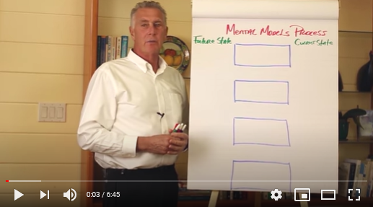
Operationalizing the Iceberg Framework
(Zuieback, 2014)
Notes:
To Know
Video (6:45 min) https://www.youtube.com/watch?v=81mJnpKJlc4
Chris Argyris and Donald Schon developed the Mental Models Process which uses the four levels of the Iceberg Framework as the context for group planning. It is used to challenge the status quo by questioning underlying values, behaviors, and strategies. In the following video, Steven Zuieback explains how the strategy works. He describes this process in the context of a personality typing framework called the Enneagram. For the purposes of this training, the Enneagram is not important. We want teams to understand how to apply the mental models process.
To Know/To Do/To Say
Chris Argyris and Donald Schon developed the Mental Models Process which uses the four levels of the Iceberg Framework as the context for group planning. It is used to challenge the status quo by questioning underlying values, behaviors, and strategies.
In the following video, Steven Zuieback explains how the strategy works. He describes this process in the context of a personality typing framework called the Enneagram. For the purposes of this training, we are not concerned with the Enneagram, we want you to focus on the mental models process. This process can help uncover solutions to problems by challenging the underlying mindset that directs the ways people operate inside a system.
As you watch the video, reflect on how this process could be used in your district to peel through the layers that are barriers to school improvement effectiveness.
References
Argyris, C., & Schön, D. (1978) Organizational learning: A theory of action perspective. Reading, Mass: Addison Wesley
Zuieback, S. (2014, Nov. 9). Mental models [Video]. YouTube. https://www.youtube.com/watch?v=81mJnpKJlc4

Slide 37
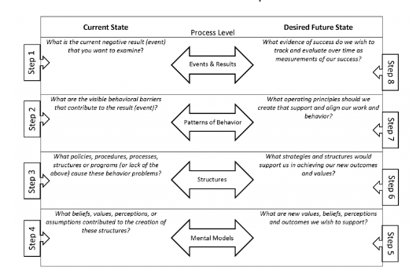
Mental Models Process
(Adapted from Zuieback, 2014)
Notes:
Handout #4
To Know/To Say/To Do
Now that you have some background with the Iceberg Framework, review the mental models process on Handout #4. After reviewing this was participants, divide them into small groups and have them reflect on the questions in the following slide. (Note, these questions are listed on the following slide for participants to view.)
What additional information about the Mental Models Process did you learn?
For what situations and groups would this process be most powerful?
What tips does the article provide for using this process with groups?
Reference
Zuieback, S. (n.d.). Planning conversations: Mental models process. https://www.stevezuieback.com/site/assets/files/1035/mental_models_process.pdf

Slide 38
Mental Models Video Models Article Reflection
What key takeways did you learn from the mental models process from the video?
For what situations and groups would this process be most powerful?
What tips does the vidoes provice for using this process with groups?
Notes:
To Do
Have questions posted on chart paper and encourage leaders to put responses on sticky notes and place on charts. Review responses with the whole group.

Slide 39
5 Pillars of DESE’s Continuous Improvement System
Leadership
Collaborative Climate and Culture
Effective Teaching and Learning
Data-Based Decision Making
Alignment of Standards, Curriculum, and Assessment
Notes:
To Know
An Infographic can be found at https://dese.mo.gov/learning-services. The DESE Continuous Improvement System and its Theory of Action underscore the primary goal of DESE’s Show-Me Success Plan: All Missouri students will graduate ready for success.
To Say
You may be familiar with DESE’s 5 Pillars for Continuous Improvement. Each of the Pillars represents an aspect that is critical for success.
Leadership: Strong leaders set the vision and influence direction at every level of the organization to create and support a culture of teaching and learning for continuous improvement.
Collaborative Climate and Culture: To achieve a collaborative climate, districts need shared values and common goals as a foundation.
Effective Teaching and Learning: To meet the needs of each student, districts must select and implement evidence-based academic and social emotional practices.
Data-Based Decision Making: Accurate, relevant data across multiple points in time provide the basis for informing progress, setting goals, and guiding decisions that will lead to improved student learning. Using a data-based decision making process shifts the work of school leadership teams from reactive to pro-active.
Alignment of Standards, Curriculum, and Assessment: Connection, clarity, and coherence must exist between standards, curriculum, and assessments in order to provide accurate and actionable information regarding student learning.
You can see within these pillars a systems thinking approach that considers a variety of aspects within a district’s educational system.

Slide 40
The Key to Educational Improvement: Data and How We Use It
Notes:
To Say
In the following video (6:33 min.) Jeff Edmondson talks about the impact of using data. The video transcript is available at: http://www.moedu-sail.org/wp-content/uploads/2020/02/4JEFFE1.pdf
To Do/To Know
We are going to watch a short Tedx talk by Jeff Edmondson. In this video, Jeff talks about how the “right” data can help us better serve our students. As you listen, think about how your district currently uses data.
Show Video: “ The Key to Educational Improvement: Data and How We Use It” https://www.youtube.com/watch?v=FLqc_9VxfCE then review the reflection questions on the next slide.
Reference
TEDx Talks. (2010). Jeff Edmondson, The key to educational improvement: Data and how we use it [Video]. YouTube. https://www.youtube.com/watch?v=FLqc_9VxfCE

Slide 41
Reflections… Data for Impact
How is data currently used in your building/district?
Do you have the data you need to make the decisions necessary to support every child in your system?
Do the people who need to use the data have access to it?
What would it take to make data more accessible and meaningful in your district?
Notes:
To Know
More information is found in Data-Based Decision Making in a module on the VLP and available on Moedu-sail.org at https://www.moedu-sail.org/mtss-facilitator-materials/
To Do/Say
Pose these questions to school leaders. Have groups discuss and share out their thoughts as a whole group. If you need further information on this there is a module for Data-Based Decision Making found on the VLP.

Slide 42
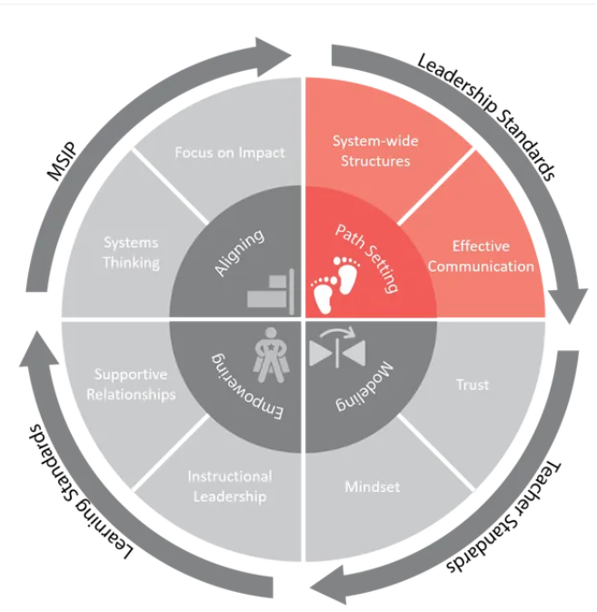
Essential Function 2: Path Setting
Leadership sets a path for continuous improvement that is data informed and occurs within a collaborative school culture.
Notes:
To Know
This slide provides an opportunity to look at the exemplary implementation indicators for Essential Function 2 and discuss how they together lead to clarity for staff regarding priorities for continuous improvement. (HO#3)
To Do/Say
Refer participants to the EF2 indicators on the Leadership for Effective Implementation of District-Wide Evidence-Based Practices Practice Profile (HO#3). Have participants review the EF2 indicators and discuss in small groups or between partners how each of these elements support a district’s continuous improvement efforts. If one of these elements is absent, how might it impact a district’s ability to implement continuous improvement activities?
Emphasize the bolded specifics in the notes below.
To set a path for continuous improvement, leadership must establish a sustainable school improvement approach that includes all of the criteria below.
A high-quality District Leadership Team as evidenced through member roles, team function, and records of meetings
Building Leadership Teams as evidenced through member roles, team function, and records of meetings
Collaborative Team structures that distribute responsibility resulting in all educators (administrators and teachers) assuming collective responsibility for the well-being of the student population
A process for aligning and monitoring performance goals throughout the district both across buildings and instructional levels, as well as within buildings and grade levels
A communication plan that provides information and data on a formal and frequent basis to communicate with district, building, and community collaborators
A district-wide open communication network that supports dialogue and discussion across the district about teaching and the recognition/identification of high-impact practices

Slide 43
Change Management or Change Leadership?
Notes:
To Know
Video: Change Management vs. Change Leadership by Dr. John Kotter (5:04 minutes). Essential Function 2 focuses on Change Management vs. Change Leadership. There is a fundamental difference between the concepts of change management and change leadership. Change management refers to strategies used to keep the change process “under control” or minimize problems associated with changes. Change leadership, however, is associated with strategies used to drive change and make the change process work more efficiently. The key word in “Building Leadership Teams” and “District Leadership Teams” is Leadership. Collaboratively, school leadership teams have the responsibility of establishing a path for data-informed school improvement. This path must be supported by (a) district-wide structures (policies, practices, and procedures) and (b) effective communication and collaboration strategies. The path, structures, and collaborations are essential for leading school improvement. Essential Function 2 focuses on operationalizing these components within your district.
To Do/Say
In the following video, Dr. John Kotter describes the difference between change management and change leadership. As you listen to this video, make notes as to the responsibilities and actions a change manager makes in comparison to a change leader.
Show the video and then use reflection questions on next slide to promote discussion.
Reference
Kotter, J. (2012, Feb. 6). Change management vs. change leadership – What is the difference? [Video]. YouTube. https://www.youtube.com/watch?v=2ssUnbrhf_U

Slide 44
Video Reflections
What are examples of change leadership that already occur in your school building or district?
Where are there opportunities for increased or improved change leadership?
Notes:
To Do/Say
Provide an opportunity for leaders to do a Turn & Talk to discuss responses. Have a brief share-out moment for a few examples and opportunities. Summarize questions on the slide.

Slide 45
An Effective Continuous Improvement Cycle Includes…
Teams (district, building, classroom)
Data and Action Planning
Communication & Alignment
Team Structures & Processes to Support Implementation
Notes:
To Know/To Say
Briefly go over the points on this slide to describe an effective continuous improvement cycle.

Slide 46
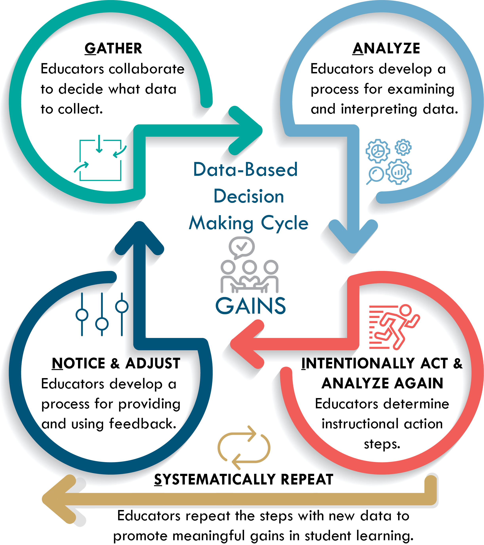
Action Planning Using the G.A.I.N.S. Process
Gather
Analyze
Act
Notice
Systematically Repeat
Notes:
To Know
The G.A.I.N.S. process is introduced in the DBDM module as a process collaborative teams can use. This process can be applied to any data-based decision making process. In this module, we are illustrating it’s use for leadership teams.
For more information and/or training on the G.A.I.N.S. DBDM Process refer participants to the DBDM online module found in the VLP and http://www.moedu-sail.org/courses/data-based-decision-making-2/
Gather district data sources that will help identify and prioritize areas needing improvement
Analyze district data, including the Mental Models Process information, to identify problematic trends/behaviors and to determine practices to be initiated or strengthened for high-impact on student learning
Intentionally act by clearly defining the change needed, identifying and communicating a vision for outcomes, and developing and implementing an action plan
Notice and adjust by monitoring the effectiveness of the plan and making changes as needed
Systematically repeat the process
To Do
Refer participants to the G.A.I.N.S. Graphic DBDM handout HO#5
Once you have the structures in place, continuous improvement must be data informed. The G.A.I.N.S. process is a data-based decision making process that is also used in the DCI - DBDM module as a process collaborative teams can use to look at student data. This process can be applied to any data-based decision making process. In this module, we are illustrating it’s use for leadership teams. On the follow slides, we will take a more in-depth look at each step as it applies to leadership teams.
For more information and/or training on the G.A.I.N.S. DBDM Process refer participants to the DBDM online module found in the VLP and http://www.moedu-sail.org/courses/data-based-decision-making-2/

Slide 47
1. Gather data that will identify and prioritize areas needing improvement
Notes:
To Know
The next few slides review the G.A.I.N.S. process as it applies to Leadership Teams (HO#5)
To Say
The first step in any planning process is to gather data. Action planning should always begin with data. Leadership teams can take a “big picture” look at the variety of data generated across the district to identify and prioritize areas needing improvement. This also includes data generated from the Mental Models Process tool. Provide or ask participants to provide some examples of data that district leadership teams might use (e.g., literacy/math universal screening data, SPED data, CWIS, SAPP results, etc.).

Slide 48
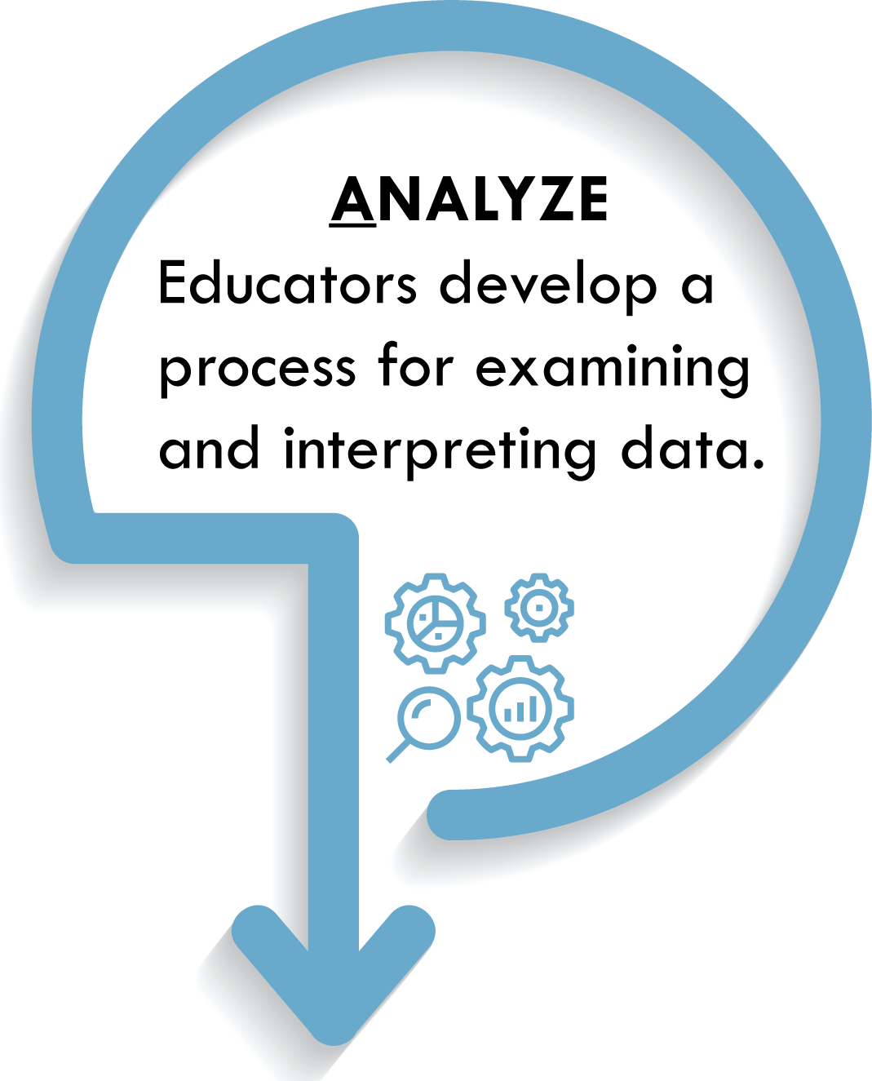
2. Analyze data to identify problematic areas and to determine practices that strengthen impact on student learning
Notes:
To Know/To Say
The second step is to Analyze District Data, including the Mental Models Process information. Your goal in analyzing the data it to identify problematic trends/ behaviors that may be contributing to the problem. Determine specific practices and patterns of behavior that are strengths, any practices or patterns that may be of concern, and identify areas that if changed will have a high-impact on student learning.
Using the Mental Models Process Tool, identify any trends or behaviors (or lack of behaviors) that may have contributed to the problem.
Determine specific practices and patterns of behavior to be initiated and/or strengthened in terms of high-impact on student learning.
Reference
Zuieback, S. (2014, Nov. 9). Mental models [Video]. YouTube. https://www.youtube.com/watch?v=81mJnpKJlc4

Slide 49
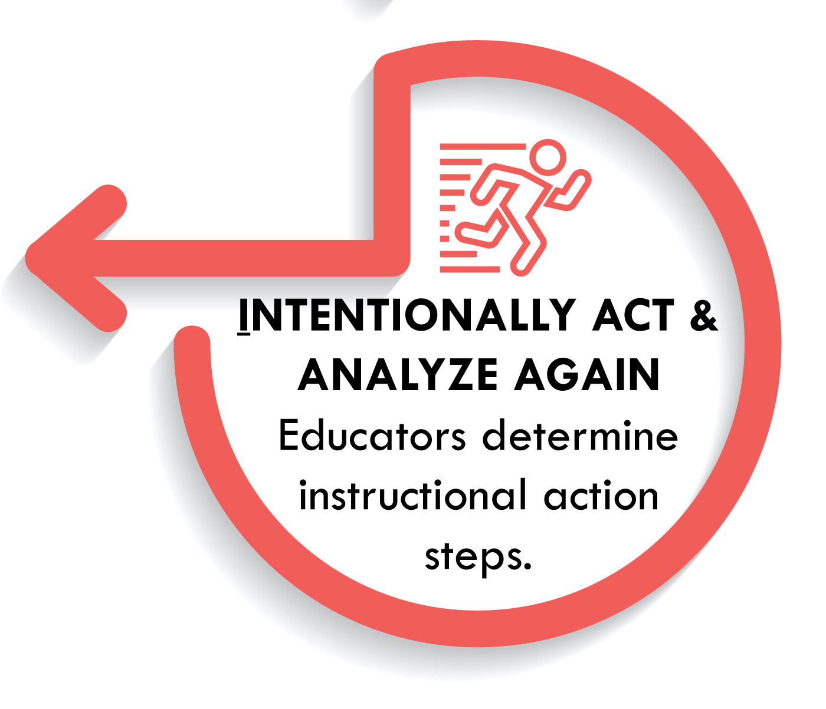
3. Intentionally Act: Define the change, communicate outcomes, develop & implement an action plan
Outline what will change and what will remain the same - be specific
Develop a vision statement that identifies desired outcomes
Communicate the purpose behind the change
Develop and implement an action plan
Notes:
To Know
The next five slides expand on Step 3 detailing specifics regarding a) defining the change, b) communication, and c) action planning.
To Say
Then you Intentionally Act by doing the following.
Clearly outlining what will change and what will remain the same
Developing a vision statement that identifies desired outcomes
Communicating the purpose behind the change
Developing and implementing an action plan that addresses the district’s need(s)
In the next few slides we will talk about some specifics of Step 3.

Slide 50
Developing a Vision/Goals
What are the district’s core values?
What is the district’s core focus in terms of impact on student learning?
What is the long-term goal that the district would like the system to accomplish?
What is the plan for implementation?
What is the 1-year plan/goal(s)?
What are the benchmarks that will indicate progress toward the goal(s)?
What issues might the system face as it moves forward?
(Adapted from EOSWorldwide, 2014)
Notes:
To Know/To Say/To Do
Expand on these questions using bolded information.
What are the district’s core values, the 3-7 characteristics that define the district?
What is the district’s core focus in terms of impact on student learning?
What is the long term (3-5 year) goal or outcome that the district would like the system to accomplish?
What is the plan for implementation? What are the key elements of the plan?
What is the 1-year plan/goal(s)?
What are the benchmarks that will indicate progress toward the goal(s)?
What issues might the system face as it moves forward? Where might there be stumbling blocks? How might the system plan for potential stumbling blocks?
Review questions with participants then ask participants “How might these questions help them to align their efforts.” Which questions do they already know the answer to? Which questions might they want to discuss further?
Reference
EOSWorldwide. (2014, Nov. 18). Align your company vision – 8 questions for your leadership team [Video]. https://www.youtube.com/watch?v=0jXP1xW5Osg

Slide 51
Action Planning
Goals and Priorities
Timelines
Tasks
Accountability Benchmarks and Measures
Necessary Structures (e.g., professional learning, coaching, guidance documents, policy changes)
Resources Needed
Notes:
To Know/To Say/To Do
The process of action planning helps teams map out strategies and small steps towards achieving their long-term goals. For large initiatives, an action plan is more than a list of things to do. The planning process provides an opportunity for teams to reflect, clarify goals, build consensus, clarify timelines, identify measures of success, and create ownership and accountability.
Outlining an action plan that breaks the implementation process into manageable steps and provides “small wins” can build momentum. Leadership teams should also consider potential barriers and ensure all stakeholders are represented. Teams might ask the following.
What organizational structure(s) might hinder implementation?
What resources/tools are needed to implement the plan?
Is there a need to restructure job descriptions and update performance review criteria so that they serve your new set of goals?
The bullets on the slide represent key considerations teams should discuss when creating an action plan.
Teams can use whatever forms help them best document their action plan. HO#6 is an example action plan form that could be used or modified.

Slide 52
Communication Planning
What key messages will need to be communicated?
How will the messages be communicated?
What communication channels and mediums might be used?
To which groups/individuals are the messages communicated?
How will feedback to the leadership team occur?
How will new staff be brought on board?
Notes:
To Know/To Say/To Do
Communication plays a critical role in developing staff “buy-in” and aligning efforts. Your teachers and staff will be the ones implementing any changes therefore it is important for them to understand the vision and their role in implementation. It is also critical for leadership teams to consider how they can prepare staff for the changes that will occur. Educators need to know they will receive needed professional development and that there will be structures in place to support the change. Planning for professional development, coaching supports, and needed structures helps to ensure the process of change goes smoothly.
A communication plan does not have to be large or formal. However, it is important to plan for communication. The purpose of a communication plan is to ensure a consistent message with the necessary information is provided to appropriate groups. It should communicate why the change is important and a timeline for the change. It should also be bi-directional. Reciprocal communication is critical so that those affected by the change have a means to communicate what they see as the impact of the change.
If time allows, presenter may give participants time to talk through the development of a communication plan.

Slide 53
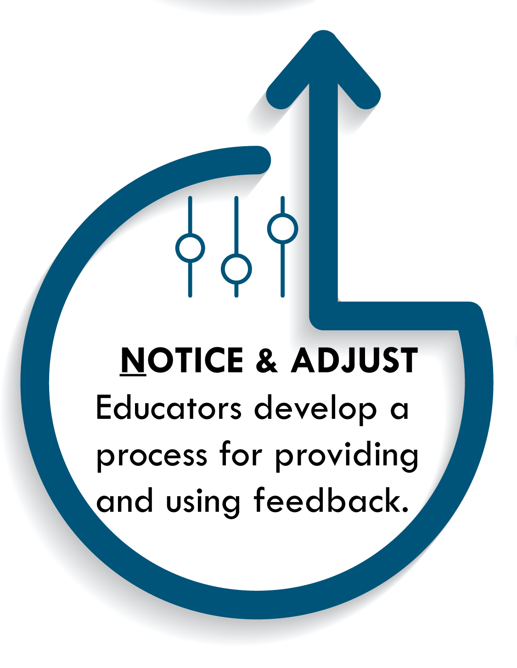
4. Notice and Adjust: Monitor the effectiveness of the plan and make changes as needed
Notes:
To Know
Prose Theme on Genesis Framework. (2019). Application performance management: Key performance indicators. https://www.applicationperformancemanagement.org/performance-testing/key-performance-indicators/
Smith, C. (2018, December 26). Change management KPIs: A crash course. https://change.walkme.com/change-management-kpis/
To Know/To Say
Once the initial implementation of the plan has begun, leadership teams need methods for monitoring the effectiveness of the plan by using key performance indicators. Key performance indicators (KPIs) specify the factors an organization wants to monitor, what will be measured, and how they will be measured. Key performance indicators (KPIs) are quantifiable measures that can be used to monitor and evaluate success in terms of meeting your district process implementation goals. Effective KPIs are directly related to the action plan’s strategic goals/objectives, identify success criteria, and include data from all levels of an organization (district, building, classroom, etc.). District KPIs may include measures around the adherence to timelines, fidelity of implementation, and/or performance improvement rates. Other metrics may include staff adoption, staff engagement, and proficiency rates along with staff feedback and requests for help or support. The identification and monitoring of key process indicators can have a major impact on implementation success. Data helps leadership monitor the implementation process and quickly make adjustments.

Slide 54
A Cycle of Continuous Improvement
Notes:
To Know/To Do
Direct attention to the S in G.A.I.N.S. Systematically Repeat! Repeat the steps with new data. Once again refer participants to the G.A.I.N.S. Graphic DBDM handout (HO#5).
To Say
It is not enough for a leadership team to collect data on key performance indicators, they also need to set aside time to analyze the data and plan next steps. The G.A.I.N.S. process is not linear, the data collected during and following implementation should cycle the team back to Step 1 to consider needed revisions and additional supports, creating the process for district continuous improvement.

Slide 55
Reflections… Operationalizing the Data Process
How would you describe the data collection policies and procedures that are currently being used in your district?
Is data collection a system-wide process within your district?
How do the current practices and procedures support a system-wide focus on learning?
In what ways might your district benefit from using the G.A.I.N.S. process to support continuous improvement?
Notes:
To Know
Ehorning, P. (2013, August 7). 5 steps to actionable key performance indicators. Unilytics. https://unilytics.com/5-steps-to-actionable-key-performance-indicators/
Mihailogie, C. (2019, April22). How can we ensure our KPIs are aligned to the strategy? Performance Magazine. https://www.performancemagazine.org/kpis-aligned-strategy-performance/
Kothari, A. (n.d). How to improve employee buy-in (4 proven methods). Tallyfi. https://tallyfy.com/improve-employee-buy-in/
To Do
Have leaders discuss questions/responses in small groups. Have representatives share out with the whole group.
Optional: Have district teams compare their current system to the G.A.I.N.S. cycle using a Venn diagram. How are they alike? How are they different? How might their current system be enhanced?

Slide 56
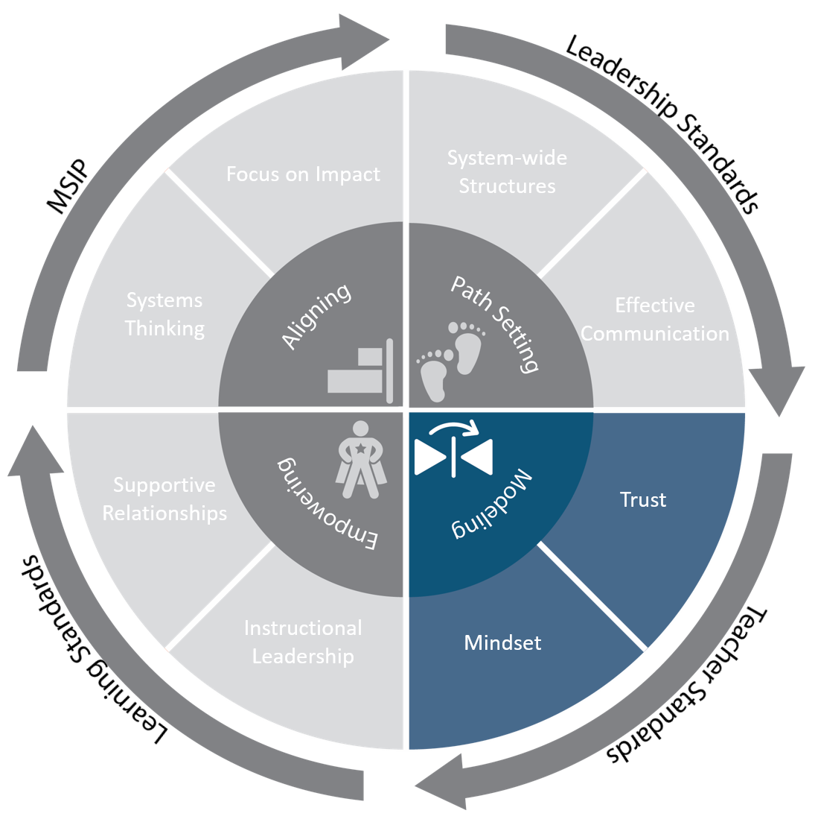
Essential Function 3: Modeling
Leadership models and facilitates qualities of trust and growth mindset as key to a culture of continuous improvement.
Notes:
To Know
This slide provides an opportunity to look at the exemplary implementation indicators for Essential Function 3: Modeling and discuss the importance of building a culture of trust and growth mindset. (HO#3)
For more information on Collective Teacher Efficacy and its importance see the Learning Module Collective Teacher Efficacy. http://www.moedu-sail.org/collective-teacher-efficacy-materials/
To Say
Essential Function 3 focuses on the involvement of educational leaders in the change process. Through your actions and decisions you communicate the importance of an initiative and your belief in the plan. For large-scale, sustainable changes, educators must believe that their actions are important to the plan and that they have the ability to impact student outcomes. Building trust and helping to foster a growth mindset are two key strategies leaders can use to foster Collective Teacher Efficacy.
To Do
Have leaders jot down strategies they believe leadership can use to build trust and promote growth mindset. Have them compare their responses with those on the Practice Profile for Leadership for Effective Implementation of District-Wide Evidence-Based Practices.
To Know/ To Say
Leadership builds an organizational culture of trust that leads to all of the criteria below.
Belief by teachers that the leadership’s actions are consistent with shared values
Belief by teachers that the leadership follows through on commitments
Belief by teachers that the leadership values all staff
Belief by teachers that they have the ability to positively affect student learning
Leadership promotes and models a growth mindset by meeting all of the criteria below.
Setting both long- and short-term organizational goals
Seeking teacher feedback and input regularly
Providing teachers with constructive, detailed feedback
Creating opportunities for teachers to observe each other’s classes to learn from one another
Discussing both successes and failures with teachers as opportunities for learning
Valuing effort as the path to mastery

Slide 57
Actions Create Reality
Notes:
To Know
Video: Peter Senge, The Fifth Discipline, 3:32 min. https://www.youtube.com/watch?v=hsLcLmQSPzs
Transcript available at http://www.moedu-sail.org/wp-content/uploads/2020/02/6-Peter-Senge-Actions-Create-Reality-Video-Transcript.pdf
To Do
Show video then debrief as a whole group about how the concepts discussed relate to Essential Function 3.
To Say
In this video, Peter Senge explains how a leader’s actions shape the perceptions of others. As you watch this video, consider how Senge’s remarks relate to Essential Function 3: Leadership models an organizational culture of continuous improvement.
Reference
Sarder, R. (2015, June 4). Can you explain the concept of “actions create reality?” Peter Senge, Author of the Fifth Discipline [Video]. https://www.youtube.com/watch?v=hsLcLmQSPzs

Slide 58
Why Trust is Vital to an Organization
Trust is a MULTIPLIER
Trust is an ACCELERATOR
Trust is an ENERGIZER
(Covey, 2008)
Notes:
To Know/ To Say
In his book The Speed of Trust, Steven Covey identifies three reasons trust is vital in an organization.
School leaders create the conditions for trust through their actions.
Trust is a MULTIPLIER
High trust creates conditions that expand to other areas and functions.
Trust is an ACCELERATOR
High trust makes it easier to make changes and make them happen more quickly.
Trust is an ENERGIZER
High trust energizes everything and everyone. It engages the culture like nothing else.
School leaders create the conditions for trust through their actions. Doug Stilwell describes trust as the underlying condition necessary to support effective interactions. Over time, the interactions of a district or school create a climate of trust or mistrust, which becomes a foundational systemic structure that influences people’s behavior (Stilwell, 2018). As you read the article “Trust as a Systemic Structure in our Organizations,” consider how trust becomes and can be viewed as a foundational systemic structure.
Reference
Covey, S., & Merrill, R. (2008). The speed of trust: The one thing that changes everything. New York, NY: Free Press.

Slide 59
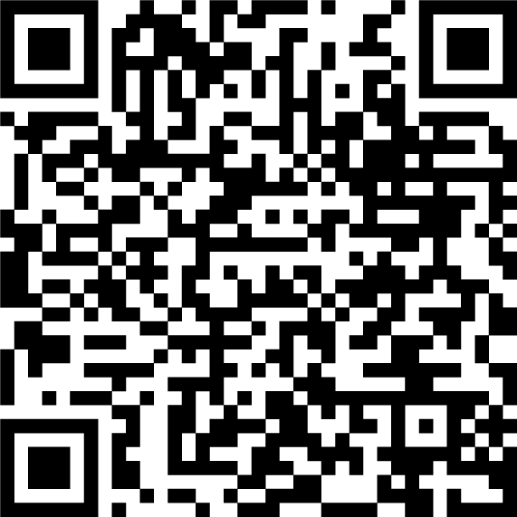
“Trust…. an underlying condition necessary to support all effective human interactions.”
Read & Reflect
Trust as a Systemic Structure in Our Organization by Doug Stillwell
How does trust become a foundational systematic structure?
(Stillwell, 2018)
Notes:
To Know/To Say
Doug Stilwell describes trust as the underlying condition necessary to support effective interactions. Over time, the interactions of a district or school create a climate of trust or mistrust, which becomes a foundational systemic structure that influences people’s behavior. As you read the article, “Trust as a Systemic Structure in our Organizations,” https://thesystemsthinker.com/trust-as-a-systemic-structure-in-our-organizations/, consider how trust becomes and can be viewed as a foundational systemic structure.
To Do
Have participants access the Doug Stillwell article “Trust as a Systemic Structure in our Organizations,” https://thesystemsthinker.com/trust-as-a-systemic-structure-in-our-organizations/. They may scan the QR code or the article is hyperlinked in the QR code.
Jig Saw reading/reflection activity
Have all participants read the article introduction
Number participants 1-6. Each participant reads their designated section of the article.
1. Defining Trust, 2. Using the Trust Lens, 3. How Trust Becomes a Structure, 4. Leveraging Trust, 5. Building Trust, 6. Benefits of a High Trust Culture
Have “expert” groups gather according to their number, discuss their section, and write key points on chart paper
A spokesperson from each group shares key points regarding their section of the article
Reference
Stilwell, D. (2018). Trust as a systemic structure in our organizations. https://thesystemsthinker.com/trust-as-a-systemic-structure-in-our-organizations/

Slide 60
Steps for Building Trust
Build authentic relationships
Improve the flow and frequency of communication
Extend trust…believe in the experience and expertise of teachers
Help teachers see the larger system and understand where they fit
Operate with the code of honor… respect, truth, keeping your word
(Beilke, 2014)
Notes:
To Know/To Say
To build organizational trust, educators need to understand the connection between their work and the other things happening in their district/buildings. These are strategies from Scott Beilke that leaders can use as steps to instill a culture of trust.
Operate with a code of honor
Consistency in the basics (i.e. showing respect, telling the truth, keeping your word) are foundational to building trust over time.
Help teachers see the larger system and understand where they fit
People often focus on their part of an organizational system. It is important to help teachers understand the connection between their work, district initiatives, and how their contributions make a difference.
Extend trust
For trust to be fully realized, it must be extended back to others. If leaders want teachers to trust them, leaders must also be willing to trust in the expertise and experience of their teachers.
Improve the flow and frequency of communication
Staff often feel they are out of the loop and not involved in decisions that impact them. Communication is key to ensuring staff know what it is happening and why. It is also important to provide opportunities for two-way communication regarding important decisions
Build authentic relationships
To build authentic relationships, leaders must be available to share their own successes and failures and encourage staff to do the same. This creates a safe working environment in which staff feel valued and less fearful of taking a risk or making a mistake.
Reference
Beilke, S. (2014, April 16). The importance of trust: It makes your culture “change ready.” TLNT. https://www.tlnt.com/the-importance-of-trust-it-makes-your-culture-change-ready/
Additional Resource
Senge, P. (2015, June 4). What are the three core learning capabilities [Video]? Sarder TV. https://www.youtube.com/watch?v=HCTJaNmYt2w

Slide 61
Reflections… Building Trust in Schools and Districts
How can you as a school leader leverage trust?
What are some strategies that might work best to build trust in your setting?
Do your district’s/building’s policies, practices, or norms have any unintended consequences that damage trust?
Notes:
To Do/To Say
Provide leaders time to discuss these questions with others from their district (if possible). Share ideas generated within small groups with all.

Slide 62
Fixed vs Growth Mindset
FIXED MINDSET BELIEFS GROWTH MINDSET BELIEFS
Notes:
To Do
Have participants jot down at least two beliefs they think individuals with a fixed mindset have. Next, have them jot down at least two beliefs they think people with a growth mindset have. Move to next slide for examples

Slide 63
Fixed Vs Growth Mindset
They are either born with talent or not
They are either naturally good at something or they are not
Intelligence is a fixed trait
Inborn talent determines success
Abilities can be developed through dedication, perseverance, and the right strategy
Anyone can be good at anything
Continual path of lifelong learning
Strengths and talents can be developed
FIXED MINDSET BELIEFS GROWTH MINDSET BELIEFS
Notes:
To Know
Craig, W. (2017, Oct. 3). Growth mindset: What it is and why it makes better leaders. https://www.forbes.com/sites/williamcraig/2017/10/03/growth-mindset-what-it-is-and-why-it-makes-better-leaders/#5769399533c8
Dweck, C. S. (2007). Mindset: The new psychology of success. New York, NY: Ballantine Books
Love, A. (2018, August 1). 4 ways leaders can foster a growth mindset within their team. TheLadders. https://www.theladders.com/career-advice/how-leaders-can-foster-a-growth-mindset
To Say
An individual’s mindset can profoundly affect their approach to life and problem-solving. Individuals with a “fixed mindset” think talent is inborn, talent determines one’s success, and intelligence is a fixed trait. In contrast, individuals with a “growth mindset” think anyone can be good at anything with enough dedication and perseverance, learning happens across the lifespan, and intelligence is malleable.

Slide 64
Benefits of a Growth Mindset
A growth mindset
Helps individuals learn from experience and persevere to success
Keeps the attention on the work needed to achieve a goal
Promotes an appreciation for the collaborative process by valuing what others have to offer
Allows one to recognize and take advantage of learning opportunities
Notes:
To Know/To Say
A growth mindset helps individuals learn from their experience. Rather than being stopped by setbacks, the focus is on learning from those experiences and persevering to success. It keeps the attention on the work needed to achieve a goal. A growth mindset promotes an appreciation for the collaborative process by recognizing and appreciating the value of what others have to offer. Lastly, a growth mindset allows one to recognize and take advantage of learning opportunities, including opportunities to learn through professional development.
Reference
Craig, W. (2017, Oct. 3). Growth mindset: What it is and why it makes better leaders. https://www.forbes.com/sites/williamcraig/2017/10/03/growth-mindset-what-it-is-and-why-it-makes-better-leaders/#5769399533c8

Slide 65
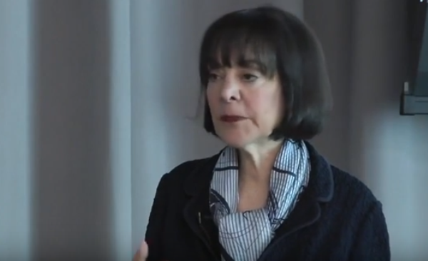
Developing a Growth Mindset Culture in Organizations
Dr. Carol Dweck
Notes:
Video
Carol Dweck on “Developing a Growth Mindset Culture in Organizations” (3:27 min)
To Know
The video transcript is available at http://www.moedu-sail.org/wp-content/uploads/2020/02/7-Developing-a-Growth-Mindset-Video-Transcript.pdf
To Do/To Say
In this video, Dr. Carol Dweck discusses the impact mindset can have on organizations and how organizational values impact people’s mindsets. As you watch this video, consider where your district/building would fall on the growth mindset continuum. What behaviors of your organization would support your rating?
Reflection questions on next slide.
Reference
The PTS Tube. (2017, March 6). Carol Dweck on developing a growth mindset culture in organizations [Video]. YouTube. https://www.youtube.com/watch?v=Mjv7TBoAYSY

Slide 66
Reflections…
In what ways can your district “organization” relate to the research findings that Dr. Dweck talked about in the video?
What strategies are currently being implemented in your district that promote growth mindset?
What might some “next steps” be in building and sustaining a growth mindset culture for your district?
Notes:
To Do
Provide time for school leaders to reflect on each of these questions and to have conversations with others. Share out as appropriate.
Optional activity
Post the questions on chart paper and have participants write responses on sticky notes to stick on the charts. Share responses with the whole group or have school leaders do a Gallery Walk to view & reflect on responses.
Additional Resources
Vedova, T. (2015, Oct. 21). How to build a growth mindset into school culture. Getting Smart. Retrieved from https://www.gettingsmart.com/2015/10/how-to-build-a-growth-mindset-into-school-culture/
Jeffrey, S. (n.d.) A complete guide to changing your fixed mindset into a growth mindset. CE sage. Retrieved from https://scottjeffrey.com/change-your-fixed-mindset/
France, S. (2016, Dec. 28). The fixed mindset vs. the growth mindset. ASAP. Retrieved from https://www.asaporg.com/articles/leadership/fixed-mindset-vs-growth-mindset
Dweck, C. (2016, March 24). Mindset, motivation, and leadership [Video file]. Kanatola Training Solutions. Retrieved from https://www.youtube.com/watch?v=yYknuaoIdME
Senge, P. (2015, June 4). What are the 3 core learning capabilities [Video file]. Sarder TV. Retrieved from https://www.youtube.com/watch?v=HCTJaNmYt2w

Slide 67
Strategies That Promote a Growth Mindset
Value professional learning
Discuss successes and areas needing adjustment
Include everyone in the implementation process
Seek and be open to feedback
Notes:
To Do
Emphasize bolded info in notes in addition to info on slide.
To Know/To Say
4 Strategies to Promote Growth Mindset
Value professional learning by investing time and resources to help staff develop new skills (including School-Based Implementation Coaching).
Spend time with staff discussing successes and areas needing adjustment. Allow time for staff to share what is going well and what may need adjusting during the implementation process. Create a feedback loop and communication structures.
Include everyone in the implementation process. Rather than limit implementation efforts to a few key people, make it a priority to involve everyone during the implementation planning and implementation. Great ideas come from everywhere!
Seek and be open to feedback. To ensure staff have a growth mindset, leadership must model these same qualities. Seeking and being open to feedback is an important way for leadership to model a growth mindset and encourage staff.
Reference
Love, A. (2018, August 1). 4 ways leaders can foster a growth mindset within their team [Online article]. Retrieved from https://www.theladders.com/career-advice/how-leaders-can-foster-a-growth-mindset

Slide 68
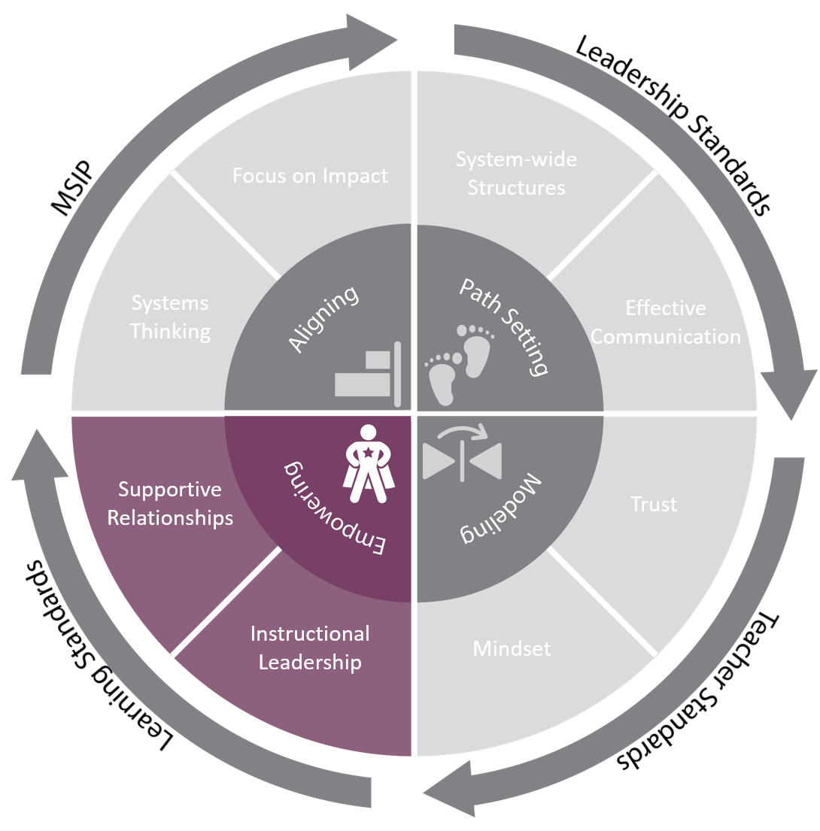
Essential Function 4: Empowering
Leadership empowers educators at all levels to active engagement in continuous improvement and collective responsibility for student growth.
Notes:
To Do
Refer participants to EF 4 on the Leadership for Effective Implementation Practice Profile (HO#3).
To Know/To Say
Essential Function 4 focuses on two key strategies leaders can use to help teachers feel empowered. By creating supportive relationships and instructional leadership, educational leaders can build a supportive environment that empowers educators.
Expand on each indicator listed below.
Leadership builds a supportive environment by meeting all of the criteria below.
Establishment of district-wide goals that address the needs of all students
Selection, ongoing training, and implementation of evidence-based methods aligned with the shared district focus
Use of data at all levels for the purpose of establishing and addressing priority areas of emphasis
Design and support for a system of School-Based Implementation Coaching
Leadership ensures that all of the following key components are used and supported across the district.
Collaborative Teams
Common Formative Assessment
Data-Based Decision Making
Developing Assessment Capable Learners with Feedback
Metacognition

Slide 69
Teacher empowerment is a process by which teachers individually and collectively trust they can master and have control over issues that concern them.
Teacher Empowerment
Schools with the highest levels of instructional and teacher leadership rank 10 percentile points higher in both math and language arts achievement on state tests compared to schools with the lowest levels.
(Ingersoll, Dougherty, Sirinides, 2017)
Notes:
To Do
Ask leaders to jot down strategies they believe will help empower teachers and then share out. Examples may include the following ideas.
Empowering teachers to make decisions regarding instruction and assessment
Asking teachers to take on select leadership tasks
Include teachers in higher-level leadership conversations and decisions
To Say
We are going to highlight two strategies - 1) creating supportive relationships and 2) instructional leadership as methods that build teacher empowerment.
To Know
More information on Teacher Empowerment can be found in the DCI Collective Teacher Efficacy (CTE) module regarding teacher voice in school decision making and shared leadership.
References
Ingersoll, R. M., Dougherty, P., & Sirinides, P. (2017). School leadership counts. Santa Cruz, CA: New Teacher Center. Retrieved from https://go.pardot.com/l/576393/2018-08-15/349bgkg

Slide 70
Systems thinking leaders help people understand and appreciate that they are part of the same system and thus responsible for both the problems and their solutions.
Supportive Relationships
(Goodman, 2011)
Notes:
To Know/To Say
Every system, by definition, is made up of a network of parts or components. What separates a system from a collection of parts are the relationships. Leaders who are system thinkers, focus on building supportive relationships that encourage interactions and interconnections among the parts and people of their system. Supportive relationships empower teachers and can eliminate “us” and “them” patterns of behavior that often result in diminished efficiency and effectiveness.
Michael Goodman wrote that within the framework of systems thinking, leaders help people understand and appreciate that they are part of the same system and thus responsible for both the problems and their solutions. Interdependence does not mean that individuals are not capable and self-reliant. It means that capable and self-reliant individuals understand they can accomplish better outcomes by working together.
To Know
The Collective Teacher Efficacy module can also be utilized for training to help build supportive relationships within schools. CTE expands on the following four focus areas.
Collaboration and Social Networks
Teacher Leadership
Teacher Voice in Decision Making and Problem-Solving
Collaborative Teacher Inquiry
References
Goodman, M. (2011). Systems thinking as a language. The Systems Thinker, 21(10), 10 – 11. Retrieved from http://bibsrv.udem.edu.mx:8080/publications/Systems_Thinker_vol_18-/Vol.%2021%20No.%2010,%20dic.-ene.%202010-2011.pdf

Slide 71
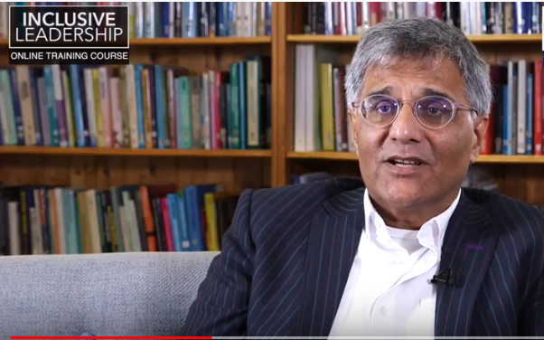
How Inclusive Leaders Build Relationships and Teams
Notes:
To Know
Video (3:08 min), How Inclusive Leaders Build Relationships and Teams, https://www.youtube.com/watch?v=KA-1s1G-_v4, min. The video transcript is available at http://www.moedu-sail.org/wp-content/uploads/2020/02/8-How-Inclusive-Leaders-Build-Relationships-and-Teams-Video-Transcript.pdf
There are reflective questions on the next slide.
To Say
The video “How Inclusive Leaders Build Relationships and Teams“ illustrates the importance of supportive relationships to effective leadership. As you watch this video, jot down the four strategies for building relationships that are highlighted.
Reference
Skill Boosters. (2018). How inclusive leaders build relationships and teams [Video file]. Retrieved from https://www.youtube.com/watch?v=KA-1s1G-_v4

Slide 72
How Inclusive Leaders Build Relationships Video Reflection
What four strategies for building relationships are highlighted in this video?
How do the actions of the leader impact the team members?
Notes:
To Do/Say
Pose questions and discuss

Slide 73
Keys to Building Supportive Relationships
Communication Feedback Loops
Collaborative Team Structures & Processes
Collaborative Teams
Data-Based Decision Making
School-Based Implementation Coaching
Autonomy Through Boundaries
Notes:
To Know/To Say
Now we will take look at some key strategies for leaders to build supportive relationships.
Communication Feedback Loops are essential to building trust and supportive relationships. Effective communication loops produce a sense of collective ownership and responsibility.
Create and Implement Collaborative Team Structures and Processes – The DCI framework includes 3 modules focused on collaborative teams structures that can be used to support districts.
Collaborative Teams (CT)
Data-Based Decision Making (DBDM)
School-Based Implementation Coaching (SBIC)
Create Autonomy Through Boundaries - Provide direction and structure for individual decisions around a common focus. School leaders can use both teacher evaluation and professional growth planning to clarify boundaries and areas of flexibility in decision making.

Slide 74
Reflections… Building Supportive Relationships
How might relationships in your district be strengthened?
Between Leaders/Teachers Within Collaborative Teams
Notes:
To Know
Use Handout: EF4 Reflection Activity (HO#7)
To Do
Have leaders reflect on their current reality regarding their district’s culture of supportive relationships. Ask them to use the handout and brainstorm ideas on how they might strengthen relationships between teachers and administrators, as well as within collaborative teams. Next have leaders participate in a Give One/Get One structure where they give an idea for each category to a colleague and that person provides them with a different idea. Have them exchange ideas with at least 3 other participants.
Additional Resources
Online Article
White, L. (2016, Jan. 4). Six ways you can empower teachers to lead. TeachStone. Retrieved from https://info.teachstone.com/blog/six-ways-you-can-empower-teachers-to-lead
Video
Buck, R. (2015, July 16). This is #teach to lead [Video file]. U.S. Dept. of Education. Retrieved from https://www.youtube.com/watch?v=o4rlENK-k5I&feature=youtu.be
Report Goyne, J., Padgett, D., Rowicki, M., & Triplitt, T. (1999, August). The journey to teacher empowerment. Retrieved from https://eric.ed.gov/?id=ED434384

Slide 75
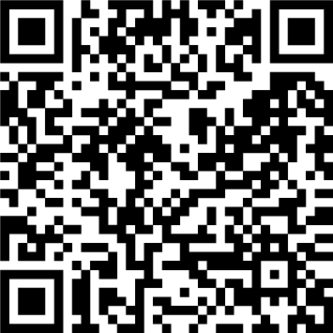
What Knowledge and Skills Do Instructional Leaders Need to be Effective in Promotive in Promoting Student Growth?
“…instructional leadership reflects those actions a principal takes to promote growth in student learning.
The instructional leader makes instructional quality the top priority of the school and attempts to bring that vision to realization.”
(Jenkins, 2009)
Notes:
To Know
The focus for this section switches slightly to the individual buildings/administrative units and their functioning as a smaller system within the scope of the larger district system. One of the key requirements for success at this level is strong instructional leadership for high-impact outcomes. District leadership plays a role in enabling building leaders to see instructional leadership as a primary responsibility of their role within the district.
To Do/To Say
Discuss the quote and emphasize the importance of instructional quality being a school leader’s priority. Have participants jot down what they believe are the necessary knowledge and skills needed for instructional leaders to be effective. Provide think time first.
Next, have participants read 10 Strategies to Improve Instructional Leadership (https://www.nassp.org/2019/08/07/10-strategies-to-improve-instructional-leadership/) and then compare their original thoughts regarding necessary skills and knowledge with information in the article. (The QR code may be scanned or web link may be entered to access the article.) Have participants share out key ideas from the article that resonated with them.
Optional Activity
Groups of 4-6 could then create mind maps illustrating knowledge and skills necessary for effective instructional leaders. These could then be posted around the room and perused.
What knowledge and skills do instructional leaders need to be effective in promoting student growth?
Reference
Jenkins, B. (2009, Jan./Feb). What it takes to be an instructional leader. Principal. https://www.researchgate.net/publication/234594862_What_It_Takes_to_Be_an_Instructional_Leader
Sheninger, E. (2019, August 7). 10 strategies to improve instructional leadership. National Association of Secondary School Principals. https://www.nassp.org/2019/08/07/10-strategies-to-improve-instructional-leadership/

Slide 76
What percentage of your day is instructional focused?
Instructional Tasks
Schedule – plan professional development
Meet with collaborative teams
Observe and provide feedback to staff
Engage in classroom walkthroughs
Managerial Tasks
Manage budgets
Run/submit reports
Manage building processes (lunch, bus, master schedules, etc.)
Manage student discipline
Notes:
To Know/To Say/To Do
Take a few minutes to reflect on how you spend your day in terms of time spent on instructional verses managerial tasks? (Examples of each are listed above.) Spend a few minutes reflecting on your last leadership day, from when you first arrived at school to when you left.
On Handout #8, write down the tasks you have identified as either instructional or managerial. Tally the instructional and managerial tasks listed to show a percentage of your time spent in each management style. Repeat this exercise a two or three times over the next few weeks to see if the percentage stays the same or changes. Reflect on how your time is being spent and consider changes to make your use of time more effective.
Ask for volunteers to share any realizations.
Activity - Instructional/Managerial Tasks HO#8
Additional Resources
Center for Educational Leadership. (2015). 4 dimensions of instructional leadership: Instructional leadership framework 2.0. http://iltmaese.weebly.com/uploads/1/0/9/8/109874920/two_column_chart_of_info.pdf

Slide 77
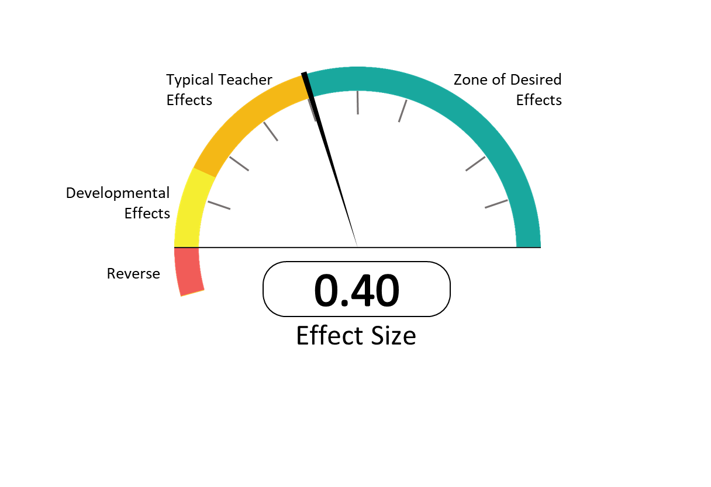
What High-Impact Practices are being used with Fidelity in Your District?
Instructional Leaders Focus on High-Impact Practices
Hinge Point
(Hattie, 2017)
Notes:
To Know
This slide is optional depending on your audience. If they already have a background in Hattie’s work move to the next slide.
To Know/To Say
John Hattie’s seminal work, Visible Learning, was based on more than 800 meta-analyses of 50,000 research articles, about 150,000 effect sizes, and about 240 million students. Since that 2008 book, Hattie continues to update effect sizes based on his current research. The effect sizes are updated on Visible Learning website (https://visible-learning.org/hattie-ranking-influences-effect-sizes-learning-achievement/). Hattie uses a “Barometer of Influence” as a graphic illustration showing the influence of a practice on learning. The effect size is a value determined through statistical analysis to show the relative impact of a practice or intervention. Any effect above zero means achievement is raised by the practice. Alternatively, if the effect size of a practice is below zero and shown in the red zone of the barometer, then the practice has actually detracted from learning. The average effect (one year growth in one year time) size is 0.40. For any teaching/learning practice to be considered worthwhile, it needs to show an improvement in student learning of at least an average gain. However, effect sizes over .40 can provide more than a year’s growth in a year’s time provide a higher impact.
Emphasize the importance of focusing on practices that provide the greatest impact on student achievement.
Reference
Hattie, J. (2017, Dec.). Hattie Ranking: 252 Influences and effect sizes related to student achievement. Visible Learning. https://visible-learning.org/hattie-ranking-influences-effect-sizes-learning-achievement/#tabs_desc_6004_2

Slide 78
High-Impact Leadership Practices
Leaders view their major role is to evaluate their impact (ES=.91)
Leaders facilitate everyone in the school working together to know and evaluate their impact (ES=.91)
Leaders facilitate high-impact teaching and learning (ES=.84)
Leaders are explicit with teachers and students about what success looks like (ES=.77)
Leaders set appropriate levels of challenge and who never retreat to ‘just do your best’ (ES=.57)
(Hattie, 2015)
Notes:
To Do/To Know/To Say
Discuss each practice & their effect size.
In his more recent work, Hattie (2015) makes clear that leadership practices are not equal in terms of impact on student achievement.
In the article High-Impact Leadership, Hattie reports on an analysis of leadership practices. The following practices of leaders who had a high-impact on student achievement were found to be significant.
Leaders who believe their major role is to evaluate their impact (ES=.91)
Leaders who get everyone in the school working together to know and evaluate their impact (ES=.91)
Leaders who learn in an environment that privileges high-impact teaching and learning (ES=.84)
Leaders who are explicit with teachers and students about what success looks like (ES=.77)
Leaders who set appropriate levels of challenge and who never retreat to ‘just do your best’ (ES=.57)
Reference
Hattie, J. (2015). High impact leadership. Educational Leadership, 72(5), 38.

Slide 79
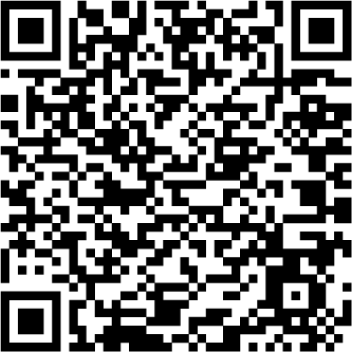
Check the Effect Size of Instructional Practices Used in Your Building
(Hattie, 2017)
Notes:
To Do/To Say
Have school leaders scan the QR code or access the web link to review high effect size practices. Suggest that they record high and low effect size practices that are currently being used in their building/district.
To Know/To Say
Practices with a high effect size should be deeply embedded throughout your district/building’s daily instructional operation. Are the practices used in your building considered high impact? Are any below the .40 hinge point?
Reference
Hattie, J. (2017, Dec.). Hattie Ranking: 252 Influences And Effect Sizes Related To Student Achievement. Visible Learning. https://visible-learning.org/hattie-ranking-influences-effect-sizes-learning-achievement/#tabs_desc_6004_2

Slide 80
Reflections… High-Impact Practices
Are practices with the highest effect sizes occurring in your district/building?
What is the knowledge level of staff concerning the effect size of various educational practices?
Are you using leadership practices that have high effect sizes?
Notes:
To Do
Provide participants time to reflect on these questions and discuss with others from their district. If time allows, allow for some large group share outs after reflections.
To Say
Next, we will look at some additional research on the impact of instructional leadership.

Slide 81
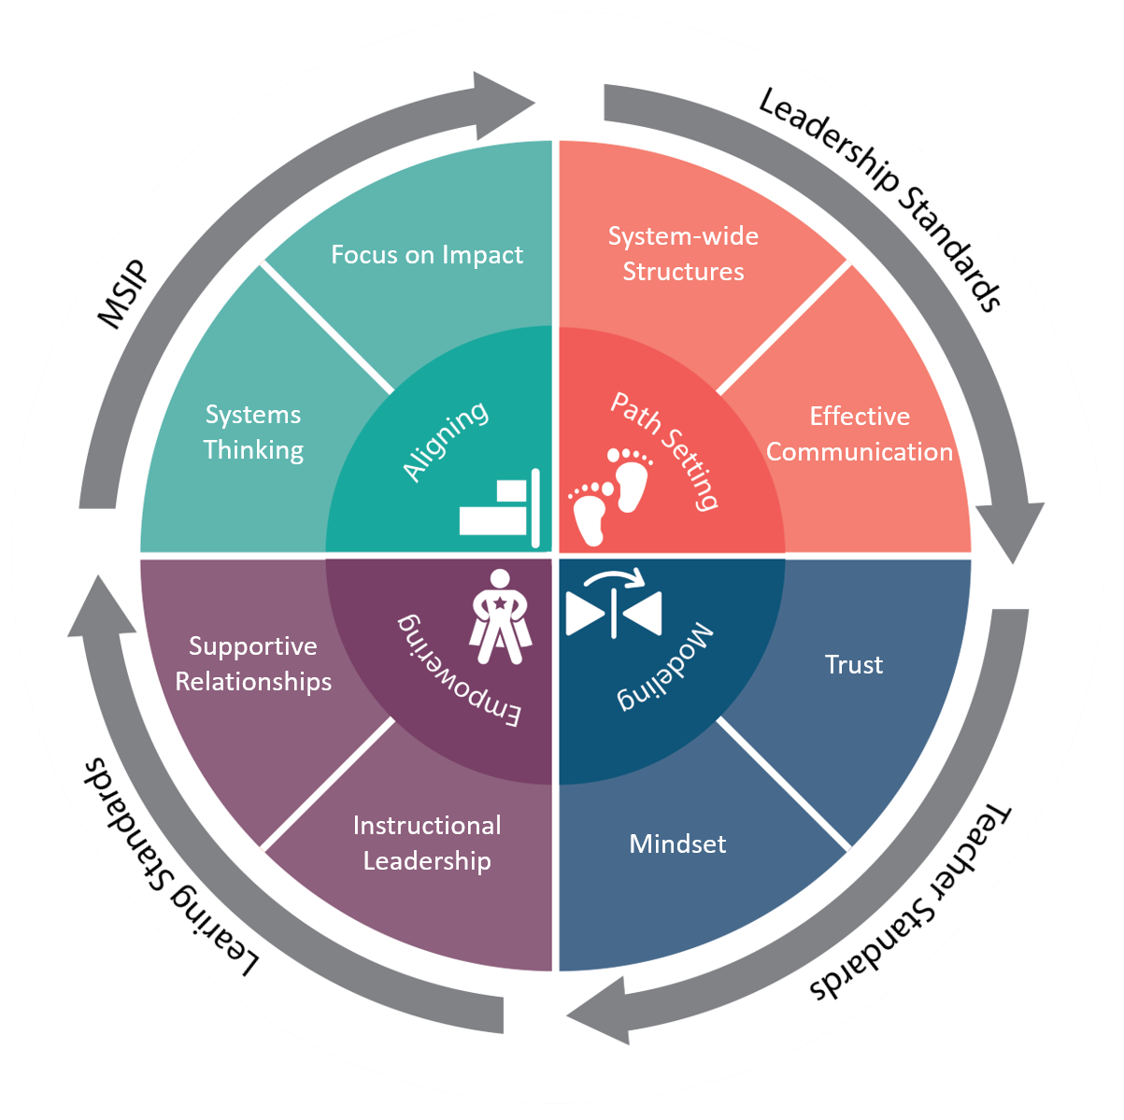
Leadership for Effective Implementation in Action
Leading Change
Implementation Science
Sustainability and the Continuous Improvement
Unpacking the DCI Framework
Notes:
To Know/To Say
We will now examine ways to put Effective Leadership into action.
These are the areas that will be addressed.
Leading Change: 5 strategies for making change work
Understanding Implementation Science
Sustainability and the PDSA Cycle for Continuous Improvement
Unpacking the DCI Framework

Slide 82
Leading Change - Randy Pennington
Notes:
To Know
Video, Making Change Work, 4:25 min. The video transcript is available at http://www.moedu-sail.org/wp-content/uploads/2020/02/9-How-Do-You-Make-Change-Work-Video-Transcript.pdf.
There are reflection points on next slide.
To Do/To Say
In the video Making Change Work, Randy Pennington discusses strategies for leading change. As you watch this video, consider the five strategies Pennington describes and how they align with previous information from this module.
Reference
New Zealand School Trustees Association. (n.d.). How do you make change work [Video]? http://www.govtalks.co.nz/how-do-you-make-change-work

Slide 83
Leading Change - Randy Pennington
Change the way people think and talk about change
Create urgency around the change through urgency and vision
Connect with people where they are
Use resistance as your friend
Go first
Notes:
To Know
Change the way people think and talk about change – As an organization we change every time we see a way to be better.
Create urgency around the change through urgency and vision - It is easy to think our district is doing OK, so leaders create urgency by creating a vision for the future.
Connect with people where they are - Leaders tend to talk about aspects of change that are important to them rather than the aspects that will be important to the people who will be asked to change.
Use resistance as your friend - When we receive resistance that’s someone actually telling us something about which they are legitimately afraid or legitimately concerned. As leaders should want to know that, because if one person is experiencing those feelings chances are that others are feeling them also.
Go first - If the people you are trying to influence to change don’t see you changing, then they have no motivation to follow you. And you have no credibility to be able to inspire them to change. You have to be able to go first.
To Do/To Say
In the video Making Change Work, Randy Pennington discusses these 5 strategies for leading change. Divide into 5 groups and have each group discuss and share their thoughts on one of the 5 strategies and examples of how they have seen it applied.
Reference
New Zealand School Trustees Association. (n.d.). How do you make change work [Video]? http://www.govtalks.co.nz/how-do-you-make-change-work

Slide 84
“ Implementation is a process involving multiple decisions, actions, and corrections to change the structures and conditions necessary to successfully implement and sustain new programs and innovations.”
Leading Change and Implementation Science
(National Implementation Research Network, NIRN)
Notes:
To Know
Identifying and adopting evidence-based practices and programs is only part of a district continuous improvement journey. It is important leaders understand how different implementation stages and practices work to move an evidence-based practice or program from a good idea to full and sustainable implementation within an educational system. Implementation and systemic change is about altering the way a system functions to support students and learning outcomes. The National Implementation Research Network continues to conduct and support the evaluation of implementation. Since their seminal work in 2005 with the publication of “Implementation Research: A Synthesis of the Literature,” NIRN continues to generate knowledge around key aspects of implementation. Understanding the stages of implementation can help a leader facilitate implementation from selection to sustainability. For more information on implementation science see the NIRN Active Implementation Hub https://nirn.fpg.unc.edu/ai-hub.
To Do/Say
Read or ask participants to read the quote on the slide and then ask them to define/discuss the meaning of the word implementation. What do we mean when we talk about implementing an evidence-based practice or program? What does it look like? What types of decisions do leaders make that impact implementation?
To Know
Dictionary.com defines implementation as “the process of putting a decision or plan into effect; execution.” Merriam-Webster.com defines implementation as “the process of making something active or effective.”
Possible drivers or decisions leaders make include competency drivers of selection; training and coaching; fidelity/performance assessment and organizational drivers of data-based decisions and systems; communication and feedback loops; adjusting policies and procedures; reducing system barriers; and leadership for use of data, collaboration and monitoring.
References
Fixsen, D., Naoom, S., Blase, K., Friedman, R., & Wallace, F. (2005). Implementation research: A synthesis of the literature. Tampa, FL: University of South Florida, Louis de la Parte Florida Mental Health Institute, National Implementation Research Network. Retrieved from https://nirn.fpg.unc.edu/resources/implementation-research-synthesis-literature
National Implementation Research Network. (n.d.) Active implementation hub. Framework 2: Implementation stages. https://nirn.fpg.unc.edu/module-1/implementation-stages

Slide 85
Implementation Stages 1. Exploration and Adoption
Guiding Questions
What do we currently have in place that is effectively supporting student learning and/or effective instruction?
How do we know our practices are effective?
What do educators need in order to improve instruction?
What does our system of professional development (coaching and training) look like? Is this addressing educator needs? How do we know?
Involves reviewing current strengths and needs, selecting an innovation, and deciding to move forward (or not).
Notes:
To Know
For more information on implementation science and this stage, visit the NIRN Active Implementation Hub https://nirn.fpg.unc.edu/ai-hub.
To Know/To Say
The National Implementation Research Network (NIRN) identified six stages organizations go through when selecting and implementing innovative programs and practices. Successful educational leaders guide and support districts and buildings through all six implementation stages.
The first stage is Exploration and Adoption. This is the stage in which a district examines their current strengths and needs and assess potential matches between needs and evidence-based practices and resources to make a decision to proceed (or not) to implementation. Leaders need to consider their goals, how the practice(s) match with district goals, and what resources and commitments will be needed.
The guiding questions are the types of questions leaders will ask to guide them through this stage.
What do we currently have in place that is effectively supporting student learning and/or effective instruction?
How do we know our practices are effective?
What do educators need in order to improve instruction?
What does our system of professional development (coaching and training) look like? Is this addressing educator needs? How do we know?
Reference
Fixsen, D., Naoom, S., Blase, K., Friedman, R., & Wallace, F. (2005). Implementation research: A synthesis of the literature. Tampa, FL: University of South Florida, Louis de la Parte Florida Mental Health Institute, National Implementation Research Network. Retrieved from https://nirn.fpg.unc.edu/resources/implementation-research-synthesis-literature

Slide 86
Implementation Stages 2. Program Installation
Guiding Questions
At the district level, what needs to be put in place to support building and district-wide implementation?
What resources, guidance, policies, support, etc. are needed for consistency across the district? Are there unique pockets of needs within the district?
How can we best address the need for information and establish ownership for implementation?
Establishing an environment supportive of implementation
Notes:
To Know
For more information on implementation science and this stage, visit the NIRN Active Implementation Hub https://nirn.fpg.unc.edu/ai-hub.
To Say
After a district makes the decision to adopt an evidence-base practice, initial planning occurs. During this step, the district creates an implementation or action plan deciding on which resources, guidance, and/or structural supports will be needed for the adoption to be successful.
The guiding questions are the types of questions leaders will ask to guide them through this stage.
At the district level, what needs to be put in place to support building and district-wide implementation?
What resources, guidance, policies, support, etc. are needed for consistency across the district? Are there unique pockets of needs within the district?
How can we best address the need for information and establish ownership for implementation?
Reference
Fixsen, D., Naoom, S., Blase, K., Friedman, R., & Wallace, F. (2005). Implementation research: A synthesis of the literature. Tampa, FL: University of South Florida, Louis de la Parte Florida Mental Health Institute, National Implementation Research Network. Retrieved from https://nirn.fpg.unc.edu/resources/implementation-research-synthesis-literature

Slide 87
Implementation Stages 3. Initial Implementation
Professional development is provided, and educators begin implementing the components. Leaders monitor these early steps for fidelity and needs that may emerge.
Guiding Questions
Are initial implementation steps proceeding as expected? What needs for resources or support are emerging?
Which aspects show promise for being effective and which need to be revisited?
What are the district-level considerations to address prior to full operation?
Notes:
To Know
For more information on implementation science and this stage visit the NIRN Active Implementation Hub https://nirn.fpg.unc.edu/ai-hub
To Know/To Say
The third stage is initial implementation. Initial implementation is marked by change. During the initial stage of implementation teachers learn new practices and begin to put them in place, new policies are practiced, organizational leadership and culture begins to change. This is a critical time for implementation. As challenges to the change process impact a district, this is the point where implementation may end without strong and committed leadership.
The guiding questions are the types of questions leaders will ask to guide them through this stage
Are initial implementation steps proceeding as expected? What needs for resources or support are emerging?
Which aspects show promise for being effective and which need to be revisited?
What are the district-level considerations to address prior to full operation?
References
Fixsen, D., Naoom, S., Blase, K., Friedman, R., & Wallace, F. (2005). Implementation research: A synthesis of the literature. Tampa, FL: University of South Florida, Louis de la Parte Florida Mental Health Institute, National Implementation Research Network. Retrieved from https://nirn.fpg.unc.edu/resources/implementation-research-synthesis-literature

Slide 88
Implementation Stages 4. Full Operation
Guiding Questions
Is fidelity of implementation being met? How do we know? If it is not, what resources and supports are needed to improve implementation with fidelity?
Which aspects of the DCI framework have proven to be effective and which require revision?
Taking implementation to scale. At a district -level, full operation is implementation of the DCI framework in all buildings.
Notes:
To Know
For more information on implementation science and this stage, visit the NIRN Active Implementation Hub https://nirn.fpg.unc.edu/ai-hub.
To Know/ To Say
The fourth stage is Full Operation. Full Operation or Full Implementation occurs once new practices, procedures, and processes become integrated into the way a district and educators “do business.” The procedures and processes become routine and as educators use new practices with fidelity the anticipated benefits should be realized.
The guiding questions are the types of questions leaders will ask to guide them through this stage.
Is fidelity of implementation being met? How do we know? If it is not, what resources and supports are needed to improve implementation with fidelity?
Which aspects of the framework have proven to be effective and which require revision?
References
Fixsen, D., Naoom, S., Blase, K., Friedman, R., & Wallace, F. (2005). Implementation research: A synthesis of the literature. Tampa, FL: University of South Florida, Louis de la Parte Florida Mental Health Institute, National Implementation Research Network. Retrieved from https://nirn.fpg.unc.edu/resources/implementation-research-synthesis-literature

Slide 89
Implementation Stages 5. Innovation
Guiding Questions
In what ways can the work and approach be improved?
What are the implications for the integrity of the work if revisions are made?
What are the considerations for sustainability? Are there district-level factors to address in order to set the stage for sustaining the work?
Data guides innovative modifications, additions, and/or subtractions to the practice. It is important to refrain from innovation until ample time has been permitted for full operation.
Notes:
To Know:
For more information on implementation science and this stage, visit the NIRN Active Implementation Hub https://nirn.fpg.unc.edu/ai-hub.
To Know/To Say
The fifth stage is Innovation. As districts implement any evidence-based practice they are learning more about the program and the conditions under which it can be used with fidelity to produce good effects. Educators working under different conditions may find challenges in implementation that require some refinement to the practice or system. It is important to first put the practice in place with fidelity before looking at ways to refine it. This ensures educators have had sufficient time to really learn and implement the practice with fidelity. In that way, it can be clear that the innovation to the practice is necessary and needed rather than a drift from the evidence-base of the practice. During this stage it is important to let data guide innovative modifications, additions, and/or subtractions to the practice.
The guiding questions are the types of questions leaders will ask to guide them through this stage.
In what ways can the work and approach be improved?
What are the implications for the integrity of the work if revisions are made?
What are the considerations for sustainability? Are there district-level factors to address in order to set the stage for sustaining the work?
References
Fixsen, D., Naoom, S., Blase, K., Friedman, R., & Wallace, F. (2005). Implementation research: A synthesis of the literature. Tampa, FL: University of South Florida, Louis de la Parte Florida Mental Health Institute, National Implementation Research Network. Retrieved from https://nirn.fpg.unc.edu/resources/implementation-research-synthesis-literature

Slide 90
Implementation Stages 6. Sustainability
Guiding Questions
What do the data tell us about the impact of the practice?
What do data tell us about fidelity of implementation?
What needs do we have to ensure the practice is used with fidelity?
How do we continue to support the work and move forward?
Data guides innovative modifications, additions, and/or subtractions to the practice. It is important to refrain from innovation until ample time has been permitted for full operation.
Notes:
To Know
For more information on implementation science and this stage, visit the NIRN Active Implementation Hub https://nirn.fpg.unc.edu/ai-hub.
To Know/To Say
The goal of any adoption of an evidence-based practice is system of services and supports that are so firmly established in the culture of the organization that it continues in subsequent years despite staff and administrator changes. While this is the last stage of implementation, it is not the end of the work it takes to sustain implementation. Leaders must continue to examine data and make data-driven decisions, all while being mindful of the changing dynamics of student outcomes and needs.
The guiding questions are the types of questions leaders will ask to guide them through this stage.
What do the data tell us about the impact of the practice?
What do data tell us about fidelity of implementation?
What needs do we have to ensure the practice is used with fidelity?
How do we continue to support the work and move forward?
References
Fixsen, D., Naoom, S., Blase, K., Friedman, R., & Wallace, F. (2005). Implementation research: A synthesis of the literature. Tampa, FL: University of South Florida, Louis de la Parte Florida Mental Health Institute, National Implementation Research Network. Retrieved from https://nirn.fpg.unc.edu/resources/implementation-research-synthesis-literature

Slide 91
District Continuous Improvement and the G.A.I.N.S. Cycle
Notes:
To Know
Since the diagram will be hard for participants to read, remind them they have a copy in HO# 5.
To Say
Just as the G.A.I.N.S. cycle is used to guide action planning when setting a path for district continuous improvement, this same cycle is a useful model when thinking about sustainability. District Continuous Improvement is a cycle of data-based decision making. Which means, through the G.A.I.N.S. cycle, problems and solutions are identified and barriers to effective implementation can be planned for and reduced. By thinking of G.A.I.N.S. as an ongoing cycle, once adjustments are made, the team gathers additional data to analyze and act upon. Implementation steps are planned, enacted, analyzed, scaled-up, and repeated for new concerns or goals a district might experience. This process assures that data is continuously used to guide decision making as districts grow and respond to emerging evidence-based practices.
.

Slide 92
Essential Questions
How do District Leadership Teams support the implementation of effective practices?
How does systems thinking lead to a culture of continuous improvement?
Why is it important to align individual efforts and goals to a district focus?
How can districts engage staff in the implementation of effective teaching and learning practices?
Notes:
To Know/To Say
We started our Systems Leadership work by reflecting on these questions. Do you have new perspectives on these? Discuss them with a partner.

Slide 93
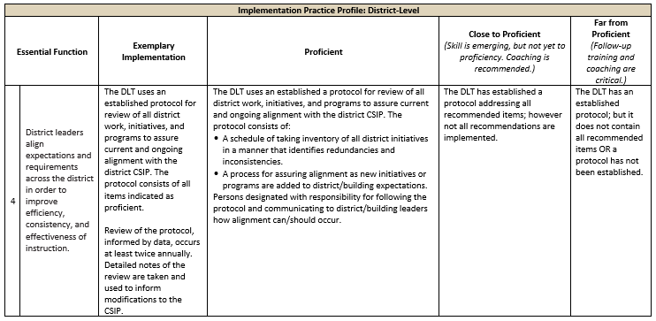
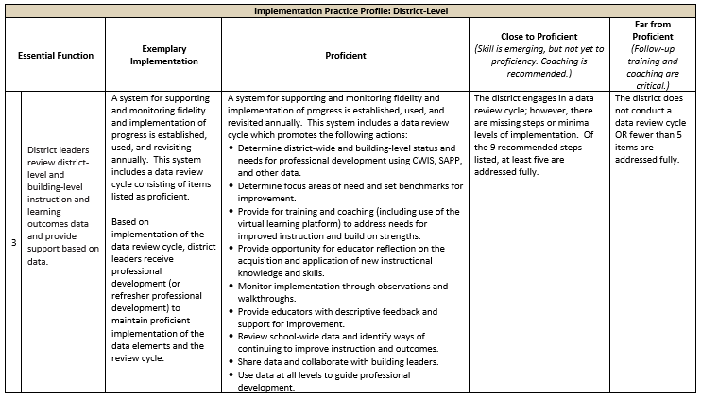
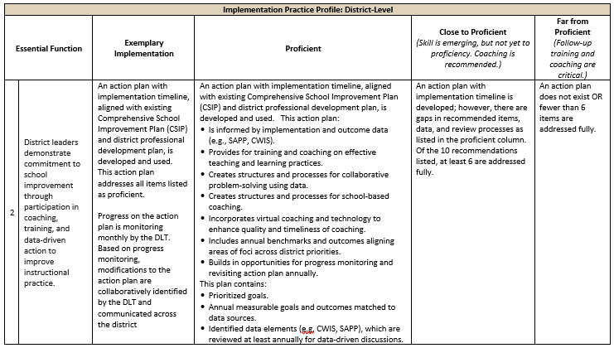
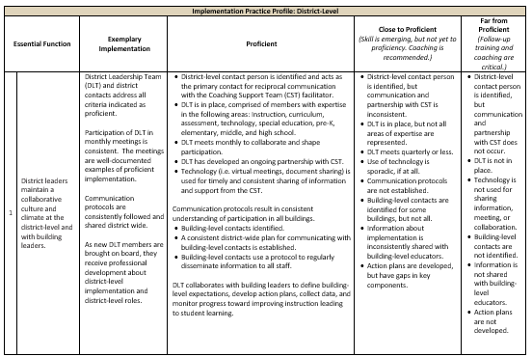
District Implementation Practice Profile
Outlines district implementation criteria for the DCI Framework
Where is your district/building in the implementation process?
Notes:
To Know/To Do
Discuss the purpose and structure of the District Implementation Practice Profile HO#9.
Provide time for leaders to peruse the District Implementation Practice Profile to determine where they are in this process.
To Do/To Say
Handout #6 is the District Implementation Practice Profile that outlines district implementation criteria for the DCI Framework using a rubric structure with clearly defined practice-level characteristics. Take some time to look over the Practice Profile and discuss where your district is in the implementation process. Allow time for discussion and sharing out.

Slide 94
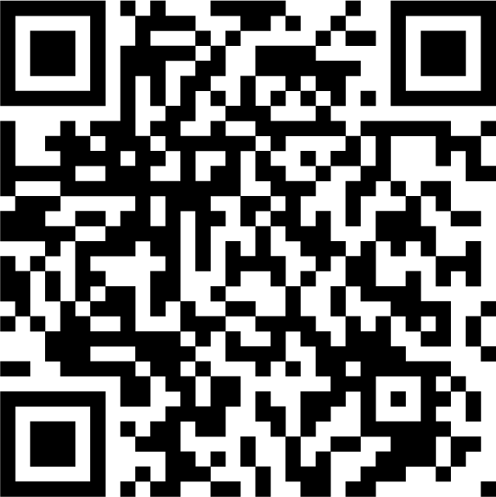
Implementation Supporting Resources
Blueprint for District and Building Leadership
Implementation Zone Guide
DCI In Action
Step-by-Step Guide
Administrator’s Guide to Coaching
Professional Learning Modules
Notes:
To Know/To Do
This slide is meant to provide a very brief overview of DCI tools and resources. Districts engaged in DCI will have other opportunities to explore and learn about these resources.
To Do/Say
Review the following documents.
Blueprint is the roadmap for leading districts through the DCI Framework, addressing all stages of the process, from early implementation through sustaining and scaling-up.
Implementation Zone Guide provides an in-depth description of Implementation Zones, including the data and criteria used for zone placement. Examples and descriptions of the IZ Worksheet and IZ Landscape are included.
DCI in Action highlights Missouri districts at differing points in their DCI journey; including sections with “advice from the field”, and thoughts from administrators, teachers and statewide support team members.
Step-by-Step Guide provides guidance and recommendations for how to effectively implement the DCI Framework by providing an in depth look at the essential functions of DCI.
Administrator’s Guide to Coaching provides support for establishing a district-wide approach to professional learning through coaching. This guide focuses on key aspects of effective coaching and information leaders need to create the conditions necessary for embedding coaching into professional learning.
Professional Learning Modules - The eight DCI Practices are delivered through a professional development approach consisting of training, coaching, and online learning. Additionally, districts/buildings have access to accompanying professional development materials for each DCI practice.
Now that you have an understanding of the purpose and benefits of these supporting resources, take some time to explore them and outline your thoughts for initial implementation in your district.
These materials can be accessed by going to the web link (http://www.moedu-sail.org/topic/getting-started-with-the-mmd-dci-framework) or by scanning the QR code.

Slide 95
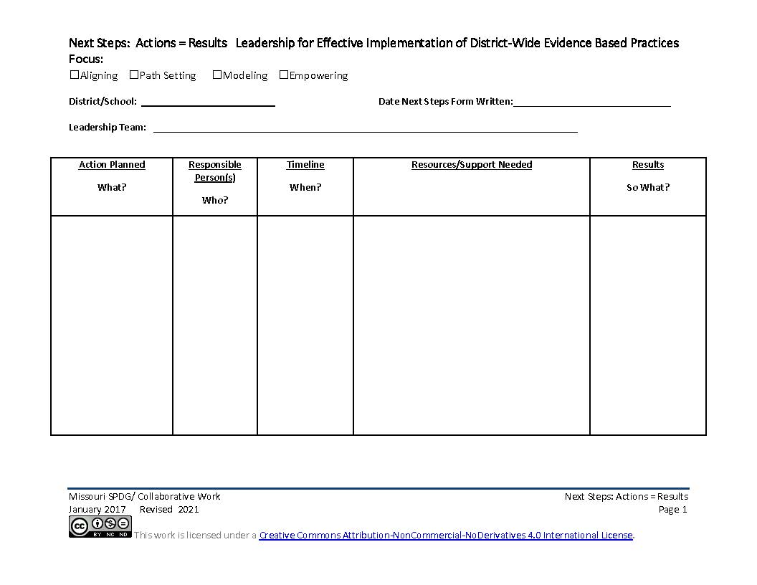
Next Steps
What is your next step toward implementation?
Self-Assessment
Action Planning
Practice Profile Leadership for Effective Implementation of District-Wide Evidence-Based Practices (Systems Leadership)
SAPP Self-Assessment Practice Profile http://sapp.missouripd.org/instructions
Notes:
To Know/To Say
Now that you have a better understanding of Leadership for Effective Implementation of District-Wide Evidence-Based Practices, your next step is to use the Practice Profile to self-assess your current leadership implementation. The Practice Profile is a rubric that aligns with the learning objectives of this Professional Learning Module. For each essential function, the Practice Profile defines four levels of implementation (from exemplary to far from proficient) and includes criteria which provide data or documentation for determining implementation levels.
This is an important tool for self-monitoring your own implementation. It serves as a reminder of the implementation criteria and is also aligned with the electronic Self-Assessment Practice Profile (SAPP) tool. These sources provide data regarding where you are in your implementation efforts, possible next steps, and focus areas on which you, your school, and/or your district might benefit from further training or coaching. http://sapp.missouripd.org/instructions
The Next Steps Action Plan template is useful for planning both now or back in your building. What support and/or resources do you need to begin implementing or improving your leadership skills?

Slide 96
Closing and Follow-Up
Notes:
To Do/To Say
Before we conclude this session, take a few minutes to plan specific next steps in your team’s work with the district.

Slide 97
References
Acaroglu, L. (2017, Sept. 7). Tools for systems thinkers: The 6 fundamental concepts of systems thinking. Disruptive Design. https://medium.com/disruptive-design/tools-for-systems-thinkers-the-6-fundamental-concepts-of-systems-thinking-379cdac3dc6a
Argyris, C., & Schön, D. (1978). Organizational learning: A theory of action perspective. Reading, Mass: Addison Wesley
Beilke, S. (2014, April 16). The importance of trust: It makes your culture “change ready.” TLNT. https://www.tlnt.com/the-importance-of-trust-it-makes-your-culture-change-ready/
Buck, R. (2015, July 16). This is #teach to lead [Video]. U.S. Dept. of Education. https://www.youtube.com/watch?v=o4rlENK-k5I&feature=youtu.be
Center for Educational Leadership. (2015). 4 dimensions of instructional leadership: Instructional leadership framework 2.0. http://iltmaese.weebly.com/uploads/1/0/9/8/109874920/two_column_chart_of_info.pdf
Covey, S., & Merrill, R. (2008). The speed of trust: The one thing that changes everything. New York, NY: Free Press.
Craig, W. (2017, Oct. 3). Growth mindset: What it is and why it makes better leaders. https://www.forbes.com/sites/williamcraig/2017/10/03/growth-mindset-what-it-is-and-why-it-makes-better-leaders/#5769399533c8
DESE. (n.d.). Leader standards. Missouri Model Standards. https://dese.mo.gov/media/pdf/oeq-ed-leaderstandards
Dweck, C. (2016, March 24). Mindset, motivation, and leadership [Video]. Kanatola Training Solutions. https://www.youtube.com/watch?v=yYknuaoIdME
Dweck, C. S. (2007). Mindset: The new psychology of success. New York, NY: Ballantine Books.
Ehorning, P. (2013, August 7). 5 steps to actionable key performance indicators. Unilytics. https://unilytics.com/5-steps-to-actionable-key-performance-indicators/

Slide 98
References 2
EOSWorldwide. (2014, Nov. 18). Align your company vision – 8 questions for your leadership team [Video]. https://www.youtube.com/watch?v=0jXP1xW5Osg
Fixsen, D., Naoom, S., Blase, K., Friedman, R., & Wallace, F. (2005). Implementation research: A synthesis of the literature. Tampa, FL: University of South Florida, Louis de la Parte Florida Mental Health Institute, National Implementation Research Network. https://nirn.fpg.unc.edu/resources/implementation-research-synthesis-literature
France, S. (2016, Dec. 28). The fixed mindset vs. the growth mindset. ASAP. https://www.asaporg.com/articles/leadership/fixed-mindset-vs-growth-mindset
Goodman, M. (n.d.) The do’s and don’ts of systems thinking on the job. The Systems Thinker. https://thesystemsthinker.com/the-dos-and-donts-of-systems-thinking-on-the-job/
Goodman, M. (2018). Systems thinking: What, why, when, where, and how? Systems Thinker. https://thesystemsthinker.com/systems-thinking-what-why-when-where-and-how/
Goyne, J., Padgett, D., Rowicki, M., & Triplitt, T. (1999, August). The journey to teacher empowerment. ERIC. https://eric.ed.gov/?id=ED434384
Hattie, J. (2015). High impact leadership. Educational Leadership, 72(5), 38.
Hattie, J. (2017, Dec.). Hattie Ranking: 252 Influences and effect sizes related to student achievement. Visible Learning. https://visible-learning.org/hattie-ranking-influences-effect-sizes-learning-achievement/#tabs_desc_6004_2
Ingersoll, R. M., Dougherty, P., & Sirinides, P. (2017). School leadership counts. Santa Cruz, CA: New Teacher Center. https://go.pardot.com/l/576393/2018-08-15/349bgkg
Jackson, T. (2016, May 25). 7 benefits of systems thinking in organizational change. https://www.linkedin.com/pulse/7-benefits-systems-thinking-organizational-change-jackson-ph-d-

Slide 99
References 3
Jeffrey, S. (n.d.) A complete guide to changing your fixed mindset into a growth mindset. CE Sage. https://scottjeffrey.com/change-your-fixed-mindset/
Jenkins, B. (2009, Jan./Feb). What it takes to be an instructional leader. Principal. https://www.researchgate.net/publication/234594862_What_It_Takes_to_Be_an_Instructional_Leader
Kothari, A. (n.d). How to improve employee buy-in (4 proven methods). Tallyfi. https://tallyfy.com/improve-employee-buy-in/
Kotter, J. (2012, Feb. 6). Change management vs. change leadership – What is the difference? [Video]. YouTube. https://www.youtube.com/watch?v=2ssUnbrhf_U
Love, A. (2018, August 1). 4 ways leaders can foster a growth mindset within their team. TheLadders. https://www.theladders.com/career-advice/how-leaders-can-foster-a-growth-mindset
Meadows, D. H. (2008). Thinking in systems. White River Junction, VT: Chelsea Green Publishing Company.
Mihailogie, C. (2019, April22). How can we ensure our KPIs are aligned to the strategy? Performance Magazine. https://www.performancemagazine.org/kpis-aligned-strategy-performance/
MoEdu-SAIL. (2021). Blueprint for district and building leadership (5th ed). Missouri Department of Elementary and Secondary Education: Northern Arizona University, Institute for Human Development. https://www.moedu-sail.org/mmd-tools-resources
National Implementation Research Network. (n.d.) Active implementation hub. Framework 2: Implementation stages. https://nirn.fpg.unc.edu/module-1/implementation-stages
New Zealand School Trustees Association. (n.d.). How do you make change work [Video]? http://www.govtalks.co.nz/how-do-you-make-change-work
Prose Theme on Genesis Framework. (2019). Application performance management: Key performance indicators. https://www.applicationperformancemanagement.org/performance-testing/key-performance-indicators/

Slide 100
References 4
Ribeiro, J. (2016). Why school system leaders need to be systems thinkers. Getting Smart. https://www.gettingsmart.com/2016/03/school-system-leaders-need-systems-thinkers/
Rouse, M. (2005). Systems thinking. https://searchcio.techtarget.com/definition/systems-thinking
Sarder, R. (2015, June 4). Can you explain the concept of “actions create reality?” Peter Senge, Author of the Fifth Discipline [Video]. https://www.youtube.com/watch?v=hsLcLmQSPzs
Senge, P. (2015, June 4). What are the three core learning capabilities [Video]? Sarder TV. https://www.youtube.com/watch?v=HCTJaNmYt2w
Senge, P. M. (1990). The fifth discipline: The art and practice of the learning organization. New York, NY: Doubleday/Currency.
Sheninger, E. (2019, August 7). 10 strategies to improve instructional leadership. National Association of Secondary School Principals. https://www.nassp.org/2019/08/07/10-strategies-to-improve-instructional-leadership/
Skill Boosters. (2018). How inclusive leaders build relationships and teams [Video]. YouTube. https://www.youtube.com/watch?v=KA-1s1G-_v4
Smith, C. (2018, December 26). Change management KPIs: A crash course. https://change.walkme.com/change-management-kpis/
Stilwell, D. (2018). Trust as a systemic structure in our organizations. https://thesystemsthinker.com/trust-as-a-systemic-structure-in-our-organizations/
Systems Innovation. (2018, Oct.15). Iceberg model [Video]. YouTube. https://www.youtube.com/watch?v=Te1VYXqUH_c&t=3s
TEDx Talks. (2010). Jeff Edmondson, The key to educational improvement: Data and how we use it [Video]. YouTube. https://www.youtube.com/watch?v=FLqc_9VxfCE
The PTS Tube. (2017, March 6). Carol Dweck on developing a growth mindset culture in organizations [Video]. YouTube. https://www.youtube.com/watch?v=Mjv7TBoAYSY

Slide 101
References 5
The Waters Foundation. (2018). The impact of the systems thinking in schools project: 20 years of research, development and dissemination. https://thinkingtoolsstudio.waterscenterst.org/resources/articles
Vedova, T., (2015, Oct. 21). How to build a growth mindset into school culture. Getting Smart. https://www.gettingsmart.com/2015/10/how-to-build-a-growth-mindset-into-school-culture/
White, L. (2016, Jan. 4). Six ways you can empower teachers to lead. TeachStone. https://info.teachstone.com/blog/six-ways-you-can-empower-teachers-to-lead
Wile, K. (2014, August 5). Peter Senge introduction to systems thinking [Video]. https://www.youtube.com/watch?v=eXdzKBWDraM
Zuieback, S. (n.d.). Planning conversations: Mental models process. https://www.stevezuieback.com/site/assets/files/1035/mental_models_process.pdf
Zuieback, S. (2014, Nov. 9). Mental models [Video]. YouTube. https://www.youtube.com/watch?v=81mJnpKJlc4

