Slide 1
Developing Standards-Based IEPs Linked to Missouri Learning Standards
2019
Notes:
Consultant Preparation
Purpose: Provide opportunity for learners to engage in the content prior to the formal training
Content: Learning objectives; Expectations for the training; Preparatory reading Reflection exercise
THIS SLIDE SHOULD BE HIDDEN PRIOR TO PRESENTATION

Slide 2
Preparation
Keys to Creating Standards Based IEPs
http://www.calstat.org/publications/article_detail.php?a_id=1&nl_id=17
Participants will be asked to read the article above and highlight information or ideas that are different from their current reality (Resource 1).
Sample email can be used to invite participants to bring their own student Present Level and goals PLUS access to Missouri Learning Standards (Resource 2).
Notes:
To Know:
The above resources are available for preparation to this training. You may choose to use what works best for yourself and your participants.
Your selection may be based on the prior experience and understanding of the audience.
** With large crowds it has proven more efficient to use the sample student examples inside this training to ensure the learning of the process and keep participants focused. Smaller crowds from the same school district or those who already have spent time working within the standards enjoy applying the learning to their own specific learning.
This slide should be hidden during presentation. This slide is for your preparation and how to prepare the participants.

Slide 3
Materials Needed
Handouts for Standards-Based IEPs #1-11
Missouri Learning Standards
Participants may bring a student’s IEP to reflect upon instead of the case studies provided within.
During application activities participants may wish to apply their learning to actual students instead of provided case studies
Pre-assessment document has been written to assess prior knowledge and can be used as a Post –test for growth.
Notes:
Materials needed are listed in the Table of Contents
Presenters need to decide ahead of time if participants bring information on a current student for application and practice activities on present level formulation and goal writing.
Case studies of students are provided for reflection and application of learning towards a standards based IEP with goals aligned to standards.
Pre-post test is written for assessment of participant knowledge and growth.
Timing thoughts for short version:
Sections
Step 1 Address Understanding Missouri Learning Standards. This portion can be left off if the participants are well versed in the standards.
Understanding Student Functioning and Writing a Good Present Level with Goals
Steps 2, 3, and 4 are Essential
(Handout #2) can be given and used as a short form for reference.
Missouri Learning Standards will be accessed during this training. There are a few options for easy access to the documents:
1. The presenter may copy off the Missouri Learning Standards bound with a sign to “LEAVE ON THE TABLES AT
THE END OF THE TRAINING” to be shared by participants.
2. Participants may be requested to bring the Missouri Learning Standards to the training. (Electronic copies already loaded on their computers especially if there is no real good internet access)
3. Participants may be asked to bring their own paper copies of the standards.
This slide will be hidden during presentation.

Slide 4
Developing Standards-Based IEPs Linked to Missouri Learning Standards
Consultant Name/Info
2018
Notes:
To Know: This will be the first slide in your presentation. You will need to edit with your personal information.
To Do: Place consultant name and information on the top of the slide

Slide 5
Opening and Introductions
Notes:
To Say:
Introduce yourself to the participants.
To Do:
Introductory activities may be applied at trainer discretion to set a culture of learning.
Some examples:
Have you met my friend? Introduce at your table – you – something about you, personal/professional = 3 things about you, plus name and where you teach
Some presenters like to have participants write their name, email and three things about themselves which includes where they teach on an index card. After everyone meets and greets, the cards are collected and then the cards are randomly selected throughout the workshop to use as “talking sticks” to designate a person who is asked to give a personal response or answer to a question given.

Slide 6
Norms
Be Respectful
Be Responsible
Be a Learner
Enjoy the day!
Notes:
To Know:
Please feel free to use a set of norms which works best with the participants. Here you will find our most common norms but there are times when a district training group will be accustomed to having their district-wide norms so you may wish to check on that ahead of time. If there are training norms which is normal procedure within your region/RPDC feel free to change this slide to fit that set of norms. You may ask the participants if there is anything else they need to have a good learning day.
To Say:
This training will take the entire time allotted to complete all of the information and activities. To get the full benefit, you will need to “Be a Learner” by “Being Present” at all times.
No questions are too big or too small, if you are questioning something, there are probably others wondering the same thing. We would like you to ask any questions that pertain to the subject matter of this training.
The goal is not to find fault with the process but to benefit students.
The process may be confusing in the beginning, but please “Pay attention to the heart and meaning” of what is being said.
There are steps that will be discussed in order to make the process more understandable, so it will help if you “Seek outcome with detachment.”
In the end you will have a clear picture of what will be needed to write Standards-based IEPs.
To Do:
If your RPDC has a specific set of norms that are typically used for their training, they can be substituted on this slide. Make this work for you and your participants.

Slide 7

Table Top Parking Lot
Notes:
To Know:
For ease in addressing questions you will need to have Post-it notes in the center of the table to record any questions participants may have as you travel through the learning. As you move through the training you can ask participants to please place stickie notes with the questions right on the end of the table nearest of the front of the room. You can decide to address questions right as they come up or ask your learners to only post on the notes and you will collect those as you move around the room throughout the day to ensure questions are addressed.
To Say:
There are Post-it notes in the center of the table to record any questions you may have as we travel in our learning. As you think of different questions, please place them right on the end of the table nearest of the front of the room. We will collect those as we move around the room throughout the day to ensure we clarify all questions.
To Do:
Ensure each table has Post-It notes available to jot questions down on as you cover content.

Slide 8

Today’s Schedule
8:00 -9:45 The Journey
9:45 – 10:00 AM BREAK
10:00 – 11:15 AM Investigations
11:15 – 12:30 PM-Lunch
12:30 – 1:45 PM-Return to the Adventure
1:45-2:00 PM BREAK
2:00 – 3:30 PM-Conclusion!
Notes:
To Say:
Here is where we are planning to head today. We will try to take a break mid-morning and mid-afternoon but we are all adults so
To Do :
You may adjust times to fit your schedule. You may also just post the schedule without the ‘time’ attached.

Slide 9
Our Learning Intentions
Participants will…
understand alignment and its benefits.
understand the 7-Step Standards-Based IEP Process.
develop awareness of the components required to construct a present level using the Standards-Based IEP process.
develop SMART Standards-Based IEP goals.
Notes:
To Know:
For our training alignment means that we will use the knowledge and terms within the standards to define student needs. This is about the planning process – not compliance.
Understanding how to align the present level and goals to standards through these 7 Steps provides a quality IEP which will provide the student with the skills, accommodations and support needed for success. You do not need to read the slide allow the participants time to read after you tell them what alignment will be for this training.
To Say:
Alignment means that we will use the knowledge and terms within the standards to define student needs. This is about the planning process – not compliance.
Understanding how to align the present level and goals to standards through these 7 Steps provides a quality IEP.
To Do:
Allow a few minutes for participants to review the slide.

Slide 10
Essential Questions
What does alignment with standards look like?
What are the 7 Steps in the Standards-Based IEP Process?
What are the components required to construct a quality present level?
What do SMART Standard- Based IEP goals look like?
Notes:
To Know:
These are the Essential Questions we should all be able to answer when we finish this training.
Essential Questions not only help participants stay focused in but provide a structure for us to remember to stay true to the essential learnings. There could be many other trainings that this one presentation of learning could inspire. Teachers or districts may find they need more help with writing good present level statements, writing goals, collecting data for educational or behavioral goals, determining good supports/accommodations, communicating with parents concerning educational goals in transition, writing a transition IEP, or several other options.
To Say:
These are the Essential Questions we should all be able to answer when we finish this training.
To Do:
Pause for participants to read over the questions.

Slide 11
Missouri Teacher Standards
Standards-Based IEPs address the following Missouri Teacher Standards:
Standard #2: Student Learning, Growth and Development
Standard #3: Curriculum Implementation
Standard #7: Student Assessment and Data Analysis
Notes:
To Say:
Our training will align to the following Missouri Teacher Standards

Slide 12
The Why
Help Students With Disabilities (SWD) move toward grade level academic standards.
Challenge SWD to excel in the general education curriculum.
Prepare SWD for success in their post-school lives.
Fulfill the mandate of IDEIA for SWD to access the general education curriculum.
Notes:
To Know:
It might be most beneficial to have those using Essential Elements to attend the process through a different training using the Essential Elements if they are only teaching students who are eligible for MAPA.
All Students with Disabilities (SWD) who do not qualify for the MAP-A must take the same assessments the other students are taking.
Therefore, we are taking a close look at how we are preparing students to perform and be successful on state assessment and for life which means – Are they college or career ready?
Participants who are writing IEPs for students who are eligible for MAP-A will be led to use the Essential Elements of the Dynamic Learning Maps. The process is very similar but the Essential Elements are used instead of the Missouri Learning Standards. When completing a training within a district, you should be able to find out if there are teachers who only teach the most severe students who did not take MAP tests. But when holding a regional training, you might not know until they arrive unless you post the training as one for teachers who must prepare students for the state tests using Missouri Learning Standards.
To Say:
This is the Rationale for Standards-Based IEPs.
All Students with Disabilities (SWD) who do not qualify for the MAP-A must take the same assessments the other students are taking.
Therefore, we are taking a close look at how we are preparing students to perform and be successful on state assessment and for life which means – Are they college or career ready?
Participants who are writing IEPs for students who are eligible for MAP-A will be led to use the Essential Elements of the Dynamic Learning Maps. The process is very similar but the Essential Elements are used instead of the Missouri Learning Standards.
To Do:
Do a quick check to see if there are any individuals that only have MAP-A students. They will want to look at the Essential Elements instead of the Missouri Learning Standards when the portion of the training takes time to look at the learning standards. The process would be the same just different standards.

Slide 13
The What
IEP development is a planning process – It is more than filling out a form.
Connecting IEPs to State Standards and the general curriculum requires a student-centered focus.
Standards-Based IEPs clarify the path to close the achievement gap.
Special Education teachers will acquire a better understanding of the Standards and where students are in relation to grade-level standards.
Notes:
To Know:
Don’t let forms drive us. Let planning drive us to the forms. Following this process not only ensures quality in planning but increases the success of educational goals and the environment created from the use of the plan.
To Say:
Instead of thinking about WRITING an IEP, think of DEVEOLPING a PLANNING PROCESS. It is the PROCESS of PLANNING that improves the development of the IEP and helps the IEP TEAM participants see the importance of connecting instructional goals to the general curriculum and grade-level standards.

Slide 14
Standards-Based IEPs are NOT…
Writing goals that restate the standards
Using the standards alone to determine goals
Assuming that every student will work only on grade-level standards
Standards-Based IEPs Form Following Process. Jennifer Huisken, & Carol Massanari
Notes:
To Know:
There is not a state requirement to write the number of the standard on the IEP. However, some districts are using the procedure. The decision is left to the Special Education Director.
To Say:
The IEP is individualized for the student. Not all goals will align with the standards. Where they align use the standards. Some goals will be behavioral or occupational.

Slide 15
Standards-Based IEPs
Include a Present Level with clear academic statements of student performance towards Missouri Learning Standards (MLS)
Include SMART goals based on the student’s functional, academic and/or behavioral needs
Identify accommodations or modifications necessary for the student to access grade level instruction and assessment
Notes:
To Know: The IEP is the plan to address student needs in reference to successfully learning what is needed per grade level. Teachers will want to know the standards that are essential to learn per grade level and subject. The plan should be the best recipe based on the standards but driven to meet the student need to access those standards.
To Say:
We have told you what Standards-Based IEPs are NOT so here is what you will find in a Standards-Based IEP.
A Present Level or some call it a PLAAFP Present Level of Academic Achievement and Functional Performance with clear academic statements about the students performance towards the Missouri Learning Standards – From this Present Level (PL) you would be able to tell what the student can do as a baseline in their academic subjects. Reading level – what math skills – writing – access to other subjects.
SMART goals are written based on the baseline written in the PL for areas that are in need of goals for functional, academic or social/behavioral needs.
The PL identifies accommodations and modifications needed for access to receive instruction, complete assignments and how assessment will be completed.

Slide 16
Standards-Based IEPs
A Standards-Based IEP is the plan for the student to achieve academic success.
Define the student’s strengths and needs based on data
Provide understanding of how the student’s needs impacts involvement and progress in the general education curriculum
Notes:
To Say:
4. Strengths and needs are defined based on data in the same areas we mentioned: functionally, academically,
socially/behaviorally.
The PL specifically provides statements that lead to an understanding of how the student’s needs impacts
their involvement and progress in the general education curriculum. It does not just say their disability
impacts involvement and progress in the general education curriculum but ‘what specifically’ keeps them
from progressing like the other students.

Slide 17

Reflection
Notes:
To Say:
The overall goal of the day is to provide you with what you need at a state level to help students be successful and to give you what you need for instruction.
If a student arrived in your classroom today, what would you want to see in the IEP Present Level that allows you to start instruction immediately?
To Do:
Divide participants into groups. Ask participants to brainstorm a list of what they would need if a new student walked into their room and they needed to start instruction.
Participants may need 8-10 minutes to complete this activity.
You may share out or post for the group to refer back to through the training as you hit upon ideas listed.

Slide 18
The Process…
[14]
HO #2
Notes:
Material Needed:
HO #2 Steps in the Process. . .
To Know: We suggest you have all handouts in a folder, reference the handouts allowing the participants to get handouts one at a time out of a table folder as the training addresses each. HO#2 has all the Steps of the Process that you will cover during your training. You will continue to refer to this handout throughout the training.
To Do:
Direct attention to Handout #2. Allowing time for participants to get the handout and be ready to move on with their learning.
Have participants refer to HO # 2 Steps in the Process as you transition to the next slide and name the steps.
To Say:
We will be using HO #2 as we move through our learning today. We will use this handout as the guiding Steps in the Process. As we address each step with information and learning applications we will use this to keep us focused on the process steps needed.

Slide 19
7 Step Standards-Based Process
Getting to know and understand the standards and the process of linking district curriculum with state standards.
Determine where the student is functioning in relation to the grade-level standards.
Develop the present level of achievement and functional performance.
Notes:
To Know:
This process helps participants to create a quality IEP which is a complete plan for implementation.
To Say:
Here are the Steps in the Process for a Standards-Based IEP. We will spend time on each step and discuss the questions to ask, information to seek and development of each step towards a quality educational plan that is centered around the unique needs of the individual student.

Slide 20
Steps (cont.)
Develop measurable annual goals aligned with grade level academic standards.
Assess and Report Progress throughout the year.
Identify specially designed instruction including accommodations and/or modifications needed to access and progress in the general education curriculum.
Determine the most appropriate assessment option.
Notes:
To Say:
As we develop goals and determine the most appropriate ways to measure these goals we will keep in mind the strengths and needs of the student in relation to the standards. Always begin with the student.

Slide 21

The Foundation:
Think Student First
Move through the process with the student’s strengths, needs, and visions for the future
Vision
Desired Outcome
HO #2
Notes:
Handout #2 Steps in the Process and Handout the Info Graphic
To Say: Let us look at the info graphic:
The Vision is to look at the connection between the student/parent vision for adulthood as a Desired Outcome. We Think Student First – as a person, what are the student’s strengths, needs, and visions for the future. It does not matter how old the student is, we are thinking about who they are and where they want to be many years from now. That ‘End in Mind’ vision is what will keep us focused on what we need to help the student acquire so they can become as independent as possible for the future.
To Know:
Getting to know and understand the student is a theme that recurs throughout the entire Standards Based-IEP Process. This can be a helpful reference point as participants move through the different steps presented in this module.
To Do:
Reference the info graphic with the student in the center of this process.

Slide 22
Knowing & understanding the student
Current formative/summative assessment data
Student work samples & other information
Team member observations & input
Looking at the whole child.
Notes:
To Say:
Start by analyzing the information you have and information you need.
--Collect and examine materials for making data-based IEP decisions.
--Other:
--Eligibility data (if current and related to learning the standards)
--Transition Assessments (at least by age 16) formal or informal required annually
--Grades, Discipline Referrals, Attendance Reports
--Analyze data to develop the student profile (before writing the present level)
--From all the data sources the profile should include:
--Strengths-include learning and/or behavior strengths from which to build
--Needs
--How the disability affects involvement/progress in the general education curriculum (great info on which to base accommodations/modifications, and supplementary aids and services)
--Assessment/Evaluation
--Status of the prior IEP goals (serves as baseline data for this IEP; essential to write new goals)
--Teacher/Parent/Student input
--Transition Needs (at least by age 16)
As we go through the process today, we are asking you to look through the eyes of the student. Look at the whole student and the vision of the future for that child. The plan we are building is based on ‘who they are and who they can become’.
What valuable information might a student provide; even students as young as third grade?
What could be other sources?

Slide 23

Questions to Ask:
What does the child learn most easily at home?
At school?
What does the child most like to do at home?
In school?
What most motivates the child at home?
At school?
What is the child curious about at home?
At school?
What does the child most often choose to do during free time at home? At school?
HO #2
Notes:
To Do: Reference HO# 2: These questions are on HO# 2.
To Say:
This information helps in many ways. They can be thought of as keys to the child. It helps us to connect new learning to their schema or background interest. When students struggle with learning, trying to find connections to what is important to the student makes the connections easier and sometimes helps the learning to ‘stick’. This information also guides us in selecting options for reinforcement, brain breaks, and motivation at school. It might also give us an insight into their learning style or preferences to keep them engaged in learning.
What are the family’s/student’s dreams and goals for the future?
What does the family/student see the student doing 3-5 years from now?
Consider this… As the teacher:
Why might I want to know this information?
How might this information help?

Slide 24

Reflection
HO #2
Notes:
To Do:
Allow think time and honor the voices in the room by allowing them to add any other information which might be helpful.
To Say:
Look over the preparation questions in HO #2 -- What other questions might you ask?
Participants may need 2-3 minutes to review in their minds what other questions might they ask and add those to the group’s knowledge if applicable.

Slide 25

Step 1: Getting to know and understand the Missouri Learning Standards (MLS) Grade Level Expectations and the process of linking district curriculum with state standards.
HO #2
Notes:
To Say:
With the student in mind, in order to create a standards based IEP, it is essential to become familiar with the Missouri Learning Standards and how they link to the curriculum being implemented within your district.
Questions to ask while you get to know the Missouri Learning Standards may include:
What is the intent of the content standard relative to district curriculum?
What does the content standard say that the student must know and be able to do?
What skills does the student need in order to meet the standard?
Do I know which standards are the priority for that content or grade level?

Slide 26

Missouri Learning Standards (MLS)
Grade Level Expectations
Let’s take a look at what we have.
Notes:
This is a Transition Slide
To Know:
Participants will need to have the Missouri Learning Standards in electronic or paper form for this next section. This section also uses HO #3 Call out Boxes to read ELA standards and the HO #3a ELA Treasure Hunt. (Handout #3b ELA Treasure Hunt Answer Key provides the trainer with the answers)
To Say:
Let’s take a look at our Missouri Learning Standards.
To Do:
Transition to the next slide if participants have the standards.
Note:
Missouri Learning Standards are located:
https://dese.mo.gov/college-career-readiness/curriculum/missouri-learning-standards#mini-panel-mls-standards1

Slide 27
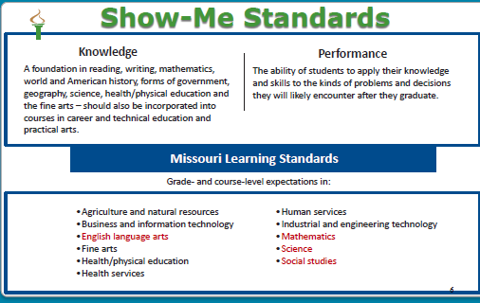
Notes:
To Know:
Missouri has operated under the Show-Me Standards for many years.
To Say:
All Missouri Grade Level and Course Level Expectations are a part of the Missouri Show-Me Standards for Knowledge and Performance. We will only highlight a few standards in our process today. Please ask or look for opportunities to learn more about specific standards if you would like to go deeper into Missouri Learning Standards Grade Level Expectations.
To Do: Have access to MLS on-line or in paper form.

Slide 28
Access to Standards
Special Education teachers cannot teach the entire set of standards for every subject and grade. Therefore, it is imperative for the classroom teacher to communicate what is the priority for the grade/subject. That is where the focus for specialized instruction is needed.
Notes:
To Say: As a special education teacher, your role is to provide access to standards. You will not have time to address all the standards per grade or course level because you are the one providing the specialized instruction needed per student. Which means that you will need to prioritize with the general education teachers what they need the most support in accessing. General education teachers have the expertise at one grade level or one content level to identify what would be their priority learning needed.
What are the priority standards for each grade or class? That should be a number 1 priority upon entering the work with each student. The general education teachers are responsible for knowing their content and grade level to the deepest extent. As a part of the IEP team, that is one of the greatest gifts they bring to the table. Then the instruction can be differentiated or specialized to meet the students needs.

Slide 29
Terminology to Read the ELA Expectations
Grade Level
Strand
Big Idea
Concept
Expectation
Notes:
To Say:
In order to read the format and code the MLS, we must understand the terminology.
Strand = Five major divisions of the ELA Reading, Writing, Speaking and Listening, Foundations and Language Big Ideas = Provide the focus direction.
Concepts = Specific understandings of the expectation.
Grade-specific expectation – From kindergarten through eighth grade, there is a specific standard aligned to each grade.
Grade level expectation stems– Some grade-specific expectations are further broken down into more specific skills referred to as stems.
To Know: Missouri is currently referring to the smallest distinguishable standard as a micro standard; other entities may be referring to them by other names, including indicators or sub standards.

Slide 30
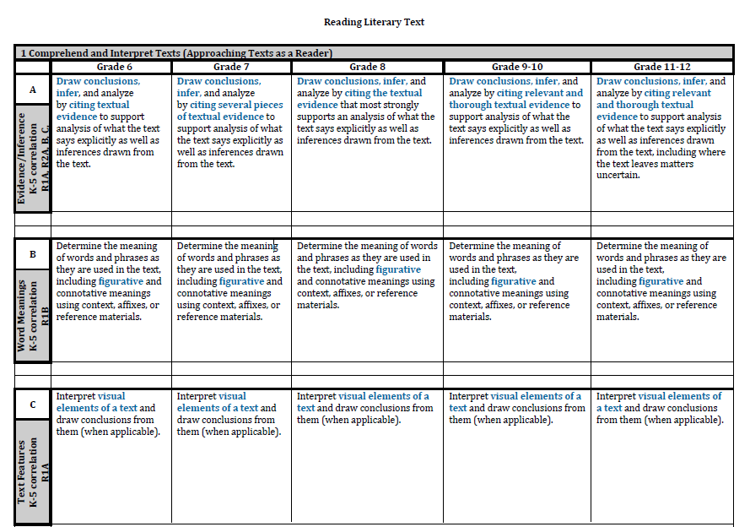
STRAND
GRADE LEVEL
BIG IDEA
CONCEPT
GRADE
SPECIFIC
EXPECTATION
HO #3
Notes:
To Say:
This slide shows how to read the ELA Grade Level Expectations. Use Handout #3 for participants to complete the ‘call out’ boxes for a handy reference in understanding the format for the ELA expectations.
To Do:
Provide HO#3 How to Read ELA Expectations for participants to complete using the slide. HO #3a will have the answers that are also on Slide 29.

Slide 31
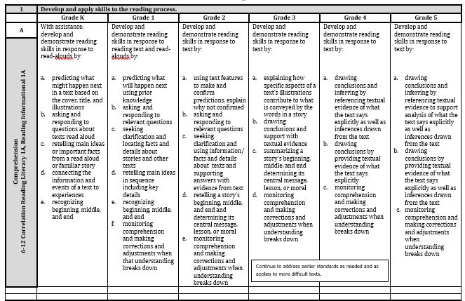
English Languages Arts Missouri Learning Standards
https://dese.mo.gov/college-career-readiness/curriculum/english-language-arts
Notes:
To Know and to Say: The link will take you to the ELA Missouri Learning Standards for Elementary or Middle School/ High School. You can download these are PDF or as work if you someone who likes to cut and paste the standards into your work.
This section is from our Elementary Reading Standards
What does this little box say? (advance to the next slide to clarify)

Slide 32
The little box says…
Continue to address earlier standards as needed and as applies to more difficult text.
Notes:
To Say: Have you seen this before?
Have your teachers?
This little box reminds us of the importance of knowing underlying standards across grades in efforts to create learning for students that address their needs. This box helps us when considering what students might need support or instruction for when trying to access grade level standards.

Slide 33
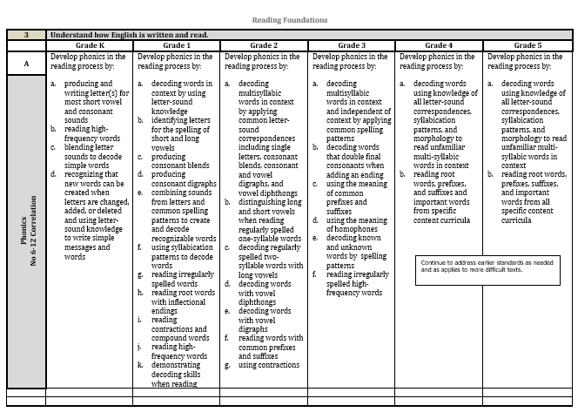
Which standards are these?
Reading Foundations
Notes:
To Say: Which standards are these? They are our Reading Foundations. The foundations that must be in place for reading instruction to be successful for students. Do you see that same box?
What does this have to do with reading and what my teachers need to understand about reading development?

Slide 34
The same little box…
Continue to address earlier standards as needed and as applies to more difficult text.
Notes:
To Say: This same little box directs us in our general education classrooms, in our title classrooms or in special education classrooms – to be mindful of the learning that might need to be scaffolded for students if there are gaps or standards that might be foundational for others. This box provides us with affirmation in teaching skills that have not been mastered for some groups of students or individuals that might need re-teaching whether through small group or MTSS systems.

Slide 35

So what does that mean to me?
Notes:
To Do: Pause for participants to consider the question.
Have participants every noticed the small box and/or consider what they means to them?

Slide 36

Small Group Treasure Hunt
English Language Arts (ELA)
HO #3b
Notes:
Treasure Hunt:
To Do:
Break into groups or pairs to read and find the answers to the ELA Treasure Hunt Questions.
Participants will need to use the Missouri Learning Standards with HO #3b to complete the ELA Treasure Hunt. (HO# 3c is the Answer Key).
Allow 10-15 minutes depending on the expertise of the audience. The timer is on the next slide.
** Move around the room checking for understanding with the participants. Some staffs have used the standards documents and could use this as a quiz (Presenter Preference based on staff knowledge) to see if they remember these things about the standards.

Slide 37
10 minutes
.
10 minutes
End
Notes:
To Know:
Use this timer as participants complete the Treasure Hunt.
This ‘sand timer’ will start on a mouse click anywhere on the slide. The ‘sand’ will drain from the top section to the lower section and when completed will show the word ‘End’.
To change the timings of this timer, you need to enter the animation settings, and change the timings for the Isosceles Triangles. There will be 2 that need changing (to the same amount) – one animates the top triangle emptying, whilst the other animates the bottom triangle filling.
When you change the timings these have to entered as a number of seconds.
To Do:
Provide 10 minutes to complete this. If participants are familiar with the standards this activity can be a short quiz or shorten time needed based on the knowledge level.
*** Presenter moves through the participants during this activity to keep their ears open to the learners and their needs. This allows for the presenter to hear the knowledge level of participants in working with the standards.
Upon the completion of the Treasure Hunt – report out answers using the audience. Presenter will have the answers on HO #3a.

Slide 38

Not enough time…
Special education needs to know which standards are the priority for each grade level or content.
Notes:
Usually students who qualify for special education need more intense targeted instruction. Since they usually need more time – we need to know which skills and standards are a priority for us to focus our attention on.

Slide 39
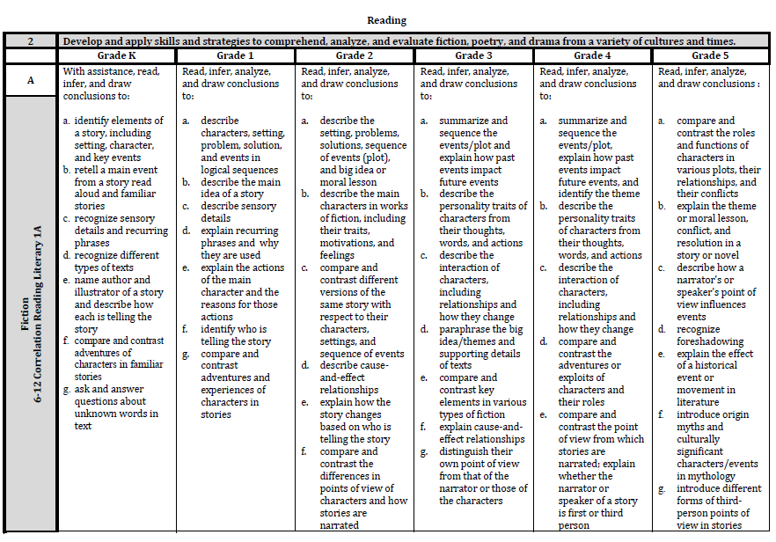
Reading
Big Idea
1 of 5 Strands in ELA
Concept
STEM
Top part
essential
for rigor
Grade-Level Expectation
Notes:
To Know:
When looking at grade level and course level expectations you will find some expectations have several parts
listed as: a, b, c, d, etc.
To Say:
Some grade level or course level expectations have several components listed under them and labeled with an a, b, c, d, etc…It is important to understand that each component needs to be looked at through the stem in order to address the essential rigor needed for the standard.

Slide 40

Five Strands in Elementary
Reading
Language
Writing
Reading
Foundations
Speaking
And
Listening
Notes:
To Say:
There are five strands in which the elementary grade level expectations are built around.

Slide 41
Reading
BIG IDEA | CONCEPT
1. Develop and apply skills to the reading process. | Comprehension Vocabulary Making Connections Independent Text
2. Develop and apply skills and strategies to comprehend, analyze and evaluate fiction, poetry and drama from a variety of cultures and times. | Fiction Poetry Drama
3. Develop and apply skills and strategies to comprehend, analyze and evaluate nonfiction (e.g. narrative, information/explanatory, opinion, persuasive, argumentative) from a variety of cultures and times. | Text Features Literary Techniques Text Structures
4. Comprehend and analyze words, images, graphics, and sounds in various media an digital forms to impact meaning. | A. Digital and Media Literacy
Grades K-5
Notes:
To Say:
Here are the Big Ideas and Concepts you will find in the Reading Strand Grades K-5.
To Do:
Pause a moment for participants to review the content.

Slide 42
Reading Foundations
BIG IDEA | CONCEPT
1. Understand how English is written and read. | Print Awareness
2. Understand how English is written and read. | Phonemic Awareness
3. Understand how English is written and read. | Phonics
4. Understand how English is written and read. | A. Fluency
Grades K-5
Notes:
To Say:
Here are the Reading Foundations Big Ideas and Concepts for Grades K-5.
To Do:
Pause a moment for participants to review the content.

Slide 43
Writing
BIG IDEA | CONCEPT
1. Apply a writing process to develop a text for audience and purpose. | Prewriting Draft Revise/Edit Produce/Publish and Share Writing
2. Compose well-developed writing texts for audience and purpose. | Opinion/Argumentative Informative/Explanatory Narrative
3. Gather, analyze, evaluate and use information from a variety of sources. | Research Process
Grades K-5
Notes:
To Say:
Here are the Big Ideas and Concepts you will find in Writing Grades K-5.
To Do:
Pause a moment for participants to review the content.

Slide 44
Language
BIG IDEA | CONCEPT
1. Communicate using conventions of English language. | Grammar Punctuation, Capitalization, Spelling
Grades K-5
Notes:
To Say:
These are the Big Ideas and Concepts you will find in Language for Grades K-5.
To Do:
Pause a moment for participants to review the content.

Slide 45
Speaking/Listening
BIG IDEA | CONCEPT
1. Listen for a purpose. | Purpose
.2. Listen for entertainment. | Entertainment
3. Speak effectively in collaborative discussions. | A. Collaborative Discussions
4. Speak effectively when presenting. | A. Presenting
Grades K-5
Notes:
To Say:
Speaking and Listening have these Big Ideas and Concepts for Grades K-5.
To Do:
Pause a moment for participants to review the content.

Slide 46

Grades 6-12 Four Strands
.
Reading
Literary
Text
Speaking and Listening
Reading
Informational Text
Writing
Notes:
To Say:
Grades 6-12 have only four strands for ELA:
Reading Literary Text
Reading Informational Text
Writing
Speaking and Listening
To Do:
Pause a moment for participants to review the content of the slide.

Slide 47
Reading Literary Text
BIG IDEA | CONCEPT
1. Comprehend and Interpret Texts (Approaching the Texts as a Reader) | Evidence/Inference Word Meanings Text Features Summarize/Theme
2. Analyze Craft and Structure (Approaching Texts as a Writer) | Structure Point of View Craft and Meaning Interaction and Meaning
3. Synthesize Ideas from Multiple Texts (Approaching Texts as a Researcher) | Texts in Forms Relationships in Texts Historical Context Comprehension
Grades 6-12
Notes:
To Say:
Reading Literary Text focuses on these Big Ideas and Concepts for Grades 6-12.
To Do:
Pause a moment for participants to review the screen.

Slide 48
Reading Informational Text
BIG IDEA | CONCEPT
1. Comprehend and Interpret Texts (Approaching the Texts as a Reader) | Evidence/Inference Word Meanings Text Features Summarize/Claim
2. Analyze Craft and Structure (Approaching Texts as a Writer) | Structure Point of View Craft and Meaning Argument/Evidence
3. Synthesize Ideas from Multiple Texts (Approaching Texts as a Researcher) | Texts/Forms Relationships/Texts Historical Content Comprehension
Grades 6-12
Notes:
To Say:
Reading Informational Text focuses on three Big Ideas and twelve Concepts for Grades 6-12.
To Do:
Pause a moment for participants to review the screen.

Slide 49
Writing
BIG IDEA | CONCEPT
1. Approaching the Task as a Researcher | Research
2. Approaching the Task as a Writer | Development
3. Approaching the Task as a Reader | Revise and Edit
Grades 6-12
Notes:
To Say:
Writing focuses on three Big Ideas approaching the task as a Researcher, a Writer, and a Reader while the Concepts for Grades 6-12 deepen research and developing the task of writing for readers.
To Do:
Pause a moment for participants to review the screen.

Slide 50
Speaking and Listening
BIG IDEA | CONCEPT
1. Collaborating | Conversations Questioning Viewpoints of Others
2. Presenting | Verbal Delivery Nonverbal Multimedia
Grades 6-12
Notes:
To Say:
Speaking and Listening focuses on two Big Ideas with these Concepts for Grades 6-12.
To Do:
Pause a moment for participants to review the screen.

Slide 51
Terminology Order to Read the ELA Expectations
Grade Level
Strand
Big Idea
Concept
Expectation
Notes:
To Say:
The order in which to read and code the ELA Expectations is as follows:
Strand = Five major divisions of the ELA Reading, Writing, Speaking and Listening, Foundations and Language Big Ideas
Concepts
Grade-specific expectation – From kindergarten through eighth grade, there is a specific standard assigned within each grade.
There are also some grade-specific expectations broken down into more specific skills referred to as stems.
To Know:
Missouri is currently referring to the smallest distinguishable standard as a micro standard; other entities may be referring to them by other names, including indicators or sub standards.

Slide 52
How to Code Grade/Course Level Expectations
Grade Level, Strand, Big Idea, Concept, Expectation
2.W.3.A.c
5.L.1.A.e
7.W.3.A.d
Notes:
To Say:
Let us practice a moment to identify which grade level expectations these coding examples represent. Participants look up expectations and volunteer to read coding.
To Know:
There is a timer on the next slide that may be activated to keep track of time.

Slide 53
Reflection
5 minutes
Notes:
To Know:
A 5 minute timer is embedded in this slide. This timer appears initially as a cream-colored circle. The timer is initiated by clicking on, at which point the circle will fill up in a clockwise direction with the color you see above.
At the end of the time, a bell will sound.
It is possible to change the timings of the timers by entering the animation settings and changing the timings of the relevant ‘Oval’. Note the timings have to be entered in seconds.
To Say:
Take about 5 minutes to review specific standards for a grade level of a student you have in mind today. Consider the standards which would be essential for the student to access.
To Do:
Allow participants time to read through some standards/expectations. If participants seem to be finished prior to the timer sounding be sure to move forward with teaching the process.

Slide 54
Coding of MLS Expectations
2.W.3.A.c
Grade Level, Strand, Big Idea, Concept, Expectation
2nd grade – Writing - Gather, analyze, evaluate and use information from a variety of sources -Research Process – Apply research process to: use their own questions to find information on their topic.
7.W.3.A.d
Grade Level, Strand, Big Idea, Concept, Expectation
Grade 7 – Writing – Approaching the Task as a Reader – Revise and Edit – Review, revise and edit writing with consideration for the task, purpose and audience. Use effective transitions to clarify relationships and connect ideas, claims and signal time shifts.
Notes:
To Say:
Here are two answers to our coding. What did the L stand for in the grade level expectation for 5th grade?
Yes, it was Language.

Slide 55

Based on Standards and Standard Resources

Slide 56
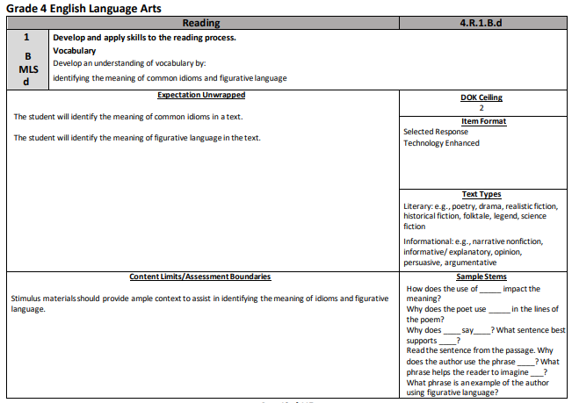
Notes:
To Say: Let us look at how to read the Item Specifications
The standards is referenced at the top of each in coding for the grade and content.
The expectations are “Unwrapped “ or separated out as individual subskills in more user friendly terms. (click to bring in the red box for each section as you address it.
The DOK Ceiling tells us what is the highest level of DOK that this will be asked.
Item Format defines how the items will be represented in the assessment. This one will always be selected response.
Text Types – defines which types of texts are fair game for this type of question. This reminds us that we might want to look at the texts in which we ask these types of questions. Do we access these standards across other types of texts or are our students only asked to answer this type of question in one type of text?

Slide 57
Notes:
To Say: There are two other portions in this document that can help us in our goal setting and assessment of access to the standards.
Content Limits/Assessment Boundaries help us to focus in.
And in the far right corner are the sample question stems that are on the MAP tests… We must be using these verbally and in writing if we are developing a standards based quality IEP..
This will help us provide access. Even if a student orally reads at a third grade reading level, is my teacher asking questions that are on the grade level in which they will be tested.

Slide 58
Math Thoughts
Notes:
This is a Transition slide:
Participants need the math portion from the Missouri Learning Standards – electronically or paper copies.
Material Needed for this section will be: HO #4 Math Treasure Hunt through MLS and the math portion of the Missouri Learning Standards
To Know: The Math Missouri Learning Standards are located on:
https://dese.mo.gov/college-career-readiness/curriculum/missouri-learning-standards#mini-panel-mls-standards2
To Say:
We will now look at the math section of the Missouri Learning Standards.
To Do: Give participants a few minutes to locate the Math Standards.

Slide 59

Reading the Math Standards
  Grade/Course Level
  Domain
  Cluster
  Expectation
Notes:
To Say:
Math is formatted in much the same way as ELA yet the terminology is different. Math is also coded in the same order as ELA. You read Math Standards in this order; Grade or Course Level, then Domain, Cluster and Expectation.
The Domain is the same as the strand in ELA.
The Cluster is essentially the “Big Idea’ in ELA standards and then you have the expectation for the grade or course.

Slide 60
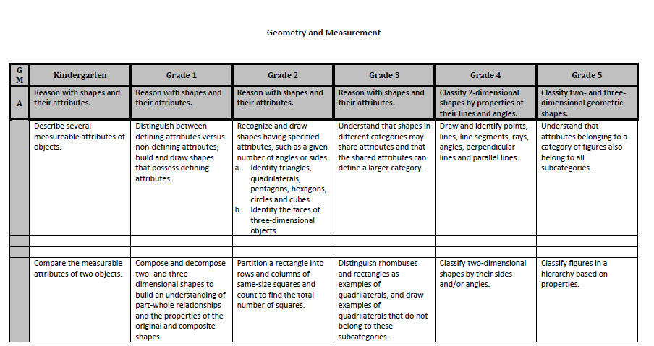
.
DOMAIN
GRADE LEVEL
CLUSTER
HEADING
CLUSTER
GRADE
LEVEL
EXPECTATION
HO #3
Notes:
To Say:
By appearance, the grade level and course level format looks the same but they are named differently. Here is how we look at Math. Use the back of HO #3 to fill in the call out boxes as a quick reference.
To Do:
Ensure participants are using the back of HO# 3 for participants to fill in for handy reference.

Slide 61
Small Group Treasure Hunt
Math Grade Level Expectations
HO #4
Notes:
Material Needed: Participants will need the MLS and HO #4.
To Do:
Ask participants to ensure they have the Treasure Hunt HO #4 (HO# 4a provides Answer Key). Participants will read through the Math Missouri Learning Standards and fill in the blanks on the Treasure Hunt. You will have participants report out on the answers as the groups are finished
*** The next slide may be used as your timer.
Provide 10 minutes to complete this. If participants are familiar with the standards this activity can be a short quiz or shorten time needed based on the knowledge level.
*** Presenter moves through the participants during this activity to keep their ears open to the learners and their needs. This allows for the presenter to hear the knowledge level of participants in working with the standards.

Slide 62
10 minutes
.
10 minutes
End
Notes:
To Know: Use this timer for participants to look through the Math Expectations.
This ‘sand timer’ will start on a mouse click anywhere on the slide. The sand will drain from the top section to the lower section and when completed will show the word ‘End’.
To change the timings of this timer, you need to enter the animation settings, and change the timings for the isosceles triangles. There will be 2 that need changing (to the same amount) – one animates the top triangle emptying, whilst the other animates the bottom triangle filling.
When you change the timings these have to entered as a number of seconds.
To Do:
Provide 10 minutes to complete this. If participants are familiar with the standards this activity can be a short quiz or shorten time needed based on the knowledge level.
*** Presenter moves through the participants during this activity to keep their ears open to the learners and their needs. This allows for the presenter to hear the knowledge level of participants in working with the standards.
Upon the completion of the treasure hunt, report out answers.

Slide 63
Elementary Math Domains
1) Number Sense
2) Number Sense Operations Base Ten
Number Sense and Operations in
Fractions
4) Relationships and Algebraic Thinking
5) Geometry and Measurement
6) Data and Statistics
HO #4
Notes:
To Say:
Elementary Math Grade Level Domains are listed on the screen. Notice the large focus on Number Sense.
To Do:
Pause for participants to review the screen.

Slide 64
Grades 6-8 Domains in Math
1) Ratios and Proportional Relationships
2) Number Sense and Operations
3) Expressions, Equations and Inequalities
4) Geometry and Measurement
5) Data Analysis, Statistics and Probability
6) Functions
HO #4
Notes:
To Say:
Here are Grades 6-8 Math Grade Level Domains.
To Do:
Pause for participants to review the screen.

Slide 65
High School Math Courses
Algebra I
Algebra II
Geometry
Algebra I and II has 10 Domains
Geometry has 7 Domains.
HO #4
Notes:
To Say: High School course levels fall under these listed above. Each course has different Domains of expectations.
Algebra I and II has these 10 Domains
Number and Quantity
Seeing Structure in Expressions
Creating Equations
Reasoning with Equations and Inequalities
Arithmetic with Polynomials and Rational Expressions
Interpreting Functions
Building Functions
Modeling
Linear, Quadratic and Exponential Models
Data and Statistical Analysis
Geometry has 7 Domains:
1) Congruence
2) Similarity, Right Triangles and Trigonometry
3) Circles
4) Exploring Geometric Properties with Equations
5) Geometric Measurement and Dimension
6) Modeling with Geometry
7) Conditional Probability and Rules of Probability

Slide 66
How to Code Math
  Grade/Course Level
  Domain
  Cluster
  Expectation
Notes:
To Say:
Math is coded in the same order as ELA so you read them in this order; Grade or Course Level, then Domain, Cluster and Expectation.

Slide 67
Coding Math Check
5.NBT.A.1 Read, write, and identify numbers…
  Grade/Course Level: (Grade 5)
  Domain: (Number Sense and Operations in Base Ten (NBT)
  Cluster: (A)
  Expectation: (1)
Notes:
To Say:
Here is math grade level expectation 5.NBT.A. 1.
How we would interpret the coding is that this is grade 5 -Number Sense and Operations in Base Ten (NBT), Cluster A and Expectation 1.
Can someone tell us what the cluster says about the learning by finding it in the standards?
Code an expectation and then find someone who can determine what you coded. (presenter may ask participants to move through the room to find others who can find their coded expectation or just whip around the table depending on the need for engagement of the participants)

Slide 68
Remember!
The Expectations are not…
  Chronological
  Curriculum
  Complete
Notes:
To Know: The expectations are NOT chronological.
To Say: You can and will teach more than just these standards/expectations as part of your curriculum to form a complete plan for any and all students to become knowledgeable, employable citizens.

Slide 69
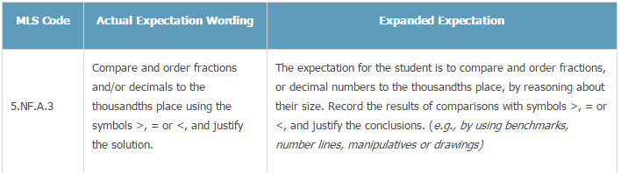
Math Expanded Expectations
Notes:
To Know: There are also other resources available to understand assessment of such standards, as well as clarify vocabulary terms.
https://dese.mo.gov/college-career-readiness/curriculum/mathematics
To Say: There are resources on the DESE website to help us understand all the expectations to a greater depth. Many teachers have stated that they feel the Expanded Expectations helped to clarify what was needed from a standard.
You will find those resources at:
https://dese.mo.gov/college-career-readiness/curriculum/mathematics

Slide 70
Standards of Mathematical Practice
Make sense of problems and persevere in solving them.
Reason abstractly and quantitatively.
Construct viable arguments and critique the reasoning of others.
Model with mathematics.
Use appropriate tools strategically.
Attend to precision.
Look for and make use of structure.
Look for and express regularity in repeated reasoning.
CCSS: Mathematics, (pgs. 6-7)
Notes:
To Say:
Read through Standards 1-8. Every Math standard will be connected to a Standard of Mathematical Practice. These practices describe varieties of expertise that mathematics educators should seek to develop in their students.
For those of us who like to think like a mathematician these are the ‘metacognitive strategies’ for math that should be used and linked to all the math standards. All standards we teach in math will and should be connected to these Eight Standards of Mathematical Practice. Many math teachers use these standards as opportunities to teach ‘how to think and what to use in completing all math daily practice”. There are videos to show what these might look like on the Teaching Channel.

Slide 71

Notes:
To Say: So let’s remind ourselves of the tools that help us in making standards accessible for our students. Working with standards not only means we write the IEP towards the standards but as we look at our tools we know what needs to be addressed per standard after we know the priority and how we address the unique needs of the student to access those standards.
Move to the next slide.

Slide 72
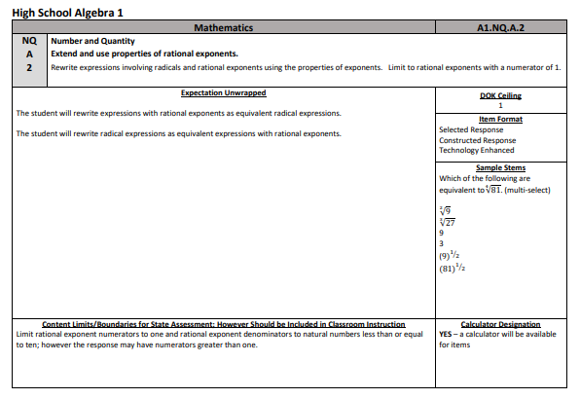
Math Item Specifications
Notes:
To Say: Math also has Item Specifications just as ELA and Science. Here is high school Algebra 1 and you see the same format yet in a slightly different spot as ELA. Every grade and high school EOC have Item specifications for us to use in goal setting and the assessments with which we will define success.
Do our teachers know about these?
This is one way to ensure that we are asking questions that access grade level questions that they will see on the MAP tests. This tool will help guide us to be asking grade level and course level content questioning as we provide access.

Slide 73
Reflection
.
Notes:
To Say:
Take a couple of minutes with your table to discuss what you want to remember from this portion of our learning.

Slide 74
Getting to Know and Understand Grade Level Expectations (MLS/EE)
Web Resources
Missouri Learning Standards
https://dese.mo.gov/college-career-readiness/curriculum/missouri-learning-standards
MAP-A Dynamic Learning Maps (DLM) Essential Elements
http://dynamiclearningmaps.org/about/model#essential-elements
Notes:
To Say:
Here are the website addresses to the Missouri Learning Standards. You will find them on your HO# 2 Steps in the Process. If you have a student who is eligible for MAP-A, you will use the Essential Elements that are linked to the Missouri Learning Standards on the Dynamic Learning Maps website.
To Do:
Show participants where the links are located on their handout.

Slide 75

Getting to Know the Process of Linking Curriculum to Standards
Think in terms of what the student must know and be able to do.
Know the intent of the content standards relative to your district’s curriculum.
MAP-A uses Claims and Conceptual Areas to set priorities with Essential Elements.
Which standards are priority for your student’s long term success?
HO #2
Notes:
To Say:
Let us review what we covered so far.
Follow the bullet points in the process to ensure understanding by:
putting student needs first
looking at the standards in relation to the priorities within a grade or course in their district. Ask participants to think of which standards are ‘essential/priority’ or most important for the particular grade or course level.
thinking LONG term what the student will need for success over time
*Consider mentioning the use of released items (from GLE / CLE and NAEP) as a part of teacher understanding of how to connect their curriculum with planned goals for individual students.
For MAP-A
Use DLM Claims and Conceptual Areas to help set priorities through the Essential Elements.

Slide 76
Step 2: Examine Classroom Data to Determine Where the Student is Functioning in Relation to the Standards
What is expected within the regular classroom?
What instructional strategies or approaches have been or are being used in the general classroom?
Has the student been provided appropriate instructional scaffolding to attain grade-level expectations?
What results have been documented for this student?
HO #2
Notes:
To Say:
Refer to HO #2: Step 2
Determine what the student can do now using classroom data all available student data.
Consider:
the vision or desired outcomes
what we know about the expectations of the general curriculum (and specifically the standards)
The process involved in Step 2 folds into Step 3, Present Level.
Description of what the student CAN do (in the context of what is expected).
Conversation to identify the gaps between skills/knowledge essential to the vision/desired
outcome and what the student can do (in context of what is expected).

Slide 77
Step 3: Develop the PLAAFP
Strengths, needs, and involvement-progress in the general education curriculum
Supports required, assessment/evaluation, status of prior IEP goals
Student-parent-teacher input, & transition needs by 16 yr
The Present Level should include information that informs you about the student.
.
HO #2
Notes:
To Say:
Refer to HO #2: STEP 3
Present Level of Academic Achievement and Functional Performance (PLAAFP) is where we identify what the student can do and help the student make plans for future. Some call this the Present Level (PL).
The Present Level should include information that allows you to complete the following:
How the disability affects involvement/progress in the general education curriculum
Strengths
Needs
Assessment/evaluation
Status of prior IEP goals
Teacher/parent/student input
Transition needs (at least by age 16)
To Know:
Transition is addressed in full through another training. We address specific steps, resources and how to write the sections needed for compliance in the IEP when addressing transition plans and paperwork towards student post-secondary goals. Depending on your audience, this might be important to note. There are resources and compliance efforts which need to be shared but through a more focused training on Transition for post-secondary.

Slide 78
Step 3: (cont.)
Present Level
Standards
Driven
Data-Driven
Understandable
Language
Measurable
Notes:
To Say:
Characteristics of quality present levels:
Standards driven
Addresses the general education curriculum (knowledge & performance standards).
Consider the challenges required to achieve the content standard (knowledge & skills, including prerequisites)—taken from Marla Davis Holbrook presentation on 7-29-2010.
Data-driven
Includes formal and informal data.
Examine data related to learning problems the student has experienced in the past.
Look at patterns in assessment data, information from eligibility reports, and family/teacher reports.—taken from Marla Davis Holbrook presentation on 7-29-2010.
Understandable Language
Uses clear, easily understood language that provides a snapshot of the student’s needs and strengths INCLUDING SUPPORTS!
Measurable
Written in terms that are observable, specific, and based on evidence

Slide 79
Step 3: (cont.)
Overall Purposes of Present Level
  To provide a summary of baseline information that indicates the student’s academic achievement and
  To identify current functional performance and
  To provide an explanation of how the disability affects the student’s involvement/progress in the general curriculum ←VERY IMPORTANT!
Notes:
To Say:
Does the Present Level (PL) help a teacher to know where to begin and move forward?
Think in terms of essential characteristics:
Imagine you are describing the student to a new teacher.
--What does the new teacher need to know to be prepared to teach the student?
--The present level should describe the essential characteristics through the Unique Educational Needs (UENs) of the student so clearly that the teacher would know what materials to pull from the shelf the first time the student and the teacher interact.
--Essential Characteristics should be addressed using clear, easily understood language that provides a snapshot of the student’s needs and strengths.
--Essential Characteristics must be written in terms that are observable, specific, and based on evidence.
Baseline is not required in the PL, however, it is best practice because you must know the current performance level of your student.
Ask yourself if you have provided an explanation of how the disability affects the student’s involvement and progress in the general education curriculum. ‘What needs are different than those who are in the general education system without special supports?’

Slide 80

Step 3: (cont.)
Critical to aligning an IEP with the standards is determining the ‘Student’s Unique Educational Needs’ (UEN)
UENs are the foundation of the present level, goals and objective, accommodations and modifications (supplementary aids, services and LRE).
HO #2
Notes:
Material Needed:
HO 2, Step 3: The Present Level answers the question: What is the student doing now? or What can the student do right now?
To Say:
Use data to summarize the Present Level.
This is the foundation – what is unique to the child?
What is needed to keep them learning and accessing what other students access in public education?
Directs the Goals and objectives
Allows an understanding for Accommodations or validates Modifications
Indicates what is unique that might need other services
The Present Level answers the question: “What is the student doing now?” or “What can the student do right now?”

Slide 81
Unique Educational Need (UEN)
Types of Educational Need
Certain conditions in order to learn that may be addressed by accommodations and modifications
    Examples: distraction-reduced environment, 1-1 introductions to new materials, immediate corrective feedback, tangible, frequent reinforcement, small group instruction, consistency in behavior plan implementation, close supervision during unstructured time with other children
HO #5
Notes:
Material Needed:
HO #5 Unique Educational Needs (UEN)
To Say:
Determining the UENs is the precursor to writing PL statements. After determining the UENs related to conditions of learning and skills and/or behavior, you are ready to address them in the present level.
Do not just think of what they need to learn but do it with a vision of what steps will need to be taken towards more independence on the part of the student.
Never start an accommodation without being mindful of how you will target skills which develop self regulation and determination.
UENs explain what needs to be addressed in the IEP so the student’s disability will have the least possible effect on their involvement and progress in the general education curriculum.
Conditions for learning, as determined through unique educational needs, are most often addressed through accommodations/modifications.
Conditions of learning are generally the type of environment and/or circumstances the student needs in order to learn.
What do we know about the student’s response to:
--Learning/Teaching strategies
--Accommodations
--Interventions
--Standards/Curriculum Instruction
ASK . . . “What have we learned about this student’s strengths?”
--Needs are prioritized in relation to how they affect involvement and progress in the
general education curriculum.
To know:
The back side of this document can be used to think student specific when presenting to a group using their own student IEP. For the groups who are using the students you provide – the reverse side is what we want them to go back to their own student and consider. (This is optional. Larger groups may take this back to apply to their own IEP.)

Slide 82
Unique Educational Need (UEN)
Skills or behavior to improve performance
  Example: The child needs to learn accurate decoding skills to replace his or her present excessive guessing at unknown words. The PL might say that the child reads second grade materials at 20-30 words per minute with five to eight errors and seldom, if ever, self-corrects.
Notes:
To Say:
Description of Skills/Behaviors should be data driven based on formal and/or informal data.
Learning skills should be Standard Centered—address the general education curriculum
(knowledge and performance standards).
Prioritize needs in relation to how they affect involvement and progress in the general
education curriculum.
. Fluency is the overall measure. What are other measures that impact fluency?
What skills lead to improved fluency?

Slide 83
Step 3: (cont.)
Determine the individual strengths in relation to assessing and mastering the curriculum.
1. What programs, accommodations (i.e., classroom and testing) and/or interventions have been successful with the student?
2. What types of mastery or emerging mastery of standards does the student demonstrate?
3. What functional/adaptive strengths does the student demonstrate?
4. For purposes of transition, what pre-vocational/work readiness strengths does the student exhibit?
HO #2
Notes:
To Say:
Think of the student and what strengths they have in relation to the curriculum needs. This list of question is not all inclusive rather a guide or process to identify student strengths. They guide us to consider all aspects of the student in our planning not just the standards.
Review the questions on the Handout #2 – Step 3- connect the questions here with the ones on the document – how can these help us see the strengths of the student?
To Know:
The questions are different on the handout than on the slide – have participants tell you how they find strengths of the student. Step 3 questions 1 and 2

Slide 84
Step 3: (cont.)
Determine the individual needs (ie. changes in current functioning) in relation to assessing and mastering the curriculum.
5. What have we learned from previous IEPs and student data that can inform decision making for need?
6. Are there assessment data (i.e., state, district and/or classroom) that can provide useful information for making decisions about the student’s strengths and needs (e.g., patterns in the data)?
7. What supports does the student need to learn the knowledge and attain the skills to progress in the general curriculum?
HO #2
Notes:
To Say:
Again, we do not consider these questions as all inclusive, rather a guide of considerations in determining current functioning in relation to future needs. Look at the questions 3-4 for Step 3 and also “Consider the factors related to the student’s disability and how the student learns and demonstrates what he or she knows” through the next 2 questions in that section.

Slide 85
Step 3: (cont.)
Determine the individual needs (i.e., changes in current functioning) in relation to assessing and mastering the curriculum (continued).
8. What prerequisite skills/knowledge does the student need to close the gap between his/her present level and the Standards?
9. How will instruction be designed and customized so that this student meets the selected and individualized (e.g., team-based learning, problem-based learning, differentiated instruction, technology, etc…)?
10. For purposes of transition, what do the transition assessments tell us about the student’s areas of work/post-secondary readiness?
HO #2
Notes:
Material Needed:
HO #2 Develop the Present Level of Academic Achievement and Functional Performance.
To Do:
Continue discussion of different questions from Handout #2 which address the student need against standards and future mastery.
To Say:
Are there any other questions or data we might want to consider?
Have we been clear to make this a student centered customized document specific to the student and their strengths and needs?
These questions guide us as we try to be clear to the readers who will address the learning needs of this student.

Slide 86
Step 3: (cont.)
Determine the individual needs (i.e., changes in current functioning) in relation to assessing and mastering the curriculum (continued).
What accommodations are needed to enable the student to access the knowledge and skills in the general curriculum?
What other items do we need to learn about the student:
  motivators, learning styles, sensory issues, etc.
  student response to interventions: socially, academically, behaviorally
Holbrook’s 2010
HO #2
Notes:
To Say:
Remember, when considering accommodations, these could be more than just checking items off a list.
Team members should have a discussion about what works and what has not worked for the student.
We must address the idea that this document will address a time span that might include time within the next grade level when we are writing an IEP that lasts for one year. You might be looking at standards from one grade level to the next. We know that sometimes we must amend an IEP because of growth or differences of needs when a student moves within the IEP year to another grade level with different demands and schedules. But be cautious in noting what might be needed within the timeframe you are writing the IEP.
For example, when using something like extended time, what does providing additional time for the student look like?
Writing as needed and non-specific descriptors of accommodations do not meet the level of detail required to provide information for both the teacher and the student.
Students must know what they need in order to not only access the curriculum, but to also self-advocate.

Slide 87

Step 3: (cont.)
  DO NOT use the student’s exceptionality to explain how the disability affects involvement/progress in the general curriculum!
  Example of what NOT to write:
  Mason’s learning disability affects his progress in the general curriculum.
  Example of what to write:
  Mason’s weakness in applying strategies, such as making inferences and making complex predictions, affect his progress in comprehending sixth grade literary materials.
HO #2
Notes:
To Say:
Take a moment to read this slide.
What do you see as different in these two statements?
Be specific in identifying which skills limit the students ability to make progress in the general education curriculum without specialized instruction. What keeps the student from accessing the curriculum at the same rate/level as peers without support?
To Know:
Refer to the bottom of page 2 HO #2.

Slide 88
Step 3: (cont.)
  Example Impacts Performance Statement:
  Olivia’s limited vocabulary knowledge is affecting her progress in achieving reading standards that include synonyms, antonyms, and multiple-meaning words.
Impacts
Performance!
HO #6
Notes:
Material Needed:
HO #6 Goldman’s IEP Extreme Makeover
To Say:
Let’s take a look at Olivia’s example Present Level Statement which specifies how her vocabulary knowledge impacts reading comprehension and vocabulary. Take a few minutes to read HO#6. Highlight statements which impact performance and discuss those with a shoulder partner.
To Do:
Participants will need time to Pair Share the article highlighting important considerations which impacts performance. (8-10 minutes)

Slide 89
Measurable Terms Activity
HO #7
Notes:
Material Needed:
HO #7 Present Level of Academic Achievement and Functional Performance
To Know:
This handout is an example of Present Level statements as compared to vague terms often seen in IEPs. Use the handout as a guide to complete the following activity.
To Do:
Tables are given words that have been seen on IEPs and participants brainstorm ways to write the words in observable, measureable terms: lazy, disrespectful, appropriate, inappropriate, friendly, hard worker, challenging, happy, participates, demonstrates, etc… (include any words the trainer feels are seen often in IEPs which allows each table a different word to define in measureable terms).
Each table is given a different term on charts or word cards. The tables work as a team to define the word(s) in observable, measureable terms specific to the individual student.
Provide 5-8 minutes.
To Say:
Take a few minutes as a table group and discuss the Present Level Statements on HO #7. Are they clear and specific? As you read and discuss I will pass out a few common words seen on IEPs which are not specifically observable or measureable. If we believe a student is friendly– define friendly. What would friendly look like? Greets people first? Or does it mean the student carries on a conversation without a peer or adult directing a conversation?

Slide 90
The first section addresses: HOW THE DISABILITY AFFECTS…
Jackie is a 5th grade student who is experiencing difficulty achieving grade level academic content standards in math, communication arts, science, health, and social studies.
Based on classroom assessments, Jackie is meeting basic grade level expectations in art, music and physical education, achieving a mastery of 75% and 65% of concepts* taught thus far in art and music, respectively; 85% of skills taught thus far in physical education.
With the infrequent usage of a graphic prompt, Jackie has shown progress in identifying and drawing lines and angles with a protractor. Jackie has demonstrated, with 1-2 prompts, per activity , that she can factor numbers 1-40. Jackie is working toward factoring numbers 1-80 by year’s end.
Impacts performance
HO #8
Notes:
To Know:
The following slides present the information given on Handout #8. The presenter may decide to use the handout only or go slide by slide discussing the words found in each section. When using a SMART board – presenters are able to highlight the words and phrases the participants highlight.
HO #8: Use the handout to discuss the information given noting what is important for the teachers who will work with Jackie. Jackie is a 5th grade student who is experiencing difficulty achieving grade level academic content standards in math, communication arts, science, health, and social studies.
To Say:
Let’s look to see if we have good information that will guide an instructional plan for Jackie. What is her baseline academically and functionally?
Please read over this section, highlighting statements or phrases which align to the standards and student needs.
Look for any wording that might need clarification or words which give you a clear idea of appropriate information needed to move forward with instruction.

Slide 91
Jackie demonstrates difficulty with 5th grade level curriculum in science and health with understanding new and especially unique words found in grade-level text.
She struggles to work independently on new material without adult verbal and non-verbal prompts. Jackie’s performance improves when partnered or part of a small cooperative group for work. Jackie’s scores on achievement tests indicate that she falls in the below-average range in mathematics and reading*.
Jackie shows difficulty with the meaning and usage of figurative language such as metaphors and similes. Jackie is challenged with quoting accurately from text when explaining what the text says as well as attempting to draw inferences. Through the use of graphic organizers, Jackie has shown progress in comparing and contrasting elements from different texts concerning the same topic.
Impacts performance
(continued)
HO #8
Notes:
To Know:
Handout #8 Continued. The following slides provide the participants the opportunity to see the handout as a group. Point out specific wording found.
To Say:
What do we see here that aligns to a standard or student need?

Slide 92
Her fourth-grade state assessment results showed math calculation as a relative strength. Once Jackie has mastered new material, she is able to apply learned concepts to grade-level material in many curriculum areas with infrequent verbal and non-verbal prompts.
Even when Jackie becomes frustrated with some grade-level concepts*, she will self-regulate to ask for assistance from a familiar adult and persist on difficult tasks with verbal and non-verbal prompting. Jackie takes pride in finishing her work and frequently requests more time to complete her assignments.
When given an accommodation of additional time, Jackie will continue to work until she is told that time is up. As her skills improve, Jackie will work to decrease the time it takes for her to complete her assignments.
Strengths
HO #8
Notes:
To Do:
When possible, briefly and concisely provide some information about specific concepts that most accurately predict performance or behavior.

Slide 93
Home and school rating scales reveal significant difficulty in the areas of social interaction and communication skills. Teachers report that Jackie is quiet in class and rarely volunteers answers.
She does not often initiate interaction with peers or adults who she is not very familiar. Jackie’s parents state that she does not frequently interact with others in church/community activities, but she likes to play with her younger sister and younger children. Jackie loves music and has recently begun to take dance lessons. Her mother hopes that dance will help Jackie feel more comfortable with children her age and improve communication skills.
Parent/ Student Concerns
HO #8
Notes:
To Know:
Handout #8 Continued discussion.

Slide 94
Jackie is working on fourth grade academic content standards in math. Results from state and classroom-based assessments, indicate that Jackie has learned math third-grade content standards with the exception of word problems. Progress monitoring data support the need for additional instruction in solving word problems at the third-and fourth-grade levels.
Jackie is making significant grade-level progress with using the four operations with whole numbers (+, -, /, x), but is having difficulty with mastering the building of fractions from equivalent fractions. Jackie has benefited from the usage of manipulatives to understand this process.
Jackie has problems with oral reading fluency and comprehension. She scored in the at risk range on the fifth grade DIBELS Oral Reading Fluency spring benchmark. Jackie can read 85-90 words per minute using 3rd grade connected text with 100% accuracy.
The next section addresses: CHANGES IN CURRENT FUNCTIONING - NEEDS
HO #8
Notes:
To Know:
Handout #8 Discussion continued

Slide 95
Her performance is consistent with the expectations for a student at the end of third grade. Jackie’s problems with oral reading fluency affect comprehension skills in all academic areas of the general curriculum. She is improving in the areas of reading with expression and in self-correcting when she misses a word.
Due to difficulties with reading fluency and comprehension, Jackie has difficulty understanding the science, health and social studies content and regularly struggles with the introduction of new and unique words. In science, Jackie can identify objects based on different physical properties, but struggles with utilizing measurement tools.
In social studies, Jackie struggles with identifying the basic roles of the three branches of government, but her performance overall improves with the use of graphics & graphic organizers.
CHANGES IN CURRENT FUNCTIONING – NEEDS (cont.)
HO #8
Notes:
To Know:
Handout #8 Discussion continued

Slide 96
Jackie’s progress on previous goals is as follows: Jackie surpassed her reading fluency goal as she consistently reads 85 to 90 words per minute from 70 to 75 words per minute on 3rd Grade level texts.
Jackie achieved her math calculation goals by multiplying and dividing whole numbers in 4th grade level content as well as utilizing models including properties of organizations and graphic organizers.
Jackie’s math problem solving goals had to be amended to reintroduce 3rd grade content simple word problems, which she mastered.
Jackie’s behavior goal was achieved as she demonstrated ability to self-regulate through the usage of a personal visual & print schedule.
Jackie’s communication goal addressing spontaneous conversations with familiar persons had to be amended to decrease the number of exchanges between Jackie and a familiar person from 4 to 2 in formal settings such as the classroom, cafeteria, or hallway, to include mastery of pragmatic phrases such as “hello, thank you, please, bless you, excuse me, goodbye, and you’re welcome.”
CHANGES IN CURRENT FUNCTIONING – NEEDS (cont.)
HO #8
Notes:
To Know:
Handout #8 Discussion continued

Slide 97
Case Study Activity
1. Choose a case study. (Max, grade 4 LD;
Jack, grade 5, ED; Rosey, grade 10, LD)
2. Determine UEN in the area of
English Language Arts.
3. Write Present Level statements based on
the Unique Educational Needs (UEN) for English Language Arts
** Create baseline data (if not provided in the sample) according to standards per grade level.
HO #9 a,b,c
Notes:
To Know:
Application of Learning Activity – Case Studies are included OR allow applicants to use their own students to apply the process. Case studies are missing some information which allow participants to include information that might fit the student or information that would fit one of their students and develop the process.
Observation by the trainer during the activities may indicate the need for in-district follow up or another date to be set up in the future for support and application of the learning.
Please note that UEN stands for Unique Educational Needs.
Material Needed:
HO #9 A B C
To Do:
Refer participants to the UENs that address Conditions of learning and Skills/Behaviors.
To Say:
Use these case studies as a team or individually and write some statements that we would find in the Present Level of Performance. You can make up any information that is not given based on their grade or the grade level the team decides to make the student. This will not be a full Present Level but some statements that show direction and link to standards. Add some present level statements which would reveal impact of performance in measureable terms.
OR
have participants bring their own to review what UENs were addressed to complete this application.
**If participants bring their own student info you may hide this slide and use slide 88 in it’s place.

Slide 98
Reflection and Application
Use your student information to write present level statements based on your student’s UENs.
HO #9 a,b,c
Notes:
To Do:
Look for UENs in student info to write present level statements.
This may be done individually or as a team.
Set a timer to keep time focused but sensitive to teacher/participant needs.
To Know:
Observation by the trainer at this point during the activities may indicate the need for in-district follow up or another date to be set up in the future for support and application of the learning.

Slide 99
Step 4: Develop Measurable Annual Goals Aligned with Grade-level Academic Content Standards
Measurable annual goals are statements that describe what a student reasonably can be expected to accomplish in one school year in the student’s special education program.
HO #2
Notes:
Material Needed:
HO #2 Step 4: Purpose
To Say:
To describe what a student can reasonably expect to accomplish in one school year
Annual Goals answer the question, “What should the student be doing?”
Annual goals are related to needs resulting from the characteristics of the student’s disability that directly affect involvement and progress in the general education curriculum.
For preschool children, as appropriate, to participate in age-appropriate activities.

Slide 100

Step 4: (cont.)
Review area(s) of instructional need.
Determine where the need fits within the standards and the general classroom expectations.
Consider the difference between actual performance and benchmarks (indicators for grade).
Identify the critical academic or functional skills the student will need to learn in order to demonstrate “proficient” or “applying” performance.
Standards-Based IEPs Huisken, & Massanari (2008)
HO #2
Notes:
Note: Standards-Based IEPs Huisken, & Massanari, 2008
To Say:
Select the need that has the greatest impact on progress and develop a goal to address that need.
Which of the critical academic or functional skills are essential to meeting the desired outcomes?
What is challenging yet attainable?
What is essential for the student to participant in the general curriculum?
The IEP Team must consider how each need impacts the student’s progress in the general curriculum.
If an alternative or “functional” curriculum is the best match for the student’s UEN, consider “alternate” content standards? (MAP-A).
The gap between what a student knows and is able to do may be narrowed by accommodations related to the disability. Such as, if a student’s disability is reading, when not a standardized test, accommodate the disability by reading to the student; if the disability is writing, use a scribe. Change the response mode so the student can successfully express what they know.
The same accommodations do not have to be used in all classes. You make accommodations decisions based on the students disability and how it affects access to general education for specific classes or subjects. When assessment accommodations are determined to be appropriate for classroom assessments, the same accommodations must be used for standardized assessment.

Slide 101
Quantifiable Data
Work Sample
End of Unit Product
Observation Checklist
Standardized Test
Notes:
To Know:
These are examples of quantifiable data.
To Say:
Can you think of any other data you use?

Slide 102
Purpose of Quantifiable Data
Rate of improvement
Determine instructional variables
Analyze progress across time
IEP development, revisions and/or priority of needs
Notes:
To Say:
Some standardized assessments used in progress monitoring (AIMSWEB (Academic Improvement Measurement System based on the Web) or DIBELS (Dynamic Indicators of Basic Early Literacy Skills) can give you a rate of improvement.
Be cautious about rate of improvement. We are wanting to close the gap. The rate allows us to see if the student is processing more efficiently and making the needed growth towards target.
But, we MUST look at error analysis to target specific instruction using research based practices or a student’s rate of improvement will never get stronger and then we only add to the slow growth instead of use our information to develop a plan for success.

Slide 103
Evaluative Criteria
How well
  Frequency
  Duration
  Distance
  Accuracy
Period of Time
  Number of Days
  Number of Weeks
  Occasions
Notes:
To Say:
These are other factors to consider when developing compliant IEP goals.

Slide 104
SMART IEP Goals
Specific – based on the student’s Present Level of Academic Achievement/Functional Performance
Measurable – progress is objectively determined at frequent data points
Achievable – realistic, related to the most critical needs
Results-oriented –developed with a standards’ outcome in mind
Time-bound – clearly defined beginning and ending dates
Notes:
To Say:
For this professional development, here are the ways we will be defining the SMART Goals. These are the ways we define SMART according to the Missouri State Plan: Standards and Indicators
(Transition to next slide)

Slide 105

SMART Annual Goals
Must include the following:
The student …(WHO)
Will do what …(BEHAVIOR)
Under what conditions…(CONDITIONS)
To what level or degree…(CRITERION)
In what length of time…(TIMEFRAME)
HO #10a
Notes:
Material Needed:
HO #10 SMART Goals Template
To Say:
As we read through these we must be sure to understand that Missouri does not require that you put in a timeframe. We assume the time will be the life of the IEP unless otherwise stated. It is just best practice to know and understand the timeframe you are considering. Many forget this IEP might last into another school year or grade level. We have added the timeframe here to the beginning of this template to remind us of the timeframe we are needing to consider as we write the goal. Check this slide against the template. The template makes us focus on the parts and then what the information will look like as a goal.
The back side of the template can be used as the frame for a good IEP SMART goal.
To Know:
This portion of the training also has pivotal places to see where follow-up or extension of this training is needed. For example other training might be needed to go deeper in:
Writing goals
Understanding how to connect goals to standards
Imbedding self –determination or ‘soft’ skills
Continuing to teach reading but increasing listening skills to keep up with grade level content

Slide 106

SMART Goal Writing Exercise
Jackie has difficulties with reading passages containing complex sentences and her lack of reading fluency negatively affect her progress in solving math word problems within time limits specified for fifth-grade classroom assessments. It also impacts her reading efficiency in all subject areas.
What skills does Jackie need in order to read (decode) complex passages and improve fluency?
HO #10a
Notes:
Material Needed:
HO #10 SMART Goals Template
To Say:
First, the IEP team needs to address fluency. Why? Fluency is a 90-95% indicator if a student can comprehend and it’s a CONCEPT in the standard. Standard 4 across grades K-5 in the Foundations.
Fluency impacts all academic areas. Therefore we must address it.
Let us read this and consider what skills Jackie needs in order to read/decode complex passages.

Slide 107
Writing a SMART Goal with Five Components
The student (Jackie)
Will do what (read 90-110 words per minute)
To what level or degree (94% accuracy)
Under what conditions (3rd grade connected text)
In what time frame (end of 36 weeks)
The Goal:
Jackie will read 90-110 words of connected text per minute [using 3-4 word phrasing] at 3rd grade reading level with 94% accuracy on 4 out of 5 data collection days by the end of 36 weeks.
HO #10a
Notes:
To Say:
Let’s move to a second example for Jackie.
What skill does Jackie need to fluently read connected text?
Answer: Decoding and phrasing. In the next slides we will only address the decoding needs.
These are also found in Reading Foundations.

Slide 108
Writing a SMART Goal with Five Components
The student (Jackie)
Will do what (Decode a passage)
Under what conditions (3rd grade connected text)
To what level or degree (90% accuracy on
4 out of 5 data collection days)
In what time frame (end of 36 weeks)
In this instance, Jackie needs to do several things for decoding based on the MLS Reading Foundations.
HO #10a
Notes:
To Say:
This is the annual SMART Goal for decoding broken into the 5 Components. For the state of Missouri the timeframe for a SMART goal is automatically considered as “the life of the IEP.”
Remember -- DESE does not consider a school out of Compliance if there is no timeframe listed within the goals.
When we look at this SMART goal we are looking at the standards called Reading Foundational Skills. Standard 4 states to “read with sufficient accuracy and fluency to support comprehension.”
Now let’s look at the annual SMART Goal with decoding benchmarks.

Slide 109
Writing a SMART Goal with Five Components
Jackie will decode a passage with 90% accuracy from third grade text on 4 out of 5 data collection days by the end of 36 weeks.
Objectives:
Jackie will break third grade text words into syllables.
Jackie will identify and pronounce vowel patterns using third grade text.
Jackie will pronounce the first sound and last sound of words (onset & rime) using third grade text.
Jackie will identify and pronounce word families using third grade text.
Jackie will pronounce letter sounds using third grade text.
[75]
HO #10b
Notes:
To Say:
If you look at Reading Foundations, you will find these are also needed in reading and addressed in Standards. Phonics and Word Recognition for reading – look at what skills the student still needs because they are not yet at a third grade reading. Error analysis will show us the skills Jackie still needs that are below grade level according to the standards but will help us reach grade level.
Benchmarks/objectives are not required unless the student participates on MAP-A. We do suggest them as best practice.
Do we need more training on how to connect understanding of reading instruction across grade levels from where a student can read on their own to the demands that the grade level reading includes? Those could be addressed in a different training.
To Know:
Benchmarks = time
Objectives = skills
Benchmarks/objectives are not required unless the student participates on MAP-A. We do suggest them as best practice.
Do we need more training on how to connect understanding of reading instruction across grade levels from where a student can read on their own to the demands that the grade level reading includes?

Slide 110

What about this student?
Camilla will increase her listening comprehension skills by selecting pictures to represent the main ideas, setting, or characters of a grade level text 4/5 data days with 90% accuracy by the end of her IEP.
Is this really reading?
HO #11
Adapted from Aligning IEPs to Academic Standards, Ginevra Courtade-Little, M.Ed. & Diane M. Browder, Ph.D.
Notes:
Material Needed:
HO # 11 Examples of Goals Linked to Standards
Adapted from Aligning IEPs Standards: Standards-Based Individualized Education Program Examples, Project Forum at NASDE, August 2007, p. 5 & 8.
To Say:
Take a moment to read this slide to yourself. (pause for participants to read the slide)
Here is a 7th grade example of how reading might look for a student who can access grade level text when it is read to her but cannot independently read grade level text. Students like Camilla here, will be working on grade level standards using a lower instructional level text. But, at the same time we might want to focus on Camilla’s listening comprehension ability. Camilla is a 7th grader but independently reads at a 3rd grade level. Since she must access all grade level texts for Science and Social Studies besides math word problems, we need to consider spending time on her listening abilities.
Is this really reading?
Yes, it is listening comprehension. Camilla cannot read 7th grade passages, but she can access age appropriate literature by listening to stories or story summaries read to her by peers. This task also links to the 7th grade focus on characterization, plot, and setting. You will also have found it true that some students cannot read independently at grade level but with support and vocabulary instruction, they can listen and respond to grade level text.
To Know:
This conversation leads to an understanding of the level of support teachers might need to write goals linked to standards. This might be a follow-up training in some districts providing work time to practice and apply goal writing.

Slide 111

Non-academic skills?
Behavioral
Functional life skills
Work or employability skills
Self determination
Notes:
To Know: This next slide might be used with a coaching companion. It can be considered optional but often schools ask if these types of goals can be used in a standards based IEP. These skills are necessary for the appropriate success in school while working with others and preparing for life.
To Say:
There are students who need more than just academic standards on their IEPs. They need the skills necessary to collaborate with others, control their own actions, ask for appropriate help, make good choices, and the list can go even farther. Let’s look on the next slide at different ideas of self-determination.

Slide 112
Component | Example
Choice-Making | Make choices within an activity Choose between two or more activities
Decision-Making | Decide topic for class project Determine best resource to use to get information
Problem-Solving | Look at a picture to determine why DVD player is not working Identify three alternative ways character in story could resolve a conflict
Goal Setting | Set a goal for number of books to be read in a month Identify and communicate IEP goals
Self- Management/ Self Evaluation | Use a bar graph to track number of assignments completed Rate self on how well performed on given assignment
Self-Awareness | Develop picture/word list of likes and dislikes Develop & learn to read a list of “facts about me”
Aligning IEPs to Academic Standards, Ginevra Courtade-Little, M.Ed. & Diane M. Browder, Ph.D.
Notes:
Optional Slide
Imbedded Self-Determination
To Say:
When we include self-determination and soft-skills on the IEP; we are preparing for functional and social success in life. Let us be mindful of all aspects a student needs for taking care of self and for communication to others in the real world. Some students need self-determination skills training and goals to effectively prepare for life, besides the daily movement/involvement in our classrooms.
What are ways you imbed self-determination? Allow time for participants to scan through and suggest.
To Know:
Do you see of hear evidence of self-determination among the participants or is this a future need for training to go deeper? This can be included in transition planning and writing IEPs for transition students or students with functional behavior that requires we address these behaviors in students.

Slide 113
Example with Self-Determination
Camilla will increase her basic reading skills by identifying initial consonant and vowel sounds 4/5 times with 80% accuracy by the end of her IEP.
Objective: Camilla will increase basic reading skills in writing words with software that anticipates the spelling from the first letters.
Objective: Camilla will identify fiction books, choose a selection of them, and set a goal of how many of those books she will read each week.
.
Adapted from Aligning IEPs to Academic Standards, Ginevra Courtade-Little, M.Ed. & Diane M. Browder, Ph.D.
Notes:
To Say:
Here are some examples of ways to embed self-determination into goals and objectives and connect Camilla to real-world application.

Slide 114
Step 4: (cont.)
Reminder!
The IEP goal is NOT the content standard.
The IEP goal is part of a plan to make the content standards immediate and specific for the student.
Notes:
To Say:
Let us read this slide together.

Slide 115

Step 5: Assess & Report Progress throughout the Year
How are the performance standards used in the general classroom? In the state standards?
What has been the rate of growth for this student in the past?
What will it take for this student to be able to be successful in the general classroom?
What is the actual deficit between current skill and desired skill?
What will it take to have confidence that the skill is at a mastery level?
HO #2
Notes:
Need:
Handout #2 Step 5
To Say:
The purpose of the IEP is to develop a plan that ensures access to the general education curriculum.
Communication with all staff who work with this student is critical.
Review these questions as you consider student need and progress. Pause for participants to read the slide then continue with questions below:
How does the student demonstrate what he/she knows on classroom, district and state
assessments?
Are a variety of assessments used to measure progress?
How will progress be reported to parents?
We should also consider past growth rate from formative assessments. (General Education or Special Education classroom progress monitoring) IEP assessment decisions should be based on previous progress monitoring data regarding rate of improvement, individual level of difficulty, and expected level attainment.

Slide 116
Step 5: Assess & Report Progress throughout the Year
Look at the standards that relate to the goals written for this student.
Consider how these standards were assessed within the regular classroom.
What kind of progress did the student make toward the standard(s)?
What will it take for the student to make progress and access the standard and close the gap?
HO #2
Notes:
To Say:
What is the deficit between typical students and current progress of the student?
What will it take?
Remember:
Look at the student in the ‘bigger picture’ as they move through the system each day. We write the IEP on selected standards but sensitivity is needed to what skills (academically, functionally and socially) for the student to find success in school.
I will pause for a bit so you may read and consider those on the slide.

Slide 117

Step 6: Identify Specially Designed Instruction including Accommodations and/or Modifications Needed to Access and Progress in the General Education Curriculum
Is the service or program research-based, or have evidence that it is effective?
Is it matched with the needs of this student, including is it culturally appropriate?
Does it increase access to instruction and assessment at grade level?
HO #2
Notes:
Material Needed:
Step 6 questions on HO #2.
To Say:
What accommodations are needed to enable the student to access the knowledge in the general education curriculum?
What accommodations have been used with the student and were they effective?
Has the complexity of the material been changed in such a way that the content has been modified?
Why would it be important to use a program or process that has research behind it? Yes, for consistency of effort and focus on results using specific skills, resources and strategies that have proven to work. Sometimes we see efforts as ‘willy- nilly’. There was no driven effort to focus with things that show evidence of working or even diving into specifically designed instruction.
Note** Be sure to take time to reflect on these.

Slide 118
Step 6:(cont.) Accommodations/Modifications
Will it require accommodations or modifications within the general classroom?
What implications does this service or program have for participation in the state or district-wide assessment?
HO #2
Notes:
To Know:
Form D was changed October, 2017 ( please ensure you check most current form changes)
Test formats now include multiple imbedded accessibility features.
Remember that DESE has Accommodation and Modifications directions for understanding the linkage to state assessments and the impact on access and scoring. Check DESE Assessment section on the web for instructions in understanding Accommodation and Modifications.
To Say:
We know we need to make sure Forms F and D match, and that we have selected accommodations for access that match daily needs to what we use during assessment. As assessment might change from year to year, take time to look at Guidance documents and also to review what is being used with the student as reflected in the IEP.

Slide 119
Step 7: Determine the Most Appropriate Assessment Options
Questions to ask:
What types of assessment options are available in Missouri?
What assessment responses are required?
How are the assessments to be administered?
What assessment accommodations can be made?
Can the accommodations also be used in the classroom?
HO #2
Notes:
Need:
HO #2 Step 7
To Say:
The entire process leads us to the success of the student in accessing grade level instruction and assessment. Everything we did in the process ensures the student is given what they need through this plan.
Do we practice through our daily work and assessment providing what the student needed through their strengths and weaknesses?
Do we look at the released assessment items and review what standards require so we know the journey our students must take for understanding and strengthening their future success?
Review these questions and consider – did we align to standards and plan from a student centered position?

Slide 120
Step 7: (cont.) Determine the Most Appropriate Assessment Option
Questions to ask (cont.):
Has the student received standards based, grade level instruction?
Can the student make progress toward grade level standards in the same timeframe as peers?
Can the student demonstrate what he/she knows on the assessment under consideration?
HO #2
Notes:
To Know:
Continue review of questions.

Slide 121
Post-Test
Take a few moments to check yourself on today’s learning.
Notes:
To Do: Show this slide and allow time for participants to check themselves against the answer key and what they know now. You may use the answer key to go over with participants.

Slide 122

Q & A
Notes:
To Say:
Are there any other questions that can wrap us up or move us forward?

Slide 123

Next Steps
How will you apply this new learning?
Notes:
To Know:
Depending on the audience and their experience levels some teachers may want a deeper training in writing present levels, setting goals, differentiation on instruction to meet grade level standards. Ask participants to share at their tables what they feel are their next steps or needs.
To Say:
Take a few minutes to make note of how you plan to use this learning.
How will you apply this learning? There are a few things you might consider:
What this learning confirmed you have in place.
What might you need to tweak?
Where might you begin?
Do I need to share this with colleagues?
To Do:
Allow a few minutes for participants to make plans and share.
Optional: You may consider having teachers place their name and email on an index card. Participants then find a partner somewhere in the room to share what their first personal goal is for applying this learning. As they meet with that partner, they trade emails (cards) and set a date in which they will touch base with each other and see how the application of the new learning is going for them.

Slide 124

.
Education is the key to success in life,
and teachers make a lasting impact
on the lives of their students.
Solomon Ortiz
Notes:
To Say:
May you and your work in developing a PLAN for the future success of your students truly impact our young people in wonderful, positive ways.

Slide 125
.
Presentation Resources:
  Standards-Based IEPs Form Following Process. Jennifer S. Huisken, NCRRC & Carol B. Massanari, MPRRC.2008
  Standards-Based IEPs A Step-By-Step Process. Mary Gage & Regina Higgins, Central RPDC. 2013.
Standards-Based IEPs. Deb Drury and Susan See, NE RPDC. 2014.
Standards-Based IEP Development. Rodney Cook, Jeanne Rothermel, CSD / RPDC. 2014.
  A Seven-Step Process to Creating Standards-Based IEPs.
  Project Forum, NASDSE.
  Creating Standards Based IEPs. Marla Davis Holbrook
  Standards-Based IEPs Form Following Process Module: Ginger Henry, Missouri Department of Elementary and Secondary Education, Jeanne Rothermel, Susan See, Sandy Majchrzak, Jane Jackson, Regional Professional Development Centers. 2015.
Notes:
To Say:
Explain the process of the development of the Standards-Based IEP training. Review list of contributors on slide. OSEP funded North Central Regional Resource Center, three Missouri Regional Professional Development Centers, NASDSE.
Caution to be sure to follow MO Standards and Indicators.
MLS

