Slide 1
What You Will Need
Handout #1 - Targeted Literacy Decision Making Flowchart
Handout #2 - Frayer Directions
Handout #2a - Frayer Sample with Four Sections
Handout #3 - Common Prefixes Chart Reading Rockets
Handout #4 - Common Suffixes Chart Reading Rockets
Handout #5 - Latin Roots Charts Reading Rockets
Handout #6 - Greek Roots Chart Reading Rockets
Handout #7 - ABC Chart
Paper for Notetaking
Resource #1 - Vocabulary Engagement Games
Resource #2 - Vocabulary Resource Links
Resource #3 – Vocabulary Glossary
Notes:
Here is a list of what you will need for this presentation.
Handout #1 Targeted Literacy Decision Making Flowchart
Handout #2 Frayer Directions
Handout #2a Frayer Sample with Four Sections
Handout #3 Common Prefixes Chart Reading Rockets
Handout #4 Common Suffixes Chart Reading Rockets
Handout #5 Latin Roots Charts Reading Rockets
Handout #6 Greek Roots Chart Reading Rockets
Paper for Notetaking
Resource #1 - Vocabulary Engagement Games - this handout has several games to engage students in practice and can be provided to participants after the training instead of during the training or you may swap out the activities that are in the presentation with any of these on the handout.
Resource #2 – Vocabulary Resource Links
Resource #3 – Vocabulary Glossary
** There are several engagement activities throughout and at the end of this module. Please feel free to use whichever activities provide the most impact for your participants.

Slide 2
Vocabulary Development
Components of Effective Literacy
Module 4
2021
Notes:
To Know: This is the fourth module in the series titled Components of Effective Literacy.
To Say: Welcome to Vocabulary Development. This is Module 4 of the Components of Effective Literacy.

Slide 3

Today’s Training
Vocabulary Connections for Language and Comprehension
Power in Words - Explicit to Scaffolded Independence
Understanding the Hierarchy of Intentional Selection
Practice for Application
Notes:
To Know and To Say: This is the overview of our training today. As we focus on vocabulary, we would like for you to see the power of words for increasing comprehension through intentional practice.
Explicit of Scaffolded Independence is how we instruct starting with direct explicit instruction then scaffolding to students being able to define the words in their own terms. We use the I do, We do, You do model. Understanding the hierarchy of intentional selection refers to being intentional about the words you select for instruction and focusing on words that are the most important.
To Do: Allow time for participants digest the agenda.

Slide 4
Learner Intentions
Participants Will
  Consider impact of vocabulary for comprehension
  Identify the power in words and language
  Practice activities for vocabulary retention
  Discuss before, during, and after reading instruction
  Take next steps for application and confirmation in current instruction
Notes:
To Know: Learner intentions help us to stay focused on the outcomes.
To Do: Direct attention to the slide and allow time for participants to read the slide.
To Say: Here are our learning intentions for the day. We will look at the impact of vocabulary instruction to consider before, during, and after reading practices for retention and take time to develop practical strategies for application. There will be times you find confirmation in your current instructional routines. We hope you take a look at how intentional vocabulary instruction can improve language and comprehension.

Slide 5
Missouri Teacher Standards
The following Missouri Teacher Standards will be addressed today
Standard #1: Content Knowledge Aligned with Appropriate Instruction
Standard #2: Student Learning, Growth and Development
Standard #3: Curriculum Implementation
Standard #7: Student Assessment and Data Analysis
Notes:
To Know: These are the Teacher Standards we will address today.
To Do: Direct participants to the slide.
To Say: If you need to document for your professional development reference, here are the Missouri Teacher Standards that we will be addressing today. I will pause a moment while you note these. We will address Standards #1, #2, #3, and #7.

Slide 6
Norms
Be Present
Turn cell phone off or silence
Minimize sidebar conversations
Ask questions
Take care of personal needs with minimal distractions
Have an open heart and an open mind
Be patient
Notes:
To Know: Please use norms that fit your audience and needs.
To Do: Change norms to fit your audience needs or usual norms. Explain break times and where to take care of personal needs, if not within the immediate learning space.
To Say: Here are what you can expect as norms for our session. We expect you to listen and interact with understanding. Questions are welcome. We will take formal breaks. Please take care of personal needs with minimal distractions and with respect for those around you. When we provide opportunities for you to learn, we do it with intention and believe that your engagement and thoughtful reflection for application is what will make this day productive for all.
Is there anything else you might want or need for this to be a good day?

Slide 7
Virtual Norms
Ask questions (chat box, raise hand, unmute)
Engage fully (clock icon when you step away)
Integrate new information
Open your mind to diverse views
Utilize what you learn
Adapted from: Mallia, G. (2013). The social classroom: Integrating social network use in education.
Notes:
To Know: Please use the norms you would use as you train.
To Say: Here are our norms during our time together. Are there additional norms you would like to add for the sake of the group?

Slide 8

Expectations Between Us
Here to Learn
Eager to Share
Respectfully Gathered
Enjoy Professional Friends
Notes:
To Know: Please use the norms that fit you and the group you are training.
To Say: These are the expectations set for our time together. “Here to learn” means you are looking at whether this makes sense to you. WE LOVE QUESTIONS! They ensure we are clear and it makes us better able to apply things to your classroom or district. “Eager to share” means we will ask you to discuss some learning with a partner or two. We ask that you be open to that opportunity. “Respectfully gathered” means we do not know your situation and we want to see and hear you. If your situation causes an unexpected distraction, we know you will mute or make sure it does not interfere with others learning. As we gather in person, consider your needs along with others in respect to the bathroom or needing to leave the room for phone calls.
Enjoy time with professional friends and share a laugh or two!

Slide 9




1 | 2 | 3 | 4
Notes:
To Know: You may use this slide to connect with the group you are training and allow them to voice their confidence in vocabulary instruction or select something that allows the group to introduce themselves to each other.
To Say: Select a picture that relates to you in your day or where you are with vocabulary instruction. You may annotate if virtual. Go to the top of the screen and select annotate and then select a stamp. Mark under the picture that best represents you as you consider vocabulary instruction. Place your number and reasoning in the ‘chat’.
In person: Introduce yourself to your table group. Select a picture that represents you and your thoughts as it relates to vocabulary instruction affirming why you chose the picture.

Slide 10

Developing Fluency for Strong Comprehension
Targeted Literacy Decision Making
If Low
Handout #1
Notes:
To Know: This is a Targeted Literacy Decision Making Flowchart that can be used per individual student data and in consideration of small groups needs for classroom instruction, intervention, special education or title.
To Do: Reference Handout #1 and ensure participants have this on hand.
To Say: Remember the goal of reading is for a student to have strong reading comprehension. To know, understand, and process through text as if watching a movie or documentary in their heads. We want to look today at how vocabulary impacts the decisions you make in instruction to create strong readers with deep comprehension.

Slide 11

When Reading Comprehension is Low
Handout #1
Reading
Comprehension
Below Grade Level/Benchmark
Check Oral Reading Fluency
On Grade Level
Focus on
Vocabulary
Comprehension
If low
Notes:
To Know and Say: When comprehension is low, you look at the students ability to read orally using an Oral Reading Fluency Test. During this assessment, you consider if a student is ‘word calling’. In other words, are they just reading word-by-word or are they reading with phrasing and intonation. Overall, you are looking for a specific benchmark ‘rate’, exploring how many words per minute a student can read. If it is determined that their oral reading fluency rate is on grade level, you will target deepening vocabulary and comprehension, understanding that the module we are looking at will increase the student’s ability in literacy. When a student’s oral fluency is low, you will look deeper into word reading to examine what is keeping a student from reading at a grade level benchmark.
To Do: Click to go to the next slide.

Slide 12
Oral Reading Rate: Vocabulary
Handout #1
On Grade Level
Focus on Fluency, Spelling,
Vocabulary, Comprehension
Check Word Reading Lists
Vocabulary
Phonics/Decoding
Notes:
To Know and Say: When a student is not able to process at the needed rate as they orally read, we move into checking the ability to read vocabulary word lists. We check the ability of the student to read words that follow phonetically regular phonics patterns and check word lists with irregular pattern. In other words, we begin to see if it is a vocabulary issue or a decoding concern. You can see on the flowchart that great ways to check this is by using word lists from CORE or CBMs (Curriculum Based Measures like AIMSweb, Acadience, etc.). Also, consider checking the students ability to use phonics when meeting unknown words. The most valuable proven tool is to use Nonsense Words. Our focus within this module is on the word level instruction of vocabulary.
To Do: Move to the next slide

Slide 13
Frayer for Notes
Vocabulary
Hand-out #2 & 2a
Notes:
To Know: Directions for making the Frayer are on Handout #2.
To Do: Provide Handout #2 for participants to make a Frayer or model how to create one.
To Say: Please select a sheet of paper and follow the directions to make a Frayer. I will model this one step at a time.
Hold a sheet of 8 ½ x 11 inch paper like a portrait. Fold the sheet in half horizontally.
Fold the paper in half vertically to create four sections when you open it up.
On the corner where the folds meet, fold a right triangle with the bottom edge of the triangle parallel to the bottom edge of the paper.
Open the paper flat, put the word in the center diamond, and label the four sections with us as we travel through our learning. We will use this Frayer for our notes.

Slide 14


Vocabulary
Vocabulary refers to the words children must know to communicate effectively and understand in written form.
Notes:
To Know: Participants will add the focus of vocabulary for today in the center of their Frayer.
To Do: Read the slide or allow time for participants to read the slide.
To Say: Oral vocabulary refers to words that we use in speaking or comprehend in listening. Reading vocabulary refers to words we comprehend or use in print. Vocabulary plays an important part in learning to read. Beginning readers must use the words they hear orally to make sense of the words they see in print. Vocabulary is also very important to reading comprehension. Readers cannot understand what they are reading without knowing what most of the words mean. As children learn to read more advanced texts, they must learn the meaning of new words that are not part of their oral vocabulary.
Place the focus of our learning on ‘ vocabulary ‘ in the center of the Frayer.

Slide 15
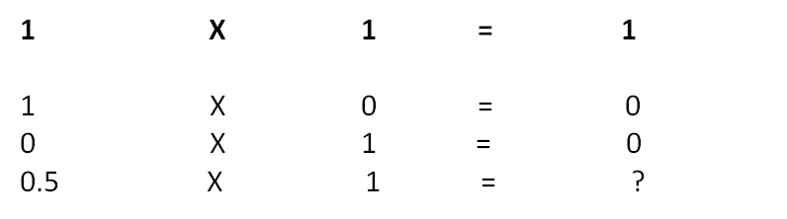
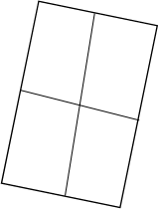
Simple View of Reading
Word
Recognition
X
Language
Comprehension
=
Reading
Comprehension
(Gough & Tunmer, 1986; Hoover & Gough, 1990)
Notes:
To Know: This will be added to the first box on the left hand side of the Frayer Note Catcher.
To Do: Ensure participants know where to put this information.
To Say: Let’s look at the Simple View of Reading and how vocabulary is a part of reading. Place this in the top left box on your Frayer. We find it fits in two places.
The first box of the Simple View reminds us of the foundational part of reading that begins the process with letters and written words. Word Recognition is the decoding piece of reading - learning the letters and patterns of letters to represent the sounds in words. We learned that the science or reading tells us that sound comes before letters. We also learned that letters will not attach to sounds without the phonological memory for those sounds. Some students will need explicit instruction in phonemic awareness while some students will automatically develop phonemic awareness. So, the Word Recognition side is the Decoding, Phonemic Awareness, and sight word recognition side. The Language Comprehension (red box) includes understanding, background knowledge, vocabulary depth and breadth, language structures, and literacy knowledge. Phonics lessons made and built words through the decoding side and today’s look at vocabulary deepens rich language for multi-meaning words. This equation has a multiplicative factor. It is not an addition factor. We discussed this in our first session. The influence these two components have on each other multiplies the different aspects of instruction. Both sides of this must be addressed to be a skilled reader. Comprehension will be our final result, if both develop well. But look what happens when one side is not complete or there is very little development of the other. Can you complete the equation at the bottom of the number sentences?
The final goal of reading is to have good reading comprehension. This graphic reminds us that it takes instruction in both and we cannot rely only on one side of this. We often find that we rely frequently more on the comprehension of language as students get older and forget that decoding skills are needed and can be developed no matter the age and grade.

Slide 16
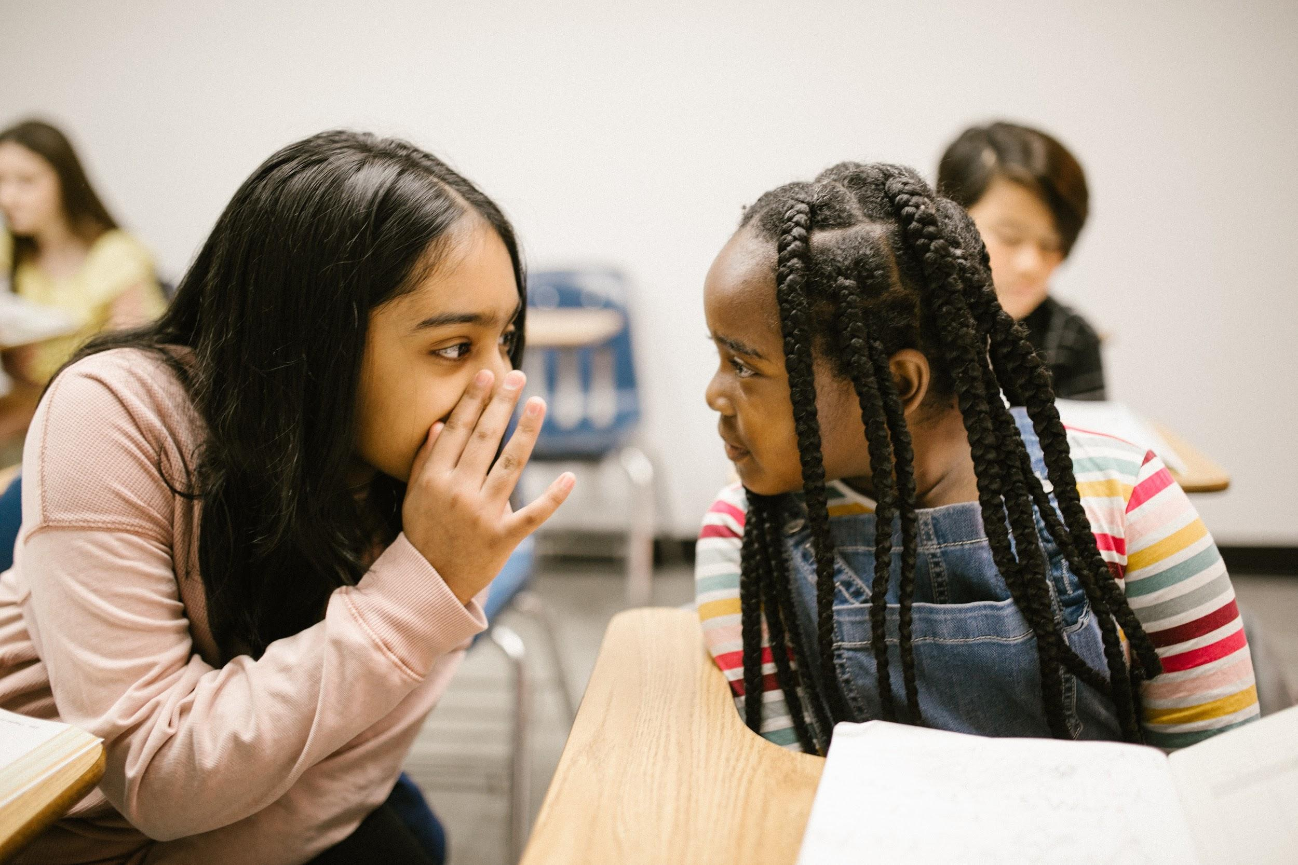


4 Types of
Vocabulary
Listening Vocabulary
Speaking Vocabulary
Reading Vocabulary
Writing Vocabulary
Adapted from: Put Reading First: The Research Building Blocks for Teaching Children to Read, Kindergarten Through Grade 3, a publication of The Partnership for Reading.
Notes:
To Know and To Say: There are four types of vocabulary. Listening vocabulary are the words we need to know to understand what we hear. Speaking vocabulary are the words we use when we speak. Reading vocabulary are the words we need to know to understand what we read, and writing vocabulary are the words we use in writing. You may place those types around the four sides of the term ‘Vocabulary’ in the middle of your Frayer models. You will want to remember your instruction will impact all of these, but today we are going to focus only on reading vocabulary.

Slide 17
Two Ways We Learn Vocabulary
Indirect - through everyday experiences with oral and written language.
Direct instruction
Ways We Learn Vocabulary
1
2
Notes:
To Say: Vocabulary plays an important part in learning to read. Beginning readers must use the words they hear orally to make sense of the words they see in print. Vocabulary is also very important to reading comprehension. Readers cannot understand what they are reading without knowing what most of the words mean. As children learn to read more advanced texts, they must learn the meaning of new words that are not part of their oral vocabulary.
Indirect instruction is when the students are exposed to a wide variety of literary sources. This type of instruction typically occurs throughout the student's day from the vocabulary they hear and see in their surrounding environments or conversations.
Direct instruction helps students learn difficult words, such as words that represent complex concepts that are not part of the students' everyday experiences. Direct instruction of vocabulary relevant to a given text leads to better reading comprehension.
According to the National Reading Panel Report in 2000, explicit instruction of vocabulary is highly effective. To develop vocabulary intentionally, students should be explicitly taught both specific words and word-learning strategies. To deepen students' knowledge of word meanings, specific word instruction should be robust. Seeing vocabulary in rich contexts provided by authentic texts, rather than in isolated vocabulary drills, produces robust vocabulary learning.
Vocabulary is acquired incidentally through indirect exposure to words and intentionally through explicit instruction in specific words and word-learning strategies.
(Beck et al., 2002) (National Reading Panel, 2000)

Slide 18
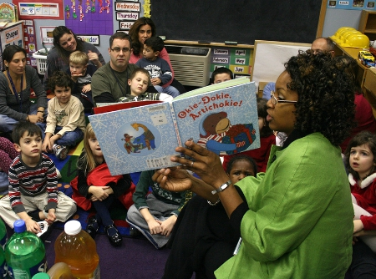
Ways We Learn
Handout #2
Vocabulary
Indirect Learning
Engage daily in oral language
Listen to adults read to them
Read extensively on their own
Indirect
Notes:
To Say: Children learn the meanings of most words indirectly, through everyday experiences with oral and written language. Children learn word meanings indirectly in three ways:
First, students engage in daily oral language. Young children learn word meanings through conversations with other people, especially adults. As they engage in these conversations, children often hear adults repeat words several times. They also may hear adults use new and interesting words. The more oral language experiences children have, the more word meanings they learn.
Researchers have found that new words stick better when used in the flow of conversation, rather than studied as part of a list. When choosing new terms for study, teachers should look ahead to see what students will be reading about and discussing in the coming weeks, and after teaching the words' meanings, they should reinforce the new vocabulary by using it often and encouraging students to use it themselves.
Second, students listen to adults read to them. Children learn word meanings from listening to adults read to them. Reading aloud is particularly helpful when the reader pauses during reading to define an unfamiliar word and, during and after reading, engages the child in a conversation about the book. Conversations about books help children to learn new words and concepts and to relate them to their prior knowledge and experience.
Third, students read extensively on their own. Children learn many new words by reading extensively on their own. The more children read on their own, the more words they encounter and the more word meanings they learn. Unfortunately, the children who often need vocabulary development the most (struggling readers) tend to be those who read the least, because of limitations in their skills or because they have had so many failure experiences with reading that they lack motivation to read. This is one reason why it’s important to combine direct teaching methods with indirect vocabulary learning.

Slide 19
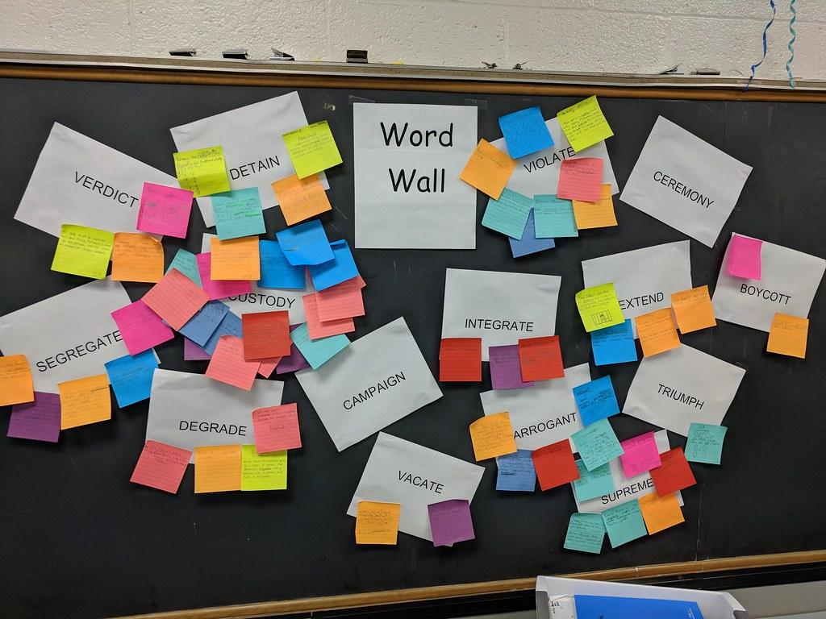
a. Daily Oral Language
Indirect Learning
Word or Sound Walls
Anchor Charts
Put Language in unexpected places
Engage students in daily conversation
Games and repetition
http://www.adlit.org/article/40345/
Notes:
To Know and To Say: Daily Oral Language is not having students correct a sentence on the board or on a handout. DOL is having rich conversations in your class and looking for ways to bring new vocabulary into your classroom. Researchers have found that it usually takes 12-24 exposures for new words to stick in people's minds. Those words stick better when used in the flow of conversation, rather than studied as part of a list. When choosing new terms for study, teachers should look ahead to see what students will be reading about and discussing in the coming weeks. After teaching the words' meanings, they should reinforce the new vocabulary by using it often and encouraging students to use it themselves.

Slide 20
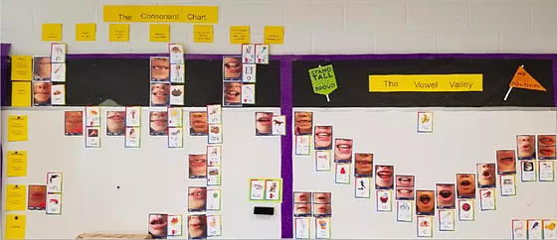
Word or Sound Walls
Indirect Learning
Provide a permanent model for high frequency words
Help students see patterns and relationship in words, thus building phonics and spelling skills
Provide reference support for students during reading and writing activities
Notes:
To Know and To Say: Word walls are a collection of words which are displayed in large visible letters on a wall, bulletin board, or other display surface in a classroom. These walls are designed to be an interactive tool for students and contains an array of words that can be used during writing and reading. These organized displays of words provide an always-available visual reference for students.
Sound walls are where teachers place the phonics patterns that make specific sounds on the wall adding words that contain the sound. For example, the word “the” will not be placed under the letter ‘t’. It would be placed under the phonics pattern ’th’ and “phone” would be spelled correctly and placed under the letter ‘f’’ spelled with ‘ph’ not under the letter ‘p’. Sound walls are more efficient for early readers who are grasping phonics concepts, to find words stored together by common sounds but with different spellings. There is an example of a Sound Wall on this slide.
These walls are a great support for struggling readers and ELLs, and may be organized around a number of concepts, including the alphabet and phonetic sounds, new vocabulary words, sight words, grammar rules, conversational phrases, and writing structures. Words can also be organized by category (for example, academic content words, words used often in your classroom, new words students have come across and love). Students can create their own word walls and keep them in a word notebook. Word Walls can also be an effective strategy through high school after students have mastered phonics skills and are ready to connect vocabulary to meaning.
https://www.google.com/search?q=mary+dahlgren+sound+walls&rlz=1C1CHBF_enUS816US816&oq=mary+dalg&aqs=chrome.2.69i57j0i10l3j46i10j0i512j0i10j0i512l2j0i10i22i30.6141j0j7&sourceid=chrome&ie=UTF-8

Slide 21
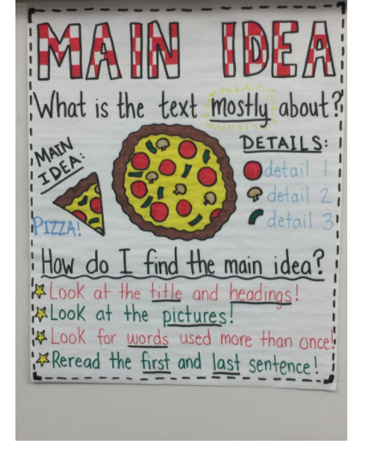
Anchor Charts
Indirect Learning
Visual prompts that provide students with information regarding their prior learning on a given topic.
Provide a scaffold to support the students during guided practice and independent work.
Notes:
To Know and To Say: An Anchor Chart is a tool used to support instruction (i.e. “anchor” the learning for students). As you teach a lesson, you create a chart, together with your students, that captures the most important content and relevant strategies.
Anchor charts are an effective way of encouraging student engagement. Not only do they increase student confidence when engaged in tasks, but they help to keep students on task by offering support in the form of visual prompts that help unstick the stuck. When helping to produce the anchor charts, students will have opportunities to reconstruct their learning and thereby deepen their comprehension of the material in the process.
More resource understanding: (The following is information if you feel you need more understanding)
These organized displays of words provide an always-available visual reference for students. Research by Robert Marzano (2004) indicates that, ". . . students' comprehension will increase by 33 percentile points when vocabulary instruction focuses on specific words important to the content they are reading as opposed to words from high-frequency lists [teaching frequently-occurring words out of context]." Students can have a say in determining the words for the word wall and/or students can make their own personal word wall in vocabulary notebooks.
More research to support this:
High-quality Classroom Language (Dickinson, Cote, & Smith, 1993)
Reading Aloud to Students (Elley, 1989; Senechal, 1997)
(Scott and Nagy, 2004).

Slide 22

Daily Conversations
Indirect Learning
Words are the currency of communication. A robust vocabulary improves all areas of communication – listening, speaking, reading and writing.
Notes:
To Know and To Say: Young children learn word meanings through conversations with other people, especially adults. As they engage in these conversations, children often hear adults repeat words several times. They also may hear adults use new and interesting words. The more oral language experiences children have, the more word meanings they learn. Look for ways to say common things using uncommon words. For example, instead of saying, “Remember to raise your hand“, say “Elevate your right, upper extremity when you wish to vocalize your thoughts.” Not only will kids find it fun, you are enriching their vocabulary. It make take some time to transition from one statement to the other and you may have to start with one word at a time.
First, simply talking to your students increases the amount of vocabulary words they are exposed to on a daily basis. Interpersonal communication requires students to use all the language you have been working to help them acquire in a natural, unstructured manner. Building time for students to have short exchanges with each other, practicing skills you’ve modeled like making eye contact, talking with and not at someone, appropriate responses, etc. Have them discuss what they read, their reaction to it, the steps to solving a problem, or what they already know about a topic you have introduced in science or social studies.
Second, students listen to adults read to them. Children learn word meanings from listening to adults read to them. Reading aloud is particularly helpful when the reader pauses during reading to define an unfamiliar word and during and after reading, engages the child in a conversation about the book. Conversations about books help children to learn new words and concepts and to relate them to their prior knowledge and experience.
Third, students read extensively on their own: Children learn many new words by reading extensively on their own. The more children read on their own, the more words they encounter and the more word meanings they learn. Unfortunately, the children who often need vocabulary development the most (struggling readers) tend to be those who read the least, because of limitations in their skills or because they have had so many failure experiences with reading that they lack motivation to read. This is one reason why it’s important to combine direct teaching methods with indirect vocabulary learning.

Slide 23
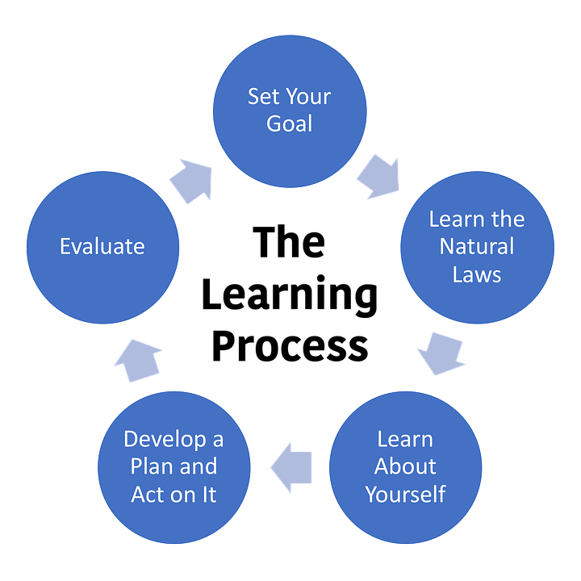
Language in Unexpected Places
Indirect Learning
Learning posters can be grouped into four categories
Illustrate a concept or thinking
Demonstrate a process
Differentiate between similar things
Capture interest and stimulate emotion
Notes:
To Know and To Say: According to a research study conducted by Pennsylvania State University, a poster is immediately in the student’s view on the classroom wall. Unconscious learning can take place through exposure to the information on the poster. The use of posters create a more stimulating and interesting environment for learning and expose students to new learning that will take place. On the slide are the main types of learning posters.
Inspirational quotes on the white board and posters can also provide additional vocabulary development. Students can develop quote quilts and talk about why a specific quote resonates with them. Because of daily exposure to the words, new words become a normal part of their everyday language. Posters can be used for choral reading or to introduce new vocabulary to the classroom.
Another way to help students develop vocabulary is by fostering word consciousness or an awareness of and interest in words. Word consciousness is not an isolated component of vocabulary instruction; it needs to be taken into account each and every day. It can be developed at all times and in several ways: through encouraging adept diction, through word play, and through research on word origins or histories.
(Education Libraries Volume 27, No. 1 Summer 2004)

Slide 24

b. Reading to Students
Indirect Learning
Models good reading
Makes complex ideas more accessible
Exposes students to more vocabulary words
Helps students make connections
Notes:
To Know and To Say: Reading aloud is the foundation for literacy development. It is the single most important activity for reading success. There are several benefits of reading to your students even in upper elementary school.
It provides children with a demonstration of phrased, fluent reading. Reading aloud provides children with a model of confident and expert reading. It reveals the rewards of reading, and develops the listener's interest in books and desire to be a reader. Listening to others read develops key understanding and skills, such as an appreciation for how a story is written and familiarity with book conventions, such as "once upon a time" and "happily ever after.”
Children can listen on a higher language level than they can read. Reading aloud makes complex ideas more accessible and exposes children to vocabulary and language patterns that are not part of everyday speech. This, in turn, helps them understand the structure of books when they read independently. It exposes less able readers to the same rich and engaging books that fluent readers read on their own and entices them to become better readers.
Since beginning readers are limited in their independent reading to simple decodable or familiar texts, exposure to novel vocabulary is unlikely to come from this source. Read-alouds fill the gap by exposing children to book language, which is rich in unusual words and descriptive language. During read-aloud interactions, word learning occurs both incidentally and as the teacher stops and elaborates on particular words to provide an explanation, demonstration, or example. Even brief explanations of one or two sentences, when presented in the context of a supportive text, can be sufficient for children to make initial connections between novel words and their meanings.
Children need to be exposed to a wide range of stories and books. They need to see themselves as well as other people, cultures, communities, and issues in the books we read to them. They need to see how characters in books handle the same fears, interests, and concerns that they experience. Selecting a wide range of culturally diverse books will help all children find and make connections to their own life experiences, other books they have read, and universal concepts.
Helping children find and make connections to stories and books requires them to relate the unfamiliar text to their relevant prior knowledge. Helping children discover these connections requires planning and modeling. Teachers can encourage and support thinking, listening, and discussion, and model "think-alouds" which reveal the inner conversation readers have with the text as they read. Teachers can point out connections between their prior experiences and the story, similarities between books they have read, and any relationship between the books and the larger community.
More Research to Support This: (Bredekamp, Copple, & Neuman, 2000) (Fountas & Pinnell, 1996) (Mooney, 1990) (Bredekamp et al., 2000) (Beck & McKeown, 2007) (Carey, 1978) (Bravo et al., 2007) (Biemiller & Boote, 2006) (Barton & Booth, 1990) (Dyson & Genishi, 1994) (Harvey & Goudvis, 2000)

Slide 25

c. Reading on Their Own
Indirect Learning
High Interest Low Vocabulary books
Graphic Novels/Comic Books
Areas of student interest
Non-fiction/Magazines
Notes:
To Know and To Say: Children learn many new words by reading extensively on their own. The more children read on their own, the more words they encounter and the more word meanings they learn.
Unfortunately, the children who often need vocabulary development the most — struggling readers — tend to be those who read the least, because of limitations in their skills or because they have had so many failure experiences with reading that they lack motivation to read. One of the keys to helping struggling readers is to provide books they can and want to read. High Interest Low Vocabulary books have controlled vocabulary and reading difficulty levels, but with topics and plots appropriate for the students.
They need to have illustrations that support the text, carefully chosen vocabulary, simple sentences, and completing stories and characters that interest the reader. Mysteries and classics do not make good books for struggling readers. Those genres require skills such as reading for specific detail, recalling various clues, making inferences and connections, as well as sustaining interest until the end; all of which are problematic for struggling readers.
Graphic novels are similar to comic books in that they weave rich lively visuals with a limited amount of text to drive the narrative. Graphic novels can be found in a wide range of genres in both fiction and non-fiction. They can help struggling readers strengthen their vocabulary, build reading confidence and stamina, and develop an appreciation for stories.
Most of us can read material well beyond our measured instructional level if we are interested in the topic and motivated to read. For boys especially, non-fiction has considerable appeal, particularly when titles can be found that match their interests and hobbies. The key is linking reading material to the things that interest the students, from extreme sports to World War II fighter jets to NHL hockey. Non-fiction text, especially, provides a number of supports for the struggling reader: headings and subheadings, graphics and illustrations, introductions, and summaries. A further advantage to non-fiction text is that the reader does not need to read the entire book in order to get benefit from it; the reader can gain information and pleasure from reading short segments. There is a wide variety of magazines related to all sorts of topics of student interest. Magazines can be good sources of short, interesting pieces of expository text with vocabulary that a student may already be familiar with due to their interest.
More Research to Support This
Wide Independent Reading (Anderson & Nagy, 1992; Cunningham & Stanovich, 1998; Nagy, Anderson, & Herman, 1987; Sternberg, 1987)
https://www.readingrockets.org/blogs/aiming-access/19-graphic-novels-engage-students-and-keep-them-readingi

Slide 26
2. Direct Vocabulary Learning
Teach specific words before reading
Teaching students more general word-learning strategies
Use vocabulary in different contexts over time (reading, speaking and writing)
Reinforce before, during and after (Repetition/Play)
Direct
2
Notes:
To Know and to Say: Although a great deal of vocabulary is learned indirectly, some vocabulary should be taught directly.
Direct instruction helps students learn difficult words, such as words that represent complex concepts that are not part of the students' everyday experiences.
Direct instruction of vocabulary relevant to a given text leads to better reading comprehension. Before students read a text, it is helpful to teach them specific words that they will see in the text and that are particularly important to understanding the text. Teaching important vocabulary before reading can help students both learn new words and comprehend the text.
Children learn words best when they are provided with instruction over an extended period of time and when that instruction has them work actively with the words – for example, using new words in their writing. The more students use new words and the more they use them in different contexts, the more likely they are to learn the words. Students learn new words better when they encounter them often and in various contexts. The more children see, hear, and work with specific words, the better they seem to learn them.
Research shows that there are more words to be learned than can be directly taught in even the most ambitious program of vocabulary instruction. Therefore a limited number of words for in-depth explicit vocabulary instruction should be used.
We might instruct three to five words per chapter in a chapter book, but at the end of the book the goal is to have students demonstrate their masterly through reading, writing, and speaking of approximately 10-12 of the words they were explicitly taught.
Most unfamiliar words require a brief definition, not for retention, but to aid comprehension.
With one exposure in context, only 10-15 percent of the words are remembered
More Research to Support This: Explicit Vocabulary Instruction (Baker, Kame’enui, & Simmons, 1998; Baumann, Kame’enui, & Ash, 2003; Beck & McKeown, 1991; Beck, McKeown, & Kucan, 2002; Biemiller, 2004; Marzano, 2004; Paribakht & Wesche, 1997)
Word-Learning Strategies (Buikima & Graves, 1993); Edwards, Font, Baumann, & Boland, 2004; Graves, 2004; White, Sowell, & Yanagihara, 1989)

Slide 27



Choosing Importance
Tier 3
Content
Specific
Tier 2
Multiple Meaning, High Frequency across several context or content
Tier I = Basic Vocabulary
Notes:
To Know: You may reference: https://www.readingrockets.org/article/choosing-words-teach
Beck, Isabel L. McKeown, M., & Kucan, L. (2002). Choosing Words to Teach. In Bringing Words to Life: Robust Vocabulary Instruction (15-30). New York, NY: Guilford Press.
Marzano, R., Pickering D. (2005) Building Academic Vocabulary. ASCD.
Biemiller A. (2009) Words Worth Teaching: Closing the Vocabulary Gap. SRA
To Say: There are three types of vocabulary words which presents a logical opportunity for explicit instruction. Explicit instruction is especially important for struggling readers and English language learners.
Tier 1 Conversational words
Basic, everyday words that students already know (cat, mom, dad etc.)
No instruction required, although struggling learners may need these taught
Tier 2 General academic vocabulary/ “suitcase” words (they are called suitcase because you can move them from one discipline to another)
Are common enough that most mature readers are familiar with them
They can be found across various contexts and topics
Understanding the meaning of these words promotes everyday reading and listening comprehension
Teach these words explicitly
Tier 3 Domain specific academic vocabulary
Low-frequency words; many of which are domain specific; not high utility use for most learners
Often defined within text and taught when a specific need arises
Language Arts: setting, characters, Math: square, circumference,/Science: precipitation
We are not advocating for the purchase of specific products. We are acknowledging products that place words into Tiers according to research.

Slide 28

Intensity of Instruction
Criteria for instructional time
Importance and utility
Instructional potential
Conceptual understanding
Beck, Isabel L. McKeown, M., & Kucan, L. (2002). Choosing Words to Teach. In Bringing Words to Life: Robust Vocabulary Instruction (15-30). New York, NY: Guilford Press.
Notes:
To Know and To Say: Tier 2 words are not always agreed upon by individuals and cannot be a set list required by all because of the differences of a students place in life. (location, future, background and life). But, we can all come close in our decisions and be better able to make choices by knowing our own students and the use of specific words by considering some criteria.
Some words will be learned easily and can just be given a nod to during the reading of our text; others need before, during, and after instructional intent for the words to become vocabulary that the learner can ‘own’ and apply independently. (‘Own’ meaning they have a deep understanding of the word allowing them to use the word correctly in conversation, in their writing, and understanding it in their reading without hesitation.)
Consider:
Importance and utility: Words of mature language users and appear frequently across a variety of domains in content and context.
Instructional potential: Words that can be worked within a variety of ways so that students can build rich representations of them and their connections to other words and concepts. Ask yourself- will this word be used in life in many different ways?
Conceptual understanding: Words which students not only understand the general concept but also can describe the concept(s) with specificity. Understanding the word clarifies the concept and is pivotal understanding the content, mood, theme, or implications of the subject being studied.

Slide 29
Keep in Mind
There is no formula for selecting age-appropriate vocabulary words despite lists that identify "fifth-grade words" or "seventh-grade words." As long as the word can be explained in known words and can apply to what students might talk or write about, it is an appropriate word to teach.
Notes:
To Know: This is a fact from research studies. Lists can help us find the most commonly needed vocabulary words by our content or grade but cannot ensure students at a different level might need them during their journey in the text and/or world.
To Say: Let me pause as you read this fact from Beck and McKeown. There are only two things that make a word inappropriate for a certain level. One is not being able to explain the meaning of a word in known terms. If the words used to explain a target word are likely unknown to the students, then the word is too hard. The other consideration for word selection is that the words be useful and interesting — ones that students will be able to find uses for in their everyday lives.
It is good to have resources for lists of vocabulary but, these are ONLY a resource. Whatever you are using must be used, practiced, and applied in the learning for vocabulary to impact overall comprehension.
Resource site:
https://www.readingrockets.org/article/choosing-words-teach

Slide 30
How NOT to Teach Vocabulary
Copying definitions from the dictionary or glossary
Copying the same word over and over
Rote memorization without context
Telling students to use “context” to figure the word out or guess
Passive reading like SSR
Isolated vocabulary practice not connected to content
Notes:
To Know: Some teacher practice does not fit with what research tells us about good vocabulary instruction.
To Do: Point out that participants may want to note the non-examples of teaching vocabulary in the lower right side of the Frayer.
To Say: This slide reminds us of practice that does not engage the student in learning vocabulary for retention and application. Students who are asked to ‘copy’ definitions will not remember what they copied and neither will writing it over and over. Words need to be attached to meaning with examples or illustrations in the students’ language for a connection to be made. Context of a passage is a great tool to confirm word meaning after a word is decoded but, if we do not have students use their phonics to decode the word, we are only teaching students to ‘guess at a word’. Reading does expose students to lots of vocabulary. But, if a student is not actively thinking as they read, and reading with intent, then some students will read and not remember what they read when complete.

Slide 31
Notes on the Back
Repeated Exposure
Notes:
To Know and To Say: Let’s add more notes to the back with the focus on how to add repeated exposure without it becoming rote drill. In this section we will look at Repeated Exposure.
To Do: Pause for participants to prepare their notes.

Slide 32
Vocabulary Instructional Routine
Introduce the word’s pronunciation and spelling
Provide a student-friendly meaning of the words
Illustrate the word with examples/non-example
Check student’s understanding
(Read it, Say it, Use it, and Write it)
Elicit student word uses
Notes:
To Know and To Say: One of the major principles for enhancing vocabulary instruction is the establishment of an efficient yet rich routine for the introduction of new words. Effective vocabulary instruction includes a series of implicit steps. Reviews of research on vocabulary instruction stress the limited effectiveness of instruction that focuses narrowly on dictionary definitions and support instruction that presents words in a variety of contexts. This instructional routine was first brought to our attention through the work of Beck, McKeown and Kucas, Anita Archer, as well as Marzano and others. We will take a look at one example of this routine in the next slide.
https://www.readingrockets.org/article/four-practical-principles-enhancing-vocabulary-instruction
More Research to Support This: (Beck, McKeown, & Kucan, 2013; Stahl & Fairbanks, 1986)

Slide 33
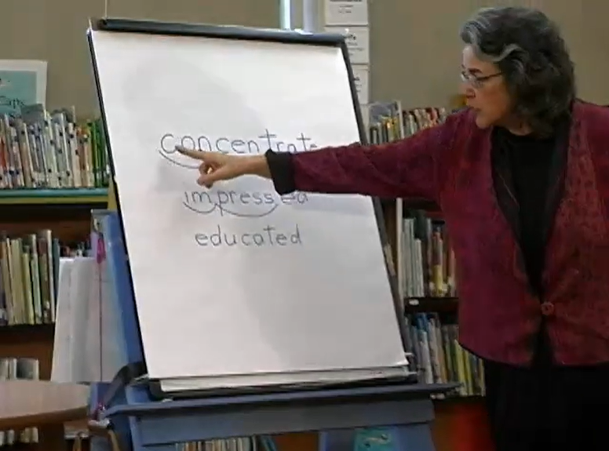

Explicit to Scaffold: I Do, You Do, We Do
Notes:
To Know: Research shows that there are more words to be learned than can be directly taught in even the most ambitious program of vocabulary instruction. Therefore, a limited number of words for in-depth explicit vocabulary instruction should be used. As teachers, we must prioritize our time and the student’s ability to utilize what is introduced.
https://explicitinstruction.org/video-elementary/elementary-video-4/
Archer, A. L., Hughes, C.A. Explicit Instruction: Effective and Efficient Teaching. (2010) Guilford Press.
To Do: Go to https://explicitinstruction.org/video-elementary/elementary-video-4/. Once there, click play found at the bottom of the image under 4. Vocabulary Instruction – 2nd. You can stop the presentation at 5:15 after the first two words or watch the entire video. Debrief after the video.
To Say: This video was recorded after the students had read the story. She is taking time after the reading to go deeper. A teacher needs to develop a consistent vocabulary routine. This routine helps the students get a solid grasp of the meaning and application of the word as well as the definition of the word. This is just one example of a vocabulary instruction routine. Let’s see what this looks like with a video from reading expert Anita Archer. Look for a scaffold from teacher model to student engagement. (You may want to have teachers tally how many times Anita says the word ‘concentrate’ while teaching and what the progression of her instruction looks like).
Debrief after the video with the participants by asking them how she did the steps.
Introduced the word
Word is printed for students to see.
They hear how the word is pronounced.
The word is broken into syllables both auditorily and visually using index finger to sweep under each syllable as it was pronounced.
Introduced the meaning
Talked about how they were able to think about the meaning and she used hand gestures. She placed the word into a student-friendly definition
Pointed to the word as she repeated it
Examples: Used doing math and coming to the libraries as examples
Non-examples: Looking around
Gave situations and students responded with yes or no
Elicit student use: Had them to repeat the words with her. “I was impressed because…”
** We are not specifically advocating to purchase this book. We are providing a resource that aligns to research-based practice.

Slide 34
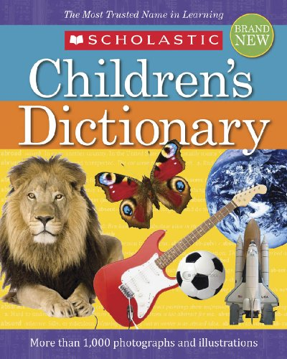



Word Learning Strategies
Student Friendly Definitions
Using Multimodal and Multisensory Engagement
Morphology and Etymology
Games for Repetition
Notes:
To Know: You may want to read and reference: https://www.readingrockets.org/article/five-key-principles-effective-vocabulary-instruction
Collins Cobuild. e Learn Aid. January, 2005 or online: https://www.collinsdictionary.com/dictionary/english
Children’s Dictionary: Scholastic. (September, 2019)
https://kids.wordsmyth.net/we/
https://www.lexico.com/
To Say: Students must learn how to use dictionaries, glossaries, and thesauruses to help broaden and deepen their knowledge of words, even though these resources can be difficult to use. The most helpful dictionaries include sentences providing clear examples of word meanings in context in what is referred to as Student Friendly Definitions.
Too often vocabulary instruction is no more than kids copying definitions from the dictionary. But researchers have identified a number of instructional approaches that outdo any learning that may accrue from copying definitions. One of those key principles is that students work with more extensive or complex definitions or explanations of word meanings.
Of course, it is not possible to provide specific instruction for all the words that students do not know. Students also need to be able to determine the meaning of words that are new to them but not taught directly. They need to develop effective word-learning strategies. Word-learning strategies include
Using multimodal and multisensory engagement through play. An example of that would be to say the word, use the word in a sentence, use the word in an illustration - in short read it, write it, say it, use it. What you are doing with your Frayer model is multimodal and multisensory engagement. Have students find antonyms and synonyms for the word. Have them use it in a sentence, determine the part of speech, illustrate the word or act it out or use gestures.
Another strategy is to teach how to use information about meaningful word parts. This is called morphology. This helps students figure out the meanings of words in text. Etymology is the origin of the word. Understanding the origin can also help a student figure out the meaning of words in text.
This page also shows some common resources for word learning
A Children’s Dictionary - Collins Cobuild - a dictionary that provides definitions in full sentences, rather than phrases so it is easier for students to understand.
Lexico - A website with free English and Spanish dictionaries using student-friendly definitions and examples of the words in sentences
Kids Wordsmyth - a children’s dictionary app that, after it is downloaded, the internet is not required.

Slide 35


Using Vocabulary in Different Contexts
Positive Connotation | Negative Connotation
Thrifty | Miserly
Unique | Peculiar
Club | Gang
Vintage | Decrepit
Notes:
To Know and Say: When we provide extended instruction that promotes active engagement, we give our students repeated exposure to new words. When our students read those same words in their texts, use those words in their writing, or when they play games with those words, they increase their exposure to the new words. Seeing vocabulary in rich contexts provided by authentic texts, rather than in isolated vocabulary drills, produces robust vocabulary learning.
There is great improvement in vocabulary when students encounter vocabulary words often. It is important that vocabulary instruction provide students with opportunities to encounter words repeatedly and in more than one context.
Exposure to words in many contexts also gives students a deeper understanding of the meaning of a word and how it is likely to be used and understand differences between similar words, how some words may have negative connotations and others more positive. Remember, a child may need to use the words 12-24 times before it becomes familiar enough they can recognize it in reading, use it in conversation, and then in their writing.
Research to support this: (National Reading Panel, 2000)

Slide 36
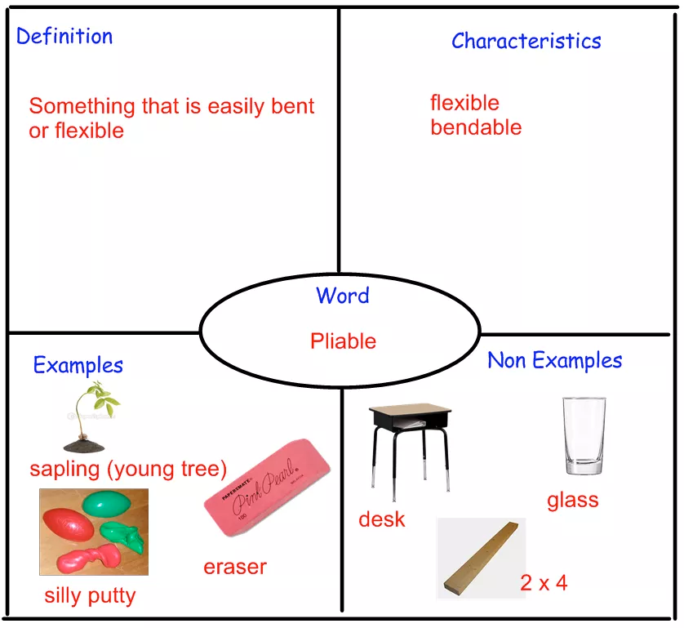
Frayer Model
Handout #2a
Notes:
To Know: There are directions for sample Frayer Models in your handouts.
To Do: Direct attention to the handouts with a variety of examples for the Frayer Model. (Handout #2a)
To Say: Here is an example of the most common way a Frayer is used for learning vocabulary. You do not always fill in the sections of the Frayer in one class period. The intention for best retention of vocabulary is to revisit the words over time and add the elements for deeper learning. Handout #2a allows you to choose how you would want to build your Vocabulary Frayer for practice with students.
Remind if needed - every good vocabulary routine includes
Introducing the word’s pronunciation and spelling
Introducing the word’s meaning - using characteristics, sentences, or pictures
Illustrating the word with examples/non-examples
Checking the student’s understanding
Read it, write it, say it, and use it
Elicit student word uses
Categories for a Frayer Model
The Word
Definition of the Word
The Word in a Sentence
The Part of Speech of the Word
A Picture of the Word (Students cut out and place in a section or illustration made by the student)
An Example of the Word
A Non-example of the Word
Characteristics of the Word
Attributes of the Word
Synonyms of the Word
Antonyms of the Word
Etymology of the Word

Slide 37
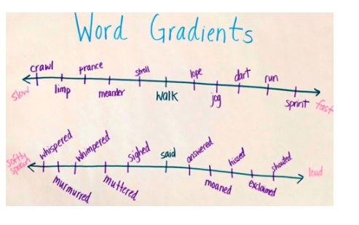

Semantic Gradients
Resource #1
Semantic gradients are a way to broaden and deepen students’ understanding of related words.
Notes:
To Know: You may use a Jamboard, if virtual, or have participants place words on sticky notes to line up words in order of the different shades of meaning. The Jamboard has two different sets of words. The odd numbered boards have words of different shades of meaning that range from small to large. The even numbered boards have the words (Went is Gone) and are different ways to say someone went away or has gone away, thus the name “Went is Gone”. Participants can click on any box to move it into a lineup showing a gradual difference in words according to their meaning.
Select which process works best for your presentation.
You may want to use Slide 38, if in-person.
To Say: Semantic gradients are a way to broaden and deepen students' understanding of related words. Students consider a continuum of words by order of degree. Semantic gradients often begin with antonyms, or opposites, at each end of the continuum. This strategy helps students distinguish between shades of meaning.
By enhancing their vocabulary, students can be more precise and imaginative in their writing. It helps them understand how words are related to each other. It can be used before, during, or after reading and can be done with the whole class, small groups, or individually.
To use semantic gradients
1. Select a pair of polar opposite words
2. Generate at least four to five synonyms for each of the opposite words
3. Arrange the words in a way that makes a bridge from one opposite word to the other Continuums can be done horizontal or vertical - in a ladder-like fashion. Have students discuss their rationale for placing certain words in certain locations. Encourage a conversation about the subtle differences among the words.
The conversation students have about the words can be interesting and even more important than the order itself. Because students are playing with words and thinking about how they are related, do not do this activity unless you plan to have students explain their reason for placing the words in a specific order. They can do this individually and then in small groups. Have them come up with an order they all agree upon based on discussion.
To Do: Place the link in the chat for participants to move the words into a gradient.
https://jamboard.google.com/d/151HdKrHbfeFM5vhUz4RrNxNCmr5ibVQw5au-77t7RAw/viewer?f=1

Slide 38

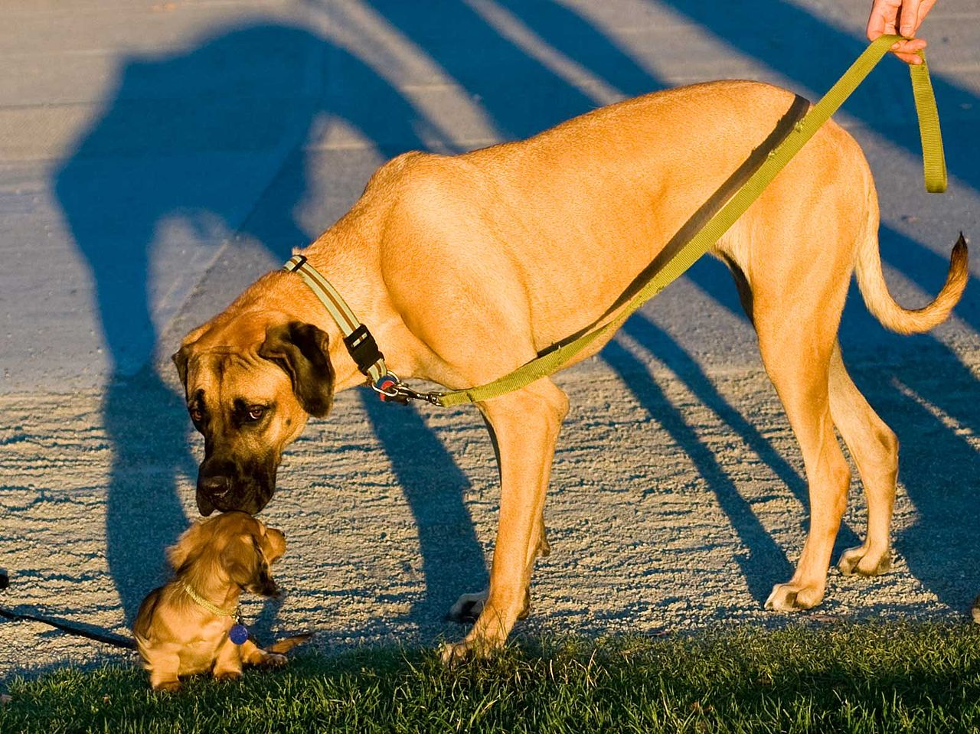
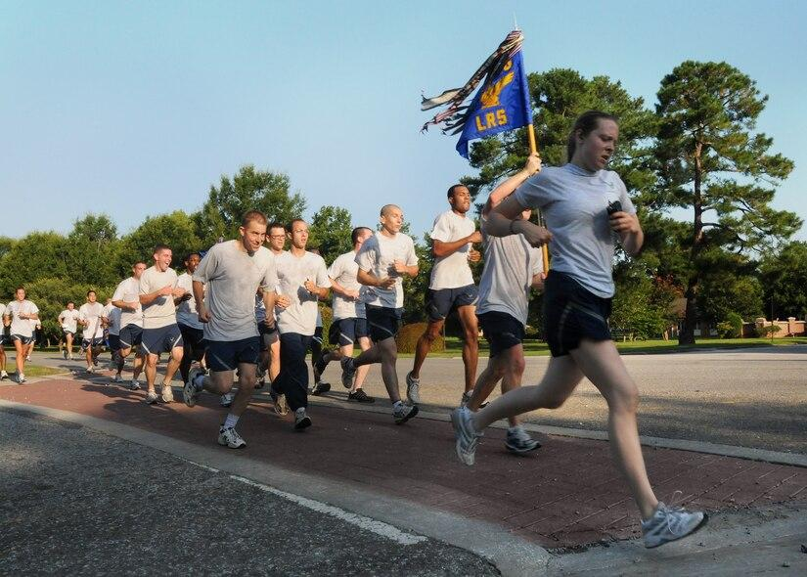
Semantic Gradients
cool
tropical
chilly
blazing
frigid
warm
crisp
balmy
immense
massive
microscopic
large
small
average
petite
teeny
stroll
rush
skip
saunter
wander
scoot
skeedaddle
amble
Notes:
To Know: You may use this slide or the previous slide to practice Semantic Gradients.
To Do: You can have the words on cards, use sticky notes, or write them and place them in order. You can give the students blank cards and have them write the words themselves. This can be done in small groups or individually. You may want to put them in a breakout room if you are virtual.
To Say: Semantic gradients are a way to broaden and deepen students' understanding of related words. Students consider a continuum of words by order of degree. Semantic gradients often begin with antonyms, or opposites, at each end of the continuum. This strategy helps students distinguish between shades of meaning.
By enhancing their vocabulary, students can be more precise and imaginative in their writing. It helps them understand how words are related to each other. It can be used before, during or after reading and can be done with the whole class, small groups, or individually.
To use semantic gradients
1. Select a pair of polar opposite words
2. Generate at least four to five synonyms for each of the opposite words
3. Arrange the words in a way that makes a bridge from one opposite word to the other. Continuums can be done horizontal or vertical - in a ladder-like fashion. Have students discuss their rationale for placing certain words in certain locations. Encourage a conversation about the subtle differences among the words
For this activity: You have three choices for gradients. You have hot to cold, small to large, and slow to fast. You have eight words that represent different gradients for those opposites. Choose which one of the gradients you want to work with and write the words on a stack of cards/sticky notes that you have been given. Then, with your table/partner, put the words in order from either hot to cold, small to large, or slow to fast. Be prepared to explain your reasoning.
The conversation students have about the words can be interesting and even more important than the order itself because students are playing with words and thinking about how they are related. Do not do this activity unless you plan to have students explain their reason for placing the words in a specific order. They can do this individually and then in small groups to come up with an order they all agree upon based on discussion.
Keep in mind that you can choose specific words and brainstorm different gradients of that word instead of starting with total opposites.

Slide 39
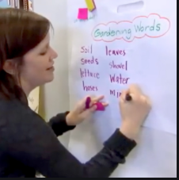
List-Group-Label Strategy
Brainstorm a list of related words
Group the words into subcategories
Label the groupings with descriptive titles
Notes:
To Say: The List-Group-Label strategy is an effective vocabulary strategy.
It helps students organize their understanding of specific vocabulary and concepts.
It builds on students' prior knowledge about a topic.
It actively engages students in learning new vocabulary and content by activating their critical thinking skills.
It teaches categorizing and labeling skills.
Teachers will need to select a concept to explore. It could be something from a story that was read or a unit of study. The teacher will name the topic and begin listing some words and then ask students to add related words. The words will be displayed visually. Once the words have been listed, they begin to think about how to group the words. The teacher will demonstrate by grouping some words together and explaining why he/she grouped them that way. There is really no right or wrong answer in step two. If the student can explain why the words go together, it is correct. Then the teacher and students will write a title which relates to why they grouped the particular words together. Students can do this activity as a group, break into small groups, or individually. For example, they can brainstorm together in a large class and then work in small groups. The teacher can come up with the words and have the students put them in their groups. It is important that the student focuses on the grouping of words before they label the groupings. The activity ends with a discussion about why the words and the knowledge of word meanings are important. When students are talking about words and putting them in categories, that is the multimodal activities that we talked about on a previous slide. One of the nice things about this activity is that it can be done in so many different ways based on the age and ability of the students and the content that is being taught.
(You might want to provide a set of words for an example.)
Model as a whole group, then have students group words together. The most important part of the grouping is the discussion about why words are placed together.
https://www.youtube.com/watch?v=K731qicwYcY&list=RDCMUCOoz4dVWq0WGJZMhkPzsWqg

Slide 40


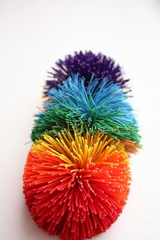


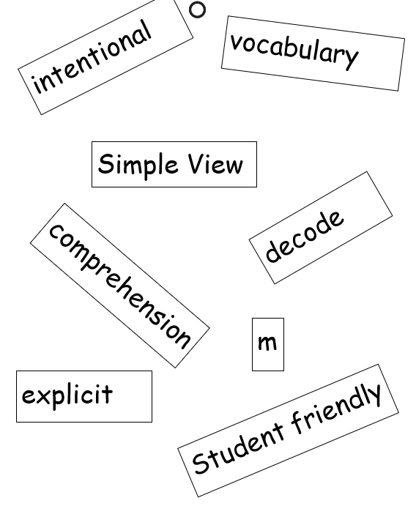
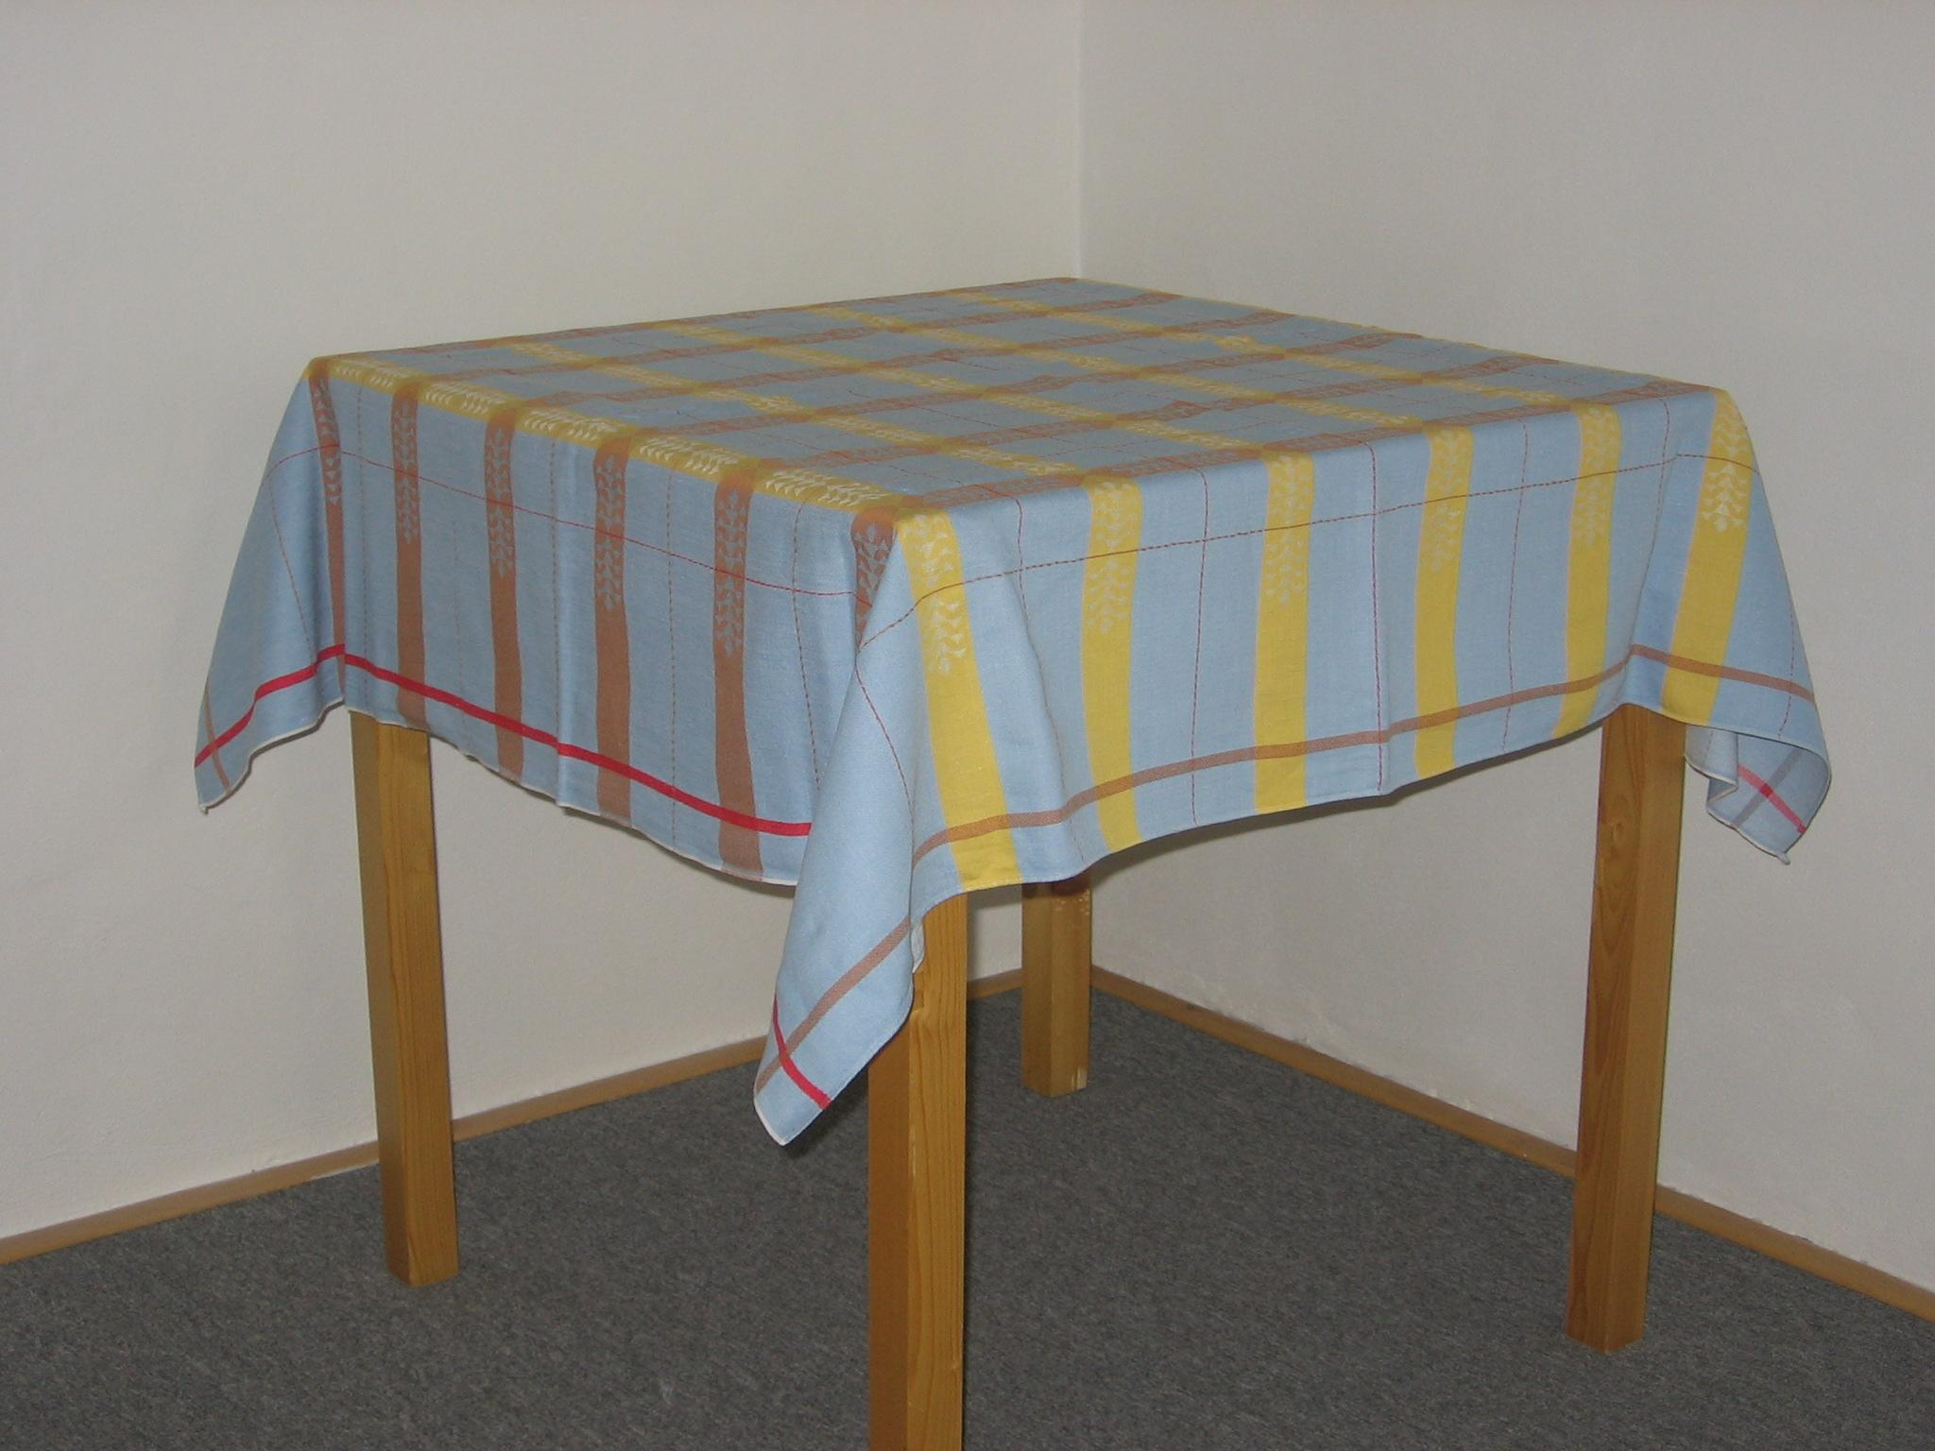
Vocabulary Word Swat
Notes:
To Know: Vocabulary Word Swat is a fun and interactive way to review vocabulary.
To Do: Have participants prepare to play a Vocabulary Word Swat game. Take a piece of paper (8 ½ X 11) folded twice. They will also need another piece of paper or a file folder with words splashed on the paper (see next slide).
To Say: We are going to look at different ways to practice vocabulary that is relevant and necessary for your content or story. These activities provide the opportunity for you to keep practice relevant.
These activities provide variety for spaced massed practice with vocabulary in your curriculum. Many times we ask ourselves how we can put more repetition in the classroom in a productive yet fun way so that repetition is not a boring drill.

Slide 41
intentional
vocabulary
Simple View
decode
comprehension
m
student friendly
explicit
Notes:
To Know: Participants (in groups of two) will need these words written on their paper (unless you print the slide out for them) to use as a Word Splash for the Vocabulary Swat Game.
To Do: If you didn’t already print this out for them, pause for participants to put these words on paper.
To Say: I am going to give you a clue, definition, or sentence that refers to one of these words. If you see the word, try to ‘swat’ the word before your partner does.
Clue 1: What is another word for sounding out words? (You will ___________ the word.) Answer: decode
Clue 2: Swat the letter/grapheme that names the sound of /m/. Answer: m
Clue 3: If you are very clear and precise in explaining something you are ______________. Answer: explicit
Clue 4: What do we call the equation that is word recognition times language comprehension equals comprehension? Answer: Simple View.
Take a moment to talk about this activity and how this engaging way might be used for repeated practice. Could you alter this to fit your needs and how?
Here are some examples to get the conversation started:
Write them on chart paper and have student team relays or competitions.
Write them in chalk on the playground and have them run and swat the word where ever it is on the playground.
Place words on cards and place them on top of the table or tablecloth and have students break into teams of three to five per team. Ask the students to swat the words as the clues or definitions are given.

Slide 42
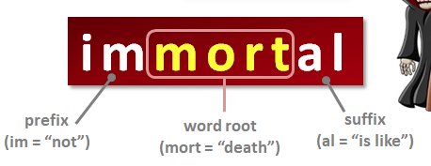
Meaningful Word Parts
Handouts #3 & #4
Affixes
Base Words
Root Words (Latin and Greek)
Notes:
To Know: Learning the meaningful parts of words is a combination of phonics and vocabulary.
To Say: The Vocabulary Engagement Games found in Resource #1 can be used to increase student vocabulary by focusing on meaningful word parts including affixes (prefixes and suffixes), base words, and word roots. Handouts #3 and #4 provide the most common word parts. Affixes are word parts that are "fixed to" either the beginnings of words (prefixes) or the ending of words (suffixes). The word disrespectful has two affixes, a prefix (dis-) and a suffix (-ful).
Explicitly teaching the definitions and parts of speech for affixes dramatically enhances a student’s vocabulary. For example, teaching that dis- can mean "not" or "opposite of" makes it easier to remember the meanings of disrespect, disinterest, and even disgust.
Base words are words that are not derived from other words. They are the word from which many other words are formed. For example, many words can be formed from the base word ‘migrate’ (migration, migrant, immigration, immigrant, migrating, and migratory). Base words can stand on their own.
Root Words are the words from other languages that are the origin of many English words. About 60 percent of all English words have Latin or Greek origins. A root word cannot stand alone. It is always part of another word. Latin and Greek word roots are found commonly in content-area school subjects, especially in the subjects of science and social studies. As a result, Latin and Greek word parts form a large proportion of the new vocabulary that students encounter in their content-area textbooks. Teachers should teach the word roots as they occur in the texts students read. Furthermore, teachers should teach primarily those root words that students are likely to see often.
We have included handouts from Reading Rockets regarding common prefixes and suffixes and their meanings.
Nice to Know:
Knowing some common prefixes and suffixes (affixes), base words, and root words can help students learn the meanings of many new words. For example, if students learn just the four most common prefixes in English (un-, re-, in-, dis-), they will have important clues about the meaning of about two-thirds of all English words that have prefixes. Prefixes are relatively easy to learn because they have clear meanings. For example, ‘un’- means "not" and ‘re’- means "again". They are usually spelled the same way from word to word, and, of course, they always occur at the beginnings of words.
Learning suffixes can be more challenging than learning prefixes. This is because some suffixes have more abstract meanings than do prefixes. For example, learning that the suffix –‘ness’ means "the state or quality of" might not help students figure out the meaning of kindness. Other suffixes, however, are more helpful. For example, ‘-less’, which means "without" (hopeless, thoughtless), and, -ful-, which means "full of" (hopeful, thoughtful).

Slide 43
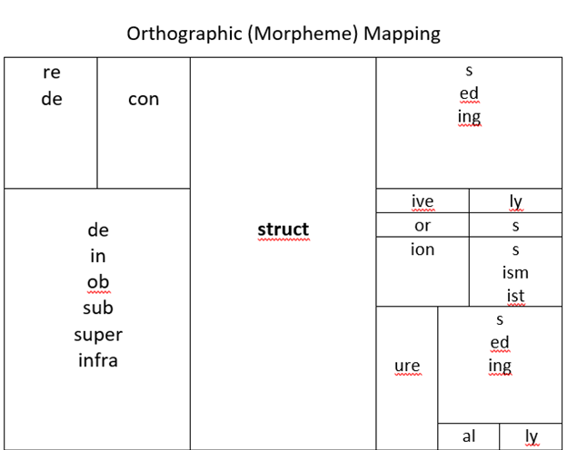
Morphology
How many words can you make?
Notes:
To Know and To Say: Morphology is the study of words, how they are formed, and their relationship to other words in the same language. It analyzes the structure of the word and parts of words, such as stems, root word, prefixes and suffixes. Direct instruction in morphology is an effective means to help with understanding and applying word structure for decoding, spelling, and vocabulary study. As early as second grade, students can be taught to recognize and spell morpheme suffixes that indicate: Numbers - such as (s) or (es); possession – using (‘s), and tense - such as (ed). Orthographic mapping is similar in that it involves the formation of letter-sound connections to bond the spellings, pronunciations, and meanings of specific words in memory.
Using the root word “struct” and the different affixes, how many words can you make in 60 seconds?
Please do NOT place root words on a matrix that have not been taught to students. Only use the words that have been introduced and will be applied to content for application.

Slide 44
Etymology
Handouts #5 and #6
Word Root | Origin | Meaning | Example
Bio | Greek | Life | Biography
Aqua | Latin | Water | Aquarium
Geo | Greek | The earth | Geography
Uni | Latin | One | Unicycle
Notes:
To Say: Etymology is the study of the origin of words and the way in which their meanings have changed throughout history. While English is a Germanic language, it shares many roots and prefixes from both Latin and Greek. Etymology is like a master key. When students learn the meanings of common prefixes, suffixes, and Latin and Greek roots, they can unlock many words. Etymology helps students understand words in a more complete and lasting way. The following words are examples that show, when you know the word parts, that you fully understand the word. When your brain understands all the pieces of a word, it gives it many more opportunities to create neural pathways.
Biography: The Greek word ‘bio’ means “life” and ‘graph’ means “to write”. So, biography means “to write one’s life”. Another ‘bio’ word is “biology”. Biology is the study of life and microbiology is the study of small living things.
Aquarium: The Greek word ‘aqua’ means “water” and ‘rium’ is a Latin word meaning “place”. So, the word means “the place where we keep water”. Other ‘aqua’ words are aquaplane meaning a plane that can land on water and aquafilter or a filter for water.
Geography: ‘Geo’ means “the earth” and ‘graph’ means “to write”. So, the word geography means to write about the earth. Another ‘geo’ word is geology meaning study of the earth.
Unicycle: ‘Uni” means “one” and ‘cycle, means “wheel”. So, unicycle means “one wheel”. Other ‘uni’ words are uniform (uni meaning one and form - form or shape). So uniform means having only one form or shape.
Latin Words: Fifty to Fifty-five percent of all English words have Latin roots, especially found in literature and social studies.
Greek Words: Always technical vocabulary used in science and math beginning in third grade.

Slide 45
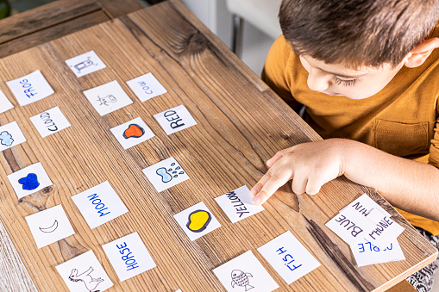
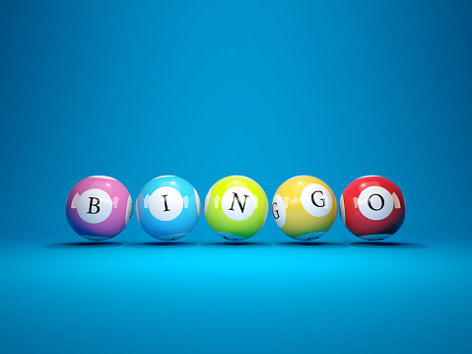

Engaging Games for Retention
Resource #1
Engaged and meaningful ‘play’ enhances repetition and retention to memory.
Word Sorts
SWAT!
Concentration
OOPS!
Old Maid
Bingo
Classroom Baseball
Connect Two
Any Board Game
Word Cards
Hot and Cold
ABC Graffiti
Notes:
To Say: These are games found in your resource packet. We are not going to be practicing these today. We offer these as ways to input intentional practice to hit 12-24 repetitions over time in different context.

Slide 46

What Are Some of Your Favorite Games?
Notes:
To Say: What are some games you play with your students for engagement to memory?

Slide 47
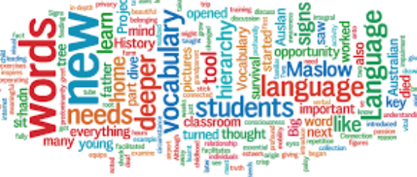
Using Technology to Teach Vocabulary
Learn from visual displays of word relationships - Word Clouds
Take a digital vocabulary field trip - TrackStar4teachers.org
Connect fun and learning with online vocabulary games
Use media to express vocabulary knowledge
Use online word reference tools
Increase reading volume by reading digital texts
Increase reading volume by utilizing text-to-speech tools and audio books
Notes:
To Know: Here is a link to some resources to support the use of technology to teach vocabulary.
https://www.readingrockets.org/article/10-ways-use-technology-build-vocabulary
To Say: In most schools, digital tools and media are available that teachers can harness to improve vocabulary learning, provide tools that will capture the interest of students, and provide scaffolds and contexts with which to learn about words. Given the fast pace of technology innovation, not all of these strategies have direct research evidence. However, they are all supported by research on effective vocabulary instruction, much of it carried out with printed materials and multimedia learning.

Slide 48

Context Clues Affirm Meaning
Before Reading
During Reading
After Reading
Notes:
To Know: Context clues affirm the meaning of a word after it has been decoded or sounded out.
To Say: Starting in second grade, the MLS includes the use of context clues for students to gain vocabulary knowledge. Instruction in using context clues as a word-learning strategy should include the idea that some contexts are more helpful than others. Teachers can use context clues all through a reading lesson. Before reading, the teacher can review how to utilize context clues to confirm the meaning of a word. They can explain the purpose of the lesson so students can use what they already know to help understand the meaning of new words. During reading, they can have students highlight unfamiliar words and the surrounding context clues that might help them understand what the new word means. They can share their thinking of the meaning of the word and search for the word in a dictionary to see if they are accurate. After reading, they can record these new words using the Frayer method and talk about how they confirmed the meaning of the new words.

Slide 49

How is This the Same or Different From Your Series or Practice?
Notes:
To Know: Networking is a benefit and much is to be gained from sharing what they have and noticing what is effective in their products or how to use their products with greater effectiveness.
To Do: Allow about five minutes to explore their products and share out.
To Say: Does your program or practice allow for targeted exposure and play with vocabulary? Do you become intentional about the selection of words by not just using the ones they list but, ensuring those words are the best for long-term retention and mastery to build moving forward? Do you ensure the vocabulary you are teaching is allowing time to practice using and applying the words orally and in writing?
** In addition to all the ideas we have presented you today
Be intentional about selection of words.
Provide student-friendly definitions for vocabulary
Remember, we all learn words in a variety of ways that are not explicit. So, what we take time on for instruction needs to be of value and relevant to your content.
Stop having students just worksheet words by copying definitions from a dictionary or glossary.
Make repetition of vocabulary engaging and spaced out over time with application so students can ‘own’ the words and use them.

Slide 50
ABC Graffiti
Handout #7
A | B | C | D | E | F
G | H | I | J | K | L
M | N | O | P | Q | R
S | T | U | V | W | X-Y-Z
Notes:
To Know: You may use this as an activity during your training or as a review at the end to sum up the learning for the day.
To Do: Have an ABC chart or Handout #7 for participants to jot down some ideas from today. The first word of each thought must begin with the letter in the top left corner of the box.
To Say: Another fun way to engage students in repetitive practice is to use the ABC Graffiti Chart. Students can review material by starting the first thought written in each box with the letter of the alphabet posted in the top left corner. Encourage participants to use key vocabulary from today or any of the prior trainings in the Components of Effective Literacy. Place individual words or short phrases to review.

Slide 51

Examples for Practice
Academic Word List
http://www.uefap.com/vocab/select/awl.htm
Words Worth Teaching by Andrew Biemiller
Games
https://pbskids.org/games/vocabulary
  https://www.flocabulary.com/vocabulary-mini-games/
  Resources
https://www.marzanoresources.com/reproducibles/vocab-common-core/#
Notes:
To Know: There are many resources for vocabulary.
To Do: Provide the Resource Handout #2 for participants to take with them for extra support and practice.
To Say: To begin instruction, you might consider using the academic word lists through the links above or the books.
Words Worth Teaching
Words Worth Teaching contains text about the importance of vocabulary for elementary students, suggestions for teaching vocabulary with primary and upper-elementary students, and how a listing of root words likely to be encountered in elementary education was established. The remainder of the book contains a listing of 11,000 root word meanings. Over 6000 word meanings were tested directly with elementary students. The 11,000 meanings were prioritized as "easy by second grade", useful to teach during the primary grades (K-2), useful to teach during the upper elementary grades (3-6), and difficult for elementary children at grade 6 or earlier. Sample sentences are provided for each meaning. In many cases, there is more than one meaning for a specific root word form (e.g., lean). The book comes with a CD which has the word list in Excel form. This listing allows teachers and publishers to select lists of word meanings they need to emphasize.
There are also many resources for play and engagement through PBS kids, Marzano Resources, and Reproducibles.

Slide 52
Thank You for Your Professional Attention
2021

Slide 53
There are other optional resource activities in the following slides for you to use during your presentation if you prefer.

Slide 54
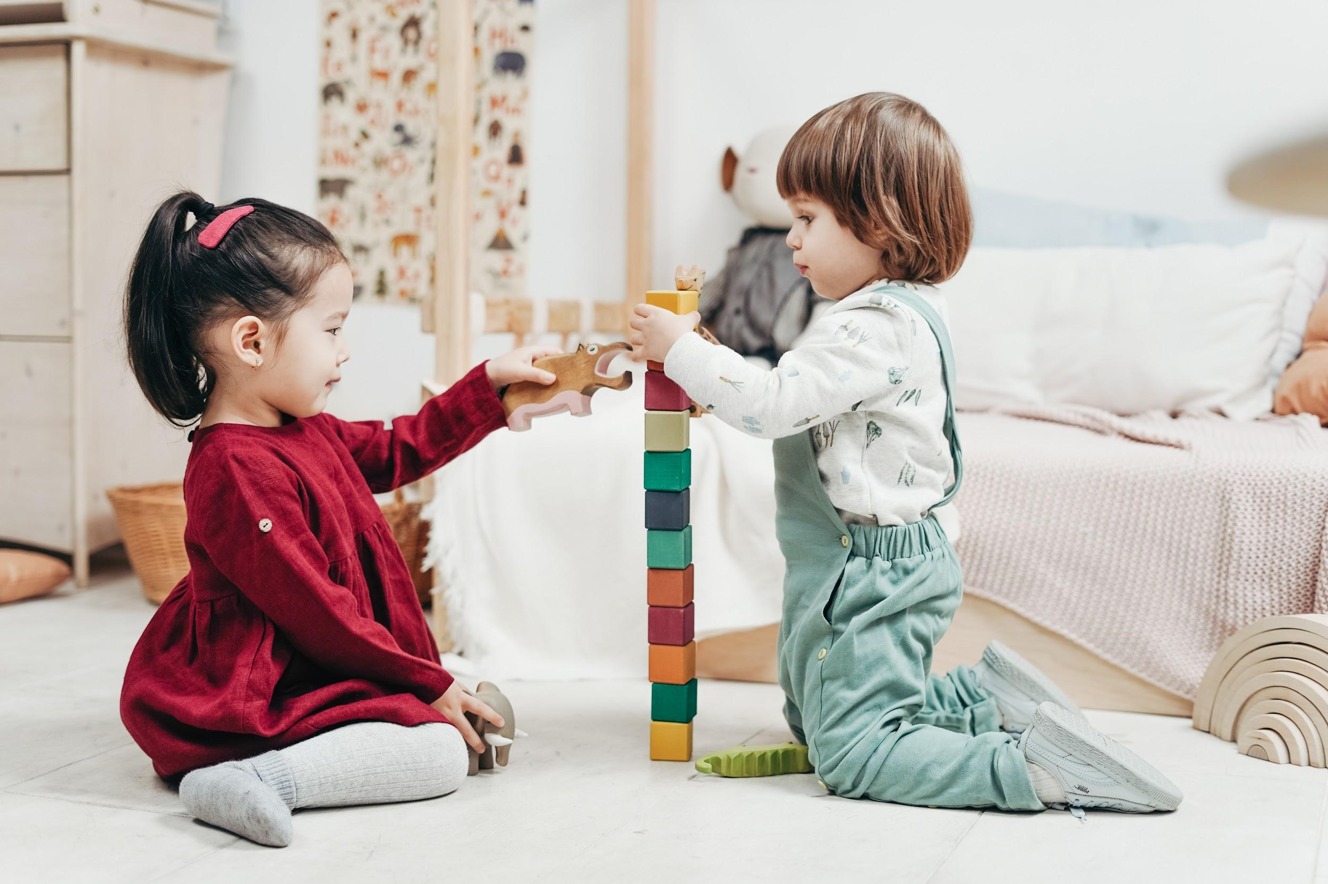
Playing with ‘Play’
Prefixes
Suffixes
Compound Words
Notes:
To Do: The participants can write words on a piece of paper. (If virtual, participants can write words on a piece of paper, share them in the chat box, unmute the mic and share, or annotate them on the slide.)
To Say: We are going to play with the word ‘play’. I want you to think of all the words you can that have the word ‘play’ in them. Think of adding a prefix, a suffix or even another word to ‘play’ and come up with a compound word. You have 30 seconds to come up with as many words as you can that have the word ‘play’ in them. Put them in the appropriate column. Does your new ‘play’ word have a prefix, a suffix, or is it a compound word, or a word that is made up of two complete words? In this case, one will play.
Examples
Prefix: Replay, interplay, misplay, teleplay, multiplayer
Suffix: Player, players, played, playful, playable, playing, plays, playfulness
Compound: Playpen, playback, downplay, playbook, playroom, playtime, playmate, playlist, playwright, horseplay, screenplay
Have the class discuss the meaning of each of their proposed words and how it relates to ‘play’.
,

Slide 55
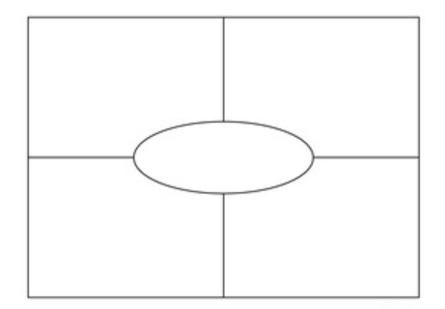
Your Turn
Words
reptiles
ugly
rectangle
precipitation
turtle
Orbit
birds
Missouri
Headings
Picture of the Word
Definition stated in your own words
The word in a sentence
Synonyms - Antonyms
Part of Speech
Attributes/characteristics
Examples -Non-examples
Notes:
To Know: This is an example for participants to practice making a Frayer.
To Do: Have participants practice a Frayer Chart. If in-person, you can pass out a blank frayer chart. You can provide words for them to use or have them all do the same word and see the differences with one word. Participants can do it individually, in pairs, or by table.
If virtual, they can simply draw the model and share by unmuting their mic or showing their picture (you can switch the screen so the one talking appears largest on the screen).
To Say: Often it is much easier to teach something once we have experienced it. So, we are going to do the Frayer Model. Take out handout #______ (or draw a picture like this on a piece of scrap paper). You can use one of the words on the slide or think of one of your own. The type of word you chose helps determine what categories you pick to fill out your model. On the right are some possible headings for your four boxes. You can chose the four you want to add.
A picture of the word
The definition of the word in your own words
Use the word in a sentence
Synonyms of the word
Antonyms of the word
Part of speech
Attributes
Examples
Non-examples

Slide 56

Vocabulary Activity
You can’t teach an old dog new tricks
Not my cup of tea
Hold your horses
Short end of the stick
Two ships passing in the night
Hit the nail on the head
Money does not grow on trees
Don’t count your chickens before they are hatched
Notes:
To Do: If in person, you can have the phrases on index cards and have them write down their restating of the phrase and have the group guess what phrase it was.
To Say: In creating language rich environments, you can take familiar phrases and restate them using different vocabulary or you can say the phrase that you made up and see if they can figure out what common phrase you are referring to. For instance, “One cannot educate an elderly canine on more current methods of antics”, might be, “You can’t teach an old dog new tricks. Correct?
Working in groups: Assign a familiar phrase to see if you can produce another way of stating or communicating the concept and meaning of the phrase.
Here are a few examples: https://knowyourphrase.com/r
A fool and his money are soon parted
Actions speak louder than words
Beating around the bush
Between a rock and a hard place
Birds of a feather flock together
Dropping like flies
Fit as a fiddle
Kill two birds with one stone
Let the cat out of the bag
Like shooting fish in a barrel
Open a can of worms
Pot calling the kettle black
Raining cats and dogs
Roll with the punches
Spill the beans

