Slide 1
What You Will Need
HO #1 – Components of Effective Literacy – Glossary – Assessment
HO #2 – Vocabulary Swat HO #3 – Data Flowchart Targeted Literacy Decision Making
HO #4 – Layers of Literacy Flipbook
HO #5 – Rasinski Multi-Dimensional Fluency Rubric
*DIBELS 8 Benchmark Grade 3 Student Materials and Teachers Scoring Guide
HO #6a – Oral Reading Fluency (Benchmark ORF.3.Beginning-Sponges – Student Materials)
HO #6b – Oral Reading Fluency (Examiner Script – Benchmark ORF.3.Beginning – Sponges – Teacher Scoring Guide)
HO #7a – Word Reading Fluency (Word List – Benchmark WRF.3. Beginning – Student Materials)
HO #7b – Word Reading Fluency (Examiner Script – Benchmark WRF 3.Beginning – Teacher Scoring Guide)
HO #8a – Nonsense Word Fluency (Word List – Benchmark NWF.3.Middle – Student Materials)
HO #8b – Nonsense Word Fluency (Examiner Script – Benchmark NWF 3.Middle – Teacher Scoring Guide)
*Advanced Decoding Survey (Really Great Reading 2019)
HO #9a – Recording Form A
HO #9b – Words to Read
HO #10 – Phonological Awareness Screening Test (PAST)
Notes:
The Data Flowchart for Literacy Decision Making was from the original Introduction handout. This session will go deeper into the document. As a presenter, you may want participants to see the ‘big’ picture and have the handout easily accessible or brought with them. Today, they will use a Layers of Literacy Flipbook for Decision Making as a note taking organizer as they go through each step of the decision making process.
For the DIBELS 8 Grade 3 and assessment you will NOT use the complete battery for grade 3. Participants will ONLY need
One Oral Reading Fluency scoring passage (teacher copy - Beginning)
One Oral Reading Fluency student copy of passage that matches the teacher copy given
Word Reading Assessment - one scoring copy with directions (Beginning)
Word Reading Assessment- one student copy matching the scoring copy given
Nonsense Word Fluency - one scoring form with directions (Middle)
Nonsense Word Fluency - one student copy to match the scoring form given
Advanced Decoding Survey - one scoring form and a copy of the student Form A- ONLY COPY THE ADVANCED SURVEY
Rasinski - Multi-Dimensional Fluency Rubric
The PAST test - one form - the standard form is what was used in the audio

Slide 2
Assessment
Components of Effective Literacy
Module 5
2022
Notes:
To Know: This module is to be used in the series of trainings developed around the components of effective literacy. Some may determine this module might need to be in a different order and not be seen as the fifth in a series. This module is not about all assessments, nor is it about how to use the data for determining instruction. It has been developed through the lens in which districts have such a vast difference and departments of literacy. We are frequently data-rich and knowledge-limited for application. Part of that limited knowledge lies in our inability to look at the drivers of literacy success. That is not because we do not want to do that, but often we have different reasons for selecting the assessments. Our district needs or motives are not always fully informed by the developmental, foundational needs of students who have not learned to read successfully. Teachers, not products, make the difference in the learning trajectory for readers. This assessment module is built to help us examine our practices of assessment in the light of how to determine which assessments need to be grade-level and which are needed to identify, guide, diagnose, and monitor the growth we wish to focus on through the literacy process.
To Say:
To Do:
If one of the above is not applicable, leave it off. Purpose: Provide opportunity for learners to engage in the content prior to the formal training.
Content: Learning objectives; Expectations for the training; Preparatory reading reflection exercise.
THIS SLIDE SHOULD BE HIDDEN PRIOR TO PRESENTATION

Slide 3
Opening and Introductions
Notes:
To Know: Please place your contact information in the module.

Slide 4
Learner Intentions
Participants Will
Examine types and purposes of assessment
Link current practice(s) of assessment with student developmental needs
Identify how sensitive, predictive measures can help align our instruction to ensure continued growth for students and decision-making for teachers
Notes:
To Know: We will take time to look at assessments that are the most predictive and sensitive to reading progress. We will ask how their assessments are the same or different than these measures. There is no way we can cover in two hours what will be needed to use and understand the data from these assessments. We will allow time to discuss or listen to what these might sound like in action for them to consider their needs.
To Do: Take time for participants to read and consider the learning set before them.
To Say: Today we will examine the types and purposes of assessment as well as consider how each has a very important place in our system of education. We hope the time committed to this learning is to consider how our current practices have and can fit the developmental needs of our students. What we hope to leave you with today is a clearer understanding of which data is important or needed at which point in time. We also hope that you will intentionally consider how the final assessments we take time to examine are used or administered in your settings. We will ask you to use those assessments as a measuring stick against your current assessments.

Slide 5
Missouri Teacher Standards
The following Missouri Teacher Standards will be addressed today
Standard #1 - Content knowledge aligned with appropriate instruction
Standard #2 - Student Learning, Growth and Development
Standard #7 - Student Assessment and Data Analysis
Notes:
To Know: These are the teacher standards we will address today.
To Do: Direct participants to the slide.
To Say: If you need to document for your professional development reference, here are the Missouri Teacher Standards that we will be addressing today. I will pause a moment while you note these, if needed. We will address Standards #1, #2, #3, and #7.

Slide 6
Norms
Be Present
Turn cell phone off or silence
Minimize sidebar conversations
Ask questions
Take care of personal needs with minimal distractions
Have open heart and open minds
Be patient
Notes:
To Know: Please use norms that fit your audience and needs.
To Do: Change norms to fit your audience needs or usual norms. Explain break times and where to take care of personal needs, if not in their normal learning space.
To Say: Here are what you can expect as norms for our session. We expect you to listen and interact with understanding. Questions are welcomed. We will take formal breaks, but please plan on taking care of yourself in every way with respect to others around you. When we provide opportunities for you to learn, we do it with intention and believe that your engagement and thoughtful reflection for application is what will make this day productive for all. Is there anything else you might want or need for this to be a good day?

Slide 7
Virtual Norms
Ask questions (chat box, raise hand, unmute)
Engage fully (clock icon when you step away)
Integrate new information
Open your mind to diverse views
Utilize what you learn
Adapted from: Mallia, G. (2013). The Social Classroom: Integrating Social Network Use in Education.
Notes:
TO Say: Are there additional norms you would like to add for the sake of the group?

Slide 8
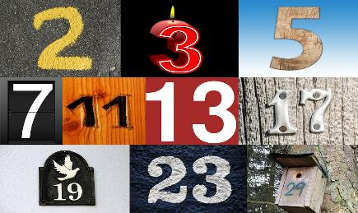
Introductions
Select two or three numbers (can explain in less than one minute)
Consider why those numbers are important to you
Introduce yourself
State your name
Where do you teach
Explain your numbers
Notes:
To Know: You may use this slide and activity or one of your own to engage participants.
To Say: We are looking at assessments with the intent of the use of data. So, why don’t we start with some data concerning yourself.
Select two or three numbers (Can explain in less than one minute)
Consider why those numbers are important to you
Then introduce yourself
State your name
Where you teach
Explain your numbers
Example:
My name is Jane.
My numbers are 3-2-1
I have three grown children, but 3+2 = 5 letting you know I have five grandchildren and of my three children - two are male and one is female. Yet, of my grandchildren, only one is a girl leaving two brothers for her in that family and two boys in my other son’s family.
Everyday it takes three others to keep me going -- The Father, Son and Holy Ghost!
Take a moment to select your numbers.

Slide 9
Agenda
The Goal of Reading: Comprehension
Types and Purpose of Assessment
Functionality of Data for Literacy
Screening to Instruction to Assessment
Consider the Validity and Reliability of In-District Assessment Use
Notes:
To Know and To Say: Here is our agenda for the day.
To Do: Pause for participants to read and consider the focus.

Slide 10
Reading
HO# 3
The intent is for the reader to understand the text. In other words, the end result of reading should be comprehension.
Reading Comprehension
Notes:
To Know: We will be looking at different types of assessments today and will consider the Data Flowchart for Effective Literacy as our anchor. (HO #3)
Since the end result of reading should be comprehension, we will look at specific assessments and ask you to consider if you have assessments that mirror these or help you to gain the same information with fidelity.
As students progress from kindergarten through third grade, they should be steadily developing the skills they need to become proficient readers. Students need to learn and then master their foundational skills (e.g., decoding individual words) while gradually developing the ability to understand and critique increasingly complex texts.
Therefore, as we move forward, you will find there are multiple types of assessments needed over time and the difference in students growth will be seen in how we use the data to make everyday decisions on instruction.

Slide 11
Assessing Reading Skills for Instruction
https://www.readingrockets.org/teaching/reading101-course/modules/assessment/assessment-depth#fytH1
Notes:
To Know: 3:06 minutes
https://www.youtube.com/watch?v=FIlNEgMItho&t=184s
As you listen to the video, be thinking about these two questions and I will give you a chance to write your thoughts.
What resonated with you after hearing those words?
Did it confirm or refute some of your ideas about assessing reading?

Slide 12
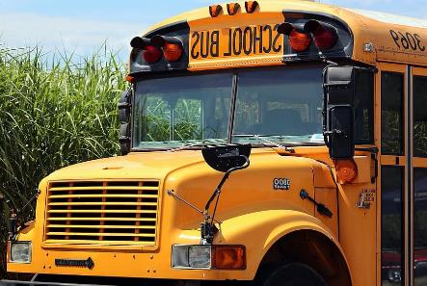
Sixty Second Reflection
What is our job as educators?
What resonated with you from this video?
Stop-N-Jot
Notes:
To Know and to Say: We are driving the assessment bus today and we would like for you to be on the same bus.
We will stop and set a timer for 60 seconds. We heard several ideas in that three-minute video and we would like for you to STOP-N-JOT on a sticky note, or in your notes, for us to return to later.
What resonated with you after hearing those words?
Did it confirm or refute some of your ideas about assessing reading?
After your reflection time, we will move forward and return to these thoughts at the end of our time together.

Slide 13
Assessment: Know Your Purpose and Type
Notes:
To Know: This is a header slide.
To Say: As we examine different assessments for reading, let us consider how we use different assessments according to purpose and type.

Slide 14
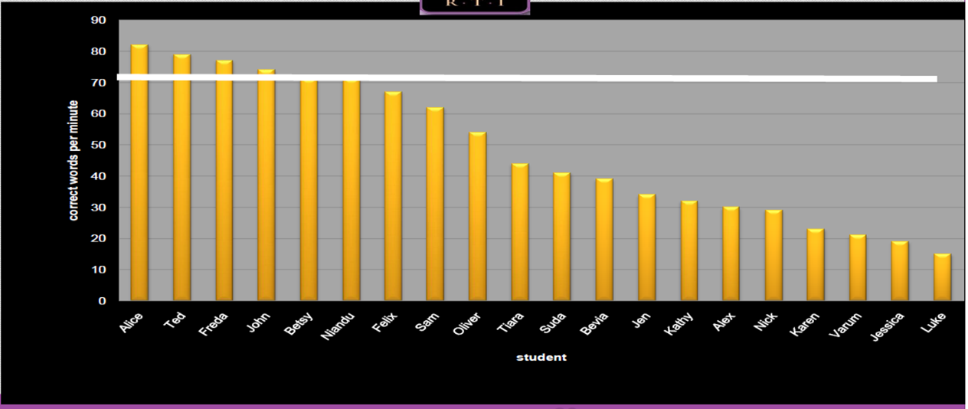
What Do You Notice?
Notes:
To Know and To Say: This screenshot is an example of data from an Oral Reading Fluency assessment.
This assessment is looking at the number of words read orally per minute by each student. As we look at individual student scores, we see there is a white line drawn between 70-80. That line represents the number of words that students would be expected to read orally per minute on this normed assessment. Some assessments call this “Word Count per Minute” or “number of words read correctly per minute.” The white line is considered the ‘benchmark’. Benchmark is set by the average of all students in the norm group. The yellow lines are the individual student scores and you can readily see where the students are in relation to the white benchmark score line.
What do you notice? (Pause for participants to consider and pose the next question).
Do you see very many students able to read at that level? (Answer: No)
This data is telling me that very few reach the benchmark target. Since Oral Reading Fluency is a predictor of who will struggle with comprehension and overall literacy, then this is an issue that needs to be addressed as a class wide concern. No matter the assessment, data like this is telling us something is not working for the student.
Ask the following rhetorical questions:
Is it the student?
Is it the instruction?
Is it the curriculum?
Of course, there are multiple factors here to consider. But, right away we can see it has to be the curriculum or the instruction. Understanding how reading develops within students through these modules should help us to know if we have the tools within our curriculum or the instruction which needs to be in place to change this class wide data. This tells us we need to look at our Tier I instruction.
Oral reading fluency, as all curriculum based measurements, are reported against a benchmark revealing where students are compared to the norm groups nationally.

Slide 15
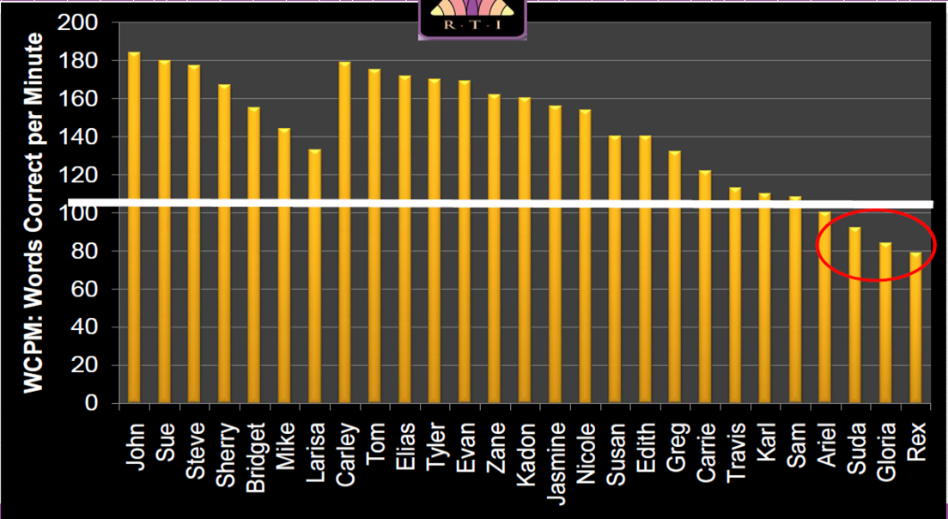
What About This?
Notes:
To Know and To Say: What is different about this data?
We are looking at the same type of data with words read correct per minute, but most students are rising above the cut-point line. Only a few students are below the target. This would indicate the instruction and curriculum used is appropriate. Now, we just need to use a diagnostic instrument to determine how to target the problem at word level.

Slide 16
Assessments reveal more than student ability
Notes:
To Say: Assessments, with data like the previous slides, affirm when a district needs to change instruction for individual students or when too many students cannot access a benchmark informing us that there is a class wide issue to address.
When we use assessments wisely focusing on the purpose and type, we can impact growth more efficiently. If we use assessments with National Norms and are sensitive to the components needed for effective readers, we readily identify need. Of course, if we do not use predictive assessments like the ones we will focus on in our final portion of our learning today, we will continue to wonder why our students are not making progress.

Slide 17
Assessment Functionality
Content Standard Aligned
Foundational Skills Aligned
Which skills do we need to focus on and when?
Notes:
To Know and To Say: There are two overarching sources of assessment measures with two different frames of focus. Assessment measures are developed to focus fully on one or the other. It is common in grades 3 and above to select and use districtwide assessments that help us to teach and assess how we will score on state or national assessments. Over the years, we have placed large sums of money into assessments that align to our state standards (MAP testing) and help prepare or predict how our students will perform on end-of-the-year state assessments. We are funded and scored or ranked based on our educational performance on these tests. There is no doubt as to why we would put our money into those types of assessments. Yet, in grades 3 and above, we rely heavily on comprehension assessments which are given to students in groups using adaptive questioning through multiple choice formats. These tests are limited in ability to score authentic reading responses, although some are working hard to include that in their measures. These assessments are more content standard aligned rather than diving into foundational skills outlined in the “Reading Foundations Standards” of our Missouri Learning Standards.
(Rhetorical Question)
This begs the question. Why aren’t we focusing as heavily on the Foundational Skills over “Standards” type questions written for statewide tests?
Assessments normally used for comprehension include adaptive measures taken online and/or multiple choice answers reducing the chance that the student might respond differently during authentic oral or silent reading.

Slide 18
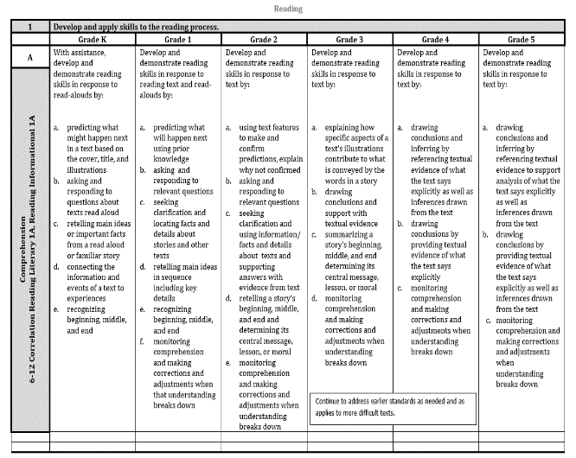
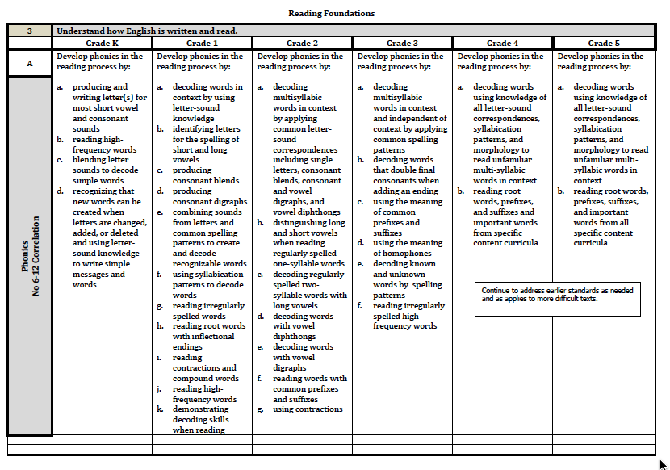
Missouri Learning Standards
Reading
Reading Foundations
Continue to address earlier standards as needed and as applied to more difficult text.
Notes:
To Say: Many teachers are not aware that our Missouri Learning Standards are not deep enough to include the development needs of early readers. The ‘Reading Foundation Standards’ are also not located in the beginning of Reading in ELA. They are like an afterthought. It is not due to negligence, rather a complicated set of misunderstandings and timeline factors in the overall development of the standards.
Our standards do not represent everything that is needed to be taught and we are told that living in a local control state we realize we have different needs per our population, but the standards provide us with a common set of directions.
Many assessments we purchase as a district were made to help us predict or gauge our growth against the comprehension questioning types and vocabulary assessed nationally in grades 3-12. We would hope that most students are reading on grade level by third grade when we move into the ‘read to learn grades’.
As we look at our standards, we notice that even our priority standards start with the end in mind. That is, they begin listing the elements of comprehension being the first listed for literacy and informational text. We are proposing that in order to get to comprehension we will need to examine what assessments help us to understand comprehension and how to identify what we need to target when a student cannot comprehend.
(Click to advance for enlargement of the red box)
We also need to remember our standards in elementary require us to continue to address earlier standards as needed and as applied to more difficult text. Students can master some skills using literary text but might not be able to apply to information text or other genre. Assessments can help us address this need.
We strongly request that you always look at what is needed nationally as we prepare students to become successful in our society. We do not want to limit their chances for that success. We do ask today, as we look at assessment, that you consider the understanding you and your staff have about the types, purposes, and function of assessment.
Other Resources:
Missouri Priority Standards
https://dese.mo.gov/college-career-readiness/curriculum/academic-standards/priority-standards
https://sites.google.com/view/priority-standards-mo-dese/home/english-language-arts?authuser=0
Missouri Grade and Course Level Standards
https://dese.mo.gov/college-career-readiness/curriculum/english-language-arts
Reading Rockets: Common Core Standards
https://www.readingrockets.org/teaching/reading101-course/modules/assessment/assessment-depth#fytH1

Slide 19
National Assessment Concerns
In the United States, over half the children have scored at the basic or below basic levels every time The National Assessment of Educational Progress (NAEP) has been administered.
(Seidenburg, 2017)
Notes:
To Know and to Say: The National Assessment of Educational Progress (NAEP) is the largest nationally represented and continuing assessment of what America's students know and can do in various subject areas. Each year NAEP randomly selects schools across the country in a specific grade level for academic testing. This approach provides them a variety of ability levels, socio-economic status, and ethnicity. Districts do not get individual results when their students take the NAEP.
When students, their parents, teachers, and principals participate in the National Assessment of Educational Progress (NAEP), they are helping to inform decisions about how to improve the education system in our country.
NAEP includes a range of subjects at grades 4, 8, and 12 to provide a comprehensive look at the wide array of academic areas that are a part of a student’s education. Subjects include civics, economics, geography, mathematics, music and visual arts, reading, science, technology and engineering literacy, U.S. history, and writing.
NAEP monitors overall educational progress for the nation, states, Trial Urban District Assessment in select districts, and for different groups of students, including students with disabilities and English language learners. NAEP is not designed to provide results for individual students or schools.
As we look through the lens of NAEP, Seidenburg reports just as NAEP has stated, over half the children in the US scored in the lowest levels of proficiency. Over half - tells us we need to be cognizant of what is needed in using assessment to make a difference at student level.
More to Know:
Mark Seidenburg is a professor in the department of psychology at the University of Wisconsin-Madison. He was originally a psycholinguist, but has often been referred to as a cognitive scientist or cognitive neuroscientist.

Slide 20
Different Purposes of Assessment
Programming
Determine success of program or curriculum
Compare teachers with different groups or strategies
Instruction
Cut-points or diagnostic for grouping
Monitoring progress with sensitivity
Notes:
To Know: Assessment has different forms and types but also different purposes.
To Do: Build on the slide.
To Say: The different purposes of assessment are frequently seen as the same, but they are not. What we might need at district level provide us with great data on whether our program or curriculum is doing what it should do. It is a great reference to see if we are getting students to a common goal even when they have different teachers or different instructional strategies. We are able to consider which subjects might need new curriculum or which teachers need different support when we thought we were using common assessments across multiple teachers. We can decide if we need to purchase math first or a different subject area. It also helps us to determine where we are in meeting state or national criteria.
The data teachers use for instruction is also very important. We value data that helps us to know where to ‘draw the line’ for students as ‘At-Risk’ or on grade level. We like to have data that can help us know what to teach to individuals or to specific groups. What we have learned within the Components of Effective Literacy is that reading is developmental in many ways and we desire to know those skills and how to know over time whether we are making progress. Since instruction is a daily task we also desire that our assessments are sensitive enough to tell us if we are heading the correct direction or making progress towards the essential components that will help our students to be successful readers.

Slide 21
Know Your Purpose and Use
Sort students across class or grade
Identify individual student strengths and weaknesses
Guide the next steps of instruction
Formal and normed
Informal aligned to daily instructional targets
Notes:
To Know: We need to know the purpose of an assessment and must understand the assessment to make sense of the data.
To Do:
To Say: As we look at different assessments, let us ensure and keep in mind the purpose you have in mind as a teacher of reading. Assessments can be invaluable in helping teachers to identify the strengths and weaknesses of each student and to guide the next steps in instruction.
No single assessment will provide insight into all of the reading related skills students need to be able to learn. Reading Assessments should be conducted throughout the school year not taking over the instructional time but guiding the instruction in the most efficient way possible.
Formal assessments are the systematic, data-based tests that measure what and how well the students have learned. Formal assessments determine the students’ proficiency or mastery of the content, and can be used for comparisons against certain standards.
Informal assessments are those more spontaneous forms of assessment that can easily be incorporated in the day-to-day classroom activities and that measure the students’ performance and progress. Informal assessments are content and performance driven.
We need both, as one compliments the other, in depicting accurate pictures of our students. We can use either type (depending on the intended purpose) to improve teaching and learning.

Slide 22
Types of Assessments
Notes:
To Know: This is a Header slide. It prepares us to focus on specific elements of the learning.
To Do: Move quickly past header slides to enter the content of the module.
To Say: So let’s take a look at the different types of assessments more specifically.

Slide 23
Categories of Assessment
Screening
Progress Monitoring
Monitoring Progress
Formative Assessments
Summative
Outcome
Diagnostic
Norm Referenced
or
Criterion Referenced
Notes:
To Know: Resource may be found at: https://www.readingrockets.org/pdfs/assessments_overview.pdf
To Do: You will need to click forward to add the green box.
To Say: There are several different types of assessment that can be used for understanding student growth and need. We will look at several different types today. It is important to understand the difference between norm-referenced and criterion-referenced assessments when talking about categories of assessment.
By norm-referenced we mean where the student is compared to his or her peers. Report whether test takers performed better or worse than a hypothetical average student, which is determined by comparing scores against the performance results of a statistically selected group of test takers, typically of the same age or grade level, who have already taken the exam.
With a norm-referenced test the kind of scores you will receive include a percentage or percentile ranking. They are usually based on national or state standards not locally developed standards. They are used to determine a young child’s readiness for kindergarten, evaluate a student’s progress for promotion or additional support to make eligibility decisions.
A criterion assessment evaluates the learning of a student against a set or pre-specified qualities of criteria without reference to the achievement of others (Brown, 1998; Harvey 2004). This standard or criteria is predetermined before students begin the test. Schools or districts choose a standard, such as a percent of items answered correctly or a state test benchmark, as the criteria for the test. The student's score then shows the progress they have made toward the agreed-upon standard. Criterion-referenced tests use cut scores to place students into categories such as basic, proficient, and advanced or results can be reported in grade-equivalents such as 3rd grade/4th month.

Slide 24
Screening
Given to all students
Beginning of the school year, mid year and final
Not to diagnose specific skill gaps
Identify children who may need intervention
Compare to research criteria or national norms and benchmarks
Notes:
To Know and to Say: Screening assessments are given to all students at the start of the school year to determine which students are at risk of struggling with reading. They are not used to diagnose specific skill gaps; rather, they help to identify children who need diagnostic assessments, as well as children who may require supplemental intervention. Screening assessments should be relatively fast and efficient to administer.
Starting in 2018-19 districts were required to conduct dyslexia screening for students in grades K-3 within the first 30 days of school. Three times a year is necessary because rigor increases throughout the school year. In most schools, systematic screening at the lower levels is taking place. So you may want to check and see what your district is doing to meet this requirement and get access to the screening results if you do not have the scores already or know how to use the data.

Slide 25
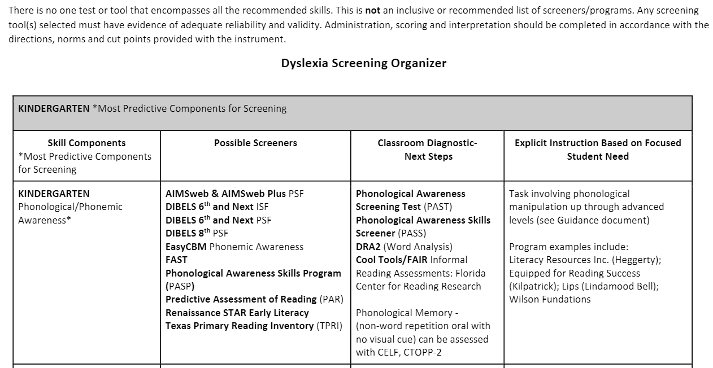
https://dese.mo.gov/sites/default/files/curr-dyslexia-screening-organizer-by-grade.pdf
Notes:
To Know: This is a screenshot of the Dyslexia Screening Organizer on the Missouri Department of Elementary and Secondary Education website. https://dese.mo.gov/sites/default/files/curr-dyslexia-screening-organizer-by-grade.pdf
To Say: Missouri passed legislation which mandated districts put into place screening using assessments that are to identify students who are at-risk of reading failure. The mandate requests districts conduct screening three times a year and report students as at-risk or not in the June MOSIS data reporting. This mandate is referred to as the Dyslexia Law but the purpose was for identifying and servicing students at-risk for dyslexia or related disorders in accordance with the provisions of Section 167.950, RSMo.
This document is similar to what other states consider important tools for assessment in screening, but also using the screening data to inform instruction. This document is on our state website. It is not an exhaustive list nor a required list, but rather a list of measures which have proven to be highly predictive and sensitive to identifying and/or monitoring student progress in the necessary skills foundational to reading success. This document is reviewed each year and may change as instruments prove valid and reliable for screening. This document also points out that screening data always needs to be followed by data which can diagnose the reason a score falls as deficient. The Screening organizer is divided per grade and listed according to the skill areas needed for a student to be a successful reader. All students grades K-3 are to be screened unless they are ID or ELL. Students in grades 4-12 are to be screened if a parent or teacher sees signs of a struggling reader and districts are to develop a plan of how they will address the literacy need for the student(s).
We will suggest if you are unaware of this document or want more information on this please let us connect you to the support you need. We will look at the assessment forms you see listed.

Slide 26
Why Do We Use Screening Assessments?
With universal screening, students who are at risk for reading difficulties can then be flagged for diagnostic assessments and given the critical early intervention that will help them overcome their specific difficulties.
Reading Rockets
Notes:
To Know and To Say: This comes from https://www.readingrockets.org/teaching/reading101-course/modules/assessment/assessment-practice#fytH1.
Universal Screening instruments can be set for national norm reporting or criterion. This ensures the validity and reliability of the cut points across a large representative sample not just reported against local students. This validation also gives the reviewer a wider lens of student growth as we determine how to create lifelong learners for success in the world.
We must remember that one score from one screening instrument is not enough to understand how to identify the exact skills needed for instruction or intervention. We would want to go deeper in the individual skills needed. That is the purpose of the Flowchart for Targeted Literacy Decision Making (HO #3). Teachers will also need to find instruments that are sensitive to change and progress monitor the growth frequently in those areas of need.

Slide 27
Monitoring Progress
Vs.
Progress Monitoring
Notes:
To Know and To Say: Sometimes these two terms are confused or used interchangeably. Monitoring progress is what we do daily to determine next steps in instruction such as quick checks through questioning as an instructional tool. Progress monitoring is a scientifically based practice through assessment that teachers can use to evaluate the effectiveness of student learning.
The greatest difference between the two is usually found in the type of tools used. Our focus will be on using the tools for Progress Monitoring.

Slide 28
Progress Monitoring
HO# 1
Formal
Curriculum Based Measures (CBM)
Dynamic Indicators of Basic Early Literacy Skills (DIBELS)
AIMSweb
FastBridge
Informal
Reading Inventories
Reading Benchmarks
Portfolios
Notes:
To Know: Many screening instruments have quality progress monitoring data dashboards that are sensitive to the growth of the student towards a given target criteria.
To Do: Ensure participants recognize the value of formal norms than just using the informal non-standardized monitoring.
To Say: Progress Monitoring: A scientifically based practice used to assess a child's academic gains and evaluate the effectiveness of instruction. Progress monitoring tells the teacher what a child has learned and what still needs to be taught. We rely on normative data to ensure we are sensitive to growth and specific to key foundational skills. By normative we mean where the student is compared to his or her peers. Examples of these kinds of measures include Curriculum-Based Measures (CBMs), or an assessment like the DIBELS which are a set of procedures and measures for assessing the acquisition of early literacy skills. They are designed to be short (one minute) fluency measures used to regularly monitor the development of early literacy and early reading skills.
Teachers have used informal ways of monitoring progress almost daily in classrooms. Informal measures such as reading inventories, a district’s reading grade level benchmarks or student portfolios of reading work. We would like to be very clear about a difference here in the words progress monitoring and monitoring progress. Take a moment to find these two words in your glossary. HO#1 After you read the two different definitions, explain to your closest shoulder partner or table teams the difference.
For us to ensure we are directing our instruction and intervention, we will want to check a student’s progress frequently through formal and informal ways for understanding and/or retention of skills learned. The CBMs listed here are all one to three minute assessments, sensitive to change against specific criteria with national norms which help us to know if we are moving students at the growth rate needed to be successful readers. Many CBMs could be given on a bi-weekly basis if desired. Research has supported and recommends the use of frequent progress monitoring with the formal measures listed on the left side of this screen. The research also suggests we make confirmation decisions every three to four data points, when given every other week. We can confirm we are heading in the right direction with what we are doing as a team or confirm that growth is not being made that will help that student meet the end of the year goal.
More to know:
Formal progress monitoring is the most reliable when checking a student against the foundational skills for literacy.
A criterion assessment evaluates the learning of a student against a set or pre-specified qualities of criteria without reference to the achievement of others. (Brown, 1998; Harvey 2004)

Slide 29
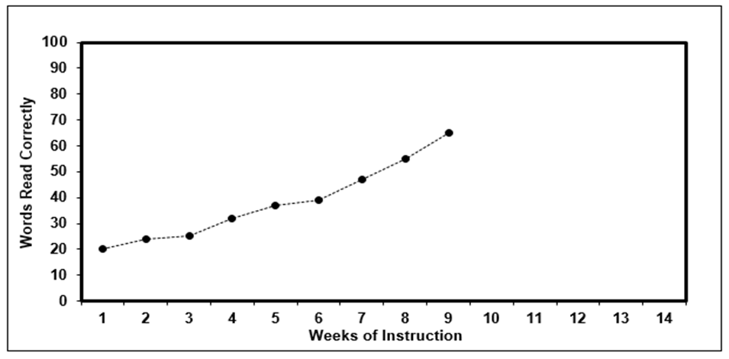
Consider Progress
X
Notes:
To Know: Individual student scores can be graphed to determine if appropriate progress is being made with instruction.
To Do: Reference the slide of actual student data.
To Say: Curriculum Based Measures (CBM) can show you student progress data alongside an aim line to determine if the student is making progress to close the gap and get to the end goal or target. The baseline is the starting point and the end goal is set based on the goal for the end of year.
The green line is called the aim line. The aim line begins at the first score received and reveals the progress necessary to meet the end of the year target. Students receiving additional daily support benefit from frequent progress monitoring about every ten days of instruction. Again remember, research supports decision making to occur after every three to four data points with assessments given weekly or every other week. If you were looking at this data, would you be able to see if the student is progressing enough?
Yes, the data here was taken every week. But, we can tell when we set the student scores beside the aim line of progress needed that this student is making the growth needed and is now rising above that needed growth.

Slide 30
Consider Progress
Words per minute
Baseline 9/15 9/29 10/14 10/28 11/12 11/25 xxxx xxxx xxxx xxxx xxxx xxxx xxxx xxxx xxxx xxxx xxxx
Notes:
To Know: Data aligned against a needed progress aim line.
To Do: Point out the data on the slide.
To Say: This student’s data when plotted against an aim line tells us the student needs to have a change in instruction possibly using a diagnostic assessment. When frequent progress monitoring is used, it can allow us to determine more quickly if we need to change our instruction through intervention digging into student errors within the components of reading.
We see this student cannot continue on the path she/he is traveling now.
Something was working but not now. So, what is different? That is a question to be resolved through investigation. Sometimes the change is due to our change of instruction between all teachers working with the student. Yet, there are times that personal life changes impact student growth, as well.

Slide 31
Formative Assessments
Rubrics with common formatives
Exit tickets
Specific, detailed, and constructive feedback
Questions designed to elicit concept understanding
Peer Assessment
Notes:
To Know: We acknowledge there are many formatives.
To Do:
To Say: Formative assessment refers to a wide variety of methods that teachers use to conduct in-process evaluations of student comprehension, learning needs, and academic progress during a lesson, unit, or course. Formative assessments help teachers identify concepts that students are struggling to understand, skills they are having difficulty acquiring, or learning standards they have not yet achieved so that adjustments can be made to lessons, instructional techniques, and academic support.
The general goal of formative assessment is to collect detailed information that can be used to improve instruction and student learning while it’s happening. What makes an assessment “formative” is not the design of a test, technique, or self-evaluation, but the way it is used - to inform current teaching and learning strategies. Formative assessment is an integral part of the teaching process. They can be as simple as students raising their hand to demonstrate they understand a concept to completing a rubric to score their own writing. With formative assessment teachers use the results to inform their current practices. https://www.edglossary.org/formative-assessment/

Slide 32
Diagnostic
Formal
Diagnostic Assessment of Reading (DAR)
Early Reading Diagnostic Assessment (ERDA)
Texas Primary Reading Inventory (TPRI)
Informal
Anecdotal Notes
Word Reading Lists
Phonics Inventory
Phonics Error Analysis
Family Interviews
Notes:
To Know: Diagnostic assessments help ensure we are targeting the needed skills. Teachers use informal means through curriculum products or based on their background of instructional tools. Formal assessments ensure we are directing attention to the foundational skills in which all literacy growth is based upon.
To Do: Reference the slide.
To Say: Diagnostic assessments are formative assessments used to assess specific skills or components of reading such as phonemic awareness, phonics skills, and fluency, which are the key foundational skills needed for effective growth and maintenance in literacy.
For our purposes today, diagnostic assessments will be defined as tests which reveal the individual skills needed to be successful readers. We are not using the term to ‘diagnose’ or label a student. We are looking at specific skills.
The results of diagnostic assessments inform instruction and intervention. Diagnostic assessments can be formal standardized tests of children’s component reading and language abilities or informal measures such as criterion-referenced tests and informal reading inventories. Not all children need this kind of in-depth reading assessment, which is most important for struggling and at-risk readers. Diagnostic Assessments can be used to help make placement decisions and identify specific skills in which students need additional support. It can help determine a student’s baseline performance in specific areas and ensure instruction begins at the level where the student is performing.
Conducting diagnostic formal or informal assessment throughout the school year can help us determine:
Whether instruction is being delivered at the right level and at the right pace
How to plan future instruction that will meet students’ needs
How students should be grouped for instruction so that each student receives instruction at the right level of difficulty
Which students need individual support
What might need to be targeted for instruction

Slide 33
Summative Assessments
End-of-unit tests
End-of-semester tests
Standardized tests (MAP, EOC, ACT)
Capstone projects
Notes:
To Know: Summative assessments allow no direction for instruction, but are usually used for grading and overall success of instruction.
To Do: Highlight slide
To Say: Summative assessments are used to evaluate student learning, skill acquisition, and academic achievement. They are given at the end of a designed instructional period; generally the end of a unit, project, course, semester, or school year. It is not the design of the assessment that makes it summative, but the way it’s used, i.e., whether to what degree a student has learned the material they have been taught. Because it is at the end of the learning cycle, they are evaluative, rather than used to drive instruction. They are used to determine progress or lack thereof, not why or why not progress was made. The results of summative assessments are often recorded as grades or scores and factored into a students’ permanent records in some form. This slide has examples of types of summative assessments used in schools.

Slide 34
Outcome Assessments
Missouri Assessment Program (MAP) - Grades 3-8
End of Course Exams (EOC) - Grades 9-12
National Assessment of Educational Progress (NAEP) Grades 4, 8, and 12
Notes:
To Know: Every type of assessment has a purpose and fulfills a need. This presentation is to help participants be aware of the different types and which will be most effective for the foundational skills of a student struggling with literacy.
To Do:
To Say: Looking at the types of assessments that are outcome assessments, what do we know about the MAP and the EOC Tests? (Allow a few people to share) Outcome assessments are also called high stakes assessments. They are given to all students in a specific grade. They measure a students’ progress against grade-level expectations.
Outcomes assessments are used to make decisions about students, teachers, or even an entire school system. How is the MAP and EOC used in Missouri? (Allow a few people to share) Accreditation process for school districts, consideration of targeted, provisionally accredited or unaccredited.
National Assessment of Educational Progress (NAEP) scores are used to develop the Nation’s Report Card, which reports student proficiency on a yearly basis on the goal of proficiency and many reports are prepared based on the NAEP regarding national and state overall scores, results by race, ethnicity, and gender.
This data does not help us make daily instructional decisions and can only be used with trend data across time for shifts in demographics and curriculum differences, but not in teaching of reading for individual students.
These assessments are needed. But, they are not what we are going to use as our measure of progress for individual students looking to meet the independent skills needed for literacy.

Slide 35
Check Your Glossary
Notes:
To Do: Ensure everyone has their Glossary
To Know and To Say: Use the glossary with your partner. Explain the difference between
Progress Monitoring vs. monitoring progress
Formal vs. informal

Slide 36
Vocabulary Swat
HO# 2
Criterion Referenced
Monitoring Progress
Formal
Assessment
Assessment
Progress Monitoring
Informal Assessment
Norm Referenced
CBM
Notes:
To Say and To Do: When we talked about vocabulary last time, we talked about using games to help reinforce vocabulary. We shared with you about a Vocabulary Swat. So, we are going to take a minute and review some of the vocabulary we have gone over so far as we have talked about types of assessment. Remember, in a vocabulary swat the teacher shares either a word or the definition, or a fill-in-the-blank and students compete against each other to see who can swat it first. Find a partner. (Provide the Vocabulary Swat handout and paper to fold). HO#2
Fold the sheet of paper you receive in half and then half again until it is long and thin like a swatter. Put the word sheet between the two of you. We will read the definition to the word - you can use your glossary and when you know what the word is, be the first to swat the correct word. Keep track of who got the word swatted first and if it was correct and give yourself a point. The one with the most points at the end wins.

Slide 37
Foundational Reading = Predictive Measures
Notes:
This is a header slide.

Slide 38
Notes:
To Know: April 27, 2021, NAEP published a study completed on students who took the fourth grade assessment during 2018. NAEP conducted a study to look at struggling readers. They gave a supplemental Oral Reading Fluency test to a portion of fourth graders. These fourth graders also took the main NAEP reading test to assess their reading comprehension. The 2018 NAEP ORF (Oral Reading Fluency) study operationally defined fluent readers as those who can “read text with speed, accuracy, and proper expression.” As you can see, there were1,800 fourth graders from 180 public schools. The study called attention to the rate and accuracy of word reading and phonological decoding because research has repeatedly supported these skills as foundational for fluency and subsequent development of reading comprehension. The more words children can recognize in print quickly and without effort, the more efficiently they can acquire new vocabulary and knowledge through reading. This, in turn, helps in the comprehension of each new text they encounter.
The study demonstrated that students’ reading comprehension was connected to their ability to read text fluently and accurately, and to their ability to recognize and decode words. The lower students scored on the main NAEP reading test, the harder time they had with reading fluency and foundational skills on the ORF. In other words, students must master the necessary skills of decoding in order to read fluently so that comprehension can occur.
https://nces.ed.gov/nationsreportcard/studies/orf/

Slide 39
NAEP Comprehension Assessments
Review Oral Reading Fluency Impact
Implications of the NAEP Reading Framework study notes that text comprehension is influenced by phonics knowledge and fluency; and, importantly, it recognizes that “without these foundational skills, comprehension will not occur.”
https://nces.ed.gov/nationsreportcard/studies/orf/ (NAEP Study 2021)
Notes:
To Know: This is the most current study conducted by NAEP to determine the link of oral reading fluency to NAEP performance data. 2021
To Do: Direct attention to the slide for participants to read.
To Say: Here are the implications of the study. I will pause for you to read.
While this test of oral reading fluency and foundational skills does provide new information, it certainly can’t prove causation as it doesn’t also factor in the role that vocabulary, syntax, morphology, and other elements of language can play.
This is a wonderful study to share alongside the Simple View of Reading as you discuss D x LC = RC and Scarborough’s Reading Rope and exactly which skills make up and need to be taught within the decoding strand.
NAEP has always provided information proving that overall, we do not do a good job of teaching reading so students score high on our comprehension assessments. We know many questions on a ‘standards focused’ assessment are product focused in nature meaning the student needed to have comprehension to answer them.
Why are we assessing fluency? (Rhetorical Question)
Fluency is the rate at which a student can process information. If a student can orally read at the appropriate rate for their grade level, then they can process curriculum at the rate and rigor needed for success. When a student cannot orally read at the rate needed, they have a hard time keeping up with the Missouri Learning Standards for their grade level. It does not just impact reading, it impacts all content areas.

Slide 40
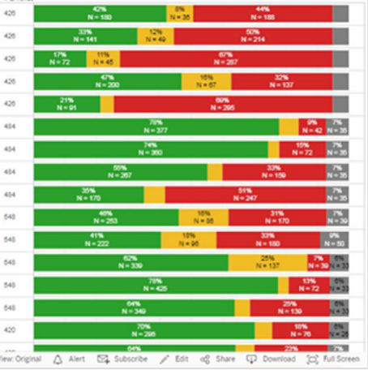
Have You Ever Been Surprised at Student Scores on District Assessments?
Kabrina - Broad Reading
Benchmark Raw Score: 224
Ty -Broad Reading
Benchmark Raw Score: 224
Notes:
To Know: In every system of assessment there are data benchmarks or reporting which can tell us who is functioning up to target or average for the grade level on skills and broad development and who is far above or far below.
To Say: Assessment reporting data has been observed to be different per tool over time reporting individual student, classwide, or even across districts. One issue we hear teachers say from time to time is that they can be amazed at where a student will fall on class reports when they felt the students were very different. So how do they get the same score? Some involve multiple choice and some involve understanding the different skills or questions which might trip up a student.
Sometimes student assessment scores do not match classroom performance. Today we are going to carry two students with us as we move forward. We will look at what makes them similar and what makes them different. Kabrina and Ty scored the same on their overall reading assessments. Teachers said these students do not read at the same level and this assessment cannot be true. Kabrina reads very quickly while Ty reads slowly decoding words from time to time.
Broad Reading scores cover several components of reading. After looking at broad scores and finding students are not at grade level, we must look into why they can’t comprehend. This will help us determine what needs to happen in whole or possibly small group instruction.
It does not matter the age or the grade, we need to review the data and help determine what skills the student needs and provide instruction in the area of need. Frequently, in special education, we are forced to become a tutor for other subjects when a student cannot read. We no longer have time to ‘teach’ a student how to read because we are tutoring them in science, social studies or in completion of work assigned by others. We have then become a tutor not a teacher.

Slide 41
The Simple View
Reading
Comprehension
Language
Comprehension
Word
Recognition
=
X
Comprehension involves two identifiable needs.
Notes:
To Know: The Simple View of Reading was first introduced in the Components of Effective Literacy Introduction.
To Do: Note the screen.
To Say: Remember, no matter the age or grade of the student, we must consider the mathematical formula for the Simple View of Reading. How and when do we divide our time to address the different comprehension needs? Today, as we consider Kabrina and Ty, we will look at how we can determine the individual needs of each student using CBMs and the Simple View of Reading. We can quickly narrow in on four different types of readers for intervention and/or instruction.
Reference the visual as you explain the different comprehension needs below:
Students who have good or adequate language comprehension and good or adequate word recognition/decoding. These students are most likely at or above grade level in reading. (Point to the Language Comprehension and Word Recognition boxes as you refer to this type of student)
Students with good language comprehension but poor word recognition/decoding typically need phonics intervention. For most of these children, effective phonics intervention, if accompanied by adequate fluency, should enable children to achieve grade-appropriate reading comprehension (Point to the Language Comprehension and Word Recognition boxes as you refer to this type of student)
Students with poor language comprehension but good word recognition/decoding do not need phonics intervention. They require comprehension interventions that address their specific needs in the domain of comprehension (e.g., vocabulary, background knowledge, inferencing).
Students with weaknesses in both language comprehension and word recognition/decoding require both phonics intervention and intervention addressing their specific comprehension needs.
Clarify the following if needed: Language comprehension encompasses
Oral vocabulary (including morphology, i.e., understanding meaningful word parts such as common roots)
Background knowledge
Sentence (syntactic) comprehension
Pragmatic language (use of language in a social context, including subtler aspects of language usage such as understanding sarcasm or idioms)
The Word recognition encompasses
Phonological and phonemic awareness
Phonics skills (both knowledge of letter sounds and decoding unfamiliar words)
Automaticity of word recognition
Reading of common phonetically irregular words
Simple View of Reading has been used to identify four profiles of young learners: a profile for students who are at or above grade level and three common profiles of students with reading difficulties. Among others, Catts and his colleagues (e.g., Catts, Adlof, & Weismer, 2006), Moats (2006), and Spear-Swerling (2015a, 2015b) have discussed these profiles.

Slide 42
"Researchers now estimate that 95 percent of all children can be taught to read by the end of first grade, with future achievement constrained only by students’ reasoning and listening comprehension abilities."
Moats. 2020
Notes:
To Do: Read a few words and have participants finish the sentence at important parts of the quote. As you read, pause for participants to read the underlined words.
To Know and To Say: Students should not leave the primary grades with word-reading difficulties. In her 2020 article, “What Expert Teachers of Reading Should Know and Be Able to Do”, reading expert Louisa Moats says, “Researchers now estimate that 95 percent of all children can be taught to read by the end of first grade, with future achievement constrained only by students’ reasoning and listening comprehension abilities.” Therefore, we need to look at the assessments we use and how to use that data to provide effective instruction.
https://www.readingrockets.org/teaching/reading101-course/modules/assessment/assessment-practice#fytH1

Slide 43
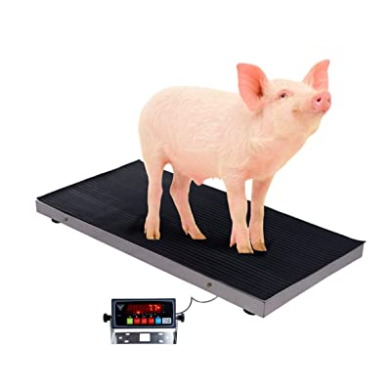
You Can’t Fatten the Pig by Weighing It!
Notes:
To Know and To Say: Look at this quote. How does it relate to what we have been talking about?
Giving students assessments and not using the assessment results to inform instruction is similar to trying to fatten a pig by weighing it. The weighing (or assessing) gives you information about the student. But unless you do something with that information, it will simply tell you where the students are (or how much the pig weighs).
You need to use the assessment information to make instructional decisions for the student. Those instructional decisions are essentially additional food for the pig. Thus, you can “fatten the pig”!

Slide 44
Align Your Measures to These Values
Reliability of screening measures (usually reported as internal consistency reliability or Cronbach's alpha) should be at least 0.70. Nunnally (1978). This information is available from the publishers' manual or website for the measure.
Predictive validity is an index of how well the measure provides accurate information on future reading performance of students — and thus is critical. Predictive validity should reach an index of 0.60 or higher.
Notes:
To Know: The next section of the training is for teachers and administrators to consider the tools that are shared as a measuring stick. Use the examples to consider how close their tools are and can they get the same results with reliability, validity taking out the element of guessing or teacher subjectivity. No one is advocating that each district or school needs to use the DIBELS Assessments presented. They were selected for their value from research.
To Do: Make sure you have taken time to ‘get to know’ these types of assessments. Also, remember that you can take questions from participants and assure them you will investigate and get back with them. We only know what we know until we learn and none of us know everything. Be honest and knowledgeable to the extent you can, but also be willing to learn and follow-up with clarity for yourself and those in attendance.
To Say: As we move into the final portion of our training, we are asking you to look at the assessments we place before you and consider how closely your assessments align to these measures. We are going to look at some specific assessments that are used to screen and to progress monitor individual students.
Screening for literacy means to identify students who will be at risk for literacy success. We will specifically look at screening measures that are reliable in consistency. There is no element of student guessing using multiple choice or evaluator judgement subjectivity.
These measures also have strong predictive validity on the critical skills needed for successful readers. When we screen for the critical skills for reading and progress monitor using those highly sensitive and predictive measures, we waste no time in finding and directing our instructional time. All Curriculum Based Measures (CBM) have these two significant features found in research.
We want to’ fatten the pig’ with the critical skills needed for successful readers.

Slide 45
Curriculum Based Measurements (CBM)
CBM has been linked to
More effective instruction
Higher student achievement
Increased student responsibility for learning
Better communication between parents and teachers
(Fuchs, Fuchs, & Hamlett 1993, Good, Simmons & Kameeuni 2001)
Adapted from the IRIS Center for Training Enhancements
Notes:
To Know: This information came from (Fuchs, Fuchs, & Hamlett 1993, Good, Simmons & Kameeuni 2001). Adapted from the IRIS Center for Training Enhancements
To Do: Highlight the slide.
To Say: Curriculum Based Measures (CBM) are designed to monitor students’ growth in basic academic skill domains. They are a set of simple, short-duration fluency measures most often applied to reading, spelling, written expression, and mathematics. Criteria that best describe CBM include measures that are:
Tied to the curriculum of instruction
Of short duration to facilitate frequent administration. Usually one to three minutes
Focus on direct and repeated measures of student performance
Capable of development of multiple forms
Sensitive to student achievement change over time (Marston, 1989)
CBM’s can be used to screen or to progress monitor. A CBM removes a teachers’ subjectivity and judgement. It provides authentic data on the student’s current performance level. CBMs are devised with standard development, administration, and scoring procedures to maintain high reliability and validity. They also have predictive value to ‘catch’ students who will struggle in reading. Most common examples of CBMs for reading include
Letter-Sound fluency - Students identify the sound each letter makes when shown a letter
Word identification - Student reads lists of common words.
Nonsense-word fluency - Students read nonsense words that contain phonics patterns (e.g. naf, fest)
Oral Reading Fluency - Students read graded passages to score on rate and accuracy
We will be looking more intently at these types of assessments as we move forward. We will not take time to look at letter identification since most schools look closely at this skill. We will move forward with the others in this short session.
Today we will be using DIBELS as our measuring tool.
Other Resources:
Take moment to look at what others have said about the linkage of the use of CBMs to instruction.
https://my.vanderbilt.edu/specialeducationinduction/files/2013/07/CBM-Tip-Sheet.pdf

Slide 46
Early Grade Assessments
Reading assessments in the early grades involve listening as the student reads aloud or responds verbally. Group-administered assessments of students’ silent reading tend to miss many key components of reading.
https://www.readingrockets.org/teaching/reading101-course/modules/assessment-introduction#fytH1
Notes:
To Know: This quote is from Reading Rockets defining why we move to student authentic reading to understand student needs.
To Do: Pause for participants to read the quote.
To Say: If we are to accurately describe a student’s progress in the early grades, we must not rely on silent reading assessments given as a group. Take a moment to digest this quote. If they are reading quietly, you are not able to determine what process the student uses when they meet an unknown word. Do they skip? Do they sound it out?
Substantial research has found that early detection of reading skills using teacher-to-student one to three minute curriculum-based assessments can identify at-risk readers when data is compiled against national norms. We will turn our focus to these types of assessments for the remainder of our time today while thinking of Kabrina and Ty.
Starting in first grade, most students are given assessments of their reading comprehension. These assessments are important, but they provide us with only a global view of a child’s reading ability. To provide useful instruction and intervention, we must be able to target instruction to a student’s specific weaknesses. For instance, two first-graders might obtain the same low reading comprehension score, but if one student’s difficulty is mainly in the area of decoding and the other student’s main weakness involves limited vocabulary knowledge, then those students will need different types of instruction to improve their overall reading comprehension.

Slide 47
Targeting Instruction from Comprehension
HO# 4
Reading Comprehension
Grade Level/Above Benchmark
Below Grade Level/Benchmark
Check Oral Reading Fluency
Continue Grade Level
Curriculum and Standards Focus
Notes:
To Do: Ensure participants have the Layers of Literacy Flipbook (HO #4) to take notes as we progress through the next steps.
To Know and To Say: We are going to revisit the Data Flowchart for Targeted Literacy Decision Making (HO #3) by completing a “Layers of Literacy Flipbook” to ensure we have a step-by-step process in sorting student data.
Our Targeted Literacy Decision Making Flowchart gives us the first division of who goes where.
We consider Benchmark - as grade level. If a student scores at or above grade level, we continue to work on grade level skills reaching to move forward in our standards and grade level curriculum. (Click to move the text to support your words for grade level support)
Kabrina and Ty were not at grade level. We will check Oral Reading Fluency with a measure that was proven through research using authentic student reading. (DIBELS, Acadience, easyCBM, FastBridge, AIMSweb, etc.)
Jan Hasbrouck, a researcher and literacy specialist, says: Teachers can and should use word count per minute (WCPM) as their canary in the coal mine — their first indicator that all may not be well with their students' reading ability.
In first through fifth grade, WCPM should be used to screen all students, help to diagnose a possible cause of struggling students' problems, and to progress monitor struggling students who are receiving additional support.
Every Curriculum Based Measurement takes into account the ‘rate’ at which a student can process to read orally. We might need to take into consideration that ‘rate’ means the ability at which a student can read. If they can process information to read at a ‘benchmark level’, then they can continue to process information at the rate needed to learn our grade level vocabulary and comprehension.
When a student cannot process at the rate needed to hit benchmark, we go further into the ‘why’ and ‘what’ is keeping them from being able to process at the needed rate.
Notes for your information
Jan Hasbrouck, Ph.D., is an educational consultant, author, and researcher. She served as Executive Consultant to the Washington State Reading Initiative and as an advisor to the Texas Reading Initiative. Jan worked as a reading specialist and literacy coach for 15 years before teaching at the University of Oregon and later became a professor at Texas A&M University. She has provided educational consulting to individual schools across the United States as well as in Mexico, Peru, Guatemala, Honduras, Jamaica, and Germany, helping teachers, specialists, and administrators design and implement effective assessment and instructional programs targeted to help low-performing readers. Jan’s research in areas of reading fluency, reading assessment, coaching, and second language learners has been published in numerous professional books and journals. She is the author and coauthor of several books including Conquering Dyslexia, Reading Fluency, The Reading Coach: A How-to Manual for Success, and Educators as Physicians, along with several assessment tools. Jan works with the McGraw Hill publishers as an author of their Wonders and Wonder Works reading and intervention programs.

Slide 48
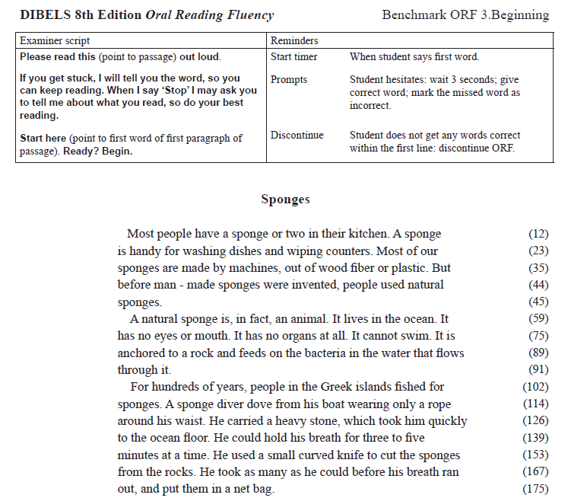
Oral Reading
Fluency
HO #6a and 6b
Notes:
To Know: This is an Oral Reading Fluency test taken from DIBELS 8 from the University of Oregon. If participants are familiar with DIBELS and use it in district, you will not need to take time to read directions. Your time might need to focus on the reiteration of ‘why’ we use National Norms and these valid, reliable, predictive measures. You might also need to remind people we are not pushing a product. We are showing examples of products teachers already have access to in their districts and/or can get free of charge.
To Do: Ensure participants have an Oral Reading Fluency Handout from DIBELS 8 Grade 3 Scoring copy and Student copy.
To Say: Ty and Kabrina were given the Oral Reading Fluency through DIBELS 8. This is a one minute cold reading of a grade level passage. ‘Cold reading’ means the students read this passage without having heard it read aloud or having read it prior to us checking them.
Both the teachers and students have their own copy of the passage. The student copy does not show the words per line. The teacher is marking the words the student misses or the teacher could be monitoring the progress on a computerized form while the student is reading.
Take a moment to look at the sample DIBELS Oral Reading Fluency handout. Read the script to administer this assessment to students. (Pause for participants to read the teacher directions)
You will notice that the teacher copy on the screen has numbers to the far right to do an easy word count on how many words the student reads. Accuracy will also be scored so we can determine an overall Fluency Score.
Ty read 95 words per minute with no mistakes.
Kabrina read 115 words with 95 words read correctly.
Since both students received the same score which indicated they were at-risk according to benchmark norms, both students will be given another assessment to consider phonics needs.
Ask participants to make note of the following questions on their Flipbook to refer to as they return to their district assessments.
How is this the same or different than what you use?
If your program has Oral Reading Fluency passages, are they aligned to National Norms to ensure greater reliability or local developed norms? Data aligned to National Norms measures student success on overall learning not just on program growth or only within that district.

Slide 49
Low Oral Reading Rate Move to the next step.
On Grade Level
Check:
Focus on Fluency, Spelling, Vocabulary, Comprehension
Vocabulary
CBMs, CORE Word Reading Lists, etc.
Notes:
To Know: Use the folding flowchart HO #3. We might need to remind people we are not pushing a product. We are showing examples of products teachers already have access to in their districts and have reliability and validity.
To Do: Direct attention to the Layers of Literacy Flipbook to take notes.
To Say: When a student is not able to process at the needed rate as they orally read, we move into checking word level reading.
We check the ability of the student to read words that follow phonetically regular phonic patterns and check word lists with irregular pattern. In other words, we begin to see if it is a vocabulary issue or a decoding concern.
You can see on the flowchart that great ways to check this is by using word lists from CORE or CBMs (Curriculum Based Measures like AIMSweb, Acadience, etc.) CORE has developed word lists for vocabulary to assess language/vocabulary development.

Slide 50
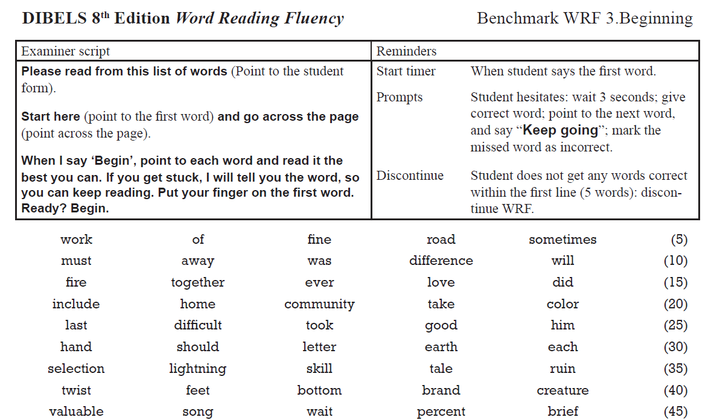
HO# 7a and 7b
Notes:
To Know: This is a Words Reading Fluency assessment. There is a copy for the student and one for the teacher. The one for the teacher has the sounds. The teacher directions will give information regarding when to stop and timing.
To Do: Ensure participants have DIBELS Word Reading Fluency handout Grade 3 scoring and student copy.
To Say: In your handouts you see an example of the DIBELS Word Reading Fluency. Take a moment to examine the directions and words listed for the students to read. It is important to stay with the script for reliability and validity. Did you notice there is a time factor involved to consider the rate at which a student can answer? The student is asked to show proof of the ‘see it - know it’ that comes with automaticity in reading.
Kabrina and Ty both scored below target but not at a high risk range.
Ask participants to make note of the following questions in their Flipbook to refer to as they return to their district assessments.
What Word Reading Fluency measures do you use?
Are they aligned to National Norms with the validity and reliability like this ?

Slide 51
Low Oral Reading Rate Move to the next step.
On Grade Level
Check:
Focus on Fluency, Spelling, Vocabulary, Comprehension
Vocabulary
Phonics/Decoding
CBMs, CORE Word Reading Lists, etc...
CBMs, Nonsense Words
Phonics Decoding Surveys
Notes:
To Do: Direct attention to the Layers of Literary Flipbook for note taking.
To Know and Say: Let’s document our next steps in our note taker. When a student is not able to process at the needed rate, we move into checking word level reading considering the ability to ‘decode’ or sound out words that follow phonetically regular phonics patterns to see if it is a vocabulary issue or a decoding concern.
When checking the students’ ability to use phonics when meeting unknown words, the most valuable proven tool is to use Nonsense Words.
Remember the impact learning had from the Simple View of Reading - was it a decoding or language issue?
The Nonsense Word or Phonics Decoding Surveys will examine which phonics patterns need to be targeted for instruction because the check into Word Level Reading probably will indicate a student needs phonics instruction.
We use Nonsense Words to rule out the ‘known word factor’. You are testing whether or not they know the patterns and can apply these patterns to any unknown word.
We must remember that the science of reading/research has taught us these students, no matter the age or grade, need instruction in how to decode unknown words as they meet them in lists or in text.
To Do: Move to the next slide.

Slide 52
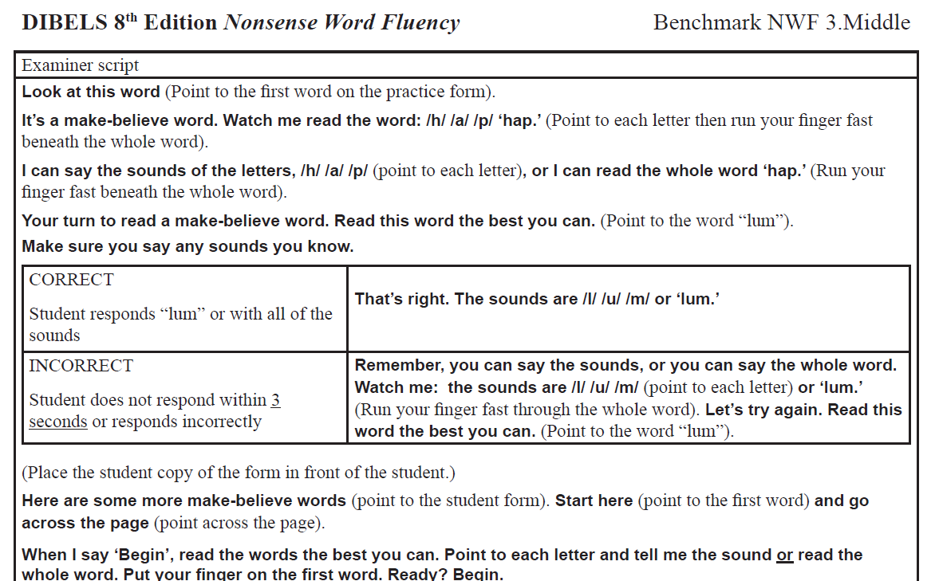
HO# 8a and 8b
Notes:
To Know: This is the DIBELS 8 Nonsense Word Fluency assessment. There is a copy for the student and one for the teacher. The teacher directions will give information regarding when to stop and timing.
Place student copy at participant tables for easy review.
To Say: Let us look at Nonsense Word Fluency. You will find this in your next handout. Take a moment to read the script in how to provide consistent directions. Signal when ready to move forward to discuss.
Take note of the patterns that are on the form. Nonsense Word Fluency assesses short vowels for younger students but increases in difficulty across many patterns as the students grade level changes. Some older versions of Nonsense Word Assessments only addressed short vowels. The newer versions of Nonsense Words will include more difficult patterns students need for reading. Nonsense words prove whether a student can read a word correctly, even if they do not know what that words should be.
Kabrina and Ty revealed a different need on this assessment. Ty scored well sounding out words keeping him at grade level for considering his phonics needs. Kabrina struggled and scored within the at-risk range.
TO DO: Move to the next slide as participants show they are ready.

Slide 53
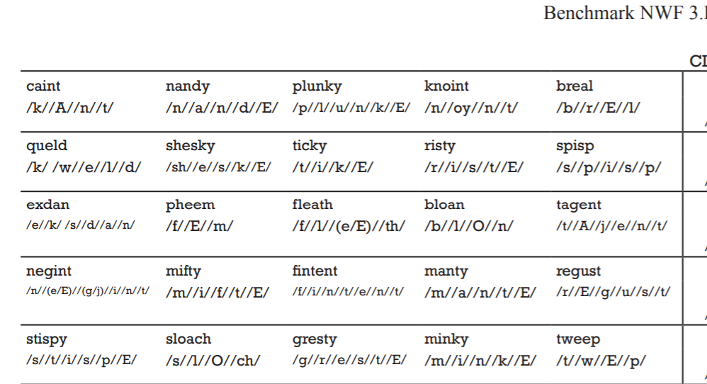
Notes:
To Know: This is a portion of the Nonsense Word Fluency Assessment. To Do: Allow time for participants to review the different assessments provided.
To Say: Please take a moment to consider what you see within this assessment. This is the teacher form. It has the individual phonemes that make up the word.
(Pause for participants to examine the assessment)
Ask participants to make note of the following in their Layers of Literacy Flipbook as they reflect on their district assessments.
How are these the same or different than what you already use?
What phonics patterns do you see on this assessment?
Are your assessments aligned to national norms with the same validity and reliability as this one assessing multiple patterns?
Remember: Earlier versions of CBMs only addressed short vowel words but newer versions have gone deeper with long vowels and other vowel patterns.

Slide 54
Kabrina and Ty
Same yet different
Kabrina will need more targeted phonics
Ty seems to have the needed decoding yet was not at grade level in vocabulary
Notes:
To Know: Kabrina and Ty started with the same score on the first benchmarks assessments given.
To Do: Ask participants to consider the two students who originally had the same score on benchmarks.
To Say: Kabrina and Ty originally had the same score on benchmark assessments surprising the teachers on their ability. When the students were assessed using the predictive measures and compared with National Norms, it was identified that they needed different instruction and intervention to change their reading ability. Ty will have more instructional time placed on vocabulary and the other elements addressed per grade level.
Kabrina will require more time with targeted phonics instruction using a Diagnostic Phonics Survey following lesson formats we taught in the phonics module connecting phonics, spelling, and decodable text. She will also continue in whole group reading with the classroom, as the extra layer of instruction, targeted in small group with phonics instruction.
Consider what can happen if we do not continue to address grade level skills and provide direct instruction for the student in a small group to focus solely on remediating their reading deficits?

Slide 55
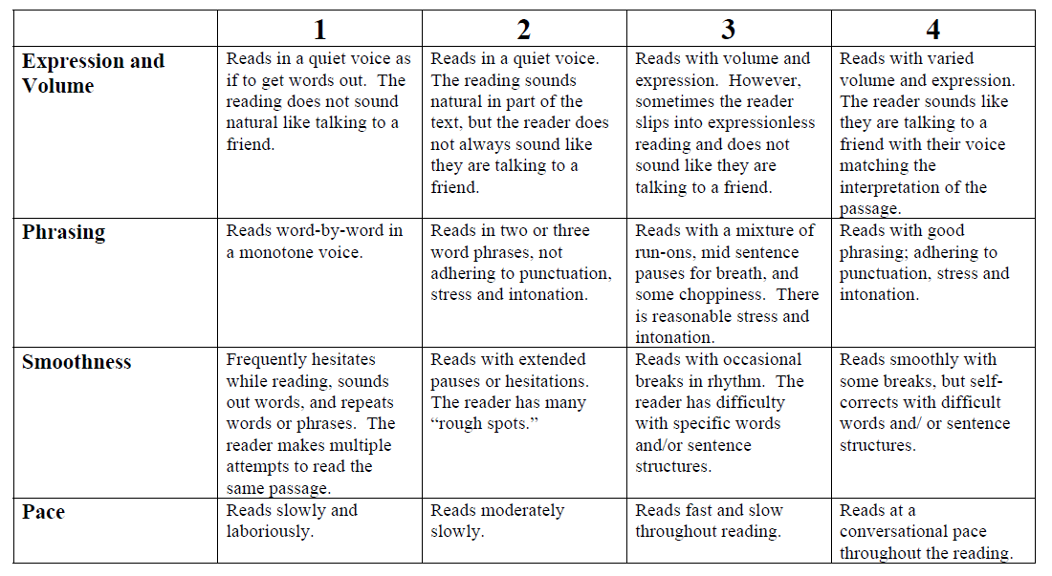
Accurate But Slow Students (Rasinski)
HO# 5
Notes:
To Know: This rubric was developed and used to guide instruction with fluency providing and understanding of prosody.
To Do: Direct attention to the Rasinski Multi-Dimensional Fluency Rubric (HO #5) for reflection of the skills needed for fluency. There is more to fluency than decoding words accurately or rate.
To Say: Remember fluency is reading at a rate which reveals automaticity with phrasing and intonation. We understand that Kabrina and Ty are somewhat different in needs for instruction. Some students might be slow in reading rate but accurate in their ability to decode or sound out words. Some students need more attention to vocabulary and language with some time working on how to read with phrasing and intonation. This rubric helps us to consider different skills that are needed to phrase sentences into meaningful parts for deeper comprehension. Timothy Rasinski used this rubric in his research and instruction to increase student fluency with better prosody (ˈpräsədē/).
This is not a predictive assessment. It is included because there are a few students who might need us to provide intervention with fluency when there is no difficulty with decoding or vocabulary. They are accurate but slow.
More to Know:
Timothy Rasinski is a professor of literacy education at Kent State University and director of its award winning reading clinic. He has written over 200 articles and has authored, co-authored or edited over 50 books or curriculum programs on reading education. He's published numerous best-selling books with Teacher Created Materials and Shell Education, and has also authored books for Scholastic. His scholarly interests include reading fluency and word study, reading in the elementary and middle grades, and readers who struggle. His research on reading has been cited by the National Reading Panel and has been published in journals such as Reading Research Quarterly, The Reading Teacher, Reading Psychology, and the Journal of Educational Research. Dr. Rasinski is the first author of the fluency chapter for the Handbook of Reading Research.
Dr. Rasinski served a three-year-term on the Board of Directors of the International Reading Association and was co-editor of The Reading Teacher, the world's most widely read journal of literacy education. He has also served as co-editor of the Journal of Literacy Research. Dr. Rasinski is past-president of the College Reading Association and he has won the A. B. Herr and Laureate Awards from the College Reading Association for his scholarly contributions to literacy education. In 2010, Dr. Rasinski was elected into the International Reading Hall of Fame.

Slide 56
When Phonics is Low
Use Diagnostic Decoding Surveys
Narrow in on phonics skills for instruction in addition to general education instruction
Use direct explicit, instruction through error analysis of patterns
Increase instructional time with making and building words, decoding those patterns in text, and spelling the patterns. Include Latin, Greek roots/ affixes as students grade level increases through phonics patterns
Notes:
To Do: Direct attention to the Layers of Literacy Flipbook for taking notes.
To Know and Say: Pick up your “Layers of Literacy” Flipbook to take notes. When phonics is low, a diagnostic survey will need to be given to determine which phonics skill instruction would benefit the student. Kabrina will need a survey to target the correct phonics skills so no time is wasted on instruction. Frequently, we pull in diagnostic surveys starting with Nonsense Words. Nonsense words help to weed out the ‘known word’ factors that can mess with authentic scores.
The most informative diagnostic decoding surveys include students reading and writing words containing different phonics patterns. Instruction in phonics will enhance decoding in reading and spelling.

Slide 57
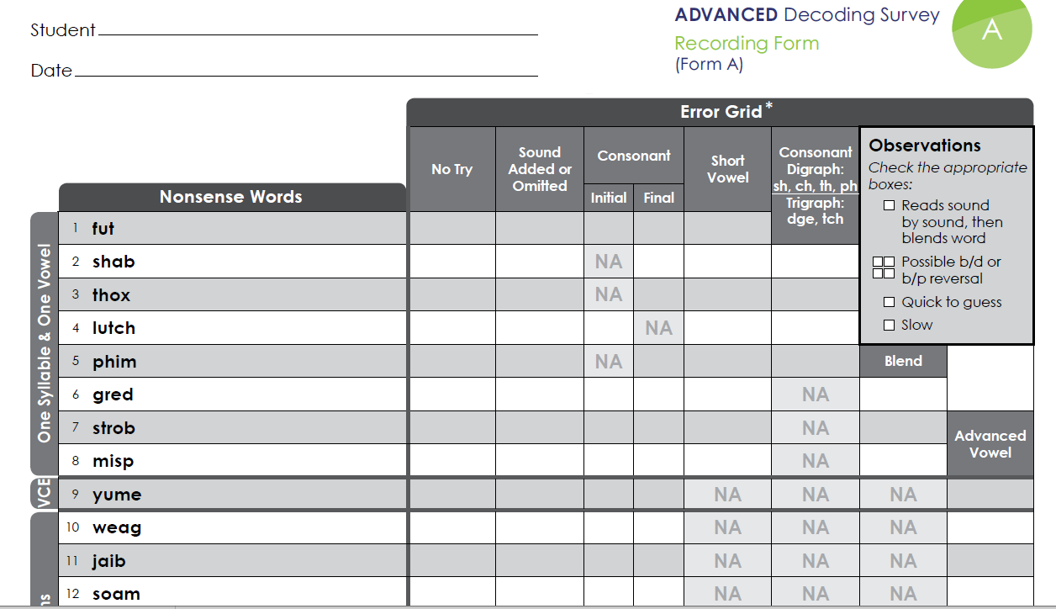
HO# 9a and 9b
Notes:
To Know: This is a free diagnostic survey from Really Great Reading. It can be downloaded for free and has access to grouping matrix for instructional use.
To Do: Show participants a free resource to target phonics errors. Have the Advanced Decoding Form A printed for participants to view. They will not need the complete packet; only the survey for reflection of an example of looking at phonics errors.
To Say: This Decoding Survey can be used with individual students to determine phonics errors that require instruction. There are two versions. One version is for beginning readers and this is the Advanced Decoding Survey. It also can be used with a grouping matrix to place students in skill-alike groups for more target instruction or intervention. This is a free diagnostic decodable survey with a grouping matrix. Again, we are not pushing a product. It is free and has proven to be a worthy tool in identifying decoding needs.

Slide 58
Phonemic Awareness in Addition to Phonics
Check Phonological and Phonemic Awareness
Basic Levels through segmentation and blending. Advanced Levels through, deletion, addition and substitution of sounds.
Use direct, explicit instruction focusing on the skill developmental sequence
Notes:
To Do: Direct participants attention to their notetaking flipbook.
To Know and Say: If decoding skills are low, we check phonemic awareness. We have learned the developmental levels of phonemic awareness and understand that when a reader is low in phonics development, they are usually low or have holes in phonemic awareness.
Phonemic Awareness has been found to be a huge predictor of reading success. Students who score low in phonological manipulation of segmentation in grades K-1 generally are struggling readers in grade 2 and above. Research trials which included phonemic awareness instruction to the advanced levels increased the success rates of readers when connecting phonics to print. As you write on your flipbook, you notice advanced levels are: deletion, addition, and substitution.
Kabrina will receive a phonemic/phonological awareness assessment to determine her needs and if low phonemic awareness will be included with her phonics instruction.
Do you remember the levels we went through in our phonemic awareness training? The advanced levels are deletion, addition, and substitution. Frequently the advanced levels are not explicitly taught and not always learned without explicit instruction.

Slide 59
Phonological Awareness Test
HO# 10
https://www.thepasttest.com/
Notes:
To Know: We will take about three minutes for participants to hear a PAST test being conducted. All PAST tests can be downloaded for free and an audio example can be downloaded from Wiley. (See page 400 in, Assessing, Preventing, and Overcoming Reading Disabilities). HO #10
To Do: Inform participants of the location of the PAST test and resources that are free online.
To Say: We are going to take a look at the PAST test. It is free. It was developed by David Kilpatrick. Dr. Kilpatrick wrote the respected and researched book, Essential of Assessing, Preventing and Overcoming Reading Difficulties. We are not going to learn how to score this assessment. The PAST test is one of the most reliable short assessments which can target phonemic awareness.

Slide 60
PAST Test Audio
Insert PAST Test audio
www.wiley.com/go/psyessresources
Enter email address click “submit”
Password: reading 2015
Notes:
To Know: We will not be learning how to score the PAST test. We will allow participants to listen so they are aware of how quick and easy it can be to target the skill level.
To Do: Take time to listen to the audio ensuring participants can hear. Direct them to more support if they want to learn more.
To Say: I would like for you to hear Dr. Kilpatrick give a student the PAST Test. We are not learning to score this today. That is for another training. But, let’s consider if we use any type of assessment similar to this to determine the level of phonemes a student can manipulate.
We will go to Wiley.com and look for resources for David Kilpatrick’s book, Essentials of Assessing, Preventing, and Overcoming Reading Difficulties. Wiley resources continues to update this link.
https://media.wiley.com/assets/7304/67/PAST_Demo.mp4
Participants will need the PAST Standard Form.

Slide 61
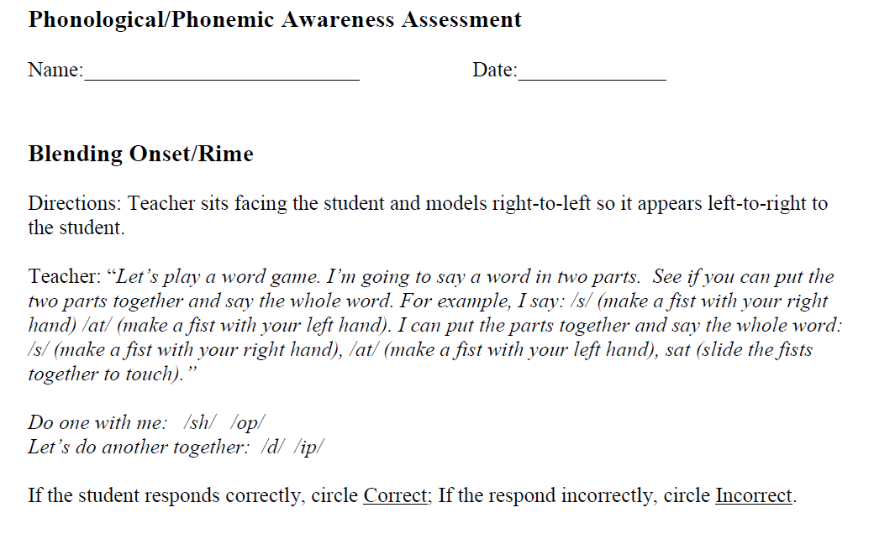
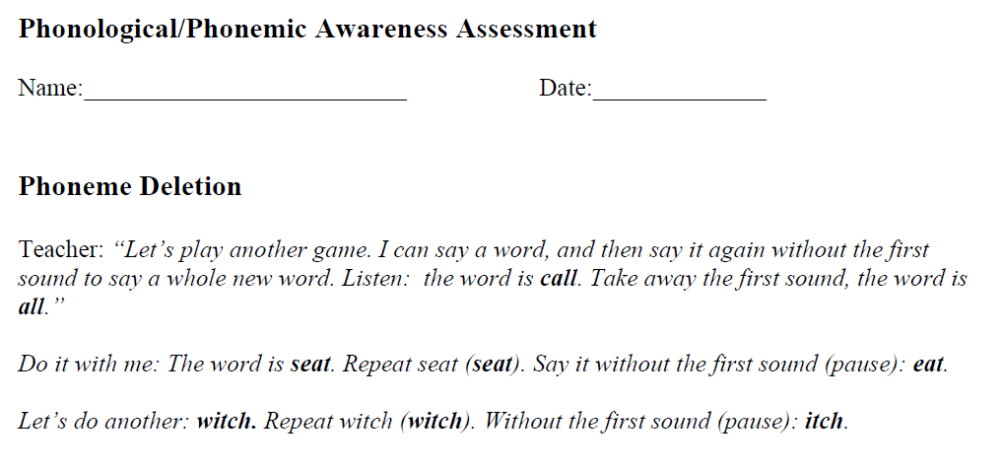
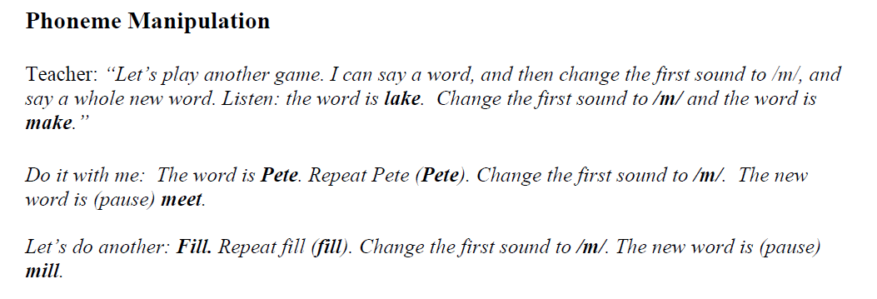
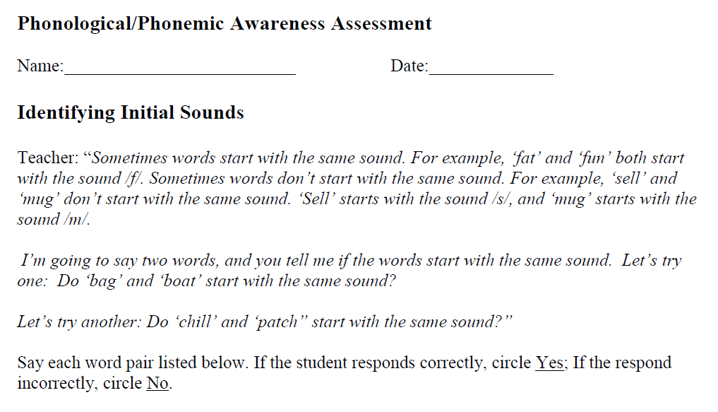
Notes:
To Know: These can be downloaded for free on Reading Rockets to use for Phonological and Phonemic assessment.
To Do: Show slide and note attention to the different resources.
To Say: The examples on the screen are Phonological Assessments that can individually be downloaded for free from Reading Rockets to assess student skill development and need.

Slide 62
Final Reflection
What is our job as educators?
What resonated with you from this video?
Stop-N-Jot
Notes:
To Know and to Say: You are driving the assessment bus today. The road we took stopped at several locations of assessment. We will stop and set a timer for 60 seconds. Return to your first STOP-N-JOT. Gather your mind around the ideas presented today.
What resonated with you?
Did it validate or disconfirm some of your ideas about assessing reading?
Consider your next steps as you get off this bus.
Which stop do you need to travel back to for yourself or your district?
What needs might you have to empower your efforts?
What gets measured gets done if we choose to reflect on those measures and what they mean to us. Otherwise, the assessment is given and a checkmark was placed on the word DONE. If our data is not showing reading growth, we are not done. Please take time to determine a true assessment of yourself and your data.
To Do: Set a timer for 60 seconds.
To Say: Please, leave a reflection on the table as you leave.
Complete the evaluation you need for your training (if needed)
Move to the final slide

Slide 63
Thank You for Your Professional Attention.
Consultant Information
Notes:
Please place your contact info on the slide.
To Say: We thank you for all your attention and dedication to the lives of our future. There are many avenues to literacy that are currently being offered and available through your RPDC. Please ask and let us know what you need to move forward.

