Slide 1
Explore Beliefs – What is Your “Why”?
Common Philosophy & Purpose
Notes:
Trainer Notes:
To Know/To Say:

Slide 2
Facilitator Notes: Delete This Slide
Handouts Needed:
Example and Activity Beliefs
Tier 1 Action Plan
Tier 1 Artifact Rubric
Tier 1 Action Planning Checklist
Participants Need Access to:
MO SW-PBS Handbook
MO SW-PBS Tier 1 Implementation Guide
Notes:
Trainer Notes:
To Know/To Say:

Slide 3
Working Agreements
Be Respectful
Be an active listener—open to new ideas
Use notes for side bar conversations
Be Responsible
Be on time for sessions
Silence cell phones—reply appropriately
Be a Problem Solver
Follow the decision making process
Work toward consensus and support decisions of the group
Notes:
Trainer Notes: Hide or delete this slide if presenting the entire PLM
To Know/To Say: “These will be the Working Agreements we will honor during all our training sessions this year.”

Slide 4
Attention Signal
Notes:
Trainer Notes: Hide or delete this slide if presenting the entire PLM; Facilitator: Select an attention signal.
To Know/To Say: “One of our agreements is to follow the attention signal.”
“Your team will work with your school to develop an attention signal you will use in every setting.”
“In order to get all of you focused after discussions, activities or breaks,
I will ________________________________________.”
(Insert your attention signal here.)
“Your task will be to finish your sentence, quiet your voice and ____________________________.”
(Insert what you want participants to do.)

Slide 5
Introductions
Notes:
Trainer Notes: Hide or delete this slide if presenting the entire PLM; Select an introductions activity.
To Know/To Say:

Slide 6
Lesson Outcomes
At the end of this session, you will be able to…
explore beliefs about discipline and establish your building’s “why”.
Notes:
Trainer Notes:
To Know/To Say:

Slide 7
Challenges Facing Schools Today
Schools today are facing intense scrutiny and are under tremendous pressure for improvement compounded by major issues that place significant demands on our schools.
Issues include:
Increasing diversity of student demographics
Changing home structures
Growing student alienation
Increased exposure to violence
Dropout crisis
Students with special needs
Stringent academic accountability
Notes:
Trainer Notes:
To Know/To Say:
Schools today are facing intense scrutiny and are under tremendous pressure for improvement compounded by major issues that place significant demands on our schools.
Some of the issues include:
Increasing diversity of student demographics
Changing home structures
Growing student alienation
Increased exposure to violence
Dropout crisis
Students with special needs
Stringent academic accountability
Another issue schools address is mental health of students and staff. School mental health, a dimension of overall health, describes the social-emotional development of school-age children. It is often described as a fluid state of being that can be impacted by wellness, mental illness, substance abuse, trauma, toxic stress, and the effects of adverse childhood experiences. Students who do not receive effective mental health supports are more likely to experience lower educational achievements such as attendance,² ability to concentrate,³ as well as academic achievement and grade completion.⁴ Implementing comprehensive school mental health services can help develop proactive, preventative systems that foster positive school climates focused on teaching and learning.

Slide 8
Activity: Round Robin Text Review
Notes:
Trainer Notes:
To Know/To Say: To gain a deeper understanding of The Scope of Challenges in schools today complete the Round Robin Text Review Activity.
Direct all teams to read the text, MO SW-PBS Handbook pages 8-10.
Each participant gets 1- 3 minutes to present what they have learned from the reading.
After the first participant shares, go clockwise or counterclockwise to the next participant until each person presents.
Select a person to record

Slide 9
Key Concepts/Big Ideas
Notes:
Trainer Notes:
To Know/To Say: One of the first steps to begin implementation involves examining staff beliefs about discipline, and engaging all staff in a common instructional view of discipline.
Effective schools commit their philosophy of discipline to writing through their beliefs, mission and vision. This philosophy creates a sense of direction that gives coherence to diverse activities. It also serves to clarify to others outside of staff how your school operates regarding discipline, and protects and helps sustain your work. Time spent examining what staff truly believe about student discipline and creating a shared philosophy is a wise investment in lasting change.

Slide 10
Key Terms
Beliefs are the underlying sentiments, assertions, or assumptions that inform the customs or practices of a group.
Notes:
Trainer Notes:
To Know/To Say: Here is a key term that will be used in this lesson.
Beliefs are the underlying sentiments, assertions, or assumptions that inform the customs or practices of a group.

Slide 11
Impact of Behavior Problems
Lower Student Achievement
School Failure
Increased Use of Exclusionary Practices
Administrative Job Demands
Teacher Effectiveness & Morale Hindered
School Improvement Initiatives Impeded
Notes:
Trainer Notes:
To Know/To Say: The focus of this course will be to first understand the impact of behavior problems on students & educators, then engage in rethinking the traditional view discipline in favor of an instructional approach, and finally commit to shared beliefs about discipline.
Impact of Behavior Problems on Students & Educators
Problem behavior exists in every school and though varied in frequency and intensity, it remains a concern for administrators, teachers, parents, students, and the community. A lack of discipline is viewed as one of the most serious challenges facing public schools.^{5,6}
Lower student achievement. Teachers report that “uncivil” behavior is increasing and is a threat to learning. Up to 50% of the school day is lost due to misbehavior during transitions, discipline, and other non-instructional activities.^{7,8}
School failure and life-long difficulties. Students with discipline problems are clearly at risk for school failure and developing more severe antisocial behaviors as well as other life-long difficulties. These students tend to experience juvenile delinquency, social isolation, diminished employment rates and income, and more frequent legal and mental health issues.⁹
Increased use of exclusionary practices. As behavior problems have increased, so have exclusionary practices such as detentions, in-school suspension, homebound instruction, shortened school day, referral to alternative schools, administrative transfers, or ignored truancies that restrict student access to learning.¹⁰ Over 90 percent of schools had implemented some form of zero tolerance policy by 2001.^{11,12}
Administrative job demands. As principals report that their workweek exceeds 60 hours, many feel their effectiveness as an instructional leader is being hindered by student discipline.^{13,14}
Teacher effectiveness and morale hindered. Studies show up to 60% of new teachers leave the profession within the first five years, often citing student discipline as the primary reasons for leaving.¹⁵ There is a growing sense of frustration, as more is demanded of educators under challenging circumstances.
School improvement initiatives impeded. Our schools have long histories of unfulfilled efforts to improve instruction, assessment and academic outcomes for students. When discipline issues impact the school climate teachers, principals, parents and students are affected.^{16,17}

Slide 12
Discussion: Challenges
What challenges or impacts of student behavior are you encountering in your school or district?
Notes:
Trainer Notes:
To Know/To Say: What challenges or impacts of student behavior are you encountering in your school or district?

Slide 13
Rethinking Discipline
“Discipline - Instruction that corrects, molds or perfects character and develops self-control.”
Websters New Collegiate Dictionary
Notes:
Trainer Notes:
To Know/To Say: Here is the definition of the word discipline from the Webster’s New Collegiate Dictionary
“Discipline – “Instruction that corrects, molds or perfects character and develops self-control.”

Slide 14
Traditional View of Discipline
Long history of being exclusive.
Punishment for rule-breaking behavior.
Punishment focuses:
on what not to do
does not teach desired behaviors
can damage relationships
impedes learning
leads to students dropping out of school
Notes:
Trainer Notes:
To Know/To Say:
For the most part, our approaches to school discipline are still based on the punitive and exclusionary policies developed when public education began in the early 1900s and schools were oriented toward the academically inclined and socially acceptable. Today, the child at the schoolhouse door has created a swing in the balance of power in schools and classrooms. While the teacher’s authority was once taken virtually for granted, now teachers are confronted with students who challenge that authority. A resulting focus or greater emphasis on maintaining control has led to an increasingly reactive and often punitive approach.
Whether intentionally or unintentionally, schools have a long history of being exclusive. Discipline policies act as a means to weed out students less able, less motivated, or poorly behaved. When educators are asked to define discipline, the most common response is “punishment for rule-breaking behavior.” Schools develop lists of prohibitive rules and a series of increasingly severe punishments for violators of these rules. Unfortunately, such a punitive view of discipline results in approaches that have questionable, if not harmful, effects.^{19,20} Punishment focuses on what not to do, does not teach desired behaviors, can damage relationships, impedes learning, and leads to students dropping out of school. Some educators feel that these punitive and exclusionary practices have served them well to eliminate the irritating and unnecessary intrusions to their teaching agendas. Many believe that students know the right way to behave, that their behavior is a performance deficit and that they have the skills but are merely choosing defiance or insubordination. They therefore assume that punishment will bring a halt to the problem behavior and the student will behave appropriately.

Slide 15
Traditional View of Discipline
Punishments satisfy the punisher but have little lasting effect on the punished.
Exclusionary approaches are in direct conflict with school missions to help all students achieve their fullest potential.
Punitive policies fail the very students they target.
Notes:
Trainer Notes:
To Know/To Say: In reality, punishments satisfy the punisher, but have little lasting effect on the punished.²¹ These exclusionary approaches are in direct conflict with school missions to help all students achieve their fullest potential. Our punitive policies fail the very students they target.

Slide 16
Discipline is Teaching
Reaching today’s students requires a teaching focus–teaching students how to be successful and behave responsibly in school.
Belief that social behavior is learned, therefore it can be taught.
Students can be taught socially acceptable ways of behaving just as one would teach any academic subject.
Notes:
Trainer Notes:
To Know/To Say: As we seek to ensure inclusive learning environments, our attitudes regarding discipline must change. Is discipline concerned with punishing misconduct or with preventing it? According to the dictionary, discipline refers to prevention and remediation, “training to act in accordance with rules;” and “instruction and exercise designed to train to proper conduct or action;” “training that is expected to produce a specified character pattern of behavior;” and “controlled behavior resulting from such training.”
Reaching today’s students requires a teaching focus–teaching students how to be successful and behave responsibly in school. This is based on the belief that social behavior is learned, therefore it can be taught. Students can be taught socially acceptable ways of behaving just as one would teach any academic subject.

Slide 17
Discipline is Teaching
Notes:
Trainer Notes:
To Know/To Say: Discipline should be based on the very same instructional concepts used to facilitate academic learning. Direct instruction in social behaviors can be provided to students, and practice, encouragement, and correction given as needed. And just as with academics, when behavior problems are complex or chronic, specialized interventions or intensive teaching arrangements may be necessary. A comparison of approaches to academic and social problems is shown in the graphic here.

Slide 18
Discussion: Rethinking Discipline
Read the section titled, “Rethinking Discipline” from the MO SW-PBS Handbook. Discuss with your team:
How are the two views different?
Traditional View | Proactive View
Notes:
Trainer Notes:
Provide access to MO SW-PBS Tier 1 Handbook, https://pbismissouri.org/wp-content/uploads/2019/11/1.-MO-SW-PBS-Handbook-2019-2020-V2.pdf
Have teams read pp. 11-12, then have participants work as a team to contrast these two views of discipline. Select a method to record the beliefs (e.g. chart paper, notebook paper, etc.)
To Know/To Say:

Slide 19
Role of Social Competence
A lack of social skills has been linked to juvenile delinquency, grade retention, suspensions, truancy, dropping out, lower self-esteem, and delayed cognitive development.
As adults, social deficits have been correlated with inability to gain and maintain employment, discharge from military service, involvement with the judicial system, and mental health problems.
Notes:
Trainer Notes:
To Know/To Say: As early as the 1970s, some educators stated that social development has more impact than cognitive development on determining success or failure in school as well as society. A lack of social skills has been linked to juvenile delinquency, grade retention, suspensions, truancy, dropping out, lower self-esteem, and delayed cognitive development.²²
In 1996, the Alliance for Curriculum Reform set goals for student learning in the 21st century:
learning how to learn and integrate knowledge,
communication skills,
thinking and reasoning,
interpersonal skills, and
personal and social responsibility.
This emphasis on social competence by schools is mirrored by the world of work. As adults, social deficits have been correlated with inability to gain and maintain employment, discharge from military service, involvement with the judicial system, and mental health problems.

Slide 20
Joint policy report Guiding Principles: A Resource Guide for Improving School Climate & Discipline, (2014)
articulates a plan to:
create positive climates that focus on prevention,
develop clear, appropriate, and consistent expectations and consequences to address disruptive student behaviors,
ensure fairness, equity, and continuous improvement.
The report specifically mentions the implementation of Positive Behavior Interventions and Supports (PBIS) as a systematic process to achieve these goals (U.S. Department of Education, 2014).
12
Notes:
Trainer Notes:
To Know/To Say: Since social competence plays such a significant role in life-long success, it is a legitimate school task worthy of our time and resources. In January of 2014 the U.S. Departments of Education and Justice published a joint policy report entitled Guiding Principles: A Resource Guide for Improving School Climate & Discipline. This document articulates a plan to
create a positive climate that focuses on prevention,
develop clear, appropriate, and consistent expectations and consequences to address disruptive student behaviors, and
ensure fairness, equity, and continuous improvement.
The report specifically mentions the implementation of Positive Behavior Interventions and Supports (PBIS) as a systematic process to achieve these goals.

Slide 21
Discussion: Views on Discipline
What did you hear that causes you to rethink your understanding of discipline? Share the key ideas that might change your view of discipline.
Notes:
Trainer Notes:
To Know/To Say:

Slide 22
Beliefs
Beliefs are the underlying sentiments, assertions, or assumptions that inform the customs or practices of a group.
Our beliefs about student behavior and discipline unify us and direct our actions–the decisions we make, the practices we choose, and how we interact with others. When we take time to articulate our beliefs, we are forced to be precise about how we want to behave.
Notes:
Trainer Notes:
To Know/To Say: One of the first steps in developing a philosophy is to examine staff beliefs. Beliefs are the underlying sentiments, assertions, or assumptions that inform the customs or practices of a group. With the realization of a need to change our approaches to discipline, old attitudes and premises that have held us in those old patterns must give way to new beliefs.
Our beliefs about student behavior and discipline unify us and direct our actions–the decisions we make, the practices we choose, and how we interact with others. When we take time to articulate our beliefs, we are forced to be precise about how we want to behave.

Slide 23
Best Practices: Beliefs
Balanced focus on both academics & social competency.
Behavior is learned.
Responsible behavior can be taught.
Student discipline is best achieved through instruction rather than punishment.
Student behavior can be taught using the same strategies used to teach academics.
Misbehavior presents the student with an opportunity to learn; the educator with an opportunity to teach.
For behavior change to occur, we must use positive approaches that strengthen teacher-student relationships.
Notes:
Trainer Notes:
To Know/To Say: The following beliefs reflect current literature and the best practices that guide how schools across the country undertake discipline initiatives. These, as well as others you may think of, provide a foundation of thinking to guide your work.
Education today must include a balanced focus on both academic achievement and social competency.
Students today may not have had the opportunity to learn acceptable behavior. We must not assume students know the behaviors and social skills that lead to success at school and in life.
Behavior is learned, therefore, responsible behavior can be taught.
Student discipline is best achieved through instruction rather than punishment.
Student behavior can be taught using the same strategies used to teach academics.
Misbehavior presents the student with an opportunity to learn, the educator with an opportunity to teach.
Punishment focuses on what not to do and does not teach the child alternative successful ways to behave.
For behavior change to occur, we must use positive approaches that strengthen teacher-student relationships.
Efforts to help students become socially competent require ongoing teaching, encouragement, and correction.
Students need and want high standards for their behavior. Maintaining high expectations does not require “get tough” or punitive approaches.
Successful change in discipline practices requires building-wide, systematic approaches.
Student discipline is a shared responsibility and requires a combined effort by all staff. We all “own” each and every student and are jointly committed to their success.
Student discipline is a collaborative effort. All staff must work together, striving for consensus on procedures and consistent implementation.
Services for students with chronic or intense behaviors are most effective within the context of a larger building-wide commitment to the social development of all students.

Slide 24
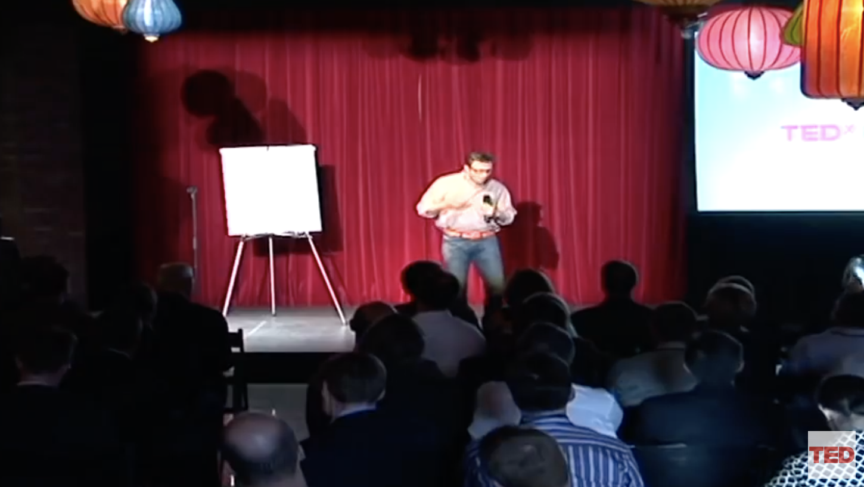
Discussion: Start With Why
What did the “How Great Leaders Inspire Change” video help explain the concept of starting with why?
How does the video message relate to education, your school and your community?
Notes:
Trainer Notes:
Watch his TED Talk called “How Great Leaders Inspire Change” using this link:
https://www.ted.com/talks/simon_sinek_how_great_leaders_inspire_action?utm_campaign=tedspread&utm_medium=referral&utm_source=tedcomshare
To Know/To Say: What did the “How Great Leaders Inspire Change” video help explain the concept of starting with why?
How does the video message relate to education, your school and your community?

Slide 25
Activity: Essential Beliefs
Work with your team, read the full list of best practice beliefs provided, then respond to the following questions using the worksheet provided.
What attitudes or beliefs are held by your staff that reflect a traditional view of discipline?
What shared beliefs do you need to unify staff around a new view of discipline and begin your work of developing a positive and proactive approach to discipline?
How can you include staff in rethinking discipline and validating these beliefs?
Notes:
Trainer Notes:
Provide access for each participant to the MO SW-PBS Tier 1 Implementation Guide, p. 31, and the HO1 Example and Activity Beliefs.
To Know/To Say:
Then say,
“We’re going to spend some time examining the current beliefs of your team and staff. Please, read p. 31, then respond to the questions on the slide, complete the worksheet provided with your team.”
Provide approximately 10-15 minutes for this discussion.

Slide 26
Discussion: Stakeholder Engagement
How can you include staff in expressing their beliefs about rethinking discipline?
Would it be beneficial to show staff the Simon Sinek video to reflect on and articulate their “whys”?
What questions might you pose to staff to help them reflect on their beliefs about underrepresented groups of students?
Consider what dimensions of diversity exist in your student body and in your families and broader community. Do staff beliefs hold true for all groups of students and families in your school? Do their beliefs support cultural equity?
Notes:
Trainer Notes:
To Know/To Say:
How can you include staff in expressing their beliefs about rethinking discipline?
Would it be beneficial to show staff the Simon Sinek video to reflect on and articulate their “whys”?
What questions might you pose to staff to help them reflect on their beliefs about underrepresented groups of students?
Consider what dimensions of diversity exist in your student body and in your families and broader community. Do staff beliefs hold true for all groups of students and families in your school? Do their beliefs support cultural equity?

Slide 27
Closing and Next Steps
Next steps include
updating your action plan. In addition,
Develop action steps to create a common list of staff beliefs about students and behavior.
Update your action plan using the Tier 1 Action Plan template and the Tier 1 Action Planning Checklist.
Use the Tier 1 Artifacts Rubric to assess the quality of the resources your team develops.
Use the results of the PBIS Self-Assessment Survey (SAS) to gain perspective from all staff, and results from the PBIS Tiered Fidelity Inventory (TFI) to gain perspective from your Building Leadership Team.
Notes:
To Know/To Say: During this lesson, you learned the scope and challenges of education today, the benefits of an instructional approach to discipline, and the importance of examining what staff truly believe about student discipline in order to create a shared philosophy about behavior.
Next steps include
updating your action plan. In addition,
Develop action steps to create a common list of staff beliefs about students and behavior.
Update your action plan using the Tier 1 Action Plan template and the Tier 1 Action Planning Checklist.
Use the Tier 1 Artifacts Rubric to assess the quality of the resources your team develops.
Use the results of the PBIS Self-Assessment Survey (SAS) to gain perspective from all staff, and results from the PBIS Tiered Fidelity Inventory (TFI) to gain perspective from your Building Leadership Team.
Additional information about beliefs can be found in the MO SW-PBS Handbook and the MO SW-PBS Tier 1 Implementation Guide.

Slide 28
References
Good, T. J., & Brophy, J. (2000). Looking into classrooms (8th Ed.) New York, NY: Longman Press.
Gall, G., Pagano, M. E., Desmond, M. S., Perrin, J. M., & Murphy, J. M. (2000). Utility of psychosocial screening at a school-based health center. The Journal of School Health, 70(7), 292-298.
Humensky, J., Kuwabara, S. A., Fogel, J., Wells, C., Goodwin, B., & Van Voorhees, B. W. (2010). Adolescents with depressive symptoms and their challenges with learning in school.
Nelson, J. R., Benner, G. J., Lane, K., & Smith, B. W. (2004). Academic achievement of k-12 students with emotional and behavior disorders. Exceptional Children, 71(1), 59-73.
National Education Goals Panel (1995). 1995 National education goals report. Washington, D.C.; author.
U.S. Department of Education (2014). Guiding principles: A resource guide for improving school climate and discipline. http://www2.ed.gov/policy/gen/guid/school-discipline/index.html
Cotton, K. (1990). Schoolwide and classroom discipline. Portland, OR: Northwest Regional Educational Laboratory.
Sugai, G., & Horner, R. (1994). Including students with severe behavior problems in general education settings: Assumptions, challenges, and solutions. In G.S.J. Marr, & G. Tindel (Eds). The Oregon Conference Monograph (Vol. 6, pp. 102-120). Eugene, OR: University of Oregon.
Gresham, F.M. (1984). Assessment of Children’s Social Skills. Journal of School Psychology, (19), No 2, pp. 120-33.
U.S. Department of Education (2014). Guiding principles: A resource guide for improving school climate and discipline. http://www2.ed.gov/policy/gen/guid/school-discipline/index.html
Kaufman, P. M., Chen, X., Choy, S.P., Peter, K., Ruddy, S. A., Miller, A.K. (2001) Indicators of school crime and safety: 2001. Washington, D.C.: U.S. Department of Education, U.S., Department of Justice.
Skiba, R.J., Peterson, R.L., & Williams, T. (1997). Office referrals and suspension: Disciplinary intervention in middle schools. Education & Treatment of Children, 20 (3), 295-316.
Hedges, W.D. (1991). How do you waste time? Principal (71), 37.
Trump, J. M. (1987). Instructional leadership–what do principals say prevents their effectiveness in this role? NASSP Bulletin. 71, 89-92.
Martinez, S., (2001). Obstacles to improved student learning. Unpublished manuscript. Kansas State Department of Education.
Bryk, A.S., & Schneider, B. (2003). Trust in schools: A core resource for school reform. Educational Leadership 60, 40-45.
Gordon, D. T. (2002). Fuel for reform: The importance of trust in changing schools. Harvard Education Letter, (18).
Webster’s New Collegiate Dictionary
Skiba, R. J., & Peterson, R. L. (2000). School discipline at a crossroads: From zero tolerance to early response. Exceptional Children, 66, 335-347.
U.S. Department of Education (2014). Guiding principles: A resource guide for improving school climate and discipline. http://www2.ed.gov/policy/gen/guid/school-discipline/index.html
Losen, D.J. (2011). Discipline Policies, Successful Schools, and Racial Justice. Boulder, CO: National Education Policy Center. Retrieved [March, 2012] from http://nepc.colorado.edu/publication/ discipline-policies.
Gresham, F.M. (1984). Assessment of Children’s Social Skills. Journal of School Psychology, (19), No 2, pp. 120-33.

Slide 29
Contact Information
Check Out MO SW-PBS on Social Media:
Facilitator Contact Information:
pbismissouri.org
facebook.com/moswpbs
@MOSWPBS

Slide 30
Review or Create Your School Mission
Common Philosophy & Purpose
Notes:
Trainer Notes:
To Know/To Say:

Slide 31
Facilitator Notes: Delete This Slide
Handouts Needed:
Example High School Mission Statement
Tier 1 Action Plan
Tier 1 Artifact Rubric
Tier 1 Action Planning Checklist
Participants Need Access to:
MO SW-PBS Handbook
MO SW-PBS Tier 1 Implementation Guide
Notes:
Trainer Notes:
To Know/To Say:

Slide 32
Working Agreements
Be Respectful
Be an active listener—open to new ideas
Use notes for side bar conversations
Be Responsible
Be on time for sessions
Silence cell phones—reply appropriately
Be a Problem Solver
Follow the decision making process
Work toward consensus and support decisions of the group
Notes:
Trainer Notes: Hide or delete this slide if presenting the entire PLM
To Know/To Say: “These will be the Working Agreements we will honor during all our training sessions this year.”

Slide 33
Attention Signal
Notes:
Trainer Notes: Hide or delete this slide if presenting the entire PLM; Facilitator: Select an attention signal.
To Know/To Say:
“One of our agreements is to follow the attention signal.”
“Your team will work with your school to develop an attention signal you will use in every setting.”
“In order to get all of you focused after discussions, activities or breaks,
I will ________________________________________.”
(Insert your attention signal here.)
“Your task will be to finish your sentence, quiet your voice and ____________________________.”
(Insert what you want participants to do.)

Slide 34
Introductions
Notes:
Trainer Notes: Hide or delete this slide if presenting the entire PLM; Select an introductions activity.
To Know/To Say:

Slide 35
Lesson Outcomes
At the end of this session, you will be able to…
review and/or create a mission statement to verify that it addresses the development of student social competence.
Notes:
Trainer Notes:
To Know/To Say:

Slide 36
Mission Statements
Every school or district has one. They define our purpose. They are practicable, a blueprint for current practice or what we do. Missions answer the questions, “Why do we exist? What do we do?”
MO SW-PBS, 2019
Notes:
.Trainer Notes:
To Know/To Say: Every school or district has one. They define our purpose. They are practicable, a blueprint for current practice or what we do. Missions answer the questions, “Why do we exist? What do we do?”
Many schools and/or districts already have developed mission statements to guide their goals and work It is critical as you begin implementation of SW-PBS that the importance of focusing on student social competence is addressed within the mission statement, making it clear that SW-PBS is not something ‘additional’, but rather, a critical component of achieving the mission of the schools and/or district.

Slide 37
Key Terms
A mission statement represents the reason that the school and/or district exists, and is usually a short statement.
Notes:
Trainer Notes:
To Know/To Say: A mission statement represents the reason that the school and/or district exists, and is usually a short statement.

Slide 38
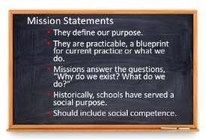
Mission Statements
Notes:
Trainer Notes:
To Know/To Say: Every school or district has one. They define our purpose. They are practicable, a blueprint for current practice or what we do. Missions answer the questions, “Why do we exist? What do we do?” Historically, schools have served a social purpose.
Parents, as they sent their children off to school, expected that they would learn essential social skills: how to get along with others, how to work cooperatively, how to be a leader. We are the one institution with a mandate to serve all children. With that mandate came an expectation to help students become not only academically skilled but also socially acceptable.
Until more recently, that role was seldom articulated or addressed directly. We assumed that social competence would be a by-product of academic learning. We now know that we must be more systematic about this important school function.

Slide 39
Discussion: Mission
Does your district or school mission address the development of student social competence?
Notes:
Trainer Notes:
To Know/To Say:
If not, it should. It will give legitimacy to your work and direct your actions. It communicates value for social competence in school and for students’ lifelong success.

Slide 40
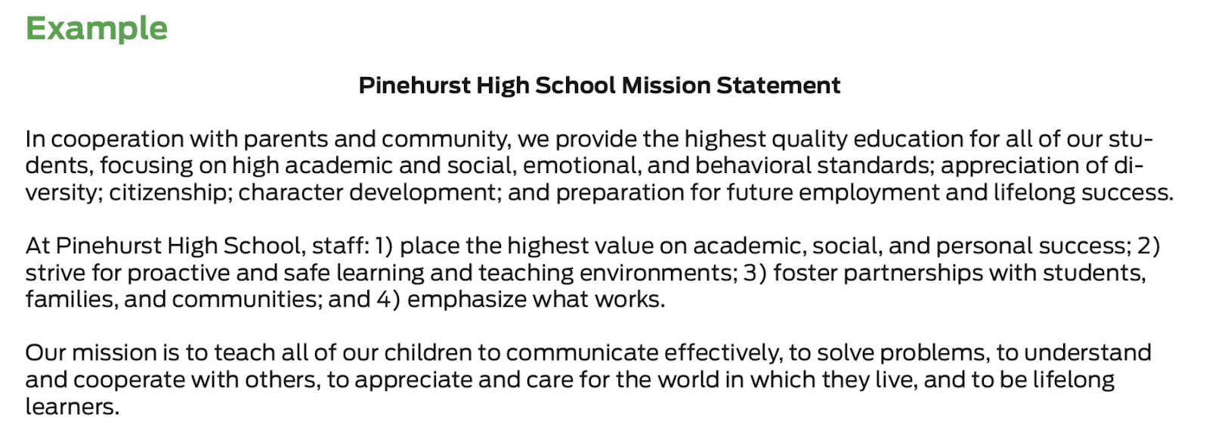
Activity: Example Mission
Review the example mission statement provided and identify the pieces that directly promote and support the development of student social competence.
Notes:
Trainer Notes:
To Know/To Say:
Review the example mission statement provided, identify the pieces that directly promote and support the development of student social competence.
HO2 Example High School Mission Statement

Slide 41
Activity: Mission Review
Working with your team, review your school or district mission statements.
Do existing statements include the essential focus on both academic and social outcomes for all students?
Do the mission statements reflect inclusive and equitable practices for all students and families?
How does your school mission relate to your “why”?
What changes does the team suggest to your school or district mission statement?
What suggestions would your team forward to your district leadership team after reviewing district mission documentation?
Notes:
Trainer Notes:
To Know/To Say: Working with your team, review your school or district mission statements.
Do existing statements include the essential focus on both academic and social outcomes for all students?
Do the mission statements reflect inclusive and equitable practices for all students and families?
How does your school mission relate to your “why”?
What changes does the team suggest to your school or district mission statement?
What suggestions would your team forward to your district leadership team after reviewing district mission documentation?

Slide 42
Discussion: Staff Engagement
How can you include staff in reviewing your school and/or district mission statement(s)?
What “look fors” would you want staff to consider when reviewing your school and/or district mission statement(s)?
How does your school mission relate to your “why”?
Notes:
Trainer Notes:
To Know/To Say: How can you include staff in reviewing your school and/or district mission statement(s)?
What “look fors” would you want staff to consider when reviewing your school and/or district mission statement(s)?
Do the mission statements reflect inclusive and equitable practices for all students and families?
How does your school mission relate to your “why”?

Slide 43
Discussion: Family Engagement
When staff have completed a draft review of the school and/or district mission statement(s), how will you share with families for their feedback?
Share the draft mission statement(s) on the school website, in school newsletters, and in classroom communications (e.g. Friday folders, mass emails) with an invitation for suggestions.
Notes:
Trainer Notes:
To Know/To Say: When staff have completed a draft review of the school and/or district mission statement(s), share with families for their feedback.
Share the draft mission statement(s) on the school website, in school newsletters, and in classroom communications (e.g. Friday folders, mass emails) with an invitation for suggestions.

Slide 44
Closing and Next Steps
How will you engage staff and families in developing and/or revising a mission statement?
Next steps include
Develop action steps for engaging staff in a review of your school and/or district mission statement(s).
Additionally, add action steps to address family engagement in the review of school and/or district mission statement(s).
Update your action plan using the Tier 1 Action Plan template and the Tier 1 Action Planning Checklist.
Use the Tier 1 Artifacts Rubric to assess the quality of the resources your team develops.
Use the results of the PBIS Self-Assessment Survey (SAS) to gain perspective from all staff, and results from the PBIS Tiered Fidelity Inventory (TFI) to gain perspective from your Building Leadership Team.
Notes:
To Know/To Say: During this lesson, you learned that having a mission statement that communicates value for social competence in school and for students’ lifelong success will give legitimacy to your work and direct your actions.
How will you engage staff and families in developing and/or revising a mission statement?
Next steps include
Develop action steps for engaging staff in a review of your school and/or district mission statement(s).
Additionally, add action steps to address family engagement in the review of school and/or district mission statement(s).
Update your action plan using the Tier 1 Action Plan template and the Tier 1 Action Planning Checklist.
Use the Tier 1 Artifacts Rubric to assess the quality of the resources your team develops.
Use the results of the PBIS Self-Assessment Survey (SAS) to gain perspective from all staff, and results from the PBIS Tiered Fidelity Inventory (TFI) to gain perspective from your Building Leadership Team.
Additional information about mission statements can be found in the MO SW-PBS Handbook and the MO SW-PBS Tier 1 Implementation Guide.

Slide 45
References
Missouri SW-PBS (2019). Missouri schoolwide positive behavior support tier 1 implementation guide.
Notes:
Trainer Notes:
To Know/To Say:

Slide 46
Contact Information
Check Out MO SW-PBS on Social Media:
Facilitator Contact Information:
pbismissouri.org
facebook.com/moswpbs
@MOSWPBS

Slide 47
Review or Create Your School Vision
Common Philosophy & Purpose
Notes:
Trainer Notes:
To Know/To Say:

Slide 48
Facilitator Notes: Delete This Slide
Handouts Needed:
Example and Activity Vision Statement
Tier 1 Action Plan
Tier 1 Artifact Rubric
Tier 1 Action Planning Checklist
Participants Need Access to:
MO SW-PBS Handbook
MO SW-PBS Tier 1 Implementation Guide
Notes:
Trainer Notes:
To Know/To Say:

Slide 49
Working Agreements
Be Respectful
Be an active listener—open to new ideas
Use notes for side bar conversations
Be Responsible
Be on time for sessions
Silence cell phones—reply appropriately
Be a Problem Solver
Follow the decision making process
Work toward consensus and support decisions of the group
Notes:
Trainer Notes: Hide or delete this slide if presenting the entire PLM
To Know/To Say: “These will be the Working Agreements we will honor during all our training sessions this year.”

Slide 50
Attention Signal
Notes:
Trainer Notes: Hide or delete this slide if presenting the entire PLM; Facilitator: Select an attention signal.
To Know/To Say:
“One of our agreements is to follow the attention signal.”
“Your team will work with your school to develop an attention signal you will use in every setting.”
“In order to get all of you focused after discussions, activities or breaks,
I will ________________________________________.”
(Insert your attention signal here.)
“Your task will be to finish your sentence, quiet your voice and ____________________________.”
(Insert what you want participants to do.)

Slide 51
Introductions
Notes:
Trainer Notes: Hide or delete this slide if presenting the entire PLM; Select an introductions activity.
To Know/To Say:

Slide 52
Lesson Outcomes
At the end of this session, you will be able to…
review and/or create a vision statement to verify that it addresses the development of student social competence.
Notes:
Trainer Notes:
To Know/To Say:
At the end of this session, you will be able to…
review and/or create a vision statement to verify that it addresses the development of student social competence.

Slide 53
Vision Statements
A vision is a clearly articulated, results-oriented picture of the future you intend to create.
MO SW-PBS, 2019
Notes:
Trainer Notes:
To Know/To Say: This lesson will prepare your team to verify that your school and/or district vision statement addresses the development of student social competence.

Slide 54
Big Ideas
Unlike a mission that is practical, a vision is idealistic.
A vision focuses on the end results and values, not on the specific means of getting there.
A vision is the crystallization of your “whys,” desires, values, and beliefs.
It is critical as you begin implementation of SW-PBS that the importance of focusing on student social competence is addressed within the vision statement.
Notes:
Trainer Notes:
To Know/To Say: Unlike a mission that is practical, a vision is idealistic. A vision is a clearly articulated, results-oriented picture of the future you intend to create. A vision focuses on the end results and values, not on the specific means of getting there. A vision is the crystallization of your “whys,” desires, values, and beliefs. Many schools and/or districts already have developed vision statements to guide their goals and work. It is critical as you begin implementation of SW-PBS that the importance of focusing on student social competence is addressed within the vision statement, making it clear that SW-PBS is not something ‘additional’, but rather, a critical component of achieving the vision of the schools and/or district.

Slide 55
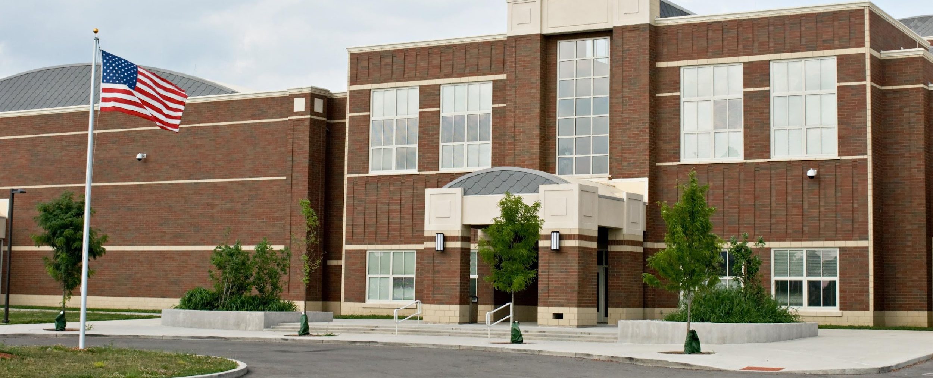
Developing a Common Vision
When a school collectively develops and owns a vision, staff, student, and family relationships to school are changed.
It is no longer “their school;” it becomes “our school.”
Notes:
Trainer Notes:
To Know/To Say: A shared vision is a force in people’s hearts and answers the question, “What do we want to create?” It is the picture that people throughout the school carry in their heads and hearts. It completes the statement, “I have a dream that one day...” and reaches into the future, drives actions, and helps to create a sense of community. When a school collectively develops and owns a vision, staff, student, and family relationships to school are changed. It is no longer “their school;” it becomes “our school.” This is particularly important as school demographics and cultures represented in your school change over time.

Slide 56
Developing a Common Vision
Vision statements derive their power from the desire to be connected in an important undertaking, to become a part of pursuing a larger purpose.
Ensuring the social and academic success of each and every student, and creating a positive school climate, can be that purpose.
Notes:
Trainer Notes:
To Know/To Say: Vision statements derive their power from the desire to be connected in an important undertaking, to become a part of pursuing a larger purpose. Ensuring the social and academic success of each and every student, and creating a positive school climate, can be that purpose.
You cannot have a learning organization without a shared vision to guide the work and pull you toward your goal.

Slide 57
Discussion: Vision
Do you have a vision that compels new ways of thinking and acting?
Does your vision consider the “whole student”?
Notes:
Trainer Notes:
To Know/To Say: Discussion: Do you have a vision that compels new ways of thinking and acting? Does your vision consider the “whole student”?

Slide 58
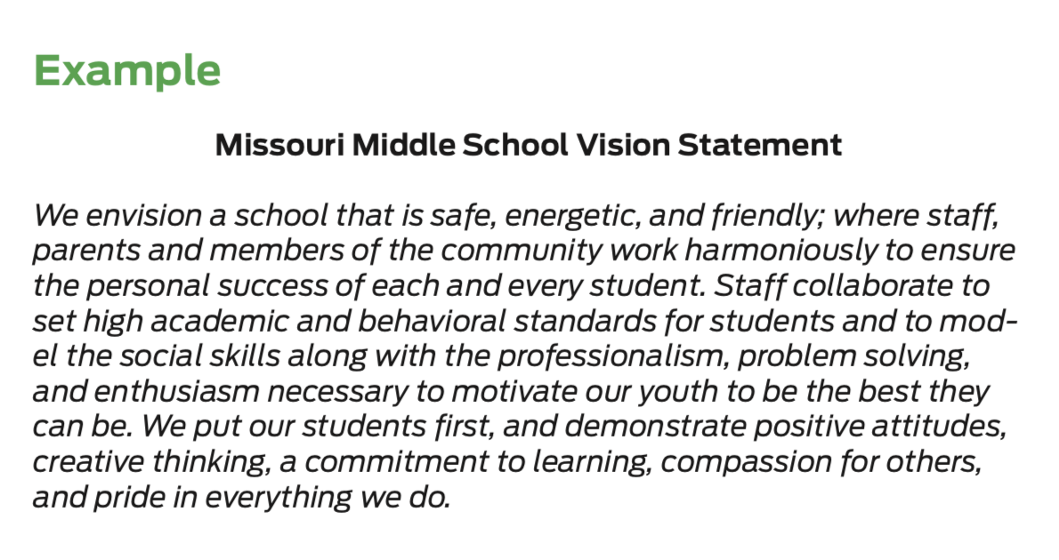
Activity: Example Vision
Review the example vision statement provided, identify the pieces that directly promote and support the development of student social competence.
Notes:
Trainer Notes: Example and Activity Vision Statement
To Know/To Say: Review the example vision statement provided, identify the pieces that directly promote and support the development of student social competence.

Slide 59
Discussion: Vision
Now that you have reviewed the example vision statement, consider the following questions, individually at first:
If you could create the school of your dreams, what would it look like?
What is your mental model for the future?
What do you want your school to be?
What is your compelling dream for how school should be as a result of your work with MO SW-PBS?
Notes:
Trainer Notes:
To Know/To Say: Working with your team, discuss your vision of your school:
If you could create the school of your dreams, what would it look like?
What is your mental model for the future?
What do you want your school to be?
What is your compelling dream for how school should be as a result of your work with MO SW-PBS?

Slide 60
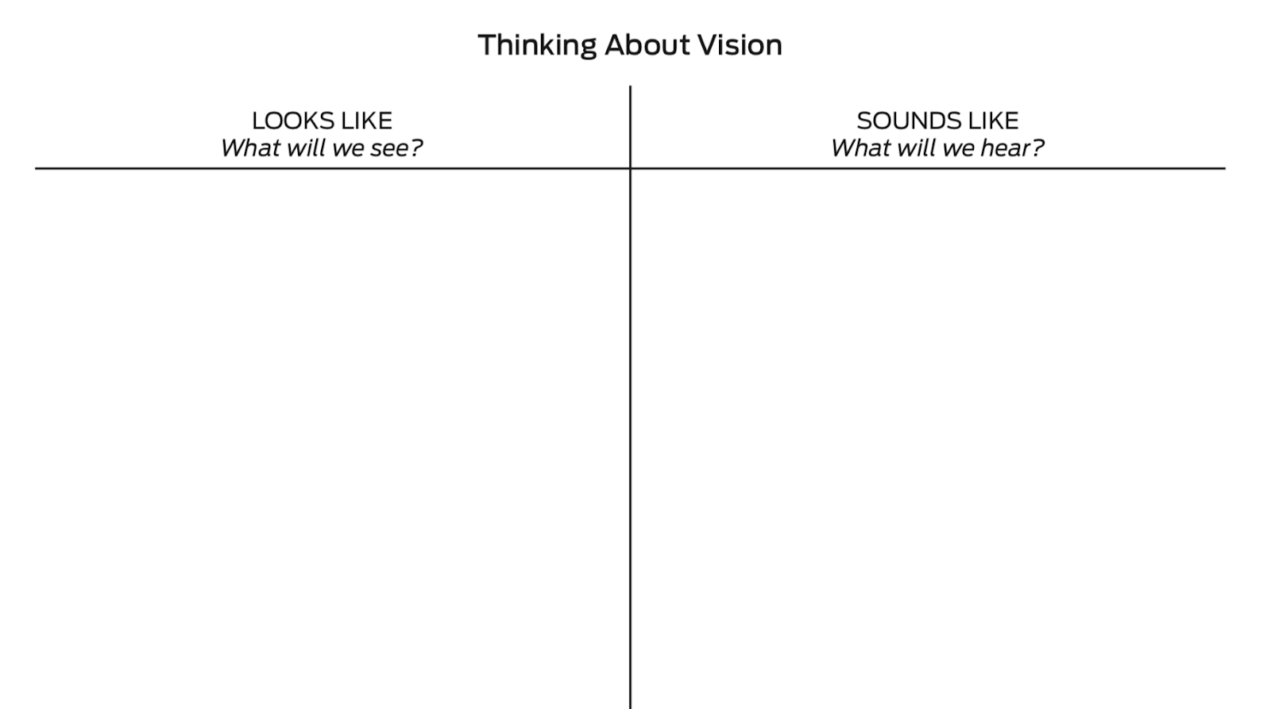
Activity: Thinking About Vision
Now as a team, use a T chart to guide a group dialog.
What will your school look like and sound like with a positive, proactive, and instructional approach to discipline?
Notes:
Trainer Notes:
To Know/To Say:

Slide 61
Discussion: Staff Engagement
How will you engage staff in your discussions about Vision?
Ideas to consider:
Share the T-chart with staff to solicit their vision about the future.
Give each staff member paper strips to complete the phrase “I have a dream that one day our school will...”
Collect the paper strips, categorize them, and use them to create your school’s vision.
Post the paper strips in a prominent area of the school.
Post chart paper during a staff professional learning session to gain staff vision of the school.
Consider how to share the collated vision with district leadership.
Notes:
Trainer Notes:
To Know/To Say: As your team engages staff in creating a vision for the school, remind them to think about every student in your school: the most academically talented students; the least academically talented; the most kind, thoughtful, and respectful students; students who are experiencing social/emotional challenges; students of all racial and ethnic make-ups; socially popular students; and students who do not have many friends. Specific activities to engage staff include:
Share the T-chart with staff to solicit their vision about the future.
Give each staff member paper strips to complete the phrase “I have a dream that one day our school will...” Collect the paper strips, categorize them, and use them to create your school’s vision. Post the paper strips in a prominent area of the school.
Post chart paper during a staff professional learning session to gain staff vision of the school.
Consider how to share the collated vision with district leadership.

Slide 62
Discussion: Family Engagement
How will you engage students and families?
Ideas to consider:
Give students and family members paper strips to complete the phrase “I have a dream that one day our school will...” Collect the paper strips, categorize them, and use them to inform your team’s work on your school’s vision. Other strip ideas include: “I want my child to go to a school that...” and “I will want to go to school every day when my school...”
Post the T-chart in a public location (main school entrance, at sporting events, concerts, etc.) to solicit student and family thoughts about the school’s vision for the future.
Ask students and families for their dream for the school on the school website, in school newsletters, and in classroom communications (e.g., Friday folders, mass emails) and then provide a mechanism for these dreams to be shared with the leadership team.
Notes:
Trainer Notes:
To Know/To Say: Specific activities to engage students and family members include:
Give students and family members paper strips to complete the phrase “I have a dream that one day our school will...” Collect the paper strips, categorize them, and use them to inform your team’s work on your school’s vision. Other strip ideas include: “I want my child to go to a school that...” and “I will want to go to school every day when my school...”
Post the T-chart in a public location (main school entrance, at sporting events, concerts, etc.) to solicit student and family thoughts about the school’s vision for the future.
Ask students and families for their dream for the school on the school website, in school newsletters, and in classroom communications (e.g., Friday folders, mass emails) and then provide a mechanism for these dreams to be shared with the leadership team.

Slide 63
Closing and Next Steps
How will you engage staff, students and families in developing and/or revising a vision statement?
Next steps include updating your action plan.
Develop action steps for reviewing, revising, or creating your current school or district vision statement with your staff.
Review the ideas for student and family engagement and decide which action steps you will add to your team Action Plan.
Update your action plan using the Tier 1 Action Plan template and the Tier 1 Action Planning Checklist.
Use the Tier 1 Artifacts Rubric to assess the quality of the resources your team develops.
Use the results of the PBIS Self-Assessment Survey (SAS) to gain perspective from all staff, and results from the PBIS Tiered Fidelity Inventory (TFI) to gain perspective from your Building Leadership Team.
Notes:
To Know/To Say: During this lesson, you learned that having a vision statement that communicates value for social competence in school and for students’ lifelong success will give legitimacy to your work and direct your actions.
How will you engage staff and families in developing and/or revising a mission statement?
Next steps include updating your action plan.
Develop action steps for reviewing, revising, or creating your current school or district vision statement with your staff.
Review the ideas for student and family engagement and decide which action steps you will add to your team Action Plan.
Update your action plan using the Tier 1 Action Plan template and the Tier 1 Action Planning Checklist.
Use the Tier 1 Artifacts Rubric to assess the quality of the resources your team develops.
Use the results of the PBIS Self-Assessment Survey (SAS) to gain perspective from all staff, and results from the PBIS Tiered Fidelity Inventory (TFI) to gain perspective from your Building Leadership Team.
Additional information about vision statements can be found in the MO SW-PBS Handbook and the MO SW-PBS Tier 1 Implementation Guide.

Slide 64
References
Missouri SW-PBS (2019). Missouri schoolwide positive behavior support tier 1 implementation guide.
Notes:
Trainer Notes:
To Know/To Say:

Slide 65
Contact Information
Check Out MO SW-PBS on Social Media:
Facilitator Contact Information:
pbismissouri.org
facebook.com/moswpbs
@MOSWPBS

Slide 66
Gain and Document Staff Commitment to SW-PBS
Common Philosophy & Purpose
Notes:
Trainer Notes:
To Know/To Say:

Slide 67
Facilitator Notes: Delete This Slide
Handouts Needed:
Example Our Beliefs, Mission, Vision
Activity Philosophy of School Discipline
Tier 1 Action Plan
Tier 1 Artifact Rubric
Tier 1 Action Planning Checklist
Participants Need Access to:
MO SW-PBS Handbook
MO SW-PBS Tier 1 Implementation Guide
Notes:
Trainer Notes:
To Know/To Say:

Slide 68
Working Agreements
Be Respectful
Be an active listener—open to new ideas
Use notes for side bar conversations
Be Responsible
Be on time for sessions
Silence cell phones—reply appropriately
Be a Problem Solver
Follow the decision making process
Work toward consensus and support decisions of the group
Notes:
Trainer Notes: Hide or delete this slide if presenting the entire PLM
To Know/To Say: “These will be the Working Agreements we will honor during all our training sessions this year.”

Slide 69
Attention Signal
Notes:
Trainer Notes: Hide or delete this slide if presenting the entire PLM; Facilitator: Select an attention signal.
To Know/To Say:
“One of our agreements is to follow the attention signal.”
“Your team will work with your school to develop an attention signal you will use in every setting.”
“In order to get all of you focused after discussions, activities or breaks,
I will ________________________________________.”
(Insert your attention signal here.)
“Your task will be to finish your sentence, quiet your voice and ____________________________.”
(Insert what you want participants to do.)

Slide 70
Introductions
Notes:
Trainer Notes: Hide or delete this slide if presenting the entire PLM; Select an introductions activity.
To Know/To Say:

Slide 71
Lesson Outcomes
At the end of this session, you will be able to…
gain and document staff commitment to SW-PBS;
draft your philosophy of discipline.
Notes:
Trainer Notes:
To Know/To Say: By the end of this lesson, participants will….gain and document staff commitment to SW-PBS as you draft your philosophy of discipline.

Slide 72
“Schools that have implemented positive, proactive, and instructional approaches to discipline see a decrease in the frequency and severity of unexpected behavior. They also find changes to culture and climate that come from the unification of staff and collaborative work.”
MO SW-PBS, 2019
Notes:
Trainer Notes:
To Know/To Say: This lesson will focus on strategies to help obtain commitment to the work from all stakeholders as well as the importance of putting your work in writing to create your philosophy of discipline.

Slide 73
Gaining Staff Commitment
Fundamental change is impossible without the participation of everybody with a stake in the problem or issue.
Without full participation of all, perspectives will be missed.
Building staff awareness of SW-PBS, the possible outcomes, the vision, and evolving beliefs about student discipline and behavior should lead to a sense of eagerness and full participation.
Notes:
Trainer Notes:
To Know/To Say: Change efforts have a great deal to do with personal motivation. Setting a new direction for the future is one of the most powerful ways of motivating any group and effecting change. Once staff is committed, together you will find ways to be effective.
Fundamental change is impossible without the participation of everybody with a stake in the problem or issue.² Without full participation of all, perspectives will be missed, there is a good chance that some of the issues involved will go unaddressed, and implementation will be restricted. Building staff awareness of SW-PBS, the possible outcomes, the vision, and evolving beliefs about student discipline and behavior should lead to a sense of eagerness and full participation.

Slide 74
Research indicates, that for initial implementation to be successful, the following are critical:
Administrative Support
Staff Buy-In
Fidelity of Implementation
Efficient and Effective Teaming
MO SW-PBS
Notes:
Trainer Notes:
To Know/To Say: Emerging research on implementation of SW-PBS, research including Missouri SW-PBS schools, indicates that for initial implementation administrative support, staff buy-in, fidelity of implementation and efficient and effective teaming are critical.³ It is also important to note that findings indicate a need to establish consensus to implement PBIS in the classroom setting as soon as it is implemented in non-classroom settings (ie., schoolwide).⁴

Slide 75
Securing Staff Commitment
Provide opportunities for new learning
Engage in the joint development of mission, vision, and beliefs or guiding principles
Confirm by an official commitment process
Notes:
Trainer Notes:
To Know/To Say: Securing staff commitment can be done by providing opportunities for new learning, the jointly developing mission, vision, and belief statements, and finally confirmed by implementing an official commitment process.

Slide 76
Providing Learning on SW-PBS
Strategies for providing new learning include:
formal presentations/staff learning opportunities,
study groups or book studies,
articles or readings,
sharing and discussion opportunities,
surveys or data, and
personal conversations.
Notes:
Trainer Notes:
To Know/To Say: Earlier in this Common Philosophy and Purpose course you learned additional strategies for fully engaging your staff in the joint development of beliefs, mission and vision.
Strategies for providing new learning include:
formal presentations/staff learning opportunities,
study groups or book studies,
articles or readings,
sharing and discussion opportunities,
surveys or data, and
personal conversations.
In the Leadership for Behavior Course you will learn additional strategies for fully engaging your staff in the joint development of vision and beliefs. Once your staff has a solid understanding of the desired change, it is helpful to confirm commitment. In some schools, the principal simply makes a point of having a personal conversation with each and every staff member, visiting about the exciting opportunity and asking if they are on board, or if they can be counted on to join in the work ahead. An agreement, contract, or covenant is another way for staff to show support.

Slide 77
Discussion: Staff Learning
How will you engage staff in learning about SW-PBS?
What conversations will you engage them in regarding a proactive, positive approach to discipline?
Notes:
Trainer Notes:
To Know/To Say:

Slide 78
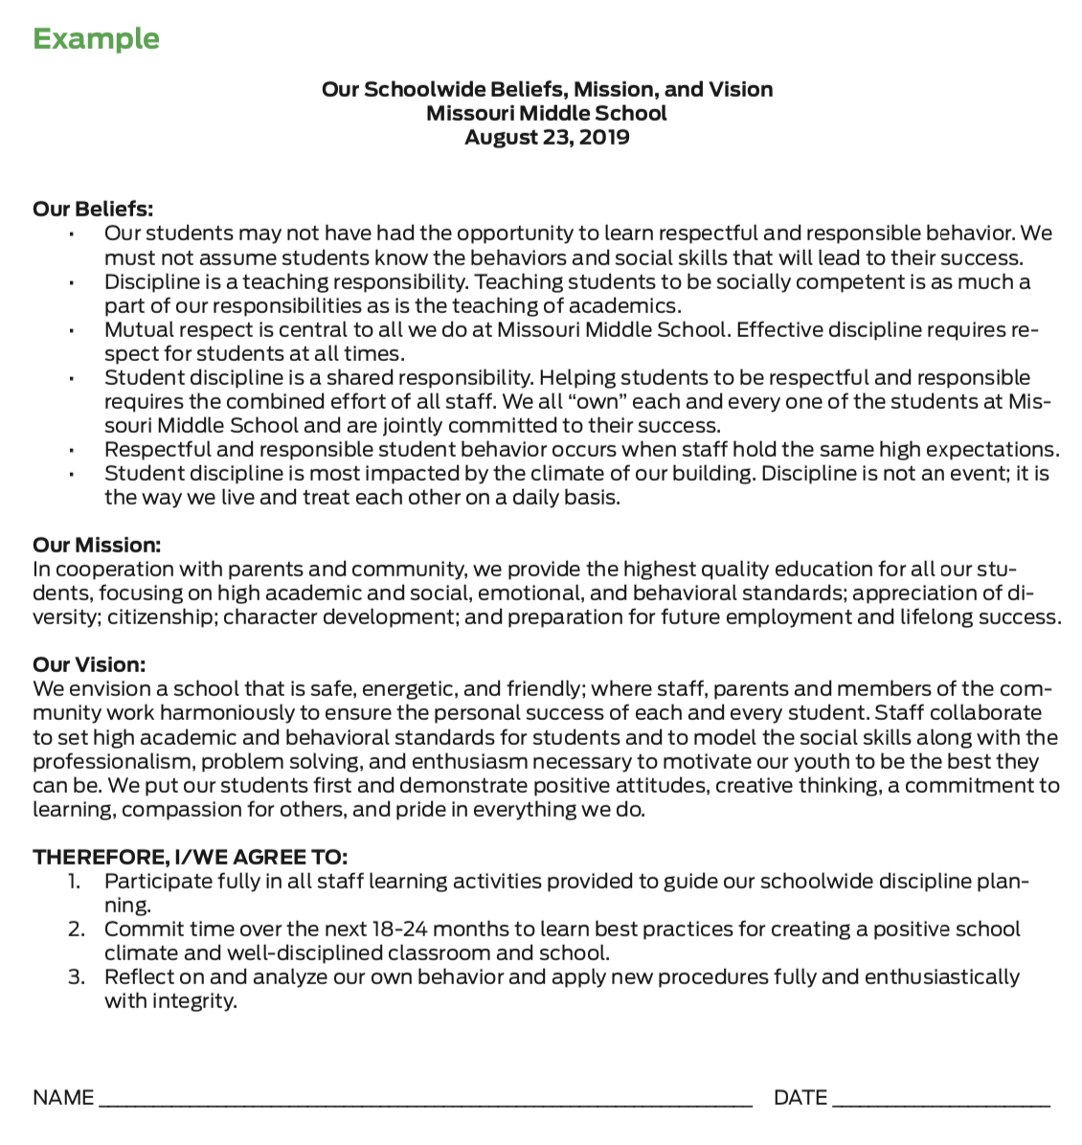
Activity: Example Agreement
Review the example that includes the school’s philosophy, beliefs and agreements that bond the staff to their schoolwide discipline work. It provides a place for staff to sign, indicating their commitment.
How might you document your staff’s commitment?
Notes:
Trainer Notes:
To Know/To Say: Review the example that includes the school’s philosophy of discipline, beliefs, mission and vision that bond the staff to their schoolwide discipline work. It provides a place for staff to sign, indicating their commitment.
How might you document your staff’s commitment to a common philosophy of discipline?

Slide 79
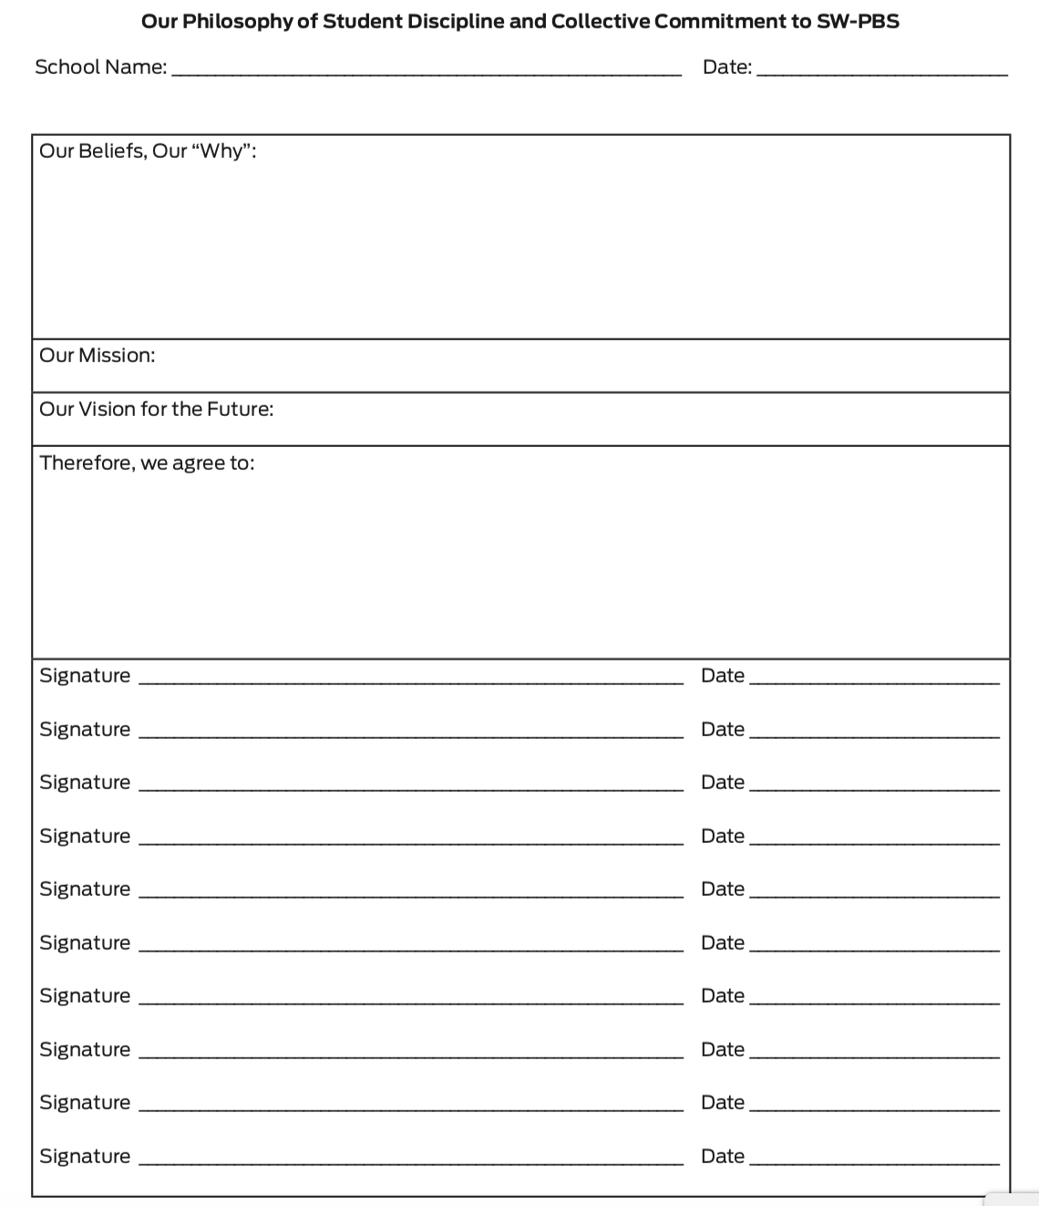
Activity: Commitment to Philosophy of Discipline
Use the handout Activity - Our Philosophy of Student Discipline and Collective Commitment to SW-PBS to combine your beliefs, mission and vision into a philosophy of discipline.
Notes:
Trainer Notes:
To Know/To Say: Use the handout Activity - Our Philosophy of Student Discipline and Collective Commitment to SW-PBS to combine your beliefs, mission and vision into a philosophy of discipline.

Slide 80
Discussion: Stakeholder Engagement and Communication
Once your team has documented a written philosophy, share with staff, students, and families by:
including in staff and student handbooks,
publish on the school website, and
posting in the main hall and main office.
Make a plan for sharing with important stakeholder.
Notes:
Trainer Notes:
To Know/To Say:
Stakeholder Engagement and Communication
Once your team has documented a written philosophy of discipline, you will want to share with staff, students, and families by:
including in staff and student handbooks,
posting on the school website, and
posting in the main hall and main office.
How will you plan to share your philosophy of discipline documentation with all stakeholders?

Slide 81
Closing and Next Steps
How will you engage staff and families in committing to your collectively drafted and documented beliefs, mission, vision, and overall philosophy of discipline?
Next steps include
Develop action steps for how you will document your philosophy of discipline including your collective beliefs, mission and vision. Be sure to add action steps about how you will communicate the written philosophy of discipline to all staff, students, and families.
Update your action plan using the Tier 1 Action Plan template and the Tier 1 Action Planning Checklist.
Use the Tier 1 Artifacts Rubric to assess the quality of the resources your team develops.
Use the results of the PBIS Self-Assessment Survey (SAS) to gain perspective from all staff, and results from the PBIS Tiered Fidelity Inventory (TFI) to gain perspective from your Building Leadership Team.
Notes:
To Know/To Say: During this lesson, you learned the importance of putting all of your work in writing and documenting staff commitment to the work of SW-PBS.
How will you engage staff and families in committing to your collectively drafted and documented beliefs, mission, vision, and overall philosophy of discipline?
Next steps include
Develop action steps for how you will document your philosophy of discipline including your collective beliefs, mission and vision. Be sure to add action steps about how you will communicate the written philosophy of discipline to all staff, students, and families.
Update your action plan using the Tier 1 Action Plan template and the Tier 1 Action Planning Checklist.
Use the Tier 1 Artifacts Rubric to assess the quality of the resources your team develops.
Use the results of the PBIS Self-Assessment Survey (SAS) to gain perspective from all staff, and results from the PBIS Tiered Fidelity Inventory (TFI) to gain perspective from your Building Leadership Team.
Additional information about gaining and documenting staff commitment can be found in the MO SW-PBS Handbook and the MO SW-PBS Tier 1 Implementation Guide.

Slide 82
References
Missouri SW-PBS (2019). Missouri schoolwide positive behavior support tier 1 implementation guide.
U.S. Department of Education (2014). Guiding principles: A resource guide for improving school climate and discipline. http://www2.ed.gov/policy/gen/guid/school-discipline/index.html
McIntosh, K., Predy, L. K., Upreti, G., Hume, A. E., Turri, M. G., & Mathews, S. (2014). Perceptions of contextual features related to implementation and sustainability of school-wide positive behavior support. Journal of Positive Behavior Interventions, 16(1), 31-43.
Mathews, S., McIntosh, K., Frank, J. L., & May, S. L. (2014). Critical Features Predicting Sustained Implementation of School-Wide Positive Behavioral Interventions and Supports. Journal of Positive Behavior Interventions, 16(3), pp 168-178.
Notes:
Trainer Notes:
To Know/To Say:

Slide 83
Contact Information
Check Out MO SW-PBS on Social Media:
Facilitator Contact Information:
pbismissouri.org
facebook.com/moswpbs
@MOSWPBS

