Slide 2
Facilitator Notes: Delete This Slide
Handouts
Example Leadership Team Composition
Action Plan
Artifact Rubric
Action Planning Checklist
MO SW-PBS
Notes:
To Know/To Say: This lesson uses 4 handouts. If you have not already done so, download the handout at this time.

Slide 3
Working Agreements
Be Respectful
Be an active listener—open to new ideas
Use notes for side bar conversations
Be Responsible
Be on time for sessions
Silence cell phones—reply appropriately
Be a Problem Solver
Follow the decision making process
Work toward consensus and support decisions of the group
MO SW-PBS
Notes:
Trainer Notes: Hide or delete this slide if presenting the entire PLM
To Know/To Say: “These will be the Working Agreements we will honor during all our training sessions this year.”

Slide 4
Attention Signal
MO SW-PBS
Notes:
Trainer Notes: Hide or delete this slide if presenting the entire PLM; Facilitator: Select an attention signal.
To Know/To Say: “One of our agreements is to follow the attention signal.”
“Your team will work with your school to develop an attention signal you will use in every setting.”
“In order to get all of you focused after discussions, activities or breaks,
I will ________________________________________.”
(Insert your attention signal here.)
“Your task will be to finish your sentence, quiet your voice and ____________________________.”
(Insert what you want participants to do.)

Slide 5
Introductions
MO SW-PBS
Notes:
Trainer Notes: Hide or delete this slide if presenting the entire PLM; Select an introductions activity.
To Know/To Say:

Slide 6
“Schools that share leadership can be responsive to and include the voice — the opinions, viewpoints, feedback, insights, and wisdom — of all members of their school community, including underserved and underrepresented families and cultures.”
MO SW-PBS
Notes:
To Know/To Say: Read Quote :“Schools that share leadership can be responsive to and include the voice — the opinions, viewpoints, feedback, insights, and wisdom — of all members of their school community, including underserved and underrepresented families and cultures.”
The process recommended for effective school improvement is based on strong leadership, shared decision-making and consensus building among all school staff. It begins with the formation of a SW-PBS Leadership Team. This team will assist staff in the continual process of developing and maintaining a positive school environment.
This lesson will provide information and examples on creating a representative SW-PBS Leadership Team for your school.

Slide 7
Lesson Outcomes
At the end of this session, you will be able to…
Create a SW-PBS Leadership Team that is representative of the school.
MO SW-PBS
Notes:
Trainer Notes:
To Know/To Say: At the end of this session, you will be able to create a SW-PBS Leadership Team that is representative of the school.

Slide 8
Key Concepts/Big Ideas
MO SW-PBS
Notes:
To Know/To Say: The purpose of the Tier 1 SW-PBS Leadership Team is to provide leadership for the development, implementation, and evaluation of universal procedures in the entire building for all students and staff. To effectively and efficiently complete their work, membership of the Tier 1 SW-PBS Leadership Team should be representative of the school as a whole.

Slide 9
Effective school leadership teams use of data were the best predictors of fidelity of implementation.
McIntosh, et al., 2013
A team-based approach to implementation is much more likely to achieve fidelity of implementation and improved outcomes.
Fixsen, et al., 2005
MO SW-PBS
Notes:
Read the slide, then say,
“Research conducted by Kent McIntosh, Mercer, Hume, Frank, Turri and Matthews involving 257 schools across 14 states, including Missouri, found that effective leadership teams were the key to successful sustained implementation.”
“Dean Fixsen, Karen Blasé, Naoon, Friedman and Wallace studied effective implementation of evidence-based practices.
They found that establishing and training a leadership team increased the likelihood of successful implementation that resulted in improved outcomes.”
Fixsen, D., Naoom, S.F., Blase, D.A., Friedman, R.M., Wallace, F. (2005). Implementation research: A synthesis of the literature. University of South Florida, Louis de la Parte Florida Mental Health Institute, The National Implementation Research Network.
McIntosh, K., Mercer, S. H., Hume, A. E., Frank, J. L., Turri, M. G., & Mathews, S.
(2013). Factors related to sustained implementation of school-wide positive behavior support. Exceptional Children.

Slide 10
SW-PBS Leadership Team Role
Assigned to provide leadership but is not to assume sole responsibility for developing a school action plan.
Involve the entire staff in:
rethinking their beliefs about student behavior,
reviewing existing procedures, and
developing more effective practices and policies.
MO SW-PBS
Notes:
Trainer Notes:
To Know/To Say: Staff members who serve on the SW-PBS Leadership Team will have the opportunity to play a key role in shaping the school climate. Assigned to provide leadership, this team is not to assume sole responsibility for developing a school action plan. Instead, they will thoughtfully involve the entire staff in rethinking their beliefs about student behavior, reviewing existing procedures, and developing more effective practices and policies. When everyone has a hand in developing schoolwide discipline procedures, ownership is increased, consensus is more readily obtained, and the likelihood staff will consistently implement procedures is increased.

Slide 11
Potential Challenges
a current lack of cohesiveness among staff,
lack of experience in knowing how to work together,
weak communication between different grade levels or departments, and
disconnects between administrators and staff.
MO SW-PBS
Notes:
Trainer Notes:
To Know/To Say: As you undertake your social behavioral school improvement effort you may uncover potential challenges that could impact your progress. Examples of this could be:
a current lack of cohesiveness among staff,
lack of experience in knowing how to work together,
weak communication between different grade levels or departments, and
disconnects between administrators and staff.
As challenges arise, it is even more important to have strong leadership that involves the entire staff in the process.

Slide 12
SW-PBS Leadership Team Responsibilities
Assess, summarize and share information with staff, students & families on important social behavioral outcomes
Discuss and Prioritize Issues
Engage staff in the work group process to develop and revise practices
Schedule and plan Professional Development
Ask for and respond to Feedback
Develop & review Action Plan
MO SW-PBS
Notes:
To Know/To Say:The SW-PBS Leadership Team is a standing committee responsible for developing and maintaining effective discipline procedures that reflect the unique needs of the school and its community. This includes:
Initially gathering input from staff, families, and students as well as other data sources to evaluate the effectiveness of current policies and practices and using that information to gain staff commitment to the needed changes.
Developing a common philosophy of discipline.
Assisting staff to understand best practices for developing responsible student behavior and the elements of an effective school discipline policy.
Guiding staff through a procedure development process to improve less effective practices and to protect effective practices by clarifying them and putting them in writing.
Once practices are developed and protected in writing, this team is responsible for overseeing the implementation, maintenance, and revision of procedures. This includes: 1) reviewing procedures with staff (especially new staff) at the start of the year to ensure consistency, 2) coordinating dissemination of information to parents and students, 3) organizing schoolwide discipline-related instructional activities, 4) bringing staff concerns to the team, and 5) reviewing ongoing data to determine successes and continuing needs for in-service or modification of procedures.

Slide 13
Team Composition
Representative of School
Administrator
Faculty
Staff
Parent
Student – if applicable
Other
MO SW-PBS
Notes:
Trainer Notes:
To Know/To Say:Schoolwide discipline planning should not be viewed as either a top-down or a bottom-up process. Rather, it is a collaborative venture with administration and staff working together. Therefore, it is essential the team include a building administrator and full representation of the building staff.
Maintaining a well-disciplined school is one of the primary roles of the building administrator. Therefore, the nature of the work of this committee, along with the need to ensure that practices are in line with board policy and legal stipulations, requires that an administrator be directly involved. Participation of the principal or assistant principal on this team is crucial.
Recommended membership for the Tier 1 SW-PBS Leadership Team, includes:
Administrator
Teacher Representatives (each grade, team, department)
Special Educator
Counselor
Paraprofessional
Student
Family Representative

Slide 14
Once the Tier 1 SW-PBS Leadership Team members are chosen, what methods will be used to communicate the names of the Tier 1 SW-PBS Leadership Team with all stakeholders?
Staff Engagement
MO SW-PBS
Notes:
To Know/To Say: Schools often expect all staff to participate on one of the school’s leadership teams, such as a building leadership team, social team, etc. When a Tier 1 SW-PBS Leadership Team is needed, it will become one of the teams that provides leadership for the entire school. Often administrators allow staff to choose a building-wide team while also “hand-picking” participants to ensure members of the team are highly qualified to do the work. Often building leadership will want to ensure the Tier 1 SW-PBS Leadership Team has a mix of highly regarded veteran members and young professionals who will learn about SW-PBS.
Other considerations for Tier 1 SW-PBS Leadership Team membership are non-certified staff (e.g., cafeteria workers, office personnel), family members, and students.

Slide 15
Student Engagement
How will student voices be represented on your team?
Regularly and actively elicit student feedback.
Seek student representatives for your team.
MO SW-PBS
Notes:
To Know/To Say: Student Engagement
How will student voices be represented on your team? Seeking student representatives on your team can take place through teacher nominations or students completing and submitting applications. If the size of the SW-PBS Leadership Team is a concern, student ownership voice and representation can be achieved through a “Respect Club” or “School Culture Club” where members’ ideas and voices are shared by one or two representatives to the SW-PBS Leadership Team. Regardless of the method used, the important point is to regularly and actively elicit student feedback and to seriously consider their ideas and viewpoints.

Slide 16
Families & Community Engagement
Seek the voices of all the families represented in your school.
Direct team member, or family & community subcommittee.
MO SW-PBS
Notes:
To Know/To Say: Families and Community Engagement
It is ideal to have family and community members on your SW-PBS Leadership Team. If team size is a concern, consider using a family and community subcommittee. It is important to seek the voices of all the families represented in your school, especially underserved families and all dimensions of diversity.

Slide 17
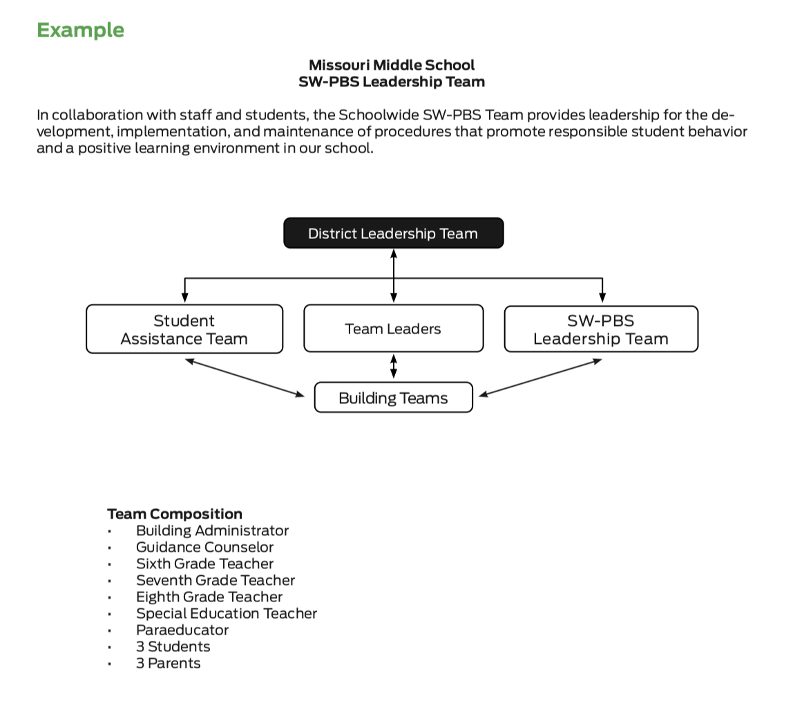
Discussion: Example Team
Review the Example Tier 1 SW-PBS Leadership Team.
Discuss how your team might be similar and what you might need to change to ensure you have a leadership team representative of your school.
Notes:
Trainer Notes:
To Know/To Say: Review the Example Tier 1 SW-PBS Leadership Team.
Discuss how your team might be similar and what you might need to change to ensure you have a leadership team representative of your school.
HO1 Example Leadership Team Composition

Slide 18
Discussion: SW-PBS Leadership Team
Discuss these questions to ensure you have a SW-PBS Leadership Team representative of your school.
Why is representation important in your school?
What would a representative team look like in your school?
How will you ensure students, families, and other stakeholders are represented?
Do you need to add any additional members to your team?
Notes:
Trainer Notes:
To Know/To Say: Discuss these questions to ensure you have a SW-PBS Leadership Team representative of your school.
Why is representation important in your school?
What would a representative team look like in your school?
How will you ensure students, families, and other stakeholders are represented?
Do you need to add any additional members to your team?

Slide 19
Closing and Next Steps
Develop action steps for establishing a representative SW-PBS Leadership Team.
Update your action plan using the Tier 1 Action Plan template and the Tier 1 Action Planning Checklist.
Use the Tier 1 Artifacts Rubric to assess the quality of the resources your team develops.
Use the results of the PBIS Self-Assessment Survey (SAS) to gain perspective from all staff, and results from the PBIS Tiered Fidelity Inventory (TFI) to gain perspective from your Building Leadership Team.
MO SW-PBS
Notes:
To Know/To Say: During this lesson, you learned the importance of creating a SW-PBS Leadership Team that is representative of your school. How will you engage students, families, and the community so that their voice is represented on your SW-PBS Leadership Team?
Next steps include updating your action plan using the Tier 1 Action Plan template and the Tier 1 Action Planning Checklist. Consider using the Tier 1 Artifacts Rubric to assess the quality of the resources your team develops. And finally, consider using the results of the PBIS Self-Assessment Survey (SAS) to gain perspective from all staff, and results from the PBIS Tiered Fidelity Inventory (TFI) to gain perspective from your Building Leadership Team.
Additional information about the creation of a SW-PBS Leadership Team can be found in the MO SW-PBS Handbook and the MO SW-PBS Tier 1 Implementation Guide.

Slide 20
References
Missouri SW-PBS (2019). Missouri schoolwide positive behavior support tier 1 implementation guide.
Missouri SW-PBS (2019). Missouri schoolwide positive behavior support handbook.
Fixsen, D., Naoom, S.F., Blase, D.A., Friedman, R.M., Wallace, F. (2005). Implementation research: A synthesis of the literature. University of South Florida, Louis de la Parte Florida Mental Health Institute, The National Implementation Research Network.
McIntosh, K., Mercer, S. H., Hume, A. E., Frank, J. L., Turri, M. G., & Mathews, S. (2013). Factors related to sustained implementation of school-wide positive behavior support. Exceptional Children.
MO SW-PBS
Notes:
Trainer Notes:
To Know/To Say:

Slide 22
Facilitator Notes: Delete This Slide
Handouts Example Team Meeting Dates Activity Team Meeting Dates Tier 1 Action Plan Tier 1 Artifact Rubric Tier 1 Action Planning Checklist
MO SW-PBS
Notes:
To Know/To Say: This lesson uses 2 handouts. If you have not already done so, download the handouts at this time.

Slide 23
Working Agreements
Be Respectful
Be an active listener—open to new ideas
Use notes for side bar conversations
Be Responsible
Be on time for sessions
Silence cell phones—reply appropriately
Be a Problem Solver
Follow the decision making process
Work toward consensus and support decisions of the group
MO SW-PBS
Notes:
Trainer Notes: Hide or delete this slide if presenting the entire PLM
To Know/To Say: “These will be the Working Agreements we will honor during all our training sessions this year.”

Slide 24
Attention Signal
Notes:
Trainer Notes: Facilitator: Select an attention signal.
To Know/To Say: “One of our agreements is to follow the attention signal.”
“Your team will work with your school to develop an attention signal you will use in every setting.”
“In order to get all of you focused after discussions, activities or breaks,
I will ________________________________________.”
(Insert your attention signal here.)
“Your task will be to finish your sentence, quiet your voice and ____________________________.”
(Insert what you want participants to do.)

Slide 25
Introductions
Notes:
Trainer Notes: Facilitator: Select an introductions activity
To Know/To Say:

Slide 26
Lesson Outcomes
At the end of this session, you will be able to…
Create a SW-PBS Leadership Team meeting schedule.
MO SW-PBS
Notes:
Trainer Notes:
To Know/To Say: To Know/To Say: At the end of this session, you will be able to create a SW-PBS Leadership Team schedule.

Slide 27
Key Concepts/Big Ideas
“Meeting and planning time is often scarce, so we must learn to work smarter, maximizing our time and outcomes.”
MO SW-PBS, 2019
MO SW-PBS
Notes:
Trainer Notes:
To Know/To Say:
Quote: “Meeting and planning time is often scarce, so we must learn to work smarter, maximizing our time and outcomes.”¹
Time is the most valuable resource for educators. This lesson will focus on the importance of establishing a SW-PBS Leadership Team meeting schedule that involves a minimum of one meeting per month, usually an hour in length, and prioritizing these meetings on the school calendar.

Slide 28
Protected Work Time is Essential
MO SW-PBS
Notes:
To Know/To Say: In order to provide leadership for the development, implementation, and evaluation of universal procedures in the entire building for all students and staff the SW-PBS Leadership Team must have protected time to work as a team.

Slide 29
Scheduling Team Meetings
Enter all dates on master calendar.
Meet for at least an hour, once per month.
MO SW-PBS
Notes:
To Know/To Say: It is recommended that your meetings be entered on the school master calendar early in the school year so other activities do not crowd out these important meetings.
Additionally, teams are encouraged to schedule the length of meetings so as to allow ample uninterrupted time to plan; at least an hour is ideal.

Slide 30
Creative Scheduling
Before or after school
Early-release days
Common planning time
Occasional “retreat” to allow longer, uninterrupted planning time.
Creative scheduling helps to provide the time necessary to ensure positive outcomes for your school.
MO SW-PBS
Notes:
To Know/To Say: Schools often schedule meetings before or after school, on early-release days, or at a time during the day when all or most share a common planning time; in some cases, substitutes could be scheduled as necessary. Some schools occasionally “retreat” to allow longer, uninterrupted planning time. Creative scheduling helps to provide the time necessary to ensure positive outcomes for your school.

Slide 31
Supporting SW PBS Leadership Team
Arranging meeting times and hiring substitutes for a portion of the day when meetings are held.
Meeting outside of regular school hours with extra pay.
Arranging for additional preparation time by periodically supervising team members’ classes for them.
Relieving participating team members of other duties such as bus supervision, recess duty, cafeteria supervision, etc.
Notes:
To Know/To Say: The time commitment to participate on a SW-PBS Leadership Team sometimes goes beyond the normal responsibilities of staff members. While respected professionals often make such a commitment gladly without thought of compensation, some consideration should be given to how to support team members for their commitment and work. This might include:
Arranging meeting times and hiring substitutes for a portion of the day when meetings are held.
Meeting outside of regular school hours with extra pay.
Arranging for additional preparation time by periodically supervising team members’ classes for them.
Relieving participating team members of other duties such as bus supervision, recess duty, cafeteria supervision, etc.

Slide 32
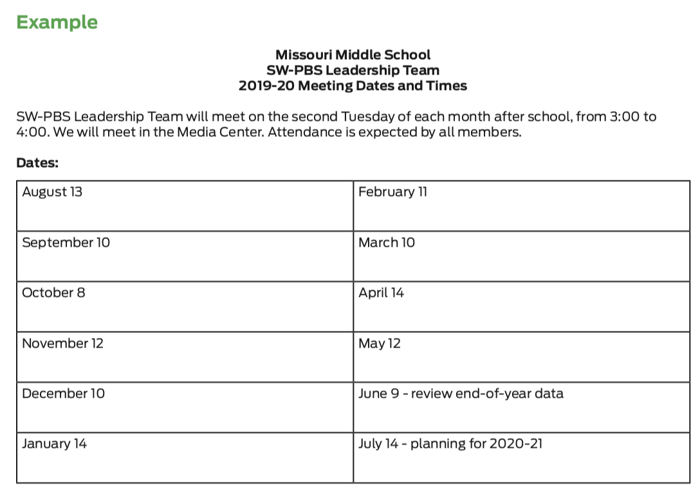
Discussion: Team Meetings
Review the example SW-PBS Leadership Team meeting schedule and consider when your SW-PBS Leadership could meet.
Notes:
To Know/To Say:
Review the example SW-PBS Leadership Team meeting schedule and consider when your SW-PBS Leadership could meet.
HO2 Example Team Meeting Dates

Slide 33
Review example SW-PBS Leadership Team meeting schedule and consider when your SW-PBS Leadership could meet.
MO SW-PBS

Slide 34
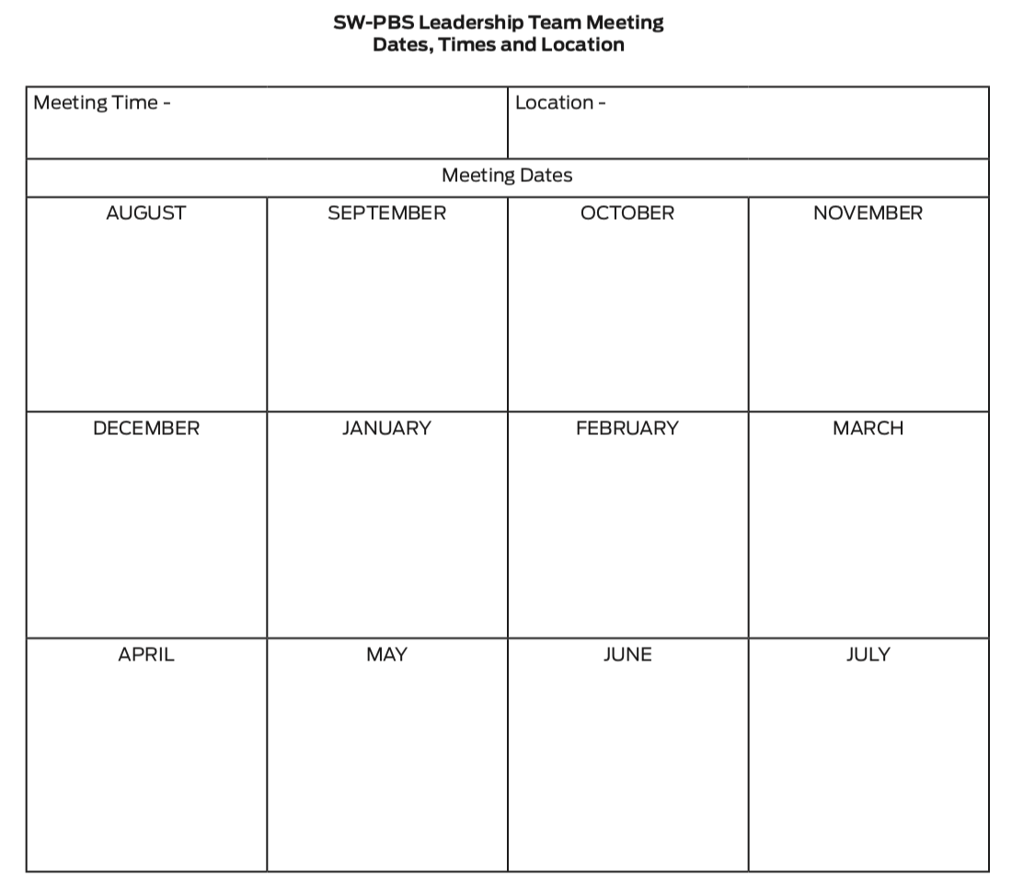
Discussion: Team Meetings
Use the form provided to schedule your SW-PBS Leadership Team meeting dates, times, and location.
Notes:
To Know/To Say: Use the form provided to schedule your SW-PBS Leadership Team meeting dates, times, and location.
HO3 Activity Team Meeting Dates

Slide 35
Review the example SW-PBS Leadership Team meeting schedule and consider when your SW-PBS Leadership could meet.
MO SW-PBS

Slide 36
Closing and Next Steps
Develop action steps for scheduling SW-PBS Leadership Team meetings and adding the dates/time to the school calendar.
Update your action plan using the Tier 1 Action Plan template and the Tier 1 Action Planning Checklist.
Use the Tier 1 Artifacts Rubric to assess the quality of the resources your team develops.
Use the results of the PBIS Self-Assessment Survey (SAS) to gain perspective from all staff, and results from the PBIS Tiered Fidelity Inventory (TFI) to gain perspective from your Building Leadership Team.
MO SW-PBS
Notes:
To Know/To Say: During this lesson, you learned the importance of establishing monthly meetings that are at least one hour in length for the SW-PBS Leadership Team to accomplish their work.
Next steps include updating your action plan. Develop action steps for scheduling SW-PBS Leadership Team meetings and adding the dates/time to the school calendar.
Additional information about SW-PBS Leadership Team meeting scheduling can be found in the MO SW-PBS Handbook and the MO SW-PBS Tier 1 Implementation Guide.

Slide 37
References
Missouri SW-PBS (2019). Missouri schoolwide positive behavior support handbook.
MO SW-PBS
Notes:
Trainer Notes:
To Know/To Say:

Slide 38
Leadership for Behavior
Notes:
Trainer Notes:
To Know/To Say:

Slide 39
Facilitator Notes: Delete This Slide
Handouts
Example and Activity Team Working Agreements
Tier 1 Action Plan
Tier 1 Artifact Rubric
Tier 1 Action Planning Checklist
MO SW-PBS
Notes:
To Know/To Say: This lesson uses one handout. If you have not already done so, download the handouts at this time.

Slide 40
Working Agreements
Be Respectful
Be an active listener—open to new ideas
Use notes for side bar conversations
Be Responsible
Be on time for sessions
Silence cell phones—reply appropriately
Be a Problem Solver
Follow the decision making process
Work toward consensus and support decisions of the group
MO SW-PBS
Notes:
Trainer Notes: Hide or delete this slide if presenting the entire PLM
To Know/To Say: “These will be the Working Agreements we will honor during all our training sessions this year.”

Slide 41
Attention Signal
Notes:
Trainer Notes: Facilitator: Select an attention signal.
To Know/To Say: “One of our agreements is to follow the attention signal.”
“Your team will work with your school to develop an attention signal you will use in every setting.”
“In order to get all of you focused after discussions, activities or breaks,
I will ________________________________________.”
(Insert your attention signal here.)
“Your task will be to finish your sentence, quiet your voice and ____________________________.”
(Insert what you want participants to do.)

Slide 42
Introductions
Notes:
Trainer Notes: Facilitator: Select an introductions activity
To Know/To Say:

Slide 43
Lesson Outcomes
At the end of this session, you will be able to…
Create clearly defined working agreements.
MO SW-PBS
Notes:
Trainer Notes:
To Know/To Say: By the end of this lesson participants will be able to create clearly defined working agreements.

Slide 44
Key Terms
Working agreements: ground rules that assist staff in achieving their meeting goals and increasing the productivity and effectiveness of their time.
MO SW-PBS
Notes:
Trainer Notes:
To Know/To Say: Working agreements: ground rules that assist staff in achieving their meeting goals and increasing the productivity and effectiveness of their time.

Slide 45
Key Concepts/Big Ideas
“Unproductive meetings can dim enthusiasm for your work and slow efforts, while effective team processes excite and inspire, and fuel progress.”
MO SW-PBS, 2019
MO SW-PBS
Notes:
Trainer Notes:
To Know/To Say: Quote: “Unproductive meetings can dim enthusiasm for your work and slow efforts, while effective team processes excite and inspire, and fuel progress.”¹
Once your SW-PBS Leadership Team has been established and is preparing for the first team meeting, it is important that working agreements be established. This lesson will provide information on the importance of working agreements, provide examples, and give guidance on developing these ground rules for team meetings.

Slide 46
Why Working Agreements?
The most common categories of ineffective meetings include:
disorganization in planning; no clear meeting objective or purpose,
ineffective processes for running the meeting, and
no closure or follow-up.
Working agreements are one way to increase productivity and avoid ineffective team meeting processes.
Notes:
To Know/To Say: Time is the most valuable resource for educators. Meeting and planning time is often scarce so we must learn to work smarter, maximizing our time and outcomes.
The most common categories of ineffective meetings include: 1) disorganization in planning; no clear meeting objective or purpose, 2) ineffective processes for running the meeting, and 3) no closure or follow-up. Working agreements are one way to increase productivity and avoid ineffective team meeting processes.

Slide 47
Effective Working Agreements
Working agreements should be:
developed by the team,
posted visibly during meetings,
reviewed as each meeting is initiated,
occasionally used to review team performance at the close of meetings, and
revised as new issues surface.
MO SW-PBS
Notes:
To Know/To Say: Working agreements provide a guide for professional staff behavior. They express the behaviors that are valued by the team and help to ensure every team member knows exactly what is expected. They not only increase productivity and staff comfort but can also help you avoid conflict and provide the standards that allow the team to evaluate their performance.
Working agreements should be:
developed by the team,
posted visibly during meetings,
reviewed as each meeting is initiated,
occasionally used to review team performance at the close of meetings, and
revised as new issues surface.

Slide 48
Effective Working Agreements
All team members should be willing to confront behaviors that are in violation.
Effective working agreements are behaviorally specific.
Working agreements create a picture of how a professional behaves and contributes to the team discipline planning process and the group’s work culture.
MO SW-PBS
Notes:
To Know/To Say: All team members should be willing to confront behaviors that are in violation of their working agreements when they occur during meetings. Effective working agreements are behaviorally specific — they should be readily understood by all — and stated as the desired or positive behavior. They create a picture of how a professional behaves and contributes to the team discipline planning process and the group’s work culture.

Slide 49
Examples
Start on time; end on time.
Stay on topic.
Avoid unnecessary repetition.
Give your full attention; silence cell phones
during meetings.
Clarify agenda/meeting outcomes and time
allotments before beginning.
If presenting, be prepared.
Watch and be considerate of time.
MO SW-PBS
Notes:
To Know/To Say:
Working Agreements: Some Possibilities
Start on time; end on time.
Stay on topic.
Avoid unnecessary repetition.
Give your full attention; silence cell phones during meetings.
Clarify agenda/meeting outcomes and time allotments before beginning.
If presenting, be prepared.
Watch and be considerate of time.
Other examples from the tier 1 Implementation Guide include:
Attend to the speaker; use sticky notes for side conversations.
Wait to speak; use active listening.
Indicate support for ideas you like or agree with.
Ask for clarification if you don’t understand.
Share concerns thoughtfully; pair criticism with a way to improve.
Keep focus on the group goal and what is best for students.
Be willing to doubt your own infallibility, and compromise when necessary.

Slide 50
Increasing Effectiveness
Written as a team.
Posted for team members to see during team meetings.
Reviewed at start of each meeting.
Reviewed at the conclusion of each meeting.
Discussion on what worked, what didn’t, what needs improved.
MO SW-PBS
Notes:
To Know/To Say: In order for working agreements to be most effective it is important that they are written as a team and then posted for team members to see during team meetings. Working agreements can be reviewed at the start of meetings by all team members and then reviewed at the conclusion of the meeting to discuss what worked, what didn’t, and what needs to be improved.

Slide 51
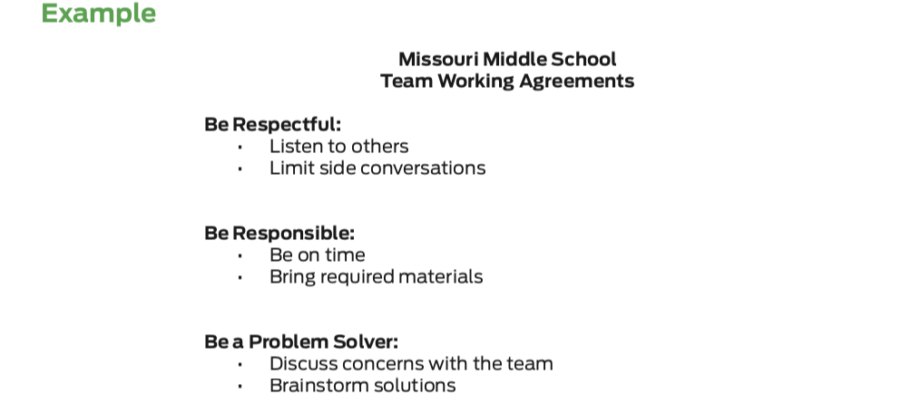
Discussion: Working Agreements
Review this example and consider what working agreements you think are important during team meetings.
Notes:
To Know/To Say: Missouri Middle School’s SW-PBS Leadership Team aligned the working agreements that they developed to the overall schoolwide expectations. Review this example and consider what working agreements you think are important during team meetings.
HO4 Example and Activity Team Working Agreements

Slide 52
Example
Be Respectful | Listen to Others Use Post-Its or Notepads to communicate ideas between times designated for discussion
Be Responsible | Be on Time Bring Required Materials
Be a Problem Solver | Discuss Concerns With The Team Brainstorm Solutions
MO SW-PBS
Notes:
To Know/To Say: “Here is an example of one set of working agreements.”

Slide 53
Activity: Creating Working Agreements
Each team member takes 2-4 Post It Notes.
Team members take time to identify agreements and write them Post It Notes --10 minutes
Put all Post It Notes on Team Parking lot.
Group the Post It Notes in silence --7 minutes.
Group and prioritize agreements--10 minutes.
Write prioritized agreements on chart paper.
Notes:
To Know/To Say: “Follow the directions above to develop your team working agreements. We have provided three expectations:
Be Respectful, Be Responsible, and Be a Problem Solver to help you get started.
You may use other expectations if you wish.”
“Some of you may already have developed working agreements that you use for collaborative meetings. If so, review and revise if needed.” When you complete this activity you will have created working agreements that will guide your meetings throughout this year.”
Provide 20-30 minutes to work on this task.

Slide 54
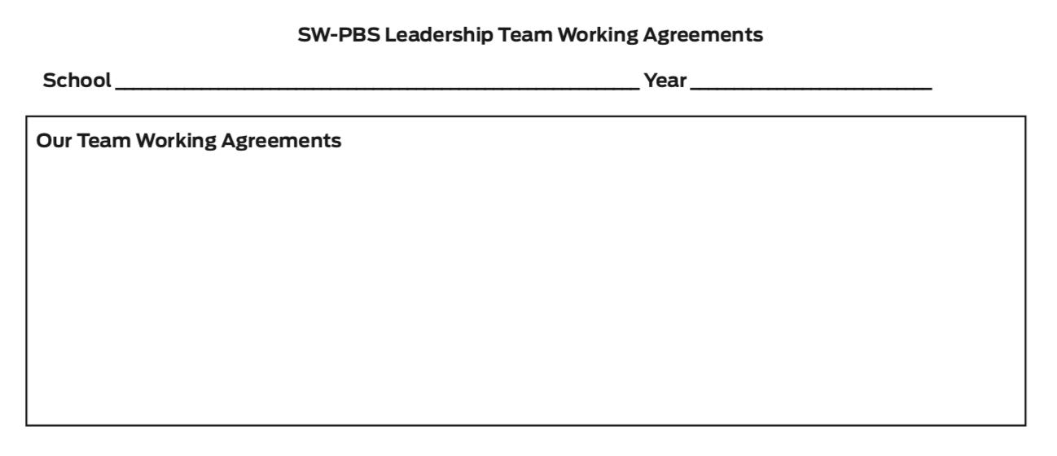
Discussion: Working Agreements
Reflect on the professional behaviors that characterize efficient and effective meetings you have attended.
What working agreements will support your team’s work and heighten your productivity?
Write your team’s working agreements using the form provided.
Notes:
To Know/To Say: Reflect on the professional behaviors that characterize efficient and effective meetings you have attended.
What working agreements will support your team’s work and heighten your productivity?
Write your team’s working agreements using the form provided.
HO4 Example and Activity Team Working Agreements

Slide 55
Closing and Next Steps
Develop action steps for developing your team working agreements and make a plan for how you will make them visible during your team meetings.
Update your action plan using the Tier 1 Action Plan template and the Tier 1 Action Planning Checklist.
Use the Tier 1 Artifacts Rubric to assess the quality of the resources your team develops.
Use the results of the PBIS Self-Assessment Survey (SAS) to gain perspective from all staff, and results from the PBIS Tiered Fidelity Inventory (TFI) to gain perspective from your Building Leadership Team.
MO SW-PBS
Notes:
To Know/To Say: During this lesson, you learned that working agreements provide a guide for professional staff behavior. They not only increase productivity and staff comfort but can also help you avoid conflict and provide the standards that allow the team to evaluate their performance.
How will you engage the SW-PBS Leadership Team in creating and continually using working agreements?
Develop action steps for developing your team working agreements and make a plan for how you will make them visible during your team meetings.
Update your action plan using the Tier 1 Action Plan template and the Tier 1 Action Planning Checklist.
Use the Tier 1 Artifacts Rubric to assess the quality of the resources your team develops.
Use the results of the PBIS Self-Assessment Survey (SAS) to gain perspective from all staff, and results from the PBIS Tiered Fidelity Inventory (TFI) to gain perspective from your Building Leadership Team.
Additional information about working agreements can be found in the MO SW-PBS Handbook and the MO SW-PBS Tier 1 Implementation Guide.

Slide 56
References
Missouri SW-PBS (2019). Missouri schoolwide positive behavior support tier 1 implementation guide.
Garmston, R. J, & Wellman, B. M. (2009). The adaptive school: A sourcebook for developing collaborative groups. Norwood, MA: Christopher-Gordon Publishers, Inc.
MO SW-PBS
Notes:
Trainer Notes:
To Know/To Say:

Slide 58
Facilitator Notes: Delete This Slide
Handouts
Example Meeting Agenda
Activity Team Agenda
Tier 1 Action Plan
Tier 1 Artifact Rubric
Tier 1 Action Planning Checklist
MO SW-PBS
Notes:
To Know/To Say: This lesson uses 2 handouts. If you have not already done so, download the handouts at this time.

Slide 59
Working Agreements
Be Respectful
Be an active listener—open to new ideas
Use notes for side bar conversations
Be Responsible
Be on time for sessions
Silence cell phones—reply appropriately
Be a Problem Solver
Follow the decision making process
Work toward consensus and support decisions of the group
MO SW-PBS
Notes:
Trainer Notes: Hide or delete this slide if presenting the entire PLM
To Know/To Say: “These will be the Working Agreements we will honor during all our training sessions this year.”

Slide 60
Attention Signal
Notes:
Trainer Notes: Facilitator: Select an attention signal.
To Know/To Say: “One of our agreements is to follow the attention signal.”
“Your team will work with your school to develop an attention signal you will use in every setting.”
“In order to get all of you focused after discussions, activities or breaks,
I will ________________________________________.”
(Insert your attention signal here.)
“Your task will be to finish your sentence, quiet your voice and ____________________________.”
(Insert what you want participants to do.)

Slide 61
Introductions
Notes:
Trainer Notes: Facilitator: Select an introductions activity
To Know/To Say:

Slide 62
Lesson Outcomes
At the end of this session, you will be able to…
Create a standard meeting agenda and format.
Notes:
Trainer Notes:
To Know/To Say: At the end of this session, you will be able to…Create a standard meeting agenda and format.

Slide 63
Key Concepts/Rationale
“Creating an effective agenda is one of the most important elements for a productive meeting.”
MO SW-PBS, 2019
MO SW-PBS
Notes:
Trainer Notes:
To Know/To Say:
Quote: “Creating an effective agenda is one of the most important elements for a productive meeting.”¹ As the SW-PBS Leadership Team begins to meet on a consistent basis, it is critical that the team meeting is driven by a well organized agenda. This lesson will walk through the important elements of an effective agenda and provide a template for the team to utilize. This same template can be used to store meeting notes related to agenda items.

Slide 64
Purpose of Agenda
The agenda typically communicates:
objectives/outcomes or topics for discussion,
a time allotment for each topic, and
the person responsible for reporting or leading.
MO SW-PBS
Notes:
To Know/To Say: Creating an effective agenda is one of the most important elements for a productive meeting.
The agenda typically communicates:
objectives/outcomes or topics for discussion,
a time allotment for each topic, and
the person responsible for reporting or leading.

Slide 65
Importance of an Effective Agenda
The most common elements of ineffective meetings include:
disorganization in planning,
lack of clear meeting objective or purpose,
ineffective processes for running the meeting, and
lack of closure or follow-up.
An effective agenda can provide an organizational structure that promotes clear meeting objectives and effective time management.
MO SW-PBS
Notes:
Trainer Notes:
To Know/To Say:
The most common elements of ineffective meetings include disorganization in planning, lack of clear meeting objective or purpose, ineffective processes for running the meeting, and no closure or follow-up. Having an effective agenda can provide an organizational structure that promotes clear meeting objectives and effective time management.

Slide 66
Agenda Template & Procedures
Distribute before the meeting, let participants know what will be discussed.
Include the following:
a space to take notes or indicate members present;
tasks, activities, or assignments to be done before the next meeting; and
the dates of future meetings and possible agenda items.
MO SW-PBS
Notes:
To Know/To Say: It can also be used as a checklist to ensure that all information is covered and, if it is distributed before the meeting, lets participants know what will be discussed. This gives the team an opportunity to come to the meeting prepared for the upcoming discussions or decisions. Additionally, agendas often include a space to take notes or indicate members present; tasks, activities, or assignments to be done before the next meeting; and the dates of future meetings and possible agenda items.
An agenda can be more focused and helpful in guiding an efficient meeting when objectives or outcomes replace simple topics. Terms such as “review and edit,” “discuss and decide,” “draft a plan for,” “determine next steps,” etc., help to avoid unfocused, long-winded discussions of topics and guide all team members toward specific outcomes. With each agenda item spelled out in this manner, the purpose and desired accomplishments are clear, and when team members are off on tangents, the speaker has a clear purpose to bring them back to.
Important Note: You may be asked to share your monthly meeting agendas with your district and/or regional SW-PBS coaches as a means to keep them informed of your work and to guide their planning for needed technical assistance. Consider an efficient and effective method to share your agendas with your support personnel.

Slide 67
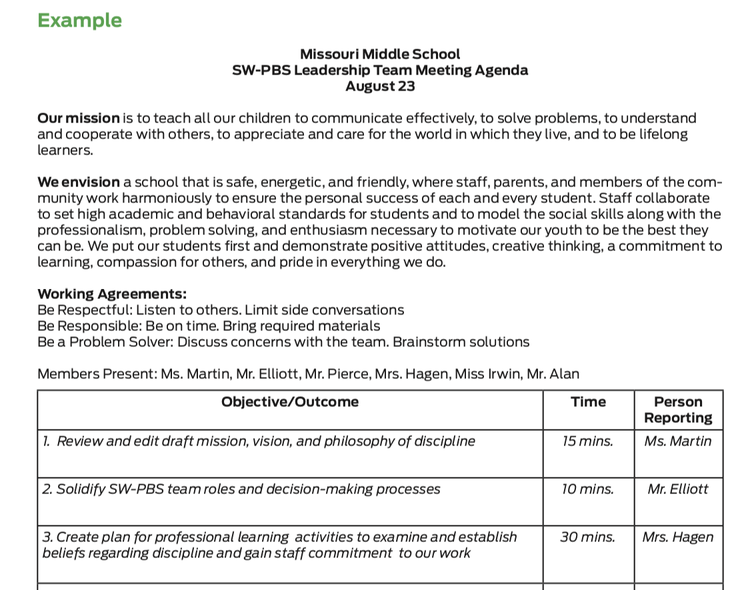
Discussion: Agenda Format
Review the example agenda and the form provided.
Decide if you will use this format or if you will adjust it.
Notes:
To Know/To Say: Review the example agenda and the form provided. Decide if you will use this format or if you will adjust it.
HO5 Example Meeting Agenda
HO6 Activity Team Agenda

Slide 68
Closing and Next Steps
Develop action steps for making a final decision about an agenda form for your SW-PBS Leadership Team meetings
Develop action steps for how your team will share meeting notes with stakeholders/district team/consultant.
Update your action plan using the Tier 1 Action Plan template and the Tier 1 Action Planning Checklist.
Use the Tier 1 Artifacts Rubric to assess the quality of the resources your team develops.
Use the results of the PBIS Self-Assessment Survey (SAS) to gain perspective from all staff, and results from the PBIS Tiered Fidelity Inventory (TFI) to gain perspective from your Building Leadership Team.
MO SW-PBS
Notes:
To Know/To Say: During this lesson, you learned the importance of having a standardized meeting agenda format and were provided an example template for your team to use.
How will you engage the SW-PBS Leadership Team in adopting an efficient meeting agenda format?
Next steps include
Develop action steps for making a final decision about an agenda form for your SW-PBS Leadership Team meetings
Develop action steps for how your team will share meeting notes with stakeholders/district team/consultant.
Update your action plan using the Tier 1 Action Plan template and the Tier 1 Action Planning Checklist.
Use the Tier 1 Artifacts Rubric to assess the quality of the resources your team develops.
Use the results of the PBIS Self-Assessment Survey (SAS) to gain perspective from all staff, and results from the PBIS Tiered Fidelity Inventory (TFI) to gain perspective from your Building Leadership Team.
Additional information about meeting agendas can be found in the MO SW-PBS Handbook and the MO SW-PBS Tier 1 Implementation Guide.

Slide 69
References
Missouri SW-PBS (2019). Missouri schoolwide positive behavior support tier 1 implementation guide.
MO SW-PBS
Notes:
Trainer Notes:
To Know/To Say:

Slide 71
Facilitator Notes: Delete This Slide
Handouts
Common Approaches to Making Decisions
Example Consensus Strategies
Tier 1 Action Plan
Tier 1 Artifact Rubric
Tier 1 Action Planning Checklist
MO SW-PBS
Notes:
To Know/To Say: This lesson uses 5 handouts. If you have not already done so, download the handouts at this time.

Slide 72
Working Agreements
Be Respectful
Be an active listener—open to new ideas
Use notes for side bar conversations
Be Responsible
Be on time for sessions
Silence cell phones—reply appropriately
Be a Problem Solver
Follow the decision making process
Work toward consensus and support decisions of the group
MO SW-PBS
Notes:
Trainer Notes: Hide or delete this slide if presenting the entire PLM
To Know/To Say: “These will be the Working Agreements we will honor during all our training sessions this year.”

Slide 73
Attention Signal
Notes:
Trainer Notes: Facilitator: Select an attention signal.
To Know/To Say: “One of our agreements is to follow the attention signal.”
“Your team will work with your school to develop an attention signal you will use in every setting.”
“In order to get all of you focused after discussions, activities or breaks,
I will ________________________________________.”
(Insert your attention signal here.)
“Your task will be to finish your sentence, quiet your voice and ____________________________.”
(Insert what you want participants to do.)

Slide 74
Introductions
Notes:
Trainer Notes: Facilitator: Select an introductions activity
To Know/To Say:

Slide 75
Lesson Outcomes
At the end of this session, you will be able to…
Create a decision-making procedure.
MO SW-PBS
Notes:
Trainer Notes:
To Know/To Say: At the end of this session, you will be able to…Create a decision-making procedure.

Slide 76
Key Concepts/Rationale
Key Concepts/Important Ideas
“Effective leaders understand the importance of striving for consensus but also understand that not all decisions should be made by the entire group or by using consensus strategies.”
MO SW-PBS, 2019
MO SW-PBS
Notes:
Trainer Notes:
To Know/To Say: Quote: “Effective leaders understand the importance of striving for consensus but also understand that not all decisions should be made by the entire group or by using consensus strategies.”¹ This lesson describes the need for clear decision making procedures for the SW-PBS Leadership Team. Having established procedures will assist in making sure the team, and staff, do not get stuck in indecision or spend time in prolonged discussions with no clear process on how to make a final decision.

Slide 77
Importance of Decision-Making Procedures
Team will encounter regular decisions that need to be made by the team as well as larger decisions, made by the entire staff, regarding the development and implementation of new approaches.
Without effective tools to make these decisions, you may get bogged down in indecision or prolonged discussions and even division.
MO SW-PBS
Notes:
To Know/To Say: As your work progresses, you will encounter regular decisions that need to be made by the team as well as larger decisions, made by the entire staff, regarding the development and implementation of new approaches. Without effective tools to make these decisions, you may get bogged down in indecision or prolonged discussions and even division.

Slide 78
Deciding How to Decide
Who decides?
Teams are most effective and productive when they are clear about whether the role is to inform, recommend or decide.
Inform –Provide specific information as requested to facilitate decision-making by another individual or group.
Recommend – Obtain and evaluate the relevant facts and then propose alternative courses of action to facilitate decision-making by another individual or group.
Decide – Obtain and evaluate the relevant facts to directly participate in reaching a decision.
MO SW-PBS
Notes:
To Know/To Say: Who Decides?
There are some decisions where it just doesn’t make sense to involve everyone. Identifying an individual point person can be very appropriate when that person has much relevant knowledge or authority. Similarly, team decisions may also be appropriate when representation of the school is needed but involving the entire staff is impractical, unnecessary, or too time-consuming. However, you will want to take the time to involve the entire staff when the issue is one that everyone needs familiarity with or that requires the support of each person to carry out. This is essential when decisions are being made about new procedures or approaches to be implemented by all.
“Your Team must understand their role in decision-making each time a decision is to be made. Examples of each role follow:
Inform –
The principal gets information from teachers about evening events for the upcoming year such as open house, music programs, etc. The principal uses this information to develop the school events calendar.
Recommend –
A committee is formed to create a draft of the school-wide expectations. The committee does not have the authority to adopt the expectations, rather the draft is submitted to the full faculty for adoption.
Decide –
The full staff reviews a draft of the staff recognition system, provides comment and suggested revisions, then reaches consensus to adopt the revised staff recognition system.
Teams can get more information from the resource, The Adaptive School: A Sourcebook for Developing Collaborative Groups by Garmston, R. & Wellman, B. (2009).”

Slide 79
Deciding How to Decide
Decision Option | Description
Consensus | Every view or position is heard. All members indicate level of support for the decision.
Majority Rule | Decision determined by a majority vote.
Participative or Representative | Those making the decision seek and take into account input from the entire team or staff.
Unilateral | One person or a group is empowered to make a decision without consulting others.
MO SW-PBS
Notes:
To Know/To Say: “Here is a list of some decision-making strategies. All strategies are utilized in effective organizations; however, effective organizations match the most efficient decision-making strategy to the type of decision that must be made.”
“Remember, your team will answer the following 2 questions before each decision is made:
1) Who should make this specific type of decision?
2) What is the best way to make this decision?
This will prevent feelings of frustration and alienation when decisions must be made unilaterally and encourage participation when decisions must be made through representation or consensus.”

Slide 80
Common Approaches to Decision Making
MO SW-PBS
Notes:
To Know/To Say: There are many consensus strategies that the SW-PBS Leadership Team can adopt to use with just the team, or with the entire staff.
HO7 Common Approaches to Making Decisions
HO8 Example Consensus Strategies

Slide 81
Discussion: Decision-Making
Overall, which approaches to deciding are currently used in your school?
Refer to HO7 Common Approaches to Making Decisions.
Who decides what, and how are those decisions made?
Are decisions being made efficiently?
Do the approaches foster cooperation and collaboration when needed?
Notes:
To Know/To Say: Overall, which approaches to deciding are currently used in your school? Refer to HO7 Common Approaches to Making Decisions.
Who decides what, and how are those decisions made?
Are decisions being made efficiently?
Do the approaches foster cooperation and collaboration when needed?

Slide 82
Discussion: Decision-Making
Overall, which approaches to deciding are currently used in your school?
Continue to refer to HO7 Common Approaches to Making Decisions.
Do the approaches foster cooperation and collaboration when needed?
Which decision-making strategies will you use in your SW-PBS work within your team?
Which decision-making strategies will you use with the entire staff?
Notes:
To Know/To Say: Overall, which approaches to deciding are currently used in your school?
Continue to refer to HO7 Common Approaches to Making Decisions.
Do the approaches foster cooperation and collaboration when needed?
Which decision-making strategies will you use in your SW-PBS work within your team?
Which decision-making strategies will you use with the entire staff?

Slide 83
Closing and Next Steps
Develop action steps for your team to address team decision-making procedures.
Update your action plan using the Tier 1 Action Plan template and the Tier 1 Action Planning Checklist.
Use the Tier 1 Artifacts Rubric to assess the quality of the resources your team develops.
Use the results of the PBIS Self-Assessment Survey (SAS) to gain perspective from all staff, and results from the PBIS Tiered Fidelity Inventory (TFI) to gain perspective from your Building Leadership Team.
MO SW-PBS
Notes:
To Know/To Say: During this lesson, you learned about a variety of different decision-making processes that can be used with your full staff and/or SW-PBS Leadership Team. Next steps include
Develop action steps for your team to address team decision-making procedures.
Update your action plan using the Tier 1 Action Plan template and the Tier 1 Action Planning Checklist.
Use the Tier 1 Artifacts Rubric to assess the quality of the resources your team develops.
Use the results of the PBIS Self-Assessment Survey (SAS) to gain perspective from all staff, and results from the PBIS
Tiered Fidelity Inventory (TFI) to gain perspective from your Building Leadership Team.
Additional information about decision making procedures can be found in the MO SW-PBS Handbook and the MO SW-PBS Tier 1 Implementation Guide.

Slide 84
References
Missouri SW-PBS (2019). Missouri schoolwide positive behavior support tier 1 implementation guide.
MO SW-PBS
Notes:
Trainer Notes:
To Know/To Say:

Slide 86
Facilitator Notes: Delete This Slide
Handouts
Team Roles
Tier 1 Action Plan
Tier 1 Artifact Rubric
Tier 1 Action Planning Checklist
MO SW-PBS
Notes:
To Know/To Say: This lesson uses 1 handout. If you have not already done so, download the handout at this time.

Slide 87
Working Agreements
Be Respectful
Be an active listener—open to new ideas
Use notes for side bar conversations
Be Responsible
Be on time for sessions
Silence cell phones—reply appropriately
Be a Problem Solver
Follow the decision making process
Work toward consensus and support decisions of the group
MO SW-PBS
Notes:
Trainer Notes: Hide or delete this slide if presenting the entire PLM
To Know/To Say: “These will be the Working Agreements we will honor during all our training sessions this year.”

Slide 88
Attention Signal
Notes:
Trainer Notes: Facilitator: Select an attention signal.
To Know/To Say: “One of our agreements is to follow the attention signal.”
“Your team will work with your school to develop an attention signal you will use in every setting.”
“In order to get all of you focused after discussions, activities or breaks,
I will ________________________________________.”
(Insert your attention signal here.)
“Your task will be to finish your sentence, quiet your voice and ____________________________.”
(Insert what you want participants to do.)

Slide 89
Introductions
Notes:
Trainer Notes: Facilitator: Select an introductions activity
To Know/To Say:

Slide 90
Lesson Outcomes
At the end of this session, you will be able to…
Create team member roles.
MO SW-PBS
Notes:
Trainer Notes:
To Know/To Say:

Slide 91
Key Terms
Coaching: Job embedded professional learning provided to support implementation of new skills and practices. Frequently involves modeling, observing, and providing feedback.
MO SW-PBS
Notes:
Coaching: Job embedded professional learning provided to support implementation of new skills and practices. Frequently involves modeling, observing, and providing feedback.

Slide 92
Key Concepts/Big Ideas
“To efficiently and effectively accomplish your SW-PBS tasks, the work must be distributed.”
MO SW-PBS, 2019
MO SW-PBS
Notes:
Trainer Notes:
To Know/To Say: Quote: “To efficiently and effectively accomplish your SW-PBS tasks, the work must be distributed.”¹
This lesson will describe the key team member roles that will be needed on your SW-PBS Leadership Team and set your team up for deciding who will be responsible for each of those roles.

Slide 93
SW-PBS Team Roles
Chairperson
Secretary
Data-Base Manager
Communication Coordinator
Time Keeper
Team Cheerleader
Historian/Archivist
MO SW-PBS
Notes:
To Know/To Say: SW-PBS Leadership Team Roles
Depending on the size of your school and team, not all teams may use all of the recommended roles; although some are essential, the most common are: 1) chairperson, 2) timekeeper, 3) secretary, recorder, or note taker.
Roles are most often assigned based on interest and the specific skill sets of individual team members. Some teams opt to rotate the main roles through all the group members in order to build the experience and skills of all participants, avoid an overreliance on a few, and equalize all while preventing any perception of concentration of power. The specifics of roles is perhaps less important than the commitment to use roles and effective group processes to heighten your operation and productivity.
“To efficiently and effectively accomplish your SW-PBS tasks, the work must be distributed. Designating the role of each member will facilitate the distribution of tasks. Here are roles recommended for members of your team:
Chairperson—this role is often fulfilled by the SW-PBS Coach since it is their job to develop the agenda and facilitate the meeting
Secretary – takes and distributes minutes
Data-Base Manager—provides data to share, including the monthly Big 5 Report (a summary of student discipline data that you will learn about during your Prep year.) The data-base manager shares data with the team and all staff during monthly staff meetings.
Communication Coordinator—is in charge of making sure information is disseminated to and feedback received from all staff, students and parents.
Time Keeper—is the task master and keeps the meeting moving so all topics on the agenda can be addressed.
Team Cheerleader—is in charge of recognizing staff and team members’ work
Historian/Archivist—is the person who keeps electronic files of team products and keeps those files up to date. Very important job!
Depending on the size of your school and team, not all teams may use all of the roles listed above.
Roles are most often assigned based on interest and the specific skill sets of individual team members.
The next activity may assist your team to identify the role(s) of each member.”

Slide 94
SW-PBS Team Roles & Responsibilities
MO SW-PBS
Notes:
To Know/To Say: Recommended roles and assigned tasks, include the following. Use HO9 Team Roles

Slide 95
Coaching
In many ways, all team members will serve in a coaching role, which includes:
listening, questioning, and reviewing data,
encouraging, teaching, prompting, providing practice, and modeling,
communicating with stakeholders,
distributing information and gathering input, and
organizing and promoting professional learning activities.
MO SW-PBS
Notes:
To Know/To Say: Coaching
In addition to suggested roles, team members may be designated to serve in a coaching role to support full SW-PBS implementation by staff. In many ways, all team members will serve in a coaching role, which includes: 1) listening, questioning, and reviewing data, 2) encouraging, teaching, prompting, providing practice, and modeling, 3) communicating with stakeholders, 4) distributing information and gathering input, and 5) organizing and promoting professional learning activities. Some teams may have the ability to identify someone who serves primarily as a coach for their staff.

Slide 96
Discussion: Team Roles
Review the description of team roles provided.
What roles will best support your team’s work and heighten your productivity?
Notes:
To Know/To Say: Review the description of team roles provided.
What roles will best support your team’s work and heighten your productivity?
Determine the roles needed and who from your SW-PBS Leadership Team will best fulfill each role.
HO9 Team Roles

Slide 97
Closing and Next Steps
Develop action steps for making final team role selections.
Update your action plan using the Tier 1 Action Plan template and the Tier 1 Action Planning Checklist.
Use the Tier 1 Artifacts Rubric to assess the quality of the resources your team develops.
Use the results of the PBIS Self-Assessment Survey (SAS) to gain perspective from all staff, and results from the PBIS Tiered Fidelity Inventory (TFI) to gain perspective from your Building Leadership Team.
MO SW-PBS
Notes:
To Know/To Say: During this lesson, you learned about the team roles that will allow your SW-PBS Leadership Team to efficiently and effectively accomplish tasks and action plan steps.
How will you engage the full SW-PBS Leadership Team in assigning and adhering to the roles?
Next steps include
Develop action steps for making final team role selections.
Update your action plan using the Tier 1 Action Plan template and the Tier 1 Action Planning Checklist.
Use the Tier 1 Artifacts Rubric to assess the quality of the resources your team develops.
Use the results of the PBIS Self-Assessment Survey (SAS) to gain perspective from all staff, and results from the PBIS Tiered Fidelity Inventory (TFI) to gain perspective from your Building Leadership Team.
Additional information about team roles and responsibilities can be found in the MO SW-PBS Handbook and the MO SW-PBS Tier 1 Implementation Guide.

Slide 98
References
Missouri SW-PBS (2019). Missouri schoolwide positive behavior support tier 1 implementation guide.
MO SW-PBS
Notes:
Trainer Notes:
To Know/To Say:

