Slide 1
Common Formative Assessment
Part 2 Eliciting Evidence of Learning
Essential Functions 3 & 4
Notes:
To Say
Today we will look at Part 2 of the Common Formative Assessment training. This module will cover Essential Functions 3 and 4 and the topic will be Eliciting Evidence of Learning. When looking at the Practice Profile, you can see that these two Essential Functions address daily formative assessments and common formative assessment and how they relate to evidence of student learning.

Slide 2
Hidden Slide #1
The Common Formative Assessment Module was designed to be used in the following manner.
The audience for this module is educators, including Building Leaders, Instructional Coaches, and teachers of all contents and levels. This module can be used for whole staff presentations.
Time should be allotted after training for participants to reflect and have conversations regarding current and needed changes. Participants should reflect on the following questions:
Where are we now? Where are we going? How can we get there?
Participants should complete the SAPP for Common Formative Assessment.
Following the training participants should complete a Next Steps Document.
Notes:
This slide is for coaches
Formative Assessment is an essential topic that all educators, building leaders, and instructional coaches need to understand. The content in this module is intended to help districts/teachers plan for the use of daily formative and common formative assessment in their districts.
If a district uses the term learning intention instead of learning target, the presenter may change reference from learning target to learning intention throughout the presentation. Learning targets are defined as the key information and ideas we want learners to know.
Consultants should possess a general understanding of the role of various types of formative assessment and the importance each plays in the DBDM process. They should also understand that the effectiveness of instructional practices is measured by assessing student impact which is done through formative assessment.

Slide 3
Hidden Slide #2
Common Formative Assessment
Module Organization
Part 1
EF 1 & 2
Part 2
EF 3 & 4
Part 3
EF 5
Introduction To Common Formative Assessment
Clarifying Learning
Identifying priority standards
Unwrapping standards
Learning targets
Success criteria
Eliciting Evidence Of Learning
Daily Formative Assessment
Common Formative Assessment
Feedback
Acting on evidence of learning
Using feedback
Notes:
This slide is for coaches
(Important) The introduction at the beginning of Part 1 of the Common Formative Assessment module provides an overview of the formative assessment process and essential background information for participants. It is important that all participants receive introduction training prior to other module sessions if they have not previously had it.
Part 1 provides content aligned with CLARIFYING LEARNING, which addresses EF1 & 2 of the CFA Practice Profile. Topics covered include identifying priority standards, unwrapping priority standards, learning targets, and success criteria.
Part 2 is aligned with EF 3 & EF 4 of the CFA Practice Profile which addresses ELICITING EVIDENCE OF LEARNING through daily formative assessment and common formative assessment.
Part 3 is aligned with EF 5 of the Practice Profile. It provides content on using evidence of learning (feedback from students) to drive instruction, as well as information on providing effective feedback to students.
Concepts addressing ACTIVATING LEARNERS are important to the formative assessment process and have been embedded throughout the module. The metacognition and DACL modules also address activating learners and can be accessed from the MoEdu-SAIL Website (https://www.moedu-sail.org/mtss-facilitator-materials/#practices) or the Missouri Virtual Learning Platform (https://apps.dese.mo.gov/WebLogin/Login.aspx?ReturnUrl=%2fweblogin%2ferrorPage.html%3faspxerrorpath%3d%2fVLP%2fapp%2findex.aspx&aspxerrorpath=/VLP/app/index.aspx)

Slide 4
Hidden Slide #3 Part 2 of the Common Formative Assessment module is designed to be completed in 4 hours. The Daily Formative Assessment section should take 2 hours and the Common Formative Assessment section should also take 2 hours.
Supplies needed
WiFi access for presenter and participants
Access to videos (through WiFi if available, but download to flash drive as a back-up)
Chart paper
Plain paper
Markers & highlighters
Post-it-Notes
You may consider requesting that participants bring a device with a QR reader to scan codes for easy access to documents.
Notes:
To Know
This slide list time allotted for each section and supplies needed.

Slide 5
Hidden Slide #4
Handouts
CFA Infographic
CFA Practice Profile
Formative Assessment Process
Question Stems
Find Someone Who
Formative Assessment T-Chart
Learning Target Planning Template
Target Type
CFA Planning Template
Next Steps-Action-CFA
Notes:
To Know
These are the handouts for Part 2 of the Common Formative Assessment module. These handouts may be sent to participants prior to the training or at the session.

Slide 6
Hidden Slide #5
General Guidance for Virtual Presentations
Notify and request prior permission from participants if session is to be videotaped.
Test your tech set-up prior to the session (download and save videos on flash drive if needed)
Keep sessions short (1 – 1.5 hours maximum)
Provide norms for participation & discussion (video on, ask questions in chat, stay engaged)
Minimize distractions (request participants to mute when not participating)
Identify roles prior to presentation (facilitator, timekeeper, notetaker, etc.)
Use 2 consultants – 1 to present, 1 to manage chat, etc.
Create opportunities for participant engagement and interaction
Each breakout room should choose a discussion leader and notetaker
End the session with an effective wrap up
Notes:
To Know
This slide is for consultants if they area doing a virtual training.

Slide 7
Hidden Slide #6
Key Terms – Common Formative Assessment Module
Academic Rigor - learning and educational experiences that are academically, intellectually, and personally challenging.
Actionable Feedback - feedback that is concrete, specific, and useful; it provides actionable information that learners can use to develop a path to improvement.
All Student Response Systems - methods that enable teachers to get responses from every student in real time.
Benchmark/Interim Assessment - a comparison of student understanding or performance against a set of uniform standards within the same school year.
Calibration - the process of checking the use of a measuring instrument to see if it is accurate.
Common Formative Assessment - an intentionally and collaboratively designed measure used and analyzed for the purpose of monitoring students' attainment of essential learning targets or skills through the instructional process.
Complexity - the degree of difficulty in determining the standards and performance evaluation of a task.
Notes:
To Know
The next five slides are for consultant use and have the key terms for the learning package. Consultants should know these terms before using this module. Consultants may choose to include some of these definitions in their training as appropriate.
References (adapted from)
Ferry, L. (2021). How to design classroom assessments using the difficulty & complexity matrix. CIESC. https://plconnect.ciesc.org/design-classroom-assessments-using-difficulty-complexity-matrix/
Hattie, J. (2017). How to empower student learning with teacher clarity. https://us.corwin.com/sites/default/files/corwin_whitepaper_teacherclarity_may2017_final.pdf
Moss, C., & Brookhart, S. (2019). Advancing formative assessment in every classroom: A guide for instructional leaders. ASCD.
Wiliam, D. (2018). Embedded formative assessment. Solution Tree Press.

Slide 8
Hidden Slide #7
Key Terms
Daily Formative Assessment - the deliberate, on-going process that provides immediate information to teachers and students during instruction regarding learning needs and academic progress of students toward learning targets.
Difficulty - determined both by learner factors (characteristics of learners that influence their ability to complete tasks) and task factors (task types or features of tasks that influence their difficulty).
Evaluative Feedback - information provided to the learner in the form of grades or evaluative comments which fail to provide a path to improvement and can often have a negative impact on learning.
Evidence of Learning - information gathered through observations, discussions, tasks, and activities that provide educators with insight and data regarding students’ thinking and understanding.
Feedback - information provided by an agent (teacher, peer, book, parent, self-experience) regarding aspects of one’s performance or understanding.
Notes:
To Know
Definitions are for consultant use and have the key terms for the learning package. Consultants should know these terms before using this module. Consultants may choose to include some of these definitions into their training as appropriate.
References (adapted from)
Hattie, J. (2017). How to empower student learning with teacher clarity. https://us.corwin.com/sites/default/files/corwin_whitepaper_teacherclarity_may2017_final.pdf
Moss, C., & Brookhart, S. (2019). Advancing formative assessment in every classroom: A guide for instructional leaders. ASCD.
Wiliam, D. (2018). Embedded formative assessment. Solution Tree Press.

Slide 9
Hidden Slide #8
Key Terms
Formative Assessment - “a process in which evidence about student achievement is elicited, interpreted, and used by teachers, learners, or their peers to make decisions about the next steps in instruction that are likely to be better, or better founded, than the decisions they would have make in the absence of that evidence .” (Wiliam, 2018)
Learning Target - lesson-sized statement of what will be taught and what students are expected to know and be able to do.
Peer Assessment - students assessing the work of peers based against a set of success criteria.
Priority Standard - prioritized learning outcomes for specific grade levels and courses determined to be essential for student understanding and success in each level of schooling, in life, and on all high-stakes assessments. Deliberately selected sets of standards form the framework of a unit.
Relevance - learning in which students apply core knowledge, concepts, or skills to solve real-world problems.
Notes:
To Know
Definitions are for consultant use and have the key terms for the learning package. Consultants should know these terms before using this module. Consultants may choose to include some of these definitions into their training as appropriate.

Slide 10
Hidden Slide #9
Key Terms
Rubric - a coherent set of criteria for students' work that includes descriptions of levels of performance quality on the criteria.
Strategic Questioning - intentionally designed questions that help teachers uncover more about what students know and don’t know.
Student Self-Assessment - the process of students reflecting on and evaluating their own work for the purpose of improving it.
Success Criteria - closely linked to learning intentions, success criteria are observable descriptions of what students would do to meet the learning target. They provide a means for students and teachers to evaluate work and gauge progress toward learning goals.
Summative Assessment - a comparison of the performance of a student or group of students against a set of uniform standards administered after the instructional cycle.
Notes:
To Know
Definitions are for consultant use and have the key terms for the learning package. Consultants should know these terms before using this module. Consultants may choose to include some of these definitions into their training as appropriate.

Slide 11
Hidden Slide #10
Key Terms
Unwrapped Standard - a decomposed priority standard that lists concepts, skills, and big ideas that can be used to more clearly define learning targets to guide instruction and assessment.
Learning Target - a comprehensive description of the goal for learning that includes the learning target statement, success criteria, lesson-sized chunk of concepts/skills, and a performance of understanding.
Notes:
To Know
Definitions are for consultant use and have the key terms for the learning package. Consultants should know these terms before using this module. Consultants may choose to include some of these definitions into their training as appropriate.

Slide 12
Hidden Slide #11
Pre-Training Preparation
Pre-read articles
7 Fast, Smart Ways to Do Formative Assessment
https://www.edutopia.org/article/7-smart-fast-ways-do-formative-assessment
Here’s How to Build Common Formative Assessments.
https://www.powerschool.com/resources/blog/new-teachers-heres-build-common-formative-assessments/
Notes:
To Know
Consultants should send both of these pre-read articles to the participants because both are used in the module.
7 Fast, Smart Ways to Do Formative Assessment provides participants with a brief overview of formative assessment and its purposes along with some smart, fast ways to do it.
New Teachers, Here’s How to Build Common Formative Assessments provides an overview of the purpose and benefits of CFAs and a detailed step-by-step process to create them. Although the title is focused on new teachers, this article provides very essential information on developing CFAs regardless of teacher experience.
To Do
Provide to participants as a pre-reads so they will be prepared to reflect on them in the presentation.
References
PowerSchool. (2016, Oct. 13). New teachers, here’s how to build common formative assessments [Blog]. https://www.powerschool.com/resources/blog/new-teachers-heres-build-common-formative-assessments/
Thomas, L. (2019, April 26). 7 smart, fast ways to do formative assessment. Edutopia. https://www.edutopia.org/article/7-smart-fast-ways-do-formative-assessment

Slide 13
Eliciting Evidence of Learning
CFA Module 2
Notes:
To Know/To Do
It is important that all participants receive introduction training prior to other module sessions if they have not previously had it.
To Say
Today we will look at Part 2 of the Common Formative Assessment training. This module will cover Essential Functions 3 and 4 and the topic will be Eliciting Evidence of Learning. When looking at the Practice Profile, you can see that these two Essential Functions address daily formative assessments and common formative assessment and how they relate to evidence of student learning.

Slide 14
Acknowledgements
Special thanks to all contributors to the development of this Professional Learning Module. The original collection of Professional Learning Modules was rolled-out for use by Regional Professional Development Center (RPDC) Consultants in July 2013 after being developed by a team of content experts through efforts funded by the Missouri State Personnel Development Grant (SPDG).
Content Development Team
Cathy Battles
Bev Boyd
Myra Collins
Liz Condray
Susan Hekmat
Brooke Prickett
Training Material Adaptation
Beverly Kohzadi
Institute for Human Development
Ronda Jenson
Jodi Arnold
Cynthia Beckmann
Chelie Nelson
Cheryl Wrinkle
Notes:
To Know/To Say
Special thanks to all contributors to the development and revision of this Professional Learning Module.

Slide 15
Welcome and Introductions
Our trainers for the day
Notes:
To Know/To Do
Add presenter information to the slide.

Slide 16
Norms
Begin and end on time
Be an engaged participant
Be an active listener - open to new ideas
Use notes for side bar conversations
Use electronics respectfully
Notes:
To Know
It is important to establish norms for training. Trainers are free to adjust this list of norms.
To Do
Consider including a check mid-way through the training to assess a norm or norms. The presenter may want to use norms printed on agenda handouts in addition to or in place of presentation slides, so the norms are always available in print for participants. Norms may be added to address specific school needs. Some schools already have established norms for all PD. In that case, adapt to their norms.
To Say
Please review the norms for this training. Are there any additions that need to be made to the norms at this time?

Slide 17
Notes:
To Know/To Say
You will see these icons on slides and handouts throughout the presentation.

Slide 18
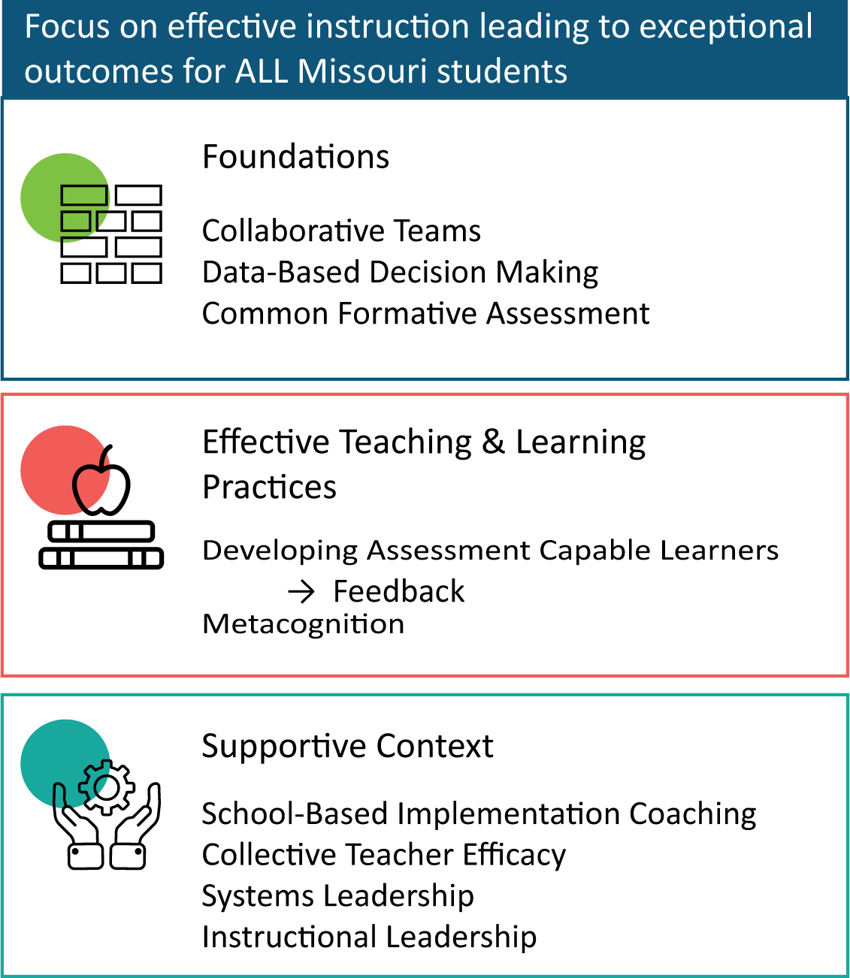
District Continuous Improvement Framework (DCI)
Notes:
To Know
Nine Professional Learning Modules make up the DCI Content within the DCI Framework as illustrated in the slide.
Three foundational educational practices essential for collaborative, data-informed instruction and decision making
Two effective teaching and learning practices shown to improve student achievement
Four practices that create a supportive context to sustain and advance effective teaching and learning
To Do/To Say
Before we delve into this module, let’s take a few minutes to review the DCI Framework graphic, looking specifically at where CFA falls into whole picture.
As you see, the focus of DCI is on effective instruction leading to exceptional outcomes for all Missouri students.
The Content Framework has three main components
Foundations (consisting of Collaborative Teams, Data-Based Decision Making, and Common Formative Assessment)
Effective Teaching and Learning Practices (Developing Assessment Capable Learners with Feedback and Metacognition)
Supportive Context (School Based Implementation Coaching, Collective Teacher Efficacy, and Systems/Instructional Leadership)
References
MoEdu-SAIL. (2022). Blueprint for district and building leadership (6th ed.). Missouri Department of Elementary and Secondary Education: Northern Arizona University, Institute for Human Development.

Slide 19
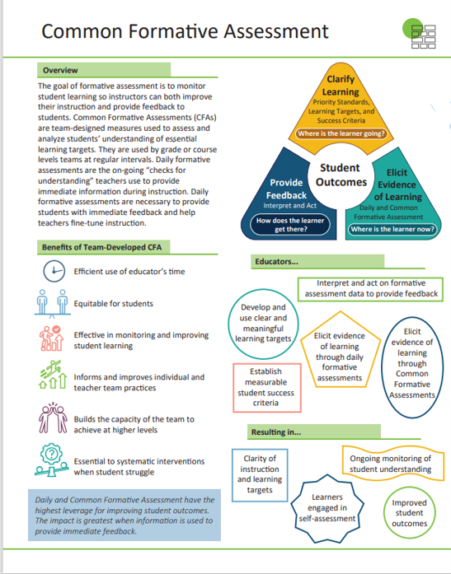
Common Formative Assessment (CFA) Infographic
Notes:
Handout #1
To Know/To Say
The CFA infographic summarizes key content from the learning package. Briefly review the infographic with participants.

Slide 20
Common Formative Assessment Module
Part 1: Essential Functions 1 & 2
Introduction
Clarifying Learning: Identifying priority standards, unwrapping standards, learning targets, and success criteria
Part 2: Essential Functions 3 & 4
Daily Formative Assessment
Common Formative Assessment
Part 3: Essential Function 5
Acting on evidence of learning
Using feedback
Notes:
To Know
Part 1 provides content aligned with the first essential function of the formative assessment process, CLARIFYING LEARNING, which addresses EF 1 & 2 of the CFA Practice Profile. Topics covered include identifying priority standards, unwrapping priority standards, learning targets, and success criteria. Please note: This module introduces the concepts of priority standards, learning targets, and success criteria as they related to formative assessment, however this information is not intended to replace the in-depth professional development through DACL regarding the development of success criteria and learning targets. If a coach feels the district would benefit more from understanding these concepts more deeply, please use the DCI DACL module materials along with the CFA module.
Part 2 is aligned with EF 3 & 4 of the CFA Practice Profile which addresses ELICITING EVIDENCE OF LEARNING through daily formative assessment and common formative assessment.
Part 3 is aligned with EF 5 of the Practice Profile. It provides content on using evidence of learning (feedback from students) to drive instruction, as well as information on providing effective feedback to students to move them toward learning goals.
Concepts addressing ACTIVATING LEARNERS are important to the formative assessment process and have been embedded throughout the module. The Metacognition and DACL modules also address activating learners and can be accessed from the MoEdu-SAIL Website (https://www.moedu-sail.org/mtss-facilitator-materials/#practices) or the Missouri Virtual Learning Platform. (https://apps.dese.mo.gov/WebLogin/Login.aspx?ReturnUrl=%2fweblogin%2ferrorPage.html%3faspxerrorpath%3d%2fVLP%2fapp%2findex.aspx&aspxerrorpath=/VLP/app/index.aspx)
To Do/To Say
This slide shows the organization of the entire CFA Module. Today we will be completing Part 2, which is Daily Formative and Common Formative Assessments. This part coincides with Essential Functions 3 and 4 on the Practice Profile.

Slide 21
CFA Module Objectives
Understand the formative assessment process, its role, and impact
Know how to clarify learning goals through learning targets and success criteria
Compare daily formative assessment and common formative assessment and explain how both benefit teachers and students
Develop effective daily and common formative assessments to elicit evidence of learning
Interpret and act on formative assessment evidence to provide feedback and make data-based decisions to improve teaching and learning
Notes:
To Know/To Say
These are the overall learning Objectives for the Common Formative Assessment module. Objectives are aligned to the Common Formative Assessment Practice Profile. Formative assessment is a process that includes 1. clarifying learning, 2. eliciting evidence of learning, and 3. interpreting and acting on evidence of learning to provide feedback and make decisions based on data to improve teaching and learning. The objectives are also aligned with this process. We will cover objectives 3 and 4 today.
To Do
Review the learning outcomes on the slide.

Slide 22
CFA Module Essential Questions
How do I create learning targets to guide instruction and clarify learning?
How do I establish measurable student success criteria to clarify learning?
How do I elicit evidence of learning through daily formative assessments to monitor student understanding to improve instruction?
How do I elicit evidence of learning through common formative assessments to improve student understanding and improve instruction?
How do I interpret and act on formative assessment data to provide feedback and improve student learning?
Notes:
To Know
These are the overall essential questions for the Common Formative Assessment module. Questions are aligned to the five essential functions on the CFA Practice Profile. These Essential Questions help to activate participant thinking and access prior knowledge regarding metacognition.
To Do
Review the essential questions and provide time for reflective thinking.
To Say
These essential questions will help you reflect on your knowledge regarding CFA Module and the content that is contained in parts 1, 2, & 3 of the module. (Read the questions.) During this training, we will answer questions 3 and 4.

Slide 23
Common Formative Assessment Practice Profile
Notes:
Handout #2
Know/To Say
This is the Common Formative Assessment Practice Profile. This Practice Profile is a rubric that serves as an educator’s roadmap for implementation of formative assessment.
Each of the five essential functions align with clarifying learning through priority standards, learning targets, and success criteria; eliciting evidence of learning through daily and common formative assessment; and providing feedback by interpreting and acting.
To Do
Make sure each participant has this handout. Briefly discuss the five essential functions. Then have educators do a quick self-assessment by highlighting indicators in EF 3 & 4 they currently see taking place in their classroom/school/district. This document will be reviewed in all three sessions.

Slide 24
CFA Alignment with MO Leader Standards
Standard #2 Teaching and Learning
Quality Indicators 2: Provide an Effective Instructional Program
Quality Indicator 3: Ensure Continuous Professional Learning
Standard #6 Professional Development
Quality Indicator 1: Increase knowledge and skills based on best practices
Notes:
To Know/To Say
These MO Leader Standards are closely aligned to the content within the Common Formative Assessment module.
Standard #2 Teaching and Learning
Education leaders have the knowledge and ability to ensure the success of all students by promoting a positive school culture, providing an effective instructional program that applies best practice to student learning, and designing comprehensive professional growth plans for staff.
Quality Indicator 2: Provide an Effective Instructional Program
Quality Indicator 3: Ensure Continuous Professional Learning
Standard #6 Professional Development
Education leaders have the knowledge and ability to ensure the success of all students by remaining current on best practices in education administration and school-related areas as evidenced in his/her annual professional development plan.
Quality Indicator 1: Increase knowledge and skills based on best practices
To Do
Review slide with participants.

Slide 25
CFA Alignment with MO Teacher Standards
Standard #2 Student Learning, Growth and Development
Quality Indicator 2: Student goals
Standard #7 Student Assessment and Data Analysis
Quality Indicators 1: Effective use of assessments
Quality Indicator 2: Assessment data to improve learning
Quality Indicator 3: Student-led assessment strategies
Quality Indicator 4: Effect of instruction on individual/class learning
Quality Indicator 5: Communication of student progress and maintaining records
Quality Indicator 6: Collaborative data analysis
Notes:
To Know/To Say
These MO Teacher Standards are closely aligned to the content within the Common Formative Assessment module.
Standard #2 Student Learning, Growth and Development The teacher understands how students learn, develop, and differ in their approaches to learning. The teacher provides learning opportunities that are adapted to diverse learners and support the intellectual, social, and personal development of all students.
Quality Indicator 2: Student goals
Standard #7 Student Assessment and Data Analysis The teacher understands and uses formative and summative assessment strategies to assess the learner’s progress and uses both classroom and standardized assessment data to plan ongoing instruction. The teacher monitors the performance of each student, and devises instruction to enable students to grow and develop, making adequate academic progress.
Quality Indicator 1: Effective use of assessments
Quality Indicator 2: Assessment data to improve learning
Quality Indicator 3: Student-led assessment strategies
Quality Indicator 4: Effect of instruction on individual/class learning
Quality Indicator 5: Communication of student progress and maintaining records
Quality Indicator 6: Collaborative data analysis
To Do
Review slide with participants.
Reference
Missouri Department of Elementary and Secondary Education. (2013, June). Leader standards. Missouri’s Educator Evaluation System. https://dese.mo.gov/media/pdf/oeq-ed-leaderstandards

Slide 26
Eliciting Evidence of Learning
Part 2
Essential Functions 3 & 4
Notes:
To Know/To Do
It is important that all participants receive introduction training prior to other module sessions if they have not previously had it.
To Say
Today we will look at Part 2 of the Common Formative Assessment training. This module will cover Essential Functions 3 and 4 and the topic will be Eliciting Evidence of Learning. When looking at the Practice Profile, you can see that these two Essential Functions address daily formative assessments and common formative assessment and how they relate to evidence of student learning.

Slide 27
3-2-1 Bridge
Jot down your thoughts to the following questions.
3 words related to common formative assessment (CFA)
2 questions you have on the topic of CFA
1 example, analogy, simile, or metaphor on the topic of CFA
Notes:
To Know
The 3-2-1 Bridge activity has participants write down some of their thoughts on a topic before and after learning something new. Then participants are asked to look at their original thoughts and compare them with their new perceptions. This helps to highlight how participants thinking on a topic has progressed and developed.
To Do
To start the 3-2-1 bridge exercise, have participants think about what they might already know on a subject and have them write down the following.
3 Words related to the topic
2 Questions they have on the topic
1 Example, analogy, simile, or metaphor of the topic
Once they have written down their thoughts you can have them discuss their 3-2-1 with a partner, a small group, or as a group. Use this time to show some of the different ways to think about the same topic. You can also collect participant’s responses to get a picture of what they already know or are thinking about the topic.
To Say
We are going to start by reflecting on what you already know about common formative assessment. Take a minute and jot down your response to the 3 questions on the slide.
(Give time to complete.) Now with the person sitting next to you talk about what you wrote and why.
Reference
Adaptive Schools. (n.d.). Teaching tip: 3-2-1 bridge. LiveBinder. https://www.livebinders.com/play/play?id=1626114

Slide 28
CFA Part 2: Session-at-a-Glance
Purpose, benefits, and use of Daily Formative Assessment
Activating students in the formative assessment process
Action planning for Daily Formative Assessment
Developing and using Common Formative Assessment
Action planning for Common Formative Assessment
Notes:
To Say
Please review this slide that details our session today.

Slide 29
CFA Part 2: Objectives
Collect evidence of learning by engineering effective discussions, observations, and tasks through Daily Formative Assessment
Collaboratively develop Common Formative Assessments that align with learning targets/success criteria and reflect learning progression
Use formative assessment evidence to make instructional and learner adjustments to improve student outcomes
Engage learners in the formative assessment process to develop and enhance self-assessment skills
Notes:
To Know/To Say
These are the learning objectives for Part 2, Eliciting Evidence of Learning which are aligned to the Common Formative Assessment Practice Profile.

Slide 30
CFA Part 2: Essential Questions
How do I collect evidence through Daily Formative Assessment?
How do I collaboratively develop Common Formative Assessments that algin to learning target/success criteria and reflect learning progression?
How do I use evidence from formative assessment to assist in making instructional decisions to improve student outcomes?
How do I use learner engagement in the formative process to develop and enhance self-assessment skills?
Notes:
To Know
Essential Questions guide the audience to begin thinking about the information provided in the module. Essential Questions also give the presenter a guide for what information needs to be reviewed and discussed at the end of the presentation. Participants will need time throughout the presentation to discuss and reflect on these questions.
The Essential Questions listed on this slide pose questions to help participants reflect on key ideas within the Eliciting Evidence Of Learning module.
To Do
Pose questions on the slide and encourage discussion around each.
To Say
Let’s use these essential questions to reflect on our knowledge about Eliciting Evidence of Learning.

Slide 31
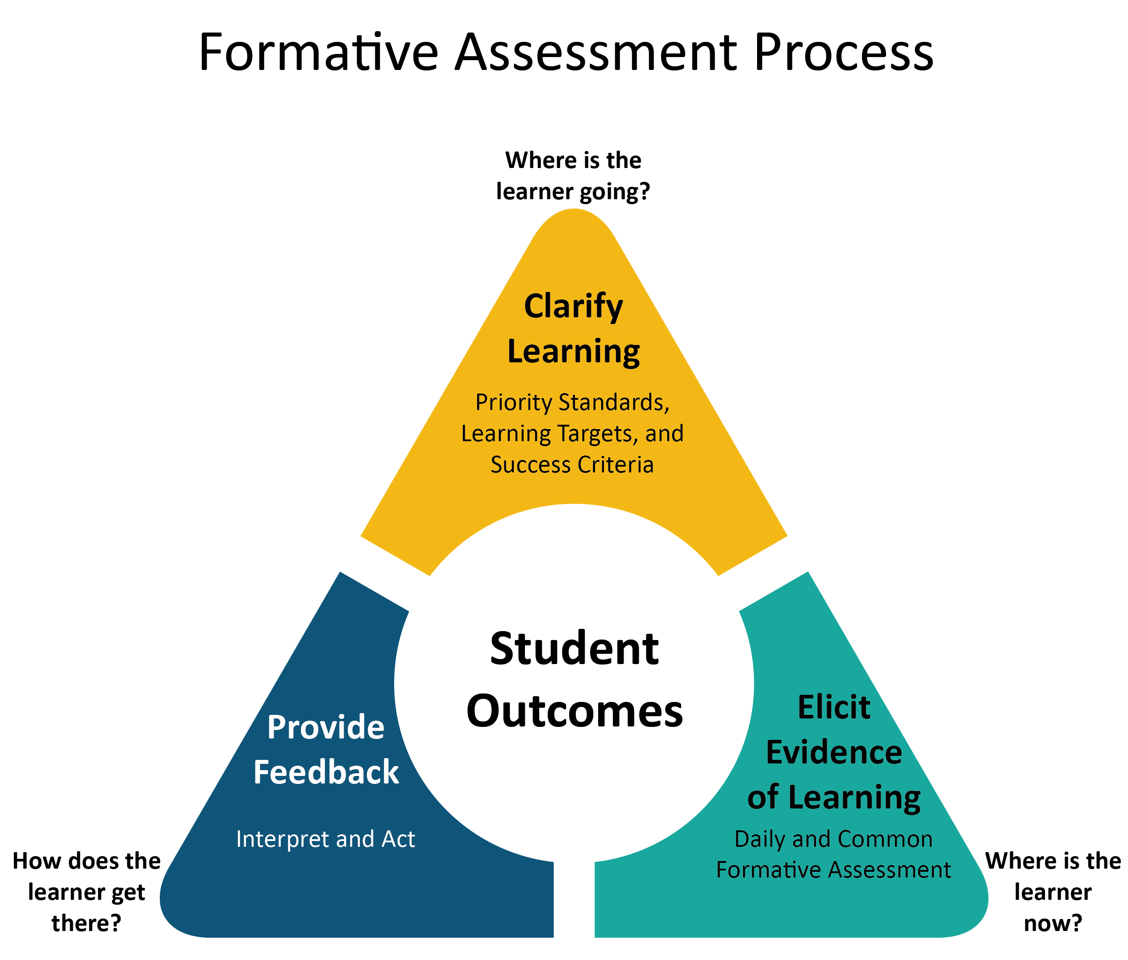
The Formative Assessment Process
Identify the learning destination by clarifying learning targets
Establish where students are by eliciting evidence of learning
Interpret and act on feedback to move learners forward
(Adapted from Wiliam, 2018; NWEA, 2016; & NCTM, 2013)
Notes:
Handout #3 - The Formative Assessment Process
To Know
This process aligns with the formative assessment strategies outlined by the National Council of Teachers of Math (NCTM), NWEA (formerly known as the Northwest Evaluation Association), the work of Dylan Wiliam, and other experts in the field.
This visual depicts the 4 keys we discussed in the previous slide. This applies to any types of formative assessment.
Key features
Student learning in center
Repeated cycle
Clarify Learning (learning targets, standards & success criteria)
Elicit Evidence ( Daily & CFA)
Feedback (Interpret and act)
Use as Transition to EF 1
To Do
Explain the formative assessment process graphic.
To Know/To Say
In Handout #3 you have a more readable version of this graphic. The formative assessment process is a continuous cycle that includes clarifying learning for students, eliciting evidence of learning from students, and interpreting and acting on feedback to support the next steps in learning. The three overarching questions that guide this process are aligned with the DACL practices: Where is the learning going? Where is the learner now? How does the learner get there? At the center of this process are students who, through formative assessment, can become engaged, skillful, self-regulated learners.
References
National Council of Teachers of Mathematics. (2013, July). Formative assessment position statement. https://www.nctm.org/uploadedFiles/Standards_and_Positions/Position_Statements/Formative%20Assessment1.pdf
Northwest Evaluation Association. (2016, March). 4 formative assessment practices that make a difference. Partnering to Help All Kids Learn. https://www.nwea.org/content/uploads/2016/04/4-Formative-Assessment-Practices-that-Make-a-Difference-in-Classrooms.pdf
Wiliam, D. (2018). Embedded formative assessment. Solution Tree Press.

Slide 32
Forms of Assessment
Daily Assessment | Common Assessments Formative Summative |  |  | District-Level Assessment | External Assessment
High-quality instruction Ongoing Student/ Teacher interaction |  | Collaboratively Developed; Collectively Scored and Analyzed |  | Benchmark(s) of Proficiency and Mastery | Ranks & Sorts State/Federal Accountability
DURING THE LEARNING AFTER THE LEARNING
(DuFour et al., 2010; Heritage, 2010; Reeves, 2003)
Notes:
To Know
This is a review slide to help ground today’s learning for participants. Formative assessment can take many forms and can happen across different time frames. The key aspect of formative assessment is that it is any activity used as an assessment for learning (versus of learning which would be summative) that occurs before or during the learning process.
To Do/Say
All educational assessments can have an impact on ensuring there is effective instruction, however not all formative assessment is equally effective. There is strong research to indicate that the more quickly assessment information is used to provide feedback (or the shorter the assessment-interpretation-action cycle is) the greater the impact on student achievement. In this module we will talk about both daily classroom-based assessments and common formative assessments as two types of formative assessment that can be used most easily to provide students with the most immediate feedback (Wiliam, 2016).
There are a variety of formative assessments used by teachers. This module will focus on daily (minute-by-minute classroom based) formative assessment and common formative assessments as they fall farthest to the left on the assessment continuum. Both combined with feedback have the potential to transform instruction. In addition, common formative assessment has application to data teams.
Reference
DuFour, R., DuFour, R., Eaker, R., & Karhanek, G. (2010). Raising the bar and closing the gap: Whatever it takes. Solution Tree Press.
Heritage, M. (Ed.). (2010). Formative assessment: Making it happen in the classroom. Corwin Press.
Reeves, D. B. (2003). The leader's guide to standards: A blueprint for educational equity and excellence. John Wiley & Sons.

Slide 33
Eliciting Evidence of Learning Daily Formative Assessment
Notes:
To Know/To Say
This graphic is Handout #3 and illustrates the formative assessment process. This process was explained in the Introduction to Common Formative Assessment in Part 1. This is a good time to review the process. Part 1 of the CFA module focused on Clarifying Learning. This presentation, Part 2, will focus on Eliciting Evidence of Learning. Part 3, will focus on Feedback.
We are now ready to look at Daily Formative Assessment which is part of Eliciting Evidence of Learning and corresponds with Essential Function 3 on the Practice Profile. You may want to refer back to Handout #2 which is the Practice Profile.
These are working definitions to use in this section:
Daily formative assessment - informal ongoing assessment that takes place within and between lessons. It is done minute-by-minute and day-by-day resulting in increased student engagement and teacher responsiveness to instruction to improve learning.
Evidence of learning - information gathered through observations, discussions, tasks, and activities that provide educators with insight and data regarding students’ thinking and understanding.
Strategic questioning - intentionally designed questions that help teachers uncover more about what students know and don’t know.
All student response systems - methods that enable teachers to get responses from every student in real time.
Student self-assessment - the process of students reflecting on and evaluating their own work for the purpose of improving it.
Peer assessment - students assessing the work of peers based against a set of success criteria.
Key terms were synthesized and adapted from the references listed.
References
Frey, N., Fisher, D. (2011). The formative assessment action plan: Practical steps to more successful teaching and learning. ASCD.
Moss, C., & Brookhart, S. (2019). Advancing formative assessment in every classroom: A guide for instructional leaders. ASCD.
Wiliam, D. (2018). Embedded formative assessment. Solution Tree Press.

Slide 34
Daily Formative Assessment is …
A process of collecting “real time” evidence of student learning for the purpose of adjusting instruction throughout the teaching process and providing learners with clear, specific, and actionable feedback. Includes a wide variety of methods (e.g., strategic questioning, observation, student response systems, self-assessment, and peer assessment) and of all formative assessment has the greatest impact on student achievement.
(Moss & Brookhart, 2019; Wiliam, 2018)
Notes:
To Know
Daily Formative Assessment is used throughout the instructional process in real time. A wide variety of methods can be used to collect evidence of learning. This process of collecting, interpreting, and using evidence of learning helps to drive learning forward. Research has found that it has the greatest impact of any type of formative assessment.
To Do
Review the definition of Daily Formative Assessment. Give participants an opportunity to share examples of how they collect and use Daily Formative Assessments.
To Say
Daily Formative Assessment refers to a wide variety of methods that teachers use to conduct in-process appraisals of student comprehension, learning needs, and academic progress during a lesson, unit, or course. The Daily Formative Assessment process is also referred to as “checking for understanding.” These minute-by-minute, day-by-day, in real time student and teacher decisions inform what to do next to provide feedback and improve learning. Here are some key features of Daily Formative Assessment. The purpose of Daily Formative Assessment is to improve instruction and student learning while it is happening. What are some ways you collect Daily Formative Assessment?
“All formative assessments have a purpose, however, not all are equally effective. The evidence is clear that the shorter the assessment-interpretation-action cycle becomes, the greater the impact on student achievement.” (Wiliam, 2018)
References
Moss, C., & Brookhart, S. (2019). Advancing formative assessment in every classroom: A guide for instructional leaders. ASCD.
Wiliam, D. (2018). Embedded formative assessment. Solution Tree Press.

Slide 35
Benefits of Daily Formative Assessment
Helps teachers and students identify concepts that students are struggling to understand, skills they are having difficulty acquiring, and/or learning standards they have not yet achieved
Provides detailed information about student learning
Teachers can make instructional adjustments and provide effective feedback
Enables students to use feedback to adjust their performance
(Great Schools Partnerships, 2016)
Notes:
To Know
The main goal of Daily Formative Assessment is to help teachers and students identify gaps in learning so teaching and learning strategies can quickly be adjusted to improve student achievement.
To Do
Expand on the purpose of Daily Formative Assessments.
To Say
Most teachers use formative assessment daily to gauge learning and improve their instruction. It is helpful to take some time to reflect on your use of formative assessment in your classroom.
How do you check for understanding?
How do you identify concepts that students are struggling to understand, skills they are having difficulty acquiring, or learning standards they have not yet achieved so that adjustments can be made to lessons, instructional techniques, and academic support?
The general overall goal of formative assessment is to collect detailed information that can be used to improve instruction and student learning while it’s happening. What makes an assessment “formative” is not the design of a test, technique, or self-evaluation, per se, but the way it is used - i.e., to inform in-process teaching and learning.
Additional Resource
This optional video can be shown, if time allows, to help illustrate the purpose of daily formative assessments. Formative Assessment in the Classroom https://www.youtube.com/watch?v=9FZR3-l8Y5Y&app=desktop
References
AITSL. (2017, Aug. 29). Formative assessment in the classroom [Video file]. https://www.youtube.com/watch?v=9FZR3-l8Y5Y&app=desktop
Great Schools Partnership. (2014, April,29). Formative assessment. The Glossary of Educational Reform. https://www.edglossary.org/formative-assessment/

Slide 36
Use Daily Formative Assessments to Identify…
Common student mistakes
Individual student needs
Small group needs
Whole class needs
Individual, group, and whole class strengths
Next phase of instruction
(Sherer, 2016)
Notes:
To Know
All types of formative assessment provide teachers and students with important information to support and drive learning forward. Daily Formative Assessments are done frequently throughout the teaching and learning process.
To Do
Present the information on the slide.
To Say
Daily Formative Assessments can be used to shape the next phase of instruction and how to look for patterns in students’ assessments and assignments - the mistakes students frequently make and the signals that tell what individuals need, what groups of kids need, what the whole class needs. It can also identify student strengths which allow teachers to utilize peer-to-peer coaching.
Reference
Sherer, M. (2016). Seeing into the minds of students. Educational Leadership. http://www.ascd.org/ASCD/pdf/siteASCD/publications/books/On-Formative-Assessment-sample-chapters.pdf

Slide 37
Strategies to Elicit Daily Formative Assessment
Conversations
Observations
Student Self-Evaluations
(NCTE, 2013)
Notes:
To Know
There are many ways to elicit evidence of learning through formative assessment. We will focus on these three important strategies for gathering student learning evidence - conversations, observations, and student self-evaluations. The following slides provide detailed examples of how they can be used for Daily Formative Assessments.
Conversations - based on questions they have about student learning; teachers may specifically ask students for further information through strategic questioning. Questions can be targeted during lessons or may be done by conducting surveys, interviews, or conferences.
Observations - careful observation is the foundation of a teacher’s assessment work. Observation can take many forms including taking field notes, using checklists, journaling, and using all student response systems that allow teachers to get a response from every student in real time. Educators can also observe and review student products such as journal entries and writing samples from prompts. Observations of student projects, presentations, and performances also provide insight and information about what students understand and can do. Although often thought of as taking place at the end of the learning cycle, they can also be shortened, adapted, and used as ongoing formative assessment. Students working on projects can utilize checklists to keep on track and provide teacher-student interaction during project development.
Student Self-Evaluations - an important component of formative assessment, student self-evaluations are deliberate efforts to elicit student perspectives on their own learning. Self-evaluations encourage students to monitor their own learning and learning needs and serve as an additional source of information on student learning. Student self-evaluations can take many forms including using checklists and rubrics, interacting with peers, as well as student led conferences.
To Do/Say
There are many ways to elicit evidence of learning through formative assessment. We will focus on these three important strategies for gathering daily student learning evidence - conversations, observations, and student self-evaluations.
References
National Council of Teachers of English. (2013, Oct.21). Formative assessment that truly informs instruction. https://cdn.ncte.org/nctefiles/resources/positions/formative-assessment_single.pdf

Slide 38
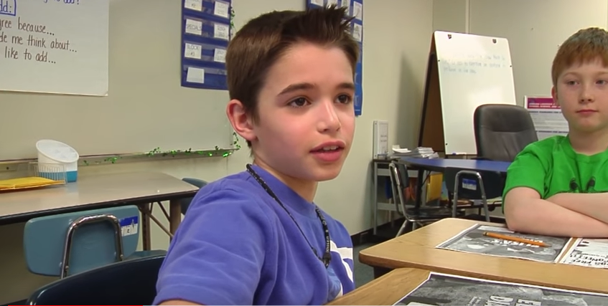
Daily Formative Assessment Through Conversations
(Engage NY, 2016)
Notes:
To Know
Video: Teacher Uses Questioning Techniques to Engage Students, Engage NY, example 19, 2:40 minutes: https://www.youtube.com/watch?v=1WQCWF7ENfI
To Do
Have participants watch the video clip. There will be a time to reflect after the video. Following the video, move to the next slide and have participants do a Stand Up, Hand Up, Pair Up to discuss the questions with a partner.
To Say
Having conversations with students is an essential key to uncovering evidence to enable teachers to move learning forward. The intent of questioning is to cause thinking, determine what a student knows and doesn’t know, and provide the teacher with information about what to do next instructionally. How questions are posed as well as the quality of the question is so important. We will watch a short video about learning through conversations. Afterwards we will reflect with each other on the following questions.
How does the teacher’s strategic questioning elicit evidence of learning?
What structures are in place that enable the teacher and class to hear multiple responses to each question?
How might this questioning session be enhanced to uncover even more evidence regarding students’ learning?
Optional Resource
This 6-minute video provides modeling for effective questioning to elicit evidence of learning in a math setting. https://www.youtube.com/watch?v=ABnYWMnAk7Y
References
Engage NY. (2016, Jan. 11). Teacher uses questioning techniques to engage students, example 19 [Video file]. https://www.youtube.com/watch?v=1WQCWF7ENfI
Engage NY. (2016, Jan. 12). Teacher uses questioning techniques to engage students, example 22 [Video file]. https://www.youtube.com/watch?v=ABnYWMnAk7Y

Slide 39
Eliciting Daily Evidence of Learning Through Conversations-Video Reflection
How does the teacher’s strategic questioning elicit evidence of learning?
What structures enable the teacher and class to hear multiple responses to each question?
How might this questioning session be enhanced to uncover even more evidence regarding students’ learning?
Notes:
To Know
This is the reflection slide with questions after the video.
To Do/To Say
Following the video, have participants do a Stand Up, Hand Up, Pair Up to discuss the questions with a partner.

Slide 40
Productive Assessment Questions: Conversation Examples
Elicitation - What do you already know about _____?
Elaboration - Tell me more about _____?
Clarification - I’m not sure what you mean by _____, can you explain it in a different way?
Divergent - What do you know about _____ that helps you understand _____?
Heuristic - What is another way it could be done?
Inventive/Reflective - What advice would you give _____?
(Frey & Fisher, 2011)
Notes:
To Know
This slide provides various types of questions educators can pose to students to gather learning information. The type of question posed depends on the type of response needed.
To Do
Provide initial discussion about the need and purpose of differentiating the types of questions teachers pose. Expand on explanations.
To Say
It’s important to remember that learners do not respond well to generic checking-for-understanding efforts such as “Are there any questions?” Since learners do not know what they do not know, strategic questioning is an essential tool teachers must use to identify where students are in their learning. Teachers often use too many reproductive questions which only require students to recognize and recall rather than productive questions which invite students to synthesize, evaluate, and create new ideas. We will examine six types of questions and sample question stems than can help teachers construct robust questions used to uncover more about what their students know and do not know.
Elicitation - to unearth misconceptions, check for factual knowledge, draw on previous knowledge
Tell me what you already know about _____. Who? What? When? Where? Why? How?
Elaboration - to extend the length and complexity of an idea
Could you tell me more about that?
Clarification - to provide further information
I’m not sure what sure what you mean by _____, can you draw a picture or explain it in a different way?
Divergent - to discover how the student uses existing knowledge to formulate new understandings.
What do you know about _____ that helps you understand _____? (draws from more than one source)
Heuristic - uses informal problem solving
How would you _____ ? What is another way?
Inventive/Reflective - stimulates imaginative thought; invites opinions and speculation
What advice would you give about _____?
What information will you need to solve _____?
References
Frey, N., & Fisher, D. (2011). The formative assessment action plan: Practical steps to more successful teaching and learning. ASCD.

Slide 41
Tips for Strategic Questioning
Plan questions prior to the lesson
Pose one question at a time
Use both discussion and diagnostic questions
Use robust questions – those that help you find out more about what students know, how they use information, and where confusions may lie
Use wait time
Listen receptively
Provide structures that enable students to also pose questions
(Frey & Fisher, 2011)
Notes:
To Know
These tips are important to effective and strategic questioning.
To Do
Review content on slide and expand on each point using the information below.
To Say
Here are some tips for designing effective questions.
Plan - make certain questions are targeted toward the learning intention and are of appropriate cognitive demand
Pose one question at a time - asking a string of questions at a time is confusing
Discussion and diagnostic questions - questions can be designed so that they serve as springboards for eliciting discussion which can provide insight into student learning. Questions can also be developed and posted with possible alternative responses showing common errors. This will help reveal how students are thinking.
Robust questions - a robust question is one that is crafted to find out more about what students know, how they use information, and where any confusion may lie. A robust question sets up subsequent instruction because it provides the information you need to further prompt, cue, or explain and model.
Wait time – students need time to consider and reason their answers. Questions with higher cognitive demand need additional wait time.
Listen receptively – a teacher’s facial expression, body language, and verbal responses all send messages to students. Students will shut down responses if they are not being listened to receptively.
Enable students to pose questions – when students ask questions of the teacher and of one another it enables them to feel empowered and engaged in discussions. It helps students clarify understandings, speculate, reason, and form hypotheses.
Optional
The following information can help you to expand on the stages of questioning, if you wish.
Stage 1: Prepare the Question
Identify instructional purpose
Determine content focus
Select cognitive level
Consider wording and syntax
Stage 2: Present the Question
Indicate response format
Ask the question
Select respondent
Stage 3: Prompt Student Responses
Pause after asking question
Assist nonrespondents
Pause following student response
Stage 4: Process Student Responses
Provide appropriate feedback
Expand and use correct responses
Elicit student reactions and questions
Stage 5: Reflect on Questioning Practice
Analyze questions
Map respondent selection
Evaluate student response patterns
Examine teacher and student reactions
References
Education Services Australia. (2002). Strategic questioning module. Assessment for Learning. https://www.assessmentforlearning.edu.au/professional_learning/modules/strategic_questioning/strategic_research_background.html#2
Fisher, D., & Frey, N. “Questioning to check for understanding.” In Guided instruction. http://www.ascd.org/publications/books/111017/chapters/Questioning-to-Check-for-Understanding.aspx
Moss, C., & Brookhart, S. (2019). Advancing formative assessment in every classroom: A guide for instructional leaders. ASCD.

Slide 42
Designing Robust Assessment Questions to Elicit Conversation
Work with a partner or small group that teaches a similar grade level or content area
Design 3 robust questions for a lesson you will be teaching that will help you check for student understanding
Use information on the previous slides and the question stem handout to help guide you
Record your questions on chart paper and post to share
Notes:
Handout #4: Question Stems
To Know
This activity provides an opportunity for teachers to get experience writing effective robust questions that elicit the information about learning they are seeking.
To Do
Group participants by partnering or putting them in groups of 3-4. Content or grade level groups may work best. Provide each group with chart paper.
Question Stems (Handout #4) should be used to support groups as they design questions. Refer back to the previous slide once the groups begin working to see more question stem samples.
When participants finish writing questions, post on the charts and share by having a Gallery Walk. Another option would be to electronically share the questions created. Be sure to point out that this activity itself demonstrates a way to check for understanding that could be used in a classroom.
To Say
Let us now put our knowledge about questioning to work by designing robust questions that can be used in our own classrooms. Work with your partner(s) to develop at least three robust questions that will elicit evidence of learning from your students. Record the questions on chart paper so we can later share them with the whole group.
Handout #4
Question Stems - This is a helpful tool to be used as a resource while planning questions for lessons.

Slide 43
Daily Formative Assessment Through Observation Examples
Journal entries
Writing from prompts
Work samples
Quizzes
Projects
Performances
Presentations
Notes:
To Know
This slide provides examples of products and performances that can uncover insightful information about student learning.
To Do
Explain the slide and use the content below to expand on the information. Ask participants to provide examples of products and performances they have used to gather information regarding student learning.
To Say
Observing and reflecting on student products and performances can uncover important clues about what students know and what they need to improve. Journal entries, writing prompts, work samples, and quizzes can provide a window into student understanding. Student projects, performances, and presentations are good sources for eliciting evidence of learning as well. Checklists that include success criteria can help keep students on track and provide teacher-student interaction during project development which provides learning evidence through both conversation and observation.
Are there any other examples you can provide? Please chat with a shoulder partner and brainstorm others? We will share in a moment.
References
National Council of Teachers of English. (2013, Oct.21). Formative assessment that truly informs instruction. https://cdn.ncte.org/nctefiles/resources/positions/formative-assessment_single.pdf
Wiliam, D. (2018). Embedded formative assessment. Solution Tree Press.

Slide 44
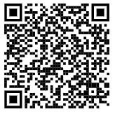
All Student Response Systems Observation Examples
Mini whiteboards
Sticky notes
Entry and exit slips
Response cards
Online tools and apps
(Wiliam, 2018; Dyer, 2019)
Notes:
To Know
There are many methods for collecting student learning information. All student response systems are methods that allow teachers to collect information from all students at the same time. This enables educators to make decisions based on more valid data.
To Do
Introduce all student response systems. Explain each. You can then provide time for participants to access the QR code or link to briefly peruse the list of online tools.
To Say
All student response systems allow teachers to observe students and get a response from every student in real time. Many teachers, looking for better ways to elicit evidence of learning, are adopting a “no hands up” policy and instead are utilizing all student response systems. Teachers often draw conclusions about learning needs from questions they pose to just a few students that have their hands up. All student response systems significantly broaden the evidence collected which results in better teacher decision making. We will look at some of these response systems that also improve student engagement.
Mini whiteboards – powerful tools in which teachers can quickly frame a question and get an answer from all students. These work all levels – from primary grades to calculus class. The whiteboard concept can also include clear plastic page protectors where graphs or maps can be inserted so responses are customized to the lesson.
Sticky notes - can be used in an endless number of ways. Posterboard can be laminated and numbered to match student numbers. All students can answer a question or write a summary on what was learned and place their response on the board. Teachers can then quickly check and sort into groups… those needing reteaching and those needing enrichment.
Entry and exit tickets – provide a check on understanding that can be done as students enter or exit the classroom.
Response cards – can be used to help make student learning visible to teachers by answering true/false or multiple-choice questions.
There are numerous online tools and apps available to engage students and provide teachers with formative evidence of learning.
Use the web address (https://www.nwea.org/blog/2019/75-digital-tools-apps-teachers-use-to-support-classroom-formative-assessment/)
or QR code to access a list of 75 classroom formative assessment tools. Take a few moments and explore this resource and tools.
References
Dyer, K. (2019, Jan. 31). 75 digital tools and apps teachers can use to support formative assessment in the classroom [Blog]. NWEA. https://www.nwea.org/blog/2019/75-digital-tools-apps-teachers-use-to-support-classroom-formative-assessment/
Wiliam, D. (2018). Embedded formative assessment. Solution Tree Press.

Slide 45
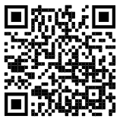
Read and Reflect: Observational Assessment
Review the pre-read article “7 Smart Fast Ways to Do Formative Assessment.”
Meet with your small group.
Each group member takes a turn sharing a way to gather evidence of learning as described in the article.
Explain how you would or have used the strategy in your classroom.
Discuss ways the method might be enhanced.
Notes:
Note: This pre-read should be sent to participants before the training. A suggestion is to have table copies of this for easy quick access.
To Know
This is a reflection activity for the pre-read article that was sent to participants prior to the session. It provides additional methods for collecting formative assessment student learning information.
To Do
Prior to reading the article, divide participants into small groups. Grouping can be done by grade levels, content, or just by numbering off 1-4. Ask participants to access the article using the link or QR code and give them a few minutes to refresh their memories of the pre-read.
To Say
This Edutopia article, 7 Smart Ways to Do Formative Assessment, sent to you as a pre-read describes some of the ways to elicit evidence of learning discussed previously, along with some additional methods. Use the QR code or web address to access and then read the article. Next, meet with your group. Members will take turns sharing a formative assessment technique described in the article that resonated with them. Be sure to explain how the strategy would be used in your classroom. Group members can then share ways they think the method could be enhanced. Also share possible challenges in implementing some of the methods how those implementation challenges might be overcome.
References
Thomas, L. (2019, April 26). 7 smart, fast ways to do formative assessment. Edutopia. https://www.edutopia.org/article/7-smart-fast-ways-do-formative-assessment

Slide 46
Daily Formative Assessment Through Self-Evaluation
(NM School of the Arts, 2016)
Notes:
To Know
This video provides exemplar modeling for educators to observe how students can reflect on and assess their own learning.
Video: 4:45 minutes, Mastering Self-Assessment: Deepening Independent Learning Through the Arts, https://www.youtube.com/watch?v=Va66oMkWP_o
To Do
Show the video
To Say
As you watch this video, reflect on structures and strategies this teacher uses to promote student self-assessment skills. Also consider how improving self-assessment abilities enable students to become owners of their own learning.
References
New Mexico School of the Arts. (2016, Oct. 5). Mastering self-assessment: Deepening independent learning through the arts [Video file]. Edutopia. https://www.youtube.com/watch?v=Va66oMkWP_o
Additional Resource
Video: Self Assessment, https://www.youtube.com/watch?v=Qo_5dJ-dlIQ, Michigan Dept. of Ed.

Slide 47
Video Reflection
“The most important assessments that take place in any school building are seen by no one. They take place inside the heads of students, all day long. Students assess what they do, say, and produce, then decide what is good enough. These internal assessments govern how much they care, how hard they work, and how much they learn.”
(Berger, 2014)
Notes:
To Know
This is the follow-up reflection activity after video on previous slide
To Do
Ask participants to read the quote from Ron Berger author of Leaders of Their Own Learning. Discuss this quote based on the video structures and strategies that were in place to help students improve self-assessment skills
To Say
What are the key take aways from his quote?
Reference
Berger, R., Rugen, L., & Woodfin, L. (2014). Leaders of their own learning. Jossey-Bass Publishing.

Slide 48
Daily Formative Assessment Self-Evaluation Examples
Examples of Strong and Weak Work
Sort into quality levels and match with own work
Examine and list best traits
Rubrics
Assess work examples for quality indicators with peers
Assess student’s own work and revise
(Moss and Brookhart, 2019)
Notes:
To Know
This slide and the next provide tools and strategies that can encourage student self-reflection and self-assessment. Connect these strategies to what teachers are already doing.
To Do
Review contents on the slide.
Pose these questions and have participants discuss.
Which of these strategies have you used?
What other ways might students make success criteria more visible to themselves and their peers?
To Say
Success criteria are a road map for a learning destination. Success criteria provide stops along the way in order to help students assess where they are so they can use strategies to reach their destination. In addition to success criteria statements, there are many tools that can help students have more clarity about their learning destination and how to get there. Here are some strategies that can be used to share criteria for success and engage students while helping them become skilled at self-assessing. How do these examples help students with self-reflection?
Reference
Moss, C., & Brookhart, S. (2019). Advancing formative assessment in every classroom: A guide for instructional leaders. ASCD.

Slide 49
Daily Formative Assessment Self-Evaluation Examples
Questioning and Conversations
Rephrase success criteria in student’s own words
Encourage students to ask clarifying questions
Use the criteria for peer- and self-assessment
Planning and Envisioning
Design checklists and planning charts for individual and group work
(Moss and Brookhart, 2019)
Notes:
To Know
This slide and the previous provide tools and strategies that can encourage student self-reflection and self-assessment. Connect these strategies to what teachers are already doing.
To Do
Review contents on the slide.
Pose these questions and have participants discuss.
Which of these strategies have you used?
What other ways might students make success criteria more visible to themselves and their peers?
To Say
Success criteria are a road map for a learning destination. Success criteria provide stops along the way in order to help students assess where they are so they can use strategies to reach their destination. In addition to success criteria statements, there are many tools that can help students have more clarity about their learning destination and how to get there. Here are some strategies that can be used to share criteria for success and engage students while helping them become skilled at self-assessing. How do these examples help students with self-reflection?
Reference
Moss, C., & Brookhart, S. (2019). Advancing formative assessment in every classroom: A guide for instructional leaders. ASCD.

Slide 50
Teachers Role in Student Self-Assessment
Share clear learning goals
Promote belief that ability is incremental, not fixed
Avoid comparing achievements of one student with another
Provide feedback focused on future action
Design opportunities to transfer control of learning to students
(Wiliam, 2018)

Slide 51
Keys for Students Who Are Assessment Capable
Insight - learning must be assessed in order to improve it
Cognition - knowledge, skills, and strategies are needed to reach goals
Metacognition - know abilities and what can be done
Motivation - match challenge with capability
(Wiliam, 2018)
Notes:
To Know/To Say
It takes time to for students to become “assessment capable.” It is a gradual process resulting from both teacher and student efforts. Here are some keys for activating students to become owners of their own learning through assessment.
Consultant may want to have table copies of this resource.
To Do
Discuss each point.
Participants may access the resource Activating Students as Owners of Their Own Learning for more information. If the article is used, provide time to peruse the article and debrief new learning. In small groups, participants can list key learning gleaned from the article on chart paper along with strategies that can be implemented in their classrooms to encourage students to self-assess in order to become owners of their own learning.
Resource
Activating Students as Owners of Their Own Learning, https://iwonderstand.files.wordpress.com/2015/12/activating-students-as-owners-of-their-own-learning.pdf
Additional Optional Resources
Video, 6:50 minutes, 4th grade students utilize self-reflection and self-talk, https://www.youtube.com/watch?v=4av28CeQC1I
Video, 3:52 minutes, animated video describing strategies to help students engage in the self and peer assessment process, https://www.youtube.com/watch?v=8WxvVgXC_NY
Reference
Olandt, C. (2017, June 21). Self-assessment and self-reflection [Video File]. Tennessee Dept. of Education. https://www.youtube.com/watch?v=4av28CeQC1I
Spencer, J. (2020, March 3). Empowering students to own the assessment process [Video file]. https://www.youtube.com/watch?v=8WxvVgXC_NY
Wiliam, D. (2018). Activating students as owners of their own learning. Embedded formative assessment. Solution Tree Press. https://iwonderstand.files.wordpress.com/2015/12/activating-students-as-owners-of-their-own-learning.pdf

Slide 52
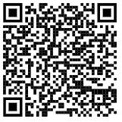
Activating Students as Instructional Resources for One Another
Activity: Choose a Question 1, 2, 3
Why are most students motivated to help their peers assess work?
What are the benefits of peer assessment?
What strategies promote peer assessment?
(Wiliam, 2011)
Notes:
To Know
This activity provides time for participants to peruse the article Activating Students as Instructional Resources for One Another by Dylan Wiliam. Consultant may want table copies of this resource.
To Do
Divide participants into groups of three to do the Choose a Question 1, 2, 3 activity.
Directions for activity:
Have each member of your group choose a question then access the article by Dylan Wiliam, Activating Students as Instructional Resources for One Another, by using the QR code to find the answers. Take turns sharing questions and answers found with team members. Feel free to add your own ideas as well.
Https://iwonderstand.files.wordpress.com/2015/12/activating-students-as-instructional-resources-for-one-another.pdf
To Say
We have learned that activating students as resources for one another is a key strategy for implementing formative assessment. Now we will find out more on why this process is so powerful and how it can be done.
Optional Resources
Video, 1:00 minute, primary students engage in a quick 60 second strategy for peer assessment and feedback called TAG feedback, https://www.youtube.com/watch?v=HM5dp50HWXQ&feature=emb_rel_pause
Video, 1:00 minute, students use a 60 minute strategy - Respond, Reflect, and Review to assess peers’ work (elementary level), https://www.youtube.com/watch?v=J4UQvt1Rn9w
Video, Peer critique: Creating a culture of revision. https://www.youtube.com/watch?v=M8FKJPpvreY
References
Concourse Village Elementary School. (2019, Feb. 8). 60 second strategy: TAG feedback [Video file]. Edutopia. https://www.youtube.com/watch?v=HM5dp50HWXQ&feature=emb_rel_pause
Savage, T. (2019, Sept. 6). 60 second strategy: Respond, reflect, and review [Video file]. Edutopia. https://www.youtube.com/watch?v=J4UQvt1Rn9w
Two Rivers Charter School. (2016, Nov.1). Peer critique: Creating a culture of revision [Video file]. Edutopia. https://www.youtube.com/watch?v=M8FKJPpvreY
Wiliam, D. (2018). Activating students as resources for one another. Embedded formative assessment. Solution Tree Press. https://iwonderstand.files.wordpress.com/2015/12/activating-students-as-instructional-resources-for-one-another.pdf

Slide 53
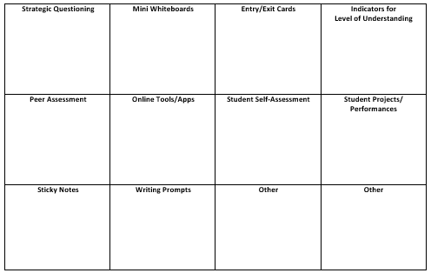
Find Someone Who… Uses Daily Formative Assessment
Notes:
Handout #5: Find Someone Who
To Know/To Do
This activity provides participants an opportunity to apply their knowledge about Daily Formative Assessments and share how they will or have used these assessments in their classrooms to elicit evidence of student learning.
Activity Handout #5 – Find Someone Who… Uses Ongoing Formative Assessment
Participants will “roam the room” and find others who have or will use these tools/strategies to elicit evidence of learning. Partner 1 will select a tool/strategy on the handout then describe how they might use it. Partner 2 will jot down notes capturing what was explained by partner 1. Partners then switch roles.
For example, if you find someone who has used Indicators for Level of Understanding… they will tell you how they have or plan to implement that strategy. They might say “I provide colored cups (red, yellow, green) for students to show me while working on a learning task (red – I need help, yellow – I need clarification, green – I can teach others). You would then jot down notes on your handout to help you remember the strategy. Next, it would be your turn to share a different Daily Formative Assessment strategy with your partner and they would jot down notes on their handout.
Continue to repeat the process, finding and sharing different formative assessment strategies with others. Allow at least 15-20 minutes so participants can meet with as many individuals as possible as time allows.
To Say
We will now take a few minutes to connect with others in this group that have used some of these Daily Formative Assessment methods. Please access Handout #5 and find someone in the group that would share one of their practices with you. As you listen to them explain what they have done to collect evidence of student learning, jot down notes in the appropriate category on your handout. Once finished, share a practice you have done with your partner. Once you both share and jot down notes, move on and find another partner.

Slide 54
Using Daily Formative Assessment Data
Note strengths and challenges
Identify learning gaps and determine how instruction can be adjusted to address learning gaps
Identify any instructional gaps
Plan instruction for students with more pronounced challenges
Plan activities for those students needing enrichment
(Teaching Matters, 2020)
Notes:
Handout #6 Formative Assessment T-Chart (adapted from https://docs.google.com/document/d/1pxYRo8dcDSNN1wUfi3-ueKy6_PqFkMKEMpFz6e3nhzM/edit)
To Know/To Say
The evidence of learning from formative assessments must be analyzed and interpreted so that instruction can be adjusted and additional feedback can then be provided to students to drive learning forward. Review key points on the slide.
Sometimes this analysis is done immediately during the lesson. Teachers must become skilled at quickly assessing learning evidence that emerges during the lesson and making instructional decisions “on the fly” based on that information. There should also be opportunities to spend a bit more time analyzing and interpreting formative assessment data, for example, after exit cards are collected or after a weekly quiz. The Formative Assessment Analysis T-Chart is a helpful tool for recording student learning strengths and gaps, as well as instructional adjustments needed to help design next teaching steps.
To Do
Provide participants with access to the handout and have them reflect on when and how this tool could be used in their setting. How might the tool be modified to better suit their needs?
Reference
Teaching Matters, Inc. (2020). Formative assessment analysis t-chart: Strength and gaps. https://docs.google.com/document/d/1pxYRo8dcDSNN1wUfi3-ueKy6_PqFkMKEMpFz6e3nhzM/edit

Slide 55
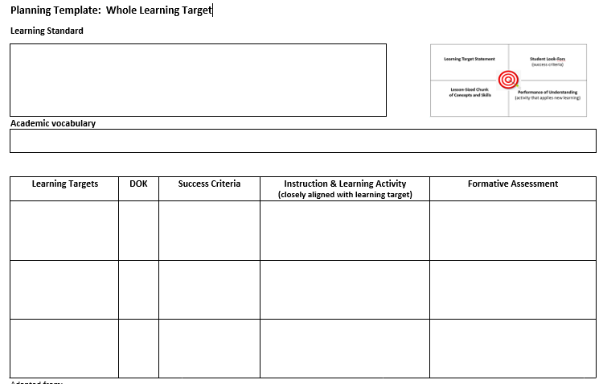
Daily Formative Assessment
Reflect on a learning target and success criteria you have identified
Develop a plan for daily formative assessment to be used within and/or between lessons
Use strategies that involve and elicit evidence of learning from all students
Notes:
Handout #7: Learning Target Planning Template
To Know/To Do
Participants will now apply what they have learned to plan/design daily formative assessment aligned with learning target(s) they will teach.
Read the directions and have participants complete the learning activity and assessment sections of the Planning Template: Learning Target. (Previously, this Handout 7 was used during Part 1, learning intentions. At that time, participants completed portions of the Learning Target Planning Template, the sections on learning standards, targets, DOK, and success criteria. Participants may want to continue working on that form and now complete the learning activities and assessment sections. If participants do not have previous work done on the template, they may complete it in its entirety. It is important that formative assessments align with the learning targets and success criteria.)

Slide 56
Eliciting Evidence of Learning Common Formative Assessment
Notes:
Handout #3
To Know
This module is designed for schools wishing to develop Common Formative Assessments. To be most effective, CFAs should be designed collaboratively by educator teams from like content or grade levels. There are instances, such as for reading or writing, when CFAs could be developed by teams across more than one grade level. For small schools having a single teacher for each grade level or content area, it is advised that they partner with educators from another school or district to develop and analyze CFAs. Collaboration could be done virtually or in person. Schools could have staff learn about the CFA process and then have educators create the unit assessments individually, however, collaboration is an important feature of CFAs. Another option would be for schools to put their focus on Daily Formative Assessments since these are developed individually by teachers.
To Say
We will now move to Essential Function 4 which covers Common Formative Assessments and is a part of eliciting evidence of learning on this graphic, which is Handout #3.
Let’s take a quick look at the working terms and definitions used in this section.
Common Formative Assessment - an intentionally collaboratively designed and analyzed measure used for the purpose of monitoring student attainment of essential learning targets or skills through the instructional process
Difficulty - a function of how many people can complete a task correctly in an assessment
Complexity - a measure of the number of ways a task can be accomplished in an assessment
Academic rigor - learning in which students demonstrate a thorough, in-depth mastery of challenging tasks to develop cognitive skills through reflective thought, analysis, problem solving, evaluation, or creativity
Relevance - learning in which students apply core knowledge, concepts, or skills to solve real-world problems
Calibration - the process of checking a measuring instrument to see if it is accurate
References (definitions are adapted from the following resource)
Wiliam, D. (2018). Embedded formative assessment. Solution Tree Press.

Slide 57
Common Formative Assessments are…
Collaboratively designed by a grade-level or course-level team
Administered to students by each participating teacher in the school
Assess a student’s understanding of unit learning intentions (derived from selected standards)
Provide feedback for students to show what they currently know and still need to learn
Provide a clear lens through which teachers see their instructional impact on student learning
(Ainsworth, 2015)
Notes:
To Know
The purpose of this slide is to describe the characteristics of Common Formative Assessment.
To Do
Review the characteristics on this slide regarding CFAs.
To Say
(Review this slide with participants.) Emphasize that CFAs are designed and analyzed collaboratively and are designed around learning units.
Please turn to a shoulder partner and discuss how Common Formative Assessment differs from Daily Formative Assessment? How are they alike? We will share out when you are finished.
References
Ainsworth, L. (2015). Common formative assessments 2.0: How teacher teams intentionally align standards, instruction, and assessment. Corwin.

Slide 58
Benefits of Common Formative Assessments
Help teachers determine WHY students are not yet proficient
Provide a strategy for determining whether students are making progress in the curriculum
Inform students and teachers of next steps in learning/instruction
All for individualization of learning for all students
Encourage collaborative reflection to improve instructional practices and monitor student progress
Build the capacity of teachers and teams to achieve at higher levels
(Ainsworth, 2015)
Notes:
To Know/To Do
CFAs help teachers identify where students are in the learning progression, why learning errors occur, and guide their next steps for instruction. CFAs also inform students of their next steps in learning.
To Say
Common Formative Assessments have a very specific purpose. They are assessments FOR learning designed. Please read each bullet point on this slide.
Team-developed common assessments are more efficient and are more equitable. They are also more effective in monitoring and improving student learning as well as informing and improving the practice of both individual teachers and teams of teachers. Building capacity is important because it helps teams achieve higher levels. Always remember that team developed CFAs are essential to systematic interventions when students do not learn.
Reference
Ainsworth, L. (2015). Common formative assessments 2.0: How teacher teams intentionally align standards, instruction, and assessment. Corwin.

Slide 59
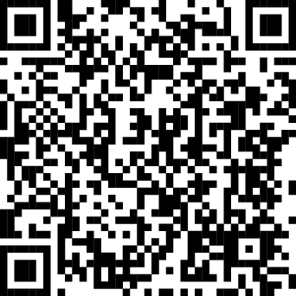
How to Build Common Formative Assessments
Use the QR code to locate the pre-read article and reflect on these questions as you peruse the article:
What are the benefits of Common Formative Assessments?
What information resonates with you most about building CFAs?
Notes:
This article is one of the pre-read articles. You may want to have some table copies of this article.
To Know/To Say
We will now reflect on the pre-read article sent to you prior to this session that presents an overview of the actions needed to develop Common Formative Assessments. The initial steps discussed in the article, deconstructing standards and identifying learning intentions were examined in previous sessions. Although this article is directed at new teachers, even the most experienced teachers will find this article informative and a good reminder of what constitutes effective CFA development. Once you have reviewed the article, you will have an opportunity to share your answers to these questions with a small group.
To Do (Reflection Activity: Read, Reflect, and Summarize)
Provide 5 minutes for participants to access and review the article.
Then, in small groups, have each member share out a benefit of CFAs. The last person sharing will then summarize benefits of CFAs that were shared by the group.
Next, members take turns sharing something that resonated with them most regarding the building of CFAs. This time, the first person to share will summarize key ideas about building CFAs shared by the group.
Reference
PowerSchool. (2016, Oct. 13). New teachers, here’s how to build common formative assessments [Blog]. https://www.powerschool.com/blog/new-teachers-heres-how-to-build-common-formative-assessments/

Slide 60
Creating Common Formative Assessments
(Fairfax Public Schools, 2013)
Notes:
To Know
This video is 8:19 minutes and focuses on a third-grade team collaboratively developing a CFA.
To Do/Say
This video will give us a clearer picture on what this collaborative process of building a CFA might look like when applied. We’ll see and hear how a third-grade team engages in this process. This video, from Fairfax Public Schools, shows how a group of educators collectively combine their efforts to develop an assessment that matches their purpose, is aligned with essential learning targets, and provides essential data needed for improving instruction. We will reflect on the next slide.
Reference
Fairfax Public Schools. (2013, Sept.). Best practices: Creating a common assessment [Video file]. https://www.youtube.com/watch?v=amipgHiAjh0

Slide 61
Reflection
In groups, discuss the key take-aways from the video you just watched.
What were the top 3 take aways your group found?
Notes:
To Know
This slide follows up the video and transitions from the make-up of the assessment to the target types and questions/items of the assessment.
To Do
Divide participants into groups and have them identify their top three take aways. If time allows have a few groups share out.
To Say
Possible key points
Teachers must ensure the assessment matches the concepts, skills, and level of thinking of the intended standard(s)/learning targets.
Align each question/item to the learning target(s). Including question/items for all targets helps teachers identify where a student is in the learning progression to proficiency.
As we move into developing/choosing questions for our CFA, it is important to know what type of evidence best demonstrates a student’s proficiency of the standard/target. Also, we will look at how to use the targets to get a complete picture of where a student is currently in terms of the learning progression.

Slide 62
Considerations for Developing a CFA
Develop the assessment around one or two essential standards
Be concise
Develop a scaffolded assessment (representing the progression of learning and including all learning targets for the standard)
Include one question that puts all the targets back together
Use a variety of question types
Align questions to the rigor of the standard
Write assessment and scoring guide/rubrics at the same time
(PowerSchool, 2016)
Notes:
To Know
This slide gives summary of Key Points to consider when developing a CFA
To Do/Say
Getting information quickly and easily is essential to the CFA process. Consider the following considerations to make the process more efficient. When developing the assessment, develop at least one question/item for each of the targets that have been unwrapped from the standard. Some questions may align to more than one target as we move to higher level intentions. Be sure to include one question/item that puts it all back together because that is where we see proficiency of the full standard. Using a variety of question/item types gives us a clearer road map of our students’ thinking. Double-check rigor required by the standard and ensure that at least one question/item reaches that level. Determine scoring guide/rubric prior to administering the assessment, helping to increase proficiency of the process and provides consistency among the team as to what proficiency looks like.
Develop the assessment around one or two essential standards
Be concise
Write a scaffolded assessment (representing the progression of learning and including all learning targets for the standard)
Include one question/item that puts all the targets back together
Use a variety of question/item types to demonstrate student thinking
Ensure questions/items are aligned to the rigor of the standard
Create assessment and scoring guide/rubrics at the same time
Reference
Adapted from
PowerSchool. (2016, Oct. 13). New teachers, here’s how to build common formative assessments [Blog]. https://www.powerschool.com/blog/new-teachers-heres-how-to-build-common-formative-assessments/

Slide 63
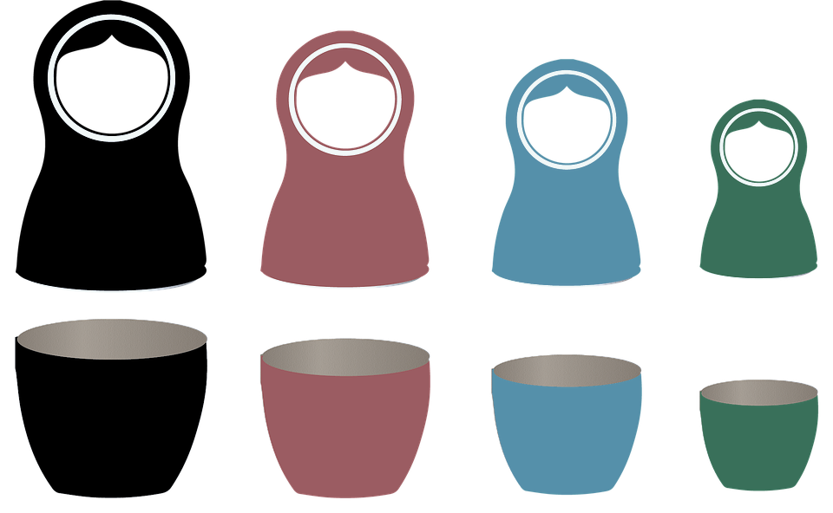
Multiple Target Types
Knowledge
Explain, understand,
describe, identify,
recognize
Reasoning
Analyze, compare/contrast,
synthesize, classify, evaluate
Skill
Observe, focus attention,
listen, perform, do, question,
conduct, work
Product
Design, produce,
create, develop
K+R+*S+P
*not always
K+R
K+R+S
K
(Adapted from Chappuis,2014)
Notes:
Handout #8: Target Types. This handout was used in the first part of this module.
To Know
The purpose of this slide is to review target types from Handout #8 (discussed previously while unwrapping standards and writing learning intentions) as we focus on developing assessment questions/items.
Learning targets fall into one of four categories: Knowledge, reasoning, skill, or product.
Knowledge-level learning targets represent factual knowledge (knowing from memory), procedural knowledge (knowing how to execute a series of steps), and conceptual understanding (being able to explain a concept). Because knowledge as defined here includes procedural knowledge and conceptual understanding, not all knowledge-level targets are considered "low-level.”
Reasoning-level learning targets define thought processes students are to learn to execute, such as predict, infer, compare, hypothesize, critique, draw conclusions, justify, and evaluate.
Skill-level targets require a real-time demonstration or physical performance. The skills category can be confusing, as we commonly talk about problem-solving skills (a reasoning target), reading skills (also reasoning targets), thinking skills (reasoning targets, again), and so on. This category is not set up to change how you use the word skills, but it is the term we use to identify a small set of content standards that have a performance of some type at the heart of the learning. Some subjects have no skill targets as part of their curriculum, and others have quite a few, such as world languages, physical education, and fine and performing arts.
Product-level targets are just what they sound like: The content standard as written calls for the creation of a product, and the evaluation of learning will be of the qualities of the product. We often have students create products to demonstrate other types of learning targets, in which case what should be evaluated is the intended learning, not the qualities of the product.
Clear learning targets guide instruction, assignments, and formative and summative assessments. Classifying learning target types helps teachers know how to structure lessons and clarifies which activities and assessment items will yield the most accurate data. For example, if you the learning target is “knows how to measure circumference,” you want to understand if the student needs to know the steps to measuring circumference (knowledge target) or can measure circumference (a performance/skill). If you classify it as a skill, your assessment will likely be a demonstration of the student solving circumference problems rather than a listing of the steps. However, that said, the Russian doll image illustrates how the learning target types build on each other. To be able the solve a circumference problem, the student will need to understand the steps (knowledge), recognize the issue, use the correct steps (reasoning), and then put it together to determine circumference (performance).
To Say
As we discussed previously in the Clarifying Learning section, notice how each of these target types can be embedded within the target, depending on its rigor. You will use this information as you construct formative assessment types.
To Do
Have participants use Handout #8. This will be beneficial for the next several slides.
Reference
Chappuis, J. (2014). Seven strategies of assessment for learning, 2nd edition. Pearson. https://smartlearningsystems.com/wp-content/uploads/2014/10/Group-1-Unit-Criteria-Targets-Reflect.pdf

Slide 64
Question Types
% of questions (approximate) | # of questions (approximate) | Level | DOK
10% | 1 | Foundational Skills | 1
20% | 2 | Close to Proficient | 2
60% | 6 | Proficient | 3
10% | 1 | Above Proficient | 3-4
Notes:
To Know
This chart provides a snapshot of a POSSSIBLE number of questions/items and knowledge levels of a CFA. The numbers here are approximate! Please state this CLEARLY. These approximate numbers are provided because teachers want to know what the CFA could/should look like. There are many variables that play into these numbers, including question/item types, number of targets, etc. There is NO set number of questions/items. These are simply examples that have worked for SOME teams.
To Say
This slide provides a snapshot of a POSSSIBLE number of questions/items and knowledge levels on a CFA. The numbers are approximate. There are many variables that influence the numbers, including question/item types, number of targets, grade level, etc. There is NO set number of questions/items, but questions at the proficient level should make up the bulk of the assessment. Questions written at the ‘advanced’ level should go above and beyond the standard/targets.
Foundational Skills - low-level knowledge and/or prerequisite skills
Close to Proficient - beginning reasoning
Proficient - use targets independently and in combination with each other
Above Proficient - for students who can do this, what is their next step? (Consider how to take it further)
To Say/To Do
Review the chart and discuss factors that might influence the numbers of questions to have on a CFA.

Slide 65
Difficulty vs. Complexity
Difficulty
A measure of effort required to complete a task
In assessment, a function of how many people can complete the task correctly
Complexity
A measure of the thinking, action, or knowledge that is needed to complete the task
In assessment, how many different ways can the task be accomplished
(Ferry, 2019)
Notes:
To Know
Difficult questions/items generally have one final, specific answer, or solution, that is either correct or incorrect. Complex questions, problems, or tasks may not have a simple, straightforward, or succinct answer, solution, or outcome. Complex questions may have more than one possible response.
To Say
In order to determine whether we’ve met the rigor of a standard, we must understand the difference between ‘difficulty’ and ‘complexity.’
To Do
Discuss the meaning of difficulty and complexity and the role of each in assessment. The presenter may wish to study the reference article listed below to build capacity around these concepts.
Reference
Ferry, L. (2019, June 19). How to design classroom assessments using the difficulty & complexity matrix. CIESC. https://plconnect.ciesc.org/design-classroom-assessments-using-difficulty-complexity-matrix/

Slide 66
For Effective CFA Items, Avoid
Unclear directions
Ambiguous statements
Unintentional clues
Complex phrasing
Difficult vocabulary
(Popham, 2003)
Notes:
To Know
James Popham warns us of possible pitfalls/roadblocks to effective items. These are common mistakes found in item development.
To Say
As we write, create, and choose items for our Common Formative Assessment, there are some roadblocks of which to be aware.
To Do
Read and discuss each roadblock. Consider giving each group one roadblock to breakdown and discuss then share out with the group. This could also be a carousel or breakout rooms activity.
Unclear directions - Read from the student’s perspective to see if they make sense.
Ambiguous Statements - Replace words having double meanings with those with singular meanings and faulty reference pronouns with the specific words to which they refer.
Unintentional Clues - Keep answer choices of equal length and avoid grammatical tip offs.
Complex phrasing - Avoid lengthy sentences and strive for simplicity of sentence structure.
Difficult vocabulary - Use everyday language wherever possible so students can understand the question/item and concentrate on answering correctly. *Use of academic vocabulary related to the content should be included, however.
Reference
Popham, J. (2003). An introduction to test building. ASCD. http://www.ascd.org/publications/books/102088/chapters/An-Introduction-to-Test-Building.aspx

Slide 67
Steps for Building a CFA
Determine the purpose of testing
Clarify essential learning targets
Create an assessment plan based on the targets
Select item format and number
Assemble the assessment
Give the assessment and collect data
Revise as needed
Power School, 2016
Notes:
To Know/To Say
These are the steps needed to develop a CFA along with guiding questions that should be reflected on during each step.
(These steps align with the video viewed earlier, as well as the steps outlined on the CFA planning template that will be used by participants as they work to develop their own CFAs.)
To Do/Say
Review the steps to developing a CFA and highlight the guiding questions associated with each.
1. Determine the purpose of testing - How will results be used?
2. Clarify essential learning targets - Which targets will be assessed?
3. Create an assessment plan based on the targets - What ongoing formative assessments will be used prior to the CFA?
4. Select item format and number - Do CFA items closely match learning targets? Do verbs and rigor match the unwrapped standards? Is the number manageable?
5. Assemble the assessment - Who is responsible for each item? Were the items reviewed and finalized with the group?
6. Give the assessment and collect data - Is the data being used to improve instruction? Is data being used to improve the assessment?
7. Revise as needed - Is a calibration process being used?
References
PowerSchool. (2016, Oct. 13). New teachers, here’s how to build common formative assessments [Blog]. https://www.powerschool.com/resources/blog/new-teachers-heres-build-common-formative-assessments/

Slide 68
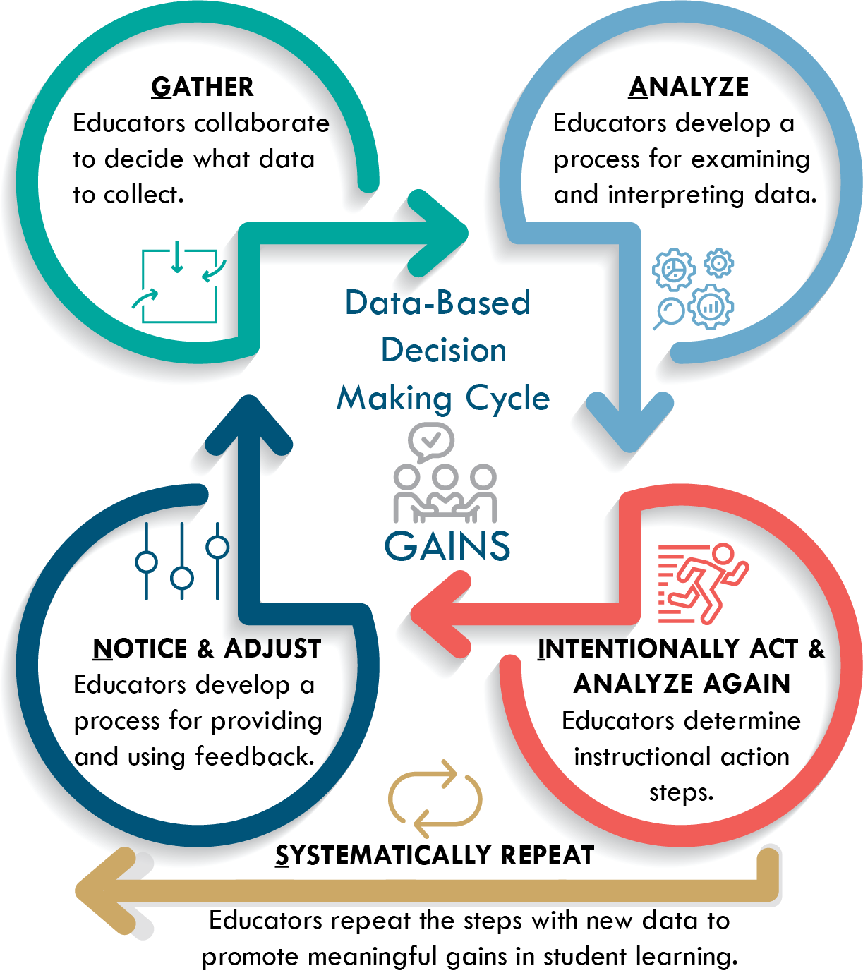
Analyze and Interpret CFA Data
Notes:
To Know/To Say
After CFAs are developed and administered to students, it is important that grade level/content teams meet for Data-Based Decision Making. These meetings provide educators an opportunity to collectively gather, analyze, interpret, and act on the data collected from CFAs. The evidence of learning from Common Formative Assessments is feedback gathered from students. Teacher teams use the feedback to make decisions about instructional adjustments and appropriate feedback students need in order to drive learning forward.
To Do
Briefly explain the GAINS process for DBDM and highlight the keys points below. Suggest that participants refer to the DBDM module for further information on Data-Based Decision Making. The module can be accessed using this link:
http://www.moedu-sail.org/courses/data-based-decision-making-2/
To Say
After CFAs are used, it is important that grade level/content teams meet for Data-Based Decision Making. These meetings provide educators an opportunity to collectively gather, analyze, interpret, and act on the data collected from CFAs.
Key points to emphasize
Meet with your DBDM team & work collaboratively to implement the GAINS process accomplish the following.
Note student strengths and challenges
Identify key learning gaps
Identify key instructional gaps
Determine how instruction will be adjusted to address learning gaps
Plan instruction for students with more pronounced challenges
Plan activities for those students needing enrichment
References
Missouri Department of Elementary & Secondary Education (2019). Data-based decision making. District Continuous Improvement (DCI). Missouri Department of Elementary & Secondary Education. http://www.moedu-sail.org/courses/data-based-decision-making-2/
Teaching Matters, Inc. (2020). Formative assessment analysis t-chart: Strength and gaps. https://docs.google.com/document/d/1pxYRo8dcDSNN1wUfi3-ueKy6_PqFkMKEMpFz6e3nhzM/edit

Slide 69
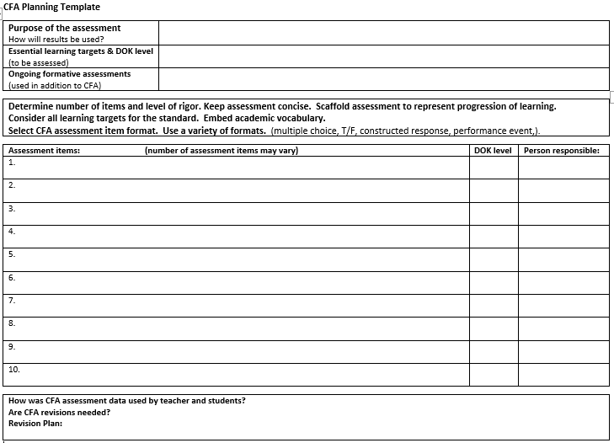
Building a CFA
Collaboratively build a CFA with your team.
Use the CFA Planning Template to help guide you.
Notes:
Handout #9
To Know/To Say
Now it’s time for your team to begin developing a CFA for a unit you will be teaching. We will use Handout #9. The information presented in the module along with the template will guide you through the process.
To Do
Provide participants a CFA Planning Template (Handout #9 ) and review the components of building a CFA. Then provide time for them to get started with the process. Teams may use the template provided, or one of their own. (Amount of team-work time will depend on time available.)
Handout
#9 CFA Planning Template

Slide 70
CFA Part 2 – Essential Questions
How do I collect real time evidence through daily formative assessment?
How do I collaboratively develop common formative assessments that align to learning target/success criteria and reflect learning progression?
How do I use evidence from formative assessment to assist in making instructional decisions to improve student outcomes?
How do I use learner engagement in the formative process to develop and enhance self-assessment skills?
Notes:
To Know
This is a review of the Essential Questions to guide the audience to begin thinking about the information provided in the module. Essential Questions also give the presenter a guide for what information needs to be reviewed and discussed at the end of the presentation. Participants will need time throughout the presentation to discuss and reflect on these questions.
The Essential Questions listed on this slide pose questions to help participants reflect on key ideas within Eliciting Evidence Of Learning module.
To Do
Pose the questions on the slide and encourage discussion around each.
To Say
We will review the Essential Questions again to reflect on our learning from today. Did we answer these Essential Questions? What do you feel you need more information on through coaching.

Slide 71
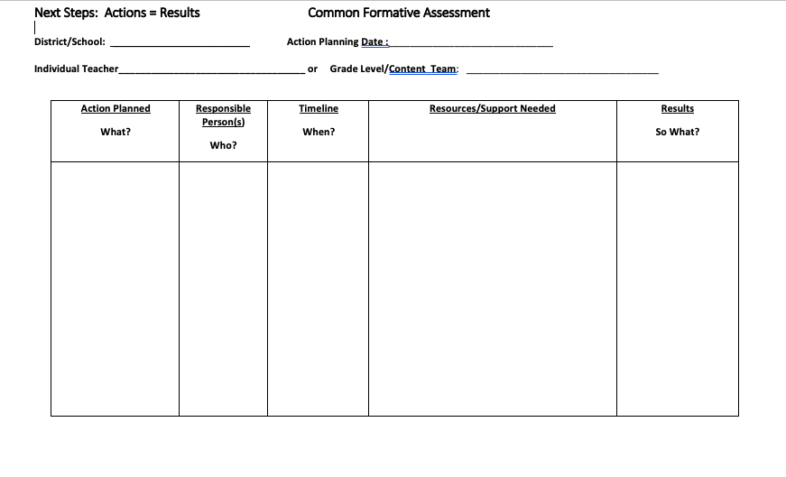
Next Steps: Actions = Results
What gets PLANNED is what gets DONE! What are actionable steps you can take to Elicit Evidence of Learning?
Notes:
Handout #10
To Know/To Do/ To Say
Use the next steps action plan to give participants an opportunity to plan for what they will do with this new learning and follow-up coaching.

Slide 72
Closing
Thank you for your participation
For further training and coaching, contact:
Notes:
To Know
Trainers may individualize this slide to fit audience.

Slide 73
Additional Resources
Notes:
To Know
Trainer may want to use or share these resources depending on time and need.
To Say
The following two slides provide additional resources you may find useful.

Slide 74
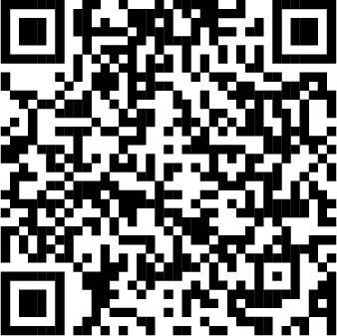
Dese Resource
Performance Level Descriptors​
An overview of critical learning in some content areas across the year and describes what successful students should know and be able to do.​
Each descriptor provides a summary of below basic, basic, proficient, and advanced student achievement. ​
Notes:
To Know/To Say​
Performance Level Descriptors​
The Missouri Department of Elementary and Secondary Education provides Performance Level Descriptors for several content areas and grade levels.​
Each descriptor provides an overview of critical learning in a content area across the year, and describes what successful students should know and be able to do.​
Each descriptor provides a summary of below basic, basic, proficient, and advanced student achievement. ​
The PLDs can be located on the DESE website by finding the Educator tab; then the Curriculum tab; then either Grade Level or EOC. Scroll down to find the Performance Level Descriptors. PLDs are not available yet for all content areas or grade levels. They are currently available at dese.mo.gov for English Language Arts, Math, Science, and Social Studies. ​
​
Remind participants that DESE content directors maintain up-to-date web pages that provide a wealth of information about assessment, instruction, professional development, and released test items for use by Missouri teachers. ​
​
References​
https://dese.mo.gov/college-career-readiness/assessment/grade-level​
https://dese.mo.gov/college-career-readiness/assessment/end-course​
​
​
​

Slide 75
Calibration Resource
If presenters wish to take participants deeper than the basics of CFA development, please find a Calibration PowerPoint in the CFA Coaching Companion. The process of calibration encourages deep conversations about all aspects of the CFA. This is a powerful process in evaluating a CFA to ensure all learning targets are covered, the highest level of DOK required by the standard is reached, scaffolding is present, and scoring criteria is agreed upon before implementing assessment.
Notes:
To Know
This slide is a hidden slide for presenters and is an excellent resource in the coaching companion that will take participants deeper in the CFA development.

Slide 76
References
Adaptive Schools. (n.d.). Teaching tip: 3-2-1 bridge. LiveBinder. https://www.livebinders.com/play/play?id=1626114
Ainsworth, L. (2015). Common formative assessments 2.0: How teacher teams intentionally align standards, instruction, and assessment. Corwin.
AITSL. (2017, Aug. 29). Formative assessment in the classroom [Video file]. https://www.youtube.com/watch?v=9FZR3-l8Y5Y&app=desktop
Berger, R., Rugen, L., & Woodfin, L. (2014). Leaders of their own learning. Jossey-Bass Publishing.
Chappuis, J. (2014). Seven strategies of assessment for learning, 2nd edition. Pearson. https://smartlearningsystems.com/wp-content/uploads/2014/10/Group-1-Unit-Criteria-Targets-Reflect.pdf
Concourse Village Elementary School. (2019, Feb. 8). 60 second strategy: TAG feedback [Video file]. Edutopia. https://www.youtube.com/watch?v=HM5dp50HWXQ&feature=emb_rel_pause
DuFour, R., DuFour, R., Eaker, R., & Karhanek, G. (2010). Raising the bar and closing the gap: Whatever it takes. Solution Tree Press.
Dyer, K. (2019, Jan. 31). 75 digital tools and apps teachers can use to support formative assessment in the classroom [Blog]. NWEA. https://www.nwea.org/blog/2019/75-digital-tools-apps-teachers-use-to-support-classroom-formative-assessment/
Education Services Australia. (2002). Strategic questioning module. Assessment for Learning. https://www.assessmentforlearning.edu.au/professional_learning/modules/strategic_questioning/strategic_research_background.html#2
Engage NY. (2016, Jan. 11). Teacher uses questioning techniques to engage students, example 19 [Video file]. https://www.youtube.com/watch?v=1WQCWF7ENfI
Engage NY. (2016, Jan. 12). Teacher uses questioning techniques to engage students, example 22 [Video file]. https://www.youtube.com/watch?v=ABnYWMnAk7Y
Fairfax Public Schools. (2013, Sept.). Best practices: Creating a common assessment [Video file]. https://www.youtube.com/watch?v=amipgHiAjh0

Slide 77
References
Ferry, L. (2021). How to design classroom assessments using the difficulty & complexity matrix. CIESC. https://plconnect.ciesc.org/design-classroom-assessments-using-difficulty-complexity-matrix/
Fisher, D., & Frey, N. “Questioning to check for understanding.” In Guided instruction. http://www.ascd.org/publications/books/111017/chapters/Questioning-to-Check-for-Understanding.aspx
Frey, N., & Fisher, D. (2011). The formative assessment action plan: Practical steps to more successful teaching and learning. ASCD.
Great Schools Partnership. (2014, April,29). Formative assessment. The Glossary of Educational Reform. https://www.edglossary.org/formative-assessment/
Hattie, J. (2017). How to empower student learning with teacher clarity. https://us.corwin.com/sites/default/files/corwin_whitepaper_teacherclarity_may2017_final.pdf
Hattie, J., (2017). 2017 ranking list of 256 influence and effect sizes related to student achievement. Visible Learning. https://visible-learning.org/backup-hattie-ranking-256-effects-2017/
Heritage, M. (Ed.). (2010). Formative assessment: Making it happen in the classroom. Corwin Press.
Leahy, S., Lyon C., Thompson, M., & Wiliam, D. (2005). Classroom assessment: Minute-by-minute, day-by-day. Educational Leadership, 62(3), 18-24.
Missouri Department of Elementary & Secondary Education (2019). Data-based decision making. District Continuous Improvement (DCI). Missouri Department of Elementary & Secondary Education. http://www.moedu-sail.org/courses/data-based-decision-making-2/
Missouri Department of Elementary and Secondary Education. (2013, June). Leader standards. Missouri’s Educator Evaluation System. https://dese.mo.gov/media/pdf/oeq-ed-leaderstandards
Missouri Department of Elementary and Secondary Education. (2013, June). Teacher standards. Missouri’s Educator Evaluation System. https://dese.mo.gov/media/pdf/oeq-ed-teacherstandards

Slide 78
References
MoEdu-SAIL. (2022). Blueprint for district and building leadership (6th ed.). Missouri Department of Elementary and Secondary Education: Northern Arizona University, Institute for Human Development.
Moss, C., & Brookhart, S. (2019). Advancing formative assessment in every classroom: A guide for instructional leaders. ASCD.
National Council of Teachers of English. (2013, Oct.21). Formative assessment that truly informs instruction. https://cdn.ncte.org/nctefiles/resources/positions/formative-assessment_single.pdf
National Council of Teachers of Mathematics. (2013, July). Formative assessment position statement. https://www.nctm.org/uploadedFiles/Standards_and_Positions/Position_Statements/Formative%20Assessment1.pdf
New Mexico School of the Arts. (2016, Oct. 5). Mastering self-assessment: Deepening independent learning through the arts [Video file]. Edutopia. https://www.youtube.com/watch?v=Va66oMkWP_o
Northwest Evaluation Association. (2016, March). 4 formative assessment practices that make a difference. Partnering to Help All Kids Learn. https://www.nwea.org/content/uploads/2016/04/4-Formative-Assessment-Practices-that-Make-a-Difference-in-Classrooms.pdf
NYC Dept. of Education. (2013, August 22). Peer assessment: Reflections from students and teachers [Video file]. Nellie Mae Educational Foundation. https://www.youtube.com/watch?v=DqWCJZH8ziQ
Northwest Evaluation Association. (2016, March). 4 formative assessment practices that make a difference. Partnering to Help All Kids Learn. https://www.nwea.org/content/uploads/2016/04/4-Formative-Assessment-Practices-that-Make-a-Difference-in-Classrooms.pdf
Olandt, C. (2017, June 21). Self-assessment and self-reflection [Video File]. Tennessee Dept. of Education. https://www.youtube.com/watch?v=4av28CeQC1I
Perkins, D. (2003). Ladder of feedback. King Authors Round Table: How Collaborative Conversations Create Smart Organizations. John Wiley Press. https://pz.harvard.edu/sites/default/files/Ladder%20of%20Feedback%202019.pdf

Slide 79
References
Perkins, D., Wilson, D. (n.d.). Ladder of feedback. Harvard Graduate School of Education, Project Zero. https://edorigami.edublogs.org/files/2012/10/Ladder-of-feedback-template-1k898ll.pdf
PowerSchool. (2016, Oct. 13). New teachers, here’s how to build common formative assessments [Blog]. https://www.powerschool.com/resources/blog/new-teachers-heres-build-common-formative-assessments/
Reeves, D. B. (2003). The leader's guide to standards: A blueprint for educational equity and excellence. John Wiley & Sons.
Savage, T. (2019, Sept. 6). 60 second strategy: Respond, reflect, and review [Video file]. Edutopia. https://www.youtube.com/watch?v=J4UQvt1Rn9w
Sherer, M. (2016). Seeing into the minds of students. Educational Leadership. http://www.ascd.org/ASCD/pdf/siteASCD/publications/books/On-Formative-Assessment-sample-chapters.pdf
Spencer, J. (2020, March 3). Empowering students to own the assessment process [Video file]. https://www.youtube.com/watch?v=8WxvVgXC_NY
Teaching Matters, Inc. (2020). Formative assessment analysis t-chart: Strength and gaps. https://docs.google.com/document/d/1pxYRo8dcDSNN1wUfi3-ueKy6_PqFkMKEMpFz6e3nhzM/edit
Thomas, L. (2019, April 26). 7 smart, fast ways to do formative assessment. Edutopia. https://www.edutopia.org/article/7-smart-fast-ways-do-formative-assessment
Two Rivers Charter School. (2016, Nov.1). Peer critique: Creating a culture of revision [Video file]. Edutopia. https://www.youtube.com/watch?v=M8FKJPpvreYWiggins, G. (2016). Seven keys to effective feedback. In On Formative Assessment: Readings from Educational Leadership. http://www.ascd.org/ASCD/pdf/siteASCD/publications/books/On-Formative-Assessment-sample-chapters.pdf

Slide 80
References
Wiliam, D. (2018). Activating students as owners of their own learning. Embedded formative assessment. Solution Tree Press. https://iwonderstand.files.wordpress.com/2015/12/activating-students-as-owners-of-their-own-learning.pdf
Wiliam, D. (2018). Activating students as resources for one another. Embedded formative assessment. Solution Tree Press. https://iwonderstand.files.wordpress.com/2015/12/activating-students-as-instructional-resources-for-one-another.pdf
Wiliam, D. (2018). Embedded formative assessment. Solution Tree Press.
Wiliam, D. (2016, July 15). Formative assessment [Video file]. Education Scotland. https://www.youtube.com/watch?v=YcJdZGz6ifY
Wiliam, D. (2014). Unpacking formative assessment. Educacao. https://pt.slideshare.net/TheresaSheen/dylan-wiliam-30820157?smtNoRedir=1

