Slide 1
Common Formative Assessment
Part 3 Feedback
Essential Function 5
Notes:
To Know
We will now begin Part 3 of the CFA training. This part will focus on feedback, which is Essential Function 5 on the Practice Profile. It is important to note that educators should interpret and act on formative assessment to provide feedback intended to improve student learning.

Slide 2
Hidden Slide #1
The Common Formative Assessment Module was designed to be used in the following manner.
The audience for this module is educators, including Building Leaders, Instructional Coaches, and teachers of all contents and levels. This module can be used for whole staff presentations.
Time should be allotted after training for participants to reflect and have conversations regarding current and needed changes. Participants should reflect on the following questions:
Where are we now? Where are we going? How can we get there?
Participants should complete the SAPP for Common Formative Assessment.
Following the training participants should complete a Next Steps Document.
Notes:
This slide is for coaches
Formative Assessment is an essential topic that all educators, building leaders, and instructional coaches need to understand. The content in this module is intended to help districts/teachers plan for the use of daily formative and common formative assessment in their districts.
If a district uses the term learning intention instead of learning target, the presenter may change reference from learning target to learning intention throughout the presentation. Learning targets are defined as the key information and ideas we want learners to know.
Consultants should possess a general understanding of the role of various types of formative assessment and the importance each plays in the DBDM process. They should also understand that the effectiveness of instructional practices is measured by assessing student impact which is done through formative assessment.

Slide 3
Hidden Slide #2 Common Formative Assessment module organization
Part 1: EF 1 & 2
Part 2: EF 3 & 4
Part 3: EF 5
INTRODUCTION TO COMMON FORMATIVE ASSESSMENT
CLARIFYING LEARNING
Identifying priority standards
Unwrapping standards
Learning targets
Success criteria
ELICITING EVIDENCE OF LEARNING
Daily Formative Assessment
Common Formative Assessment
FEEDBACK
Acting on evidence of learning
Using feedback
Notes:
This slide is for coaches
(Important) The introduction at the beginning of Part 1 of the Common Formative Assessment module provides an overview of the formative assessment process and essential background information for participants. It is important that all participants receive introduction training prior to other module sessions if they have not previously had it.
Part 1 provides content aligned with CLARIFYING LEARNING, which addresses EF1 & 2 of the CFA Practice Profile. Topics covered include identifying priority standards, unwrapping priority standards, learning targets, and success criteria.
Part 2 is aligned with EF 3 & EF 4 of the CFA Practice Profile which addresses ELICITING EVIDENCE OF LEARNING through daily formative assessment and common formative assessment.
Part 3 is aligned with EF 5 of the Practice Profile. It provides content on using evidence of learning (feedback from students) to drive instruction, as well as information on providing effective feedback to students.
Concepts addressing ACTIVATING LEARNERS are important to the formative assessment process and have been embedded throughout the module. The metacognition and DACL modules also address activating learners and can be accessed from the MoEdu-SAIL Website (https://www.moedu-sail.org/mtss-facilitator-materials/#practices) or the Missouri Virtual Learning Platform (https://apps.dese.mo.gov/WebLogin/Login.aspx?ReturnUrl=%2fweblogin%2ferrorPage.html%3faspxerrorpath%3d%2fVLP%2fapp%2findex.aspx&aspxerrorpath=/VLP/app/index.aspx)

Slide 4
Hidden Slide #3
Part 3 of the Common Formative Assessment module is designed to be completed in 4 hours.
Supplies needed
WiFi access for presenter and participants
Access to videos (through WiFi if available, but download to flash drive as a back-up)
Chart paper
Plain paper
Markers & highlighters
Post-it-Notes
You may consider requesting that participants bring a device with a QR reader to scan codes for easy access to documents.
Notes:
To Know
Please have these supplies ready before training session. This part will take up to four hours but you may allow more time if you plan to access and peruse the additional resources.

Slide 5
Hidden Slide #4
Handouts
CFA Infographic
CFA Practice Profile
Formative Assessment Process
Judgmental Informative Feedback
Feedback Examples (and 5. Optional)
Feedback Scenarios
Next Steps-Action-CFA
Notes:
To Know
These are the handouts for Part 3 of the Common Formative Assessment module which includes feedback. The master list of handouts may be given to participants prior to the session or during the session.

Slide 6
Hidden Slide #5 General Guidance for Virtual Presentations
Notify and request prior permission from participants if session is to be videotaped.
Test your tech set-up prior to the session (download and save videos on flash drive if needed)
Keep sessions short (1 – 1.5 hours maximum)
Provide norms for participation & discussion (video on, ask questions in chat, stay engaged)
Minimize distractions (request participants to mute when not participating)
Identify roles prior to presentation (facilitator, timekeeper, notetaker, etc.)
Use 2 consultants – 1 to present, 1 to manage chat, etc.
Create opportunities for participant engagement and interaction
Each breakout room should choose a discussion leader and notetaker
End the session with an effective wrap up
Notes:
This slide is for consultants providing virtual training.

Slide 7
Hidden Slide #6
Key Terms – Common Formative Assessment Module
Academic Rigor - learning and educational experiences that are academically, intellectually, and personally challenging.
Actionable Feedback - feedback that is concrete, specific, and useful; it provides actionable information that learners can use to develop a path to improvement.
All Student Response Systems - methods that enable teachers to get responses from every student in real time.
Benchmark/Interim Assessment - a comparison of student understanding or performance against a set of uniform standards within the same school year.
Calibration - the process of checking the use of a measuring instrument to see if it is accurate.
Common Formative Assessment - an intentionally and collaboratively designed measure used and analyzed for the purpose of monitoring students' attainment of essential learning targets or skills through the instructional process.
Complexity - the degree of difficulty in determining the standards and performance evaluation of a task.
Daily Formative Assessment - the deliberate, on-going process that provides immediate information to teachers and students during instruction regarding learning needs and academic progress of students toward learning targets.
Notes:
To Know
The next three slides are for consultant use and have the key terms for the learning package. Consultants should know these terms before using this module. Consultants may choose to include some of these definitions in their training as appropriate.
References (adapted from)
Ferry, L. (2021). How to design classroom assessments using the difficulty & complexity matrix. CIESC.
Hattie, J. (2017). How to empower student learning with teacher clarity. https://us.corwin.com/sites/default/files/corwin_whitepaper_teacherclarity_may2017_final.pdf
Moss, C., & Brookhart, S. (2019). Advancing formative assessment in every classroom: A guide for instructional leaders. ASCD.
Wiliam, D. (2018). Embedded formative assessment. Solution Tree Press.

Slide 8
Hidden Slide #7 Key Terms
Difficulty - determined both by learner factors (characteristics of learners that influence their ability to complete tasks) and task factors (task types or features of tasks that influence their difficulty).
Evaluative Feedback - information provided to the learner in the form of grades or evaluative comments which fail to provide a path to improvement and can often have a negative impact on learning.
Evidence of Learning - information gathered through observations, discussions, tasks, and activities that provide educators with insight and data regarding students’ thinking and understanding.
Feedback - information provided by an agent (teacher, peer, book, parent, self-experience) regarding aspects of one’s performance or understanding.
Formative Assessment - “a process in which evidence about student achievement is elicited, interpreted, and used by teachers, learners, or their peers to make decisions about the next steps in instruction that are likely to be better, or better founded, than the decisions they would have make in the absence of that evidence .” (Wiliam, 2018)
Learning Target - lesson-sized statement of what will be taught and what students are expected to know and be able to do.
Peer Assessment - students assessing the work of peers based against a set of success criteria.
Priority Standard - prioritized learning outcomes for specific grade levels and courses determined to be essential for student understanding and success in each level of schooling, in life, and on all high-stakes assessments. Deliberately selected sets of standards form the framework of a unit.
Notes:
To Know
Definitions are for consultant use and have the key terms for the learning package. Consultants should know these terms before using this module. Consultants may choose to include some of these definitions into their training as appropriate.
References (adapted from)
Hattie, J. (2017). How to empower student learning with teacher clarity. https://us.corwin.com/sites/default/files/corwin_whitepaper_teacherclarity_may2017_final.pdf
Moss, C., & Brookhart, S. (2019). Advancing formative assessment in every classroom: A guide for instructional leaders. ASCD.
Wiliam, D. (2018). Embedded formative assessment. Solution Tree Press.

Slide 9
Hidden Slide #8 Key Terms
Relevance - learning in which students apply core knowledge, concepts, or skills to solve real-world problems.
Rubric - a coherent set of criteria for students' work that includes descriptions of levels of performance quality on the criteria.
Strategic Questioning - intentionally designed questions that help teachers uncover more about what students know and don’t know.
Student Self-Assessment - the process of students reflecting on and evaluating their own work for the purpose of improving it.
Success Criteria - closely linked to learning intentions, success criteria are observable descriptions of what students would do to meet the learning target. They provide a means for students and teachers to evaluate work and gauge progress toward learning goals.
Summative Assessment - a comparison of the performance of a student or group of students against a set of uniform standards administered after the instructional cycle.
Unwrapped Standard - a decomposed priority standard that lists concepts, skills, and big ideas that can be used to more clearly define learning targets to guide instruction and assessment.
Learning Target - a comprehensive description of the goal for learning that includes the learning target statement, success criteria, lesson-sized chunk of concepts/skills, and a performance of understanding.
Notes:
To Know
Definitions are for consultant use and have the key terms for the learning package. Consultants should know these terms before using this module. Consultants may choose to include some of these definitions into their training as appropriate.

Slide 10
Hidden Slide #9
Pre-Training Preparation
Pre-read article
What Does Effective Student Feedback Look Like?
https://www.sec-ed.co.uk/best-practice/what-does-effective-student-feedback-look-like-part-1/
Notes:
To Know
This article is to be sent to participants prior to the Part 3 session on feedback. The activity within the session provides participants an opportunity to process the article and share key points. You may want to have table copies for participants.
Reference
Webb, H. (2016, Sept. 7). What does effective student feedback look like? Part 1. SecEd. https://www.sec-ed.co.uk/best-practice/what-does-effective-student-feedback-look-like-part-1/

Slide 11
Understanding Formative Assessment
Feedback
Interpreting and Acting
Notes:
To Know/To Say
As we begin this session, it is important to look at what we have already covered in the two previous sessions. We have clarified learning and answered the question “Where is the learner going?” We have learned about eliciting evidence of learning and answered the question “Where is the learner now?” Now we will look at feedback which answers the question “How does the learner get there?” (or “Where is the Learner Going?”) This aligns with the Essential Function 5 which is Interpreting and Acting.
These are working definitions to use in Part 3, Feedback and are embedded in the content of this section:
Actionable Feedback – information that supports the learner with a plan of action for improvement as well as opportunities to act on the feedback (review, revise, practice, retry, self-adjust)
Evaluative Feedback - information provided to the learner in the form of grades or judgmental comments, which fail to provide a path to improvement and can often have a negative impact on learning.
Evidence of learning - information gathered through observations, discussions, tasks, and activities that provide educators with insight and data regarding students’ thinking and understanding.
Feedback - information provided by an agent (teacher, peer, book, parent, self-experience) regarding aspects of one’s performance or understanding.
Rubric - a coherent set of criteria for students' work that includes descriptions of levels of performance quality on the criteria.
References
Frey, N., Fisher, D. (2011). The formative assessment action plan: Practical steps to more successful teaching and learning. ASCD.
Moss, C., Brookhart, S. (2019). Advancing formative assessment in every classroom: A guide for instructional leaders. ASCD.
Wiliam, D. (2018). Embedded formative assessment. Solution Tree Press.

Slide 12
Acknowledgements
Special thanks to all contributors to the development of this Professional Learning Module. The original collection of Professional Learning Modules was rolled-out for use by Regional Professional Development Center (RPDC) Consultants in July 2013 after being developed by a team of content experts through efforts funded by the Missouri State Personnel Development Grant (SPDG).
Content Development Team
Cathy Battles
Bev Boyd
Myra Collins
Liz Condray
Susan Hekmat
Brooke Prickett
Training Material Development
Beverly Kohzadi
Institute for Human Development
Ronda Jenson
Jodi Arnold
Cynthia Beckmann
Chelie Nelson
Cheryl Wrinkle
Notes:
To Know/To Say
Special thanks to all contributors to the development and revision of this Professional Learning Module.

Slide 13
Welcome and Introductions
Our trainers for the day
Notes:
To Know/ To Do
Add presenter information to the slide.

Slide 14
Norms
Begin and end on time
Be an engaged participant
Be an active listener - open to new ideas
Use notes for side bar conversations
Use electronics respectfully
Notes:
To Know​
It is important to establish norms for training. Trainers are free to adjust this list of norms.​
​
To Do​
Consider including a check mid-way through the training to assess a norm or norms. The presenter may want to use norms printed on agenda handouts in addition to or in place of presentation slides, so the norms are always available in print for participants. Norms may be added to address specific school needs. Some schools already have established norms for all PD. In that case, adapt to their norms. ​
​
To Say​
Please review the norms for this training. Are there any additions that need to be made to the norms at this time?​

Slide 15
Icon Glossary
Notes:
To Know/To Say
You will see these icons on slides and handouts throughout the presentation.

Slide 16
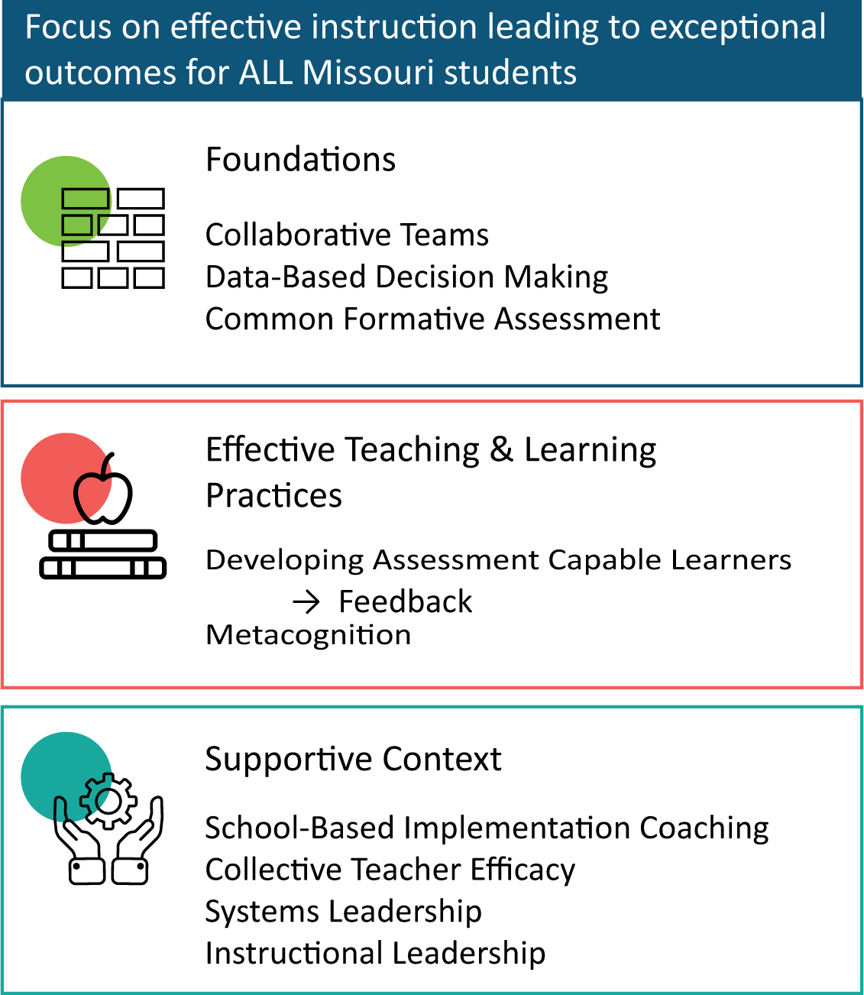
District Continuous Improvement Framework (DCI)
Notes:
To Know
Nine Professional Learning Modules make up the DCI Content within the DCI Framework as illustrated in the slide.
Three foundational educational practices essential for collaborative, data-informed instruction and decision making
Two effective teaching and learning practices shown to improve student achievement
Four practices that create a supportive context to sustain and advance effective teaching and learning
To Do/To Say
Before we delve into Part 3, let’s take a few minutes to review the DCI Framework graphic, looking specifically at where CFA falls into whole picture.
As you see, the focus of DCI is on effective instruction leading to exceptional outcomes for all Missouri students.
The Content Framework has three main components
Foundations (consisting of Collaborative Teams, Data-Based Decision Making, and Common Formative Assessment)
Effective Teaching and Learning Practices (Developing Assessment Capable Learners with Feedback and Metacognition)
Supportive Context (School Based Implementation Coaching, Collective Teacher Efficacy, and Systems/Instructional Leadership)
References
MoEdu-SAIL. (2022). Blueprint for district and building leadership (6th ed.). Missouri Department of Elementary and Secondary Education: Northern Arizona University, Institute for Human Development.

Slide 17
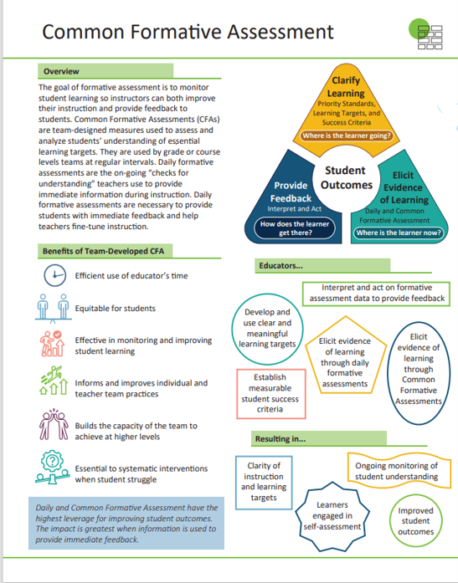
Common Formative Assessment (CFA) Infographic
Notes:
Handout #1
To Know/To Say
The CFA infographic summarizes key content from the learning package. Briefly review the infographic with participants.

Slide 18
Common Formative Assessment Module
Part 1: Essential Functions 1 & 2
Introduction
Clarifying Learning: Identifying Priority Standards, Unwrapping Standards, Learning Targets, and Success Criteria
Part 2: Essential Functions 3 & 4
Daily Formative Assessment
Common Formative Assessment
Part 3: Essential Function 5
Acting On Evidence of Learning
Using Feedback
Notes:
To Know
Part 1 provides content aligned with the first essential function of the formative assessment process, CLARIFYING LEARNING, which addresses EF 1 & 2 of the CFA Practice Profile. Topics covered include identifying priority standards, unwrapping priority standards, learning targets, and success criteria. Please note: This module introduces the concepts of priority standards, learning targets, and success criteria as they related to formative assessment, however this information is not intended to replace the in-depth professional development through DACL regarding the development of success criteria and learning targets. If a coach feels the district would benefit more from understanding these concepts more deeply, please use the DCI DACL module materials along with the CFA module.
Part 2 is aligned with EF 3 & 4 of the CFA Practice Profile which addresses ELICITING EVIDENCE OF LEARNING through daily formative assessment and common formative assessment.
Part 3 is aligned with EF 5 of the Practice Profile. It provides content on using evidence of learning (feedback from students) to drive instruction, as well as information on providing effective feedback to students to move them toward learning goals.
Concepts addressing ACTIVATING LEARNERS are important to the formative assessment process and have been embedded throughout the module. The Metacognition and DACL modules also address activating learners and can be accessed from the MoEdu-SAIL Website (https://www.moedu-sail.org/mtss-facilitator-materials/#practices) or the Missouri Virtual Learning Platform. (https://apps.dese.mo.gov/WebLogin/Login.aspx?ReturnUrl=%2fweblogin%2ferrorPage.html%3faspxerrorpath%3d%2fVLP%2fapp%2findex.aspx&aspxerrorpath=/VLP/app/index.aspx)
To Do/To Say
This slide shows the organization of the entire CFA Module. Today we will be completing Part 3, which coincides with Essential Function 5 on the Practice Profile.

Slide 19
CFA Module Objectives
Understand the formative assessment process, its role, and impact
Know how to clarify learning goals through learning targets and success criteria
Compare daily formative assessment and common formative assessment and explain how both benefit teachers and students
Develop effective daily and common formative assessments to elicit evidence of learning
Interpret and act on formative assessment evidence to provide feedback and make data-based decisions to improve teaching and learning
Notes:
To Know/To Say
These are the overall learning Objectives for the Common Formative Assessment module. Objectives are aligned to the Common Formative Assessment Practice Profile. Formative assessment is a process that includes 1. clarifying learning, 2. eliciting evidence of learning, and 3. interpreting and acting on evidence of learning to provide feedback and make decisions based on data to improve teaching and learning. The objectives are also aligned with this process. We will cover objective 5 today.
To Do
Review the learning outcomes on the slide.

Slide 20
CFA Module Essential Questions
How do I create learning targets to guide instruction and clarify learning?
How do I establish measurable student success criteria to clarify learning?
How do I elicit evidence of learning through daily formative assessments to monitor student understanding to improve instruction?
How do I elicit evidence of learning through common formative assessments to improve student understanding and improve instruction?
How do I interpret and act on formative assessment data to provide feedback and improve student learning?
Notes:
To Know
These are the overall essential questions for the Common Formative Assessment module. Questions are aligned to the five essential functions on the CFA Practice Profile. These Essential Questions help to activate participant thinking and access prior knowledge regarding metacognition.
To Do
Review the essential questions and provide time for reflective thinking.
To Say
These essential questions will help you reflect on your knowledge regarding CFA Module and the content that is contained in parts 1, 2, & 3 of the module. (Read the questions.) During this training, we will answer the final question.

Slide 21
Common Formative Assessment Practice Profile
Notes:
Handout #2
Know/To Say
This is the Common Formative Assessment Practice Profile. This Practice Profile is a rubric that serves as an educator’s roadmap for implementation of formative assessment.
Each of the five essential functions align with clarifying learning through priority standards, learning targets, and success criteria; eliciting evidence of learning through daily and common formative assessment; and providing feedback by interpreting and acting.
To Do
Make sure each participant has this handout. Briefly discuss the five essential functions. Then have educators do a quick self-assessment by highlighting indicators in EF 1 & 2 they currently see taking place in their classroom/school/district. This document will be reviewed in all three sessions.

Slide 22
CFA Alignment with MO Leader Standards
Standard #2 Teaching and Learning
Quality Indicator 2: Provide an Effective Instructional Program
Quality Indicator 3: Ensure Continuous Professional Learning
Standard #6 Professional Development
Quality Indicator 1: Increase knowledge and skills based on best practices
Notes:
To Know/To Say
These MO Leader Standards are closely aligned to the content within the Common Formative Assessment module.
Standard #2 Teaching and Learning
Education leaders have the knowledge and ability to ensure the success of all students by promoting a positive school culture, providing an effective instructional program that applies best practice to student learning, and designing comprehensive professional growth plans for staff.
Quality Indicator 2: Provide an Effective Instructional Program
Quality Indicator 3: Ensure Continuous Professional Learning
Standard #6 Professional Development
Education leaders have the knowledge and ability to ensure the success of all students by remaining current on best practices in education administration and school-related areas as evidenced in his/her annual professional development plan.
Quality Indicator 1: Increase knowledge and skills based on best practices
To Do
Review slide with participants.
Reference
Missouri Department of Elementary and Secondary Education. (2013, June). Leader standards. Missouri’s Educator Evaluation System. https://dese.mo.gov/media/pdf/oeq-ed-leaderstandards

Slide 23
CFA Alignment with MO Teacher Standards
Standard #2 Student Learning, Growth and Development
Quality Indicator 2: Student goals
Standard #7 Student Assessment and Data Analysis
Quality Indicator 1: Effective use of assessments
Quality Indicator 2: Assessment data to improve learning
Quality Indicator 3: Student-led assessment strategies
Quality Indicator 4: Effect of instruction on individual/class learning
Quality Indicator 5: Communication of student progress and maintaining records
Quality Indicator 6: Collaborative data analysis
Notes:
To Know/To Say
These MO Teacher Standards are closely aligned to the content within the Common Formative Assessment module.
Standard #2 Student Learning, Growth and Development The teacher understands how students learn, develop, and differ in their approaches to learning. The teacher provides learning opportunities that are adapted to diverse learners and support the intellectual, social, and personal development of all students.
Quality Indicator 2: Student goals
Standard #7 Student Assessment and Data Analysis The teacher understands and uses formative and summative assessment strategies to assess the learner’s progress and uses both classroom and standardized assessment data to plan ongoing instruction. The teacher monitors the performance of each student, and devises instruction to enable students to grow and develop, making adequate academic progress.
Quality Indicator 1: Effective use of assessments
Quality Indicator 2: Assessment data to improve learning
Quality Indicator 3: Student-led assessment strategies
Quality Indicator 4: Effect of instruction on individual/class learning
Quality Indicator 5: Communication of student progress and maintaining records
Quality Indicator 6: Collaborative data analysis
To Do
Review slide with participants.
Reference
Missouri Department of Elementary and Secondary Education. (2013, June). Leader standards. Missouri’s Educator Evaluation System. https://dese.mo.gov/media/pdf/oeq-ed-leaderstandards

Slide 24
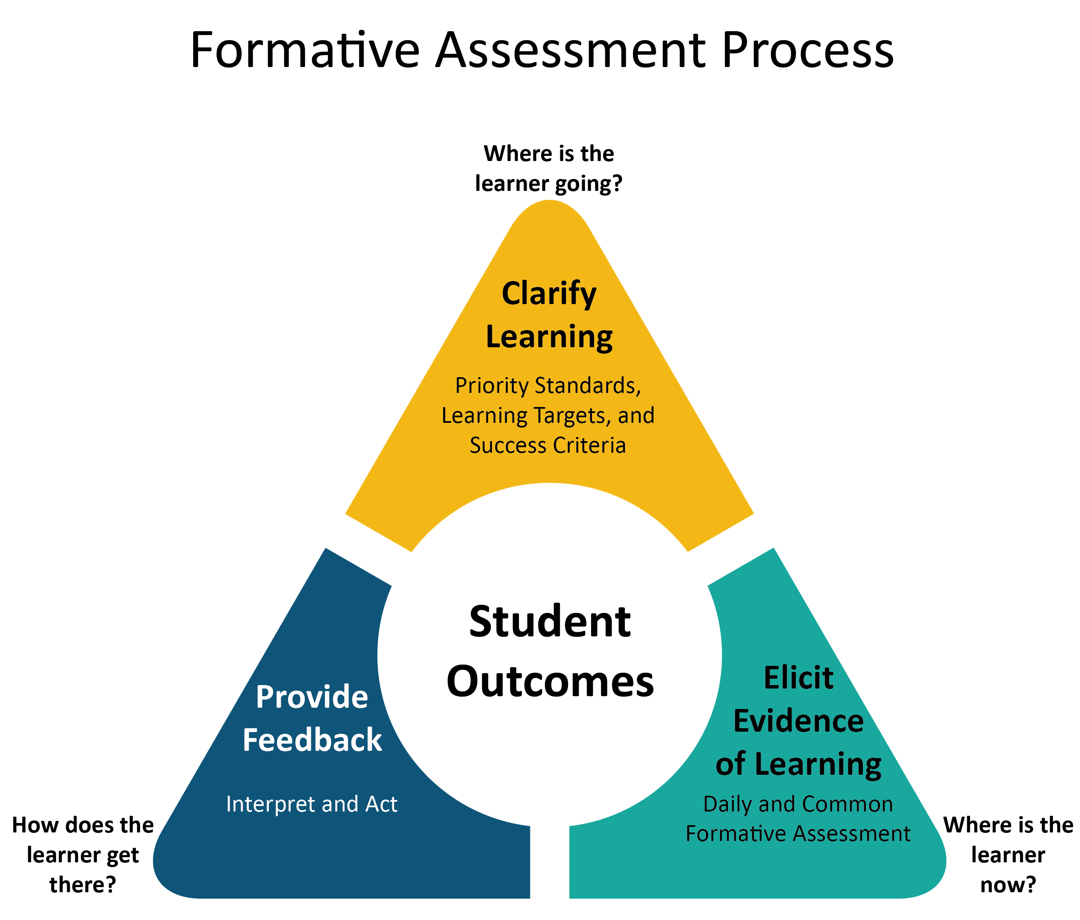
Daily Formative Assessment
Notes:
Handout #3
To Know
This graphic illustrates the formative assessment process and is Handout #3. This process was explained in the Introduction to Formative Assessment in Part 1. This is a good time to review the process. Part 1 of the CFA module focused on Clarifying Learning, Part 2 focuses on Eliciting Evidence of Learning, and Part 3, this session, focuses on Feedback.
To Say
We are now ready to look at feedback which is part of Essential Function 5 on the Practice Profile. You may want to refer back to Handout #2 which is the Practice Profile. This is handout #3.

Slide 25
Around the Room and Back Again
Write a response to the following prompt: I find formative assessment most helpful when ….
Move around the room and share your response with different colleagues.
When signaled, return to your seat and be ready to share the responses you heard at your table.
Notes:
To Know
The purpose of this activity is to help participants activate their thinking regarding formative assessment.
To Do/Say
The steps to this activity include asking participants to write one response to a prompt.
Have participants move about the room and share responses, mentally cataloguing the responses of others.
Signal participants to return to their seats and list the responses they heard from others.
In table groups participants should pool responses.
Reference
Thinking Collaboratively. (n.d.). The Adaptive School. https://www.thinkingcollaborative.com/_files/ugd/6a5cc9_ed28b325ab6a4362b834f4bbf295d408.pdf

Slide 26
CFA Part 3: Session-at-a-Glance
Definition and role of feedback in formative assessment
Using formative assessment to guide feedback
Purposes, benefits, and implications of providing effective feedback
Criteria for effective feedback
Notes:
To Know/To Say/To Do
Show slide to participants and review it.

Slide 27
CFA Part 3: Objectives
Use formative assessment feedback to guide instruction, based on student need
Provide effective, actionable feedback to move students forward in their learning
Align feedback directly with the learning targets and success criteria
Use strategies to encourage student thinking and self-reflection based on feedback
Notes:
To Know/To Say
These are the learning intentions/objectives for the Feedback part of this module. They are aligned with EF 5 on the Common Formative Assessment Practice Profile which is Handout #2. You may want to use the Practice Profile throughout this training.

Slide 28
CFA Part 3: Essential Questions
Why is it beneficial to clarify learning for both students and teachers?
How does identifying and unwrapping priority standards aid in formative assessment?
How do learning targets and success criteria impact formative assessment?
In what ways does engaging students move them toward their learning goal?
Notes:
To Know
Essential questions guide the audience to begin thinking about the information provided in the module. Essential questions also give the presenter a guide for what information needs to be reviewed and discussed at the end of the presentation. Participants will need time throughout the presentation to discuss and reflect on these questions.
The essential questions listed on this slide pose questions to help participants reflect on key ideas within Feedback module.
To Do
Pose questions on the slide and encourage discussion around each.
To Say
We will use these essential questions to reflect on our knowledge and actions related to feedback.

Slide 29
The Role of Feedback in Formative Assessment
(Adapted from Wiliam, 2018; NWEA, 2016; & NCTM, 2013)
Notes:
Handout #3- The Formative Assessment Process
To Know/To Do
The next step in the formative assessment process is interpreting and acting on feedback. Use the graphic to explain how the pieces of this module fit together in the formative assessment process.
To Say
Please look at Handout #3. We will now begin by reviewing the formative assessment process thus far. In previous sessions, we examined Step 1, clarify learning by developing learning targets and success criteria that enable learning goals to be visible to students. Next, we took an in-depth look at Step 2, eliciting evidence of learning, using both daily and common formative assessments. These “assessments for learning” enable teachers and students to know where learners are in their learning.
The next step that we will be examining is feedback, which provides learners with the information about what to do next as they strive to meet their learning targets. Feedback should be provided timely, appropriately, and relative to the questions “Where am I going, Where am I now? How do I close the gap?”
Feedback relies on educators using evidence to adjust instruction based upon student need and aligned to learning targets and success criteria.
References
National Council of Teachers of Mathematics. (2013, July). Formative assessment position statement. https://www.nctm.org/uploadedFiles/Standards_and_Positions/Position_Statements/Formative%20Assessment1.pdf
Northwest Evaluation Association. (2016, March). 4 formative assessment practices that make a difference. Partnering to Help All Kids Learn. https://www.nwea.org/content/uploads/2016/04/4-Formative-Assessment-Practices-that-Make-a-Difference-in-Classrooms.pdf
Wiliam, D. (2018). Embedded formative assessment. Solution Tree Press.

Slide 30
The Formative Assessment Process
Identify the learning destination by clarifying learning targets
Establish where students are by eliciting evidence of learning
Interpret and act on feedback to move learners forward
(Adapted from Wiliam, 2018; NWEA, 2016; & NCTM, 2013)
Notes:
Handout #3- The Formative Assessment Process
To Know
This process aligns with the formative assessment strategies outlined by both the National Council of Teachers of Math (NCTM), NWEA (formerly known as the Northwest Evaluation Association), the work of Dylan Wiliam and other experts in the field.
This visual depicts the 4 keys we discussed in the previous slide. This applies to any types of formative assessment.
Key features
Student learning in center
Repeated cycle
Clarify Learning (learning targets, standards, & success criteria)
Elicit Evidence (daily & CFA)
Feedback (interpret and act)
Use as Transition to EF 5
To Do
Explain the formative assessment process graphic.
To Know/To Say
In Handout #3 you have a more readable version of this graphic. The formative assessment process is a continuous cycle that includes clarifying learning for students, eliciting evidence of learning from students, and interpreting and acting on feedback to support the next steps in learning. The three overarching questions that guide this process are aligned with the DACL practices: Where is the learning going? Where is the learner now? How does the learner get there? At the center of this process are students who through formative assessment can become engage, skillful ,self-regulated learners.
References
National Council of Teachers of Mathematics. (2013, July). Formative assessment position statement. https://www.nctm.org/uploadedFiles/Standards_and_Positions/Position_Statements/Formative%20Assessment1.pdf
Northwest Evaluation Association. (2016, March). 4 formative assessment practices that make a difference. Partnering to Help All Kids Learn. https://www.nwea.org/content/uploads/2016/04/4-Formative-Assessment-Practices-that-Make-a-Difference-in-Classrooms.pdf
Wiliam, D. (2018). Embedded formative assessment. Solution Tree Press.

Slide 31
information about a task that fills a gap between what is understood and what is aimed to be understood. It can lead to increased effort, motivation or engagement to reduce the discrepancy between current status and the goal; it can lead to alternative strategies to understand the materials; it can confirm for the student that they are correct or incorrect, or how far they have reached the goal; it can indicate that more information is available or needed; it can point to directions that students could pursue; and finally, it can lead to restructuring understandings.
Feedback is…
(Hattie & Clarke, 2019)
Notes:
To Know/To Say
Formative assessment is the tool that enables educators to provide immediate and ongoing feedback, and feedback is the key to student learning. Feedback is information about the task that fills a gap between what is understood and what is needed to be understood.
When Hattie examined studies on learning it was clear that feedback is a strong influence on achievement, along with direct instruction, reciprocal teaching, and students’ prior cognitive ability. The meta-analysis on the effects of feedback does show considerable variability, indicating that some types of feedback are more powerful than others. Those studies showing the highest effect sizes involved students receiving information (feedback) about a task and how to do it more effectively.
This is John Hattie’s definition of feedback (read definition). The goal, however, of this session is to examine ways to make feedback most effective so that it moves students forward toward their learning goals.
It is important to remember that educators should provide timely, actionable, and descriptive feedback relative to the three important feedback questions: Where am I going? Where am I now? and How do I get there (how do I fill the gap)? We will come back to this later in the session.
Reference
Hattie, J., & Clarke, S. (2019). Visible learning feedback. Routledge.

Slide 32
What Does Effective Student Feedback Look Like?
Review the pre-read article
Find 2 key points from the article you think are most important & jot them down on a note card
Use a Stand Up/Hand Up/Pair Up and share your key points with a partner
(Webb, 2016)
Notes:
To Know
This activity provides an opportunity for participants to reflect on and discuss the pre-read article that was sent to them prior to this session. They can use the link or the QR code to access it. You may want to have table copies of this pre-read for easy access.
To Do
Review the activity directions with participants.
Ask participants to access the article. Once participants are ready, have them stand up and find a partner to share key ideas. Depending on time, they might share again with different partners.
To Say
Next, we’ll dive a little deeper into what effective feedback is by reviewing and reflecting on the article that was sent out as a pre-read - What Does Effective Student Feedback Look Like? First, review the article, then find two key points from the article that you think are most important and jot them down on a note card. Finally, a Stand Up, Hand Up, Pair Up structure will be used to share and discuss key points you found most important.
Additional Resource
What Does Effective Student Feedback Look Like? Part 2
Helen Webb continues her research review on effective feedback, looking at assessment for learning, peer and self-assessment, and the role of marking.
https://www.sec-ed.co.uk/best-practice/what-does-effective-student-feedback-look-like-part-2/
References
Webb, H. (2016, Sept. 7). What does effective student feedback look like? Part 1. SecEd. https://www.sec-ed.co.uk/best-practice/what-does-effective-student-feedback-look-like-part-1/
Webb, H. (2016, Sept. 14). What does effective student feedback look like? Part 2. SecEd. https://www.sec-ed.co.uk/best-practice/what-does-effective-student-feedback-look-like-part-2/

Slide 33
Effective Feedback Improves Learning By
Reducing the gap between current understanding or performance and the desired goal
Involving students in self-assessment
Helping students understand how to improve
Motivating and building self-esteem in learners
(Wiliam,2018)
Notes:
To Know
Educators use the information (feedback) they collect from students to adjust instruction to improve learning. Equally important is for educators to provide effective feedback that encourages and supports students, moving them forward toward their learning goals. As mentioned previously, feedback is the key to to student learning.
Feedback is information about the task that fills a gap between what is understood and what is needed to be understood. When Hattie examined studies on learning it was clear that feedback is a strong influence on achievement. The meta-analysis on the effects of feedback does show considerable variability, indicating that some types of feedback are more powerful than others. Those studies showing the highest effect sizes involved students receiving information (feedback) about a task and how to do it more effectively.
To Do/To Say
Discuss the points
With evidence about current knowledge and skill development, educators can help students reduce the gap between what they know and are able to do and the learning goal.
Student self-regulation of learning is developed when learners have a clear picture of their goal and self-assess to see how close they are to the learning target.
Feedback is most beneficial when it provides information which triggers students to use thinking and problem-solving skills and enables them to build on their strengths.
As students are able to use feedback to improve learning, they become more motivated learners.
References
Hattie, J., & Timperley, H. (2007). The power of feedback. Review of Educational Research, 77(1), 81-112.
Wiliam, D. (2018). Embedded formative assessment. Solution Tree Press.

Slide 34
How Teachers Use Feedback from Students
To design and provide instruction that fills gaps and extends knowledge, understandings, and skills
Create learning tasks that help move student learning forward
Differentiate learning to support students’ individual needs and develop flexible groups
Teacher
Feedback
Student
(NCTE, 2013)
Notes:
To Know/To Say
Feedback has two sides. In this case, we’re talking about the feedback teachers gather from students (evidence of learning), which illustrates what learners know and understand. When it is carefully interpreted and analyzed it can then be acted upon to adjust instruction, determine flexible grouping, and support differentiation to improve learning.
To Do
Read the key points bulleted on the slide that explain how teachers use the feedback they gather from students through formative assessments. Expand on the ideas.
References
National Council of Teachers of English. (2013, Oct.21). Formative assessment that truly informs instruction. https://cdn.ncte.org/nctefiles/resources/positions/formative-assessment_single.pdf

Slide 35
Why Teachers Provide Feedback for Students
To guide students in using their data to set goals and monitor their progress in learning and meeting goals
To provide information about where and how students can improve
To teach students to use feedback to deepen their understanding
Teacher
Feedback
Student
(NCTE, 2013)
Notes:
To Know/To Say
The second side is when educators provide feedback to students to enable them to be successful and meet their learning goals.
To Do
Read the last two bullets that explain how feedback provided to students moves their learning forward. Expand on the ideas.
References
Dyer, K. (2018, May 29). Formative assessment instructional practice: Using the results and data are what matters [Blog]. NWEA. https://www.nwea.org/blog/2018/formative-instructional-practice-using-the-results-and-data-are-what-matters/#:~:text=Eliciting%20and%20gathering%20evidence%20of,data%20that%20make%20it%20formative.&text=The%20use%20of%20formative%20assessment,of%20understanding%20among%20the%20learners
National Council of Teachers of English. (2013, Oct.21). Formative assessment that truly informs instruction. https://cdn.ncte.org/nctefiles/resources/positions/formative-assessment_single.pdf

Slide 36
Feedback Loop
Teaching is adapted based on student responses
SO THAT..
teaching is
responsive.
Regular and specific improvement points are used to close the learning gap
SO THAT..
learning is informed.
Teacher
Feedback
Student
(Class Teaching, 2014)
Notes:
To Know/To Do/To Say
This graphic shows a feedback loop to illustrate the desired goal, establishing the student’s current state through evidence of learning, comparing their current state with the desired state, and finding ways to bring their current state to the desired goal. Feedback should be designed as an exchange between teacher and learner, made up of a series of actions that bring the learner closer to his/her goal.
Reference
Class Teaching. (2014, June 8). Some thoughts on feedback [Blog]. https://classteaching.wordpress.com/2014/06/08/some-thoughts-on-feedback/

Slide 37
Using Feedback To Guide Instruction
Notes:
To Know
This video is 7:06 minutes long. It provides modeling on how educators can use information gathered from formative assessment to improve student learning.
To Say
Using student feedback collected from formative assessment evidence to plan, guide, and pace instruction can have significant effects on student learning. After you watch this video - Formative Assessments: Using Feedback to Guide Instruction (7:06 minutes) - we will discuss some of the key points.
To Do
Show Video
Reference
SanBdocitySchools. (2015, Dec, 3). Formative Assessments: Using Feedback to Guide Instruction [Video file]. San Bernardino Unified School District. https://youtu.be/Ecp5tFwXA_M

Slide 38
Video Reflection
How can educators use information gained from formative assessment to improve student learning?
How will formative assessment evidence be used in your classroom to improve learning?
Notes:
To Do/To Know
Pose these questions as a reflection for the previous slide’s video. Give participants time to share with a shoulder partner.
To Say
You can use formative assessment to guide your instruction as the video has illustrated. Please get with a shoulder partner and discuss these questions on this slide. We will have time to share out when we are finished.

Slide 39
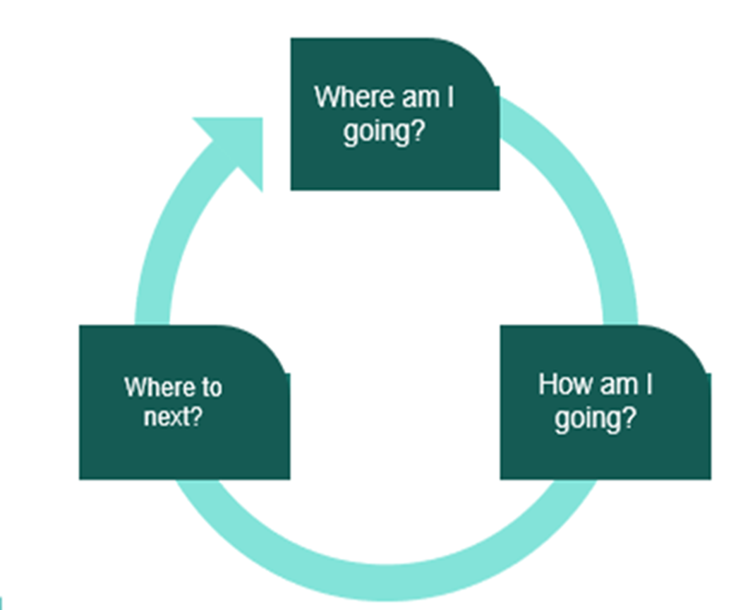
Effective Feedback Answers Questions Related To
Where am I going?
How am I going?
Where to next?
(Hattie & Timperley, 2007; Moss et al., 2019)
Notes:
To Know
These questions, as mentioned earlier, are directly linked to Developing Assessment Capable Learners. Hattie and Timperley (2007) identified three important components of effective feedback which they called feed up, feedback, and feed forward. Feed up involves establishing a clear purpose or goal (‘Where am I going?’), feedback provides information about a student’s progress toward that goal and suggests actions that might be taken (‘How am I going?’), while feed forward is about future planning and focuses on what further improvements need to be made to advance progress (‘Where to next?’).
To Say
We mentioned these questions earlier when we discussed the Hattie definition of feedback but will now go into more detail. Effective feedback answers these three questions:
Where am I going? The focus of this first question is on goals. It is important for both students and teachers to have a clear understanding of the learning targets and success criteria. Feedback allows them to set reasonable goals and to track their performance in relation to their goals so that adjustments in effort, direction, and even strategy can be made as needed.
How am I going? This relates to the progress students are making towards their goals based on the success criteria. The feedback would include where they started, where they are now, and progress made towards the learning target. Feedback observes where work met criteria and where it didn’t.
Where to next? The third question addresses how to ‘feed forward’ in order to help students improve. Feedback should provide scaffolding or support in how learners can close the gap between where they are in their learning journey and where they are going in their journey. Taking small focused steps and providing opportunities for students to engage in self-reflection and revision is the key to success.
To Do
Review the three questions of effective feedback and the key points associated with each. Once they are discussed, explain how these questions create a feedback loop for students to self-regulate their learning.
References
Ellis, N. J. & Loughland, T. (2017). ‘Where to next?’ Examining feedback received by teacher education students. Issues in Educational Research, 27(1), 51-63. http://www.iier.org.au/iier27/ellis.pdf
Hattie, J., & Timperley, H. (2007). The power of feedback. Review of Educational Research, 77(1), 81-112.
Locke, E., & Latham, G. (1991). A theory of goal setting & task performance. The Academy of Management Review, 16, 10.
Moss, C., & Brookhart, S. (2019). Advancing formative assessment in every classroom: A guide for instructional leaders. ASCD.

Slide 40
Effective Feedback Is …
Timely, consistent, and ongoing
Specific & goal oriented
Student friendly
Actionable
(Chicago Literacy Alliance, 2020)
Notes:
To Know/To Say
Effective feedback is like fuel used to keep learners focused, motivated, and supported to keep moving forward toward their learning goal. These criteria are essential for feedback to be truly effective.
These criteria have been adapted/updated from Grant Wiggins’ 7 Keys to Effective Feedback, 2012 (reference listed below).
Timely, Consistent, and Ongoing - provided as a continuous process while the learner is still focused on the learning target for relevance and motivation.
Specific & Goal Oriented - concisely focused on areas of strength and areas of growth, aligned with the learning goal that will have the greatest impact.
Student Friendly - communicated in an encouraging and engaging oral or written form using language students clearly understand so that the learner immediately wants and knows how to take action toward reaching their learning goal.
Actionable - supported with a plan of action for the learner to improve, as well as opportunities to act on the feedback (review, revise, practice, retry, self-adjust). The feedback educators provide should clearly describe successes and shortfalls the learner is experiencing and directly reference their work in order to point them toward the next steps. To advance students' metacognition and enable them to self-assess their work, probing questions should be asked that will spark thoughtful reflection and a new understanding of how to move their work forward.
To Do
Review slide with the additional information listed above and discuss. Have participants give examples of each or have them work in table groups and then share out examples.
References
Chicago Literacy Alliance. (2020). Putting the 7 hallmarks of effective feedback to work in your classroom [Blog]. The Graide Network. https://www.thegraidenetwork.com/blog-all/2019/7/15/putting-the-7-hallmarks-of-effective-feedback-to-work-in-your-classroom#:~:text=%233%3A%20Actionable,his%20or%
Frey, N., & Fisher, D. (2011). The formative assessment action plan: Practical steps to more successful teaching and learning. ASCD.
Wiggins, G. (2012, Sept.) Seven Keys to Effective Feedback. ASCD, 70(1), 10-16. http://www.ascd.org/publications/educational-leadership/sept12/vol70/num01/Seven-Keys-to-Effective-Feedback.aspx
Wiliam, D. (2018). Embedded formative assessment. Solution Tree Press.

Slide 41
Effective Feedback
Provides clarity on learning targets and success criteria
Uses examples of strong and weak work
Is informative, actionable, and nonevaluative
Anticipates students will adjust based on feedback
Focuses on one aspect at a time
Provides students with information on next steps
Teaches focused revision
Engages students in self-reflection
(Moss and Brookhart, 2019)
Notes:
To Do/Do Know
Besides answering the three questions, effective feedback also goes deeper by providing the information on this slide.
To Say
Effective feedback offers many benefits to students. This slide shows several things that effective feedback will do for students when used during instruction.
Read the slide and ask participants if there are others they might add.
References
Moss, C., & Brookhart, S. (2019). Advancing formative assessment in every classroom: A guide for instructional leaders. ASCD.

Slide 42
Types of Feedback
Discuss differences between judgmental and informative feedback with a partner
Highlight a key statement from each category that resonates with you, for both types of feedback
Share with the group
Judgmental/ Evaluative
Feedback
VS
Informative/
Actionable
Feedback
Notes:
Handout #4
Judgmental – Informative Feedback
To Know/To Say
The type of feedback provided to students makes a tremendous difference in how they react to it, as well as the outcomes. It is important to keep feedback specific to the learning target and success criteria. It is also important to make sure it informs the student and is actionable. Informative/actionable feedback creates a growth mindset in students. An example….”These are your goals, this what you do well, and this is how to get better.” If feedback becomes evaluative (“Here is my measure”) you may find that students stop listening and responding. Feedback must be focused on the process and the work, not on the student.
We will now take some time to examine the differences between judgmental/evaluative feedback and informative/actionable feedback. You will have an opportunity to read a document that looks at characteristics, effect on self-esteem, learning theory, and reaction of low achievers for each type of feedback.
Next, you will talk with a group to discuss the differences between judgmental and informative feedback, highlight key statements in the document that resonate with you, and summarize the findings to share with the group.
To Do
Review directions for the activity (Handout #4) and guide participants through the activity. Participants may share their summaries of the two types of feedback in several ways including orally or by creating a poster or concept map.
Reference
Rose, Ainsley. (n.d).This slide and handout was adapted from the work of Ainsley Rose and the Leadership and Learning Center founded by Douglas B. Reeves. The slide/handout was created by the original team who wrote the module.

Slide 43
Informative Or Evaluative Feedback?
As a team, read each card and decide what type of feedback is used.
Sort the cards into two piles:
Informative/Actionable
Judgmental/Evaluative
Are there any that would fit into both categories? Why?
How might some of the feedback statements be improved?
Informative/Actionable
Judgmental/Evaluative
Notes:
Handout #5 and #5 Optional
To Know
Please note there is an optional activity and an optional handout for this.
This activity provides an opportunity for participants to apply their new knowledge about effective feedback. There are cards designed for different content areas so those most suited to the audience can be selected.
Handout #5 Cut into cards
Feedback Example Sort (You may want to color code the cards by content area to make it easier to select cards for each group.)
Optional Activity - If you use this activity, use Handout #5-Optional for Feedback Examples
As an alternative, instead of a sorting activity, you could provide the handout Feedback Examples for Responding. Participants highlight the type of feedback that is described, then discuss and jot down how to improve it. Feedback examples are the same for both activities.
To Do
Have participants work in pairs or small groups. Read the directions on the slide and then provide cards to teams for sorting. Encourage deep discussion by having teams chose one category for each card even if some might fit in both. Also encourage discussion on how the feedback might be improved.

Slide 44
Timing of Feedback
When should formative assessment feedback occur?
How much feedback is appropriate?
What role does success criteria play when giving feedback?
(Almarode & Vandas, 2019)
Notes:
To Know
This slide provides an opportunity for participants to reflect on some important aspects of effective feedback.
To Do/To Say
Pose each question to participants and provide time for discussion.
When should formative assessment feedback occur? Feedback for daily formative assessments should happen immediately. CFA feedback should happen as quickly as possible, ideally, within a day.
How much feedback is appropriate? Feedback should focus on 1 or 2 key aspects for improvement and point out at least one strength.
What role does success criteria play when giving feedback? Feedback should be closely aligned with success criteria. It must be specific about the action, event, or process, and provide next steps for the learner.
Pose questions to participants and have them turn and talk to a partner for discussion. Then elaborate on each answer suggested by Almarode & Vandas.
Reference
Almarode, J., & Vandas, K. (2018). Clarity for learning: Five essential practices that empower students and teachers. Corwin Press.

Slide 45
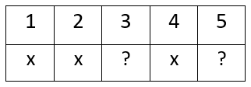
Informative Feedback Strategies
Based on Success Criteria for
Choosing a Math Operation
Feedback Grid
Highlighted operation clue words in the problem
Used clue words to choose the correct operation to solve the problem
Wrote an accurate equation using the correct operation and numbers from the problem
Accurately solved the operation problem accurately
Answer uses the correct units (e.g., $, cm, miles)
(Wiliam, 2018)
Notes:
To Know
This slide provides an example of techniques for providing feedback to students while encouraging them to think.
To Do
Discuss the importance of providing feedback that encourages student thinking. Explain the technique illustrated on the slide.
To Say
Providing feedback that encourages students to reflect on their work and apply thinking skills is critical to its effectiveness. Take a look at some techniques that generate mindfulness so students can take ownership of their learning.
The feedback grid promotes thinking to enable students to meet their learning goals. This is how it works.
A numbered list of success criteria is posted in the classroom and reviewed before and during the lesson. (Example: An art teacher communicates criteria for drawing a successful portrait. Criteria is listed by number… 1. Eyes halfway down face; 2. Distance between the eyes should be approximately the width of one eye; 3…etc. )
When the assignment is checked by the teacher and returned to the student, each student is given a feedback grid. The grid shows the criterion number with a mark showing whether the criteria was met or if more work needs to be done. This provides the student with specific clues about how to improve. The student now must apply this feedback to make adjustments to his work.
Reference
Wiliam, D. (2018). Embedded formative assessment. Solution Tree Press.

Slide 46
Informative Feedback Strategies
Assessment Dialogue Form
Section 1: Student opinion about strengths and what they need to do next
Section 2: Teacher feedback about strengths and what student should work on next
Section 3: Student creates a plan for what they will do next
(Chappuis, 2009)
Notes:
To Know
This slide provides an example technique for providing feedback to students while encouraging them to think.
To Do
Discuss the importance of providing feedback that encourages student thinking. Explain the technique illustrated on the slide.
To Say
Providing feedback that encourages students to reflect on their work and apply thinking skills is critical to its effectiveness. Take a look at some techniques that generate mindfulness so students can take ownership of their learning.
The Assessment Dialogue Form by Jan Chappuis provides a structure for students to first reflect and comment on their work prior to the teacher providing feedback and an action plan to revise and improve work. Students complete the first part of the form before receiving feedback. The teacher then provides the feedback on the form and the student responds with the plan for what to do next. The form can be found in Chappuis (2009) book or educators can create a form based on the example provided.
Reference
Chappuis, J. (2009). Seven strategies of assessment for learning. Allyn & Bacon.

Slide 47
Overfeedback Example
Along with military technice of
ther own the perian’s apted the
Assyrians state-of-the art warfar
wich increased ther secrity as
an Empire
their
adopted
warfare
which
Their security
(Chappuis, 2009)
Notes:
To Know
This slide illustrates an example of overfeedback. The next two slides show different approaches, depending on the level of support needed.
To Do
Discuss the two feedback techniques, feedback with guidance and feedback noting areas needing work (illustrated on the next two slides)
To Say
Teachers should be cautious when providing feedback, not to give more guidance than students need. For example, teachers often correct all spelling and grammatical errors thinking the corrections will serve as effective feedback. Instead, this type of feedback does the thinking for the student and fails to deepen the learning. It can actually do more harm than good, causing students to become discouraged, resulting in them feeling overwhelmed and shutting down.
Reference
Chappuis, J. (2009). Seven strategies of assessment for learning. Allyn & Bacon.

Slide 48
Feedback with Guidance Example
Along with military technice of
ther own the perian’s apted the
Assyrians state-of-the art warfar
wich increased ther secrity as
an Empire
S
SPCPS
PPSP
SSS
CP
S = Spelling; P = Punctuation; C= Capitalization
(Chappuis, 2009)
Notes:
To Do
Discuss the first example, feedback with guidance
To Say
The example on this slide, Feedback with Guidance, provides a bit of support without “overfeedbacking.” Guidance is given by indicating which types of errors appear in each line (C = capitalization, U = usage, P = punctuation, S = spelling), but it doesn't do all the thinking for the student.
Reference
Chappuis, J. (2009). Seven strategies of assessment for learning. Allyn & Bacon.

Slide 49
Feedback That Notes Areas of Needed Work Example
Along with military technice of
ther own the perian’s apted the
Assyrians state-of-the art warfar
wich increased ther secrity as
an Empire
(Chappuis, 2009)
Notes:
To Do
Discuss feedback noting areas needing work.
To Say
The second example, Feedback Noting Areas Needing Work, indicates areas still needing work with a dot in the margin for each error in that line. The feedback in the example above shows the student an error or errors appear but requires the student to determine what the errors are and how to correct them. The student is doing more of the thinking, thereby increasing the chances that he or she will learn from the experience.
Reference
Chappuis, J. (2009). Seven strategies of assessment for learning. Allyn & Bacon.

Slide 50
Providing Feedback to Peers and Self
Notes:
To Know
This video models how educators can involve students in the feedback process to improve self-regulation skills. (You may show the entire video or the introduction and one of the segments.) This video is 8:19 minutes.
Video: Self/Peer/Teacher Feedback by Shirley Clarke
0:00 - 1:33, Shirley Clarke discusses the benefits of student engagement in self and peer feedback
1:33 - 4:36, Kindergarten art segment – modeling feedback at the foundational level
4:37 - 8:18, 4th grade writing – teacher modeling and peers providing feedback
To Do
Show video.
To Say
Feedback can instill in students the idea that improvement is up to them and they can do something about it. Activating learners to provide feedback to peers and self is an excellent way to promote growth mindset. To ensure that students use effective strategies for providing feedback to both peers and themselves, it is important for teachers to model how to effectively give feedback.
Through teacher modeling and practice, students can enhance metacognitive skills and improve self-regulation of learning. Effective feedback enhances cognitive processing by providing needed information to move learning forward. Students develop a higher degree of self-efficacy and become better at appraising their own work.
We will now watch the video. As you watch, pay attention to how educators involve the students in the feedback process and create a classroom climate that strives toward a quest for improvement.
References
Clarke, S. (2013, Nov. 11). Self, peer, teacher feedback [Video file]. Formative Assessment in Schools. University of Cambridge Faculty of Education. http://oer.educ.cam.ac.uk/wiki/Video/Formative_Assessment_in_Schools.mp4

Slide 51
Providing Feedback to Peers and Self
How is success criteria being modeled for students?
How is timely, consistent, and ongoing feedback ensured?
How does feedback encourage student thinking and provide cues and support for next steps?
What is done to make sure feedback is actionable and students have opportunities to review, revise, and self adjust?
Notes:
To Know/To Do/To Say
Show the video on the previous slide and follow up with additional questions and discussion.
How is success criteria being modeled for students?
How is timely, consistent, and ongoing feedback ensured?
How does feedback encourage student thinking and provide cues and support for next steps?
What is done to make sure feedback is actionable and students have opportunities to review, revise, and self adjust?
Optional Activity
Presenter numbers and writes questions 1-4 at the top of chart paper.
Participants choose questions that relate to something they feel they are doing well and can provide helpful answers to. (Encourage them to respond to as many as possible.) Participants then use a sticky note to number, jot down a response, and post to the appropriate chart. Finally, all participants peruse the charts to see ideas others have shared, especially for areas they need to improve.

Slide 52
Effective Feedback
Informs rather than corrects
Focuses on a small number of key points
Points out as many strengths as weaknesses
Is given in small attainable steps the learner can use to improve performance and feel successful
Provides “just enough” to help learners become “unstuck” without providing complete solutions
Causes thinking… is more work for the learner than for the teacher
(Wiliam, 2018 ; Almarode & Vandas, 2019)
Notes:
To Know/To Say
Feedback is used to provide information to students to fuel their learning and to keep them going forward toward their goal rather than just pointing out errors. Feedback should trigger students to “think” which means it should require more work from the learner than the educator giving it. Feedback is more effective if it helps students retrieve things themselves.
A good rule for providing feedback is “less is more.” Focusing on one or two key points to address and taking small steps will be much more effective in the long run than having too much. Feedback overkill results in students becoming overwhelmed and shutting down. Providing complete solutions takes away learning from students. Students given minimal amount of support to get them “unstuck” learn more and retain it longer. Providing students opportunities to think through solutions provides the biggest pay off in learning. Teachers should intervene as little as possible… just enough to get students going… promotes better learning.
Effective feedback is an exchange between the learner and the educator.
An exchange of ideas
An exchange of expectations based on the learning targets/success criteria
To Do
Discuss and expand on each point that is listed on the slide.
Reference
Almarode, J., & Vandas, K. (2018). Clarity for learning: Five essential practices that empower students and teachers. Corwin Press.
Wiliam, D. (2018). Embedded formative assessment. Solution Tree Press.

Slide 53
Mr. Ramsey scored a 5-item assessment he recently gave to his reading class. He found that 56% of his students missed item 2 and 72% missed item 4. These were the test items aligned with the learning target I can draw conclusions from a story and support it with evidence from the text.
Do Students Need Feedback?
(Guskey, 2003)
Notes:
To Know
This slide helps to emphasize the fact that there are times when feedback is not the appropriate next step for teachers to take. Reteaching is recommended when half or more students are not understanding the concept. Teachers must take ownership and realize that their teaching was ineffective.
Scores on these test items indicate that students do not understand how to draw conclusions from a story and support it with evidence. This concept needs to be retaught using a different method of instruction rather than just providing feedback to students.
To Do
Ask participants to read the scenario outlined in blue and then turn to a partner to discuss whether giving feedback to students is the appropriate thing to do in this case.
Continue a discussion about how it is often uncomfortable for teachers to admit the problem is not the students and their lack of learning but rather a teaching problem. Emphasize the positive benefits of being a “reflective” teacher and, rather than taking it personally, it’s all about improving practice… the same as other professions.
To Say
What should Mr. Ramsey do? Why did so many students miss those items? Should he provide feedback to students missing those items?
After participant discussion share Guskey’s quote:
“When as many as half the students in a class answer a clear question incorrectly or fail to meet a particular criterion, it’s not a student learning problem--it’s a teaching problem. Whatever teaching strategy was used, whatever examples were employed, or whatever explanation was offered, it simply didn’t work.”
Sometimes providing feedback just is not the answer. When a large percent of students fail to meet learning goals, it is time for educators to reflect on their own practice and realize that a new and different instructional strategy might need to be implemented in lieu of providing corrective feedback. Instructional alternatives that present those concepts in new ways and engage students in different and more appropriate learning experiences may be the best course of action for those not mastering the skills/concepts. Students showing mastery should be provided enrichment opportunities to broaden and expand their learning.
Reference
Guskey, T. (2003). How classroom assessment improves learning. ASCD. http://www.ascd.org/publications/educational-leadership/feb03/vol60/num05/How-Classroom-Assessments-Improve-Learning.aspx/

Slide 54
Practicing Effective Feedback
Describe the student’s work in terms of success criteria
Compare the work to the success criteria or to the student’s past performance
Provide positive comments coupled with descriptions of where the work needs improvement
Suggest specific actions or provide guiding questions that lead toward improvement and goal attainment
(Wiliam, 2018; Hattie, 2011)
Notes:
Handout #6
To Know
Handout #6, Feedback Scenarios, has different scenarios that participants can use to practice feedback by using the information on this slide.
To Do
Have participants group themselves in a manner that fits the number of your group size. They may use shoulder partners, table groups, or number off into groups.
To Say
We will now get into groups and look at several different scenarios on Handout #5. Please read the scenarios and use the information on this slide to help provide effective feedback. When we are finished, please designate a spokesperson to share out your feedback.
Reference
Hattie, J. (2011). Feedback in schools. From Sutton, Hornsey, & Douglas. Feedback: The communication of praise, criticism, and advice. https://www.visiblelearning.com/sites/default/files/Feedback%20article.pdf
Wiliam, D. (2018). Embedded formative assessment. Solution Tree Press.

Slide 55
CFA Part 3: Essential Questions
How do I use formative assessment feedback to guide instruction based on student need?
How do I provide effective, actional feedback to move students forward in their learning?
How does my feedback directly align with learning targets and success criteria?
What strategies do I use to encourage student thinking and self-reflection based on feedback?
Notes:
To Know
Essential Questions guide the audience to begin thinking about the information provided in the module. Essential Questions also give the presenter a guide for what information needs to be reviewed and discussed at the end of the presentation. Participants will need time throughout the presentation to discuss and reflect on these questions.
The Essential Questions listed on this slide pose questions to help participants reflect on key ideas within the Feedback module.
To Do
Pose questions on the slide and encourage discussion around each.
To Say
I hope we have answered these Essential Questions as we have learned about feedback. As you look at these questions, are they answered? What other questions might you have?

Slide 56
CFA Module Essential Questions
How do I create learning targets to guide instruction and clarify learning?
How do I establish measurable student success criteria to clarify learning?
How do I elicit evidence of learning through Daily Formative Assessments to monitor student understanding to improve instruction?
How do I elicit evidence of learning through Common Formative Assessments to improve student understanding and improve instruction?
How do I interpret and act on formative assessment data to provide feedback and improve student learning?
Notes:
To Know
These are the overall Essential Questions for the Common Formative Assessment Module. Questions are aligned to the five essential functions on the CFA Practice Profile. These Essential Questions help to activate participant thinking and access prior knowledge regarding metacognition. Part 3 of the CFA training should have answered question five.
To Do
Review the Essential Questions and provide time for reflective thinking.
To Say
We have finished the entire CFA module. During this training, we covered question five. Do you feel we answered all of these and do any you feel you still need additional coaching?

Slide 57
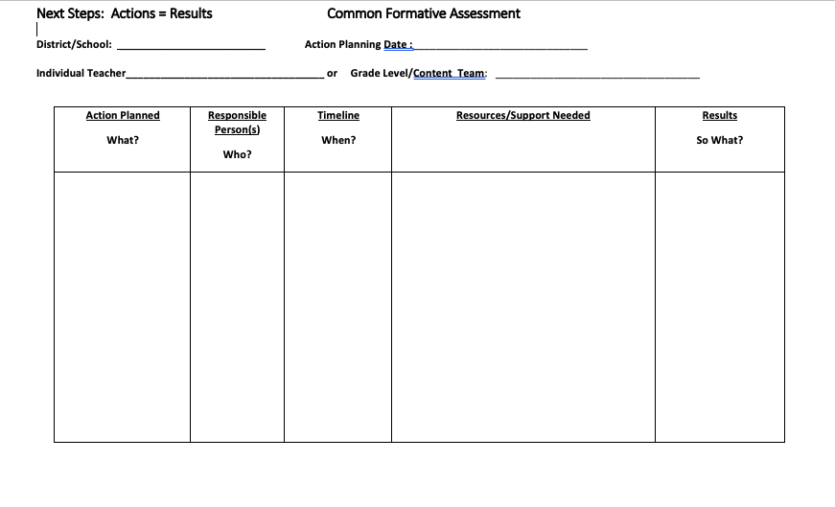
Next Steps: Actions = Results
What gets PLANNED is what gets DONE! What are actionable steps you can take to provide effective feedback?
Notes:
Handout #7 Action Planning
To Know/To Do/To Say
Use the next steps action plan to give participants an opportunity to plan for what they will do with this new learning and follow up coaching.
To Say
What are your next steps to ensure that you as a teacher or teacher team provide effective feedback to the students you teach? You might also consider how to provide more opportunities for students and peers to engage in the feedback process. Please use your Handout #7 for this activity.

Slide 58
Closing
Thank you for your participation​
For further training and coaching, please contact
Notes:
To Know​
Trainers may individualize this slide to fit audience.​

Slide 59
References
Almarode, J., & Vandas, K. (2018). Clarity for learning: Five essential practices that empower students and teachers. Corwin Press.
Chappuis, J. (2009). Seven strategies of assessment for learning. Allyn & Bacon.
Chicago Literacy Alliance. (2020). Putting the 7 hallmarks of effective feedback to work in your classroom [Blog]. The Graide Network. https://www.thegraidenetwork.com/blog-all/2019/7/15/putting-the-7-hallmarks-of-effective-feedback-to-work-in-your-classroom#:~:text=%233%3A%20Actionable,his%20or%
Clarke, S. (2013, Nov. 11). Self, peer, teacher feedback [Video file]. Formative Assessment in Schools. University of Cambridge Faculty of Education. http://oer.educ.cam.ac.uk/wiki/Video/Formative_Assessment_in_Schools.mp4
Class Teaching. (2014, June 8). Some thoughts on feedback [Blog]. https://classteaching.wordpress.com/2014/06/08/some-thoughts-on-feedback/
Dyer, K. (2018, May 29). Formative assessment instructional practice: Using the results and data are what matters [Blog]. NWEA. https://www.nwea.org/blog/2018/formative-instructional-practice-using-the-results-and-data-are-what-matters/#:~:text=Eliciting%20and%20gathering%20evidence%20of,data%20that%20make%20it%20formative.&text=The%20use%20of%20formative%20assessment,of%20understanding%20among%20the%20learners
Ellis, N. J., & Loughland, T. (2017). ‘Where to next?’ Examining feedback received by teacher education students. Issues in Educational Research, 27(1), 51-63. http://www.iier.org.au/iier27/ellis.pdf
Ferry, L. (2021). How to design classroom assessments using the difficulty & complexity matrix. CIESC.
Frey, N., & Fisher, D. (2011). The formative assessment action plan: Practical steps to more successful teaching and learning. ASCD.
Guskey, T. (2003). How classroom assessment improves learning. ASCD. http://www.ascd.org/publications/educational-leadership/feb03/vol60/num05/How-Classroom-Assessments-Improve-Learning.aspx/
Hattie, J. (2011). Feedback in schools. From Sutton, Hornsey, & Douglas. Feedback: The communication of praise, criticism, and advice. https://www.visiblelearning.com/sites/default/files/Feedback%20article.pdf

Slide 60
References
Hattie, J. (2017). How to empower student learning with teacher clarity. https://us.corwin.com/sites/default/files/corwin_whitepaper_teacherclarity_may2017_final.pdf
Hattie, J., & Clark, S. (2019). Visible learning feedback. Routledge.
Hattie, J., & Timperley, H. (2007). The power of feedback. Review of Educational Research, 77(1), 81-112.
Locke, E., & Latham, G. (1991). A theory of goal setting & task performance. The Academy of Management Review, 16, 10.
Missouri Department of Elementary and Secondary Education. (2013, June). Leader standards. Missouri’s Educator Evaluation System. https://dese.mo.gov/media/pdf/oeq-ed-leaderstandards
Missouri Department of Elementary and Secondary Education. (2013, June). Teacher standards. Missouri’s Educator Evaluation System. https://dese.mo.gov/media/pdf/oeq-ed-teacherstandards
MoEdu-SAIL. (2022). Blueprint for district and building leadership (6th ed.). Missouri Department of Elementary and Secondary Education: Northern Arizona University, Institute for Human Development.
Moss, C., & Brookhart, S. (2019). Advancing formative assessment in every classroom: A guide for instructional leaders. ASCD.
National Council of Teachers of English. (2013, Oct.21). Formative assessment that truly informs instruction. https://cdn.ncte.org/nctefiles/resources/positions/formative-assessment_single.pdf
National Council of Teachers of Mathematics. (2013, July). Formative assessment position statement. https://www.nctm.org/uploadedFiles/Standards_and_Positions/Position_Statements/Formative%20Assessment1.pdf
Northwest Evaluation Association. (2016, March). 4 formative assessment practices that make a difference. Partnering to Help All Kids Learn. https://www.nwea.org/content/uploads/2016/04/4-Formative-Assessment-Practices-that-Make-a-Difference-in-Classrooms.pdf

Slide 61
References
Reeves, D. B. (2009). Providing students with effective feedback. http://ahs.canyonsdistrict.org/uploads/3/3/1/2/3312041/3_feedback_powerpoint.pptx
SanBdocitySchools. (2015, Dec, 3). Formative Assessments: Using Feedback to Guide Instruction [Video file]. San Bernardino Unified School District. https://youtu.be/Ecp5tFwXA_M
Thinking Collaboratively. (n.d.). The Adaptive School. https://www.thinkingcollaborative.com/_files/ugd/6a5cc9_ed28b325ab6a4362b834f4bbf295d408.pdf
Webb, H. (2016, Sept. 7). What does effective student feedback look like? Part 1. SecEd. https://www.sec-ed.co.uk/best-practice/what-does-effective-student-feedback-look-like-part-1/
Webb, H. (2016, Sept. 14). What does effective student feedback look like? Part 2. SecEd. https://www.sec-ed.co.uk/best-practice/what-does-effective-student-feedback-look-like-part-2/
Wiggins, G. (2012, Sept.) Seven Keys to Effective Feedback. ASCD, 70(1), 10-16. http://www.ascd.org/publications/educational-leadership/sept12/vol70/num01/Seven-Keys-to-Effective-Feedback.aspx
Wiliam, D. (2018). Embedded formative assessment. Solution Tree Press.

