Slide 1
Hidden Slide #1
The Metacognition Module was designed to be used in the following manner.
The audience for this module is educators, building leaders, instructional coaches, and teachers of all contents and levels. This module can be used for whole staff presentations.
Time should be allotted after training for participants to reflect and have conversations regarding current status and needed changes. Participants should reflect on the following questions. Where are we now? Where are we going? How can we get there?
Participants should complete the SAPP for metacognition prior to training.
Following the training participants should complete a Next Steps Action Plan – note there is a separate action plan for each of the three parts of the module.
Notes:
To Know
It is important for all educators, building leaders, and instructional coaches to understand the importance and benefits of developing and nurturing metacognitive thinking.
The content in this module is intended to help educators develop capacity regarding the knowledge of cognition and regulation of cognition, and additionally how to create a supportive classroom environment that fosters metacognitive thinking for students and teachers.
Strategies and tools will be presented that will help educators create thinking classrooms and schools.

Slide 2
Metacognition Module Organization
Hidden Slide #2
Part 1, EF 1
Intro and Increasing Cognitive Awareness
Part 3, EF 3
Creating a Metacognitive
Classroom Culture and Environment
Part 2, EF 2
Regulation of Cognition
Intro to metacognition
Increasing cognitive awareness
Declarative
Procedural
Conditional
Planning
Monitoring
Controlling
Evaluating
Thinking norms
Expectations, goals, reflective thinking
Language to describe thinking
Rigorous tasks and productive struggle
Physical environment to support thinking
Time, opportunities, and interactions
Notes:
To Know
Part 1 provides an introduction to metacognition and content aligned with the first Essential Function of the Metacognition Practice Profile (increasing cognitive awareness), including declarative, procedural, and conditional knowledge. It is important that all participants have an understanding of Part 1 prior to other module sessions.
Part 2 is aligned with EF 2 of the Metacognition Practice Profile which addresses regulation of cognition, including planning, monitoring, controlling, and evaluating.
Part 3 is aligned with EF 3 of the Metacognition Practice Profile and provides content on how to create a metacognitive climate and environment. This session includes information on creating thinking norms, expectations, goals, and reflective thinking opportunities. It also addresses language to describe thinking, create rigorous tasks, interactions, time, opportunities, and a physical environment that supports and improves thinking.

Slide 3
Hidden Slide #3
In-person professional development suggestions
The following estimated times for Metacognition Module parts are based on providing participants with ample time to process and reflect on content.
Part 1: Introduction and Increasing Cognitive Awareness, 2.5 hours
Part 2: Regulation of Cognition, 3 hours
Part 3: Creating a Metacognitive Climate and Environment, 2.5 hours
Total = 8 hours
Read the slide notes thoroughly as they provide detailed information to assist you in preparation for and delivery of the presentation.
Some reflection activities can be expanded by using the activities designated OPTIONAL.
Breaks can be added at the presenter’s discretion.
Notes:
Presenter notes information
The slide includes estimated times for each of the three parts. Part 1 of the Metacognition Module is designed to be completed in 2.5 hours.
Estimated training times for each section of the Part 1 are listed below.
Introduction to Metacognition: 1 hour
Increasing Cognitive Awareness: 1 hour
Next Steps Action Planning: 30 minutes
Presenter notes are included in the PowerPoint slides. Background information for the presenter is shown as “To Know.” Statements and activities to be shared with participants are shown as either “To Say” or “To Do.” In some instances, there are various combinations of “To Know/To Do/To Say.” The presenter notes also include cues for “Handouts” and activities.
Additional activities, examples, videos, etc. are included in the Metacognition Coaching Companion. You can add material from the Coaching Companion to corresponding PowerPoint content.
A printed Practice Profile and an electronic Self-Assessment Practice Profile (SAPP) tool are available for use by individuals, teams, or schools for periodic self-assessment, monitoring of implementation of the practice, or to identify training/coaching needs.
The presenter should download any video intended for use in a training, as you may not have internet access in all school sites.
Breaks should be inserted at the discretion of the presenter based on the needs of participants.

Slide 4
Hidden Slide #4
Supplies and information needed
WIFI access for presenter and participants
Access to videos (through WIFI if available, but download to flash drive as a back-up)
Chart paper
Plain paper
Markers and highlighters
Post-it-Notes
Consider inserting QR codes and requesting that participants bring a device with a QR reader to scan codes for easy access to documents

Slide 5
Hidden Slide #5
General guidance for virtual presentations
Notify and request prior permission from participants if session is to be videotaped.
Test your tech set up prior to the session (download and save videos on flash drive if needed)
Keep sessions as short as possible and/or provide breaks
Provide and discuss norms for participation (camera on, ask questions in chat – if that is your preference, stay engaged)
Minimize distractions (request participants mute when not speaking)
Use 2 consultants – 1 to present, 1 to manage chat, etc.
Identify other roles prior to presentation, as appropriate (timekeeper, notetaker, etc.)
Create opportunities for participant engagement and interaction (e.g., HQ Tools for Audience Engagement Collaborative Notetaking Document)
When using breakout rooms, equip each room with 1 consultant to facilitate and 1 to take notes, if possible
End the session with an effective wrap-up
Notes:
To Know/To Do
If presenting this module virtually, the notes on this slide will help you prepare for the presentation.

Slide 6
Hidden Slide #6
Handouts
HO 1, Metacognition Infographic
HO 2, Metacognition Practice Profile
HO 3, Metacognition Key Terms
HO 4, Next Steps Action Plan, Part 1, Increasing Cognitive Awareness in My Classroom
Notes:
To Know
Handouts listed are in the handout packet.
Numerous sites are also provided throughout the module for participants to access via a web link.
Due to copyright regulations, some materials are linked to their original source and must be downloaded from the link.

Slide 7
Hidden Slide #7
Key Terms
Cognition refers to the mental processes involved in gaining knowledge and comprehension.
Cognitive assets include versatile thinking tools that can be taught to help students problem solve and master learning.
Conditional knowledge refers to knowledge used to assist with the selection of strategies and approaches based on the circumstances under which the activity is taking place.
Culture of thinking includes cultural forces that provide goals and define and promote a thinking climate in a classroom. These forces include opportunities, time, modeling, language, environment, interactions, routines, and expectations.
Declarative knowledge refers to what the learner knows about the topic and about their own skills and intellectual resources.
Exam wrapper is a reflection tool used by students to examine test readiness and areas of learning needing improvement so specific strategies can be applied to improve outcomes of future assessments.
Notes:
Handout 3
Metacognition Key Terms
To Know/To Do
The comprehensive list of key terms for the Metacognition Module can be found in the handout packet. Access the handout for the complete list. Key terms that align with each Essential Function can be found in the notes section at the beginning of each EF module.
References
Cherry, K. (2023, April 18). Cognition in psychology. Verywell Mind. https://www.verywellmind.com/what-is-cognition-2794982
Peteranetz, M. S. (2016). Fostering metacognition in K-12 classrooms: Recommendations for practice. The Nebraska Educator, 3. https://digitalcommons.unl.edu/cgi/viewcontent.cgi?article=1040&context=nebeducator
Tarricone, P. (2011). The taxonomy of metacognition. Psychology Press. https://doi.org/10.4324/9780203830529
Torrisi-Steele, G. (2016). Online learning and metacognition: A design framework. In V. Wang (Ed.), Handbook of research on learning outcomes and opportunities in the digital age (pp. 221-241). IGI Global. https://www.igi-global.com/chapter/online-learning-and-metacognition/142378
Wilson, D., & Conyers, M. (2016). Teaching students to drive their brains: Metacognitive strategies, activities, and lesson ideas. Association for Supervision and Curriculum Development.

Slide 8
Hidden Slide #8
Key Terms
Executive function refers to using brain processes and mental faculties in goal-setting, planning, execution, reasoning, problem solving, working memory, and organization.
Higher order thinking includes using higher level thinking skills such as analyzing, synthesizing, and transferring knowledge to other applications.
Knowledge of cognition is the knowledge that learners have about themselves. It includes procedural, declarative, and conditional knowledge.
Metacognition refers to knowledge, awareness, and control of one’s own cognition and human cognition in general.
Metacognitive controlling is the cognitive ability to stay focused on the learning task or goal by ignoring distractions and refraining from responding to negative stimuli.
Metacognitive culture refers to an environment that promotes and models a knowledge and learner centered classroom where students engage in meaningful and complex tasks using reflection, critical thinking, and strategic strategies to achieve success.

Slide 9
Hidden Slide #9
Key terms
Metacognitive evaluating involves assessing what you know and how and why you know it, in addition to being able to generalize for transfer to new situations.
Metacognitive monitoring is a mental process used to check one’s progress during the learning process; allowing for constant adjustment and revision along the way.
Metacognitive planning is a mental process that allows one to collect necessary information, synthesize it, and then anticipate the right way to carry-out a task or reach a specific goal.
Procedural knowledge is knowledge used to successfully execute an appropriate procedure or process.
Regulation of cognition means you have an awareness and control over your own thinking that enables you to metacognitively plan, monitor, control, and evaluate your learning.
Thinking routine is a set of questions or a brief sequence of steps used to scaffold and support student thinking.
Thinking school is a school where thinking is at the heart of the curriculum and all staff and students support metacognition at a high level.

Slide 10
Hidden Slide #10
Pre-Read Article
Metacognition: The Gift That Keeps Giving
https://www.edutopia.org/blog/metacognition-gift-that-keeps-giving-donna-wilson-marcus-conyers
Notes:
Pre-Read Article
Metacognition: The Gift That Keeps Giving
https://www.edutopia.org/blog/metacognition-gift-that-keeps-giving-donna-wilson-marcus-conyers
To Know
The article Metacognition: The Gift That Keeps Giving is to be sent to participants prior to the session. You may want to have table copies of this pre-read.
To Do
Send this article to participants to read prior to the session. Slides 31-32 present the article and a follow-up activity to review and debrief the article.
Reference
Wilson, D., & Conyers, M. (2014, October 7). Metacognition: The gift that keeps giving. Edutopia. https://www.edutopia.org/blog/metacognition-gift-that-keeps-giving-donna-wilson-marcus-conyers

Slide 11
Metacognition
Part One
Introduction and Increasing Cognitive Awareness
Notes:
To Know/To Say
Metacognition Part 1 will provide an overview of metacognition and cover Essential Function 1, which focuses on increasing cognitive awareness. Parts 2 and 3 of this training cover Essential Functions 2 and 3 and are separate PowerPoint presentations. The presenter can use judgement on how to present this information to the participants depending on time allotted for training, but you must not deviate from the module in terms of deleting or adding information.

Slide 12
Acknowledgements
Special thanks to all contributors to the development of this Professional Learning Module. The original collection of Professional Learning Modules was rolled-out for use by Regional Professional Development Center (RPDC) Consultants in July 2013 after being developed by a team of content experts through efforts funded by the Missouri State Personnel Development Grant (SPDG). The collection has expanded in content offerings and modules are updated and/or revised on a regular basis.
Content Development Team
Beverly Kohzadi
Gina Bell-Moore
Training Module Development
Beverly Kohzadi
MoEdu-SAIL
Ronda Jenson, Director
Chelie Nelson
Cheryl Wrinkle
Cynthia Beckmann
Nicole Stone
Notes:
To Know/To Say
First, I want to give a special thanks to all contributors to the development and revision of this Professional Learning Module.

Slide 13
Metacognition
Setting the Stage
Notes:
To Know/To Say
We will first set the stage for this presentation and then provide a general overview of metacognition discussing some of the fundamental concepts. We will then explore the role of cognitive awareness and creating a ”thinking” environment in our classrooms.

Slide 14
Welcome and Introductions
Our trainers for the day
Notes:
To Know/To Do/To Say
Add presenter information to the slide and introduce yourself and other presenters.
An icebreaker can be added here as a way for participants to introduce themselves if you’d like.

Slide 15
Norms
Begin and end on time
Be an engaged participant
Be an active listener - open to new ideas
Use notes for side bar conversations
Use electronics respectfully
Notes:
To Know
It is important to establish norms for training. Trainers are free to adjust this list of norms.
To Do
Consider including a check mid-way through trainings to assess a norm or norms.
The presenter may want to print norms on agenda handouts in addition to, or in place of, presentation slides, so the norms are always available in print for participants.
Norms may be added to address specific school needs. Some schools already have established norms for all PD. In that case, adapt to their norms.
To Say
Please review the norms for this training. Are there any additions that need to be made to the norms at this time?

Slide 16
District Continuous Improvement (DCI) Framework
Focus on effective instruction leading to exceptional outcomes for ALL Missouri students
Foundations
Collaborative Teams
Data-Based Decision Making
Common Formative Assessment
Effective Teaching and Learning Practices
Developing Assessment Capable Learners
> Feedback
Metacognition
Supportive Context
School-Based Implementation Coaching
Collective Teacher Efficacy
Systems Leadership
Instructional Leadership
Notes:
To Know
Nine Professional Learning Modules make up the DCI Content within the DCI Framework as illustrated in the slide.
Three foundational educational practices essential for collaborative, data-informed instruction and decision making
Two effective teaching and learning practices shown to improve student achievement
Four practices that create a supportive context to sustain and advance effective teaching and learning
To Do/To Say
Before we delve into this module, let’s take a few minutes to review the DCI Framework graphic, looking specifically at where metacognition falls into big picture.
As you see, the focus of DCI is on effective instruction leading to exceptional outcomes for all Missouri students.
Review the elements of each section of the three main components.
Foundations (consisting of Collaborative Teams, Data-Based Decision Making, and Common Formative Assessment)
Effective Teaching and Learning Practices (Developing Assessment Capable Learners with Feedback and Metacognition). We will focus on metacognition in this module. It is a part of Effective Teaching and Learning Practices and represents a student’s self regulation. As students become assessment capable, they learn to take and give feedback with leads to metacognitive skills. This is a part of monitoring and self assessment.
Supportive Context (School-Based Implementation Coaching, Collective Teacher Efficacy, and Systems/Instructional Leadership)
References
MoEdu-SAIL. (2023). Blueprint for district and building leadership (7th ed.). Missouri Department of Elementary and Secondary Education: Northern Arizona University, Institute for Human Development.

Slide 17
Metacognition Alignment with Missouri Leader Standards
Standard #2 Teaching and Learning
Education leaders have the knowledge and ability to ensure the success of all students by promoting a positive school culture, providing an effective instructional program that applies best practice to student learning, and designing comprehensive professional growth plans for staff.
Standard #6 Professional Development
Education leaders have the knowledge and ability to ensure the success of all students by remaining current on best practices in education administration and school-related areas as evidenced in his/her annual professional development plan.
Notes:
To Know/To Say
These Missouri Leader Standards are closely aligned to the content within the Metacognition Module. Take a moment to read the slide as I summarize the standards.
Reference
Missouri Department of Elementary & Secondary Education. (n.d.). Leader standards. https://dese.mo.gov/media/pdf/oeq-ed-leaderstandards

Slide 18
Metacognition Alignment with Missouri Teacher Standards
Standard #2 Student Learning, Growth, and Development
The teacher understands how students learn, develop, and differ in their approaches to learning. The teacher provides learning opportunities that are adapted to diverse learners and support the intellectual, social, and personal development of all students.
Standard #4 Critical Thinking
The teacher uses a variety of instructional strategies and resources to encourage students’ critical thinking, problem solving, and performance skills Students actively participate and are successful in the learning process.
Standard #5 Positive Classroom Environment
The teacher uses an understanding of individual/group motivation and behavior to create a learning environment that encourages active engagement in learning, positive social interaction, and self-motivation. The teacher keeps current on instructional knowledge and seeks and explores changes in teaching behaviors that will improve student performance.
Notes:
To Know/To Say
These Missouri Teacher Standards are closely aligned to the content within the Metacognition Module. Please read the slide as I review the standards.
Reference
Missouri Department of Elementary & Secondary Education. (n.d.). Teacher standards. https://dese.mo.gov/media/pdf/oeq-ed-teachstandards

Slide 19
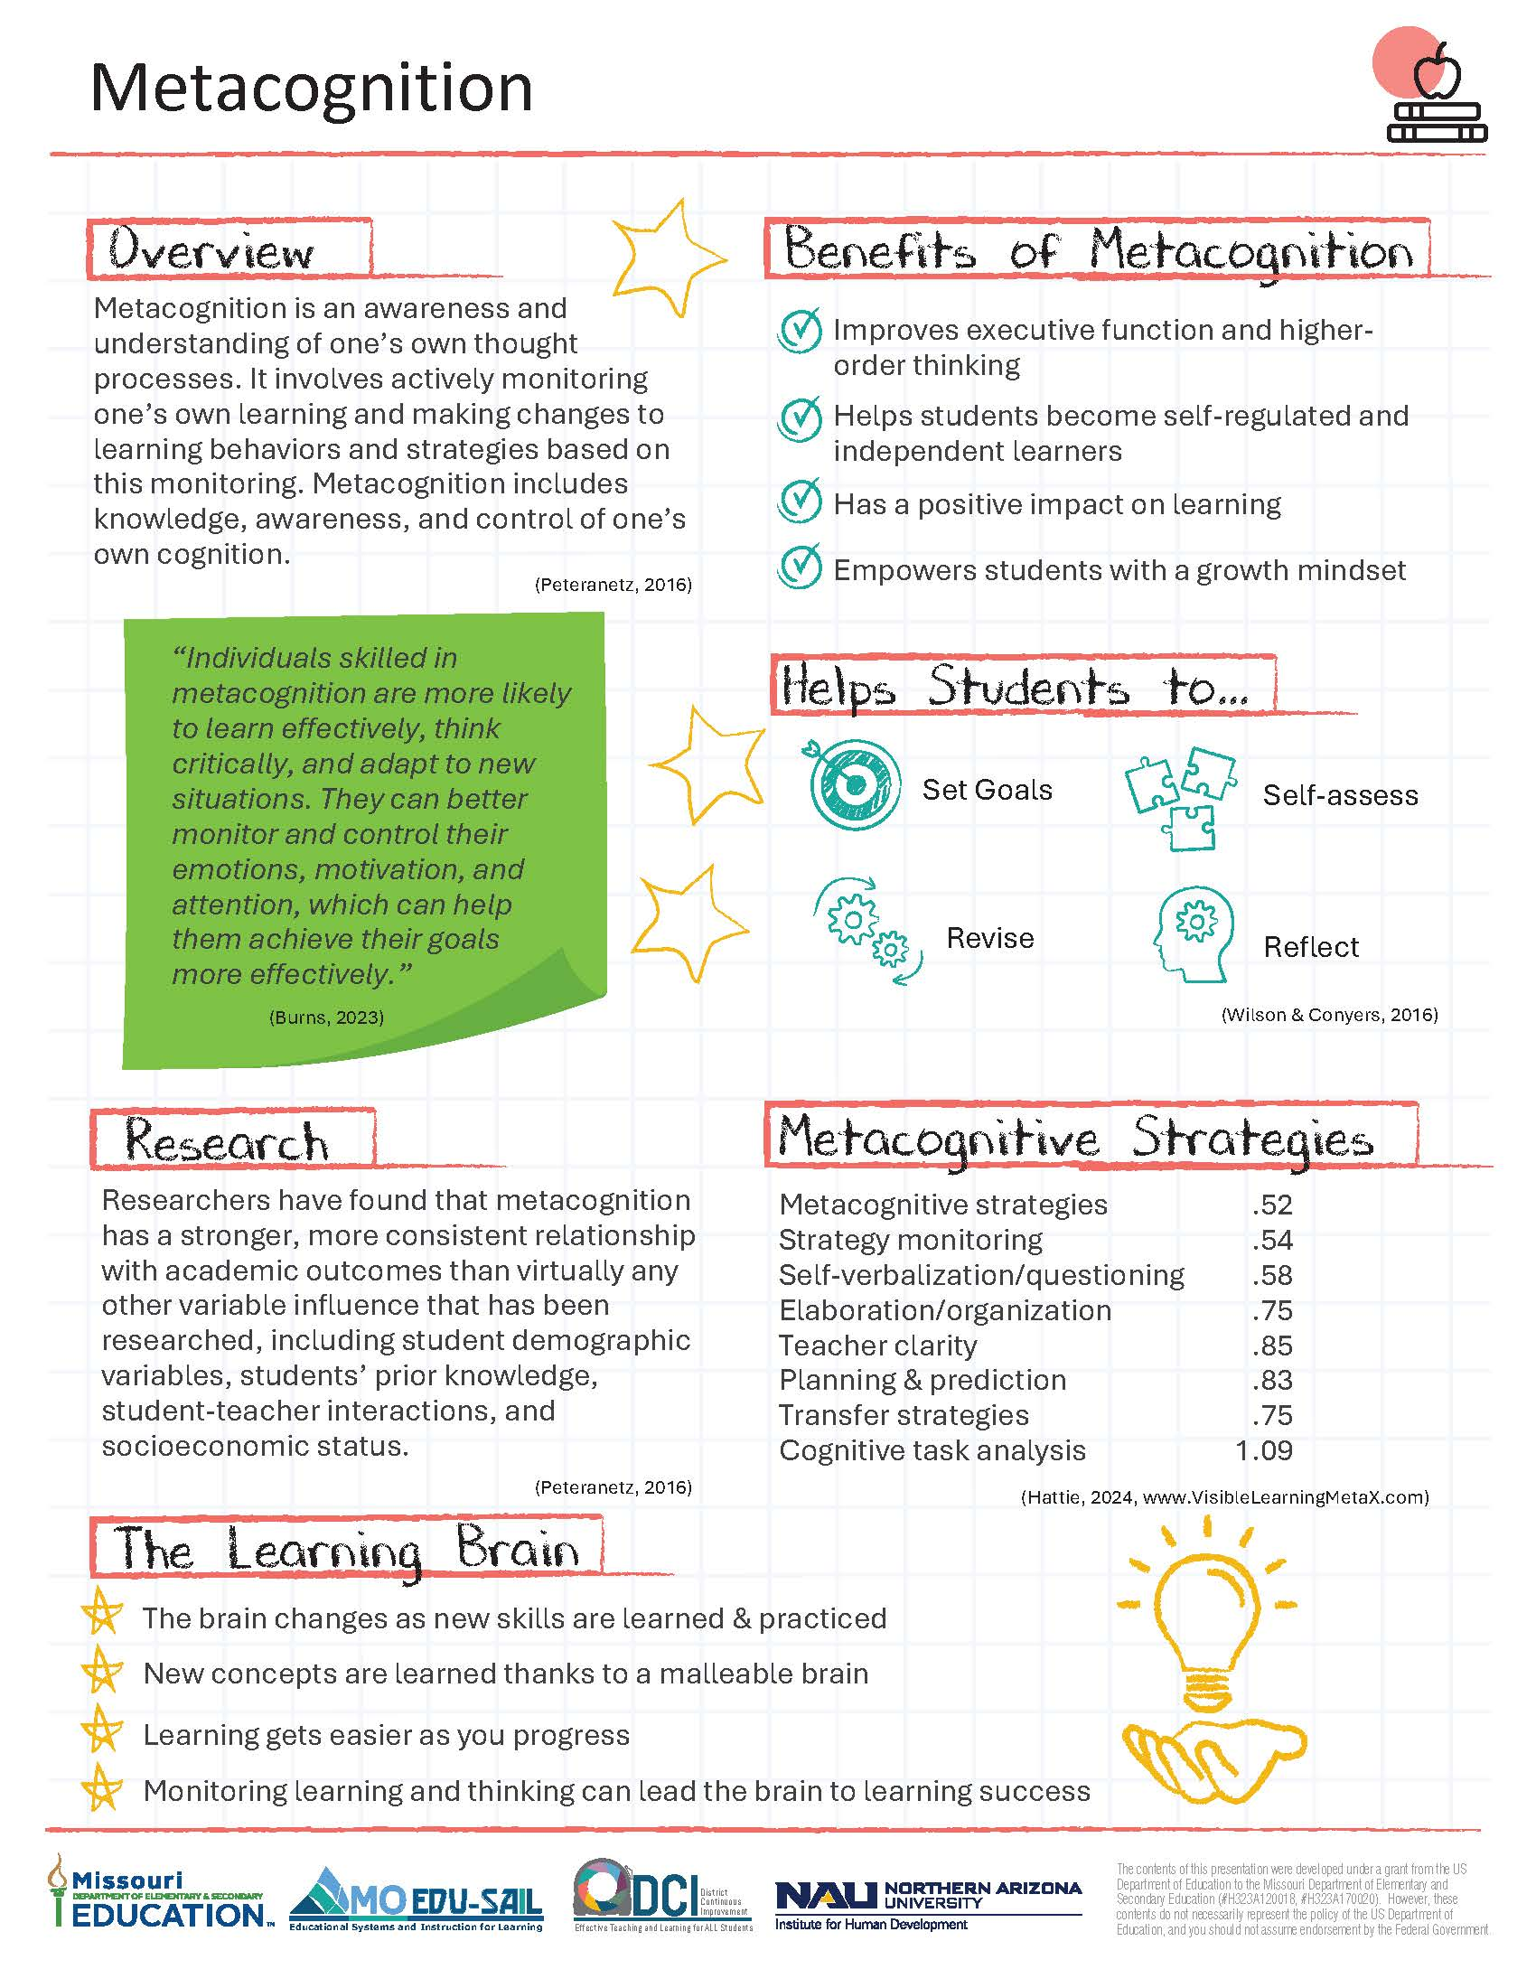
Metacognition Infographic
Notes:
Handout 1
Metacognition Infographic
To Know
The infographic, Handout 1, provides a snapshot of the essential learning contained in the module. This is an opportunity for the presenter to provide a hook as to why metacognition is important. It also helps participants see how metacognition is key to developing assessment capable learners.
To Do
Direct attention to each component and provide a quick overview.
To Say
The metacognition infographic summarizes key content from the Professional Learning Module. You can see how developing metacognition is key to helping students become assessment capable and self-regulated learners. (Explain/summarize each component on the infographic.)

Slide 20
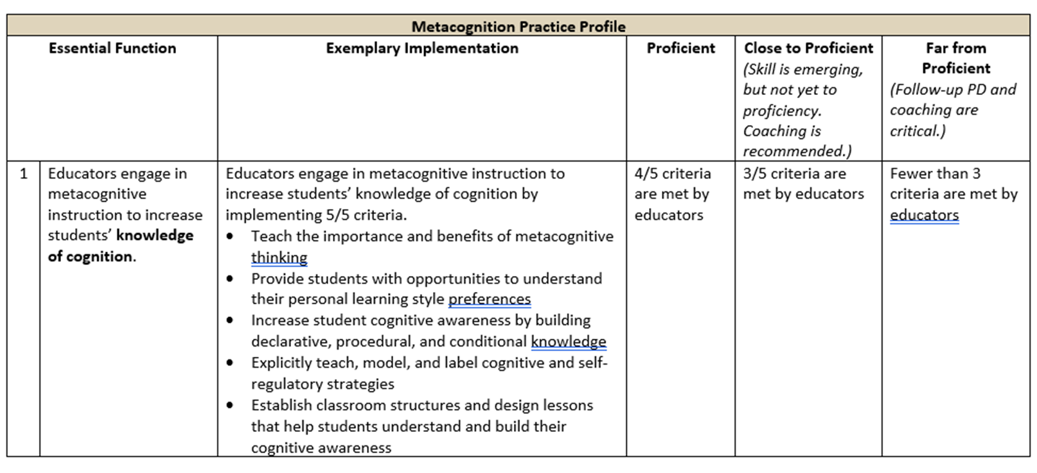
Metacognition Practice Profile
Notes:
Handout 2
Metacognition Practice Profile
To Know
The Practice Profile for Metacognition is Handout 2
To Do/To Say
Review the Practice Profile with the participants.
The Practice Profile template is anchored by the Essential Functions. First, is the foundation of implementation that philosophically grounds implementation. Then moving from left to right across the template are the Essential Functions of the practice, implementation performance levels, and lastly, evidence which provides data or documentation for determining implementation levels.
The Essential Functions align with the teaching/learning objectives for each Professional Learning Module. Four levels of implementation are described for each teaching/learning objective: exemplary, proficient, close to proficient, and far from proficient. The professional development provider should walk through the Practice Profile with the educator-learners, referring to the data and artifacts listed as suggested evidence. It is an important tool for self-monitoring their own implementation because it serves as a reminder as to the implementation criteria and is also aligned with the fidelity checklists and the electronic Self-Assessment Practice Profile (SAPP). These sources provide data regarding further training or coaching.
As we look at the Metacognition Practice Profile, we see three Essential Functions. Essential Function 1 is “educators engage in metacognitive instruction to increase students’ knowledge of cognition.” Essential Function 2 is “educators engage students in metacognitive regulation processes for planning, monitoring, controlling, and evaluating.” Essential Function 3 is “educators promote a classroom culture and environment conducive to developing, encouraging, and supporting metacognitive thinking.” You will also find the criteria to determine the level of implementation for you, your school, and/or district.
Today we will cover a basic introduction of metacognition and Essential Function 1. There are two other parts to this module which cover Essential Functions 2 and 3.

Slide 21
Metacognition
Introduction

Slide 22
Session-at-a-Glance
An introduction to metacognition
Benefits, key features, and impact of metacognitive thinking
Understanding cognitive awareness
Building declarative, procedural, and conditional knowledge to increase cognitive awareness
Establishing classroom structures and lessons to enhance cognition
Next Steps Action Plan, Part 1, Strengthening Knowledge of Cognition
Notes:
To Know
This slide provides an overview of the contents of Part 1 of the Metacognition Module, which includes an introduction and increasing cognitive awareness (EF1).
To Do/To Say
Review the content contained within this module as listed on the slide.
To Say
Today we will first introduce the entire Metacognition Module and then go into cognitive awareness, which is Essential Function 1. Please take a moment and look at the slide as I summarize the session today.

Slide 23
Part 1: Learning Objectives for Cognitive Awareness
Provide students with opportunities to understand their personal cognitive assets and weaknesses
Increase students’ cognitive awareness by building declarative, procedural, and conditional knowledge
Explicitly teach, model, and label cognitive strategies/tools to strengthen metacognitive skills
Establish classroom structures and lessons that help students understand and build their cognitive assets
Apply knowledge of cognition in reaching learning goals
Notes:
To Know
It is important that educators use metacognitive instruction to increase students’ cognitive awareness. These are the learning targets for Part 1 of the Metacognition Module. They are aligned with EF 1 of the Metacognition Practice Profile.
To Do
Review the learning objectives listed on the slide for cognitive awareness and expand on them.
To Say
These are the learning objectives for cognitive awareness. Our session today will focus on… (discuss the objectives your session will be focusing on if your session does not include all of Part 1).
Provide students with opportunities to understand their personal cognitive assets and weaknesses
Increase students’ cognitive awareness by building declarative, procedural, and conditional knowledge
Explicitly teach, model, and label cognitive strategies/tools to strengthen metacognitive skills
Establish classroom structures and lessons that help students understand and build their cognitive assets
Apply knowledge of cognition in reaching learning goals

Slide 24
Part 1: Essential Questions for Cognitive Awareness
Why is it important for students to engage in metacognitive thinking?
How can educators increase students’ knowledge of cognition?
What strategies and tools can be used to help students improve metacognitive regulation processes?
How can a classroom culture and environment be established to encourage and support metacognitive thinking?
Notes:
To Know
Essential Questions help to activate participant thinking and access prior knowledge regarding metacognition. These questions can be posed initially, at the end, or throughout the session.
To Do
Review the Essential Questions and provide time for reflective thinking.
Optional Activity
Essential Questions may be written on individual chart paper and placed around the room so they can be referred to throughout the presentation. You may have participants respond to the questions initially and then later provide opportunities to add to the responses once more learning has taken place. If time permits, a carousel structure could be used so participants can respond, collaborate, and process the questions.
To Say
These Essential Questions will help you reflect on your knowledge regarding metacognition. (Read the questions.)

Slide 25
Metacognition Starter Activity
https://www.globalmetacognition.com/copy-of-tbc
Notes:
Optional Activity (slides 25-33)
Note: if you decide not to include the activity, hide the slides
To Know
Learners that are aware of the elements that help them prepare to learn and strive toward being prepared for learning are much more likely to successfully reach their learning goals.
This starter activity is a great way to have participants reflect on different aspects of their readiness to learn before beginning the session. This, or a similar activity, can be done with students prior to learning episodes. Learners rate their current state-of-mind in terms of energy, concentration, mood, attitude, etc. It helps learners reflect on important elements to optimize learning and what might be done to improve readiness to learn in the future.
To Do/To Say
Let’s begin with a starter activity that will help you reflect on different aspects of your readiness to learn. Activities such as these are great to use with students prior to learning episodes to help them reflect on important things to consider to optimize learning.
You will begin by standing up. Move to the left side of the room if you agree with the statement. Move to the right if you disagree.
Show the slides and directions starting with the next slide. Following the activity, encourage small group sharing and discussion on what might be done in the future to better enhance preparation for learning.
Reference
The Global Metacognition Institute. (2022). Starter activity (metacognition). https://www.globalmetacognition.com/copy-of-tbc

Slide 26
The purpose of this activity is to reflect on your current state of mind and factors that affect your current learning power. Participants should stand in some open space in the room, facing the projected slides.
For each of the questions on the next few slides, move to the left side of the room if you agree with the statement and to the right side if you disagree.
Discuss the metacognition “factoid” on each slide after participants choose a side.
https://www.globalmetacognition.com/copy-of-tbc

Slide 27
(Read statement out loud)
“I am in a good state of mind for learning right now.”
(Participants move to left or right side of the room)
Factoid: Research has found that mental powers (such as intelligence, memory, and concentration) are not fixed but can change and grove over time. Understanding and realizing this fact leads to a “growth mindset” which can help you to succeed.
https://www.globalmetacognition.com/copy-of-tbc

Slide 28
“I feel tired and lacking in energy due to a lack of sleep.”
Factoid: Sleep helps to maintain a healthy and effective brain. Most adults need at least 8 hours sleep every night. Long-term sleep deprivation reduces the mind’s power and capacity to learn.
https://www.globalmetacognition.com/copy-of-tbc

Slide 29
“I am distracted by irrelevant thoughts and feelings.”
Factoid: Meditation and mindfulness can help people to become better at concentrating for long periods of time! Turning back into the present moment (for example, by focusing on your breath) is a good way to help regulate thoughts and feelings.
https://www.globalmetacognition.com/copy-of-tbc

Slide 30
“My mind feels relaxed but focused.”
Factoid: There are three main ways metacognition can help to build your learning power.
Boosting metacognitive powers (e.g., intelligence)
Enhancing metacognitive skills (e.g., organization and planning)
Using metacognitive strategies (e.g., setting long-term goals)
https://www.globalmetacognition.com/copy-of-tbc

Slide 31
“I feel positive about both myself and this subject today.”
Factoid: Research has shown that mental powers (such as intelligence, memory, and concentration) are not fixed but can change and grow over time. Understanding and realizing this fact leads to a ‘growth mindset’ which can help you to succeed.
https://www.globalmetacognition.com/copy-of-tbc

Slide 32
“I haven’t had enough physical activity today.”
Factoid: Metacognition focuses on thought and how we think. ‘Metamemory’ focuses on how we remember things; why we remember some things easily and forget others; and how we can enhance our memory. There are ways to improve your memory over time.
https://www.globalmetacognition.com/copy-of-tbc

Slide 33
What is Metacognition?
Notes:
To Know/To Do/To Say
Metacognition is frequently given the succinct definition “thinking about thinking,” however, it is much more. How can the term metacognition be expanded on? What does metacognition include? Does it include behavior as well as academics?
Jot down your own definition for metacognition without using the words “thinking about thinking.” Consider how this can be related to behavior as well as academics.
Discuss your thoughts with a partner.

Slide 34
Metacognition is…
an awareness and understanding of one's own thought processes. It includes knowledge, awareness, and control of one’s own cognition and human cognition in general.
(Cambridge, n.d.; Peteranetz, 2016; Tarricone, 2011)
Notes:
To Know/To So/To Say
Read and expand on slide content.
Although metacognition does involve thinking about one’s thinking, it is more complex than that.
A large part of metacognition is actively monitoring one’s own learning and making changes to one’s own learning behaviors and strategies based on this monitoring.
Metacognition includes knowledge, awareness, and control of one’s own cognition and human cognition in general.
References
Cambridge International Education. (n.d.). Getting started with metacognition. https://cambridge-community.org.uk/professional-development/gswmeta/index.html#article
Peteranetz, M. S. (2016). Fostering metacognition in K-12 classrooms: Recommendations for practice. The Nebraska Educator, 3. https://digitalcommons.unl.edu/cgi/viewcontent.cgi?article=1040&context=nebeducator
Tarricone, P. (2011). The taxonomy of metacognition. Psychology Press. https://doi.org/10.4324/9780203830529

Slide 35
Metacognition in Action
Hmmm..
I don’t know what I just read!
Notes:
To Know
This slide provides a working definition, that all participants can relate to, of what metacognition is (an awareness of knowing what we don’t know).
To Do
Show the slide and have participants reflect on strategies they have used when they discover they have finished reading a page and don’t know what they just read. Encourage participant pair discussion.
To Say
Think of a time when you were reading and suddenly got to the bottom of the page of text and a little voice inside your head said “I don’t know what I just read.” Now, turn to a partner and discuss what you did.
(After discussion, say this)
You had an awareness of knowing what you didn’t know and then employed a recovery strategy. Perhaps you read the last sentence again or scanned each paragraph looking for key words. Maybe you read the entire page again. Whatever you did, you probably tried capturing the meaning and went on. This awareness… knowing what you know and what you don’t know, along with strategies you employ to control your thinking is all part of metacognition.
Reference
Fogarty, R., & Pete, B. M. (2020). Metacognition: The neglected skill set for empowering students. Solution Tree Press.

Slide 36
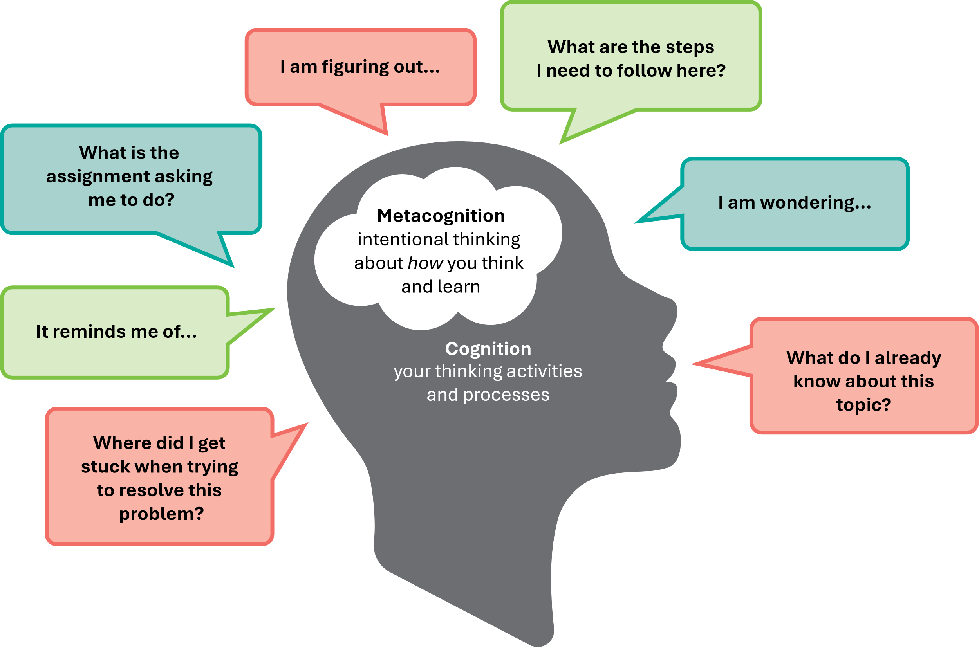
Metacognitive Processes
(adapted from Queen’s University)
Notes:
To Know/To Say
This slide illustrates how metacognition uses cognitive processes to intentionally think about your thoughts and how you learn.
Metacognition involves knowing when you know, knowing when you don’t know, and knowing what to do when you don’t know. In other words, it involves self-monitoring and correcting your own learning processes.
Metacognition also involves knowing yourself as a learner; that is, knowing your strengths and opportunities for growth as a learner.
Metacognitive processes can be applied to learning and thinking in all disciplines and contexts. It is an essential skill for life-long learning and therefore metacognitive skills need to be taught and discussed with students.
Take a moment and look at this slide. Can you relate to your own thinking and learning?
Reference
Queen’s University. (n.d.). Teaching for effective learning. https://www.queensu.ca/teachingandlearning/modules/students/24_metacognition.html

Slide 37
Teaching students to be metacognitive involves…
Building knowledge about cognition
Improving the ability to take charge of one’s own brainpower
Understanding how, why, and when to use cognitive assets
Assessing the use of learning strategies
Monitoring progress and considering ways learning can be improved
(Hattie, 2008; Wilson & Conyers, 2016)
Notes:
To Know/To Say
Hattie describes metacognition as “higher order thinking which involves active control over the cognitive process engaged in learning.” Students that build and use their cognitive assets become metacognitive and can take charge of their own learning and behavior.
We will look at what is involved when teaching students to be metacognitive.
Building knowledge about cognition
Improving the ability to take charge of one’s own brainpower
Understanding how, why, and when to use cognitive assets
Assessing the use of learning strategies
Monitoring progress and considering ways learning can be improved – including monitoring behavior as well as academics, and how behavior might be improved
To Do
Read and expand on the key points listed on the slide.
References
Hattie, J. (2008). Visible learning: A synthesis of over 800 meta-analyses relating to achievement (1st ed.). Routledge. https://doi.org/10.4324/9780203887332
Wilson, D., & Conyers, M. (2016). Teaching students to drive their brains: Metacognitive strategies, activities, and lesson ideas. Association for Supervision and Curriculum Development.

Slide 38
Pre-Read Article Discussion
Metacognition: The Gift That Keeps Giving
Donna Wilson and Marcus Conyers
Discussion Questions
Why do the authors say that metacognition is a gift that keeps giving?
What strategies do successful students use?
How can teachers help students learn to “drive their brains?”
What is your biggest take away from this article?
https://www.edutopia.org/blog/metacognition-gift-that-keeps-giving-donna-wilson-marcus-conyers
Notes:
Pre-Read Article
Metacognition: The Gift That Keeps Giving
https://www.edutopia.org/blog/metacognition-gift-that-keeps-giving-donna-wilson-marcus-conyers
To Know
This activity provides an opportunity for participants to process the pre-read article that was sent prior to the session. You may want to have table copies of this pre-read.
To Do
Provide about 3 minutes for participants to review/refresh the article that was sent prior to the session.
To Do/To Say
Have participants take about three minutes to review/refresh this article that was sent prior to the training.
Decide on time allotted for discussion and share out.
Divide participants into groups of 4-6.
Select a facilitator for each group to pose the questions and elicit responses from the group (one with most teaching years, shortest hair, most pets, etc.).
Choose a recorder to jot down the biggest take-aways on chart paper. These can be posted around the room for all to see.
The group facilitator will read the questions above. Group members can then provide responses. Make sure that everyone contributes to the discussion. A recorder will jot down the biggest take-aways on poster paper.
When we are finished, we will share out.
Reference
Wilson, D., & Conyers, M. (2014, October 7). Metacognition: The gift that keeps giving. Edutopia. https://www.edutopia.org/blog/metacognition-gift-that-keeps-giving-donna-wilson-marcus-conyers

Slide 39
Conceptual Framework
Supportive Learning Environment
Metacognition
Knowledge of Cognition
Declarative
Procedural
Conditional
Regulation of Cognition
Planning
Monitoring
Controlling
Evaluating
Two Dimensions
(adapted from Peteranetz, 2016)
Notes:
To Know/To Say
This graphic illustrates the conceptual framework components of metacognition.
The first dimension, knowledge of cognition, includes what a person knows about learning. It consists of overall cognitive thought processes, one’s own thought processes, and knowledge of strategies used for reflection and critical thinking. Sub-components include declarative, procedural, and conditional knowledge.
The second dimension, regulation of cognition, involves the “active” side of metacognition. Regulation is what learners do about their learning. Processes such as planning, monitoring, controlling, and evaluating cognition are used to regulate thinking.
A supportive learning environment and culture helps metacognition flourish in classrooms. The importance of developing thinking skills is an important aspect to learning. Metacognitive instruction can be embedded within authentic learning contexts through both implicit and explicit instruction.
Each of these components for developing metacognitive thinking will be examined and expanded on throughout the Metacognition Module.
Reference
Peteranetz, M. S. (2016). Fostering metacognition in K-12 classrooms: Recommendations for practice. The Nebraska Educator, 3. https://digitalcommons.unl.edu/cgi/viewcontent.cgi?article=1040&context=nebeducator

Slide 40
Benefits of Metacognition Video
Notes:
Video
What are the Benefits of Metacognition? (1:31 minutes)
https://cambridge-community.org.uk/professional-development/gswmeta/index.html
To Know
This brief video from Cambridge International Education sums up the most important benefits of metacognition. Reflection questions for this video are on the next slide.
To Say
We will now watch a short video of three experts in the field of education discussing the benefits and power of metacognition. As you watch the video think about the benefits of metacognition.
Reference
Cambridge International Education. (n.d.). Getting started with metacognition. https://cambridge-community.org.uk/professional-development/gswmeta/index.html#article

Slide 41
Video Refection Questions
What strategies have you seen students use to reach their goals?
What are the processes you use to be aware of and control your own thinking and thoughts?
What are some examples of students monitoring their learning and making adjustments?
Notes:
To Know
These are reflective questions based on the video in the previous slide.
To Do/To Say
Have participants discuss with a shoulder partner. Give time to share out at end of discussion.

Slide 42
Benefits Of Metacognition
Improves executive function and higher-order thinking
Supports self-regulation and independent learning
Positively impacts learning
Is useful across a range of ages, subjects, and abilities
Is inexpensive to implement
Empowers students through a growth mindset
(Cambridge Int’l Education, n.d.; Dweck, 2006; Wilson & Conyers, 2016)
Notes:
To Know/To Do/To Say
These are some of the benefits that make metacognition so powerful. Expand on the benefits of metacognition listed on the slide.
Metacognition improves executive function and higher-order thinking.
Brain processes and mental faculties involved in planning, reasoning, and problem-solving become sharper. Skills such as analyzing, synthesizing, and transferring knowledge are enhanced.
Metacognition helps students become self-regulated, independent learners.
Metacognitive practices help learners monitor their own progress and take control of their learning as they read, write, and solve problems in the classroom.
Metacognition has a positive impact on learning.
Metacognition makes a unique contribution to learning over and above the influence of intellectual ability. Learners who use metacognitive strategies are likely to achieve more. Research shows that improving a learner’s metacognitive practices may compensate for any cognitive limitations they have. “Too often, we teach students what to think but not how to think.” OECD Insights (2014)
Metacognition is useful across a range of ages, subjects, and abilities.
Metacognitive practices are useful for all learners from primary level upwards. Using metacognition improves students’ academic achievement across learning domains. Metacognitive skills help students transfer what they have learned from one context to another or from a previous task to a new task. This includes reading and text comprehension; writing; mathematics; reasoning and problem-solving; and memorizing. Metacognitive practices may also help lower achieving students compensate for any cognitive limitations they have.
Metacognition is inexpensive to implement.
Unlike many other educational interventions, implementing metacognition does not require expensive, specialized equipment or changes to school infrastructure. The only cost of implementing a metacognitive approach is the cost of professional development. Later we will look at practical ways you can introduce metacognition into your school.
Metacognition empowers students through a growth mindset.
Students who become metacognitive realize that intelligence is not fixed and they can grow as learners. This creates motivation and a positive attitude toward learning.
References
Cambridge International Education. (n.d.). Getting started with metacognition. https://cambridge-community.org.uk/professional-development/gswmeta/index.html#article
Dweck, C. S. (2006). Mindset: The new psychology of success. Random House.
Wilson, D., & Conyers, M. (2016). Teaching students to drive their brains: Metacognitive strategies, activities, and lesson ideas. Association for Supervision and Curriculum Development.

Slide 43
Know Thy Impact!
The VisibleLearningMetaX website provides the most current numbers for Hattie strategies.
Hattie’s Effect Sizes
Metacognitive strategies .52
Strategy monitoring .54
Self verbalization/questioning .58
Elaboration/organization .75
Teacher clarity .85
Planning and prediction .83
Transfer strategies .75
Cognitive task analysis 1.09
(VisibleLearningMetaX, 2024)
Notes:
To Know
Hattie’s ongoing meta-analysis currently ranks metacognitive strategies at .52. The VisibleLearningMetaX website provides the most current numbers for Hattie strategies. Many of the key supporting practices used to implement metacognition in schools/classrooms rank even higher. When these effective practices are used together the impact on positive student outcomes is greater.
Other studies also show the high impact of metacognition.
Research consistently shows that metacognition is positively related to academic achievement (Labuhn, Zimmerman, & Hasselhorn, 2010; Pintrich, 2002; Swanson, 1990; Veenman, Wilhelm, Beishuizen, 2004).
Metacognition is one of the greatest influences on academic performance (Schraw, 1998; van der Stel & Veenman, 2010; Veenman & Spaans, 2005; Veenman et al., 2006; Wang, Haertel, & Walberg, 1990).
In a 1990 meta-review to determine which variables had the strongest influence on learning outcomes, Wang, Haertel, & Walberg concluded that metacognition has a stronger, more consistent relationship with academic outcomes than virtually any other variable that has been researched, including student demographic variables, students’ prior knowledge, student-teacher interactions, and socioeconomic status. (Peteranetz, 2016).
To Do
Review the data on the slide and emphasize the need to use metacognitive strategies along with key supporting practices for the greatest student impact. Point out that other research (listed above) has also shown a consistent relationship between metacognition and higher academic outcomes.
To Say
We will now look at the impact of using metacognitive practices.
Hattie’s meta-analysis ranked metacognitive strategies at .52. (Remember, 4.0 is the hinge point, one year of implementation = 1 year of student growth.)
However, when you look at the effect size of other metacognitive practices that go hand in hand with metacognitive and self-regulated learning, you see that metacognition is very highly effective when implemented with all the key supporting practices.
It is important that all these practices work together to make the impact on students as powerful as possible.
Using highly effective teaching practices is key to achieving the best student outcomes.
References
Hattie, J. (2023). Visible learning: The sequel: A synthesis of over 2,100 meta-analyses relating to achievement. Routledge. https://doi.org/10.4324/9781003380542
Peteranetz, M. S. (2016). Fostering metacognition in K-12 classrooms: Recommendations for practice. The Nebraska Educator, 3. https://digitalcommons.unl.edu/cgi/viewcontent.cgi?article=1040&context=nebeducator
Visible Learning MetaX. (2024). Global Research Database. Retrieved January 31, 2024, from https://www.visiblelearningmetax.com/influences

Slide 44
Metacognitive Strategies
.52
(Hattie, J. 2023; VisibleLearningMetaX, 2024)
Notes:
Note
This thermometer is now editable and updateable at the data updates. (See VisibleLearningMetaX.com/influences for the most up to date numbers.)
To Do
Explain Hattie’s thermometer of influence. If participants are not familiar with this, you may want to go into more detail.
To Know/To Say
This slide also shows the impact of metacognitive strategies. Hattie’s thermometer of influence illustrates the effect size. The average effect size, 0.40, may be viewed as a typical one year of growth in student learning.
John Hattie’s most recent meta-analysis determined metacognitive strategies has a .52 effect size. One can easily see the positive impact metacognition has on student learning.
Reference
Hattie, J. (2023). Visible learning: The sequel: A synthesis of over 2,100 meta-analyses relating to achievement. Routledge. https://doi.org/10.4324/9781003380542
Visible Learning MetaX. (2024). Global Research Database. Retrieved January 31, 2024, from https://www.visiblelearningmetax.com/influences

Slide 45
Key Aspects Of Metacognition
All students are capable of and benefit from metacognition.
Metacognitive skills increase both developmentally and through instruction.
Explicit and implicit instruction can improve metacognitive skills.
Metacognitive awareness is key to DACL student practices.
Goal-setting
Self-assessment
Revision
Reflecting on and documenting learning
(Cambridge International Education, n.d.; Peteranetz, 2016)
Notes:
To Know/To Do/To Say
Expand on the key points listed on the slide.
All students are capable of and benefit from metacognition. Studies have shown children as young as 18 months use metacognitive skills! Developing metacognitive skills is particularly helpful to struggling students.
Metacognitive skills increase both developmentally as learners age and instructionally, as they are taught.
Both explicit (direct teaching) and implicit instruction (indirect teaching, such as modeling) can improve metacognitive skills. PK–elementary students benefit from explicit metacognitive instruction to build healthy learner attitudes and reflective habits. Middle and high school students are capable of more independent metacognition.
Metacognitive awareness is key to DACL (Developing Assessment Capable Learners) student practices including goal-setting, self-assessment, revision, and reflecting on/documenting learning.
References
Cambridge International Education. (n.d.). Getting started with metacognition. https://cambridge-community.org.uk/professional-development/gswmeta/index.html#article
Peteranetz, M. S. (2016). Fostering metacognition in K-12 classrooms: Recommendations for practice. The Nebraska Educator, 3. https://digitalcommons.unl.edu/cgi/viewcontent.cgi?article=1040&context=nebeducator

Slide 46
Teaching FOR and WITH Metacognition
v
v
Improved Student Outcomes
Improved Student Outcomes
FOR
Teaching students to use metacognitive and cognitive strategies
WITH
Reflecting on one’s teaching approach and outcomes
(Wilson & Conyers, 2016)
Notes:
To Know/To Do/To Say
Review and expand on the key concepts illustrated on the slide.
It is important for educators to teach both for and with metacognition. Teaching for metacognition equips students with skills to “drive their brains” so they are more self-reflective and learn to become self-directed learners by understanding why, how, when, and where to use metacognitive and cognitive strategies.
Teaching with metacognition means continuously reflecting on your teaching approach and practices to become a better educator. Improving student outcomes is the goal for both teaching for and with metacognition.
Reference
Wilson, D., & Conyers, M. (2016). Teaching students to drive their brains: Metacognitive strategies, activities, and lesson ideas. Association for Supervision and Curriculum Development.

Slide 47
A Metacognition Self-Assessment
Do I include clear learning objectives?
Do I encourage my students to monitor their learning?
Do I create opportunities for learners to practice new strategies?
Do I allow time for learner self-reflection?
How does the classroom environment support metacognitive practices?
(Cambridge Int’l Education, n.d.)
Notes:
To Know
This slide provides prompts for teachers to do a quick self-assessment of their current teaching practices in relation to metacognitive practices. At the end of Part 3 of the Metacognition Module, educators will complete a comprehensive self-assessment to be used for their Next Steps Action Plan.
To Do
Read the questions on the slide and provide time for participants to reflect on each. Expand on and clarify the checklist questions using information in To Say (below). Possibly have educators jot down responses to the questions as a processing strategy.
To Say
Before we start building capacity around metacognition, we will first reflect on our own teaching practices. Ask yourself these questions to determine “Where am I?”
Do I include clear learning objectives? Students need to understand what the learning objectives are so they can plan how to achieve them.
Do I encourage my students to monitor their learning? Effective learners commonly use metacognitive strategies whenever they learn. However, they may fail to recognize which strategy is the most effective for a particular learning situation. Teachers can ask questions to prompt learners to monitor the strategies they are using.
Do I create opportunities for learners to practice new strategies? When you introduce your learners to a new strategy, give them the opportunity to use it both with support and independently. It is important to monitor your learners’ progress and provide them with feedback on the specific strategies they are using to shape their learning process.
Do I allow time for learner self-reflection? Self-reflection enables learners to critically analyze their performance in relation to a particular task and consider what they might do differently to improve their performance in future tasks. It is important that teachers dedicate time for learners to reflect and provide them with the appropriate tools.
How does the classroom environment support metacognitive practices? Teachers are instrumental in shaping the culture of learning in a classroom. By establishing a supportive learning environment that fosters and anticipates metacognitive practices, these practices will become an integral part of the learning process.
Reference
Cambridge International Education. (n.d.). Getting started with metacognition. https://cambridge-community.org.uk/professional-development/gswmeta/index.html#article

Slide 48
Metacognition
Increasing Cognitive Awareness
Notes:
To Know
This section of the module addresses Essential Function 1.
To Do
Draw the participants’ attention back to the Practice Profile (Handout 1)
To Say
Our next focus is on Essential Function: Using Metacognitive Instruction to Increase Students’ Cognitive Awareness. It will be helpful to have the Practice Profile handy as we cover this Essential Function.

Slide 49
Defining Cognition
The mental processes involved in gaining knowledge and comprehension
Thinking
Knowing
Remembering
Judging
Problem solving
(Cherry, 2023)
Notes:
To Know/To Do/To Say
Review and expand on the key points listed on the slide to define cognition.
Cognition refers to the mental processes involved in gaining knowledge and comprehension. These processes include thinking, knowing, remembering, judging, and problem solving. These are higher-level functions of the brain and encompass language, imagination, perception, and planning.
Reference
Cherry, K. (2023, April 18). Cognition in psychology. Verywell Mind. https://www.verywellmind.com/what-is-cognition-2794982

Slide 50
Conceptual Framework
Supportive Learning Environment
Metacognition
Knowledge of Cognition
Declarative
Procedural
Conditional
Regulation of Cognition
Planning
Monitoring
Controlling
Evaluating
Two Dimensions
(adapted from Peteranetz, 2016)
Notes:
To Know/To Say/To Do
The first dimension of the metacognition conceptual framework, knowledge of cognition, will be examined. We will look at overall cognitive thought processes, one’s own thought processes, and knowledge of strategies used for reflection and critical thinking. Sub-components of cognition include declarative, procedural, and conditional knowledge.
Reference
Peteranetz, M. S. (2016). Fostering metacognition in K-12 classrooms: Recommendations for practice. The Nebraska Educator, 3. https://digitalcommons.unl.edu/cgi/viewcontent.cgi?article=1040&context=nebeducator

Slide 51
Why is it Important to Increase Cognitive Awareness?
(Wilson and Conyers, 2016)
Notes:
To Know/To Say
When a student understands himself as a learner, factors that impact his performance and knowledge of cognitive strategies (cognitive assets), including when and how to use them, can allow students to take charge of their brainpower to improve learning. As students learn more about cognition and come to realize that they can literally “drive their brains” they develop a growth mindset that increases motivation, confidence, and persistence.
To Do
Pose the question to participants and have them turn to a partner and discuss. Provide time for sharing out.
Reference
Wilson, D., & Conyers, M. (2016). Teaching students to drive their brains: Metacognitive strategies, activities, and lesson ideas. Association for Supervision and Curriculum Development.

Slide 52
Teach Students About “The Learning Brain”
Introduce the concept of brain plasticity
Explain how the brain changes as new skills are learned and practiced
Share a new concept that can be learned thanks to a malleable brain
Note that learning gets easier as you progress
Emphasize that monitoring learning and thinking can lead brains to learning success
(Peteranetz, 2016; Wilson and Conyers, 2016)
Notes:
To Know/To Say
Students benefit from explicit instruction regarding metacognition and how the brain works. Understanding the malleable brain will help students realize that learning is a process that occurs in phases. Students can enhance their strengths, overcome challenges, and learn new skills by using cognitive strategies, along with opportunities for practice and revision.
Share the points on the slides and elaborate.
Introduce brain plasticity – share ideas about things that were initially difficult but became easier after practice (riding a bike, reading, etc.).
Explain how the brain changes as new skills are learned and practiced. The brain stores strategies and information so content and skills learned previously become more automatic.
Share a new concept that can be learned thanks to a malleable brain. Just because you don’t know or aren’t good at a concept or skill doesn’t mean you can’t get better.
Note that learning gets easier as you progress. The brain builds on concepts and skills already been learned.
Emphasize that monitoring learning and thinking can lead brains to learning success!
References
Peteranetz, M. S. (2016). Fostering metacognition in K-12 classrooms: Recommendations for practice. The Nebraska Educator, 3. https://digitalcommons.unl.edu/cgi/viewcontent.cgi?article=1040&context=nebeducator
Wilson, D., & Conyers, M. (2016). Teaching students to drive their brains: Metacognitive strategies, activities, and lesson ideas. Association for Supervision and Curriculum Development.

Slide 53
Types of Cognitive Knowledge
Declarative – includes knowledge about one’s own cognitive skills and factors that influence learning and performance (What?)
Procedural – knowledge of how to carry out tasks and strategies (How?)
Conditional – the understanding of when and why to use a particular strategy (When?, Why?)
(Peteranetz, 2016; Torrisi-Steele, 2016)
Notes:
To Know/To Do/To Say
Use the key points on the slide to discuss the types of knowledge learners need to become metacognitive. Expand on each.
Learners need declarative, procedural, and conditional knowledge in order to truly become metacognitive.
Declarative knowledge includes knowledge about one’s own cognitive skills and factors that influence learning and performance.
Procedural knowledge helps students carry out tasks and strategies.
Conditional knowledge is the understanding of when and why to use a particular strategy.
These various types of knowledge enable students to answer questions about learning, including What?, How?, Why?, and When?
References
Peteranetz, M. S. (2016). Fostering metacognition in K-12 classrooms: Recommendations for practice. The Nebraska Educator, 3. https://digitalcommons.unl.edu/cgi/viewcontent.cgi?article=1040&context=nebeducator
Torrisi-Steele, G. (2016). Online learning and metacognition: A design framework. In V. Wang (Ed.), Handbook of research on learning outcomes and opportunities in the digital age (pp. 221-241). IGI Global. https://www.igi-global.com/chapter/online-learning-and-metacognition/142378

Slide 54
Declarative Knowledge
Learner Questions
Who am I as a learner?
What are my most productive learning environments?
What kinds of regulatory strategies are available to me?
In what ways do I need to grow?
Strategies and Tools
Learner inventories
Reflective journals
Social emotional learning experiences
Self-regulatory skills
Personality assessments
(Peteranetz, 2016; Torrisi-Steele, 2016)
Notes:
To Know/To Do/To Say
Review the key points on the slide and expand on them.
Declarative knowledge is used to answer the questions about learning. Who am I as a learner? What are my most productive learning environments? What kinds of regulatory strategies are available to me? In what ways do I need to grow?
Strategies and tools that help learners answer these questions include the following.
Learner inventories
Reflective journals
Social emotional learning experiences
Self-regulatory skills
Personality assessments
References
Peteranetz, M. S. (2016). Fostering metacognition in K-12 classrooms: Recommendations for practice. The Nebraska Educator, 3. https://digitalcommons.unl.edu/cgi/viewcontent.cgi?article=1040&context=nebeducator
Torrisi-Steele, G. (2016). Online learning and metacognition: A design framework. In V. Wang (Ed.), Handbook of research on learning outcomes and opportunities in the digital age (pp. 221-241). IGI Global. https://www.igi-global.com/chapter/online-learning-and-metacognition/142378

Slide 55
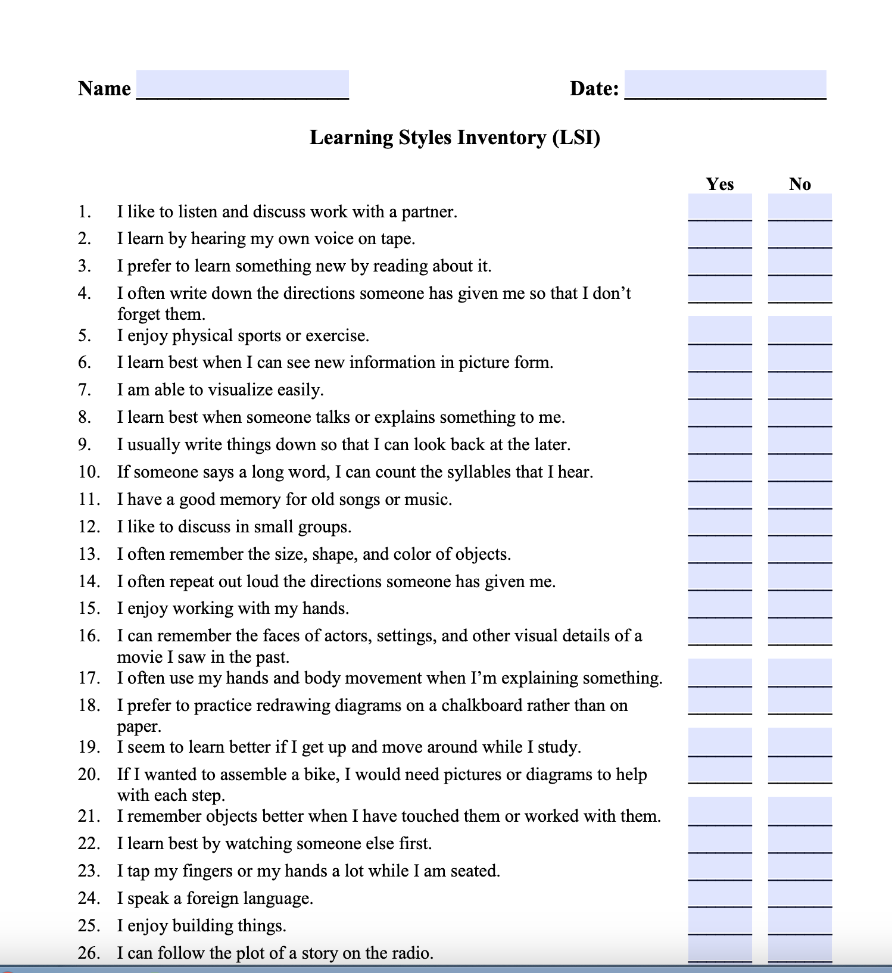
Learning style inventories can…
be a quick method to help learners understand their learning preferences;
lead to more productive learning habits; and
help teachers personalize learning experiences for every student.
(James, 2023; Middlesex Community College, n.d.)
Notes:
To Know
The following learning inventory is to be accessed, downloaded, and completed by participants: https://www.middlesex.mass.edu/ace/downloads/learnstyles.pdf.
There is little evidence that matching a student's learning preferences to instructional methods produces better educational outcomes, however, research does indicate that people have definite preferences for how they learn new information.
At best, learning style inventories can be a way for students to develop study habits that keep them interested and engaged in the learning process. Students may find it useful to discover their preferences and hone their study routines accordingly. Visual learners, for example, might benefit from creating symbols, graphs, and other visual information while studying the material in question.
Participants will learn about the purpose and benefits of learning inventories. They will also have an opportunity to take a learning inventory, one that can also be given to students. The inventory helps identify learning strengths and opportunities for growth. Inventories such as these are NOT about determining and fitting into a category, rather a measure to help identify how to improve learning. Some learning inventories and personality assessments can not only elicit self-awareness, but also encourage empathy and awareness of learning strengths of other individuals or teams. Team awareness can help individuals view diversity as valuable and productive.
To Do
Review the key points on the slide regarding learning inventories. Have participants download the inventory so they can enter their responses. Allow 5-10 minutes for participants to assess their own learning strengths and opportunities for growth. After completing the inventories, provide time for partner or small group discussion on ways their own learning might be improved.
To Say
Learning inventories are tools for identifying your learning strengths and ways to improve learning. They should always be used to focus on continual growth. By becoming aware of your strengths, you can develop even more strategies to broaden and enhance your learning.
References
James. (2023, February 28). What are learning style inventories, and should you use them? Classrooms. https://classrooms.com/what-are-learning-style-inventories-and-should-you-use-them/
Middlesex Community College. (n.d.). Learning styles inventory [PDF file]. https://www.middlesex.mass.edu/ace/downloads/learnstyles.pdf

Slide 56
Procedural Knowledge
Learner Questions
How do I carry out the strategies that I need?
What should be going on in my head while I carry out certain strategies?
How do I verbally explain, model, or make those strategies visible to others?
How should I keep my thinking organized?
Strategies
Planning and flexibility
Modeling through think-alouds
Clarifying with peer support
Making thinking visible
Creating a reference for strategies
(Peteranetz, 2016; Torrisi-Steele, 2016)
Notes:
To Know/To Do/To Say
Review and expand on slide information.
Procedural knowledge is information used to tell you how to carry out tasks and strategies. Posing questions (such as the examples on the slide) to oneself help to elicit procedural knowledge.
A few strategies for helping students access and use procedural knowledge are listed on the slide.
References
Peteranetz, M. S. (2016). Fostering metacognition in K-12 classrooms: Recommendations for practice. The Nebraska Educator, 3. https://digitalcommons.unl.edu/cgi/viewcontent.cgi?article=1040&context=nebeducator
Torrisi-Steele, G. (2016). Online learning and metacognition: A design framework. In V. Wang (Ed.), Handbook of research on learning outcomes and opportunities in the digital age (pp. 221-241). IGI Global. https://www.igi-global.com/chapter/online-learning-and-metacognition/142378

Slide 57
Promoting Procedural Knowledge
Notes:
Video
Number Talks, 4th Grade (8:35 minutes)
https://www.youtube.com/watch?v=xKC3eijnUNw
To Know
This video shows the benefits of using Number Talks to promote metacognitive thinking in students. The teacher encourages students to access and use procedural knowledge to explain strategies used and thinking processes involved to solve math problems. Number Talks help to model internal thinking processes and make thinking visible to students. Reflection questions are found on the next slide.
To Say
As you watch the video think about how a Number Talk promotes access and use of procedural knowledge. After the video we will look at some reflection questions.
To Do
Show at least 5 minutes of the video.
Optional video
High School Algebra Number Talk, https://www.youtube.com/watch?v=UxPvY8wGoh0
Additional options for promoting visible thinking and student metacognition
Reading Salad (Tanny McGregor, Comprehension Connections), https://www.youtube.com/watch?v=mEntupZqm88
HS Social Studies (teacher think-aloud with reading), https://www.youtube.com/watch?v=02fFFjmp7Gc&t=201s
The Difference Between Thinking Aloud and Modelling a Performance, https://www.youtube.com/watch?v=UmhLgsBD1-I
Reference
LUSD Learns. (2016, April 5). Number talk: Fourth grade LUSD [Video]. YouTube. https://www.youtube.com/watch?v=xKC3eijnUNw

Slide 58
Video Reflection
How did the Number Talk encourage access and use of procedural knowledge?
What teacher actions lead to visible thinking and student metacognition?
How did students help one another clarify solutions?
Notes:
To Do/To Say
Have participants address these questions with a shoulder partner. Give time for discussion afterwards.

Slide 59
Conditional Knowledge
Learner Questions
What kind of problem/text/etc. is this?
When does this strategy work best?
How do I determine a place to start?
Why is this strategy helpful?
When should I try something different?
Strategies
Model think-alouds
Have students use think-alouds and defend their choices
Name strategies and discuss benefits
Notice and praise when students use strategies
(Peteranetz, 2016; Torrisi-Steele, 2016)
Notes:
To Know/To Do/To Say
Review and expand on slide information.
To be successful, students must understand when and why to use a particular strategy. This is when conditional knowledge is put into place. Learners activate their conditional knowledge by asking themselves questions such as those listed on the slide.
Suggested strategies include the following.
Teachers can use think-alouds to demonstrate asking oneself such questions.
They can also provide opportunities for students to engage in their own think-alouds with justifications.
Asking students to name the strategies they use along with their benefits will help to clarifying how these thinking skills are advantageous.
Praising students when they access and discuss strategies helps to reinforce their use.
References
Peteranetz, M. S. (2016). Fostering metacognition in K-12 classrooms: Recommendations for practice. The Nebraska Educator, 3. https://digitalcommons.unl.edu/cgi/viewcontent.cgi?article=1040&context=nebeducator
Torrisi-Steele, G. (2016). Online learning and metacognition: A design framework. In V. Wang (Ed.), Handbook of research on learning outcomes and opportunities in the digital age (pp. 221-241). IGI Global. https://www.igi-global.com/chapter/online-learning-and-metacognition/142378

Slide 60
Metacognition
Increasing Cognitive Awareness In Action
Notes:
To Know/To Say
We will now look at how to put these concepts into action.

Slide 61
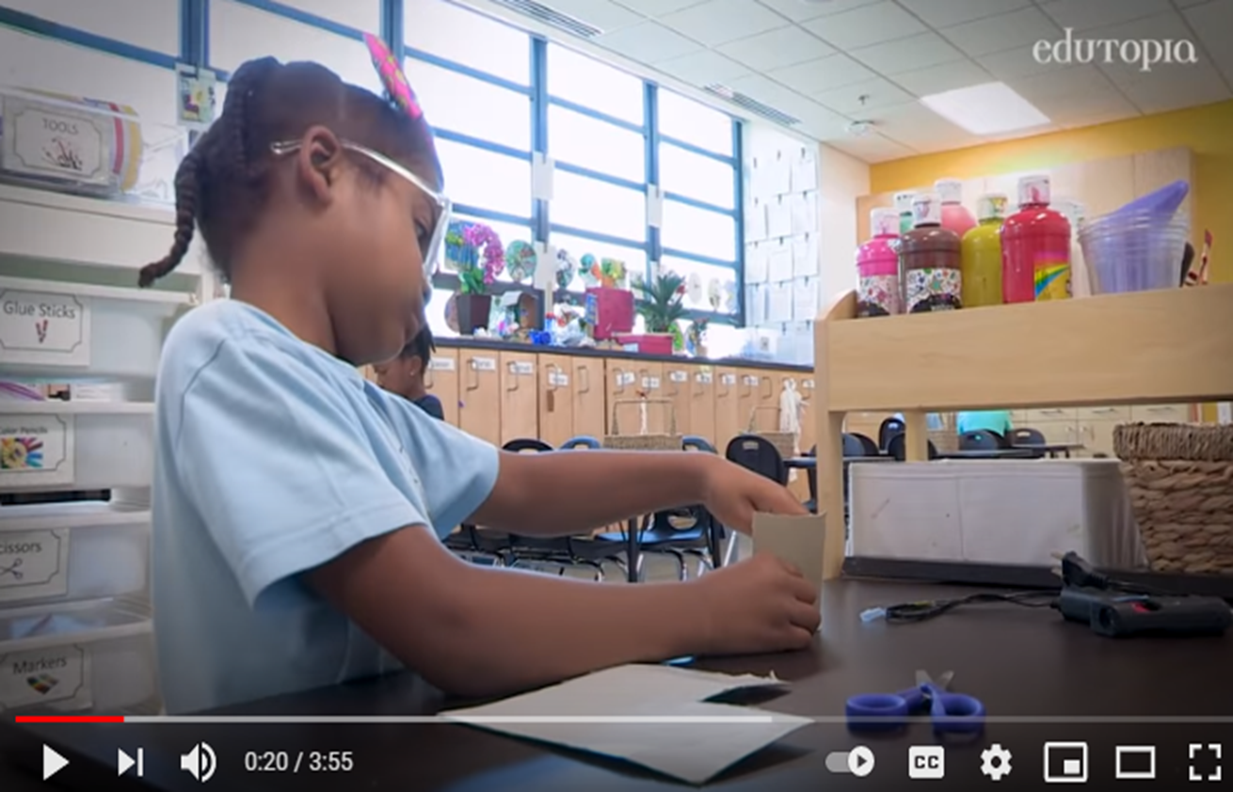
Enhancing Cognition
Notes:
Video
Learning Problem Solving and Growth Mindset in a Makerspace (3:55 minutes)
https://www.youtube.com/watch?v=oQvcbLmNfok
To Know
This video provides modeling of a classroom structure that helps to strengthen metacognitive skills and illustrates how to enhance classrooms. Reflection questions follow on the next slide.
To Say
Educators need to provide structures and opportunities for students to build and enhance their cognitive skills. As you watch the video, think about how classroom structures enhance cognitive skills, what types of questions students ask themselves as they engage in tasks, what actions teachers take to strengthen student cognition, and how you might enhance student cognition in your setting. We will reflect on the video after viewing.
Optional videos (Reflection questions can be revised to align with videos)
Design Thinking: Prioritizing Process Skills (middle school), https://www.youtube.com/watch?v=l7-MVYjZYOE
How To Lead a Lesson Using Cognitively Guided Instruction (primary), https://vimeo.com/144018215
Reference
Edutopia. (2018, November 16). Learning problem solving and growth mindset in a makerspace [Video]. YouTube. https://www.youtube.com/watch?v=oQvcbLmNfok

Slide 62
Video Reflection
How did the structure of this classroom help build cognitive skills?
How does self-regulation relate to cognitive development?
What types of questions would we expect students to ask themselves as they engage in a project-based learning task?
What actions can teachers take to strengthen student cognition?
Notes:
To Do/To Say
Ask participants to talk to a shoulder partner and address these questions. Provide time to share out.

Slide 63
5-Step Strategy for Reaching Learning Goals
Establish clear intent (What?)
Develop a detailed action plan (How?)
Execute the action steps (Who?, When?)
Assess, monitor, and adjust thoughts and actions (How will you know you are successful?)
Look for gains and ways to improve
(Wilson & Conyers, 2016)
Notes:
To Know
This five-step strategy applies knowledge of cognition. It can be used by both teachers and students to develop and implement plans to achieve learning goals.
To Do/To Say
Both teachers and students can use this five-step strategy that applies declarative, procedural, and conditional knowledge to achieve goals.
One major benefit of becoming more metacognitive is in goal setting and the impact it has on motivation when an individual can take charge of a learning goal.
As a result of thinking more consciously about how to learn and more effectively work toward a learning goal, a student will be much more likely to achieve or even exceed the goal.
That success in turn fuels motivation to continue employing metacognition and honing the use of metacognitive and cognitive strategies.
This simple five-step strategy for reaching learning goals can be taught to students to help them take charge of their learning goals. Teachers in turn can model this process for students, helping them see how the steps are applied in different contexts with different learning goals.
Ask participants to talk with a partner about how they might apply this strategy with their students.
Reference
Wilson, D., & Conyers, M. (2016). Teaching students to drive their brains: Metacognitive strategies, activities, and lesson ideas. Association for Supervision and Curriculum Development.

Slide 64
Cognitive Awareness Essential Questions
Why is it important for students to engage in metacognitive thinking?
How can educators increase students’ knowledge of cognition?
What strategies and tools can be used to help students improve metacognitive regulation processes?
How can a classroom culture and environment be established to encourage and support metacognitive thinking?
Notes:
To Know
This slide revisits the Essential Questions for EF1 cognitive awareness. Essential Questions help to activate participant thinking and access prior knowledge regarding metacognition. These questions can be posed initially, at the end, or throughout the session.
To Do
Review the Essential Questions and provide time for reflective thinking. These Essential Questions will help you reflect on your knowledge regarding metacognition. Do you feel that we answered these questions today?
Optional
Essential Questions may be written on individual chart paper and placed around the room to refer to throughout the presentation. You may have participants respond to the questions initially and then later provide opportunities to add to the responses once more learning has taken place. If time permits, a carousel structure could be used so participants can respond, collaborate, and process the questions.

Slide 65
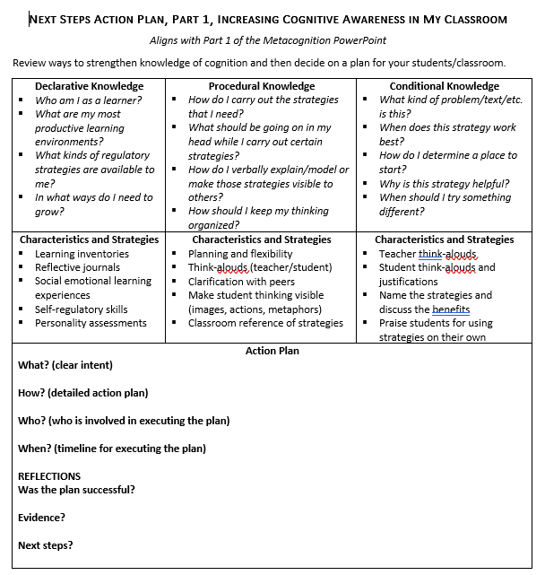
Next Steps Action Plan, Part 1
Increasing Cognitive Awareness in My Classroom
Review ways to strengthen your students’ declarative, procedural, and conditional knowledge
Develop a plan to enhance knowledge of cognition for your content/classroom
(Peteranetz, 2016; Torrisi-Steele, 2016)
Notes:
Handout 4
Next Steps Action Plan, Part 1, Increasing Cognitive Awareness in My Classroom
To Know
Participants will have an opportunity to make a plan and apply content learned in Metacognition Part 1 to strengthen their students’ knowledge of cognition.
To Do
Provide Handout 4 to participants. Ask them to review the suggestions that appear on the handout and develop a plan to enhance knowledge of cognition for their students/classroom.
To Say
It’s now time to apply what you have learned in Part 1 of the Metacognition Module to your own students and classroom. Begin by reviewing ways to strengthen your students’ knowledge of cognition that are listed on the handout. You might also think of additional ways. Decide on one or two areas you would like to focus on and develop a plan that addresses the action steps… What?, How?, Who?, and When? Also think of ways you might assess your plan to see if it was successful once implemented.
References (adapted from)
Peteranetz, M. S. (2016). Fostering metacognition in K-12 classrooms: Recommendations for practice. The Nebraska Educator, 3. https://digitalcommons.unl.edu/cgi/viewcontent.cgi?article=1040&context=nebeducator
Torrisi-Steele, G. (2016). Online learning and metacognition: A design framework. In V. Wang (Ed.), Handbook of research on learning outcomes and opportunities in the digital age (pp. 221-241). IGI Global. https://www.igi-global.com/chapter/online-learning-and-metacognition/142378
Wilson, D., & Conyers, M. (2016). Teaching students to drive their brains: Metacognitive strategies, activities, and lesson ideas. Association for Supervision and Curriculum Development.

Slide 66
Closing and Thank You!
For more information, contact
Note: References are on the following slides
Notes:
To Know/To Do/To Say
Choose how to close this part of the training and include your contact information.
Make sure participants know when the next training is scheduled.
You might want to review what the next trainings will cover.
Show the reference slides if appropriate.

Slide 67
Part 1 References
Cambridge International Education. (n.d.). Getting started with metacognition. https://cambridge-community.org.uk/professional-development/gswmeta/index.html#article
Cherry, K. (2023, April 18). Cognition in psychology. Verywell Mind. https://www.verywellmind.com/what-is-cognition-2794982
Dweck, C. S. (2006). Mindset: The new psychology of success. Random House.
Edutopia. (2018, November 16). Learning problem solving and growth mindset in a makerspace [Video]. YouTube. https://www.youtube.com/watch?v=oQvcbLmNfok
Fogarty, R., & Pete, B. M. (2020). Metacognition: The neglected skill set for empowering students. Solution Tree Press.
Hattie, J. (2008). Visible learning: A synthesis of over 800 meta-analyses relating to achievement (1st ed.). Routledge. https://doi.org/10.4324/9780203887332
Hattie, J. (2023). Visible learning: The sequel: A synthesis of over 2,100 meta-analyses relating to achievement. Routledge. https://doi.org/10.4324/9781003380542
James. (2023, February 28). What are learning style inventories, and should you use them? Classrooms. https://classrooms.com/what-are-learning-style-inventories-and-should-you-use-them/
LUSD Learns. (2016, April 5). Number talk: Fourth grade LUSD [Video]. YouTube. https://www.youtube.com/watch?v=xKC3eijnUNw
Middlesex Community College. (n.d.). Learning styles inventory [PDF file]. https://www.middlesex.mass.edu/ace/downloads/learnstyles.pdf
Missouri Department of Elementary & Secondary Education. (n.d.). Leader standards. https://dese.mo.gov/media/pdf/oeq-ed-leaderstandards
Missouri Department of Elementary & Secondary Education. (n.d.). Teacher standards. https://dese.mo.gov/media/pdf/oeq-ed-teachstandards
Notes:
To Know
The next also contains references. You can choose whether to show to the participants at the end of the training.

Slide 68
Part 1 References (continued)
MoEdu-SAIL. (2023). Blueprint for district and building leadership (7th ed.). Missouri Department of Elementary and Secondary Education: Northern Arizona University, Institute for Human Development.
Peteranetz, M. S. (2016). Fostering metacognition in K-12 classrooms: Recommendations for practice. The Nebraska Educator, 3. https://digitalcommons.unl.edu/cgi/viewcontent.cgi?article=1040&context=nebeducator
Queen’s University. (n.d.). Teaching for effective learning. https://www.queensu.ca/teachingandlearning/modules/students/24_metacognition.html
Tarricone, P. (2011). The taxonomy of metacognition. Psychology Press. https://doi.org/10.4324/9780203830529
The Global Metacognition Institute. (2022). Starter activity (metacognition). https://www.globalmetacognition.com/copy-of-tbc
Torrisi-Steele, G. (2016). Online learning and metacognition: A design framework. In V. Wang (Ed.), Handbook of research on learning outcomes and opportunities in the digital age (pp. 221-241). IGI Global. https://www.igi-global.com/chapter/online-learning-and-metacognition/142378
Visible Learning MetaX. (2024). Global Research Database. Retrieved January 31, 2024, from https://www.visiblelearningmetax.com/influences
Wilson, D., & Conyers, M. (2014, October 7). Metacognition: The gift that keeps giving. Edutopia. https://www.edutopia.org/blog/metacognition-gift-that-keeps-giving-donna-wilson-marcus-conyers
Wilson, D., & Conyers, M. (2016). Teaching students to drive their brains: Metacognitive strategies, activities, and lesson ideas. Association for Supervision and Curriculum Development.

