Slide 1
Hidden Slide #1
The Metacognition Module was designed to be used in the following manner.
The audience for this module is educators, building leaders, instructional coaches, and teachers of all contents and levels. This module can be used for whole staff presentations.
Time should be allotted after training for participants to reflect and have conversations regarding current status and needed changes. Participants should reflect on the following questions. Where are we now? Where are we going? How can we get there?
Participants should complete the SAPP for metacognition prior to training.
Following the training participants should complete a Next Steps Action Plan – note there is a separate action plan for each of the three parts of the module.
Notes:
To Know
It is important for all educators, building leaders, and instructional coaches to understand the importance and benefits of developing and nurturing metacognitive thinking.
The content in this module is intended to help educators develop capacity regarding the knowledge of cognition and regulation of cognition, and additionally how to create a supportive classroom environment that fosters metacognitive thinking for students and teachers.
Strategies and tools will be presented that will help educators create thinking classrooms and schools.

Slide 2
Metacognition Module Organization
Hidden Slide #2
Part 1, EF 1
Introduction and Increasing Cognitive Awareness
Part 3, EF 3
Creating a Metacognitive
Classroom Culture and Environment
Part 2, EF 2
Regulation of Cognition
Intro to metacognition
Increasing cognitive awareness
Declarative
Procedural
Conditional
Planning
Monitoring
Controlling
Evaluating
Thinking norms
Expectations, goals, reflective thinking
Language to describe thinking
Rigorous tasks and productive struggle
Physical environment to support thinking
Time, opportunities, and interactions
Notes:
To Know
Part 1 provides an introduction to metacognition and content aligned with the first Essential Function of the Metacognition Practice Profile (increasing cognitive awareness), including declarative, procedural, and conditional knowledge. It is important that all participants have an understanding of Part 1 prior to other module sessions.
Part 2 is aligned with EF 2 of the Metacognition Practice Profile which addresses regulation of cognition, including planning, monitoring, controlling, and evaluating.
Part 3 is aligned with EF 3 of the Metacognition Practice Profile and provides content on how to create a metacognitive classroom culture and environment. This session includes information on creating thinking norms, expectations, goals, and reflective thinking opportunities. It also addresses language to describe thinking, create rigorous tasks, interactions, time, opportunities, and a physical environment that supports and improves thinking.

Slide 3
Hidden Slide #3
In-person professional development suggestions
The following estimated times for Metacognition Module parts are based on providing participants with ample time to process and reflect on content.
Part 1: Introduction and Increasing Cognitive Awareness, 2.5 hours
Part 2: Regulation of Cognition, 3 hours
Part 3: Creating a Metacognitive Climate and Environment, 2.5 hours
Total = 8 hours
Read the slide notes thoroughly as they provide detailed information to assist you in preparation for and delivery of the presentation.
Some reflection activities can be expanded by using the activities designated OPTIONAL.
Breaks can be added at the presenter’s discretion.
Notes:
Presenter notes information
The slide includes estimated times for each of the three parts. Part 1 of the Metacognition Module is designed to be completed in 2.5 hours.
Presenter notes are included in the PowerPoint slides. Background information for the presenter is shown as “To Know.” Statements and activities to be shared with participants are shown as either “To Say” or “To Do.” In some instances, there are various combinations of “To Know/To Do/To Say.” The presenter notes also include cues for “Handouts” and activities.
Additional activities, examples, videos, etc. are included in the Metacognition Coaching Companion. You can add material from the Coaching Companion to corresponding PowerPoint content.
A printed Practice Profile and an electronic Self-Assessment Practice Profile (SAPP) tool are available for use by individuals, teams, or schools for periodic self-assessment, monitoring of implementation of the practice, or to identify training/coaching needs.
The presenter should download any video intended for use in a training, as you may not have internet access in all school sites.
Breaks should be inserted at the discretion of the presenter based on the needs of participants.

Slide 4
Hidden Slide #4
Supplies and information needed
WIFI access for presenter and participants
Access to videos (through WIFI if available, but download to flash drive as a back-up)
Chart paper
Plain paper
Markers and highlighters
Post-it-Notes
Consider inserting QR codes and requesting that participants bring a device with a QR reader to scan codes for easy access to documents

Slide 5
Hidden Slide #5
General guidance for virtual presentations
Notify and request prior permission from participants if session is to be videotaped.
Test your tech set up prior to the session (download and save videos on flash drive if needed)
Keep sessions as short as possible and/or provide breaks
Provide and discuss norms for participation (camera on, ask questions in chat – if that is your preference, stay engaged)
Minimize distractions (request participants mute when not speaking)
Use 2 consultants – 1 to present, 1 to manage chat, etc.
Identify other roles prior to presentation, as appropriate (timekeeper, notetaker, etc.)
Create opportunities for participant engagement and interaction (e.g., HQ Tools for Audience Engagement Collaborative Notetaking Document)
When using breakout rooms, equip each room with 1 consultant to facilitate and 1 to take notes, if possible
End the session with an effective wrap-up
Notes:
To Know/To Do
If presenting this module virtually, the notes on this slide will help you prepare for the presentation.

Slide 6
Hidden Slide #6
Handouts
HO 1, Metacognition Infographic
HO 2, Metacognition Practice Profile
HO 3, Metacognition Key Terms
HO 4, Conversations That Boost Thinking
HO 5, Next Steps Action Plan, Part 3, Creating a Metacognitive Classroom Culture and Environment
Notes:
To Know
Handouts listed are in the handout packet.
Numerous sites are also provided throughout the module for participants to access via a web link.
Due to copyright regulations, some materials are linked to their original source and must be downloaded from the link.

Slide 7
Hidden Slide #7
Key Terms
Cognition refers to the mental processes involved in gaining knowledge and comprehension.
Cognitive assets include versatile thinking tools that can be taught to help students problem solve and master learning.
Conditional knowledge refers to knowledge used to assist with the selection of strategies and approaches based on the circumstances under which the activity is taking place.
Culture of thinking includes cultural forces that provide goals and define and promote a thinking climate in a classroom. These forces include opportunities, time, modeling, language, environment, interactions, routines, and expectations.
Declarative knowledge refers to what the learner knows about the topic and about their own skills and intellectual resources.
Exam wrapper is a reflection tool used by students to examine test readiness and areas of learning needing improvement so specific strategies can be applied to improve outcomes of future assessments.
Notes:
Handout 3
Metacognition Key Terms
To Know/To Do
The comprehensive list of key terms for the Metacognition Module can be found in the handout packet. Access the handout for the complete list. Key terms that align with each Essential Function can be found in the notes section at the beginning of each EF module.
References
Cherry, K. (2023, April 18). Cognition in psychology. Verywell Mind. https://www.verywellmind.com/what-is-cognition-2794982
Peteranetz, M. S. (2016). Fostering metacognition in K-12 classrooms: Recommendations for practice. The Nebraska Educator, 3. https://digitalcommons.unl.edu/cgi/viewcontent.cgi?article=1040&context=nebeducator
Tarricone, P. (2011). The taxonomy of metacognition. Psychology Press. https://doi.org/10.4324/9780203830529
Torrisi-Steele, G. (2016). Online learning and metacognition: A design framework. In V. Wang (Ed.), Handbook of research on learning outcomes and opportunities in the digital age (pp. 221-241). IGI Global. https://www.igi-global.com/chapter/online-learning-and-metacognition/142378
Wilson, D., & Conyers, M. (2016). Teaching students to drive their brains: Metacognitive strategies, activities, and lesson ideas. Association for Supervision and Curriculum Development

Slide 8
Hidden Slide #8
Key Terms
Executive function refers to using brain processes and mental faculties in goal-setting, planning, execution, reasoning, problem solving, working memory, and organization.
Higher order thinking includes using higher level thinking skills such as analyzing, synthesizing, and transferring knowledge to other applications.
Knowledge of cognition is the knowledge that learners have about themselves. It includes procedural, declarative, and conditional knowledge.
Metacognition refers to knowledge, awareness, and control of one’s own cognition and human cognition in general.
Metacognitive controlling is the cognitive ability to stay focused on the learning task or goal by ignoring distractions and refraining from responding to negative stimuli.
Metacognitive culture refers to an environment that promotes and models a knowledge and learner centered classroom where students engage in meaningful and complex tasks using reflection, critical thinking, and strategic strategies to achieve success.

Slide 9
Hidden Slide #9
Key terms
Metacognitive evaluating involves assessing what you know and how and why you know it, in addition to being able to generalize for transfer to new situations.
Metacognitive monitoring is a mental process used to check one’s progress during the learning process; allowing for constant adjustment and revision along the way.
Metacognitive planning is a mental process that allows one to collect necessary information, synthesize it, and then anticipate the right way to carry-out a task or reach a specific goal.
Procedural knowledge is knowledge used to successfully execute an appropriate procedure or process.
Regulation of cognition means you have an awareness and control over your own thinking that enables you to metacognitively plan, monitor, control, and evaluate your learning.
Thinking routine is a set of questions or a brief sequence of steps used to scaffold and support student thinking.
Thinking school is a school where thinking is at the heart of the curriculum and all staff and students support metacognition at a high level.

Slide 10
Hidden Slide #10
Pre-Read Article
Developing A Culture of Metacognition – The Art of Teaching
How To Think
https://www.teachnkidslearn.com/developing-student-metacognition/
Notes:
Pre-Read Article
Developing A Culture of Metacognition – The Art of Teaching How To Think
https://www.teachnkidslearn.com/developing-student-metacognition/
To Know/To Do
The article Developing A Culture of Metacognition – The Art of Teaching How To Think is to be sent to participants prior to the session. You may want to have table copies of this pre-read.
Slide 26 presents the article and a follow-up activity to review and debrief the article.
Reference
Teach & Kids Learn. (2017, January 9). Developing a culture of metacognition - the art of teaching how to think. https://www.teachnkidslearn.com/developing-student-metacognition/

Slide 11
Metacognition
Part Three
Creating a Metacognitive Classroom Culture and Environment
Notes:
To Know/To Say
Welcome everyone. This is the third part of the Metacognition Module and focuses on Essential Function 3, Creating a Metacognitive Climate and Environment.
Please have your Handouts 1 (Infographic) and 2 (Practice Profile) available as we begin this training.

Slide 12
Acknowledgements
Special thanks to all contributors to the development of this Professional Learning Module. The original collection of Professional Learning Modules was rolled-out for use by Regional Professional Development Center (RPDC) Consultants in July 2013 after being developed by a team of content experts through efforts funded by the Missouri State Personnel Development Grant (SPDG). The collection has expanded in content offerings and modules are updated and/or revised on a regular basis.
Content Development Team
Beverly Kohzadi
Gina Bell-Moore
Training Module Development
Beverly Kohzadi
MoEdu-SAIL
Ronda Jenson, Director
Chelie Nelson
Cheryl Wrinkle
Cynthia Beckmann
Nicole Stone
Notes:
To Know/To Say
First, I want to give a special thanks to all contributors to the development and revision of this Professional Learning Module.

Slide 13
Metacognition
Setting the Stage
Notes:
To Know/To Say
We will first set the stage for this presentation and then explore metacognitive regulation processes.

Slide 14
Welcome and Introductions
Our trainers for the day
Notes:
To Know/To Do/To Say
Add presenter information to the slide and introduce yourself and other presenters.

Slide 15
Norms
Begin and end on time
Be an engaged participant
Be an active listener - open to new ideas
Use notes for side bar conversations
Use electronics respectfully
Notes:
To Know
It is important to establish norms for training. Trainers are free to adjust this list of norms.
To Do
Consider including a check mid-way through trainings to assess a norm or norms.
The presenter may want to print norms on agenda handouts in addition to, or in place of, presentation slides, so the norms are always available in print for participants.
Norms may be added to address specific school needs. Some schools already have established norms for all PD. In that case, adapt to their norms.
To Say
Please review the norms for this training. Are there any additions that need to be made to the norms at this time?

Slide 16
District Continuous Improvement (DCI) Framework
Focus on effective instruction leading to exceptional outcomes for ALL Missouri students
Foundations
Collaborative Teams
Data-Based Decision Making
Common Formative Assessment
Effective Teaching and Learning Practices
Developing Assessment Capable Learners
> Feedback
Metacognition
Supportive Context
School-Based Implementation Coaching
Collective Teacher Efficacy
Systems Leadership
Instructional Leadership
Notes:
To Know
Nine Professional Learning Modules make up the DCI Content within the DCI Framework as illustrated in the slide.
Three foundational educational practices essential for collaborative, data-informed instruction and decision making
Two effective teaching and learning practices shown to improve student achievement
Four practices that create a supportive context to sustain and advance effective teaching and learning
To Do/To Say
Before we delve into this module, let’s take a few minutes to review the DCI Framework graphic, looking specifically at where metacognition falls into big picture.
As you see, the focus of DCI is on effective instruction leading to exceptional outcomes for all Missouri students.
Review the elements of each section of the three main components.
Foundations (consisting of Collaborative Teams, Data-Based Decision Making, and Common Formative Assessment)
Effective Teaching and Learning Practices (Developing Assessment Capable Learners with Feedback and Metacognition). We will focus on metacognition in this module. It is a part of Effective Teaching and Learning Practices and represents a student’s self regulation. As students become assessment capable, they learn to take and give feedback with leads to metacognitive skills. This is a part of monitoring and self assessment.
Supportive Context (School-Based Implementation Coaching, Collective Teacher Efficacy, and Systems/Instructional Leadership)
References
MoEdu-SAIL. (2023). Blueprint for district and building leadership (7th ed.). Missouri Department of Elementary and Secondary Education: Northern Arizona University, Institute for Human Development.

Slide 17
Metacognition Alignment with Missouri Leader Standards
Standard #2 Teaching and Learning
Education leaders have the knowledge and ability to ensure the success of all students by promoting a positive school culture, providing an effective instructional program that applies best practice to student learning, and designing comprehensive professional growth plans for staff.
Standard #6 Professional Development
Education leaders have the knowledge and ability to ensure the success of all students by remaining current on best practices in education administration and school-related areas as evidenced in his/her annual professional development plan.
Notes:
To Know/To Say
Review this slide from Part 1. These Missouri Leader Standards are closely aligned to the content within the Metacognition Module. Take a moment to read the slide as I summarize the standards.
Reference
Missouri Department of Elementary & Secondary Education. (n.d.). Leader standards. https://dese.mo.gov/media/pdf/oeq-ed-leaderstandards

Slide 18
Metacognition Alignment with Missouri Teacher Standards
Standard #2 Student Learning, Growth, and Development
The teacher understands how students learn, develop, and differ in their approaches to learning. The teacher provides learning opportunities that are adapted to diverse learners and support the intellectual, social, and personal development of all students.
Standard #4 Critical Thinking
The teacher uses a variety of instructional strategies and resources to encourage students’ critical thinking, problem solving, and performance skills Students actively participate and are successful in the learning process.
Standard #5 Positive Classroom Environment
The teacher uses an understanding of individual/group motivation and behavior to create a learning environment that encourages active engagement in learning, positive social interaction, and self-motivation. The teacher keeps current on instructional knowledge and seeks and explores changes in teaching behaviors that will improve student performance.
Notes:
To Know/To Say
These Missouri Teacher Standards are closely aligned to the content within the Metacognition Module. Please read the slide as I review the standards.
Reference
Missouri Department of Elementary & Secondary Education. (n.d.). Teacher standards. https://dese.mo.gov/media/pdf/oeq-ed-teachstandards

Slide 19
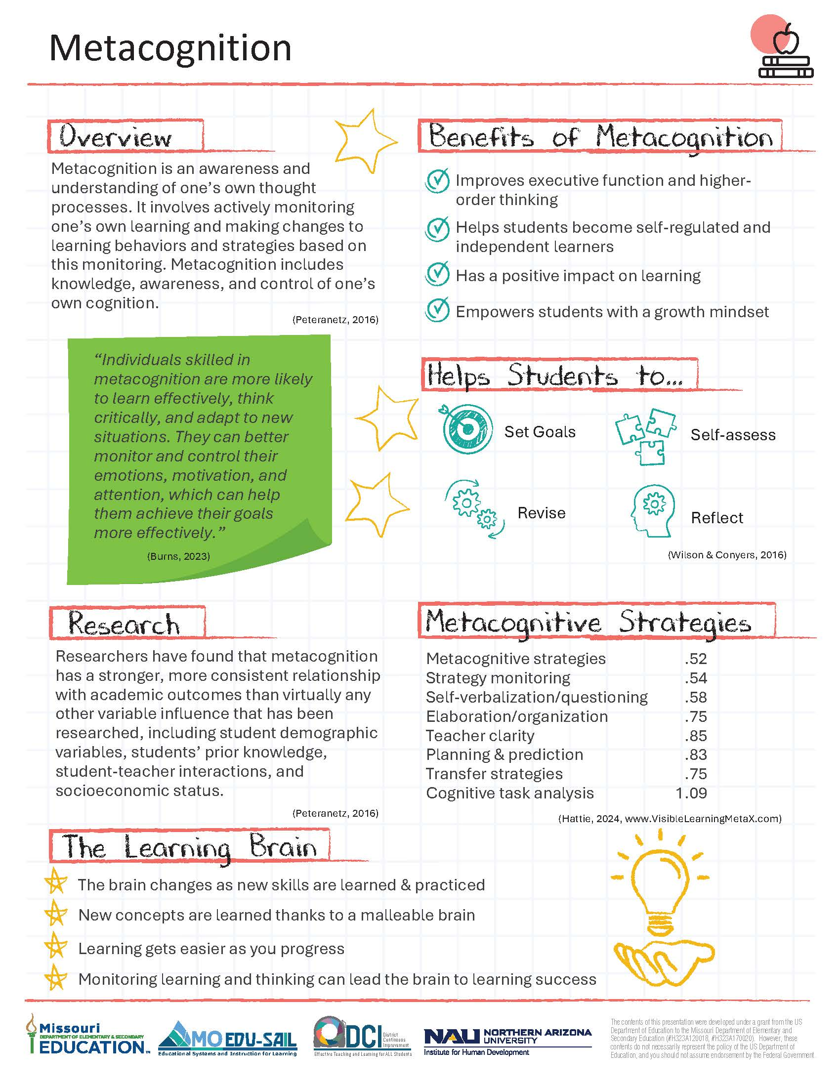
Metacognition Infographic
Notes:
Handout 1
Metacognition Infographic
To Know
The infographic provides a snapshot of the essential learning contained in the module. This is an opportunity for the presenter to provide a hook as to why metacognition is important. It also helps participants see how metacognition is key to developing assessment capable learners.
To Do
Direct attention to each component and provide a quick overview.
To Say
The metacognition infographic summarizes key content from the Professional Learning Module. You can see how developing metacognition is key to helping students become assessment capable and self-regulated learners. (Explain/summarize each component on the infographic.)

Slide 20
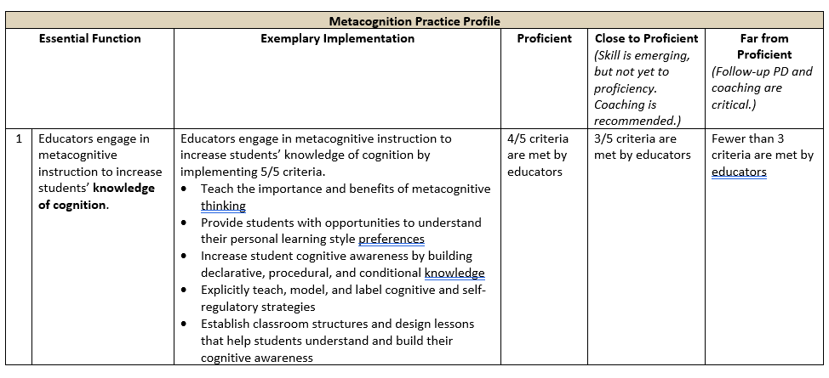
Metacognition Practice Profile
Notes:
Handout 2
Metacognition Practice Profile
To Do/To Say
Review the Practice Profile with the participants.
The Practice Profile template is anchored by the Essential Functions. First, is the foundation of implementation that philosophically grounds implementation. Then moving from left to right across the template are the Essential Functions of the practice, implementation performance levels, and lastly, evidence which provides data or documentation for determining implementation levels.
The Essential Functions align with the teaching/learning objectives for each Professional Learning Module. Four levels of implementation are described for each teaching/learning objective: exemplary, proficient, close to proficient, and far from proficient. The professional development provider should walk through the Practice Profile with the educator-learners, referring to the data and artifacts listed as suggested evidence. It is an important tool for self-monitoring their own implementation because it serves as a reminder as to the implementation criteria and is also aligned with the fidelity checklists and the electronic Self-Assessment Practice Profile (SAPP). These sources provide data regarding further training or coaching.
As we look at the Metacognition Practice Profile, we see three Essential Functions. Essential Function 1 is “educators engage in metacognitive instruction to increase students’ knowledge of cognition.” Essential Function 2 is “educators engage students in metacognitive regulation processes for planning, monitoring, controlling, and evaluating.” Essential Function 3 is “educators promote a classroom culture and environment conducive to developing, encouraging, and supporting metacognitive thinking.” You will also find the criteria to determine the level of implementation for you, your school, and/or district.
Today we will cover Essential Function 3. There are two other parts to this module which cover Essential Functions 1 and 2.

Slide 21
Creating a Metacognitive Classroom Culture and Environment
Notes:
Handout 3
Metacognition Key Terms
To Know/To Say
This is the third part of the Metacognition module and covers Essential Function 3.
These are the key terms that align with EF 3 Metacognitive Regulation Processes. The comprehensive list of Metacognition key terms are listed on handout 3.
Culture of thinking includes cultural forces that provide goals and define and promote a thinking culture in a classroom. These forces include opportunities, time, modeling, language, environment, interactions, routines, and expectations.
Metacognitive culture refers to an environment that promotes and models a knowledge and learner centered classroom where students engage in meaningful and complex tasks using reflection, critical thinking, and strategic strategies to achieve success.
Thinking routine is a set of questions or a brief sequence of steps used to scaffold and support student thinking.
Thinking school is a school where thinking is at the heart of the curriculum and all staff and students support metacognition at a high level.
It will be helpful to have this handout with you throughout this training.
References
Cherry, K. (2023, April 18). Cognition in psychology. Verywell Mind. https://www.verywellmind.com/what-is-cognition-2794982
Peteranetz, M. S. (2016). Fostering metacognition in K-12 classrooms: Recommendations for practice. The Nebraska Educator, 3. https://digitalcommons.unl.edu/cgi/viewcontent.cgi?article=1040&context=nebeducator
Tarricone, P. (2011). The taxonomy of metacognition. Psychology Press. https://doi.org/10.4324/9780203830529
Torrisi-Steele, G. (2016). Online learning and metacognition: A design framework. In V. Wang (Ed.), Handbook of research on learning outcomes and opportunities in the digital age (pp. 221-241). IGI Global. https://www.igi-global.com/chapter/online-learning-and-metacognition/142378
Wilson, D., & Conyers, M. (2016). Teaching students to drive their brains: Metacognitive strategies, activities, and lesson ideas. Association for Supervision and Curriculum Development

Slide 22
Session-at-a-Glance
Shifting our thinking and doing
Thinking schools
Creating a thinking culture
Physical environment for metacognition
Next Steps Action Plan, Part 3, Promoting a metacognitive environment and culture
Notes:
To Know
This slide provides an overview of the contents of Part 3 of the Metacognition Module.
To Do/To Say
Review the content contained within this module as listed on the slide.

Slide 23
Part 3: Learning Objectives
Develop an environment that promotes and supports metacognition
Model and encourage the use of language that clearly describes thinking
Understand the importance of allocating time, opportunities, and interactions that promote metacognitive thought
Notes:
To Say
These are the learning targets/objectives for Part 3, Promoting a Metacognitive Culture and Environment.
Our session today will focus on… (Discuss which targets your will be focusing on if your session does not include all of part 3.) These are aligned with the Metacognition Practice Profile.
Although classroom is mentioned in the title and essential function, the goal is actually to promote a metacognitive culture that is district- and building-wide.

Slide 24
Part 3: Essential Questions
Why is it important for educators to promote a culture that develops and supports metacognitive thought?
How can educators establish and advance an environment that values and encourages reflective and high-level thinking?
Notes:
To Know/To Say
These essential questions help to guide thinking before, during, and after this session of learning. Notice how they coincide with the EF 3 criteria in the Practice Profile.

Slide 25
Conceptual Framework
Supportive Learning Environment
Metacognition
Knowledge of Cognition
Declarative
Procedural
Conditional
Regulation of Cognition
Planning
Monitoring
Controlling
Evaluating
Two Dimensions
(adapted from Peteranetz, 2016)
Notes:
To Know/To Say
This graphic illustrates the conceptual framework components of metacognition.
The first dimension, knowledge of cognition, includes what a person knows about learning. It consists of overall cognitive thought processes, one’s own thought processes, and knowledge of strategies used for reflection and critical thinking. Sub-components include declarative, procedural, and conditional knowledge.
The second dimension, regulation of cognition, involves the “active” side of metacognition. Regulation is what learners do about their learning. Processes such as planning, monitoring, controlling, and evaluating cognition are used to regulate thinking.
A supportive learning environment and culture helps metacognition flourish in classrooms. The importance of developing thinking skills is an important aspect to learning. Metacognitive instruction can be embedded within authentic learning contexts through both implicit and explicit instruction.
Each of these components for developing metacognitive thinking will be examined and expanded on throughout the Metacognition Module.
Reference
Peteranetz, M. S. (2016). Fostering metacognition in K-12 classrooms: Recommendations for practice. The Nebraska Educator, 3. https://digitalcommons.unl.edu/cgi/viewcontent.cgi?article=1040&context=nebeducator

Slide 26
Pre-Read Article Discussion
Developing A Culture of Metacognition – The Art of Teaching
How To Think
https://www.teachnkidslearn.com/developing-student-metacognition/
Article Discussion
Review/refresh the article and jot down key take-aways
Divide into teams of 4-6
Take turns sharing key ideas gleaned from the article
The last person then summarizes all ideas expressed by their team and shares with the whole group
(Teach and Kids Learn, 2017)
Notes:
Pre-Read Article
Developing A Culture of Metacognition – The Art of Teaching How To Think
https://www.teachnkidslearn.com/developing-student-metacognition/
To Know/To Do/To Say
This slide provides the opportunity to debrief the pre-read article. This link was sent to the participants prior to the training. You may want to have some table copies of this pre-read.
Review the instructions on the slide.
Reference
Teach & Kids Learn. (2017, January 9). Developing a culture of metacognition - the art of teaching how to think. https://www.teachnkidslearn.com/developing-student-metacognition/

Slide 27
Shifting Thinking and Doing
Notes:
To Say
We will next discuss how we can shift our thinking from a traditional classroom to a metacognitive classroom.

Slide 28
Shifting Our Thinking and Doing
Traditional Classrooms
Learning is teacher driven
Discussion focuses on what to learn, not how
Tasks are weakly aligned to learning goals
Few opportunities exist to review, reflect, and revise
Metacognitive Classrooms
Learning is a shared responsibility
Ways to learn are frequently discussed
Tasks are directly aligned to goals and include both content and process learning
Learning is seen as an ongoing process
(Building Learning Power, 2019)
Notes:
To Know
To move from a more traditional classroom culture to one that is learning friendly and compatible to metacognitive thought, there must be a shift from the classroom being teacher driven, to one in which learning is a shared responsibility.
The focus is on ways to learn and tasks are directly aligned to learning goals.
Both content and process learning take place and the learning is ongoing.
Celebrating learning as it happens, for both students and teacher, is an essential part of the culture.
To Say/To Do
Discuss the shift from a traditional to a metacognitive classroom. Review and expand on key points listed on the slide.
Ask participants to do a STAND UP, HAND UP, PAIR UP. Share out after pair discussion.
They can then engage in a partner discussion that focuses on their current classroom practices.
Are there still traditional practices taking place?
Which metacognitive classroom practices are currently being implemented?
Reference
Building Learning Power. (n.d.). Creating learning friendly classroom cultures. https://www.buildinglearningpower.com/2018/05/creating-metacognitive-classroom-cultures/

Slide 29
Cultural Shifts
Creating a Learning Friendly Classroom
Relating for Learning | Talking for Learning | Constructing Learning | Celebrating Learning
Learning is a shared responsibility. | The object of conversation is learning. | Tasks and routines feed learning habits. | Learning is the object of attention!
(Ritchhart, 2015)
Notes:
To Know/To Say/To Do
Discuss the four cultural shifts as listed on the slide and expand on each.
There are four cultural shifts, that taken together, move a traditional classroom culture to a learning friendly culture. Those shifts include relating, talking, constructing, and celebrating.
Relating for learning makes learning a shared responsibility, and the roles of teacher and student change.
The role of the teacher changes from ‘the sage on the stage’ to ‘the guide by your side.’
Students are given more responsibility for their own learning and their role changes from ‘passenger’ to ‘crew’ and ultimately ‘pilots of their own learning.’
Talking for learning makes learning the object of conversation.
The way we express ourselves in the classroom creates a powerful linguistic environment that teaches young people the best of what we know about learning.
The language of learning helps students to discuss, understand, and become conscious of using their learning behaviors.
Constructing learning makes learning the object.
Activities and classroom routines feed learning habits.
Challenging activities are designed to enable students to have a dual focus of understanding both the content and the process of learning. By exploring content and stretching students’ use of their learning behaviors, they are not just ‘doing’ learning but reviewing and reflecting on the process in order to make meaning and apply it elsewhere.
Celebrating learning, as learning is the object of our attention: the outward signs of the values that underpin the culture.
In this dimension common notions of classroom learning are flipped or re-defined (e.g., being stuck is seen as interesting, mistakes are useful). Effort, questioning, and taking risks are defined, recognized, attended to, acknowledged, and praised.
These, and the recognition of the development of learning habits, serve to make visible and public the underlying values of the learning friendly environment, one in which learners are being taught to be meta-learners.
Application to Behavior Management
When constructing learning, tasks and routines can be beneficial for students in various ways, especially in terms of behavior management. Here are several ways in which tasks and routines can help students with their behavior.
Predictability and Structure: Routines provide a sense of predictability and structure. Knowing what to expect and when can help students feel more secure and in control, reducing anxiety and disruptive behavior.
Establishing Expectations: Clearly defined tasks and routines help establish expectations for behavior. Students understand what is expected of them in different situations, which can lead to better compliance and a more positive learning environment.
Time Management: Routines assist in developing time management skills. Knowing when assignments are due, when class starts, and when breaks occur helps students prioritize tasks and manage their time effectively.
Building Habits: Regular routines help students build positive habits. Consistently following a schedule encourages habits such as completing homework, staying organized, and being prepared for class.
Reducing Decision-Making Stress: Routines reduce the number of decisions students need to make, especially regarding daily tasks. This can be particularly helpful for students who struggle with decision-making, as it minimizes stress and potential behavioral challenges.
Enhancing Focus and Attention: Following a routine can improve a student's ability to focus and sustain attention on tasks. When they know what to expect, they can more easily engage in learning activities without becoming distracted or disruptive.
Improving Transitions: Clearly defined routines can make transitions between activities smoother. Transition times can be challenging for some students, and having a predictable routine can help minimize disruptions during these periods.
Promoting Independence: Tasks and routines encourage students to take responsibility for their own actions. As they become more familiar with routines, they can learn to manage their time, belongings, and behavior independently.
Positive Reinforcement: Incorporating positive reinforcement within routines can motivate students to adhere to expected behaviors. This could include praise, rewards, or other positive consequences for following the established routine.
Supporting Special Needs: For students with special needs, routines can be particularly crucial. Predictability can help create a more inclusive environment and support students with various learning and behavioral challenges.
It's important to note that while routines can be highly effective, flexibility is also key. Some degree of flexibility allows for adjustments based on individual needs or unexpected events. Additionally, involving students in the creation of routines can enhance their sense of ownership and engagement in the learning process.
References
Ritchhart, R. (2015). Creating cultures of thinking: The 8 forces we must master to truly transform our schools. John Wiley & Sons.

Slide 30
New Roles
Learners
Teachers
Do more of the thinking
Collaborate and talk about how they understand things
Develop curiosity, perseverance, and open-mindedness
Monitor and assess their work
Value mistakes, challenge, and feedback
Regulate and improve their own learning
Act as learning coaches
Model thinking processes
Design rigorous lessons that get students thinking and learning for themselves
Encourage students to explore challenging questions and problems
Enable students to become regulators of their own learning
(Building Learning Power, 2018)
Notes:
To Know/To Do/To Say
Both learners and teachers take on new roles when moving from a traditional classroom culture to a culture that fosters metacognition.
Discuss new roles for learners and teachers in order to promote a metacognitive classroom culture & environment.
Students grow their learning habits by embracing rigorous learning challenges and productive struggle.
The teacher strives to support students uncover learning by becoming the ultimate model of a meta-learner.
References
Building Learning Power. (n.d.). Creating learning friendly classroom cultures. https://www.buildinglearningpower.com/2018/05/creating-metacognitive-classroom-cultures/
Ritchhart, R. (2015). Creating cultures of thinking: The 8 forces we must master to truly transform our schools. John Wiley & Sons.

Slide 31
Supporting a Metacognitive Environment
Create a culture where students feel connected and supported
Instill a positive approach to learning so students become self-directed and intrinsically motivated learners
Provide clear performance goals
Show students models and examples of how work is evaluated
(Teach & Kids Learn, 2017)
Notes:
To Know/To Say/To Do
Review and expand on the key points listed on this slide and the next. Each helps to establish and support a metacognitive classroom environment.
A metacognitive classroom environment is one that provides students with opportunities to exercise voice, agency, and leadership in designing, developing, and assessing their own learning. Such a classroom is conducive to students becoming resilient and independent learners. The key points on this slide and the next are ways an environment for metacognitive thinking can be created and supported.
Reference
Teach & Kids Learn. (2017, January 9). Developing a culture of metacognition - the art of teaching how to think. https://www.teachnkidslearn.com/developing-student-metacognition/

Slide 32
Supporting a Metacognitive Environment
Provide knowledge and learner centered complex tasks
Give students opportunities to regularly review and analyze their work
Provide opportunities to revisit work to revise and improve
Use student and teacher modelling to illustrate how feedback is an important part of learning
(Teach & Kids Learn, 2017)

Slide 33
Thinking Schools
Notes:
To Say
It is now time to talk about Thinking Schools in this next section of the presentation.

Slide 34
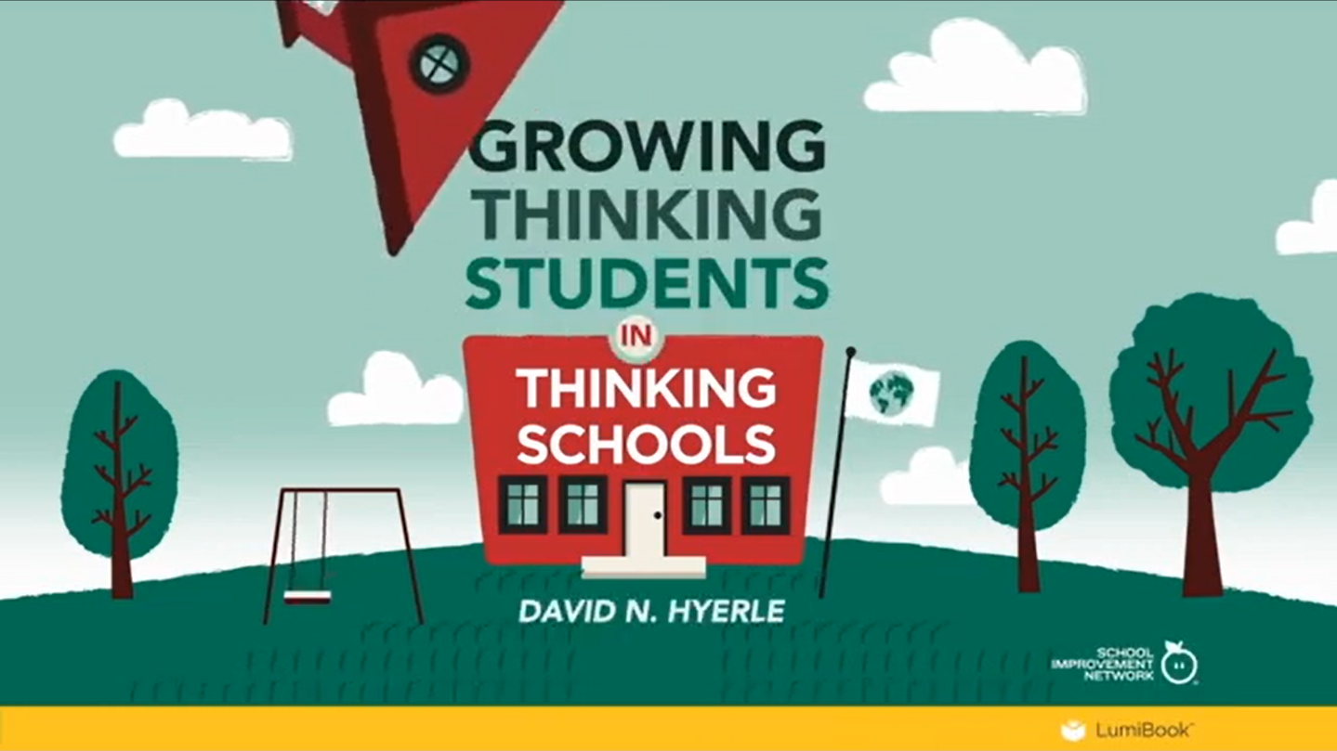
Video: What is a Thinking School?
(Thinking Schools International, 2017)
Notes:
Video
What is a Thinking School? (4:58 minutes)
https://youtu.be/b9JGEEBuQqw?si=6XiInYbeLzNlt5dW
To Know
Metacognition is at the heart of the curriculum for schools that focus on “Thinking.” Everyone in the school (including students, teachers, and support staff) promote metacognitive thought at a high level. Such schools are student centered and work to help their scholars become adaptable, able to deconstruct their own learning, problem solve, and develop tools for thinking. Metacognition is embedded into everything that takes place in the classroom. Both content and process are simultaneously presented as the teacher becomes a facilitator of student-driven learning.
To Do
Ask participants to jot down key take-aways about how the culture of a thinking school differs from a traditional school as they watch the video.
Debrief/discuss the video after showing.
Optional Activity
Ask participants to design a chart illustrating the characteristics of a traditional school vs a “thinking school.”
Reference
Thinking Schools International. (2017, May 3). What is a thinking school? [Video]. YouTube. https://youtu.be/b9JGEEBuQqw?si=6XiInYbeLzNlt5dW

Slide 35
Strategy Spotlight: Conversations to Boost Thinking
Make thinking valued, visible, and actively promoted by…
Describing
Wondering
Considering different viewpoints
Building explanations
Reasoning with evidence
Making connections
Capturing the main point and forming conclusions
Uncovering complexity
Notes:
Handout 4
Conversations that Boost Thinking
To Know/To Say
This slide and the next discuss strategies, conversation type, and questions that help create schools where thinking is valued, visible, and actively promoted.
Reference
Ritchhart, R. (2012). Cultures of thinking observations [PDF file]. https://pz.harvard.edu/sites/default/files/CoT%20Observation%20Guide.pdf

Slide 36
Conversations to Boost Thinking
Make thinking valued, visible, and actively promoted by…
Describe What’s There
What do you see and notice?
Wondering
What are you curious about here?
Consider Different Viewpoints
What’s another angle on this?
Build Explanations
What’s really going on here?
Reason with the Evidence
Why do you think so?
Make Connections
How does this fit with what you already know?
Capture the Heart and Form Conclusions
What’s at the core or center of this?
Uncovering Complexity
What lies beneath the surface of this?
(Ritchhart, 2012)
Notes:
Handout 4
Conversations that Boost Thinking
To Know/To Do/To Say
This slide shows conversation types and strategies matched with questions that promote them to engage students; boost and expand thinking; and foster metacognition.
Review each type of thinking conversation/strategy that is listed on the slide.
Have participants work in small groups (2-4) using Handout 4.
Ask them to work cooperatively and match the questions to the types of conversations they promote.
Also ask them to brainstorm and add additional questions to spark each type of conversation.
Share out the additional questions they have created that promote various types of thinking conversations.
Reference
Ritchhart, R. (2012). Cultures of thinking observations [PDF file]. https://pz.harvard.edu/sites/default/files/CoT%20Observation%20Guide.pdf

Slide 37
Strategy Spotlight: Classroom Norms That Promote Metacognition
What?
Expectations and behaviors that establish the classroom as a collective thinking and learning community
Why?
Fosters an environment where students view learning as their own
Helps create a culture where student thinking is visible and valued
Promotes high-expectations for students’ involvement in their learning
(College of Natural Science, n.d.)
Notes:
To Know
This activity provides an opportunity for participants to understand the importance of developing classroom norms that help to value thinking and foster metacognition. Participants will develop metacognitive norms to be used and posted in their classroom.
To Do/To Say
Classroom norms that foster metacognition
Help establish a culture that encourages student self-reflection and self-assessment, empowering students to become independent learners
Articulate expectations and behaviors that establish a collective thinking and learning community
The norms should focus on the following, to develop and support a metacognitive learning environment.
Be positive, inclusive, and productive
Students view learning as their own and strive to work collaboratively for deeper understanding
Student thinking is visible and valued
Student involvement in their learning is a high expectation
Including students in the process of a creating norms is a great way to give them to give feedback; ensure norms are remembered and acted upon; and help students begin to take charge of their own learning.
Activity
Supply chart paper and markers for groups to record the metacognitive norms they develop.
Group participants in small groups from similar grade level/content.
Ask groups to develop norms (expectations and behaviors) that would support students in becoming a collective thinking and learning community.
They can brainstorm ideas by writing norms down on sticky notes, then coming to a consensus about which are best.
Provide a few examples from the Sample Classroom Norms below.
Share out and have group discussion.
Sample Classroom Norms to Foster Metacognition
Think, reason, and wonder
Be willing to collaborate and share your thinking
Focus during lessons and take notes
Use resources to find answers
Persevere - Don’t give up!
Be curious, open minded, and ask questions
Accept challenges and be open to feedback
View mistakes as learning opportunities
Reflect on and self-assess your work often
Listen, respond, and connect to the thinking of others
Reference
College of Natural Science. (n.d.). Choosing and establishing classroom norms. Michigan State University. https://connectedmath.migrate.natsci.msu.edu/classroom/student-centered-classroom/classroom-norms.aspx

Slide 38
Teaching a Culture of Thinking in the Classroom
Expectations
Language
Modeling
Time
Opportunities
Thinking routines
Physical environment
Interactions
(Brooks & Ritchhart, 2012)
Notes:
To Know
This slide provides important keys to developing a classroom metacognitive culture. These forces can be implemented to foster metacognition and improve student “thinking” skills while creating a classroom environment conducive of collective inquiry.
To Do/To Say
Review the key points on the slide and expand on each.
Educators who are intentional about developing a culture of thinking in the classroom are going to be the ones most successful. There are specific, tangible actions teachers can take that will enable metacognition to flourish. We will briefly look at what these actions are and then examine each more closely in consequent slides.
Clear expectations are set for learning and thinking.
Language conveys the importance reflection and thinking skills.
Modeling is used to illustrate strategic thought processes.
Time for questions, contributions, thinking, and processing is provided. Students are given both time and space to elaborate and develop ideas of their own and others. Teacher talk is monitored so student conversation dominates.
Opportunities exist to make connections, direct one’s own learning, and provoke thinking and reflection. Content and learning tasks are intentionally selected that foster higher-level thinking skills.
Thinking routines and structures to organize thoughts are established. Students become so familiar and experienced with thinking structures that they become routine and students become self-activated learners.
A physical environment that inspires and facilitates thinking and learning is provided. The classroom space is arranged to facilitate thoughtful interactions and displays inspire learning and positive messages about how thinking can unlock knowledge. Numerous avenues to document and capture thinking, including technology are readily available to students.
Interactions are promoted so that ideas can be critiqued, challenged, and expanded on. Mistakes are viewed as opportunities for deeper learning and respect is shown for all other’s thinking. Students drive learning in groups and the teacher plays the role of listener and supporter.
.
References
Brooks, S., & Ritchhart, R. (2012). The development of a culture of thinking in my classroom: Self-assessment [PDF file]. https://pz.harvard.edu/sites/default/files/Self%20Assessing%20CoT.pdf

Slide 39
Strategy Spotlight: Set Clear Expectations for Learning and Thinking
Focus on the value of improving thinking and learning
Provide the purpose and benefits of learning the content
Clearly communicate learning targets and success criteria
Strive to develop independent learners
(Brooks & Ritchhart, 2012)
Notes:
To Know/To Say/To Do
Metacognitive classrooms focus on the value of improving thinking and learning rather than merely “completing tasks.”
It is important to provide students with the purpose and benefits for learning the content.
Communicating learning targets and success criteria throughout the lesson enables students to be clear about what and how they are learning.
Developing independent learners is the ultimate goal and setting clear expectations helps students to become more self-activated.
References
Brooks, S., & Ritchhart, R. (2012). The development of a culture of thinking in my classroom: Self-assessment [PDF file]. https://pz.harvard.edu/sites/default/files/Self%20Assessing%20CoT.pdf

Slide 40
Strategy Spotlight: Use Language to Describe the Thinking Processes
Provide students with vocabulary for describing and thinking
Describe and elaborate on teacher’s thinking
Share and discuss thinking strategies demonstrated by students
Provide specific actionable feedback to guide student improvement
Use inclusive community building language
(Brooks & Ritchhart, 2012)
Notes:
To Know/To Say
Using the language of thinking is another way to foster metacognition.
Provide students with the vocabulary they need for describing and reflecting on thinking.
Make sure language is deliberately used to describe the thinking the teacher is engaged in.
Share and discuss thinking strategies that students themselves demonstrate.
Feedback teachers provide to students should contain language that provides clear actionable information about what students need to do in order to improve their learning.
It is also important that language helps to build the classroom community as an inclusive place to think and learn. Talk about what “we” are learning and how to answer “our” questions.
References
Brooks, S., & Ritchhart, R. (2012). The development of a culture of thinking in my classroom: Self-assessment [PDF file]. https://pz.harvard.edu/sites/default/files/Self%20Assessing%20CoT.pdf

Slide 41
Strategy Spotlight: Modeling Thought Processes
Thought processes are modeled by teachers, students, and their peers
Thought processes are discussed, shared, and made visible
Evidence and justification are provided to support one’s thinking
Everyone in the classroom feels they are learning together
(Brooks & Ritchhart, 2012)
Notes:
To Know/To Say
Both teacher and student thinking should regularly be on display.
Establish norms of curiosity, open-mindedness, risk taking, and reflection for all members of the class, including the teacher.
Model who we are as thinkers and learners so that the process of our thinking is discussed, shared, and made visible. This is essential for developing students who are metacognitive.
Evidence and justification should be expected and provided to support one’s thinking.
Everyone in the classroom should feel that they are learning together.
Activity
Participants work in small groups.
Each team member jots down a description of a practice they are currently using or have seen used that aligns with one of the bulleted points. They should be specific when describing the practice.
A Round Robin structure can be used for members to share their ideas with the group.
References
Brooks, S., & Ritchhart, R. (2012). The development of a culture of thinking in my classroom: Self-assessment [PDF file]. https://pz.harvard.edu/sites/default/files/Self%20Assessing%20CoT.pdf

Slide 42
Strategy Spotlight: Provide Time and Opportunities for Thinking
Provide time and space for students to think, question, and develop ideas
Allow more student conversation in place of teacher talk
Create opportunities for students to formulate and provide thoughtful responses and explore topics in depth
Provide purposeful tasks to actively engage students in the thinking processes
(Brooks & Ritchhart, 2012)
Notes:
To Know/To Say
Students need to be given both time and space to elaborate and develop ideas of their own and others in order to foster metacognition.
Teacher talk should be monitored so student conversation dominates.
Provide “thinking time” for exploring topics more in depth, as well as time to formulate thoughtful responses helps to advance metacognitive skills.
Make certain activities are purposeful. Require students to “engage in thinking” as part of their ongoing experience of the classroom.
References
Brooks, S., & Ritchhart, R. (2012). The development of a culture of thinking in my classroom: Self-assessment [PDF file]. https://pz.harvard.edu/sites/default/files/Self%20Assessing%20CoT.pdf

Slide 43
Strategy Spotlight: Thinking Routines
Establish thinking routines and structures for organizing students’ thoughts
Support student thinking through scaffolding to help them make sense of skills and concepts
Help students become familiar and experienced with thinking structures so their use becomes routine
Provide tools to support thinking that can be used independently
(Brooks & Ritchhart, 2012)
Notes:
Activity Link
Project Zero’s Thinking Routine Toolbox
http://www.pz.harvard.edu/thinking-routines
To Know/To Say
A thinking routine is a set of questions or a brief sequence of steps used to scaffold and support student thinking. These structures help students organize and make sense of their thoughts. Thinking routines should become so familiar with students that they become second nature and enable students to be self-activated learners. Review the key points on slide and expand on each.
Establish thinking routines and structures to assist in organizing students’ thoughts.
Support student thinking through scaffolding…step by step…minute by minute… to help them make sense of skills and concepts,
Help students become familiar and experienced with thinking structures so their use becomes routine. Model the structures for them to see.
Provide tools to support thinking that can be used independently. These help students become self-activated learners.
Activity
Next, provide time to participants to go deeper and enhance their understanding of Thinking Routines by accessing Project Zero’s Thinking Routine Toolbox (http://www.pz.harvard.edu/thinking-routines) which includes several thinking routines.
First, have participants access the website
Provide about 3 minutes for them to explore the website, maybe starting with the “please click here to explore more about thinking routines” (near the end of the paragraph).
Ask them to jot down a new key bit of new learning that resonates with them and share with their group once the reading is completed.
Next, provide 5 minutes for participants to peruse some of the thinking structures on the site.
The next slide has another activity associated with this website.
References
Brooks, S., & Ritchhart, R. (2012). The development of a culture of thinking in my classroom: Self-assessment [PDF file]. https://pz.harvard.edu/sites/default/files/Self%20Assessing%20CoT.pdf
Harvard Graduate School of Education. (n.d.). Project zero’s thinking routine toolbox. https://pz.harvard.edu/thinking-routines

Slide 44
Thinking Routine: Think, Puzzle, Explore
Things we know
Questions?
What puzzles us?
Ideas we want to explore!
Notes:
Activity Link
Think, Puzzle, Explore
https://pz.harvard.edu/sites/default/files/Think%20Puzzle%20Explore_1.pdf
To Know
This activity provides an opportunity for participants to experience a thinking routine. The guiding questions enable thinking to go deeper and generate discussion to clarify and expand on the topic.
To Do
Introduce the activity then ask each participant to access and read the resource that explains the thinking routine “Think, Puzzle, Explore” (you can provide a QR code or link for access).
Then have participants work in teams of 4-6 to engage in the thinking routine.
They will create chart like the one on the slide for the routine and record responses regarding their thoughts about Metacognition.
Once teams have completed the activity debrief by asking how the structure helped them be more reflective, go deeper, and elaborate on their thinking.
To Say
Now, we’ll have an opportunity to experience a thinking routine called Think, Puzzle, Explore. We will begin by accessing the handout that explains this core thinking routine. Once you have finished the reading, meet with members of your group. Choose a facilitator, a recorder, and create a chart to record responses regarding your thoughts about metacognition. Then begin the thinking routine by encouraging each member to contribute responses to these questions:
What do you think you know about this topic?
What questions do you have?
What puzzles you about this topic?
What ideas does the topic make you want to explore?
Have a group member record responses on the chart.
References
Harvard Graduate School of Education. (n.d.). Project zero’s thinking routine toolbox. https://pz.harvard.edu/thinking-routines

Slide 45
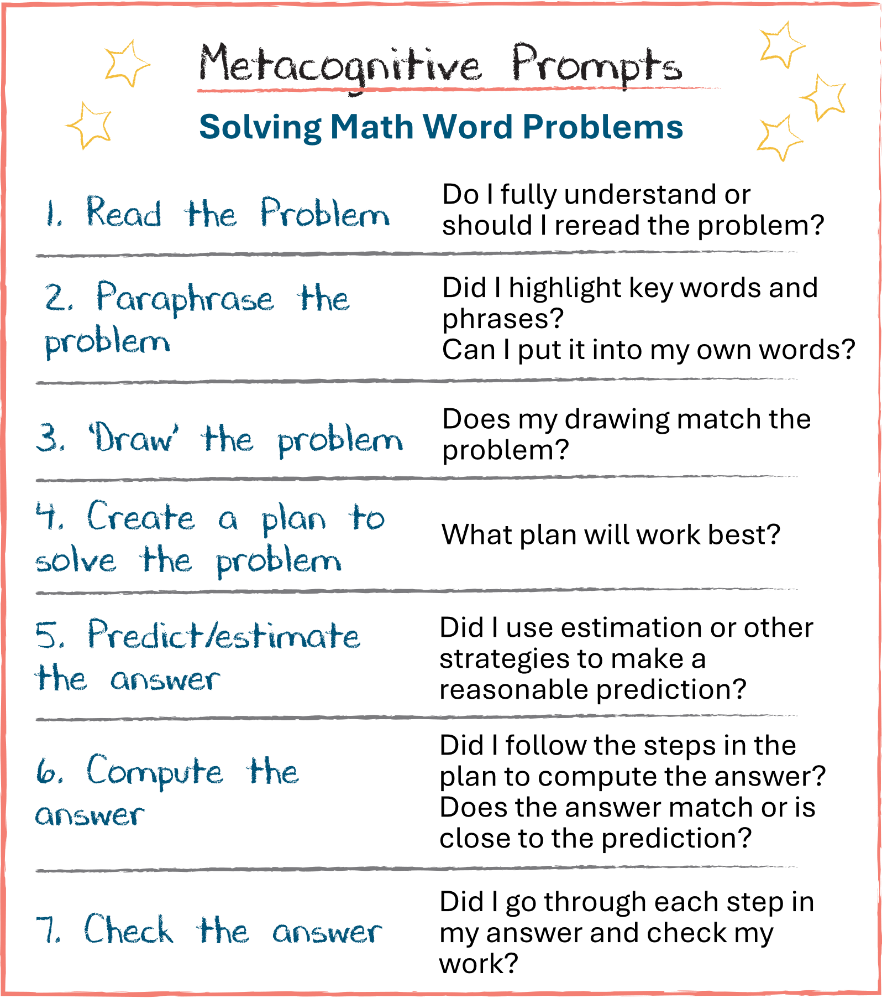
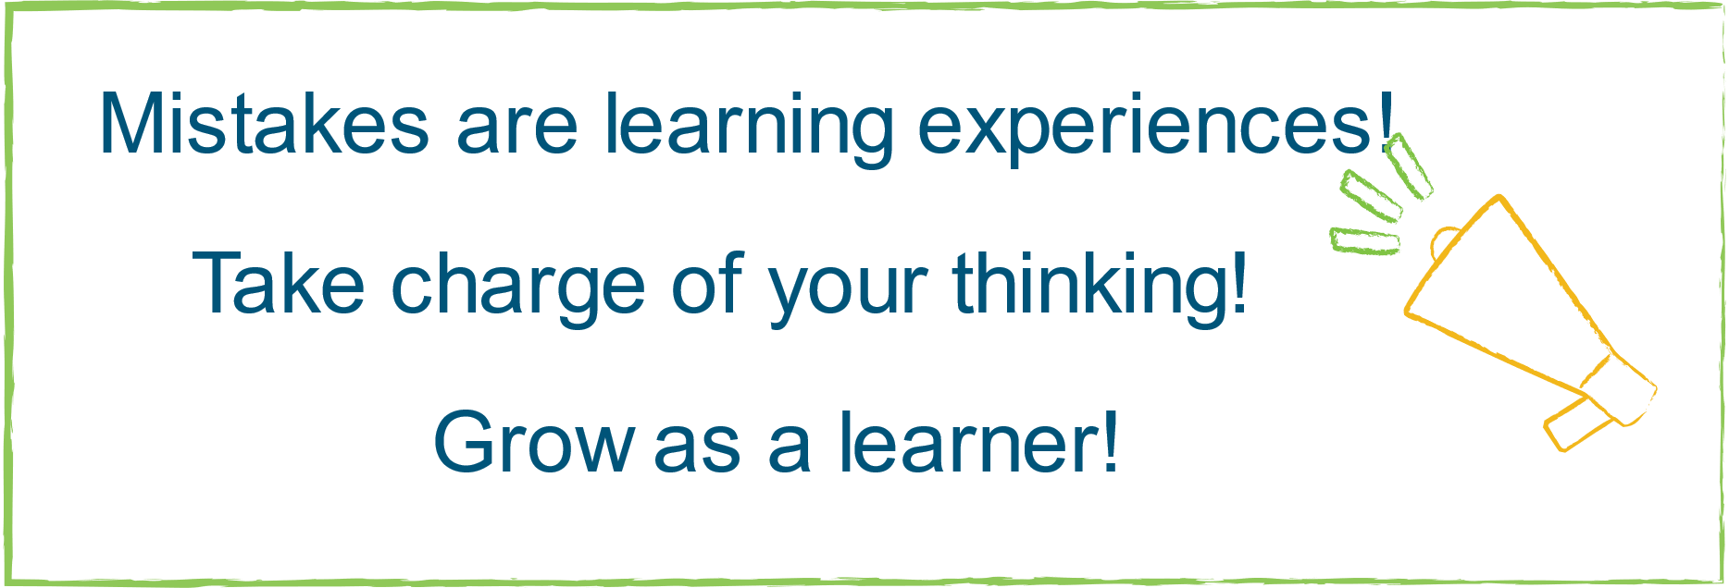
Strategy Spotlight: Provide Prompts for Metacognitive Thinking
Display thinking prompts/processes
Arrange space to facilitate interactions
Provide inspiring and positive messages
Document and capture thinking
(Brooks & Ritchhart, 2012)
Notes:
To Know/To Say
A physical environment that inspires and facilitates thinking and learning is sure to foster metacognition.
Displaying the process of thinking and the development of ideas on charts and posters makes thinking visible in your classroom.
Also, make sure classroom space is arranged to encourage thoughtful interactions and to generate discussions.
Having easy access to numerous avenues to document and capture thinking, including technology, helps provide students with a record of their thoughts that can be used to refresh memories and push thinking further.
References
Brooks, S., & Ritchhart, R. (2012). The development of a culture of thinking in my classroom: Self-assessment [PDF file]. https://pz.harvard.edu/sites/default/files/Self%20Assessing%20CoT.pdf
Montague, M. (1992). The effects of cognitive and metacognitive strategy instruction on the mathematical problem solving of middle school students with learning disabilities. Journal of Learning, 25, 230-248. https://www.interventioncentral.org/sites/default/files/pdfs/pdfs_interventions/math_meta_cog_strategy_montague_SAY_ASK_CHECK.pdf

Slide 46
Strategy Spotlight: Metacognitive Feedback – Exit Tickets
Today my learning stopped because….
Today, I considered a a question, new idea or new perspective…
Today I understood and learned…
(Owen & Vista, 2017)
Notes:
To Know/To Say
Classrooms that collect and use feedback about students’ thinking regarding their learning provide opportunities for students to process their learning accomplishments and what can be improved on. Exit Tickets are one such feedback tool. Students reflect on their learning and complete them at the end of a lesson. They prompt students to think about how and what they learn, as well as challenges they are still facing.
To Do
Review the exit ticket on the slide and discuss the benefits of using feedback tools in classrooms to collect metacognitive thoughts from students regarding their learning. Ask participants to share other tools or strategies they use to collect metacognitive feedback from their students.
Reference
Owen, D., & Vista, A. (2017, November 15). Strategies for teaching metacognition in classrooms. Brookings. https://www.brookings.edu/articles/strategies-for-teaching-metacognition-in-classrooms/

Slide 47
Strategy Spotlight: Promote Interaction of Ideas
Respect and value others’ contributions
Create a spirit of ongoing collaboration
Help students expand on ideas and encourage critiques and challenges
View mistakes as opportunities for deeper learning
Listen thoughtfully and show genuine curiosity and interest
Let students drive learning
(Brooks & Ritchhart, 2012)
Notes:
To Know/To Say/To Do
Showing respect for and valuing of one another’s contributions of ideas and thinking is an excellent way to encourage interaction.
A spirit of ongoing collaboration makes it much more likely that all students will engage and contribute.
Through questioning, teachers gently push students to expand on ideas, encourage critiques, and address challenges. These exchanges help the mind to delve deeper and examine things closely.
Mistakes are opportunities for deeper learning and this message must be clearly communicated.
By being a thoughtful listener and showing genuine curiosity and interest in student thinking, a collaborative and interactive classroom culture can be built. It is important to be a teacher that listens, encourages, and supports while letting students drive the learning!
References
Brooks, S., & Ritchhart, R. (2012). The development of a culture of thinking in my classroom: Self-assessment [PDF file]. https://pz.harvard.edu/sites/default/files/Self%20Assessing%20CoT.pdf

Slide 48
How is a metacognitive culture being developed in your classroom?
(Brooks & Ritchhart, 2012)
Notes:
Self-Assessment Activity Link
https://pz.harvard.edu/sites/default/files/Self%20Assessing%20CoT.pdf
Note: Presenter will need to bring copies of this self-assessment for participants to use to the training.
To Know
This activity is designed to reflect on what has been learned and validate that teachers may already have practices in place that foster metacognition. By recognizing and building on teacher strengths, educators will be more receptive to improving metacognitive practices in their classrooms.
To Do
Ask participants to reflect on what they’ve learned about metacognition and think about what is currently taking place in their classroom/building to foster a metacognitive culture.
Next take “The Development of a Culture of Thinking in My Classroom: Self-Assessment” which provides a great opportunity for teachers to reflect on areas of strength and opportunities to enhance metacognitive thinking.
Partner with a peer or small group to discuss results.
Use the discussion and results to have initial “action planning” conversations so that a culture for metacognitive thought is fostered in their classroom/building.
Ask participants to share what they have learned about the metacognitive culture in their classroom and some potential actions to increase it. Share out.
The “action planning” portion of this activity continues in detail on slide 50 with the Next Steps Action Plan Template.
Reference
Brooks, S., & Ritchhart, R. (2012). The development of a culture of thinking in my classroom: Self-assessment [PDF file]. https://pz.harvard.edu/sites/default/files/Self%20Assessing%20CoT.pdf

Slide 49
Promoting a Metacognitive Classroom Essential Questions
Why is it important for educators to promote a classroom culture that develops and supports metacognitive thought?
How can educators establish and advance an environment that values and encourages reflective and high-level thinking?
Notes:
To Know/To Say
These essential questions help to guide thinking before, during, and after this session of learning. Notice how they coincide with the EF 3 criteria in the Practice Profile.
To Do
Let’s review the essential questions for the session. What questions do you still have?

Slide 50
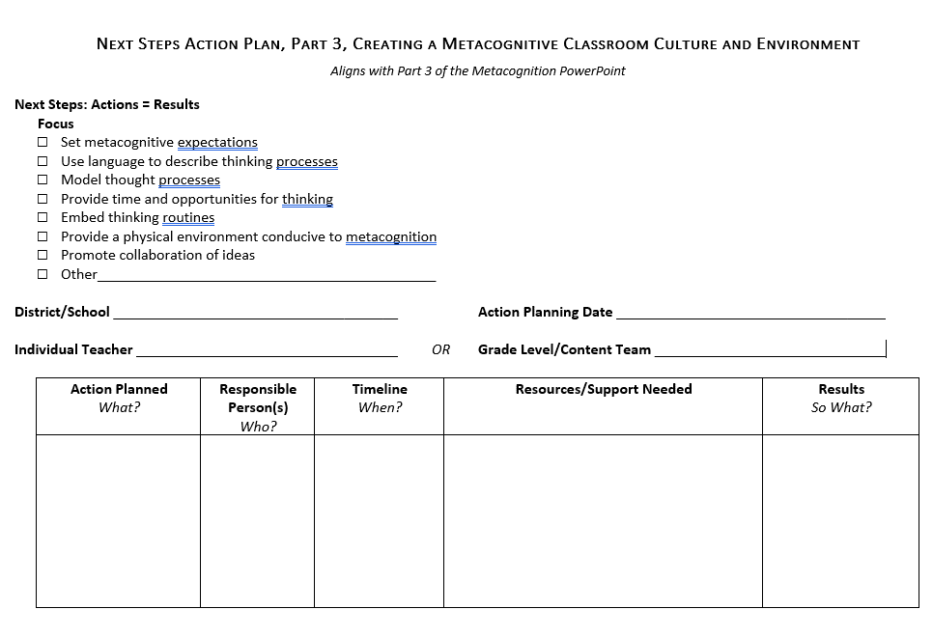
Next Steps Action Plan, Part 3
Creating a Metacognitive Classroom Culture and Environment
Review strategies that successful metacognitive thinkers employ
Review strategies that successful metacognitive classrooms exhibit
Develop an action plan to create or enhance a metacognitive culture and environment for your classroom
Notes:
Handout 5
Next Steps Action Plan, Part 3, Creating a Metacognitive Classroom Culture and Environment
To Know/To Do
Action Planning enables participants to reflect on what they have learned, their strengths, and opportunities for growth. A documented action plan that includes the action, person responsible, timeline, and resources makes it much more likely that change will take place. Recording results will encourage educators to reflect on their accomplishments and continue actions that prove successful.
Provide participants with a copy of the action planning template (electronic or hard copy). Individual teachers or teams can design their plans based on data collected from the self-assessment taken (slide 48). One or more focus areas may be addressed.
To Say
Take some time to review the data collected on the self assessment you just took. Use the data to help design an action plan (Handout 5) to promote a metacognitive classroom culture and environment. You may select one or more areas of focus. You might work to develop a plan individually, or you may work collaboratively with a team. Be sure to include the actions that will be taken; who will take the actions; a timeline for completing your work; resources and support needed; as well as follow-up that details the results. We will take a bit of time to discuss your next steps with the group.

Slide 51
Closing and Thank You!
For more information or if you need further coaching, please contact
Note: References are on the following slides
Notes:
To Know/To Do/To Say
Choose how to close this final part of the training and include your contact information. Offer further opportunities for training that might be of interest.
Show the reference slides if appropriate.

Slide 52
Part 3 References
Brooks, S., & Ritchhart, R. (2012). The development of a culture of thinking in my classroom: Self-assessment [PDF file]. https://pz.harvard.edu/sites/default/files/Self%20Assessing%20CoT.pdf
Building Learning Power. (n.d.). Creating learning friendly classroom cultures. https://www.buildinglearningpower.com/2018/05/creating-metacognitive-classroom-cultures/
Cherry, K. (2023, April 18). Cognition in psychology. Verywell Mind. https://www.verywellmind.com/what-is-cognition-2794982
College of Natural Science. (n.d.). Choosing and establishing classroom norms. Michigan State University. https://connectedmath.migrate.natsci.msu.edu/classroom/student-centered-classroom/classroom-norms.aspx
Duquesne University Center for Teaching Excellence. (2015, March 30). Helping students learn from returned tests. The Flourishing Academic. https://flourishingacademic.wordpress.com/2015/03/30/helping-students-learn-from-returned-tests/
Harvard Graduate School of Education. (n.d.). Project zero’s thinking routine toolbox. https://pz.harvard.edu/thinking-routines
Kruse, M. (n.d.). How to create classroom norms with students. Reading and Writing Haven. https://www.readingandwritinghaven.com/how-to-create-classroom-norms-with-students
Lovett, C. M. (2013). Make exams worth more than the grade: Using exam wrappers to promote metacognition. In N. Silver, M. Kaplan, D. LaVaque-Manty, & D. Meizlish (Eds.), Using reflection and metacognition to improve student learning: Across the disciplines, across the academy (pp. 18-52). Routledge.
Missouri Department of Elementary & Secondary Education. (n.d.). Leader standards. https://dese.mo.gov/media/pdf/oeq-ed-leaderstandards
Missouri Department of Elementary & Secondary Education. (n.d.). Teacher standards. https://dese.mo.gov/media/pdf/oeq-ed-teachstandards
MoEdu-SAIL. (2023). Blueprint for district and building leadership (7th ed.). Missouri Department of Elementary and Secondary Education: Northern Arizona University, Institute for Human Development.
Notes:
To Know
The next slide also contain references. You can choose whether to show to the participants at the end of the training.

Slide 53
Part 3 References, continued
Montague, M. (1992). The effects of cognitive and metacognitive strategy instruction on the mathematical problem solving of middle school students with learning disabilities. Journal of Learning, 25, 230-248. https://www.interventioncentral.org/sites/default/files/pdfs/pdfs_interventions/math_meta_cog_strategy_montague_SAY_ASK_CHECK.pdf
Owen, D., & Vista, A. (2017, November 15). Strategies for teaching metacognition in classrooms. Brookings. https://www.brookings.edu/articles/strategies-for-teaching-metacognition-in-classrooms/
Peteranetz, M. S. (2016). Fostering metacognition in K-12 classrooms: Recommendations for practice. The Nebraska Educator, 3. https://digitalcommons.unl.edu/cgi/viewcontent.cgi?article=1040&context=nebeducator
Ritchhart, R. (2012). Cultures of thinking observations [PDF file]. https://pz.harvard.edu/sites/default/files/CoT%20Observation%20Guide.pdf
Ritchhart, R. (2015). Creating cultures of thinking: The 8 forces we must master to truly transform our schools. John Wiley & Sons.
Tarricone, P. (2011). The taxonomy of metacognition. Psychology Press. https://doi.org/10.4324/9780203830529
Teach & Kids Learn. (2017, January 9). Developing a culture of metacognition - the art of teaching how to think. https://www.teachnkidslearn.com/developing-student-metacognition/
Thinking Schools International. (2017, May 3). What is a thinking school? [Video]. YouTube. https://youtu.be/b9JGEEBuQqw?si=6XiInYbeLzNlt5dW
Torrisi-Steele, G. (2016). Online learning and metacognition: A design framework. In V. Wang (Ed.), Handbook of research on learning outcomes and opportunities in the digital age (pp. 221-241). IGI Global. https://www.igi-global.com/chapter/online-learning-and-metacognition/142378
Wilson, D., & Conyers, M. (2016). Teaching students to drive their brains: Metacognitive strategies, activities, and lesson ideas. Association for Supervision and Curriculum Development.

