Slide 1
Hidden Slide Intro
Collaborative Teams, Part 1
This module starts with hidden slides providing information for the presenter.

Slide 2
Hidden Slide #1
The Collaborative Teams Module was designed to be used in the following manner.
The audience for this module is educators, building leaders, instructional coaches, and teachers of all contents and levels. This module can be used for whole staff presentations.
Time should be allotted after training for participants to reflect and have conversations regarding current status and needed changes. Participants should reflect on the following questions. Where are we now? Where are we going? How do we get there?
Participants should complete the SAPP for collaborative teams prior to training. Presenters should use this information to assess the district’s current level of implementation and select module activities and content that align with the district’s specific needs.
Following the training participants should complete a Next Steps Action Plan – note there is a separate action plan for each of the three parts of the module.
Notes:
To Know
It is important for all educators, building leaders, and instructional coaches to understand the importance and benefits of developing effective collaborative teams.
The content in this module is intended to help educators develop capacity regarding the culture, structures, and processes that are necessary to implement effective collaborative teams.
Strategies and tools that help educators create efficient and effective collaborative teams will be presented.

Slide 3
Hidden Slide #2
Collaborative Team Module Organization
Part 1 EF 1 | Part 2 EF 2 | Part 3 EF 3
Building a Culture of Collective Responsibility | Effective Team Structures & Skills | Group Processes for Impactful Collaboration
Purpose/Goals Trust Communication | Team Configurations Time Roles Collaborative Skills | Agendas/Minutes Norms Consensus Protocol
Notes:
To Know
The CT module is designed around the Collaborative Team Framework and aligns with each essential function on the CT Practice Profile:
Part 1, Culture (EF1): Building a culture of collective responsibility
Part 2, Structure (EF2): Structuring team meetings to assure authentic and effective collaboration
Part 3, Process (EF3): Using group processes for impactful collaboration

Slide 4
Hidden Slide #3
In-person professional development suggestions
The following estimated times for each Collaborative Teams Module part are based on providing participants with ample time to process and reflect on content.
Part 1: Introduction & Building a Culture of Collective Responsibility, 2.5 hours
Part 2: Effective Team Structures & Skills, 3 hours
Part 3: Group Processes for Impactful Collaboration, 3 to 4 hours
Total = 8.5 to 9.5 hours
Read the slide notes thoroughly as they provide detailed information to assist you in preparation for and delivery of the presentation.
Some reflection activities can be expanded by using the activities designated OPTIONAL.
Breaks can be added at the presenter’s discretion.
Notes:
To Know
The slide includes estimated times for each of the three parts. This PPT, Part 1 of the Collaborative Teams module is designed to be completed in 2.5 hours.
Presenter notes are included in the PowerPoint slides. Background information for the presenter is shown as “To Know.” Statements and activities to be shared with participants are shown as either “To Say” or “To Do.” In many instances, there are various combinations of “To Know/To Do/To Say.” The presenter notes also include cues for “Handouts” and activities.
Additional activities, examples, videos, etc. are included in the Collaborative Teams Coaching Companion. You can add material from the Coaching Companion to corresponding PowerPoint content.
A printed Practice Profile and an electronic Self-Assessment Practice Profile (SAPP) tool are available for use by individuals, teams, or schools for periodic self-assessment, monitoring of implementation of the practice, or to identify training/coaching needs.
The presenter should download any video intended for use in a training, as you may not have internet access in all school sites.

Slide 5
Hidden Slide #4
Supplies and information needed
WIFI access for presenter and participants
Access to videos (through WIFI if available, however, download to flash drive as a back-up)
Chart paper
Plain paper
Markers and highlighters
Post-it-Notes
Consider inserting QR codes and requesting that participants bring a device with a QR reader to scan codes for easy access to documents
Notes:
To Know
This slide is for presenters as they prepare.

Slide 6
Hidden Slide #5
General guidance for virtual presentations
Notify and request prior permission from participants if session is to be videotaped
Test your tech set up prior to the session (download and save videos on flash drive as back-up)
Keep sessions as short as possible and/or provide breaks
Provide and discuss norms for participation (camera on, ask questions in chat – if that is your preference, stay engaged)
Minimize distractions (request participants mute when not speaking)
Use 2 consultants – 1 to present, 1 to manage chat, etc.
Identify other roles prior to presentation, as appropriate (timekeeper, notetaker, etc.)
Create opportunities for participant engagement and interaction (e.g., HQ Tools for Audience Engagement Collaborative Notetaking Document)
When using breakout rooms, equip each room with 1 consultant to facilitate and 1 to take notes, if possible
Encourage reflection and action
Notes:
To Know/To Do
If presenting this module virtually, the notes on this slide will help you prepare for the presentation.

Slide 7
Hidden Slide #6
Handouts
CT 1.1, Collaborative Teams Infographic
CT 1.2, Collaborative Teams Practice Profile
CT 1.3, Collaborative Teams Key Terms
CT 1.4, Mindframes for High Impact Teams
CT 1.5, Team Trust Survey
CT 1.6, Culture of Collective Responsibility Checklist
CT 1.7, Next Steps Action Plan, Part 1
Notes:
To Know
Handouts listed are in the handout folder.
Numerous sites are also provided throughout the module for participants to access via a web link. It is suggested that QR codes are added to those slides so participants can easily access the links.
Due to copyright regulations, some materials are linked to their original source and must be downloaded from the link.

Slide 8
Hidden Slide #7
Collaborative Teams Key Terms (Part 1)
Collaborative teaming. Educators working together toward a common goal, leveraging their unique skills, perspectives, and expertise to achieve a common purpose and support student success.
Collaborative culture. An environment where educators, administrators, and staff work together in a spirit of trust, shared responsibility, and continuous learning to improve student outcomes.
Collective teacher efficacy. The shared belief by a group of teachers in a particular educational environment that they have the ability to positively impact student outcomes.
Data-based decision making. A process of collecting, organizing, and analyzing data for the purposes of problem-solving, making instructional decisions, and for ongoing continuous school improvement.
Notes:
Handout CT 1.3
Collaborative Teams Key Terms
To Know/To Do
Key terms that align with each Essential Function can be found in the notes section at the beginning of each module. Presenters may choose to provide participants with Handout 1.3, which contains terms associated with the module. Another consideration is to provide table copies of this handout.
References (adapted from)
Bloomberg, P., & Pitchford, B. (2016). Leading impact teams: Building a culture of efficacy (1st ed.). Corwin.
Ferriter, W.M. (2020, April 7). Spotting collaborative teams with high levels of collective efficacy. Solution Tree. https://www.solutiontree.com/blog/spotting-collaborative-teams-with-high-levels-of-collective-efficacy/
Hattie, J., & Zierer, K. (2017). 10 mindframes for visible learning. Teaching for success (1st ed.). Routledge.
Horton, D. (2022, November 18). Successful systems of communication for school teams. The Core Collaborative. https://thecorecollaborative.com/successful-systems-of-communication-for-school-teams/
Mantell, M. (2025, March 19). What is social perceptiveness? 12 skills you need to master. Science of People. https://www.scienceofpeople.com/social-perceptiveness/
Marzano, R. J., Heflebower, T., Hoegh, J. K., Warrick, P., Grift, G., Hecker, L., & Wills, J. (2016). Collaborative teams that transform schools: The next step in PLCs. Marzano Research.
MoEdu-Sail. (2018). Data-based decision making online module. http://www.moedu-sail.org/courses/data-based-decision-making-2/
Rouda, R. (2018, March 28). A framework for effective data use in schools. Learning for Action. https://learningforaction.com/lfa-blogpost/data-matters-framework
Solone, C.J., Thornton, B.E., Chiappe, J.C., Perez, C., Rearik, M.K., & Falvey, M.A. (2020). Creating collaborative schools in the United States: A review of best practices. International Electronic Journal of Elementary Education. 12(3). 283-292. https://files.eric.ed.gov/fulltext/EJ1242461.pdf

Slide 9
Hidden Slide #8
Collaborative Teams Key Terms (Part 1)
Data cycles. A structured, ongoing process of collecting, analyzing, and using data to inform decision making and improve student outcomes. These cycles help educators track progress, identify areas for improvement, and adjust instructional practices to meet student needs effectively.
Interdependent. Dependence upon one another.
Mindframes for high impact teams. Refers to shared beliefs, attitudes, and ways of thinking that drive effective collaboration, decision making, and continuous improvement within a team. These mindframes influence how team members interact, solve problems, and work toward common goals, ultimately enhancing team performance and outcomes.
Social perceptiveness. The ability to accurately perceive and understand the thoughts, feelings, and behaviors of others in social settings.
Notes:
Handout CT 1.3
Collaborative Teams Key Terms
To Know/To Do
Key terms that align with each Essential Function can be found in the notes section at the beginning of each module. Presenters may choose to provide participants with Handout 1.3, which contains terms associated with the module. Another consideration is to provide table copies of this handout.
References (adapted from)
Bloomberg, P., & Pitchford, B. (2016). Leading impact teams: Building a culture of efficacy (1st ed.). Corwin.
Ferriter, W.M. (2020, April 7). Spotting collaborative teams with high levels of collective efficacy. Solution Tree. https://www.solutiontree.com/blog/spotting-collaborative-teams-with-high-levels-of-collective-efficacy/
Hattie, J., & Zierer, K. (2017). 10 mindframes for visible learning. Teaching for success (1st ed.). Routledge.
Horton, D. (2022, November 18). Successful systems of communication for school teams. The Core Collaborative. https://thecorecollaborative.com/successful-systems-of-communication-for-school-teams/
Mantell, M. (2025, March 19). What is social perceptiveness? 12 skills you need to master. Science of People. https://www.scienceofpeople.com/social-perceptiveness/
Marzano, R. J., Heflebower, T., Hoegh, J. K., Warrick, P., Grift, G., Hecker, L., & Wills, J. (2016). Collaborative teams that transform schools: The next step in PLCs. Marzano Research.
MoEdu-Sail. (2018). Data-based decision making online module. http://www.moedu-sail.org/courses/data-based-decision-making-2/
Rouda, R. (2018, March 28). A framework for effective data use in schools. Learning for Action. https://learningforaction.com/lfa-blogpost/data-matters-framework
Solone, C.J., Thornton, B.E., Chiappe, J.C., Perez, C., Rearik, M.K., & Falvey, M.A. (2020). Creating collaborative schools in the United States: A review of best practices. International Electronic Journal of Elementary Education. 12(3). 283-292. https://files.eric.ed.gov/fulltext/EJ1242461.pdf

Slide 10
Hidden Slide #9
Collaborative Teams Key Terms (Part 1)
Team communication system. A consistent and systematic method to keep all stakeholders informed in an efficient and timely manner as well as an avenue for feedback.
Trusting environment. An environment where individuals feel respected, valued, and free to express themselves without fear of judgment, embarrassment, or harm. It involves fostering trust, open communication, and positive relationships so that people can take risks, share ideas, and engage fully without anxiety or fear of negative consequences.
Notes:
Handout CT 1.3
Collaborative Teams Key Terms
To Know/To Do
Key terms that align with each Essential Function can be found in the notes section at the beginning of each module. Presenters may choose to provide participants with Handout 1.3, which contains terms associated with the module. Another consideration is to provide table copies of this handout.
References (adapted from)
Bloomberg, P., & Pitchford, B. (2016). Leading impact teams: Building a culture of efficacy (1st ed.). Corwin.
Ferriter, W.M. (2020, April 7). Spotting collaborative teams with high levels of collective efficacy. Solution Tree. https://www.solutiontree.com/blog/spotting-collaborative-teams-with-high-levels-of-collective-efficacy/
Hattie, J., & Zierer, K. (2017). 10 Mindframes for visible learning. Teaching for success (1st ed.). Routledge.
Horton, D. (2022, November 18). Successful systems of communication for school teams. The Core Collaborative. https://thecorecollaborative.com/successful-systems-of-communication-for-school-teams/
Mantell, M. (2025, March 19). What is social perceptiveness? 12 skills you need to master. Science of People. https://www.scienceofpeople.com/social-perceptiveness/
Marzano, R. J., Heflebower, T., Hoegh, J. K., Warrick, P., Grift, G., Hecker, L., & Wills, J. (2016). Collaborative teams that transform schools: The next step in PLCs. Marzano Research.
MoEdu-Sail. (2018). Data-based decision making online module. http://www.moedu-sail.org/courses/data-based-decision-making-2/
Rouda, R. (2018, March 28). A framework for effective data use in schools. Learning for Action. https://learningforaction.com/lfa-blogpost/data-matters-framework
Solone, C.J., Thornton, B.E., Chiappe, J.C., Perez, C., Rearik, M.K., & Falvey, M.A. (2020). Creating collaborative schools in the United States: A review of best practices. International Electronic Journal of Elementary Education. 12(3). 283-292. https://files.eric.ed.gov/fulltext/EJ1242461.pdf

Slide 11
Hidden Slide #10
Pre-Training Preparation
Spotting Teams With a High Level of Collective Efficacy
https://www.solutiontree.com/blog/spotting-collaborative-teams-with-high-levels-of-collective-efficacy/
Notes:
Link
Spotting Teams with a High Level of Collective Efficacy, https://www.solutiontree.com/blog/spotting-collaborative-teams-with-high-levels-of-collective-efficacy/
To Know/To Do
The link should be sent to participants prior to the training.
The article emphasizes the importance of collaborative teams having a shared confidence in their ability, by working together and using data, to move learning forward, consequently significantly improving student outcomes.
A debrief activity over the blog article will be presented during the introduction to the module.
Reference
Ferriter, W.M. (2020, April 7). Spotting collaborative teams with high levels of collective efficacy. Solution Tree. https://www.solutiontree.com/blog/spotting-collaborative-teams-with-high-levels-of-collective-efficacy/

Slide 12
Collaborative Teams
Overview & Part 1
Building a Culture of Collective Responsibility
Notes:
To Know/To Say
Collaborative Teams, Part 1 will provide an overview of collaborative teams and cover Essential Function 1, which focuses on building a culture of collective responsibility.
Parts 2 and 3 of this training cover Essential Functions 2 and 3 and are separate PowerPoint presentations.
The presenter can use judgement on how to present this information to the participants depending on time allotted for training, but you must not deviate from the module in terms of deleting or adding information.

Slide 13
Acknowledgements
Special thanks to all contributors to the development of this Professional Learning Module. The original collection of Professional Learning Modules was developed starting in 2013 by a team funded by the Missouri State Personnel Development Grant (SPDG). The current SPDG has a focus on creating Multi-Tiered Systems of Support (MTSS). Modules developed during 2025 and later will incorporate strategies to integrate an MTSS framework.
Content Development
Beverly Kohzadi
Training Module Development
Beverly Kohzadi
Cheryl Wrinkle
Chelie Nelson
MoEdu-SAIL Module Development Team
Ronda Jenson, Director
Chelie Nelson
Cheryl Wrinkle
Beverly Kohzadi
Cynthia Beckmann
Nicole Stone
Notes:
To Know/To Say
Give special thanks to all contributors to the development and revision of this Professional Learning Module.

Slide 14
Welcome and Introductions
Our trainers for the day
<Presenter name>
<Presenter name>
<Presenter name>
Notes:
To Know/To Do/To Say
Add presenter information to the slide and introduce yourself and other presenters.
An icebreaker can be added here as a way for participants to introduce themselves if you would like.

Slide 15
Norms
Begin and end on time
Be an engaged participant
Be an active listener, open to new ideas
Use notes for side bar conversations
Use electronics respectfully
Notes:
To Know/To Do/To Say
It is important to establish norms for training. Review the norms for this training, trainers are free to adjust this list of norms.
Consider including a check mid-way through trainings to assess a norm or norms.
The presenter may want to print norms as handouts, or on the agenda, so they are always present.
Norms may be added to address specific school needs. Some schools already have established norms for all PD. In that case, adapt to their norms.
Ask if there are any additions/adjustments that need to be made to the norms at this time.

Slide 16



District Continuous Improvement (DCI) Framework
Focus on effective instruction leading to exceptional outcomes for ALL Missouri students
Foundations
Collaborative Teams
Data-Based Decision Making
Common Formative Assessment
Effective Teaching and Learning Practices
Developing Assessment Capable Learners
> Feedback
Metacognition
Supportive Context
School-Based Implementation Coaching
Collective Teacher Efficacy
Systems Leadership
Instructional Leadership
Notes:
Note
This slide should be used if you are presenting to a district involved only in DCI. Hide the next slide if that is the case. If presenting to a DCI-MTSS district or building, hide this slide and use the next one.
To Know
Nine Professional Learning Modules make up the DCI Content within the DCI Framework as illustrated in the slide.
Three foundational educational practices essential for collaborative, data-informed instruction and decision making
Two effective teaching and learning practices shown to improve student achievement
Four practices that create a supportive context to sustain and advance effective teaching and learning
To Do/To Say
Take a few minutes to review the DCI Framework graphic, looking specifically at where collaborative teams fall into the big picture.
As you see, the focus of DCI is on effective instruction leading to exceptional outcomes for all Missouri students.
Review the elements of each section of the three main components.
Foundations (consisting of Collaborative Teams, Data-Based Decision Making, and Common Formative Assessment)
Effective Teaching and Learning Practices (Developing Assessment Capable Learners with Feedback and Metacognition)
Supportive Context (School-Based Implementation Coaching, Collective Teacher Efficacy, and Systems/Instructional Leadership)
Reference
MoEdu-SAIL. (2025a). Blueprint for district and building leadership (9th ed.). Missouri Department of Elementary and Secondary Education: Northern Arizona University, Institute for Human Development.

Slide 17
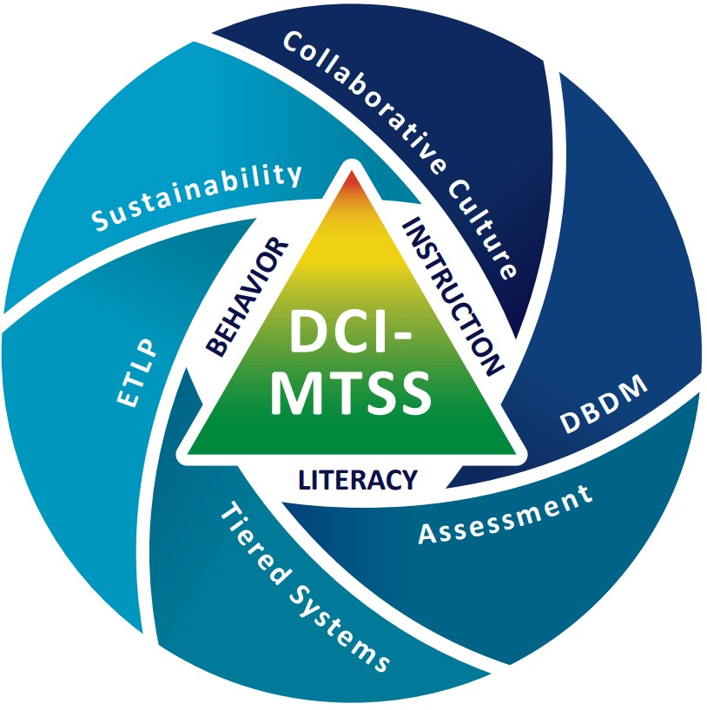
DCI-MTSS Framework
Notes:
Note
Use this slide if you are presenting to a district/building involved in DCI-MTSS and hide the previous DCI Framework Slide.
To Know
DCI-MTSS focuses on blending elements of DCI, SW-PBS, and/or Literacy providing a Multi-Tiered System of Support (MTSS) based on the specific needs of a district.
DCI-MTSS is built on the evidence-based premises of an MTSS framework. With an overarching goal to improve outcomes for all students, especially students with disabilities, by providing high-quality professional development focused on district- and building-level implementation within a multi-tiered system of support (MTSS), the DCI-MTSS Framework creates a cohesive system that focuses on increasing both academic and behavioral outcomes to equitably support the varying needs of all students.
This graphic illustrates the DCI-MTSS Framework as described in the DCI-MTSS District-Level Implementation Practice Profile.
The outside of this graphic highlights the 6 essential functions that have been identified as important for district leadership teams in the effective implementation of DCI-MTSS.
District leaders maintain a collaborative culture and climate to build capacity for an outcome-driven approach to school improvement.
District leaders maintain an assessment system designed to support educational teams in making informed instructional and programmatic decisions to support students.
District leaders engage in cycles of data-based decision making to meet the needs of all students.
District leaders maintain a tiered system of supports that provides efficient, effective, and equitable allocation of resources to support all students.
District leaders select and align effective teaching and learning practices to increase the probability that instruction, interventions, and supports meet the needs of all students.
District leaders provide staff with ongoing support to ensure the integration and sustainability of their continuous improvement efforts.
Within the white space in the center you see the three content areas on which DCI-MTSS focuses: behavior, instruction, and literacy. The triangular center of the diagram represents the tiers.
Collaborative teams fit into several of the essential functions and content areas.
To Do/To Say
Describe the meaning of the illustration.
Note that for this module we are focused on collaborative teams, which impact each of the essential functions.
Without strong collaborative teams, districts may struggle to effectively implement and sustain MTSS practices, leading to inconsistencies in decision making, resource allocation, and student support.
Collaborative teams ensure alignment, shared responsibility, and a collective approach to problem-solving, ultimately driving student success.
Reference
MoEdu-SAIL. (2023). DCI-MTSS district-level implementation practice profile. Missouri Department of Elementary and Secondary Education. https://www.moedu-sail.org/wp-content/uploads/2023/09/DCI-MTSS-District-Level-Implementation-Practice-Profile-June-2023.docx

Slide 18
C.T. Alignment with Missouri Teacher & Leader Standards
Standard #2 Teaching and Learning
Education leaders have the knowledge and ability to ensure the success of all students by promoting a positive school culture, providing an effective instructional program that applies best practice to student learning, and designing comprehensive professional growth plans for staff.
Standard #3 Management of Organizational Systems
Education leaders have the knowledge and ability to ensure the success of all students by managing the organizational structure, personnel, and resources in a way that promotes a safe, efficient, and effective learning environment.
Standard #6 Effective Communication
The teacher models effective verbal, nonverbal, and media communication techniques with students, colleagues and families to foster active inquiry, collaboration, and supportive interaction in the classroom.
Notes:
To Know/To Say
These Missouri Teacher and Leader Standards are closely aligned to the content within the Collaborative Teams Module. Please read the slide as I review the standards.
References
Missouri Department of Elementary and Secondary Education. (2013a). Leader standards. https://dese.mo.gov/media/pdf/oeq-ed-leaderstandards
Missouri Department of Elementary and Secondary Education. (2013b). Teacher standards. https://dese.mo.gov/media/pdf/oeq-ed-teachstandards

Slide 19
C.T. Alignment with Missouri Teacher and Leader Standards
Standard #7 Student Assessment and Data Analysis
The teacher understands and uses formative and summative assessment strategies to assess the learner’s progress and uses both classroom and standardized assessment data to plan ongoing instruction. The teacher monitors the performance of each student, and devises instruction to enable students to grow and develop, making adequate academic progress.
Standard #8 Professionalism
The teacher is a reflective practitioner who continually assesses the effects of choices and actions on others. The teacher actively seeks out opportunities to grow professionally in order to improve learning for all students.
Standard #9 Professional Collaboration
The teacher has effective working relationships with students, parents, school colleagues,
and community members.
Notes:
To Know/To Say
These Missouri Teacher and Leader Standards are closely aligned to the content within the Collaborative Teams Module. Please read the slide as I review the standards.
References
Missouri Department of Elementary and Secondary Education. (2013a). Leader standards. https://dese.mo.gov/media/pdf/oeq-ed-leaderstandards
Missouri Department of Elementary and Secondary Education. (2013b). Teacher standards. https://dese.mo.gov/media/pdf/oeq-ed-teachstandards

Slide 20

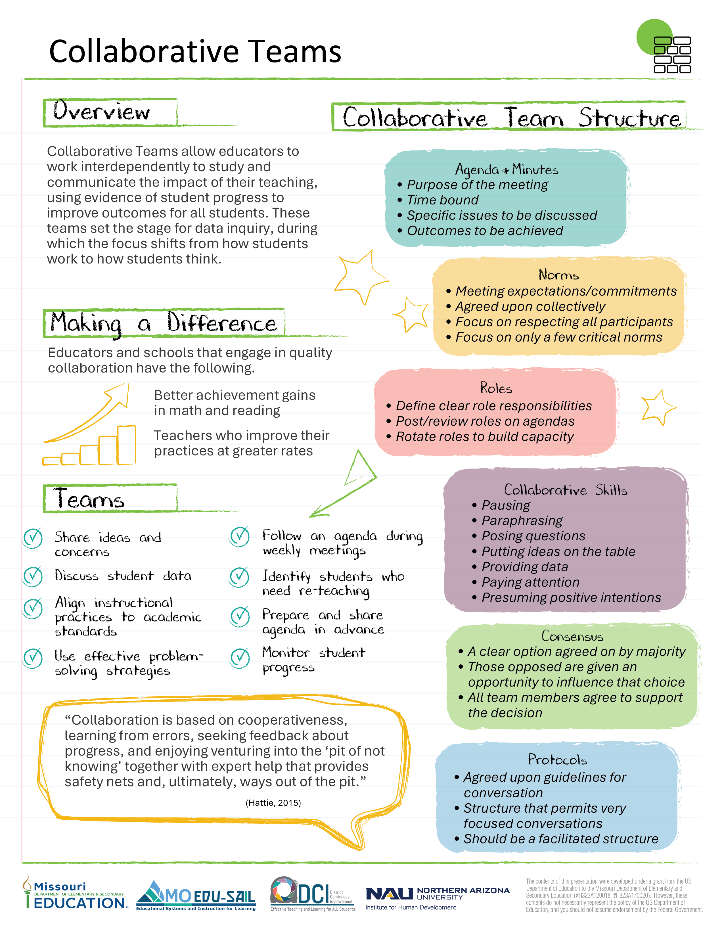
Collaborative Teams Infographic
Find this at www.moedu-sail.org/dci-practice-profiles-and-infographics
Notes:
Handout CT 1.1
Collaborative Teams Infographic
To Know/To Do/To Say
The infographic, Handout CT 1.1, provides a snapshot of the essential learning contained in the module. This is an opportunity for the presenter to provide a hook as to why developing collaborative teams is important. It also helps participants see how collaborative teams and data-based decision making go hand in hand.

Slide 21
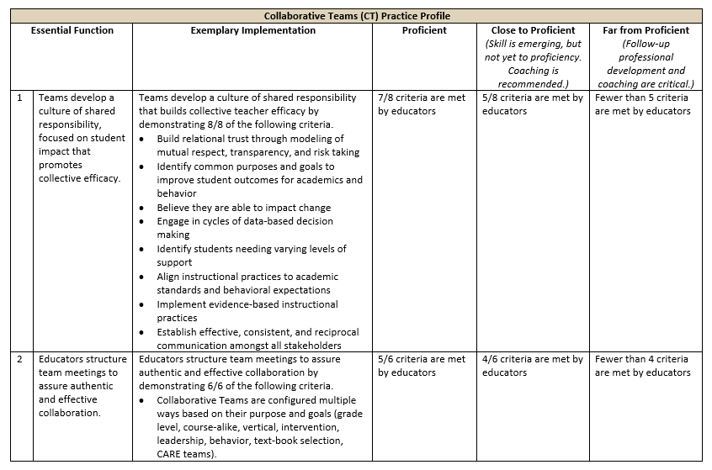
Collaborative Teams Practice Profile
Find this at www.moedu-sail.org/dci-practice-profiles-and-infographics
Notes:
Handout CT 1.2
Collaborative Teams Practice Profile
To Know/To Do/To Say
The Practice Profile for Collaborative Teams is Handout CT 1.2. Review the Practice Profile with the participants reviewing the following key points.
The Practice Profile template is anchored by the Essential Functions and implementation performance levels and criteria.
The three Essential Functions for collaborative teams are as follows.
Essential Function1, Teams develop a culture of shared responsibility, focused on student impact that promotes collective efficacy.
Essential Function 2, Educators structure team meetings to assure authentic and effective collaboration.
Essential Function 3, Educators effectively use group processes for impactful collaboration.
Implementation Performance Levels and Criteria
Four levels of implementation are described for each teaching/learning objective: exemplary, proficient, close to proficient, and far from proficient.
Within each implementation level, evidence which provides data or documentation for determining implementation levels is provided.
The Practice Profile is an important tool for self-monitoring implementation because it serves as a reminder as to the implementation criteria and is also aligned with the fidelity checklists and the electronic Self-Assessment Practice Profile (SAPP). These sources provide data regarding further training or coaching needs.
Part 1 includes a basic introduction to collaborative teams and Essential Function 1. There are two other parts to this module which cover Essential Functions 2 and 3.

Slide 22
Session-at-a-Glance
An introduction to collaborative teaming focusing on benefits, key features, and impact
Establishing common beliefs, purposes, and goals based on data
Building trust and team confidence
Developing effective team communication
Next Steps Action Plan, Part 1, Building a Culture of Collective Responsibility
Notes:
To Know/To Do/To Say
This slide provides an overview of Part 1 of the Collaborative Teams Module, which includes an introduction and content focused on building a culture of collective responsibility (EF1).

Slide 23
Part 1: Learning Objectives
Develop shared team beliefs, purposes, and goals grounded in data to improve student outcomes
Utilize data-driven approaches to support effective and objective decision making within teams
Apply strategies that foster trust, confidence, and collaboration among team members
Implement systematic, transparent, and effective communication practices within teams
Strengthen collective teacher and leader efficacy through intentional team-based practices
Notes:
To Know
It is important that educators build a culture of shared responsibility in order to have effective collaborative teams. These are the learning objectives for Part 1 of the Collaborative Teams Module. They are aligned with EF 1 of the Collaborative Teams Practice Profile.
To Do/To Say
Review the learning objectives listed on the slide for building a culture of shared responsibility for collaborative teams and expand on each.
Develop shared team beliefs, purposes, and goals grounded in data to improve student outcomes
Utilize data-driven approaches to support effective and objective decision making within teams
Apply strategies that foster trust, confidence, and collaboration among team members
Implement systematic, transparent, and effective communication practices within teams
Strengthen collective teacher and leader efficacy through intentional team-based practices
Identify the objectives your session will be focusing on if your session does not include all of Part 1.

Slide 24
Part 1: Essential Questions
Why is building a culture of shared responsibility so important for developing effective teams?
What common beliefs should be shared by all team members?
Why should team goals and decisions be based on data?
How can team trust and confidence be built?
What are the characteristics of an effective team communication system?
Notes:
To Know/To Do/To Say
Essential Questions help to activate participant thinking and access prior knowledge regarding collaborative teaming. These questions can be posed initially, throughout the session, or at the end. These questions are taken directly from the Blueprint.
Review how the Essential Questions will help participants reflect on their knowledge for building a culture of shared responsibility for collaborative teaming. Provide time for reflective thinking.
Optional Activity
Essential Questions may be written on individual chart paper and placed around the room so they can be referred to throughout the presentation.
You might have participants respond to the questions initially and then later provide opportunities to add to the responses once more learning has taken place.
If time permits, a carousel structure could be used so participants can respond, collaborate, and process the questions.

Slide 25
Introduction
Collaborative Teams

Slide 26
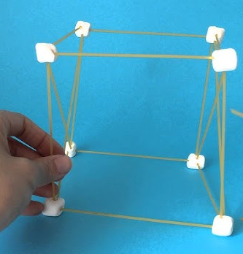
The Power of Teamwork!
Goal. To build the highest tower
Steps
Take 2 minutes to collaboratively discuss a plan for success.
Work collectively without talking for 3 minutes to build the highest tower using only the materials you are given.
Determine the team with the highest tower and discuss winning strategies.
(Tanner, 2023)
Notes:
To Know/To Do/To Say
This icebreaker teambuilding activity sets the stage for the importance of developing collaborative skills to accomplish goals.
Marshmallow Towers
Group participants into collaborative teams of 4-6.
Give each team 10 mini-marshmallows and 10 sticks of spaghetti.
Provide 2 minutes for teams to collaboratively discuss a plan for building the highest tower.
Next, have the teams work for 3 minutes to build the highest tower possible only using the supplies given. Allow no talking during the building phase. Nonverbal communication is allowed.
Measure or compare to determine the highest tower.
Reflect on these questions
Did having a common goal keep members focused?
How was team planning helpful?
What could have improved team planning?
How did limited team communication during the building phase impede team progress?
What collaborative skills were helpful in reaching your goal?
What collaborative skills could have been improved to more easily reach the goal?
Optional Activity
Paper Towers: The same procedure is followed as Marshmallow Towers but 8 sheets of paper are given to each team. The paper is folded or configured in any way to build a tower.
Reference
Tanner, K. (2023, November 2). 41 games for educators to build better teams. Teaching Expertise. https://www.teachingexpertise.com/teacher-life/games-for-educators/

Slide 27
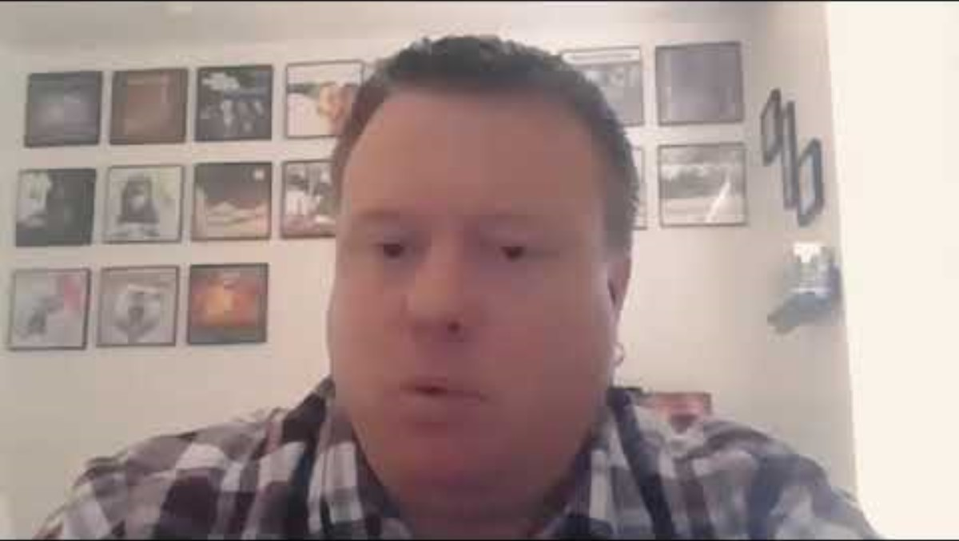
Benefits of Teaming
www.youtube.com/watch?v=5OTRWm7wNbY
Notes:
Optional Slide/Activity
Link
Benefits of teaming: Educator retention, educator leadership opportunities, and student learning, https://www.youtube.com/watch?v=5OTRWm7wNbY, 2:51
To Know/To Say
We will now listen to a testimonial as Justin Wing, Assistant Superintendent of Human Resources at Mesa Public Schools, shares three benefits of collaborative teaming: educator retention, educator leadership opportunities, and student learning.
To Do
Introduce and show the video. Ask participants to then Turn & Talk to a shoulder partner about the benefits they have seen from participating in collaborative teams. They can also share challenges they have faced with teaming and strategies to overcome the challenges.
Reflection Questions
Why does collaborative teaming help to retain teachers?
How is educator leadership strengthened through collaborative teaming?
How does having collaborative teams improve student learning?
Reference
ASU Mary Lou Fulton College. (2020, August 5). Benefits of teaming: Educator retention, educator leadership opportunities, and student learning [Video]. YouTube. https://www.youtube.com/watch?v=5OTRWm7wNbY

Slide 28
Collaborative Teaming
In schools, collaborative teaming involves educators working interdependently to discover and communicate the impact of their practices, using evidence of student progress to improve outcomes for all students.
(Adapted from Bloomberg & Pitchford, 2016; Marzano et al., 2016)
Notes:
To Know/To Say
In this definition, the educators refers to all relevant school personnel (teachers, paraprofessionals, specialized teachers, special education teachers, counselors, administrators, social workers, etc.). Every school setting is different, but when appropriate, any or all of these educators must be actively engaged in the work of collaborative teams.
To Do
Review and discuss the definition on the slide. Depending on the size of the group, these questions can be addressed in pairs or could be an open discussion with all participants engaged in the dialogue.
What does interdependent mean?
What does it mean to communicate the impact of teaching?
What evidence of student progress might be used?
How does this definition align with the teambuilding activity?
How does this apply to different school teams?
Reflect on your own building and district. Is there a focus on collaborative teaming? What types of collaborative teams are in place?
References
Bloomberg, P., & Pitchford, B. (2016). Leading impact teams: Building a culture of efficacy (1st ed.). Corwin.
Marzano, R. J., Heflebower, T., Hoegh, J. K., Warrick, P., Grift, G., Hecker, L., & Wills, J. (2016). Collaborative teams that transform schools: The next step in PLCs. Marzano Research.

Slide 29

Collaboration Increases Student Achievement
Schools and districts engaged in teacher collaborative processes have shown significant increases in student achievement.
12.5%
English
Language Arts
4.5%
Math
(Adapted from Rubinstein, 2014)
Notes:
To Know/To Say/To Do
Here's how teacher collaboration impacts student achievement:
Improved student outcomes. Studies have shown that schools with strong collaborative cultures see better results in math and literacy.
Increased teacher effectiveness. Collaboration can lead to more effective teaching practices, which in turn benefit students.
Enhanced teacher certainty. When teachers work together, they can develop a stronger sense of confidence about good teaching practices. This certainty can positively influence student learning.
Shared responsibility. In collaborative environments, teachers take collective responsibility for implementing what they discover, leading to improved student outcomes.
Joint problem solving. Collaborative settings provide opportunities for teachers to work together to improve their understanding of what learning is (or could be), generate evidence of what’s working (and what’s not), make decisions about next steps, and take action to introduce improvements and innovations.
Focus on student needs. Collaborative inquiry can lead to teachers focusing on student data and adjusting instruction to meet student needs.
Integration of student feedback. Some collaborative practices involve including students in the discussion of their learning, which can further enhance the effectiveness of instruction.
Improved school culture. A collaborative culture within a school is strongly associated with teachers' self-efficacy and job satisfaction, which can positively influence the learning environment.
However, it is important to note that not all collaboration is beneficial. Some forms of collaboration, such as "contrived collegiality," which is administratively controlled, may not be as effective.
Effective collaboration requires a culture of openness, trust, and support where teachers define their own purposes and learning goals.
In summary, teacher collaboration is a powerful tool for improving student achievement, but the quality and nature of that collaboration matters. When implemented thoughtfully, it can lead to significant gains in student learning and create a more positive and effective learning environment
Discuss the how teacher collaboration impacts student achievement.
References
Hargreaves, A. (2019). Teacher collaboration: 30 years of research on its nature, forms, limitations and effects. Teachers and Teaching, 25(5), 603–621. https://doi.org/10.1080/13540602.2019.1639499
Rubinstein, S.A. (2014). Strengthening partnerships: How communication and collaboration contribute to school improvement. American Educator, Winter 2013-2014, 22-28. https://www.aft.org/sites/default/files/Rubinstein.pdf

Slide 30

Collaboration Improves Teacher Retention
When collaboration is high, there is no statistical difference in teacher turnover between high-poverty and low-poverty schools.
Teacher Retention in
Districts
With High Collaboration (regardless of poverty rate)
Teacher Retention in High Poverty Districts
Teacher Retention in Low Poverty Districts
(Adapted from Rubinstein, 2014)
Notes:
To Know/To Say
Teacher retention is significantly impacted by collaboration, particularly in high-poverty schools.
Reduced teacher turnover. When collaboration is low, teacher turnover in high-poverty schools is 3.5 times greater than in low-poverty schools. However, when collaboration is high, there is no significant statistical difference in teacher turnover between high-poverty and low-poverty schools. This demonstrates that strong collaboration can mitigate the negative effects of poverty on teacher retention.
Improved work environment. Collaboration fosters a more positive work environment. When teachers feel supported, respected, and empowered, they are more likely to stay in their positions.
Increased educator empowerment. Collaboration increases educator empowerment by giving teachers more voice in decisions related to teaching and learning. This sense of empowerment contributes to job satisfaction and a greater commitment to the school.
Stronger relationships. Collaborative environments foster stronger mentoring relationships between educators, which further enhances teacher satisfaction and retention.
When teachers are involved in decision making, it results in a nurturing environment that can mitigate teacher turnover, even in high-poverty schools.
In summary, teacher collaboration significantly improves retention, especially in high-poverty schools, by creating a more supportive, empowering, and effective work environment. By ensuring teachers feel valued, heard, and supported, schools can create a more stable and positive learning environment for both teachers and students.
To Do
Explain Rubinstein’s findings on the effect of collaboration on teacher retention by discussing the chart.
Reference
Rubinstein, S.A. (2014). Strengthening partnerships: How communication and collaboration contribute to school improvement. American Educator, Winter 2013-2014, 22-28. https://www.aft.org/sites/default/files/Rubinstein.pdf

Slide 31
Interdependent Team Structures
District Leadership Team
IMPACT
Building Leadership Team
Teacher Teams
Grade level
Content
Behavior and academic interventions
(Adapted from Bloomberg & Pitchford, 2016)
Notes:
To Know/To Say
Collaborative school teams in DCI and DCI-MTSS include a district leadership team, building leadership teams, and teacher teams that can be configured in various ways based on their purpose. These may include grade level, content area, intervention (CARE) teams, and others. It is critical that these teams are interdependent of one another and there is alignment with the district mission/vision and comprehensive school improvement plans.
Teams support and depend on one another, working toward the common goal of creating the greatest impact on student achievement. Communicating information regarding the impact of instructional practices on student outcomes and using evidence of student progress to support decision making is key to the effectiveness of teams.
To Do
Review the graphic on the slide.
Emphasize the importance of each of these collaborative teams and how they must be aligned and work together to be effective.
Reference
Bloomberg, P., & Pitchford, B. (2016). Leading impact teams: Building a culture of efficacy (1st ed.). Corwin.

Slide 32
Pre-Read: Teams and Collective Efficacy
What are the qualities of collaborative teams that have the greatest impact on student outcomes?
What is the difference between true collective efficacy and simply feeling good about collaboration?
How often do you and your colleagues engage in deep, reflective conversations about teaching practices?
www.solutiontree.com/blog/spotting-collaborative-teams-with-high-levels-of-collective-efficacy/
Notes:
Link
Spotting Teams with a High Level of Collective Efficacy, https://www.solutiontree.com/blog/spotting-collaborative-teams-with-high-levels-of-collective-efficacy/
To Know/To Do
The link to the blog article was sent to participants prior to the training.
This is an opportunity for debriefing the article.
You may add a QR code to the slide so participants can easily access the article.
To Do/To Say
The article emphasizes the importance of collaborative teams having a shared confidence and, by working together and using data to move learning forward, they can significantly improve student outcomes.
Review the questions on the slide.
Provide 3 minutes for all to quickly review the article.
Then have small groups discuss the questions on the slide and record responses on chart paper under each question.
Post chart paper with responses around the room and ask participants to do a brief gallery walk in order to see all responses.
Share key ideas with the whole group.
Reference
Ferriter, W. M. (2020, April 7). Spotting collaborative teams with high levels of collective efficacy. SolutionTree. https://www.solutiontree.com/blog/spotting-collaborative-teams-with-high-levels-of-collective-efficacy/

Slide 33
High Impact Teams
Are intentional with a clear purpose
Use intentional processes
Are focused on discussion of high impact practices
Build a culture of shared responsibility and educator empowerment
Use data to improve student outcomes
(MoEdu-SAIL, n.d.-a)
Notes:
To Know/To Say
What we do in high impact collaborative teams includes being intentional in our purpose, focused on high impact instruction, and using data effectively.
High impact collaborative teams integrate and tie together the important components of DCI and DCI/MTSS content as noted parenthetically below.
Collaboration is intentional with a clear purpose and utilizes effective processes. (Collaborative Teams)
Collaboration is focused around the discussion of high impact practices. (Effective Teaching and Learning Practices)
Collaboration uses data effectively to improve student outcomes. (Data-Based Decision Making and Common Formative Assessment)
Collaboration builds a culture of shared responsibility and educator empowerment. (Collective Teacher Efficacy)
To Do
Review the content on the slide and highlight the link to the DCI/DCI-MTSS professional learning modules.
Reference
MoEdu-SAIL. (n.d.-a). Collaborative teams online module. https://www.moedu-sail.org/courses/collaborative-team-structures/

Slide 34
High Impact Teams Use Data
Collecting and analyzing data provides insights into…
Student academic performance
Student behavioral patterns
Instructional success
Level of support needed for each student to be successful
Intervention effectiveness
Attendance patterns
Program effectiveness
(National Center for Education Evaluation and Regional Assistance, 2023)
Notes:
To Know/To Say
Collecting and analyzing relevant data provides objective insights into student academic performance, student behavioral patterns, instructional success, level of support needed for each student, intervention effectiveness, attendance patterns, program effectiveness, and more. Educators can use these insights to meet the unique needs of their students, buildings, and districts.
To Do
Pose this question and share participants’ ideas:
What other insights are provided to educators through the process of collecting, analyzing, and discussing data?
Reference
National Center for Education Evaluation and Regional Assistance. (2023, November 9). Data-driven decision-making in education: How REL work makes a difference. NCEE Blog. https://web.archive.org/web/20250110023105/https://ies.ed.gov/blogs/ncee/post/data-driven-decision-making-in-education-how-rel-work-makes-a-difference

Slide 35
Function of Data Cycles
Teams use data to accomplish the following.
Determine if learning standards and behavior expectations are met.
Identify students needing various levels of academic and behavioral support.
Tier 1 - Universal, Tier 2 - Targeted, Tier 3 - Intensive
Select the most effective evidence-based instructional practices to use that align with academic standards and behavioral expectations.
Design “action plans” that describe the how and when for improving instruction.
Evaluate impact!
(Rouda, 2018)
Notes:
To Know/To Say/To Do
Review and expand on the slide content.
The function of data cycles is to provide teams with valuable information to use for decision making that will result in improved student outcomes. Data collected during these cycles can be used for multiple purposes:
Determining if learning standards and behavioral expectations have been met.
Identifying students needing various levels of support.
Selecting the most effective evidence-based instructional practices to use in order to address student academic and behavioral needs. Practices should always align with academic standards and behavioral expectations.
Designing instructional action plans, based on data collected, that describe how and when instruction will be improved to meet the needs of students.
Evaluating our actions to see if we are positively impacting student outcomes.
What other decisions does your team make based on the data they collect?
Data cycles should vary in length and frequency depending on the team’s purpose.
4-6 weeks work well when collaborative teams are collecting data related to common units of instruction, adjusting Tier 1 interventions or instructional strategies, or using CFA data.
Shorter cycles of 1-3 weeks are needed for intensive interventions (Tiers 2/3) or progress monitoring of at-risk students.
Longer cycles of 9-12 weeks can be suitable for evaluating broader instructional changes or using summative data.
When planning, teams should discuss these issues and pre-determine the appropriate data cycle.
Reference
Rouda, R. (2018, March 28). A framework for effective data use in schools. Learning for Action. https://learningforaction.com/lfa-blogpost/data-matters-framework

Slide 36
High Impact Practices Used by Effective Teams
Evaluation and reflection, 0.75
Teacher clarity (learning intentions, success criteria, assessment), 0.85
Feedback (reinforcement and cues), 0.92
Self-reported grades (DACL), 0.96
Microteaching/video review of lessons, 0.99
Collective teacher efficacy, 1.01
Teacher estimates of achievement, 1.29
The next slide shows a graph of these effect sizes!
https://www.visiblelearningmetax.com/
Notes:
To Know/To Say
Effective collaborative teams operationalize multiple influences that are proven to have the highest impact on student learning. These are some of the influences used by the most effective teams.
Others include Teacher-student relationships (0.57), transfer strategies (0.75), alternative assessment methods (0.66), and more. (See Visible learning Meta, https://www.visiblelearningmetax.com/ )
Please note that effect sizes change often, as more research is added. Please check effect sizes and note any discrepancies prior to your presentation. The graph on the next slide allows for editing of effect sizes as they change.
To Do
Review the influences and effect sizes that are listed on the slide. Next, have participants work with a shoulder partner to discuss how each of the high impact influences can be operationalized by teams. Have partners determine whether the high impact strategy influences the team, individual educators, students, or all?
Provide time for key ideas to be shared with the whole group.
References
Bloomberg, P., & Pitchford, B. (2016). Leading impact teams: Building a culture of efficacy (1st ed.). Corwin.
Hattie, J. (2024, November). Visible learning homepage. Visible Learning Meta X. https://www.visiblelearningmetax.com/

Slide 37
Effect Size of High Impact Practices used by Effective Teams
Notes:
Note
Teacher clarity includes learning intentions, success criteria, assessment.
Again, effect sizes change often. Please check effect sizes and note any discrepancies prior to your presentation. This graph allows for editing of effect sizes as they change.

Slide 38
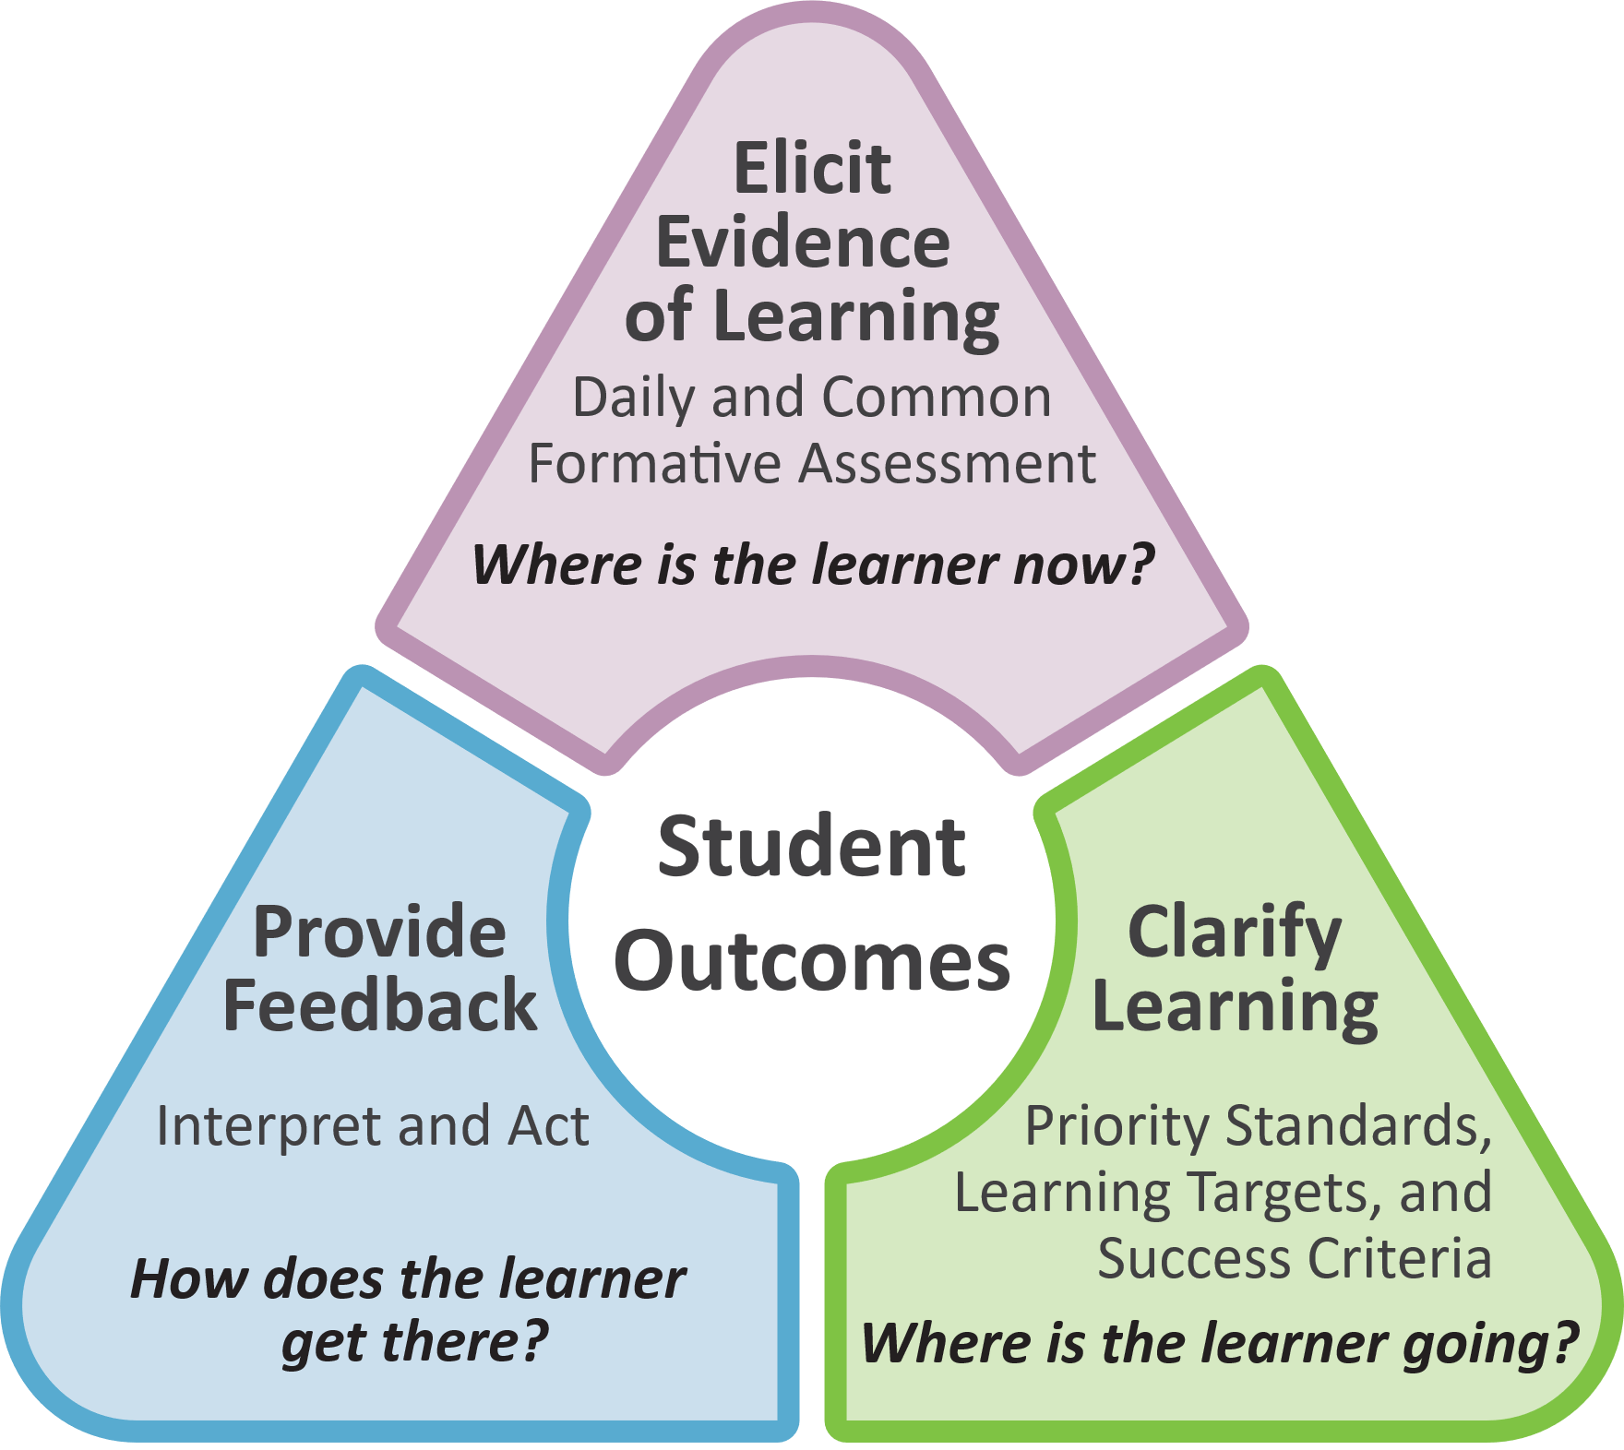
Formative Assessment Process
Elicit Evidence of Learning
Clarify Learning
Provide Feedback
(MoEdu-SAIL, 2022b)
Notes:
To Know/To Say/To Do
High impact collaborative teams also operationalize the formative assessment process in the classroom and put students at the center of learning.
This process accomplishes the following.
Elicits evidence of learning through daily and common formative assessment
Clarifies the learning by identifying priority standards and developing learning targets and success criteria
Provides feedback that educators interpret and act upon
The formative assessment process provides answers to these questions: Where is the learner now? Where is the learner going? and How does the learner get there?
Teacher teams will implement the process in classrooms. DLTs and BLTs should promote and support the use of the formative assessment process.
For an in-depth look at the formative assessment process review the CFA module on MoEdu-Sail at https://www.moedu-sail.org/cfa-materials/
Reference
MoEdu-SAIL. (2022b). Common formative assessment module.

Slide 39
Reflecting on Your District’s Collaborative Teams
What are the strengths of your district’s collaborative teams?
Are all teams aligned with a focus on student impact?
Do all teams communicate information regarding impact of instructional practices on student outcomes?
Is communication between teams clear and supportive?
Is evidence always used to support decision making?
How might your team effectiveness be improved?
Notes:
To Know/To Say/To Do
The purpose of this activity is to help teams take an inventory of current collaborative team structures and/or processes and identify strengths and needs they may have to improving the structures. This activity may be adjusted to fit your time frame. If there is not time for participants to design a graphic (second bullet below), just discuss the guiding questions.
Activity
Take a moment to reflect on your own district’s collaborative teams.
Make a list of all the collaborative teams within your district.
Design your own graphic showing how they are interdependent.
Use the guiding questions on the slide to discuss the strengths of your district’s teams and the opportunities for improving team effectiveness.
Conclude the activity by providing teams with time to share out key ideas they have discussed.

Slide 40
Collaborative Team Framework
Part 1 EF 1 | Part 2 EF 2 | Part 3 EF 3
Building a Culture of Collective Responsibility | Effective Team Structures & Skills | Group Processes for Impactful Collaboration
Purpose/Goals Trust Communication | Team Configurations Time Roles Collaborative Skills | Agendas/Minutes Norms Consensus Protocol
(Adapted from Bloomberg & Pitchford, 2016)
Notes:
Handout CT 1.2
CT Practice Profile
To Know/To Say/To Do
Review and expand on slide content.
Collaborative teams need a solid infrastructure or framework in order to be productive and high performing. An effective collaborative team framework should include the following.
Culture. Developing a learning network which includes purpose, trust, and communication.
Structure. What it takes for authentic collaboration to take place. Structure includes time, configuration, and roles. Teams must be structured so meetings are planned during protected time; configured according to purpose and goals; and team roles are identified, described, and align with the skills of team members.
Process. Refers to a systematic set of steps used to attain goals set by by the team. Agendas, minutes, and protocols are all processes that should be used consistently by effective teams to reach their desired outcomes. Collaborative skills are used by team members as they engage in these processes to assure more authentic collaboration in order to achieve optimum outcomes.
The CT module is designed around this Collaborative Team Framework:
Part 1 - Culture (EF1): Building a culture of collective responsibility.
Part 2 - Structure (EF2): Structuring team meetings to assure authentic and effective collaboration
Part 3 - Process (EF3): Using group processes for impactful collaboration.
Next, take a look at the CT Practice Profile and see how it aligns with the Collaborative Team Framework.
Ask participants to highlight indicators on the Practice Profile that show alignment with the CT Framework.
Share out reflections.
Reference
Bloomberg, P., & Pitchford, B. (2016). Leading impact teams: Building a culture of efficacy (1st ed.). Corwin.

Slide 41
Part 1
Building a Culture of Collective Responsibility
Notes:
To Know
Again, this aligns with EF1, “Building a Culture of Collective Responsibility” of the CT Practice Profile.

Slide 42
Building a Culture of Collective Responsibility
Purpose & Goals | Trust | Communication
Common purposes and goals are identified to improve student outcomes. A shared belief that educators are change agents is promoted. | Relational trust is built through mutual respect, transparency, and risk taking. | A system of effective, consistent, and transparent communication is established and maintained.
(Bloomberg & Pitchford, 2016; National Labor Management Partnership, 2022)
Notes:
To Know/To Say/To Do
Teams develop a culture of collective responsibility through three key components: purpose/goals, trust, and communication. We will look at each of these components in greater detail starting with the next slide. The content below provides an overview of all three.
Purpose & Goals
A high impact team is grounded in a strong purpose, a collective commitment to improving student outcomes through data-driven decision making and shared beliefs about teaching and learning.
Clear understanding of team goals based on data
Teams use multiple data sources (formative assessments, student progress monitoring, and instructional feedback) to set specific, measurable, and achievable goals.
Goals are aligned with school/district priorities and reflect student learning needs.
Teams regularly review and adjust goals based on progress and new data insights.
Shared beliefs around teaching and learning
Teams operate with a common vision of high-quality instruction and evidence-based practices.
There is a shared commitment to equity, student-centered learning, and continuous improvement.
Professional learning communities (PLCs) reinforce collective ownership of instructional strategies and interventions.
Why purpose matters
Ensures alignment across team members so that all actions support student learning.
Strengthens team motivation and collective accountability for results.
Helps educators stay focused on long-term impact rather than short-term challenges.
Trust
Trust sets the foundation for collaboration and innovation. It is the bedrock of effective collaboration. When educators trust one another, they feel safe to take risks, challenge ideas, and engage in honest dialogue.
Mutual respect
Team members value diverse perspectives and expertise.
Constructive feedback is given and received without defensiveness.
Differences in opinion are seen as opportunities to strengthen team decisions.
Transparency
Data, goals, and instructional decisions are openly shared.
There is clarity in roles, responsibilities, and expectations.
Challenges are acknowledged and addressed collectively.
Confidence and safety to take risks
Educators feel empowered to experiment with new strategies without fear of failure.
Mistakes are viewed as learning opportunities, not weaknesses.
Team members advocate for innovative approaches to meet student needs.
Why trust matters
Builds psychological safety, allowing educators to collaborate openly and authentically.
Encourages growth mindsets, where feedback is welcomed and used for improvement.
Strengthens team cohesion, leading to greater efficiency and problem-solving capacity.
Communication
Communication is the engine of high impact collaboration. Effective communication ensures that all team members remain informed, engaged, and aligned. Without clear and systematic communication, even the best strategies and intentions can fall apart.
Systematic
Teams establish structured meeting protocols (e.g., agenda-driven PLCs, data review meetings, and check-ins).
Clear processes exist for decision making, documentation, and follow-up.
Communication is timely, relevant, and actionable.
Transparent
Team decisions, instructional adjustments, and intervention plans are clearly documented and accessible.
Expectations for student learning and professional collaboration are clearly defined.
Honest conversations occur without fear of misinterpretation or backlash.
Why communication matters
Ensures alignment between educators, school leaders, and stakeholders.
Reduces misunderstandings and increases efficiency in decision making.
Strengthens team collaboration, engagement, and shared accountability.
When purpose, trust, and communication are strong, high impact teams make informed, strategic decisions that improve student learning. They create a collaborative environment where educators support and challenge one another. And finally, they foster a culture of continuous improvement that benefits students, teachers, and schools.
References
Bloomberg, P., & Pitchford, B. (2016). Leading impact teams: Building a culture of efficacy (1st ed.). Corwin.
National Labor Management Partnership. (2022). Collaborating for student success: A comprehensive, practical guidebook for increasing shared decision-making through lasting partnerships. https://www.nea.org/sites/default/files/2022-05/NLMP%20Collaborating%20for%20Student%20Success%20Guidebook%202022%205-5-22.pdf

Slide 43
Purpose & Goals
Building a Culture of Collective Responsibility
3 Key Components

Slide 44
Team Purpose & Goals
To be productive and effective educators must know the following:
Why they are meeting
What they are meeting about
How the meeting will be structured
How the meeting will improve educator practices
How the meeting will help to improve student outcomes
(Bloomberg & Pitchford, 2016; MoEdu-SAIL, n.d.)
Notes:
To Know/To Say/To Do
Collaborative team meetings must be purposeful and intentional in order to be productive and effective for improving outcomes for all students.
Purposeful team meetings result in improved teaching and learning practices.
Purpose answers the “why” of collaborative team meetings.
Purpose can also provide answers to the “what” and “how.”
Data should drive the purpose of team meetings.
References
Bloomberg, P., & Pitchford, B. (2016). Leading impact teams: Building a culture of efficacy (1st ed.). Corwin.
MoEdu-SAIL. (n.d.-a). Collaborative teams online module. https://www.moedu-sail.org/courses/collaborative-team-structures/

Slide 45
How Shared Goals Impact Collaboration
Fosters belonging, solidarity, and trust
Result in increased cooperation and collaboration
Focuses the group on collective benefits
Motivates collaborative efforts
Supports project planning
Fosters authentic partnerships
(NLMP, 2022)
Notes:
To Know/To Say/To Do
Review the importance of shared goals as listed on the slide.
Shared goals significantly impact collaboration by fostering a sense of belonging, solidarity, and trust, and by serving as a powerful motivator for collective action.
Belonging, solidarity, and trust. Shared goals create a sense of unity and common purpose among team members, strengthening the bonds between them. When individuals work toward the same objectives, they feel like they are part of something larger than themselves, fostering a sense of belonging. This shared experience builds solidarity, as members understand and support each other’s efforts. The shared commitment to a common goal also fosters trust, as team members rely on each other to contribute their best towards the achievement of the collective goal.
Increased cooperation and collaboration. When individuals are aligned on shared goals, they are more inclined to cooperate and collaborate effectively. This alignment fosters an environment of mutual support and shared responsibility, where team members are more willing to contribute their expertise and resources. This leads to better problem solving, more creative solutions, and more efficient teamwork.
Focus on collective benefits. Shared goals encourage team members to prioritize collective benefits over individual gains. This is especially important in collaborative environments, where the success of the team is dependent on the contributions of all members. When individuals are motivated by a shared objective, they are more likely to defer personal gain for the benefit of the team as a whole.
Powerful motivator. Shared goals act as a powerful motivator for collaborative efforts. When individuals feel a connection to the goal, they are more likely to be engaged and committed to the collaborative work. This intrinsic motivation can increase team productivity and performance.
Importance for project planning and authentic partnership. Shared goals are not only crucial for project planning, but also play a vital role in fostering authentic partnerships. The process of identifying and defining shared goals provides a foundation for a collaborative relationship, ensuring all partners are focused on the same outcomes. By developing these goals collaboratively, partners build trust, mutual respect, and transparency. This, in turn, creates the psychological safety needed for effective shared problem solving.
In essence, shared goals are the cornerstone of successful collaboration. They create a sense of unity, drive cooperation, and motivate team members to work together effectively toward a common purpose. By focusing on shared goals, teams can foster strong relationships, achieve meaningful results, and build a collaborative culture
Encourage discussion around this question: What happens when teams don’t share common goals?
Note
For additional training/resource materials on common philosophy and purpose see MO SW-PBIS Common Philosophy and Purpose Module: https://pbismissouri.org/tier-1-workbook-resources/.
Reference
National Labor Management Partnership. (2022). Collaborating for student success: A comprehensive, practical guidebook for increasing shared decision-making through lasting partnerships. https://www.nea.org/sites/default/files/2022-05/NLMP%20Collaborating%20for%20Student%20Success%20Guidebook%202022%205-5-22.pdf

Slide 46
Mindframes for High Impact Teams
I am an evaluator of impact on student learning.
I see assessment as informing my impact and next steps.
I collaborate with my peers and my students about my conceptions of progress and my impact.
I am a change agent and believe all students can improve.
I strive for challenge and not merely “doing your best.”
(continued on next slide)
(Bloomberg & Pitchford, 2016; Hattie & Zierer, 2017)
Notes:
Handout CT 1.4
Mindframes for High Impact Teams
To Know/To Say
Along with intentional purpose, teams who share common beliefs can better align their purpose.
The 10 Mindframes for Visible Learning, developed by John Hattie, are a set of beliefs and attitudes that educators should adopt to maximize student learning. They emphasize how teachers and school leaders think about their impact, rather than just what they do.
The purpose of these mindframes is to create a culture where learning is visible, evidence-driven, and continuously improved. These mindframes have particular relevance to implementing high impact collaborative teams focused on improving student outcomes. The 10 Mindframes for Visible Learning are as follows (they appear on 2 slides – notes are duplicated):
I am an evaluator of impact on student learning.
I see assessment as informing my impact and next steps.
I collaborate with my peers and my students about my conceptions of progress and my impact.
I am a change agent and believe all students can improve.
I strive for challenge and not merely “doing your best.”
I give and help students understand feedback and I interpret and act on feedback to me.
I engage in dialogue as much as monologue.
I explicitly inform students what successful impact looks like from the outset (provide success criteria).
I build relationships and trust so that learning can occur in a place where it is safe to make mistakes and learn from others.
I focus on learning and the language of learning.
Collaborative teams can use Hattie's 10 Mindframes for Visible Learning to strengthen shared beliefs by fostering a collective commitment to reflection, evidence-based practice, and student-centered learning.
Activity
Provide the Mindframes handout to participants.
Working in small groups, have participants discuss which mindframes they believe are most important to high impact collaborative teams and why.
Have them circle 5 they feel are most critical for collaborative teams.
Have participants add mindframes of their own that they feel are important but not included in Hattie’s list.
Provide time for each small group to share their choices and justifications with the larger group.
References
Bloomberg, P., & Pitchford, B. (2016). Leading impact teams: Building a culture of efficacy (1st ed.). Corwin.
Hattie, J., & Zierer, K. (2017). 10 mindframes for visible learning. Teaching for success (1st ed.). Routledge.

Slide 47

Mindframes for High Impact Teams (continued)
I give and help students understand feedback and I interpret and act on feedback to me.
I engage in dialogue as much as monologue.
I explicitly inform students what successful impact looks like from the outset.
I focus on learning and the language of learning.
I build relationships and trust so that learning can occur in a place where it is safe to make mistakes and learn from others.
(Bloomberg & Pitchford, 2016; Hattie & Zierer, 2017)
Notes:
Handout CT 1.4
Mindframes for High Impact Teams
To Know/To Say
Along with intentional purpose, teams who share common beliefs can better align their purpose.
The 10 Mindframes for Visible Learning, developed by John Hattie, are a set of beliefs and attitudes that educators should adopt to maximize student learning. They emphasize how teachers and school leaders think about their impact, rather than just what they do.
The purpose of these mindframes is to create a culture where learning is visible, evidence-driven, and continuously improved. These mindframes have particular relevance to implementing high impact collaborative teams focused on improving student outcomes. The 10 Mindframes for Visible Learning are as follows (they appear on 2 slides – notes are duplicated):
I am an evaluator of impact on student learning.
I see assessment as informing my impact and next steps.
I collaborate with my peers and my students about my conceptions of progress and my impact.
I am a change agent and believe all students can improve.
I strive for challenge and not merely “doing your best.”
I give and help students understand feedback and I interpret and act on feedback to me.
I engage in dialogue as much as monologue.
I explicitly inform students what successful impact looks like from the outset (provide success criteria).
I build relationships and trust so that learning can occur in a place where it is safe to make mistakes and learn from others.
I focus on learning and the language of learning.
Collaborative teams can use Hattie's 10 Mindframes for Visible Learning to strengthen shared beliefs by fostering a collective commitment to reflection, evidence-based practice, and student-centered learning.
Activity
Provide the Mindframes handout to participants.
Working in small groups, have participants discuss which mindframes they believe are most important to high impact collaborative teams and why.
Have them circle 5 they feel are most critical for collaborative teams.
Have participants add mindframes of their own that they feel are important but not included in Hattie’s list.
Provide time for each small group to share their choices and justifications with the larger group.
References
Bloomberg, P., & Pitchford, B. (2016). Leading impact teams: Building a culture of efficacy (1st ed.). Corwin.
Hattie, J., & Zierer, K. (2017). 10 mindframes for visible learning. Teaching for success (1st ed.). Routledge.

Slide 48
Building a Data Culture to Support Teams
School Leadership. Promotes a culture of data use
Continuous Improvement Mindset. All school staff embrace data as an important tool for continuously improving student outcomes
Alignment. Advancing strategies that support deep collaboration to reach shared goals based on data
(Rouda, 2018)
Notes:
To Know/To Say/To Do
Building a culture of data use goes hand-in-hand with the high impact team mindframes. Using data to guide decision making is one of the first and most important steps for teams whose goal is to improve student learning.
There are three components which are critical to ensure that schools are set up to effectively support teams in using data: school leadership, continuous improvement mindset, and alignment.
School Leadership. A culture of data can be established by setting clear expectations about data, providing access to data, modeling good data use, and allowing time and space for staff to engage with data.
Continuous Improvement Mindset. When a school-wide continuous improvement effort is demonstrated through the use of data and collaborative inquiry, all staff embrace data as an important tool.
Alignment. Schools embrace strategies that support deep collaboration to reach shared goals, based on data.
Reference
Rouda, R. (2018, March 28). A framework for effective data use in schools. Learning for Action. http://learningforaction.com/lfa-blogpost/data-matters-framework

Slide 49

Reflecting on Team Purpose & Goals
How do we define success as a team?
What does it look like when we share common purposes and goals?
How do our beliefs about teaching and learning shape the way we work together?
What are some examples of times when data led to meaningful instructional changes?
(Rouda, 2018)
Notes:
To Know/To Say
Take a moment to reflect on the purpose and goals of teams, both very important components of team culture.
Data should always drive the purpose and goals of teams.
Shared goals and common team mindframes help to strengthen collective efficacy and improve student outcomes.
Teams that work within a culture that uses data for decision making are more effective in identifying what their essential goals should be and how to attain them.
To Do
Use the “Stand Up/Hand Up/Pair Up” structure and ask participants to discuss these reflection questions with a partner.
Then have volunteers share responses given by their partner.
Reference
Rouda, R. (2018, March 28). A framework for effective data use in schools. Learning for Action. http://learningforaction.com/lfa-blogpost/data-matters-framework

Slide 50
Trust
Building a Culture of Collective Responsibility
3 Key Components

Slide 51
How Trust Impacts Collaboration
Provides safety
Reduces blame
Promotes honest discussions
Motivates and energizes
Enhances group performance
Builds collective teacher efficacy
(Bloomberg & Pitchford, 2016; Marzano et al., 2016)
Notes:
To Know/To Say/To Do
Trust is the foundation of strong collaborative teams, especially in educational settings. When trust is present, teams can work together more effectively to improve student learning and professional practices. Here’s how trust impacts collaboration in relation to the points listed on the slide.
Provides safety
Trust creates a psychologically safe environment where team members feel comfortable taking risks, sharing ideas, and experimenting with new teaching strategies without fear of judgment or retaliation.
When educators trust one another, they are more likely to ask for help, admit when they need support, and seek constructive feedback, leading to continuous growth.
Reduces blame
In a high-trust team, challenges are viewed as shared problems rather than individual failures.
Teachers in trusting environments work together to identify solutions and improve practices instead of blaming students, administrators, or colleagues.
This mindset shift fosters collaborative problem solving and a focus on improvement rather than defensiveness.
Promotes honest discussions
Trust encourages open and meaningful conversations about teaching practices, student outcomes, and areas for growth.
Educators are more likely to engage in data-driven dialogues where they can discuss what is and isn’t working without fear of criticism.
This honesty leads to more effective decision making and stronger alignment on instructional goals.
Motivates and energizes
A trusting environment fuels motivation by creating a sense of shared purpose and belonging.
When team members trust one another, they are more engaged and committed to their collective mission.
Positive relationships and mutual respect make collaboration feel rewarding rather than obligatory, reducing burnout and increasing job satisfaction.
Enhances group performance
Teams that trust each other work more efficiently because they don’t waste energy navigating conflicts or second-guessing intentions.
Trust leads to better communication, stronger alignment on goals, and greater follow-through on commitments.
This ultimately improves instructional quality, student outcomes, and overall team effectiveness.
Builds collective teacher efficacy
Trust is essential for developing collective teacher efficacy - the shared belief that a team of educators can positively impact student learning.
When teachers trust that their colleagues are competent, supportive, and committed to shared success, they feel more empowered to take on challenges and believe in their collective ability to make a difference.
Research by John Hattie shows that collective teacher efficacy has one of the highest impacts on student achievement, making trust a critical factor in school improvement efforts.
Building and maintaining trust within collaborative teams requires intentional effort, but the benefits are immense. Trust strengthens relationships, enhances communication, and drives collective growth, ultimately leading to better teaching practices and improved student outcomes. By fostering trust, educators create a culture where collaboration thrives, and every student benefits.
Ask participants to share their thoughts on why trust is so vital for effective teams.
References
Bloomberg, P., & Pitchford, B. (2016). Leading impact teams: Building a culture of efficacy (1st ed.). Corwin.
Marzano, R. J., Heflebower, T., Hoegh, J. K., Warrick, P., Grift, G., Hecker, L., & Wills, J. (2016). Collaborative teams that transform schools: The next step in PLCs. Marzano Research.

Slide 52

Building Trust in Our Teams
www.youtube.com/watch?v=08RU6oiFTdg
Notes:
Video
How do we actually build trust in our teams?, https://www.youtube.com/watch?v=08RU6oiFTdg, 2:08 minutes
To Know/To Say/To Do
Mr. Sinek discusses trust from the perspective of a business owner, however, what he says about trust applies to all teams.
Show the video How Do We Actually Build Trust in Our Teams, then reflect on the questions that appear on the next slide.
Reference
Sinek, S. (2023, August 4). How do we actually build trust in our teams? [Video]. YouTube. https://www.youtube.com/watch?v=08RU6oiFTdg

Slide 53
Video Reflections
How can trust be defined?
What role does the “environment” play in trust?
What generates trust?
What actions have you seen teams take to build trust?
(Sinek, 2023)
Notes:
To Know/To Do/To Say
Encourage participants to discuss these questions in small groups. Then share key ideas with the whole group.
Reference
Sinek, S. (2023, August 4). How do we actually build trust in our teams? [Video]. YouTube. https://www.youtube.com/watch?v=08RU6oiFTdg

Slide 54

Key Components of Trust
Honesty
TRUST
Openness
Benevolence
Competence
Respect
Reliability
(Marzano et al., 2016; NLMP, 2022)
Notes:
To Know/To Say/To Do
Teams that create an environment where these key components of trust are promoted enable members to feel safe and become more productive.
Take a look at each of these trust related words and reflect on the meaning.
Work with a partner and identify actions that would promote each component.
Ask participants to provide examples of what these components look like in effective collaborative teams.
Below are some examples to share if participants cannot come up with their own examples.
Reliability. Team members consistently follow through on their commitments, such as bringing data to meetings, completing assigned tasks, and meeting deadlines.
Benevolence. A teacher offers to help a colleague who is struggling with a new instructional strategy, without expecting anything in return.
Honesty. A team openly discusses challenges with student learning data, acknowledging when certain instructional approaches aren’t working instead of masking weaknesses.
Competence. A literacy coach shares research-based strategies to help the team improve student reading outcomes, demonstrating expertise in the subject.
Openness. A team leader invites all members to contribute ideas on improving behavior management strategies rather than imposing a top-down decision.
Respect. During meetings, team members actively listen, avoid interrupting, and acknowledge each other’s contributions, even when they disagree.
Optional Activity: Ranking and Refining Components
Divide participants into small groups of 3–5 people.
Provide each group with a list of the components related to the concept (e.g., printed on cards, a handout, or slide).
Ask each group to discuss and rank the components in order of importance from most to least important. Encourage them to justify their rankings with examples or reasoning based on their own experience or context.
Challenge the group to select one component to delete - the one they believe is least critical to the concept. Note: They must come to consensus, even if it’s difficult.
Once all groups have made their decision, facilitate a whole-group discussion with the following questions:
Was it hard to eliminate one? Why?
Did your group feel that all components were important?
Did you agree that the importance of each component might vary depending on the situation?
References
Marzano, R. J., Heflebower, T., Hoegh, J. K., Warrick, P., Grift, G., Hecker, L., & Wills, J. (2016). Collaborative teams that transform schools: The next step in PLCs. Marzano Research.
National Labor Management Partnership. (2022). Collaborating for student success: A comprehensive, practical guidebook for increasing shared decision-making through lasting partnerships. https://www.nea.org/sites/default/files/2022-05/NLMP%20Collaborating%20for%20Student%20Success%20Guidebook%202022%205-5-22.pdf

Slide 55

Taking a Team “TRUST” Snapshot
Gather baseline data
Each team member takes an anonymous trust survey
Analyze anonymous trust survey data
Collaborate on ways to build areas of trust that are weak
Implement changes as a team
Take a “TRUST” snapshot every 3 to 6 months
(Bloomberg & Pitchford, 2016)
Notes:
Handout CT 1.5
Team Trust Survey
To Know/To Say
Relational trust occurs when team member genuinely listen to one another, respecting opinions even if they differ from their own.
Team members in a trusting environment willingly share knowledge and feel empowered by their teammates.
One way for teams to begin building trust is by having all team members anonymously take a trust survey.
The trust survey data is then analyzed by the team so they can collaborate on ways to build areas of trust that are weak.
Teams then implement changes to improve relational trust. It is recommended that teams take a trust survey several times a year to ensure that trust is continuing to be built.
To Do (Engage participants in the above described process if presenting to a group that is “a team.”)
Provide team members with a copy of the trust survey to take anonymously. Teams can then determine their TRUST temperature. They can also review the data and find root causes for lack of trust and collaborate on ways to strengthen team trust.
Reference
Bloomberg, P., & Pitchford, B. (2016). Leading impact teams: Building a culture of efficacy (1st ed.). Corwin.

Slide 56
Tips for Building Trust
Get to know your team members
Be an encourager, don’t place blame
Foster two-way communication
Engage in collaborative decision making
Celebrate team member contributions and team successes
Conduct short team-building activities regularly
(Marzano et al., 2016; Indeed Editorial Team, 2025; Minshew, 2024)
Notes:
To Know/To Say
Get to know your team members
Trust begins with relationships. Take time to understand your team members’ strengths, communication styles, and personal motivations.
Small gestures, like asking about their interests or recognizing their challenges, go a long way in creating a supportive environment.
Be an encourager, don’t place blame
A trusting team focuses on solutions rather than pointing fingers.
When mistakes happen, approach them as learning opportunities. Encourage growth by providing constructive feedback and highlighting efforts.
Foster two-way communication
Trust is built through open and honest dialogue. Encourage all voices to be heard and ensure that feedback flows both ways.
Active listening is key - validate concerns, ask questions, and show that every perspective matters.
Engage in collaborative decision making
Teams thrive when everyone has a role in shaping decisions.
Ensure all members feel valued by seeking their input and building consensus, rather than making top-down choices. This increases commitment to shared goals.
Celebrate team member contributions and team successes
Recognition fuels motivation and strengthens trust. Take time to acknowledge individual and group achievements, whether big or small.
A culture of appreciation builds confidence and reinforces that each person’s work is meaningful.
Conduct short team-building activities regularly
Team-building doesn’t have to be lengthy or complex - simple activities like icebreakers, shared reflections, or problem-solving challenges can enhance collaboration.
These moments help break down barriers, improve morale, and create a more cohesive and trusting team.
By implementing these strategies consistently, teams can cultivate a culture of trust, collaboration, and collective success.
To Do
Have participants work in small groups.
Provide a minute for each member to jot down on a sticky note other tips for building trust.
Use a Round Robin format to share out brainstorming ideas, having each small group share a key tip with the whole group.
Optional Video
How to Build Cohesive Teams, https://video.search.yahoo.com/search/video?fr=mcafee&p=how+to+build+collaborative+team&type=E211US1441G0#id=2&vid=39b4a797fa014035fd64d0d352a7bdb0&action=click, 2:14 minutes
References
Marzano, R. J., Heflebower, T., Hoegh, J. K., Warrick, P., Grift, G., Hecker, L., & Wills, J. (2016). Collaborative teams that transform schools: The next step in PLCs. Marzano Research.
Indeed Editorial Team. (2025, April 14). 17 benefits of team building for your organization. Indeed. https://www.indeed.com/career-advice/career-development/benefits-of-team-building
Minshew, A. (2024, January 10). 6 tips for building trust between teachers and administrators as a school leader. Waterford. https://www.waterford.org/education/building-trust-school-leader/

Slide 57

Rewards of Team Building
Inspires collaboration
Increases productivity
Enhances communication
Develops confidence
Discovers strengths of team members
Improves morale
Builds trust
Team Building Activities
www.teachingexpertise.com/teacher-life/games-for-educators
Notes:
Link
Team Building Activities document, https://www.teachingexpertise.com/teacher-life/games-for-educators/
Add a QR link to the slide so participants can quickly access the link to peruse the various team builder activities.
To Know/To Say
Team building activities are great for building team trust. Team building has many other benefits as well including inspiring collaboration, increasing productivity, enhancing communication, developing confidence, discovering team strengths, and improving morale.
Brief activities such as those found on this link can instill the team with a shared purpose and appreciation for differences.
Occasionally engaging in brief team builders will provide opportunities to energize members and add enjoyment to being a team.
To Do
Take 5 minutes to access the link and peruse the various team building activities.
Which do you think your team would enjoy most?
What other team building activities have you found to be motivating and fun?
Optional Activity
Human Skis Team Building Activity, Activity 1 on the document.
To see example, view https://principalprinciples.net/the-power-of-data-and-teambuilding/
References
Marzano, R. J., Heflebower, T., Hoegh, J. K., Warrick, P., Grift, G., Hecker, L., & Wills, J. (2016). Collaborative teams that transform schools: The next step in PLCs. Marzano Research.
Indeed Editorial Team. (2025, April 14). 17 benefits of team building for your organization. Indeed. https://www.indeed.com/career-advice/career-development/benefits-of-team-building
Tanner, K. (2023, November 2). 41 games for educators to build better teams. Teaching Expertise. https://www.teachingexpertise.com/teacher-life/games-for-educators/

Slide 58
Reflecting on Trust
How does trust impact the way teams collaborate and achieve goals?
What components of trust do your teams naturally demonstrate and which should you improve on?
What signs indicate whether trust is strong or lacking within your team and how would intentionally assessing the team’s temperature impact the team?
What specific actions or behaviors could you put into action that would deepen trust and strengthen relationships?
Notes:
To Know/To Do/To Say
Encourage participants to reflect on these questions in small groups, then share out key ideas with the whole group.

Slide 59
Communication
Building a Culture of Collective Responsibility
3 Key Components

Slide 60
Team Communication…
reflects the process of sharing information, ideas, and feedback among team members to achieve common goals effectively.
It involves clear, open, and structured exchanges that ensure everyone is informed, aligned, and engaged in decision making before, during, and after meetings.
(Bloomberg & Pitchford, 2016)
Notes:
To Know/To Say/To Do
Strong team communication isn’t just about exchanging information - it’s about creating an environment where ideas flow, challenges are addressed, and everyone feels empowered to contribute. By focusing on team communication, teams can build trust, strengthen problem solving, and achieve their goals more efficiently.
References
Bloomberg, P., & Pitchford, B. (2016). Leading impact teams: Building a culture of efficacy (1st ed.). Corwin.
BetterHelp Editorial Team. (2025, February 24). Understanding the importance of effective communication in teamwork. BetterHelp. https://www.betterhelp.com/advice/teamwork/understanding-the-importance-of-communication-in-teamwork/

Slide 61
Effective Team Communication
Promotes cohesiveness
Supports problem solving
Facilitates decision making
Improves morale
Increases productivity
Strengthens trust
(Better Help Editorial Team, 2025)
Notes:
To Know/To Say/To Do
Team communication is more than just passing information around. It’s actually the glue that holds the team together and builds trust within the team and with stakeholders.
Team communication promotes cohesiveness by providing an avenue for inclusion and involvement for team members and stakeholders.
Clear communication results in more ideas being generated to solve problems and make better decisions.
When communication is effective, morale is improved and productivity increases.
Each of the benefits of effective team communication results in trust being strengthened… not just within the team, but outside the team and with all stakeholders.
Encourage participants to share other important benefits of clear and effective team communication
.
Reference
BetterHelp Editorial Team. (2025, February 24). Understanding the importance of effective communication in teamwork. BetterHelp. https://www.betterhelp.com/advice/teamwork/understanding-the-importance-of-communication-in-teamwork/

Slide 62

Clear communication keeps teams connected to…
All team members
Students
Parents
School leadership
Other school staff
Community partners
(Horton, 2022)
Notes:
To Know/To Say
Strong systems of communication keep all team stakeholders informed and connected.
The information needed by each group may vary in form as well as the method by which the information is delivered.
How can teams assure that there is a system that provides an effective and consistent method for keeping everyone informed and connected?
To Do
Review and expand on slide content. Emphasize that the way teams share information with other groups or individuals varies in form and delivery. For example, a team might communicate and connect with students through the teacher sharing learning targets that the team collaboratively developed.
Reference
Horton, D. (2022, November 18). Successful systems of communication for school teams. The Core Collaborative. https://thecorecollaborative.com/successful-systems-of-communication-for-school-teams/

Slide 63

PACK your BAGS
Read the article Effective Team Communication: A First Step to Getting Along by Elena Aguilar
Work collaboratively as a team to PACK YOUR BAGS.
Sketch a large empty suitcase on chart paper.
Discuss key ideas from the article that your team should pack away and use.
Pack the best ideas into your suitcase.
Share your key ideas with other teams.
https://www.edutopia.org/blog/effective-team-communication-first-step-getting-along-elena-aguilar
Notes:
Link
Effective team communication: A first step to getting along, https://www.edutopia.org/blog/effective-team-communication-first-step-getting-along-elena-Aguilar.
To Know
Participants will read an article and then participate in a debrief activity to create a mental suitcase of key ideas to improve team communication.
To Say/To Do
Provide 3 minutes for participants to read Effective Team Communication: A First Step to Getting Along by Elena Aguilar.
You may want to add a QR code to the slide so participants can easily access the article.
Next, gather with your team and collaboratively discuss key ideas from the article.
Draw a large empty suitcase on chart paper.
Then, pack your team suitcase with the best ideas by recording them within the suitcase.
Finally, share with others the key ideas to improve team communication that are packed in your teams’ mental suitcase.
Reference
Aguilar, E. (2015, December 3). Effective team communication: A first step to getting along. Edutopia. https://www.edutopia.org/blog/effective-team-communication-first-step-getting-along-elena-aguilar

Slide 64
Collaborative Communication...
Is open and involves all members
Is transparent
Prioritizes shared goals
Promotes mutual understanding
Values diverse perspectives
Works toward solutions
(ClickUp Customer Experience Team, 2024)
Notes:
To Know/To Say
Collaborative communication is focused on involving everyone in the conversation and working together toward solutions to improve student outcomes.
A strong and effective team operates with openness, ensuring that all members have a voice in discussions and decision making. By actively encouraging participation, teams can leverage the strengths and expertise of each individual, leading to more well-rounded and informed decisions.
Transparency is another key pillar of a successful team dynamic. When communication is clear and information is readily shared, it eliminates confusion and builds a sense of collective purpose. Transparency allows everyone to stay aligned with the team’s objectives and ensures that all members are aware of progress, challenges, and expectations.
Prioritizing shared goals keeps the team focused on its mission, preventing silos or competing interests from derailing progress.
A commitment to common objectives fosters unity and motivation, reinforcing the idea that success is a collective effort rather than an individual pursuit.
Mutual understanding and valuing diverse perspectives further strengthen team collaboration. When team members take the time to listen and appreciate different viewpoints, they create an environment where innovation thrives.
Recognizing the unique backgrounds, experiences, and expertise that each member brings enhances problem solving and decision making.
A team that works toward solutions rather than dwelling on obstacles is one that remains forward-thinking and resilient.
By embracing open dialogue, shared purpose, and a commitment to constructive problem-solving, teams can achieve meaningful and sustainable outcomes.
To Do
Ask participants to share experiences and discuss what happens to teams when these keys to collaborative communication are lacking. Also discuss strategies for promoting these qualities of collaborative communication.
Reference
ClickUp Customer Experience Team. (2024, January 24). How to encourage collaborative communication in the workplace. ClickUp. https://clickup.com/blog/collaborative-communication/

Slide 65
Social Perceptiveness
Pay close attention
Pick up on subtle clues… both verbal and non-verbal
Promote equal involvement
No one dominates
Make inferences
Pose questions and coordinate discussions based on perceived feelings and behaviors of others
(Mantell, 2025; Vedantam & Woolley, 2023; Woolley et al., 2023)
Notes:
To Know/To Say
Social perceptiveness is the ability to accurately perceive and understand the thoughts, feelings, and behaviors of others in social settings.
Anita Woolley’s research (2023) focused on collective intelligence and team dynamics, particularly the role of social perceptiveness in enhancing team performance. Her studies indicate that teams with higher collective intelligence - measured by their ability to perform well across various tasks - are not solely dependent on the intelligence of individual members. Instead, social perceptiveness, or the ability to recognize and respond to social cues, plays a critical role in fostering effective collaboration. Woolley’s research suggests that teams with members who are more socially perceptive, tend to communicate more effectively, engage in more balanced participation, and make better decisions.
Team members exhibit social perceptiveness when they accomplish the following as noted on the slide.
Pay close attention
Pick up on subtle clues - both verbal and non verbal. Team members that can read body language are much more perceptive.
Promote equal involvement
No one dominates
Make inferences
Pose questions and coordinate discussions based on perceived feelings and behaviors of others
To Do
Pose theses questions and encourage discussion: Why do you think social perceptiveness is such a powerful characteristic of effective teams? How might team members strengthen social perceptiveness?
Optional Activity
Provide a QR code so the link to the article What is Social Perceptiveness? 12 Skills You Need to Master can easily be accessed. https://www.scienceofpeople.com/social-perceptiveness/
Provide 5-10 minutes for the group to review the article and video to see specific ways to decode positive and negative body language cues in order to strengthen social perceptiveness.
References
Mantell, M. (2025, March 19). What is social perceptiveness? 12 skills you need to master. Science of People. https://www.scienceofpeople.com/social-perceptiveness/
Vedantam, S., & Woolley, A. (2023, September 26). The secret to great teams. Hidden Brain. https://hiddenbrain.org/podcast/the-secret-to-great-teams/
Woolley, A.W., Chow, R. M., Mayo, A.T., Riedl, C., & Chang, J.W. (2023). Collective attention and collective intelligence: The role of hierarchy and team gender composition. Organization Science, 34(3), 1315-1331. https://doi.org/10.1287/orsc.2022.1602

Slide 66
Communication Focused on Learning
What should students to know and be able to do?
What instructional strategies can be used to best reach our learning goals?
What supports will be provided at each tier so all students succeed?
Who can provide the needed supports? How? When?
How is student progress and instructional impact being evaluated?
Does the data tell us regarding student proficiency?
Which learning goals have or have not been met? Why?
What are our next steps to move learning forward?
(Sloper et al., 2021)
Notes:
To Know/To Say
Perhaps the most important aspect of team communication is that it should be focused on student learning.
Students and parents need clarity on what learners need to know and be able to do.
Collaborative teams communicate this information through learning targets and success criteria.
Team members engage in collaborative communication about how instruction can be improved to best help students reach learning goals.
Communication with support staff about student learning is essential in order to meet the individual and varied needs of all students, both academically and behaviorally.
Two-way communication is also important between teacher teams and school leadership so information is consistently shared regarding student progress. This communication provides valuable information to help school leaders make informed decisions regarding allocation of resources, professional development, and other supports to help improve student outcomes.
The questions posed on the slide provide possible prompts for team communications. There are many more.
To Do
Review and expand on slide content. Ask participants “What other questions regarding student learning are answered through your team’s communication system?”
Reference
Sloper, C., Grift, G., & Muhammad, A. (2021). Collaborative teams that work: The definitive guide to cycles of learning in a PLC. Solution Tree Press.

Slide 67
Team Communication Tools
Internal
Face-to-face team meetings
Online meetings
Email
File storage system
Shared calendar
Chats
Online workspace
External
Newsletters
Course outlines
School website
Parent handbook
Conferences
Email
Text
Phone
(Bitrix24, 2022; Fellow, 2023)
Notes:
To Know/To Say
Teams should have a variety of communication tools available for communicating with team members (internal communication) and communicating with those outside the team (external communication with students, parents, support staff, school leaders, etc.).
The type of communication tool used depends on what is being communicated and how best to deliver that particular information.
All communication tools should be easy to use, secure, and fit your team’s needs.
The list on the slide shows common examples of internal and external communication tools, however, some tools often overlap and can be used for both purposes.
To Do
Review and expand on slide content.
Turn & Talk with a partner using these guiding questions:
Which of these tools does your team use and for what purpose?
What additional tools would you recommend to other teams? How are they used by your team?
Optional Activity
Provide a QR code link to the article 15 best communication tools and apps 2024, https://fellow.app/blog/productivity/most-efficient-team-communication-tools/
Provide 3-5 minutes for participants to peruse the link and discuss which new tool(s) would be helpful to their team and why.
References
Bitrix24. (2022, January 21). How to improve team communication: Five effective tools [Video]. YouTube. https://www.youtube.com/watch?v=KSRLK31lq_4
Fellow. (2023, May 2). 15 best team communication tools & apps in 2024. https://fellow.app/blog/productivity/most-efficient-team-communication-tools/

Slide 68

Team Communication
A successful team communication system should be…
Agreed upon
Systemized
Transparent
(Bloomberg & Pitchford, 2016; BetterHelp Editorial Team, 2025)
Notes:
To Know/To Say
Effective communication practices empower teams and leads to better team performance.
Team communication should be…
Agreed upon. Communication should be a collaborative effort where all members provide input.
Systemized. A consistent structure is developed where all team members and essential stakeholders have ongoing access to needed information in a timely manner. Most importantly, a two-way feedback mechanism should be part of the system.
Transparent. All team members have equal access to all information.
References
Bloomberg, P., & Pitchford, B. (2016). Leading impact teams: Building a culture of efficacy (1st ed.). Corwin.
BetterHelp Editorial Team. (2025, February 24). Understanding the importance of effective communication in teamwork. BetterHelp. https://www.betterhelp.com/advice/teamwork/understanding-the-importance-of-communication-in-teamwork/

Slide 69
Team Communication System
Reflect on all team stakeholders that need team information
Sketch out your communication network illustrating connections
List tools your team uses for communicating
List the type of information usually shared with each connection
Notes:
To Know/To Say/To Do
It’s important for teams to keep all their stakeholders informed and connected. This include those within their team and those outside their team.
Individuals and groups require different forms and deliveries of communication.
Teams need to be intentional about developing effective communication systems so information is routinely provided efficiently and timely.
Review the steps on the slide before the activity.
Activity
Provide chart paper & markers.
Participants are to use any type of graphic to illustrate the connections with others that their team has.
Remind them to label each connection.
Also, ask that they list communication tools their team uses and the type of information that needs to be shared.
Teams will also need to designate who on their team is responsible for communications.
Post and share the team communication system charts.

Slide 70
Reflecting on Communication
How does effective team communication impact collaboration and overall team success?
What key characteristics define a strong and engaging team communication system?
In what ways does social perceptiveness enhance teamwork and decision making?
What strategies, tools, or systems does your team rely on to ensure all stakeholders stay informed and engaged.
Notes:
To Know/To Do/To Say
Encourage participants to discuss questions on the slide. Share key ideas with the whole group.

Slide 71

Summing it up…
Building a Culture of Collective Responsibility
Purpose and goals
Trust
Communication
Notes:
To Know/To Say
This presentation, Part 1 of Collaborative Teams, has provided an opportunity to review and discuss the key building blocks needed for building a culture of collective responsibility. They include establishing purpose and goals, building team trust, and developing clear communication systems to inform all stakeholders. Briefly summarize these concepts with input from participants.

Slide 72
Part 1: Essential Questions
Why is building a culture of shared responsibility so important for developing effective teams?
What common beliefs should be shared by all team members?
Why should team goals and decisions be based on data?
How can team trust and confidence be built?
What are the characteristics of an effective team communication system?
Notes:
To Do
Revisit and review the Essential Questions and provide time for reflective thinking and conversation.
Optional Follow-up Activity
If earlier in the session you wrote the questions on individual chart paper, providing opportunities for participants to add to the responses as more learning took place, review and discuss the comments.

Slide 73
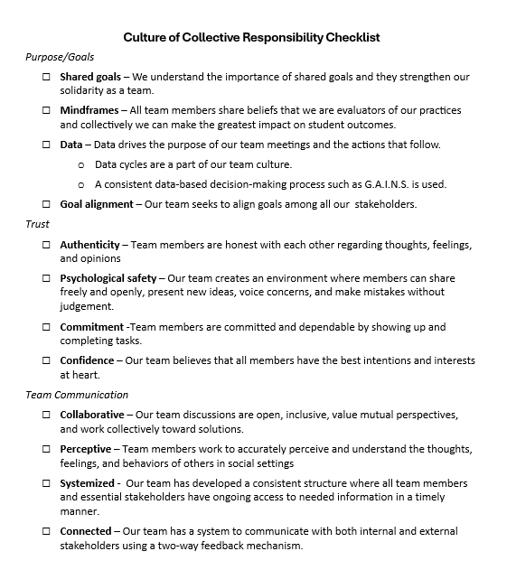
Is Your Team Building a Culture of Collective Responsibility?
Ask each team member to reflect on the items and place a checkmark by those they believe are strengths for their team.
The team then engages in collaborative discussion to identify and prioritize areas that have not been checked and need improvement.
Data and discussion are then used to guide action planning.
Notes:
Handout CT 1.6
Culture of Collective Responsibility Checklist
To Know
This checklist provides a quick way for teams to reflect on key elements that characterize a Culture of Collective Responsibility. It is a helpful tool to use to identify areas needing strengthening in order to make action planning easier and more effective.
To Do/To Say
Provide each team member with the handout Culture of Collective Responsibility Checklist.
Each teach member will reflect on the Culture of Collective Responsibility checklist and place a checkmark by proficient items. Areas needing strengthening are to left blank.
Next, all team members will discuss their reflections and the team will come to a consensus on what items need to be strengthened.
These data and discussion points will then be used for action planning purposes (next slide).
Reference
National Labor Management Partnership. (2022). Collaborating for student success: A comprehensive, practical guidebook for increasing shared decision-making through lasting partnerships. https://www.nea.org/sites/default/files/2022-05/NLMP%20Collaborating%20for%20Student%20Success%20Guidebook%202022%205-5-22.pdf

Slide 74

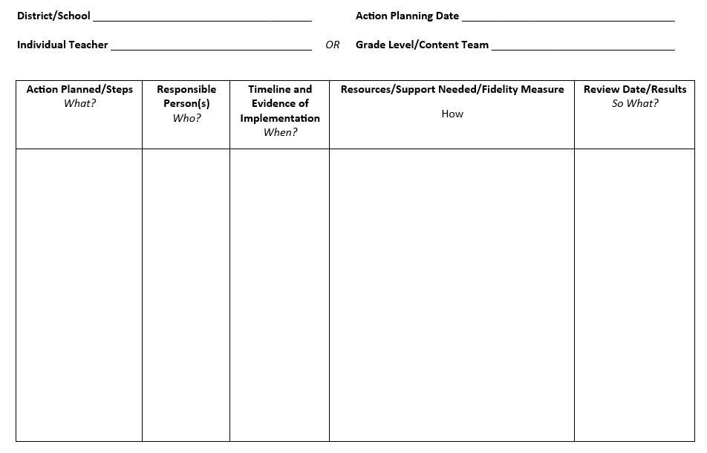
Next Steps Action Plan, Part 1
Notes:
Handout CT 1.7
Next Steps Action Plan, Part 1
To Know
Action planning enables participants to reflect on what they have learned, their strengths, and opportunities for growth.
A documented action plan that includes the action, person responsible, timeline, and resources makes it much more likely that change will take place.
Recording results will encourage educators to reflect on their accomplishments and continue actions that prove successful.
To Say/To Do
Provide participants with a copy of the action planning template (electronic or hard copy).
Review Action Planning Steps.
Action Planned/Steps – "What?” This column outlines what the team is actually planning to do. Think of it as the key actions or strategies they believe will help them reach their goal. Each step should be specific, actionable, and aligned to their school or team priorities.
Responsible Person(s) – "Who?” Here, the plan identifies the person or people responsible for ensuring each step is carried out. While implementation may be collaborative, assigning responsibility ensures accountability and avoids confusion about ownership.
Timeline and Evidence of Implementation – "When?” This section includes the timeline for when actions will occur, along with the evidence that will confirm implementation. Evidence might include artifacts such as sign-in sheets, lesson plans, photos, or documentation that demonstrate the work is taking place as planned.
Resources/Support Needed/Fidelity Measure – "How?” In this column, the team specifies what resources or support will be needed (such as professional development, materials, or coaching). Importantly, this is also where fidelity of implementation is addressed. The team defines how they will measure whether the action is being implemented as intended, using tools like checklists, observation rubrics, or walkthroughs.
Review Date/Results – "So What?” This final column captures the scheduled review date and documents what the data reveals about the results. The team reflects on the effectiveness of the action: What impact did it have? Is it working? Should the plan be continued, revised, or stopped? This reflective step ensures that the action plan remains responsive and results-driven.
Design action plan
Individual teachers or teams can design their plans based on data collected from the self-assessment taken.
Take some time to review the data collected on the self-assessment (Culture of Collective Responsibility Checklist) participants just took.
Use the data to help design an action plan (Handout CT 1.7) to promote a culture of collective responsibility.
One or more focus areas may be addressed.
You might work to develop a plan individually or collaboratively with a team.
Be sure to include the actions that will be taken; who will take the actions; a timeline for completing your work; resources and support needed; as well as follow-up that details the results.
We will take a bit of time to discuss your next steps with the group.

Slide 75

Closing and Thank You!
For more information contact us!
<Presenter name and contact info>
<Presenter name and contact info>
<Presenter name and contact info>
References are on the following slides.
Notes:
To Know/To Do/To Say
Choose how to close this part of the training and include your contact information.
Make sure participants know when the next training is scheduled.
You might want to review what the next trainings will cover.
Show the reference slides if appropriate.

Slide 76
References for all Collaborative Teams Modules
Adams, S (2025, March 8). What is minute taking? An ultimate guide. The Knowledge Academy. https://www.theknowledgeacademy.com/blog/what-is-minute-taking/
Aguilar, E. (2015, December 3). Effective team communication: A first step to getting along. Edutopia. https://www.edutopia.org/blog/effective-team-communication-first-step-getting-along-elena-aguilar
AllBusiness. (n.d.). 5 reasons why meeting minutes are important. https://www.allbusiness.com/importance-of-meeting-minutes
American Institutes for Research. (2022). MTSS infrastructure and support mechanisms series: MTSS school teams. Center on MTSS Multi-Tiered Systems of Supports. https://mtss4success.org/sites/default/files/2022-02/MTSS-Teams.pdf
ASU Mary Lou Fulton College. (2020, August 5). Benefits of teaming: Educator retention, educator leadership opportunities, and student learning [Video]. YouTube. https://www.youtube.com/watch?v=5OTRWm7wNbY
BetterHelp Editorial Team. (2025, February 24). Understanding the importance of effective communication in teamwork. BetterHelp. https://www.betterhelp.com/advice/teamwork/understanding-the-importance-of-communication-in-teamwork/
Bitrix24. (2022, January 21). How to improve team communication: Five effective tools [Video]. YouTube. https://www.youtube.com/watch?v=KSRLK31lq_4
Bloomberg, P. J., & Pitchford, B. (2016). Leading impact teams: Building a culture of efficacy (1st ed.). Corwin.
Cargal, A. (2021, June 10). Opening the door to professional learning. Edutopia. https://www.edutopia.org/article/opening-door-professional-learning/

Slide 77
References, Page 2
Corentus, Inc. (2019, March 19). Setting team norms that stick [Video]. YouTube. https://www.youtube.com/watch?v=tOtMcCM5zZc
Center for Creative Leadership. (2024, June 23). 10 steps for establishing team norms. https://www.ccl.org/articles/leading-effectively-articles/the-real-world-guide-to-team-norms/
Center for Leadership and Educational Equity. (n.d.-a). A rationale for protocols. https://www.clee.org/resources/rationale-for-protocols/
Center for Leadership and Educational Equity. (n.d.-b). Why protocols? School reform initiative. https://www.clee.org/resources/why-protocols/
Center for Research on Learning and Teaching. (2021). Guidelines for discussing difficult or high-stakes topics. University of Michigan. https://crlt.umich.edu/publinks/generalguidelines
ChandlerUnified. (2020, July 24). Multi-tiered systems of support (MTSS) [Video]. YouTube. https://www.youtube.com/watch?v=CAZ4CNtOHNo
ClickUp Customer Experience Team. (2024, January 24). How to encourage collaborative communication in the workplace. ClickUp. https://clickup.com/blog/collaborative-communication/
DavidLeeEdTech. (2021, April 21). Key elements for effective collaboration in schools [Video]. YouTube. https://www.youtube.com/watch?v=D4ciN-mJSaI
Doyle, A. (2022, June 7). What are collaboration skills? The Balance. https://www.thebalancemoney.com/collaboration-skills-with-examples-2059686

Slide 78
References, Page 3
Edutopia. (2016, April 20). Collaborative planning: Integrating curriculum across subjects [Video]. YouTube. https://www.youtube.com/watch?v=yCy4PSOvkL4
Edutopia. (2017, April 6). Teacher labs: Making professional development collaborative [Video]. YouTube. https://www.youtube.com/watch?v=gf5KcyHGhRA&t=168s
Edutopia (2024, April 26). Calibrating best practices across a whole school [Video]. https://www.edutopia.org/video/calibrating-whole-school-best-practices
Entelechy. (2024, February 1). The importance of horizontal and vertical collaborative teams in schools. https://backup.theedadvocate.org/the-importance-of-horizontal-and-vertical-collaboration-teams-in-schools/
EL Education. (2018, January 19). Grade level data meeting with third grade teachers [Video]. YouTube. https://www.youtube.com/watch?v=BLCbNX84ll4
EL Education. (2019a, April 3). Leading teams with data protocols [Video]. YouTube. https://www.youtube.com/watch?v=OdG7_ggEBlk&feature=youtu.be
EL Education. (2019b, June 21). Shared leadership through instructional leadership teams [Video]. YouTube. https://www.youtube.com/watch?v=T-hqrR5pcDo
Fellow. (2023, May 2). 15 best team communication tools & apps in 2024. https://fellow.app/blog/productivity/most-efficient-team-communication-tools/​
Ferriter, B. (n.d.). Five important roles for successful collaborative teams. Building Confident Learners. https://buildingconfidentlearners.com/2018/09/five-important-roles-for-successful-collaborative-teams/​

Slide 79
References, Page 4
Ferriter, W. M. (2020, April 7). Spotting collaborative teams with high levels of collective efficacy. SolutionTree. https://www.solutiontree.com/blog/spotting-collaborative-teams-with-high-levels-of-collective-efficacy/​
Garmston, R, & Wellman, B. (1999). The adaptive school: A sourcebook for developing collaborative groups (1st ed.). Christopher-Gordon Publishers, Inc.
Garmston, R, & Wellman, B. (2016). The adaptive school: A sourcebook for developing collaborative groups (3rd ed.). Rowman & Littlefield Publishers.
Garmston, R, & Wellman, B. (2019a). Norms inventory. Adaptive Schools Foundation Seminar Learning Guide. https://www.thinkingcollaborative.com/_files/ugd/6a5cc9_2fd56baa9f2d484ea25904373efe2e55.pdf
Garmston, R., & Wellman, B. (2019b). Personal seven norms assessment. Adaptive Schools Foundation Seminar Learning Guide. https://www.thinkingcollaborative.com/_files/ugd/6a5cc9_6e66a89e719e4ca1a7a81012582bb91c.pdf
Garmston, R., & Wellman, B. (2019c). Seven norms of collaboration: A supporting toolkit. Adaptive Schools Foundation Seminar Learning Guide. https://www.thinkingcollaborative.com/_files/ugd/6a5cc9_263cffd70d0d4a988fdfa77deaaa769c.pdf
Garmston, R., & Wellman, B. (2019d). The seven norms of collaborative work. Adaptive Schools Foundation Seminar Learning Guide. https://www.thinkingcollaborative.com/_files/ugd/6a5cc9_d080a1bbb7c84e43934a019d684214d2.pdf
Hargreaves, A. (2019). Teacher collaboration: 30 years of research on its nature, forms, limitations and effects. Teachers and Teaching, 25(5), 603–621. https://doi.org/10.1080/13540602.2019.1639499
Hattie, J. (2024, November). Visible learning homepage. Visible Learning Meta X. https://www.visiblelearningmetax.com/

Slide 80
References, Page 5
Hattie, J., & Zierer, K. (2024). 10 mindframes for visible learning: Teaching for success (2nd ed.). Routledge.
Hattie, J., & Zierer, K. (2017). 10 mindframes for visible learning: Teaching for success (1st ed.). Routledge.
Holmes, S. (2019). Are the lack of team norms sabotaging your team’s success? Make A Dent Leadership. https://madl.s3.amazonaws.com/products/team-norms/team-norms.pdf
Horton, D. (2022, November 18). Successful systems of communication for school teams. The Core Collaborative. https://thecorecollaborative.com/successful-systems-of-communication-for-school-teams/
Indeed Editorial Team. (2025, April 14). 17 benefits of team building for your organization. Indeed. https://www.indeed.com/career-advice/career-development/benefits-of-team-building
Kitch, B. (2023, September 7). How to create a team working agreement. Mural. https://www.mural.co/blog/team-agreement-guide​
Lynch, M. (2020, July 6). Creating effective leadership teams in schools. The Edvocate. https://www.theedadvocate.org/creating-effective-leadership-teams-in-schools/​
Mantell, M. (2025, March 19). What is social perceptiveness? 12 skills you need to master. Science of People. https://www.scienceofpeople.com/social-perceptiveness/​
Marzano, R. J., Heflebower, T., Hoegh, J. K., Warrick, P., Grift, G., Hecker, L., & Wills, J. (2016). Collaborative teams that transform schools: The next step in PLCs. Marzano Research.
Mattone, J. (2025, May 3). Consensus building: What is it and why is it crucial to leadership? John Mattone Global, LLC. https://johnmattone.com/blog/consensus-building-what-is-it-and-why-is-it-crucial-to-leadership/

Slide 81
References, Page 6
Meltzer, R. (2022, July 15). How to write meeting minutes, with examples. Grammarly. https://www.grammarly.com/blog/business-writing/meeting-minutes/
Minshew, A. (2024, January 10). 6 tips for building trust between teachers and administrators as a school leader. Waterford. https://www.waterford.org/education/building-trust-school-leader/
Missouri Department of Elementary and Secondary Education. (2013a). Leader standards. https://dese.mo.gov/media/pdf/oeq-ed-leaderstandards
Missouri Department of Elementary and Secondary Education. (2013b). Teacher standards. https://dese.mo.gov/media/pdf/oeq-ed-teachstandards
MoEdu-SAIL. (2022a). Collaborative teams module.
MoEdu-SAIL. (2022b). Common formative assessment module.
MoEdu-SAIL. (2023). DCI-MTSS district-level implementation practice profile. Missouri Department of Elementary and Secondary Education. https://www.moedu-sail.org/wp-content/uploads/2023/09/DCI-MTSS-District-Level-Implementation-Practice-Profile-June-2023.docx
MoEdu-SAIL. (2025a). Blueprint for district and building leadership (9th ed.). Missouri Department of Elementary and Secondary Education: Northern Arizona University, Institute for Human Development.
MoEdu-SAIL. (2025b). DCI-MTSS roadmap, an overview. Missouri Department of Elementary and Secondary Education: Northern Arizona University, Institute for Human Development. https://www.moedu-sail.org/dci-mtss-roadmap-view-2/
​

Slide 82
References, Page 7
MoEdu-SAIL. (n.d.-a). Collaborative teams online module. https://www.moedu-sail.org/courses/collaborative-team-structures/
MoEdu-SAIL. (n.d.-b). Common formative assessment online module. https://www.moedu-sail.org/courses/common-formative-assessment/
MoEdu-SAIL. (n.d.-c). Data-based decision making online module. https://www.moedu-sail.org/courses/data-based-decision-making-2/
National Center for Education Evaluation and Regional Assistance. (2023, November 9). Data-driven decision-making in education: How REL work makes a difference. NCEE Blog. https://web.archive.org/web/20250110023105/https://ies.ed.gov/blogs/ncee/post/data-driven-decision-making-in-education-how-rel-work-makes-a-difference
National Labor Management Partnership. (2022). Collaborating for student success: A comprehensive, practical guidebook for increasing shared decision-making through lasting partnerships. https://www.nea.org/sites/default/files/2022-05/NLMP%20Collaborating%20for%20Student%20Success%20Guidebook%202022%205-5-22.pdf
New South Wales Education Standards Authority. (n.d.). 10 mindframes for visible learning. Thinking Pathways. https://thinkingpathwayz.weebly.com/10-mindframes-visible-learning.html
North American Students of Cooperation. (n.d.). Fist to five voting and consensus. https://www.nasco.coop/resources/fist-to-five-voting
Philaphandeth, K. (2022, September 2). How to write an effective team meeting agenda (with templates!). Work Life by Atlassian. https://www.atlassian.com/blog/productivity/team-meeting-agenda
PlanBook. (n.d.). How to improve collaboration across your school. https://blog.planbook.com/improve-collaboration/
Poplar Bluff School District. (n.d.). Effective practices: Data-based decision making [Video]. MoEdu-Sail. https://www.moedu-sail.org/lessons/collaborative-team-structures-overview/

Slide 83
References, Page 8
Principal’s Playbook. (n.d.). Instructional leadership teams. https://www.theprincipalsplaybook.com/instructional-leadership/instructional-leadership-teams
Reading Rockets. (n.d.). Inclusive classrooms. https://www.readingrockets.org/helping-all-readers/inclusive-classrooms
Rouda, R. (2018, March 28). A framework for effective data use in schools. Learning for Action. http://learningforaction.com/lfa-blogpost/data-matters-framework
Rubinstein, S.A. (2014). Strengthening partnerships: How communication and collaboration contribute to school improvement. American Educator, Winter 2013-2014, 22-28. https://www.aft.org/sites/default/files/Rubinstein.pdf
Ruckes, V. (2021, August 2). Why schools need both horizontal and vertical collaboration. We Are Teachers. https://www.weareteachers.com/collaboration-teams/
Schleifer, D., Rinehart, C., & Yanisch, T. (2017). Teacher collaboration in perspective: A guide to research. Spencer Foundation, Public Agenda. https://files.eric.ed.gov/fulltext/ED591332.pdf
Seeds for Change. (2018a, April 11). How to do consensus decision making [Video]. YouTube. https://www.youtube.com/watch?v=FgjgXIxHmmI
Seeds for Change. (2018b, April 11). What is consensus decision making? [Video]. YouTube. https://www.youtube.com/watch?v=OYMgLi1WrNg
Seeds for Change. (2020a). Short guide to consensus decision making. http://www.seedsforchange.org.uk/shortconsensus
Seeds for Change. (2020b). Introduction to consensus decision making. https://seedsforchange.org.uk/downloads/shortconsensus.pdf

Slide 84
References, Page 9
Seeds for Change. (2020c). Consensus decision-making: A short guide. https://seedsforchange.org.uk/shortconsensus#why
Senn, G., McMurtrie, D., & Coleman, B. (2019). Collaboration in the middle: Teachers in interdisciplinary planning. Current Issues in Middle Level Education, 24(1), Article 6. https://files.eric.ed.gov/fulltext/EJ1204875.pdf
Shero, P. (2017, December 4). 3 reasons team members need roles. Masterminds Leadership. https://mastermindsleadership.com/development-blog/team-members-roles/
Sinek, S. (2023, August 4). How do we actually build trust in our teams? [Video]. YouTube. https://www.youtube.com/watch?v=08RU6oiFTdg
SkyHealth Learning Academy (2025, January 3). How to build cohesive teams as a new leader: A step by step guide. [Video]. YouTube. https://youtu.be/sIOqw9-8-w8
Sloper, C., Grift, G., & Muhammad, A. (2021). Collaborative teams that work: The definitive guide to cycles of learning in a PLC. Solution Tree Press.
Solone, C. J., Thornton, B. E., Chiappe, J. C., Perez, C., Rearick, M. K., & Falvey, M. A. (2020). Creating collaborative schools in the UnitedStates: A review of best practices. International Electronic Journal of Elementary Education, 12(3), 283–292.https://doi.org/10.26822/iejee.2020358222
StanfordSCOPE. (2018, March 20). Time matters: Teacher collaboration for learning and leading [Video]. YouTube. https://www.youtube.com/watch?v=Ex1zfl-MsDk
Tallman, T. (2020, July 23). How teachers experience collaboration. Journal of Education, 201(3). https://journals.sagepub.com/doi/10.1177/0022057420908063

Slide 85
References, Page 10
Tanner, K. (2023, November 2). 41 games for educators to build better teams. Teaching Expertise. https://www.teachingexpertise.com/teacher-life/games-for-educators/
Team Asana. (2025, February 7). Meeting agenda examples: How to plan, write, and implement. Asana. https://asana.com/resources/meeting-agenda
Team Scholarship Acceleration Lab. (n.d.). Seven norms of collaboration: A supporting toolkit. https://tsal.uci.edu/lesson/seven-norms-of-collaboration-a-supporting-toolkit/
Thinking Collaborative. (n.d.). Adaptive schools resources. https://www.thinkingcollaborative.com/as-resources
Valenzuela, J. (2022, August 12). Shared agreements for working together benefit teachers and administrators. Edutopia. https://www.edutopia.org/article/shared-agreements-working-together-benefit-teachers-and-administrators/
VanZandt, P. (2023, July 25). What is rose, bud, and thorn? Definition, templates and exercise. IdeaScale. https://ideascale.com/blog/rose-bud-and-thorn/
Vedantam, S., & Woolley, A. (2023, September 26). The secret to great teams. Hidden Brain. https://hiddenbrain.org/podcast/the-secret-to-great-teams/
Welch, D., & Garmston, R. J. (2007). Results-oriented agendas transform meeting into valuable collaborative events. The Learning Professional, 28(2). https://learningforward.org/journal/time/results-oriented-agendas-transform-meeting-into-valuable-collaborative-events/
Woolley, A.W., Chow, R. M., Mayo, A.T., Riedl, C., & Chang, J.W. (2023). Collective attention and collective intelligence: The role of hierarchy and team gender composition. Organization Science, 34(3), 1315-1331. https://doi.org/10.1287/orsc.2022.1602
Yussif. (2024, February 28). Nineteen strategies for teaching teamwork in your classroom. Classroom Management Expert. https://classroommanagementexpert.com/blog/19-strategies-for-teaching-teamwork-in-your-classroom/

