Slide 1
Hidden Slide Intro
Collaborative Teams, Part 2
This module starts with hidden slides providing information for the presenter.

Slide 2
Hidden Slide #1
The Collaborative Teams Module was designed to be used in the following manner.
The audience for this module is educators, building leaders, instructional coaches, and teachers of all contents and levels. This module can be used for whole staff presentations.
Time should be allotted after training for participants to reflect and have conversations regarding current status and needed changes. Participants should reflect on the following questions. Where are we now? Where are we going? How do we get there?
Participants should complete the SAPP for collaborative teams prior to training. Presenters should use this information to assess the district’s current level of implementation and select module activities and content that align with the district’s specific needs.
Following the training participants should complete a Next Steps Action Plan – note there is a separate action plan for each of the three parts of the module.
Notes:
To Know
It is important for all educators, building leaders, and instructional coaches to understand the importance and benefits of developing effective collaborative teams.
The content in this module is intended to help educators develop capacity regarding the culture, structures, and processes that are necessary to implement effective collaborative teams.
Strategies and tools that help educators create efficient and effective collaborative teams will be presented.

Slide 3
Collaborative Team Module Organization
Hidden Slide #2
Part 1 EF 1 | Part 2 EF 2 | Part 3 EF 3
Building a Culture of Collective Responsibility | Effective Team Structures & Skills | Group Processes for Impactful Collaboration
Purpose/Goals Trust Communication | Team Configurations Time Roles Collaborative Skills | Agendas/Minutes Norms Consensus Protocol
Notes:
To Know
The CT module is designed around the Collaborative Team Framework and aligns with each essential function on the CT Practice Profile:
Part 1, Culture (EF1): Building a culture of collective responsibility
Part 2, Structure (EF2): Structuring team meetings to assure authentic and effective collaboration
Part 3, Process (EF3): Using group processes for impactful collaboration

Slide 4
Hidden Slide #3
In-person professional development suggestions
The following estimated times for each Collaborative Teams Module part are based on providing participants with ample time to process and reflect on content.
  Part 1: Introduction & Building a Culture of Collective Responsibility, 2.5 hours
  Part 2: Effective Team Structures & Skills, 3 hours
  Part 3: Group Processes for Impactful Collaboration, 3 to 4 hours
  Total = 8.5 to 9.5 hours
Read the slide notes thoroughly as they provide detailed information to assist you in preparation for and delivery of the presentation.
Some reflection activities can be expanded by using the activities designated OPTIONAL.
Breaks can be added at the presenter’s discretion.
Notes:
To Know
The slide includes estimated times for each of the three parts. This PPT, Part 2, is designed to be completed in 3 hours.
Presenter notes are included in the PowerPoint slides. Background information for the presenter is shown as “To Know.” Statements and activities to be shared with participants are shown as either “To Say” or “To Do.” In many instances, there are various combinations of “To Know/To Do/To Say.” The presenter notes also include cues for “Handouts” and activities.
Additional activities, examples, videos, etc. are included in the Collaborative Teams Coaching Companion. You can add material from the Coaching Companion to corresponding PowerPoint content.
A printed Practice Profile and an electronic Self-Assessment Practice Profile (SAPP) tool are available for use by individuals, teams, or schools for periodic self-assessment, monitoring of implementation of the practice, or to identify training/coaching needs.
The presenter should download any video intended for use in a training, as you may not have internet access in all school sites.

Slide 5
Hidden Slide #4
Supplies and information needed
WIFI access for presenter and participants
Access to videos (through WIFI if available, however, download to flash drive as a back-up)
Chart paper
Plain paper
Markers and highlighters
Post-it-Notes
Consider inserting QR codes and requesting that participants bring a device with a QR reader to scan codes for easy access to documents
Notes:
To Know
This slide is for presenters as they prepare.

Slide 6
Hidden Slide #5
General guidance for virtual presentations
Notify and request prior permission from participants if session is to be videotaped
Test your tech set up prior to the session (download and save videos on flash drive as back-up)
Keep sessions as short as possible and/or provide breaks
Provide and discuss norms for participation (camera on, ask questions in chat – if that is your preference, stay engaged)
Minimize distractions (request participants mute when not speaking)
Use 2 consultants – 1 to present, 1 to manage chat, etc.
Identify other roles prior to presentation, as appropriate (timekeeper, notetaker, etc.)
Create opportunities for participant engagement and interaction (e.g., HQ Tools for Audience Engagement Collaborative Notetaking Document)
When using breakout rooms, equip each room with 1 consultant to facilitate and 1 to take notes, if possible
Encourage reflection and action
Notes:
To Know/To Do
If presenting this module virtually, the notes on this slide will help you prepare for the presentation.

Slide 7
Hidden Slide #6
Handouts
CT 2.1, Collaborative Teams Infographic
CT 2.2, Collaborative Teams Practice Profile
CT 2.3, Collaborative Teams Key Terms
CT 2.4, Video Reflections
CT 2.5, Horizontal and Vertical Teams
CT 2.6, Video Reflections
CT 2.7, Team Roles and Responsibilities
CT 2.8, Team Roles and Skills Needed
CT 2.9, Norms of Collaboration Table Tents
CT 2.10, Connecting Norms of Collaboration
CT 2.11, Next Steps Action Plan, Part 2
Notes:
To Know
Handouts listed are in the handout folder.
Numerous sites are also provided throughout the module for participants to access via a web link. It is suggested that QR codes are added to those slides so participants can easily access the links.
Due to copyright regulations, some materials are linked to their original source and must be downloaded from the link.

Slide 8
Hidden Slide #7
Collaborative Teams Key Terms (Part 2)
Building Leadership Teams. A team comprised of building-level administrators, teacher leaders, instructional coaches, and other persons integral to building-level continuous improvement.
Collaborative Time. Time exclusively allocated for educators to meet, plan, engage in dialogue, analyze data, and/or take action to improve student outcomes.
Collaborative Skills. Behaviors that help groups work more effectively toward shared goals. These skills facilitate and sustain group interaction; enhance the quality and productivity of group conversation; and help to generate creative and innovative ideas.
Data Cycle. A systematic cycle for turning data into actionable steps. The steps in a typical data cycle include 1) gathering data, 2) analyzing data, 3) acting on data, and 4) noticing effects and adjusting action steps. Collaborative teams engage in this ongoing process to inform decision making.
District Leadership Teams. Comprised of district-level administrators; district-wide coaches; curriculum and assessment leader; professional development coordinators; and other instructional and administrative leaders to lead district-level DCI implementation.
Notes:
Handout CT 2.3
Collaborative Teams Key Terms (Part 2)
To Know/To Do
Key terms that align with each Essential Function can be found in the notes section at the beginning of each module. Presenters may choose to provide participants with Handout CT 2.3, which contains terms associated with Part 2 of the CT module. Another consideration is to provide table copies of this handout.
References (adapted from)
American Institutes for Research. (2022). MTSS infrastructure and support mechanisms series: MTSS school teams. Center on MTSS Multi-Tiered Systems of Supports. https://mtss4success.org/sites/default/files/2022-02/MTSS-Teams.pdf
Bloomberg, P. J., & Pitchford, B. (2016). Leading impact teams: Building a culture of efficacy (1st ed.). Corwin.
Garmston, R, & Wellman, B. (1999). The adaptive school: A sourcebook for developing collaborative groups (1st ed.). Christopher-Gordon Publishers, Inc.
Garmston, R., & Wellman, B. (2019d). The seven norms of collaborative work. Adaptive Schools Foundation Seminar Learning Guide. https://www.thinkingcollaborative.com/_files/ugd/6a5cc9_d080a1bbb7c84e43934a019d684214d2.pdf
Lynch, M. (2020, July 6). Creating effective leadership teams in schools. The Edvocate. https://www.theedadvocate.org/creating-effective-leadership-teams-in-schools/
Marzano, R. J., Heflebower, T., Hoegh, J. K., Warrick, P., Grift, G., Hecker, L., & Wills, J. (2016). Collaborative teams that transform schools: The next step in PLCs. Marzano Research.
National Labor Management Partnership. (2022). Collaborating for student success: A comprehensive, practical guidebook for increasing shared decision-making through lasting partnerships. https://www.nea.org/sites/default/files/2022-05/NLMP%20Collaborating%20for%20Student%20Success%20Guidebook%202022%205-5-22.pdf
Reading Rockets. (n.d.). Inclusive classrooms. https://www.readingrockets.org/helping-all-readers/inclusive-classrooms
Rouda, R. (2018, March 28). A framework for effective data use in schools. Learning for Action. http://learningforaction.com/lfa-blogpost/data-matters-framework
Solone, C. J., Thornton, B. E., Chiappe, J. C., Perez, C., Rearick, M. K., & Falvey, M. A. (2020). Creating collaborative schools in the United States: A review of best practices. International Electronic Journal of Elementary Education, 12(3), 283–292. https://doi.org/10.26822/iejee.2020358222

Slide 9
Hidden Slide #8
Collaborative Teams Key Terms (Part 2)
Feedback Loop. A continuous process of gathering and/or sharing information/data with relevant stakeholders to ensure data-driven decision making.
Horizontal School Teams. Collaborative teams comprised of educators who instructionally serve the same grade level, subject area, or common focus.
Mutual Goals. A specific, measurable objective that supports the vision and guides actions and decision-making.
Parity. A state of equality ensuring everyone’s contribution is equally valued, and each person has the same status, opportunities, or value within the system.
Seven Norms of Collaboration. Developed by Adaptive Schools (Garmston & Wellman, 1999), The Seven norms are essential behaviors that promote productive dialogue, teamwork, and decision making and include pausing, paraphrasing, posing questions, putting ideas on the table, providing data, paying attention to self and others, and presuming good intentions.
Shared Resources. Materials, time, and knowledge are shared with all to improve the overall effectiveness of a team.

Slide 10
Hidden Slide #9
Collaborative Teams Key Terms (Part 2)
Shared Responsibility. Everyone participants in completing team tasks and takes accountability for outcomes.
Teacher Teams. Collaborative teams comprised of educators and include grade level teams, content alike teams, intervention teams, and special focus teams.
Team Configurations. The way in which teams are organized and structured based on their responsibilities, functions, and goals.
Team Roles. The specific responsibilities or functions that each member of a team assumes to help achieve the team's goals.
Team Synergy. The concept that a group’s collective efforts produce greater results than the sum of individual contributions. It occurs when team members collaborate effectively, leveraging their strengths, skills, and perspectives to achieve shared goals.
Vertical School Teams. Collaborative teams comprised of educators who instructionally serve different grade levels within a school or across districts, ensuring that student learning builds effectively from one level to the next.

Slide 11
Hidden Slide #10
Pre-Training Preparation
Pre-read articles
The Importance of Horizontal and Vertical Collaborative Teams in Schools,
https://backup.theedadvocate.org/the-importance-of-horizontal-and-vertical-collaboration-teams-in-schools/
Why Schools Need Both Horizontal and Vertical Collaboration, Why Schools Need Both Horizontal and Vertical Collaboration (weareteachers.com)
Notes:
Links
The Importance of Horizontal and Vertical Collaborative Teams in Schools, https://backup.theedadvocate.org/the-importance-of-horizontal-and-vertical-collaboration-teams-in-schools/
Why Schools Need Both Horizontal and Vertical Collaboration, Why Schools Need Both Horizontal and Vertical Collaboration (weareteachers.com)
To Know
An activity early in the session will debrief the content of these articles.
To Do
Send participants the links and instructions to read both articles prior to the training session.
References
Entelechy. (2024, February 1). The importance of horizontal and vertical collaborative teams in schools. https://backup.theedadvocate.org/the-importance-of-horizontal-and-vertical-collaboration-teams-in-schools/
Ruckes, V. (2021, August 2). Why schools need both horizontal and vertical collaboration. We Are Teachers. https://www.weareteachers.com/collaboration-teams/

Slide 12
Collaborative Teams
Part 2
Effective Team Structures & Skills
Notes:
To Know/To Say
Collaborative Teams, Part 2 covers Essential Function 2, which focuses on effective team structures and skills.
Parts 1 and 3 of this training cover Essential Functions 1 and 3 and are separate PowerPoint presentations.
The presenter can use judgement on how to present this information to the participants depending on time allotted for training, but you must not deviate from the module in terms of deleting or adding information.

Slide 13
Acknowledgements
Special thanks to all contributors to the development of this Professional Learning Module. The original collection of Professional Learning Modules was developed starting in 2013 by a team funded by the Missouri State Personnel Development Grant (SPDG). The current SPDG has a focus on creating Multi-Tiered Systems of Support (MTSS). Modules developed during 2025 and later will incorporate strategies to integrate an MTSS framework.
Content Development
Beverly Kohzadi
Training Module Development
Beverly Kohzadi
Cheryl Wrinkle
Chelie Nelson
MoEdu-SAIL Module Development Team
Ronda Jenson, Director
Chelie Nelson
Cheryl Wrinkle
Beverly Kohzadi
Cynthia Beckmann
Nicole Stone
Notes:
To Know/To Say
Give special thanks to all contributors to the development and revision of this Professional Learning Module.

Slide 14
Welcome and Introductions
Our trainers for the day
<Presenter name>
<Presenter name>
<Presenter name>
Notes:
To Know/To Do/To Say
Add presenter information to the slide and introduce yourself and other presenters.
An icebreaker can be added here as a way for participants to introduce themselves if you would like.

Slide 15
Norms
Begin and end on time
Be an engaged participant
Be an active listener, open to new ideas
Use notes for side bar conversations
Use electronics respectfully
Notes:
To Know/To Do/To Say
It is important to establish norms for training. Review the norms for this training, trainers are free to adjust this list of norms.
Consider including a check mid-way through trainings to assess a norm or norms.
The presenter may want to print norms as handouts, or on the agenda, so they are always present.
Norms may be added to address specific school needs. Some schools already have established norms for all PD. In that case, adapt to their norms.
Ask if there are any additions/adjustments that need to be made to the norms at this time.

Slide 16



District Continuous Improvement (DCI) Framework
Focus on effective instruction leading to exceptional outcomes for ALL Missouri students
Foundations
Collaborative Teams
Data-Based Decision Making
Common Formative Assessment
Effective Teaching and Learning Practices
Developing Assessment Capable Learners
> Feedback
Metacognition
Supportive Context
School-Based Implementation Coaching
Collective Teacher Efficacy
Systems Leadership
Instructional Leadership
Notes:
Note
This slide should be used if you are presenting to a district involved only in DCI. Hide the next slide if that is the case. If presenting to a DCI-MTSS district or building, hide this slide and use the next one.
To Know
Nine Professional Learning Modules make up the DCI Content within the DCI Framework as illustrated in the slide.
Three foundational educational practices essential for collaborative, data-informed instruction and decision making
Two effective teaching and learning practices shown to improve student achievement
Four practices that create a supportive context to sustain and advance effective teaching and learning
To Do/To Say
Before we delve into this module, let’s take a few minutes to review the DCI Framework graphic, looking specifically at where metacognition falls into big picture.
As you see, the focus of DCI is on effective instruction leading to exceptional outcomes for all Missouri students.
Review the elements of each section of the three main components.
Foundations (consisting of Collaborative Teams, Data-Based Decision Making, and Common Formative Assessment)
Effective Teaching and Learning Practices (Developing Assessment Capable Learners with Feedback and Metacognition)
Supportive Context (School-Based Implementation Coaching, Collective Teacher Efficacy, and Systems/Instructional Leadership)
Reference
MoEdu-SAIL. (2025a). Blueprint for district and building leadership (9th ed.). Missouri Department of Elementary and Secondary Education: Northern Arizona University, Institute for Human Development.

Slide 17
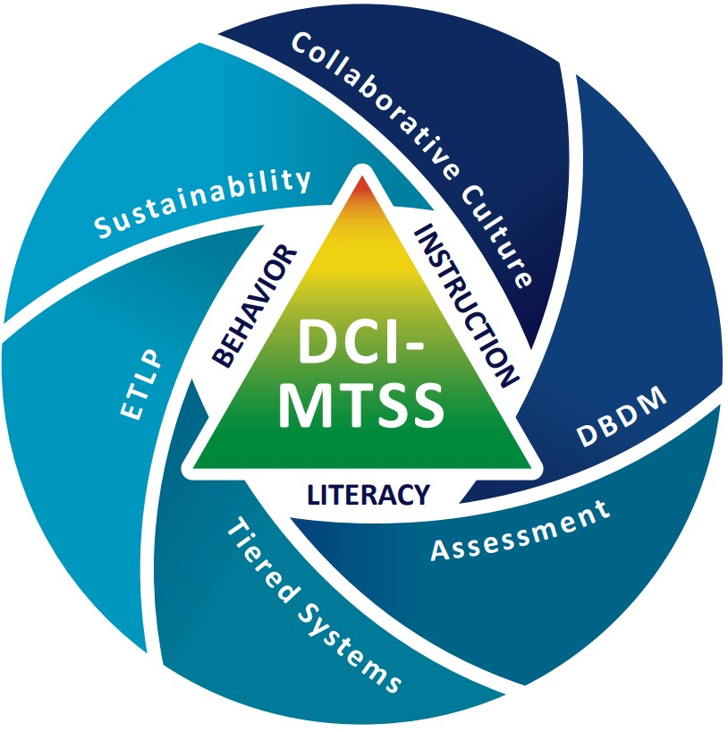
DCI-MTSS Framework
Notes:
Note
Use this slide if you are presenting to a district/building involved in DCI-MTSS and hide the previous DCI Framework Slide.
To Know
DCI-MTSS focuses on blending elements of DCI, SW-PBS, and/or Literacy providing a Multi-Tiered System of Support (MTSS) based on the specific needs of a district.
DCI-MTSS is built on the evidence-based premises of an MTSS framework. With an overarching goal to improve outcomes for all students, especially students with disabilities, by providing high-quality professional development focused on district- and building-level implementation within a multi-tiered system of support (MTSS), the DCI-MTSS Framework creates a cohesive system that focuses on increasing both academic and behavioral outcomes to equitably support the varying needs of all students.
This graphic illustrates the DCI-MTSS Framework as described in the DCI-MTSS District-Level Implementation Practice Profile.
The outside of this graphic highlights the 6 essential functions that have been identified as important for district leadership teams in the effective implementation of DCI-MTSS.
District leaders maintain a collaborative culture and climate to build capacity for an outcome-driven approach to school improvement.
District leaders maintain an assessment system designed to support educational teams in making informed instructional and programmatic decisions to support students.
District leaders engage in cycles of data-based decision making to meet the needs of all students.
District leaders maintain a tiered system of supports that provides efficient, effective, and equitable allocation of resources to support all students.
District leaders select and align effective teaching and learning practices to increase the probability that instruction, interventions, and supports meet the needs of all students.
District leaders provide staff with ongoing support to ensure the integration and sustainability of their continuous improvement efforts.
Within the white space in the center you see the three content areas on which DCI-MTSS focuses: behavior, instruction, and literacy. The triangular center of the diagram represents the tiers.
Collaborative teams fit into several of the essential functions and content areas.
To Do/To Say
Describe the meaning of the illustration.
Note that for this module we are focused on collaborative teams, which impact each of the essential functions.
Without strong collaborative teams, districts may struggle to effectively implement and sustain MTSS practices, leading to inconsistencies in decision making, resource allocation, and student support.
Collaborative teams ensure alignment, shared responsibility, and a collective approach to problem-solving, ultimately driving student success.
Reference
MoEdu-SAIL. (2023). DCI-MTSS district-level implementation practice profile. Missouri Department of Elementary and Secondary Education. https://www.moedu-sail.org/wp-content/uploads/2023/09/DCI-MTSS-District-Level-Implementation-Practice-Profile-June-2023.docx

Slide 18
C.T. Alignment with Missouri Teacher & Leader Standards
Standard #2 Teaching and Learning
Education leaders have the knowledge and ability to ensure the success of all students by promoting a positive school culture, providing an effective instructional program that applies best practice to student learning, and designing comprehensive professional growth plans for staff.
Standard #3 Management of Organizational Systems
Education leaders have the knowledge and ability to ensure the success of all students by managing the organizational structure, personnel, and resources in a way that promotes a safe, efficient, and effective learning environment.
Standard #6 Effective Communication
The teacher models effective verbal, nonverbal, and media communication techniques with students, colleagues and families to foster active inquiry, collaboration, and supportive interaction in the classroom.
Notes:
To Know/To Say
These Missouri Teacher and Leader Standards are closely aligned to the content within the Collaborative Teams Module. Please read the slide as I review the standards.
References
Missouri Department of Elementary and Secondary Education. (2013a). Leader standards. https://dese.mo.gov/media/pdf/oeq-ed-leaderstandards
Missouri Department of Elementary and Secondary Education. (2013b). Teacher standards. https://dese.mo.gov/media/pdf/oeq-ed-teachstandards

Slide 19
C.T. Alignment with Missouri Teacher and Leader Standards
Standard #7 Student Assessment and Data Analysis
The teacher understands and uses formative and summative assessment strategies to assess the learner’s progress and uses both classroom and standardized assessment data to plan ongoing instruction. The teacher monitors the performance of each student, and devises instruction to enable students to grow and develop, making adequate academic progress.
Standard #8 Professionalism
The teacher is a reflective practitioner who continually assesses the effects of choices and actions on others. The teacher actively seeks out opportunities to grow professionally in order to improve learning for all students.
Standard #9 Professional Collaboration
The teacher has effective working relationships with students, parents, school colleagues,
and community members.
Notes:
To Know/To Say
These Missouri Teacher and Leader Standards are closely aligned to the content within the Collaborative Teams Module. Please read the slide as I review the standards.
References
Missouri Department of Elementary and Secondary Education. (2013a). Leader standards. https://dese.mo.gov/media/pdf/oeq-ed-leaderstandards
Missouri Department of Elementary and Secondary Education. (2013b). Teacher standards. https://dese.mo.gov/media/pdf/oeq-ed-teachstandards

Slide 20

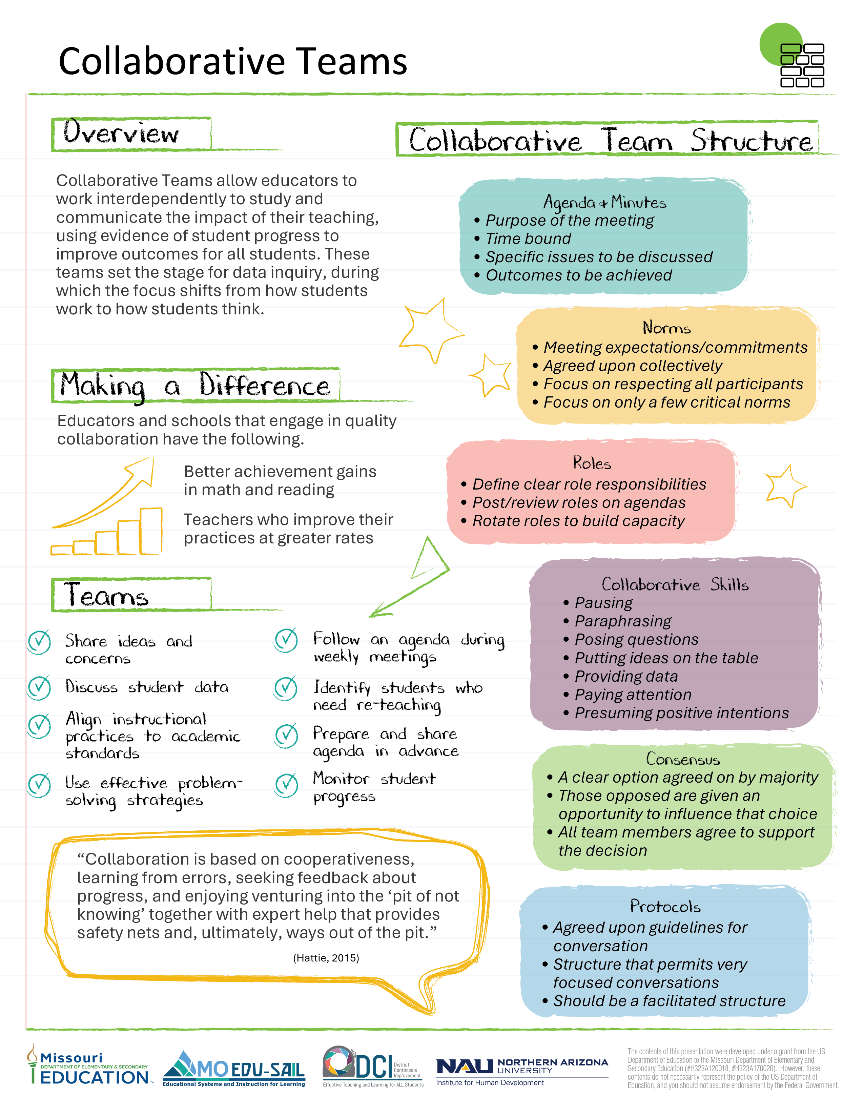
Collaborative Teams Infographic
Find this at www.moedu-sail.org/dci-practice-profiles-and-infographics
Notes:
Handout CT 2.1
Collaborative Teams Infographic
To Know/To Do/To Say
The infographic, Handout CT 2.1, provides a snapshot of the essential learning contained in the module. This is an opportunity for the presenter to provide a hook as to why developing collaborative teams is important. It also helps participants see how collaborative teams and data-based decision making go hand in hand.

Slide 21
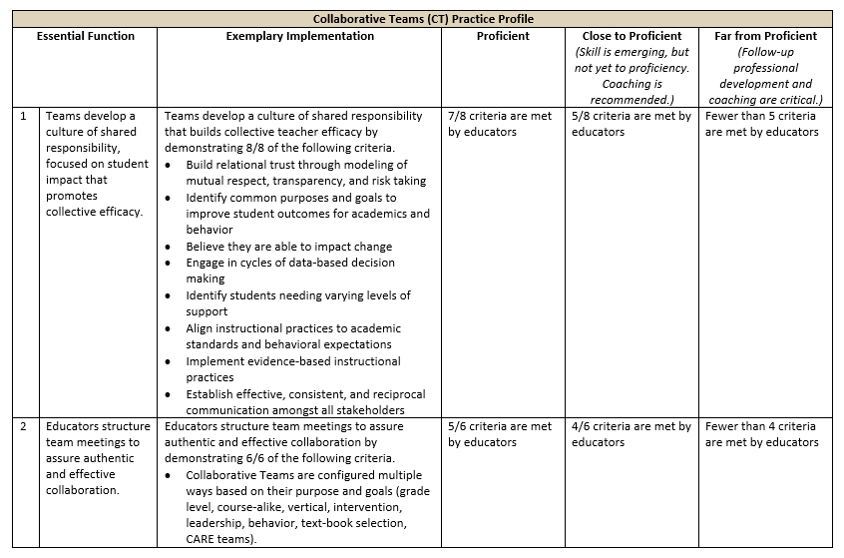
Collaborative Teams Practice Profile
Find this at www.moedu-sail.org/dci-practice-profiles-and-infographics
Notes:
Handout CT 2.2
Collaborative Teams Practice Profile
To Know/To Do/To Say
The Practice Profile for Collaborative Teams is Handout CT 2.2. Review the Practice Profile with the participants reviewing the following key points.
The Practice Profile template is anchored by the Essential Functions and implementation performance levels and criteria.
The three Essential Functions for collaborative teams are as follows.
Essential Function1, Teams develop a culture of shared responsibility, focused on student impact that promotes collective efficacy.
Essential Function 2, Educators structure team meetings to assure authentic and effective collaboration.
Essential Function 3, Educators effectively use group processes for impactful collaboration.
Implementation Performance Levels and Criteria
Four levels of implementation are described for each teaching/learning objective: exemplary, proficient, close to proficient, and far from proficient.
Within each implementation level, evidence which provides data or documentation for determining implementation levels is provided.
The Practice Profile is an important tool for self-monitoring implementation because it serves as a reminder as to the implementation criteria and is also aligned with the fidelity checklists and the electronic Self-Assessment Practice Profile (SAPP). These sources provide data regarding further training or coaching needs.
Part 2 focuses on Essential Function 2. There are two other parts to this module which cover Essential Functions 1 and 3.

Slide 22
Part 2
Effective Team Structures and Skills

Slide 23
Session-at-a-Glance
Designing effective collaborative teams
Safeguarding time for productive teaming
Establishing team roles
Strengthening collaborative skills
Next steps action planning
Notes:
To Know/To Do/To Say
This slide provides an overview of Part 2 of the Collaborative Teams module.

Slide 24
Collaborative Team Framework
Part 1 EF 1 | Part 2 EF 2 | Part 3 EF 3
Building a Culture of Collective Responsibility | Effective Team Structures & Skills | Group Processes for Impactful Collaboration
Purpose/Goals Trust Communication | Team Configurations Time Roles Collaborative Skills | Agendas/Minutes Norms Consensus Protocol
(Adapted from Bloomberg & Pitchford, 2016)
Notes:
To Know/To Say
The CT module is designed around this Collaborative Team Framework:
Part 1 - Culture (EF1): Building a culture of collective responsibility.
Part 2 - Structure (EF2): Structuring team meetings to assure authentic and effective collaboration
Part 3 - Process (EF3): Using group processes for impactful collaboration.
To Do
Review the organizational structure of the CT module and note how this module addresses the Part 2 components.

Slide 25
Part 2: Learning Objectives
Configure collaborative teams to effectively align with the district’s purpose and goals
Develop strategies to provide adequate time for teams work collaboratively
Establish team roles that are purposeful, clearly described, and align with team member skills
Consistently use collaborative skills that enhance team performance
Notes:
To Know/To Say
The learning objectives for Part 2, Effective Team Structures and Skills, are aligned with EF 2 of the Collaborative Teams Practice Profile.
Our session today will focus on… (Discuss the targets the session will focus on if it does not include all of part 2.)

Slide 26
Part 2: Essential Questions
What are key considerations when configuring effective collaborative teams?
How can adequate time be provided to teams to ensure goals are achieved?
Why is it important that team roles are purposeful, clearly defined, and align with team member skills?
How does strengthening collaborative skills enhance team performance?
Notes:
To Know/To Say
These essential questions help to guide thinking before, during, and after this session of learning. Notice how they coincide with the EF 2 criteria in the Practice Profile.
Optional Activity
Essential Questions may be written on individual chart paper and placed around the room so they can be referred to throughout the presentation.
You might have participants respond to the questions initially and then later provide opportunities to add to the responses once more learning has taken place.
If time permits, a carousel structure could be used so participants can respond, collaborate, and process the questions.

Slide 27
Team Configurations
Effective Team Structures & Skills

Slide 28
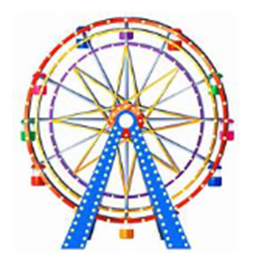






Making Analogies
Notes:
To Know/To Say
This opening activity provides an opportunity for participants to reflect on their prior knowledge regarding qualities and components of effective teams and make connections.
Activity
Making Analogies
Ask participants to work in teams of 4-6. Provide an example or two using the analogies listed below to help participants understand the activity. Feel free to substitute your own pictures for this activity.
First, provide 2 minutes for group members to study the pictures on the slide and to think about how effective teams are similar to these structures.
Next, ask each team member to jot down analogies on sticky notes.
Finally, share analogies with their team and then later some can be shared with the whole group.
Analogy examples
Nest. Effective teams are safe places where new ideas can take flight.
Ferris wheel. Effective teams keep everyone going forward in the same direction to reach goals.
Bridge. The sum of a team’s parts are stronger than each individual piece.
Water tower. Team member knowledge is pooled together to create a supply of collective intelligence.
Big Ben. Effective teams are like Big Ben, time is valued and protected.
Wind turbine. Effective teams generate energy and power to reach their goals.
Lighthouse. An effective team guides and lights the way to student success.

Slide 29
Team Configurations Chart
District Leadership Team
IMPACT
Building Leadership Team
Teacher Teams
      Grade level
      Content
      Behavior and academic
      interventions
(Adapted from Bloomberg & Pitchford, 2016)
Notes:
To Know/To Say/To Do
Each district will configure their collaborative teams in different ways depending on their goals and resources.
Regardless of the size of the district, all districts will need three types of teams to ensure continuous improvement. Districts will need a district leadership team, building leadership teams, and collaborative teacher teams to align the work and improve outcomes for all students.
Each of these teams is a type of collaborative team and each has a distinct purpose.
Teams support and depend on one another, working toward a common goal of creating conditions that have a positive impact on student achievement.
Emphasize the importance of each of these collaborative teams and how they must be aligned and work together to be effective.
The following slides outline each team’s role.
Note
For additional training/resource materials on Leadership Teams, see MO SW-PBIS Leadership Module: Lesson 1 Leadership Teams, https://pbismissouri.org/tier-1-workbook-resources/
Reference
Bloomberg, P. J., & Pitchford, B. (2016). Leading impact teams: Building a culture of efficacy (1st ed.). Corwin.

Slide 30
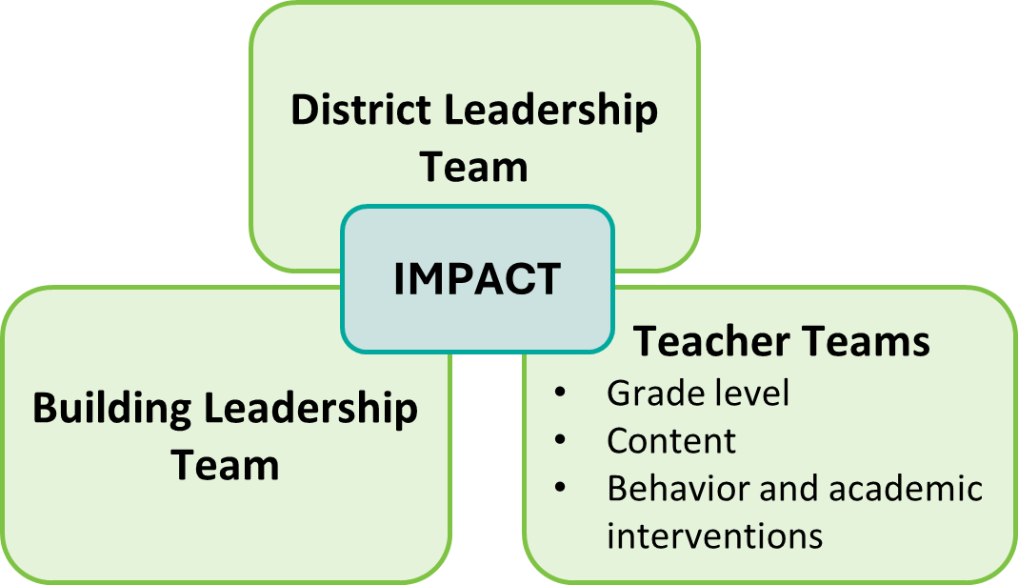
District Leadership Team (DLT)
Representatives from…
District administrators
Coaches/PD
Curriculum and assessment leaders
Building leaders
Regular and special education teachers
Other instructional leaders and stakeholders
The DLT is critical to the success of the entire district.
(MoEdu-SAIL, 2025b)
Notes:
To Know/To Say
The District Leadership Team (DLT) is typically comprised of district-level administrators who impact instruction.
Any district-wide initiative, such as Multi-Tiered System of Supports (MTSS), DCI, DW-PBS requires a district-wide, collaborative approach to be effective.
Broad representation on district leadership teams ensures that implementation is comprehensive and sustainable across schools and student populations.
Membership will vary depending on the size of the district and the district’s goals/needs.
The DLT may include the superintendent, building principals, special education director or coordinator, curriculum/instructional leadership, MTSS or intervention coordinator, school counselor, teacher leaders, instructional coaches, data or assessment coordinators, board liaison, parent or community member, technology coordinator, etc.
Key Reasons for Broad Representation in District Leadership Teams
Ensures diverse perspectives and expertise
District-wide initiatives require input from curriculum experts, special education, mental health professionals, and administrators.
Different perspectives help identify and address the unique needs of all students.
Strengthens decision making and buy-in
Including teachers, principals, counselors, interventionists, and family representatives ensures stakeholder buy-in and shared ownership of decisions.
When all voices are heard, implementation is more effective and widely accepted.
Promotes consistency and alignment across schools
District-wide initiatives require systematic implementation across all schools in a district.
Representation from elementary, middle, and high schools helps create consistent policies, procedures, and professional development for all grade levels.
Improves data-driven decision making
A broad team ensures multiple sources of data (academic, behavioral, attendance, etc.) are considered.
Data teams, interventionists, and assessment coordinators can help identify trends, gaps, and necessary adjustments.
Enhances resource allocation & sustainability
Including district finance, professional development, and operations staff ensures that district-wide initiatives are properly funded, supported, and sustained over time.
Special education and general education leaders can work together to maximize funding sources and avoid duplication of efforts.
Supports all students
A well-represented team ensures that district-wide decisions consider the needs of all student populations, including students with disabilities and students from different cultural backgrounds.
Family and community representatives bring valuable insights into barriers to access and engagement.
Reference
MoEdu-SAIL. (2025b). DCI-MTSS roadmap, an overview. Missouri Department of Elementary and Secondary Education: Northern Arizona University, Institute for Human Development. https://www.moedu-sail.org/dci-mtss-roadmap-view-2/

Slide 31
Key Responsibilities of a DLT
Use data to inform policy and evaluate systems
Assure implementation drivers are addressed
Provide adaptive and technical solutions essential for sustaining and scaling-up initiatives
Monitor implementation progress and address challenges
Collaborate with BLTs to gain insight into the effectiveness of implementation and challenges
(MoEdu-SAIL, 2025b)
Notes:
To Know/To Say
Responsibilities for implementation
Use data to inform district-level policy and evaluate district-level systems
Data-driven decision making helps districts identify trends, gaps, and successes in implementation of district-wide initiatives.
Analyzing academic, behavioral, and social-emotional data ensures evidence-based policy adjustments.
Assure implementation drivers are addressed within each building
Leadership teams must ensure training, coaching, and administrative support are in place for effective district-wide implementation.
Strong communication and professional development drive consistency across schools.
Provide adaptive and technical solutions essential for sustaining and scaling up initiatives across the district
Scaling district-wide initiatives requires flexibility to adapt strategies based on building-specific needs while maintaining fidelity to the framework.
District leaders support sustainability by aligning funding, staffing, and resources with district-wide goals.
Monitor implementation progress and address challenges at the district level
Regular progress monitoring ensures ongoing improvement and prevents implementation drift.
Addressing barriers - such as staff capacity, resource allocation, and fidelity concerns - keeps initiatives moving forward.
Collaborate with Building Leadership Teams to gain insight into the effectiveness of implementation and challenges shared across the district
Effective MTSS implementation requires open communication between district and building leaders.
Regular collaboration allows for real-time problem-solving, shared best practices, and system-wide improvements.
Reference
MoEdu-SAIL. (2025b). DCI-MTSS roadmap, an overview. Missouri Department of Elementary and Secondary Education: Northern Arizona University, Institute for Human Development. https://www.moedu-sail.org/dci-mtss-roadmap-view-2/

Slide 32
Building Leadership Team (BLT)
Representatives from…
Building administrators
Teacher leaders
Instructional coaches
Other integral stakeholders
The BLT ensures
alignment with
district goals.
(MoEdu-SAIL, 2025b)
Notes:
To Know/To Say
The Building Leadership Team (BLT) is comprised of building-level administrators, teacher leaders, instructional coaches, and others integral to the overall building-level system.
A Building Leadership Team plays a critical role in ensuring the successful implementation of district-wide initiatives, professional learning, and school improvement efforts.
Broad representation on a BLT ensures diverse perspectives, equitable decision making, and sustainable change.
Possible roles include principal, general education teachers, special education teachers, instructional coaches, school counselors, paraprofessionals, and/or parent representatives.
Key reasons for broad representation in a BLT
Ensures diverse perspectives and expertise
Schools serve students with a variety of needs, including academic, behavioral, and social-emotional support.
A team that includes general and special education teachers, interventionists, school counselors, and administrators ensures that all aspects of student success are addressed.
Strengthens collaboration and buy-In
When teachers, staff, and specialists are included in leadership discussions, they feel ownership over decisions, increasing engagement and commitment.
A representative team helps ensure initiatives are not seen as top-down mandates but as collaborative efforts that benefit everyone.
Supports data-driven decision making
A diverse team helps analyze multiple data sources, including academic performance, attendance, behavior, and student well-being.
Different perspectives provide deeper insights into trends and barriers affecting student outcomes.
Promotes the success of ALL students
Broad representation ensures that the voices of different student groups (e.g., students with disabilities, economically disadvantaged students) are considered.
Family and community representatives help bridge gaps between home and school.
Enhances communication between staff and leadership
Teachers and staff members serve as liaisons, bringing concerns, successes, and feedback from their teams to leadership.
Strong communication prevents misalignment between school leadership and classroom needs.
Improves implementation of school-wide initiatives
A well-rounded BLT ensures systematic implementation of professional learning and school improvement efforts.
By including instructional coaches, counselors, and specialists, the team can coordinate interventions effectively and problem-solve challenges in real time.
Reference
MoEdu-SAIL. (2025b). DCI-MTSS roadmap, an overview. Missouri Department of Elementary and Secondary Education: Northern Arizona University, Institute for Human Development. https://www.moedu-sail.org/dci-mtss-roadmap-view-2/

Slide 33
Key Responsibilities of a BLT
Use data to inform building policy and evaluate the building system
Monitor and address implementation efforts
Provide adaptive and technical solutions essential for sustaining and scaling-up district initiatives
Communicate and collaborate with the DLT and CTs to share insights and challenges
(MoEdu-SAIL, 2025b)
Notes:
To Know/To Say
Key Responsibilities of a Building Leadership Team (BLT)
Use data to inform building policy and evaluate the building system
Data-driven decision making helps building leaders identify areas for improvement, ensuring policies support student success.
Regular analysis of academic, behavioral, and attendance data guides interventions and instructional strategies.
Aligning building policies with district goals ensures consistency in district-wide implementation.
Monitor and address implementation efforts
The BLT is responsible for ensuring fidelity to instructional frameworks, intervention strategies, and behavior support systems.
Ongoing monitoring allows the team to adjust professional development, provide targeted coaching, and support staff in executing best practices.
Early identification of challenges helps prevent implementation drift and ensures sustainable progress.
Provide adaptive and technical solutions essential for sustaining and scaling up district initiatives
Schools need flexible and context-specific solutions to support district-wide initiatives while meeting the unique needs of students and staff.
Technical solutions, such as progress monitoring tools, assessment systems, and intervention frameworks, ensure efficient data collection and decision making.
The BLT plays a critical role in scaling-up successful practices, ensuring alignment with district district-wide efforts.
Communicate and collaborate with the District Leadership Team (DLT) and Collaborative Teams (CTs) to share insights and challenges
Effective two-way communication ensures district leaders understand building-level challenges and can provide necessary resources.
Collaboration with grade-level and content-area teams helps ensure consistency in instruction and intervention strategies.
Sharing insights across buildings fosters continuous improvement and innovation in district-wide efforts.
Reference
MoEdu-SAIL. (2025b). DCI-MTSS roadmap, an overview. Missouri Department of Elementary and Secondary Education: Northern Arizona University, Institute for Human Development. https://www.moedu-sail.org/dci-mtss-roadmap-view-2/

Slide 34

Shared Leadership Through Leadership Teams
www.youtube.com/watch?v=T-hqrR5pcDo
Notes:
Handout CT 2.4
Video Reflections
Video
Shared leadership through instructional leadership teams, https://www.youtube.com/watch?v=T-hqrR5pcDo, 6:43 minutes
To Know/To Say/To Do
This video illustrates many of the qualities and tasks of an effective school leadership team.
Provide the handout and show the video.
Ask participants to reflect on the qualities and tasks (listed on the handout) of an effective building leadership team by checking those they observed in the video.
Provide an opportunity to discuss reflections. How might this team become even more effective?
After watching and reflecting on the video, ask participants to work with others from their specific school building.
First, have them discuss whether their BLT has representatives from district administrators, all departments, special district programs, building leaders, and the diversity that meets the needs of staff, students, and the community.
Then have the groups discuss the strengths of their BLTs as well as areas needing improvement.
Leadership team key points can be used as discussion prompts.
Reference
EL Education. (2019b, June 21). Shared leadership through instructional leadership teams [Video]. YouTube. https://www.youtube.com/watch?v=T-hqrR5pcDo

Slide 35
Collaborative Teacher Teams
Have administrative support and represent…
Classroom teachers
Special subject educators
Special ed professionals
Interventionists, other specialized staff
Paraprofessionals, other support staff
Other stakeholders
Teacher teams are committed to improving outcomes for all students.
(MoEdu-SAIL, 2025b)
Notes:
To Know/To Say
Collaborative teacher teams focus on student level implementation and are committed to improving outcomes for all students.
They can take many forms, including grade level teams, content alike teams, or special focus teams for MTSS intervention.
Special education teachers and specialized staff such as interventionists may meet regularly with others in their field but should also be an integral part of grade level & content area teams.
These teams collaboratively plan units and lessons; review assessment data; identify root causes for students not reaching goals; develop and implement instructional improvement plans; and engage in lesson studies, microteaching, evidence walks, and other ways to improve teaching and learning.
Teacher teams should have administrative support and their members should represent the following.
Classroom teachers
Special subject educators
Special ed. professionals
Interventionists and other specialized staff
Paraprofessionals and other support staff
Parents, students, and community members - these may or may not actually serve on teams, however, their perspective and input are important.
Reference
MoEdu-SAIL. (2025b). DCI-MTSS roadmap, an overview. Missouri Department of Elementary and Secondary Education: Northern Arizona University, Institute for Human Development. https://www.moedu-sail.org/dci-mtss-roadmap-view-2/

Slide 36
Key Responsibilities of Teacher Teams
Analyze student data and identify academic and behavioral needs
Implement evidence-based practices, interventions, and strategies to support student success
Monitor student progress and adjusting interventions
Provide targeted support and resources to students who require additional assistance
Engage in professional development to enhance instructional practices
Share strategies and resources
(American Institutes for Research, 2022; Lynch, 2020; National Labor Management Partnership, 2022)
Notes:
To Know/To Say
Key responsibilities of collaborative teacher teams (CTTs)
Collaborating to analyze student data and identify academic and behavioral needs
CTTs use formative and summative assessments, behavior reports, and attendance data to identify student needs.
Data discussions help teams target interventions and adjust instruction for both struggling and advanced learners.
Implementing evidence-based practices, interventions, and strategies to support student success
Teachers apply research-backed instructional strategies to improve student outcomes.
Collaboration ensures consistency in implementation, fostering equitable learning experiences.
Monitoring student progress and adjusting interventions as needed
Regular progress monitoring helps teachers determine whether interventions are effective or need modification.
Teams use data cycles to refine instructional approaches and ensure students receive the right level of support.
Providing targeted support and resources to students who require additional assistance
CTTs help identify students needing Tier 2 or Tier 3 interventions in both academic and behavioral areas.
Personalized supports, such as small-group instruction, behavioral check-ins, or tutoring, ensure equity in learning.
Engaging in professional development to enhance instructional practices and behavior techniques
Ongoing PD allows teachers to stay current on best practices in instruction, classroom management, and SEL strategies.
Collaborative learning fosters shared expertise, improving teaching effectiveness across teams.
Sharing best practices and resources to promote a culture of collaboration and continuous improvement in teaching and learning
Open communication and resource-sharing strengthen instructional consistency across grade levels and subjects.
A culture of collaboration encourages innovation and professional growth, benefiting both educators and students.
References
American Institutes for Research. (2022). MTSS infrastructure and support mechanisms series: MTSS school teams. Center on MTSS Multi-Tiered Systems of Supports. https://mtss4success.org/sites/default/files/2022-02/MTSS-Teams.pdf
Lynch, M. (2020, July 6). Creating effective leadership teams in schools. The Edvocate. https://www.theedadvocate.org/creating-effective-leadership-teams-in-schools/
National Labor Management Partnership. (2022). Collaborating for student success: A comprehensive, practical guidebook for increasing shared decision-making through lasting partnerships. https://www.nea.org/sites/default/files/2022-05/NLMP%20Collaborating%20for%20Student%20Success%20Guidebook%202022%205-5-22.pdf

Slide 37

Horizontal and Vertical Collaborative Teacher Teams
Partner up!
Review the pre-read article The Importance of Horizontal and
Vertical Collaborative Teams in Schools
Partner A, focus on Horizontal Collaboration
Partner B, focus on Vertical Collaboration
Peer Teach
Partner A, What is horizontal collaboration and what are its benefits?
Partner B, What is vertical collaboration and what are its benefits?
https://backup.theedadvocate.org/the-importance-of-horizontal-and-vertical-collaboration-teams-in-schools/
Notes:
Link
The importance of horizontal and vertical collaborative teams in schools, https://backup.theedadvocate.org/the-importance-of-horizontal-and-vertical-collaboration-teams-in-schools/
To Know/To Do
This slide provides directions for a pre-read article debriefing activity. Participants will peer teach in partner groups.
Add a QR code to the slide so the article can be accessed easily by participants or provide a copy of the article.
To Say
Collaborative teams can be configured both horizontally and vertically. Let’s take a few minutes to debrief the article, The Importance of Horizontal and Vertical Collaborative Teams in Schools, that was sent to you prior to this session.
Debriefing Activity
Begin by standing up and finding a partner that you haven’t had a chance to work with before. Next, review the article.
Partner A should focus on Horizontal Collaboration and Partner B should focus on Vertical Collaboration.
Then, engage in a peer teaching session with your partner. Partner A teaches B what horizontal collaboration is and what its benefits are. Partner B teaches A what vertical collaboration is along with benefits.
A share out with the whole group can follow so key takeaways can be discussed on the importance of having both horizontal and vertical grouping.
References
Entelechy. (2024, February 1). The importance of horizontal and vertical collaborative teams in schools. https://backup.theedadvocate.org/the-importance-of-horizontal-and-vertical-collaboration-teams-in-schools/
Ruckes, V. (2021, August 2). Why schools need both horizontal and vertical collaboration. We Are Teachers. https://www.weareteachers.com/collaboration-teams/

Slide 38
Examples of Horizontal and Vertical Teams
HORIZONTAL TEAMS
Grade level
Special education
Specials (art, music, gym, ...)
Ancillary staff (social worker, speech pathologist, school psychologist, etc.)
Paraeducator
VERTICAL TEAMS
School leadership
Primary teachers (K-3)
Upper elementary (3-5)
Co-teaching
School improvement (content areas: literacy, math, science, …)
Social, emotional improvement
(Entelechy, 2024; Ruckes, 2021)
Notes:
Handout CT 2.5
Horizontal and Vertical Teams
To Know/To Say
The need for efficient communication among all stakeholders is critical.
The most effective way to do this is by implementing both horizontal and vertical collaborative teams within schools and districts.
This strategy brings together all staff members from various grade levels, content areas, as well as those with specialized expertise, to support one another in creating an environment for students to succeed. Ideally, staff will have time throughout the year to work with both horizontal and vertical teams.
Horizontal teams are teams comprised of individuals from the same grade level, discipline, or support area. They meet to share expertise, ideas, information and resources within their specialty group. Horizontal teams include grade level teams, special education teams, specials teacher teams (art, music, p.e., science, social studies, etc.), ancillary staff (social worker, speech, psychologist, etc.), paraeducators, and others.
Note, horizontal teams are often blended. For example, special educators and other experts attend grade level teams, depending on purpose and goals of the meeting.
Vertical teams are made of individuals that come together for a common interest/purpose. Individuals from these teams possess various expertise. They may come from a wide range of grade levels, disciplines, support areas, and/or leadership positions. They meet collaboratively to discuss and share a variety of perspectives to make decisions that will benefit all students. Examples of vertical teams include school leadership, primary teachers, upper elementary teachers, teachers that co-teach, school improvement, and social-emotional improvement teams.
References
Entelechy. (2024, February 1). The importance of horizontal and vertical collaborative teams in schools. https://backup.theedadvocate.org/the-importance-of-horizontal-and-vertical-collaboration-teams-in-schools/
Ruckes, V. (2021, August 2). Why schools need both horizontal and vertical collaboration. We Are Teachers. https://www.weareteachers.com/collaboration-teams/

Slide 39
Configuring Teacher Teams Based on Need
Examples
Grade level teams
Content area teams
Interdisciplinary teams
Specialized staff teams
Special purpose teams
Intervention teams
Notes:
To Know/To Say
Teacher teams can be configured in a myriad of ways depending on need and purpose. Each specialized team, however, always works toward the common goal of improving student performance. Examples of collaborative teacher teams include the following:
Grade level teams. These teams can be configured horizontally, where all members meet with those who teach the same grade, or, they can be vertically configured. For example, in smaller schools, where there is only one teacher per grade level there might be K-3, 4-6, 7-8 teacher teams. Teacher teams share expertise, discuss standards, design instruction, and develop assessments that align.
Content area teams. Middle and secondary teachers often meet in teams comprised of those who teach the same subject to plan and share expertise and resources. They also discuss standards, design instruction, and develop assessments that align.
Interdisciplinary teams. Many middle and secondary schools are moving toward more integrated teams that engage in cross-curricular planning. Implementing interdisciplinary unit planning encourages teachers to move beyond their content areas and provide opportunities to create curriculum that provides connections, making learning more relevant and engaging to adolescents.
Specialized staff teams. These teams provide an opportunity for staff with a common specialization to share expertise and resources. Examples include special education teacher teams, paraprofessional teams, counselor teams, etc.
Special purpose teams. There are numerous reasons teams may be developed for special purposes. Examples include walkthrough teams, textbook selection team, technology selection team, grandparent day planning team, etc. Special purpose teams change frequently and are usually of short duration.
Intervention teams. Intervention teams, such as those for MTSS, are developed around the needs of students. They are fluid and their composition varies depending on purpose and student needs. Intervention teams may focus on identifying students needing Tier 2 and Tier 3 supports. They may also focus on progress monitoring those students receiving interventions for closing academic or behavioral gaps.
Optional videos
These videos may be used instead of the teacher team video (that follows in two slides), or they may be used in addition to it.
Calbrating Best Practices Across a Whole School, https://www.edutopia.org/video/calibrating-whole-school-best-practices
A special purpose team performs walkthroughs to assess a school’s best practices.
Teacher Labs: Making Professional Development Collaborative, https://www.youtube.com/watch?v=gf5KcyHGhRA&t=168s
A team of educators observe each other teaching and then reflect together.
Key Elements for Effective Collaboration in Schools, https://www.youtube.com/watch?v=D4ciN-mJSaI
Highlights an interdisciplinary team
Collaborative Planning: Integrating Curriculum Across Subjects, https://www.youtube.com/watch?v=yCy4PSOvkL4
An interdisciplinary team plans together for an integrated lesson.
References
Bloomberg, P. J., & Pitchford, B. (2016). Leading impact teams: Building a culture of efficacy (1st ed.). Corwin.
Marzano, R. J., Heflebower, T., Hoegh, J. K., Warrick, P., Grift, G., Hecker, L., & Wills, J. (2016). Collaborative teams that transform schools: The next step in PLCs. Marzano Research.
Schleifer, D., Rinehart, C., & Yanisch, T. (2017). Teacher collaboration in perspective: A guide to research. Spencer Foundation, Public Agenda. https://files.eric.ed.gov/fulltext/ED591332.pdf
Senn, G., McMurtrie, D., & Coleman, B. (2019). Collaboration in the middle: Teachers in interdisciplinary planning. Current Issues in Middle Level Education, 24(1), Article 6. https://files.eric.ed.gov/fulltext/EJ1204875.pdf

Slide 40
Finding a team that’s a “good fit”
Options for “singleton” teachers
Find the best fit within the school based on…
Teams who share the same students
Teams who share the same planning time
Connect across schools…
Collaborate in person with those in other schools
Connect with those in other schools through technology
Notes:
To Know/To Say
Often there are staff members that don’t fit a specific team description.
This is true with “singleton” teachers, like one choir teacher or one French teacher.
The best advice is to try to find the best fit for that educator.
Have them consider teams with whom they share the same students or perhaps teams with the same planning time.
They might also find it beneficial to connect with others, from like or similar disciplines, across schools. This could be done by either meeting in person or connecting through technology. Whatever the decision, make sure the educator’s voice guides the choice that is made.
References
Bloomberg, P. J., & Pitchford, B. (2016). Leading impact teams: Building a culture of efficacy (1st ed.). Corwin.
Marzano, R. J., Heflebower, T., Hoegh, J. K., Warrick, P., Grift, G., Hecker, L., & Wills, J. (2016). Collaborative teams that transform schools: The next step in PLCs. Marzano Research.
Schleifer, D., Rinehart, C., & Yanisch, T. (2017). Teacher collaboration in perspective: A guide to research. Spencer Foundation, Public Agenda. https://files.eric.ed.gov/fulltext/ED591332.pdf

Slide 41

Poplar Bluff Teacher Team Video
https://www.moedu-sail.org/lessons/collaborative-team-structures-overview/
Notes:
Handout CT 2.6
Video Reflections
Link
Poplar Bluff Teacher Team Video, https://www.moedu-sail.org/lessons/collaborative-team-structures-overview/, 9:41 minutes
To Know/To Say/To Do
Provide the handout and show the video.
Ask participants to reflect on the qualities and tasks of an effective teacher team by checking those they observe (listed on the handout).
Next ask participants to work with others from their specific teacher team.
First discuss their reflections of the video. How might this team be even more effective?
Does their teacher team have administrative support and represent all those who support their students’ learning?
Discuss the strengths of their teacher teams as well as areas needing improvement.
Teacher team key points listed on the handout can be used as discussion prompts.
Optional Video
Grade level data team meeting with third grade teachers, https://www.youtube.com/watch?v=BLCbNX84ll4
References
Poplar Bluff School District. (n.d.). Effective practices: Data-based decision making [Video]. MoEdu-Sail. https://www.moedu-sail.org/lessons/collaborative-team-structures-overview/
EL Education. (2018, January 19). Grade level data meeting with third grade teachers [Video]. YouTube. https://www.youtube.com/watch?v=BLCbNX84ll4

Slide 42

Team Collaboration = Successful Education for ALL
Parents, Students, Community
Specialized
Staff
Support Staff
Successful Education for ALL
General Ed Teachers
Special Ed Teachers
Notes:
To Know/To Say
ALL students, regardless of labels, are general education students first, including students with disabilities, students receiving interventions, and those who need enrichment. It’s about creating a system where every student is seen as a full member of the school community and is held to high expectations with the supports needed to get there.
In many schools, general and special education still operate as parallel systems. However, we know that when these systems remain siloed, students fall through the cracks. Instead, our goal is a blended or merged system where special education is not a place, but a set of services and supports that happen within the general education environment. This is what it means to be truly responsive to the needs of all students.
To make this possible, teacher collaborative teams are critical. No one person can meet all students’ needs alone. General education teachers, special education teachers, interventionists, behavior specialists, paraprofessionals, and others each bring different knowledge and strengths. When these individuals work together, with a focus on shared responsibility for all students, they can design supports that meet the needs of all students.
It is also important to remember the value of including families, students, and even community members as collaborators. Parents bring deep insight into their children. Students, especially as they get older, have important perspectives on their learning. And community partners can offer support and resources that expand the school’s reach. Effective collaborative teams actively seek and use these voices.
To Do
Explain the importance of team collaboration to the success of all students
Emphasize that education for students who are at-risk is not a responsibility of one group (e.g., just special educators).
Point out that collaboration allows for shared problem-solving around instructional design, behavior supports, and progress monitoring.
Reinforce the idea that collaboration leads to better outcomes, both academically and socially, for all students.
Discuss the value of having a wide range of expertise and perspectives on the team
Use examples: a special education teacher might contribute a knowledge of accommodations, while a behavior specialist brings strategies for emotional regulation, and a general educator ensures alignment to core standards.
Mention how support staff (e.g., paraprofessionals) often have strong relationships with students and can offer insight into what works well day-to-day.
Share that families and students offer essential information about strengths, preferences, and needs.
Review and expand on the graphic
Highlight how the different layers (e.g., academic, behavior, SEL) overlap, and how teams can use data to drive decisions across these domains.
Reinforce that the graphic represents not just structure, but mindset shift - from isolated roles to integrated, collective responsibility.
References
Solone, C. J., Thornton, B. E., Chiappe, J. C., Perez, C., Rearick, M. K., & Falvey, M. A. (2020). Creating collaborative schools in the United States: A review of best practices. International Electronic Journal of Elementary Education, 12(3), 283–292. https://doi.org/10.26822/iejee.2020358222
Reading Rockets. (n.d.). Inclusive classrooms. https://www.readingrockets.org/helping-all-readers/inclusive-classrooms

Slide 43
Teams and Feedback Loops
District Leadership Team
IMPACT
Building Leadership Team
Teacher Teams
      Grade level
      Content
      Behavior and academic
      interventions
(Adapted from Bloomberg & Pitchford, 2016)
Notes:
To Know/To Say/To Do
Review the graphic on the slide, emphasizing the importance of each of these collaborative teams and the communication necessary for the system to be aligned and work together to be effective.
Establishing effective feedback loops between district leadership, building leadership, and teacher teams is essential for continuous school improvement. These loops ensure that decision making is informed by real-time data, classroom experiences, and system-wide goals, creating a more responsive and effective educational system.
When communication flows both top-down and bottom-up, initiatives are more likely to be aligned, effective, and sustainable.
At the district level, leadership teams set policies, allocate resources, and define broad instructional priorities. However, without input from building administrators and teachers, district initiatives may fail to address the actual challenges faced in schools and classrooms. By maintaining regular feedback loops, districts can gather firsthand insights into what is working and what needs adjustment. This allows for data-driven decision making, ensuring that policies and initiatives remain relevant, actionable, and effective.
At the building level, school leadership teams act as a bridge between district directives and classroom implementation. They play a crucial role in adapting district policies to fit their school's unique context while ensuring that teacher teams receive the necessary support, training, and resources. By collecting feedback from teacher teams on student progress, instructional strategies, and intervention effectiveness, building leaders can communicate successes and challenges to district leaders. This ensures that schools receive the guidance and resources they need while also allowing for continuous refinement of district-wide initiatives.
At the teacher team level, collaborative discussions around student data, instructional strategies, and intervention effectiveness provide valuable insights that should be shared with building and district leadership. Teachers are the closest to student learning, making their feedback crucial for adjusting instruction, identifying professional development needs, and improving intervention strategies. When teachers feel that their input is valued and leads to meaningful changes, morale and engagement increase, leading to better student outcomes.
Ultimately, strong feedback loops create a culture of collaboration, trust, and continuous improvement. When district, building, and teacher teams regularly communicate and act on shared insights, schools can better meet the diverse needs of students, adapt to emerging challenges, and drive long-term success. Would you like this tailored into a report, presentation, or professional development resource?
Reference
Bloomberg, P. J., & Pitchford, B. (2016). Leading impact teams: Building a culture of efficacy (1st ed.). Corwin.

Slide 44

Reflecting on Team Configurations
What are the purposes and functions of DLTs and BLTs?
What should be considered in your district when configuring teacher teams?
Why is it important to have both horizontal and vertical teaming?
How might effective collaborative teaming positively impact outcomes?
What might educators at your school do to improve collaborative teaming?
Notes:
To Know/To Do/To Say
“Pause and Reflect” is an opportunity for participants to reflect on each main section of the module. It provides an avenue to discuss content covered along with collaboration regarding application aspects.
Ask participants to reflect on the questions posed on the slide. Encourage partner or small group discussion and then share key takeaways with the whole group.

Slide 45
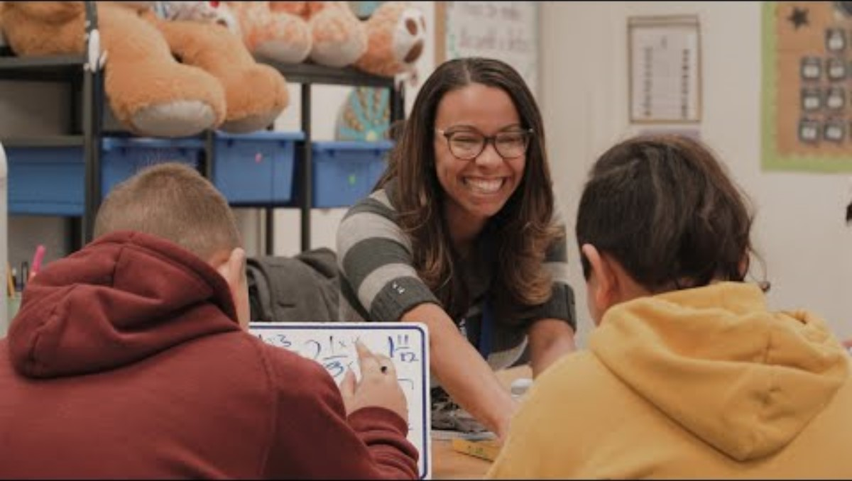
Collaborative Teams Support MTSS
https://www.youtube.com/watch?v=CAZ4CNtOHNo
Notes:
Optional Slide
Link
Multi-Tiered Systems of Support, https://www.youtube.com/watch?v=CAZ4CNtOHNo, 4:02 minutes
To Know/To Say
This video briefly reviews the structure of MTSS and reinforces the importance of collaborative teams for supporting MTSS.
Show the video and debrief using the reflection questions on the next slide.
Reference
ChandlerUnified. (2020, July 24). Multi-tiered systems of support (MTSS) [Video]. YouTube. https://www.youtube.com/watch?v=CAZ4CNtOHNo

Slide 46
Time
Effective Team Structures & Skills

Slide 47
Time and Effective Collaboration
Collaborative meeting time, more than any other type of school meeting, provides the greatest opportunity to improve student learning.
(Sloper et al., 2021)
Notes:
To Know/To Say
Scheduled collaboration time is crucial for U.S. teachers because it allows for meaningful professional growth, instructional alignment, and improved student outcomes. Unlike many high-performing countries where teachers have dedicated time for collaboration, U.S. educators often struggle to find structured opportunities to engage in joint planning, data analysis, and strategy development.
Enhancing instructional practices. Scheduled collaboration time gives teachers the opportunity to share best practices, analyze student data, and co-develop lesson plans. This leads to more effective and consistent teaching strategies across grade levels and subjects.
Supporting student success. When teachers collaborate, they can identify trends in student performance, adjust instructional methods, and implement targeted interventions. This ensures that students receive the support they need in a timely and coordinated manner.
Reducing teacher isolation. Many teachers work independently in their classrooms, which can limit opportunities for professional dialogue and peer learning. Dedicated collaboration time fosters a sense of community and shared responsibility, ultimately improving job satisfaction and reducing burnout.
Encouraging data-driven decision making. Regular meetings allow teachers to review student progress using assessment data and adjust their instruction accordingly. This practice supports evidence-based teaching and ensures that interventions are effective.
Promoting consistency. Scheduled collaboration ensures that all students, regardless of their teacher, receive high-quality instruction based on aligned curriculum and shared strategies
High-performing educational systems, such as those in Finland and Singapore, emphasize scheduled collaboration as a key component of teacher effectiveness. For U.S. schools to remain competitive and improve student outcomes, prioritizing structured time for collaboration is essential.
Discuss the following questions
Are educators given specific time to collaborate with others? If so, how is that time provided? If not, what are some ideas on how more time can be structured for collaboration?
Note
For additional training/resource materials on meeting schedules see MO SW-PBIS Leadership Module: Lesson 2 Meeting Schedules https://pbismissouri.org/tier-1-workbook-resources/
Reference
Sloper, C., Grift, G., & Muhammad, A. (2021). Collaborative teams that work: The definitive guide to cycles of learning in a PLC. Solution Tree Press.

Slide 48
Protecting Time for Formal Collaboration
School leaders create a clear meeting schedule that allows collaborative teams to meet during the contractual day.
Meetings should occur regularly and on time.
Interruptions must be avoided.
Professional learning is provided to build team capacity around tasks, skills, and actions necessary to work at high levels of collaboration.
(Marzano et al., 2016; Sloper et al., 2021; StanfordSCOPE, 2018)
Notes:
To Know/To Say
It’s important that school leaders and staff understand the value of educator collaboration. A master schedule should be developed that spells out when and where teachers are to meet to collaborate. Meetings should occur on a consistent basis without interruptions. There must be careful consideration that collaboration time is just as important as instructional time and the collaboration time should not be replaced with other duties or obligations.
Professional learning is also an important part of becoming a more collaborative school. Team capacity should be built around tasks, skills, and actions that are necessary for educators to work at high levels of collaboration.
Optional Activity
If school leaders/decision makers are present, time can be spent developing a master schedule for collaboration for their school. This process must involve school leaders collaborating with building educators in order to develop the best plan.
References
Marzano, R. J., Heflebower, T., Hoegh, J. K., Warrick, P., Grift, G., Hecker, L., & Wills, J. (2016). Collaborative teams that transform schools: The next step in PLCs. Marzano Research.
Sloper, C., Grift, G., & Muhammad, A. (2021). Collaborative teams that work: The definitive guide to cycles of learning in a PLC. Solution Tree Press.
StanfordSCOPE. (2018, March 20). Time matters: Teacher collaboration for learning and leading [Video]. YouTube. https://www.youtube.com/watch?v=Ex1zfl-MsDk

Slide 49
Guidelines for Collaborative Team Meetings
CTs meet at least weekly for 45-60+ minutes of dedicated/protected time for collaboration.
DLT and BLT meet at least monthly for 60-90+ minutes to guide, support, and monitor school-wide collaborative teams.
(Bloomberg & Pitchford, 2016)
Notes:
To Know/To Say
The slide presents minimal guidelines for providing time for team collaboration.
How does the amount of time your teams spend meeting collaboratively compare with these numbers?
Reference
Bloomberg, P. J., & Pitchford, B. (2016). Leading impact teams: Building a culture of efficacy (1st ed.). Corwin.

Slide 50
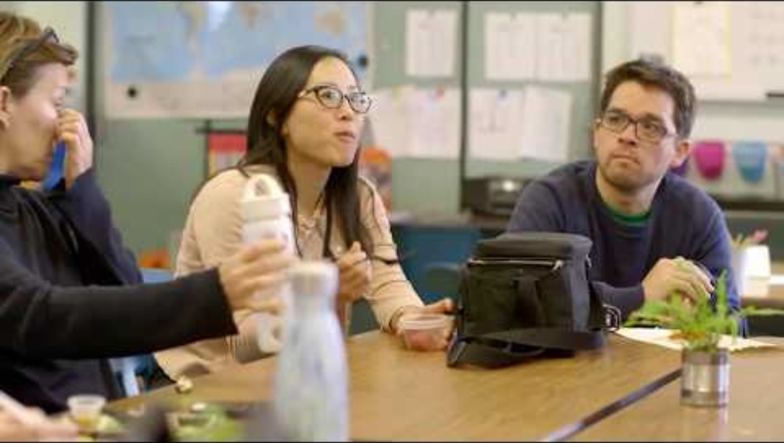
Time Matters
www.youtube.com/watch?v=Ex1zfl-MsDk
Notes:
Link
Time Matters: Teacher Collaboration for Learning and Leading, https://www.youtube.com/watch?v=Ex1zfl-MsDk, approx 12 mins (if time is limited, be sure to show 0-3:51 and 8:21 -9:50)
To Know/To Do
This video highlights the importance of providing protected structured time for educator collaboration. It looks at how four public schools worked to put collaboration at the forefront to improve teacher and student learning.
Follow up with discussion of the video reflection questions on the following slide.
Reference
StanfordSCOPE. (2018, March 20). Time matters: Teacher collaboration for learning and leading [Video]. YouTube. https://www.youtube.com/watch?v=Ex1zfl-MsDk

Slide 51
Video Reflections
Why is it important that collaboration time be structured and protected?
What are the benefits of creating a master schedule for collaboration?
How did organizing more time for collaboration benefit teachers in these schools?
How did students benefit both academically and socially/emotionally from teacher collaboration?
Notes:
To Know/To Do/To Say
Ask participants to use the questions on the slide to reflect on video.
They can first discuss the questions in small groups and then share out key takeaways with the whole group.

Slide 52
Strategies for Collaborative Teacher Team Meetings
Embedded collaboration in the daily schedule
Rotating or shared coverage models
Flexing non-instructional time
Calendar innovations
Technology and tools to supplement live time
Cross-school or regional teaming
Other ideas?
(Marzano et al., 2016; Sloper et al., 2021)
Notes:
To Know/To Say
The most successful approaches come from intentional scheduling together with a district-level commitment that collaborative time is sacred, not optional. Time reflects priorities, and collaboration is a cornerstone of high-performing schools.
To Do
Review the sample structures for embedding collaborative time. Encourage discussion around other possible structures to increase formal collaborative time.
Embedded collaboration in the daily schedule
Common planning time. Build master schedules so grade-level or content-area teachers have overlapping planning periods.
Instructional blocks covered by specialists. During art, music, PE, or library, core teachers have time for teaming while students are engaged in specials.
Staggered early release or late start days. Designate one day per week/month where students arrive late or are released early providing staff 60–90 minutes of team time.
Rotating or shared coverage models
Leadership or support staff coverage. Principals, coaches, counselors, or interventionists cover classes periodically (e.g., once a month) to provide team collaboration time.
Paraprofessional rotation. In elementary settings, paraprofessionals rotate through classrooms to allow teachers to step out and collaborate.
Creative use of substitutes (“Sub Days for Teams"). Hire subs a few days per quarter to release entire teams at once for substantive, collaborative work and planning.
Flexing non-instructional time
Reallocating faculty meeting time. Instead of whole-staff meetings every week, alternate with team-based collaboration time.
“Double-Duty” meetings. Combine team time with professional development or data discussions to maximize use of required meeting times.
Virtual collaboration windows. Some schools use asynchronous or short virtual meetings before/after school using tools like Zoom, Google Meet, or shared documents.
Calendar innovations
Collaboration days built into the calendar. Designate early-release days, PD days, or "collaboration Fridays" for teaming.
Summer and intersession planning retreats. Use non-instructional days for strategic, forward-looking collaboration.
Four-day instructional weeks. Some districts are moving to four-day weeks use the fifth day for staff collaboration and planning.
Technology and tools to supplement live time
Collaborative platforms (e.g., Google Workspace, Trello, Padlet). Allow teachers to contribute ideas, analyze data, and plan lessons asynchronously.
Instructional rounds or video sharing. Teams watch and analyze recorded lessons asynchronously, then meet briefly to reflect and refine.
Cross-school or regional teaming
Especially in small or rural districts, schools create vertical or cross-building teams that meet virtually across campuses to share practices and data.
Encourage discussion around other ideas, as well.
References
Marzano, R. J., Heflebower, T., Hoegh, J. K., Warrick, P., Grift, G., Hecker, L., & Wills, J. (2016). Collaborative teams that transform schools: The next step in PLCs. Marzano Research.
Sloper, C., Grift, G., & Muhammad, A. (2021). Collaborative teams that work: The definitive guide to cycles of learning in a PLC. Solution Tree Press.

Slide 53
Innovative Ideas to Increase Collaboration Time
Team book studies
Breakfast club
Feedback teams
Pineapple charts
Share box
Specialist “skill board”
Space for collaboration
(Cargal, 2021; PlanBook, n.d.; Tallman, 2020)
Notes:
Optional Slide
To Know/To Say
Collaboration is a powerful tool for professional development and an excellent way for teachers to reflect on their practice. Teacher-initiated collaboration builds trust and promotes openness among colleagues. In addition to formal team time, teacher collaboration can be enhanced in a variety of innovative ways.
Many of these ideas for increasing informal collaboration can also add a bit of enjoyment while teachers build professional capacity. These are some informal ways educators can increase horizontal and/or vertical collaboration time:
Team book study. Team members meet and discuss recent educational publications that provide new insight on evidence-based instructional strategies and practices. This is a great way to stay connected during summer months and build professional capacity.
Breakfast club. Teacher teams meet once a month before school for coffee, donuts, etc. and share their teaching successes for the month.
Feedback teams. Small groups of educators visit other classrooms to provide only positive feedback. This can be done on a rotating basis. They return feedback via email using a “ two stars and a question” feedback form.
Pineapple charts. A chart is posted in the teacher workroom where teachers volunteer to have guests observe specific lessons. For more information, see https://www.edutopia.org/article/opening-door-professional-learning/
Share box. Team members voluntarily share resources, materials, quizzes, and lesson plans with colleagues by placing them in a centrally located box. This could be expanded by having shared electronic folders for each team. These folders could be shared with all staff.
Specialist “skill board.” A chart that lists teachers’ expert skills is placed in a central location such as the teachers’ lounge. This chart could include literacy experts, technology experts, artists, those mechanically inclined, musicians, mathematicians, etc. The list should be totally voluntary and only include those that are willing to share their expertise to help others. This is a great way to connect teachers and build collective efficacy.
Space for collaboration. With the encouragement of school leaders, design a comfortable space in the school that invites collaboration away from the typical teacher workroom. Soft comfortable seating arranged to promote discussion along with professional journals, peaceful lighting, etc. will encourage educators to meet and collaborate more frequently with one another.
To Do
Discuss and expand on the informal ways to increase teacher collaboration time as outlined on the slide.
Pose these questions for further discussion:
Do you currently use any of these strategies for promoting more teacher collaboration? If so, what is working well and/or how might the strategy be improved?
What other strategies might be implemented to increase informal collaboration among educators?
References
Cargal, A. (2021, June 10). Opening the door to professional learning. Edutopia. https://www.edutopia.org/article/opening-door-professional-learning/
PlanBook. (n.d.). How to improve collaboration across your school. https://blog.planbook.com/improve-collaboration/
Tallman, T. (2020, July 23). How teachers experience collaboration. Journal of Education, 201(3). https://journals.sagepub.com/doi/10.1177/0022057420908063

Slide 54
Reflecting on Team Time
What challenges does your district face in finding time for collaboration, and how can they be addressed?
How can school leaders and administrators prioritize and support meaningful teacher collaboration?
How can schools balance the need for collaboration with the demands of instructional time and other professional responsibilities?
Notes:
To Do
Ask participants to reflect on the questions posed on the slide.
Encourage partner or small group discussion.
Share key takeaways with the whole group.

Slide 55
Roles
Effective Team Structures & Skills

Slide 56
How Meeting Roles Support Collaboration
Clarify expectations and responsibilities
Increase efficiency
Increase engagement
Add accountability
Build capacity
Improve decision making
(Shero, 2017; Yussif, 2024)
Notes:
To Know/To Say
Another structure that can improve collaboration is the use of specific assigned roles during meetings. Using assigned roles can improve efficiency, accountability, and engagement.
Roles are beneficial because they can accomplish the following:
Clarify expectations and responsibilities. Assigned roles set clear expectations for participation, ensuring that everyone understands their contributions and responsibilities. Assigned roles ensure that key tasks (e.g., facilitating, note-taking, timekeeping) are covered, preventing confusion or overlap.
Increase efficiency. When everyone knows their role, meetings stay structured and on track, reducing wasted time.
Increase engagement. Roles encourage participation from all team members, preventing dominant voices from taking over while ensuring quieter members have a way to contribute.
Add accountability. Clearly defined roles help distribute responsibility so that tasks (such as documenting decisions or following up on action items) don’t get forgotten.
Build capacity. Rotating roles allows team members to develop leadership, communication, and organizational skills in a supportive setting.
Improve decision making. Having designated roles like a “devil’s advocate” or a “process checker” can ensure a diversity of perspectives and keep discussions balanced.
Note
For additional training/resource materials on roles see MO SW-PBIS Leadership Module: Lesson 6 Roles https://pbismissouri.org/tier-1-workbook-resources/
References
Shero, P. (2017, December 4). 3 reasons team members need roles. Masterminds Leadership. https://mastermindsleadership.com/development-blog/team-members-roles/
Yussif. (2024, February 28). Nineteen strategies for teaching teamwork in your classroom. Classroom Management Expert. https://classroommanagementexpert.com/blog/19-strategies-for-teaching-teamwork-in-your-classroom/

Slide 57
Steps for Establishing Meeting Roles
Select roles that will help the team reach its goals
Gain consensus by all team members on needed roles
Clearly define the responsibilities of each role
Decide if roles will be assigned, rotated, or chosen by members
Include roles on the agenda and review at the beginning of each meeting
(Shero, 2017; Yussif, 2024)
Notes:
To Know/To Say
Select roles that will help the team reach its goals.
Choose roles that directly support the objectives of the team. Consider the tasks that need to be accomplished in each meeting and determine which roles will enhance efficiency, accountability, and productivity.
Example. If a team’s goal is to improve project planning, key roles might include a facilitator (to guide discussions), a timekeeper (to keep the meeting on schedule), and a note-taker (to document key decisions and action items).
Gain consensus by all team members on needed roles.
Make sure all team members agree on the roles to be assigned. Consensus-building helps create buy-in, making it more likely that people will fulfill their responsibilities effectively.
Example. The team discusses and agrees that in addition to the facilitator and note-taker, they will also have a “devil’s advocate” to challenge assumptions and encourage deeper discussion.
Clearly define the responsibilities of each role.
Define what each role entails so that expectations are understood, reducing confusion and ensuring accountability.
Example. The team documents that the facilitator will lead discussions, the timekeeper will notify the group of time limits, and the note-taker will summarize decisions and next steps.
When assigning roles, align them to team member strengths or allow team members to choose a role that matches their preference.
Assign roles based on individuals’ skills and interests or let them volunteer for roles that fit their interest. This increases engagement and effectiveness. Teams may also choose to rotate roles to build team capacity; encourage skill development; increase engagement and ownership; and foster decision making.
Example: A detail-oriented team member volunteers to be the note-taker, while a team member skilled in conflict resolution takes on the facilitator role.
Include roles on the agenda and review them at the beginning of each meeting.
Include assigned roles on the meeting agenda and review them at the start of each meeting to reinforce responsibilities and set expectations.
Example: The meeting agenda lists:
Facilitator: Alex
Timekeeper: Jordan
Note-Taker: Taylor
To Do
Review and expand on the steps to establish team roles as outlined on the slide.
References
Shero, P. (2017, December 4). 3 reasons team members need roles. Masterminds Leadership. https://mastermindsleadership.com/development-blog/team-members-roles/
Yussif. (2024, February 28). Nineteen strategies for teaching teamwork in your classroom. Classroom Management Expert. https://classroommanagementexpert.com/blog/19-strategies-for-teaching-teamwork-in-your-classroom/

Slide 58
Basic Meeting Roles
Facilitator
Note-Taker/recorder
Timekeeper
Communication coordinator
Data manager
Norm-minder
(Shero, 2017; Yussif, 2024)
Notes:
Handout CT 2.7
Team Roles and Responsibilities
To Know/To Say
These are basic or foundational roles that most collaborative teams use in order to operate effectively and efficiently.
Facilitator
Develops agenda with input from team
Sends agenda to al team members.
Facilitates team meetings
Follows up on assigned tasks
Seeks input from team members/staff
Facilitators are not expected to…
Serve as pseudo-administrators
Shoulder the responsibilities of the whole team or department
Evaluate colleagues’ performance
Note-Taker/recorder
Takes meeting minutes
Distributes team minutes to members/staff
Timekeeper
Review time slots on agenda
Maintain time parameters
Use established signal to keep team on task
Communication coordinator
Notify/provide meeting reminder to team
Collect and compile any feedback and/or input from staff
Share compiled feedback/input from staff
Lead planning for stakeholder communication
Provide updates to staff
Coordinate stakeholder communication (e-mails, newsletters, website, etc.)
Data manager
Prepare summary of data
Present update on data
Lead data discussion utilizing a DBDM process
Share data highlights with staff
Collect any other necessary data
Norm-minder
Remind all members of the agreed upon norms at the beginning of the meeting
Briefly celebrate norms that were followed/ reminder of norms if needed.
All team members
Collaborate with others
Seek and provide data/input
Monitor own and others’ adherence to the norms
Be an active part of the collaborative team. Members…
Support the work of the team by staying focused on the agenda, purpose, and goal of the team
Actively engage in the team’s work and monitor their own behavior(s) to adhere to the team’s agreements
Assist the facilitator and other team members to accomplish the work of the team
Recognize their responsibility for the team’s success
It is the responsibility of every team member to be prepared for the meeting and be an engaged participant!
To Do
After reviewing the basic team roles, ask participants to work in teams and have each person name and describe a role using information from the handout. This can be done for both the basic roles on this slide and the additional team roles on the next slide.
References
Shero, P. (2017, December 4). 3 reasons team members need roles. Masterminds Leadership. https://mastermindsleadership.com/development-blog/team-members-roles/
Yussif. (2024, February 28). Nineteen strategies for teaching teamwork in your classroom. Classroom Management Expert. https://classroommanagementexpert.com/blog/19-strategies-for-teaching-teamwork-in-your-classroom/

Slide 59
Additional Meeting Roles
Strengthener
Encourager
Realist
“Devil’s Advocate”
Summarizer
Others?
(Ferriter, 2021; Shero, 2017; Yussif, 2024)
Notes:
Handout CT 2.8
Team Roles and Skills Needed
To Know/To Say
In addition to the basic team roles, additional roles can be added that enhance the functions of the team. These additional team roles might work well for larger teams since it's advisable that all member have a role. Additional team roles might also help to strengthen the functions of teams that already have basic roles in place.
These are some of the additional roles that could be added to your team:
Strengthener. Encourages trust and open conversations, promotes feedback, supports team bonding, enhances problem-solving
Encourager. Fosters a positive and inclusive environment where all members feel comfortable sharing their ideas and contributing to the discussion
Realist. Plays a crucial role in providing a grounded and practical perspective, contrasting with overly optimistic viewpoints
“Devil’s Advocate.” Challenges assumptions and encourages critical thinking to encourage deeper discussion
Summarizer. Recaps key points, decisions, and action items discussed, ensuring clarity among members
What other team roles to you think should be added to help your team function more efficiently and effectively?
To Do
Activity
Discuss additional roles that might be added to collaborative teams. Ask participants to brainstorm and discuss ideas regarding other roles that might be needed.
Provide time for team members to discuss and come to a consensus regarding which roles would help their team function most efficiently and effectively. Use the handout to record decisions made by placing a * star by the roles the team will utilize.
References
Ferriter, B. (n.d.). Five important roles for successful collaborative teams. Building Confident Learners. https://buildingconfidentlearners.com/2018/09/five-important-roles-for-successful-collaborative-teams/
Shero, P. (2017, December 4). 3 reasons team members need roles. Masterminds Leadership. https://mastermindsleadership.com/development-blog/team-members-roles/
Yussif. (2024, February 28). Nineteen strategies for teaching teamwork in your classroom. Classroom Management Expert. https://classroommanagementexpert.com/blog/19-strategies-for-teaching-teamwork-in-your-classroom/

Slide 60
Reflecting on Meeting Roles
How does having assigned roles impact the efficiency and effectiveness of meetings?
What meeting roles have been most beneficial for your teams? Why?
How do we hold each other accountable for fulfilling out roles effectively?
How can we ensure that meeting roles support our team’s goals and priorities?
Notes:
To Know
Pause and Reflect is an opportunity for participants to reflect on each main section of the module. It provides an avenue to discuss content covered along with collaboration regarding application aspects.
To Do/To Say
Ask participants to reflect on the questions posed on the slide. Encourage partner or small group discussion. Share key takeaways with the whole group.

Slide 61
Collaborative Skills
Effective Team Structures & Skills

Slide 62
Collaborative Skills Defined
Collaborative skills are the abilities that enable individuals to work effectively with others toward a shared goal.
These skills include communication, teamwork, problem-solving, adaptability, conflict resolution, accountability, and creativity.
Strong collaboration fosters trust, encourages diverse perspectives, and enhances productivity in group settings.
(Doyle, 2022; Thinking Collaborative, n.d.)
Notes:
To Know/To Say/To Do
Collaborative skills are the abilities that enable individuals to work effectively with others toward a shared goal. These skills include communication, teamwork, problem-solving, adaptability, and conflict resolution. Strong collaboration fosters trust, encourages diverse perspectives, and enhances productivity in group settings.
Key Collaborative Skills
Communication. Clearly expressing ideas, actively listening, and providing constructive feedback
Teamwork. Working cooperatively, respecting different viewpoints, and supporting team members
Problem-solving. Identifying challenges, brainstorming solutions, and making decisions collaboratively
Adaptability. Being flexible and open to change, adjusting to different working styles and ideas
Conflict resolution. Addressing disagreements respectfully, finding common ground, and maintaining a positive team dynamic
Accountability. Taking responsibility for tasks, following through on commitments, and ensuring shared goals are met
Creativity and innovation. Contributing new ideas, thinking outside the box, and encouraging diverse perspectives
Have participants turn to a partner and talk about specific collaborative skills they have seen modeled and how those skills impact teamwork.
References
Doyle, A. (2022, June 7). What are collaboration skills? The Balance. https://www.thebalancemoney.com/collaboration-skills-with-examples-2059686
Thinking Collaborative. (n.d.). Adaptive schools resources. https://www.thinkingcollaborative.com/as-resources

Slide 63
Collaborative Skills Help Groups…
Work more effectively toward shared goals
Facilitate and sustain group interaction
Enhance the quality and productivity of group conversations
Generate ideas and become more creative and innovative
(Doyle, 2022; Thinking Collaborative, n.d.)
Notes:
To Know/To Say/To Do
Collaborative skills, are strategies that when used help groups work more effectively. They enable teams to…
Work more effectively toward shared goals
Strong communication and active listening help align individual efforts with team priorities.
Clearly defined roles and responsibilities prevent duplication of work and enhance efficiency.
Encouraging a culture of accountability ensures that team members follow through on commitments.
Facilitate and sustain group interaction
Collaborative skills like active listening and constructive feedback create a positive, inclusive environment.
Encouraging open dialogue fosters trust and psychological safety, allowing all voices to be heard.
Conflict resolution skills help teams navigate disagreements productively instead of letting them derail progress.
Using structured meeting roles (e.g., facilitator, timekeeper) ensures engagement and balanced participation.
Enhance the quality and productivity of group conversations
Effective collaboration ensures that discussions remain focused and solutions-oriented.
Asking clarifying questions and summarizing key points ensures mutual understanding.
Encouraging diverse perspectives leads to well-rounded, thoughtful decision making.
Keeping conversations goal-driven helps teams stay on track and make the best use of their time.
Generate ideas and become more creative and innovative
Collaborative environments encourage brainstorming and idea-sharing without fear of judgment.
Leveraging different perspectives leads to creative problem-solving and fresh insights.
Teams that value open communication and experimentation are more likely to take calculated risks and innovate.
Encouraging iteration and feedback cycles leads to refining and improving ideas over time.
References
Doyle, A. (2022, June 7). What are collaboration skills? The Balance. https://www.thebalancemoney.com/collaboration-skills-with-examples-2059686
Thinking Collaborative. (n.d.). Adaptive schools resources. https://www.thinkingcollaborative.com/as-resources

Slide 64
Norms of Collaboration
Pausing
Paraphrasing
Posing questions
Putting ideas on the table
Providing data
Paying attention to self and others
Presuming positive intentions
(Garmston & Wellman, 2019d)
Notes:
To Know/To Say
The 7 Norms of Collaboration were developed by Robert Garmston and Bruce Wellman in the 1990s.
Their work focused on improving group effectiveness in educational and professional settings by fostering productive dialogue, shared leadership, and collective problem-solving.
The norms emerged from research on group dynamics and organizational learning, emphasizing the behaviors that create trust, psychological safety, and meaningful collaboration.
The norms were designed to enhance teamwork, decision making, and communication.
The 7 Norms of Collaboration serve as foundational principles for fostering effective and inclusive group interactions.
Pausing. Taking time to think before responding promotes thoughtful contributions and deeper discussions
Paraphrasing. Restating what someone has said in your own words ensures understanding and demonstrates active listening
Posing questions. Asking clarifying or probing questions encourages deeper thinking and expands perspectives
Putting ideas on the table. Sharing thoughts openly while being mindful of how they contribute to group goals fosters creative collaboration
Providing data. Using facts, observations, and evidence rather than opinions or assumptions strengthens discussions and decision making
Paying attention to self and others. Being aware of verbal and nonverbal communication helps maintain a respectful and inclusive environment
Presuming positive intentions. Approaching conversations with the belief that others have good intentions builds trust and encourages open dialogue
Reference
Garmston, R., & Wellman, B. (2019d). The seven norms of collaborative work. Adaptive Schools Foundation Seminar Learning Guide. https://www.thinkingcollaborative.com/_files/ugd/6a5cc9_d080a1bbb7c84e43934a019d684214d2.pdf

Slide 65
Exploring the 7 Norms of Collaborative Work
Activity. Jigsaw Experts
Number off 1-7, each number reads their assigned norm definition
Form groups of like numbers and share understanding of norm
    Share examples of the norm being demonstrated
Then form groups of 7, with numbers 1-7 in each group
    Teach assigned norm to group members
https://www.thinkingcollaborative.com/_files/ugd/6a5cc9_d080a1bbb7c84e43934a019d684214d2.pdf
Notes:
Link
The Seven Norms of Collaborative Work, https://www.thinkingcollaborative.com/_files/ugd/6a5cc9_d080a1bbb7c84e43934a019d684214d2.pdf
To Know
This activity enables participants to build capacity around the 7 Norms of Collaboration through collaborative discussion and peer teaching. If the whole group is smaller than 14, have each person select more than one norm and adjust accordingly.
To Do
You may want to add a QR code to the slide so participants can easily assess the link.
Review and expand on the slide directions for the activity.
Assist with the grouping processes.
To Say
Next, you’ll have a chance to explore the Seven Norms of Collaborative Work through collaborative discussion and peer teaching.
Let’s begin by numbering off 1-7.
Next you’ll need to read over the definition of your norm. (Go to online link.)
Now meet with others that have like numbers. Take turns sharing your understanding of the norm. Also share examples of how you have seen the norm demonstrated.
Finally, you will meet with a group that has #s 1-7. Now that you are an expert, you’ll teach your norm to this group.
Reference
Garmston, R., & Wellman, B. (2019d). The seven norms of collaborative work. Adaptive Schools Foundation Seminar Learning Guide. https://www.thinkingcollaborative.com/_files/ugd/6a5cc9_d080a1bbb7c84e43934a019d684214d2.pdf

Slide 66
Implementing Norms of Collaboration
Introduce the “7 Norms of Collaboration”
Post norms during team meetings
Focus on implementing one norm at a time
Practice each norm until proficiency achieved
Sustain engagement with all norms
Monitor and assess consistency with norms
(Team Scholarship Acceleration Lab, n.d.)
Notes:
Handout CT 2.9
Norms of Collaboration Table Tents
To Know
The slide outlines some basic steps for implementing the 7 Norms of Collaboration. For a more detailed description of the process, access this link: https://tsal.uci.edu/lesson/seven-norms-of-collaboration-a-supporting-toolkit/
To Say
It’s important for teams to be intentional regarding the implementation of the 7 Norms of Collaboration.
Teams should begin by having a member introduce and review the purpose of the norms of collaboration as well as the definition of each.
Make sure the norms are posted during meetings to serve as a reminder.
Attempting to implement all the norms of collaboration at once may prove to be a bit overwhelming. Begin by focusing on one norm at a time and practice it until the team is proficient with it by demonstrating automaticity.
Once all norms have been implemented, sustain engagement with all the norms.
It’s important that after the initial introduction of all the norms, the team continues to monitor and assess the consist use of the norms.
The use of collaborative norms can be monitored by using both a solo and/or group self-reflection inventory to assess each of the 7 behavior domains for the 7 Norms of Collaboration. We’ll be looking at these tools a bit later.
To Do
Review and expand on the steps to implement the 7 Norms of Collaboration.
Table tents with the 7 Norms of Collaboration may be printed and placed on tables as an example of what to do at each team meeting to encourage reflection on the norms.
Reference
Team Scholarship Acceleration Lab. (n.d.). Seven norms of collaboration: A supporting toolkit. https://tsal.uci.edu/lesson/seven-norms-of-collaboration-a-supporting-toolkit/

Slide 67

Connecting Collaborative Skills to Hattie’s Mindframes
thinkingpathwayz.weebly.com/10-mindframes-visible-learning.html
Notes:
Handout CT 2.10
Connecting Norms of Collaboration
To Know/To Say
John Hattie’s Visible Learning research has found that one of the most important influences of student achievement is how teachers think about learning and their own role as evaluators and change agents. These roles require educators to use effective collaborative skills to attain their goal of improving student outcomes.
We will first take a close look at John Hattie’s powerful Mindframes for Visible Learning and then see how the 7 Norms of Collaboration connect to them.
Together, the 7 Norms of Collaboration and Hattie’s 10 Mindframes reinforce the importance of reflective practice, evidence-based decision making, and strong relationships in enhancing both individual and group learning.
Activity
Ask participants to access the link and to familiarize themselves with John Hattie’s 10 Mindframes for Visible Learning.
Next, ask participants to work in small groups and discuss how the 7 Norms of Collaboration connect to the mindframes. (See examples below.)
The handout can be used to draw lines from the norms to mindframes that they align with. Comments regarding connections can be added to the bottom of the handout. Share key ideas with the whole group.
Examples
The 7 Norms of Collaboration align closely with John Hattie’s 10 Mindframes for Visible Learning, as both emphasize the importance of intentional communication, reflection, and collective efficacy in improving learning and collaboration. Below are examples of how they connect.
Pausing → I collaborate with others and think deeply about learning.
Pausing allows individuals to slow down, reflect, and process ideas before responding, fostering deeper thinking and more meaningful discussions - key aspects of effective collaboration.
Paraphrasing → I listen, seek to understand, and learn from others.
Paraphrasing supports active listening and ensures understanding, aligning with Hattie’s emphasis on valuing diverse perspectives and learning from colleagues and students.
Posing Questions → I see assessment as feedback about my impact.
Asking thoughtful, open-ended questions encourages curiosity and reflective thinking, much like Hattie’s focus on using assessment and inquiry to gauge and improve teaching effectiveness.
Putting Ideas on the Table → I engage in dialogue and challenge ideas.
Sharing ideas openly promotes transparency and constructive discourse, fostering an environment where ideas can be debated and refined, reinforcing Hattie’s belief in professional dialogue.
Providing Data → I use evidence to inform my decisions.
Using factual data to support discussions and decisions aligns with Hattie’s emphasis on evidence-based teaching and learning strategies.
Paying Attention to Self and Others → I build and develop trust-based relationships.
Being mindful of verbal and nonverbal cues ensures respectful interactions, creating a collaborative culture that supports trust—essential for effective teaching and learning.
Presuming Positive Intentions → I believe that all students can improve.
Approaching discussions with the assumption that others have good intentions helps foster a culture of growth, aligning with Hattie’s belief in student potential and continuous improvement.
To Do
You may want to add a QR code to the slide so participants can easily access the link. Facilitate the activity below.
References
Hattie, J., & Zierer, K. (2024). 10 mindframes for visible learning: Teaching for success (2nd ed.). Routledge.
Hattie, J., & Zierer, K. (2017). 10 mindframes for visible learning: Teaching for success (1st ed.). Routledge.
New South Wales Education Standards Authority. (n.d.). 10 mindframes for visible learning. Thinking Pathways. https://thinkingpathwayz.weebly.com/10-mindframes-visible-learning.html

Slide 68
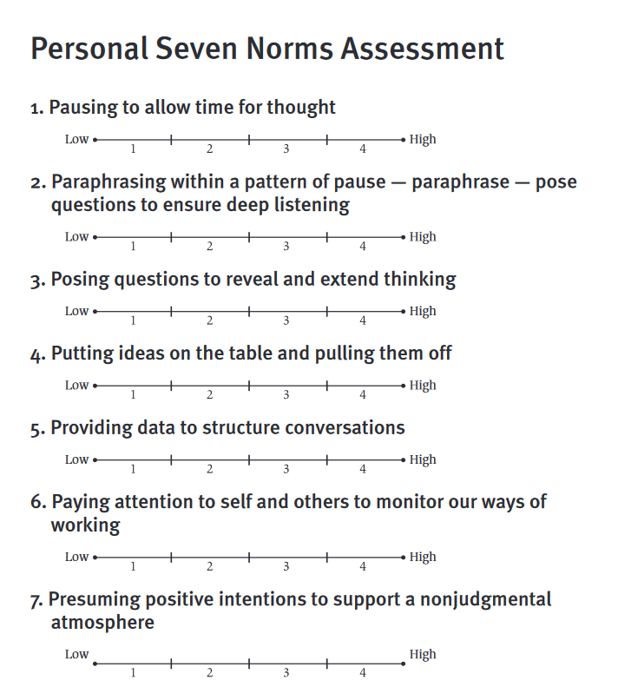

Assess Your Individual Collaborative Skills
Norms of Collaboration
Individual Assessment
https://www.thinkingcollaborative.com/_files/ugd/6a5cc9_6e66a89e719e4ca1a7a81012582bb91c.pdf
Notes:
To Know
To improve their use of collaborative norms, teams can use this tool to assess the consistency in which the seven norms of collaboration are implemented. Group behavior is a result of the decisions and actions of individuals. Therefore, when assessing implementation of the norms of collaboration, it is important to assess both individual and overall team behaviors. When individual behaviors align with productive collaborative skills it's more likely the group will generate positive results.
The Personal Norms Assessment is a reflection tool for individual team members. It guides individuals in assess the consistency with which they practice the behavior promoted by each of the seven norms. Participants should consider their own behavior, and also the collective behavior of the group (next slide).
See the Norms of Collaboration Toolkit for complete directions and suggestions for both evaluating self and group behavior: Seven Norms of Collaboration: A Supporting Toolkit and go to assessing consistency with the norms of collaboration https://www.thinkingcollaborative.com/_files/ugd/6a5cc9_263cffd70d0d4a988fdfa77deaaa769c.pdf
Facilitators/Coaches, please be thoroughly familiar with the toolkit, which explains how to use both of the norms inventories.
To Do
You may want to add a QR code to the slide so participants can access the assessment electronically and mark responses. Hard copies can also be made if preferred.
Ask participants to reflect on their collaborative skills and mark their skill level for each of the 7 norms.
Also ask them to think about strategies that could be used to strengthen the norms.
Encourage pair or small group discussion so strengthening strategies can be shared and added to.
To Say
Reflect on the behaviors that align with each of the 7 Norms of Collaboration. How would you rate your skill level for each of the Norms? Mark 4 if you feel you are highly skilled with the Norm, 1 if your skill is low. Mark 2 or 3 if it’s somewhere in between based on this continuum. Now think of strategies that could be used to strengthen collaborative skills that are weak.
Be prepared to share strengthening strategies with a partner or small group.
References
Garmston, R., & Wellman, B. (2019b). Personal seven norms assessment. Adaptive Schools Foundation Seminar Learning Guide. https://www.thinkingcollaborative.com/_files/ugd/6a5cc9_6e66a89e719e4ca1a7a81012582bb91c.pdf
Garmston, R., & Wellman, B. (2019c). Seven norms of collaboration: A supporting toolkit. Adaptive Schools Foundation Seminar Learning Guide. https://www.thinkingcollaborative.com/_files/ugd/6a5cc9_263cffd70d0d4a988fdfa77deaaa769c.pdf

Slide 69
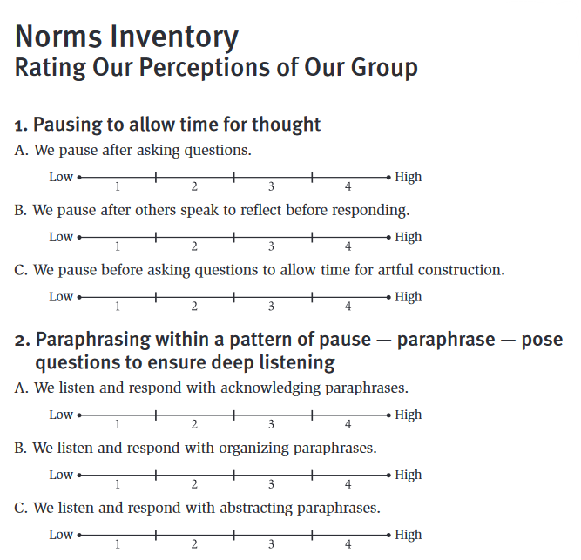
Assess Your Team’s Collaborative Skills
Norms of Collaboration
Group Assessment
https://www.thinkingcollaborative.com/_files/ugd/6a5cc9_2fd56baa9f2d484ea25904373efe2e55.pdf
Notes:
Cbok
To Know
This activity is designed to be flexible. If you have an audience of individuals who represent different teams, or if you have an audience of a single team in a coaching situation, you will need to structure the activity in slightly different ways.
Participants should consider their own behavior and also the collective behavior of the group.
See the Norms of Collaboration Toolkit for complete directions and suggestions for both evaluating self and group behavior. Seven Norms of Collaboration: A Supporting Toolkit and go to assessing consistency with the norms of collaboration https://www.thinkingcollaborative.com/_files/ugd/6a5cc9_263cffd70d0d4a988fdfa77deaaa769c.pdf
Facilitators/Coaches, please be thoroughly familiar with the Toolkit, which explains how to use both of the norms inventories.
As time allows, it is beneficial to consider both individual and group behaviors. You may wish to use these materials over time, evaluating individual behavior first, allowing time for application during group meetings, and then evaluating the collective behavior of the group. Emphasize the need for continued reference to and engagement with these skills.
To Say
The norms inventory is a tool for team members to rate the consistency in which their group implements the 7 Norms of Collaboration.
The inventory includes twenty-one behaviors, three for each of the 7 norms.
Each member’s scores can be averaged and then used to find a team average for each of the Norms. This data can be used to discover norms the team needs to strengthen. Collaborative dialogue should occur and guide strategies that can be used to strengthen Norm implementation.
To Do
You may want to add a QR code to the slide for easy access to the online inventory. A hard copy of the inventory can be used if preferred.
Ask each member of their team to take the survey and then average their scores for each norm.
The team can then compile the data to find team averages.
References
Garmston, R, & Wellman, B. (2019a). Norms inventory. Adaptive Schools Foundation Seminar Learning Guide. https://www.thinkingcollaborative.com/_files/ugd/6a5cc9_2fd56baa9f2d484ea25904373efe2e55.pdf
Garmston, R., & Wellman, B. (2019c). Seven norms of collaboration: A supporting toolkit. Adaptive Schools Foundation Seminar Learning Guide. https://www.thinkingcollaborative.com/_files/ugd/6a5cc9_263cffd70d0d4a988fdfa77deaaa769c.pdf

Slide 70
Reflecting on Collaborative Skills
Which Norms of Collaboration have been used effectively during team meetings?
Which skills need strengthening?
How might these collaborative skills be improved?
Norms of Collaboration
Pausing; Paraphrasing; Posing Questions; Putting Ideas on the Table; Providing Data; Paying Attention to Self and Others; Presuming Positive Intentions
(Garmston & Wellman, 2019c)
Notes:
cbok
To Know
Use this opportunity for participants to engage in reflective dialogue about how these skills have been used effectively during team meetings as well as examples of when these skills were lacking and the implications.
To Do
Engage participants in small group reflection and conversation about these skills using data collected from the norms inventory. Include examples from meetings you have attended or invite them to share examples.
Examples
Describe a time when you left a meeting without summarizing the group’s thoughts. Then at the next meeting, people return to find the work they have done in the interim has been disconnected.
Or consider a time when a decision has been made without examining data thoroughly.
Another possibility may be meetings where decisions are rushed and participants do not take time to pause and consider the implications.
To Say
Reflect on your team’s current practices around the 7 Norms of Collaboration using the data collected from the norms inventory.
Discuss the questions on the slide with your team members.
Be ready to share suggestions with the whole group on how to improve collaborative skills.
Reference
Garmston, R., & Wellman, B. (2019c). Seven norms of collaboration: A supporting toolkit. Adaptive Schools Foundation Seminar Learning Guide. https://www.thinkingcollaborative.com/_files/ugd/6a5cc9_263cffd70d0d4a988fdfa77deaaa769c.pdf

Slide 71

Summing it up…
Building Effective Team Structures & Skills
Productive team configurations
Adequate team time
Meeting roles
Collaborative skills
Notes:
To Know/To Say
This module, Part 2 of Collaborative Teams, has provided an opportunity to review and discuss the key building blocks needed for establishing effective team structures and enhancing collaborative skills. Key building blocks include configuring teams so they meet their designed purpose, providing adequate time to achieve intended goals, establishing purposeful team member roles, and enhancing collaborative skills to improve team productivity.
To Do
Review and expand on slide content to briefly summarize the key components of Part 2, Building Effective Team Structures and Skills.

Slide 72
Part 2: Essential Questions (Follow Up)
What are key considerations when configuring effective collaborative teams?
How can adequate time be provided to teams to ensure goals are achieved?
Why is it important that team roles are purposeful, clearly defined, and align with team member skills?
How does strengthening collaborative skills enhance team performance?
Notes:
To Do
Revisit and review the Essential Questions and provide time for reflective thinking and conversation.
Optional Follow-up Activity
If earlier in the session you wrote the questions on individual chart paper, providing opportunities for participants to add to the responses as more learning took place, review and discuss the comments.

Slide 73
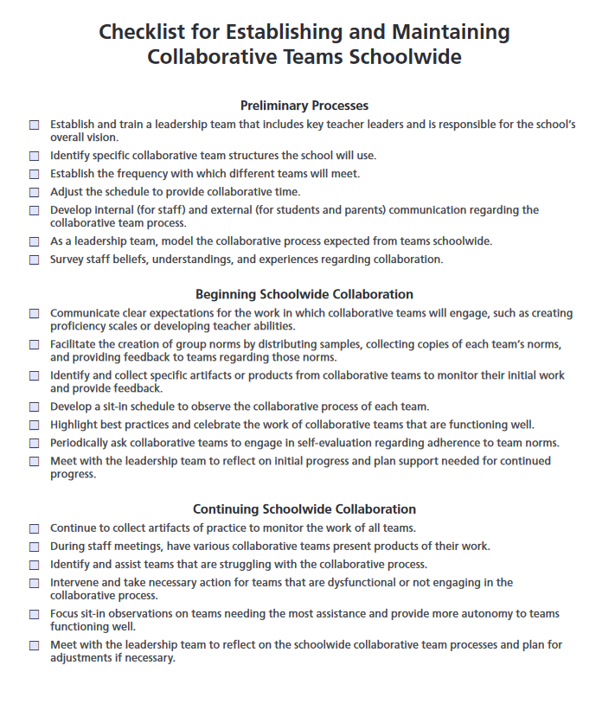
Checklist
for establishing and maintaining collaborative teams schoolwide
https://soltreemrls3.s3-us-west-2.amazonaws.com/marzanoresources.com/media/documents/reproducibles/collaborative_teams/checklistforestablishingandmaintainingcollaborativeteamsschoolwide.pdf
Notes:
Optional Slide
This content, especially important for school leaders, can be presented here or at the very end of Part 3, prior to action planning with school leaders. All school staff could also benefit by having a transparent process communicated for implementing collaborative teams.
To Know
This slide provides a checklist for establishing and maintaining collaborative teams schoolwide.
The comprehensive checklist includes recommended steps for preliminary, beginning, and continuing processes for establishing and maintaining collaborative teams in schools.
The intended users would primarily be building leaders and building leadership teams. All school staff, however, could benefit by having a transparent process communicated for implementing collaborative teams.
To Do
Add a QR code to the slide so participants can also easily access the checklist.
The presenter can either review each part of the checklist with the whole group, or participants can work with school colleagues to review the checklist and determine where they are with the collaborative team implementation process and to determine next steps.
To Say
Implementing collaborative teams schoolwide is a complex and timely but important endeavor.
This checklist provides a systematic look at the steps necessary to do so. It provides an itemized list outlining where to start (preliminary process), how to support teams (beginning school wide collaboration), and sustaining the collaborative process (continuing school wide collaboration).
Work with other leaders from your school.
Review each item on the checklist to determine where you are in the implementation process.
Discuss your next steps in establishing or maintaining collaborative teaming in your school.
Reference
Marzano, R. J., Heflebower, T., Hoegh, J. K., Warrick, P., Grift, G., Hecker, L., & Wills, J. (2016). Collaborative teams that transform schools: The next step in PLCs. Marzano Research.

Slide 74

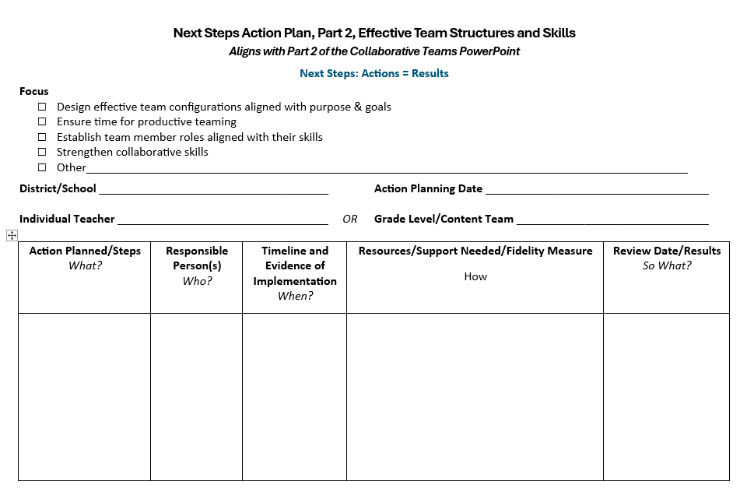
Next Steps Action Plan, Part 2
Notes:
Handout CT 2.11
Next Steps Action Plan, Part 2
To Know
Action planning enables participants to reflect on what they have learned, their strengths, and opportunities for growth.
A documented action plan that includes the action, person responsible, timeline, and resources makes it much more likely that change will take place.
Recording results will encourage educators to reflect on their accomplishments and continue actions that prove successful.
To Say/To Do
Provide participants with a copy of the action planning template (electronic or hard copy).
Review Action Planning Steps.
Action Planned/Steps – "What?” This column outlines what the team is actually planning to do. Think of it as the key actions or strategies they believe will help them reach their goal. Each step should be specific, actionable, and aligned to their school or team priorities.
Responsible Person(s) – "Who?” Here, the plan identifies the person or people responsible for ensuring each step is carried out. While implementation may be collaborative, assigning responsibility ensures accountability and avoids confusion about ownership.
Timeline and Evidence of Implementation – "When?” This section includes the timeline for when actions will occur, along with the evidence that will confirm implementation. Evidence might include artifacts such as sign-in sheets, lesson plans, photos, or documentation that demonstrate the work is taking place as planned.
Resources/Support Needed/Fidelity Measure – "How?” In this column, the team specifies what resources or support will be needed (such as professional development, materials, or coaching). Importantly, this is also where fidelity of implementation is addressed. The team defines how they will measure whether the action is being implemented as intended, using tools like checklists, observation rubrics, or walkthroughs.
Review Date/Results – "So What?” This final column captures the scheduled review date and documents what the data reveals about the results. The team reflects on the effectiveness of the action: What impact did it have? Is it working? Should the plan be continued, revised, or stopped? This reflective step ensures that the action plan remains responsive and results-driven.
Design action plan
Take some time to review the data collected from previous collaborative team discussions, along with any data collected during this presentation (checklist and surveys).
Use the data to help design an action plan (Handout CT 2.11) to strengthen your teams structures and collaborative skills.
You may select one or more areas of focus.
If possible work collaboratively with a team, if not, develop a plan individually to be shared later with your team.
Be sure to include the actions that will be taken; who will take the actions; a timeline for completing your work; resources and support needed; as well as follow-up that details the results. We will then take a bit of time to discuss your next steps with the group.

Slide 75

Closing and Thank You!
For more information contact us!
<Presenter name and contact info>
<Presenter name and contact info>
<Presenter name and contact info>
References are on the following slides.
Notes:
To Know/To Do/To Say
Choose how to close this part of the training and include your contact information.
Make sure participants know when the next training is scheduled.
You might want to review what the next trainings will cover.
Show the reference slides if appropriate.

Slide 76
References for all Collaborative Teams Modules
Adams, S (2025, March 8). What is minute taking? An ultimate guide. The Knowledge Academy. https://www.theknowledgeacademy.com/blog/what-is-minute-taking/
Aguilar, E. (2015, December 3). Effective team communication: A first step to getting along. Edutopia. https://www.edutopia.org/blog/effective-team-communication-first-step-getting-along-elena-aguilar
AllBusiness. (n.d.). 5 reasons why meeting minutes are important. https://www.allbusiness.com/importance-of-meeting-minutes
American Institutes for Research. (2022). MTSS infrastructure and support mechanisms series: MTSS school teams. Center on MTSS Multi-Tiered Systems of Supports. https://mtss4success.org/sites/default/files/2022-02/MTSS-Teams.pdf
ASU Mary Lou Fulton College. (2020, August 5). Benefits of teaming: Educator retention, educator leadership opportunities, and student learning [Video]. YouTube. https://www.youtube.com/watch?v=5OTRWm7wNbY
BetterHelp Editorial Team. (2025, February 24). Understanding the importance of effective communication in teamwork. BetterHelp. https://www.betterhelp.com/advice/teamwork/understanding-the-importance-of-communication-in-teamwork/
Bitrix24. (2022, January 21). How to improve team communication: Five effective tools [Video]. YouTube. https://www.youtube.com/watch?v=KSRLK31lq_4
Bloomberg, P. J., & Pitchford, B. (2016). Leading impact teams: Building a culture of efficacy (1st ed.). Corwin.
Cargal, A. (2021, June 10). Opening the door to professional learning. Edutopia. https://www.edutopia.org/article/opening-door-professional-learning/

Slide 77
References, Page 2
Corentus, Inc. (2019, March 19). Setting team norms that stick [Video]. YouTube. https://www.youtube.com/watch?v=tOtMcCM5zZc
Center for Creative Leadership. (2024, June 23). 10 steps for establishing team norms. https://www.ccl.org/articles/leading-effectively-articles/the-real-world-guide-to-team-norms/
Center for Leadership and Educational Equity. (n.d.-a). A rationale for protocols. https://www.clee.org/resources/rationale-for-protocols/
Center for Leadership and Educational Equity. (n.d.-b). Why protocols? School reform initiative. https://www.clee.org/resources/why-protocols/
Center for Research on Learning and Teaching. (2021). Guidelines for discussing difficult or high-stakes topics. University of Michigan. https://crlt.umich.edu/publinks/generalguidelines
ChandlerUnified. (2020, July 24). Multi-tiered systems of support (MTSS) [Video]. YouTube. https://www.youtube.com/watch?v=CAZ4CNtOHNo
ClickUp Customer Experience Team. (2024, January 24). How to encourage collaborative communication in the workplace. ClickUp. https://clickup.com/blog/collaborative-communication/
DavidLeeEdTech. (2021, April 21). Key elements for effective collaboration in schools [Video]. YouTube. https://www.youtube.com/watch?v=D4ciN-mJSaI
Doyle, A. (2022, June 7). What are collaboration skills? The Balance. https://www.thebalancemoney.com/collaboration-skills-with-examples-2059686

Slide 78
References, Page 3
Edutopia. (2016, April 20). Collaborative planning: Integrating curriculum across subjects [Video]. YouTube. https://www.youtube.com/watch?v=yCy4PSOvkL4
Edutopia. (2017, April 6). Teacher labs: Making professional development collaborative [Video]. YouTube. https://www.youtube.com/watch?v=gf5KcyHGhRA&t=168s
Edutopia (2024, April 26). Calibrating best practices across a whole school [Video]. https://www.edutopia.org/video/calibrating-whole-school-best-practices
Entelechy. (2024, February 1). The importance of horizontal and vertical collaborative teams in schools. https://backup.theedadvocate.org/the-importance-of-horizontal-and-vertical-collaboration-teams-in-schools/
EL Education. (2018, January 19). Grade level data meeting with third grade teachers [Video]. YouTube. https://www.youtube.com/watch?v=BLCbNX84ll4
EL Education. (2019a, April 3). Leading teams with data protocols [Video]. YouTube. https://www.youtube.com/watch?v=OdG7_ggEBlk&feature=youtu.be
EL Education. (2019b, June 21). Shared leadership through instructional leadership teams [Video]. YouTube. https://www.youtube.com/watch?v=T-hqrR5pcDo
Fellow. (2023, May 2). 15 best team communication tools & apps in 2024. https://fellow.app/blog/productivity/most-efficient-team-communication-tools/​
Ferriter, B. (n.d.). Five important roles for successful collaborative teams. Building Confident Learners. https://buildingconfidentlearners.com/2018/09/five-important-roles-for-successful-collaborative-teams/​

Slide 79
References, Page 4
Ferriter, W. M. (2020, April 7). Spotting collaborative teams with high levels of collective efficacy. SolutionTree. https://www.solutiontree.com/blog/spotting-collaborative-teams-with-high-levels-of-collective-efficacy/​
Garmston, R, & Wellman, B. (1999). The adaptive school: A sourcebook for developing collaborative groups (1st ed.). Christopher-Gordon Publishers, Inc.
Garmston, R, & Wellman, B. (2016). The adaptive school: A sourcebook for developing collaborative groups (3rd ed.). Rowman & Littlefield Publishers.
Garmston, R, & Wellman, B. (2019a). Norms inventory. Adaptive Schools Foundation Seminar Learning Guide. https://www.thinkingcollaborative.com/_files/ugd/6a5cc9_2fd56baa9f2d484ea25904373efe2e55.pdf
Garmston, R., & Wellman, B. (2019b). Personal seven norms assessment. Adaptive Schools Foundation Seminar Learning Guide. https://www.thinkingcollaborative.com/_files/ugd/6a5cc9_6e66a89e719e4ca1a7a81012582bb91c.pdf
Garmston, R., & Wellman, B. (2019c). Seven norms of collaboration: A supporting toolkit. Adaptive Schools Foundation Seminar Learning Guide. https://www.thinkingcollaborative.com/_files/ugd/6a5cc9_263cffd70d0d4a988fdfa77deaaa769c.pdf
Garmston, R., & Wellman, B. (2019d). The seven norms of collaborative work. Adaptive Schools Foundation Seminar Learning Guide. https://www.thinkingcollaborative.com/_files/ugd/6a5cc9_d080a1bbb7c84e43934a019d684214d2.pdf
Hargreaves, A. (2019). Teacher collaboration: 30 years of research on its nature, forms, limitations and effects. Teachers and Teaching, 25(5), 603–621. https://doi.org/10.1080/13540602.2019.1639499
Hattie, J. (2024, November). Visible learning homepage. Visible Learning Meta X. https://www.visiblelearningmetax.com/

Slide 80
References, Page 5
Hattie, J., & Zierer, K. (2024). 10 mindframes for visible learning: Teaching for success (2nd ed.). Routledge.
Hattie, J., & Zierer, K. (2017). 10 mindframes for visible learning: Teaching for success (1st ed.). Routledge.
Holmes, S. (2019). Are the lack of team norms sabotaging your team’s success? Make A Dent Leadership. https://madl.s3.amazonaws.com/products/team-norms/team-norms.pdf
Horton, D. (2022, November 18). Successful systems of communication for school teams. The Core Collaborative. https://thecorecollaborative.com/successful-systems-of-communication-for-school-teams/
Indeed Editorial Team. (2025, April 14). 17 benefits of team building for your organization. Indeed. https://www.indeed.com/career-advice/career-development/benefits-of-team-building
Kitch, B. (2023, September 7). How to create a team working agreement. Mural. https://www.mural.co/blog/team-agreement-guide​
Lynch, M. (2020, July 6). Creating effective leadership teams in schools. The Edvocate. https://www.theedadvocate.org/creating-effective-leadership-teams-in-schools/​
Mantell, M. (2025, March 19). What is social perceptiveness? 12 skills you need to master. Science of People. https://www.scienceofpeople.com/social-perceptiveness/​
Marzano, R. J., Heflebower, T., Hoegh, J. K., Warrick, P., Grift, G., Hecker, L., & Wills, J. (2016). Collaborative teams that transform schools: The next step in PLCs. Marzano Research.
Mattone, J. (2025, May 3). Consensus building: What is it and why is it crucial to leadership? John Mattone Global, LLC. https://johnmattone.com/blog/consensus-building-what-is-it-and-why-is-it-crucial-to-leadership/

Slide 81
References, Page 6
Meltzer, R. (2022, July 15). How to write meeting minutes, with examples. Grammarly. https://www.grammarly.com/blog/business-writing/meeting-minutes/
Minshew, A. (2024, January 10). 6 tips for building trust between teachers and administrators as a school leader. Waterford. https://www.waterford.org/education/building-trust-school-leader/
Missouri Department of Elementary and Secondary Education. (2013a). Leader standards. https://dese.mo.gov/media/pdf/oeq-ed-leaderstandards
Missouri Department of Elementary and Secondary Education. (2013b). Teacher standards. https://dese.mo.gov/media/pdf/oeq-ed-teachstandards
MoEdu-SAIL. (2022a). Collaborative teams module.
MoEdu-SAIL. (2022b). Common formative assessment module.
MoEdu-SAIL. (2023). DCI-MTSS district-level implementation practice profile. Missouri Department of Elementary and Secondary Education. https://www.moedu-sail.org/wp-content/uploads/2023/09/DCI-MTSS-District-Level-Implementation-Practice-Profile-June-2023.docx
MoEdu-SAIL. (2025a). Blueprint for district and building leadership (9th ed.). Missouri Department of Elementary and Secondary Education: Northern Arizona University, Institute for Human Development.
MoEdu-SAIL. (2025b). DCI-MTSS roadmap, an overview. Missouri Department of Elementary and Secondary Education: Northern Arizona University, Institute for Human Development. https://www.moedu-sail.org/dci-mtss-roadmap-view-2/
​

Slide 82
References, Page 7
MoEdu-SAIL. (n.d.-a). Collaborative teams online module. https://www.moedu-sail.org/courses/collaborative-team-structures/
MoEdu-SAIL. (n.d.-b). Common formative assessment online module. https://www.moedu-sail.org/courses/common-formative-assessment/
MoEdu-SAIL. (n.d.-c). Data-based decision making online module. https://www.moedu-sail.org/courses/data-based-decision-making-2/
National Center for Education Evaluation and Regional Assistance. (2023, November 9). Data-driven decision-making in education: How REL work makes a difference. NCEE Blog. https://web.archive.org/web/20250110023105/https://ies.ed.gov/blogs/ncee/post/data-driven-decision-making-in-education-how-rel-work-makes-a-difference
National Labor Management Partnership. (2022). Collaborating for student success: A comprehensive, practical guidebook for increasing shared decision-making through lasting partnerships. https://www.nea.org/sites/default/files/2022-05/NLMP%20Collaborating%20for%20Student%20Success%20Guidebook%202022%205-5-22.pdf
New South Wales Education Standards Authority. (n.d.). 10 mindframes for visible learning. Thinking Pathways. https://thinkingpathwayz.weebly.com/10-mindframes-visible-learning.html
North American Students of Cooperation. (n.d.). Fist to five voting and consensus. https://www.nasco.coop/resources/fist-to-five-voting
Philaphandeth, K. (2022, September 2). How to write an effective team meeting agenda (with templates!). Work Life by Atlassian. https://www.atlassian.com/blog/productivity/team-meeting-agenda
PlanBook. (n.d.). How to improve collaboration across your school. https://blog.planbook.com/improve-collaboration/
Poplar Bluff School District. (n.d.). Effective practices: Data-based decision making [Video]. MoEdu-Sail. https://www.moedu-sail.org/lessons/collaborative-team-structures-overview/

Slide 83
References, Page 8
Principal’s Playbook. (n.d.). Instructional leadership teams. https://www.theprincipalsplaybook.com/instructional-leadership/instructional-leadership-teams
Reading Rockets. (n.d.). Inclusive classrooms. https://www.readingrockets.org/helping-all-readers/inclusive-classrooms
Rouda, R. (2018, March 28). A framework for effective data use in schools. Learning for Action. http://learningforaction.com/lfa-blogpost/data-matters-framework
Rubinstein, S.A. (2014). Strengthening partnerships: How communication and collaboration contribute to school improvement. American Educator, Winter 2013-2014, 22-28. https://www.aft.org/sites/default/files/Rubinstein.pdf
Ruckes, V. (2021, August 2). Why schools need both horizontal and vertical collaboration. We Are Teachers. https://www.weareteachers.com/collaboration-teams/
Schleifer, D., Rinehart, C., & Yanisch, T. (2017). Teacher collaboration in perspective: A guide to research. Spencer Foundation, Public Agenda. https://files.eric.ed.gov/fulltext/ED591332.pdf
Seeds for Change. (2018a, April 11). How to do consensus decision making [Video]. YouTube. https://www.youtube.com/watch?v=FgjgXIxHmmI
Seeds for Change. (2018b, April 11). What is consensus decision making? [Video]. YouTube. https://www.youtube.com/watch?v=OYMgLi1WrNg
Seeds for Change. (2020a). Short guide to consensus decision making. http://www.seedsforchange.org.uk/shortconsensus
Seeds for Change. (2020b). Introduction to consensus decision making. https://seedsforchange.org.uk/downloads/shortconsensus.pdf

Slide 84
References, Page 9
Seeds for Change. (2020c). Consensus decision-making: A short guide. https://seedsforchange.org.uk/shortconsensus#why
Senn, G., McMurtrie, D., & Coleman, B. (2019). Collaboration in the middle: Teachers in interdisciplinary planning. Current Issues in Middle Level Education, 24(1), Article 6. https://files.eric.ed.gov/fulltext/EJ1204875.pdf
Shero, P. (2017, December 4). 3 reasons team members need roles. Masterminds Leadership. https://mastermindsleadership.com/development-blog/team-members-roles/
Sinek, S. (2023, August 4). How do we actually build trust in our teams? [Video]. YouTube. https://www.youtube.com/watch?v=08RU6oiFTdg
SkyHealth Learning Academy (2025, January 3). How to build cohesive teams as a new leader: A step by step guide. [Video]. YouTube. https://youtu.be/sIOqw9-8-w8
Sloper, C., Grift, G., & Muhammad, A. (2021). Collaborative teams that work: The definitive guide to cycles of learning in a PLC. Solution Tree Press.
Solone, C. J., Thornton, B. E., Chiappe, J. C., Perez, C., Rearick, M. K., & Falvey, M. A. (2020). Creating collaborative schools in the UnitedStates: A review of best practices. International Electronic Journal of Elementary Education, 12(3), 283–292.https://doi.org/10.26822/iejee.2020358222
StanfordSCOPE. (2018, March 20). Time matters: Teacher collaboration for learning and leading [Video]. YouTube. https://www.youtube.com/watch?v=Ex1zfl-MsDk
Tallman, T. (2020, July 23). How teachers experience collaboration. Journal of Education, 201(3). https://journals.sagepub.com/doi/10.1177/0022057420908063

Slide 85
References, Page 10
Tanner, K. (2023, November 2). 41 games for educators to build better teams. Teaching Expertise. https://www.teachingexpertise.com/teacher-life/games-for-educators/
Team Asana. (2025, February 7). Meeting agenda examples: How to plan, write, and implement. Asana. https://asana.com/resources/meeting-agenda
Team Scholarship Acceleration Lab. (n.d.). Seven norms of collaboration: A supporting toolkit. https://tsal.uci.edu/lesson/seven-norms-of-collaboration-a-supporting-toolkit/
Thinking Collaborative. (n.d.). Adaptive schools resources. https://www.thinkingcollaborative.com/as-resources
Valenzuela, J. (2022, August 12). Shared agreements for working together benefit teachers and administrators. Edutopia. https://www.edutopia.org/article/shared-agreements-working-together-benefit-teachers-and-administrators/
VanZandt, P. (2023, July 25). What is rose, bud, and thorn? Definition, templates and exercise. IdeaScale. https://ideascale.com/blog/rose-bud-and-thorn/
Vedantam, S., & Woolley, A. (2023, September 26). The secret to great teams. Hidden Brain. https://hiddenbrain.org/podcast/the-secret-to-great-teams/
Welch, D., & Garmston, R. J. (2007). Results-oriented agendas transform meeting into valuable collaborative events. The Learning Professional, 28(2). https://learningforward.org/journal/time/results-oriented-agendas-transform-meeting-into-valuable-collaborative-events/
Woolley, A.W., Chow, R. M., Mayo, A.T., Riedl, C., & Chang, J.W. (2023). Collective attention and collective intelligence: The role of hierarchy and team gender composition. Organization Science, 34(3), 1315-1331. https://doi.org/10.1287/orsc.2022.1602
Yussif. (2024, February 28). Nineteen strategies for teaching teamwork in your classroom. Classroom Management Expert. https://classroommanagementexpert.com/blog/19-strategies-for-teaching-teamwork-in-your-classroom/

