Slide 1
Hidden Slide Intro
Collaborative Teams, Part 3
This module starts with hidden slides providing information for the presenter.

Slide 2
Hidden Slide #1
The Collaborative Teams Module was designed to be used in the following manner.
The audience for this module is educators, building leaders, instructional coaches, and teachers of all contents and levels. This module can be used for whole staff presentations.
Time should be allotted after training for participants to reflect and have conversations regarding current status and needed changes. Participants should reflect on the following questions. Where are we now? Where are we going? How do we get there?
Participants should complete the SAPP for collaborative teams prior to training. Presenters should use this information to assess the district’s current level of implementation and select module activities and content that align with the district’s specific needs.
Following the training participants should complete a Next Steps Action Plan – note there is a separate action plan for each of the three parts of the module.
Notes:
To Know
It is important for all educators, building leaders, and instructional coaches to understand the importance and benefits of developing effective collaborative teams.
The content in this module is intended to help educators develop capacity regarding the culture, structures, and processes that are necessary to implement effective collaborative teams.
Strategies and tools that help educators create efficient and effective collaborative teams will be presented.

Slide 3
Hidden Slide #2
Collaborative Team Module Organization
Part 1 EF 1 | Part 2 EF 2 | Part 3 EF 3
Building a Culture of Collective Responsibility | Effective Team Structures & Skills | Group Processes for Impactful Collaboration
Purpose/Goals Trust Communication | Team Configurations Time Roles Collaborative Skills | Agendas/Minutes Norms Consensus Protocol
Notes:
To Know
The CT module is designed around the Collaborative Team Framework and aligns with each essential function on the CT Practice Profile:
Part 1, Culture (EF1): Building a culture of collective responsibility
Part 2, Structure (EF2): Structuring team meetings to assure authentic and effective collaboration
Part 3, Process (EF3): Using group processes for impactful collaboration

Slide 4
Hidden Slide #3
In-person professional development suggestions
The following estimated times for each Collaborative Teams Module part are based on providing participants with ample time to process and reflect on content.
  Part 1: Introduction & Building a Culture of Collective Responsibility, 2.5 hours
  Part 2: Effective Team Structures & Skills, 3 hours
  Part 3: Group Processes for Impactful Collaboration, 3 to 4 hours
  Total = 8.5 to 9.5 hours
Read the slide notes thoroughly as they provide detailed information to assist you in preparation for and delivery of the presentation.
Some reflection activities can be expanded by using the activities designated OPTIONAL.
Breaks can be added at the presenter’s discretion.
Notes:
To Know
The slide includes estimated times for each of the three parts. This PPT, Part 3, is designed to be completed in 3-4 hours.
Presenter notes are included in the PowerPoint slides. Background information for the presenter is shown as “To Know.” Statements and activities to be shared with participants are shown as either “To Say” or “To Do.” In many instances, there are various combinations of “To Know/To Do/To Say.” The presenter notes also include cues for “Handouts” and activities.
Additional activities, examples, videos, etc. are included in the Collaborative Teams Coaching Companion. You can add material from the Coaching Companion to corresponding PowerPoint content.
A printed Practice Profile and an electronic Self-Assessment Practice Profile (SAPP) tool are available for use by individuals, teams, or schools for periodic self-assessment, monitoring of implementation of the practice, or to identify training/coaching needs.
The presenter should download any video intended for use in a training, as you may not have internet access in all school sites.

Slide 5
Hidden Slide #4
Supplies and information needed
WIFI access for presenter and participants
Access to videos (through WIFI if available, however, download to flash drive as a back-up)
Chart paper
Plain paper
Markers and highlighters
Post-it-Notes
Consider inserting QR codes and requesting that participants bring a device with a QR reader to scan codes for easy access to documents
Notes:
To Know
This slide is for presenters as they prepare.

Slide 6
Hidden Slide #5
General guidance for virtual presentations
Notify and request prior permission from participants if session is to be videotaped
Test your tech set up prior to the session (download and save videos on flash drive as back-up)
Keep sessions as short as possible and/or provide breaks
Provide and discuss norms for participation (camera on, ask questions in chat – if that is your preference, stay engaged)
Minimize distractions (request participants mute when not speaking)
Use 2 consultants – 1 to present, 1 to manage chat, etc.
Identify other roles prior to presentation, as appropriate (timekeeper, notetaker, etc.)
Create opportunities for participant engagement and interaction (e.g., HQ Tools for Audience Engagement Collaborative Notetaking Document)
When using breakout rooms, equip each room with 1 consultant to facilitate and 1 to take notes, if possible
Encourage reflection and action
Notes:
To Know/To Do
If presenting this module virtually, the notes on this slide will help you prepare for the presentation.

Slide 7
Hidden Slide #6
Handouts
CT 3.1, Collaborative Teams Infographic
CT 3.2, Collaborative Teams Practice Profile
CT 3.3, Collaborative Teams Key Terms
CT 3.4, Components of Effective Agendas
CT 3.5, Sample Ineffective Agenda
CT 3.6, Effective Agenda Template and Example
CT 3.7, Team Norm Examples
CT 3.8, Norms Monitoring Chart and Template
CT 3.9, A Rationale for Protocols
CT 3.10, Next Steps Action Plan, Part 3
Notes:
To Know
Handouts listed are in the handout folder.
Numerous sites are also provided throughout the module for participants to access via a web link. It is suggested that QR codes are added to those slides so participants can easily access the links.
Due to copyright regulations, some materials are linked to their original source and must be downloaded from the link.

Slide 8
Hidden Slide #7
Collaborative Teams Key Terms (Part 3)
Agenda. A document that provides a clear framework outlining the purpose, proposed outcomes, and sequence of events of a team meeting. It specifies each item to be discussed, the time allocated for each task, and is used to facilitate a productive flow of discussion.
Consensus Building. A collaborative decision making process in which a group works together to reach an agreement that is acceptable to all members. It focuses on open communication, active listening, and mutual respect to ensure that diverse perspectives are considered.
Fist-to-Five. A visual gesture tool used as a consensus building strategy that allows the level of support of each individual to be quickly and clearly indicated through the use of the number of fingers raised, or a closed fist.
Group Processes. The implementation of team tools and resources such as agendas, minutes, norms/working agreements, and protocols to support schools while saving time and ensuring shared collaborative decision making and follow-up.
Minute Taking. The process of capturing and documenting essential details of a meeting including discussions, decisions, and action items. Minutes serve as an official record and reference for team participants and all stakeholders to review outcomes of the meeting.
Protocols. Structured guidelines or procedures that help groups communicate, collaborate, and make decisions effectively. They provide a clear framework for discussions, ensuring that interactions are organized and goal-oriented.
Schoolwide Norms. Guidelines that convey the message that all educators are linked to a network of collaborative teams within their school, working toward common schoolwide goals. Such norms create consistency across the school enabling individual teams to operate effectively.
Team Minutes. A concise record of discussions that occurred and decisions that were made during a team meeting, as well as who is responsible for follow up tasks, along with timelines.
Team Norms. Guidelines that define and govern how teams want to work together. These agreements are a list of behaviors and attitudes group members expect from one another to create an environment where all can feel safe to interact, learn, problem solve, and achieve desired outcomes.
Notes:
Handout CT 3.3
Collaborative Teams Key Terms (Part 3)
To Know/To Do
Key terms that align with each Essential Function can be found in the notes section at the beginning of each module. Presenters may choose to provide participants with Handout CT 3.3, which contains terms associated with Part 3 of the CT module. Another consideration is to provide table copies of this handout.
References (adapted)
Adams, S (2025, March 8). What is minute taking? An ultimate guide. The Knowledge Academy. https://www.theknowledgeacademy.com/blog/what-is-minute-taking/
Bloomberg, P. J., & Pitchford, B. (2016). Leading impact teams: Building a culture of efficacy (1st ed.). Corwin.
Center for Creative Leadership. (2024, June 23). 10 steps for establishing team norms. https://www.ccl.org/articles/leading-effectively-articles/the-real-world-guide-to-team-norms/
Center for Leadership and Educational Equity. (n.d.-b). Why protocols? School reform initiative. https://www.clee.org/resources/why-protocols/
Mattone, J. (2025, May 3). Consensus building: What is it and why is it crucial to leadership? John Mattone Global, LLC. https://johnmattone.com/blog/consensus-building-what-is-it-and-why-is-it-crucial-to-leadership/
Marzano, R. J., Heflebower, T., Hoegh, J. K., Warrick, P., Grift, G., Hecker, L., & Wills, J. (2016). Collaborative teams that transform schools: The next step in PLCs. Marzano Research.
North American Students of Cooperation. (n.d.). Fist to five voting and consensus. https://www.nasco.coop/resources/fist-to-five-voting
Seeds for Change. (2020c). Consensus decision-making: A short guide. https://seedsforchange.org.uk/shortconsensus#why
Team Asana. (2025, February 7). Meeting agenda examples: How to plan, write, and implement. Asana. https://asana.com/resources/meeting-agenda
Welch, D., & Garmston, R. J. (2007, April). Results-oriented agendas transform meeting into valuable collaborative events. The Learning Professional, 28(2). https://learningforward.org/journal/time/results-oriented-agendas-transform-meeting-into-valuable-collaborative-events/

Slide 9
Hidden Slide #10
Pre-Training Preparation
Items to bring to the session
An agenda and minutes from their team’s most recent meeting
A copy of the group norms they are currently using for collaborative team meetings
A laptop for creating documents and for searching selected websites
Pre-read article
Rationale for Protocols, https://www.clee.org/resources/rationale-for-protocols/
Notes:
Link
Rationale for Protocols, https://www.clee.org/resources/rationale-for-protocols/
To Know/To Do
Presenters should send information about the pre-read article and a request for participants to bring the following items to the session:
Most recent team meeting agenda and minutes
A copy of their group norms
A laptop or electronic tablet

Slide 10
Collaborative Teams
Part 3
Group Processes for Impactful Collaboration
Notes:
To Know/To Say
Collaborative Teams, Part 3 covers Essential Function 3, which focuses on group processes for impactful collaboration.
Parts 1 and 2 of this training cover Essential Functions 1 and 2 and are separate PowerPoint presentations.
The presenter can use judgement on how to present this information to the participants depending on time allotted for training, but you must not deviate from the module in terms of deleting or adding information.

Slide 11
Acknowledgements
Special thanks to all contributors to the development of this Professional Learning Module. The original collection of Professional Learning Modules was developed starting in 2013 by a team funded by the Missouri State Personnel Development Grant (SPDG). The current SPDG has a focus on creating Multi-Tiered Systems of Support (MTSS). Modules developed during 2025 and later will incorporate strategies to integrate an MTSS framework.
Content Development
Beverly Kohzadi
Training Module Development
Beverly Kohzadi
Cheryl Wrinkle
Chelie Nelson
MoEdu-SAIL Module Development Team
Ronda Jenson, Director
Chelie Nelson
Cheryl Wrinkle
Beverly Kohzadi
Cynthia Beckmann
Nicole Stone
Notes:
To Know/To Say
Give special thanks to all contributors to the development and revision of this Professional Learning Module.

Slide 12
Welcome and Introductions
Our trainers for the day
<Presenter name>
<Presenter name>
<Presenter name>
Notes:
To Know/To Do/To Say
Add presenter information to the slide and introduce yourself and other presenters.
An icebreaker can be added here as a way for participants to introduce themselves if you would like.

Slide 13
Norms
Begin and end on time
Be an engaged participant
Be an active listener, open to new ideas
Use notes for side bar conversations
Use electronics respectfully
Notes:
To Know/To Do/To Say
It is important to establish norms for training. Review the norms for this training, trainers are free to adjust this list of norms.
Consider including a check mid-way through trainings to assess a norm or norms.
The presenter may want to print norms as handouts, or on the agenda, so they are always present.
Norms may be added to address specific school needs. Some schools already have established norms for all PD. In that case, adapt to their norms.
Ask if there are any additions/adjustments that need to be made to the norms at this time.

Slide 14



District Continuous Improvement (DCI) Framework
Focus on effective instruction leading to exceptional outcomes for ALL Missouri students
Foundations
Collaborative Teams
Data-Based Decision Making
Common Formative Assessment
Effective Teaching and Learning Practices
Developing Assessment Capable Learners
> Feedback
Metacognition
Supportive Context
School-Based Implementation Coaching
Collective Teacher Efficacy
Systems Leadership
Instructional Leadership
Notes:
Note
This slide should be used if you are presenting to a district involved only in DCI. Hide the next slide if that is the case. If presenting to a DCI-MTSS district or building, hide this slide and use the next one.
To Know
Nine Professional Learning Modules make up the DCI Content within the DCI Framework as illustrated in the slide.
Three foundational educational practices essential for collaborative, data-informed instruction and decision making
Two effective teaching and learning practices shown to improve student achievement
Four practices that create a supportive context to sustain and advance effective teaching and learning
To Do/To Say
Before we delve into this module, let’s take a few minutes to review the DCI Framework graphic, looking specifically at where metacognition falls into big picture.
As you see, the focus of DCI is on effective instruction leading to exceptional outcomes for all Missouri students.
Review the elements of each section of the three main components.
Foundations (consisting of Collaborative Teams, Data-Based Decision Making, and Common Formative Assessment)
Effective Teaching and Learning Practices (Developing Assessment Capable Learners with Feedback and Metacognition)
Supportive Context (School-Based Implementation Coaching, Collective Teacher Efficacy, and Systems/Instructional Leadership)
Reference
MoEdu-SAIL. (2025a). Blueprint for district and building leadership (9th ed.). Missouri Department of Elementary and Secondary Education: Northern Arizona University, Institute for Human Development.

Slide 15
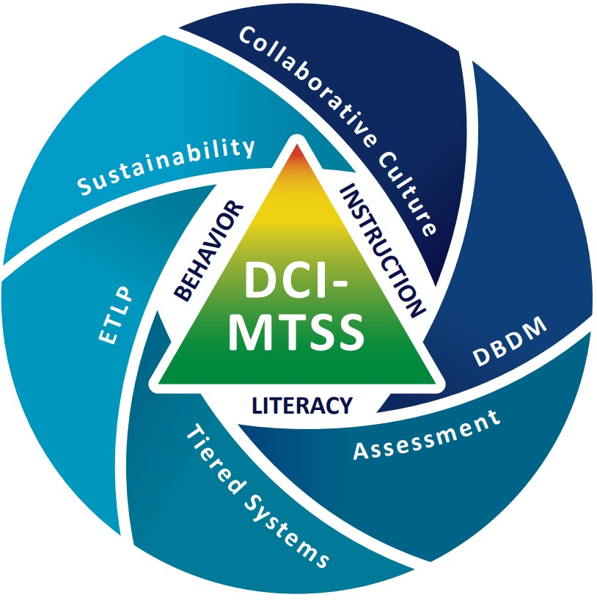
DCI-MTSS Framework
Notes:
Note
Use this slide if you are presenting to a district/building involved in DCI-MTSS and hide the previous DCI Framework Slide.
To Know
DCI-MTSS focuses on blending elements of DCI, SW-PBS, and/or Literacy providing a Multi-Tiered System of Support (MTSS) based on the specific needs of a district.
DCI-MTSS is built on the evidence-based premises of an MTSS framework. With an overarching goal to improve outcomes for all students, especially students with disabilities, by providing high-quality professional development focused on district- and building-level implementation within a multi-tiered system of support (MTSS), the DCI-MTSS Framework creates a cohesive system that focuses on increasing both academic and behavioral outcomes to equitably support the varying needs of all students.
This graphic illustrates the DCI-MTSS Framework as described in the DCI-MTSS District-Level Implementation Practice Profile.
The outside of this graphic highlights the 6 essential functions that have been identified as important for district leadership teams in the effective implementation of DCI-MTSS.
District leaders maintain a collaborative culture and climate to build capacity for an outcome-driven approach to school improvement.
District leaders maintain an assessment system designed to support educational teams in making informed instructional and programmatic decisions to support students.
District leaders engage in cycles of data-based decision making to meet the needs of all students.
District leaders maintain a tiered system of supports that provides efficient, effective, and equitable allocation of resources to support all students.
District leaders select and align effective teaching and learning practices to increase the probability that instruction, interventions, and supports meet the needs of all students.
District leaders provide staff with ongoing support to ensure the integration and sustainability of their continuous improvement efforts.
Within the white space in the center you see the three content areas on which DCI-MTSS focuses: behavior, instruction, and literacy. The triangular center of the diagram represents the tiers.
Collaborative teams fit into several of the essential functions and content areas.
To Do/To Say
Describe the meaning of the illustration.
Note that for this module we are focused on collaborative teams, which impact each of the essential functions.
Without strong collaborative teams, districts may struggle to effectively implement and sustain MTSS practices, leading to inconsistencies in decision making, resource allocation, and student support.
Collaborative teams ensure alignment, shared responsibility, and a collective approach to problem-solving, ultimately driving student success.
Reference
MoEdu-SAIL. (2023). DCI-MTSS district-level implementation practice profile. Missouri Department of Elementary and Secondary Education. https://www.moedu-sail.org/wp-content/uploads/2023/09/DCI-MTSS-District-Level-Implementation-Practice-Profile-June-2023.docx

Slide 16
C.T. Alignment with Missouri Teacher & Leader Standards
Standard #2 Teaching and Learning
Education leaders have the knowledge and ability to ensure the success of all students by promoting a positive school culture, providing an effective instructional program that applies best practice to student learning, and designing comprehensive professional growth plans for staff.
Standard #3 Management of Organizational Systems
Education leaders have the knowledge and ability to ensure the success of all students by managing the organizational structure, personnel, and resources in a way that promotes a safe, efficient, and effective learning environment.
Standard #6 Effective Communication
The teacher models effective verbal, nonverbal, and media communication techniques with students, colleagues and families to foster active inquiry, collaboration, and supportive interaction in the classroom.
Notes:
To Know/To Say
These Missouri Teacher and Leader Standards are closely aligned to the content within the Collaborative Teams Module. Please read the slide as I review the standards.
References
Missouri Department of Elementary and Secondary Education. (2013a). Leader standards. https://dese.mo.gov/media/pdf/oeq-ed-leaderstandards
Missouri Department of Elementary and Secondary Education. (2013b). Teacher standards. https://dese.mo.gov/media/pdf/oeq-ed-teachstandards

Slide 17
C.T. Alignment with Missouri Teacher and Leader Standards
Standard #7 Student Assessment and Data Analysis
The teacher understands and uses formative and summative assessment strategies to assess the learner’s progress and uses both classroom and standardized assessment data to plan ongoing instruction. The teacher monitors the performance of each student, and devises instruction to enable students to grow and develop, making adequate academic progress.
Standard #8 Professionalism
The teacher is a reflective practitioner who continually assesses the effects of choices and actions on others. The teacher actively seeks out opportunities to grow professionally in order to improve learning for all students.
Standard #9 Professional Collaboration
The teacher has effective working relationships with students, parents, school colleagues,
and community members.
Notes:
To Know/To Say
These Missouri Teacher and Leader Standards are closely aligned to the content within the Collaborative Teams Module. Please read the slide as I review the standards.
References
Missouri Department of Elementary and Secondary Education. (2013a). Leader standards. https://dese.mo.gov/media/pdf/oeq-ed-leaderstandards
Missouri Department of Elementary and Secondary Education. (2013b). Teacher standards. https://dese.mo.gov/media/pdf/oeq-ed-teachstandards

Slide 18

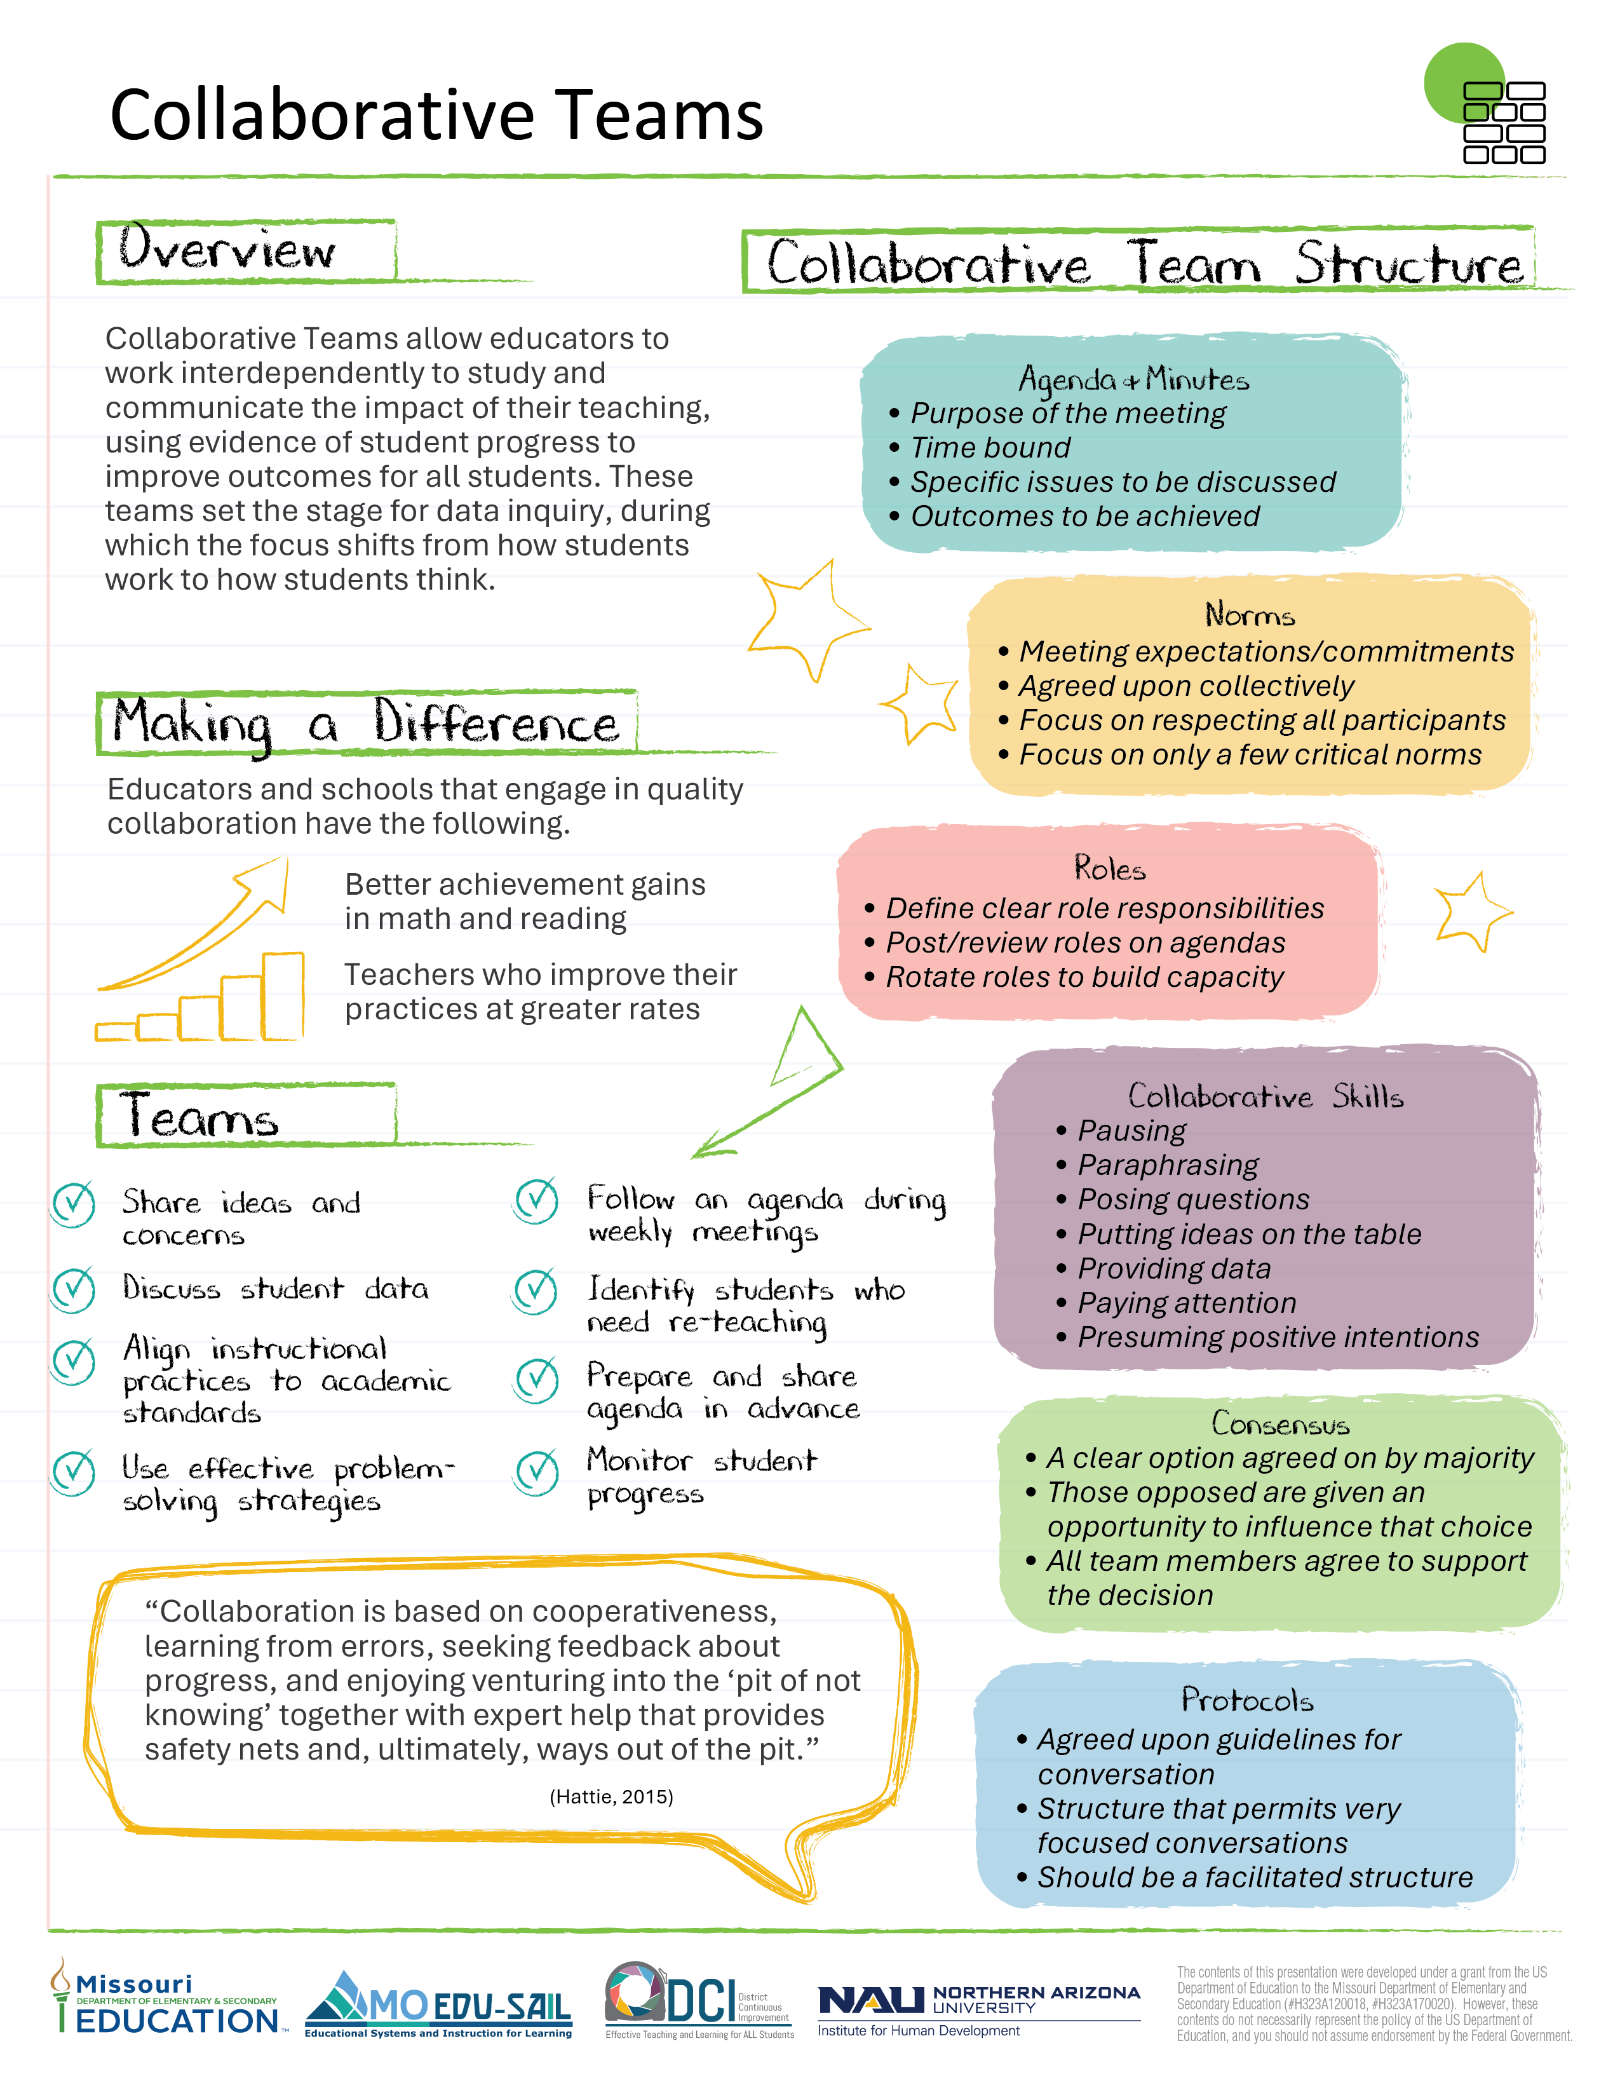
Collaborative Teams Infographic
Find this at www.moedu-sail.org/dci-practice-profiles-and-infographics
Notes:
Handout CT 3.1
Collaborative Teams Infographic
To Know/To Do/To Say
The infographic, Handout CT 3.1, provides a snapshot of the essential learning contained in the module. This is an opportunity for the presenter to provide a hook as to why developing collaborative teams is important. It also helps participants see how collaborative teams and data-based decision making go hand in hand.

Slide 19
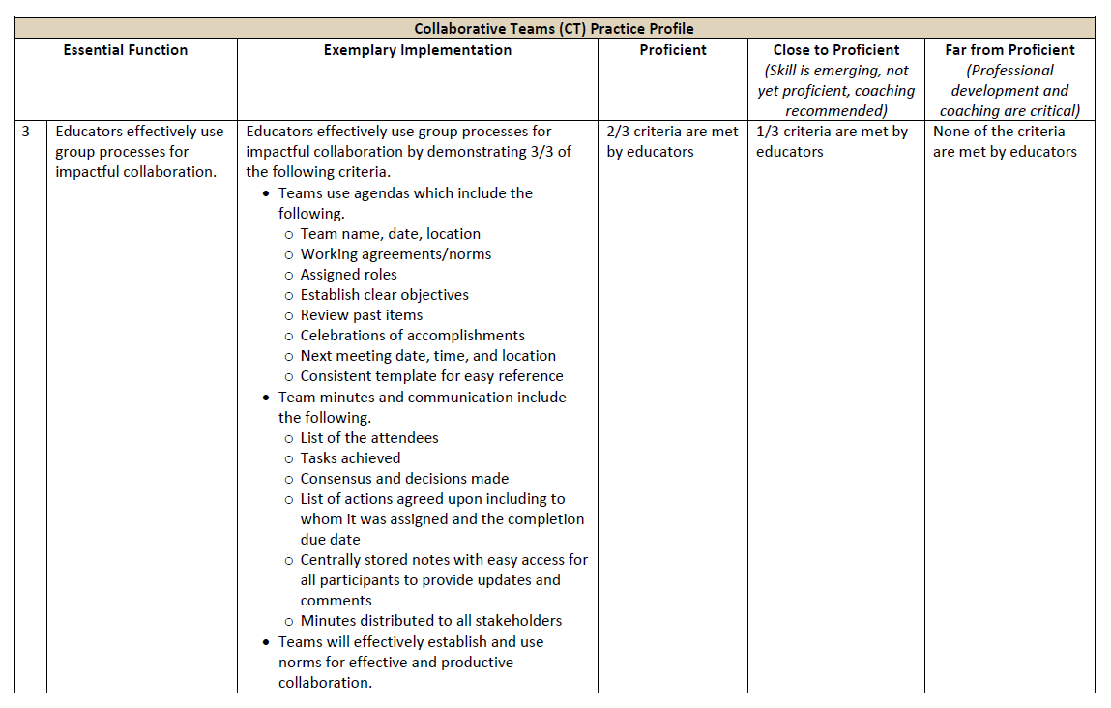
Collaborative Teams Practice Profile
Find this at www.moedu-sail.org/dci-practice-profiles-and-infographics
Notes:
Handout CT 3.2
Collaborative Teams Practice Profile
To Know/To Do/To Say
The Practice Profile for Collaborative Teams is Handout CT 3.2. Review the Practice Profile with the participants reviewing the following key points.
The Practice Profile template is anchored by the Essential Functions and implementation performance levels and criteria.
The three Essential Functions for collaborative teams are as follows.
Essential Function1, Teams develop a culture of shared responsibility, focused on student impact that promotes collective efficacy.
Essential Function 2, Educators structure team meetings to assure authentic and effective collaboration.
Essential Function 3, Educators effectively use group processes for impactful collaboration.
Implementation Performance Levels and Criteria
Four levels of implementation are described for each teaching/learning objective: exemplary, proficient, close to proficient, and far from proficient.
Within each implementation level, evidence which provides data or documentation for determining implementation levels is provided.
The Practice Profile is an important tool for self-monitoring implementation because it serves as a reminder as to the implementation criteria and is also aligned with the fidelity checklists and the electronic Self-Assessment Practice Profile (SAPP). These sources provide data regarding further training or coaching needs.
Part 3 focuses on Essential Function 3. There are two other parts to this module which cover Essential Functions 1 and 2.

Slide 20
Part 3
Group Processes for Impactful Collaboration

Slide 21
Session-at-a-Glance
Overview
Team meeting agendas
Team minutes
Group norms (working agreements)
Decision making
Protocols
Next steps action plan, part 3
Notes:
To Know/To Do/To Say
This slide summarizes our session for Part 3. Are there any questions?

Slide 22
Part 3: Learning Objectives
Create a high-quality team meeting agenda template
Implement effective systems for recording meeting minutes and informing stakeholders
Establish team norms to support productive collaboration
Develop strategies for building consensus
Use protocols appropriately designed to meet team goals
Notes:
To Know/To Say/To Do
Review the learning objectives/targets for Part 3, Group Processes for Impactful Collaboration.
Our session today will focus on… (Discuss which targets your will be focusing on if your session does not include all of part 3.) These are aligned with the Collaborative Teams Practice Profile.

Slide 23
Part 3: Essential Questions
How do group processes help strengthen team collaboration?
What are the components of an effective team meeting agenda?
What elements of team minutes ensure clear communication and follow up?
How do norms promote a culture of collaboration?
Why is consensus important for team decision making?
How can the use of protocols streamline team decision making?
Notes:
To Know/To Say
These essential questions help to guide thinking before, during, and after this session of learning. Notice how they coincide with the EF 3 criteria in the Practice Profile.
Optional Activity
Essential Questions may be written on individual chart paper and placed around the room so they can be referred to throughout the presentation.
You might have participants respond to the questions initially and then later provide opportunities to add to the responses once more learning has taken place.
If time permits, a carousel structure could be used so participants can respond, collaborate, and process the questions.

Slide 24
Collaborative Team Framework
Part 1 EF 1 | Part 2 EF 2 | Part 3 EF 3
Building a Culture of Collective Responsibility | Effective Team Structures & Skills | Group Processes for Impactful Collaboration
Purpose/Goals Trust Communication | Team Configurations Time Roles Collaborative Skills | Agendas/Minutes Norms Consensus Protocol
(Adapted from Bloomberg & Pitchford, 2016)
Notes:
To Know/To Say
The CT module is designed around this Collaborative Team Framework:
Part 1 - Culture (EF1): Building a culture of collective responsibility.
Part 2 - Structure (EF2): Structuring team meetings to assure authentic and effective collaboration
Part 3 - Process (EF3): Using group processes for impactful collaboration.
To Do
Review the organizational structure of the CT module and note how this module addresses the Part 3 components.
Reference
Bloomberg, P. J., & Pitchford, B. (2016). Leading impact teams: Building a culture of efficacy (1st ed.). Corwin.

Slide 25
Group Processes for
Team Collaboration
Agendas/minutes
Norms (working agreements)
Consensus
Protocols
(Bloomberg & Pitchford, 2016; Marzano et al., 2016)
Notes:
To Know
This presentation covers group processes which, when used together, support collaboration: agendas/minutes, norms, consensus, and protocols.
To Say
Today we’ll talk about the overarching functions of agendas/minutes, norms (sometimes referred to as working agreements), consensus, and protocols. Each of these tools (processes) enables collaborative teams to conduct more efficient, productive, and effective meetings.
References
Bloomberg, P. J., & Pitchford, B. (2016). Leading impact teams: Building a culture of efficacy (1st ed.). Corwin.
Marzano, R. J., Heflebower, T., Hoegh, J. K., Warrick, P., Grift, G., Hecker, L., & Wills, J. (2016). Collaborative teams that transform schools: The next step in PLCs. Marzano Research.

Slide 26

Rose, Thorn, Bud
Group Processes
Agendas/minutes
Norms
Consensus
Protocols
Rose. Something positive
Thorn. A challenge
Bud. A fresh new idea
(VanZandt, 2023)
Notes:
To Know/To Say/To Do
Activity
Rose, Thorn, Bud
This activity provides an opportunity for participants to reflect on their prior knowledge and experiences regarding group processes.
Participants should think back to teams on which they have participated (or observed) and the group processes (agendas/minutes, norms, protocols) used by those teams.
Ask participants to individually reflect on these questions and jot down a response for each (rose, thorn, bud).
Rose. What was something positive you observed regarding team processes used by a team you were on or observed?
Thorn. Which of these processes was a struggle or challenge for the team? Why?
Bud. What fresh idea do you have to improve any of these group processes so teams can be more productive and effective?
Ask participants to randomly gather in groups of 3 or 4.
Take turns discussing responses.
Ask each small group to share a key take away with the group.
Reference
VanZandt, P. (2023, July 25). What is rose, bud, and thorn? Definition, templates and exercise. IdeaScale. https://ideascale.com/blog/rose-bud-and-thorn/

Slide 27
Agendas & Minutes
Group Processes for Team Collaboration

Slide 28
Purpose of a Team Agenda
Sets tone and framework for the meeting
Identifies outcomes
Encourages prepared participation
Focuses team on priority items
Keeps team on task
Saves time
(Team Asana, 2025; Welch & Garmston, 2007)
Notes:
To Know/To Say
Sets tone and framework. A team agenda should provide a clear framework outlining the purpose, proposed outcomes, and sequence of events of a team meeting. It specifies each item to be discussed, the time allocated for each item, and is used to facilitate a productive flow of discussion.
Effective agendas set the tone and enable teams to guide their time in a more intentional and productive manner toward the goals they wish to accomplish.
Identifies outcomes. Meetings need to be results-oriented and identify outcomes to be achieved, so all team members are clear regarding the purpose of the meeting.
Encourages prepared participation. Agendas let attendees know the priorities to be discussed.
Focuses team. Meeting agendas can focus participants in ways that verbal guidance cannot. Participants have a written reminder of what needs to be accomplished during the meeting, allowing them to drive each discussion toward conclusion. Agendas also prevent members from placing non-prioritized issues on the table.
Keeps team on task. Following the agenda items will help keep meetings on track to address prioritized items so the most important discussions are not missed.
Saves time. Teams guided by agendas can be laser-focused and therefore more productive, saving time for all team members. Agendas let participants know that there’s a legitimate business purpose for meeting, with specific issues to be discussed, so time is not wasted.
Note
For additional training/resource materials on meeting agendas, see MO SW-PBIS Leadership Module: Lesson 4 Working Agreements, https://pbismissouri.org/tier-1-workbook-resources/
References
Team Asana. (2025, February 7). Meeting agenda examples: How to plan, write, and implement. Asana. https://asana.com/resources/meeting-agenda
Welch, D., & Garmston, R. J. (2007). Results-oriented agendas transform meeting into valuable collaborative events. The Learning Professional, 28(2). https://learningforward.org/journal/time/results-oriented-agendas-transform-meeting-into-valuable-collaborative-events/

Slide 29
Components of Effective Agendas
Team name, date/time, meeting location
Norms
Assigned roles
Clear objectives/outcomes
Review past items
(more items on next slide)
(Philaphandeth, 2022; Welch & Garmston, 2007)
Notes:
Handout CT 3.4
Components of Effective Agendas
To Know
The next two slides present the components of effective agendas. The handout is used for taking notes and for a follow-up activity.
To Do/To Say
Provide the handout. Participants can take notes as the components are reviewed in more depth. They will also need the handout for an activity that follows.
An agenda is a document used to let team members know the purpose of the meeting. It is time-bound with specific issues to be discussed and outcomes to be achieved.
Team name, date/time, and meeting location. To encourage full participation, team members need to know the time, date, and location of the meeting. Team/group name is important to include as there may be members who are on multiple teams, and they need to be clear as to which team is meeting.
Norms. Meeting norms (working agreements) should be listed on every agenda as a reminder of expected collaborative behaviors.
Assigned roles. At minimum, team members need to be assigned to take notes, keep track of time, keep the discussion on track, and any other roles the team decides will be helpful.
Clear objectives and outcomes. When you place the outcomes/outcomes/goals of the meeting on the agenda, you are sending a gentle reminder to come prepared and stay on track with the discussion. This can also help focus the meeting and is especially critical when reviewing student data. It is suggested that the use of outcomes, instead of topics, sets a tone for desired accomplishment and goals. Using the word topic suggests items for discussion, whereas outcomes promotes action.
Review past items. By including a time for past items, it provides an opportunity to reflect, update, or report on prior business and holds team members accountable for follow-up.
References
Philaphandeth, K. (2022, September 2). How to write an effective team meeting agenda (with templates!). Work Life by Atlassian. https://www.atlassian.com/blog/productivity/team-meeting-agenda
Welch, D., & Garmston, R. J. (2007). Results-oriented agendas transform meeting into valuable collaborative events. The Learning Professional, 28(2). https://learningforward.org/journal/time/results-oriented-agendas-transform-meeting-into-valuable-collaborative-events/

Slide 30
Components of Effective Agendas (cont)
New items
Team decisions including tasks, person responsible, and follow-up dates
Celebrations
Next meeting date, time, and location
Consistent template for easy reference
Note: Agendas should be designed for both academic and behavioral considerations.
(Philaphandeth, 2022; Welch & Garmston, 2007)
Notes:
To Know/To Say
Additional agenda components include the following.
New items. New topics should be placed on the agenda so members will have time to consider the item prior to the meeting and bring well thought-out ideas to the table.
Team decisions. During conversation, teams need to document what was agreed upon at the meeting, who will follow up, and by what date.
Celebrations. Don’t skip this one! When teams take time to reflect on what they have done well and accomplished, it promotes a sense of group efficacy, which as Hattie points out strongly supports student learning.
Next meeting date, time, and location. These details prompt participants to schedule the next meeting in their calendars.
Consistent template. A consistent template makes the agenda predictable, easier to read, and easier to complete.
Note
Ensure your agenda is designed for discussing both behavioral and academic issues.
References
Philaphandeth, K. (2022, September 2). How to write an effective team meeting agenda (with templates!). Work Life by Atlassian. https://www.atlassian.com/blog/productivity/team-meeting-agenda
Welch, D., & Garmston, R. J. (2007). Results-oriented agendas transform meeting into valuable collaborative events. The Learning Professional, 28(2). https://learningforward.org/journal/time/results-oriented-agendas-transform-meeting-into-valuable-collaborative-events/

Slide 31

Strengthening the Power of Agendas
Deliver to participants at least 48 hours in advance
Consider the impact of a consistent agenda across teams
Use team member input and feedback
Combine agenda/minutes template
Develop a long-term agenda to prioritize upcoming tasks
(Philaphandeth, 2022; Welch & Garmston, 2007)
Notes:
To Know
Consultants may wish to read the article “Results Oriented Agendas Transform Meetings into Valuable Collaborative Events” to build capacity regarding agendas. https://learningforward.org/journal/time/results-oriented-agendas-transform-meeting-into-valuable-collaborative-events/#:~:text=The%20results-oriented%20agendas%20provided%20open%20time%20to%20analyze,and%20increased%20time%20spent%20on%20student%20learning%20issues
To Do/To Say
Review and expand on ways to strengthen agendas as listed on the slide. Ask participants to share their ideas on other ways to strengthen agendas.
When agendas are delivered early, preferably at least 48 hours in advance, members have time to review items for discussion – time to think about the items and organize their thoughts, suggestions, or questions – all of which will make for a more productive meeting.
When possible, have a consistent agenda template for all teams in the building.
If a team member brings up a topic not on the agenda, make sure it is acknowledged and determine when and where the topic can be discussed.
It is very effective to use the agenda template to record minutes, then the agenda and minutes become one document after the meeting.
Developing a long-term agenda for the team is also important. It enables teams to prioritize work and ensures that important tasks are not overlooked.
References
Philaphandeth, K. (2022, September 2). How to write an effective team meeting agenda (with templates!). Work Life by Atlassian. https://www.atlassian.com/blog/productivity/team-meeting-agenda
Welch, D., & Garmston, R. J. (2007). Results-oriented agendas transform meeting into valuable collaborative events. The Learning Professional, 28(2). https://learningforward.org/journal/time/results-oriented-agendas-transform-meeting-into-valuable-collaborative-events/

Slide 32
Strategies for Positive and Productive Team Meetings
Start and end meetings on time
Use thoughtful inquiry
Confront issues and address challenges with a solution mindset
Engage all team members
Provide context and examples
(Principal’s Playbook, n.d.)
Notes:
To Know/To Say
Agendas are tremendously helpful tools to ensure team meetings are run effectively and efficiently. In addition to having a detailed and comprehensive agenda, here are some additional tips for ensuring positive and productive team meetings:
Start and end on time. Create a culture of efficiency and effectiveness.
Use thoughtful inquiry. Questions can be used to clarify, reflect, probe, narrow, or expand the group’s thinking: "How does this connect to our overall goal?”; “What are the possible unintended consequences?”; "If we take this route, what will success look like?”; "What would happen if we did the opposite?”; "Which of these ideas aligns best with our priorities?“
Confront issues and address challenges. Meetings should focus on solving problems of practice. The problem identified should be solvable, measurable, and specific.
Engage all team members. This encourages diversity of thought. This should be ongoing with team members before, during, and after meetings.
Provide context and examples. This should be done both when offering suggestions and when issues are raised. It helps to model the solution in the current context and through multiple contexts.
What other tips can be added to ensure positive and productive team meetings?
Reference
Principal’s Playbook. (n.d.). Instructional leadership teams. https://www.theprincipalsplaybook.com/instructional-leadership/instructional-leadership-teams

Slide 33

Reflecting on Team Agendas
Take 5 minutes to review the agenda template your team uses against the components of an effective agenda.
Make note of needed revisions to your team’s current agenda template.
Review Handout CT 3.6 (the Effective Agenda Template and Example handout) and make note of additional content and/or formatting changes needed.
You’ll create your own effective agenda template on the next slide.
Notes:
Handout CT 3.4, Components of Effective Agendas
Handout CT 3.5, Sample Ineffective Agenda
Handout CT 3.6, Effective Agenda Template and Example
To Know
This activity provides an opportunity for teams to review agenda templates they are currently using and compare them with the essential components of an effective agenda.
Have copies of the Handout CT 3.5, Sample Ineffective Agenda available for participants who didn’t bring their own team’s agenda.
To Do/To Say
Encourage participants, if possible, to work with others from their school team to review their agenda. Distribute Handout CT 3.5 to those who did not bring their own agenda.
Ask participants to review their own team’s agenda, compare with the components of an effective agenda (Handout CT 3.4, Components of Effective Agendas), and make notes of needed improvements.
Discuss with your team which components are currently included on your agenda template and which are not.
Make notes on how your team’s current agenda template can be improved.
Next, provide participants with a copy of the exemplar agenda (Handout CT 3.6, Effective Agenda Template and Example) to compare with their own.
Again, encourage discussion and notetaking on how their team’s agenda template could be improved, including content and format.
The next slide provides time for the team to design an effective agenda.

Slide 34
Designing an Effective Team Agenda
Revise or create an agenda template for your team.
Use Handouts CT 3.4 and CT 3.6 as guides.
Check to ensure you have all the necessary components of an effective agenda.
Create your template electronically for ease of use and sharing.
Notes:
Handout CT 3.4, Components of Effective Agendas
Handout CT 3.6, Effective Agenda Template and Example
To Know
This activity provides time for individuals or teams to revise their current team agenda template, making sure it includes all the essential components of an effective agenda.
To Do
Provide participants with time to review their notes and work on developing or redesigning their team’s agenda template to improve team meeting efficiency and effectiveness.
It would be best for teams to create the template electronically for easy sharing.
Encourage team members to work collaboratively to develop or refine their team agenda template using Handouts 3.4 and 3.6 to guide them.
Once finished, ask participants to exchange their revised agenda template to be checked by another team.

Slide 35
Benefits of Meeting Minutes
Effective decision making
Accountability and responsibility
Historical reference
Communication and transparency
Reflection and improvement
(Adams, 2025)
Notes:
To Know/To Say/To Do
While an agenda is a plan for a meeting, the minutes are a concise record of what actually happened at the meeting, as well as who is responsible for follow-up tasks, along with timelines.
Benefits of accurate team meeting minutes include the following.
Effective decision making. Minutes capture the discussions, ideas, and arguments exchanged during the meeting, allowing participants a reference when making decisions. By having a clear record of the meeting's proceedings, individuals can ensure that decisions align with the agreed-upon objectives.
Accountability and responsibility. When actions and responsibilities are assigned and recorded in the minutes, individuals are likelier to follow through on their commitments. This fosters a sense of responsibility and ensures everyone remains accountable for contributing to the meeting's outcomes.
Historical reference. Minutes serve as a historical record of meetings. They document the evolution of ideas, the decision making process, and the actions taken over time. Minutes can be in valuable for tracking progress, evaluating the effectiveness of past decisions, and providing context for future discussions.
Communication and transparency. Minutes are a means of communication between meeting participants and those who cannot attend. They summarize the discussions, decisions, and action items, enabling individuals to stay informed and involved even if they are not physically present. Moreover, transparent and accessible minutes promote trust and openness.
Reflection and improvement. By reviewing past minutes, educators can reflect on their meeting practices, identify areas for improvement, and refine their decision-making processes. Furthermore, it offers valuable insights into the effectiveness of meetings, allowing for continuous growth and enhancement of collaborative efforts.
To Do
Review and expand on slide content.
Reference
Adams, S (2025, March 8). What is minute taking? An ultimate guide. The Knowledge Academy. https://www.theknowledgeacademy.com/blog/what-is-minute-taking/

Slide 36
Essential Components of Effective Minutes
Clear objectives/outcomes
Team decisions including tasks, person responsible, and follow-up dates
Celebrations
Next meeting date, time, location
(Meltzer, 2022)
Notes:
To Know/To Say/To Do
These are essential components of effective team meeting minutes. Look at the minutes from your team that you brought. Do they include these components?
Show a thumbs up if your minutes include all of these components, thumbs to the side if they include some, and thumbs down if they only include one or two.
Next, discuss with your team which components are missing from your minutes and why it is important to include each component.
Reference
Meltzer, R. (2022, July 15). How to write meeting minutes, with examples. Grammarly. https://www.grammarly.com/blog/business-writing/meeting-minutes/

Slide 37
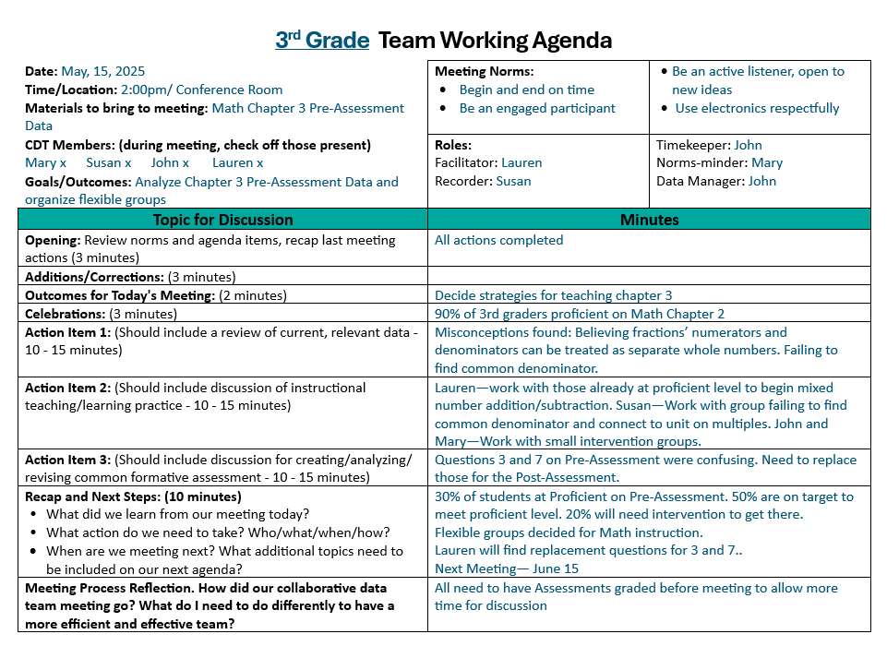
Combine and Align Team
Minutes with the Agenda
(Meltzer, 2022)
Notes:
Handout CT 3.6
Effective Agenda Template and Example (used previously)
To Know/To Say/To Do
Many of the essential items to include in meeting minutes are the same as those found in the agenda, such as date, time, location, participants, purpose, proposed outcomes, and topics discussed.
Using a template that combines both agenda and minutes, therefore, is the most efficient way to record the meeting minutes.
Meeting minutes should be concise, to the point, and capture a succinct summary of each action item discussed.
They should include next steps to be taken and those responsible for completing tasks.
It is also important that the date, time, and location for the next meeting appear in the minutes.
As you review and reflect on this example of team minutes, what suggestions do you have to improve them?
References
Meltzer, R. (2022, July 15). How to write meeting minutes, with examples. Grammarly. https://www.grammarly.com/blog/business-writing/meeting-minutes/

Slide 38
Tips for Writing Effective Minutes
Clarify who is responsible for recording team minutes before meeting.
Be consistent by using a template aligned with the agenda so minutes are structured the same way for each meeting.
Make notes viewable on a projector or shared screen during meetings to allow teammates to contribute to them.
Summarize by simplifying and clarifying what happened during the meeting.
(Meltzer, 2022)
Notes:
To Know/To Say
Here are some additional tips for writing effective team minutes.
To Do
Review the tips listed on the slide and ask participants to share other tips they may have for recording minutes.
Reference
Meltzer, R. (2022, July 15). How to write meeting minutes, with examples. Grammarly. https://www.grammarly.com/blog/business-writing/meeting-minutes/

Slide 39
Tips for Communicating Minutes
Disseminate the minutes within 24 hours of the meeting.
Store electronic documents in a central location so minutes don’t get lost in an inbox or on a server.
Provide easy access for updating and adding comments.
Distribute and give access to all appropriate stakeholders.
Draw attention to action items and follow-up tasks.
(All Business, n.d.; Marzano et al., 2016)
Notes:
To Know/To Say/To Do
It is important to consider your team’s communication structures for sharing minutes.
Discuss these criteria in some detail and provide opportunities for participants to reflect on their current communication structures and how they can be strengthened.
References
AllBusiness. (n.d.). 5 reasons why meeting minutes are important. https://www.allbusiness.com/importance-of-meeting-minutes
Marzano, R. J., Heflebower, T., Hoegh, J. K., Warrick, P., Grift, G., Hecker, L., & Wills, J. (2016). Collaborative teams that transform schools: The next step in PLCs. Marzano Research.

Slide 40
Using Team Minutes
Who should receive your team minutes?
    All team members?
    School leaders?
    Others impacted by team?
What feedback mechanisms are in place to know minutes are being read and used?
What steps can your team take to strengthen communication structures regarding dissemination and usage of meeting minutes?
(All Business, n.d.; Marzano et al., 2016)
Notes:
To Know
Team minutes are only effective if they are read and used to guide follow-up tasks and communicate the actions of the team to others. This activity will help teams reflect on who should receive team minutes and whether team minutes are being used to facilitate task completion and as communication tools so other stakeholders will be kept abreast of the team’s work.
To Do/To Say
Ask participants to work with other members of their team (if possible) to reflect and discuss these three questions.
Have chart paper/markers available so they can record questions and responses.
Have teams make a list of everyone they believe should receive their meeting minutes. Encourage them to consider why it is important to consider disseminating minutes to additional staff impacted by their actions, such as school leaders, special subject, intervention teachers, etc.
Conclude the activity by having each team provide a brief summary of their next steps for strengthening meeting minute communication structures.
References
AllBusiness. (n.d.). 5 reasons why meeting minutes are important. https://www.allbusiness.com/importance-of-meeting-minutes
Marzano, R. J., Heflebower, T., Hoegh, J. K., Warrick, P., Grift, G., Hecker, L., & Wills, J. (2016). Collaborative teams that transform schools: The next step in PLCs. Marzano Research.

Slide 41
Making it Happen. Implementing an Effective Agenda and Minutes
Who else in the building should be consulted in order to get this new template implemented?
When, where, and how will the new template be shared with all teams and team members?
How will you field questions and suggestions about the new template and minutes?
How will the teams evaluate the use of the revised agenda template and minutes?
Notes:
To Know/To Say/To Do
As a final step in this process, let’s think about the steps you’ll need to take in order to implement your revised agenda and minutes.
Ask participants to work with their team members to discuss the questions that are posed on the slide and make a plan for implementation.
Facilitate their action planning.
Extend this activity by having the team build an actual agenda for their next team meeting that includes the aspects of the new learning so they walk out with a finished/useful agenda.

Slide 42
Reflecting on Team Minutes
Do your minutes include all the essential components?
Is a consistent template used that combines and aligns minutes with agenda items?
Are your minutes clear and concise?
Do they capture a succinct summary of each action item?
Do the minutes indicate who is responsible for each action item and include a timeline for completion?
What adjustments do you need to make to your template to make it a high-quality method to communicate the meeting minutes?
Notes:
To Know
This activity provides an opportunity for team members to work collaboratively to reflect on the essential components of effective team meetings and to review and refine their current team minutes practices.
To Do
Facilitate teams as they evaluate their team minutes using the bulleted points listed on the slide to make improvements to their current practices.
You may want to post the Essential Components of Effective Minutes on chart paper for teams to refer to.
Clear objectives/outcomes
Team decisions including tasks, person responsible, and follow-up dates
Celebrations
Next meeting date, time, location
Provide time for teams to develop and implement a plan for improving their team minutes.
To Say
We will take some time to work collaboratively with your other team members to reflect on the essential components of effective team meetings and see how your current minutes compare. Discuss each of the bulleted points on the slide with your team and develop a plan to improve your team minutes. Spend time implementing your plan by revising your current agenda/minute template.

Slide 43
Group Norms
Working Agreements
Group Processes for Team Collaboration
Notes:
To Do
Before showing the next slide, ask participants to turn to a shoulder partner and discuss what they believe norms are (sometimes referred to as working agreements). Then share the definition on the next slide and have participants discuss how their definitions are similar or different to the one shown.

Slide 44
Norms Definition
Norms, sometimes referred to as working agreements, are guidelines that define how groups will work together.
These agreements include a list of behaviors and attitudes group members expect from one another to create an environment where all can feel safe, learn, problem solve, and achieve desired outcomes.
(Center for Creative Leadership, 2024; Garmston & Wellman, 2016)
Notes:
To Know/To Say
When people meet in groups, there generally are agreements, spoken or unspoken, about how interactions between the group members will happen.
Norms/working agreements make clear how group members agree to engage with each other during the meeting so that everyone has a set of expectations to follow.
Norms help participants achieve their meeting goals, increasing productivity and effectiveness of their time.
Creating norms can help reduce conflict, build trust, and improve communication within the team.
They can also create trust that all team members will be held to the same high standards of collaborative behaviors.
Note
For additional training/resource materials on working agreements see MO SW-PBIS Leadership Module: Lesson 3 Working Agreements https://pbismissouri.org/tier-1-workbook-resources/
References
Center for Creative Leadership. (2024, June 23). 10 steps for establishing team norms. https://www.ccl.org/articles/leading-effectively-articles/the-real-world-guide-to-team-norms/
Garmston, R, & Wellman, B. (2016). The adaptive school: A sourcebook for developing collaborative groups (3rd ed.). Rowman & Littlefield Publishers.

Slide 45
Purpose of Norms
Create and reinforce collaborative efforts and culture
Clarify expectations
Provide a powerful tool for holding groups accountable
Respect the time of all participants
Encourage open and vulnerable dialogue
Reduce conflict and stress within a group
Promote greater productivity
(Holmes, 2019; Marzano et al., 2016)
Notes:
To Know/To Say
Groups function more effectively when norms are established, practiced, and monitored. Without norms, groups can lose focus and loose sight of their purpose and goals.
Group norms are powerful influencers of group behavior, enabling groups to reach their intended goals.
To Do
Review the key reasons team norms are powerful influencers of team behavior and team success. Expand on the slide content.
References
Holmes, S. (2019). Are the lack of team norms sabotaging your team’s success? Make A Dent Leadership. https://madl.s3.amazonaws.com/products/team-norms/team-norms.pdf
Marzano, R. J., Heflebower, T., Hoegh, J. K., Warrick, P., Grift, G., Hecker, L., & Wills, J. (2016). Collaborative teams that transform schools: The next step in PLCs. Marzano Research.

Slide 46

Keys to Effective Team Norms
Simple, powerful statements about the way meetings should be run
Commitments agreed upon collectively
Consistent reminder of fundamental meeting guidelines
Focus on respecting all participants
Brief in number
(Center for Creative Leadership, 2024; Marzano et al., 2016; Valenzuela, 2022)
Notes:
To Know/To Say
These are the keys to developing effective team norms.
To Do
Review and expand on slide content.
Emphasize that teams post norms during team meetings and provide frequent reminders.
When developing norms begin with 5 norms at most. Too many will be difficult to remember and will overwhelm.
Additional norms can always be added as needed.
References
Center for Creative Leadership. (2024, June 23). 10 steps for establishing team norms. https://www.ccl.org/articles/leading-effectively-articles/the-real-world-guide-to-team-norms/
Marzano, R. J., Heflebower, T., Hoegh, J. K., Warrick, P., Grift, G., Hecker, L., & Wills, J. (2016). Collaborative teams that transform schools: The next step in PLCs. Marzano Research.
Valenzuela, J. (2022, August 12). Shared agreements for working together benefit teachers and administrators. Edutopia. https://www.edutopia.org/article/shared-agreements-working-together-benefit-teachers-and-administrators/

Slide 47
Examples of Team Norms
Adhere to meeting and agenda times
Actively participate and contribute
Listen to understand
Share discussion space
Handle problems quickly
Use electronics respectively
Have courageous conversations
Show respect for one another
Enter discussions with an open mind
Maintain confidentiality
Voice opinions during the meeting, not after
Make decisions by consensus
Celebrate efforts as well as results
(Holmes, 2019; Marzano et al., 2016; Valenzuela, 2022)
Notes:
Handout CT 3.7
Team Norm Examples
To Know/To Do/To Say
Provide Handout CT 3.7 to participants.
This slide provides examples of team norms. The handout contains a more extensive list of examples.
Show the slide and emphasize the following.
Norms should be worded concisely to easily convey the intended meaning.
Teams should begin by developing, prioritizing, and implementing a few norms (no more than five) that best fit the needs of the team. Additional norms can be added as needed.
Too many norms can overwhelm teams and reduce norm effectiveness.
Many teams find it beneficial to include a norm such as “celebrate efforts as well as results.” Collective teacher efficacy has a powerful influence on student achievement and celebrating shared success can leave team members feeling empowered and connected with their fellow educators.
Norms should be consistently implemented and monitored until they become common practice for all team members.
Keep in mind, if a team is not functioning effectively, the first step is to revisit the team norms.
References
Holmes, S. (2019). Are the lack of team norms sabotaging your team’s success? Make A Dent Leadership. https://madl.s3.amazonaws.com/products/team-norms/team-norms.pdf
Marzano, R. J., Heflebower, T., Hoegh, J. K., Warrick, P., Grift, G., Hecker, L., & Wills, J. (2016). Collaborative teams that transform schools: The next step in PLCs. Marzano Research.
Valenzuela, J. (2022, August 12). Shared agreements for working together benefit teachers and administrators. Edutopia. https://www.edutopia.org/article/shared-agreements-working-together-benefit-teachers-and-administrators/

Slide 48
Examples of Norms that Address
Disagreement
We approach disagreements with curiosity, not judgement.
We recognize that different perspectives strengthen our work.
We ask clarifying questions instead of making assumptions.
We express our thoughts honestly while remaining professional and respectful.
We avoid blaming and focus on problem solving.
We challenge ideas, not individuals.
We bring concerns to the team rather than discussing them outside the group.
Once a decision is made, we commit to moving forward.
Notes:
To Know/To Say/To Do
It’s helpful to keep in mind the difficulties of team decision making as norms are being crafted.
Well written (and followed) norms can head off conflicts.
Teams should create an environment where disagreements are expected and even encouraged, since it is through considerate conversations that various perspectives can be presented and alternative ideas discussed.
The way in which team members disagree, however, is important. Disagreements should always be done in a respectful way - void of personal attacks.
The team’s goal is to create an environment where differences of opinion are encouraged and respected.
Respectful communication includes striving to understand prior to disagreeing; and the team offers alternative ideas rather than simply disagreeing.
Reference
Marzano, R. J., Heflebower, T., Hoegh, J. K., Warrick, P., Grift, G., Hecker, L., & Wills, J. (2016). Collaborative teams that transform schools: The next step in PLCs. Marzano Research.

Slide 49
Holding Each Other Accountable
Identify prompts to be used when norms are violated.
Decide who facilitates norm monitoring.
Assure that everyone takes responsibility for their commitments.
    Clarify and review individual team member roles and responsibilities
    Establish deadlines
    Set up check-ins to track progress
(Kitch, 2023; Marzano et al., 2016; Valenzuela, 2022)
Notes:
To Know/To Say
As you develop your team norms, also include accountability mechanisms so that everyone takes responsibility for their actions and commitments.
Define roles and responsibilities, establish deadlines, and set up regular check-ins to track progress. This accountability fosters a sense of ownership and active contribution to the team's success.
To Do
Review and expand on slide content.
References
Kitch, B. (2023, September 7). How to create a team working agreement. Mural. https://www.mural.co/blog/team-agreement-guide
Marzano, R. J., Heflebower, T., Hoegh, J. K., Warrick, P., Grift, G., Hecker, L., & Wills, J. (2016). Collaborative teams that transform schools: The next step in PLCs. Marzano Research.
Valenzuela, J. (2022, August 12). Shared agreements for working together benefit teachers and administrators. Edutopia. https://www.edutopia.org/article/shared-agreements-working-together-benefit-teachers-and-administrators/

Slide 50



Monitoring Norms
Do a quick check of how well the team followed each of the norms at the end of meetings.
Use this data to identify norms that need to be improved and those the team can celebrate!!!
Notes:
To Know/To Say
Once norms have been established, it’s important to monitor adherence to them.
At the end of each meeting, consider a quick check of how well the team followed the stated norms using thumbs up, side, or down.
Celebrate all thumbs up and consider refinement for the side/down turned thumbs. This should take no more than a few minutes.

Slide 51
Norms Monitoring Chart
Norm | Example | Non Example | Rating
Show respect and maintain confidentiality | Team members are kind and supportive and discuss student/teacher data only within team meetings. | A lack of supportive words and actions exist and confidential information is provided to those outside the team.
Participate and contribute actively | All team members take part in discussions, offering ideas and providing constructive feedback to others. | One or more team members often disengage from conversations.
Follow time allocations | The team focuses on each topic for the time specified on the agenda. | Discussions of specific topics often run too long and therefore other topics aren’t addressed.
Have courageous conversations | The team proactively discusses difficult topics before they become larger problems. | The team is reluctant to discuss topics that are difficult to resolve.
(Marzano et al., 2016)
Notes:
Handout CT 3.8
Norms Monitoring Chart and Template
To Know
An example of a norms monitoring chart is provided along with an activity for teams to develop a norms monitoring chart specific to their needs.
To Do/To Say
It is important to monitor norms over time. This can be accomplished by creating a norms monitoring chart like the example shown on the slide. This strategy can be used to head off challenges and help everyone more clearly understand the behaviors.
Discuss the norms monitoring chart example on the slide.
Next, provide the handout so teams can develop a norms monitoring chart specific for their team needs.
Activity
Developing a norms monitoring chart
Work collaboratively to develop a norms monitoring chart specific to your team needs. Handout CT 3.8 provides a template to guide your team through this process.
Ask teams to enter their team norms and clearly describe examples and nonexamples.
Next, have them discuss and decide on a rating scale. (Example 0-5 with 5 the being the highest.)
Ask the team to discuss both benefits, potential roadblocks, and ways to overcome those challenges.
Finally, make a plan on how often the norms will be rated using this chart.
Reference
Marzano, R. J., Heflebower, T., Hoegh, J. K., Warrick, P., Grift, G., Hecker, L., & Wills, J. (2016). Collaborative teams that transform schools: The next step in PLCs. Marzano Research.

Slide 52
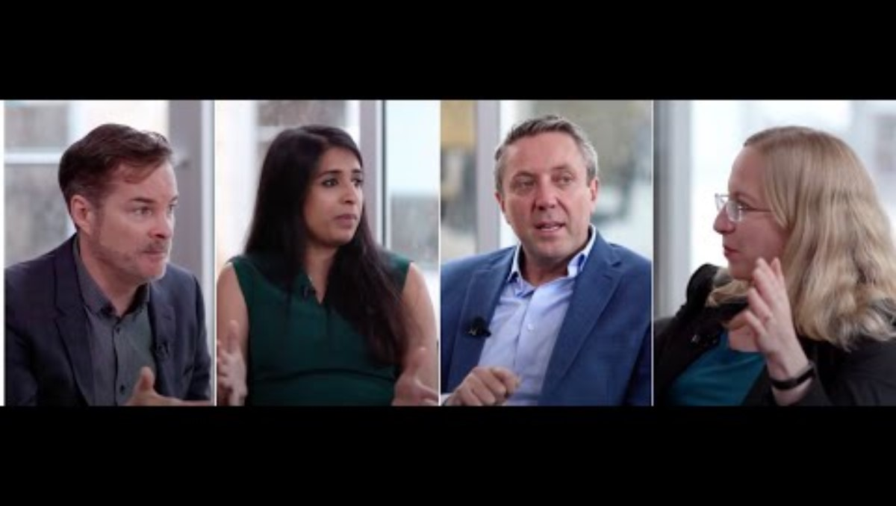
Revising and Adding Norms
https://www.youtube.com/watch?v=tOtMcCM5zZc
Notes:
Link
Setting Team Norms That Stick, https://www.youtube.com/watch?v=tOtMcCM5zZc, 4:25 minutes
This video emphasizes the importance of regularly reviewing and updating team norms based on team needs.
To Know/To Say
Creating working agreements isn’t a one-time task. Teams need to regularly review and update their norms to reflect the evolving needs and dynamics of the team to strengthen performance.
You may find that your norms need to be adjusted or perhaps new norms should be added.
As the composition of your team changes over time, it's important to update the working agreement accordingly.
New team members should be onboarded with a clear understanding of the team's norms and expectations.
As you watch the video, reflect on key takeaways that might benefit your team.
References
Corentus, Inc. (2019, March 19). Setting team norms that stick [Video]. YouTube. https://www.youtube.com/watch?v=tOtMcCM5zZc
Kitch, B. (2023, September 7). How to create a team working agreement. Mural. https://www.mural.co/blog/team-agreement-guide

Slide 53
Video Reflections
How can teams ensure that norms are relevant and applicable to their specific needs?
Can you recall a time when your team experienced a problem and which norms might have helped your team navigate this challenge?
How can teams avoid creating norms that are too broad or not meaningful?
Notes:
To Know/To Do/To Say
After watching the video, ask participants to first reflect on these questions with a partner. Then, share out key takeaways with the whole group.

Slide 54
Developing Meeting Norms
ALL team members collaboratively brainstorm and record a list of positively stated norms of acceptable behaviors that fit their team’s needs.
Each member selects two important norms.
Each member pairs with a partner and each decides on one priority norm based on conversation.
Meet with another pair and decide on the two most important priority norms.
Share the suggested norms with the team and record them for all to see.
The team then clarifies, combines, and selects 4-5 of the most essential norms.
Lastly, the team comes to a consensus and adopts the group norms.
(Center for Creative Leadership, 2024; Kitch, 2023; Marzano et al., 2016; Valenzuela, 2022)
Notes:
To Know/To Say
This activity provides time for teams to develop effective norms or to revise the norms they currently have.
As you consider what norms may be important to you, consider the following questions:
What behaviors are most important for the team to engage in?
How can norms clearly illustrate expected behaviors?
Activity
Developing meeting norms
All team members brainstorm and record a list of positively stated norms of acceptable behaviors that fit their team’s needs. Clearly illustrate the behaviors in the positively worded statements. Post for all to see.
Consider these questions: What behaviors are important for the team to frequently engage in? What are unacceptable behaviors?
Each member selects two important norms.
Each member pairs with a partner and each decides on one most important priority norm based on conversation.
Next, each pair meets with another pair and decides on the two most important priority norms. (If the team is small, this step can be skipped.)
Then, share the suggested norms with the whole team. Be sure to have these most important team norms recorded and posted for all to see.
Take time for the team to discuss each of the suggested norms so they are clarified. It may be helpful to combine some of the norms before selecting 4 or 5 that are most essential for the team.
Lastly, the whole team comes to a consensus and adopts the final collaboratively determined most important and essential team norms. These are the norms that will be reviewed and implemented at the next meeting.
References
Center for Creative Leadership. (2024, June 23). 10 steps for establishing team norms. https://www.ccl.org/articles/leading-effectively-articles/the-real-world-guide-to-team-norms/
Kitch, B. (2023, September 7). How to create a team working agreement. Mural. https://www.mural.co/blog/team-agreement-guide
Marzano, R. J., Heflebower, T., Hoegh, J. K., Warrick, P., Grift, G., Hecker, L., & Wills, J. (2016). Collaborative teams that transform schools: The next step in PLCs. Marzano Research.
Valenzuela, J. (2022, August 12). Shared agreements for working together benefit teachers and administrators. Edutopia. https://www.edutopia.org/article/shared-agreements-working-together-benefit-teachers-and-administrators/

Slide 55
Reflecting on Current Norms
Are your team’s current norms working effectively during meetings?
Which of your team’s norms are most important?
Which are the hardest to maintain?
Are norms frequently reviewed?
What happens when team norms are not followed?
Do your norms set the stage to acknowledge and celebrate successes?
Notes:
To Know
Participants will review their current team norms for reflection and discussion. This slide can be skipped if teams don’t currently have norms.
To Do/To Say
Ask participants to meet with their team members (if possible) and look over their current team norms, reflecting on and discussing the questions that appear on the slide. (Participants were asked to bring a copy of their current team norms to this session.)
Make note of key recommendations.

Slide 56
Decision Making
Consensus Building
Group Processes for Team Collaboration
Notes:
To Do/To Say
Before showing the next slide, ask participants to jot down 3-5 keywords that come to mind when they think of consensus building. Then have them share and discuss how those words relate to consensus building with a partner.
Next, show the definition on the next slide.

Slide 57
Consensus Building Definition
Consensus building is a collaborative decision making process in which a group works together to reach an agreement that is acceptable to all members. It focuses on open communication, active listening, and mutual respect to ensure that diverse perspectives are considered.
Notes:
To Do
Have participants check to see if the words they wrote appear in the definition shown on the slide.
Encourage participants to suggest ways this definition might be improved. (Key words: agreement, collaboration, voice, decision-making, unified, support, commitment)
Note
For additional training/resource materials on decision-making see MO SW-PBIS Leadership Module: Lesson 5 Decision Making https://pbismissouri.org/tier-1-workbook-resources/
Reference
Mattone, J. (2025, May 3). Consensus building: What is it and why is it crucial to leadership? John Mattone Global, LLC. https://johnmattone.com/blog/consensus-building-what-is-it-and-why-is-it-crucial-to-leadership/

Slide 58
Four Team Decision Making Methods
Decision by authority (one person decides)
Minority control (small group decides)
Majority control (voting)
Consensus (all decide together)
Notes:
To Know/To Say/To Do
When making group decisions, it’s essential to identify up front how decisions will be made. Choosing the right method depends on the complexity of the decision, the need for buy-in, and available time and resources. Discussing these factors openly helps teams select the best approach for success. Any of these decision-making process may be appropriate given a specific situation; however, teams should know/decide in advance how a decision will be made. In the following slides we will expand on consensus building as it will often be a team's chosen approach.
Four Decision-Making Methods
Decision by authority (one person decides)
Best for routine decisions, time-sensitive issues, or when expertise is required
Strength: Efficient when the group lacks knowledge or time
Weakness: Can lead to lack of support or group resentment
Minority control (small group decides)
Best for situations when only a few members have expertise or interest
Strength: Useful for quick, routine decisions
Weakness: Limits group involvement and buy-in
Majority control (voting)
Best for situations requiring efficiency or when group members are equally informed
Strength: Is clear and democratic
Weakness: Can create winners and losers, leading to division
Consensus (all decide together)
Best for complex, high-stakes decisions requiring commitment
Strength: Ensures strong support and long-term success
Weakness: Time-consuming and difficult in large groups

Slide 59

What is Consensus Decision Making?
https://www.youtube.com/watch?v=OYMgLi1WrNg
Notes:
Link
What is consensus decision making?, https://www.youtube.com/watch?v=OYMgLi1WrNg, 1:53 minutes
To Know/To Say/To Do
Show the video and then ask participants to discuss the questions on the next slide.
Reference
Seeds for Change. (2018b, April 11). What is consensus decision making? [Video]. YouTube. https://www.youtube.com/watch?v=OYMgLi1WrNg

Slide 60
Video Reflections Consensus Decision Making
How does building consensus help promote team trust?
How does consensus building generate diverse ideas and creative solutions?
Why are members more committed to team decisions when they have been reached by consensus?
Notes:
To Know/To Say/To Do
Ask participants to review and discuss the video reflection questions in small groups and then share out key ideas with the whole group.

Slide 61

Process for Consensus
https://www.youtube.com/watch?v=FgjgXIxHmmI
Notes:
Link
How to do consensus decision making, https://www.youtube.com/watch?v=FgjgXIxHmmI, 2:48 minutes
To Know/To Say/To Do
This video provides a more thorough look at the steps to building a consensus.
Reflections will be shared on the next slide.
Reference
Seeds for Change. (2018a, April 11). How to do consensus decision making [Video]. YouTube. https://www.youtube.com/watch?v=FgjgXIxHmmI

Slide 62
Video Reflections Process for Consensus
Jot down 3 key takeaways from the video you just watched regarding the consensus process.
Meet in groups of 3-4 and share your reflections.
Discuss pros of the consensus process and implementation challenges your team may have.
Brainstorm ways to overcome the challenges.
Notes:
Reflection Activity
Share reflections over the video Process for Consensus Decision-Making.

Slide 63
Consensus Building Process
Introduce, define, and clarify the issue
All members voice needs, hopes, and concerns
Explore ideas
Form an initial proposal
Discuss and adjust the proposal with input from all
State the revised proposal and check for agreement
(Seeds for Change, 2020b)
Notes:
To Know
This is a summary of the process described on the video. For more detailed information on the consensus building process refer to this guide on consensus making: https://seedsforchange.org.uk/shortconsensus#why
To Say
Prior to engaging in the consensus decision making process, team members should become familiar with the its purpose and benefits.
All team members should understand that if the group agrees to a decision by consensus, then all team members should be willing to support the decision even if the position is different from their own.
A consistent process should be used to help teams reach a consensus that all members need to support.
Discuss and elaborate on the steps from the slide.
Introduce, define, and clarify the issue. Make sure all team members clearly understand the issue.
All members voice needs, hopes, and concerns. Be accepting of all perspectives and evaluate concerns.
Explore ideas. Keep an open mind to all ideas that are generated and put forth whether or not you agree. Consider all pros and cons.
Form an initial proposal. Remind team members this is just a start.
Discuss and adjust the proposal with input from all. This step is where the proposal can be added to or revised to address member concerns. Often times, tweaking a proposal just a bit, results in more team buy-in and commitment.
State the revised proposal and check for agreement. If there is a block (someone who totally disagrees), or several that don’t fully support the proposal, it would be best to find out why and then work to revise so that all are onboard.
Reference
Seeds for Change. (2020b). Introduction to consensus decision making. https://seedsforchange.org.uk/downloads/shortconsensus.pdf

Slide 64
Key Guidelines for Consensus
Understand the purpose and benefits of consensus decision making and agree to its use
Create a respectful and trusting atmosphere
Describe your viewpoints and reasoning openly and clearly so others understand
Listen actively to other people's ideas and try to understand their reasoning
View differences of opinion as helpful rather than harmful
Avoid changing your mind only to reach agreement and avoid conflict
Be willing to work towards the solution that’s best for the situation
(Seeds for Change, 2020c)
Notes:
To Know/To Do/To Say
Following these guidelines enable teams to build consensus more effectively.
Review and discuss the guidelines.
Understand the purpose and benefits of consensus decision making and agree to its use. Do this prior to engaging in the process.
Create a respectful and trusting atmosphere. Keep an open mind and create space for everyone to express their ideas and opinions. Remembering that we all have different needs, values, and ways of communicating.
Describe your viewpoints and reasoning openly and clearly so others understand. Avoid arguing for your own ideas and trying to make others change their minds to agree with you.
Listen actively to other people's ideas and try to understand their reasoning. Make an effort to understand someone’s position and their underlying needs, concerns, and emotions. If you don’t understand, say so.
View differences of opinion as helpful rather than harmful.
Avoid changing your mind only to reach agreement and avoid conflict. Do not "go along" with decisions until you have resolved any reservations that you consider important.
Be willing to work towards the solution that’s best for everyone, not just what’s best for you. Be flexible and willing to give up your favorite idea if there’s another solution that meets your core needs. Avoid conflict-reducing techniques such as majority vote. Stick with the process a little longer and see if you can't reach consensus after all.
Reference
Seeds for Change. (2020c). Consensus decision-making: A short guide. https://seedsforchange.org.uk/shortconsensus#why

Slide 65






Fist to Five
5 - Full support and will help lead the work
4 - Full support and will work hard to implement
3 - Support with a few reservations
2 - Support but have numerous reservations
1 - Stand aside, don’t support but won’t stand in the way
0 - Block, revisions or a new proposal need to be made
(NASCO, n.d.; Seeds for Change, 2020c)
Notes:
To Know/To Say
One effective strategy that can be applied to a consensus building situation is “Fist to Five,” a visual gesture response that allows the level of support to be quickly and clearly indicated to the group through the use of the number of fingers raised, or a closed fist.
5 - Full support and will help lead the work
4 - Full support and will work hard to implement
3 - Support with a few reservations
The proposal can go ahead but you have a few concerns the team needs to acknowledge.
2 - Support but have numerous reservations
There are numerous concerns that need to be discussed and resolved, even though I support it.
1 - Stand aside
I don’t support the proposal, but won’t stand in the way. I may not have the time or energy to help implement.
0 – Block
Revisions or a new proposal need to be made. I have serious concerns and can’t support the current proposal.
Once team members share their level of support, it is up to the team to discuss those concerns indicated by a 3, 2, 1, or 0.
The team can then clarify and/or make revisions to the proposal to gain more support.
This dialogue and willingness to make concessions to gain greater support is what makes consensus decision making so powerful.
If a block continues after much effort to do this, a vote can be taken to see if 75% or more agree to go forward with the proposal.
References
North American Students of Cooperation. (n.d.). Fist to five voting and consensus. https://www.nasco.coop/resources/fist-to-five-voting
Seeds for Change. (2020c). Consensus decision-making: A short guide. https://seedsforchange.org.uk/shortconsensus#why

Slide 66
Addressing Controversy
Listen openly and respectfully, without interrupting
Encourage everyone to participate, share ideas, and avoid assumptions
Seek to understand all perspectives
Restate (paraphrase) what someone has said if it is not clear
Discuss ideas, rather than criticize individuals
Avoid blame, speculation, and inflammatory language
Focus on making the best possible decision, not winning
Bring out all the ideas and facts supporting all sides, then try to put them together in a way that makes sense
Be open to changing your mind
(Center for Research on Learning and Teaching, 2021)
Notes:
To Know/To Say/To Do
It’s important for teams to follow these guidelines, especially when discussing controversial/difficult topics. By following these guidelines, teams are more likely to become unified in finding solutions that all team members can support. Review the guidelines.
Activity
Think/Talk/Share
Ask participants to meet with their fellow team members to discuss the following questions. You can write the questions on chart paper.
Which of the guidelines is most difficult for you as a team member to follow?
Which of the guidelines is most difficult for your team to follow?
What strategies could help teams become better at following these guidelines?
Share out key ideas with the whole group.
Reference
Center for Research on Learning and Teaching. (2021). Guidelines for discussing difficult or high-stakes topics. University of Michigan. https://crlt.umich.edu/publinks/generalguidelines

Slide 67
Reflecting on Consensus Building
In what ways does consensus building foster trust and create a more cohesive, collaborative team culture?
How do the outcomes of consensus building compare to majority vote in terms of long-term commitment and team alignment?
Can you recall a time when your team (or another group) successfully used consensus building? What made it effective?
What strategies have helped your team navigate controversial decisions while maintaining respect and engagement?
Looking ahead, what types of decisions would most benefit from a consensus-driven approach, and how can your team prepare for that process?
Notes:
To Know/To Say/To Do
Take this opportunity for participants to reflect on Consensus Building by discussing the questions posed on the slide. Encourage partner or small group discussion and then share key takeaways with the whole group.

Slide 68
Protocols
Group Processes for Team Collaboration

Slide 69
A Rationale for Protocols
Use the reading strategy “Left Margin / Right Margin”
In the left margin, summarize each section of reading in 10-words or less.
In the right-hand margin, ask questions you have about the reading.
When you are finished reading, choose one key idea from your left margin and choose one key question from the right margin to share.
(Center for Leadership and Educational Equity, n.d.-a)
Notes:
Handout CT 3.9
A Rationale for Protocols
To Do
Provide hard copies of the handout to all participants (or ask them to bring a hard copy).
To Know
This article provides an opportunity to reflect on the pre-read article (which you sent prior to the session). To gain a deeper understanding of protocols, a reading strategy called Left Margin/Right Margin will be used as the protocol for discussing the article A Rationale for Protocols.
To Do/To Say
As participants were provided this as a pre-read, this activity will provide the opportunity for a review of the article, reflection, and discussion.
Review the Left Margin/Right Margin protocol as detailed on the slide. Ask them to follow the steps listed on the slide.
Sharing and discussion can occur in small groups.
Please note that this protocol can also be used for impacting teacher/student learning.
Reference
Center for Leadership and Educational Equity. (n.d.-a). A rationale for protocols. https://www.clee.org/resources/rationale-for-protocols/

Slide 70
Benefits of a Protocol
Creates a structure that makes it safe to ask challenging questions
Promotes insightful conversations about teaching and learning
Ensures there is equal opportunity to contribute
Provides a forum to gain differing perspectives and insights
Builds a space for active listening
Makes the most productive use of the time available
(Center for Leadership and Educational Equity, n.d.-b)
Notes:
To Know/To Say/To Do
Protocols are helpful tools for educator teams to use, especially when reviewing and discussing data for decision making. They promote insightful conversation regarding teaching and learning. Review and expand upon slide content regarding the benefits of protocols.
Creates a structure that makes it safe to ask challenging questions
Establishes clear guidelines that support open and respectful dialogue
Reduces fear of judgement, allowing team members to ask difficult but necessary questions
Encourages inquiry-driven discussions that lead to deeper learning and reflection
Promotes insightful conversations about teaching and learning
Provides a framework to analyze instructional practices and student outcomes
Helps teams move beyond surface-level discussions to uncover meaningful insights
Encourages data-informed decision making to improve teaching and learning
Ensures there is equal opportunity to contribute
Prevents dominant voices from overshadowing others, ensuring diverse perspectives are valued
Helps create a culture of shared ownership in problem-solving and decision making
Provides a forum to gain differing perspectives and insights
Encourages collaboration by bringing multiple viewpoints to the table
Supports a richer understanding of challenges and opportunities in education
Strengthens collective problem-solving by leveraging diverse experiences
Builds a space for active listening
Encourages participants to listen fully before responding
Reduces misunderstandings and fosters respect among team members
Helps build stronger professional relationships by validating different perspectives
Makes the most productive use of the time available
Keeps discussions structured and goal-oriented, avoiding wasted time
Ensures meetings are focused, efficient, and lead to clear next steps
Maximizes the impact of collaboration by maintaining clarity and purpose
Reference
Center for Leadership and Educational Equity. (n.d.-b). Why protocols? School reform initiative. https://www.clee.org/resources/why-protocols/

Slide 71
Types of C.T. Tasks that Benefit from a Protocol
Determining priority standards
Creating common formative assessments
Analyzing student data
Calibrating and analyzing student work
Engaging in lesson study
Progress monitoring
Observing evidence walks
(Bloomberg & Pitchford, 2016)
Notes:
To Know/To Say/To Do
Team protocols provide rules of engagement, as well as structure to guide collaborative inquiry so team meetings are more efficient and effective. Listed on the slide are some of the most common and useful types of protocols for collaborative team work.
Determining priority standards
Creating common formative assessments
Analyzing student data
Calibrating and analyzing student work
Progress monitoring
Engaging in lesson study
Observing evidence walks
What other types of protocols does your collaborative team frequently uses? Please share your thoughts and experiences with the group.
Next, we’ll take a more in-depth look at examples of those for analyzing data and reviewing student work.
Reference
Bloomberg, P. J., & Pitchford, B. (2016). Leading impact teams: Building a culture of efficacy (1st ed.). Corwin.

Slide 72
Example of a Protocol for Unwrapping Standards
Select Priority Standards.
  Identify and select a small number of priority standards for a specific unit of study.
“Unwrap” the Standards.
    Underline key concepts (nouns and noun phrases) in the standards.
    Circle or capitalize skills (verbs) that students must demonstrate.
Create a Graphic Organizer.
  Transfer “unwrapped concepts and skills” into a three-column chart.
    Column 1: Concepts
    Column 2: Skills
    Column 3: DOK levels or Bloom
(continued on next slide)
Notes:
To Know/To Say/To Do
This is a version of a protocol to guide the collaborative process of unwrapping standards. By following this protocol, you can ensure that a team has a shared understanding of the learning standards and is well-equipped to plan and deliver high-quality instruction.
Step 1: Task Explanation & Details
Begin by selecting a few key standards for a specific unit or learning area.
Clearly define the purpose of the unit and the specific learning targets you want students to achieve.
Step 2: Clarification
Carefully examine each standard, underlining key concepts (nouns and noun phrases) and circling or capitalizing skills (verbs).
Discuss any ambiguities or questions you have about the standards.
Ensure everyone has a shared understanding of the meaning and intent of each standard.
Step 3: Silent Observation
Each team member will independently analyze the standards and begin to identify key concepts and skills. This step allows for individual reflection and initial interpretation.
Step 4: Analysis and Judgement
Share your initial findings and discuss your interpretations of the standards.
Compare and contrast your findings and identify any areas of disagreement.
Analyze the student work samples to gain a deeper understanding of the standards in action.
Step 5: Open Discussion
Engage in an open and collaborative discussion to refine your understanding of the standards.
Address any remaining questions or concerns.
Work together to reach consensus on the key concepts and skills.
Step 6: Reflection and Debrief
Reflect on the process and identify any challenges or areas for improvement.
Discuss how this process will help you plan more effective instruction and assessments.
Document your findings and share them with other team members.
Benefits of This Protocol
Increased understanding of learning standards
Enhanced alignment of instruction and assessment
Improved communication and collaboration among teachers
More effective and equitable instruction for all students
By following this protocol, you can ensure that your team has a shared understanding of the learning standards and is well-equipped to plan and deliver high-quality instruction.

Slide 73
Example of a Protocol for Unwrapping Standards (cont.)
Team Discussion.
    Discuss and agree on the identified concepts and skills.
    Collaboratively determine the appropriate DOK or Bloom levels for each skill.
    Address any discrepancies or disagreements within the team.
Document and Share.
    Document the “unwrapped” standards and complete the graphic organizer.
    Share the information with other team members and relevant stakeholders
Notes:
To Know/To Say/To Do
This is a version of a protocol to guide the collaborative process of unwrapping standards. By following this protocol, you can ensure that a team has a shared understanding of the learning standards and is well-equipped to plan and deliver high-quality instruction.
Step 1: Task Explanation & Details
Begin by selecting a few key standards for a specific unit or learning area.
Clearly define the purpose of the unit and the specific learning targets you want students to achieve.
Step 2: Clarification
Carefully examine each standard, underlining key concepts (nouns and noun phrases) and circling or capitalizing skills (verbs).
Discuss any ambiguities or questions you have about the standards.
Ensure everyone has a shared understanding of the meaning and intent of each standard.
Step 3: Silent Observation
Each team member will independently analyze the standards and begin to identify key concepts and skills. This step allows for individual reflection and initial interpretation.
Step 4: Analysis and Judgement
Share your initial findings and discuss your interpretations of the standards.
Compare and contrast your findings and identify any areas of disagreement.
Analyze the student work samples to gain a deeper understanding of the standards in action.
Step 5: Open Discussion
Engage in an open and collaborative discussion to refine your understanding of the standards.
Address any remaining questions or concerns.
Work together to reach consensus on the key concepts and skills.
Step 6: Reflection and Debrief
Reflect on the process and identify any challenges or areas for improvement.
Discuss how this process will help you plan more effective instruction and assessments.
Document your findings and share them with other team members.
Benefits of This Protocol
Increased understanding of learning standards
Enhanced alignment of instruction and assessment
Improved communication and collaboration among teachers
More effective and equitable instruction for all students
By following this protocol, you can ensure that your team has a shared understanding of the learning standards and is well-equipped to plan and deliver high-quality instruction.

Slide 74
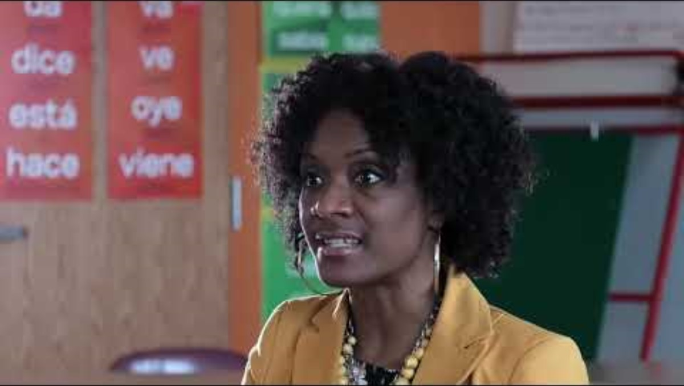
Leading Teams with Data Protocols
https://www.youtube.com/watch?v=OdG7_ggEBlk&feature=youtu.be
Notes:
Link
Leading teams with data protocols, https://www.youtube.com/watch?v=OdG7_ggEBlk&feature=youtu.be
To Know/To Do/To Say
The video illustrates how the use of a protocol helps focus and guide discussion around data to make the best decisions to drive student learning forward.
Two different protocols are used for two different purposes.
00:00-4:50 shows the protocol used for quantitative data - Notice, Wondering, Implications, Next Steps
4:50 - 8:20 shows the protocol used for observational data - Post It Sort protocol, successes, challenges, needs.
Show only the first part if time is limited.
Ask participants to make note on how the use of protocols impact team discussion and decision making around both quantitative and non quantitative data.
Note there are discussion questions on the next slide.
Reference
EL Education. (2019a, April 3). Leading teams with data protocols [Video]. YouTube. https://www.youtube.com/watch?v=OdG7_ggEBlk&feature=youtu.be

Slide 75
Leading Teams… Video Reflections
How did the use of a protocol impact team discussions around data?
What was the greatest benefit of using either of the protocols?
How might either of the protocols be improved?
Does your team use a protocol for discussing data? If so, share details and effectiveness.
Notes:
To Know/To Do/To Say
After watching the video, ask participants to first, reflect on these questions with a partner. Then share out key takeaways with the whole group.

Slide 76
Basic Process for the Use of Data Protocols
Task explanation and details
Clarification
Silent observation
Analysis and judgement
Open discussion
Reflection and debrief
(Center for Leadership and Educational Equity, n.d.-b; EL Education, 2019a)
Notes:
To Know/To Say/To Do
Review the suggested components in a protocol used to review student data or work. Expand on each point.
Data protocols provide boundaries for team conversations. The following are basic components or stages of many protocols that are designed to provide the members of the group time to listen, notice, think, and speak about student data and/or student work.
Explain task and details. A facilitator explains the how and why of the process and presents student data or work.
Clarification. Questions regarding the process are clarified so everyone has a clear understanding.
Silent observation. The team silently studies the data or student work without interruption or conversation.
Analysis and judgement. Team members make comments about the data or student work based on their observations and analysis.
Open discussion. The team considers and discusses all comments, new thoughts, questions, and suggestions for next steps.
Reflection and debrief. The team reflects on the protocols process and evaluates its effectiveness.
In some protocols you will find additional features or modifications of the above steps that have been designed for a specific purpose.
Tips for using protocols
Ensure a responsive and attentive facilitator
Explicitly align the protocol and the purpose
Model and review the protocol with participants
Follow the steps of the protocol with fidelity
Allow time to reflect on the effectiveness of the protocol
Use feedback to improve the protocol, if needed
References
Center for Leadership and Educational Equity. (n.d.-b). Why protocols? School reform initiative. https://www.clee.org/resources/why-protocols/
EL Education. (2019a, April 3). Leading teams with data protocols [Video]. YouTube. https://www.youtube.com/watch?v=OdG7_ggEBlk&feature=youtu.be

Slide 77

Sample Protocols
Take one minute to peruse the various types of team protocols that are listed on the handout.
Each team member then chooses a different protocol to study carefully.
Using a round robin structure, members take turns explaining their protocol to the rest of the team.
Discuss how the protocols would be beneficial to the team and how they might be adapted to best meet their needs.
https://1drv.ms/w/s!ArdaJCIbJJvwrAl-7kj-Bhv48T5-?e=yAOIZM
Notes:
Link
https://1drv.ms/w/s!ArdaJCIbJJvwrAl-7kj-Bhv48T5-?e=yAOIZM
To Know/To Say
This activity provides an opportunity for teams to review sample protocols and discuss how they might benefit from their use.
Have participants work with their teams following the steps on the slide.
To Do
You may want to add a QR code to the slide so links can be quickly accessed.

Slide 78
Reflecting on Team Protocols
How could a team protocol enhance the quality of collaborative conversations and build trust among team members?
What protocols does your team rely on most and how do they shape the way you work together?
What additional protocols could strength your team’s collaboration and how might they address current challenges?
How has your understanding of team protocols changed?
Notes:
To Know
Pause and Reflect is an opportunity for participants to reflect on each main section of the module. It provides an avenue to discuss content covered along with collaboration regarding application aspects.
To Do
Ask participants to reflect on the questions posed on the slide. Encourage partner or small group discussion and then we’ll share out key takeaways with the whole group.

Slide 79
Collaboration thrives when group processes are intentionally designed to promote shared decision making, mutual accountability, and collective problem solving.
(Bloomberg & Pitchford, 2016; Marzano et al., 2016)
Notes:
To Know/To Say
When group processes are intentionally designed and implemented, they reinforce a collaborative culture by promoting efficiency and collective ownership of outcomes. Examples of the use of group processes to support a collaborative culture include the following.
Structured decision making
Group processes (e.g., consensus building and collaborative problem solving) ensure all voices are heard, increasing buy-in and shared responsibility.
Techniques such as nominal group technique (NGT) or multi-voting help prioritize ideas fairly.
Effective communication and shared understanding
Protocols for discussions, such as structured dialogue or the use of a facilitator, keep conversations focused and productive.
Collaborative norms, such as active listening and constructive feedback, enhance trust and psychological safety.
Defined roles and responsibilities
Processes can help clarify team member roles, reducing confusion and ensuring efficiency.
Rotating roles in meetings (facilitator, timekeeper, note-taker) distribute leadership and engagement.
Accountability and reflection
Regular check-ins and progress monitoring through structured meetings ensure teams stay on track.
Reflection protocols like Plus/Delta (What went well? What can improve?) encourage continuous improvement.
Encouraging innovation and problem solving
Group brainstorming techniques such as design thinking or structured inquiry (e.g., five whys, fishbone diagrams) foster creative solutions.
Safe spaces for risk-taking and piloting new ideas cultivate a culture of innovation.
Participation
Facilitation strategies (e.g., think-pair-share, round-robin discussion) ensure all members contribute, not just the most vocal.
Using digital collaboration tools (e.g., shared documents, Miro boards) allows asynchronous contributions, making participation more flexible.
To Do
Review slide content asking participants to offer examples of how group processes can support a collaborative culture and adding to their comments with additional ideas.
References
Bloomberg, P. J., & Pitchford, B. (2016). Leading impact teams: Building a culture of efficacy (1st ed.). Corwin.
Marzano, R. J., Heflebower, T., Hoegh, J. K., Warrick, P., Grift, G., Hecker, L., & Wills, J. (2016). Collaborative teams that transform schools: The next step in PLCs. Marzano Research.

Slide 80
Part 3: Essential Questions Repeated
How do group processes help strengthen team collaboration?
What are the components of an effective team meeting agenda?
What elements of team minutes ensure clear communication and follow up?
How do norms promote a culture of collaboration?
Why is consensus important for team decision-making?
How can the use of protocols streamline team decision making?
Notes:
To Do
Revisit and review the Essential Questions and provide time for reflective thinking and conversation.
Optional Follow-up Activity
If earlier in the session you wrote the questions on individual chart paper, providing opportunities for participants to add to the responses as more learning took place, review and discuss the comments.

Slide 81

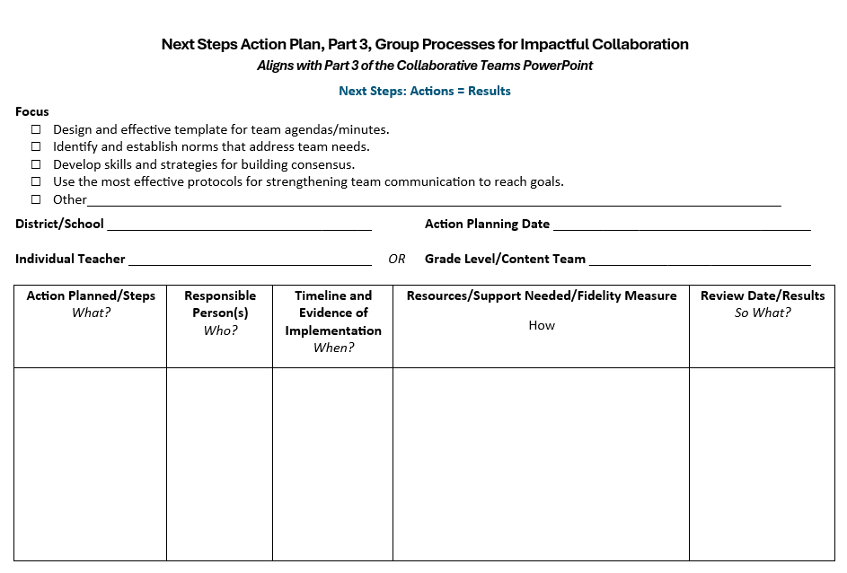
Next Steps Action Plan, Part 3
Notes:
Handout CT 3.10
Next Steps Action Plan, Part 3
To Know
Action planning enables participants to reflect on what they have learned, their strengths, and opportunities for growth.
A documented action plan that includes the action, person responsible, timeline, and resources makes it much more likely that change will take place.
Recording results will encourage educators to reflect on their accomplishments and continue actions that prove successful.
To Say/To Do
Provide participants with a copy of the action planning template (electronic or hard copy).
Review Action Planning Steps
Action Planned/Steps – "What?” This column outlines what the team is actually planning to do. Think of it as the key actions or strategies they believe will help them reach their goal. Each step should be specific, actionable, and aligned to their school or team priorities.
Responsible Person(s) – "Who?” Here, the plan identifies the person or people responsible for ensuring each step is carried out. While implementation may be collaborative, assigning responsibility ensures accountability and avoids confusion about ownership.
Timeline and Evidence of Implementation – "When?” This section includes the timeline for when actions will occur, along with the evidence that will confirm implementation. Evidence might include artifacts such as sign-in sheets, lesson plans, photos, or documentation that demonstrate the work is taking place as planned.
Resources/Support Needed/Fidelity Measure – "How?” In this column, the team specifies what resources or support will be needed (such as professional development, materials, or coaching). Importantly, this is also where fidelity of implementation is addressed. The team defines how they will measure whether the action is being implemented as intended, using tools like checklists, observation rubrics, or walkthroughs.
Review Date/Results – "So What?” This final column captures the scheduled review date and documents what the data reveals about the results. The team reflects on the effectiveness of the action: What impact did it have? Is it working? Should the plan be continued, revised, or stopped? This reflective step ensures that the action plan remains responsive and results-driven.
Design action plan
Take some time to review the data collected from previous collaborative team discussions, along with any data collected during this presentation (checklist and surveys).
Review Action Plan Parts 1 and 2 if appropriate.
Use the data to help design an action plan (Handout CT 3.10) to strengthen your teams structures and collaborative skills.
You may select one or more areas of focus.
If possible work collaboratively with a team, if not, develop a plan individually to be shared later with your team.
Be sure to include the actions that will be taken; who will take the actions; a timeline for completing your work; resources and support needed; as well as follow-up that details the results. We will then take a bit of time to discuss your next steps with the group.

Slide 82

Closing and Thank You!
Contact us with any follow-up questions or requests!
<Presenter name and contact info>
<Presenter name and contact info>
<Presenter name and contact info>
References are on the following slides.
Notes:
To Know/To Do/To Say
Include your contact information in case participants have follow-up questions or requests.
Show the reference slides if appropriate.

Slide 83
References for all Collaborative Teams Modules
Adams, S (2025, March 8). What is minute taking? An ultimate guide. The Knowledge Academy. https://www.theknowledgeacademy.com/blog/what-is-minute-taking/
Aguilar, E. (2015, December 3). Effective team communication: A first step to getting along. Edutopia. https://www.edutopia.org/blog/effective-team-communication-first-step-getting-along-elena-aguilar
AllBusiness. (n.d.). 5 reasons why meeting minutes are important. https://www.allbusiness.com/importance-of-meeting-minutes
American Institutes for Research. (2022). MTSS infrastructure and support mechanisms series: MTSS school teams. Center on MTSS Multi-Tiered Systems of Supports. https://mtss4success.org/sites/default/files/2022-02/MTSS-Teams.pdf
ASU Mary Lou Fulton College. (2020, August 5). Benefits of teaming: Educator retention, educator leadership opportunities, and student learning [Video]. YouTube. https://www.youtube.com/watch?v=5OTRWm7wNbY
BetterHelp Editorial Team. (2025, February 24). Understanding the importance of effective communication in teamwork. BetterHelp. https://www.betterhelp.com/advice/teamwork/understanding-the-importance-of-communication-in-teamwork/
Bitrix24. (2022, January 21). How to improve team communication: Five effective tools [Video]. YouTube. https://www.youtube.com/watch?v=KSRLK31lq_4
Bloomberg, P. J., & Pitchford, B. (2016). Leading impact teams: Building a culture of efficacy (1st ed.). Corwin.
Cargal, A. (2021, June 10). Opening the door to professional learning. Edutopia. https://www.edutopia.org/article/opening-door-professional-learning/

Slide 84
References, Page 2
Corentus, Inc. (2019, March 19). Setting team norms that stick [Video]. YouTube. https://www.youtube.com/watch?v=tOtMcCM5zZc
Center for Creative Leadership. (2024, June 23). 10 steps for establishing team norms. https://www.ccl.org/articles/leading-effectively-articles/the-real-world-guide-to-team-norms/
Center for Leadership and Educational Equity. (n.d.-a). A rationale for protocols. https://www.clee.org/resources/rationale-for-protocols/
Center for Leadership and Educational Equity. (n.d.-b). Why protocols? School reform initiative. https://www.clee.org/resources/why-protocols/
Center for Research on Learning and Teaching. (2021). Guidelines for discussing difficult or high-stakes topics. University of Michigan. https://crlt.umich.edu/publinks/generalguidelines
ChandlerUnified. (2020, July 24). Multi-tiered systems of support (MTSS) [Video]. YouTube. https://www.youtube.com/watch?v=CAZ4CNtOHNo
ClickUp Customer Experience Team. (2024, January 24). How to encourage collaborative communication in the workplace. ClickUp. https://clickup.com/blog/collaborative-communication/
DavidLeeEdTech. (2021, April 21). Key elements for effective collaboration in schools [Video]. YouTube. https://www.youtube.com/watch?v=D4ciN-mJSaI
Doyle, A. (2022, June 7). What are collaboration skills? The Balance. https://www.thebalancemoney.com/collaboration-skills-with-examples-2059686

Slide 85
References, Page 3
Edutopia. (2016, April 20). Collaborative planning: Integrating curriculum across subjects [Video]. YouTube. https://www.youtube.com/watch?v=yCy4PSOvkL4
Edutopia. (2017, April 6). Teacher labs: Making professional development collaborative [Video]. YouTube. https://www.youtube.com/watch?v=gf5KcyHGhRA&t=168s
Edutopia (2024, April 26). Calibrating best practices across a whole school [Video]. https://www.edutopia.org/video/calibrating-whole-school-best-practices
Entelechy. (2024, February 1). The importance of horizontal and vertical collaborative teams in schools. https://backup.theedadvocate.org/the-importance-of-horizontal-and-vertical-collaboration-teams-in-schools/
EL Education. (2018, January 19). Grade level data meeting with third grade teachers [Video]. YouTube. https://www.youtube.com/watch?v=BLCbNX84ll4
EL Education. (2019a, April 3). Leading teams with data protocols [Video]. YouTube. https://www.youtube.com/watch?v=OdG7_ggEBlk&feature=youtu.be
EL Education. (2019b, June 21). Shared leadership through instructional leadership teams [Video]. YouTube. https://www.youtube.com/watch?v=T-hqrR5pcDo
Fellow. (2023, May 2). 15 best team communication tools & apps in 2024. https://fellow.app/blog/productivity/most-efficient-team-communication-tools/​
Ferriter, B. (n.d.). Five important roles for successful collaborative teams. Building Confident Learners. https://buildingconfidentlearners.com/2018/09/five-important-roles-for-successful-collaborative-teams/​

Slide 86
References, Page 4
Ferriter, W. M. (2020, April 7). Spotting collaborative teams with high levels of collective efficacy. SolutionTree. https://www.solutiontree.com/blog/spotting-collaborative-teams-with-high-levels-of-collective-efficacy/​
Garmston, R, & Wellman, B. (1999). The adaptive school: A sourcebook for developing collaborative groups (1st ed.). Christopher-Gordon Publishers, Inc.
Garmston, R, & Wellman, B. (2016). The adaptive school: A sourcebook for developing collaborative groups (3rd ed.). Rowman & Littlefield Publishers.
Garmston, R, & Wellman, B. (2019a). Norms inventory. Adaptive Schools Foundation Seminar Learning Guide. https://www.thinkingcollaborative.com/_files/ugd/6a5cc9_2fd56baa9f2d484ea25904373efe2e55.pdf
Garmston, R., & Wellman, B. (2019b). Personal seven norms assessment. Adaptive Schools Foundation Seminar Learning Guide. https://www.thinkingcollaborative.com/_files/ugd/6a5cc9_6e66a89e719e4ca1a7a81012582bb91c.pdf
Garmston, R., & Wellman, B. (2019c). Seven norms of collaboration: A supporting toolkit. Adaptive Schools Foundation Seminar Learning Guide. https://www.thinkingcollaborative.com/_files/ugd/6a5cc9_263cffd70d0d4a988fdfa77deaaa769c.pdf
Garmston, R., & Wellman, B. (2019d). The seven norms of collaborative work. Adaptive Schools Foundation Seminar Learning Guide. https://www.thinkingcollaborative.com/_files/ugd/6a5cc9_d080a1bbb7c84e43934a019d684214d2.pdf
Hargreaves, A. (2019). Teacher collaboration: 30 years of research on its nature, forms, limitations and effects. Teachers and Teaching, 25(5), 603–621. https://doi.org/10.1080/13540602.2019.1639499
Hattie, J. (2024, November). Visible learning homepage. Visible Learning Meta X. https://www.visiblelearningmetax.com/

Slide 87
References, Page 5
Hattie, J., & Zierer, K. (2024). 10 mindframes for visible learning: Teaching for success (2nd ed.). Routledge.
Hattie, J., & Zierer, K. (2017). 10 mindframes for visible learning: Teaching for success (1st ed.). Routledge.
Holmes, S. (2019). Are the lack of team norms sabotaging your team’s success? Make A Dent Leadership. https://madl.s3.amazonaws.com/products/team-norms/team-norms.pdf
Horton, D. (2022, November 18). Successful systems of communication for school teams. The Core Collaborative. https://thecorecollaborative.com/successful-systems-of-communication-for-school-teams/
Indeed Editorial Team. (2025, April 14). 17 benefits of team building for your organization. Indeed. https://www.indeed.com/career-advice/career-development/benefits-of-team-building
Kitch, B. (2023, September 7). How to create a team working agreement. Mural. https://www.mural.co/blog/team-agreement-guide​
Lynch, M. (2020, July 6). Creating effective leadership teams in schools. The Edvocate. https://www.theedadvocate.org/creating-effective-leadership-teams-in-schools/​
Mantell, M. (2025, March 19). What is social perceptiveness? 12 skills you need to master. Science of People. https://www.scienceofpeople.com/social-perceptiveness/​
Marzano, R. J., Heflebower, T., Hoegh, J. K., Warrick, P., Grift, G., Hecker, L., & Wills, J. (2016). Collaborative teams that transform schools: The next step in PLCs. Marzano Research.
Mattone, J. (2025, May 3). Consensus building: What is it and why is it crucial to leadership? John Mattone Global, LLC. https://johnmattone.com/blog/consensus-building-what-is-it-and-why-is-it-crucial-to-leadership/

Slide 88
References, Page 6
Meltzer, R. (2022, July 15). How to write meeting minutes, with examples. Grammarly. https://www.grammarly.com/blog/business-writing/meeting-minutes/
Minshew, A. (2024, January 10). 6 tips for building trust between teachers and administrators as a school leader. Waterford. https://www.waterford.org/education/building-trust-school-leader/
Missouri Department of Elementary and Secondary Education. (2013a). Leader standards. https://dese.mo.gov/media/pdf/oeq-ed-leaderstandards
Missouri Department of Elementary and Secondary Education. (2013b). Teacher standards. https://dese.mo.gov/media/pdf/oeq-ed-teachstandards
MoEdu-SAIL. (2022a). Collaborative teams module.
MoEdu-SAIL. (2022b). Common formative assessment module.
MoEdu-SAIL. (2023). DCI-MTSS district-level implementation practice profile. Missouri Department of Elementary and Secondary Education. https://www.moedu-sail.org/wp-content/uploads/2023/09/DCI-MTSS-District-Level-Implementation-Practice-Profile-June-2023.docx
MoEdu-SAIL. (2025a). Blueprint for district and building leadership (9th ed.). Missouri Department of Elementary and Secondary Education: Northern Arizona University, Institute for Human Development.
MoEdu-SAIL. (2025b). DCI-MTSS roadmap, an overview. Missouri Department of Elementary and Secondary Education: Northern Arizona University, Institute for Human Development. https://www.moedu-sail.org/dci-mtss-roadmap-view-2/
​

Slide 89
References, Page 7
MoEdu-SAIL. (n.d.-a). Collaborative teams online module. https://www.moedu-sail.org/courses/collaborative-team-structures/
MoEdu-SAIL. (n.d.-b). Common formative assessment online module. https://www.moedu-sail.org/courses/common-formative-assessment/
MoEdu-SAIL. (n.d.-c). Data-based decision making online module. https://www.moedu-sail.org/courses/data-based-decision-making-2/
National Center for Education Evaluation and Regional Assistance. (2023, November 9). Data-driven decision-making in education: How REL work makes a difference. NCEE Blog. https://web.archive.org/web/20250110023105/https://ies.ed.gov/blogs/ncee/post/data-driven-decision-making-in-education-how-rel-work-makes-a-difference
National Labor Management Partnership. (2022). Collaborating for student success: A comprehensive, practical guidebook for increasing shared decision-making through lasting partnerships. https://www.nea.org/sites/default/files/2022-05/NLMP%20Collaborating%20for%20Student%20Success%20Guidebook%202022%205-5-22.pdf
New South Wales Education Standards Authority. (n.d.). 10 mindframes for visible learning. Thinking Pathways. https://thinkingpathwayz.weebly.com/10-mindframes-visible-learning.html
North American Students of Cooperation. (n.d.). Fist to five voting and consensus. https://www.nasco.coop/resources/fist-to-five-voting
Philaphandeth, K. (2022, September 2). How to write an effective team meeting agenda (with templates!). Work Life by Atlassian. https://www.atlassian.com/blog/productivity/team-meeting-agenda
PlanBook. (n.d.). How to improve collaboration across your school. https://blog.planbook.com/improve-collaboration/
Poplar Bluff School District. (n.d.). Effective practices: Data-based decision making [Video]. MoEdu-Sail. https://www.moedu-sail.org/lessons/collaborative-team-structures-overview/

Slide 90
References, Page 8
Principal’s Playbook. (n.d.). Instructional leadership teams. https://www.theprincipalsplaybook.com/instructional-leadership/instructional-leadership-teams
Reading Rockets. (n.d.). Inclusive classrooms. https://www.readingrockets.org/helping-all-readers/inclusive-classrooms
Rouda, R. (2018, March 28). A framework for effective data use in schools. Learning for Action. http://learningforaction.com/lfa-blogpost/data-matters-framework
Rubinstein, S.A. (2014). Strengthening partnerships: How communication and collaboration contribute to school improvement. American Educator, Winter 2013-2014, 22-28. https://www.aft.org/sites/default/files/Rubinstein.pdf
Ruckes, V. (2021, August 2). Why schools need both horizontal and vertical collaboration. We Are Teachers. https://www.weareteachers.com/collaboration-teams/
Schleifer, D., Rinehart, C., & Yanisch, T. (2017). Teacher collaboration in perspective: A guide to research. Spencer Foundation, Public Agenda. https://files.eric.ed.gov/fulltext/ED591332.pdf
Seeds for Change. (2018a, April 11). How to do consensus decision making [Video]. YouTube. https://www.youtube.com/watch?v=FgjgXIxHmmI
Seeds for Change. (2018b, April 11). What is consensus decision making? [Video]. YouTube. https://www.youtube.com/watch?v=OYMgLi1WrNg
Seeds for Change. (2020a). Short guide to consensus decision making. http://www.seedsforchange.org.uk/shortconsensus
Seeds for Change. (2020b). Introduction to consensus decision making. https://seedsforchange.org.uk/downloads/shortconsensus.pdf

Slide 91
References, Page 9
Seeds for Change. (2020c). Consensus decision-making: A short guide. https://seedsforchange.org.uk/shortconsensus#why
Senn, G., McMurtrie, D., & Coleman, B. (2019). Collaboration in the middle: Teachers in interdisciplinary planning. Current Issues in Middle Level Education, 24(1), Article 6. https://files.eric.ed.gov/fulltext/EJ1204875.pdf
Shero, P. (2017, December 4). 3 reasons team members need roles. Masterminds Leadership. https://mastermindsleadership.com/development-blog/team-members-roles/
Sinek, S. (2023, August 4). How do we actually build trust in our teams? [Video]. YouTube. https://www.youtube.com/watch?v=08RU6oiFTdg
SkyHealth Learning Academy (2025, January 3). How to build cohesive teams as a new leader: A step by step guide. [Video]. YouTube. https://youtu.be/sIOqw9-8-w8
Sloper, C., Grift, G., & Muhammad, A. (2021). Collaborative teams that work: The definitive guide to cycles of learning in a PLC. Solution Tree Press.
Solone, C. J., Thornton, B. E., Chiappe, J. C., Perez, C., Rearick, M. K., & Falvey, M. A. (2020). Creating collaborative schools in the UnitedStates: A review of best practices. International Electronic Journal of Elementary Education, 12(3), 283–292.https://doi.org/10.26822/iejee.2020358222
StanfordSCOPE. (2018, March 20). Time matters: Teacher collaboration for learning and leading [Video]. YouTube. https://www.youtube.com/watch?v=Ex1zfl-MsDk
Tallman, T. (2020, July 23). How teachers experience collaboration. Journal of Education, 201(3). https://journals.sagepub.com/doi/10.1177/0022057420908063

Slide 92
References, Page 10
Tanner, K. (2023, November 2). 41 games for educators to build better teams. Teaching Expertise. https://www.teachingexpertise.com/teacher-life/games-for-educators/
Team Asana. (2025, February 7). Meeting agenda examples: How to plan, write, and implement. Asana. https://asana.com/resources/meeting-agenda
Team Scholarship Acceleration Lab. (n.d.). Seven norms of collaboration: A supporting toolkit. https://tsal.uci.edu/lesson/seven-norms-of-collaboration-a-supporting-toolkit/
Thinking Collaborative. (n.d.). Adaptive schools resources. https://www.thinkingcollaborative.com/as-resources
Valenzuela, J. (2022, August 12). Shared agreements for working together benefit teachers and administrators. Edutopia. https://www.edutopia.org/article/shared-agreements-working-together-benefit-teachers-and-administrators/
VanZandt, P. (2023, July 25). What is rose, bud, and thorn? Definition, templates and exercise. IdeaScale. https://ideascale.com/blog/rose-bud-and-thorn/
Vedantam, S., & Woolley, A. (2023, September 26). The secret to great teams. Hidden Brain. https://hiddenbrain.org/podcast/the-secret-to-great-teams/
Welch, D., & Garmston, R. J. (2007). Results-oriented agendas transform meeting into valuable collaborative events. The Learning Professional, 28(2). https://learningforward.org/journal/time/results-oriented-agendas-transform-meeting-into-valuable-collaborative-events/
Woolley, A.W., Chow, R. M., Mayo, A.T., Riedl, C., & Chang, J.W. (2023). Collective attention and collective intelligence: The role of hierarchy and team gender composition. Organization Science, 34(3), 1315-1331. https://doi.org/10.1287/orsc.2022.1602
Yussif. (2024, February 28). Nineteen strategies for teaching teamwork in your classroom. Classroom Management Expert. https://classroommanagementexpert.com/blog/19-strategies-for-teaching-teamwork-in-your-classroom/

