Slide 1
MO SW-PBS Advanced Tiers
Course 1- Lesson 2
Advanced Tiers Collaborative Teaming Processes

Slide 2
Meeting Working Agreements
Be Respectful
Be an active listener—open to new ideas
Use notes for side bar conversations
Be Responsible
Be on time for sessions
Silence cell phones—reply appropriately
Be a Problem Solver
Follow the decision making process
Work toward consensus and support decisions of the group
Notes:
Trainer Notes:
To Know/To Say: “These will be the Working Agreements we will honor during all of our training sessions.”

Slide 3
Attention Signal
Notes:
Trainer Notes: Facilitator: Select an attention signal.
To Know/To Say: “One of our agreements is to follow the attention signal.”
“Your team will work with your school to develop an attention signal you will use in every setting.”
“In order to get all of you focused after discussions, activities or breaks,
I will ________________________________________.”
(Insert your attention signal here.)
“Your task will be to finish your sentence, quiet your voice and ____________________________.”
(Insert what you want participants to do.)

Slide 4
Introductions
Notes:
Trainer Notes: Facilitator: Select an introductions activity
To Know/To Say:

Slide 5
Advanced Tiers Team (ATT) Handouts
ATC1L2 HO-1 Schedule of Meeting Dates & Times - Example
ATC1L2 HO-2 Schedule of Meeting Dates & Times - Template
ATC1L2 HO-3 Meeting Agenda - Example
ATC1L2 HO-4 Meeting Agenda -Template
ATC1L2 HO-5 Pre-meeting Organizer - Template
ATC1L2 HO-6 Working Agreements - Example / Template
ATC1L2 HO-7 Communication Plan - Example
ATC1L2 HO-8 Communication Plan - Template
ATC1L2 HO-9 Decision Making Approaches - Example / Template

Slide 6
Lesson Description:
Advanced Tiers Processes
This lesson provides guidance on developing systems to support collaborative teaming processes within an Advanced Tiers Team.
Notes:
Trainer Notes:
To Know/To Say:
This lesson provides guidance on developing systems to support collaborative teaming processes within an Advanced Tiers Team.

Slide 7
Lesson Outcomes
At the end of this session, the Advanced Tiers Teams will …
create a meeting schedule for the year
create a standard meeting agenda
develop working agreements for Advanced Tiers meetings
use a Pre-Meeting Organizer to increase efficiency
create a communication system
implement a standard decision-making protocol
create an organizational system for housing and sharing Advanced Tiers artifacts
Notes:
Trainer Notes:
To Know/To Say:
At the end of this session, the Advanced Tiers Teams will …
create a meeting schedule for the year
create a standard meeting agenda
develop working agreements for Advanced Tiers meetings
use a pre-meeting organizer to increase efficiency
create a communication system
implement a standard decision-making protocol
create an organizational system for housing and sharing Advanced Tiers artifacts

Slide 8
Rationale
The Advanced Tiers Team must create effective systems in order to be efficient in providing support to students who are at-risk and high-risk according to the team’s criteria measures.
Notes:
Trainer Notes:
To Know/To Say: The Advanced Tiers Team must create effective systems in order to be efficient in providing support to students who are at-risk and high-risk according to the team’s criteria measures.

Slide 9
Reflective Questions
What collective commitments has your building leadership team (BLT) and staff made to Tier 1 Universal Supports?
What teaming procedures and processes are in place with fidelity in your BLT / Tier 1 Team? What would make your Tier 1 team even better?
How can you build upon what your BLT already knows how to do efficiently and effectively as you begin Advanced Tiers Teaming?
Notes:
Trainer Notes:
To Know/To Say: Once you have gathered your Advanced Tier Team members together and consider:
What Collective commitments has your building leadership team (BLT) and staff made to Tier 1 Universal Supports?
What teaming procedures and processes are in place with fidelity in your BLT / Tier 1 Team? What would make that team even better?
How can you build upon what your BLT already knows how to do efficiently and effectively as you begin Advanced Tier Teaming?

Slide 10
Pre-Requisites
Advanced Tiers Course 1 Team Roles and Responsibilities
Notes:
Trainer Notes:
To Know/To Say: The Prerequisite for this lesson is the Advanced Tiers Course 1 Team Roles and Responsibilities.

Slide 11
Missouri Teacher Standards Addressed
2.1: Cognitive, social, emotional and physical development
2.6: Language, culture, family and knowledge of community
3.1: Implementation of curriculum standards
5.1: Classroom management, motivation and engagement
5.2: Managing time, space, transitions and activities
5.3: Classroom, school and community culture
6.1: Verbal and nonverbal communication
6.2: Sensitivity to culture, gender, intellectual and physical differences
8.1: Self-assessment and improvement
8.2: Professional learning
Missouri Teacher Standards can be viewed at: DESE.MO.GOV
Notes:
Trainer Notes:
To know/To say: These are the Missouri Teacher Standards that will be addressed in this lesson. If you want more information regarding these standards visit DESE.MO.GOV

Slide 12
Key Terms
Pre-Meeting Organizer
Notes:
Trainer Notes:
To Know/To Say: The Pre-Meeting Organizer (PMO) is a tool that will help your team know which students to add to your Advanced Tiers meeting agenda to help the team engage in continuous progress monitoring. You will learn more about the PMO in this lesson.

Slide 13
Effective Teams…
Assign Team Roles and Responsibilities (Lesson 1)
Create a meeting schedule for the year
Create a standard meeting agenda
Use a pre-meeting organizer (PMO) for student data
Develop working agreements for Advanced Tiers meetings
Create a communication system
Implement a standard decision-making protocol
Create an organizational system for housing and sharing Advanced Tiers Team artifacts
Notes:
Trainer Notes:
To Know/To Say:
“We have too much important work to accomplish to have meetings that are not efficient and effective. On the following slides, we will talk about a variety of ways to make your team efficient and effective including:
Meeting Regularly
Using a standard meeting agenda
Following our working agreements
Using an Advanced Tiers Development Checklist to guide our work
Create an organizational system for housing and sharing artifacts
Create and use an effective communication system
Define our decision-making process
Define and Fulfill Roles and Responsibilities.”

Slide 14
MEETING SCHEDULING

Slide 15
Meeting Schedule
Once the Advanced Tiers Team is fully implemented, it is recommended for the team to meet, at a minimum,
twice per month.
Additional meetings may need to be scheduled, as needed, to achieve your goals and timeline.
Notes:
Trainer Notes:
To Know/To Say: Your team will need to decide how to best make scheduling accommodations to ensure all team members are able to attend the meetings.
Once students are placed in Tier 2 and Tier 3 interventions, the team will meet more frequently to progress monitor the interventions.

Slide 16
What happens at an Advanced Tiers Meeting?
At the regular monthly meeting, teams will discuss all students who have been identified as possibly benefitting from a Tier 2 or Tier 3 intervention and discuss the progress of students who are already being served by a Tier 2 or Tier 3 intervention.
*Additionally, bi-monthly PROGRESS MONITORING meetings will be required.
Notes:
Trainer Notes:
To Know/To Say:It is recommended that teams decide on a date they can meet each month to discuss students who have been identified as possibly benefitting from a Tier 2 or Tier 3 intervention and discuss students who are having positive, questionable or poor responses to interventions
*Teams will need to meet in between the regularly scheduled meetings for the following reasons:
follow-up on observations
completion of FACTS
identify if any student is having a negative response to an intervention, indicating the team needs to intervene

Slide 17
Schedule of Meetings
Meeting Frequency
  Planning Stage – at minimum, once per month.
  Full implementation – at minimum, twice per month
1. Student Intake
2. Progress Monitoring
Establish Standard Meeting Dates and Times
  Allow ample, uninterrupted time to achieve the team’s goal
  Ensure that all team members are able to attend the meetings
Notes:
Trainer Notes:
To Know/To Say:Meeting frequency will vary somewhat depending on the implementation stage your team is currently operating. For instance, teams that are in the exploration or installation stages of implementation may decide that they need to meet less frequently than those teams who are regularly using student data and making decisions during the initial and full implementation stages.
During exploration or installation stages, it is recommended that teams meet, at a minimum, once per month. For schools that have progressed to the initial or full implementation stages, it is recommended that teams meet, at a minimum, twice per month. In both instances, additional meetings may need to be scheduled to achieve your goals and timelines.
When planning for meetings, teams should identify standard meeting dates and times and utilize existing school structures to publicize those meetings. Additionally, when making decisions on meeting dates and times, teams should schedule the length of the meeting to allow ample, uninterrupted time to achieve the team’s goals. While some schools have found an hour meeting commitment to be ideal, other schools have found it beneficial to supplement those meetings times with periodic “retreats” to allow for longer, uninterrupted work time.
Your team will need to decide how to best make scheduling accommodations to ensure that all team members are able to attend the meetings. Some schools have been able to collectively commit to before or after school meetings, utilizing early-release days, or utilizing building schedules that allow for shared collaboration or planning time for team members. Other schools have found it necessary to secure substitutes to provide release time for team members to meet. Creative scheduling may be required in order to ensure the necessary time and to ensure progress is made on team goals and timelines.

Slide 18

SAMPLE Schedule of Meeting Dates and Times Advanced Tiers Team ATC1L2 HO-1
AUGUST 2 Advanced Tiers Meeting Days prior school beginning 8:00 – 4:00 | SEPTEMBER 2nd and 4th Wednesdays 9:00 – 10:00 | OCTOBER 2nd and 4th Wednesdays 9:00 – 10:00 | NOVEMBER 2nd and 3rd Wednesdays 9:00 – 10:00
DECEMBER 2nd and 3rd Wednesdays 9:00 – 10:00 | JANUARY 2nd and 4th Wednesdays 9:00 – 10:00 | FEBRUARY 2nd and 4th Wednesdays 9:00 – 10:00 | MARCH 2nd and 3rd Wednesdays 9:00 – 10:00
APRIL 2nd and 3rd Wednesdays 3:00 – 4:00 (after school) | MAY 2nd and 4th Wednesdays 9:00 – 10:00 | JUNE MO SW-PBS Summer Institute Training 1.5 days | JULY No Meetings
Notes:
Trainer Notes:
To Know/To Say: Here is an example of one school’s meeting schedule for the year. The team recognized that the same days for meetings would not work throughout the year due to various activities that take place. It is very important to set this schedule at the beginning of the year; otherwise, the meetings will not be a priority and probably will not occur. SEE Advanced Tier Course 1 Lesson 2 HO-1.

Slide 19
Activity: Advanced Tiers Meeting Schedule
Take some time to decide your meeting schedule for the year based on existing systems and structures.
Your team will need to decide how to best make scheduling accommodations to ensure all team members are able to attend the meetings.
Notes:
Trainer Notes:
To Know/To Say :Your team will need to decide how to best make scheduling accommodations to ensure that all team members are able to attend the meetings. Some schools have been able to collectively commit to holding before- or after-school meetings, utilizing early-release days, or utilizing building schedules that allow for shared collaboration or planning time for team members. Other schools have found it necessary to secure substitutes to provide release time for team members to meet. Creative scheduling may be required in order to ensure the necessary time and to ensure progress is made on team goals and timelines.

Slide 20
STANDARD MEETING AGENDA

Slide 21
Standard Meeting Agenda - Purpose
In the same way you have used a meeting agenda during your work with Tier 1, maintaining an effective agenda is one of the most important elements for a productive meeting. The agenda typically communicates:
• topics for discussion
• the time allotted for each topic
• the person responsible for reporting or leading
Notes:
Trainer Notes:
To Know/To Say: The meeting agenda can also be used as a checklist to ensure all information is covered and, if distributed before the meeting, to let participants know what will be discussed. This gives the team an opportunity to come prepared for the upcoming discussions or decisions. Additionally, agendas often include a space to take notes or indicate members present; discuss tasks, activities, or assignments to be done before the next meeting; and confirm the date and possible agenda items for the next meeting.

Slide 22
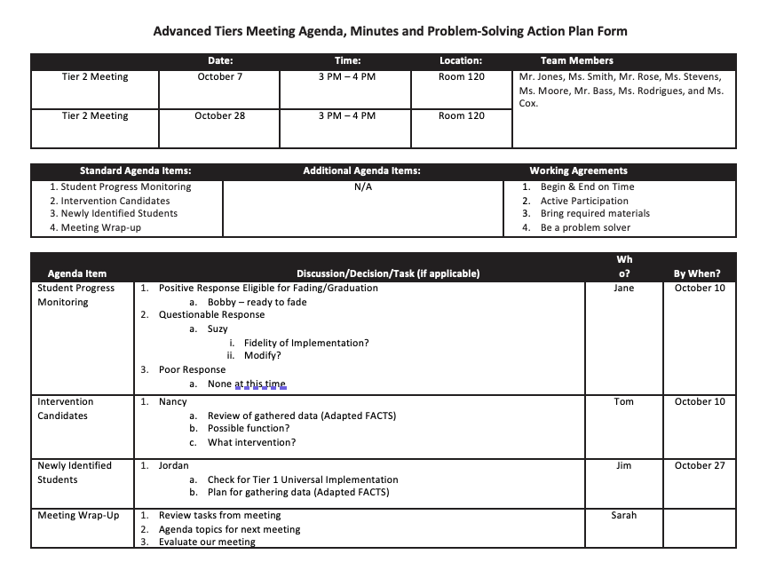
Standard Meeting Agenda
Notes:
Trainer Notes:
To Know/To Say: This is an example of a possible agenda a team may utilize for their Advanced Tiers Team meetings. Your team may choose to create your own agenda. Some common features that are recommended include: time, location, members present, working agreements, topics to be discussed, time allotted for each topic, a place to take notes, and an evaluation of the meeting.

Slide 23
Activity: Advanced Tiers Agenda
Using the preceding example as a reference, develop and / or revise the agenda your team will use for your Advanced Tiers Team meetings.
Document your actions on the AT Development Checklist / Action Plan and /or link your draft AT Agenda.
Notes:
Trainer Notes:
To Know/To Say: Make sure participants have an example agenda to use as guidance as they develop their own.
Using the preceding example as a reference, develop/revise the agenda your team will use for your Advanced Tiers Team meetings.
Document any decisions made including action to be taken, by who and when it will be completed.
Once you are finished, you will learn about an additional guide used to help facilitate completing an agenda before each meeting, the Pre-Meeting Organizer.

Slide 24
PRE-MEETING MEETING ORGANIZER

Slide 25
Advanced Tiers Pre-Meeting Organizer (PMO)
Student progress monitoring is one portion of your Advanced Tiers agenda.
Once your team has students in Tier 2 and/or Tier 3 interventions, the Pre-Meeting Organizer (PMO) is a tool that will help your team know which students to add to your agenda to engage in continuous progress monitoring.
Notes:
Trainer Notes:
To Know/To Say:
Student progress monitoring is one portion of your Advanced Tiers agenda.
Once your team has students in Tier 2 and/or Tier 3 interventions, the Pre-Meeting Organizer (PMO) is a tool that will help your team know which students to add to your agenda to engage in continuous progress monitoring.

Slide 26
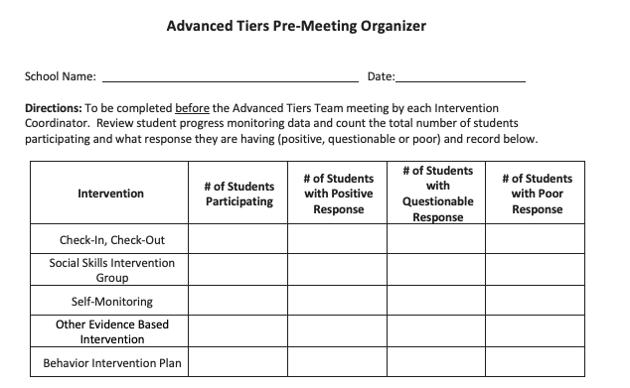
Advanced Tiers Pre-Meeting Organizer
Notes:
Trainer Notes: Make sure participants have a digital or paper copy of the Pre-Meeting Organizer. (PMO)
To Know/To Say: The Advanced Tiers Pre-Meeting Organizer is a tool the Advanced Tiers Team Coordinator should complete before each meeting. This helps the team to be laser focused on the students who need a change in their intervention, from graduation to a change in the dose or intensity of the intervention support.
Here’s how it works, the coordinator reviews all the monitoring data to document how many students are in each intervention AND their current status. In the first table they only document numbers of students.

Slide 27
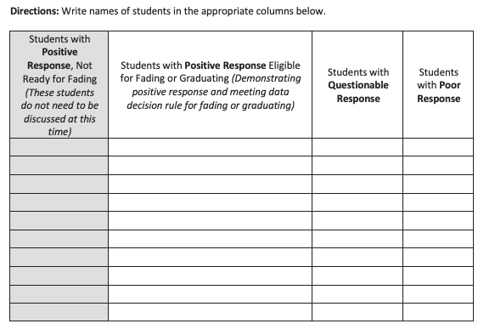
Advanced Tiers Pre-Meeting Organizer - Continued
Notes:
Trainer Notes:
To Know/To Say: The second step is to document the names of students in each category.
For students who are demonstrating a positive response but are not ready to faded or graduate there is no need to discuss their progress.
For students who are based on data demonstrating readiness to fade or graduate the team has decisions to make.
Finally, for students with a Questionable or Poor Response the team has decisions to make.
This handy pre-meeting organizer helps the team to maximize efficiency by reducing the number of students to be addressed. You will learn more about this guide once you begin students in tiered interventions.

Slide 28
WORKING AGREEMENTS

Slide 29
Advanced Tiers - Working Agreements
Working Agreements should be
  Developed by the members of the group.
  Posted visibly during meetings.
  Reviewed as each meeting is initiated.
  Periodically used to review team performance.
  Revised as new issues surface.
Notes:
Trainer Notes:
To Know/To Say: During the initial stages of your SW-PBS efforts, you established working agreements for assisting staff in achieving the meeting goals and to increase the productivity and effectiveness of their time. The process of establishing working agreements in advanced Tiers teams should be similar.
Working Agreements should be
Developed by the members of the group.
Posted visibly during meetings.
Reviewed as each meeting is initiated.
Periodically used to review team performance.
Revised as new issues surface.

Slide 30
Advanced Tier Team Working Agreements
Be Respectful
Be an active listener—open to new ideas
Use notes for side bar conversations
Respect confidentiality of individual student information
Be Responsible
Be on time for sessions
Silence cell phones—reply appropriately
Be a Problem Solver
Follow the decision-making process
Work toward consensus and support decisions of the group
Notes:
Make sure all participants have a copy of working agreements to use as a guide.
Here is an example of working agreements. Do you currently have working agreements for other team meetings? If so, will you adopt those or do you need to create some for your Advanced Tiers Team? All staff should be willing to address and discuss behaviors that are in violation of their working agreements when they occur during meetings. Some common working agreements are:
• Start on time; end on time.
• Stay on topic.
• Avoid unnecessary repetition.
• Give your full attention; silence cell phones during the meeting.
• Clarify agenda/meeting outcomes and time allotments before beginning.
• If presenting, be prepared.
• Watch and be considerate of time.
• Attend to the speaker; use sticky notes for side conversations.
• Wait to speak; use active listening.
• Indicate support for ideas you like or agree with.
• Ask for clarification if you don’t understand.
• Share concerns thoughtfully; pair criticism with a way to improve.
• Communicate authentically; avoid “parking lot” talk.
• Keep focus on the group goal and what is best for students.
• Be willing to doubt your own infallibility and compromise when necessary.

Slide 31
Activity: Advanced Tiers Working Agreements
Do you currently have Working Agreements for other team meetings?
If so, will you adopt those, and adjust given the responsibilities of this team?
If not, use the Advanced Tiers Team Working Agreements Example & Template to begin a draft set of expectations.
Notes:
Trainer Notes: Allow up to 15 minutes for this discussion.
To Know/To Say:
Do you currently have Working Agreements for other team meetings?
If so, will you adopt those, and adjust given the responsibilities of this team?
If not, use the Advanced Tiers Team Working Agreements Example & Template to begin a draft set of expectations.

Slide 32
Communication Systems

Slide 33
Communication Systems - Purpose
One of the most important systems the Advanced Tiers Team must consider is how to keep all staff, students, and families informed. Ongoing updates and sharing with all partners in the Advanced Tiers operations maintains “buy-in,” sustains and enriches interest, and promotes ongoing commitment to SW-PBS.
Notes:
Trainer Notes:
To Know/To Say:
If you want “buy-in” from everyone, you must make a plan to communicate with ALL partners the day-to-day operations as well as long term goals.

Slide 34
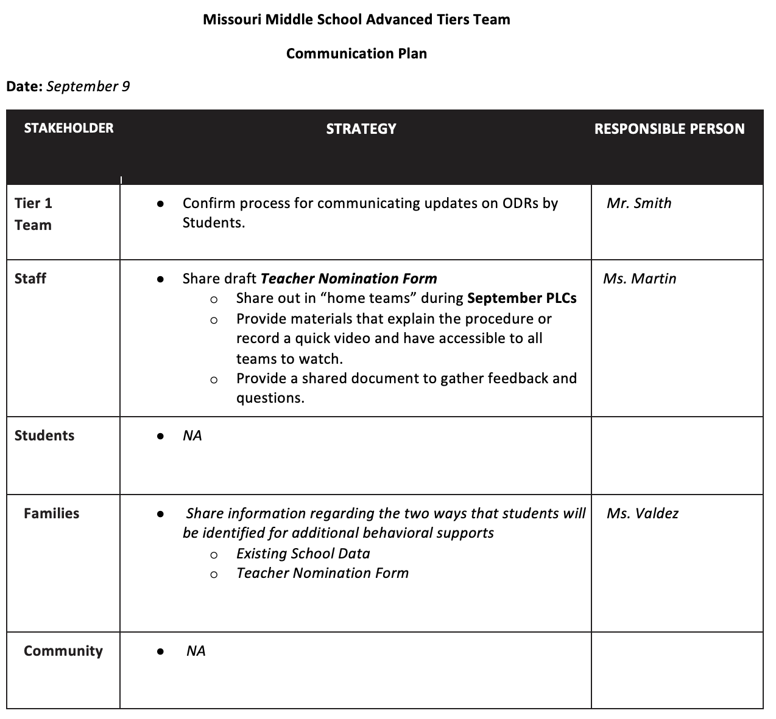
Sample of Advanced Tiers Communication Systems
Who will you need / want to communicate with?
How will you communicate information and gather input & feedback?
When and how often will you communicate?
Notes:
Trainer Notes: Make sure all participants have a copy of “Sample of Advanced Tiers Communication Systems.”
To Know/To Say:
Creating partnerships with all partners (e.g., staff, students, families) is a critical component of SW-PBS implementation, across all tiers. Effective teams proactively plan for partner engagement and communication by designing systems in which they will share information and also seek input/feedback. Plans for two-way partner engagement and communication are most effective when considerations are made for every step of the development, implementation, and evaluations phases.
When developing your communication system, teams should consider the following questions:
What will be communicated?
Who will communicate this information?
How will this information be communicated?
When will this information be communicated?
Each of these questions should be asked across partners, including: team members, staff members who are implementing interventions, staff members who are directly connected to students in interventions, all staff members, families, other stakeholders.
Additionally, teams should analyze what communication systems already exist within their building (e.g., email, newsletters, social media), the strength and opportunities for improvement of these systems and leverage those structures, when possible, instead of creating different communication systems.

Slide 35
Advanced Tiers Communication - Staff
Regular sharing of individual student data for staff directly involved with students in interventions that complies with Family Educational Rights and Privacy Act (FERPA) and other federal, state, and local policies.
Updates on implementation efforts and outcomes
Process for staff voice in the work
Access to Advanced Tiers resources
Notes:
Trainer Notes:
To Know/To Say:
As teams decide what information to include in their Advanced Tiers system, teams should consider the following based upon potential partners, For Staff
Regular sharing of individual student data for staff directly involved with students in interventions that complies with Family Educational Rights and Privacy Act (FERPA) and other federal, state, and local policies.
Ongoing updates, with all staff on implementation fidelity and outcomes for students receiving Advanced Tier supports (e.g., number of students receiving services, number of students showing positive response, number of students needing additional support).
A process by which staff can voice questions, concerns, or identify celebrations.
Prompts/reminders on how to access organizational files (e.g., meeting dates/times, nomination forms).

Slide 36
Advanced Tiers Communication - Families
Ongoing updates of individual student data for families whose student is involved in an Advanced Tiers intervention.
Establish a variety of processes by which families can voice questions, concerns, or identify celebrations.
Notes:
Trainer Notes:
To Know/To Say:
When considering information reporting and receiving input or feedback from families consider a plan for
Ongoing updates of individual student data for families whose student is involved in an Advanced Tier intervention.
Establish a variety of processes by which families can voice questions, concerns, or identify celebrations.
Given that family and community engagement is an identified barrier and priority for improvement in most buildings and districts, take time to critically analyze what is working in engagement for your organization, and where improvements can be made. One size, two-way communication cannot be the norm given the rapid pace of change in the world today and the impact on family structures, work expectations as well as child-care and custody arrangements.

Slide 37
Activity: Advanced Tiers Communication System
Who are the relevant partners with whom your team will be communicating?
What different methods are currently being used by your school to engage and communicate with these groups?
What new opportunities/modalities might exist to engage partners?
What is your current system for gathering input/feedback from relevant partners?
Notes:
Trainer Notes: Allow up to 15 minutes for this discussion.
To Know/To Say: Circle up your Advanced Tiers team and begin to formulate a draft communication plan, again, consider
Who are the relevant partners with whom your team will be communicating?
What different methods are currently being used by your school to engage and communicate with these groups?
What is your current system for gathering input/feedback from relevant partners?
How effective are your current structures in actually engaging the voice of all partners in the educational process? What would make the process even better?

Slide 38
DECISION-MAKING PROTOCOL

Slide 39
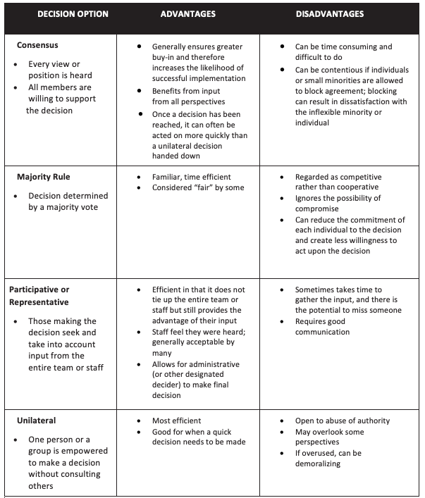
Decision-Making Protocol
As a team, you will have to decide:
- WHO Decides (e.g., AT Team or all staff)
- How to Decide (consensus, majority rule, unilateral decision).
Notes:
Trainer Notes: Make sure all participants have a copy of “Decision-Making Protocol.”
To Know/To Say:
As your teamwork progresses, you will encounter decisions that need to be made by the team as well as larger decisions that involve stakeholders outside of the team. Without effective tools to make these decisions, teams may suffer from indecision, prolonged discussions, or even division. Effective teams proactively make systems that will support their decision-making processes.
WHO DECIDES – There are some decisions where it just doesn’t make sense to involve everyone. Identifying an individual point person (e.g., administrator, selected team member) can be very appropriate when that person has relevant knowledge or authority. Similarly, team decisions also may be appropriate when representation of the school is needed but involving the entire staff is impractical, unnecessary, or too time consuming. However, you will want to take the time to involve the entire staff when the issue is one that everyone needs familiarity with or that requires the support of each person to carry out. This is essential when decisions are being made about new procedures or approaches to be implemented by all.
HOW TO DECIDE – Once consideration has been made about who needs to be involved in the decision-making process, the team needs to determine how to decide. When divisiveness is present, schools should revisit mission, vision, guiding principles, or beliefs to foster harmony before moving on to make decisions using a consensus model. Effective leaders understand the importance of striving for consensus but also understand that not all decisions should be made by the entire group or by using consensus strategies. In that case a majority rule or unilateral decision will be made. In addition, when the group is “stuck,” a smaller group can be assigned to bring suggestions back to all. This would be an example of participative or representative decision-making.

Slide 40
Activity: Advanced Tiers Decision-Making Protocol
  What are some of the decision-making protocols that everyone is familiar with?
  What are the pros and cons of each?
  Which are the most efficient?
Notes:
Trainer Notes: Allow up to 10 minutes for this discussion.
To Know/To Say:
At this point, your team will not have a clear understanding of what decisions you will need to make and who will need to be involved in the decision-making process. However, now is a good time to begin formulating general case decision-making protocols.
What are some of the decision-making protocols that everyone is familiar?
What are the pros and cons of each?
Which are the most efficient?
Consider using “Decision-Making Protocol” as a starting point for establishing a clear decision-making protocol.

Slide 41
ORGANIZATIONAL SYSTEM TO HOUSE
ADVANCED TIERS ARTIFACTS

Slide 42
Advanced Tiers Artifacts
Documentation of your school’s systems and procedures is critical to ensure that structures and practices are sustained over time.
It is important, when possible, to make sure that these documents are
accessible to all relevant stakeholders.
Align when possible or ethical with dissemination practices that currently exist with other procedures (e.g., fire emergencies, intruder procedures, Tier 1 Staff Handbook).
Notes:
Trainer Notes:
To Know/To Say: Teams should always make sure all systems and procedures are documented. Staff turnover often disrupts/ slows down a team’s momentum when systems and procedures have not been documented and made easily accessible to everyone.

Slide 43
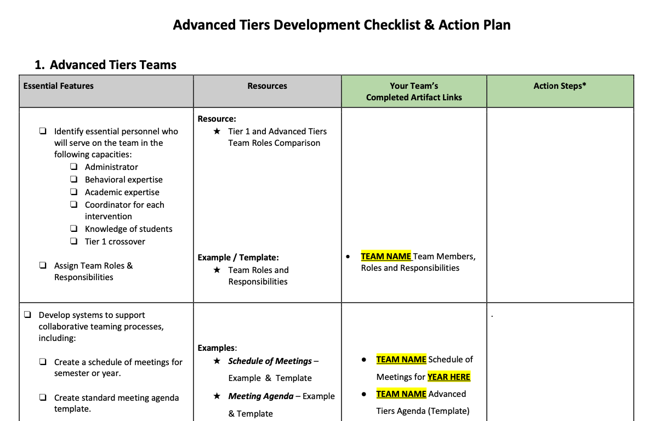
Organizational System - Advanced Tiers Artifacts
Notes:
Trainer Notes:
To Know/To Say:
The Advanced Tiers Development Checklist will serve an organizer/storage place for all of you Advanced Tiers artifacts/templates.
You will learn about all of the artifacts/templates as you continue to complete the lessons for Advanced Tiers.

Slide 44
Activity: Advanced Tiers Organizational System
With your team, consider how to create a system of organization around critical documents:
How does your team organize and document other systems?
What are strengths and barriers to how those systems are organized?
What might need to similar and what might need to be different?
Notes:
Trainer Notes: Allow up to 15 minutes for this discussion.
To Know/To Say:
With your team, consider how to create a system of organization around critical documents:
How does your team organize and document other systems?
What are strengths and barriers to how those systems are organized?
What might need to similar and what might need to be different?
When Advanced Tiers Development Checklist is completed, add the following as the last bullet point on the slide. Document any decisions made including action to be taken, by who and when it will be completed on the Advanced Tier Development Checklist and Action Plan.

Slide 45
Next Steps
Finalize and communicate your Advanced Tiers Meeting Schedule..
To ensure efficient and effective meetings
  Lean into your Advanced Tiers Meeting Working Agreements
  Use your Advanced Tiers Meeting Agenda to draft agendas and send to relevant attendees 2-5 days ahead of meeting
  Use the Advanced Tiers Meeting Pre-Meeting Organizer to ensure you engage in continuous cycles of progress monitoring.
  Engage in archiving meetings agenda and implementation artifacts as your new plan outlines
Follow up with timely updates as needed to relevant partners

Slide 46
References
Garmston, R., J., & Wellman, B. M. (2016). The adaptive school: A sourcebook for developing collaborative groups (3rd ed.). Lanham, MA: Rowman & Littlefield.
Guskey, T. R., & Huberman, M. (Eds.) (1995). Professional development in education: New paradigms and practices. New York, NY: Teachers College Press.
Missouri Schoolwide Positive Behavior Support (2019). Missouri schoolwide positive behavior support handbook.
Missouri Schoolwide Positive Behavior Support (2019). Missouri schoolwide positive behavior support tier 1 implementation guide.
Missouri Schoolwide Positive Behavior Support(2025). Missouri schoolwide positive behavior support advanced tier implementation guide.
Kraft, M. A., Blazar, D., & Hogan, D. (2018). The effects of teacher coaching on instruction and achievement: A meta-analysis of the causal evidence. Review of Educational Research, 88(4), 547-588. https://doi. org/10.3102/0034654318759268
Simonsen, B., Freeman, J., Myers, D., Dooley, K., Mad dock, E., Kern, L., & Byun, S. (2020). The effects of targeted professional development on teachers’ use of empirically supported classroom management practices. Journal of Positive Behavior Interventions, 22(1), 3-14. https://doi. org/10.1177/1098300719859615
State, T. M., Simonsen, B., Hirn, R. G., & Wills, H. (2019). Bridging the research-to-practice gap through effective professional development for teachers working with students with emotional and behavioral disorders. Behavioral Disorders, 44(2), 107-116. https://doi. org/10.1177/0198742918816447

Slide 47


Contact Information
Check Out MO SW-PBS on Social Media:
Facilitator Contact Information:
pbismissouri.org
List HERE
facebook.com/moswpbs
instagram.com/moswpbs/

