Slide 1
MO SW-PBS Advanced Tiers
Check-In, Check-Out
Course 6, Lesson 2

Slide 2
Facilitator Notes: Delete This Slide
Include the following slides:
Attention Signal
Introduction
Breaks (optional)
Determine how you will provide access to resources:
Make a copy of the CICO Development Checklist Action Plan and provide forced copy for each team to download and save. Encourage all teams to make a copy of this document and use it throughout all of the lessons for developing CICO Systems.
This presentation is designed to cover the core content in a concise manner. Each consultant has the option to add activities that will help to enhance the content.

Slide 3
Working Agreements
Be Respectful
Be an active listener—open to new ideas
Use notes for side bar conversations
Be Responsible
Be on time for sessions
Silence cell phones—reply appropriately
Be a Problem Solver
Follow the decision making process
Work toward consensus and support decisions of the group
Notes:
Trainer Notes:
To Know/To Say: “These will be the Working Agreements we will honor during all our training sessions this year.”

Slide 4
Attention Signal
Notes:
Trainer Notes: Facilitator: Select an attention signal.
To Know/To Say: “One of our agreements is to follow the attention signal.”
“Your team will work with your school to develop an attention signal you will use in every setting.”
“In order to get all of you focused after discussions, activities or breaks,
I will ________________________________________.”
(Insert your attention signal here.)
“Your task will be to finish your sentence, quiet your voice and ____________________________.”
(Insert what you want participants to do.)

Slide 5
Introductions
Notes:
Trainer Notes: Facilitator: Select an introductions activity
To Know/To Say:

Slide 6
Handouts
CICO Intervention Development Checklist
1. DPR example
Advanced Tiers Spreadsheet https://pbismissouri.org/tier-2-and-tier-3-data-tools/ -
2. Example Data Sheets from Adv. Tiers Spreadsheet
3. Pre-Meeting Organizer
4. CICO Modifications
5. CICO Fading Process Flowchart
Notes:
Trainer Notes: These are the handouts for this course. They are available on the https://pbismissouri.org/ website. You can also download and create a google folder to share them with participants.

Slide 7
Lesson Description
This lesson provides SW-PBS teams with a description of how to collect and analyze data in order to evaluate student progress in the Check-In, Check Out (CICO) intervention.
It also provides guidance on how to respond to student data as well as options for modifying or fading the intervention based on the student’s response.
Notes:
Trainer Notes: Check-In/Check-Out (CICO) is a Tier 2 intervention within a Positive Behavioral Interventions and Supports (PBIS) framework designed to help students improve their behavior and academic performance by providing consistent support and feedback..

Slide 8
Pre-Requisites
Tier 1 Essential Components
Function Based Thinking
Advanced Tiers Teaming
Student Identification
Matching Function to Intervention: Gather and Review of Existing Data
Intervention Data Decision Rules
Intensifying the 8 ETLPS
CICO Introduction and Systems of Implementation
Pre-Requis
ites:Tier 1 Essential Components
Science of Behavior
Advanced Tiers Teaming
Student Identification
DBDM FACTS (Part 1)
Intervention Data Decision Rules
Intensifying the 8 ETLPS
Notes:
Trainer Notes: These are the prerequisites that your team should have participated in prior to engaging with this content.
Tier 1 Essential Components
Function Based Thinking
Advanced Tiers Teaming
Student Identification
DBDM FACTS (Part 1)
Intervention Data Decision Rules
Intensifying the 8 ETLPS
CICO Introduction and Systems of Implementation

Slide 9
Lesson Outcomes
At the end of this session, you will be able to…
Collect and analyze implementation data
Create a Daily Progress Report(DPR) for CICO
Design a menu of modifications for CICO
Determine process for fading students from CICO
Notes:
Trainer Notes:
The outcomes for this lesson are as follows:
Collect and analyze implementation data
Create a Daily Progress Report(DPR) for CICO
Design a menu of modifications for CICO
Determine process for fading students from CICO

Slide 10
Organization of CICO Course Lessons
L1 - Systems for Implementation
(what we do for adults)
Personnel
Serviceable Base Rate
Location
System for Reinforcing Expected Behavior
L2 - Data for Implementation
(how we make decisions)
Process for monitoring student progress
Analyzing data
Responding to data
  Modifications
  Generalization of Skills
  Self-Monitoring
  Fading
L3 - Practices for Implementation
(what we do for students)
Communication for personnel, families & students
Training for personnel, families & students
Notes:
Trainer Notes: The Lessons will be organized by Systems Data and Practices for Implementation. This 2nd lesson is all about how your team makes decisions and will cover data that will be collected and analyzed. This lesson will include
Progress monitoring for student progress
Analyzing data
Responding to data

Slide 11

Rational
Once a student is participating in an intervention it is critical to monitor their progress to ensure it is having a positive impact.
Notes:
Trainer Notes:
CICO provides a structured framework to provide students with individualized attention, feedback, and support, helping them develop positive behaviors and improve their overall school experience. Once a student is participating in an intervention it is critical to monitor their progress to ensure it is having a positive impact.

Slide 12
Reflective Questions
How can you ensure that interventions are having the intended impact?
How are you currently tracking student data?
Who analyzes the data?
How does your team respond to the data?
Notes:
Trainer Notes:
Before we begin this lesson here are some questions that your team might need to consider.
How can you ensure that interventions are having the intended impact?
How are you currently tracking student data?
Who analyzes the data?
How does your team respond to the data?
You may not have these answers at this time but once you have completed this lesson your team should be able to answer these.

Slide 13
Missouri Teacher Standards Addressed
2.1: Cognitive, social, emotional and physical development
2.6: Language, culture, family and knowledge of community
3.1: Implementation of curriculum standards
5.1: Classroom management, motivation and engagement
5.2: Managing time, space, transitions and activities
5.3: Classroom, school and community culture
6.1: Verbal and nonverbal communication
6.2: Sensitivity to culture, gender, intellectual and physical differences
8.1: Self-assessment and improvement
8.2: Professional learning
Notes:
Trainer Notes:
These are the Missouri Teacher Standards that will be addressed in this lesson. If you want more information regarding these standards visit DESE.MO.GOV

Slide 14
Key Terms
Daily Progress Report or DPR
Advanced Tiers Spreadsheet
CICO Modifications
Fading
Notes:
Trainer Notes: Here are some of the key terms you will be learning about as you go through this lesson.

Slide 15
Data for Implementation
Notes:
Trainer Notes: This lesson will focus on the data for implementation.

Slide 16
Purpose Behind Collecting Data
To ensure students are making adequate progress toward goals.
To determine if the intervention is being implemented with fidelity
Notes:
Trainer Notes: The data that will be collected will help teams determine if the student is making adequate progress towards their goal.
Refer back for to your Intervention Data Decision rule for your process on checking implementation fidelity. (Course 4 Intervention Data Decision Rules Handout)

Slide 17
Designing a Daily Progress Report (DPR)
A Daily Progress Report (DPR) should include the following components:
Positively stated behavioral expectations that align with the school-wide expectations.
A minimum of 4 rating periods with scoring intervals no longer than 75 minutes.
A range of scores for rating behavioral performance (e.g., 1, 2, 3) with specific criteria to define how points are earned.
Adaptations (if applicable) so that the DPR is age appropriate for all students you serve (e.g., use of pictures; start and end time for class periods).
Space to record student success, total points earned, percentage of points earned, and the student’s daily goal.
Notes:
Trainer notes: A Daily Progress Report (DPR) is designed that includes the following components: SInce this is a Tier 2 intervention you will want to have a standard DPR card for the students participating.
Positively stated behavioral expectations that will be listed on the DPR have been determined and align with the school-wide expectations. No more than 5 .
The DPR consists of a minimum of 4 rating periods with scoring intervals no longer than 75 minutes.Include a minimum of 4 rating periods
Correspond with natural transitions in day
Optimally, marking period is 50 minutes but not longer than 75 minutes
A range of scores to be listed on the DPR for rating behavioral performance has been determined (e.g., 1, 2, 3) with specific criteria to define how points are earned. It is helpful for the rating key to be documented on the DPR as a reminder of how points are awarded.
Adaptations have been made (if applicable) so that the DPR is age appropriate for all students you serve (e.g., use of pictures; start and end time for class periods).
The DPR includes space to record student success, total points earned, percentage of points earned, and the student’s daily goal.

Slide 18
Optional Considerations :
Daily Progress Report (DPR)
Consider a place to record “success” rather than “comments”
Non-Classroom Settings (optional but helps with generalization of skills)
Include a column/place for teacher initials
Include a line for parent signature (optional)
Notes:
Trainer Notes: Additional options to consider: One way to make the point card personal is to provide a place for students to write their own goal or reminder related to an expectation. If the expectation is to be respectful, a personal reminder could be to use kind words. Use a space like this as a prompt for the student to remember a specific goal throughout the day.
The comment space might serve better as a ‘success’ space to provide positive feedback.
A reminder that non-classroom settings are not typically on the DPR. This is because the main concern is students missing instruction.
The DPR should include a minimum of 4 rating periods a day. These should be at natural transitions and ideally the marking period is not longer than 75 minutes.

Slide 19
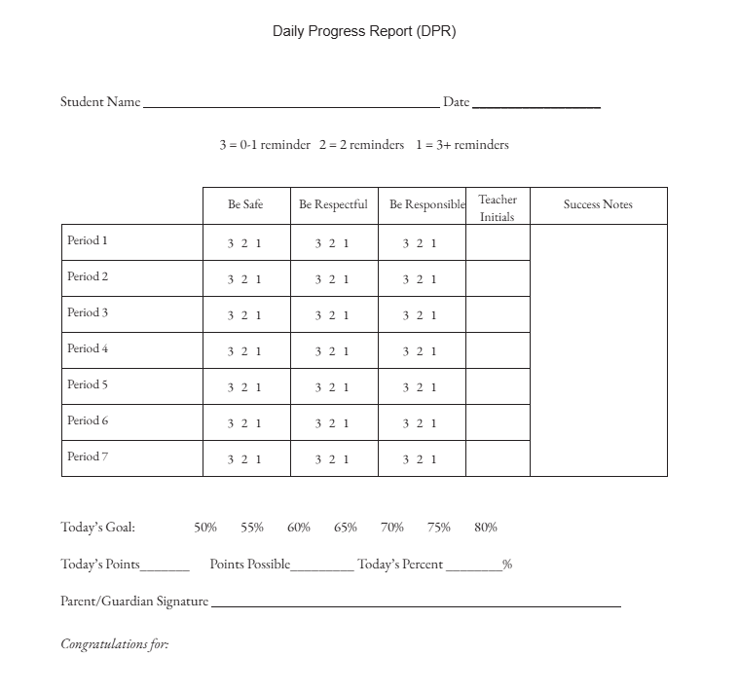
Example: Daily Progress Report (DPR)
Notes:
Trainer Notes: Review the components on the example of the DPR with the participants. .

Slide 20
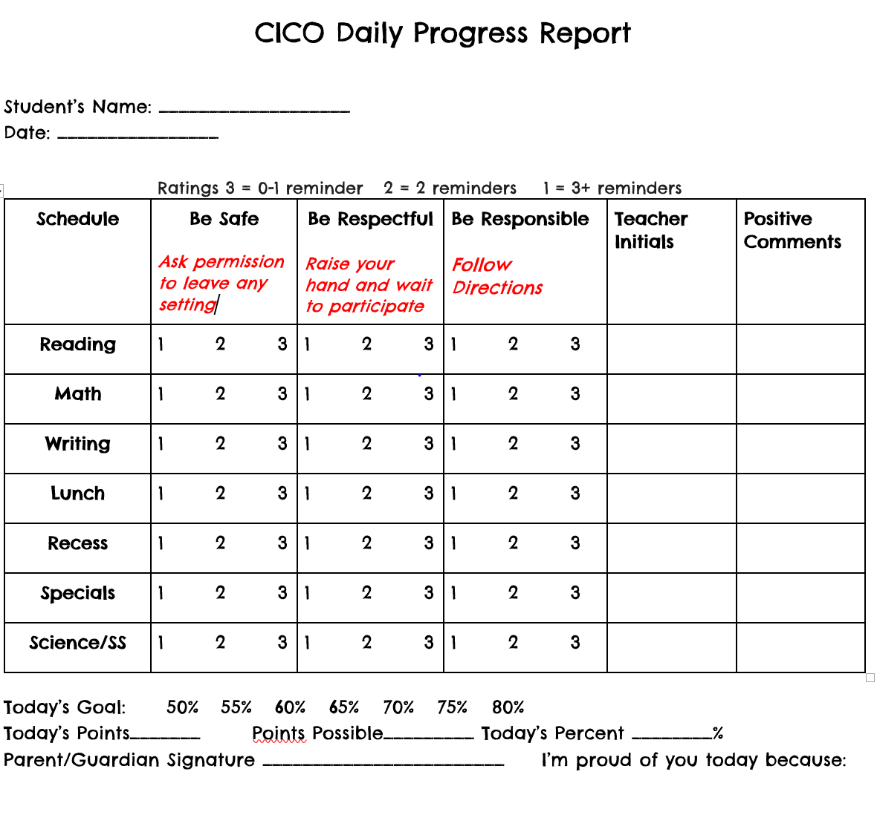
Selecting the Student’s Goal
Notes:
Trainer Notes: Selecting Contextually Appropriate Replacement Behaviors for the Student’s Goal
To set goals for the student you will want to review the behaviors that got them referred. You should be able to select this information directly from your matrix. Based on these behaviors determine the appropriate replacement behaviors. Keeping in mind that CICO is for students craving adult attention. Inappropriate behaviors such as talking out, interrupting class, refusing to follow directions or getting out of their seat without permission may have been some of the behavioral concerns. So what do we want students to do instead? Use their words to ask for help appropriately. Raise their hand and wait to be called on. Follow directions when asked. Stay in assigned areas
You can write the specific rules/replacement behaviors on the DPR under the expectations.

Slide 21
Early Childhood DPR
May include:
Pictures that illustrate the behavioral expectations
Visual representation of performance or color-coding system
Notes:
Trainer Notes: As mentioned previously CICO can also be implemented in preschools and high schools, but modifications may be needed
Many key features remain the same:
• Intervention is continuously available.
• Students receive intervention access quickly.
• Students check-in/check-out daily.
• Copy of DPR is sent home for signature and returned the following day.
In the same manner that schoolwide expectations are listed on a student DPR,
However it may find it helpful to include
pictures that illustrate the behavioral expectations. Rather than a numerical system, a preschool DPR will likely include a visual representation of performance
such as a smile, neutral or star, or a color-coding system. Instead of
identifying a point goal, the number of faces to earn may be listed.

Slide 22
Secondary DPR
Track common academic goals, homework completion or organizational needs.
Example Goals:
  Responsible = complete assignments
  Respectful = Use appropriate language
Notes:
Trainer Notes: Simple adaptations to the Check-In, Check-Out Daily Progress Report (DPR)can be made to incorporate modifications at the secondary level for tracking academic goals, homework, or organizational concerns. For example, student
DPR goals can be tied to meeting schoolwide expectations developed as part of the school’s Tier I intervention (e.g., “Be Respectful”). Thus, “be respectful” could be defined as raising your hand if you need help, and “be responsible”
could be defined as completing all assignments. Work with teachers in your school to define schoolwide expectations around common academic behavior goals.

Slide 23
Discussion
Review the DPR examples
How will you design your DPR ?
Will you have students take home a copy? How often?
Will they be reinforced for bringing it back signed?
AT-C6L2 Daily Progress Report Template
Notes:
Trainer Notes: Provide access to the DPR examples for teams to review.
As a team, consider which elements you will include on your DPR. Use the considerations previously mentioned as well as the examples to design your DPR.

Slide 24
Pause & Reflect
Action Step:
Who will be responsible for creating the DPR?
When will it be completed?
Where will it be accessed?
Notes:
Trainer Notes: What steps do you need to add to your action plan?

Slide 25
Engage in Progress Monitoring Student Response
Notes:
Trainer Notes: The next outcome will cover how to engage your team in the process of monitoring the student response to the intervention This process will include methods for collecting the data and storing it so that it is accessible for team members to review. .

Slide 26
Monitoring Student Progress
Collect 3-5 Baseline Data points to determine initial daily goal
Monitor progress toward the Goal
  Daily by the Facilitator
  Biweekly by the Advanced Tiers Team
Long-term Goal
    -80% on DPR 4 out of 5 days per week for 4 weeks
    -Decrease in rate of office referrals/classroom minors
    -Increase in attendance and/or grades
Notes:
Trainer Notes: Just a reminder that you determined your process for collecting baseline data in the intervention data decision rules lesson.
Within the context of a team and before the student begins with the program, an outcome goal should be determined. That goal should align with the SW Matrix. First think about, what is it you want this student to do that he/she is not currently doing? This comes from your behavior matrix. Is it follow directions? Complete work? Keep hands and feet to self?
Then we ask. “How will we know the student is consistently demonstrating the goal?”
Teams typically examine student baseline data to decide on a performance goal the student is likely to meet fairly rapidly. It is important that students experience early success with the CICO intervention because this will encourage continued participation. For example, students with baseline data in the 50-55% range may not increase performance to 80% in a short period of time. Instead the behavior support team may choose to select an initial goal of 65-70% so that the child can reach his or her first goal immediately or shortly after beginning the intervention. Gradually, over time, the support team will increase expectations for the student.
We monitor points earned on the DPR, but we may also want to consider other data indicators… attendance, grades, work, office referrals etc.
Continue to monitor progress on whatever information brought this student to the attention of the team

Slide 27
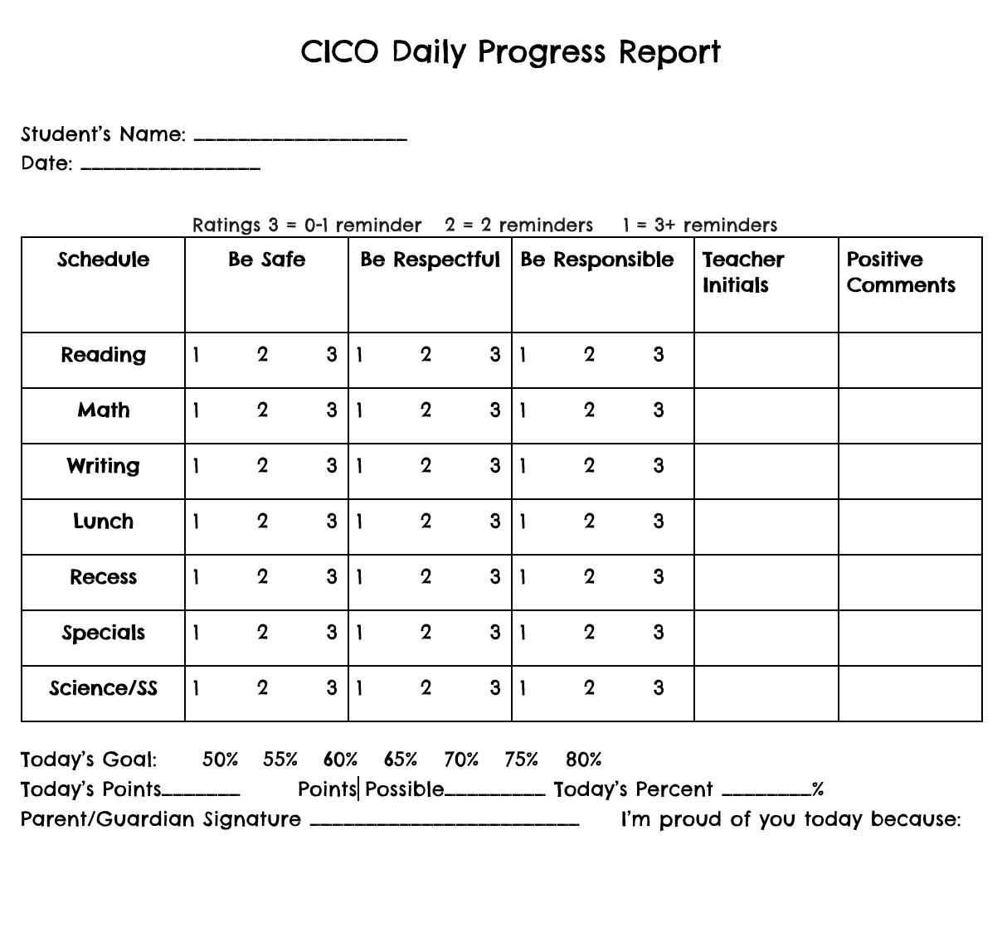
Collect Baseline Data to Establish Student Goals
Notes:
Trainer Notes: The Classroom Teacher should track data on the school expectations for 3- 5 days prior to beginning the intervention to determine baseline and establish the student’s beginning goal . The goal should be 10-15% higher than the baseline.
Trainer Notes: The teacher will be responsible for collecting this baseline data in the classroom.
The Adv. Tiers team will Define the Target Behavior Clearly
Use observable and measurable terms.
Example: Instead of “being disruptive,” define it as “talking out loud without permission during class.”
Use the DPR to assign point to the number of time the behavior occurs so you can determine the percentage and then establish goal. The goal should be addressing the replacement behavior and should be 10% higher than their baseline.
Determine the Observation Period
Choose a consistent time and setting (e.g., math class, recess).
Observe over multiple days to get a reliable sample.
📌 Tips for Success
Stay objective—avoid interpreting behavior emotionally.
Keep the environment as typical as possible to avoid influencing behavior.

Slide 28

Graphing Student Data
Notes:
Trainer Notes: The next piece is to use a systematic approach to graph the students data from their DPRs into a system that is easily accessible by the Adv. Tiers team when they meet to discuss how the student is progressing.

Slide 29
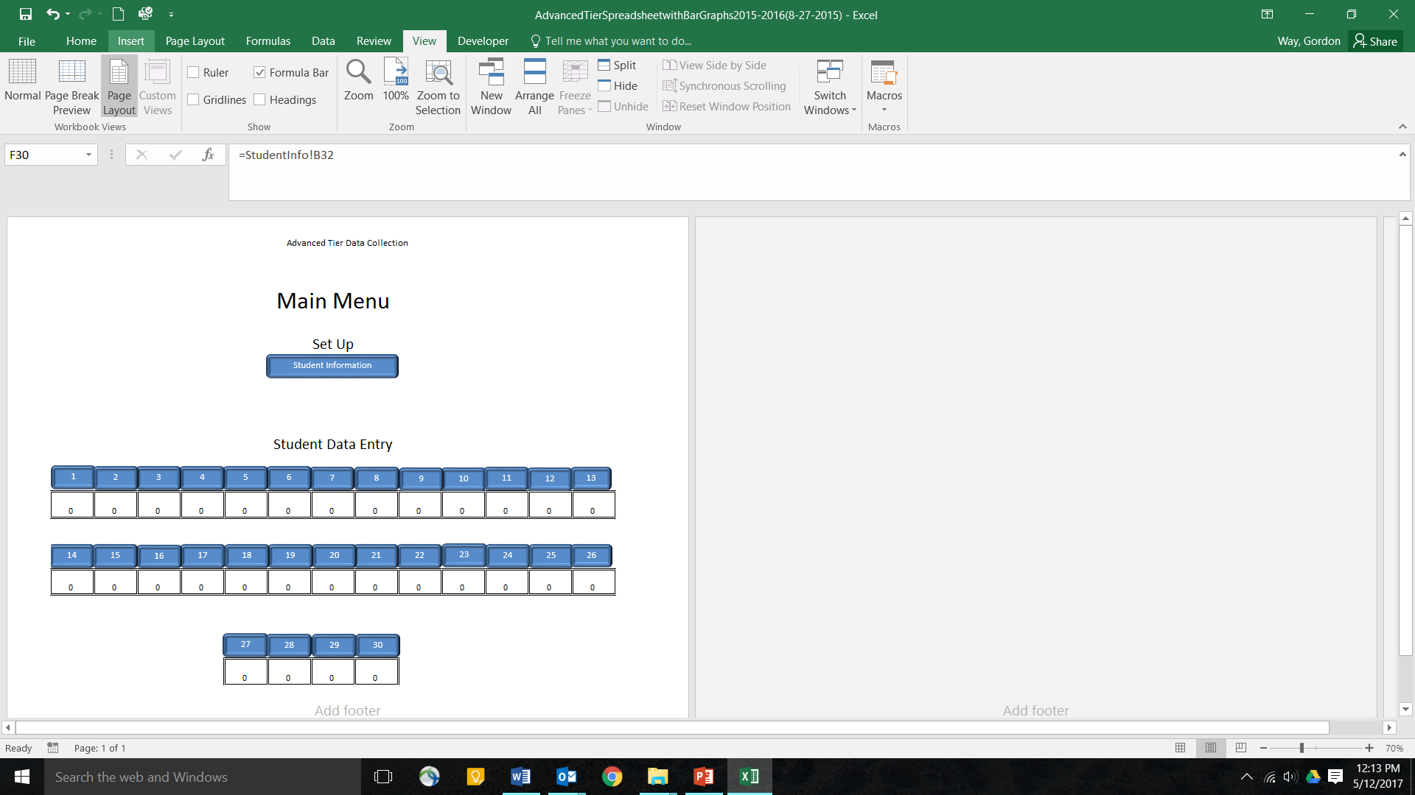
Advanced Tier Spreadsheet
A free student information and progress monitoring tool
Collects and charts DPR points and other frequency data
Access the spreadsheet at MO SW-PBIS website.
  MO SW-PBS Website: Tier 2 Data Tools
Notes:
Trainer Notes: The Advanced Tier Spreadsheet is an electronic collection system option that your team could choose to utilize and it is free. We love free! You can access it on the MO SW-PBS website. ( Reminder: you may need to enable macros.)

Slide 30
Example Student Data
Example ATS
Student 1 = a student’s progress from baseline through graduation.
Student 2 = baseline, implementation of the intervention for 3 weeks, poor response, phase change.
Student 3 = Baseline data was below 80% so the student’s 1st goal was set at 60% after 3 weeks of meeting his goal the goal was moved to 80%
AT-C6L2 Example ATS with Data
Notes:
Trainer Notes: Let’s go through an example graph of 3 students to get a better idea of how the system works.
In the example ATS Student 1 = a student’s progress from baseline all the way to graduation.
Student 2 = baseline, implementation of the intervention for 3 weeks. The student was not having a positive response so modification was made which is referenced by the black phase line.
Student 3 = Baseline data was below 80% so the student’s 1st goal was set at 60% after 3 weeks of meeting his goal the goal was moved to 80%.

Slide 31
Considerations for
Developing your Data Collection Process
Organization Suggestions to consider:
Create a common data folder
Use one spreadsheet to record data of all students participating in Adv. Tiers Interventions.
Use a seperate spreadsheet for each intervention
Use a separate spreadsheet for each facilitator
Who will be responsible for entering the daily data?
When will it be entered?
Notes:
Trainer Notes: Reminder to go to course 4 regarding what your data intervention rules are. If you choose to use the Adv. Tiers Spreadsheet you may want to create a common data folder that will be shared with the adv. Tiers team. Some other considerations are as follows: Use one spreadsheet to record data of all students participating in Tier 2 Interventions.
Use a seperate spreadsheet for each intervention
Use a separate spreadsheet for each facilitator

Slide 32
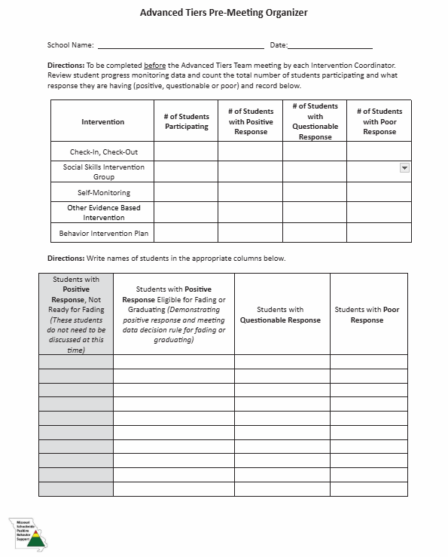
Team Review of Student Data
Team should review data on a bi-weekly basis to determine if the intervention is meeting the student’s needs.
AT-C6L2 Pre-Meeting Organizer
Notes:
Trainer notes: The team should review data every 2 weeks to determine the impact of the intervention. It might be helpful for the chairperson or coordinator to use the Pre-Meeting organizer to organize which students need to be discussed. Reminder that the The Pre-Meeting organizer from the Teaming lesson can help keep track of which students you need to review at each meeting.

Slide 33
Discussion
What will your common data folder look like?
Where will it be stored ?
Who will have access to it?
Who will be responsible for entering the daily data?
When will it be entered?
Notes:
Trainer Notes: Discuss the following questions.

Slide 34
Pause & Reflect
What steps do you need to add to your action plan to develop your data collection process ?
Notes:
Trainer Notes: What steps do you need to add to your action plan?

Slide 35
Analyzing Student Data
Notes:
Trainer Notes: Now that you have the student data how will your team analyze it.

Slide 36
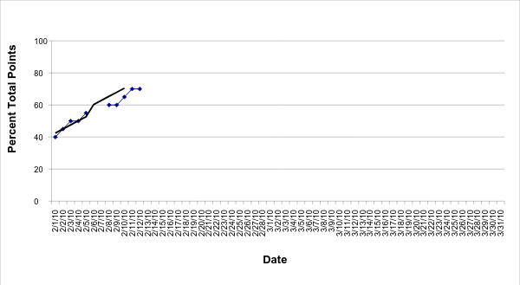
Positive Response
Goal Line
Trend Line
Level of Performance
Notes:
Trainer Notes: In reviewing this data you can see that this student’s current rate of progress, he will reach the goal line in 3 weeks. The student is making progress toward the goal at an acceptable rate.
Which means they are having a Positive Response to the Intervention.
Depending on your intervention data decision rules your team will decide if the student should do one of the following:
Continue intervention with the current goal
Continue intervention with goal increased
If goal was not at 80%
Begin Fading

Slide 37
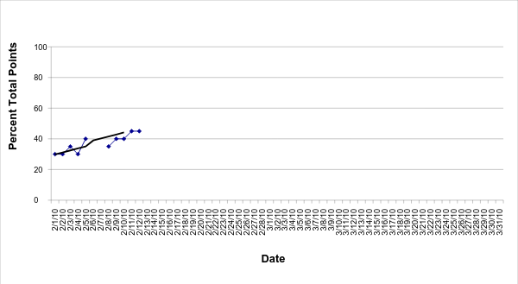
Questionable Response to Intervention
Goal Line
Trend Line
Level of Performance
Notes:
Trainer Notes: At this student’s current rate of progress, he will require 6 weeks to reach the goal. The student is making progress, however, the rate is slower than what we would considerable acceptable.
Which means this student is having a Questionable Response to the Intervention. So the team needs to discuss the following:
Was intervention implemented as intended?
If no - employ strategies to increase fidelity of implementation
If yes -increase intensity of current intervention for a short period of time and assess impact.
If rate improves, continue.
If rate does not improve, return to problem solving.

Slide 38
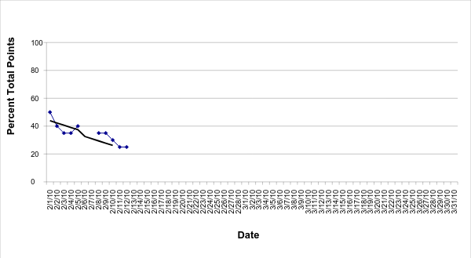
Poor Response to the Intervention
Trend Line
Notes:
Trainer Notes:
This child’s level of performance ranges from 50% to 25%.
The gap between this child’s trend line and the goal line is growing wider. The response to the intervention is poor. So the team needs to discuss the following
Was intervention implemented as intended?
If no - employ strategies to increase fidelity of implementation
If yes -
Was the problem identified correctly?
Is intervention aligned with the function?
Are there other functions to consider?

Slide 39
Reminder: Intervention Data Decision Rules
A student in a Tier 2 Intervention should first reach the goal line within 3 weeks. (Sprague, 2008)
The general recommendation from most researchers is that we need at least eight data points within 3 weeks of instruction before making a decision about whether or not an intervention change is needed. (Lembke, 2008)
Notes:
Trainer Notes: Sprague (2008) indicates that a student in a Tier 2 Intervention should first reach the goal line within 3 weeks.
If the student in a Tier 2 Intervention does not reach the goal line within 3 weeks, the rate of progress may be considered too slow.
Dr. Erica Lembke advises that the general recommendation from most researchers is that we need at least eight data points within 3 weeks of instruction before making a decision about whether or not an intervention change is needed

Slide 40
Responding to Student Progress
Notes:
Trainer Notes: The next step is how will your team respond to student data.

Slide 41
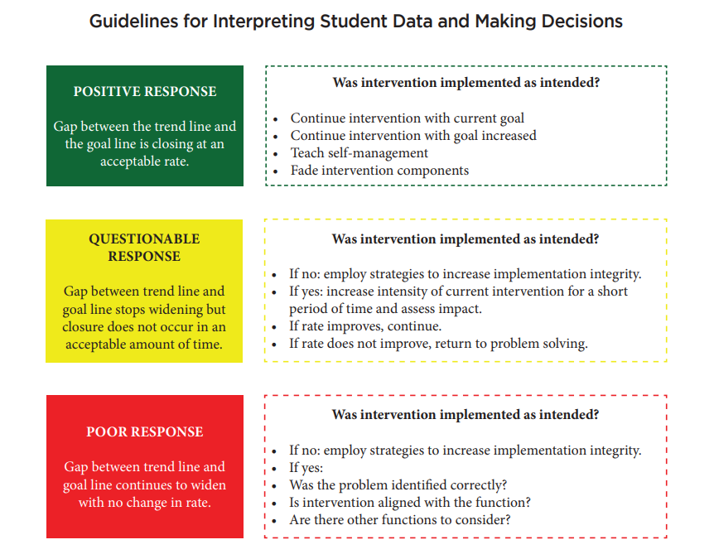
Notes:
Trainer Notes: The purpose of reviewing the data is to determine if the student is having positive, questionable, or poor response to intervention.
Based on the student response the team will decide whether to continue the intervention, fade, intensify or modify the intervention
-Refer to the colored boxes for explanation:
*Positive Response: Gap between the trendline and Goal Line is closing at an acceptable rate. Continue with current intervention/increase goal/Fade Intervention
*Questionable: Closure of gap lines at an unacceptable rate. Look into implementation fidelity
*Poor Response: Gap between Goal and Trendline widens. Was the problem identified correctly?
The purpose of reviewing the data is to determine if the student is having positive, questionable, or poor response to intervention.
Based on the student response the team will decide whether to continue the intervention, fade, intensify or modify the intervention
Refer to the colored boxes for explanation:
*Positive Response: Gap between the trendline and Goal Line is closing at an acceptable rate. Continue with current intervention/increase goal/Fade Intervention
*Questionable: Closure of gap lines at an unacceptable rate. Look into implementation fidelity
*Poor Response: Gap between Goal and Trendline widens. Was the problem identified correctly? Did you identify the correct intervention?

Slide 42
Positive Student Response
Continue Intervention
Increase Goal
Collect a minimum of 8 data points within the 1st 3 weeks
Collect data continuously for at least an additional 4 weeks after the student has met the goal of 80%.
The team will determine if the student needs to continue support after this time or begin fading
If current goal is below 80% increase goal until student meets the goal of 80% or above for 4-6 weeks.
Notes:
Trainer Notes: To determine if student is meeting their 1st goal
Intervention Coordinator or Team member will review the data regularly during this time frame to determine if the student continues to meet their goal at an acceptable rate.
Teams have the latitude to choose how frequently they will review the data during this time.
Students will be reviewed at least every 4 weeks to determine if they are making progress if not they should be added to the agenda for further discussion.

Slide 43
What happens if a student is not making progress?
Check Fidelity First!!!
Implementation Fidelity is...
The delivery of the intervention in the way it was designed to be delivered.
(Gresham, MacMillan, Boebe-Frankenberger, & Bocian, 2000)
Notes:
Trainer Notes: Refer back to Intervention Data decision rules lesson on how your team determined you would monitor implementation fidelity. The research results from this intervention are based on all of the parts being fully implemented. If some of the parts are missing it is not CICO.Sure, CICO is a simple program. Even simple programs need proper attention. As easily as you set it up, it can just as quickly fall apart. When you look at your CICO data, do you notice many students fail to meet their goal or is it just a couple? How many periods are marked without data? Does that happen for lots of students or just some? If many students on CICO struggle in the intervention, it’s possible the problem is systemic rather than isolated.​

Slide 44
Questionable or Poor Response
If fidelity has been checked:
Reconsider function
  Ensure the correct function was identified
  Confirm the intervention aligns with the function
Reconsider the goal
  Review the initial goal to ensure it was appropriately established based on the baseline data
Intensify the intervention
Notes:
Trainer Notes: Is the student seeking adult attention? If not, you may need to change the intervention. Did you set their goal too high? Do you need to intensify the intervention?

Slide 45
Modifications for CICO
Notes:
Trainer Notes: Next steps is to consider developing a menu of accommodations to modify or intensify the intervention if a student needs additional support.

Slide 46
Modifying the Intervention
Provide more frequent feedback
Individualize the feedback procedure
Individualize the reinforcer
Add a Self-Monitoring Component
Notes:
Trainer Notes: The team may need to modify the intervention by individualizing the feedback procedure, individualizing the reinforcement or adding a self-monitoring component.

Slide 47
Strategies for Modifying the Intervention
Provide more frequent feedback
Implement an additional feedback session with the intervention facilitator (i.e. noon check-in)
Allow for more frequent interactions between the student and his or her teachers (i.e. shorten the time periods between ratings)
Notes:
Trainer Notes: If the intervention facilitator meets with all students in an intervention before and after school, an additional meeting could be scheduled in the middle of the day for students who require more frequent feedback.
Often, the teachers specifically interact with students in an intervention before and after class, additional interactions could be planned for students who require more frequent feedback.

Slide 48
Strategies for Modifying the Intervention
2. Individualize the feedback procedure
Allow the student to select the adult with whom he or she will regularly meet to review progress
Cross out behaviors on the DPR which are not problematic for the student
Be more specific with behaviors which are problematic
Make sure time periods which are problematic are monitored on the DPR
Notes:
Trainer Notes: Other strategies to consider are as follows: ,Can the student select the adult to check in and check out with? If some behaviors on the DPR are almost always at or above 80%, cross them off so student is concentrating on only those behaviors which are problematic. If student has difficulty in unstructured times such as recess or lunch, add those time frames to the DPR

Slide 49
Strategies for Modifying the Intervention
3. Individualize the reinforcer
Collaboratively develop an individualized contract that specifies the reinforcers the student will earn
Allow the student to select an adult with whom he or she can spend additional time
Notes:
(This Big Bang video clip is a great example of reinforcing behavior. https://www.youtube.com/watch?v=qy_mIEnnlF4 )
Trainer Notes:
The 4th strategy is to individualize the reinforcer. The facilitator might collaboratively develop an individualized contract that specifies the reinforcers the student will earn.
Allow the student to select an adult with whom he or she can spend additional time

Slide 50
Strategies for Modifying the Intervention
4. Add a Self-Monitoring Component
  Identify and define the target behavior
  Collect baseline data
  Design procedure and materials
  Teach student to self-monitor
  Monitor progress
Notes:
Trainer Notes: The team may consider adding a self-monitoring component. This may help with those students who argue or become frustrated with the teacher’s ratings.

Slide 51
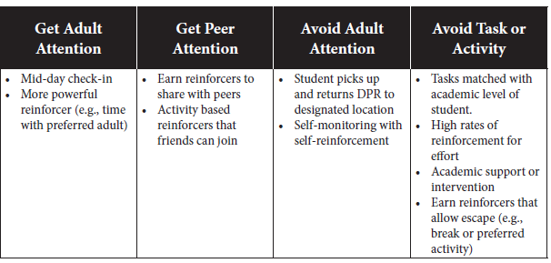
Example Modifications for the CICO Intervention
AT-C6L2 Modifications for CICO Interventions
Notes:
Trainer Notes: If the student is in the intervention for a period of time and they are exhibiting additional behaviors that are not focused on gaining adult attention then you may want to modify the intervention to include one or more of the additional strategies on this graph.
The team will need to consider which modification(s) best match the student’s needs. Listed are several example modifications suggested by authors of the intervention manual (Crone, Hawken, & Horner, 2010).

Slide 52
CICO Modifications at the Secondary Level
Teach students
How to be socially and academically successfully
How to appropriately engage in activities
Basic Study Skills
Using a planner
Organize materials
Follow a daily schedule
Study and test taking skills
Notes:
Trainer Notes: At the secondary level, a critical outcome of CICO participation is teaching students how to be both socially and academically successful in school so they remain engaged in activities. To reach this goal, CICO for older students should also provide instruction for basic study skills (Crone et al., 2010).
In addition to feedback about social behavior, students should participate in lessons that teach them to use a planner, organize materials and supplies, establish and follow a daily schedule, apply study skill strategies, and know beneficial test-taking skills.

Slide 53
Discussion
Develop a Menu of Modifications for CICO Intervention.
How long would a student have a poor or questionable response before modifying the intervention?
Notes:
Trainer Notes: Discuss with your team what will be included in your menu of modifications so it is readily available when discussing students who needs additional supports.
How long would a student have a poor or questionable response before modifying or intensifying the intervention?

Slide 54
Pause & Reflect
What action steps need to be taken in order to develop your process for analyzing and responding to student progress?
Notes:
Trainer Notes: Consider the steps do you need to add to your action plan.

Slide 55
Self-Monitoring
Notes:
Trainer Notes: Self-monitoring is a behavioral strategy that can be used for students of all ages. A student will observe, record, and evaluate their own behavior to increase awareness and promote change. It involves tracking specific actions.often using a checklist or rating scale—and comparing them to a set goal or standard
This should be taught before Fading takes place in order to increase the student’s ability to manage their own behavior without direct adult supervision.

Slide 56
Self-Monitoring within CICO Intervention
Students gradually take responsibility for monitoring and evaluating their own behavior
The goal is for students to manage their behavior independently without adult prompting
It is a gradual fading of teacher support and increasing student autonomy.
Notes:
Trainer Notes: Students gradually take responsibility for monitoring and evaluating their own behavior throughout the day, instead of relying solely on teacher feedback
Goal is for students to manage their behavior independently without adult prompting,
gradual fading of teacher support and increasing student autonomy.

Slide 57
Benefits of Self-Monitoring
Increased student accountability
Improved generalization of behavior change
Preparation for independent functioning
Notes:
Trainer Notes: Benefits of self-monitoring in CICO:
Increased student accountability:
By actively monitoring their own behavior, students are more likely to take responsibility for their actions.
Improved generalization of behavior change:
As students learn to self-regulate, they are better equipped to manage their behavior across different settings and situations.
Preparation for independent functioning:
The ultimate goal is to transition students from relying on external feedback to effectively self-manage their behavior without constant adult prompts

Slide 58
Key Components of Self-Monitoring
Observation: The student pays attention to their own behavior.
Recording: The student documents when the behavior occurs.
Evaluation: With the teacher the student reflects on whether the behavior meets expectations or goals.
Notes:
Trainer Notes:
Key Components of Self-Monitoring
Observation: The student pays attention to their own behavior.
Recording: The student documents when the behavior occurs.
Evaluation: The student reflects on whether the behavior meets expectations or goals.

Slide 59
Example Scenario: A student trying to reduce classroom disruptions might:
Keep a tally of how many times they spoke without raising their hand.
Review the data weekly to see improvement.
Notes:
Trainer Notes: Self-monitoring is widely used in education because encourages accountability and independence on the part of the student.

Slide 60
Self-Monitoring
Needs to be taught and practiced with the student
May be used as a modification to the CICO intervention.
Will be used as part of the fading process once the student meets the criteria determined in your Intervention Data Decision Rules.
Notes:
Trainer Notes: It is helpful to inform the team and staff that self-monitoring will be implemented in the classroom setting. The CICO facilitator will be responsible for teaching the student the skills and providing ample time to practice them. The goal is for the student to gain self-awareness about their behavior.
If a student does not respond well with the teacher giving direct feedback then the team may decide to modify the intervention by switching to self-monitoring of their specific goals.
Self-Monitoring will be used as part of the fading process so it is important the student is taught these skills prior to fading them from the intervention.

Slide 61
Fading CICO
Notes:
Trainer Notes: Next step is to develop a process for fading of intervention (e.g., self-monitoring).

Slide 62
Fading an Intervention
Purpose of Fading is to encourage long-term behavioral change.
The fading process is nonlinear with no hard and fast rules (best judgement).
Systematic fading involves removing or reducing one intervention component at a time while continuing to monitor student progress
  Intervention components include reducing:
    the number of goals
    the dosage of self-monitoring
    the frequency of feedback and reinforcements
**Feedback should be one of the last components faded because students in CICO thrive on adult attention.
Notes:
Trainer Notes: Fading refers to a process of gradually removing CICO intervention components for students who have met program goals. To increase the likelihood of student success after graduation CICO program components are typically removed in a systematic and thoughtfully planned fashion rather than cold turkey. Students should receive instruction for self-management skills before the CICO components are faded.
Something to keep in mind when starting to fade – if a student is doing well on a DPR, is that translating to improved performance on the criteria that brought the student to your attention?
For example, if a student accrued multiple classroom minors prior to participating in the intervention, has the student reduced the number of classroom minors for the focused behavior after participating in the intervention?
Consider which components will you fade and in what order will they be faded. Systematic fading refers to a plan for slowly adapting or reducing only one component at a time, like dosage (e.g., self-monitoring every other day instead of every day). If more than one component is faded and behavior begins to regress, knowing which component was working best for the student may be unclear. There are no hard and fast rules as to which intervention component should be adapted first or which should be adapted last.teachers should make their best judgment about one component to adapt first based on individual student characteristics and contextual fit. SInce the main function tied to this intervention is seeking adult attention feedback should be the last component faded.

Slide 63
Guidelines for Fading
Student response is positive and consistent for a predetermined amount of time.(e.g 4 out of 5 days for at least 4 weeks)
Student has not received a referral for at least 4 weeks
The Advanced Tiers team reviews the data to determine if a student is a candidate for fading
  Consider if there is any reason the student should stay enrolled.
Gradual process rather than abrupt
Incorporate a Self-Monitoring component
  Increases student responsibility
  Increases the student’s ability to manage own behavior without adult prompting and redirection
Notes:
Trainer Note: Some guidelines to consider:
Fade students from CICO who:
Consistently meet their goals for at least four weeks. This is an average across days. If a student meets the goal four out of five days for at least four weeks, it’s a good indicator their ready to move off of CICO.
Haven’t received an office discipline referral for at least four weeks.
Talk about students who meet your team’s criteria for exiting the intervention. Does anyone have a reason why a student should stay enrolled? Use your conversation as another piece of information guiding your decisions.
Ending CICO routines abruptly isn’t ideal and might unintentionally escalate a student’s behavior. Whenever a student is ready, transition off of the intervention and into more self-guided routines.

Slide 64
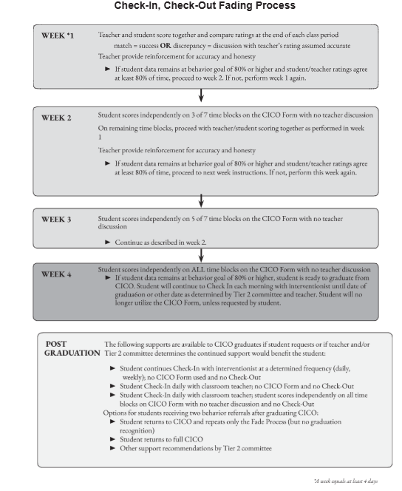
Example Flow Chart
Notes:
Trainer Notes: (Cooper et al., 2007).This is an example of a fading process. The intervention must be faded systematically by gradually reducing and eventually eliminating key elements, such as (a) goals, (b) feedback, (c) reinforcement, (d) dosage. Slowly removing intervention components and monitoring student responses increases the likelihood that positive behavioral change will maintain over time (Rusch & Kazdin, 1981).
If an intervention is stopped “cold turkey” once the student demonstrates improved behavior the student may to revert to pre-intervention behaviors, which defeats the purpose of teaching and reinforcing desired behaviors (Cooper, Heron, & Heward, 2007). Teachers can avoid this relapse by systematically fading intervention components. Generally, examining behavioral data (e.g., direct observation data, direct behavior ratings) every 3 to 5 days can help teachers determine how a student is progressing (or not) with intervention (Bruhn et al., 2018). Teachers can examine whether students have met behavioral goals, if behavior is becoming more stable, if there is an overall change in the level of behavior, or if behavior is trending in the right direction.

Slide 65
Fading Example
Student rates and completes DPR with teacher (Student states opinion and teacher confirms or discusses difference)
Student rates and completes DPR during ½ the periods, teacher randomly checks
Periods in which the student independently rates increase gradually
Check-in and Check-out is last thing to be removed
Transition back to Tier 1
Notes:
Trainer Notes: This example demonstrates how to move a student from teacher rating to self-monitoring. . Because initial success does not guarantee long-term success, a gradual and systematic approach to individualizing interventions based on data about student response is the best way to maintain behavioral change.
The process of reducing or removing intervention components continues until all intervention components are faded completely, with the ultimate goal of transitioning students back to only Tier 1 supports.

Slide 66
Discussion
Establish your data decision rule for fading students out of the program
Develop a plan for training student for self-monitoring (goal setting, self-evaluation, self-recording)
AT-C6 L2 Check In Check Out Fading Process Flowchart
Notes:
Trainer Notes: Eventually the team will need to decide when/how to fade students off the intervention. These (bulleted items) are things to consider and should be the topic of team discussion.
It is not uncommon that after participating in CICO over a period of time, students, along with parents and teachers as well, do not want to give up this support. Students report they like receiving extra adult attention and the feeling of success CICO gives them. This is why generalization is so important. Additionally, teachers and parents have concerns about how well children will continue to perform when the program is no longer provided. Therefore, moving students out of the CICO program requires careful planning.

Slide 67

Graduation
Successful demonstration of self-monitoring skills
Decisions should be based on students meeting their goal for demonstrating the skill a majority of days
Provide opportunity to celebrate success.
Notes:
Trainer Notes: Once a student has fading from the intervention successfully then they will graduate from the program.
GRADUATION: A plan for how students will graduate from the CICO program should be developed and documented before a school team begins implementing the intervention. The goal of CICO is to help students develop skills for functioning independently and once they are successful wean them off and when ready graduate them from the program.
After successful demonstration of self-management procedures, the Tier 2 Team should organize a graduation ceremony or provide an opportunity to celebrate success. Many schools choose to plan a formal ceremony and invite parents of participating students to attend. school teams are encouraged to consider how recognition for students who participated can naturally and meaningfully be incorporated into existing celebrations. Many schools provide recognition for outstanding academic performance but may neglect to consider behavioral performance in the same regard. Thus, students who participate in any Tier 2 or 3 interventions need to be recognized and celebrated in the same way educators and families acknowledge academic achievement and accomplishments.

Slide 68
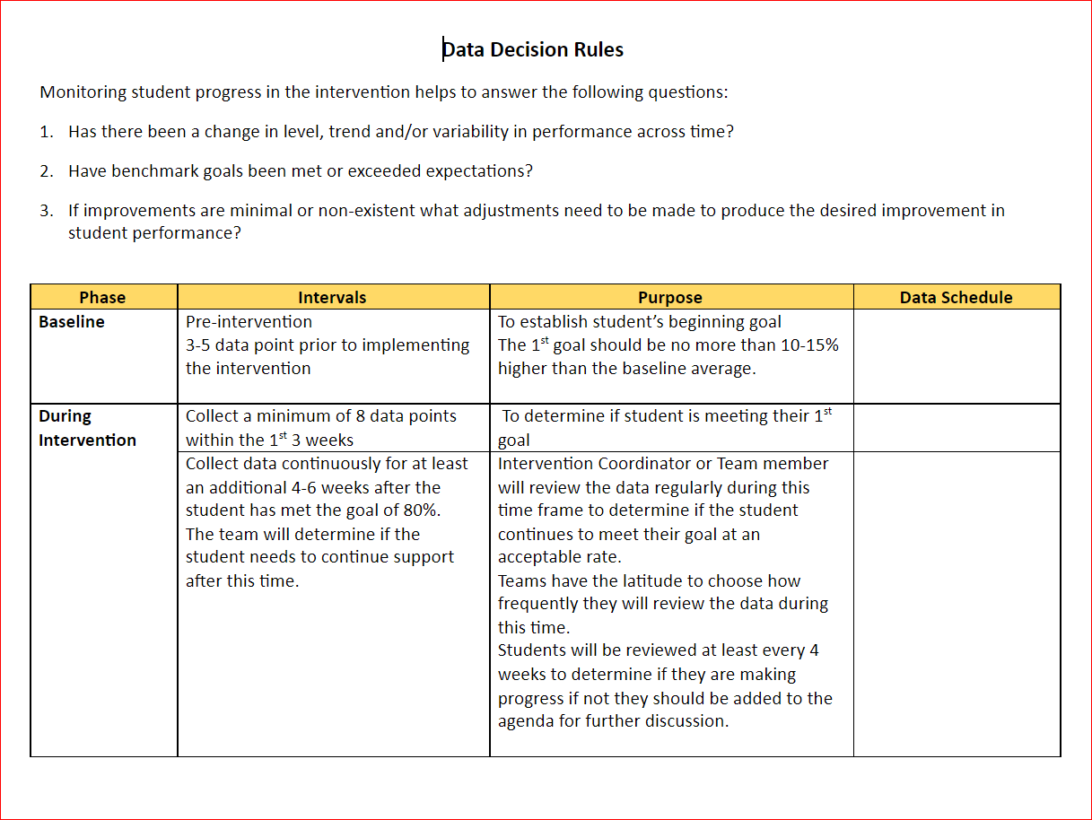
Revisit Intervention Data Decision Rules
Refer to Intervention Data Decision Rules for the following:
How and when will you monitor Implementation Fidelity?
How and when will you monitor Social Validity
Who will be responsible for tracking student outcome data related to how many have:
# of students that participated
# of students that graduated
# participated but required additional supports
When will students graduate from the intervention?
When and how will you conduct maintenance checks?
Notes:
Trainer Notes: Remind teams to refer back to the Intervention Data Decision rules your team created in the Intervention Data Decision Rules Lesson.and apply them to each intervention.

Slide 69
Pause & Reflect
What steps do you need to add to your action plan for fading student intervention?
Notes:
Trainer Notes: What steps do you need to add to your action plan?

Slide 70
Next Steps
Next Lesson: Practices of Implementation and Piloting the Intervention
Notes:
Trainer Notes: The final CICO lesson will walk you through the practices of implementation and how your team may piloting CICO to work on the kinks.

Slide 71
References
Algozzine, B., Barrett, S., Eber, L., George, H., Horner, R., Lewis, T., Putnam, B., Swain-Bradway, J., McIn tosh, K., & Sugai, G. (2019). School wide PBIS Tiered Fidelity Inventory. OSEP Technical Assistance Center on Positive Behavioral Interventions and Supports. https://www.pbis.org/ resource/tfi
Anderson, C. M., & Turtura, J. (2010). Academic behavior Check-in/Check out (ABC): Implementation manual. University of Oregon.
Crone, D., Hawken, L. S. & Horner, R. H. (2010). Responding to problem behavior in schools: The behavior ed ucation program (2nd ed.). New York: The Guilford Press.
Hawken, L. S., & Breen, K. (Directors). (2017). Check-in, check-out: A tier 2 intervention for students at risk (2nd ed.) [DVD]. New York: The Guilford Press.
Hawken, L. S., & Johnston, S. S. (2007). Preventing severe problem be havior in young children: The Behavior Education Program. Journal of Early and Intensive Behavior Intervention, 4(3), 599-613. http://doi.org/10.1037/ h0100394
National Implementation Research Network. (2014). PDSA - Who am I? University of North Carolina, Chapel Hill. Accessed July 29, 2020 from https://nirn.fpg.unc.edu/sites/nirn. fpg.unc.edu/files/resources/AI%20 Hub%20Activity%205.2%20PDSA%20 Who%20Am%20I.pdf

Slide 72


Contact Information
Check Out MO SW-PBS on Social Media:
Facilitator Contact Information:
pbismissouri.org
List HERE
facebook.com/moswpbs
instagram.com/moswpbs/

