Slide 1
MO SW-PBS Advanced Tiers
Check In Check Out
Course 6, Lesson Three

Slide 2
Facilitator Notes: Delete This Slide
Include the following slides:
Attention Signal
Introduction
Breaks (optional)
Determine how you will provide access to resources:
Optional : Make a copy of the CICO Development Checklist Action Plan and provide forced copy for each team to download and save.
Encourage all teams to make a copy of this document and use it throughout all of the lessons for developing CICO Systems.
This presentation is designed to cover the core content in a concise manner. Each consultant has the option to add activities that will help to enhance the content.

Slide 3
Working Agreements
Be Respectful
Be an active listener—open to new ideas
Use notes for side bar conversations
Be Responsible
Be on time for sessions
Silence cell phones—reply appropriately
Be a Problem Solver
Follow the decision making process
Work toward consensus and support decisions of the group
Notes:
Trainer Notes: “These will be the Working Agreements we will honor during all our training sessions this year.”

Slide 4
Attention Signal
Notes:
Trainer Notes: Facilitator: Select an attention signal.
To Know/To Say: “One of our agreements is to follow the attention signal.”
“Your team will work with your school to develop an attention signal you will use in every setting.”
“In order to get all of you focused after discussions, activities or breaks,
I will ________________________________________.”
(Insert your attention signal here.)
“Your task will be to finish your sentence, quiet your voice and ____________________________.”
(Insert what you want participants to do.)

Slide 5
Introductions
Notes:
Trainer Notes: Facilitator: Select an introductions activity

Slide 6
Handouts
Staff Notifications includes
  Participation
  Self-Monitoring
  Fading
  Graduation
Example Progress Report
Family Notifications of Participation Examples
Notification of student progress
  Weekly
  Fading
  Graduation
CICO Training Outline for Facilitators
CICO Training Outline for Classroom Teachers
CICO Training Outline Families
CICO Training Outline for Students
Responsibilities associated with CICO
Piloting 2 Videos
Notes:
Trainer Notes: These are the handouts for this course. They are available on the https://pbismissouri.org/ website. You can also download and create a google folder to share them with participants.

Slide 7
Lesson Description
This lesson provides SW-PBS teams with a guide for how to communicate and teach staff, families and students about CICO. It also provides examples and recommendations on how to pilot the intervention before beginning implementing fully.
Notes:
Trainer Notes: This lesson provides SW-PBS teams with a guide for how to communicate and teach staff, families and students about CICO. It also provides examples and recommendations on how to pilot the intervention before beginning implementing fully.
,In the teaming structures your team engaged in an activity for creating a system of two-way communication that broadly focused on who, what, when, and how communication occurs with essential partners..
Communication with staff and families about a student’s CICO milestones (e.g., entry, fading, graduation) should align with these communication practices.
In addition, a written description that explains important details of the intervention is one effective method for clear communication with ALL partners.

Slide 8
Pre-Requisites:
Tier 1 Essential Components
Science of Behavior
Advanced Tiers Teaming
Student Identification
Matching Function to Intervention: Gather and Review of Existing Data
Intervention Data Decision Rules
Intensifying the 8 ETLPS
CICO Purpose and Developing the Essential
Data for Implementation
Notes:
Trainer Notes: These are the prerequisites that your team should have participated in prior to engaging with this content.
Tier 1 Essential Components
Function Based Thinking
Advanced Tiers Teaming
Student Identification
DBDM FACTS (Part 1)
Intervention Data Decision Rules
Intensifying the 8 ETLPS
CICO Introduction and Systems of Implementation
Data for Implementation

Slide 9
Lesson Outcomes
At the end of this session, you will be able to…
Develop a plan for communication with staff, families and students regarding the CICO intervention
Develop a plan for training staff, families and students about the CICO expectations.
Develop a plan for Piloting the CICO intervention.
Notes:
Trainer Notes:
The outcomes for this lesson include developing the practices for communication, training and piloting CICO.

Slide 10
Organization of CICO Course Lessons
L1 - Systems for Implementation
(what we do for adults)
Personnel
Serviceable Base Rate
Location
System for Reinforcing Expected Behavior
L2 - Data for Implementation
(how we make decisions)
Process for monitoring student progress
Analyzing data
Responding to data
  Modifications
  Generalization of Skills
  Self-Monitoring
  Fading
L3 - Practices for Implementation
(what we do for students)
Communication for personnel, families & students
Training for personnel, families & students
Notes:
Trainer Notes: The Lessons will be organized by Systems Data and Practices for Implementation. This 3rd lesson is guiding teams how to develop a plan for how they will communicate and train personnel, families and students about CICO.

Slide 11

Rationale:
A student engages in unexpected behaviors because they efficiently and effectively meet the needs of the student. In order to decrease these behaviors it is important for staff, families and students to have a clear understanding of the intervention as well as have an opportunity to give input.
Piloting CICO will give the team time to test the systems, evaluate, and adjusted as needed before beginning full implementation.
Notes:
Trainer Notes:
The rationale behind this lesson: A student engages in unexpected behaviors because they efficiently and effectively meet the needs of the student. In order to decrease these behaviors it is important for staff, families and students to have a clear understanding of the intervention. They also need an opportunity to provide feedback , ask questions and voice concerns. This lesson will
Piloting CICO will give the team time to test the systems, evaluate, and adjusted as needed before beginning full implementation.

Slide 12
Reflective Questions
How can you involve staff and families in supporting student success in an intervention?
How can you ensure the student understands what is expected of them prior to participating in CICO?
Would there be any benefit to piloting the intervention with a few students prior to full implementation?
Notes:
Trainer Notes: Before proceeding to the CICO lesson here are some of the questions that your team needs to consider. You may not have these answers at this time but once you have completed this lesson your team should be able to answer these.

Slide 13
Missouri Teacher Standards Addressed
2.1: Cognitive, social, emotional and physical development
2.6: Language, culture, family and knowledge of community
3.1: Implementation of curriculum standards
5.1: Classroom management, motivation and engagement
5.2: Managing time, space, transitions and activities
5.3: Classroom, school and community culture
6.1: Verbal and nonverbal communication
6.2: Sensitivity to culture, gender, intellectual and physical differences
8.1: Self-assessment and improvement
8.2: Professional learning
Notes:
Trainer Notes:
These are the Missouri Teacher Standards that will be addressed in this lesson. If you want more information regarding these standards visit DESE.MO.GOV

Slide 14
Key Terms
CICO - Check in Check Out
Communication Plan
Piloting
Notes:
Trainer Notes: In this lesson here are a few of the key terms you will be introduced to.

Slide 15

Communication Plan
Notes:
Trainer Notes: Your team was introduced to the concept of establishing a system of two-way communication that broadly focused on who, what, when, and how communication occurs with
stakeholders. Communication with staff and families about a student’s CICO milestones (e.g., entry, fading, graduation) should align with these existing in
school communication practices.
To make communication as efficient as possible, your Team will want to create standard documents to notify families and teachers as students enter the different phases of the CICO intervention.

Slide 16
Staff Communication Plan Includes:
Notification of student participation
An introduction to the CICO Intervention
Regular sharing of individual student data for staff directly involved with students in the intervention
A general sharing to all staff of how many students are in the intervention and how many are having a positive response
A means for staff to voice questions, concerns or celebrations
Notes:
Trainer Notes: Some things that should be included in your staff Communication Plan are as follows:
A place for them to access written documentation about the intervention.
Regular sharing of individual student data for staff directly involved with students in the intervention
A general sharing to all staff of how many students are in the intervention and how many are having a positive response
A means for staff to voice questions, concerns or celebrations

Slide 17
Staff Notification Example 1
Teacher: _______________ Student: ___________________ Date: _______
Our school’s Advanced Tier Team has determined the above-named student has met eligibility criteria for participation in Check-In, Check-Out (CICO). The student’s parents/guardians have been contacted, and we are planning for the student to begin participation in CICO soon.
As the CICO Coordinator, I will be supporting you as you implement CICO. I will contact you soon to review the steps of CICO and your implementation responsibilities.
Mrs. Brown,
CICO Coordinator
AT- C6L3 Staff Notifications for CICO
Notes:
Trainer Notes: To make communication as efficient as possible, your Team will want to
create standard documents to notify teachers as students enter the different phases of the CICO intervention. The following examples are standardized templates that schools have created for communication with staff for the various phases of implementation

Slide 18
Staff Notification Example 2
Staff Notification of Self-Monitoring Phase of CICO
Teacher: ____________________ Student: ______________________ Date: ________ Date Self-Monitoring Is to Begin: __________________
Our school’s Advanced Tiers Team has reviewed the daily progress data for the above-named student and determined the student is ready to begin the self-monitor phase of Check-In, Check Out (CICO). Self-monitor involves both you and the student scoring the daily progress report (DPR).
As the CICO Coordinator, I will contact you soon to review the steps for self-monitor and your implementation responsibilities.
Mrs. Brown,
CICO Coordinator
AT- C6L3 Staff Notifications for CICO
Notes:
Trainer Notes: To make communication as efficient as possible, your Team will want to
create standard documents to notify teachers as students enter the different phases of the CICO intervention. The following example is one that schools have created for communication with staff when the student is moving to self monitoring phase of implementation.

Slide 19
Staff Notification Example 3
Staff Notification of Fading from CICO
Teacher: ____________________ Student: ______________________ Date: ________ Date
Fading Is to Begin: __________________
Our school’s Advanced Tier Team has reviewed the daily progress data for the above-named student and determined the student is ready to begin fading from Check-In, Check-Out (CICO). Fading involves gradually reducing the number of times both you and the student score the daily progress report (DPR).
As the CICO Coordinator, I will contact you soon to review the steps for fading and your implementation responsibilities.
Mrs. Brown,
CICO Coordinator
AT- C6L3 Staff Notifications for CICO
Notes:
Trainer Notes; To make communication as efficient as possible, your Team will want to
create standard documents to notify teachers as students enter the different phases of the CICO intervention. The following example is one that schools have created for communication with staff when the student is moving to fading phase of implementation.

Slide 20
Staff Notification Example 4
Staff Notification of Graduation from CICO
Teacher: ____________________ Student: _______________________________ Date: ___________ Date CICO will end: __________________
Our school’s Advanced Tier Team has reviewed the daily progress data for the above-named student and determined the student is ready to graduate from Check-In, Check-Out (CICO)! Congratulations and thank you for your effort to help the student be successful in CICO. This would not have been possible without your ongoing dedication!
The Advanced Tier Team is planning a graduation ceremony where you and the student will be recognized. The graduation ceremony will be announced through the Principal’s Notes to Staff.
Again, thank you for everything you have done to help this student be successful in CICO.
Mrs. Brown,
CICO Coordinator
AT- C6L3 Staff Notifications for CICO
Notes:
Trainer Notes: To make communication as efficient as possible, your Team will want to
create standard documents to notify teachers as students enter the different phases of the CICO intervention. The following example is one that schools have created for communication with staff when the student is graduating from the intervention. .

Slide 21
Sharing Student Progress with Staff
Considerations:
Share progress with classroom teacher on a biweekly (ex. email)
Send a progress report to the teacher quarterly
Share progress with all staff on quarterly basis.
Number of students participating
Number graduated
Notes:
Trainer Notes: Regular sharing of individual student data for staff directly involved with students in interventions should comply with Family Educational Rights and Privacy Act (FERPA) and other federal, state, and local policies.
Updates on implementation efforts and outcomes are some of the data you may want to share with staff.
The team will need to consider the frequency and mode that student progress data will be shared with staff.

Slide 22

Example for Classroom Teacher
AT-C6L3 Stars progress
Notes:
Trainer Notes: Here is a simple example of how you may want to share information with the teachers directly involved with the student participating in CICO.

Slide 23
Staff Voice
Inform staff that feedback is welcomed.
Options for feedback
  Email facilitator or coordinator
  Use a suggestion box
  Coordinator or Facilitator can ask open-ended questions about their experience with the current check-in/check-out system
Notes:
Trainer Notes: A means for staff to voice questions, concerns, and celebrations. It is important to ensure you create a safe space for honest feedback and clearly communicate that their input is valued.

Slide 24
Discussion
Review the staff notification examples.
Develop staff notification templates to meet the needs of your building.
Determine who will notify staff as students move through the phases of implementation(Coordinator/Facilitator)
How often will you share student progress data and how?
What method will you use for staff to voice questions, concerns, and celebrations?
Notes:
Trainer Notes:
What materials will be used to orientate staff to the students joining the intervention? Who will do this task?
Decide who will take responsibility for introducing the intervention and how you will notify the staff.

Slide 25
Family Communication Plan Includes:
Notification of participation
Introducing the Intervention
The frequency and mode that student progress data will be shared with families.
A means for families to voice questions, concerns, and celebrations.
Notes:
Trainer Notes: Communication Plan with families may need to be individualized as to the mode (text, email, phone call, note sent home) but should include
Notifying families when their child is going to begin participating in CICO. An introduction to the intervention. Sharing student progress and providing a means for 2 way communication.

Slide 26
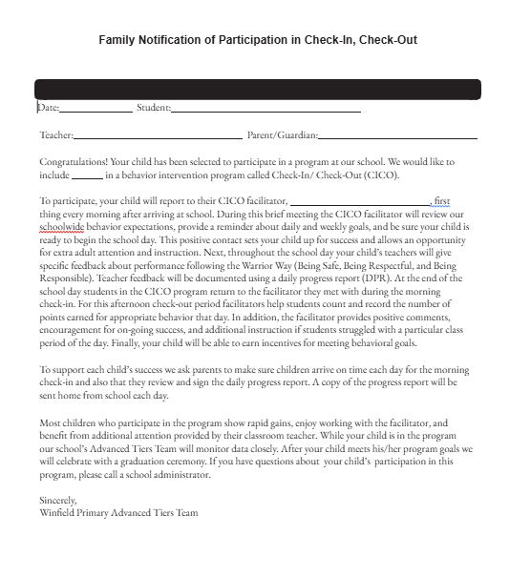
Family Notification Example 1
AT-C6L3 Family Notification for Check-In, Check-Out
Notes:
Trainer Notes: Families are typically notified rather than asked permission. This can be done by the coordinator or facilitator. .
To ensure communication is clear, schools need to be sensitive to the language used by families and to the preferred methods of communication. If the primary language is not English, attempts must be made
to develop letters and notes in the language the family uses.
Here are some example family notification letters that could be used to notify families when their student is going to participate in CICO. Review these examples and draft your own letter that your team will use when notifying families of participation.

Slide 27
Family Notification Example 2
Dear Mr. and Mrs. Jones,
We have a wonderful school wide goal this year. Our goal is to create an inclusive and welcoming environment which values, recognizes and affirms the worth of each individual in our learning community. To help us reach our goal, we are starting a very effective program for students who need additional support.
We call this program “Check In/Check Out (CICO).” Students involved in this program will check in with a staff member in the morning. At Check In they receive a point card allowing them to receive points for being a safe, respectful, responsible citizen of our school. The staff member and the student talk together, setting a goal of how many points the student will get that day. As they go through the day, they must periodically check in with their teacher to receive points. At the end of the day they check out with a staff member who totals the points and discusses how the day went. Students will bring home a report each day to let the parent know if they met their goal. There is a place for the parent to sign and then your child will bring the form back to school. Students can accumulate points to spend in various ways, like lunch with a teacher or computer time.
Joey has been chosen to participate in CICO. We are excited that he will be a part of our plan to make our school a safe, caring and fun place for students to go to school. If you have any questions, please contact me at ***.
AT-C6L3 Family Notification for Check-In, Check-Out
Notes:
Trainer Notes: The need for clear and open communication with families about their child’s CICO milestones is essential .daily communication with the child’s family as they provided feedback on the DPR form.
To ensure communication is clear, schools need to
be sensitive to the language used by families and to the preferred methods of
communication. If the primary language is not English, attempts must be made
to develop letters and notes in the language the family uses.

Slide 28
Family Notification Example 3
Dear Parent/Guardian:
This letter is to inform you that your student has been recommended for the Check-In, Check-Out program. The Check-In, Check-Out program is a positive intervention that allows students to start their day by checking in with an adult to promote positive behavior throughout the day. Students will also spend a few minutes at the end of each day with an adult reviewing their progress. Progress sheets may be sent home for you to review.
If you have any questions about the Check-In, Check-Out program, please feel free to contact me at 555-555-5555.
AT-C6L3 Family Notification for Check-In, Check-Out
Family Notification Examples
Notes:
Trainer Notes: Parents are typically notified rather than asked permission. This is done by the coordinator or facilitator. .
Here are some example family notification letters that could be used to notify families when their student is going to participate in CICO. Review these examples and draft your own letter that your team will use when notifying families of participation.

Slide 29
Sharing Student Progress with Families
Considerations:
Share progress daily via copy of the DPR.
Send a progress report to the families weekly or quarterly
Notes:
Trainer Notes: It is also important to communicate with families regarding their child’s progress in the CICO intervention

Slide 30
Example of Progress Report
Notes:
Trainer Notes: You could use this same example to send to parents on a weekly or quarterly basis.

Slide 31
Example: Student Progress Notification for Families
Weekly Progress Note to Family
Dear Parent or Guardian,
This week your child’s average percentage of CICO points earned was ________%.
Your child’s goal is _____%.
We thank you for encouraging your child to follow expectations at school.
Contact me if you have questions or concerns.
Check-In, Check-Out Facilitator
Phone Number
Email
AT-C6L3 Family Notification for Check-In, Check-Out
Notes:
Trainer Notes: While your team may choose to send home copies of the student DPR daily some may choose to provide weekly progress notes to the family

Slide 32
Example: Family Fading Notification
Dear Parent or Guardian,
This week your child’s average percentage of CICO points earned was ________%. Your child’s goal is _____%.
We are excited to inform you that your child has met his/her goal often enough that it is time to help him/her become more independent. We will slowly fade the number of times your child checks in with his teacher(s) throughout the day. We will continue to monitor progress to ensure she/he is successful.
We thank you for encouraging your child to follow expectations at school. Contact me if you have questions or concerns.
Check-In, Check-Out Facilitator
Phone Number
Email
AT-C6L3 Family Notification for Check-In, Check-Out
Notes:
Trainer Notes: As the student progresses to the fading process you may also want to notify the family of this milestone.

Slide 33
Example: Family Graduation Notification
Dear Parent or Guardian,
Congratulations! Your child has successfully completed our school Check-In, Check-Out (CICO) program and will be graduating from it.
We are proud of the progress your child has made and look forward to continued success at school.
Please contact us if you have any concerns or questions.
Sincerely,
Building CICO Coordinator or Facilitator Name
AT-C6L3 Family Notification for Check-In, Check-Out
Notes:
Trainer Notes: It is important to inform the families when the student is ready to graduate from the program.

Slide 34

Family Voice
Inform families that feedback is welcomed
Options for feedback
  Email or call facilitator or coordinator
  Write comments on the DPR when signing daily
Notes:
Trainer Notes: A means for families to voice questions, concerns, and celebrations. It is important to ensure you create a safe space for honest feedback and clearly communicate that their input is valued. Keep in mind that some may not have internet access so they may not be able to communicate via email.

Slide 35
Student Communication Plan
Communication Plan with student should include:
Notification of participation
Who their facilitator will be
When and where they will be checking in and out
Information regarding the DPR
Notes:
Trainer Notes:Communication with students entering and transitioning through CICO is just as important as keeping staff and families informed. How your school will do that
will depend on the size of your school, age of your students and typical communication methods.
Communication Plan with student should include:
Notification of participation
Who their facilitator will be
When and where they will be checking in and out
Information regarding the DPR expectations.

Slide 36
Discussion
Review the family notification examples.
Develop family notification templates to meet the needs of your building.
Determine who will send out the notifications (Coordinator/Facilitator)
How often will you share student progress data ?
What method will you use for families to voice questions, concerns, and celebrations?
What information will be shared with students and how?
Notes:
Trainer Notes:
What materials will be used to orientate parents to the intervention? Who will do this task?
Decide who will take responsibility for notifying families that their student is starting in the intervention?

Slide 37
Pause & Reflect
What steps do you need to add to your action plan about communicating to staff, families and students?
Notes:
Trainer Notes: What steps do you need to add to your action plan?

Slide 38

Plan for Training
Personnel, Families and Students
Notes:
Trainer Notes: It is important to teach all members how to perform tasks associated with their role in the intervention. To ensure maximum effectiveness, explicit instruction should occur with each participant.

Slide 39
Training Staff
All Staff members should know…
What the intervention is named in your building
Who coordinates and facilitates
How children are identified to participate
the maximum number of students that can be served at one time
The purpose of the intervention
Progress of children participating in the group
Some staff members will need to know…
Baseline data collection procedures
Providing positive and corrective feedback statements and precorrects
Awarding points
How to complete the progress report
Initiating positive interactions with students
How to interpret response to intervention data
How to support the self-management procedures
Who is available for assistance if needed
Response to major or minor referrals
Notes:
Trainer Notes: Training about Check-In, Check-Out should be provided for all staff members, however, the level of detail needed and timeframe for providing information varies according to extent of participation.
The following general guidelines will be helpful as your Advanced Tiers Team identifies professional learning opportunities associated with this Intervention. This information should be provided annually at minimum. In addition, all staff members should receive periodic updates (e.g., 2-3 per school year) about the number of students participating and general response to the intervention.
Teachers: Teachers play a crucial role in CICO. Using expectations listed on the DPR, teachers give regularly scheduled positive specific feedback about behavioral performance to students in CICO. Teacher feedback occurs at the
end of each class period or during natural transitions throughout the school day. Specifically, the classroom teacher gives positive, specific praise for expected behavior, provides corrective feedback when applicable, and then rates student
demonstration of expectations using a predetermined point system. Teachers are explicitly directed to initiate the feedback interactions; it is not the student’s responsibility to initiate this task. Some teachers may be reluctant to implement
CICO, stating they don’t have the time to give additional feedback. Once a teacher becomes fluent in providing feedback, it should take less than one min ute, per student, per feedback interaction. While this may seem like an addition
Understanding the CICO concept:
Explain the purpose of CICO as a Tier 2 intervention designed to provide targeted support to students needing additional behavioral guidance, focusing on positive reinforcement and frequent feedback to improve behavior.
Identifying eligible students:
Discuss the criteria for selecting students who would benefit from CICO, including behavioral concerns and potential need for increased adult support.
Role of the "check-in" facilitator:
Clearly outline the responsibilities of the staff member who will be conducting the check-ins and check-outs, including greeting students positively, setting clear expectations, and reviewing daily goals.
Data collection tools:
Introduce the "Daily Progress Report" (DPR) or similar form used to track student behavior throughout the day, including specific targeted behaviors and rating scales.
Providing feedback:
Emphasize the importance of giving frequent, specific, and positive feedback throughout the day, including providing praise for positive behaviors and constructive feedback when needed.
Behavior expectations:
Clearly define the targeted behaviors that will be focused on during CICO, ensuring all staff members understand the expectations for student behavior.
Positive reinforcement strategies:
Discuss effective methods for providing positive reinforcement, such as verbal praise, tangible rewards, or privileges, based on student needs and progress.
Addressing challenging situations:
Role-play scenarios to practice how to handle potential challenges, such as non-compliance or escalated behaviors, while maintaining a positive and supportive approach.
Communication with parents/guardians:
Explain the importance of involving parents in the CICO process by providing regular updates on student progress and ensuring they understand the intervention goals.

Slide 40
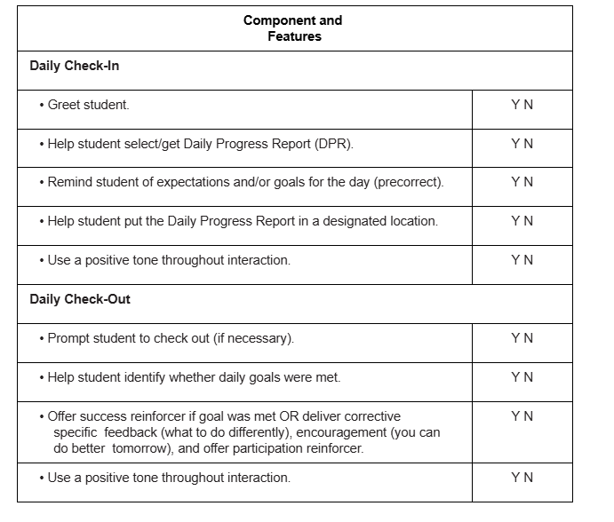
Example:
CICO Training Outline for Facilitators
AT-C6L3 CICO Teaching Outline Facilitator
Notes:
Trainer Notes: Teaching Outline for Facilitator
• Providing the daily check-in and check-out components of CICO.
• Entering DPR data.
• Maintaining records.
• Creating student graphs.
• Meeting with the coordinator to prioritize students who will be discussed
during team meetings.
• Attending team meetings as requested.
• Assisting with school-to-home communication.
Following is the CICO Teaching Outline for Facilitators, which is an example checklist of implementation procedures that the Adv, Tier Team can use when training.
In addition, the Teaching Outline may also serve as a self-assessment by providing space for facilitators to mark each feature completed
. During initial implementation (e.g., the first week or two) it may be effective to ask facilitators to submit completed Teaching Outline forms to the CICO Coordinator.
This provides the coordinator with an indirect method for monitoring implementation fidelity, and it also allows facilitators a mechanism for receiving assistance if they have difficulty implementing a particular step.

Slide 41
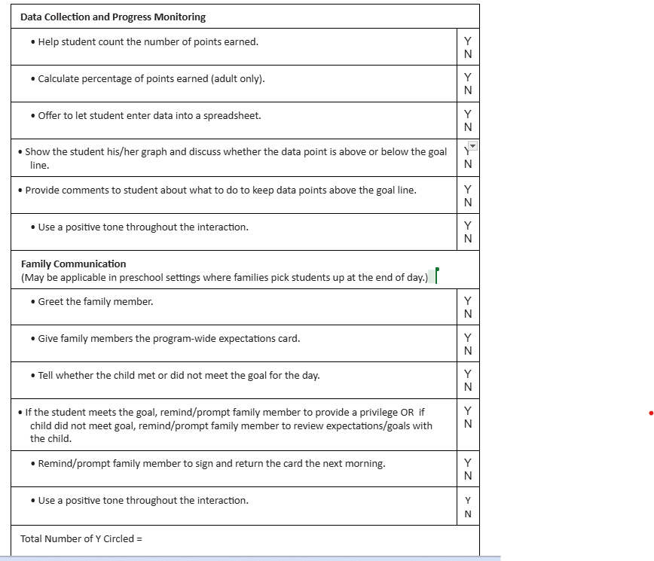
Example:
CICO Training Outline for Facilitators
Notes:
Trainer Notes: This example includes the components for Data Collection and Progress Monitoring
•

Slide 42
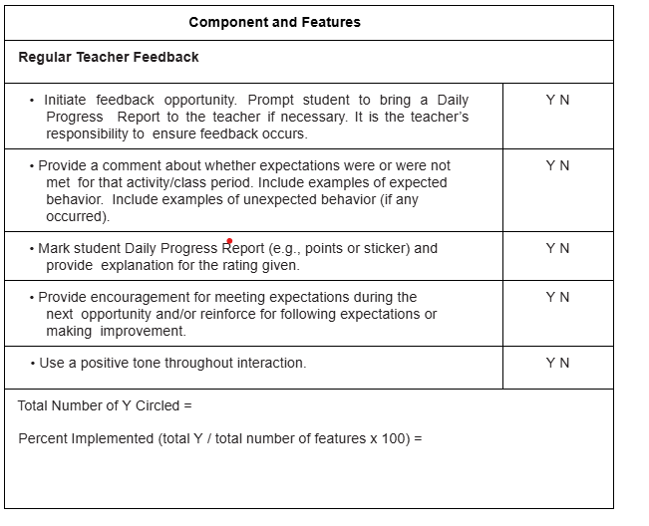
Example:
CICO Training Outline for Classroom Teachers
AT-C6L3 CICO Teaching Outline for Teachers
Notes:
Trainer Notes: This is CICO Teaching Outline for Teachers, which is an example outline of implementation procedures that the Adv, Tier team could use when training.
In addition, the Teaching Outline may also serve as a self-assessment by providing space for teachers to mark each feature completed. During initial implementation (e.g., the first week or two) it may be effective to ask teachers to submit completed Teaching Outline forms to the CICO Coordinator.
This provides the coordinator with an indirect method for monitoring implementation fidelity and also allows teachers a mechanism for receiving assistance if they have difficulty implementing a particular step.
Teachers will • Read the steps and consider your level of participation.
Then Circle the “Y” which means, “Yes” if you feel you understand and consistently complete the step. • Circle the “N” which means “No” if you do not consistently use the step or if you do not understand how to complete a step.

Slide 43
Informing Families
Families need to be informed about the following:
Basic procedures for participating in and supporting the intervention
Purposes of the intervention
Expectations for child’s daily participation
Reviewing and signing the DPR
Consideration of reinforcers provided at home for meeting goals
Self-monitoring, fading and graduation
Notes:
Trainer Notes: Some of things that families need to be informed about
Basic procedures for participating in and supporting the intervention
Purposes of the intervention
Expectations for child’s daily participation
Reviewing and signing the DPR
Consideration of reinforcers provided at home for meeting goals
Self-monitoring, fading and graduation

Slide 44
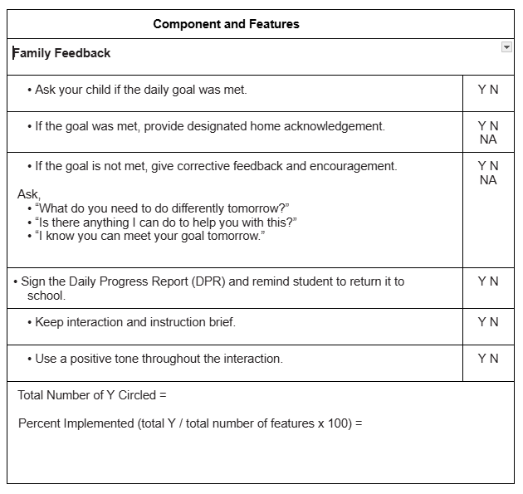
Example:
CICO Training Outline for Families
AT-C6L3 CICO Teaching Outline Families
Notes:
Trainer Notes:Once a student is selected to participate, the CICO coordinator or facilitator should provide explanation and details about the purpose and process of the intervention to the families of students that will be participating. Ideally, this introduction will occur in a face-to-face format with the student, his or her parents, and at least one classroom teacher attending together. The introductory meeting is the time to establish commitment for active participation from each individual stakeholder (i.e., teacher, parent, and student). Providing written materials that specifically describe steps for active participation will be helpful for communicating how the intervention components will be implemented across the facilitator, the student, the classroom teacher(s), and family members.
This is an example CICO Teaching Outline for Families. This checklist can be used when teaching families how to effectively support the intervention at home and can also be used by families as a self-assessment and as a reminder of the important role they play in the CICO process

Slide 45
Teaching Students
Participating students need to know basic procedures for participating in the intervention.
Purposes of the intervention
Behavioral Expectations
Purpose of the DPR
Opportunities to periodically see and receive feedback about their graphed data.
Menu of Reinforcers
Role Play (accepting positive and corrective feedback, handling disappointment if goal is not met, target skill including any steps)
How and when to self-monitor
Notes:
Trainer Notes: Who will be responsible for explaining the intervention to the participating students?
Participating students need to know basic procedures for participating in the intervention.
Purposes of the intervention
Behavioral Expectations
Purpose of the DPR
Opportunities to periodically see and receive feedback about their graphed data.
Menu of Reinforcers
Role Play (accepting positive and corrective feedback, handling disappointment if goal is not met, target skill including any steps)
How and when to self-monitor

Slide 46
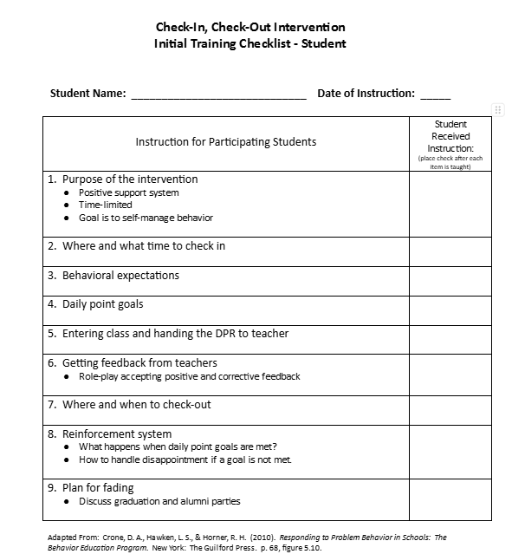
Example:
CICO Training Outline for Students
AT-C6L3 Student CICO Initial Training Checklist
Notes:
Trainer Notes:Teaching students how to accept both positive specific feedback and corrective specific feedback and how to handle disappointment if a goal is not met is an important step that is sometimes overlooked. Role-playing various scenarios of the teacher giving feedback and scoring the DPR can help students master these skills.

Slide 47
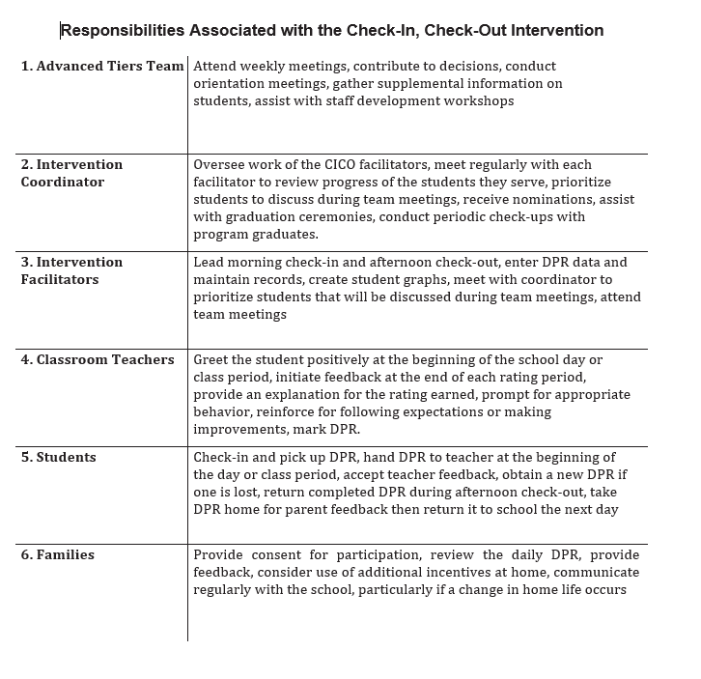
AT-C6L3 Responsibilities Associated with the Check-In, Check-Out Intervention
Notes:
Trainer Notes: Delineating roles by identifying specific responsibilities that need to be accomplished by each person involved in the intervention can be beneficial for all partners. This handout might be a beneficial tool for helping all partners understand their responsibilities

Slide 48
Discussion
When will you train relevant partners?
What materials will be needed?
Who will do the training?
Notes:
Trainer Notes:Each person who participates or contributes to the intervention must deeply understand and agree to his or her responsibility. Initial training should include basic information about the DPR, how to sign and rate, and how to provide effective feedback.

Slide 49
Pause & Reflect
What steps do you need to add to your action plan about training personal, families, and students?
Notes:
Trainer Notes: What steps do you need to add to your action plan?

Slide 50
Preparing to Pilot/Implement
Notes:
Trainer Notes: The last outcome that is covered in this lesson is piloting the intervention with students.
A pilot gives you a chance to test how your plan works. Once your team has a small number of volunteers for the CICO pilot, you will need to provide an overview of CICO to give them the background knowledge to implement CICO.
Implementing a CICO pilot will allow your Adv. Tier Team to practice all of the essential features of CICO with a small group of students and staff, then work out any barriers or “kinks” in your system before beginning full implementation.
In addition, a pilot will help staff and students understand the purpose of CICO and all the essential features needed to implement it. Those staff and students involved in the pilot can celebrate their successes and advocate for expanded, full implementation.

Slide 51
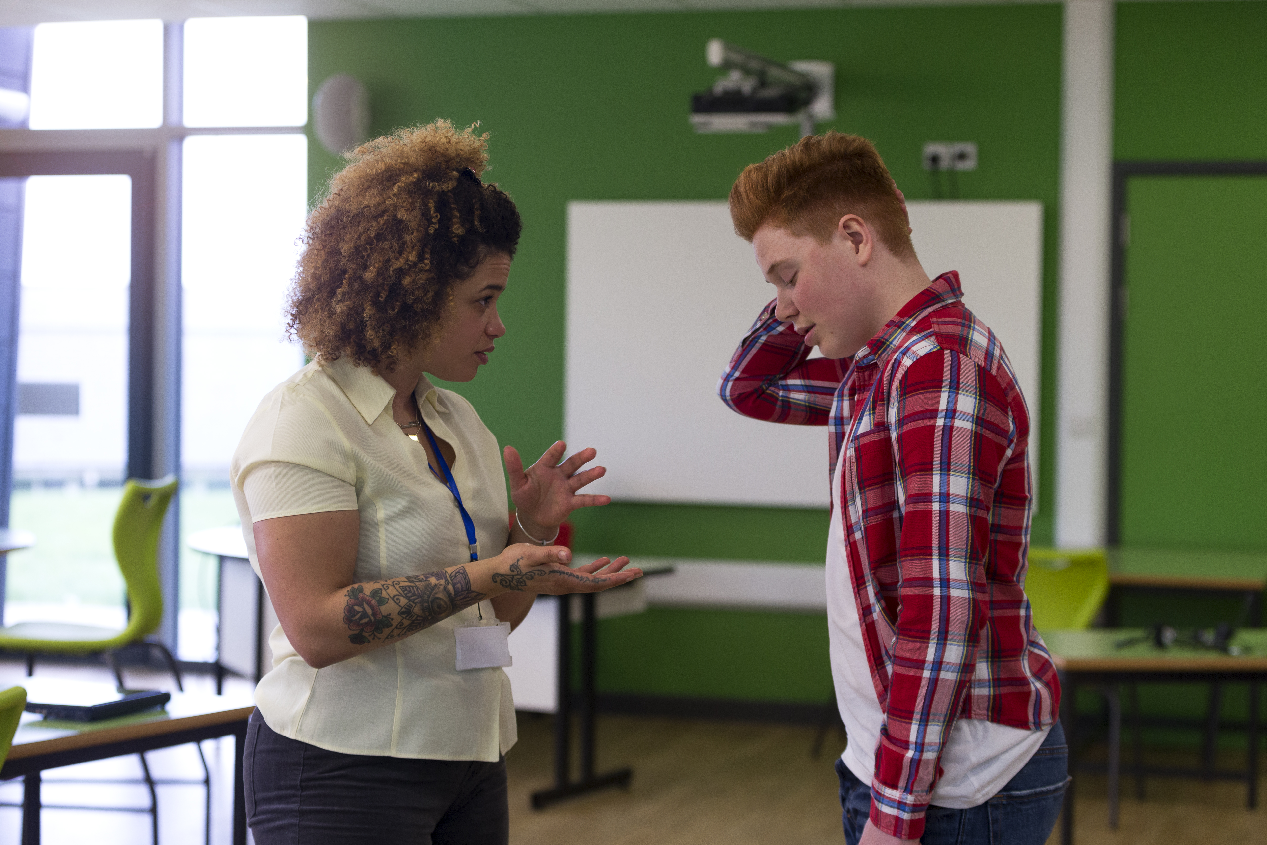
Staff Participation in Piloting
Options:
Advanced Tiers Team may choose to pilot first
Advanced Tiers Team may seek volunteers from staff
Notes:
Trainer Notes: It is suggested the Adv. Tiers Team seek volunteer staff to participate in the pilot. People who want to learn the process are more likely to give it their best effort. The other option is for the Adv. Tiers Team members to pilot the intervention.

Slide 52

Student Participation in Pilot
Pilot 1-3 students until CICO Systems are solid
Notes:
Trainer Notes: You may want a team member to pilot with 1-3 students to see how the logistics work before beginning full implementation. This will give the team time to test the system evaluate, and adjusted as needed.

Slide 53

When to Pilot
Six to eight weeks would be the minimum time needed to fully implement your pilot.
Schools may choose to pilot either in the beginning of the year or last trimester/semester.
Notes:
Trainer Notes: Six to eight weeks would be the minimum time needed to fully implement your pilot so you can implement the entire Adv. Tiers system and CICO process.
Some schools find it helpful to implement a pilot early enough in the school year so you can implement the entire Adv. Tiers system and CICO process and make changes as needed.
Others prefer to pilot last trimester or semester of the school year, which gives them ample time and time over the summer to plan for full implementation at the beginning of a new school year. Either is fine. Your team will decide what works best for your building.

Slide 54
Student Recommended for CICO
CICO Implemented
Morning
Check-in with assigned Factiliator
CICO Coordinator
Summarizes Data
For Decision Making
Parent
Feedback
Regular Teacher
Feedback
Bi-weekly CICO Meeting
to Assess Student
Progress
Afternoon
Check-out with assigned Factiliator
Revise
Program
Exit
Program
Notes:
Trainer Notes: Painting a clear picture of the CICO process is important for staff to have a clear understanding of the expectations. Once developed, the CICO intervention is designed to be continuously available and easily accessed soon after a student is identified. In addition, although more time is required from staff members who coordinate the program, classroom teachers can usually implement the intervention in less than 5-10 minutes per day.

Slide 55
Implementation Example
Morning Check-in
  Consistent location
  Begin with positive greeting
  Prompt for picking up daily progress report (DPR)
  Prepare for day (breakfast, pencil, paper, planner)
  Reminder of Expectations
  Provides access to positive adult attention, pre-correct for behavioral and academic expectations and organizes student materials
Notes:
Trainer Notes:
CHECK-IN. Participating students complete a “check-in” with a CICO facilitator each morning after arriving to school. The facilitator provides students with a Daily Progress Report (DPR) and offers precorrects for meeting daily behavior expectations and point goals.
Morning check-in:
The student meets with their designated adult (often a teacher or counselor) to discuss their goals for the day and set a positive mindset.

Slide 56

Check in Example
Notes:
Trainer Notes: CICO Pre-1 Video clip It took approximately 2 minutes to check the student in for the day and help her set her daily goals.

Slide 57
Implementation Example
Throughout the Day
  Student carries a Daily Progress Report (DPR)
  Teacher greets, assist with setting goals and provides pre-corrects
  Established criteria for pre-corrects and points
  Teacher provides feedback and awards points
  Provides high rates of adult attention and specific performance feedback
Notes:
Trainer Notes: REGULAR TEACHER FEEDBACK. Using expectations listed on the DPR, students receive regularly scheduled specific feedback about behavioral performance from their classroom teacher. Teacher feedback occurs at the end of each class period or during natural transitions throughout the school day. Specifically, the classroom teacher gives positive, specific praise for appropriate behavior, provides corrective feedback when applicable, and then rates student demonstration of expectations using a predetermined point system. Teachers are explicitly directed to initiate the feedback interactions if a child does not independently ask for ratings on the DPR.
Throughout the day:
Teachers or other staff members provide feedback on the student's behavior, noting progress towards their goals.

Slide 58
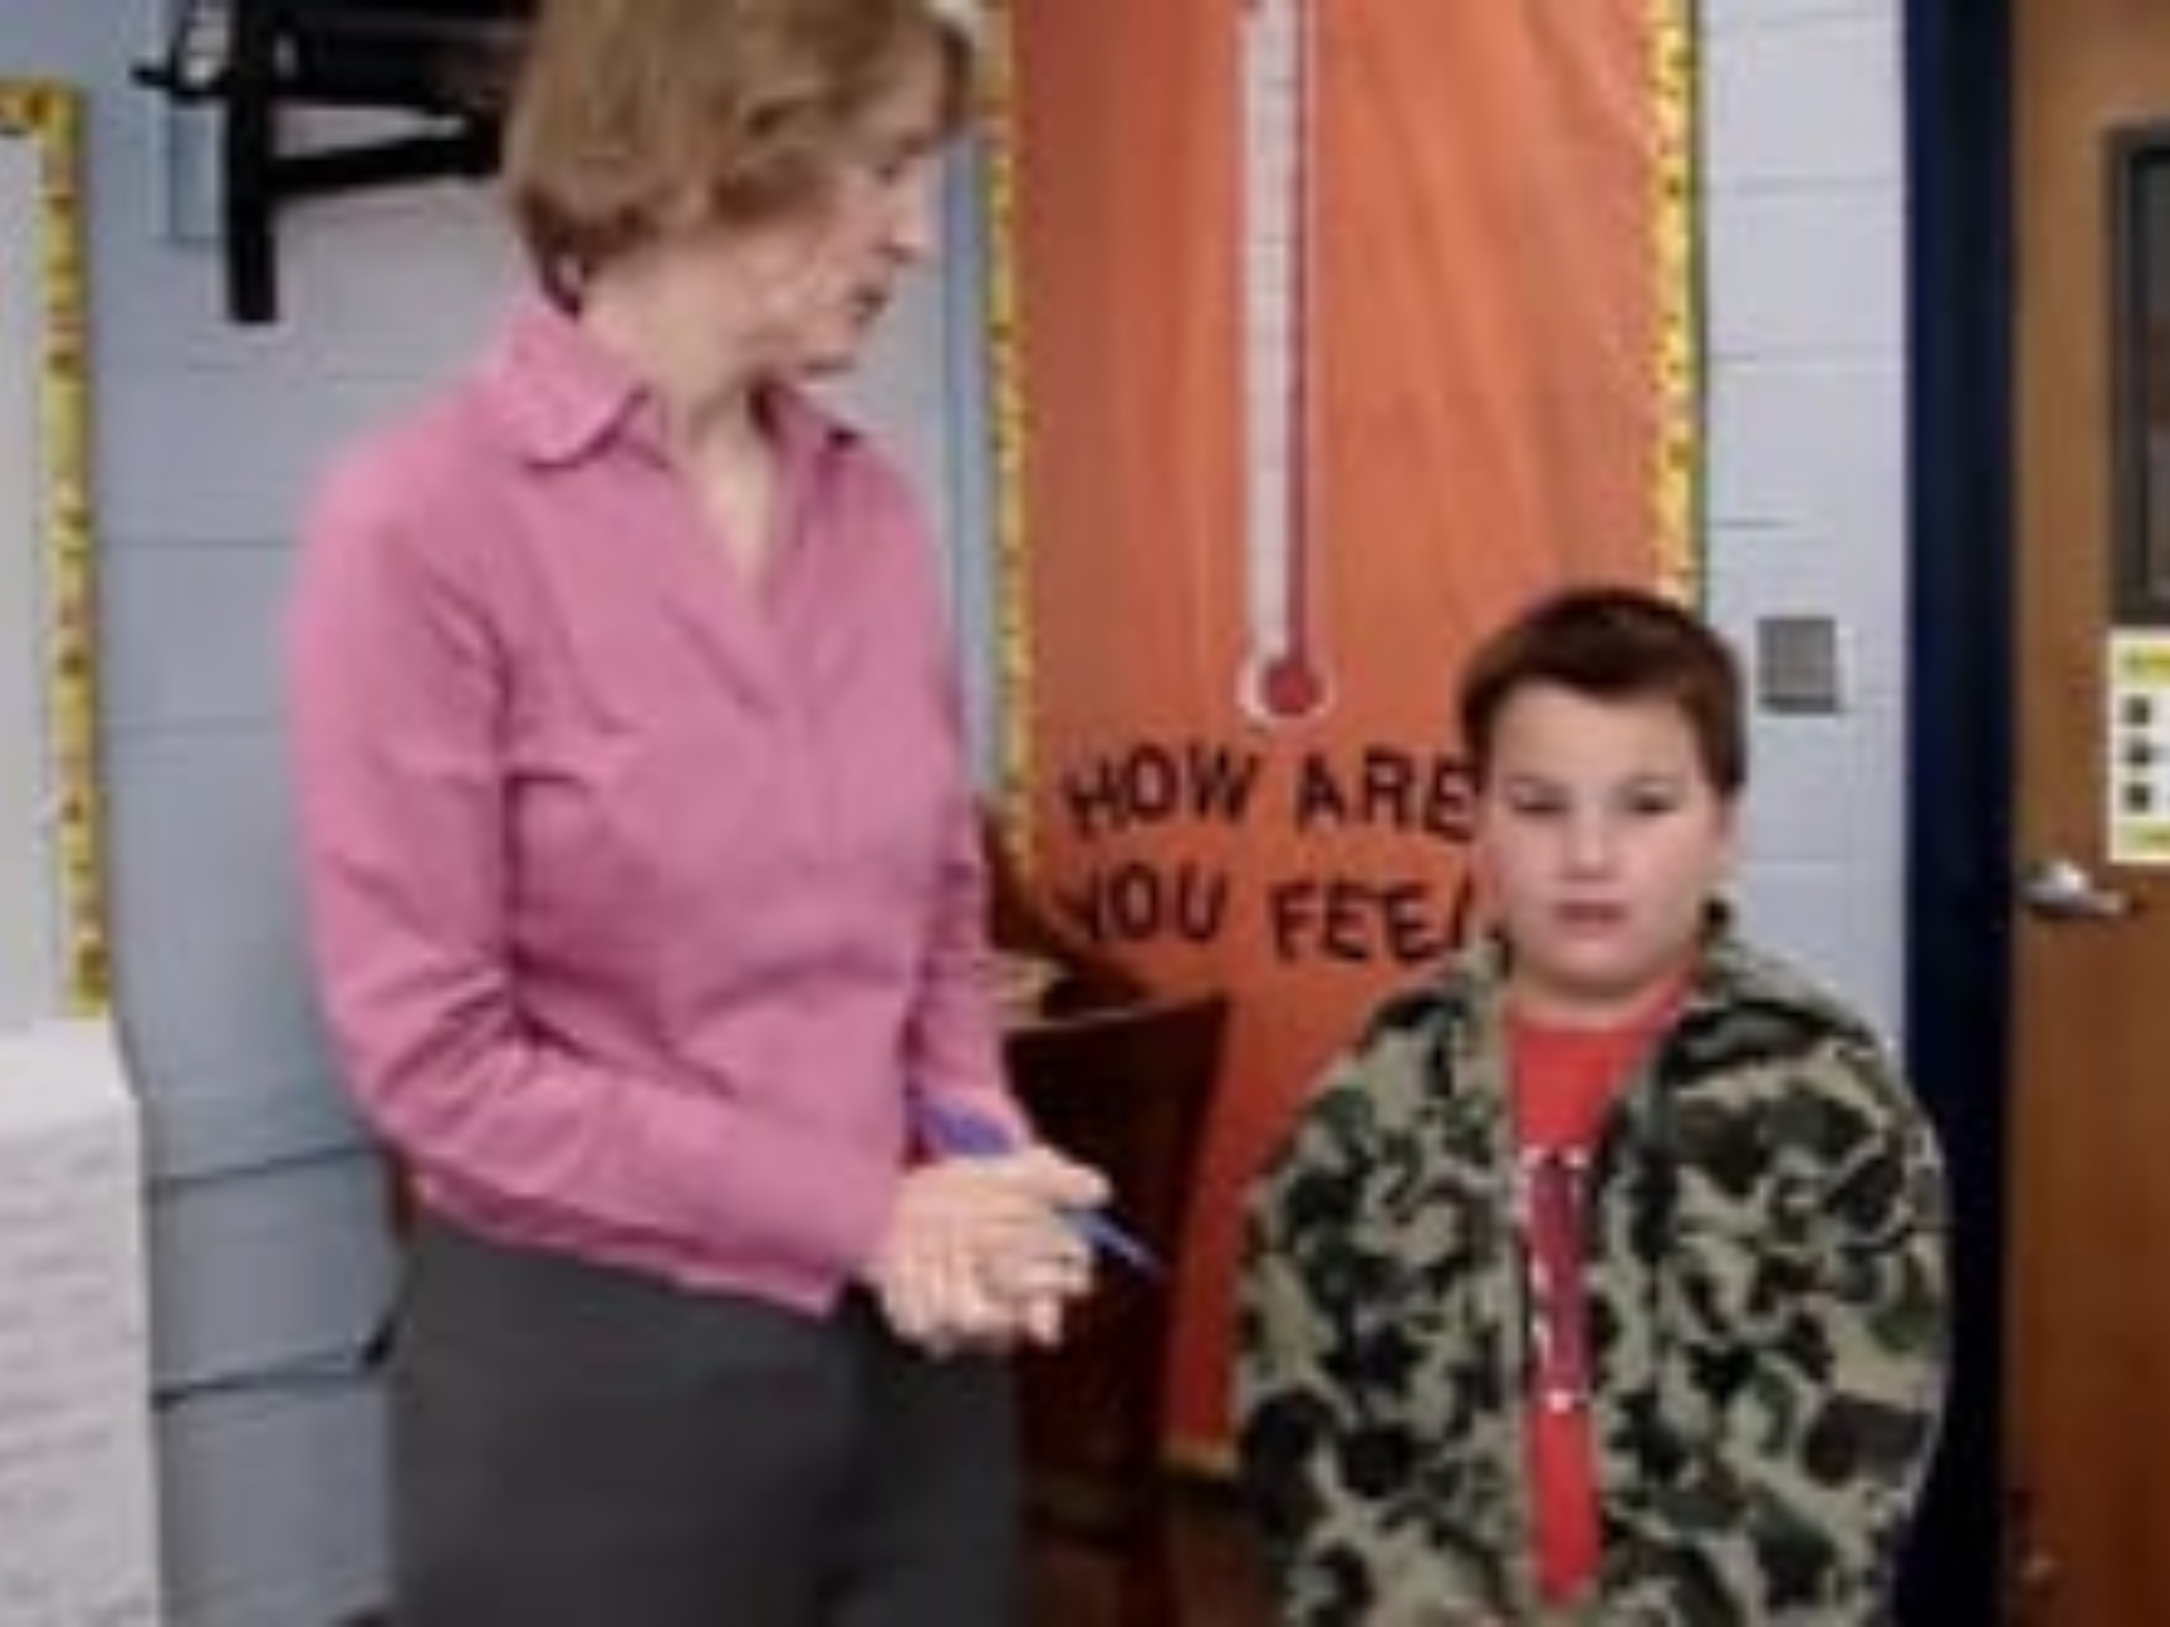
Teacher Positive
Notes:
Trainer Notes: Positive Feedback Video Clip is a sample of providing positive recognition. This took approximately a minute for the teacher to provide positive feedback to the student. (After viewing, ask teams to discuss what they saw and heard).

Slide 59

Teacher Corrective
Notes:
Trainer Notes: ( it takes a 98 sec. for the teacher to provide feedback) Corrective Feedback Video Clip is a sample of providing corrective feedback. (After viewing, ask teams to discuss what they saw and heard) How do you think the student felt? How do you think the interaction affected their relationship? Why?

Slide 60
Implementation Example
End of Day Check-out
  Consistent Location
  Adult positive greeting
  Total points, calculate percentage, and enter data
  Daily and/or weekly reinforcement for meeting goals
  Quick debrief with student
  Provide parent communication
  Provides positive adult attention, specific performance feedback and progress monitoring
Notes:
Trainer Notes: CHECK-OUT. At the end of each school day, students return to the intervention facilitator for “check- out”. At this time points earned on the DPR are totaled. Intervention facilitators provide students with additional verbal praise and may offer a token associated with the existing schoolwide recognition system if daily or weekly goals are met. If a point goal is not met, the facilitator provides re-teaching of expectations and supportive encouragement.\
Afternoon check-out:
The student meets with their adult again to review their day, receive feedback on their behavior, and discuss any challenges they faced.

Slide 61

Check Out Example
Notes:
Trainer Notes: CICO Post-1 Video clip The facilitator took a minute and a half to check the student out.

Slide 62
Implementation Example
Data Collection and Progress Monitoring
  Facilitators (or students) enter DPR percentages in an excel spreadsheet or other graphing tool(Advanced Tiered Spreadsheet)
  Student data graphed
  Results reviewed and intervention decisions are made
Notes:
Trainer Notes: Intervention facilitators enter percentage of DPR points earned by each student into a data collection spreadsheet. Student data is periodically graphed and then reviewed by the school’s behavior support team. Results are used to monitor progress and make intervention decisions.

Slide 63

Implementation Example
Family Participation
  Students are reminded to take DPR home
  Students receive additional feedback from parent
  Parents sign and return DPR to school the following day
  Students are reinforced for returning their DPR signed.
Notes:
Trainer Notes: The intervention facilitator promotes school to home communication and family participation with the intervention. Students are reminded each day to take their DPR home. This allows an opportunity to receive additional feedback from a parent or guardian. Parents are asked to sign and then return the DPR to school the following day. If a DPR is not signed and returned, re-teaching and encouragement are provided but no point loss or punitive responses occur.

Slide 64

Evaluating the Pilot
Data to collect, analyze, and use for evaluation of your CICO pilot include:
• Fidelity of Implementation
• Team process
• Social validity
• End of session/year evaluation
Notes:
Trainer Notes: One important advantage of a pilot is that it allows you to practice collecting evaluation data and subsequently using that data to make adjustments prior
to full implementation.
Data to collect, analyze, and use for evaluation of your CICO pilot include:
• Fidelity of Implementation
• Team process
• Social validity
• End of session/year evaluation

Slide 65
Discussion
When will you begin piloting CICO ?
With which students?
Who will be the facilitators?
How will you communicate this information to your staff?
How will you evaluate your CICO pilot?
Notes:
Trainer Notes: Decide how your pilot will be structured. Which teachers, grades, or departments might be dedicated CICO pilot implementers? What will your timeline be
to begin your pilot?

Slide 66
Pause & Reflect
What steps do you need to add to your action plan about piloting CICO?
Notes:
Trainer Notes: Add steps to your action plan regarding piloting CICO.

Slide 67
Next Steps
Refer to your action plan and decide what is next to meet the needs of your students and staff.
Notes:
Trainer Notes: Do you need to add any final steps to your action plan?

Slide 68
Closing
Social Skills Intervention Group (SSIG) Course
Notes:
Trainer Notes: The next step is for your team to engage in the course on how to establish SSIG in your building as a Tier 2 Intervention.

Slide 69
References
Algozzine, B., Barrett, S., Eber, L., George, H., Horner, R., Lewis, T., Putnam, B., Swain-Bradway, J., McIn tosh, K., & Sugai, G. (2019). School wide PBIS Tiered Fidelity Inventory. OSEP Technical Assistance Center on Positive Behavioral Interventions and Supports. https://www.pbis.org/ resource/tfi
Anderson, C. M., & Turtura, J. (2010). Academic behavior Check-in/Check out (ABC): Implementation manual. University of Oregon.
Crone, D., Hawken, L. S. & Horner, R. H. (2010). Responding to problem behavior in schools: The behavior ed ucation program (2nd ed.). New York: The Guilford Press.
Hawken, L. S., & Breen, K. (Directors). (2017). Check-in, check-out: A tier 2 intervention for students at risk (2nd ed.) [DVD]. New York: The Guilford Press.
Hawken, L. S., & Johnston, S. S. (2007). Preventing severe problem be havior in young children: The Behavior Education Program. Journal of Early and Intensive Behavior Intervention, 4(3), 599-613. http://doi.org/10.1037/ h0100394
National Implementation Research Network. (2014). PDSA - Who am I? University of North Carolina, Chapel Hill. Accessed July 29, 2020 from https://nirn.fpg.unc.edu/sites/nirn. fpg.unc.edu/files/resources/AI%20 Hub%20Activity%205.2%20PDSA%20 Who%20Am%20I.pdf

Slide 70


Contact Information
Check Out MO SW-PBS on Social Media:
Facilitator Contact Information:
pbismissouri.org
List HERE
facebook.com/moswpbs
instagram.com/moswpbs/

