Slide 1
MO SW-PBS Advanced Tiers
Social Skills Intervention Groups
Course 7, Lesson 2 : Data for Implementation of SSIG

Slide 2
Facilitator Notes: Delete This Slide
Make copies of the SSIG Development Checklist and Action Plan to share with your teams. It is recommended that you create a google folder with all of the handouts and add the links so they can access them electronically.
Include the following slides:
Attention Signal
Introduction
Breaks
Determine how you will provide access to resources:
This presentation is designed to cover the core content in a concise manner. Each consultant has the option to add activities that will help to enhance the content.

Slide 3
Working Agreements
Be Respectful
Be an active listener—open to new ideas
Use notes for side bar conversations
Be Responsible
Be on time for sessions
Silence cell phones—reply appropriately
Be a Problem Solver
Follow the decision making process
Work toward consensus and support decisions of the group
Notes:
Trainer Notes:
To Know/To Say: “These will be the Working Agreements we will honor during all our training sessions this year.”

Slide 4
Attention Signal
Notes:
Trainer Notes: Facilitator: Select an attention signal.
To Know/To Say: “One of our agreements is to follow the attention signal.”
“Your team will work with your school to develop an attention signal you will use in every setting.”
“In order to get all of you focused after discussions, activities or breaks,
I will ________________________________________.”
(Insert your attention signal here.)
“Your task will be to finish your sentence, quiet your voice and ____________________________.”
(Insert what you want participants to do.)

Slide 5
Introductions
Notes:
Trainer Notes: Facilitator: Select an introductions activity
To Know/To Say:

Slide 6
Handouts
SSIG Development Checklist
Weekly Monitoring Sheet Example 1
Weekly Monitoring Sheet Example 2
SSIG Group Monitoring Sheet Example 1
SSIG Group Monitoring Sheet EXCEL Example
Classroom Observation Checklist
Advanced Tiers Spreadsheet ( https://pbismissouri.org/ )
AT Pre-Meeting Organizer
SSIG Modification Menu
SSIG Self-Monitoring Sheet Example
Notes:
Trainer Notes: These are the handouts for this course. They are available on the https://pbismissouri.org/ website. You can also download and create a google folder to share them with participants.

Slide 7
Lesson Description
This lesson provides SW-PBS teams with a description of how to collect and analyze data in order to evaluate student progress in the intervention, Social Skills Intervention Groups(SSIG).
It also provides guidance on how to respond to student data as well as options for modifying or fading the intervention based on the student’s response.
Notes:
Trainer Notes: Social Skills Intervention Group (SSIG) is a Tier 2 intervention within a Positive Behavioral Interventions and Supports (PBIS) framework designed to help students improve their behavior and academic performance by teaching students the skills they need to be successful.

Slide 8
Pre-Requisites
Pre-Requisites:
Tier 1 Essential Components
Science of Behavior
Advanced Tiers Teaming
Student Identification
Matching Function to Intervention: Gather and Review of Existing Data
Intervention Data Decision Rules
Intensifying the 8 ETLPS.
CICO Introduction and Systems of Implementation
CICO Data for Implementation
CICO Practices for Implementation
SSIG Introduction and Systems of Implementation
Notes:
Trainer Notes: These are the prerequisites that your team should have participated in prior to engaging with this content.

Slide 9
Lesson Outcomes
At the end of this session, you will be able to…
Collect and analyze implementation data
Create a Progress Report for SSIG (DPR/WPR)
Design a menu of modifications for SSIG
Determine a process for ensuring Generalization of skills are monitored for fluency
Determine process for fading students from SSIG
Notes:
Trainer Notes: The outcomes for this lesson are as follows:
Collect and analyze implementation data
Create a Weekly Progress Report (WPR) for SSIG
Design a menu of modifications for SSIG
Determine process for fading students from SSIG

Slide 10
Organization of SSIG Course Lessons
L1 - Systems for Implementation
(what we do for adults)
Personnel
Serviceable Base Rate
Location
Scheduling Sessions
Assessment of Social Skills
Designing the Curriculum
Teaching Social Skills
System for Reinforcing Expected Behavior
L2 - Data for Implementation
(how we make decisions)
Process for monitoring student progress
Analyzing data
Responding to data
  Modifications
  Generalization of Skills
  Self-Monitoring
  Fading
L3 - Practices for Implementation
(what we do for students)
Communication for personnel, families & students
Training for personnel, families & students
Notes:
Trainer Notes: The Lessons will be organized by Systems Data and Practices for Implementation. This 2nd lesson is all about how your team makes decisions and will cover data that will be collected and analyzed. This lesson will include
Progress monitoring for student progress
Analyzing data
Responding to data

Slide 11

Rationale:
Social Skills are essential to the success and well-being of all people. There is evidence suggesting a link between demonstrating mastery of social skills and academic achievement.
Monitoring student progress will help the team respond to students’ needs in a timely manner.
Notes:
Trainer Notes:
SSIG provides a structured framework to provide students with essential social skills helping them develop positive behaviors and improve their overall school experience. Once a student is participating in an intervention it is critical to monitor their progress to ensure it is having a positive impact.

Slide 12
Reflective Questions
How can you ensure that interventions are having the intended impact?
How are you currently tracking student data?
Who analyzes the data?
How does your team respond to the data?
Notes:
Trainer Notes:
Before we begin this lesson here are some questions that your team might need to consider.
How can you ensure that interventions are having the intended impact?
How are you currently tracking student data?
Who analyzes the data?
How does your team respond to the data?
You may not have these answers at this time but once you have completed this lesson your team should be able to answer these.

Slide 13
Missouri Teacher Standards Addressed
2.1: Cognitive, social, emotional and physical development
2.6: Language, culture, family and knowledge of community
3.1: Implementation of curriculum standards
5.1: Classroom management, motivation and engagement
5.2: Managing time, space, transitions and activities
5.3: Classroom, school and community culture
6.1: Verbal and nonverbal communication
6.2: Sensitivity to culture, gender, intellectual and physical differences
8.1: Self-assessment and improvement
8.2: Professional learning
Notes:
Trainer Notes:
These are the Missouri Teacher Standards that will be addressed in this lesson. If you want more information regarding these standards visit DESE.MO.GOV

Slide 14
Key Terms
WPR - Weekly Progress Report
Advanced Tiers Spreadsheet
SSIG Modifications
Fading
Notes:
Trainer Notes: Here are some of the key terms you will be learning about as you go through this lesson.

Slide 15
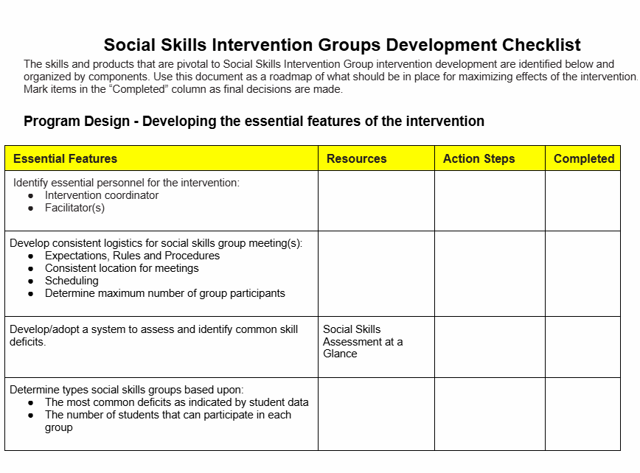
The Development Checklist and Action Plan
AT-SSIG Development Checklist & Action Plan
Notes:
Trainer Notes: This Development Checklist is your guide to developing your data systems and includes all the resources your team will need to effectively implement SSIG. It also has a column for action steps and a completion date to keep your team on track.

Slide 16
Data for Implementation
Notes:
Trainer Notes: This lesson will focus on the data for implementation.

Slide 17
Purpose Behind Collecting Data
To ensure
Students are making adequate progress toward goals
Implementation of intervention is being done with fidelity
Notes:
Trainer Notes: The data that will be collected will help teams determine if the student is making adequate progress towards their goal. It will also help the team determine if the intervention has been implemented with fidelity. Keep in mind your intervention data decision rules .
Monitoring students' progress in attaining goals during a social skills intervention involves a structured, ongoing process. This allows facilitators/coordinators to assess the effectiveness of the intervention and make data-informed adjustments.

Slide 18
Steps
Set Clear Measurable Goals
Choose a Progress monitoring tool
Establish a data collection schedule
Notes:
. Set Clear, Measurable Goals
SMART Goals: Goals should be Specific, Measurable, Achievable, Relevant, and Time-bound.
Example: “Student will initiate a greeting with a peer 3 out of 5 opportunities during structured play over 2 consecutive weeks.”
📊 2. Choose Appropriate Progress Monitoring Tools
Different tools can help gather data on social skills:
Quantitative Tools:
Frequency counts: How often a behavior occurs (e.g., number of greetings).
Duration tracking: How long a student engages in a behavior (e.g., maintaining eye contact).
Rating scales: Teacher or counselor rates behavior on a scale (e.g., 1 to 5).
Rubrics: Pre-set criteria for evaluating performance levels.
Qualitative Tools:
Anecdotal records: Descriptive notes of specific incidents.
Observations: Formal or informal tracking by educators or therapists.
Student self-assessments: Reflections or checklists completed by the student.
Peer feedback (if appropriate): Classmate input on social interactions.
📅 3. Establish a Data Collection Schedule
Baseline: Gather data before starting intervention to compare progress.
Ongoing Monitoring: Daily, weekly, or bi-weekly tracking depending on the goal and intensity.
Review Periods: Set intervals (e.g., every 4-6 weeks) to formally review data.
🔍

Slide 19
Define Clear Goals and Objectives:
Identify specific social skills: determine the specific social skills the group will be working on improving (e.g., self-regulation, turn-taking, conflict resolution, communication).
Set measurable goals: Establish clear, achievable, and time-bound goals for each student.
Establish baseline data: Before starting the intervention, refer back to the assessment that was conducted to determine each student's current level of performance in the target social skills.
Notes:
Trainer Notes: Before beginning to monitor student progress it is important to define clear goals and objectives with the students so they know what is expected of them to be successful. The baseline data will be determined by the social skills assessment performed as part of the identification process.

Slide 20
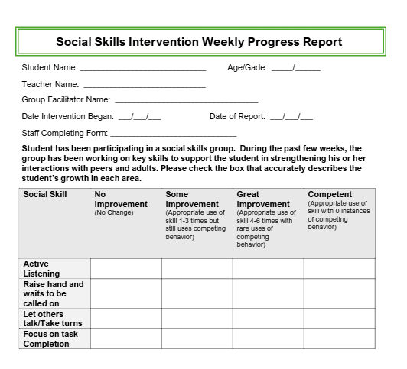
Weekly Progress Report Example 1
Staff will rate student on a likert scale from no improvement to competent.
It may be helpful if they tally under each skill when they notice the student using the targeted skills throughout the week.
Staff will turn the information into the facilitator at the end of each week.
The facilitator will record progress into a data sheet.
AT-C7L2 Social Skills Intervention Weekly Progress Report
Notes:
Trainer Notes: Staff will rate student on a likert scale from no improvement to competent.
It may be helpful if they tally under each skill when they notice the student using the targeted skills throughout the week.
Staff will turn the information into the facilitator at the end of each week.
The facilitator will record progress into a data sheet.
The facilitator can provide the teachers that work with the student a copy of this form or choose to interview the teachers on a scheduled basis.

Slide 21
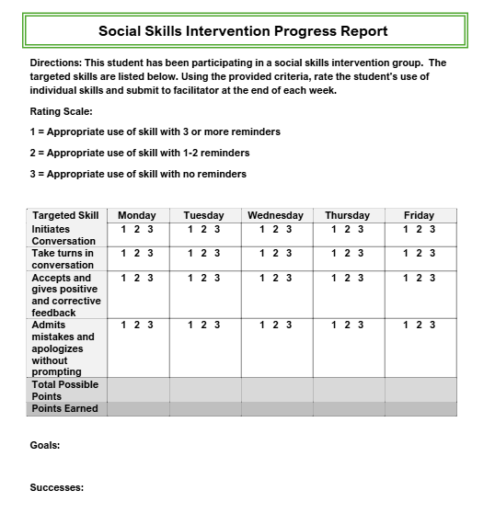
Progress Report Example 2
Staff may choose to document the students progress based on a 1-3 scale.
This format allows Staff to track daily.
Staff will submit this documentation to the facilitator at the end of the each week.
The facilitator will record progress into a data sheet.
AT-C7L2 Social Skills Intervention Progress Report
Notes:
Trainer Notes: This is another example of how your team may choose to document student progress.

Slide 22
Observations
  Checklists: Use checklists to systematically record the frequency or presence of specific social behaviors during the intervention group as well as in the classroom. .
  Classroom Observation: Observe students during group activities, interactions, and transitions and document when they demonstrate the targeted skills.
Notes:
Trainer Notes: Implement Data Collection Methods:Perception Data can be based on observations, experiences and interviews.
Informal Observation:
Checklists: Use checklists to systematically record the frequency or presence of specific social behaviors during the intervention group as well as in the classroom. .
Classroom Observation: Observe students during group activities, interactions, and transitions to note their social behaviors.

Slide 23
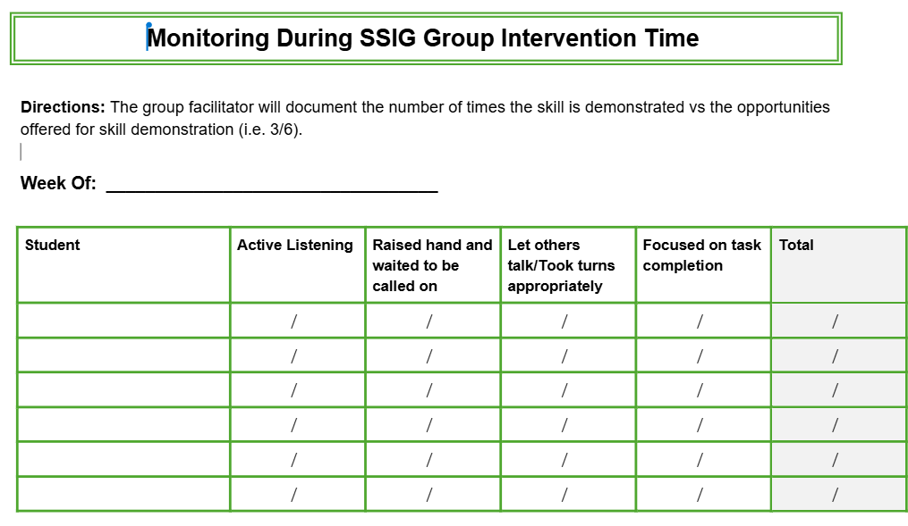
AT-C7L2 Example Monitoring During SSIG Time
Notes:
Trainer Notes: The facilitator may collect data during the group session when they observe a student using the skills taught.
The facilitator of the ss group can tally the number of times the participant had an opportunity to demonstrate the skills and how many times they actually demonstrated the skill with accuracy.

Slide 24
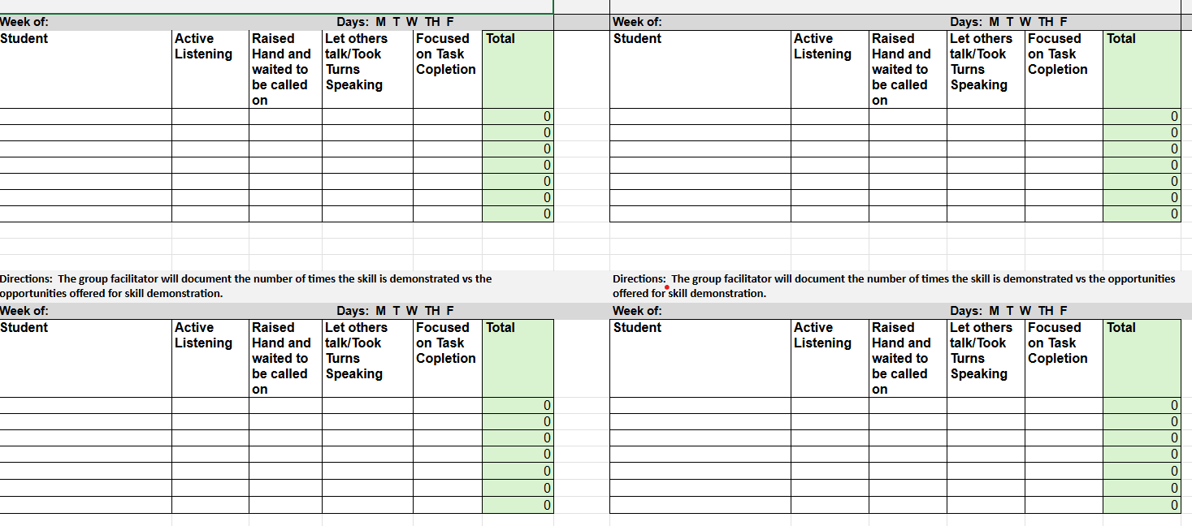
AT-C7L2 Example 2 Monitoring During SSIG Time
Notes:
Trainer Notes: This is an excel option that can be used to track student’s demonstration of the skills during group time.

Slide 25
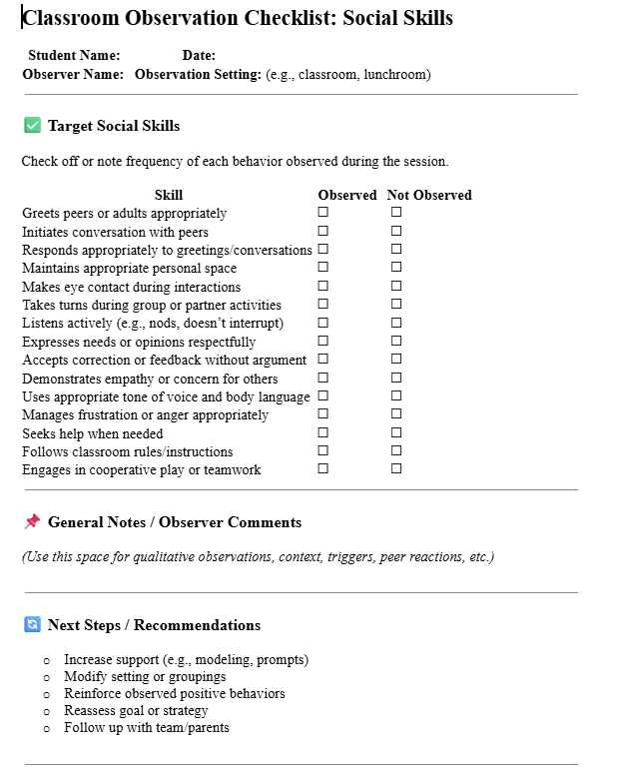
AT-C7L2 Example SSIG Classroom Observation Checklist
Notes:
Trainer Notes: Observational Checklists are a systematic process for observing and documenting targeted skills in the intervention. The facilitator could ask for input from the staff directly associated with the student via an observation checklist.

Slide 26
Discussion
Review Progress Report examples
How will you design your Progress Report ?
How frequently will you gather the data?
How will you gather data from the staff directly working with the students participating in the intervention?
Notes:
Trainer Notes: Provide access to the WPR examples for teams to review.
As a team, consider which elements you will include on your WPR. Use the considerations previously mentioned as well as the examples to design your WPR.

Slide 27
Pause & Reflect
Action Step:
Who will be responsible for creating the WPR that will be used to progress monitor students?
When will it be completed?
How will it be accessed?
Notes:
Trainer Notes: What steps do you need to add to your action plan?

Slide 28

Graphing Student Data
Notes:
Trainer Notes: The next piece is to use a systematic approach to graph the students’ data from their WPRs into a system that is easily accessible by the Adv. Tiers team when they meet to discuss how the student is progressing.
Your system for analyzing the data
Should be able to graph or chart the data for visual representation.
Allow the team to look for trends such as; Is the behavior increasing, decreasing, or remaining static?
Should allow for comparison between baseline and goals.

Slide 29
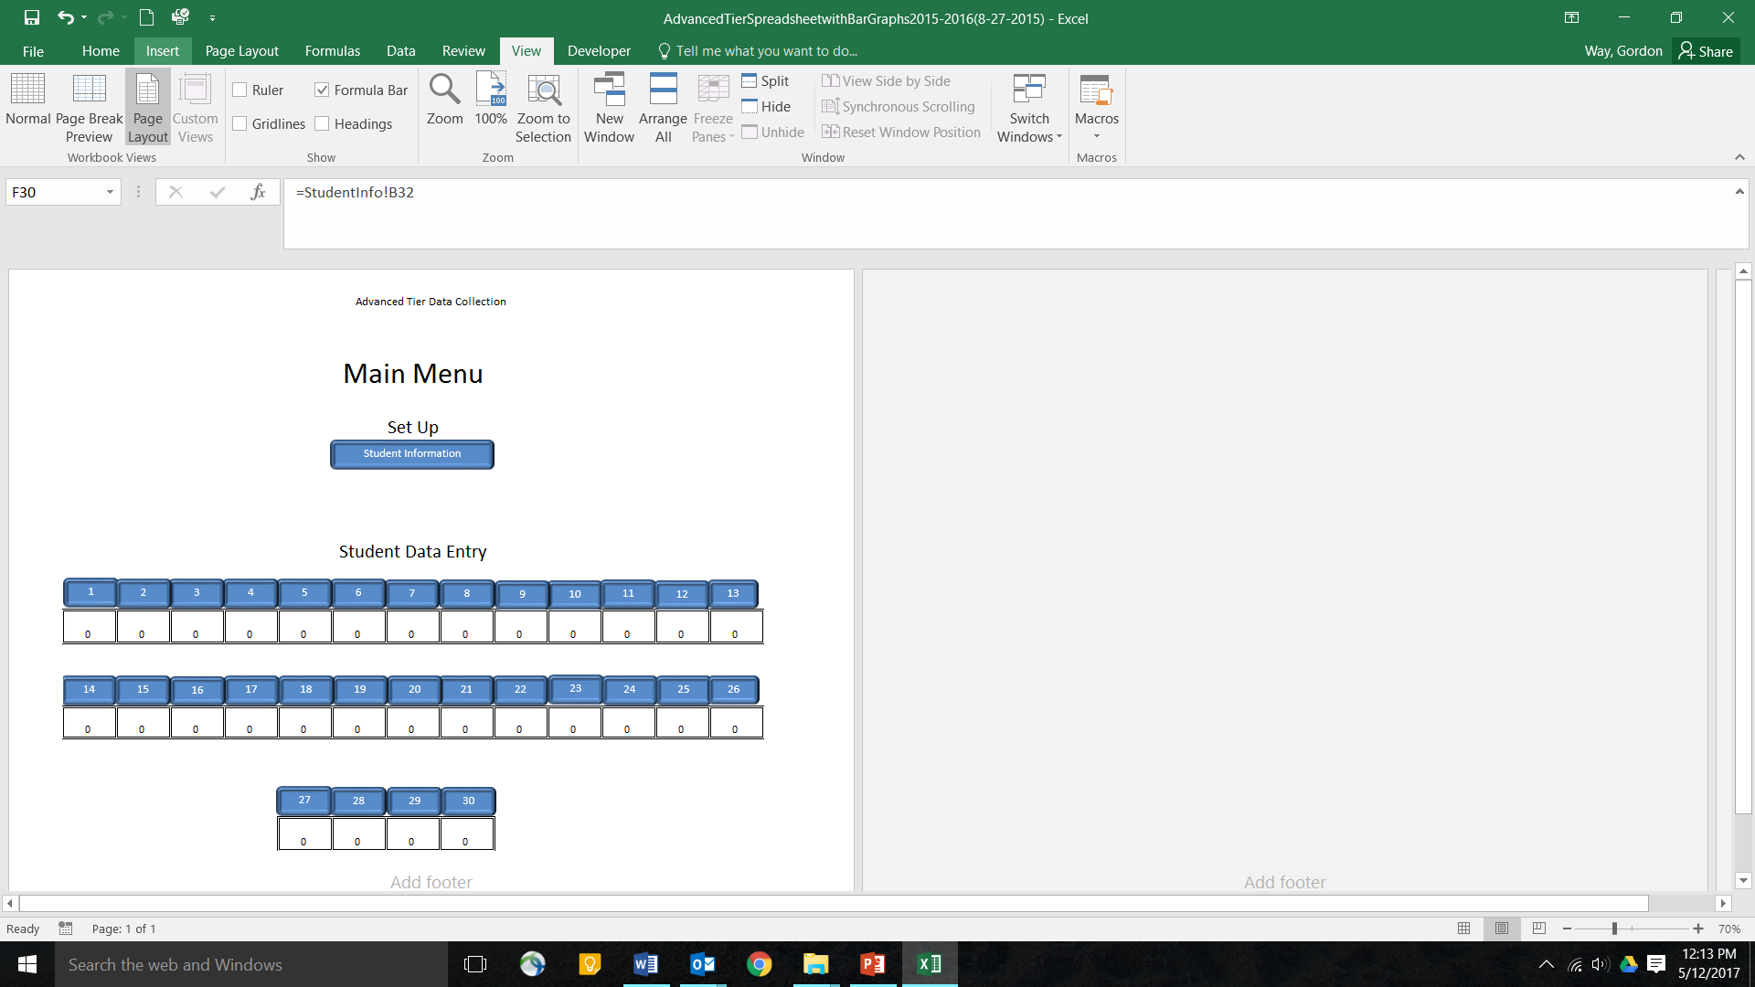
Advanced Tier Spreadsheet
A free student information and progress monitoring tool
Collects and charts DPR points and other frequency data
Access the spreadsheet at MO SW-PBIS website.
  MO SW-PBS Website: Tier 2 Data Tools
Notes:
Trainer Notes: The Advanced Tier Spreadsheet is an electronic collection system option that your team could choose to utilize and it is free. We love free! You can access it on the MO SW-PBS website. ( Reminder: you may need to enable macros.)

Slide 30
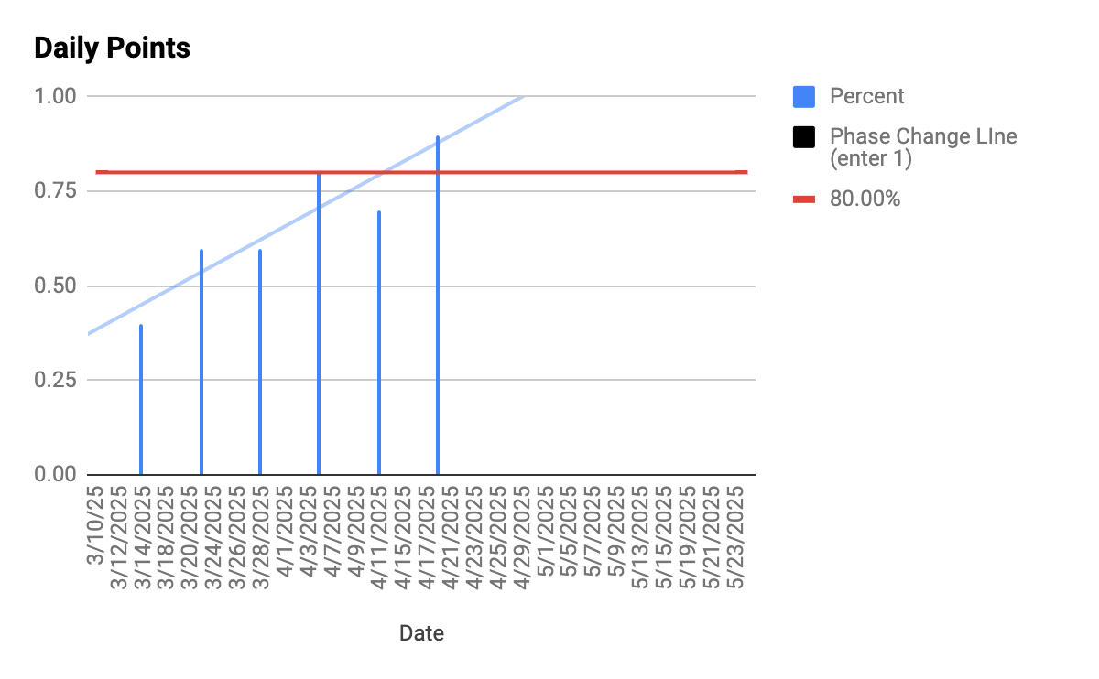
Graph from ADV. Tiers of Weekly Progress
Notes:
Trainer Notes: From this example you can see that it still shows the trends and progress even if using the adv. Tiers spreadsheet to document weekly progress.
If your team chooses to use the Adv. Tiers spreadsheet here are the directions for how you can use it to record weekly instead of daily:
Open the Advanced Tiers Spreadsheet found on the MO SW- PBS website.
Add student information in the first tab.
Click on the tab for the student whose data you are adding.
When filling out the first column, the first date must fall on a Monday. The remaining dates will autofill.
Fill in the goal for the week and then add the weekly data to the day of your choice (i.e. if you are entering every Friday, only enter in Friday rows).
A graph will appear to the right of the data as you progress.

Slide 31
Considerations for
Developing your Data Collection Process
Organization Suggestions to consider:
Create a common data folder
Use one spreadsheet to record data of all students participating in Tier 2 Interventions.
Use a seperate spreadsheet for each intervention
Use a separate spreadsheet for each facilitator
Who will be responsible for entering the daily data?
When will it be entered?
Notes:
Trainer Notes: If you choose to use the Adv. Tiers Spreadsheet you may want to create a common data folder that will be shared with the adv. Tiers team. Some other considerations are as follows: Use one spreadsheet to record data of all students participating in Tier 2 Interventions.
Use a seperate spreadsheet for each intervention
Use a separate spreadsheet for each facilitator

Slide 32
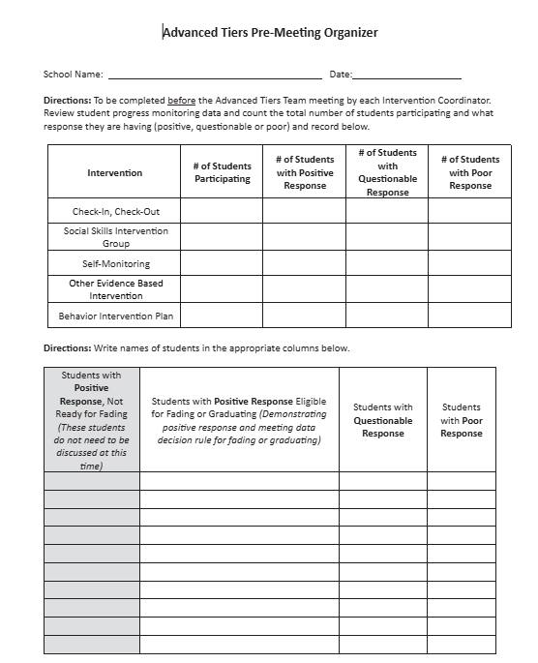
Team Review of Student Data
Team should review data on a bi-weekly basis to determine if the intervention is meeting the student’s needs.
This document might be a helpful tool for organizing your meetings.
AT-C7L2 Pre-Meeting Organizer
Notes:
Trainer notes: The team should review data every 2 weeks to determine the impact of the intervention. It might be helpful for the chairperson or coordinator to use the Pre-Meeting organizer to organize which students need to be discussed. Reminder: the Pre-Meeting organizer from the Teaming lesson can help keep track of which students you need to review at each meeting.

Slide 33
Discussion
What will your common data folder look like?
Where will it be stored ?
Who will have access to it?
Who will be responsible for entering the weekly data?
When will it be entered?
Notes:
Trainer Notes: Discuss the following questions.

Slide 34
Pause & Reflect
What steps do you need to add to your action plan to develop your data collection process ?
Notes:
Trainer Notes: What steps do you need to add to your action plan?

Slide 35
Analyzing Student Data
Notes:
Trainer Notes; Now that you have the student data, how will your team analyze it?

Slide 36
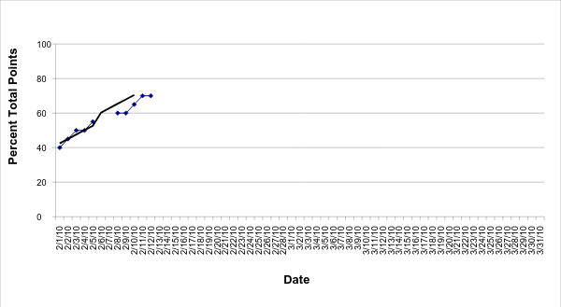
Positive Response
Goal Line
Trend Line
Level of Performance
Notes:
Trainer Notes: In reviewing this data you can see that this student’s current rate of progress, he will reach the goal line in 3 weeks. The student is making progress toward the goal at an acceptable rate.
Which means they are having a Positive Response to the Intervention.
Depending on your intervention data decision rules your team will decide if the student should do one of the following:
Continue intervention with the current goal
Continue intervention with goal increased
If goal was not at 80%
Begin Fading

Slide 37
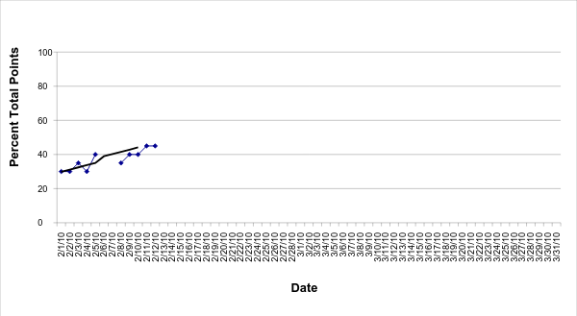
Questionable Response to Intervention
Goal Line
Trend Line
Level of Performance
Notes:
Trainer Notes: At this student’s current rate of progress, he will require 6 weeks to reach the goal. The student is making progress, however, the rate is slower than what we would considerable acceptable.
Which means this student is having a Questionable Response to the Intervention. So the team needs to discuss the following:
Was intervention implemented as intended?
If no - employ strategies to increase fidelity of implementation
If yes -increase intensity of current intervention for a short period of time and assess impact.
If rate improves, continue.
If rate does not improve, return to problem solving.

Slide 38
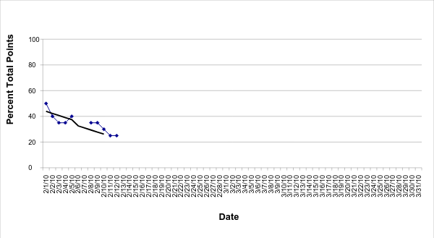
Poor Response to the Intervention
Trend Line
Notes:
Trainer Notes:
This child’s level of performance ranges from 50% to 25%.
The gap between this child’s trend line and the goal line is growing wider. The response to the intervention is poor. So the team needs to discuss the following
Was the intervention implemented as intended?
If no - employ strategies to increase fidelity of implementation
If yes -
Was the problem identified correctly?
Is intervention aligned with the function?
Are there other functions to consider?

Slide 39
Reminder: Intervention Data Decision Rules
A student in a Tier 2 Intervention should first reach the goal line within 3 weeks.
(Sprague, 2008)
The general recommendation from most researchers is that we need at least eight data points within 3 weeks of instruction before making a decision about whether or not an intervention change is needed.
(Lembke, 2008)
Notes:
Trainer Notes: Sprague (2008) indicates that a student in a Tier 2 Intervention should first reach the goal line within 3 weeks.
If the student in a Tier 2 Intervention does not reach the goal line within 3 weeks, the rate of progress may be considered too slow.
Dr. Erica Lembke advises that the general recommendation from most researchers is that we need at least eight data points within 3 weeks of instruction before making a decision about whether or not an intervention change is needed

Slide 40
Responding to Student Progress
Notes:
Trainer Notes: The next step is how will your team respond to student data.

Slide 41
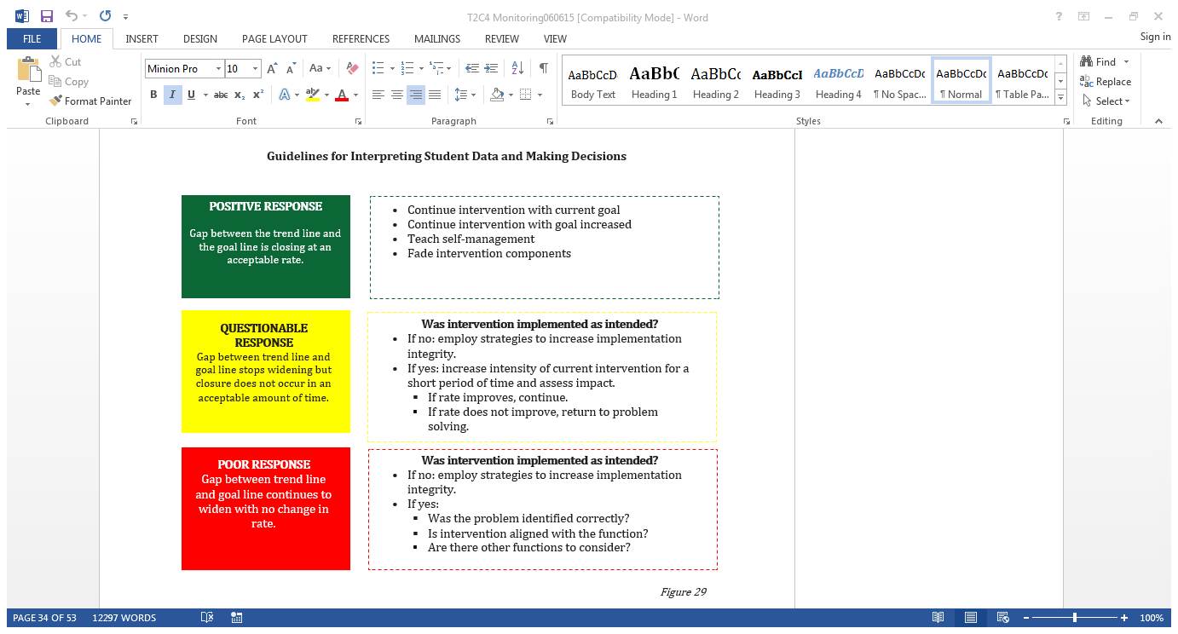
Notes:
Trainer Notes: The purpose of reviewing the data is to determine if the student is having positive, questionable, or poor response to intervention.
Based on the student response the team will decide whether to continue the intervention, fade, intensify or modify the intervention
-Refer to the colored boxes for explanation:
*Positive Response: Gap between the trendline and Goal Line is closing at an acceptable rate. Continue with current intervention/increase goal/Fade Intervention
*Questionable: Closure of gap lines at an unacceptable rate. Look into implementation fidelity
*Poor Response: Gap between Goal and Trendline widens. Was the problem identified correctly?
The purpose of reviewing the data is to determine if the student is having positive, questionable, or poor response to intervention.
Based on the student response the team will decide whether to continue the intervention, fade, intensify or modify the intervention
Refer to the colored boxes for explanation:
*Positive Response: Gap between the trendline and Goal Line is closing at an acceptable rate. Continue with current intervention/increase goal/Fade Intervention
*Questionable: Closure of gap lines at an unacceptable rate. Look into implementation fidelity
*Poor Response: Gap between Goal and Trendline widens. Was the problem identified correctly? Did you identify the correct intervention?

Slide 42
Positive Student Response
Continue Intervention
Increase Goal
Collect data for at least an additional 4 weeks after the student has met the goal of 80%.
The team will determine if the student needs to continue support after this time or begin fading
If current goal is below 80% increase goal until student meets the goal of 80% or above for 4-6 weeks.
Notes:
Trainer Notes: To determine if student is meeting their 1st goal
Intervention Coordinator or Team member will review the data regularly during this time frame to determine if the student continues to meet their goal at an acceptable rate.
Teams have the latitude to choose how frequently they will review the data during this time.
Students will be reviewed at least every 4 weeks to determine if they are making progress if not they should be added to the agenda for further discussion.

Slide 43
What happens if a student is not making progress?
Check Fidelity First!!!
Implementation Fidelity is...
The delivery of the intervention in the way it was designed to be delivered.
(Gresham, MacMillan, Boebe-Frankenberger, & Bocian, 2000)
Notes:
Trainer Notes: Refer back to Intervention Data decision rules lesson on how your team determined you would monitor implementation fidelity. The research results from this intervention are based on all of the parts being fully implemented. If some of the parts are missing it is not CICO.Sure, CICO is a simple program. Even simple programs need proper attention. As easily as you set it up, it can just as quickly fall apart. When you look at your CICO data, do you notice many students fail to meet their goal or is it just a couple? How many periods are marked without data? Does that happen for lots of students or just some? If many students on CICO struggle in the intervention, it’s possible the problem is systemic rather than isolated.​

Slide 44
Questionable or Poor Response
If fidelity has been checked:
Reconsider function
  Ensure the correct function was identified
  Confirm the intervention aligns with the function
Reconsider the goal
  Review the initial goal to ensure it was appropriately established based on the baseline data
Modify the intervention
Notes:
Trainer Notes: Did the team identify the correct function of behavior? If not, you may need to change the intervention. Did you set their goal too high? Do you need to modify the intervention?

Slide 45
Modifications for SSIG
Notes:
Trainer Notes:If fidelity of implementation has been checked then it is time for the team to discuss making Modifications to the intervention for those students who are having a poor or questionable response.
Adjust the Intervention as Needed If progress is not sufficient, consider modifying:
Strategies (e.g., more role play, visual supports, peer modeling).
Settings (e.g., smaller groups, different times of day).
Goals (e.g., breaking into smaller steps).
If goals are met, set new ones or begin fading supports.

Slide 46
Modifications
Provide pre-corrects for use of the target skill(s)
Utilize a signal or non-verbal to cue student to stop the problem behavior and to perform the targeted skill.
Cue cards with skills and steps listed can be prominently displayed or smaller cards can be taped to a student’s desk.
Assign peer role models to give cues and reminders to their buddies
Allow student to choose reinforcers
High rates of reinforcement for effort
Earn reinforcers to share with peers
Provide opportunities for breaks or preferred activity
Academic support or interventions
AT-C7L2 Modifications for SSIG
Notes:
Trainer Notes: Next steps is to consider developing a menu of accommodations to modify or intensify the intervention if a student needs additional support.
When SSIG is implemented with fidelity, a majority of identified students will respond positively. However, some students may continue to struggle acquiring the targeted skills during and/or after the social skills instruction ends. To support these students modifications to the intervention content and/or process may be needed to enhance success. Avoid a "one size fits all" approach and adapt the intervention to meet the individual or particular group needs. These modifications can include antecedent and/or consequence strategies. The following are some suggested modifications for intensifying SSIG for a student who is experiencing a questionable response:
Provide pre-correct for use of the target skill(s)
Utilize a signal or non-verbal to cue student to stop the problem behavior and to perform the targeted skill.
Cue cards with skills and steps listed can be prominently displayed or smaller cards can be taped to a student’s desk.
Allow student to choose reinforcers
High rates of reinforcement for effort
Earn reinforcers to share with peers
Tasks matched with academic level of student
Academic support or intervention
Provide opportunities for breaks or preferred activity
Self-Monitoring ( if student is not provided a reminder in any other format than this would be a form of intensification for the student to mark did I use the skills or not)
Planned ignoring of attention seeking behaviors
Assign peer role models to give cues and reminders to their buddies
When thinking about potential ways to intensify the SSIG intervention, there will always be instances in which your team will need to make specific modifications for an individual student. However, to save time, your team can proactively identify a menu of strategies to intensify SSIG so they are readily available when and if they are needed.

Slide 47
When to Individualize
If a student doesn’t respond well to the small group
If the student is uncomfortable or distracted
If the student takes over the group
If the student breaks the trust of the group
If the student ridicules the content
Adapted from Behavior Academies pg. 149. (2024)
Notes:
Trainer Notes: When referring to small group social skills usually you are delivering instruction to a group of 4-6. However if a individual student does respond in small group you may consider individual sessions. For instance if you notice the student is uncomfortable or distracted by other students. Or you might offer individualized instruction for that student that takes over the whole group or ridicules the content. For the most part students respond well in a small group but there are unique cases. This needs to be a team discussion initiated by the the facilitator. You may also have a conversation with the student privately.

Slide 48
Discussion
Discuss different ways you may modify SSIG to support students who need additional supports to be successful.
Develop a menu of modifications for students who may need additional support.
Notes:
Trainer Notes: Discuss the questions on the slide to determine how you will create a menu of modifications that you will refer to if a student is having a questionable or poor response to the intervention.

Slide 49
Pause & Reflect
What steps do you need to add to your action plan regarding developing a menu of modifications?
Notes:
Trainer Notes: What steps do you need to add to your action plan?

Slide 50
Generalization of Social Skills
Notes:
Trainer Notes: In the context of social skills, generalization means applying a learned social behavior or skill in various situations, with different people, and in different settings beyond the initial learning environment. It's about transferring and adapting learned behaviors to new contexts, ensuring the individual can use the skill effectively in real-world scenarios.

Slide 51
Generalization
Intended to extend the skills taught in a structured classroom environment to other environments where skills could or should be used.
Embedding generalization strategies in the intervention should increase the likelihood that skills will occur across settings.
The appropriate skills should be reinforced across all settings.
Notes:
Trainer Notes: The intent of generalization is to extend the skills taught in a structured classroom environment to other environments where skills could or should be used.
Embedding generalization strategies in the intervention from the first day of planning can increase the likelihood that skills will occur across settings.
The appropriate skills should be taught and reinforced across all settings.

Slide 52
Strategies to Support Generalization
Real life examples relevant to the students’ circumstances
Embed practice in role playing and video modeling.
Train in the problem setting with peers
Regular communication with teachers and staff
Reinforcement of student efforts
Post the skill and steps in prominent locations.
Encourage students to teach new skills to the entire class.
Notes:
Trainer Notes: Some intervention design components that promote generalization include, but are not limited to, these strategies.
Example : Invite adults to drop in a session on “greeting adults” and see if students utilize the skills to greet the adult appropriately.
Train in the problem setting with peers the at-risk students are likely to encounter.
Regular communication with teachers and staff as to social skills lessons taught encourages them to prompt for use of the skill.
Reinforcement of student efforts and regular feedback further increases the generalization of skills.
Posters of the skill and steps for use can be posted in prominent locations

Slide 53
Promote generalization to different settings/circumstances by:
practicing in different settings and under various conditions
prompting and coaching the student in naturally occurring situations
having the student submit self-report forms for each class period
meeting with the student to discuss performance throughout school or life
Notes:
Trainer Notes: Some additional strategies to promote generalization are …..

Slide 54
Homework Supports Generalization
Ask students to plan on when they will use the skill and a target of how many times at home.
Communicate the targeted skill to parents and ask them to reinforce their child when using the skills.
Notes:
Trainer Notes: Homework can support generalization as well. Encourage students to plan on when they will use the skill and a target of how many times at home.
Again, even if the student fabricates when and where they have used the skill, they are still creating scenarios of how to use the skill. Don’t get hung up on trying to determine if they actually performed the skill. Creating the scenario is still practice
Communicating the targeted skill to parents and ask them to reinforce their child when using the skills is also beneficial in promoting generalization skills.

Slide 55
Monitoring Generalization of Skills
Ensure Targeted Social Skills goals are clear
Identify Settings for Generalization
Determine where the skill should be demonstrated beyond the teaching environment:
Ensure fidelity of implementation with all relevant Stakeholders
Track the student’s progress towards goals.
WPR
Observation
Analyze the Data (review the data weekly or bi-weekly)
Look for patterns of consistent behavior across settings and people.
Identify settings where the skill is not generalizing.
Provide Feedback and support
Notes:
Trainer Notes:
Determine a process for ensuring Generalization of skills are monitored for fluency.
Ensure the goals that the student is working on are clear and align to the skills being taught. Example: “Initiates greetings with peers,” or “Maintains appropriate personal space.”
Ensure the skill is observable and measurable.
Identify Settings for Generalization
Determine where the skill should be demonstrated beyond the teaching environment:
School settings: Classroom, cafeteria, recess, gym
Community settings: Library, store, extracurricular activities
Home settings: Family gatherings, playing with siblings
Ensure fidelity of implementation with all relevant Stakeholders
4. Track the student’s progress towards goals.
WPR - review the student’s progress reports to determine areas of success and areas for improvement.
Generalization probes: Observations scheduled in different settings
Plan for observations at multiple times and settings over weeks:
Include both structured (adult-led) and unstructured (peer-led) activities.
Vary peer groups and environmental cues.
5. Analyze the Data (review the data weekly or bi-weekly)
Look for patterns of consistent behavior across settings and people.
Identify settings where the skill is not generalizing.
6. Provide Feedback and support Reinforce success with specific praise and reinforcement.
Provide additional supports in settings where generalization is weak (e.g., prompts, peer models).Collaborate with the Student
Share progress in student-friendly ways.
Involve them in goal-setting and self-monitoring (if age/ability appropriate).

Slide 56
Team Discussion
As a team, discuss and document how you will ensure generalization strategies are included in the monitoring process of social skills.
Notes:
Trainer Notes: Discuss and document how you will ensure generalization strategies are included in the teaching process of social skills.

Slide 57
Pause & Reflect
What steps do you need to add to your action plan ?
Notes:
Trainer Notes: What steps do you need to add to your action plan?

Slide 58
Self-Monitoring
Notes:
Trainer Notes: Self-Monitoring is a broad term that refers to a child’s ability to effectively be aware of and modify his/her own behavior. This should be taught before Fading takes place in order to increase the student’s ability to manage their own behavior without direct adult supervision.

Slide 59
Self-Monitoring within SSIG Intervention
Students gradually take responsibility for monitoring and evaluating their own behavior
The goal is for students to manage their behavior independently without adult prompting
It is a gradual fading of teacher support and increasing student autonomy.
Notes:
Trainer Notes: Students gradually take responsibility for monitoring and evaluating their own behavior throughout the day, instead of relying solely on teacher feedback
Goal is for students to manage their behavior independently without adult prompting,
gradual fading of teacher support and increasing student autonomy.

Slide 60
Benefits of Self-Monitoring
Increased student accountability
Improved generalization of behavior change
Preparation for independent functioning
Notes:
Trainer Notes: Benefits of self-monitoring in SSIG
Increased student accountability:
By actively monitoring their own behavior, students are more likely to take responsibility for their actions.
Improved generalization of behavior change:
As students learn to self-regulate, they are better equipped to manage their behavior across different settings and situations.
Preparation for independent functioning:
The ultimate goal is to transition students from relying on external feedback to effectively self-manage their behavior without constant adult prompts

Slide 61
Key Components of Self-Monitoring
Observation: The student pays attention to their own behavior.
Recording: The student documents when the behavior occurs.
Evaluation: With the teacher, the student reflects on whether the behavior meets expectations or goals.
Notes:
Trainer Notes:
Key Components of Self-Monitoring
Observation: The student pays attention to their own behavior.
Recording: The student documents when the behavior occurs.
Evaluation: The student reflects on whether the behavior meets expectations or goals.

Slide 62
Example Scenario: A student trying to reduce classroom disruptions may:
Keep a tally of how many times they are out of their seat.
Review the data weekly to see improvement.
Notes:
Trainer Notes: Self-monitoring is widely used in education because it encourages accountability and independence on the part of the student.

Slide 63
Self-Monitoring
Needs to be taught and practiced with the student
May be used as a modification to the SSIG intervention.
Will be used as part of the fading process once the student meets the criteria determined in your Intervention Data Decision Rules.
Notes:
Trainer Notes: It is helpful to inform the team and staff that self-monitoring will be implemented in the classroom setting. The SSIG facilitator will be responsible for teaching the student the skills and providing ample time to practice them. The goal is for the student to gain self-awareness about their behavior.
If a student does not respond well with the teacher giving direct feedback then the team may decide to modify the intervention by switching to self-monitoring of their specific goals.
Self-Monitoring will be used as part of the fading process so it is important the student is taught these skills prior to fading them from the intervention.

Slide 64
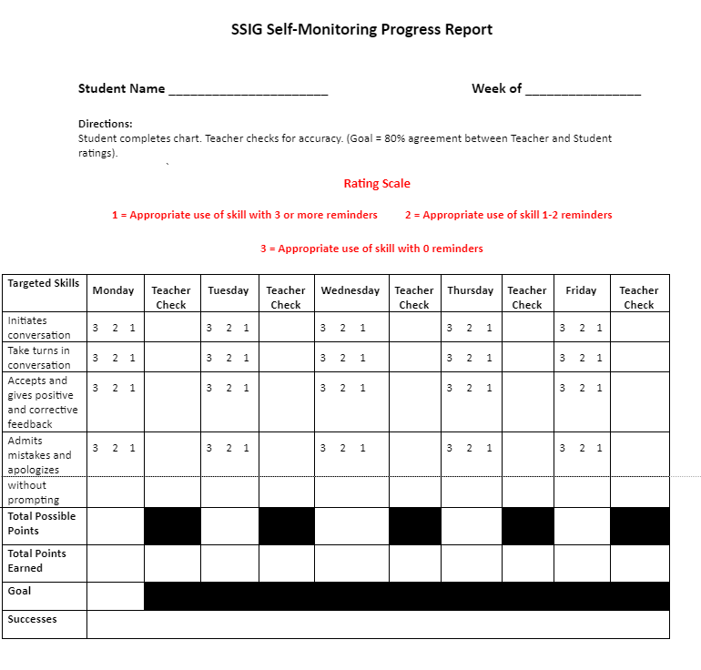
AT-C7L2 SSIG Self Monitoring Form
Notes:
Trainer Notes: Example of self monitoring progress report

Slide 65
Fading SSIG
Notes:
Trainer Notes: Next step is to develop a process for fading of intervention (e.g., self-monitoring). Fading refers to the a process of gradually removing intervention components for students who have met program goals.
The SSIG Facilitator can work with students as they learn self-monitoring skills. In fact, lessons for self-monitoring can be incorporated as skills taught during group meetings. Teachers can support this process by continuing to monitor student use of social skills and periodically checking in with student for accuracy of ratings.

Slide 66
The Fading Process
Once the student has successfully met his or her goal(s) for a predetermined period of time the intervention may be systematically faded.
Systematic fading involves the gradual reduction, and eventually elimination, of key intervention components (e.g., goals, prompts, feedback).
Notes:
Trainer Notes: After the student completes all of the lessons specific to their identified skill deficits and has met their daily goal of 80% or above for a period of at least 2 weeks, then the fading process can begin. The most logical next step is to have the student self-monitor then reduce the frequency until they have been completely faded and are still demonstrating the skills in settings across the school and home.

Slide 67
Fading Strategies
Gradual removal of prompts.
Make prompts less intrusive (e.g. move from visual reminders of the targeted behaviors to verbal pre-correctsl).
Focus on reinforcing more independent responses.
Provide access to reinforcers for unprompted skill responses.
Notes:
Trainer Notes:Students may be encouraged to self-monitor their use of the skill across all settings.
Some of the fading strategies to consider are as follows
Gradual removal of prompts.
Make prompts less intrusive (e.g. move from visual reminders of the targeted behaviors to verbal pre-correctsl).
As prompts are faded, remember to reinforce more independent responses.
Provide access to reinforcers for unprompted skill responses.
Students who begin the fading process should still be intermittently monitored to make sure the student maintains performance of the target skills.
Students may be encouraged to continue self-monitoring their use of the skill across all settings

Slide 68
Fading using Self-Monitoring
Points are still totaled and graphed.
Student still participates in rating social skills until self-monitoring has shown positive results.
Frequency of self-monitoring is adjusted as needed.
Notes:
Trainer Notes: Teams should determine the rate of fading which may be individualized for a specific student. Ideally fading will incorporate a self-monitoring component
The benefits can increase student responsibility, as well as their ability to manage own behavior without adult prompting & redirection

Slide 69
Discussion
Do your current Intervention Data Decision Rules for Fading apply to SSIG?
If not, establish a data decision rule for fading students
Develop a plan for training student for self-monitoring (goal setting, self-evaluation, self-recording)
Notes:
Trainer Notes: Eventually the team will need to decide when/how to fade students off the intervention. These (bulleted items) are things to consider and should be the topic of team discussion.
It is not uncommon that after participating in SSIG over a period of time, students, along with parents and teachers as well, do not want to give up this support. Students report they like receiving extra adult attention and the feeling of success SSIG gives them. This is why generalization is so important. Additionally, teachers and parents have concerns about how well children will continue to perform when the program is no longer provided. Therefore, moving students out of the SSIG program requires careful planning.

Slide 70
Pause & Reflect
What steps do you need to add to your action plan?
Notes:
Trainer Notes: What steps do you need to add to your action plan?

Slide 71
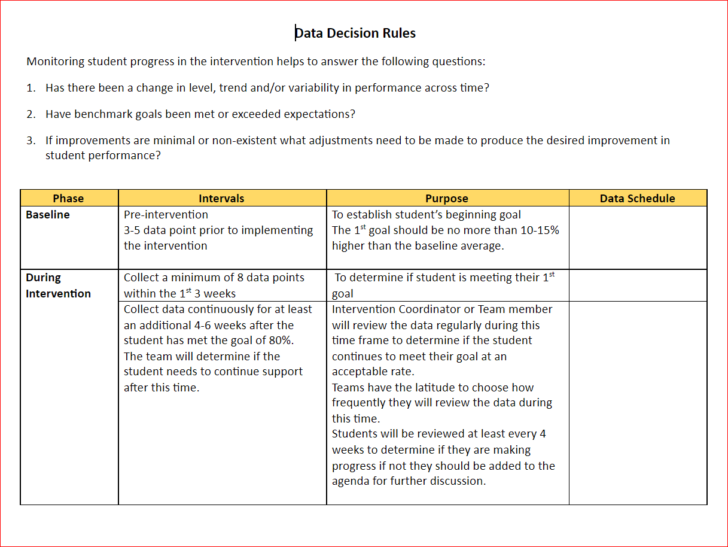
Revisit Intervention Data Decision Rules
Refer to Intervention Data Decision Rules for the following:
How and when will you monitor Implementation Fidelity?
How and when will you monitor Social Validity
Who will be responsible for tracking student outcome data related to how many have:
# of students that participated
# of students that graduated
# participated but required additional supports
When will students graduate from the intervention?
When and how will you conduct maintenance checks?
Notes:
Trainer Notes: Remind teams to refer back to the Intervention Data Decision rules your team created in the Intervention Data Decision Rules Lesson.and apply them to each intervention.

Slide 72
Next Steps
Next Lesson: Practices of Implementation and Piloting the SSIG Intervention
Notes:
Trainer Notes: The final SSIG lesson will walk you through the practices of implementation and how your team may piloting SSIG to work on the kinks.

Slide 73
References
Bierman, K. L. (2004). Peer Rejection: Developmental Processes and Intervention Strategies. Guildford.
Caprara, G. V., Barbaranelli, C., Pastorelli, C., Bandura, A., & Zimbardo, P. G. (2000). Prosocial foundations of children's academic achievement. Psychological Science, 11, 302– 306. https://doi.org/10.1111/1467‐9280.00260
DiPerna, J. C., & Elliott, S. N. (1999). Development and validation of the academic competence evaluation scales. Journal of Psychoeducational Assessment, 17, 207– 225. https://doi.org/10.1177/073428299901700302
Green, R. (2014). The Explosive Child.Harper
Gresham, F. M., Sugai, G., & Horner, R. H. (2001). Interpreting outcomes of social skills training for students with high-incidence disabilities. Exceptional Children, 67(3), 331-344.
Hannigan,J.D. & Hannigan,J. (2024). Behavior Academies. Solution Tree Press.
Killen, M., Mulvey, K.L., & Hitti, A. (2013). Social exclusion in childhood: A developmental intergroup perspective. Child Development, 84(3), 772–790. https://doi.org/10.1111/cdev.12012
Ladd, G. W. (2006). Peer rejection, aggressive or withdrawn behavior, and psychological maladjustment from ages 5 to 12: An examination of four predictive models. Child Development, 77(4), 822–846. https://doi.org/10.1111/j.1467-8624.2006.00905.x
National Center on Student Progress Monitoring (2006). Retrieved March 9, 2006, from www.studentprogress.org.
Olweus, D. (1993). Victimization by peers: Antecedents and long-term outcomes. In K. H. Rubin & J. B. Asendorpf (Eds.), Social withdrawal, inhibition, and shyness in childhood (pp. 315–341). Lawrence Erlbaum.
Olweus, D. (2001). Peer harassment: A critical analysis and some important issues. In J. Juvonen & S. Graham (Eds.), Peer harassment in school: The plight of the vulnerable and victimized (pp. 3–20). Guilford.
Notes:
Trainer Notes: References

Slide 74
References
Ray, C. E., & Elliott, S. N. (2006). Social adjustment and academic achievement: A predictive model for students with diverse academic and behavior competencies. School Psychology Review, 35, 493– 501. https://doi.org/10.1080/02796015.2006.12087980
Rubin, K. H., Bukowski, W., & Parker, J. G. (2006). Peers, relationships, and interactions. In W. Damon & R. Lerner (Eds.), Handbook of child psychology (pp. 141–180). Wiley
Rutherford, L. E., Dupaul, G. J., & Jitendra, A. K. (2008). Examining the relationship between treatment outcomes for academic achievement and social skills in school‐age children with attention‐deficit hyperactivity disorder. Psychology in the Schools, 45, 145– 157. https://doi.org/10.1002/pits.20283
Stokes, T., & Baer, D. (1977). An implicit technology of generalization. Journal of Applied Behavior Analysis, 30(2), 349-367.
Wentzel, K. R., Jablansky, S., & Scalise, N. R. (2021). Peer social acceptance and academic achievement: A meta-analytic study. Journal of Educational Psychology, 113(1), 157–180. https://doi.org/10.1037/edu0000468
Wentzel, K. R., & Watkins, D. E. (2002). Peer relationships and collaborative learning as contexts for academic enablers. School Psychology Review, 31, 366– 377. https://doi.org/10.1080/02796015.2002.12086161
Notes:
Trainer Notes: References

Slide 75


Contact Information
Check Out MO SW-PBS on Social Media:
Facilitator Contact Information:
pbismissouri.org
List HERE
facebook.com/moswpbs
instagram.com/moswpbs/
Notes:
Trainer Notes: Add your contact information.

